Slide 1
Measuring Re-Entry Aeroheating of Satellite Components at True Flight Total Enthalpies
James Leader, Joseph Steer, Peter Collen and Matthew McGilvray
Oxford Thermofluids Institute
9th International Workshop on the Radiation of High Temperature Gases for Space Missions (RHTG-9)
12 – 16 September 2022. Azores, Portugal

Slide 2
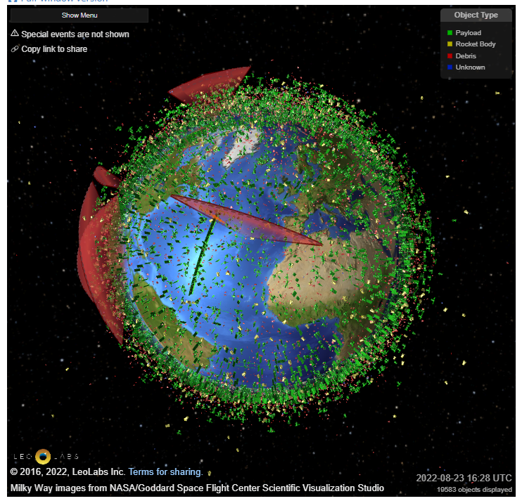
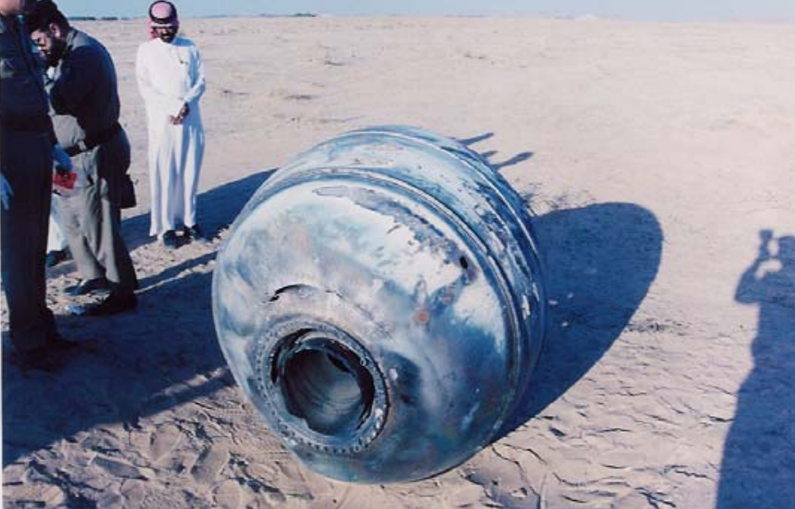
Motivation
2
31690 tracked debris objects^{[1]}
130 million debris objects larger than 1 mm^{[1]}
PAM-D 90kg debris^{[2]}
LEO population visualisation^{[3]}
Notes:
Low Earth Orbit visualisation from LeoLabs
32000 tracked
Orbital velocities in region of 18,000 mph
Inter-Agency Space Debris Coordination Committee
Computational models – rarefied and reacting gas effects
Earth impact events - 2001

Slide 3
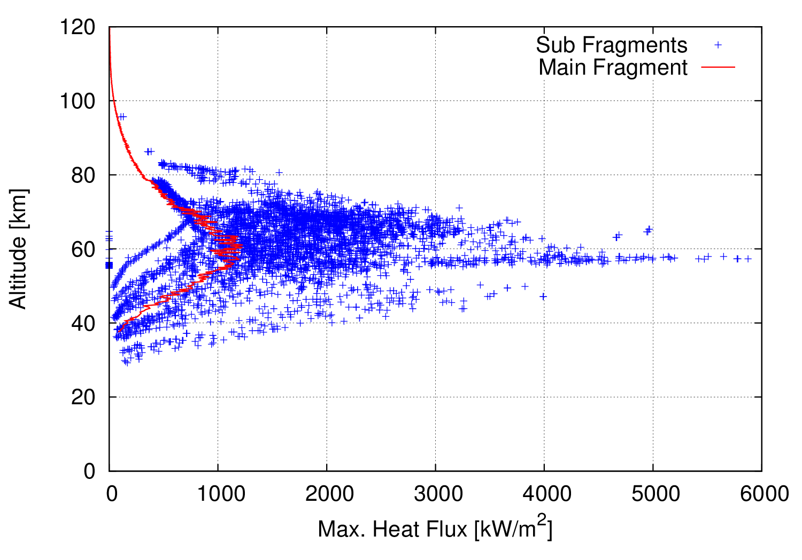
Experimental Objectives
3
Achieve a rarefied flow regime
Capture convective heating including thermochemistry
Be able to use any size and shape of debris model
Be able to obtain data with different model orientations
Obtain surface heat flux measurements across the model body
Kn > 0.1
Typical LEO re-entry heating^{[5]}
Notes:
-experiment must achieve rarefied flow while capturing heat transfer – thermochemical effects
-any size and shape debris
-various orientations
-build full spatial picture of surface heat transfer
-figure demonstrates significant portion of heating occurs in upper atmosphere

Slide 4
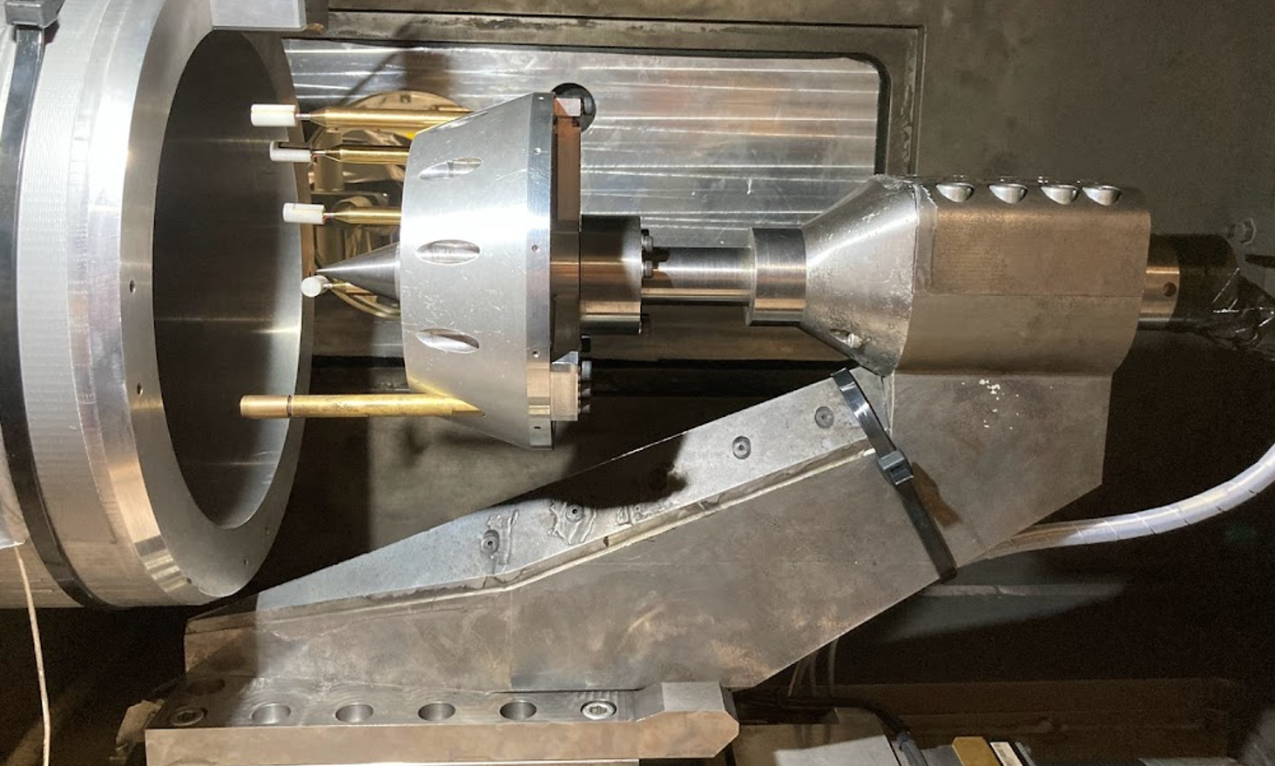
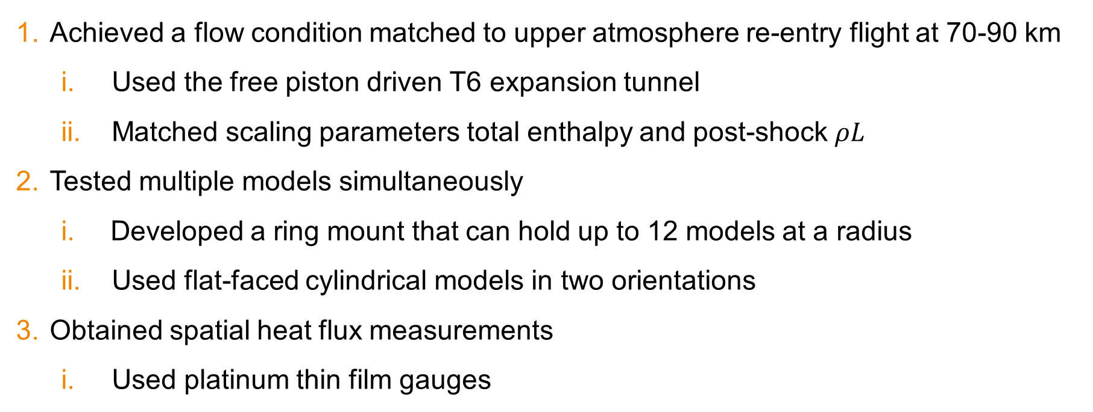
Summary of Present Work
4
Achieved a flow condition matched to upper atmosphere re-entry flight at 70-90 km
  Used the free piston driven T6 expansion tunnel
  Matched scaling parameters total enthalpy and post-shock $ρL$
Tested multiple models simultaneously
  Developed a ring mount that can hold up to 12 models at a radius
  Used flat-faced cylindrical models in two orientations
Obtained spatial heat flux measurements
  Used platinum thin film gauges
Notes:
-free piston driven
-three distinct flow regimes – matched via parameters – need ExT
-looked at 70-90 km where U = 7 km/s – h0 = 24.5 MJ/kg – got close
-developed infrastructure – used flat-faced cylindrical models
-obtained heat flux w TFG

Slide 5
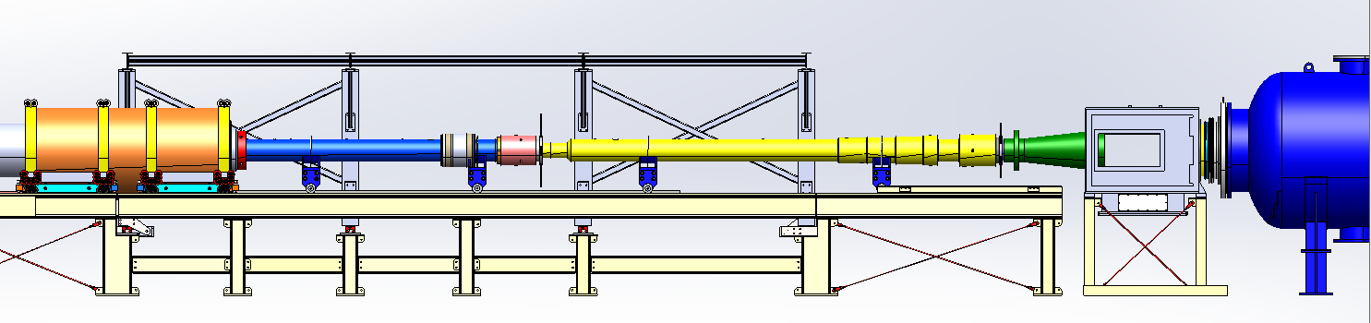
Tunnel Configuration
5
Free piston driven T6 expansion tunnel
Low condition driver
Primary diaphragm
Secondary diaphragm
Acceleration tube
Test section
Compression tube
M10 nozzle
Dump tank
Shock tube
Notes:
Free-piston driven expansion tunnel mode
Shock heating test gas – unsteady - steady
M10 coupled to ex tube
low densities – rarefied flow – avoids particulates – large core flow
25 MJ/kg - Low condition driver w lightweight piston
Can vary driver gas composition and fill pressures

Slide 6
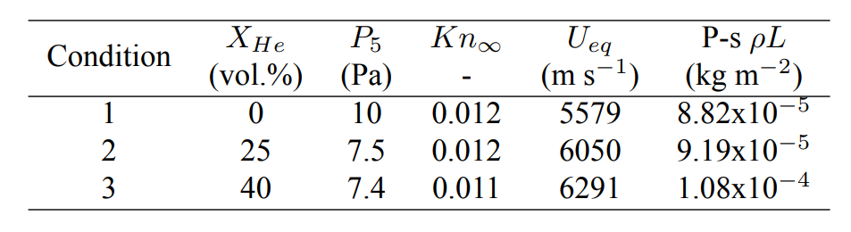
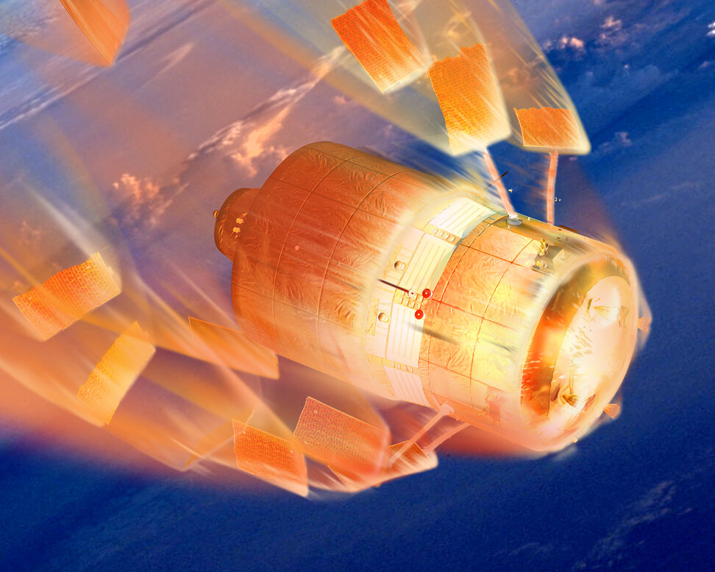
Condition Matching
6
Experimental condition data (L = 10 mm)
L
D4D ATV reentry – ESA^{[4]}
Notes:
Key flow parameters
-gas composition
-Total enthalpy
-post shock rho L
-Developed three distinct flow conditions by varying the driver gas composition - L = D – model diameter of 10 mm
-All had freestream Kn of 0.01, indicating that we are well within the slip regime of rarefied flow and similar post-shock rho L values
-If we look to the figure on the right, we can see the flight diameters that each condition is matched to across the altitude range of interest
-The conditions all collapse close to one trajectory due to the similar rho L values but again the flight-equivalent velocities
-Clearly, to adjust the matched diameter you could use larger models
-red dashed lines are from the heat transfer experiments which were all conducted at condition 3 – so all at 6.3 km/s – but post-shock rho L varied slightly due to varying fill pressures
-

Slide 7
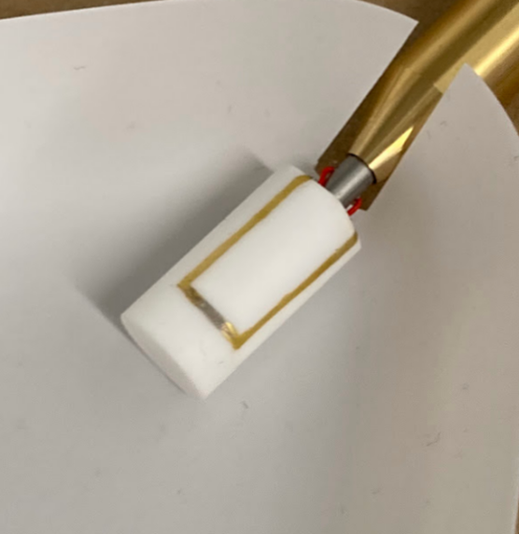
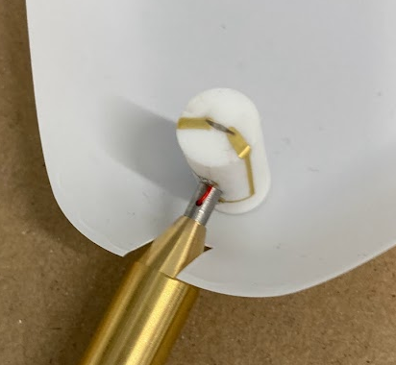
Models and Instrumentation
7
Subscale Macor models
Platinum thin film gauges
Silicon dioxide film coating
V
20
Gauge calibration
T
Subtract T_0
10
ΔT
Oldfield^{[6]} impulse response
[mm]
q
Axial model
Crossflow model
Notes:
Macor – two configs
Pt TFG w/ SiO2 750 nm film thickness to insulate from free electrons in the mildly ionised flow
Thin film is constant current device – T at gauge causes R to change
So in terms of processing data
V to T through gauge calibration data
T to q using Oldfield’s impulse response technique
This assumes a semi-infinite substrate with a constant surface temperature during the test time – a radial correction was applied to gauges on the side face but was found to have no effect due to the short test times

Slide 8
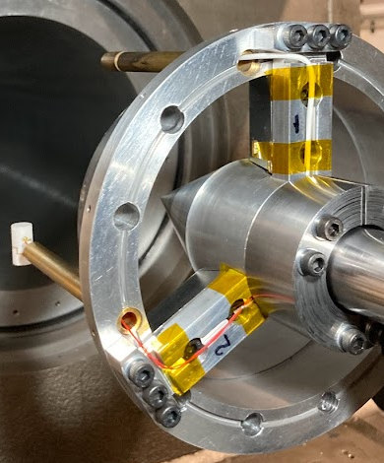
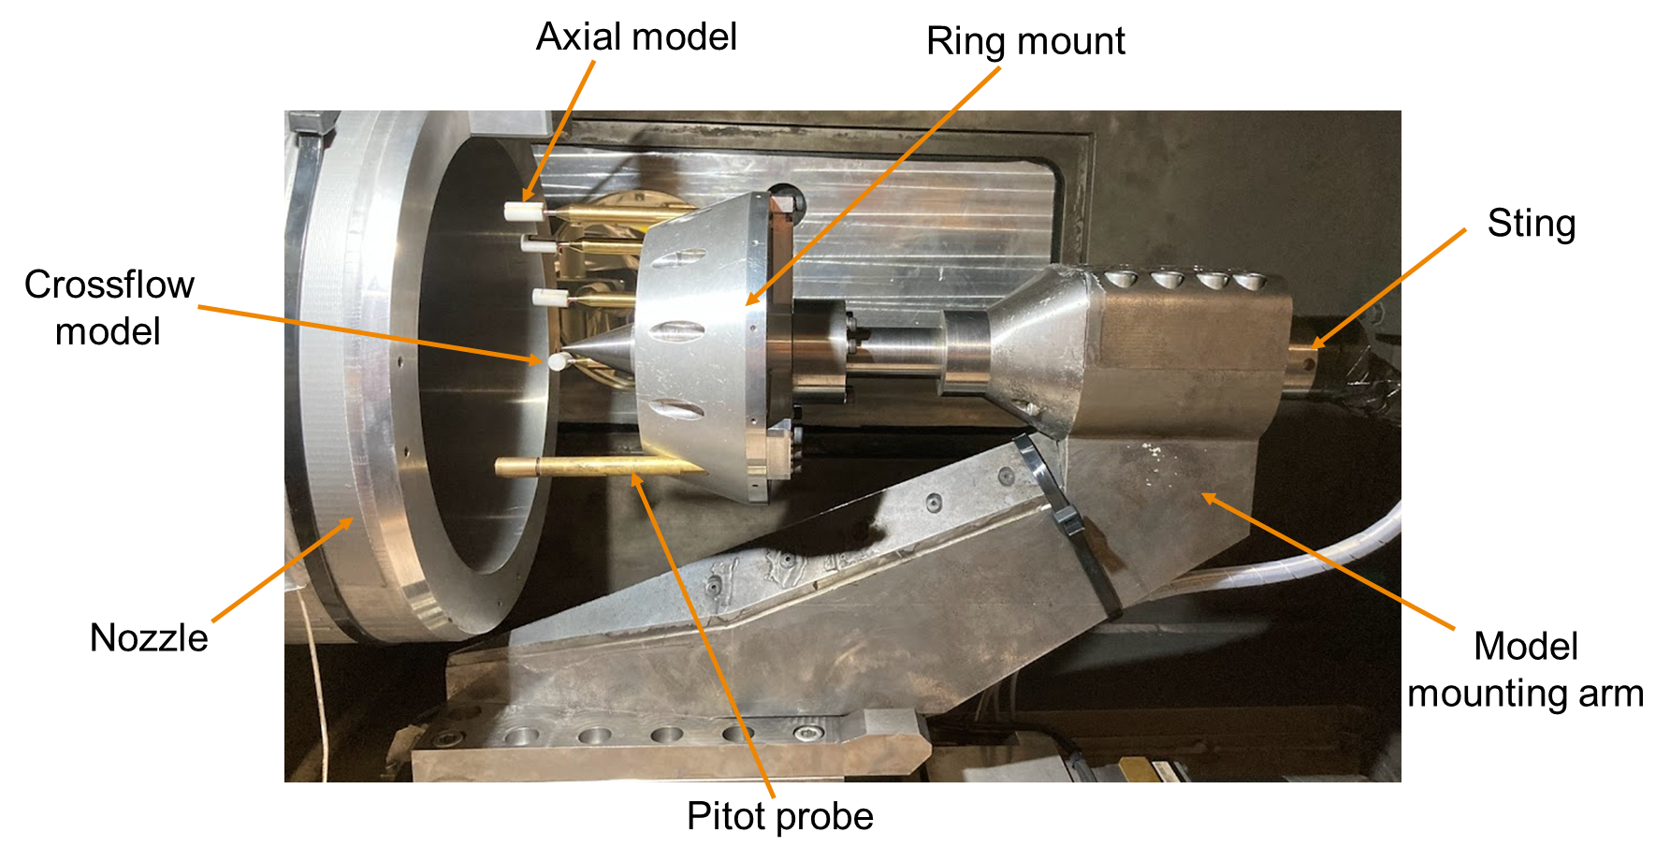
Ring Mount
8
Notes:
Ring mount – 12 models – 75 mm
Radius – debris and radial variation
Sting – blockage
Pitot probes – useful for

Slide 9
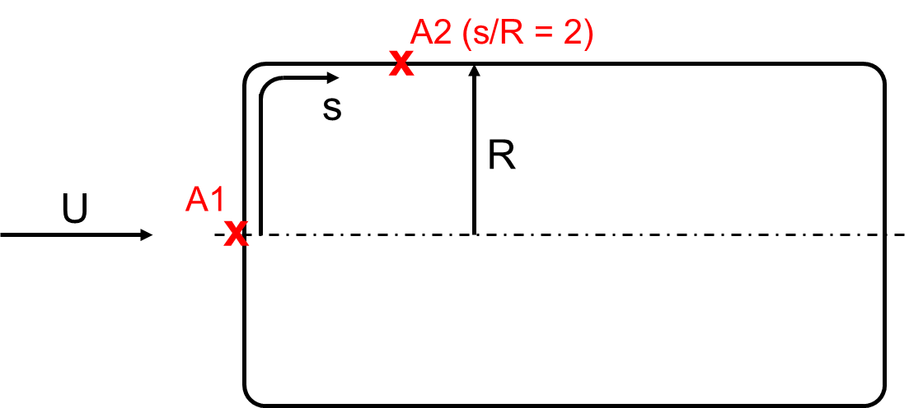
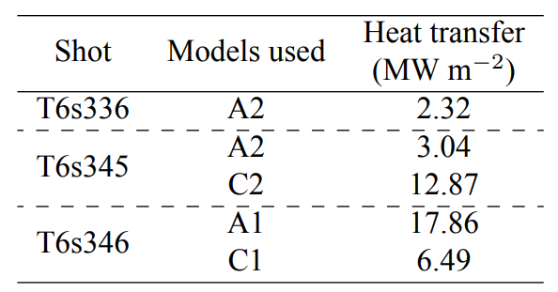
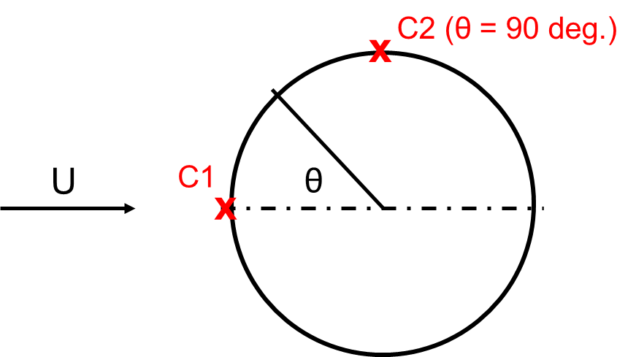
Heat Transfer Results
9
Axial model gauge positions
Crossflow model gauge positions
Notes:
At least one model in each test
5 models – 4 gauge positions
A2, A1, C1, C2

Slide 10
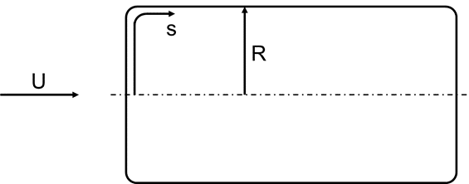
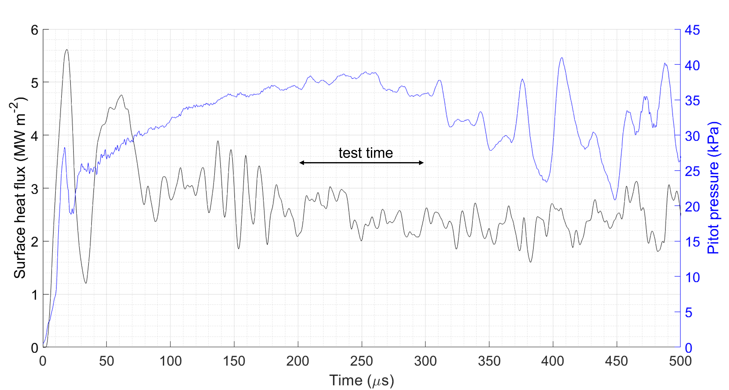
Heat Transfer Results – T6s336
10
x
Notes:
Sensor data T6s336 – A2
Appear physical – indicated gauge death after test time

Slide 11
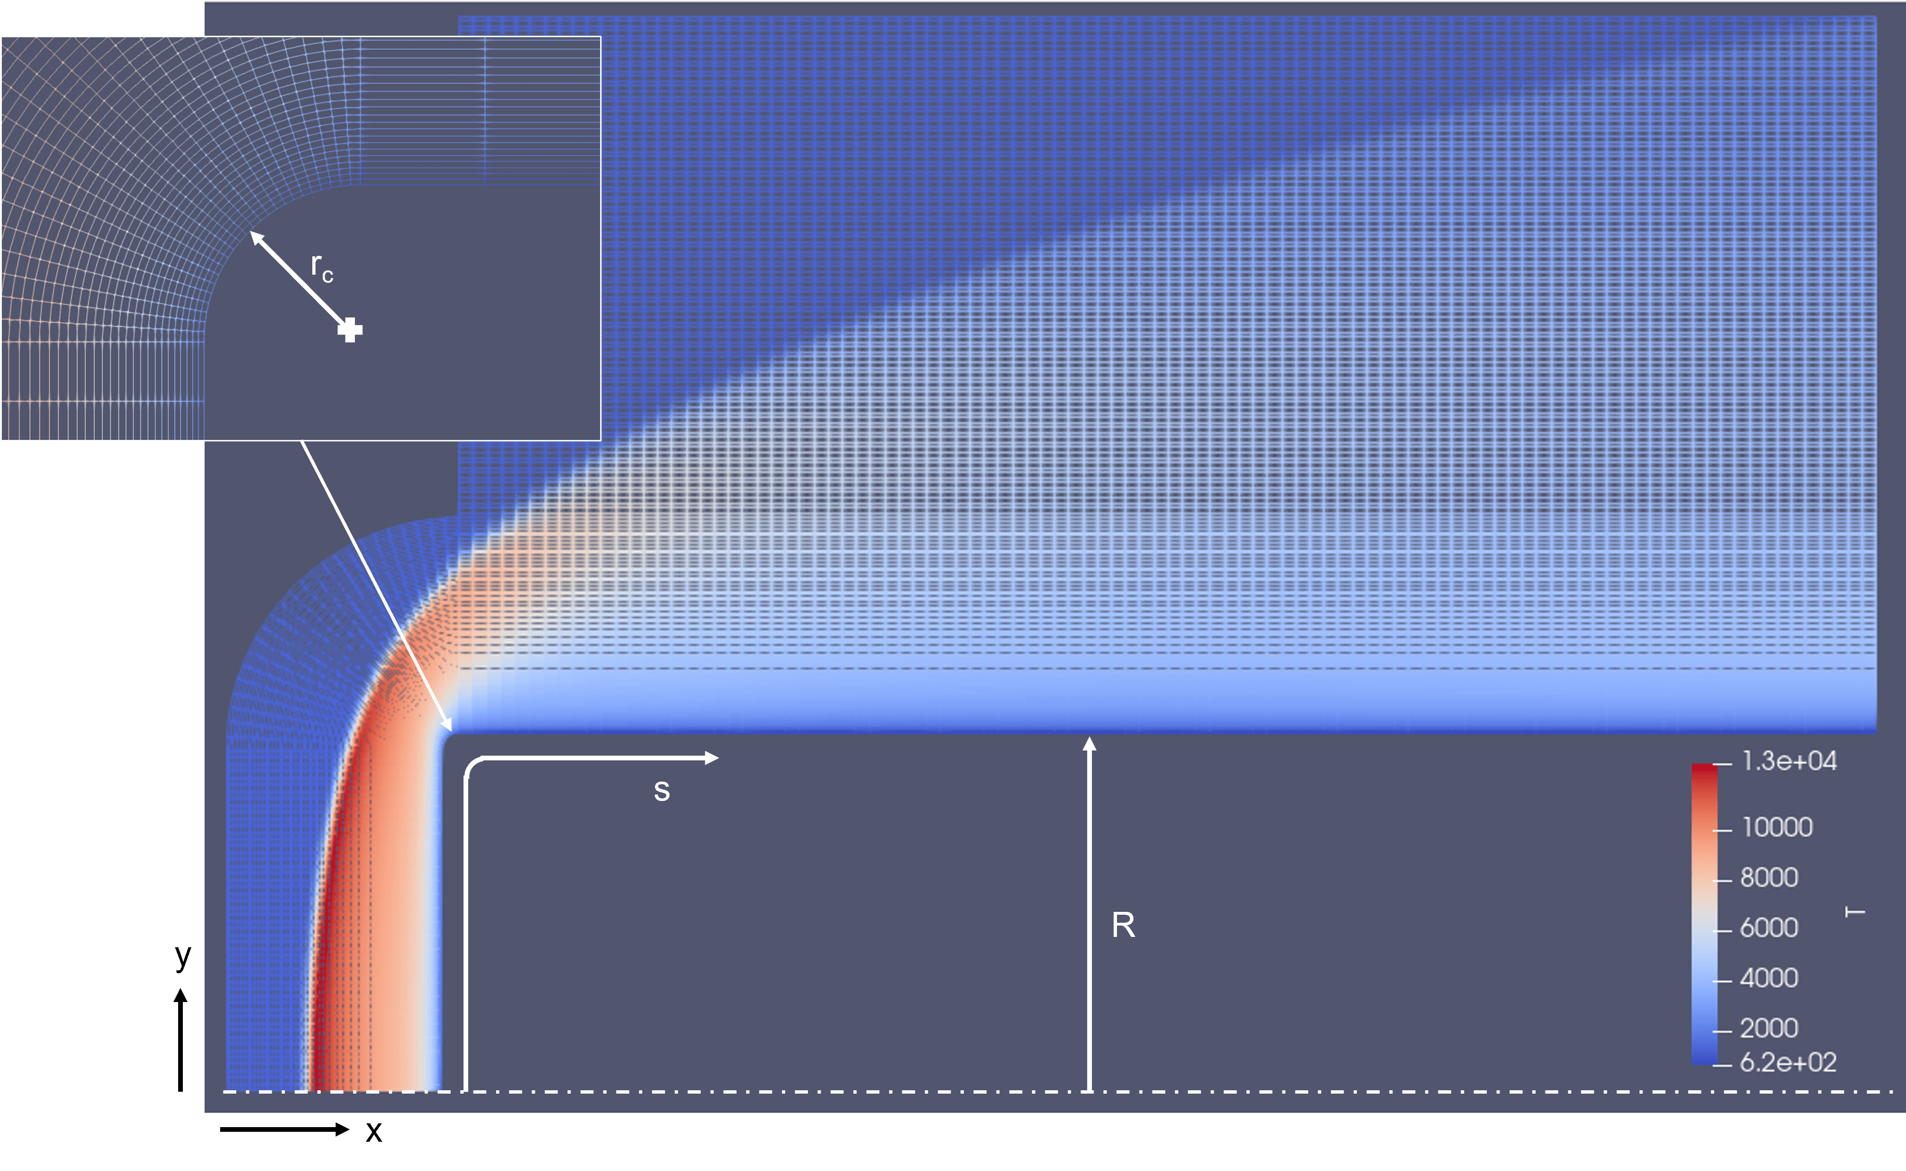
Axial Heat Transfer Predictions
11
Eilmer4 CFD
  1T finite rate reaction model
  11 species reacting air gas model
  300 K no slip wall boundary condition
Sutton-Graves correlation
  R_{eff} = 3.45R
  Frozen – 3.64 MW/m²
  Equilibrium – 8.93 MW/m²
Notes:
Eilmer 4
1T finite rate, 11 species, 300 K no slip BC
Sutton-Graves w radial correction supplied by Zoby
-Frozen and eqbm approximations

Slide 12
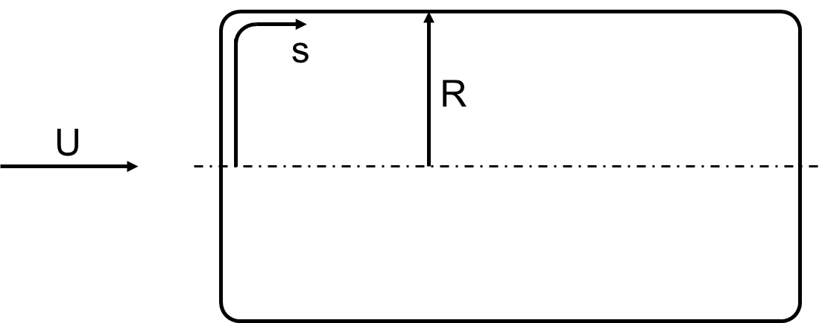
Results – Axial Models
12
Notes:
Axial model results compared to Sutton-Graves and Eilmer4 CFD
Cat and non-cat
Consistently high heat fluxes

Slide 13
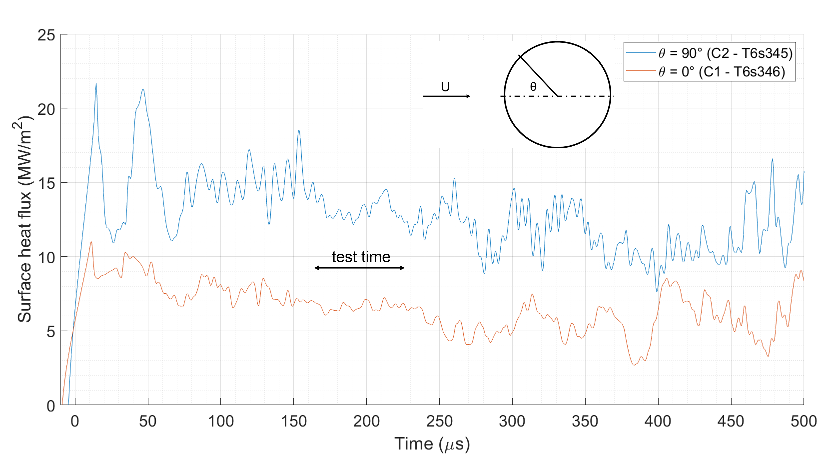
Results – Crossflow Models
13
Notes:
S-G cylinder was 9.6 to 23.4 – stag point heating is low
Side face is high

Slide 14
Summary and Further Work
14
Satellite demise test bed established
  Flight-equivalent velocities up to 6500 m/s
  Freestream Kn of 0.01
  Post-shock conditions matched to flight at 81-90 km
  Successful multi-model testing

Slide 15
References
15
[1] ESA. Space debris by the numbers. 2022. https: //www.esa.int/Safety_Security/Space_ Debris/Space_debris_by_the_numbers
[2] The Orbital Debris Program Office. The Orbital Debris Quarterly News, Vol. 6 Issue 2, 2001. https:// orbitaldebris.jsc.nasa.gov/quarterly-news/pdfs/odqnv6i2.pdf
[3] LeoLabs. Low Earth Orbit Visualisation (LEOV). 2022. https://platform.leolabs.space/visualization
[4] ESA. Simulating reentries for safer satellites. 2016. https://www.esa.int/Space_Safety/Clean_Space/Simulating_reentries_for_safer_satellites
[5] David Leiser. 2022
[6] Impulse response processing of transient heat transfer gauge signals. Journal of Turbomachinery, 130(2), 2008.

Slide 16
Thank you
16

