Slide 1
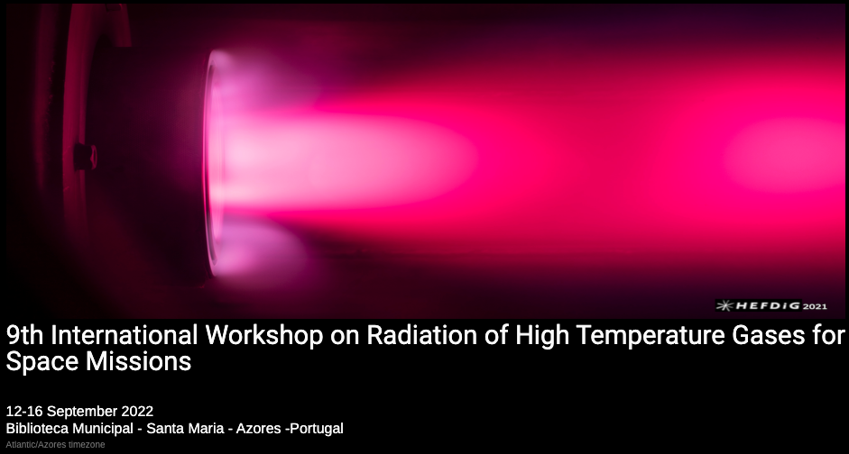
DESIGN OF A SPATIALLY RESOLVED VUV SPECTROSCOPY SYSTEM FOR SHOCK TUBE FLOWS
Maïlys Buquet, Alex Glenn, Peter Collen, Benjamin Williams, Matthew McGilvray and Tobias Hermann
University of Oxford
Tuesday 13 – Sept – 2022
RHTG Conference

Slide 2
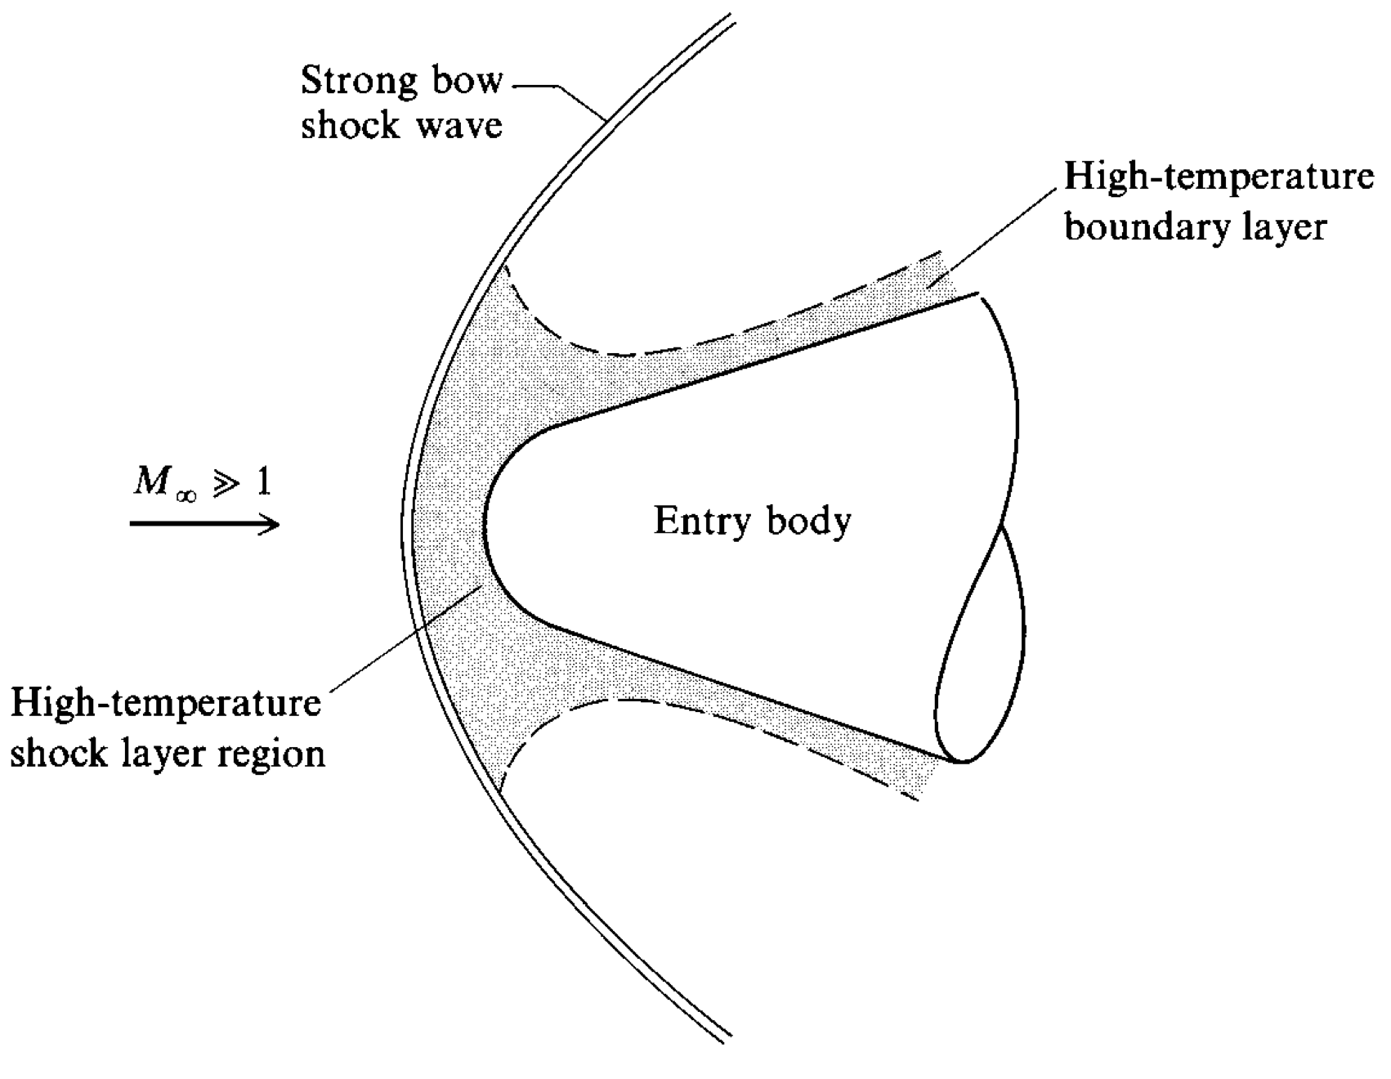
What? Shock Layer and Radiative Heating
Through shock
    Temperature increase
        Ionization & dissociation
          Chemical reactions induce radiation
→ Radiation causes additional heating
Fig 1: Schematic of the high-temperature regions
in an entry-body flowfield [1]
[1] Hypersonic and High Temperature Gas Dynamics, John D. Anderson Jr

Slide 3
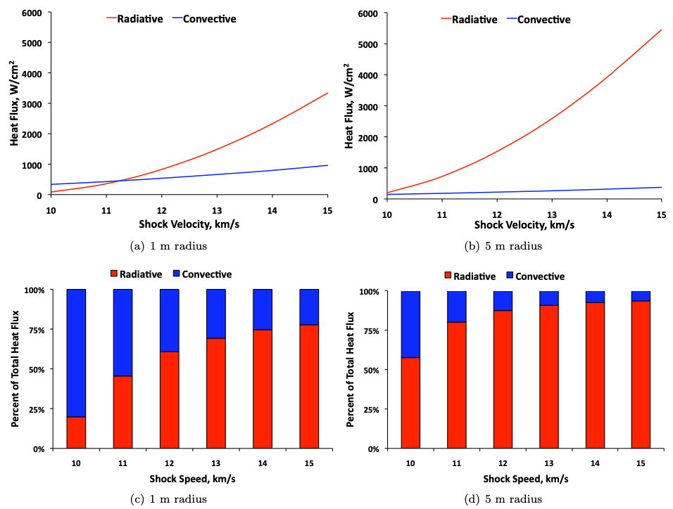
What? Shock Layer and Radiative Heating
Through shock
    Temperature increase
        Ionization & dissociation
          Chemical reactions induce radiation
→ Radiation causes additional heating
At speeds > 10 km.s⁻¹ :
Radiation becomes substantial / main source of heat load
→ non-equilibrium region
→ high energy transition in the vacuum ultra-violet (VUV) can
become dominant
(up to 85% of the total post-shock radiance for high enthalpy shock tube tests [3])
→
Large
uncertainties
Largest source of
uncertainties
→
Due to complexity of measuring rad. in this wavelength – fully absorbed by atmosphere
Fig.2: Share of radiative and convective heat fluxes at stagnation point for different velocities and nose radii. LAURA/HARA simulations, earth atmosphere. [2]
[2] Characterization of Stagnation-Point Heat Flux for Earth Entry, A. M. Brandis and C. O. Johnston, 45th AIAA Plasmadynamics and Lasers Conference, 2014
[3] Air Radiation in Superorbital Expanding Flow, Han Wei, Thesis

Slide 4
What? Shock Layer and Radiative Heating
→
Large
uncertainties
Radiation becomes substantial / main source of heat load
→ non-equilibrium region
→ high energy transition in the vacuum ultra-violet (VUV) can
become dominant
Largest source of
uncertainties
→
→ Overdesign of thermal protection systems
Reduced travel distance / useful load
Increased cost / waste
Better understanding → better model → more sensible design
Obtain spectra and absolute radiance from VUV:
very valuable
→ species number densities
→ temperature
Fig.2: Share of radiative and convective heat fluxes at stagnation point for different velocities and nose radii. LAURA/HARA simulations, earth atmosphere. [2]
[2] Characterization of Stagnation-Point Heat Flux for Earth Entry, A. M. Brandis and C. O. Johnston, 45th AIAA Plasmadynamics and Lasers Conference, 2014

Slide 5
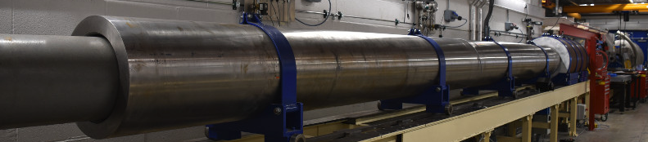
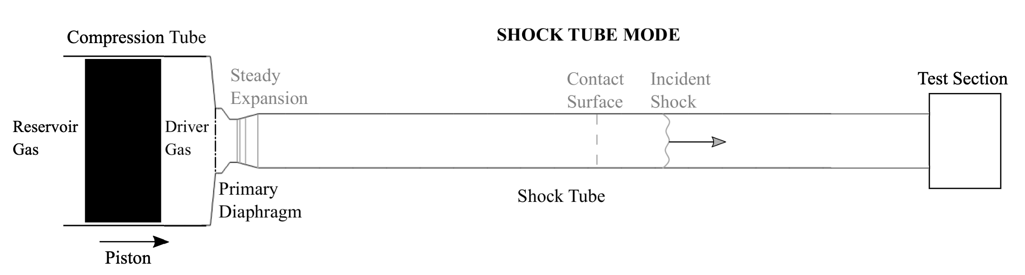
How? Shock tube to recreate conditions
T6 shock tube mode
High speed, high enthalpy facility
≡
Fig 4: T6 shock tube schematic, modified from [4]
Fig 1: Schematic of the high-temperature regions
in an entry-body flowfield [1]
[1] Hypersonic and High Temperature Gas Dynamics, John D. Anderson Jr
[4] High Enthalpy Effects in Transpiration Cooled System, S. D. Subiah

Slide 6
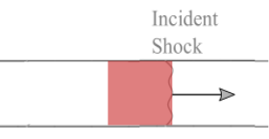
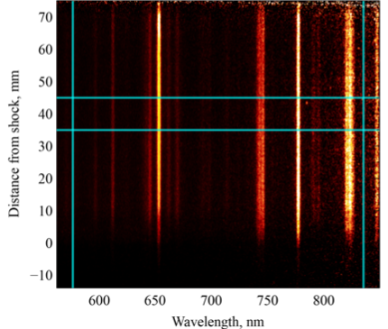
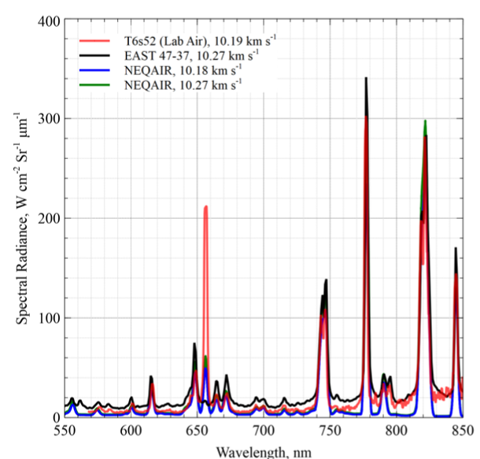
How? Spectroscopy to investigate the flow
Temperature
Species
Species number
densities
Tunnel
axis
Vacuum chambers
containing mirrors
Spectrometer
Shock direction
Andor iStar sCMOS
Shock
Intensified
camera
Fig 5: Example spectra (T6s52, 10.18 km.s⁻¹) red spectrum [5]
[5] Measurements of Radiating Hypervelocity Air Shock Layers in the T6 Free-piston Driven Shock Tube, P. L. Collen, L. J. Doherty, M. McGilvray

Slide 7
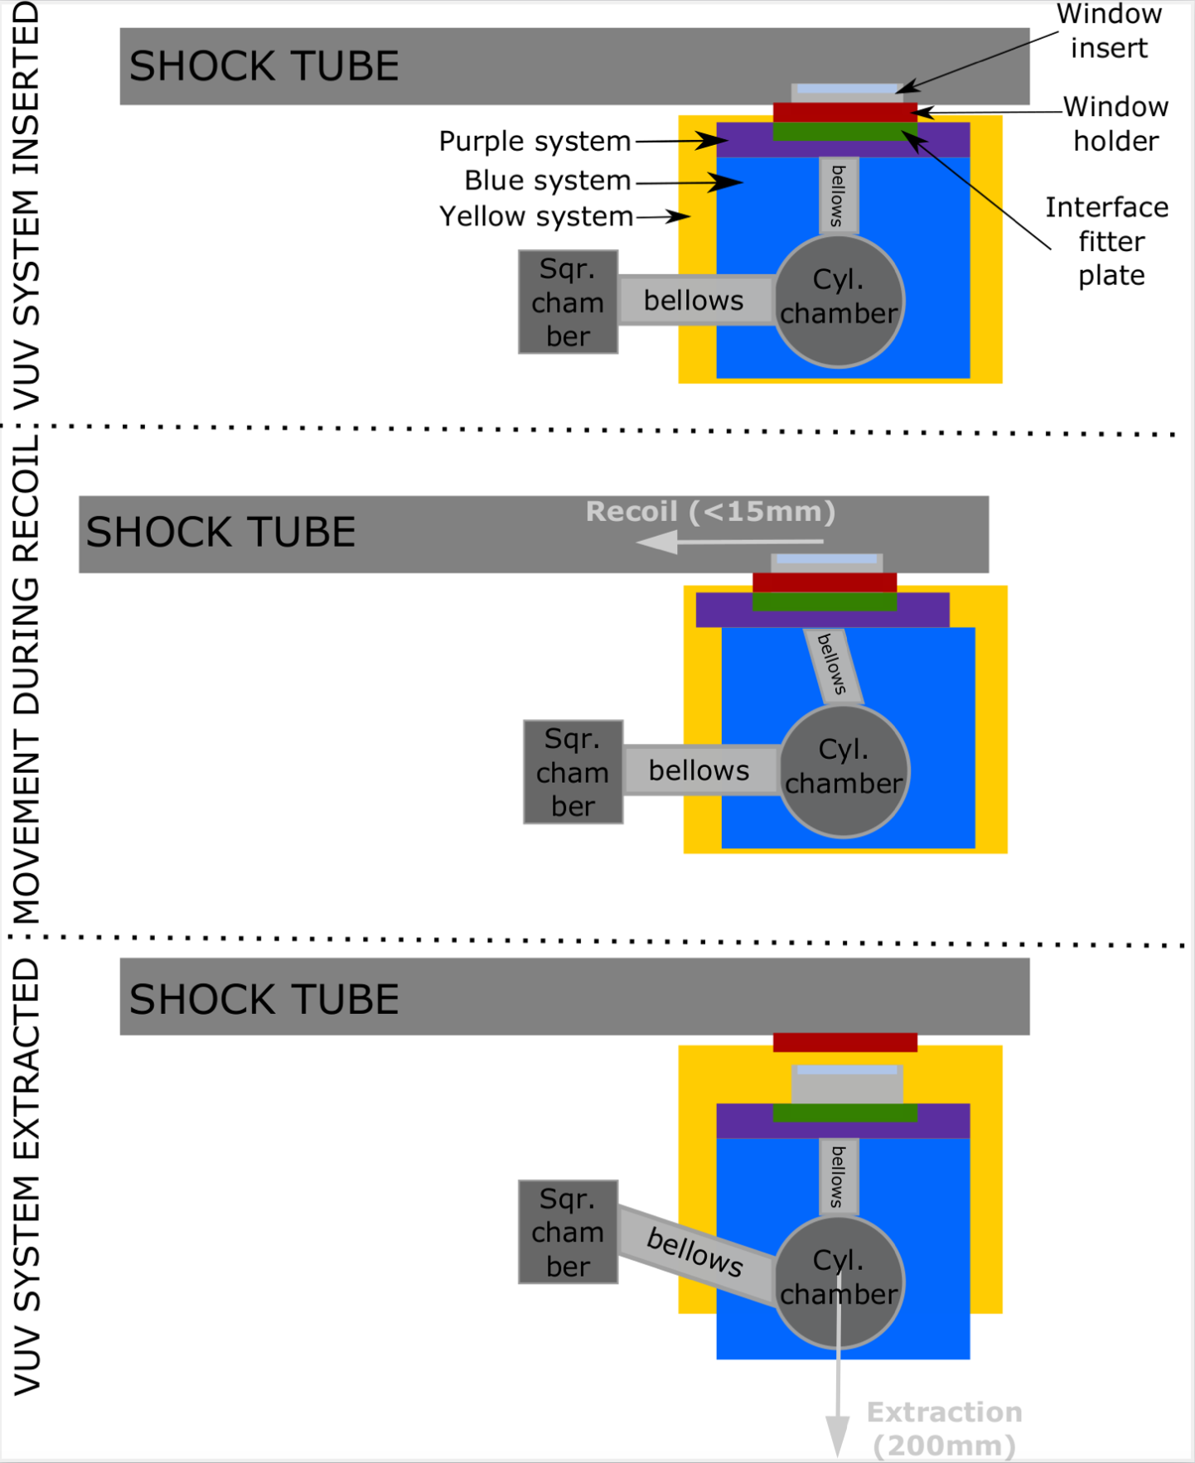
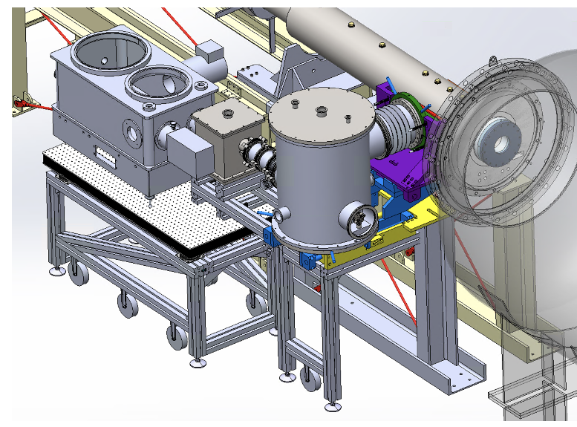
How? Spectroscopy set-up on T6
Shock
tube
Turbopump
Test section
→ Allows to keep
system under
vacuum during
tunnel turn-around
Spectrograph
Camera
Vacuum chambers

Slide 8
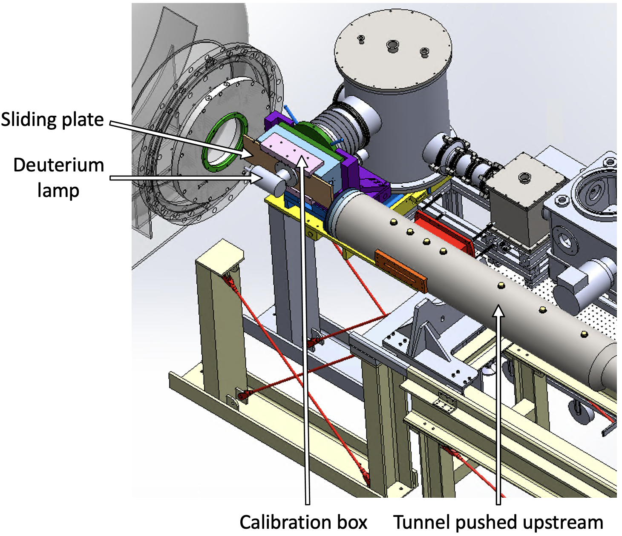
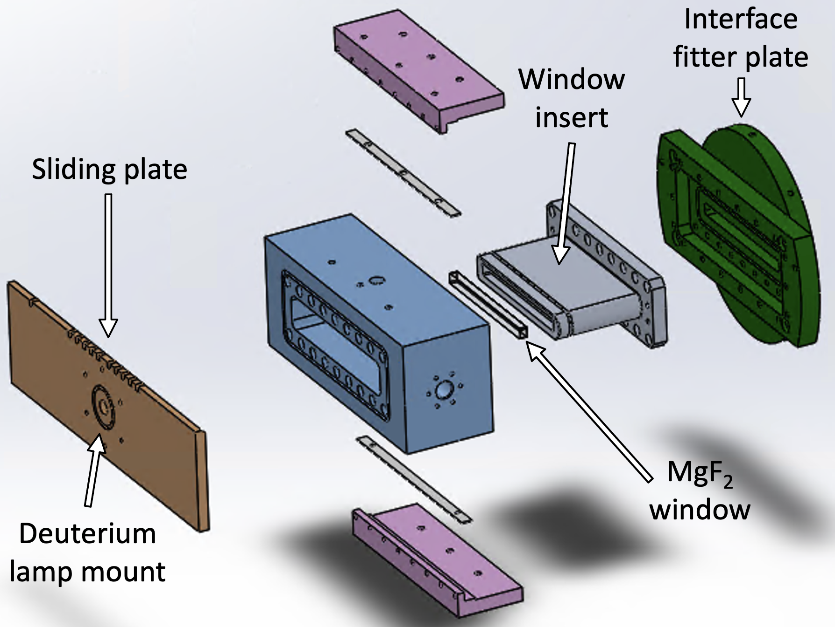
How? Spectroscopy set-up on T6
→ Can perform calibration during turn-around using a deuterium lamp

Slide 9
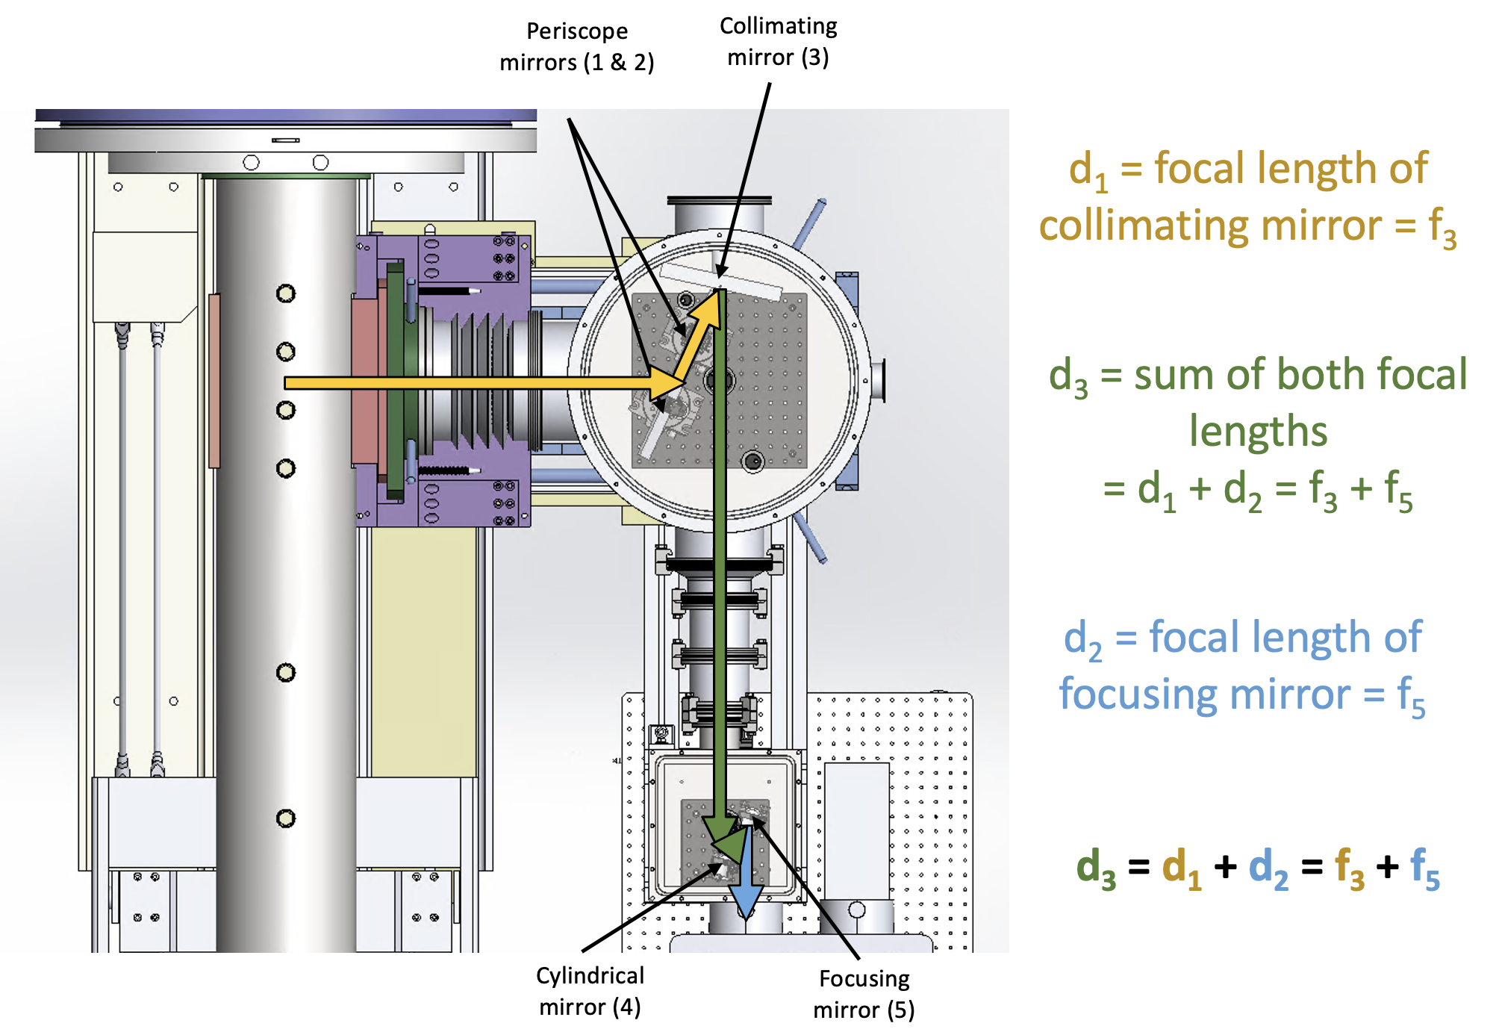
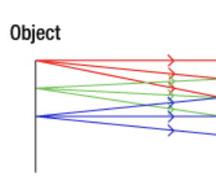
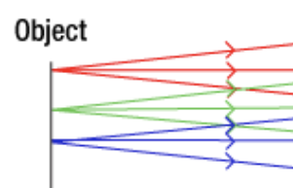
How? Optical system design
θ
Shock
Blur
Tunnel
axis
Blurring effects due to
non-telecentricity [6]
Chief rays from all object points
perpendicular to shock tube
[6] Collection Optics for Imaging Spectroscopy of an Electric Arc Shock Tube, Greenberg, Reid, Cruden, Brett, Grinstead, Jay, Yeung, Dickson

Slide 10
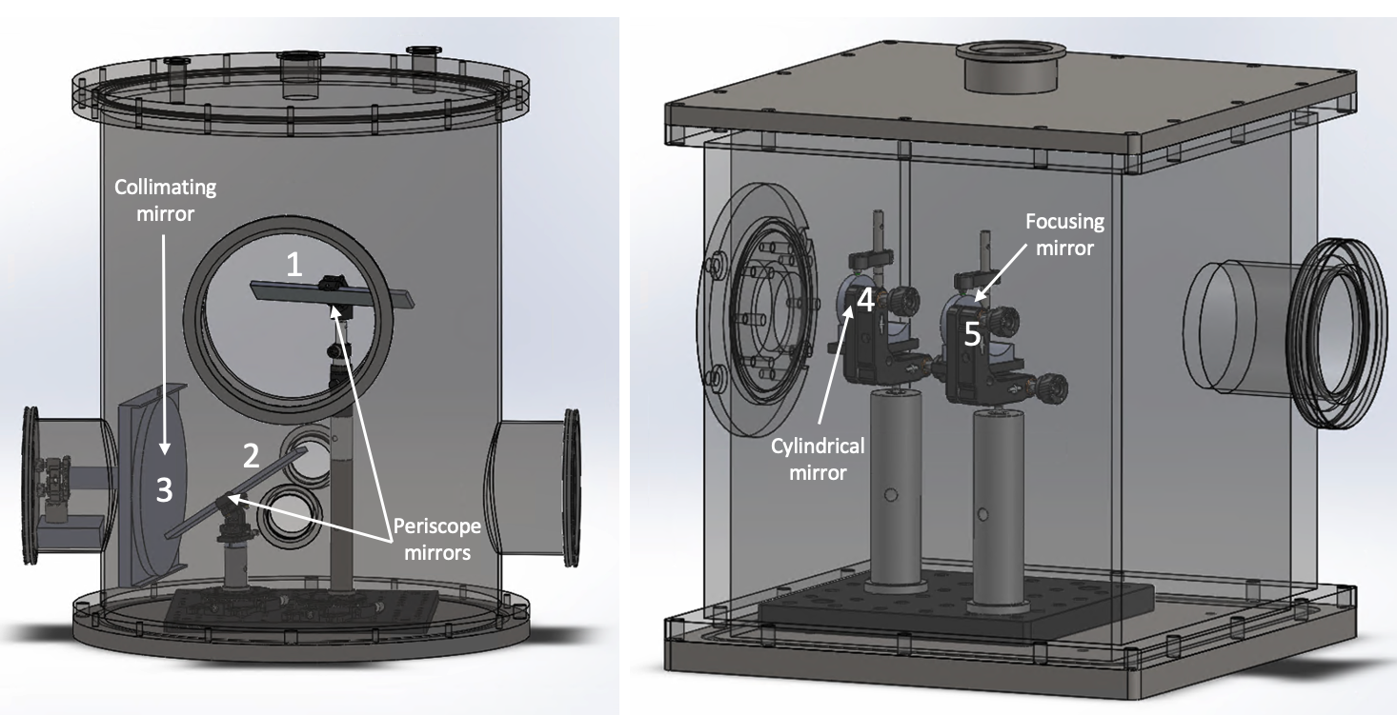
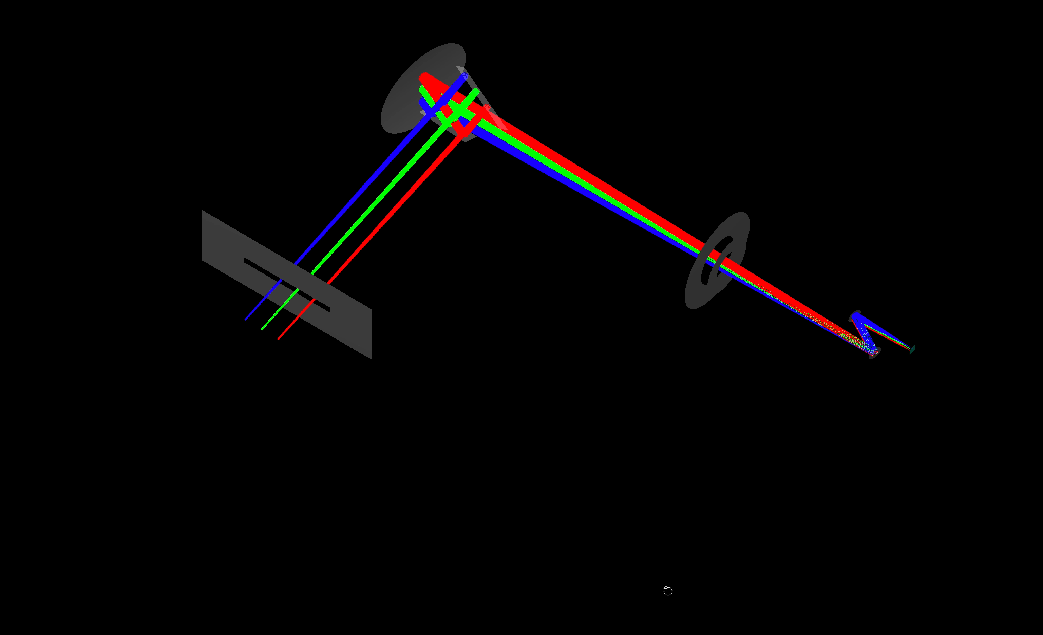
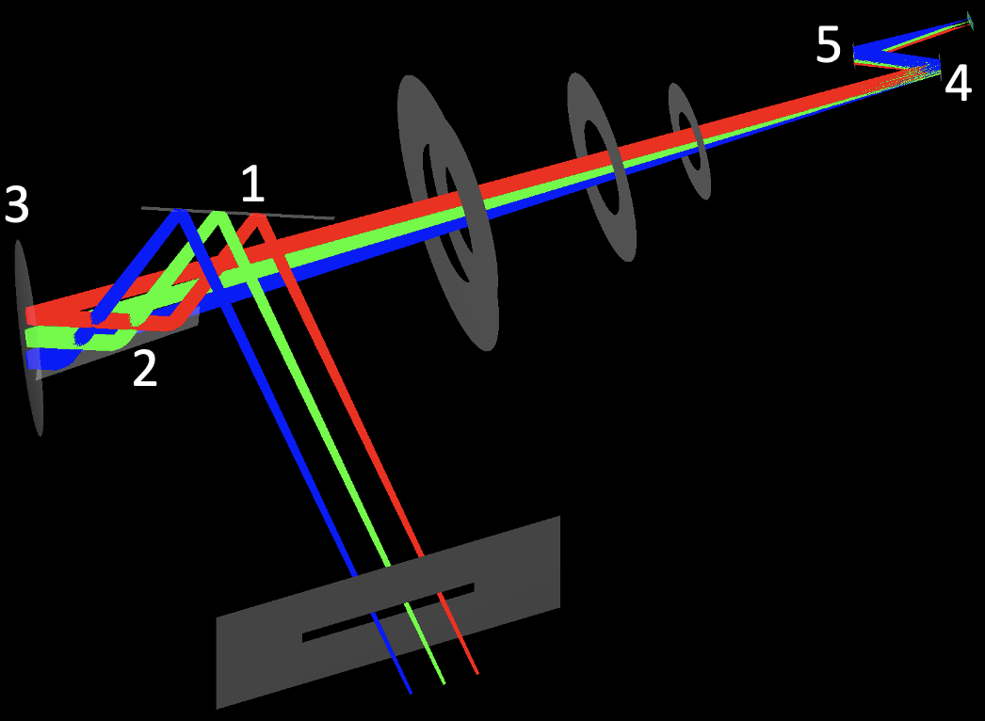
How? Optical system design
Bunch of constraints
Optimisation approach with a code
Position and geometry of mirrors
Optical
Ray-tracing simulation using OPTOMETRIKA [7]
Magnification
Matching F#
Focal lengths
Spec.
slit
90deg turn for camera
Minimum number of mirrors, smallest angles possible…
Geometrical
Tilting mirror makes it harder to make them fit
Must fit in boxes
Must not be on optical path
Tunnel axis
[7] Optometrika (https://github.com/caiuspetronius/Optometrika), Yury, 2002

Slide 11
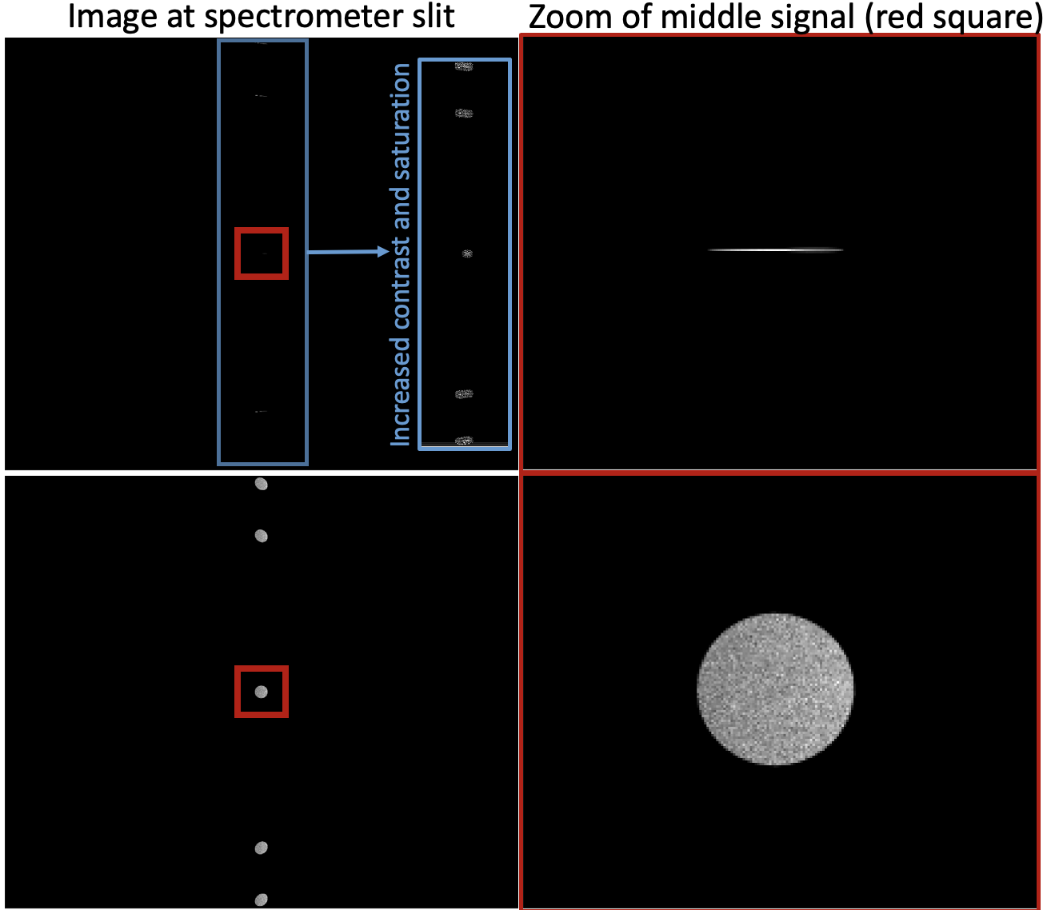
How? Optical system characterisation
Cylindrical mirror
Helps rays lying in perpendicular planes on the optical axis to focus at different distance
Strategy used for the VUV
spectroscopy set-up in EAST [6]
[6] Collection Optics for Imaging Spectroscopy of an Electric Arc Shock Tube, Greenberg, Reid, Cruden, Brett, Grinstead, Jay, Yeung, Dickson

Slide 12
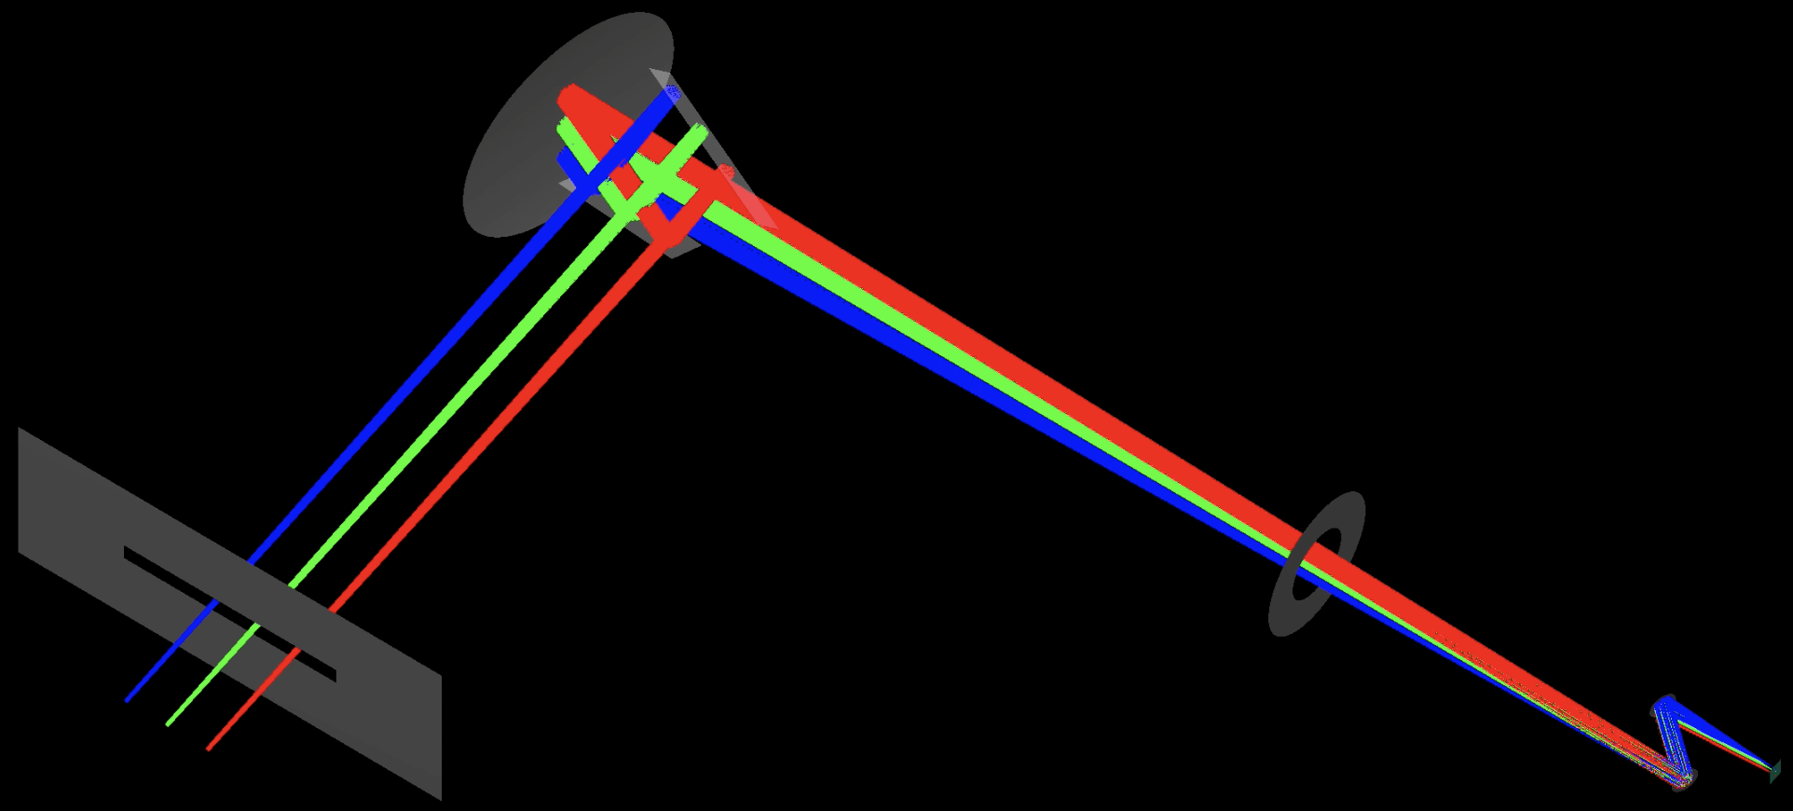

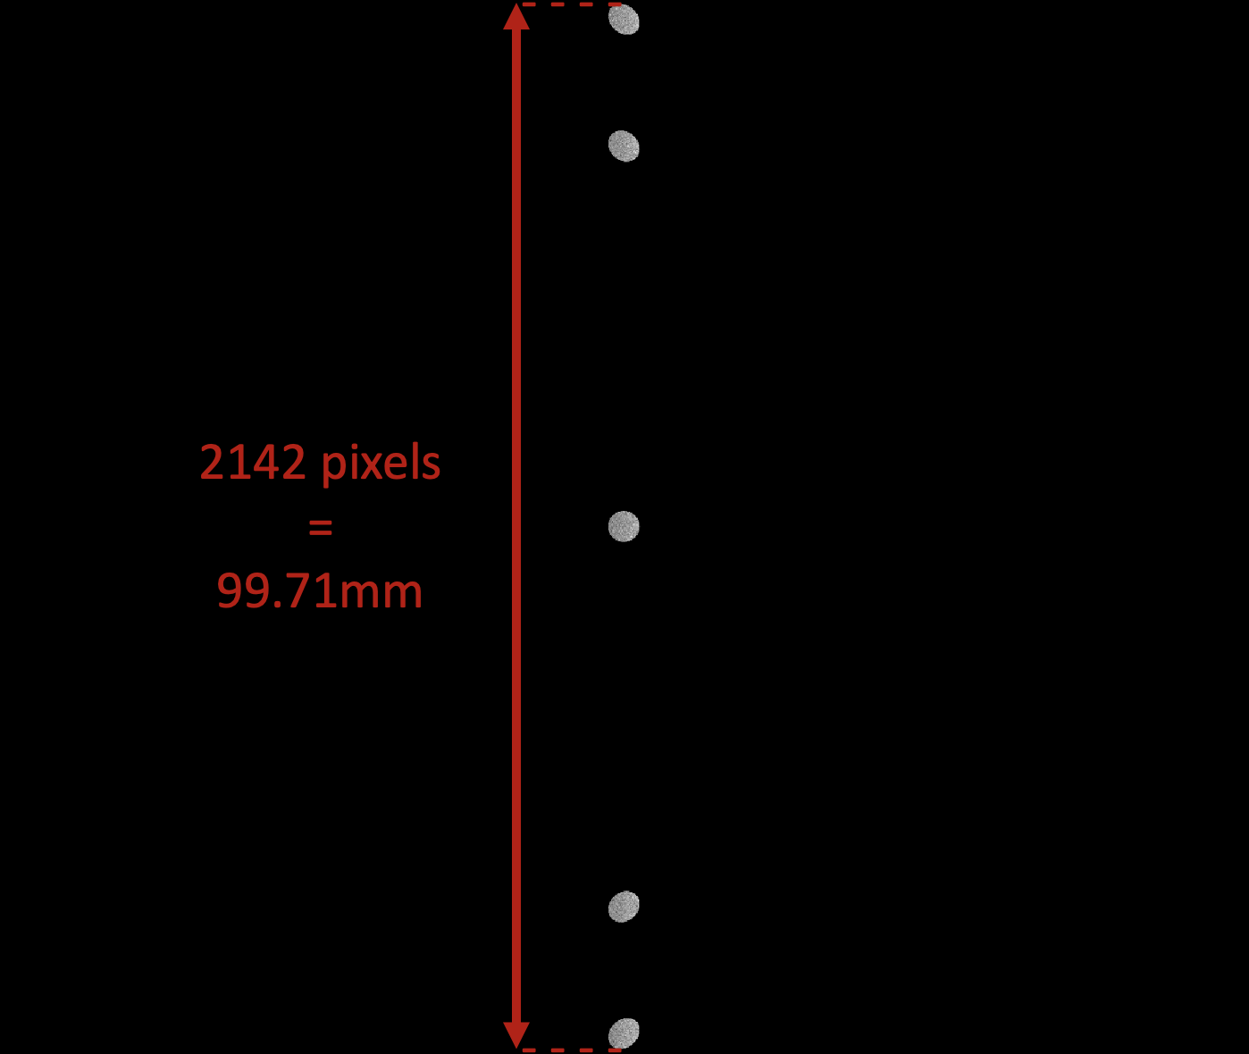
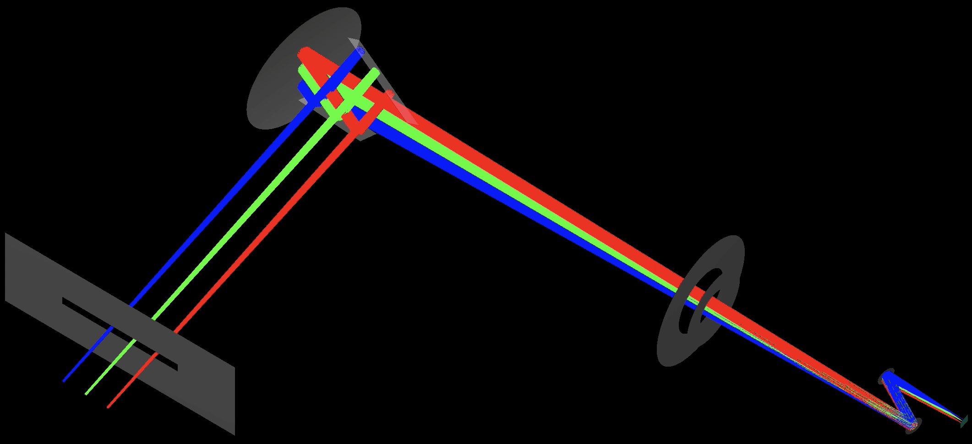
How? Optical system characterisation
θ > 40deg
θ = 30deg
Magnification:
M = 10.5 → M = 7.2

Slide 13
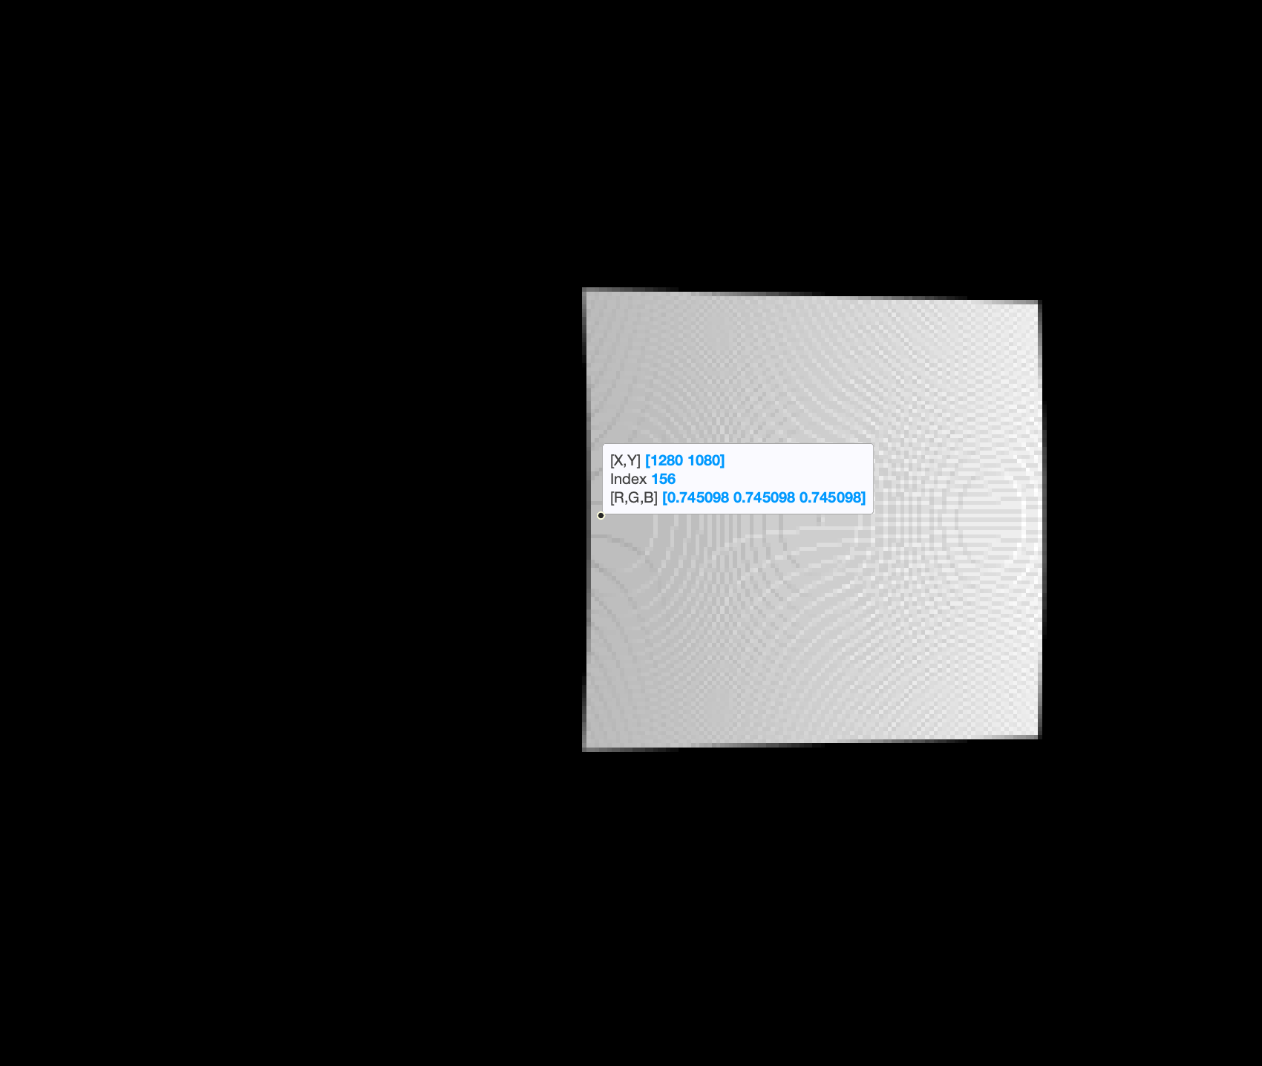
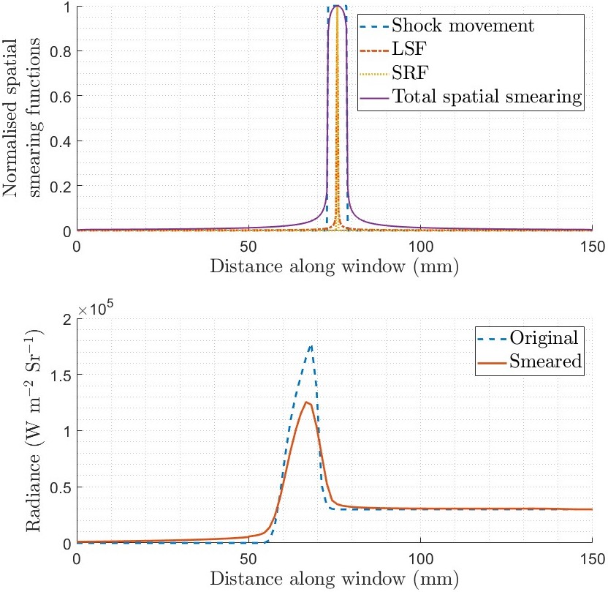
How? Calibration
SPACE
→ Some effects obtained from simulations
LSF
SRF
→

Slide 14
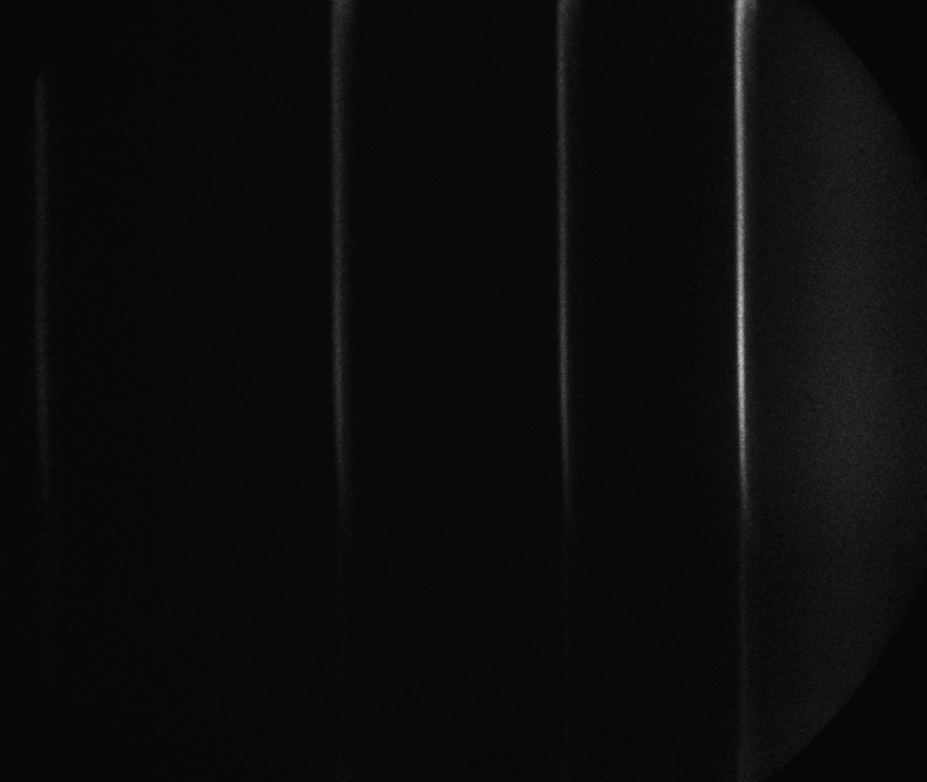
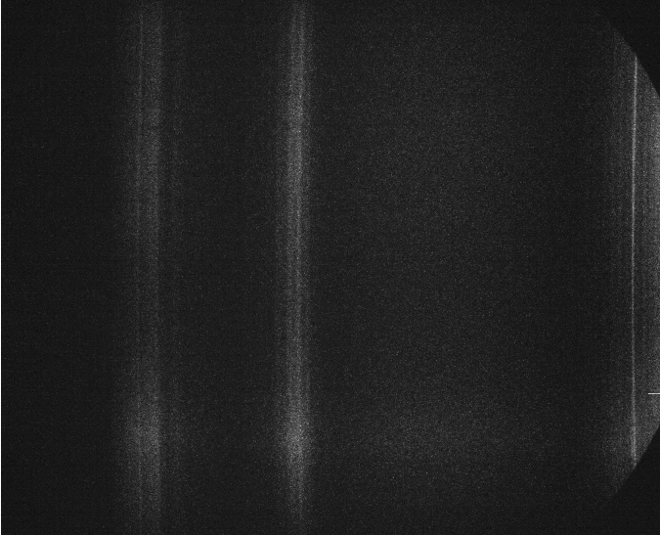
How? Calibration
WAVELENGTH –
SPACE
– INTENSITY
→ Some effects obtained experimentally
Mercury lamp spectra
Deuterium lamp spectra

Slide 15
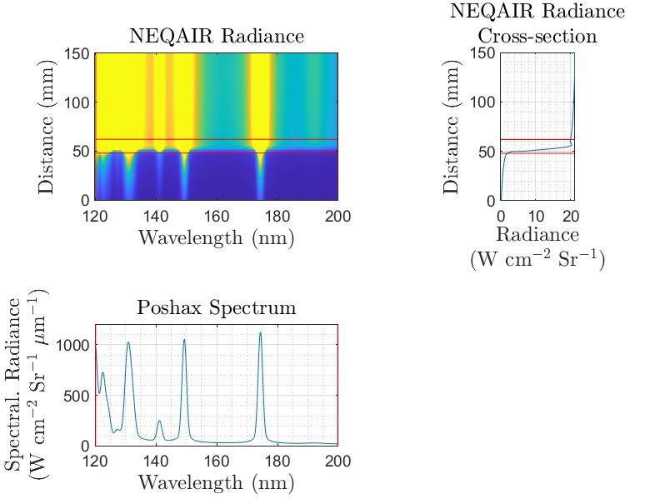
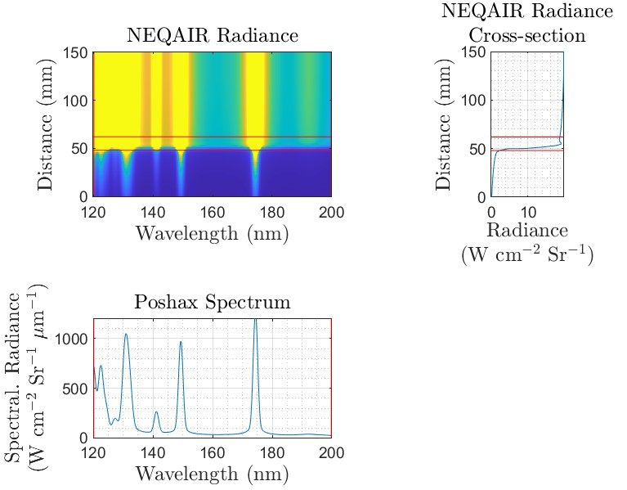
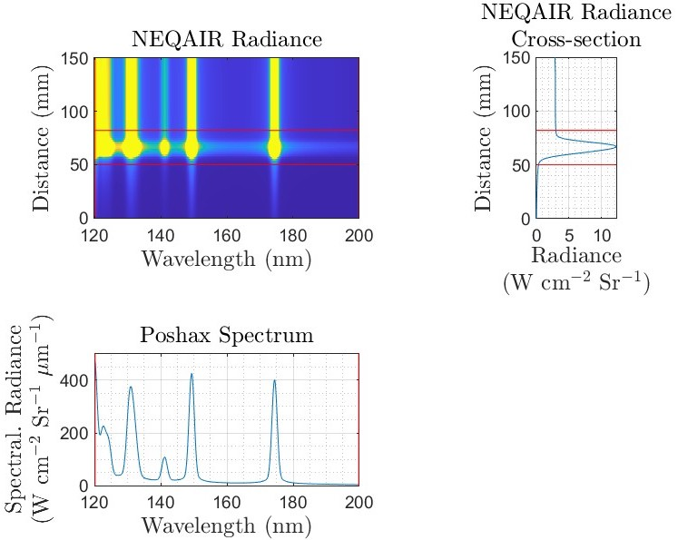
What’s to come… hopefully
→ Calibration applied to Poshax [8] and NEQAIR [9] simulations
→ Simulations ran to select wind-tunnel conditions
P∞ = 26.66 Pa
u∞ = 10.66 km.s⁻¹
P∞ = 2.08 Pa
u∞ = 11.36 km.s⁻¹
P∞ = 6.66 Pa
u∞ = 11.38 km.s⁻¹
→ EAST conditions - gave good VUV data
→ Fire II re-entry datapoint
→ Data point from previous T6 campaign
[8] Eilmer 4.0 flow simulation program. P. A. Jacobs and R. J. Gollan, 2022.
[9] NEQAIR - Nonequilibrium Radiative Transport and Spectra Program, NASA

Slide 16
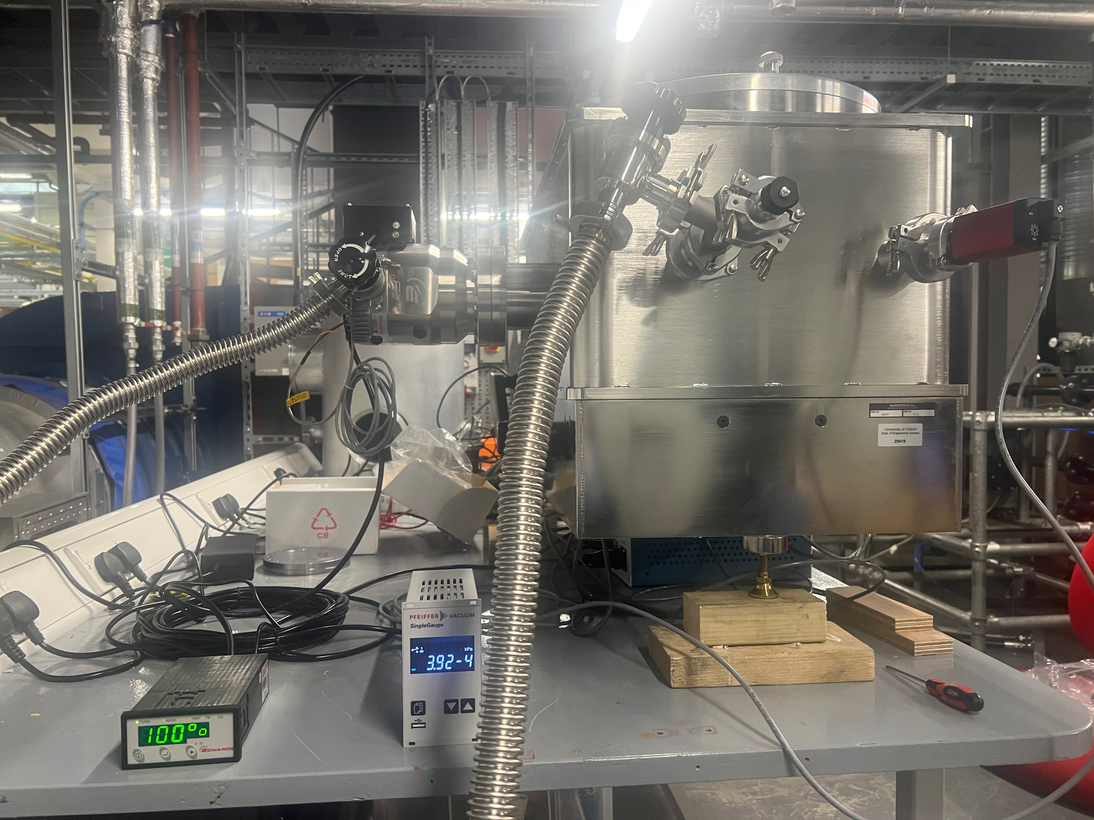
Summary
So far…
→ Mechanical system designed,
almost fully assembled
→ Optics designed and characterised
→ Couple of test conditions selected
To come…
→ Characterised rest of optics (mirrors)
→ Pump down full volume
→ T6 test campaign to obtain spectra

Slide 17
Thank you for listening!

