Slide 1
Delta-II Second stage
Test case
ATD3 Working group meeting
October 27, 2022

Slide 2
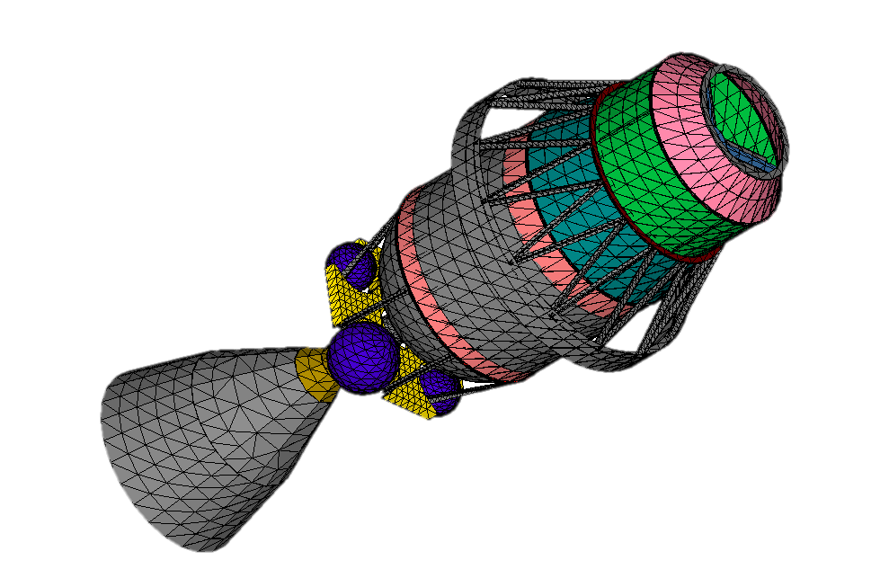
Why the Delta-II second stage
It is a historical object used for many missions (from 1989 to 2018)
How many remain in orbit?
  41 according to DISCOS (i.e. Delta-K and Delta II second stage)
Fragments from re-entry have been found on ground

Slide 3
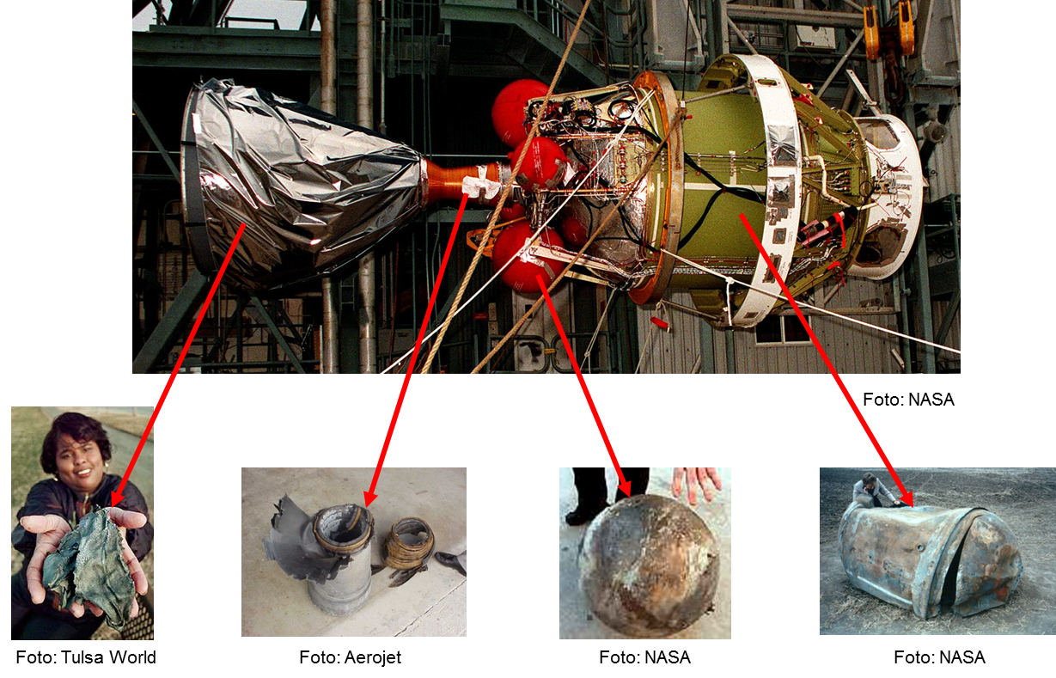
Fragments found on-ground

Slide 4
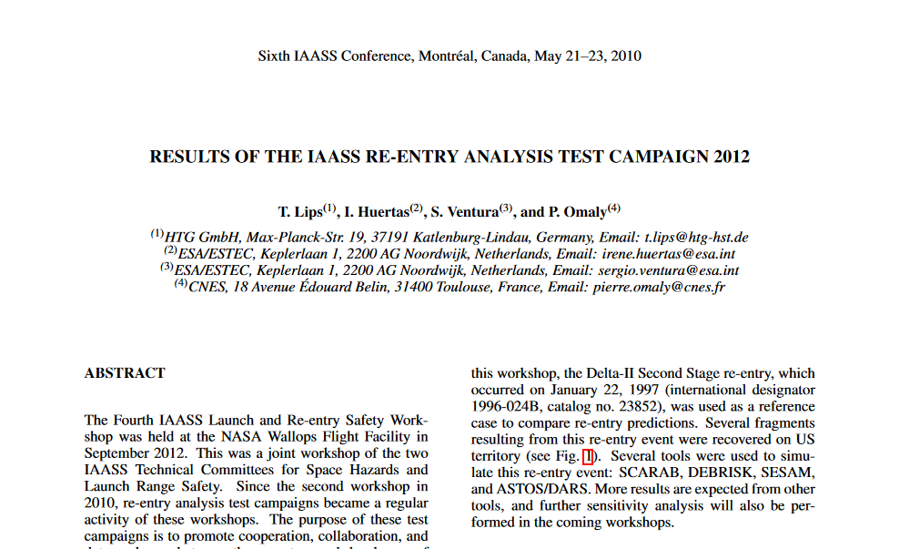
IAASS Benchmark

Slide 5
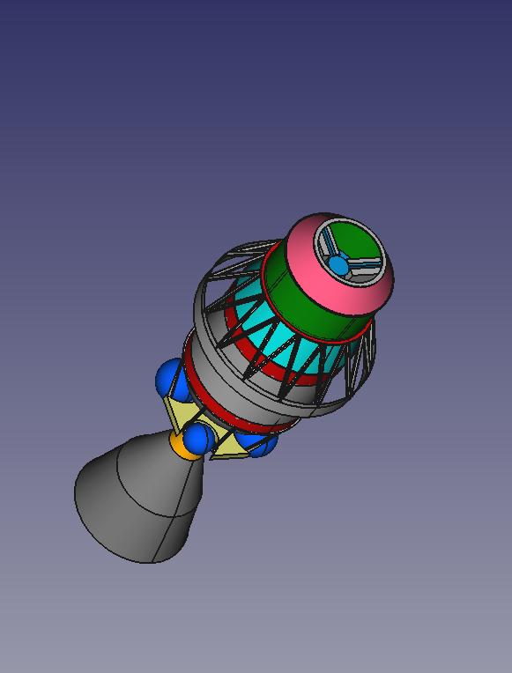
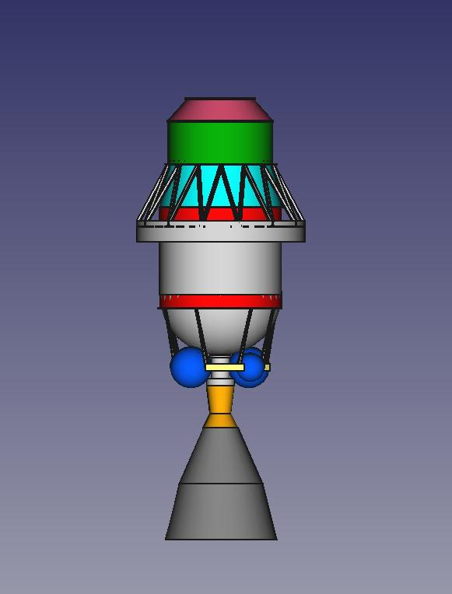
CAD model

Slide 6
Mass and Dimensions

