Slide 1
DMF-03
Enabling Attitude-Based Applications
Gennaro Principe
DEIMOS
DRAMA WORKSHOP
23-24/06/2022

Slide 2
DMF03
Enabling Attitude-Based Applications
GOAL:
Upgrade analysis modules used in debris mitigation and risk analyses (in MASTER and DRAMA software), taking into account spacecraft attitude-related dynamics
Integration of a suitable 6 DOF simulator
Account for movable parts (solar panels)
Improve disposal analyses based on attitude modes
DMF03
Estimate drag and solar radiation coefficients given object model and attitude law
Augment analysis modules

Slide 3
DMF03
Enabling Attitude-Based Applications
MAIN ACTIVITIES:
Development and integration of a 6 DOF simulator
Development of a new module for coefficient estimation
Improve/update ARES, MIDAS and OSCAR

Slide 4
Attitude Simulation – architecture definition
Trade-off performed to identify the best approach.
FOCUS cannot be modified so it is used as it is to perform 6DOF attitude simulation
FOCUS interface modification is required to ensure that physical models are the same. This requires some parameters/functionalities to be available to the attitude simulator.
Attitude simulation input file
Dedicated file with attitude simulation data
JSON format for better integration in the DRAMA environment
Attitude simulation component generates attitude outputs:
Attitude information reported at each propagation step → same steps as propagation outputs
Computed in post-processing, after propagation outputs merging
Information reported depends on attitude law

Slide 5
Attitude Simulation Interfaces
Static view of Attitude Simulator I/F with DRAMA environment
FOCUS ICD extension

Slide 6
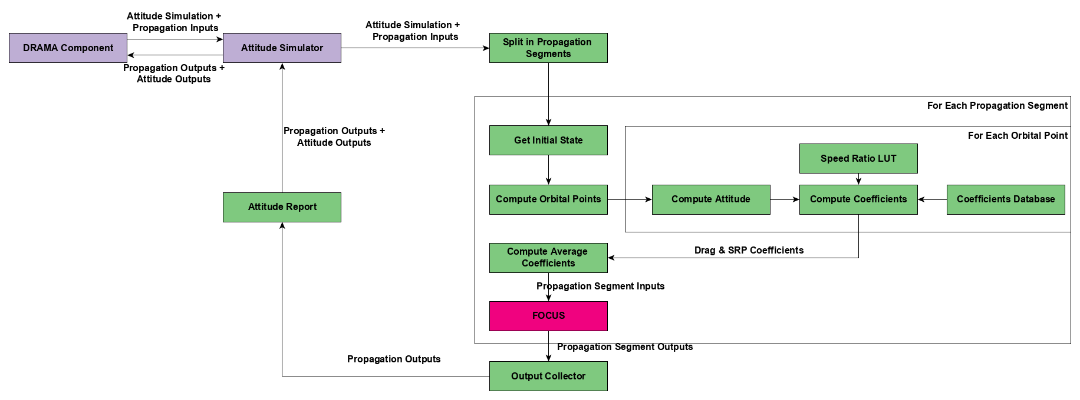
Attitude Simulation Procedure – functional diagram
Functional diagram of Attitude Simulator

Slide 7
Coefficient Estimator Concept
Calculation of aerodynamics and solar radiation pressure (SRP) force coefficients for a given DMF 3D model, considering surface material properties and up to two rotating parts, i.e. solar arrays or large antennas

Slide 8
ARES improvements
ARES (Assessment of Risk Event Statistics) is used to assess collision-related events between an operational spacecraft and trackable objects orbiting the Earth. It provides:
Statistical (annual) collision probability
Mean number of collision avoidance manoeuvres
Fuel consumption associated with those manoeuvres
NEW FUNCTIONALITIES
Use attitude law to derive the equivalent target satellite radius (rather than considering constant cross section area)
Introduce differential drag collision avoidance strategy
Include user-defined constellations
Update detection equations that allows to distinguish between observable and not-observable population

Slide 9
MIDAS Update
MIDAS (MASTER-based impact flux and Damage Assessment software) is used to model the collision flux and damage statistics for a mission
Example surface-1.att file:
...
#
# Epoch as ISO8601 string (CHAR*26)
#
# A - Azimuth / Right ascension
# -180 deg < A < 180 deg : azimuth of surface normal for Earth-oriented
# -180 deg < A < 180 deg : right asc. deviation from sun LOS for Sun-oriented
# -180 deg < A < 180 deg : right asc. of surface normal for inertially fixed
# h - Elevation / declination
# -90 deg < h < 90 deg : elevation of surface normal for Earth-oriented
# -90 deg < h < 90 deg : declination deviation from sun LOS for Sun-oriented
# -90 deg < h < 90 deg : declination of surface normal for inertially fixed
#
#--------------------------------------------------------------------------------------------------
# Epoch / UTC A / deg h / deg
#--------------------------------------------------------------------------------------------------
2021-11-28T21:29:07.255784 0.0012 0.0146
2021-11-28T23:59:07.255456 0.0015 0.0148
2021-11-28T01:29:07.255345 179.5674 0.0234
2021-11-28T02:59:07.255345 179.5774 0.0123
#--------------------------------------------------------------------------------------------eof---
MIDAS damage analysis based on attitude ephemerides:
DMF framework parses the CCSDS AEM
DMF framework converts Quaternions to Euler angles
DMF framework converts ephemerides into (JSON) ephemerides array
pyMIDAS converts JSON ephemerides to new surface-<X>.att file
MIDAS parses the attitude information and calls MASTER

Slide 10
OSCAR improvements
OSCAR (Orbital Spacecraft Active Removal) addresses disposal manoeuvres at end-of-life and assesses the compliance of the latter stages of a mission with the mitigation guidelines.
Different possible future scenarios for solar and geomagnetic activity can be analysed, as they are the main drivers in the estimation of the residual lifetime of an orbit.
NEW FUNCTIONALITIES
Use 6dof simulator and coefficient estimator modules developed in this project
Introduce circular delayed de-orbit (only for chemical propulsion)
Transfer time taken into account when using electric propulsion
Update tether module
Exploit resonance effects among several orbital perturbations for long-term disposals
Extend definition of protected regions, introducing user-defined volumes

Slide 11
Thank you
www.elecnor-deimos.com

