Slide 1


Optimizing Ge substrate usage in the manufacturing of MJ solar cells
Guillaume Courtois, Valerie De Houwer, Jinyoun Cho, Kristof Dessein
Notes:
Until it found its way into MJ solar cells. These solar cells were historically produced on GaAs substrates, but in the early 1990s, germanium pushed those out completely. Why is that?

Slide 2
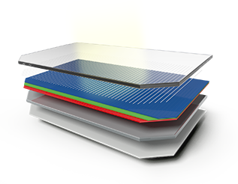
Outline
Ge substrates for multi-junction solar cells
  Sourcing
  Recycling of losses incurred at Umicore
Substrates thinning down at end-of-line
  Recycling of Ge losses incurred at a customer’s
Future thin Ge substrates
  Just as enough Ge as needed in solar cells
ESA Projects
Effective Use of Ge*
ELLA⁺
GaInP
GaAs
Ge
*Contract 4000128156/19/NL/FE
⁺Contract 4000129924/20/NL/FE

Slide 3
1. Ge substrates for MJ solar cells

Slide 4







Germanium Solutions
Sustainable closed-loop model
High Purity
Germanium
GeCl4
Germanium
Substrates
Germanium
Solutions
Production scraps
& EoLife products
Germanium
Sourcing & Supply
Germanium
Recycling

Slide 5
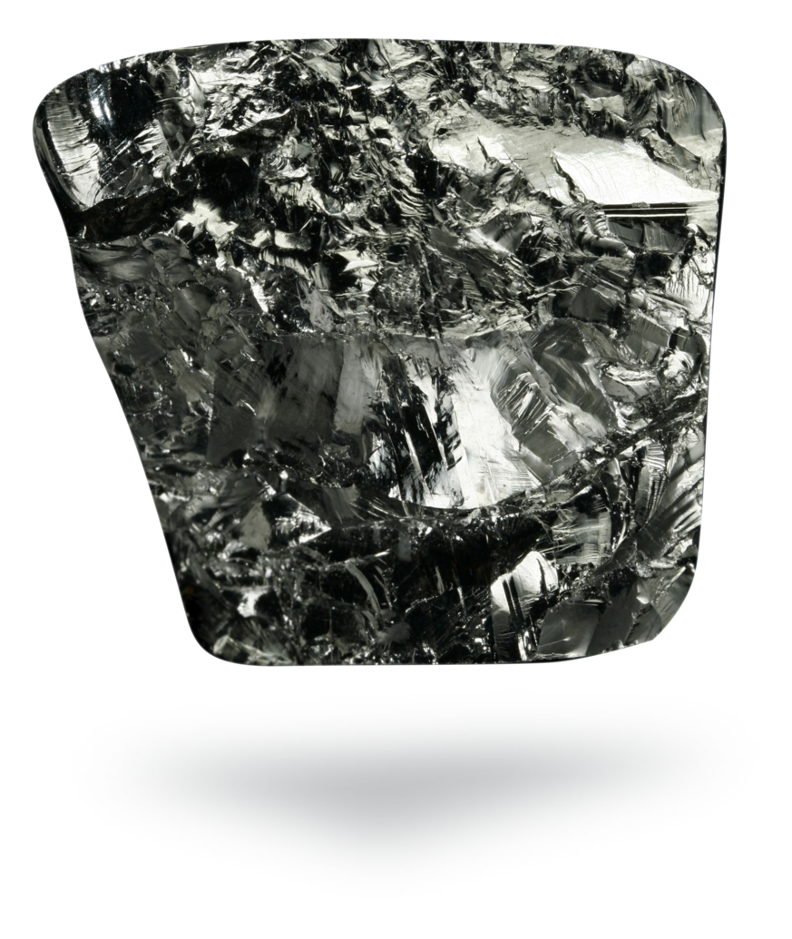
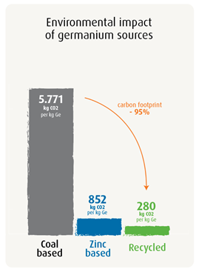
Germanium sources
Global market is 120 – 150 tons per year
Global Primary Germanium Sources
Umicore sourcing 2022
Robertz, B., Verhelle, J. & Schurmans, M. JOM67(2015) : 412

Slide 6



Importance of germanium recycling
CO₂ impact lower for entire production line
Germanium is included in list of EU’s Critical Raw Materials (CRM)
Win-win for customer & Umicore
➔ insusceptible to germanium price fluctuations
➔ lower end-product price

Slide 7
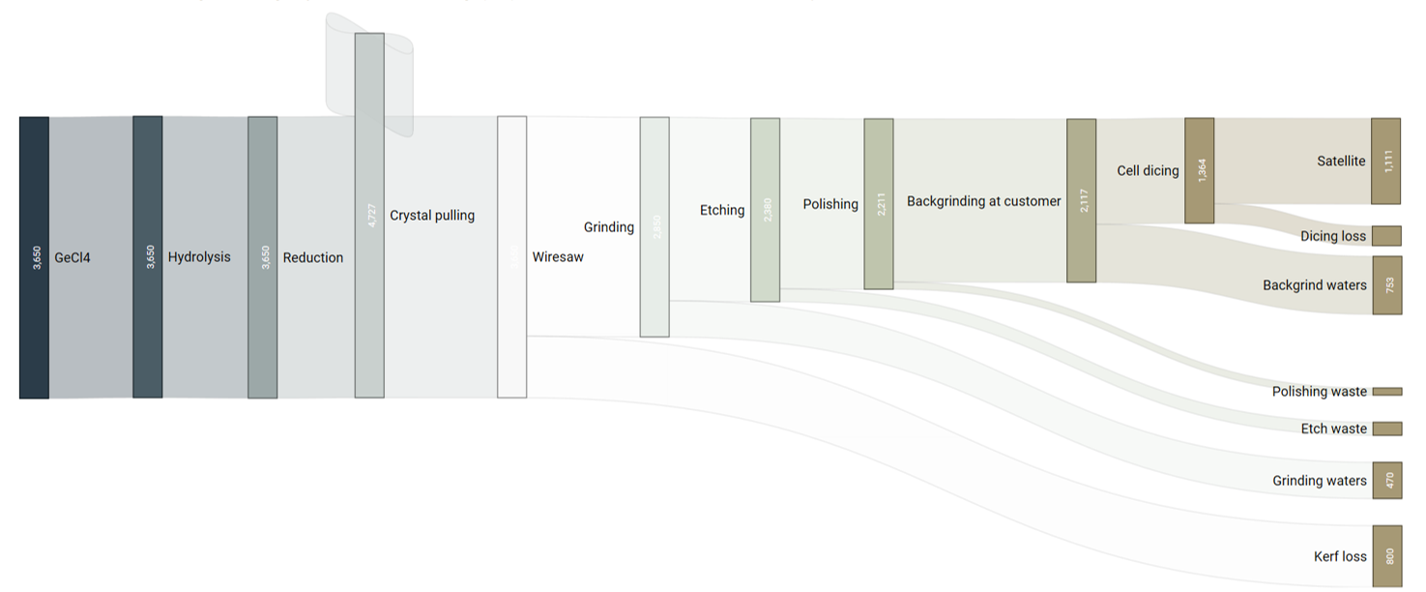
Production scrap recycling
Study case: 100k wafers, Ø 150 mm, 225 µm delivered to customer, 145 µm after backgrinding
Umicore
Customers
Wafering
Space (30%)
Recovered at
customers’
Recycled internally
All Ge losses incurred in Umicore’s internal flow are recycled
New: Recycling of Ge losses incurred at customers’ being implemented

Slide 8
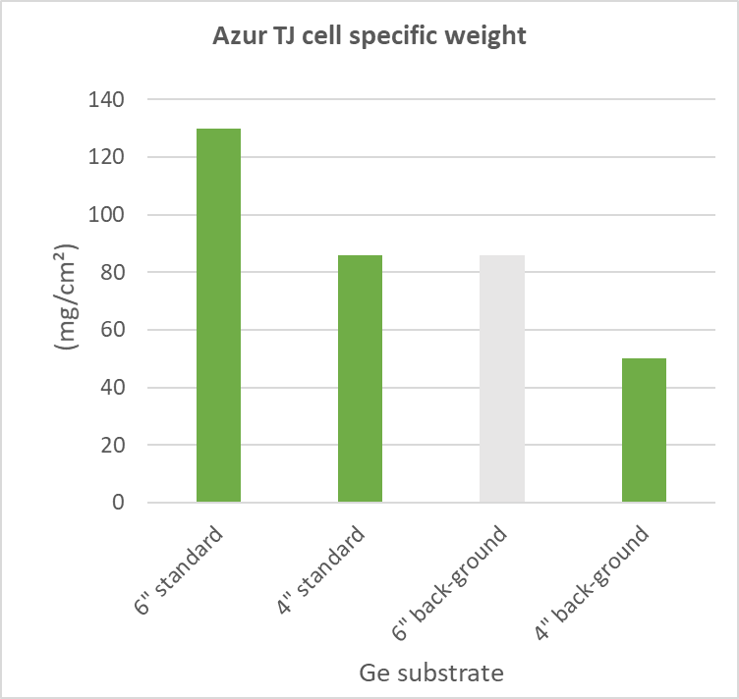
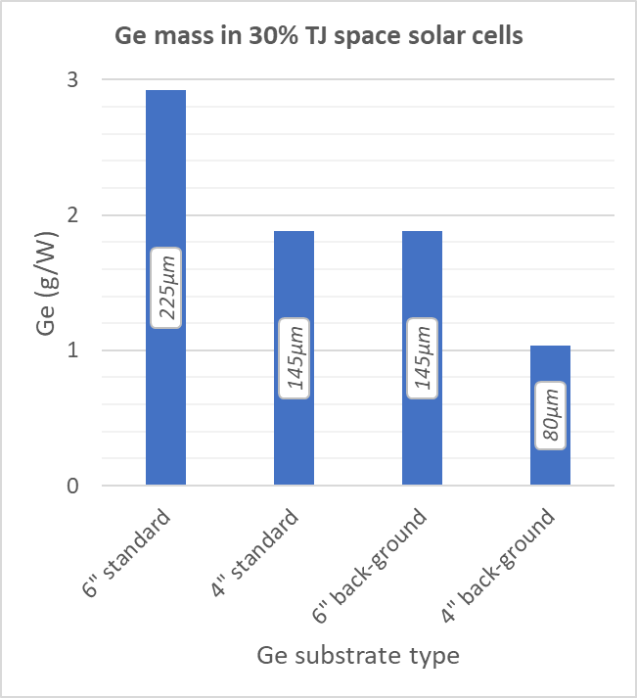
Motivation for back-grinding
Lighter cells, leaner in Ge
AzurSpace 3G30C GaInP/GaAs/Ge triple junction solar cells

Slide 9
2. Recycling of Ge losses incurred at customer’s

Slide 10

Recycling Ge from End-of-Line back-grinding
Up-concentration needs to occur at the customer’s
Backgrinding
Ship grinding waters to Umicore
Storage
Backgrinding
Ship grinding waters to Umicore
Up-concentration
Backgrinding
Up-concentration at customer’s facility
Up-concentration
0 % Ge recovered (dissolved in water)
30 % Ge recovered (dissolved in water)
90 % Ge recovered (bench top setup)

Slide 11
Summary of experimental work
Ge separation
Instability of solution over time
➔ Tests onsite necessary
Volume reduction of 98%
High concentration achieved
Stable operation
Successful commissioning of on-site upconcentration process
Successfully closed the loop starting from Azur’s material
Lab trials @ Umicore
Lab trials @ Azur
Pilot trials @ Azur
Production run using pilot
Installation of final process
New 2022!
Ge recovery > 80%
Optimization process parameters
Long-term stable operation guaranteed

Slide 12
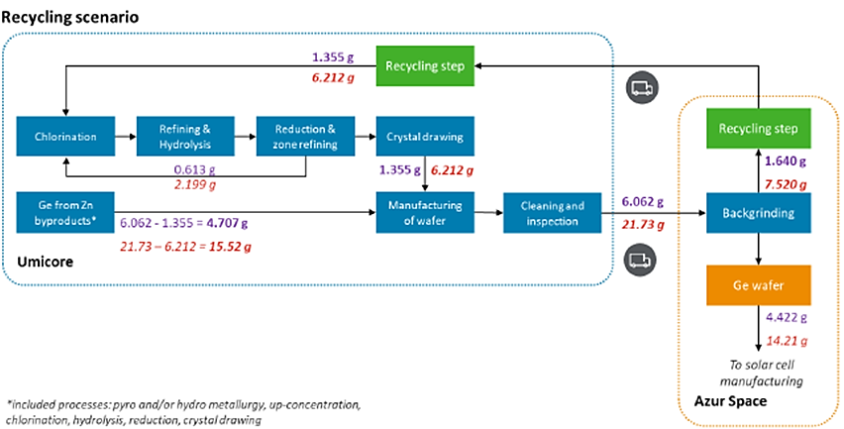
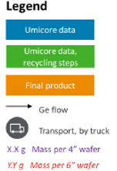
Scope of the LCA study
Functional unit
= Manufacturing of one output 4” or 6” Ge wafer with back-grinding
Baseline scenario: no recycling

Slide 13
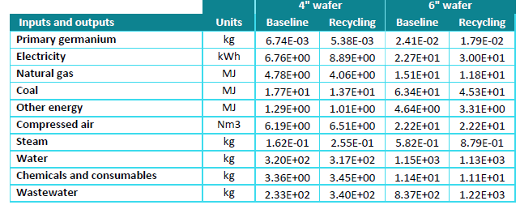
Progress of the LCA study
Iteration 1
  Outcome: relative low climate change impact results compared to previous studies
  ➔ Include Umicore’s process data for primary Ge route (Zinc by-product)
Iteration 2
Outcome: wafer manufacturing + cleaning & inspection processes had relatively small contribution
➔ Include Umicore’s process data for manufacturing + cleaning & inspection
Iteration 3
Outcome: updated LCI

Slide 14
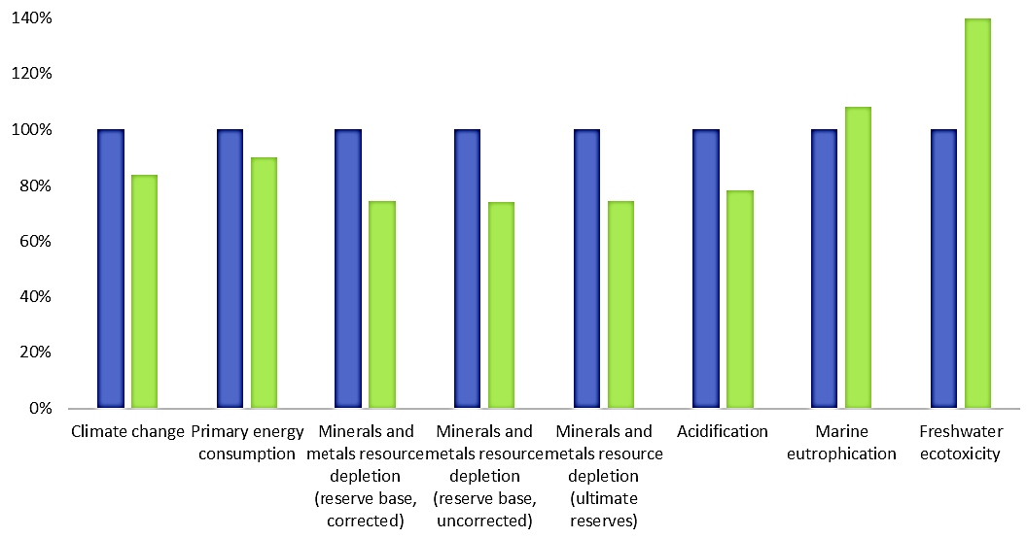
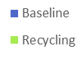
Back-grinding LCA: Results third iteration
2 scenarios:
  Baseline: back-grinding without recycling
  Back-grinding + Recycling
6” wafer: Comparison between
baseline and recycling scenarios
Recycling decreases:
  Climate change impact
  Primary energy usage
  Minerals & metals resource depletion
  Acidification
Recycling increases:
  Marine eutrophication
  Freshwater ecotoxicity
Due to hydrometallurgical recycling step

Slide 15
3. Future thin Ge substrates

Slide 16
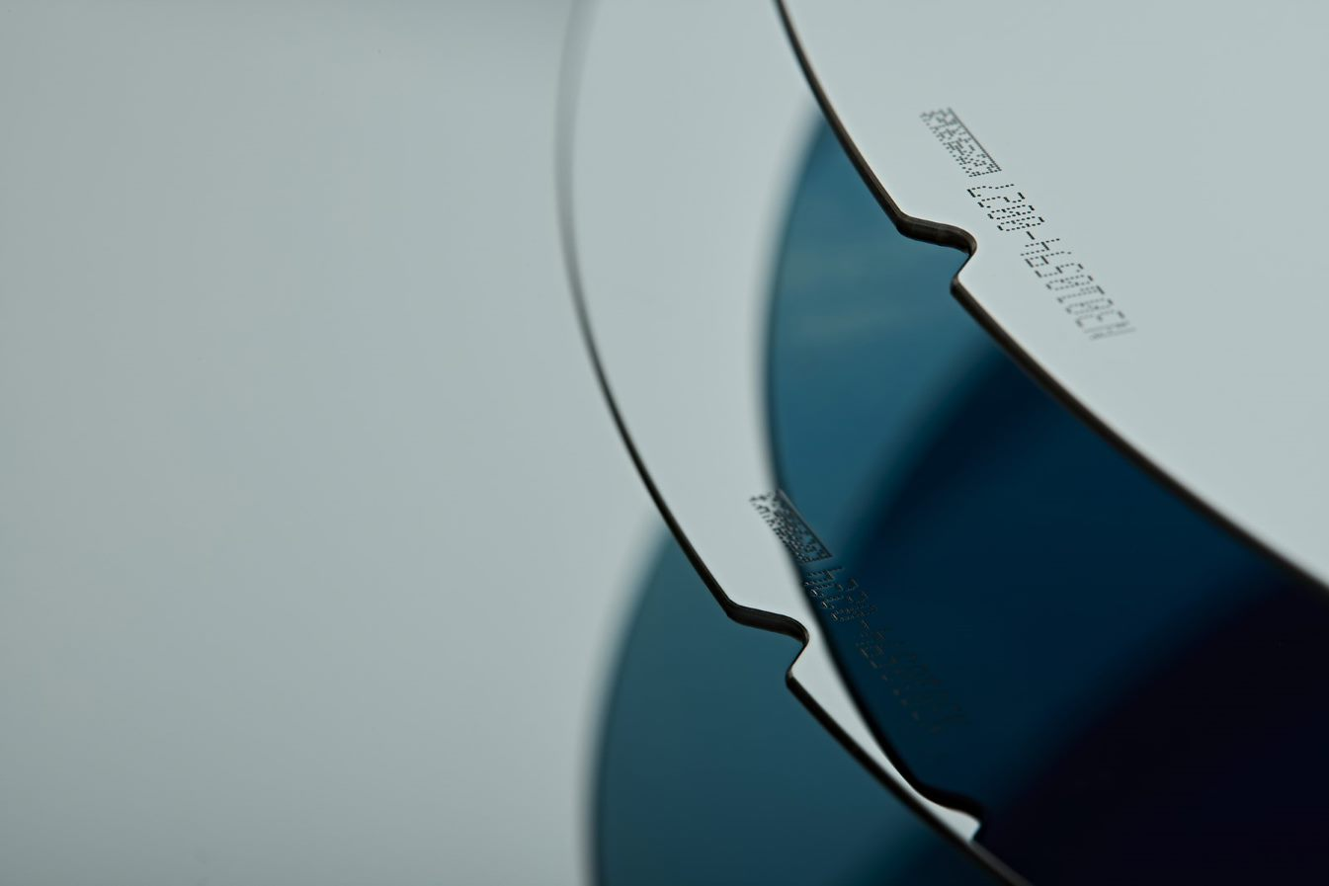
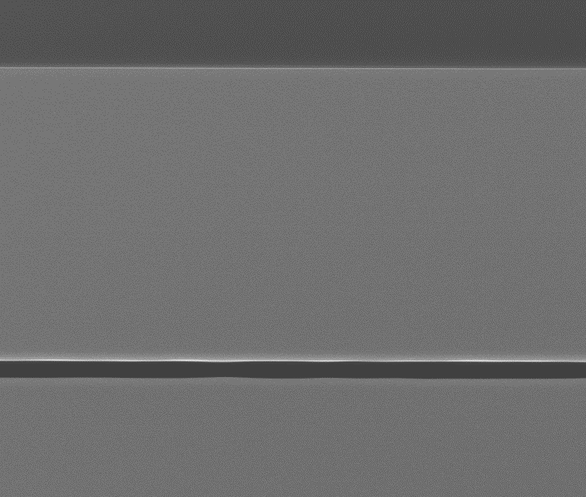
How thick a Ge substate?
functionality for which Ge is indispensable
growth template (< 1µm)
bottom cell (< 10 µm)
functionality for which Ge is optional
radiation shielding (> 20 µm)
mechanical support (> 100 µm)
Going for...
Lighter
Flexible
Cheaper
Ge substrates
Ge Epi layer, 10µm
Ge mother substrate

Slide 17






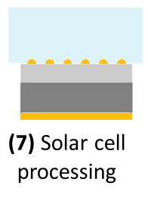


Ge-on-Ge platform
(1) Ge wafer
(2) Ge-on-Ge engineering
(6) Reconditioned Ge wafer
Closing the loop
(5) Layer transfer
(4) Device processing
(3) Epitaxial thickening
(optional)

Slide 18
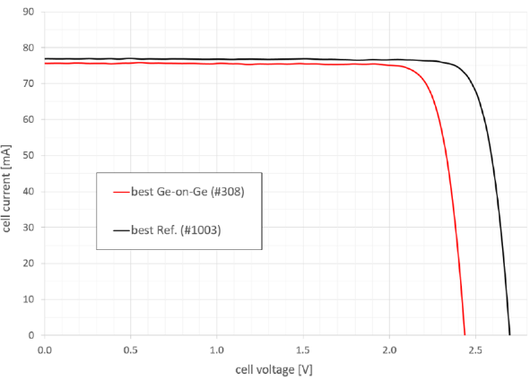
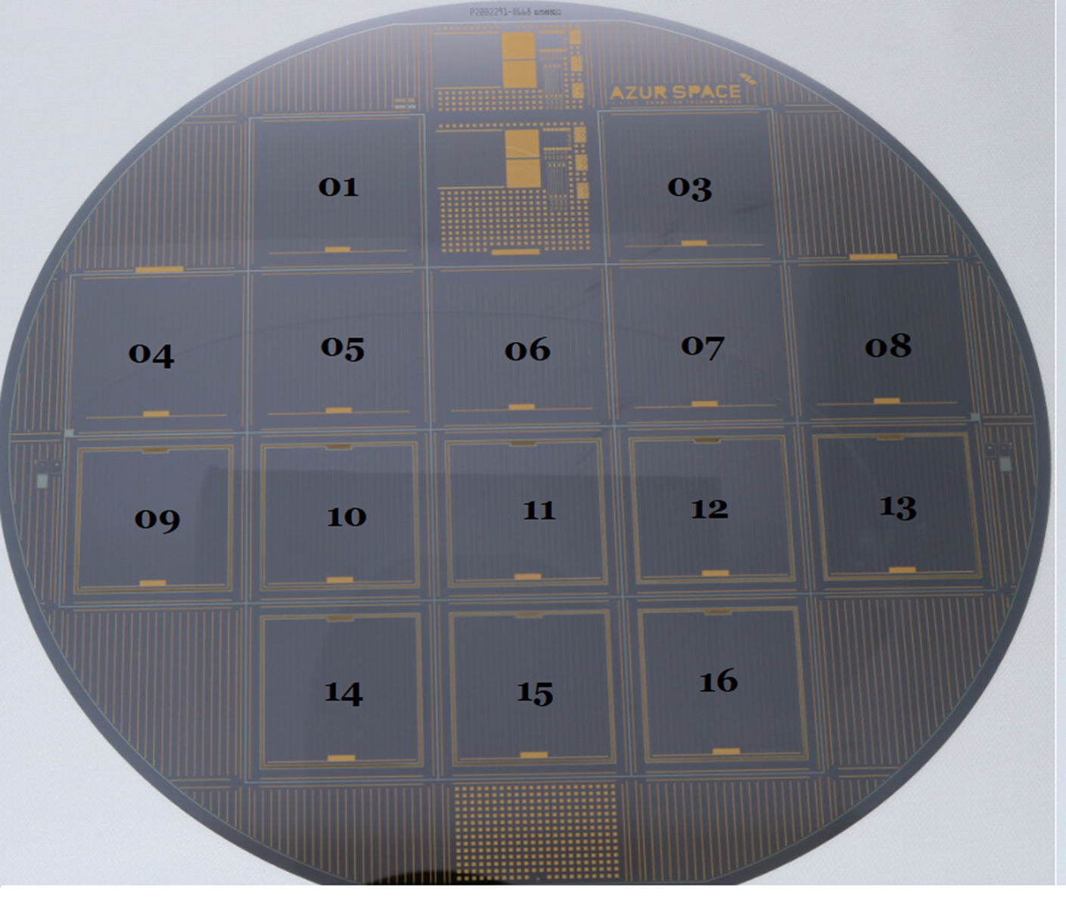
Ge-on-Ge wafers processed into 2J solar cells
6” wafers
n-type Ge → no bottom cell
Engineered: pores
  No risk of delamination
Standard ARC added
Reference cells: on standard wafer
J_{sc} on par with reference cell
V_{oc} loss mostly explained by
absence of Ge bottom cell
Normal FF
Best Ref cell
Best Ge-on-Ge cell
6”

Slide 19
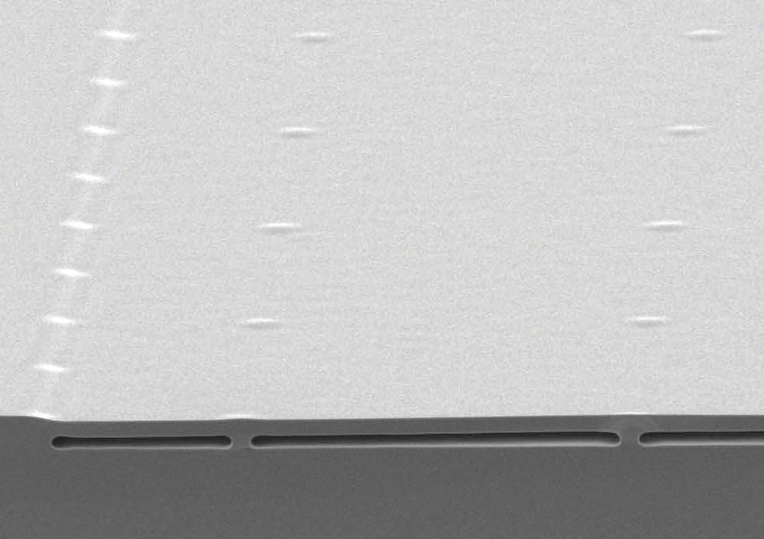

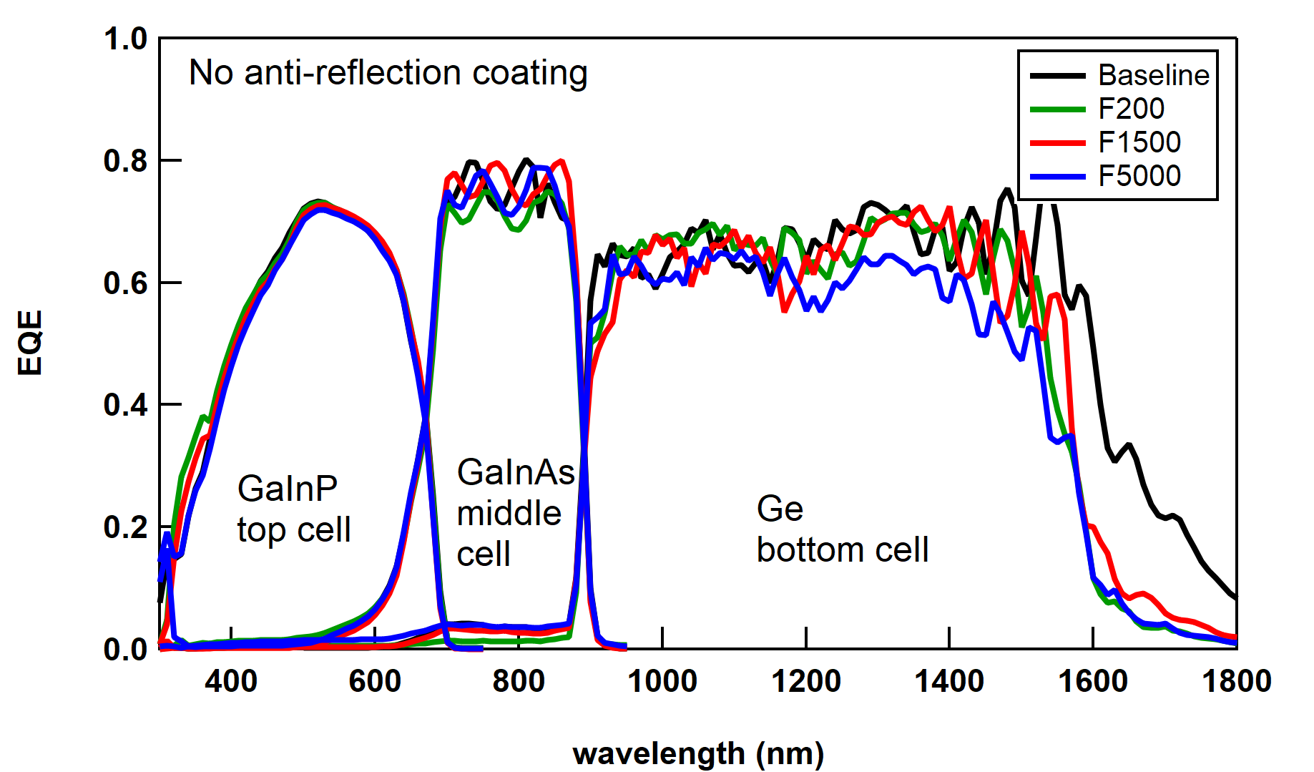
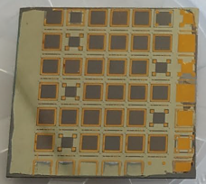
Ge-on-Ge foils surviving the full solar cell process
With comparable EQE as Ref cell
Ge-on-Ge wafers thickened with 7µm epiGe
GaInP/GaInAs/Ge TJ solar cells still attached
Ref cell
Ge-on-Ge cells
Plated Ti/Ni/Au
No ARC!
GaInP
5.5 µm
GaInAs
Ge-on-Ge + 7 µm epiGe
7.5 µm
Ge-on-Ge
Ge
Ga-doped Ge
~ 5E17/cm³
~ 2.5 cm
V. Depauw et al., Progress in PV (accepted)

Slide 20
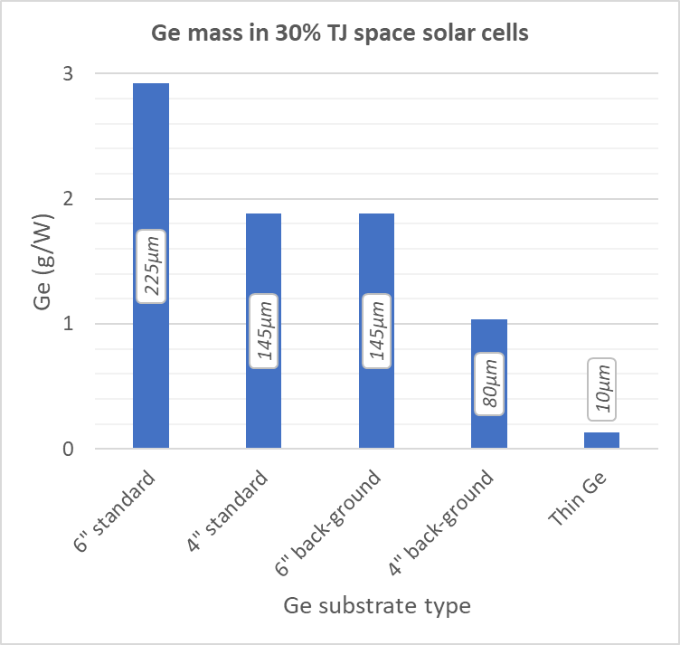
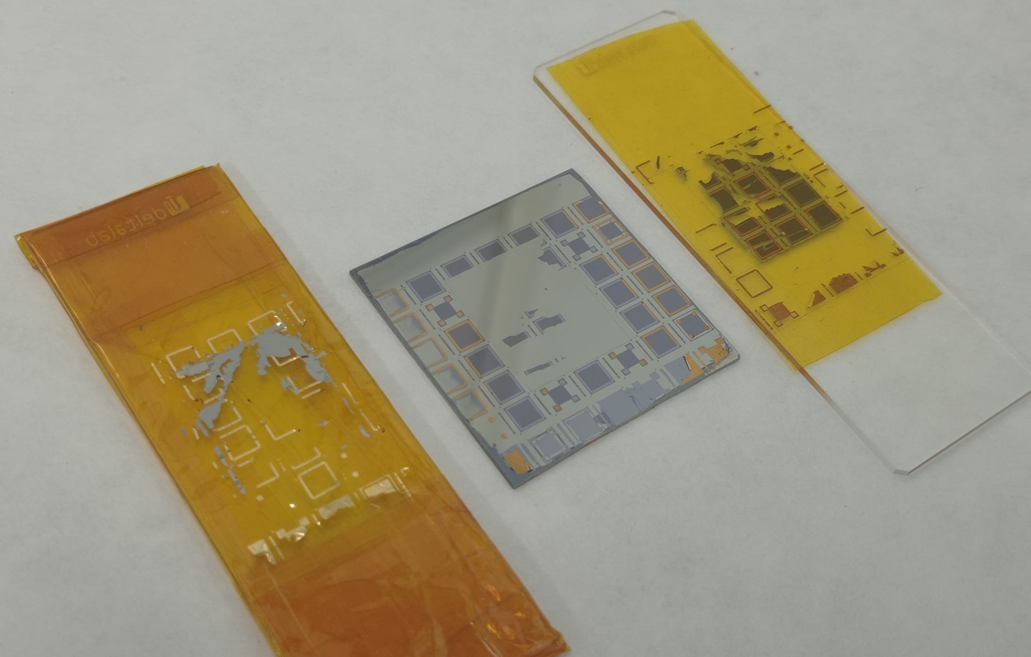
Ge-on-Ge engineered substrates: What’s next?
The device detachment challenge
Need dedicated bonding/detachment process
Process and measure detached solar cells
Target
Triple-junction solar cell on Ge-on-Ge
Glass slide
Kapton tape
3-junction cell

Slide 21
Conclusion & Outlook
Present generation of substrates: Improve Ge recycling
  Back-grinding losses incurred @ AzurSpace fully recycled
  Similar request from other customers
  Towards 100% recycling of Ge production scraps
Reduce Ge usage in solar cells: Future, thin substrates
  10µm Ge foil for triple junction cells
  Ge consumption down to 130 mg/W
  Promising III-V stack quality and preliminary device results
  Challenge: Detachment of large area devices & back-side metallization

Slide 22
We are hiring!
careers.umicore.com
Guillaume.Courtois@eu.umicore.com

Slide 23



ESA Effective Use of Germanium
Contract number: 4000128156/19/NL/FE
The work presented here was supported by the European Space Agency under the Effective Use of Germanium project
Project partners:
Key external service providers:
Key goals:
Recycling of backgrinding waters of Azur Space
Ge-on-Ge engineered substrates as alternative growth substrates

Slide 24
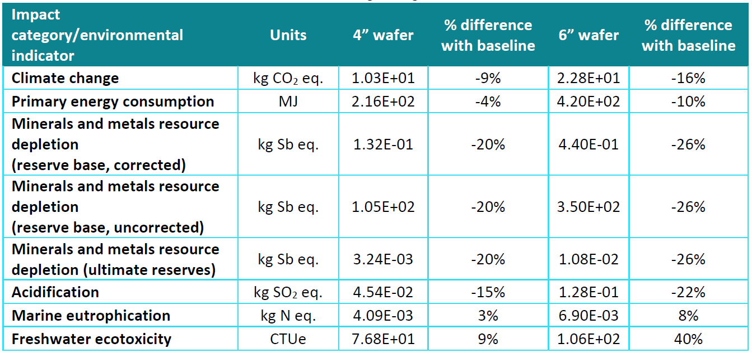

Slide 25



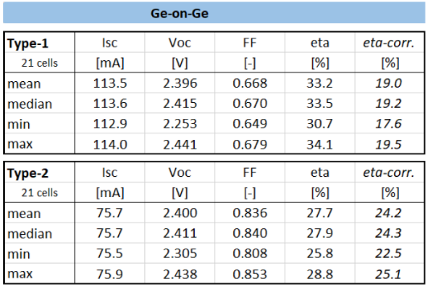
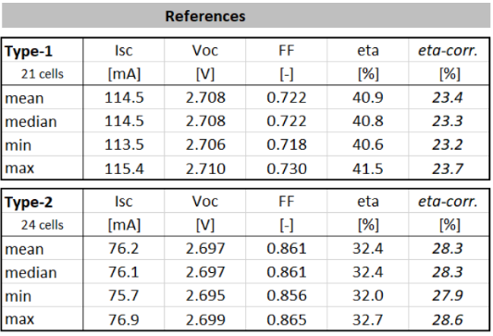
Batch 3
v1.0
v2.0
3G30 on 6” v1.1: cell results
v3.0
I_{sc}= nearly on target
V_{oc} = difference due to lack of Ge bottom cell
FF = nearly on target

Slide 26


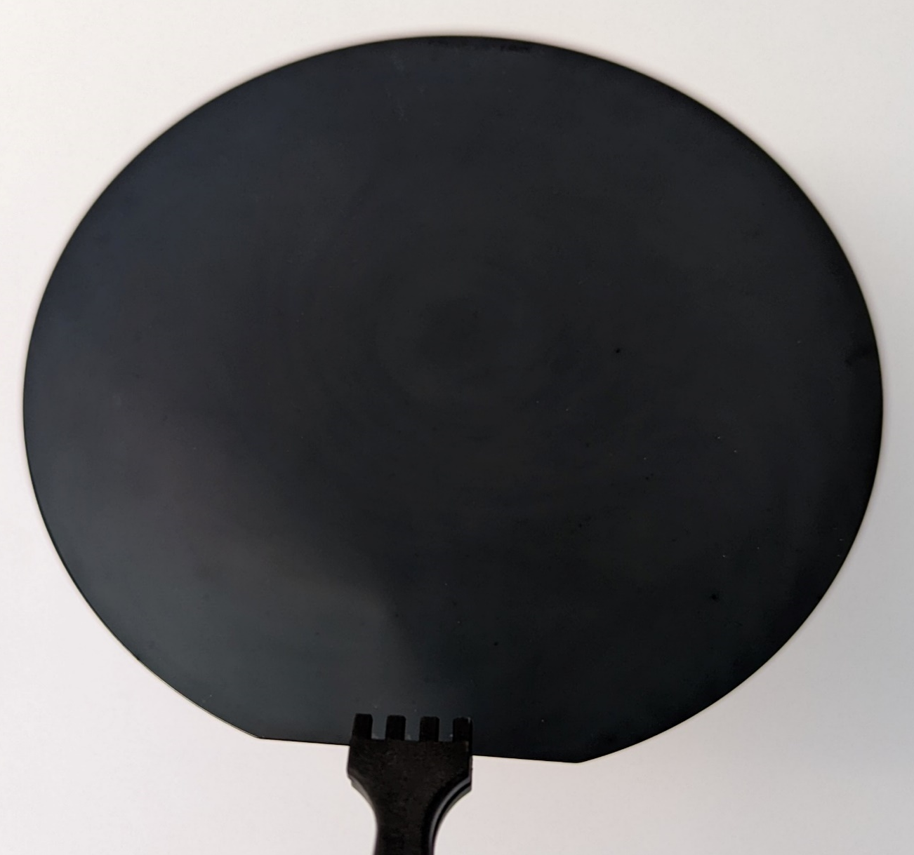
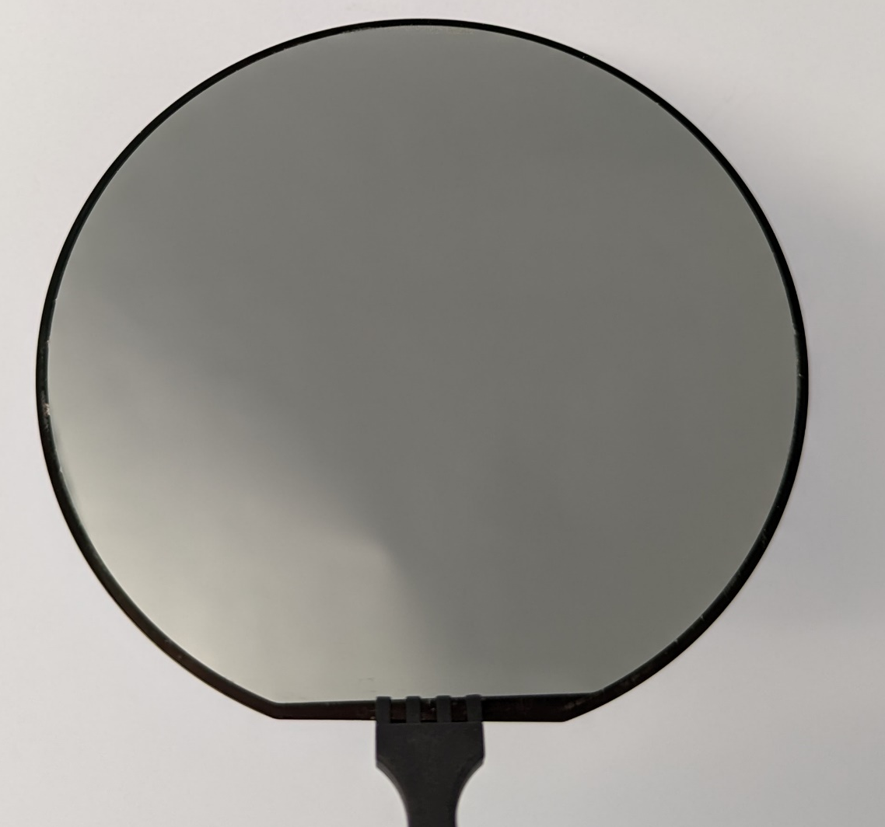
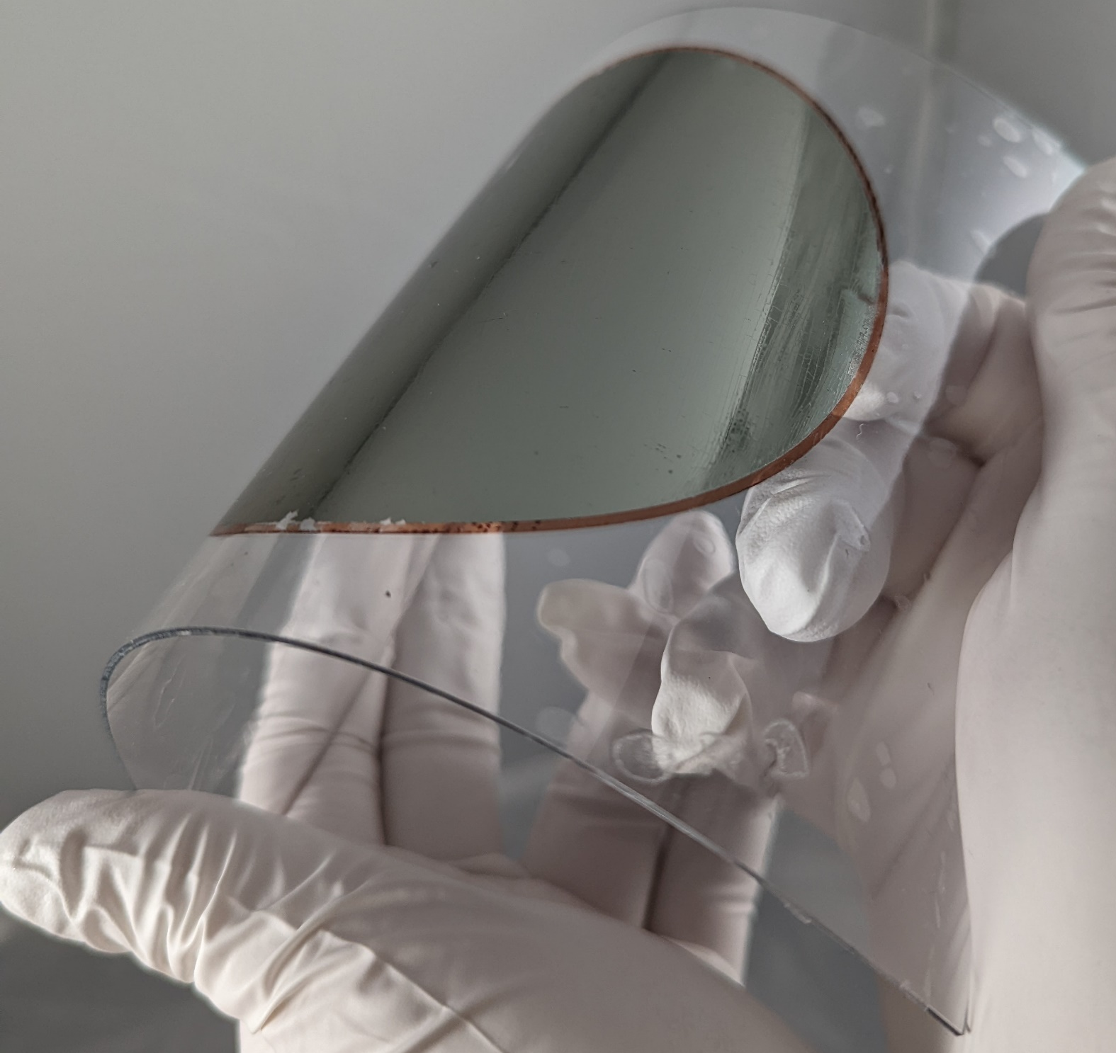

Ge lift-off techniques 2/2: Wet etching
Porous Ge: High-porosity PGe structure enable easy detachment
PGe substrate
Ge epilayer
Free-standing Ge membrane
Mirror like surface, without any delaminations
High quality Epitaxial Ge with formation of weak layer
Low roughness (RMS ~1 nm)
Highly oriented monocrystalline nature of Ge membrane
Crack free surface Ge membrane
N. Paupy et al., IEEE-PVSC49 (2022)
T. Hanus et al., E-MRS Fall (2022)
Same Ge benefits
Potential for low cost starting substrate, low cost and good re-usability potential
Early in development cycle

Slide 27
4”, 145µm
5µm
N. Paupy et al., 2022, submitted

