Slide 1
Assisted Spacecraft Demise with Exothermic reactions
P. Kärräng

Slide 2


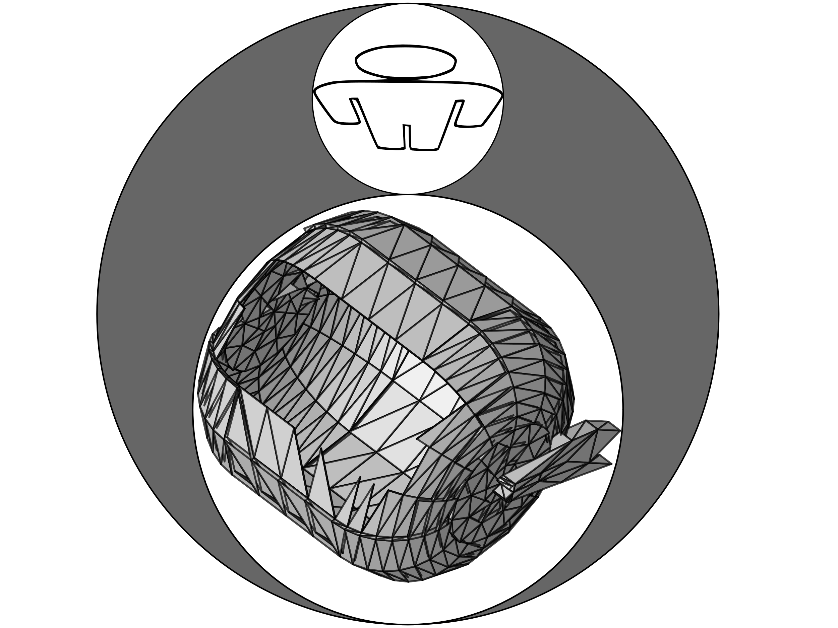
Some common spacecraft equipment pose a risk on-ground
Common critical equipment include:
Propellant tanks
Reaction wheels
Solar array drive mechanisms

Slide 3
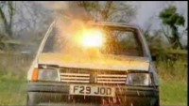
There is not enough heat to demise!
What can we do?
Thermite!
Thermite vs. Car
https://www.youtube.com/watch?v=rdCsbZf1_Ng&t=106s

Slide 4
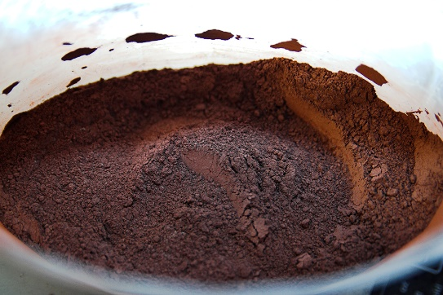
What is Thermite?
Thermites are mixtures of a metal and a metal oxide, usually in powder form. Once the redox reaction is triggered, a noticeable amount of heat is released.
Aluminium is the best candidate for the metallic component:
  High energy output
  Great availability (and low cost)
  Non-toxic
The metal oxides selection drivers:
  Theoretical Maximum Density (TMD)
  Adiabatic reaction temperature
  Fraction of products in gaseous state
  Specific reaction enthalpy

Slide 5
Exothermic reactions can aid the demise process
ERASD - Exothermic Reaction Aided Spacecraft Demise - Proof of Concept Testing –
Final Report, Contract No. 4000126547/19/NL/AR/ig, Issue 1, Revision 2, 10/05/2019

Slide 6
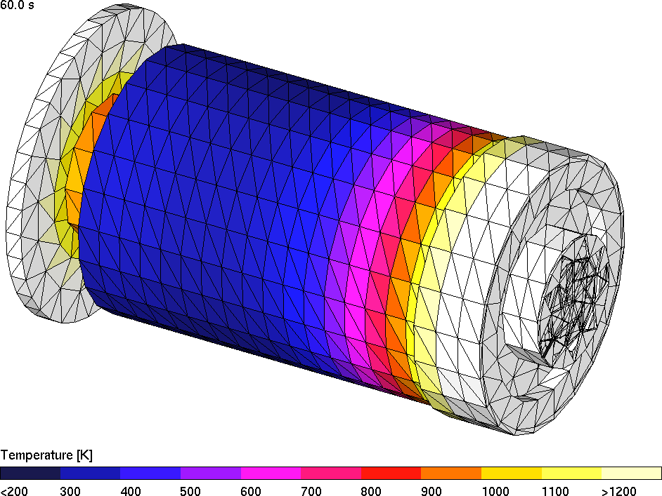
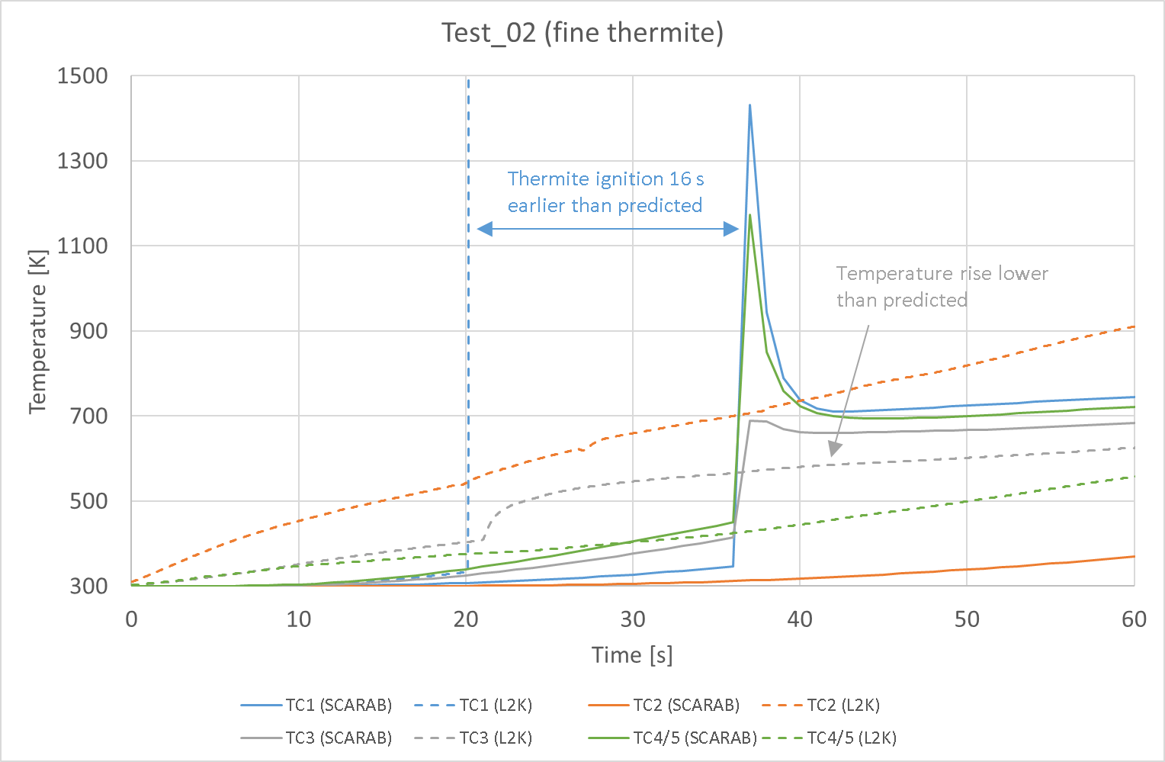
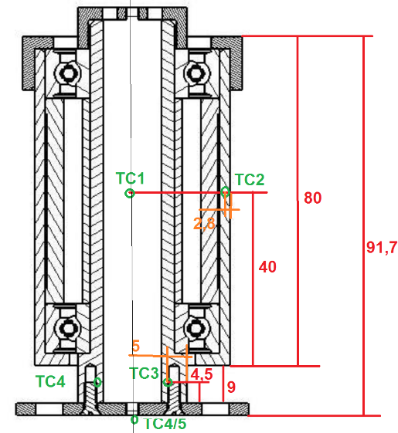
Numerical re-building improve our understanding of the demise process
ERASD - Exothermic Reaction Aided Spacecraft Demise - Proof of Concept Testing –
Final Report, Contract No. 4000126547/19/NL/AR/ig, Issue 1, Revision 2, 10/05/2019

Slide 7
The on-going SPADEXO project aims making exothermic reactions practical for demise purposes
SPADEXO [HTG / PoliMi & ReActive / DLR]
The goal of the current project is to:
  Design, optimize and prove the concept of using exothermic reactions for demise purposes.
  Design and verification of different fuse concepts.
  Devise guidelines for use of the technology in various equipment
Currently the project is in the design phase for the breadboard. The test campaign is scheduled for early 2023

Slide 8
Energetic material selection
Al-Fe₂O₃ has been selected as the main formulation to be investigated.
It is important to have the possibility of tuning the ignition temperature of the charge:
  Use of other thermite formulations as primer
  Mechanical activation
Mechanical activation can be used to increase powder reactivity, while maintaining the benefits typical of micrometric powders:
  High active metal content
  Safety
Notes:
Al-Fe₂O₃ main drawback is having a rather high ignition temperature: good for safety, but can be a problem in the final application. The benefits of typical of micrometric powders: (1) High active metal content and (2) Safety

Slide 9
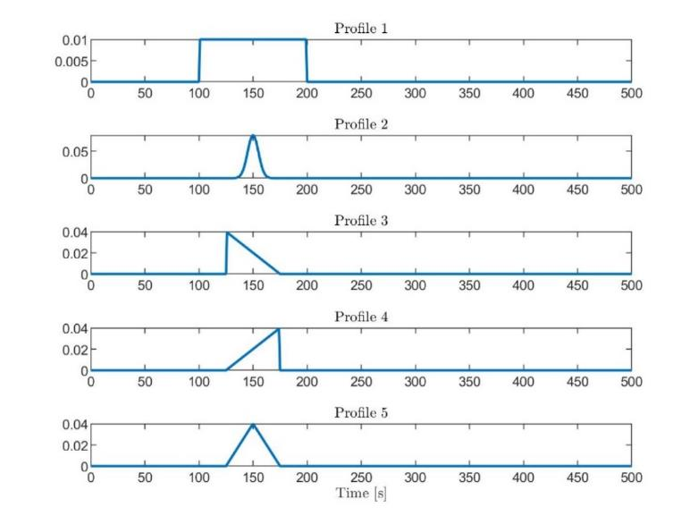
Update to the thermite model in SCARAB
A new thermite model will be implemented and based on thermite theoretical available heat.
Notes:
A new model has been defined and will be integrated in Scarab. It will be used to foresee and, later, rebuild the experiments in plasma wind tunnel.

Slide 10
Practical test cases will be tested in wind-tunnel
Ball Bearing Unit and Solar Array Mechanism simplified geometry
Wire bundle cutter
Notes:
Ball Bearing Unit and Solar Array Mechanism simplified geometry:
Objective: Investigate thermite interaction with the vessel in case of geometric variations
How: Different L/D and different thickness of the samples
Final application: Direct integration in the objects to be demised
Wire bundle cutter:
Objective: Investigate the possibility to use thermites to cut structural connections
How: Testing the demise of a wire bundle in proximity of a thermite charge
Final application: Improve satellite demisability by early fragmentation

Slide 11
Conclusion
Exothermic reactions has the potential to facilitate demise for many common spacecraft equipment.
Several on-going activities are working on making exothermic reactions for demise purposes practical.
Exothermic reactions can in the future be a method to help space systems be compliant with the re-entry risk requirements

Slide 12
Thank you for listening!
Contact:
Patrik Kärräng
p.kaerraeng@htg-gmbh.com

Slide 13
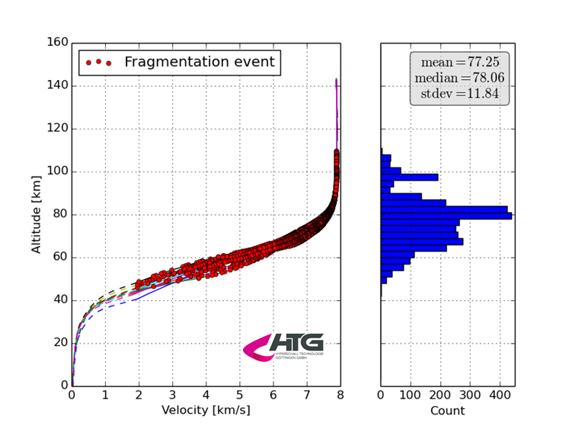
Release altitude from a “typical” spacecraft
Fragmentation data from 16 simulations of a generic “typical” spacecraft, extracted from SCARAB.

Slide 14
DIVE Guidelines
Equipment level Verification Tree
Step 1: Select initial conditions
Step 6: Iterate again with the engineers
Step 2: Choose your tool (e.g. ESA DRAMA)
Step 3: Create the equipment model
Step 4: Assess equipment model re-entry
Step 5: Identify feasible D4D option
Step 7: Perform demise test in wind tunnel facility
to validate the model demise behaviour
DIVE - Guidelines for Analysing and Testing the Demise of Man Made Space Objects During Re-entry,
Technical Note: ESA-TECSYE-TN-01831, Issue 1, Rev. 0, Date 20/04/2020
Step 8: Create component based model
and add to equipment database

