Slide 1
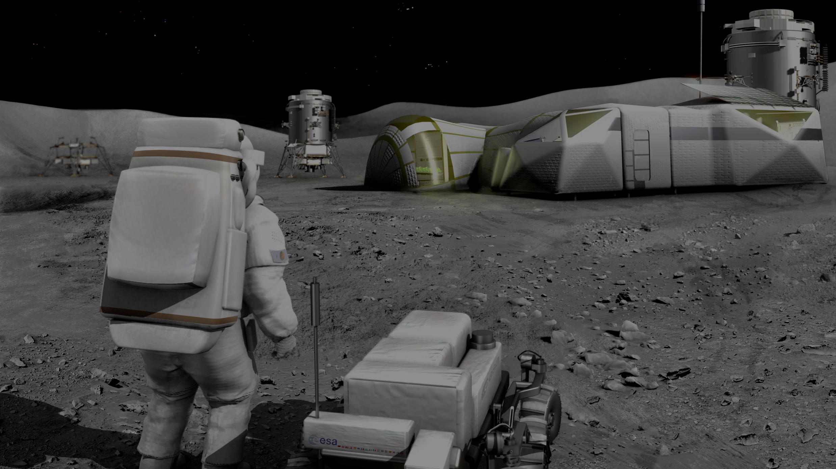
Advanced hybrid sensing system for prospecting on the Moon and Mars and Mars
Authors:
B.Eng., M.Sc. Gustavo Jamanca-Lino, Canadian Space Mining Corporation
B.E., B.Sc., M.S. Elise Marie Eckman, Canadian Space Mining Corporation
Pr. Pooneh Maghoul, Polytechnique of Montreal
Richard Boudreault, Canadian Space Mining Corporation

Slide 2
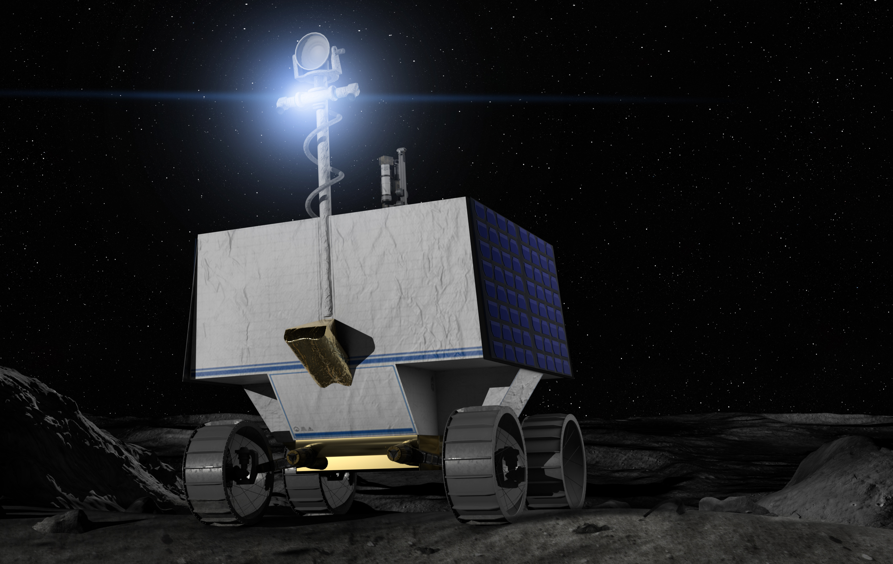
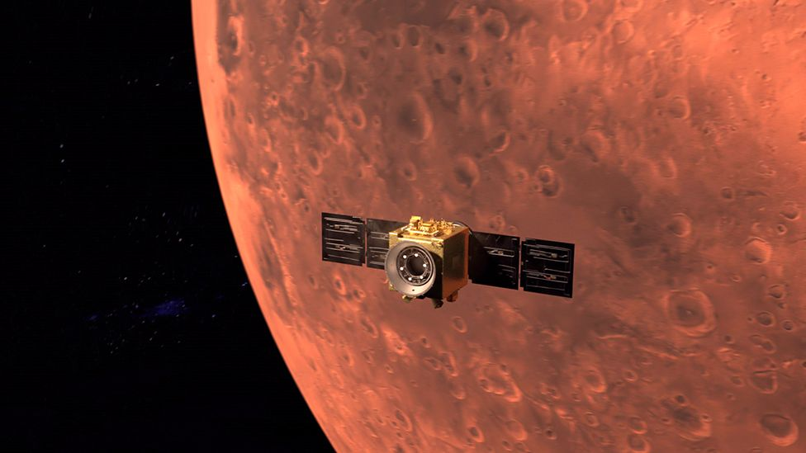
Introduction
Planetary exploration is based on gathering new data from Off-Earth solid objects with scientific purposes and, more recently, business opportunities.
Future places for a detailed exploration are Moon, Mars, and asteroids. Every year different missions are launched to sense the surface from orbit or measure the properties directly from the soil by landers and rovers.
Resources' prospection is focused on finding elements to use as prime matters for a sustainable human settlement on other worlds.
Fig.2. Rover exploration on the Moon [2]
Fig 3. Exploration of Mars by remote sensing[3]

Slide 3
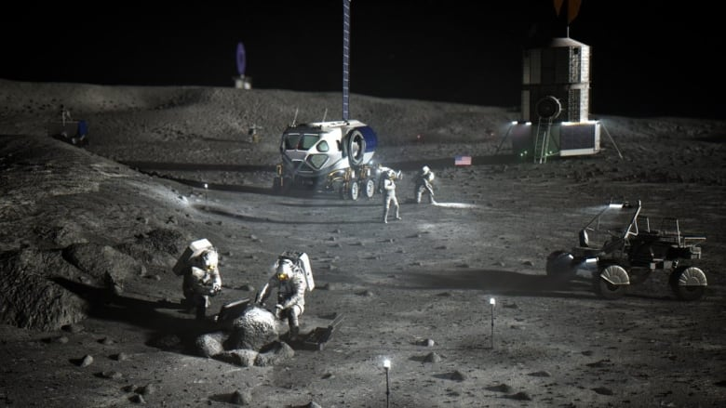
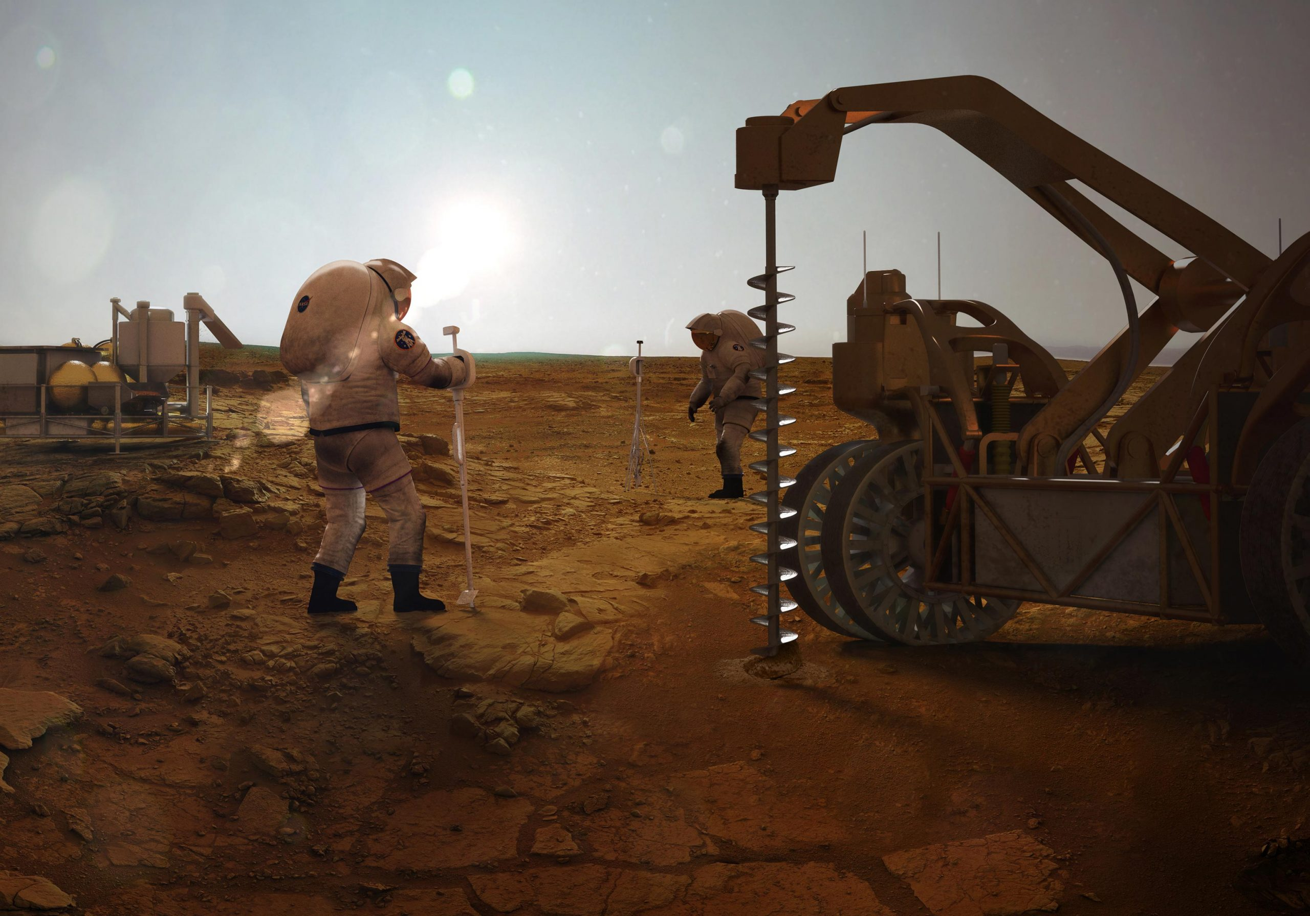
ISRU
In-Situ Resource Utilization (ISRU) is related to major resources (polar water, solar wind volatiles, oxygen/metals from regolith, and construction and manufacturing)
Fig. 4. Artistic view of human activities planned on the Moon [4]
Fig. 5. Artistic view of human activities planned on Mars [5]
Fig. 6. ISRU description [6]

Slide 4
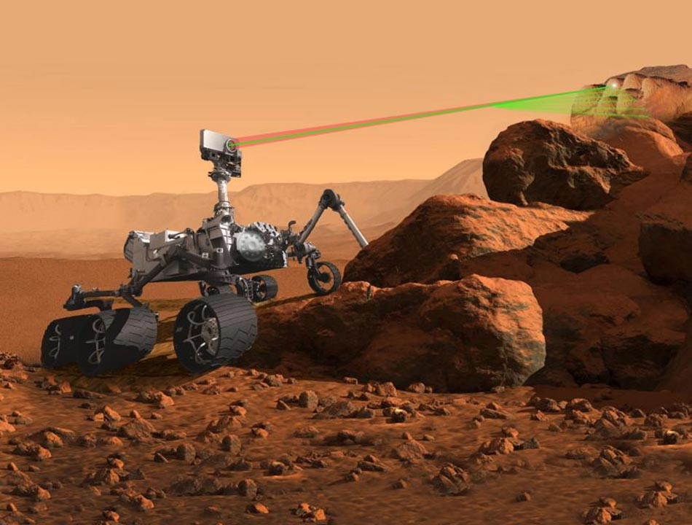
Geochemical methods
Most of the projects on surface exploration are based on geochemical methods to identify chemical properties on regolith and rocks.
Fig. 7. Perseverance Rover on Mars, ready to drill the Surface [7]
Fig. 8. Perseverance Rover on Mars, measuring the chemical composition of rocks by lasers [8]

Slide 5
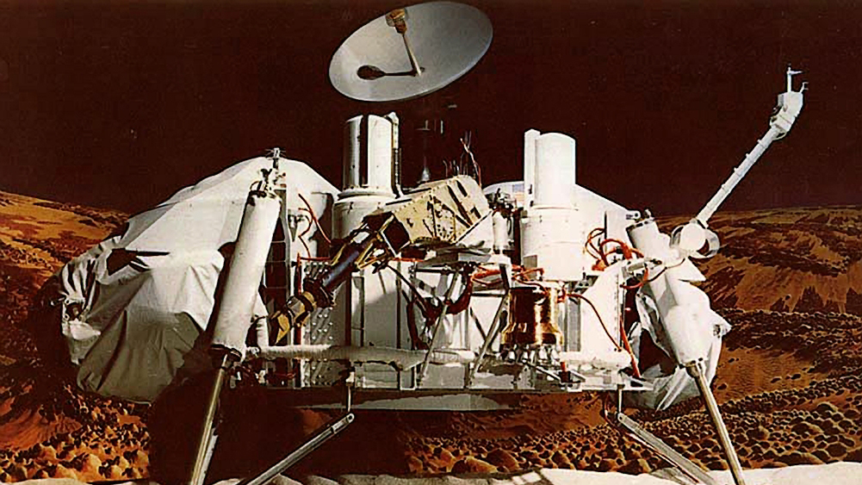
Challenges of Geochemical studies
Since Viking, we assumed that precise instrumentation where the key to discovery successes, hoping that extraterrestrial life or valuable planetary resources were ubiquitous.
Well, we were wrong in many cases. Imaging techniques from orbit or from soil perspective reveals only partial information onto the underground structures.
Thus, identify a material only based on chemical properties, is restricted to specific areas and shallow depth, which is not representative for ISRU projects, restricted to “extrapolate” the information to present models and designs.
Planetary surfaces scarcity of geomechanics information, so it is hard to predict the efficiency of drills and excavators to recover a sample, as in the Insight mission on Mars.
Fig. 9. Viking Lander [9]
Fig. 10. Insight mission [10]

Slide 7
Geophysics methods
Method | Physical Properties | Measured Parameter | Depth (m) | Vertical Resolution (m) | Main applications
Seismic reflection | Density and acoustic velocity | Travel times of refracted seismic energy (p- or s- wave) | 0 – 10,000 | 1 - 10 | Geology (Basin analysis)
Seismic refraction | Acoustic velocity | Travel times of refracted seismic energy (p- or s- wave) | 0– 150,000 | 1 - 10 | Geology (Plate tectonics)
Electromagnetic radiation or Ground penetrating Radar | Dielectric constant, Electromagnetic velocity (EM) | Travel times and amplitudes of reflected pulsed EM energy | 0-50 | 0.1 - 2 | Geology, Hydrology, Archeology
Electromagnetic induction (FDEM/TDEM) | Electrical conductivity and inductivity | Response to natural–induced EM energy | 0 – 10,000 | 0.5 - 10 | Geology and Mining, metal detection
Electrical Resistivity | Electrical resistivity/conductivity | Potential differences in response to induced current | 0 – 100 | 0.5 - 10 | Geology, Hydrology, Mining, Civil construction
Induced polarization (IP) | Electrical capacity | Polarization voltages or frequency dependent ground resistance | 0 – 100 | 0.5 - 10 | Geology, Hydrology, Mining, sulfide detection, Civil construction
Gravimetry/Gradiometer | Bulk density | Gravity effect measured in free-fall | Earth | 0.2 | Geology, Hydrology and Mining
Nuclear magnetic resonance | Decay in nuclear magnetization | Relaxation time constant | 50 - 100 | 1 - 10 | Hydrology
Magnetostatic | Magnetic permeability | Magnetic field vector | 0 – 20,000 | 3- 5 | Geology (Plate tectonics)
Magnetotellurics | Resistivity/Conductivity | Amplitude of electromagnetic fields | 0 – 150,000 | Lower than seismic | Geology, Hydrology
Table 1. Main geophysical methods [11, 12, 13, 14]

Slide 8
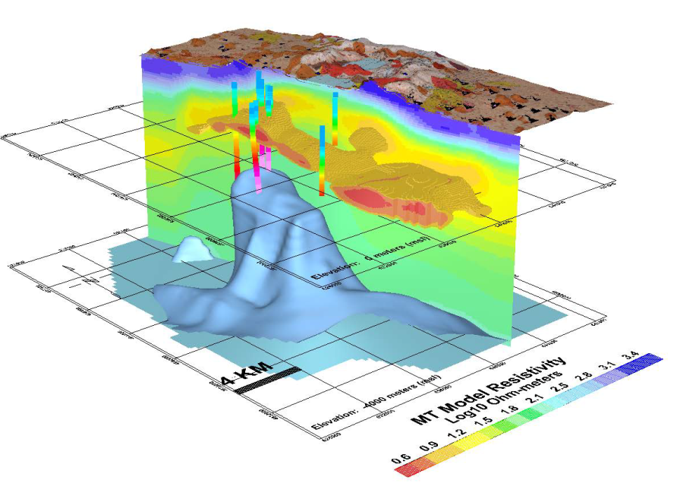
Efficiency of Geophysics
Geophysics can offer ground truth data in a resolution of meters and even centimeters according to the method selected.
Geophysics can cover extensive areas and support the definition of deposits without extrapolation of chemical data or geostatistics, which increases the risk of the resources model.
Both methodologies are critical (geochemical and geophysics) and need to be harmonized.
Fig.12. Resistivity model of a deposit [16]

Slide 9
Geophysics current market
The market study about the geophysical equipment and services size was estimated at $12.8 billion in 2021, and it is expected to increase to USD 14.3 billion in 2026, considering a 1.6% CARG [17]. Exploration activities contributes to the growth of this market.
The market is directly related to exploration projects, especially in the oil and gas industry, conventional mining, and materials for clean energy such as lithium. North America (48%) represents the highest demand in the world, mainly in the United States and Mexico.
Geophysical instruments generally include these technologies: Electrical Resistivity, Electromagnetic, Seismic, Multispectral imager, Hyper-spectral optical imagers, Gravity, Gradiometry, Light Detection, and Ranging.

Slide 10
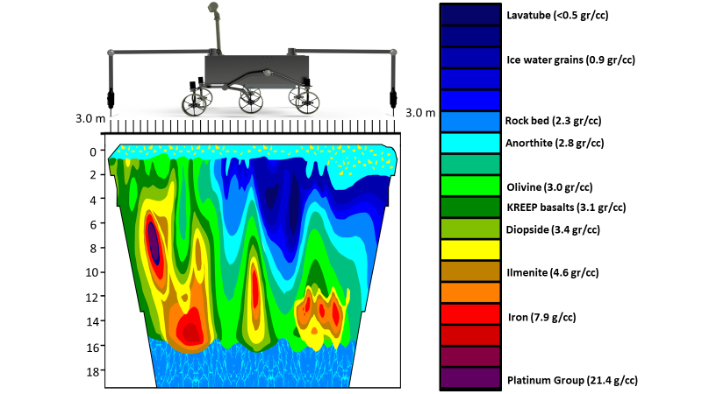
T.I.P.S. Temporal Impedance and Prospecting Sensor
(TIPS) is a rover deployable sensor package that will provide geophysical information on surface and subsurface 3D tomography using AI/ML. TIPS is a novel design that combines measurements of ultrasound and electrical impedance interacting within the Time-Domain to generate non- invasive tomography.
Fig.14. Artistic view of TIPS on board of a lunar rover
Fig.15. Performance of TIPS in the detection of underground bodies on the Moon

Slide 11
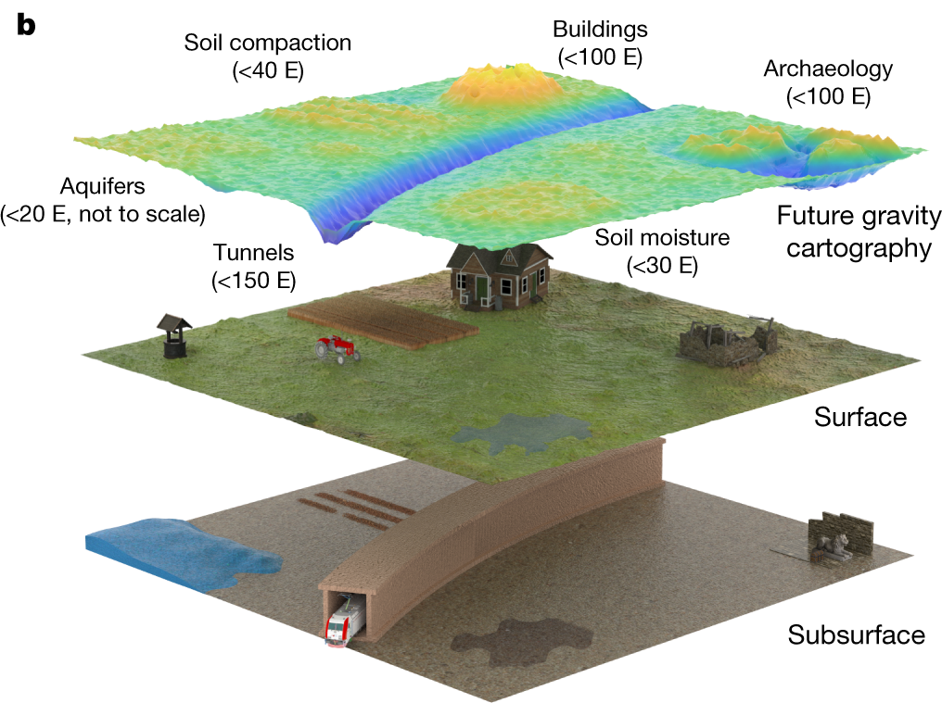
(QASM) Quantum Atomic Subsurface Mapper
It is an orbital sensor that combines modern AI/ML techniques with Quantum Mechanics to create 3D subsurface maps faster and more precise than existing technologies.
QASM will be ready to answer:
Fundamental questions about the universe. Dark Matter, local black holes, NE and EC Asteroids
It can remote sense near earth asteroids, provide tomography of Lunar Resources (Water, REE, He3) and identify infrastructure ready Lava Tubes, provide geotechnical survey of lunar real estate.
It can be used to survey under-ice conditions of Jovian and Neptunian icy moons, monitor for life there.
Fig. 13. Possible results of detection with quantum gravity [18]

Slide 12
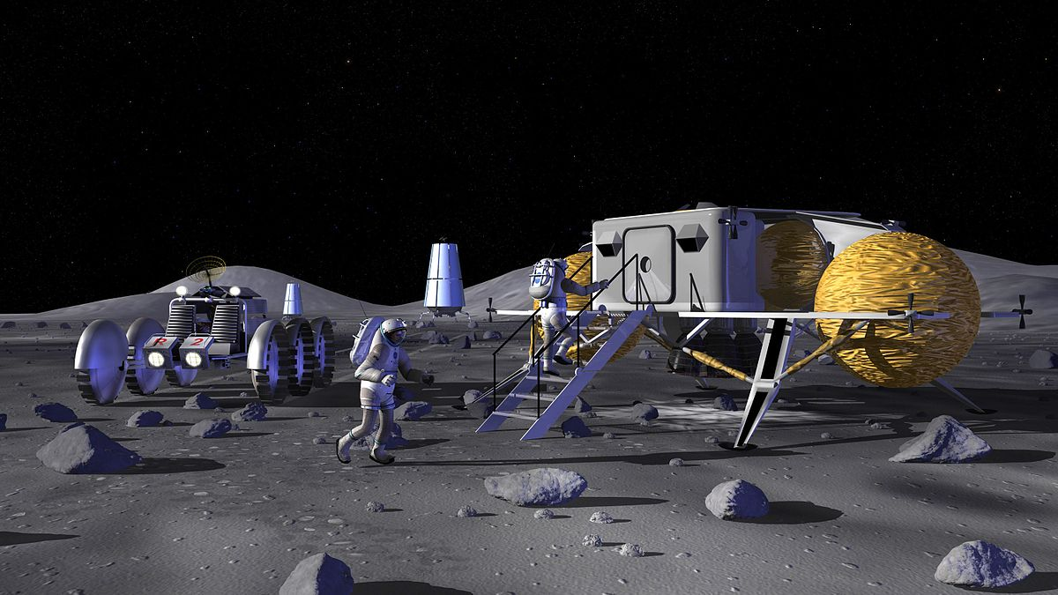
Applications
Almost all space agencies are working on instruments for physical/geotechnical and mineral/chemistry characterization of lunar/martian regolith.
There is strong interest on instruments and hardware for subsurface ice indirect and direct characterization.
Requires ground truth at the 10 meter scale (laterally) over 1‐5 km baselines. Must determine trafficability, compressibility, rolling resistance, bulk density variations, and grain sizes.
Requires knowledge of regolith, in particular in PSRs, of mineral/chemical characteristics as a function of depth and lateral distribution
Must determine the form, concentration (including mineralogical, elemental, molecular, isotopic make‐up of volatiles), and distribution of these species and how they vary from depths 0-3 m over distances of 10‐100 m scales.
Fig. 16. Future human operations on the Moon [19]

Slide 13
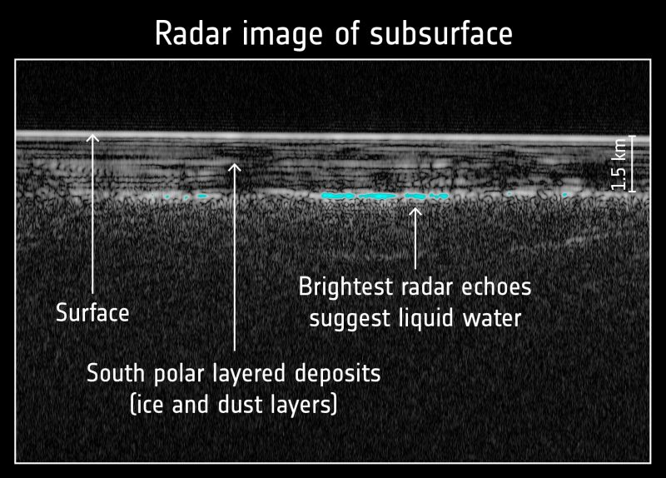
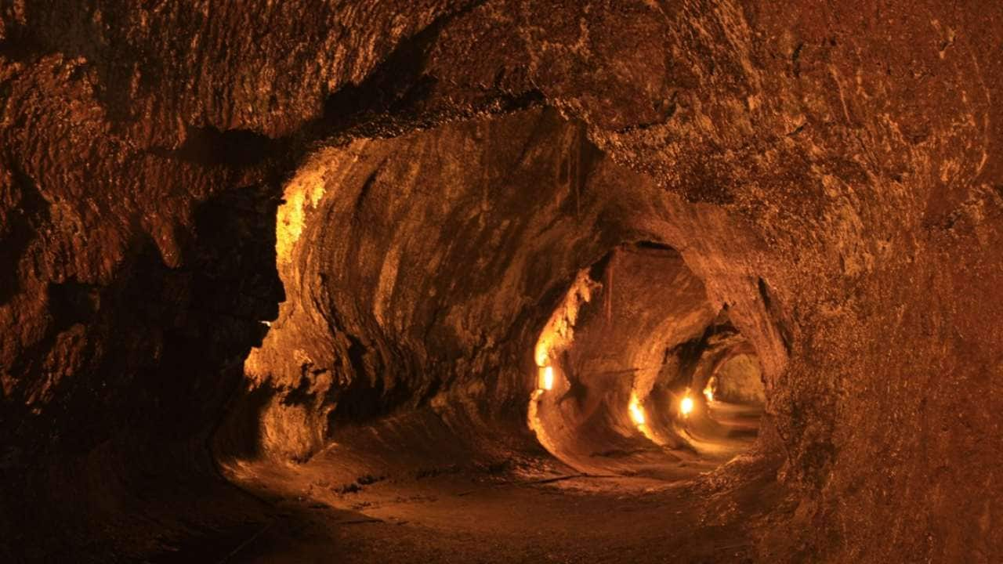
Applications
Prospection and characterization of water underground on Mars and geological formations as lava tubes. On Mars, localizing and sizing underground water reservoirs and thus be a decisive advantage in astrobiology research and finding life in the solar system.
Radar images of Mars subsurface for wáter detection [20]
Lava tubes on Earth, posible to find similar on Mars for shield radiation [21]

Slide 14
Conclusions
Geochemical methodologies are not sufficient to fill all the gaps required for planetary exploration. Geophysical services are a keystone option to acquire conclusive results to move forward in ISRU technologies.
We conclude that a layer of instrumentation is missing between low orbit optical and radar systems and inground chemistry sensors.
The absence of this instrumentation layer is artificially augmenting the relative costs of space missions, slowing, and reducing data acquisition that can lead to the tomographic knowledge required for improve siting of chemical and biological sensor samplings.

Slide 15
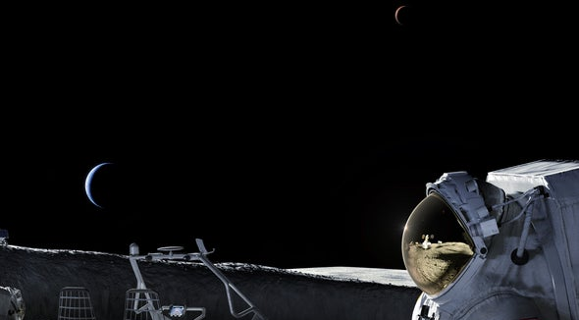
Questions?

Slide 16
References
[1] B. Yirka, “New report indicates private industry interested in building moon base,” Phys.org, 27-May-2013. [Online]. Available: https://phys.org/news/2013-05-private-industry-moon-base.html . [Accessed: 30-Oct-2022].
[2] “NASA selects Astrobotic to fly water-hunting rover to the Moon,” 2020.
[3] J. Amos, “Emirates Mars Mission: Hope spacecraft enters orbit,” BBC, BBC News, 09-Feb-2021.
[4] J. Bernstien, “Humans want to mine the moon. Here’s what space law experts say the rules are,” CBC News.
[5] M. O’Neill, “Life could exist deep underground on mars,” SciTechDaily, 17-Oct-2020. [Online]. Available: https://scitechdaily.com/life-could-exist-deep-underground-on-mars/ [Accessed: 30-Oct-2022].
[6] “In-situ resource utilization gap assessment report,” Globalspaceexploration.org. [Online]. Available: https://www.globalspaceexploration.org/wordpress/wp-content/uploads/2021/04/ISECG-ISRU-Technology-Gap-Assessment-Report-Apr-2021.pdf. [Accessed: 30-Oct-2022].
[7] M. O’Neill, “NASA’s Mars 2020 Perseverance rover will launch in less than a month – 7 things to know,” SciTechDaily, 12-Jul-2020. [Online]. Available: https://scitechdaily.com/nasas-mars-2020-perseverance-rover-will-launch-in-less-than-a-month-7-things-to-know/ . [Accessed: 30-Oct-2022].
[8] M. O’Neill, “NASA’s Mars perseverance rover: Laser marking on Mars,” SciTechDaily, 04-Aug-2022. [Online]. Available: https://scitechdaily.com/nasas-mars-perseverance-rover-laser-marking-on-mars/ . [Accessed: 30-Oct-2022].
[9] “Viking 1,” NASA Jet Propulsion Laboratory (JPL). [Online]. Available: https://www.jpl.nasa.gov/missions/viking-1 . [Accessed: 30-Oct-2022].
[10] D. Cooper, “NASA abandons InSight mission to crack the surface of Mars,” Engadget, 15-Jan-2021. [Online]. Available: https://www.engadget.com/nasa-insight-mole-drill-mars-failure-122006403.html . [Accessed: 30-Oct-2022].
[11] K. Erkan, “A comparative overview of geophysical methods,” 2008.
[12] R. Knight et al., “Geophysics at the interface: Response of geophysical properties to solid-fluid, fluid-fluid, and solid-solid interfaces,” Rev. Geophys., vol. 48, no. 4, 2010.
[13] Atomionics, “Atomionics,” Atomionics.com. [Online]. Available: https://www.atomionics.com/our-solution . [Accessed: 30-Oct-2022].
[14] “Overview of coal mining problems,” Org.za. [Online]. Available: http://www.scielo.org.za/pdf/jsaimm/v114n10/17.pdf . [Accessed: 30-Oct-2022].

Slide 17
References
[15] “Illustrative geophysical exploration methods poster,” Burgex Mining Consultants, 03-Jul-2017. [Online]. Available: https://burgex.com/geophysical-exploration-methods/ . [Accessed: 30-Oct-2022].
[16] “Geophysics for geothermal exploration,” Zonge International. [Online]. Available: http://zonge.com/example-projects/geothermal-case-studies/. [Accessed: 30- Oct-2022].
[17] “Geophysical Services market size 2022 and growth analysis,” Thebusinessresearchcompany.com. [Online]. Available: https://www.thebusinessresearchcompany.com/report/geophysical-services-global-market-report . [Accessed: 30-Oct-2022].
[18] B. Stray et al., “Quantum sensing for gravity cartography,” Nature, vol. 602, no. 7898, pp. 590–594, 2022.
[19] Wikipedia contributors, “NASA lunar outpost concepts,” Wikipedia, The Free Encyclopedia, 16-Oct-2022. [Online]. Available: https://en.wikipedia.org/w/index.php?title=NASA_lunar_outpost_concepts&oldid=1116436670.
[20] P. S. Anderson, “Subsurface lake discovered on Mars?,” EarthSky | Updates on your cosmos and world, 26-Jul-2018. [Online]. Available: https://earthsky.org/space/mars-express-spacecraft-finds-evidence-of-subsurface-lake-on-mars/ . [Accessed: 30-Oct-2022].
[21] F. P. Trending, “Lava tubes on Mars and Moon are massive; could act as shield from cosmic and solar radiation,” Tech2, 17-Aug-2020. [Online]. Available: https://www.firstpost.com/tech/science/lava-tubes-on-mars-and-moon-are-massive-could-act-as-shield-from-cosmic-and-solar-radiation-8720511.html . [Accessed: 30-Oct-2022].
[22] R. Boyle, “Can a moon base be safe for astronauts?,” Scientific American, 2022.

