Slide 1


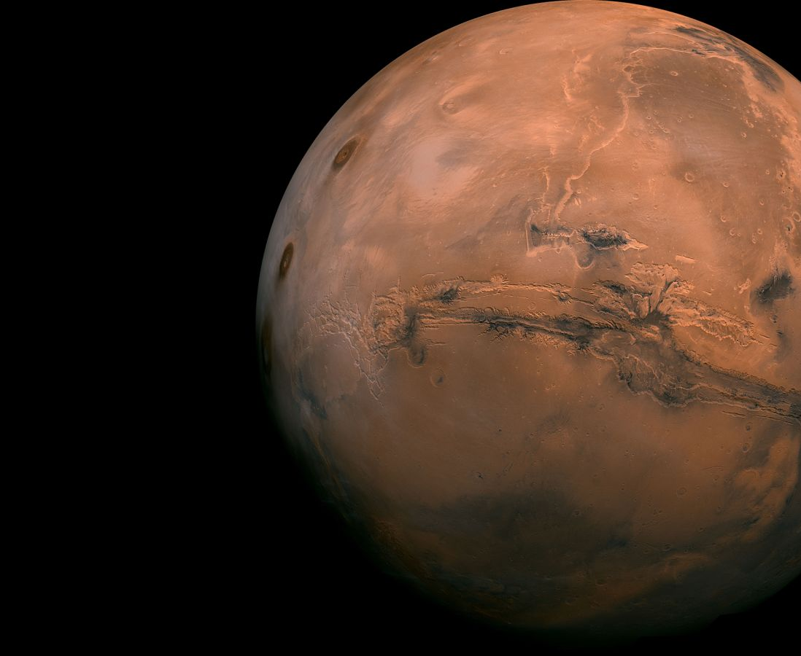



MAVERIC
Speaker: Antonio Rotondi, Riccardo Moro
Moving To Mars Workshop

Slide 2

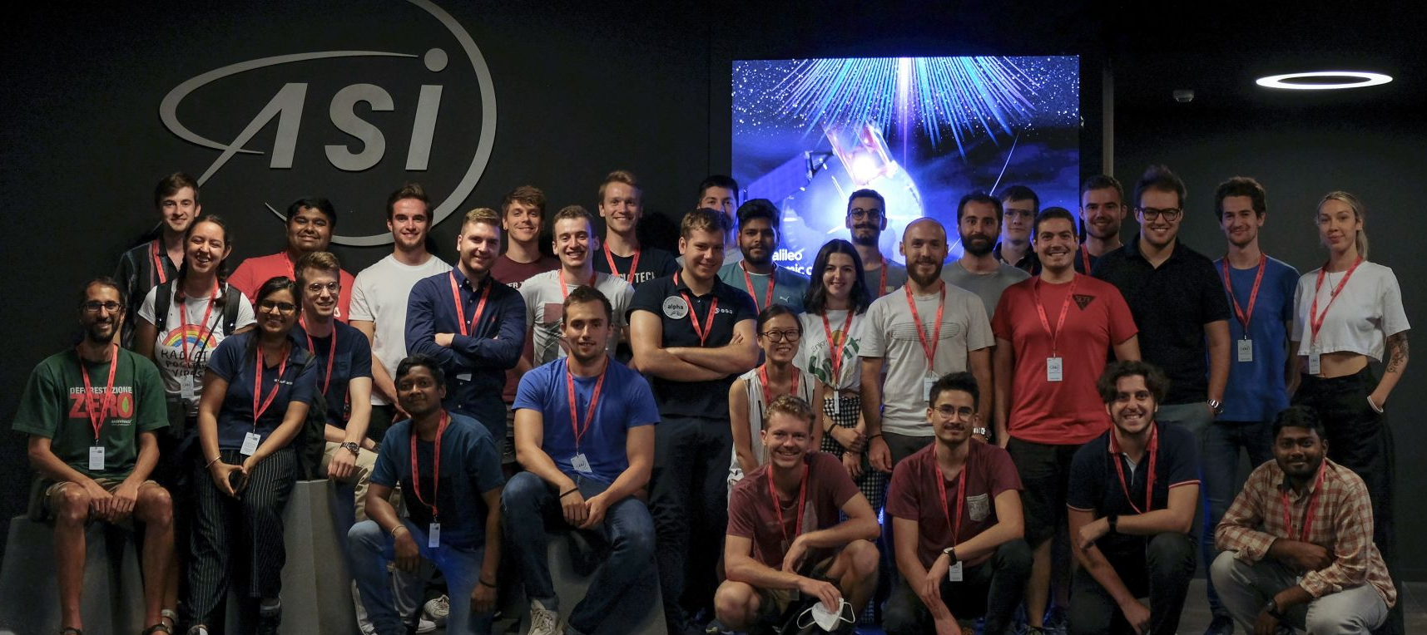







SEEDS XIV: OUR TEAM

Slide 3
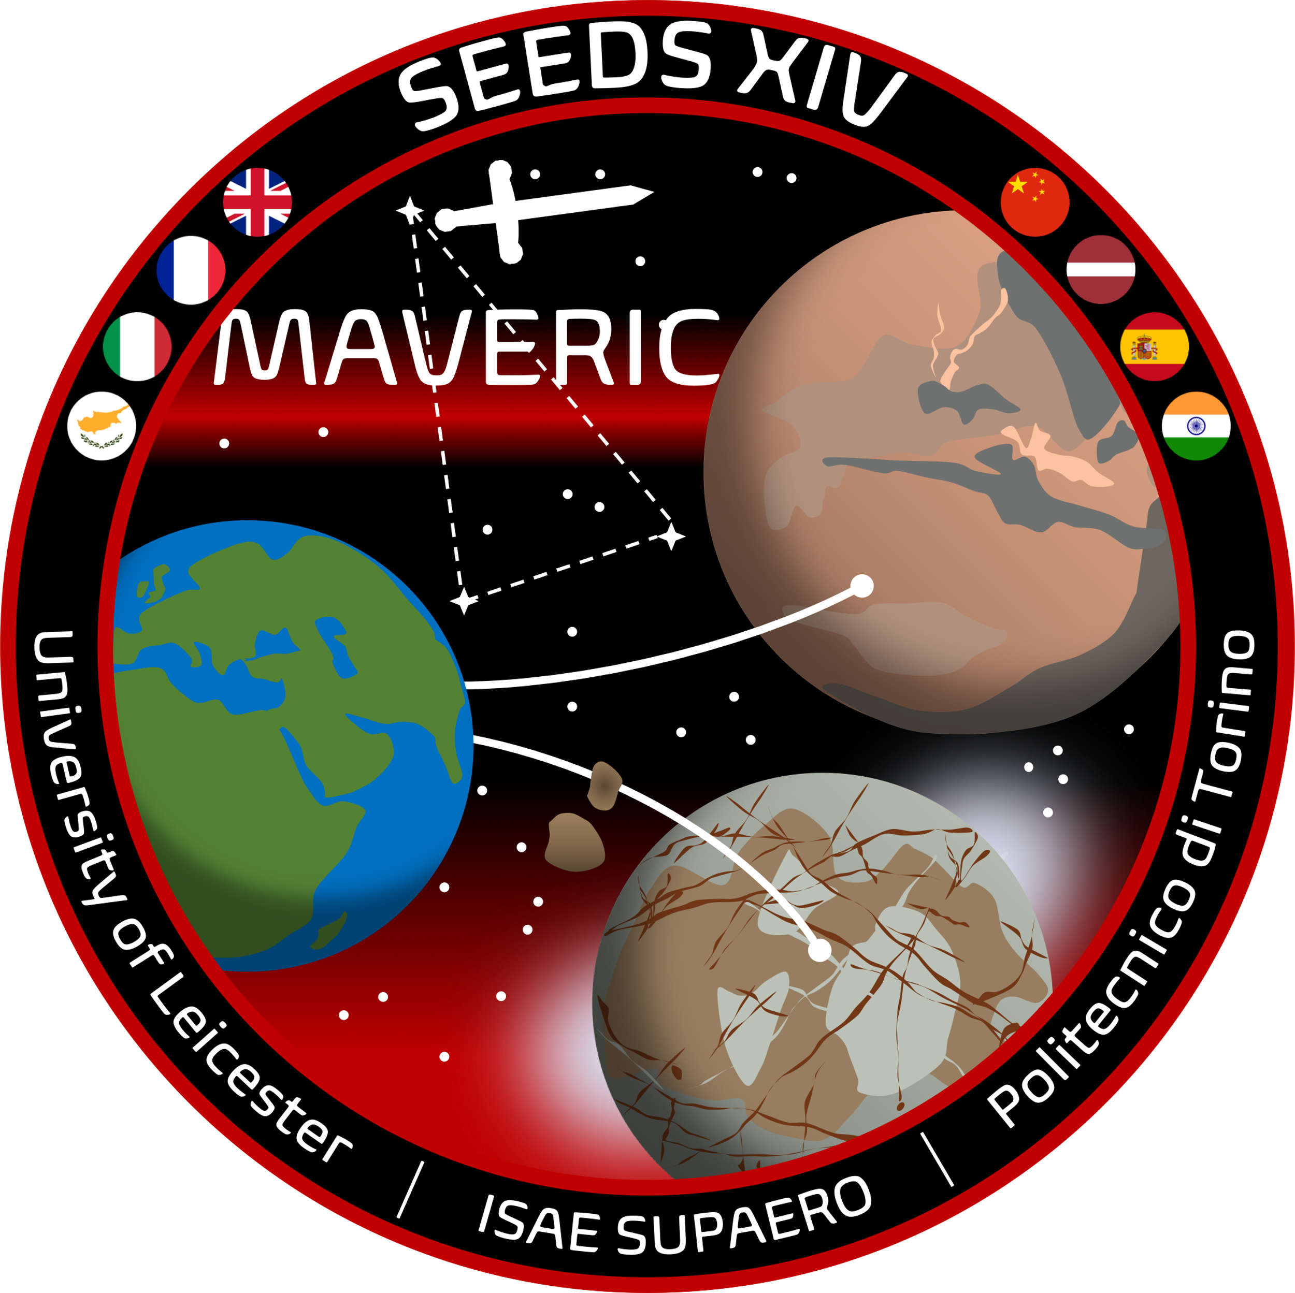
Mission Statement
“To safely transfer the crew from Earth on a roundtrip mission to Mars, cooperating with international infrastructure to pave the way to human exploration of Mars.”
Mars
VEhicle
forR
Interplanetary
Cruise

Slide 4









Design Reference Mission
Assembly in Lunar orbit
Interplanetary trajectory to Mars
Assumption
1
Launch
2
3
4
Mars Capture
Transfer to MPO
Mars Ascent and Descent Vehicle
5
Total ΔV
7.1 km/s
Earth Ascent and Descent Vehicle
space tugs
Transfer to Moon PO
Infrastructure with supply
8
7
Moon capture
Interplanetary trajectory to the Moon
6

Slide 5
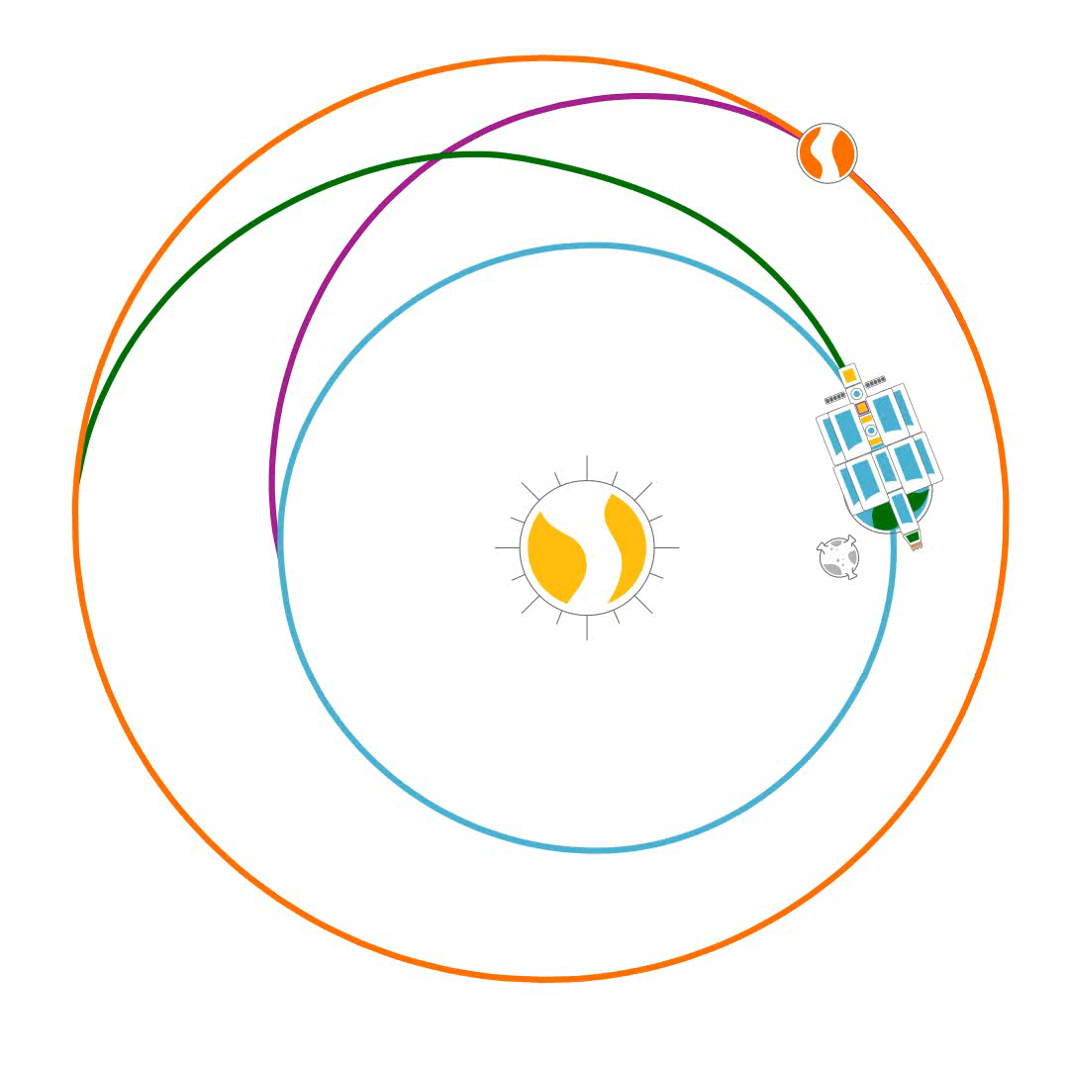
Trajectory
Departure from the Moon
13th of October 2039
250 days
Arrival on Mars
19th of June 2040
381 days
Departure from Mars
5th of July 2041
265 days
Arrival on the Earth
27th of March 2042
TOTAL TIME: 896 days

Slide 6
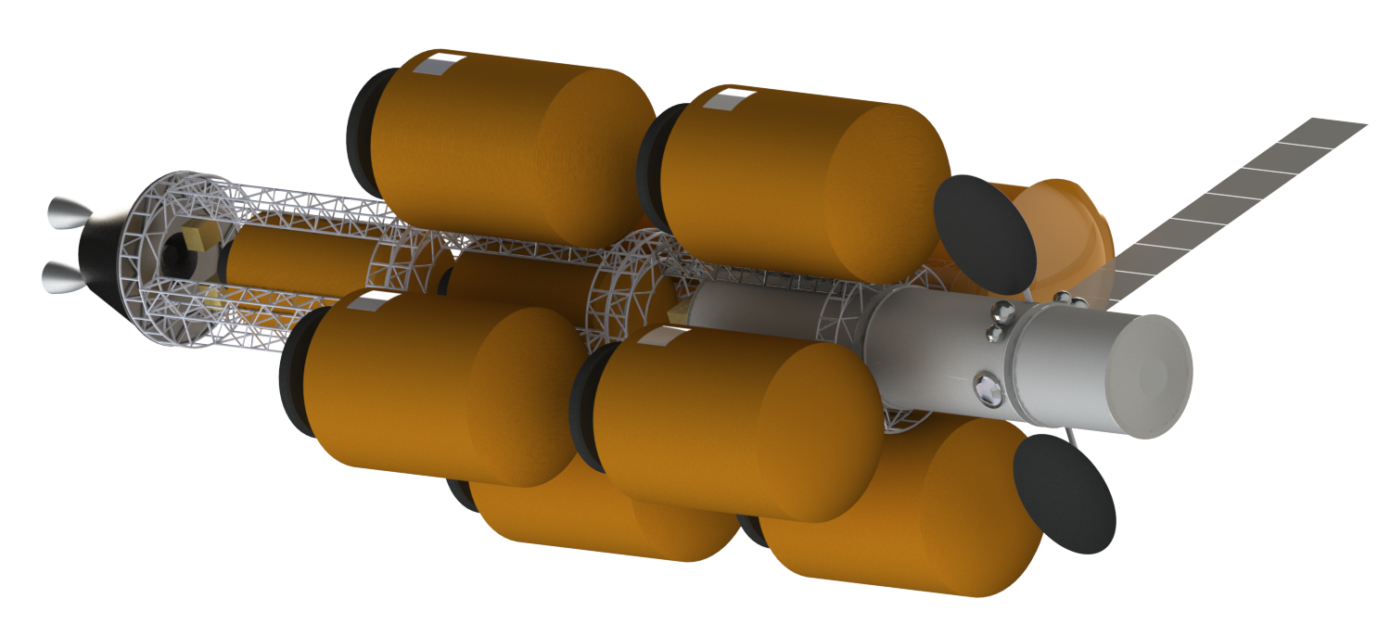


Overall view of the spacecraft
Nuclear reactors
Tanks
Dimensions
Radiators
Radiators
Length ∼ 60 m
Diameter ∼ 22 m
Habitat
Truss structure
Mass ∼ 420 tons
Bryton generator
Antenna

Slide 7
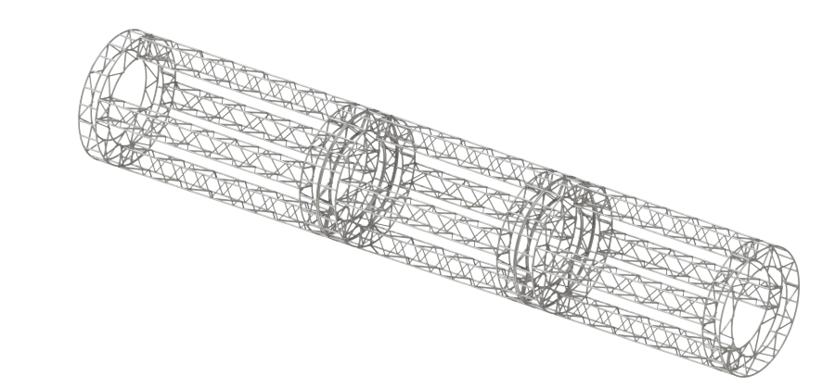
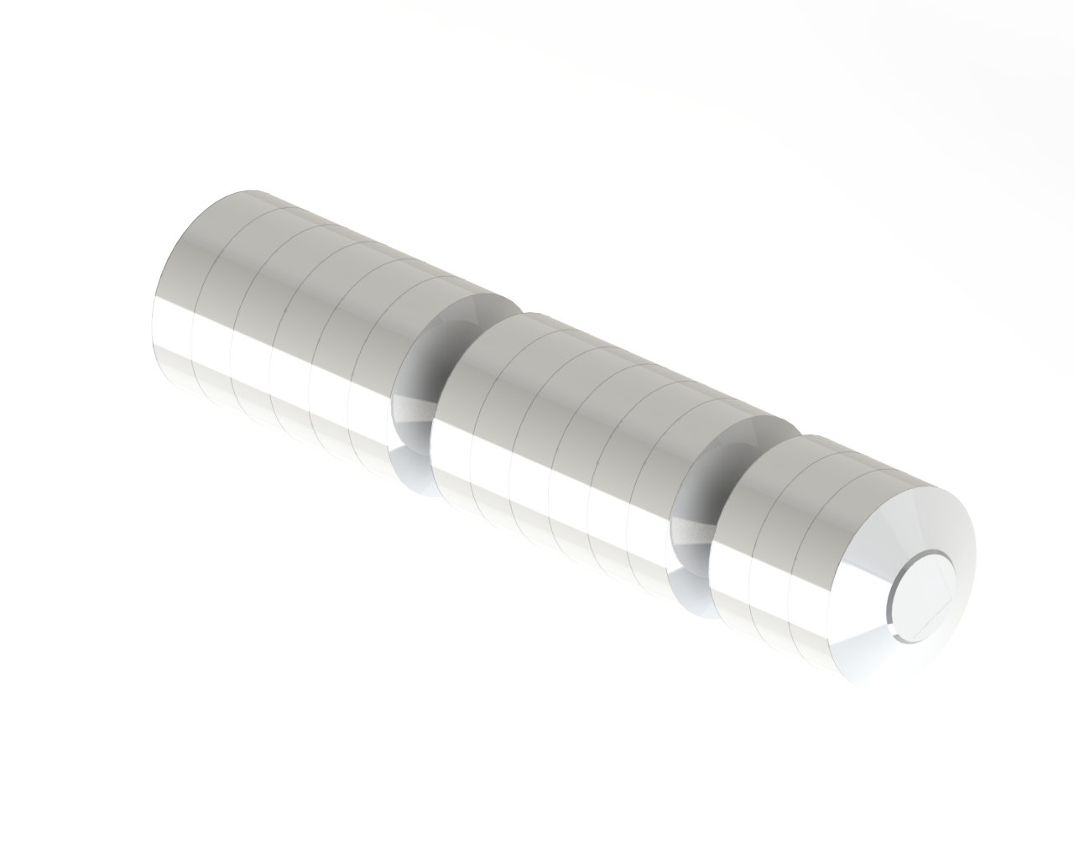
Structures
The Truss structure have to sustain the loads during the orbital manoeuvres while habitable modules have to sustain the mechanical stress caused by the internal pressure
Truss Structure
Pressurized Module

Slide 8


Electric Power System
Nominal mode = 58.8 kW
Bimodal Nuclear PG
Brayton Engine
Safe mode = 45.9 kW
Li-ion batteries
Autonomy 18 h

Slide 9
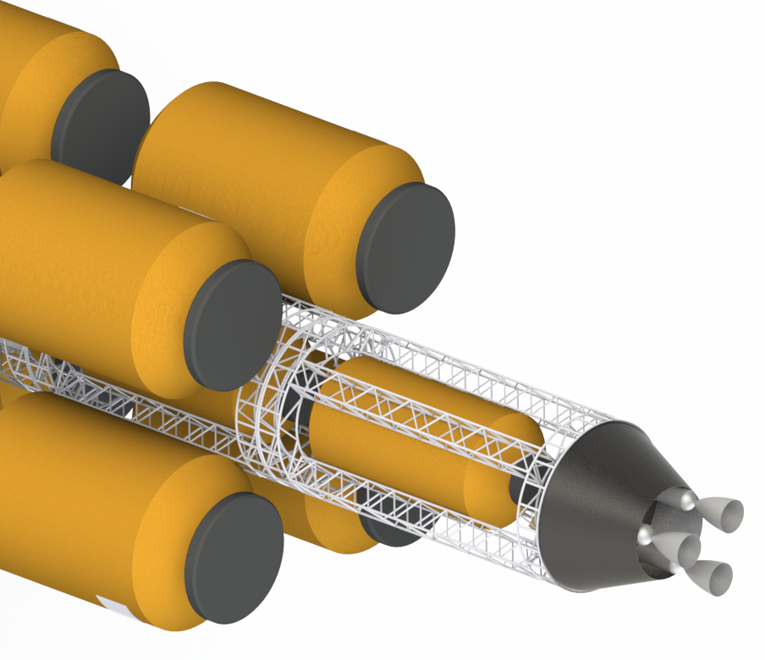
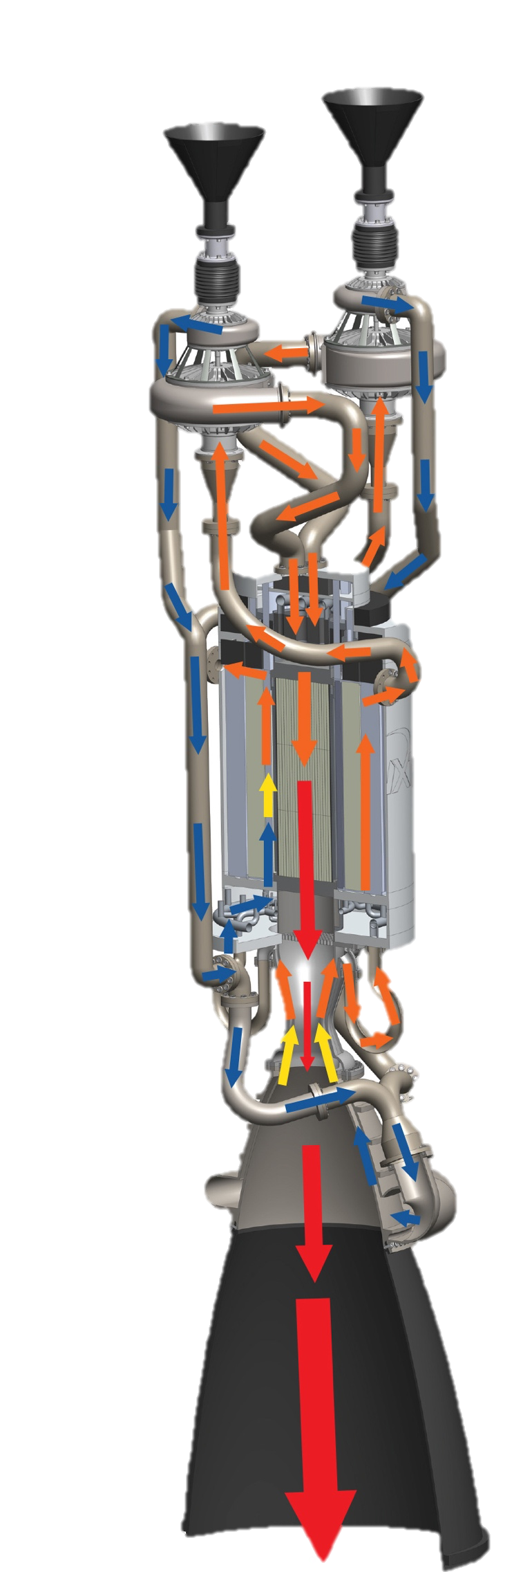


Propulsion
8 radial tanks
12m x ⌀ 6.8m
24.7 t capacity
2 inline tanks
10m x ⌀ 4.5m
8.9 t capacity
Total capacity: 215 t of LH₂
x3 engines
Nuclear Reactors
33 kN
925 s
Credit: BWX Technologies

Slide 10
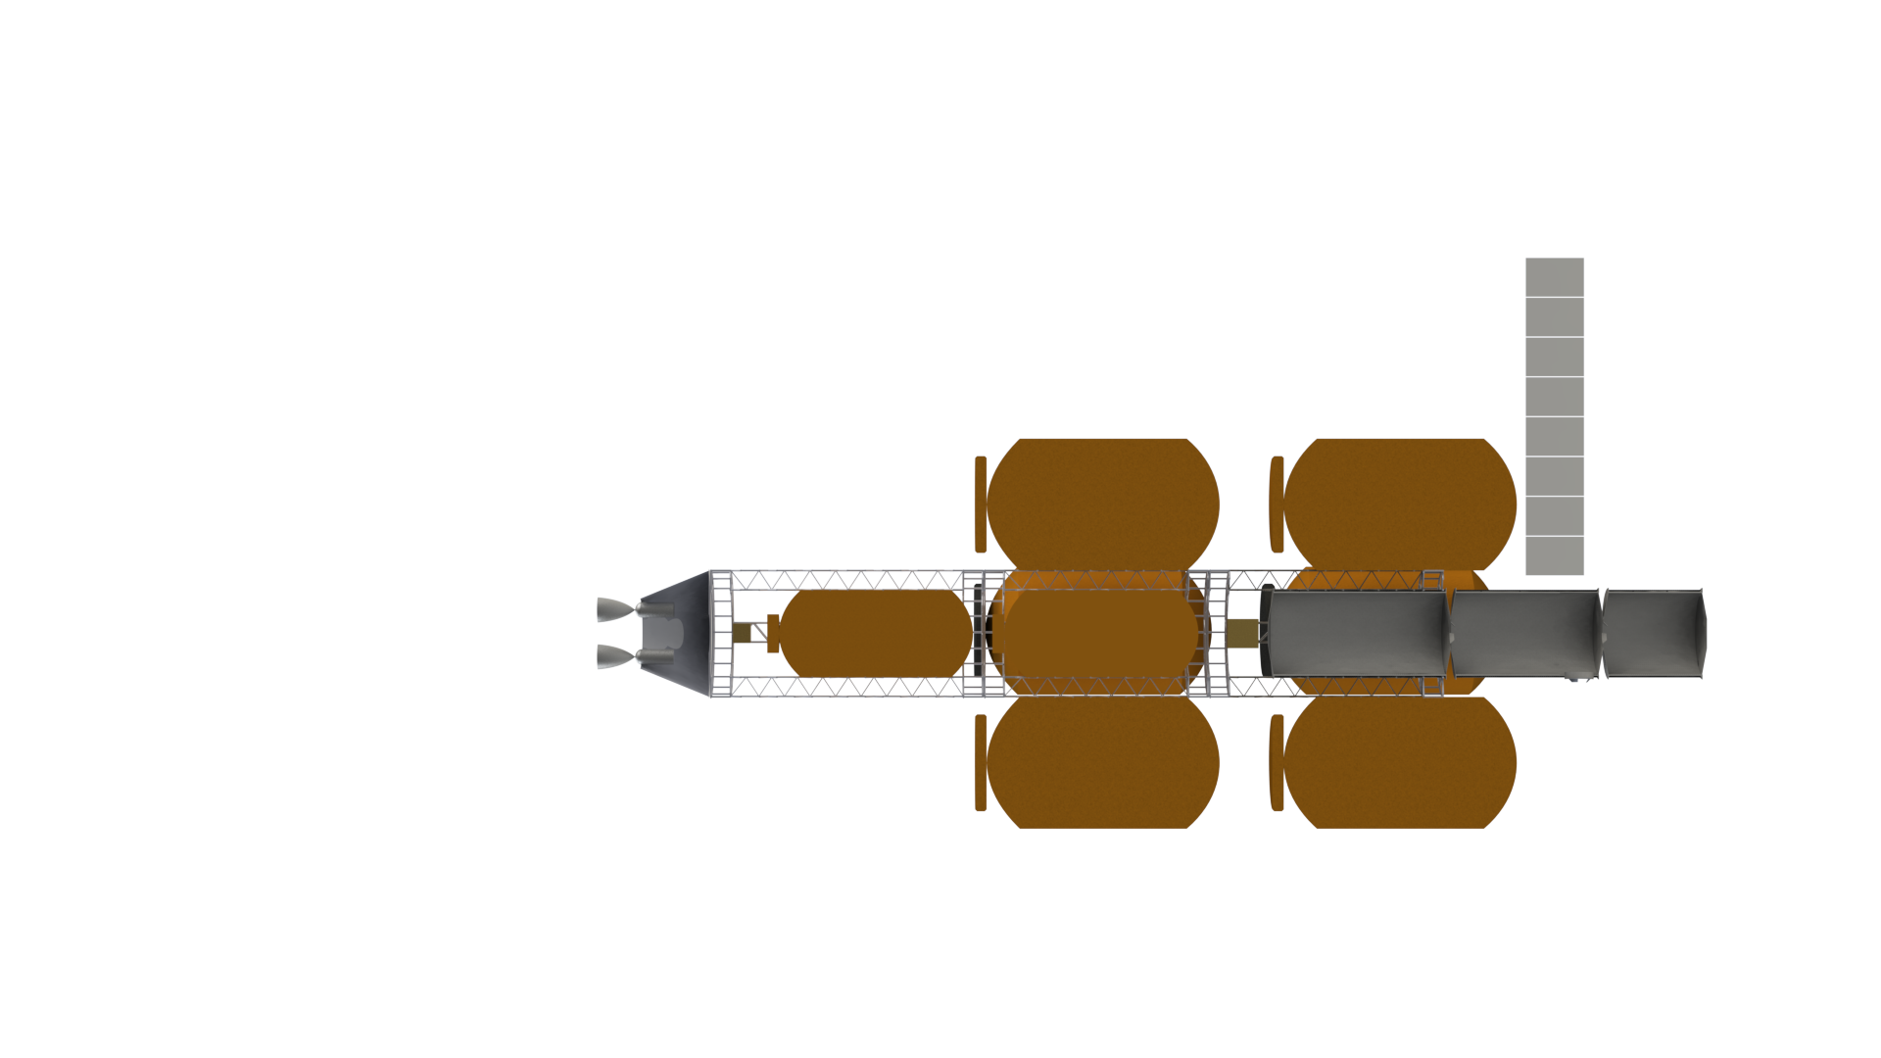
Thermal Control System
25 Layer MLI
40 layer MLI
25 Layer MLI
Fluid Loops
Radiators
Cryocooler
60 Layer MLI

Slide 11
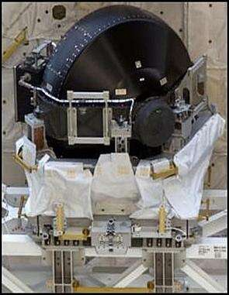
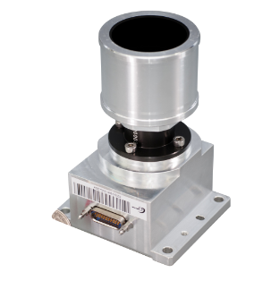
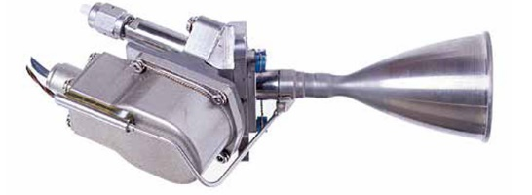
Attitude and Orbital Control System
Sensors
Actuators
1
Control moment gyros
Inertial Measurement Unit
Radius: 0.4 m
Sun sensors
Angular momentum: 6000 Nm
Mass: 109 kg
Star trackers
2
Reaction control system
Navigation Camera
Arm lever: 20 m
Space sextant
Trust: 219 N
Propellant mass: 449 kg

Slide 12
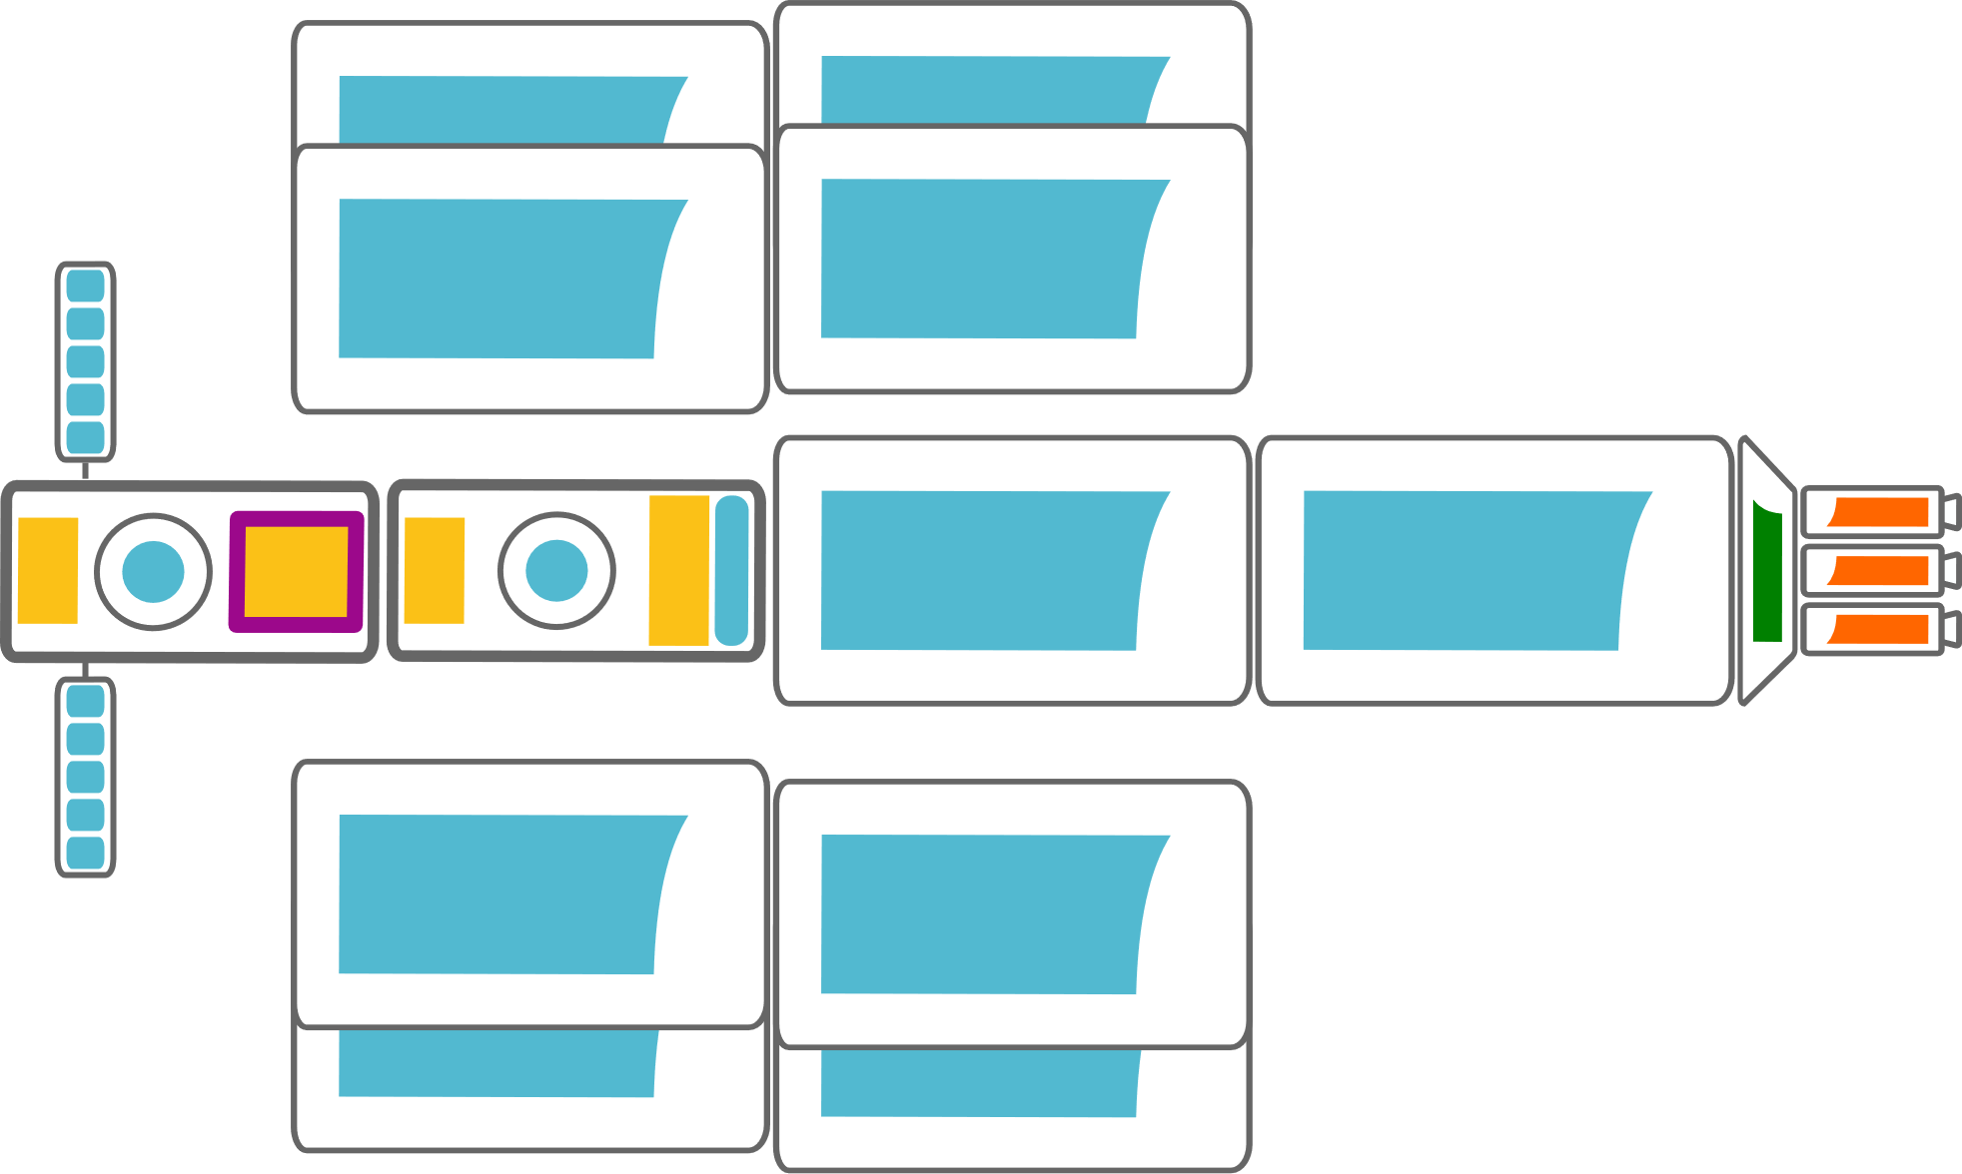




Communication strategy
MAVERIC
HGA
MAVERIC High Gain Antenna x2
5 m diameter
Mars Relay
X Band
S Band
Deep Space Network
Ka Band
L4/L5 Relay
*S Band

Slide 13



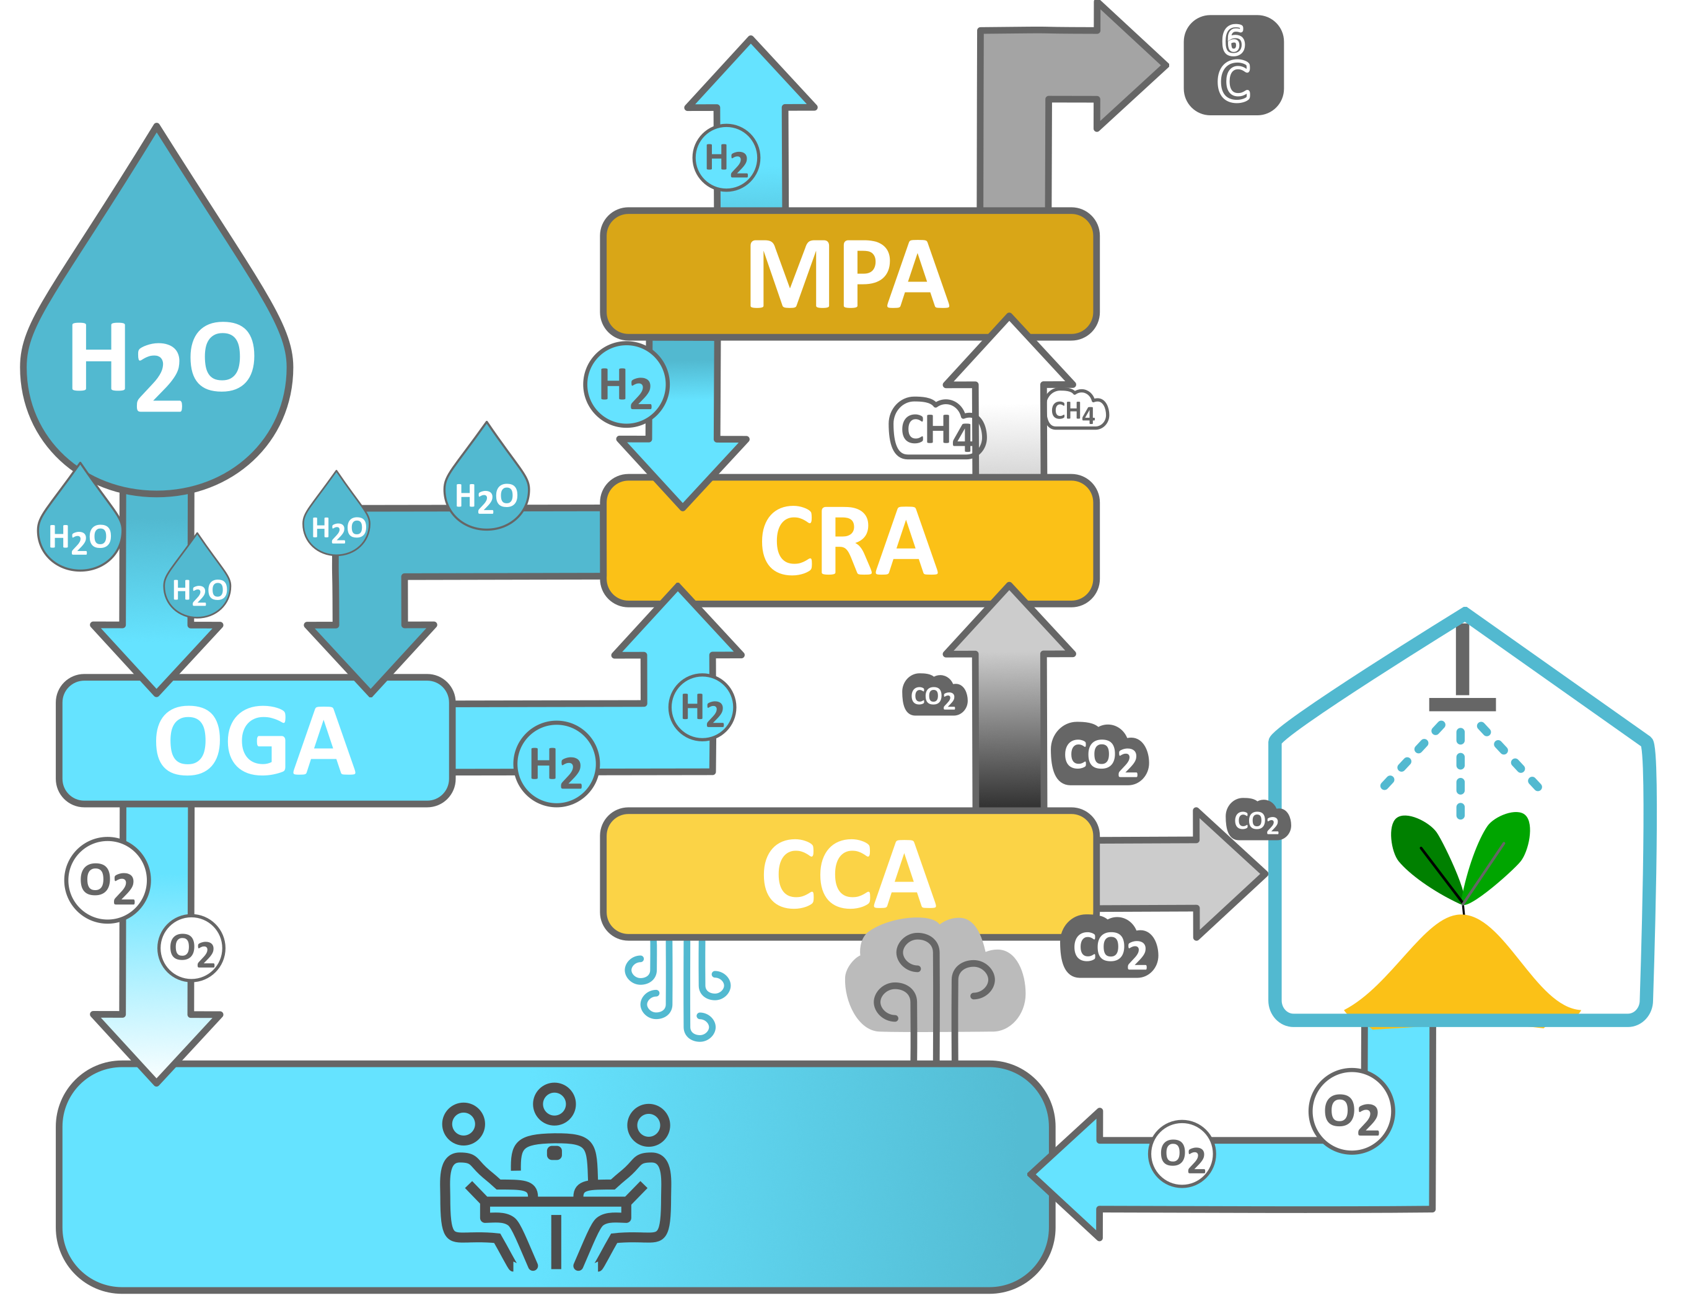








Environmental Control System
Air
Revitalisation System
Atmosphere
Control
Supply
Crew metabolic heat: 440 W_{th}
Pressure: 97 - 103 kPa
Temperature: 18 - 27 °C
Humidity: 40 - 70%
Temperature Humidity Control
Fire
Detection
Suppression
Mass budget | 2640 kg
Nominal power | 8.23 kW
Safe mode | 4.15 kW
Subsystem margin | 10%
Remove CO₂: 4.0 kg/day
Provide O₂: 3.3 kg/day
OGA = Oxygen Generation Unit (Water Electrolyser) CCA = Carbon Concentration Assembly (4BMS)
CRA = Carbon Removal Assembly (Sabatier Reactor) MPA = Methane Processing Assembly
Notes:
To support the crew The environmental control system provide O2 and remove CO2 from the internal atmosphere. A oxygen generator unit create oxygen from water electrolysis while a corbon removal assembly based on a sabbatier reactor will process the (Comon Cambin Assembly) and Methan Processing Assenbly (MPA)

Slide 14
Life Support
FOOD
WATER
WASTE
Supply
1,8 kg/CM/day
Total of 8500 kg
Urine Processor
Assembly
Water Processor
Assembly
Heat Melt Compactor
Sabatier cycle
Brine Processor
Assembly
Greenhouse
Surface: 11.8 m²
Mass: 1200 kg
Volume: 12 m³
Power: 6.5 kW
Recover water
Reduce volume of trash
Reduce biological activity
Stabilize processed trash
Tiles used as radiation shields
13.02 kg/CM/day
η = 97.6%
Total water onboard 1940 kg
Notes:
The food resources are composed by a supply of 8500 kg that cam ensure 1.8 kg per CM per Dauwe also implement a grwwnhouse to provide about 2% of the crew needed but most important it can provide fresh food.

Slide 15





Spare Management
Reduction
37% | Volume
37% | Mass
From ground
Raw material
Waste on board
Printing
From ground
Mass: 2495.48 kg
Volume: 8.25 m³
Foam

Slide 16


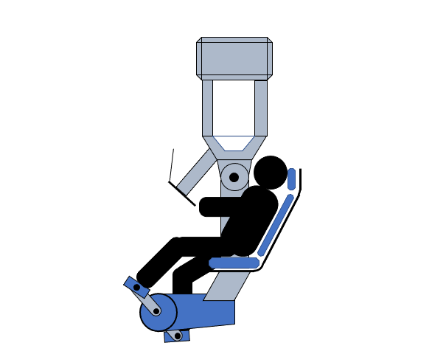



Zero-G countermeasures
1
Short Arm Centrifuge
Combination of a centrifuge with
a cycle ergometer
2
Suits
Lower body negative suits and gravity suits
P_{neg}
F
3
Exercises Equipment
Treadmill and resistive exercise machine
4
Drugs
Promethazine, Amoxicillin, Bisphosphonates

Slide 17
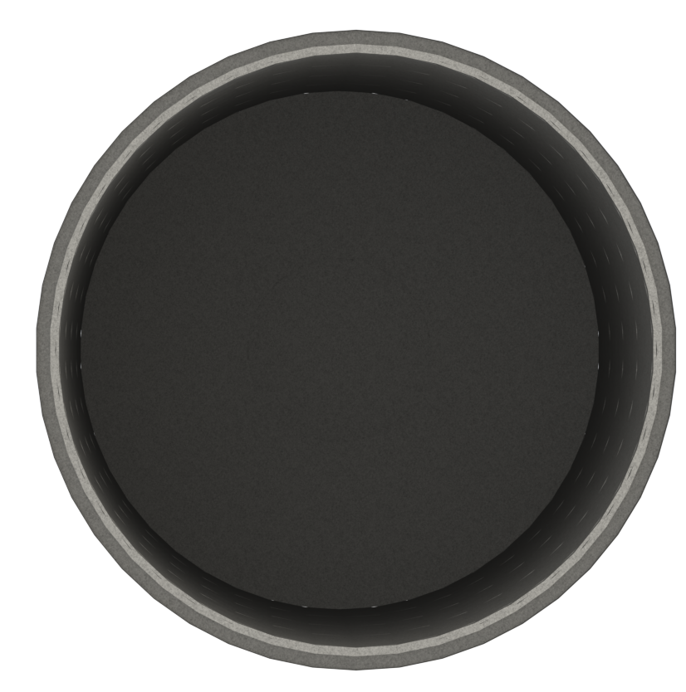
Radiation Protection
Polyethylene + Waste tiles
External reactor shielding
(180mm Be, 20mm W, 50mm LiH)
Cargo
Hydrogen tank
BNNT (20% H₂)
Internal Reactor shielding
Water
Polyethylene (50mm)
Waste tiles (50mm)
Al structure
BNNT (20% H₂) (2mm)

Slide 18
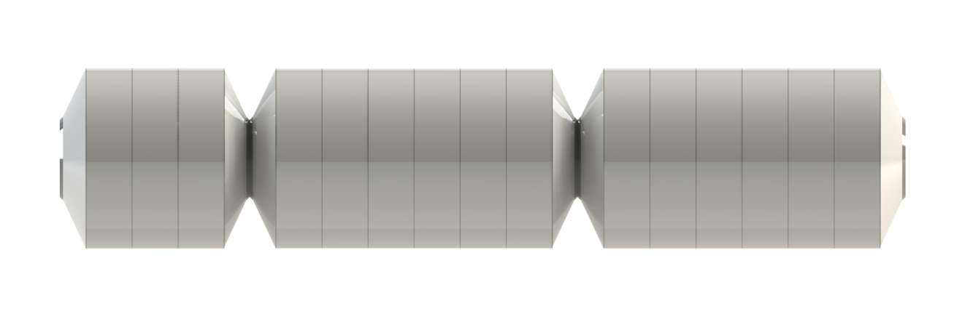
Habitable Module Configuration
The habitable volume is designed to host 4 astronauts.
Internal habitable volume 25 m³ per astronaut
Divided in 3 segments to optimize launch
The length of the modules is 21 m
Internal Dimensions
Cargo
Habitable 1
Habitable 2
2.2 m
4.2 m
21 m

Slide 19
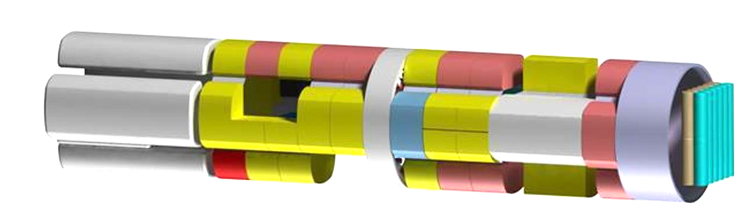
Habitable Module description
Medical area
Physical
exercise
Medical Area
Positioned to reduce passages in case a crew member is ill
Cargo
Greenhouse
Crew quarters
Living Room
Leisure activities and institutional meetings
Green House
A small greenhouse is present to produce part of the food needed
Galley and
Living room
Workspace
Waste and Hygiene
Water tanks
Workspace
Payload and 3D printer
Physical Exercise
Short arm centrifuge and training machines
Racks Contents
Waste and Hygiene
Area devoted to water recycling and waste management (tiles production)
ECLSS
Shower
Water Tanks
Clear water tanks and brine tanks
Stowage
Surgery Table

Slide 20
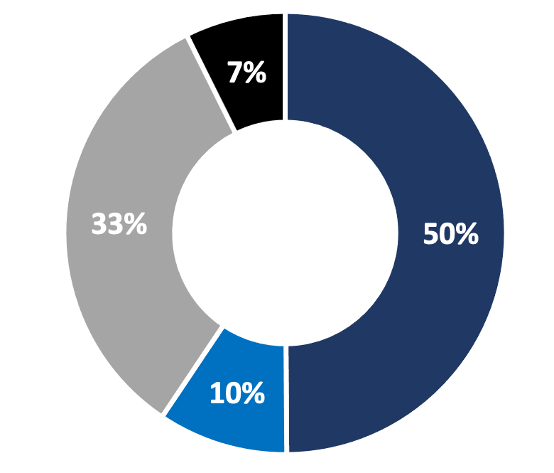
Mass Budget
Costs
Launch
Development
Operation
Advanced Missions Cost Model*
66.65 B€*
Manufacturing
TOTAL MASS:
420 tons
Ref : «Comparing NASA and ESA Cost Estimating Methods for Human Missions to Mars» / ISS Operation cost / Colombus cost analysis
*Neglecting inflaction in 2040

Slide 21

2nd Level Specialising Master’s Programme
SPACE EXPLORATION AND DEVELOPMENT SYSTEMS
bit.ly/SEEDSMaster22
Enrolment Deadline: November 25th 2022

Slide 22




key partners and sponsors

Slide 23
Moro Riccardo
s305160@studenti.polito.it
Rotondi Antonio
s305112@studenti.polito.it

