Slide 1
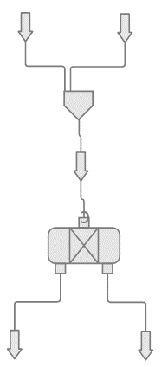
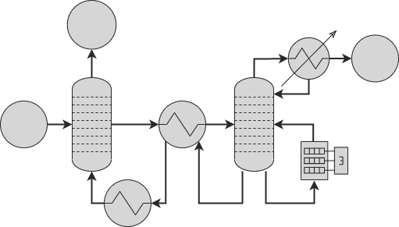
Moving to Mars 2022
Feasibility of vehicle-based propellant production on Mars using the Sabatier reaction
4:10 pm, 17 Novembre 2022,
Concordia University
Francis Desilets-Mayer
UBC Mars Colony
University of British Columbia
Engineering Design Team

Slide 2
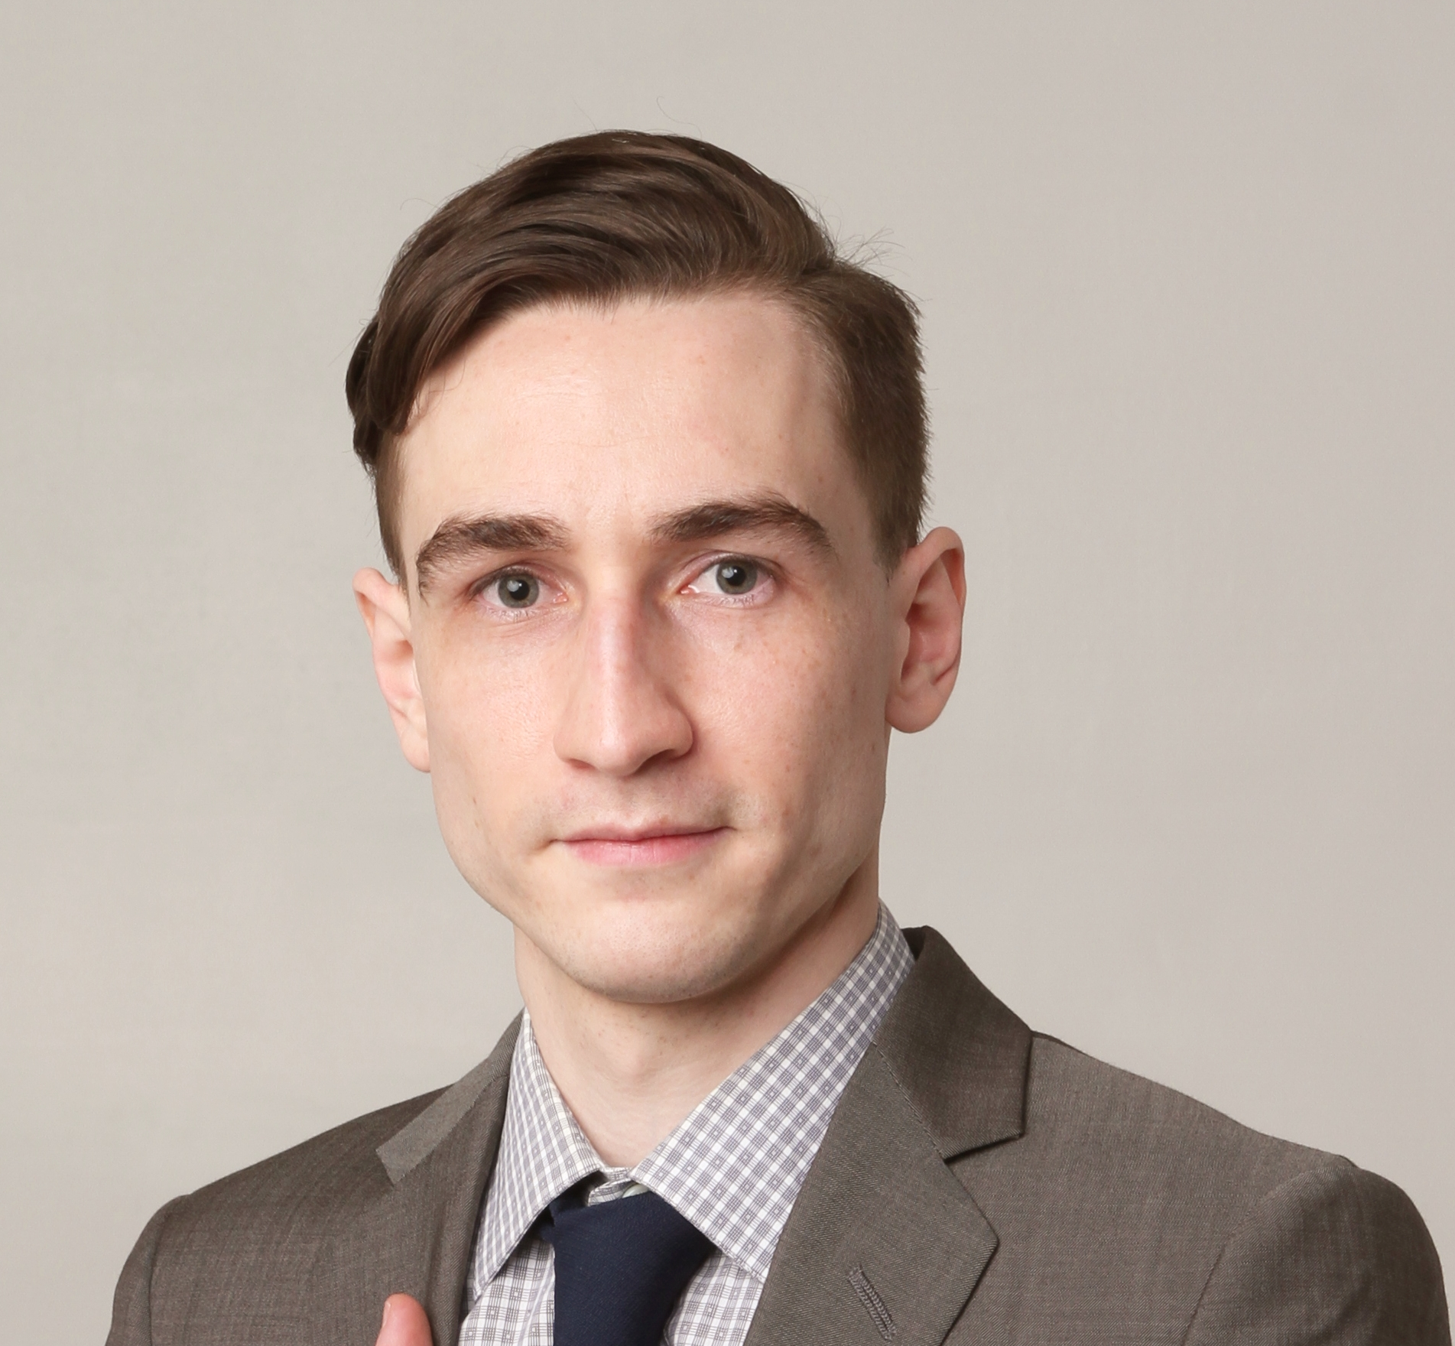
Introduction
Francis Desilets-Mayer, P. Eng,
MASc. (UBC), BSc. (UofC)
UBC Mars Colony (ubcmarscolony.com)
University of British Columbia, (UBC) Canada
≈20 members
Multiyear research project

Slide 3
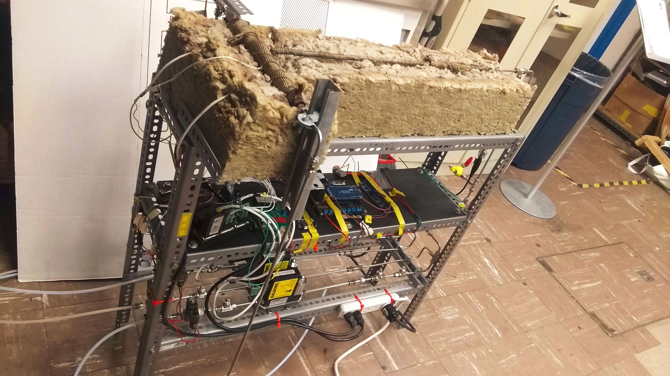
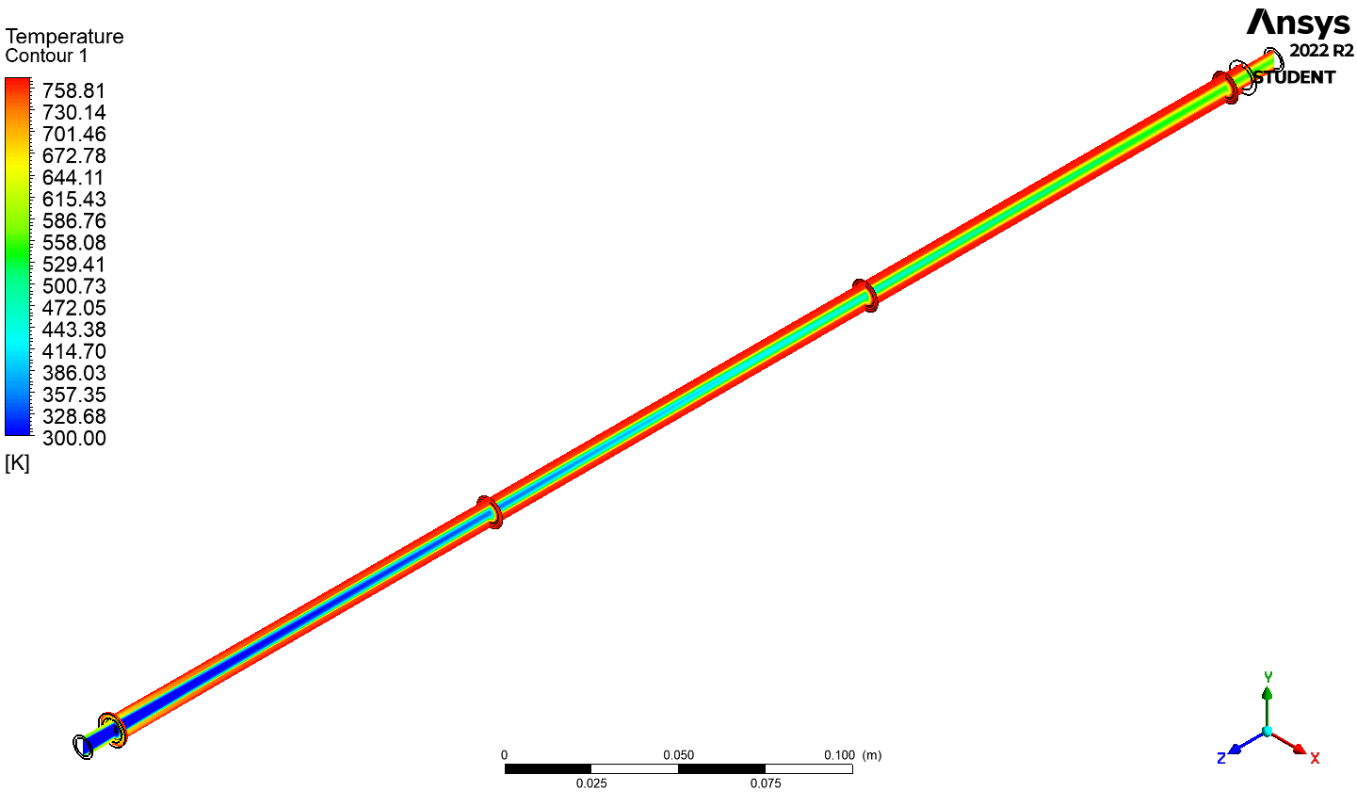
Project background
SpaceX 2016 mission architecture¹
Refuel a Starship Rocket on Mars
1200 tons of Methalox in 26 month
Sabatier reaction²
${CO}_{2}+4H_{2}→{CH}_{4}+{2H}_{2}O$
Martian air (95% CO₂), H₂O ice (trace HClO₄)
Sabatier reactor project
Benchtop reactor sub-project³
Sabatier plant design sub-project

Slide 4
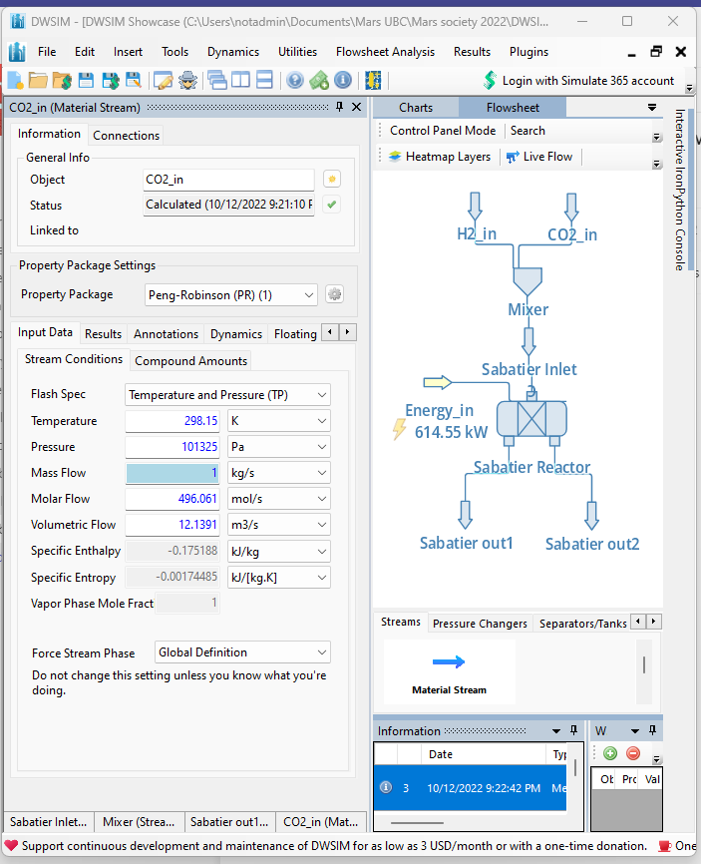
Methodology
Process flow simulation
Give you flowrate and duty (kW)
DWSIM (dwsim.org)
Equipment sizing
Use flow rate and duty kW to get size
Fitting equipment chart

Slide 5
Process flow diagram
0.006 atm
-63 °C
0.0117 kg/s
1.000 atm
-161 °C
0.0037 kg/s
0.030 atm
-53 °C
0.0092 kg/s
1.000 atm
-183 °C
0.0153 kg/s
252 tons CH₄; 1051 tons O₂ in 26 months
Notes:
Fuel ratio 3.764065
Leftover oxygen 102.5175 tons

Slide 6
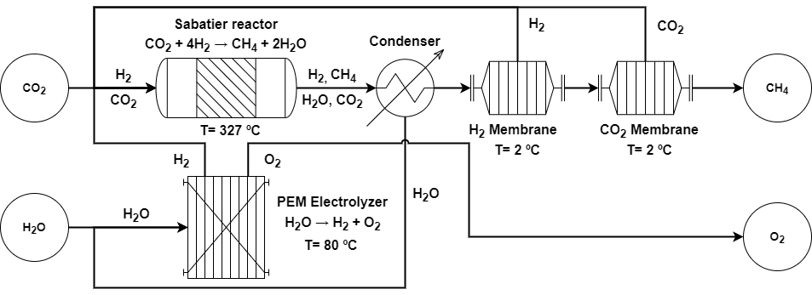
Reactor and Electrolysis Loop⁴
Power: 335 kW, Size: 3.9 m³
Electrolyser energy efficiency 83%
Overall energy efficiency 7.1%

Slide 7
Atmosphere Acquisition and Cooling
Atmosphere capture⁵
5 kW input gives 1 kW cooling
Power: 42 kW, Size: 4.5 m³
Cooling⁶
Air flow: 16.4 kg/s
Power: 78 kW,
Size: 1.1 m³

Slide 8
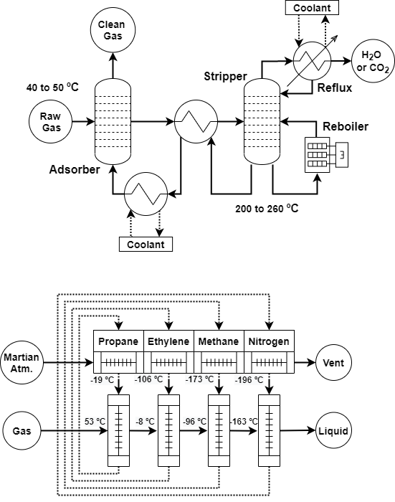
Gas Treatment and Liquefaction
Gas liquefaction⁷
Power: 194 kW, Size: 10.4 m³
Energy efficiency: 5.2%
Gas conditionning⁸
Power: 23 kW, Size: 6.3 m³
Energy efficiency: 3.4%

Slide 9
Result Size and Energy
Total Size: 25.2 m³
Total Power: 598 kW
Overall energy efficiency: 7.1%
SpaceX’s Starship cargo space ⁹ : 1000 m³

Slide 10
Conclusion
Key takeaway
The propellant plant fits in the rocket
Even if energy efficiency is low
Sabatier reactor is a minute contributor
Liquefaction and electrolysis are important
Recommendation
Sabatier reaction: not the best choice
Less complex system are possible
Always propose full plant
Total Power: 598 kW

Slide 11
Acknowledgements

Slide 12
Reference
1. Musk, E. Elon Musk Unveils SpaceX’s Mars Interplanplanetery Transport System Architecture AT IAC 2016. www.youtube.com/watch?v=SPblvBnEDk (2016).
2. Franco, C., Devor, R. W., Snyder, S. J., Petersen, E. & Hintze, P. E. Study of Sabatier Catalyst Performance for a Mars ISRU Propellant Production Plant. 1–12 (2019).
3. Schoen, D. Design and Validation of a Lab-scale Methalox Fuel Plant for In-situ Propellant Production on Mars Dagan Schoen. in Congress, International Astronautical 18–22 (2022).
4. Falbo, L. et al. Kinetics of CO2 methanation on a Ru-based catalyst at process conditions relevant for Power-to-Gas applications. Appl. Catal. B Environ. 225, 354–363 (2018).
5. Clark, D. L., Payne, K. S. & Trevathan, J. R. Carbon dioxide collection and purification system for mars. AIAA Sp. 2001 Conf. Expo. 1–5 (2001) doi:10.2514/6.2001-4660.
6. Colgan, N., Nellis, G. & Anderson, M. Forced Convection Heat Rejection System for Mars Surface Applications. in 1–13 (2021).
7. Naik, M. Y. 4-Stage Refrigeration Process with Propylene , Ethylene , Methane and Nitrogen.
8. Vaidya, S. Sweetening of Natural Gas Followed By Manufacturing of LPG.
9. Paul, R. A., Lamontagne, M. & Senna, B. Proposed ITS pressurized cargo modules to initiate a chemical industry on mars. AIAA Sp. Astronaut. Forum Expo. Sp. 2017 (2017) doi:10.2514/6.2017-5335.

Slide 13
Francis Desilets-Mayer,
fdmayer@student.ubc.ca
UBC Mars Colony
ubcmarscolony.com
Q&A
Contact us
for simulation file and details

