Slide 1


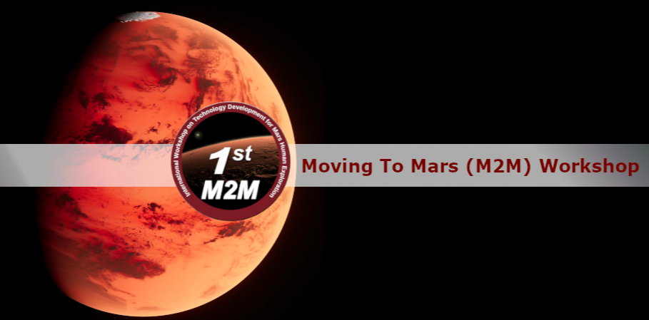
A Deep Learning Method for Shear Wave Velocity Inversion on Mars
Nov. 18, 2022
Shihao Cui, PhD student,
Polytechnique Montreal
Shihao.Cui@Polymtl.ca
Dr. Pooneh Maghoul, PEng, Associate Professor, Polytechnique Montreal
Pooneh.Maghoul@Polymtl.ca
Richard Boudreault, Canadian Space Mining Corporation
Richard@techaero.ca
Department of Civil, Geological and Mining Engineering

Slide 2
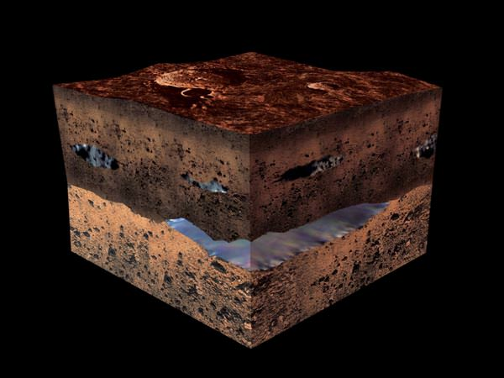
Background
Mars exploration
Mars may contain ores that would be very useful to potential colonists (Landis, 2009).
The Mars landers Viking 1, Viking 2, Pathfinder Road, Opportunity, and Spirit found aluminum, iron, magnesium, and titanium in Martian soil (Fairen, 2009).
Subsurface exploration on Mars.

Slide 3
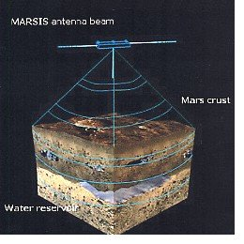
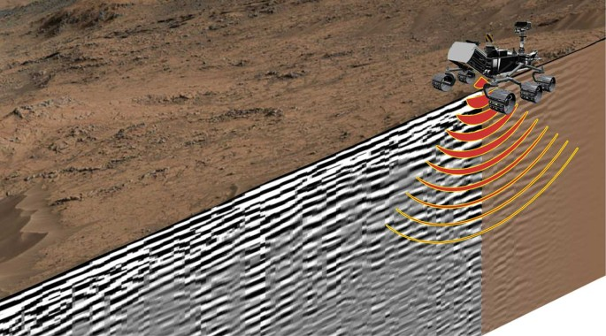
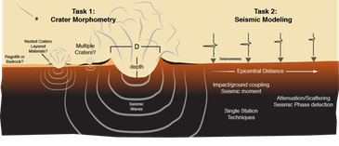
Background
Mars exploration
Subsurface radar and seismic method
Mars Express radar MARSIS
(Cicchetti et al., 2017)
Mars 2020 Perseverance rover traversing the surface of Mars(Hamran et al, 2020)
Martian Seismology (Compaire et al., 2020)

Slide 4
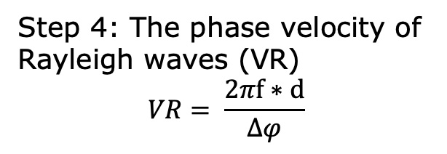
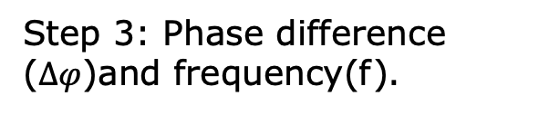
Methodology
Spectral analysis of surface waves
Source
Sensor 1
Sensor 2
d
Step 1: Data acquisition. S1 and S2
Step 2: Phase difference of S1 and S2 in frequency domain.
Step 3: Phase difference ($∆φ$)and frequency(f).
Step 4: The phase velocity of Rayleigh waves (VR)
$$VR= \frac{2πf∗d}{∆φ}$$
d is the sensor distance.

Slide 5
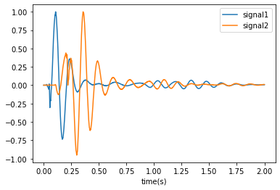
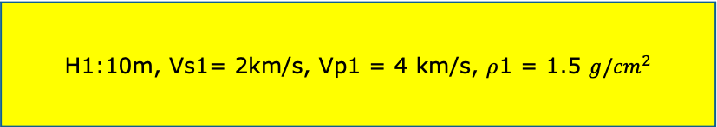

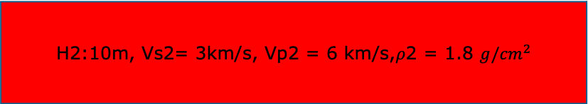
Methodology
Spectral analysis of surface waves- An example
Step 1: Data acquisition.
Source
Sensor 1
Sensor 2
Simulation by a finite difference method.
d
Excitation: Ricker wavelet. Frequency: 5 Hz.
H1:10m, Vs1= 2km/s, Vp1 = 4 km/s, $ρ$1 = 1.5 $g/{cm}^{2}$
d = 30 m.
Signal1: Sensor 1.
Signal2: Sensor 2.
H2:10m, Vs2= 3km/s, Vp2 = 6 km/s,$ρ$2 = 1.8 $g/{cm}^{2}$
H3:15m, Vs3= 5km/s, Vp3 = 10 km/s,$ρ$3= 2.1 $g/{cm}^{2}$
H i: thickness; Vs i: S wave velocity; Vp i: P wave velocity.; $ρ$ i: density.

Slide 6
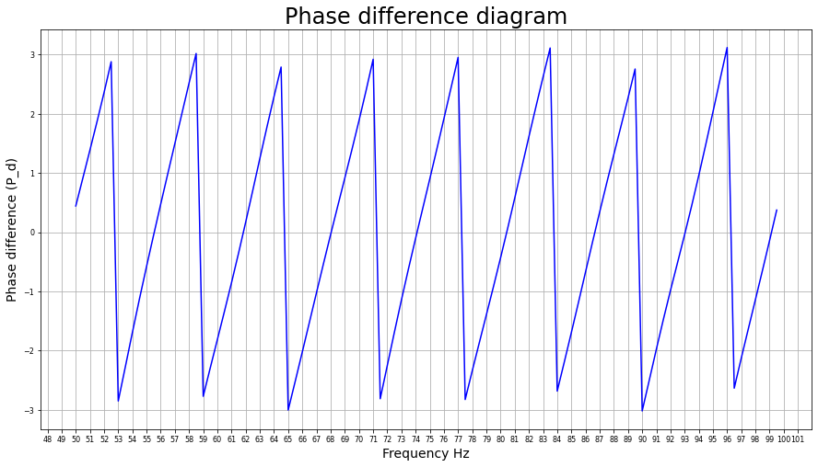
Methodology
Spectral analysis of surface waves- An example
Step 2: Phase difference of S1 and S2 in frequency domain.

Slide 7
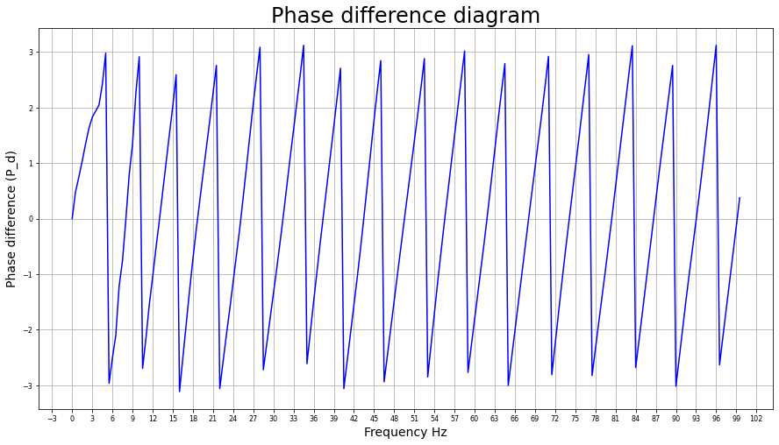

Methodology
Spectral analysis of surface waves- An example
Step 3: Phase difference ($∆φ$)and frequency(f).
($f_{i},{∆φ}_{i}$)

Slide 8
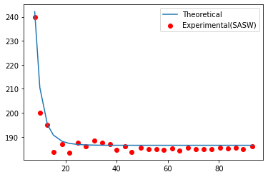
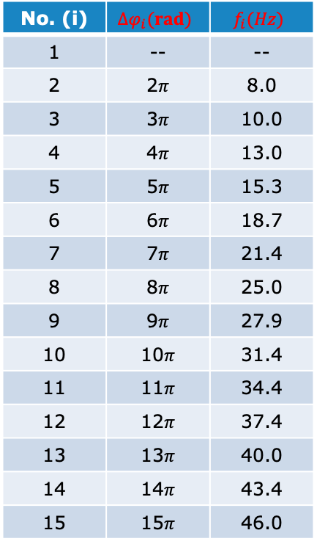
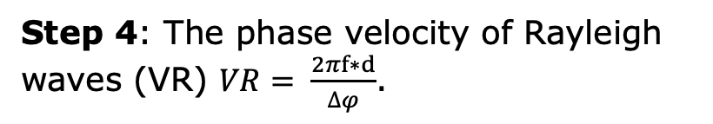
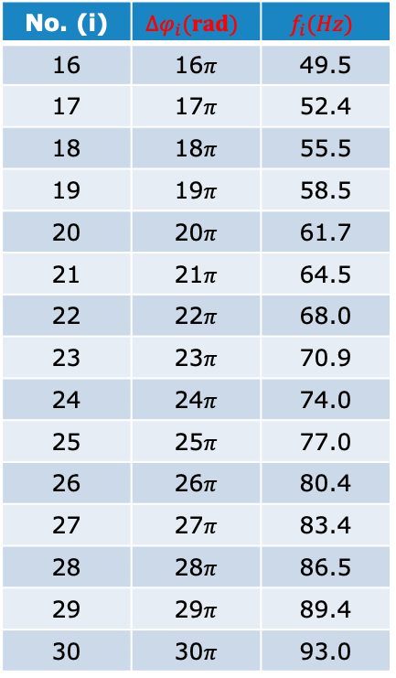
Methodology
Spectral analysis of surface waves- An example
Step 3: Phase difference ($∆φ$)and frequency(f).
Step 4: The phase velocity of Rayleigh waves (VR) $VR= \frac{2πf∗d}{∆φ}$.
No. (i) | $${∆φ}_{i}(rad)$$ | $$f_{i}(Hz)$$
1 | -- | --
2 | 2$π$ | 8.0
3 | 3$π$ | 10.0
4 | 4$π$ | 13.0
5 | 5$π$ | 15.3
6 | 6$π$ | 18.7
7 | 7$π$ | 21.4
8 | 8$π$ | 25.0
9 | 9$π$ | 27.9
10 | 10$π$ | 31.4
11 | 11$π$ | 34.4
12 | 12$π$ | 37.4
13 | 13$π$ | 40.0
14 | 14$π$ | 43.4
15 | 15$π$ | 46.0
No. (i) | $${∆φ}_{i}(rad)$$ | $$f_{i}(Hz)$$
16 | 16$π$ | 49.5
17 | 17$π$ | 52.4
18 | 18$π$ | 55.5
19 | 19$π$ | 58.5
20 | 20$π$ | 61.7
21 | 21$π$ | 64.5
22 | 22$π$ | 68.0
23 | 23$π$ | 70.9
24 | 24$π$ | 74.0
25 | 25$π$ | 77.0
26 | 26$π$ | 80.4
27 | 27$π$ | 83.4
28 | 28$π$ | 86.5
29 | 29$π$ | 89.4
30 | 30$π$ | 93.0
The dispersion relation: Experimental Vs Theoretical(Fast delta matrix method
(https://keurfonluu.github.io))

Slide 9
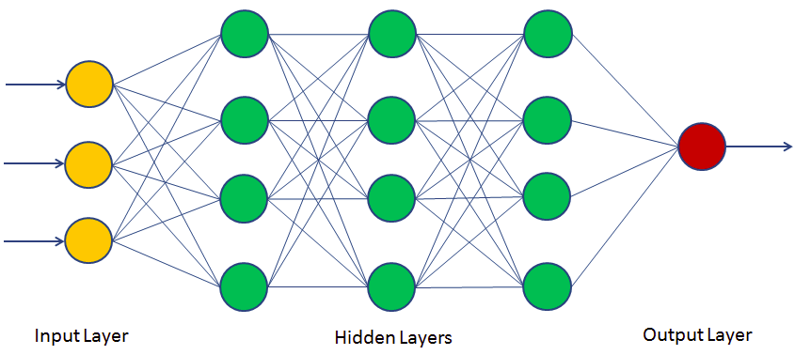
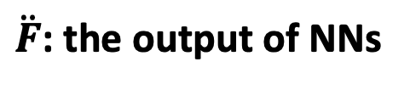


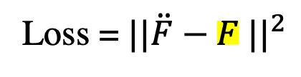

Methodology
Deep learning
Universe approximation theorem.
$$NN(θ)$$
X
Y
$$\ddot{F}$$
Loss = ${||\ddot{F}−F ||}^{2}$
Z
$\ddot{F}$: the output of NNs
No
Convergent?
X,Y,Z Input. F: output.
Yes
$$θ^{∗}$$

Slide 10
Methodology
Overview
(a). Data acquisition.
(b). Wave speed model generation.
(c). Synthetic data generation.
(d). Deep learning model
(Training and prediction)
Forward model and inversion model.
CNN: Convolution neural networks(NNs).
DNN: Dense NNs.

Slide 11
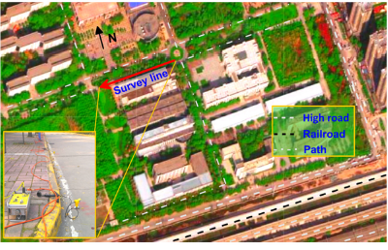
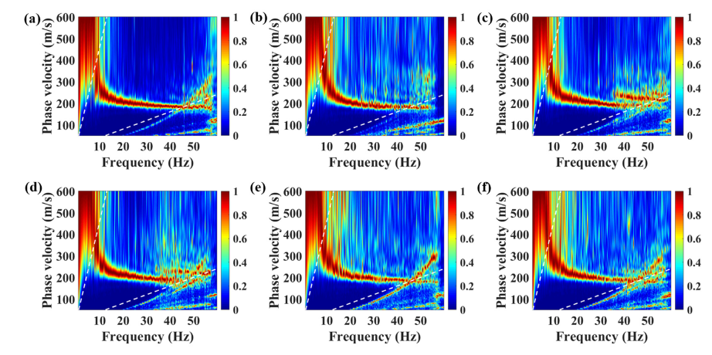
Validation
Data collection
Data acquisition field
Experimental dispersion relation

Slide 12

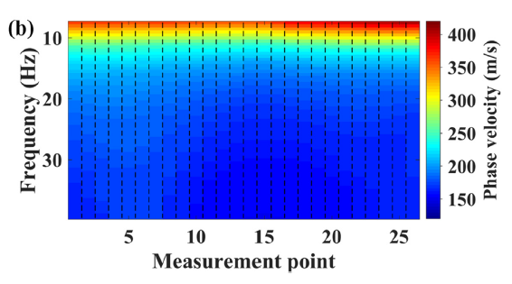
Validation
Dispersion relation curves (26 points)

Slide 13
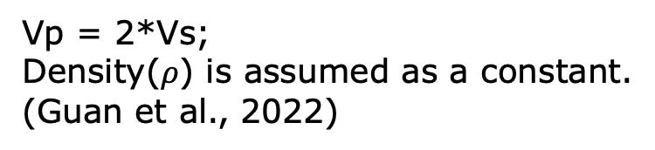
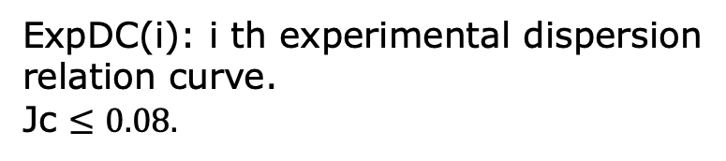
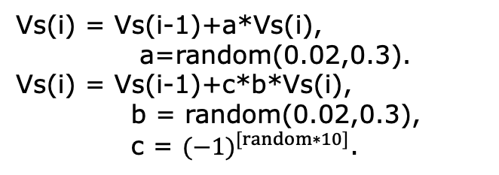
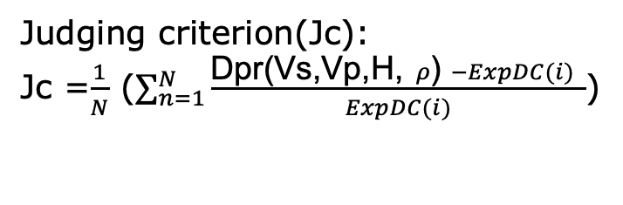

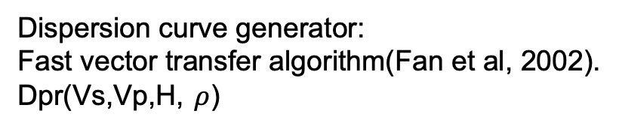
Validation
Synthetic data collection
Wave speed model generation
Synthetic data generation
The subsurface detection depth: 30 m.
Layers: 10.
The thickness of each layer: 3 m.
(Vs, Vp, H, $ρ$ )
Dispersion curve generator:
Fast vector transfer algorithm(Fan et al, 2002).
Dpr(Vs,Vp,H, $ρ$)
The first layer shear wave velocity(Vs)
Vs1 = random(150,250) m/s.
Vs of the half space: 600 m/s.
Judging criterion(Jc):
Jc =$\frac{1}{N}$ ($\sum_{n=1}^{N}{\frac{\text{Dpr}\text{(}\text{Vs}\text{,}\text{Vp}\text{,}\text{H}\text{,} ρ\text{)} −ExpDC(i) }{ExpDC(i)}}$)
The i th layer(i = 2,3, …, 10).
Vs(i) = Vs(i-1)+a*Vs(i),
a=random(0.02,0.3).
Vs(i) = Vs(i-1)+c*b*Vs(i),
b = random(0.02,0.3),
c = ${(−1)}^{[random∗10]}$.
ExpDC(i): i th experimental dispersion relation curve.
Jc $≤0.08.$
Vp = 2*Vs;
Density($ρ$) is assumed as a constant.
(Guan et al., 2022)
Dataset: 100,000 Samples

Slide 14
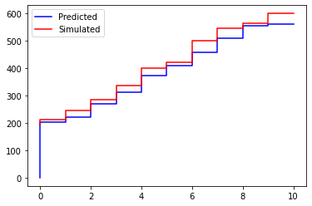
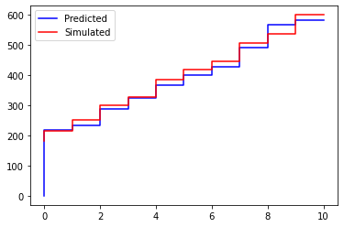
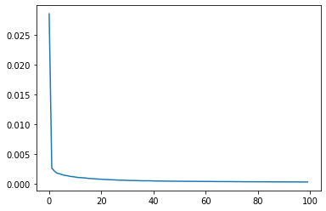
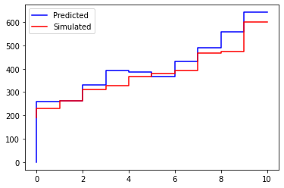
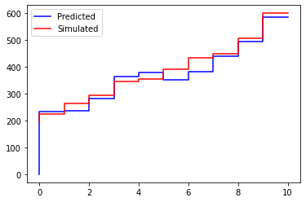
Validation
Numerical result
90% of the samples as the training dataset.
10% as the test dataset.
Some inversion results:
Accuracy on the test set: 91%.
Loss function:

Slide 15
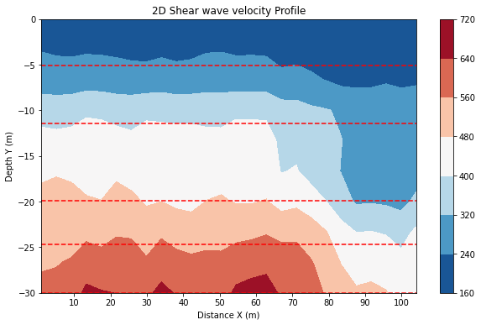
Validation
Experimental result
The result of 26-point dispersion relation curve
Borehole log:

Slide 16
Conclusion and ongoing work
Summary
A deep learning method for the shear wave velocity of the subsurface characterization on Mars.
The data generation policy is designed for synthetic data generation.
A deep learning model based on CNN+GRU+Attention is built.
Ongoing and future work
Extracting dispersion relation curve on the seismic data on Mars.
Increasing the robustness of the Deep learning model.
Improving the reliability of the synthetic data generation policy.

Slide 17
References
Landis, G. 2009. Meteoritic steel as a construction resource on Mars. Acta Astronautica: 64. 183-187.
Fairen, A. et al. 2009. Nature: 459. 401-404.
Zhang Y. and Lin J., Molten iron in Earth-like exoplanet cores, Science, 375, 6577:146-147, 2022.
Hamran, SE., Paige, D.A., Amundsen, H.E.F. et al. Radar Imager for Mars’ Subsurface Experiment—RIMFAX. Space Sci Rev 216, 128 (2020).
Cicchetti, A., et al. "Observations of Phobos by the Mars Express radar MARSIS: Description of the detection techniques and preliminary results." Advances in Space Research 60.10 (2017): 2289-2302.
Compaire, N., et al., Stutzmann, E., Knapmeyer-Endrun, B., Lognonné, P. H., Pike, W. T., Schmerr, N. C., Gizon, L., & Banerdt, W. B. (2020). Autocorrelation of the ground vibrations recorded by the SEIS-InSight seismometer on Mars. Journal of Geophysical Research – Planets, Vol 126, (4)
Fan, Y., Liu, J. and Xiao, B., 2002. Fast vector-transfer algorithm for computation of Rayleigh wave dispersion curve, J. Hunan Univ. (Nat. Sci.), 2002(5), 25–30.
Guan, Jianbo, et al. "Linear array analysis of passive surface waves combined with mini-Sosie technique." Geophysical Journal International 230.3 (2022): 2131-2146.

Slide 18
MERCI !

