Slide 1
16th ESA Workshop on Avionics, Data, Control and Software Systems - ADCSS 2022
Welcome & Logistics – Day 3
Ali Zadeh Head of Data Systems, Microelectronics and Component Technology Division
Benedicte Girouart Head of GNC, AOCS and Pointing Division
Joachim Fuchs Head of Software System Division
Maris Tali, Alberto Urbón, Tomasz Szewczyk
ESA ESTEC – 26 October 2022

Slide 2
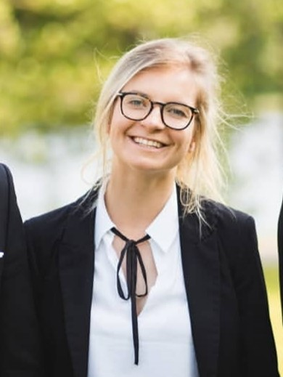
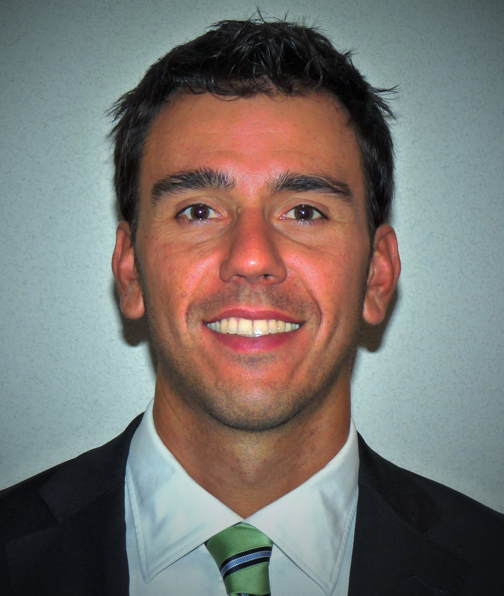
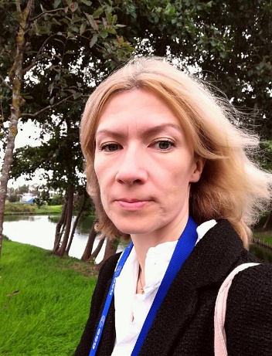
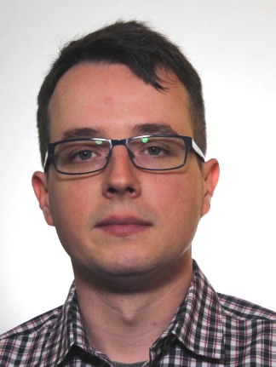
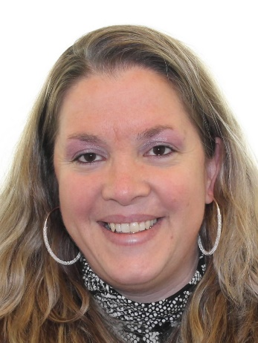
Organisation Team
Maris Tali TEC-EDD On-Board Data Processing Engineer | Alberto Urbón TEC-EDM Micro-Electronics Engineer | Milena Van Schendel TEC-ED Admin. | Tomasz Szewczyk TEC-EDD On-Board Computers & Data Handling Engineer | Kathleen Gerlo TEC-SW Admin.
Presentations will be available at the end of each day
Last version of slides or issues with Indico, Wifi
Please don’t hesitate to contact us!

Slide 3
Presenter Instructions

Slide 4
Registrations Statistics
Total number of participants 297, Onsite 209, Non-ESA 148

Slide 5
Participants Countries Statistics

Slide 6
Registrations Statistics

Slide 7
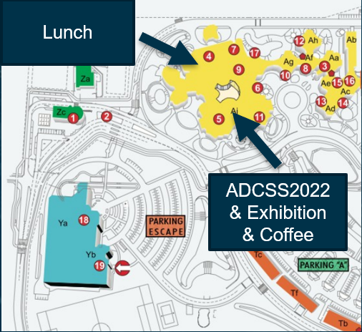
Overview
Day 1 – SAVOIR
Industrial Exhibition Flash Presentations
17:20 – 17:50 | Newton
Welcome Drink
17:50 – 19:00 | Outside Newton
Day 2 – Technical Sessions
On-board processing, co-processing and SW
12:30 – Exhibition & Networking
GNC – New generation of inertial sensors
Day 3 – Technical Sessions
Processor architectures & SW supporting multi core
Functional verification
Round Table

Slide 8
Processor arch. & SW supporting multi core – Day 3
Conveners: Richard Jansen (Ho TEC-EDM) & Christophe Honvault (Ho TEC-SWT)
Time | Title
09:00 | Welcome and Logistics
09:10 | NASA’s Vision for Spaceflight Computing
09:40 | Cobham Gaisler - GR740, GR765 and GR7xV: SPARC V8 and RISC-V for On-Board Computing
10:10 | Microchip - Space Processing solutions from Microchip ARM & RISC-V
10:40 | NanoXplore - Linux goes to space in Ultra7
11:30 | ADS - NG-Ultra, the European rad-hard multicore ARM system-on-chip + FPGA suitable for future space applications
12:00 | TAS - HW/SW experience with Integrated OBC featuring MultiCore SoC
12:30 | JAXA - Introduction of a Space Grade Micro Processing Unit for Future Space Applications

Slide 9
Functional Verification – Day 3
Conveners: Bénédicte Girouart (Ho TEC-SA) & Robert Blommestijn (Ho Ground SW Systems & Func. Ver.)
* All presentations will be released at the end of the day
Time | Title
14:00 | Spacecraft LSI views on Avionics Functional Verification sub-sessions by TASI, OHB System and ADS
16:00 | Focus on Nanosats & Smallsats: ESA lessons learnt & guidelines for Nanosat Avionics Functional Verification
17:15 | Focus on Verification for AI-based SW and AOCS/GNC systems
17:45 | ADCSS’22 closing

Slide 10
Industrial Exhibition
Location –> Outside Newton
Opportunities for Networking:
Day 2 | 12:30 - 13:00 – Exhibition & Networking
Coffee Breaks
Companies:

Slide 11
Upcoming Events
22-23 November 2022 ESTEC ADHA 2022 Workshop (Advanced Data Handling Architecture)
https://indico.esa.int/event/427/
30 Nov - 01 Dec 2022 ESTEC TEC-ED & TEC-SW Final Presentation Days - Autumn 2022
https://indico.esa.int/event/405/
13-14 December GR740 User Day and RISC-V in Space Day
https://indico.esa.int/event/431/
March 2023 ESTEC – 6th SEFUW (SpacE FPGA Users Workshop)
12 Jun - 16 Jun 2023 ESA GNC & ICATT conference (Sopot, Poland)

