Slide 1
ESA Lessons Learned & Guidelines on Nano - SmallSat Functional Verification
Contributions:
R. Blommestjin - TEC-SWG
R. Walker, C. Pirat - TEC-SPC
I.Cantiello, A. Hyslop - TEC-SAA
T. Szewczyk - TEC-EDD
ESA ESTEC
For ESA Internal Use Only
27-Oct-2022

Slide 2
Agenda
Functional Verification of ESA CubeSat and SmallSat projects
Lessons Learned from ESA IOD CubeSat Projects relevant to Functional Verification
Lessons Learned from ESA CubeSat AOCS Functional Verification
ESA ESTEC Avionic Systems Lab

Slide 3
Focus/Context
Focus: Lessons Learned & Guidelines on NanoSat – SmallSat platforms Avionics Functional Verification
CubeSat – SmallSat
Typically the larger the S/C, the higher the complexity, cost, with longer development
Although….For a given S/C size/mass, the specific Cost vs Risk-Acceptance combination of the mission flows down into a certain Design/ Implementation/ Verification/Operations complexity
Nanosats (<10kg)
Microsats (10-100kg)
Medium
(500 - 1000 kg)
Smallsats (100-500 kg)
Large
(>1000kg)
Overall Functional Avionics Verification effort tends to increase
Picosats (<1kg)
Notes:
1)Classification by mass is only indicative and not universally accepted!
2)CubeSat have standardized dimensions launched inside container
cubesats

Slide 4
Functional Verification of ESA CubeSat and SmallSat projects
ESA ESTEC
For ESA Internal Use Only
27-Oct-2022

Slide 5
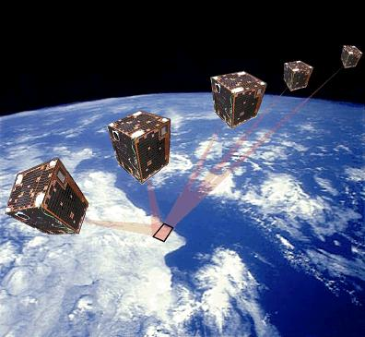
Trend and Considerations on V&V for SmallSat/CubeSat
Growing interest for “Faster, Smaller, Cheaper” Spacecraft for wide range of missions (but mainly commercial)
94% of S/C launched in 2021 are <600 kg according to Bryce Tech Report (https://brycetech.com/reports)
Evolution from higher risk IOD missions to Operational/Commercial/Institutional and Science missions with more stringent Reliability and Availability requirements
Demand for higher performance and capabilities
Avionics Architecture & Design increased complexity (closer to larger S/C)
Call for a more rigorous and reliable Verification process
Which actors?
from more experienced companies & SME to newcomers in the space industry
Good expertise in S/C design (flight heritage)
Well established V&V process
More “adherent” to tailored ECSS
Limited expertise in S/C design
V&V process less mature

Slide 6
Issues / limitations encountered with (some) Smallsats/Cubesats
Simulator Validation often missing or not adequate
AOCS units errors modelling just based on datasheet (for NewSpace/ COTS HW often optimistic)
V&V facilities
Poor Validation of Simulation Environment
No PFM/FM Close-loop tests
Absence of SVF
“reduced” or No ATB HIL close-loop test capability
EGSE not available
Only Open Loop tests on PFM
ATB becomes the “reference” for closed-loop testing
Applicability (colour code)
Smallsats only
Cubesats only
Cubesats and smallsats
Only System functional & I/F tests on ATB (OL)
Some AOCS EM HW cannot be used in closed-loop
Validation of AOCS HW emulator (incl. delays) is key
“Hybrid” ATB between HIL & PIL, reduced confidence
First “Real-time” tests on ATB HIL
Impacts on OBSW Verification, “moved” to ATB
AOCS-SW integration with OBSW directly on HIL
SW bugs discovered “late” during HIL tests

Slide 7
Issues / limitations encountered with (some) Smallsats/Cubesats
V&V process
Verification approach defined while designing for the “first time”
No or Limited experience at System / AIV/ Testing Level
FDIR testing
underestimated
Less testing due to schedule /budget constraints
Continuity between verification facilities not always ensured
Reference Cases not clearly defined
Regression tests overlooked
SW versioning not always under control
Less mature V&V process at company level
Design doesn’t often takes into account Verification effort
Verification plan not defined (or clear) only until later stage
Wrong Verification Method for Requirements
No/Reduced Montecarlo Campaign
Polarity test not correct
Accepting the risk that issues might be discovered at later stages
In flight verification to “fill the gap”
FDIR can be complex, still not properly tested
Applicable to any bench (both simulation and HW)

Slide 8
Flaws and limitations on the verification testing flow
AOCS Performance / Functional campaign
OBSW Verification campaign
Functional Verification Campaign
AIT Campaign
Verified SW from previous bench
AOCS Simulators
SVF
ATB
PFM/FM
SW Unit & Integration Tests
Open Loop
AOCS Tests
(EM HW)
Analysis/Simulation in Matlab/Simulink
Open Loop
AOCS Tests
(FM HW)
Closed Loop AOCS tests
(w/ Real or Emulated OBC)
HIL Closed Loop AOCS tests
(Real OBC. EM HW)
Test Campaign on Hi-Fi Simulator (FES or FVB)
MIL or SIL
Closed Loop
AOCS Tests
(FM HW)
System Functional tests on S/C
Polarity Test on S/C
Reference
cases
System Functional Tests
AOCS Performance Validation
OBSW Validation
On SVF
AOCS HW-SW Validation
AOCS HW Integration onto S/C validation
AOCS Verified for Flight

Slide 9
Example of Verification Testing flow for Smallsats/cubesats
AOCS Performance / Functional campaign
Functional Avionics Verification Campaign
AIT Campaign
Verified SW from previous bench
AOCS Simulators
ATB
PFM/FM
Note:
Closed loop (CL) tests could be done either on ATB or PFM
For cubesats, typically Hi-Fi simulator not available
SW & HW/SW
Integration Tests
OL AOCS Tests
(EM HW)
Final SW re-run on ATB in Closed-loop
OL test Results with Final SW compared with same tests on ATB (static output)
Analysis/Simulation in Matlab/Simulink
Final SW
Closed Loop AOCS tests
(HIL / PIL EM HW or emulated)
Test Campaign on Hi-Fi Simulator (FES or FVB)
MIL or SIL
Open Loop
AOCS Tests
(FM HW)
System Functional tests on S/C
Polarity Test on S/C
Reference
cases
System Functional Tests
AOCS Performance Validation
OBSW Validation
On ATB
AOCS HW-SW Validation
AOCS HW Integration onto S/C validation
AOCS Verified for Flight

Slide 10
Further Recommendations and Way forward
Limitations with V&V facilities are difficult to overcome, but improvements to the overall process are possible
Some guidelines:
Ensure a mapping between “Item to be tested vs Available Verification Bench” is available/agreed early on
Reduced Montecarlo for AOCS perf. Validation may be accepted (esp. for Cubesats), provided the right edge cases are simulated
If adopted, Autocoding for AOCS SW development (w/ ESA HB guidelines) can streamline the V&V process
Pay attention to SW versioning, especially in “fast-paced” design developments (with no clear baselines..)
HIL Close-loop tests with at least Real OBC and I/F boards with Avionics equipment are highly recommended
Given that AOCS HW used in CL not always possible, validation of HW emulators (incl. delays) is crucial
Ensure that a minimum amount of Regression Tests (e.g. on mission critical functionalities) are planned
FDIR tests (esp. for Smallsats) may be run at just one Verification stage (in CL if available) to reduce testing effort
Dedicated Functional Avionics V&V workshops between Prime and ESA are encouraged (as early as possible)

Slide 11
Lessons Learned from ESA IOD CubeSat Projects relevant to Functional Verification
CubeSat Systems Unit, Directorate of Technology, Engineering & Quality
ESA ESTEC
For ESA Internal Use Only
27-Oct-2022

Slide 12
EM Flatsat Model Philosophy & Testing
Issues:
  Engineering Model not flight representative for critical environmental tests, test results not relevant
  EM flatsat found to highly beneficial for system-level functional verification during OBSW development, AIT and operations, but was incomplete in terms of EM units
  Lack of an EM flatsat prior CDR, leading to high number of NCRs during AIT related to electrical & software interfaces with the payloads/payload computer
  Unrepresentative flatsat with anomalous system behavior not present in flight
  Lack of EM for payloads, leading to major NCR on EMI between two P/L PFMs preventing their concurrent operation in flight
Impacts:
  Schedule delays & cost impacts prior CDR due to the need to repeat EM environmental tests
  Incomplete system-level functional verification on ground & difficulties/delays to complete commissioning/maintenance activities during operations
Process Improvements:
  In SoW: for EM environmental tests, require EM be flight representative and test setup representing flight conditions
  In SoW: require complete flight representative EM flatsat & testing prior CDR, including EMs for all subsystems/payloads, require EM auto-compatibility test to identify any EMC issues
  Ensure sufficient allocation/margin in project schedule for EM development & testing prior to CDR

Slide 13
System-level Testing
Issues:
  Incomplete system-level & ground segment verification prior to QAR, leading to issues during LEOP/commissioning
  Ground station functions not tested simultaneously, interference between UHF & S-band during LEOP
  No E2E RF performance test before/after environmental testing in anechoic chamber and due to no antenna re-stowability
  No end-to-end polarity check on ADCS sensors & actuators, leading to corrective HW/SW measures during AIT & in flight
  Solar Panels in +Y face were wrongly connected to EPS during AIT, no time to correct, 20-25% power reduction from panel in flight
  SW instability in P/L interface & redundant OBC not identified in ground tests due to short test duration
Impacts:
  Risks to communicate with the satellite, provide sufficient power & detumble, control/monitor payload
  Schedule delays during LEOP/commissioning to troubleshoot & rectify issues
Process Improvements:
  In SoW: require day-in-the-life E2E testing at system level to cover operational scenarios, E2E RF test in anechoic chamber in all S/C configurations; specify ground segment acceptance tests, MPPT verification via flasher test, long duration SW stability test
  In Engineering Guidelines: detail procedures of DITL testing, recommend test setups for E2E RF, EMC, GS acceptance, MPPT tests
  Require re-stowage of antennas and other mechanisms after integration in S/C
  In Engineering Guidelines: recommended to perform a suspended polarity test (satellite PFM suspended on cable or air bearing table to check RW torque against gyro measurements), recommend that all functional control chain polarities be tested in single shot end-to-end tests involving sensor stimulus and observation of actuator physical effect (e.g. hanging or air bearing table)

Slide 14
SW/FW Reconfigurability in flight
Issues:
  Capability to reconfigure or implement completely new images of OBSW found to be beneficial during operations
  Implementation of Direct Spread Spectrum scheme in Software-Defined Radio (SDR) of the Inter-Satellite Link during flight to overcome ITU PFD limitations and extend ISL range to 4500 km
  New ADCS SW image uploaded to correct error in Momentum dumping
  New ADCS SW image uploaded to improve functionality for tuning & enhance performance
  Star tracker FW patched to correct for memory block corruption, recovered functionality
  New ADS-B payload SW image uploaded to correct bug on geographical location
  New OBC & COM FW images uploaded to correct bugs causing periodic resets
Impacts:
  SW re-configurability ensures possibility to resolve bugs and implement new functions in flight, conduct IOD experiments
  With usage of SDRs, even new waveforms for Rx/Tx (modcods, spread spectrum, hopping) can be implemented during operations
Process Improvements:
  In PA/QA Requirements: reinforce reqt that critical SW and FW is updateable in flight (patch/full image) and verified on ground on EM flatsat prior to upload
  In Engineering Guidelines: recommend SW re-configurability methods, usage of SDR where appropriate/feasible to have reconfigurability in flight (whilst ensuring mission safety)

Slide 15
Lessons Learned from CubeSat AOCS Functional Verification
ESA ESTEC
For ESA Internal Use Only
27-Oct-2022

Slide 16
Optimistic pointing claims
Issues
  Cubesat AOCS suppliers typically claim pointing performance of
    <1 deg with magnetometer, gyro and sun sensors
      possible with stationary white noise assumptions, or over some favorable periods in the orbit, but pointing is significantly affected by:
        Earth albedo impact on Sun sensor
        Satellite magnetic fields impact on magnetometer
        Gyro bias thermal dependency
        Communications issues (delay, missing packets, etc.)
    <0.1 deg with star tracker
      often only achievable in eclipse or when angular rates are low
Impacts
  Extreme prolonging of commissioning phases to identify issues with pointing and attempt calibration where possible
  Mission objectives not met
Process Improvements
  Star tracker sensitivities demand that there is a prelude low angular rate mode to initiate star tracker measurements
  Albedo, magnetic, thermal effects should be designed for and well calibrated
  Characterize sensor data carefully in terms of delay, missing packets, etc.
  AOCS simulators require higher fidelity modelling for verification of performance requirements

Slide 17
Optimistic pointing claims
ESA’s experience:
Pointing APE 3σ | Sensors | Actuators
20° - 30° | Magnetometer without on-orbit calibration, fine/coarse sun sensors affected by LEO albedo | Magnetorquers
15° | As above, but with gyro | Reaction wheels & magnetorquers
10° | As above, but avoiding albedo on sun sensors
5° | As above, but with on-orbit calibration of magnetometer
1° | External (or multiple internal) magnetometer, fine (or multiple coarse) sun sensor & fine (or multiple coarse) gyro (& GNSS receiver if Earth pointed)
0.1° | Reliable star tracker (& GNSS receiver if Earth pointed)

Slide 18
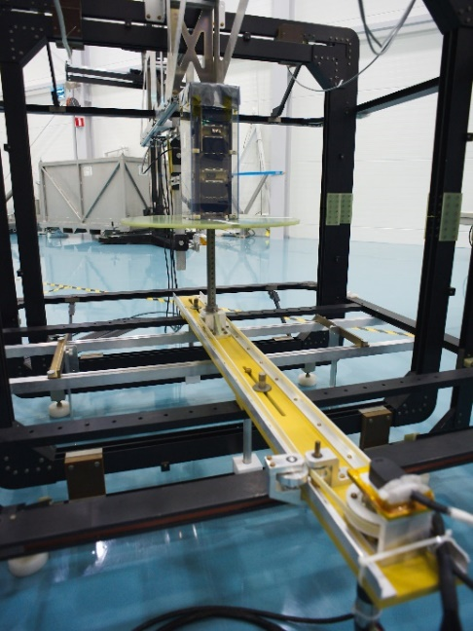
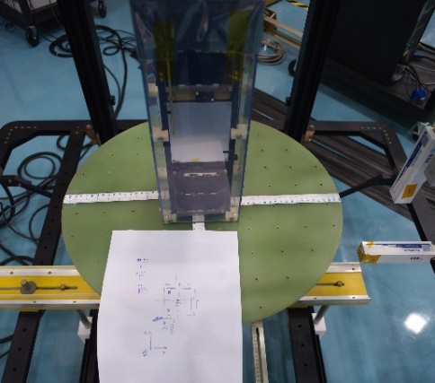
Magnetic residual dipole is underestimated
Issues
  Magnetic residual dipole underestimated and actuation can be insufficient to counteract
  Spin-up during periods of non-actuation is possible and can potentially be attributed to solar-fixed magnetic dipoles
Impacts
  Loss of pointing in parts of the orbit
  Potentially unbounded spin-up if control disabled for long periods
Process Improvements
  Estimate using NASA standard SP-8018 Class III mass-based formula; 0.01 Am2/kg (upper bound)
  Ensure magnetorquers are sufficiently sized to counteract residual dipole and other torques with margin
  Keep track during design via budgeting approach if possible
  Ensure solar array current loops are designed to balance out
  Never allow a cubesat to remain uncontrolled for more than a couple of days since small unbalanced solar array currents can hypothetically lead to spin-up and comms loss
  Measure units and/or integrated cubesat in Helmholtz cage (e.g. at ESTEC or universities or cubesat primes)
  Perform de-perm as standard process prior to flight

Slide 19

Cubesat star trackers are less robust
Issues
  Cubesat star trackers experience frequent outages due to:
    Straylight (poor baffle design, baffle volume constraints, albedo from s/c)
    Poor software robustness (incl. robustness to false stars, changes in background)
    Optics darkening due to use of COTS (decreases SNR)
    High sensitivity to angular rates
Impacts
  Loss of pointing in parts of the orbit
  Failure of mission objectives, when stable star-tracker-based pointing cannot be achieved
Process Improvements
  Investigate heritage by contacting past customers of star tracker suppliers
  Check what radiation testing has been done on the unit
  Robustify AOCS (e.g. low-rate 3-axis pointing mode, FDIR) / operations as safeguard against outages
  Perform detailed accommodation analysis for shadowing/straylight from s/c into sensors
  Perform dedicated star tracker verification if possible
    Characterise optics on ground (not just centering but also focal length / aberration)
    Night sky testing of star trackers with physically emulated slew rates is a useful robustness test

Slide 20

Sun sensors can have issues
Issues
  Cubesat sun sensors may be simple but they can still cause significant problems due to:
    Calibration in non-representative facility
    Earth Albedo effect (up to 15º additional error)
    Shading from or visibility of appendages
Impacts
  Significantly degraded pointing in parts of the orbit
Process Improvements
  Avoid albedo by ignoring sensors with Earth view factor or tilt sensors away from Earth
  Ensure appendages visibility/shading of sensors is considered and impact mitigated if unavoidable
  Ensure sensor has been tested in a facility (or outdoors) with 1 solar constant if it contains active electronics

Slide 21
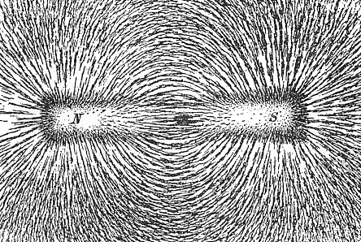
Magnetometer Interference
Issues
  Magnetometer (MAG) measurement accuracy is entirely dominated by interference from on-board units, which is worse in cubesats due to tight volume constraints
    Bias offset due to s/c residual dipole; e.g. a 2 uT bias can lead to 6º attitude knowledge error!
    Magnetorquer (MTQ)
      insufficient OFF time before sampling magnetometer
      magnetization of magnetometer
    Noise from reaction wheels
Impacts
  Significantly degraded pointing
  Failure of mission objectives, if magnetometer interference is too great and cannot be ‘calibrated-out’
Process Improvements
  Check magnetometer detector type (ask supplier) for any limits on maximum field it can safely handle
  Place magnetometer on external boom or outside main box
  Averaging over multiple non co-located magnetometers can help reduce measurement bias
  Test non-interference between MTQ and MAG (via telem check), with periods of max duty cycle commanding
  Calibrate mag. bias, scale factor and orthogonality in a Helmholtz cage or at least on-orbit (against IGRF norm)

Slide 22
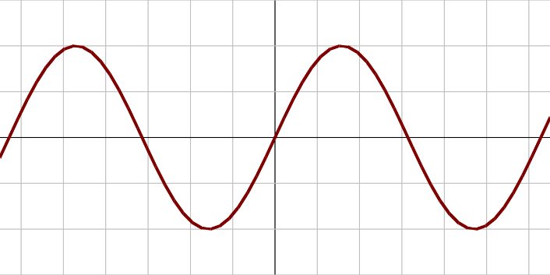
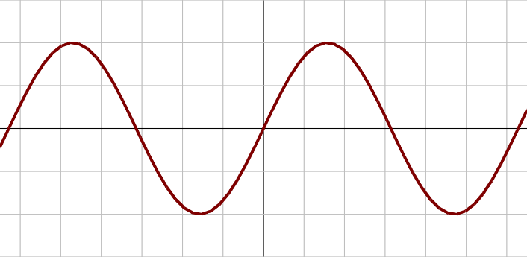
Controller delays neglected
Issues
  Control systems have delays due to sensors, actuators and on-board processing
  Some sources are not properly identified/handled in the design and can easily lead to a full AOCS cycle of delay
    i.e. depending on order of data acquisition and sending commands etc and interaction with intermediate avionics boards
  Delays can lead to instability, particularly for Bdot control at high angular rates
Impacts
  Failure to damp angular rates after separation if higher than some threshold
  Spin-up can occur and lead to communications loss, and loss of mission.
Process Improvements
  Verify timing (via avionics / s/c real-time tests) assumed in the AOCS simulator
  Include artificial full cycles of delay in discrete blocks in simulators/stability analysis for robustness
Bdot
Bdot measured

Slide 23
Polarity verification is often incomplete
Issues
  Sign/polarity errors have often led to near loss of mission, due to e.g.:
    magnetorquer polarity checked on A side but not B side
    wrong test conclusions
    wheel alignment matrix not inspected in final SW version
    magnetometer polarity tested at unit level but not with AOCS SW
Impacts
  Loss of mission, if not corrected in time
Process Improvements
  Ensure polarity can be corrected in-flight
  Produce a table clearly demonstrating how each functional control chain combination is tested (each mode, each sensor-to-actuator, each avionics board / OBC path)
    Perform single-shot physical-stimulus-to-actuator-command tests where possible (at least for safe modes)
      Cubesat small formfactor makes this easier (e.g. for spinning, hanging or use of airbearing table / Helmholtz cage)
    For split tests (unit HW polarities tested separately to SW), TM parameter overlap must be demonstrated in test report
    Position placement of compass crucial in magnetorquer polarity tests
  Take complete set of photos of wiring & integration (with unit and satellite frame illustrated in photo)
  Tests should be done with final SW version; any SW changes since test shall be assessed for impact / regression tested
sensor
SW
actuator

Slide 24
ESA ESTEC
Avionic Systems Lab
ESA ESTEC
For ESA Internal Use Only
27-Oct-2022

Slide 25
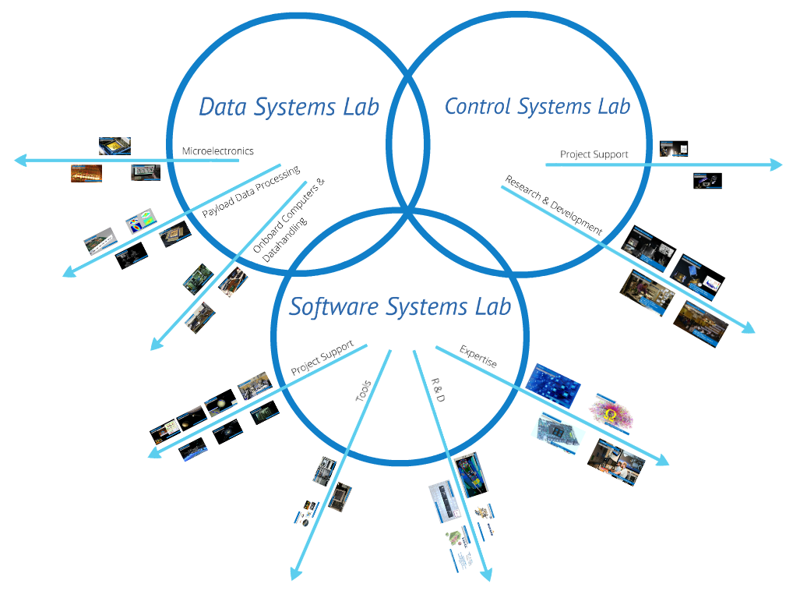
Avionic Systems Lab
Three labs are closely working together: Avionic Systems Lab
Data Systems Lab (TEC-EDD)
Micro-electronics
Payload Data Processing
Onboard Computers & Data handling
Control Systems Lab (TEC-SA)
(aka AOCS and Pointing Systems Lab)
Sensors
Actuators
AOCS Models and Algorithms
AOCS Verification
Software Systems Lab (TEC-SW)
On-board and Ground Software
Simulators, Functional Verification Facilities and EGSE
Simulation/Visualization/Virtual Reality
System Software Co-Engineering

Slide 26
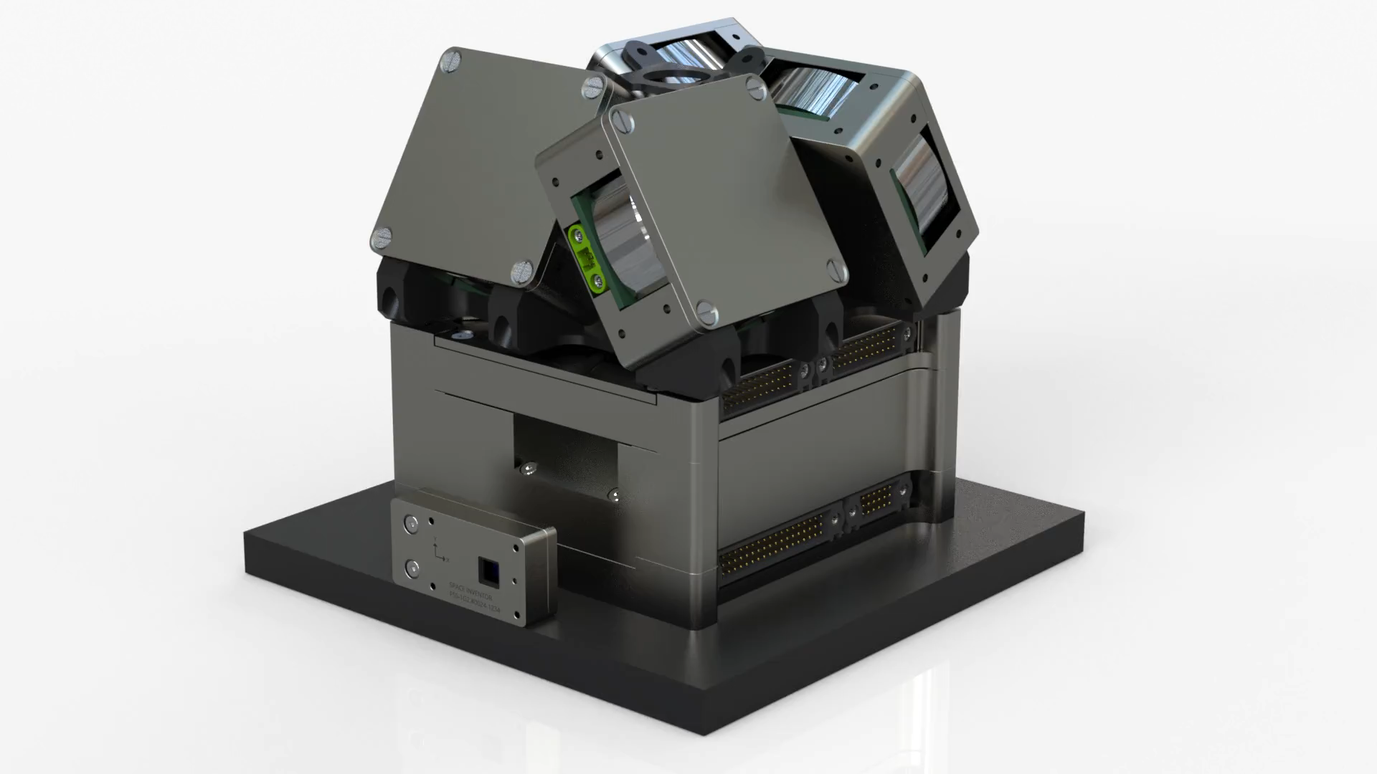
ESA AOCS verification lab
ESTEC is developing an AOCS verification lab
  This will allow testing of algorithms, SW & HW at subsystem level to complement ESTEC’s existing AOCS/GNC sensor characterisation lab and cubesat avionics lab.
Rationale: meet an identified need for more thorough verification of integrated cubesat AOCS
  Gaps/mistakes in verification campaigns have led to on-orbit issues
    → prolonged commissioning
    → degraded mission performance
Lab Objective: enable open-loop and test-as-you-fly closed-loop testing of cubesat AOCS
Planned operational date: late 2023
Envisaged project use cases:
  Open loop polarity testing
  Auto-compatibility checks with Sun and magnetic stimulus
  Satellite magnetic characterisation in Helmholtz cage
  Sensor/estimator performance
  Closed-loop pointing performance
  Algorithm testing
    (on Space Inventor cubesat HW)

Slide 27
ESA AOCS verification lab – 3dof attitude control air bearing facility
Key ingredient: 3 d.o.f. attitude control air bearing facility
Spherical (roll, pitch, yaw) air bearing table – to be developed by University of Bologna / Nautilus
  1.3 m Helmholtz cage for magnetometer/magnetorquer stimulus (field can be upscaled to help magnetorquer overcome lab disturbances)
  1 Solar constant Sun lamp on rail for Sun sensor stimulus in different orbits
  Albedo stimulus lamp
  0.01° Truth attitude (via independent stereo cameras)
    Available to platform
    (with optional star tracker noise/delay model)
  Platform for mounting 1U - 12U cubesats
  Automated mass balancing
To be housed in ISO8 clean tent to allow testing of flight hardware
Support Equipment:
  Battery pack for autonomous cubesat
  Wireless unit for transferring truth attitude and/or TM/TC between ground station and cubesat (CAN or I2C)

Slide 28
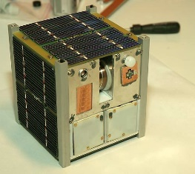
ESA AOCS verification lab – 3dof attitude control air bearing facility
Any 1U to 12U nanosat with own GSE
Sensors: physically stimulated (Sun lamp, Helmholtz cage, star tracker meas. replaced by independent camera)
Actuators: physical effect rotates the satellite on the air bearing table
Disturbances: dominated by mass imbalance residual, <5e-5 Nm depending on cubesat size

Slide 29
ESA AOCS Sensors Lab
AOCS Sensors Lab is designed as a laboratory mostly for internal use (independent characterization)
It includes:
  Single star simulator with precision 2-axis table for distortion estimation (and compensation), as well as PSF verification and S-curve measurement
  Sun emulator (Xenon or bright halogen lamp) with precision 2-axis table for Sun Sensor testing and UV-testing of Star Trackers with detectors using micro-lenses
  Gyroscope characterisation via single-axis rate table in a thermal chamber (ambient pressure)
Plans for external use facilities:
  Medium-accuracy Straylight measurement bench for Star Trackers to support characterisation of cubesat/smallsat STRs
  Planned operational date: 2023

Slide 30
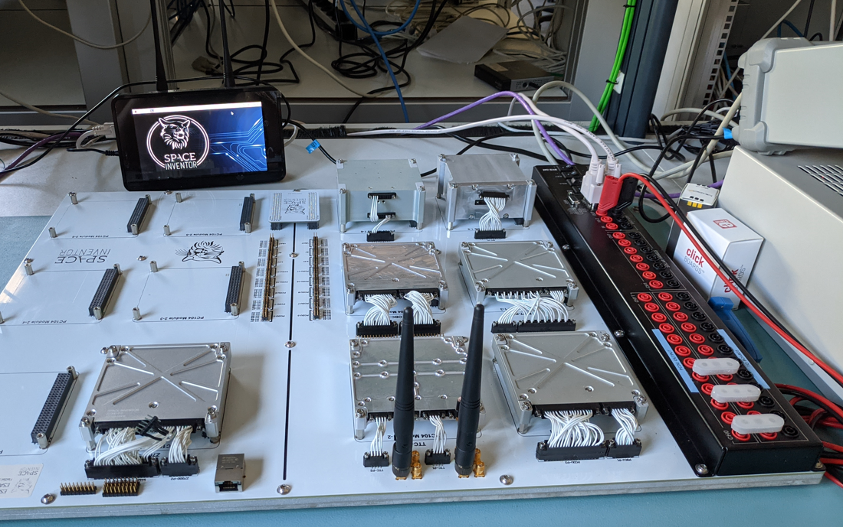
ESA ESTEC CubeSat FlatSat
CubeSat FlatSat is located in TEC-EDD
  Representative set-up with all the core subsystems available on CubeSat (OBC/TT&C/PCDU/AOCS/Battery/MPPT/Payload OBC/S-Band)
  A number of slots left for other subsystems/payloads to be integrated in the future
  FlatSat implements “good engineering practices” i.e.: CAN Bus, CubeSat Space Protocol, redundant subsystems
  Operational since December 2020
Number of activities were already carried out:
  Baseline for two master thesis (FDIR algorithm, radiation payload integration)
  Internal trainee activities (AI experiment, TM&Ground Station integration)
  Basic verification of 3rd party SDR Payload
  In preparation: testbed for EGSE tools development
Future possibilities:
  Test-Bed for 3rd party developments
  Validation of various Data-Handling concepts (i.e. FDIR algorithms, implementation of SAVOIR functionality etc.)
  Validation of newly developed payloads/subsystems in representative functional environment
  End-to-End mission testing

Slide 31
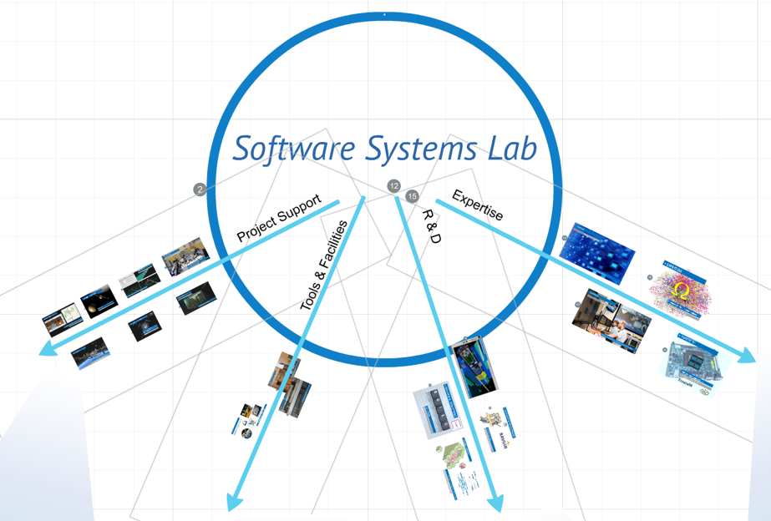
Software Systems Lab
ESTEC (Software Systems Division) has a lab (> 15 years) for:
Project Support:
CDF simulation support
JUICE & Euclid Payload Algorithms
Rosetta, SGEO, Galileo SVF, ….
Tools & Facilities
Collaborative Software Development Environment (C-SDE),
AR/VR applications
Simulation & 3D Visualization (Open-IGS)
Avionic Test Bench (ATB)
European Ground System Common Core (EGS-CC)
European Space Software Repository (ESSR)
R&D: prototype new concepts
SAVOIR
TASTE
…….
Expertise: maintain skills of technical staff
essr.esa.int

Slide 32
Software Systems Lab: CubeSats/SmallSats
Observations (see CubeSat WS 2018, SEPS 2017/2019, Stakeholder questionnaire) :
Functional Verification of OBSW and equipment is still underrated,
Heavy cost of developing these facilities in the traditional way is not affordable nor justified,
Also from “time-constraint perspective” the traditional approach is not “the way”,
OBC emulator traditionally seen as difficult area, however cheaper / availability of OBC hardware is seen as a solution
Objectives:
Development of a CubeSat Reference Testing Facility, to recurrently support CubeSat projects [target 2023]
  Based on existing building block (i.e. ATB/EGS-CC), tailored for CubeSat projects, tested with EagleEye
  Multiple instantiations outside ESTEC, “suitable” license (e.g. ESA Software Community License)
  Remotely accessible, “ tele-testing”
  Adaptability: easy configurable, tailoring support, designed for extension
Use in pilot project (e.g. CubeSpec) in shadow mode, for independent verification, regression or additional testing demonstrating feasibility and added value [target 2023/2024]
Use of European Ground System Common Core (EGS-CC) in SmallSat pilot project (e.g. ALTIUS) [target 2023/2024]
In parallel, modernization of existing infrastructure:
Integration, maintenance and evolution of European Ground System Common Core (EGS-CC) [ongoing]
Use of System Reference Database (SRDB)

Slide 33
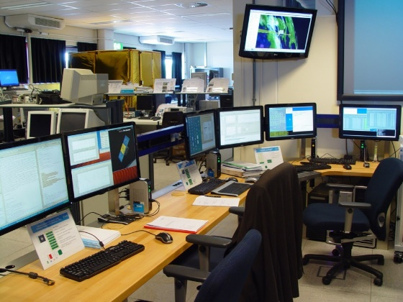
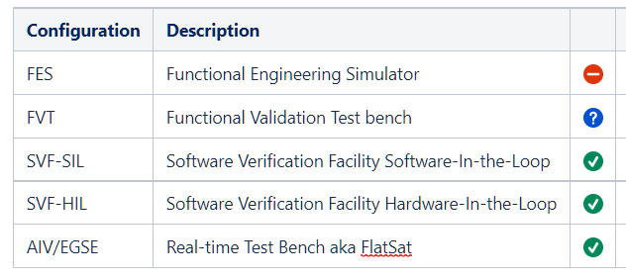
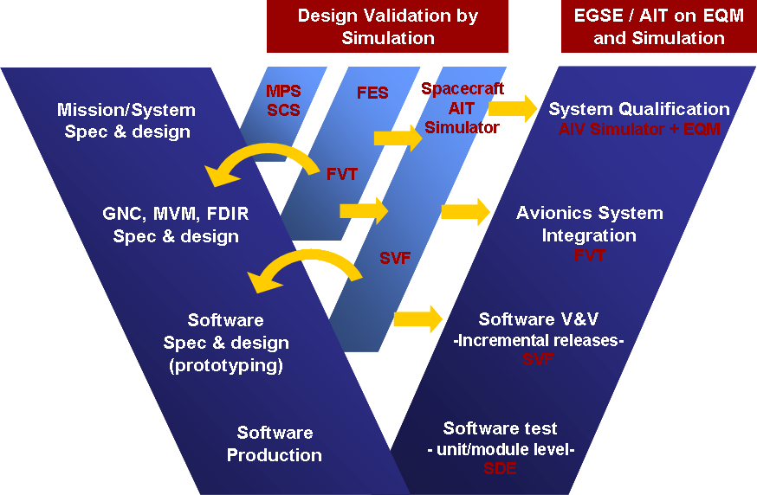
Software Systems Lab: CubeSat Use cases/Facilities
Targeting Functional Verification for CubeSat, following use cases selected:
OBSW Verification and Validation at System Level,
Failure Detection, Isolation and Recovery (FDIR) Verification in context,
Onboard Data Handling (OBDH) Verification in context,
Onboard Software (OBSW) Modes transition verification in context,
Data Management Verification
And following facilities selected for use:
Two parallel Industry contracts/activities to support this initiative !

Slide 34
Thank you for your attention

