Slide 1
AI for AOCS&GNC
Benedicte Girouart (benedicte.girouart@esa.int)
27/10/2022

Slide 2
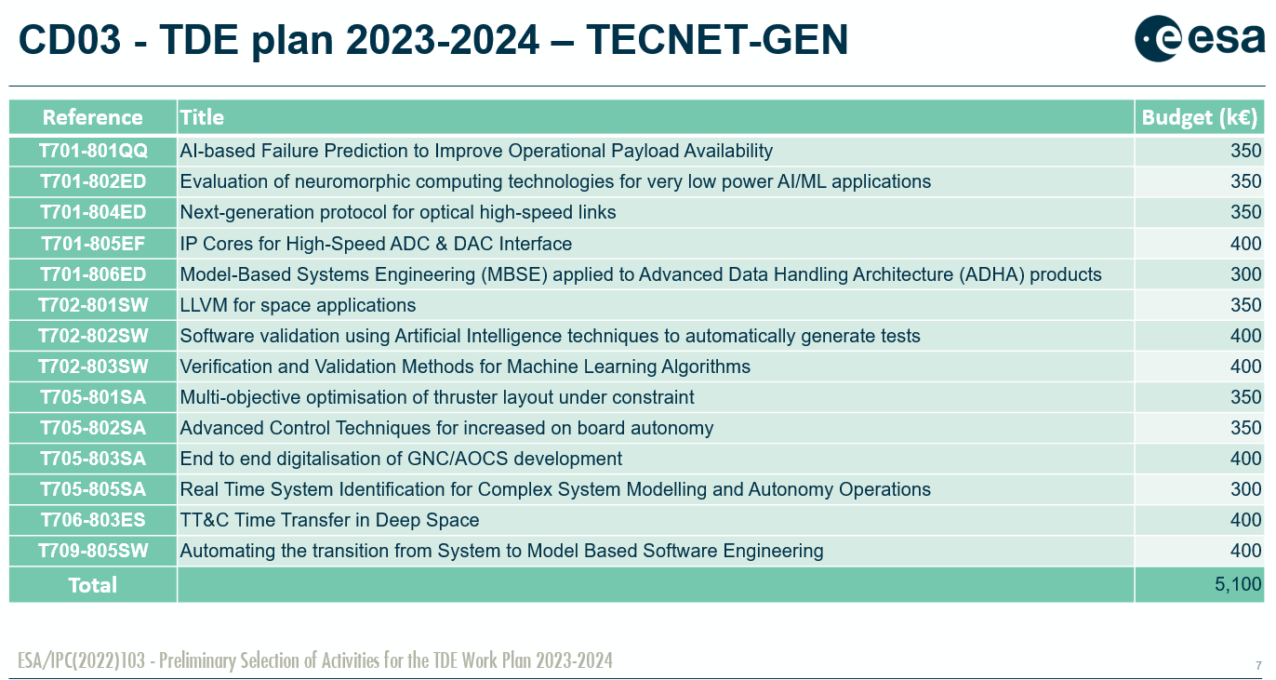
AI/ML in CD3 TDE plan

Slide 3
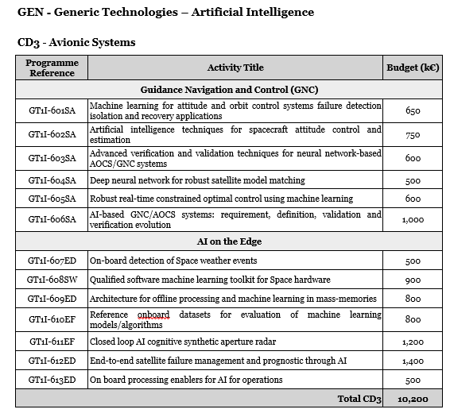
AI/ML in GSTP - AI Compendium (draft)
. Key concepts to explore
. Capacity to specify AI-based GNC functions
. Capacity to define verification metrics (math. formal) for AI-based GNC system
. Capacity to perform risk analysis of AI-based GNC system and contribution to overall system/mission risk/safety
. Capacity to assess (stochastic) performance of AI-based GNC system
. Capacity to define, develop and validate the calibration / testing models and scenarios for the typical GNC system V&V facilities : simulation campaign, avionics bench test, satellite (system) test
. Adequate evolution of simulation means (computing capacity)
.

Slide 4

Thank you for your attention, any questions ?

