Slide 1
SpOC: Delivery Scheduling
Pablo Gómez¹, Dario Izzo¹, Marcus Märtens¹, Emmanuel Blazquez¹, Alexander Hadjiivanov¹
¹ Advanced Concepts Team, TEC-SF, European Space Agency

Slide 2
Problem setup
In the distant 33rd century…
Insufficient material for a colony.
…but people are travelling towards Trappist-1!
A time-critical operation
Asteroids are sent to processing stations
Maximum mission duration: 80 days
Optimise the material at all 12 stations
A lot of inspiration drawn from GTOC 11

Slide 3
Problem setup
Chromosome
1044 dimensions
12 tuples of initial and final operation windows for each station
340 3-tuples containing an asteroid ID, a station ID and an opportunity ID
A 3-tuple uniquely defines an opportunity for an asteroid to visit a certain station
All asteroids have to appear in the chromosome
Station 0 means unassigned asteroid
80 days to complete all stations
1 day minimum gap between station operation windows
T¹_{i} | T¹_{f} | T²_{i} | T²_{f} | … | AstID¹ | StatID¹ | OppID¹ | … | AstID³⁴⁰ | StatID³⁴⁰ | OppID³⁴⁰
24
1020

Slide 4
Objective
Multiple constraints
12 stations
340 candidate asteroids
3 materials
80 days
Minimax problem: maximise the minimum mass
Stations are populated sequentially
But it is OK for stations to be out of order
AI artist’s impression of a processing station

Slide 5
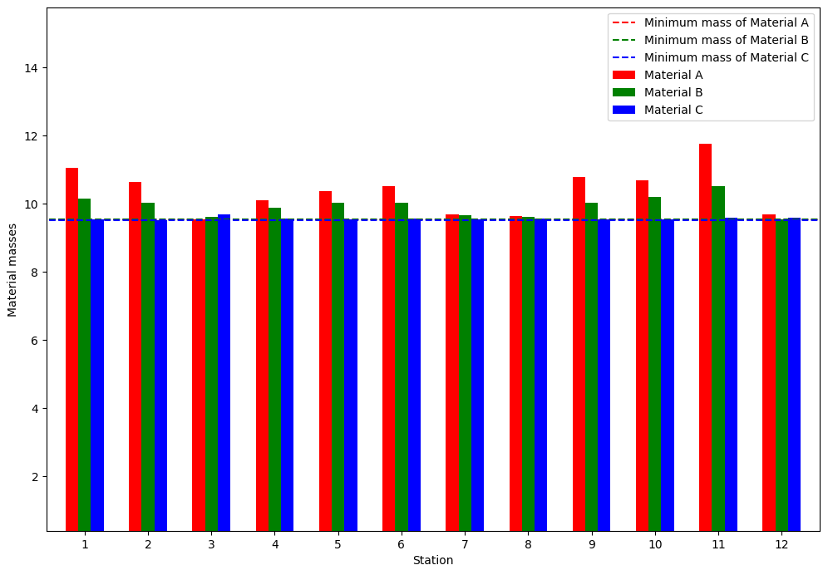
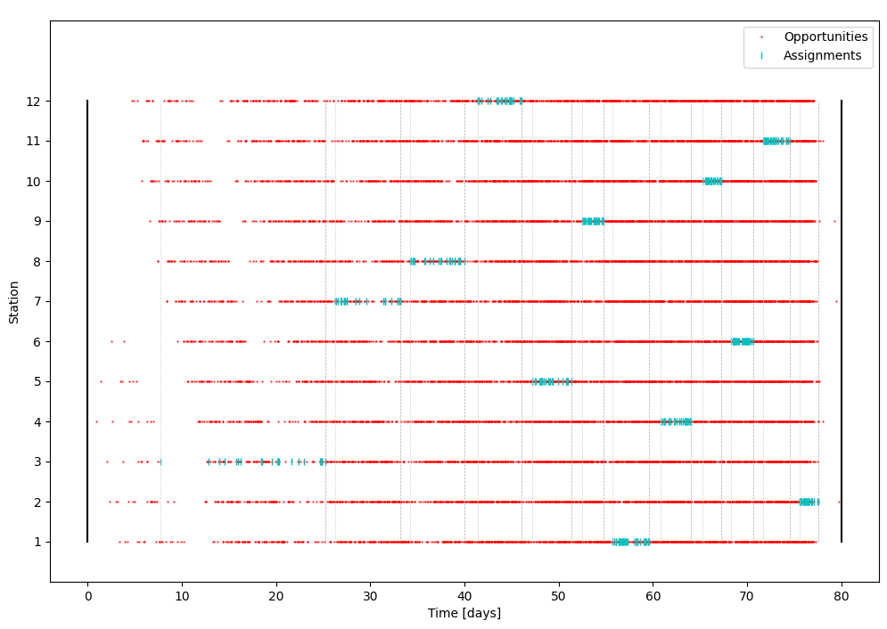
Presenters
IIIA-CSIC (-9.52)
Albert López I Serrano, Christian Blum, Guillem Rodríguez I Corominas, Mehmet Anil Akbay, Roberto Maria Rosati

Slide 6
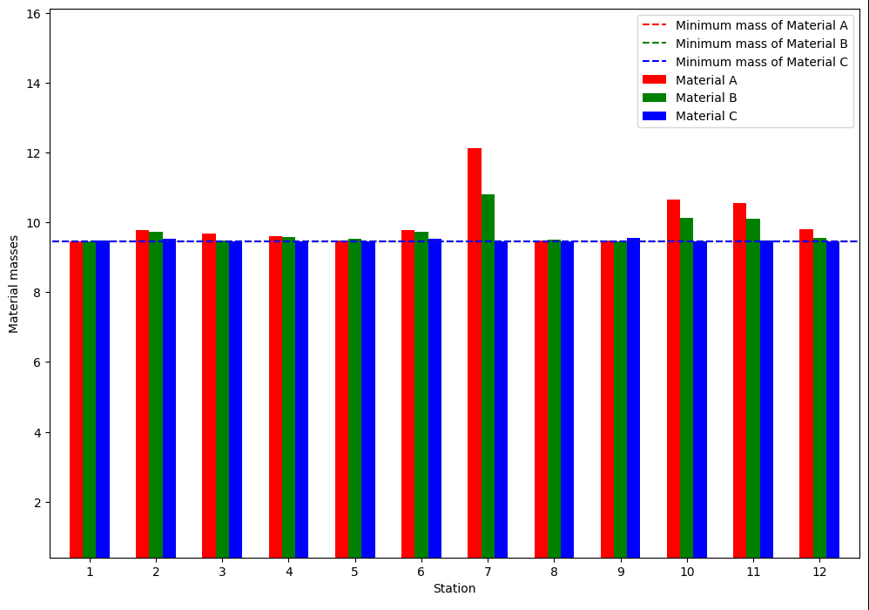
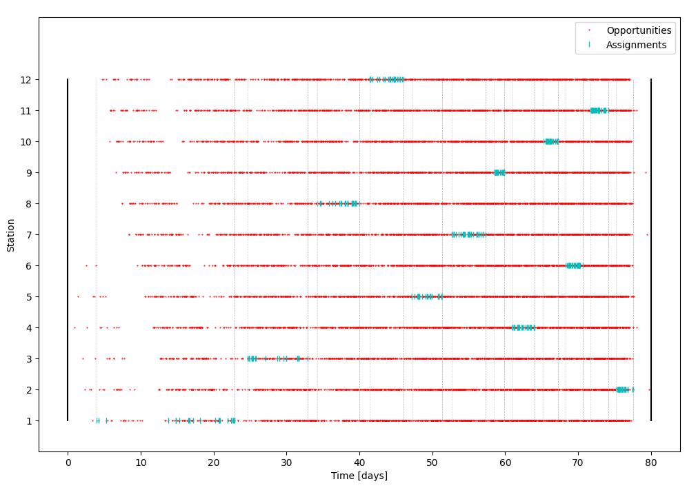
Presenters
CS Group (-9.446)
Sébastien Goulet, Vincent Debout

Slide 7
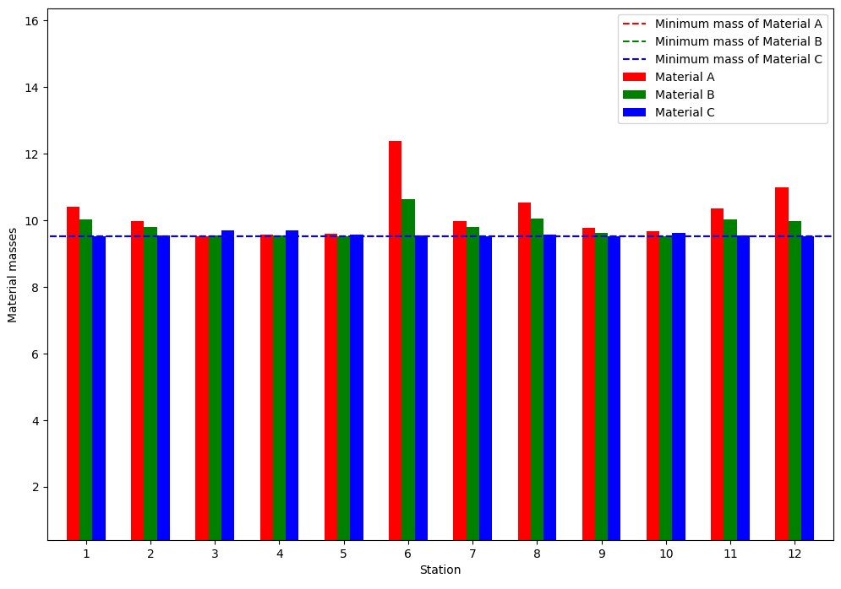
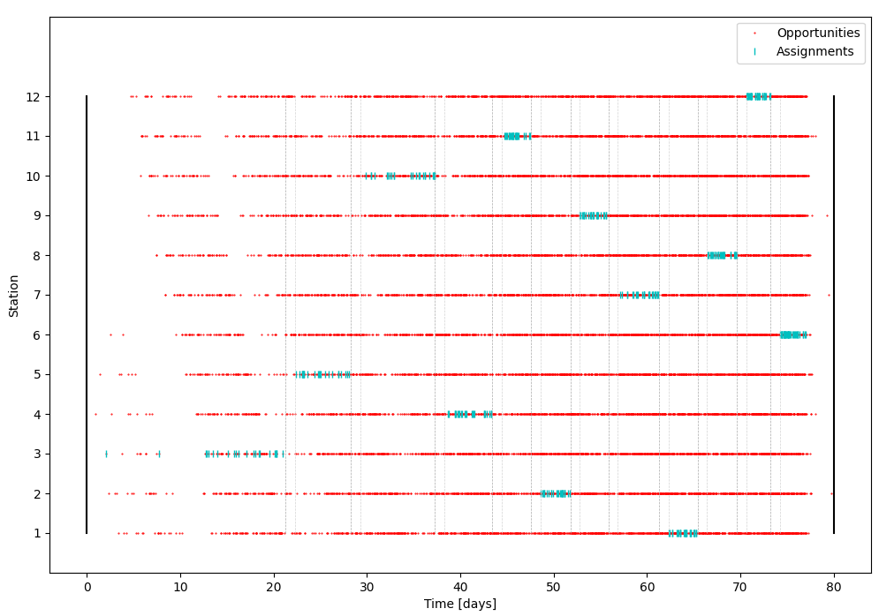
Presenters
Honda Research Institute Europe (-9.514)
Felix Lanfermann, Nils Einecke, Steffen Limmer

Slide 8
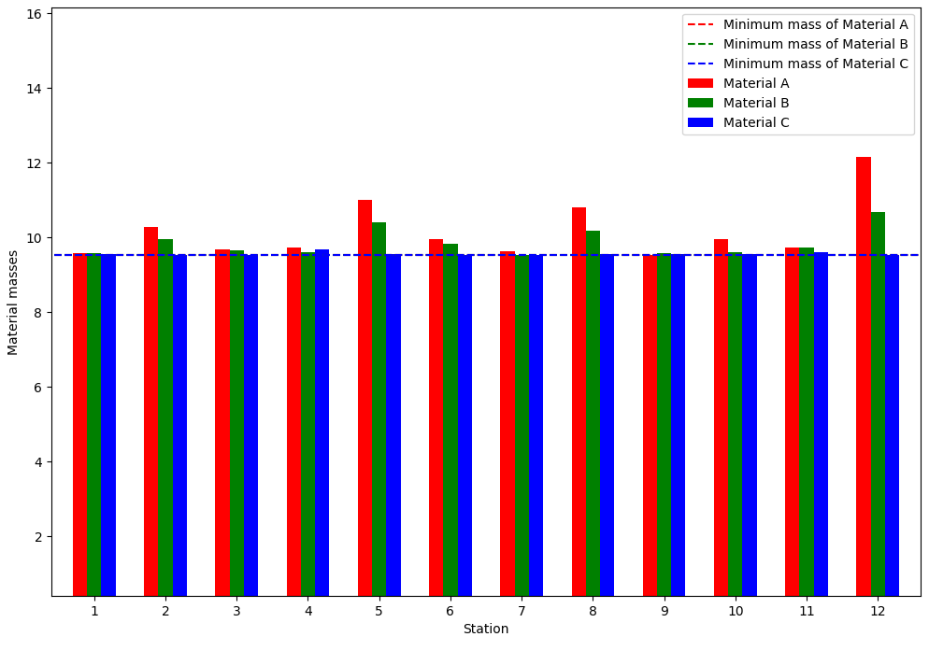
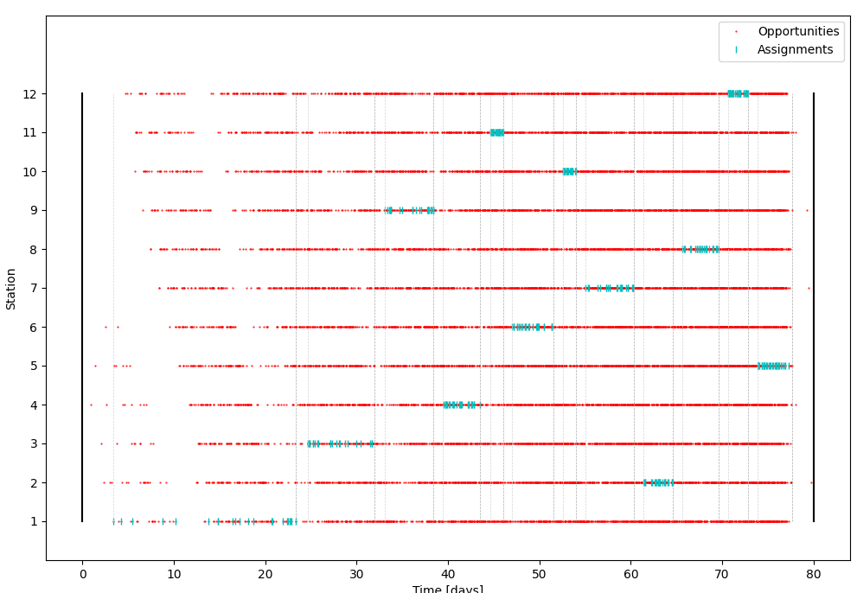
Presenters
Bielefeld University (-9.522)
Michael Römer, Kevin Tierney, Paulina Heine, Gereon Kuiter

