Slide 1
Model-based Avionics
SAVOIR CubeSats Workshop
24 October 2022
David Peña Hidalgo
TEC-SW
Notes:
Additional Notes

Slide 2
SAVOIR CubeSats Workshop: model-based avionics
MBSE objectives
Model-Based Avionics for preliminary definition: MBA ETD
Model-Based Avionics for detailed definition, production, validation & verification: PLATO model
Conclusions & Roadmap
Notes:
Additional Notes

Slide 3
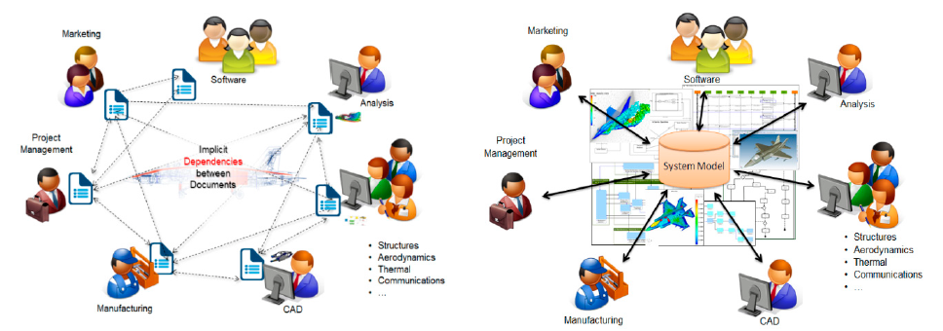
SAVOIR CubeSats Workshop: model-based avionics
MBSE: objectives
Model: abstract representation of a reality (existing or to be created)
Model-Based System Engineering builds a system using models to describe all the system components and the relations between them in a hierarchical manner. Information usually included in documents is maintained in a model repository, then allowing processing by software tools.
Model-based system engineering supports requirement management, analysis, design, verification&validation enhacing consistency and traceability
“ESA projects are characterised by heavy engineering efforts from geographically dispersed teams in ESA and industry. Digital continuity throughout the life cycle of projects allows the substantial reduction of cost and errors, and will shorten schedules.”
ESA Agenda 2025
Notes:
Additional Notes

Slide 4
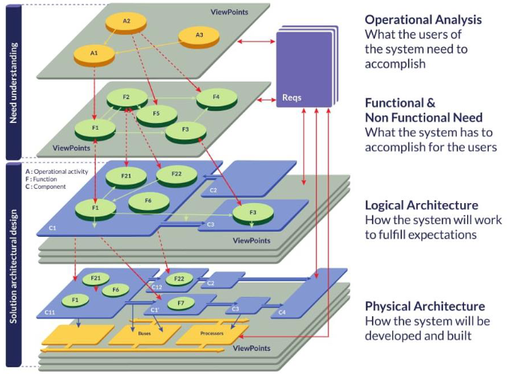
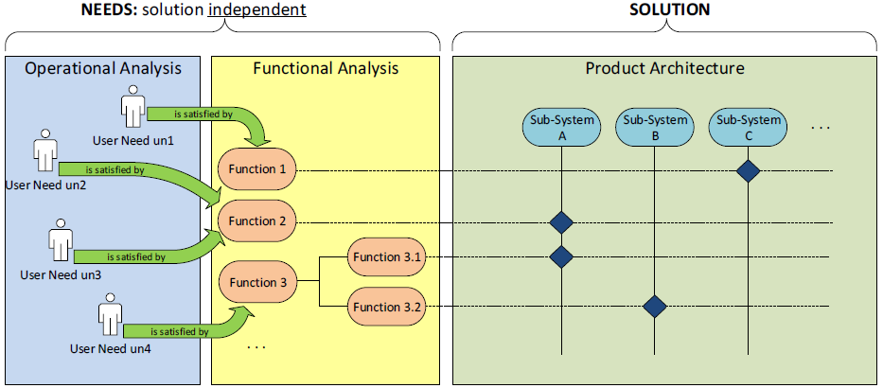


SAVOIR CubeSats Workshop: model-based avionics
MBA ETD: avionics model from a functional chain viewpoint
Revisit avionics architecture from a functional point of view instead of physical (blocks/units) as it was historically done
Driven by the fact that technology pushes towards integration of functionalities
Arcadia/Capella: notion of functional chains
ARCADIA/CAPELLA
Notes:
Additional Notes

Slide 5
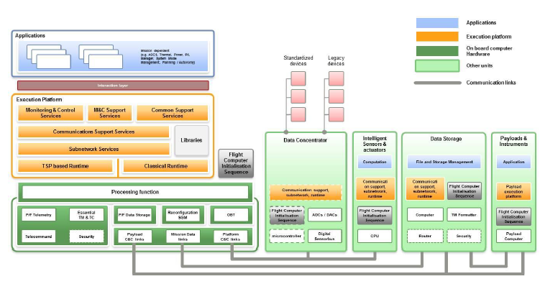
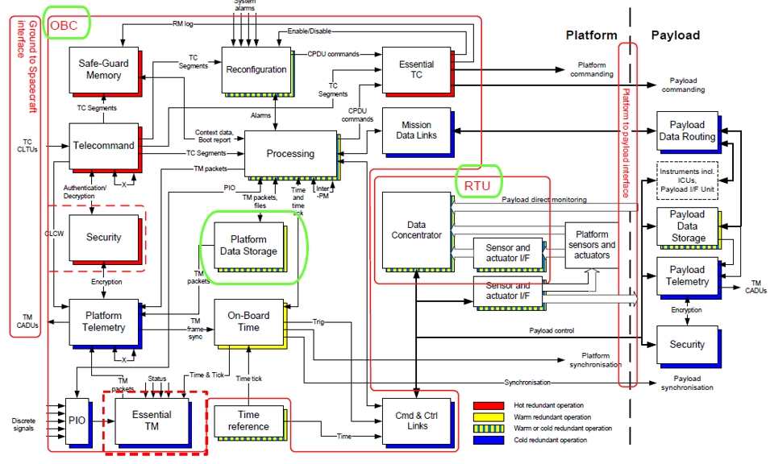
SAVOIR CubeSats Workshop: model-based avionics
MBA ETD: avionics model from a functional chain viewpoint
SAVOIR-TN-001:
Functional Reference Architecture
SAVOIR Functional Reference Architecture as a basis
Map SAVOIR requirements into the different elements of the model: logical functions & functional exchanges
SAVOIR-GS-001: Generic OBC Func Spec
SAVOIR-GS-003: RTU Func & Ops Reqs
Focus on processing functions
Notes:
Additional Notes

Slide 6
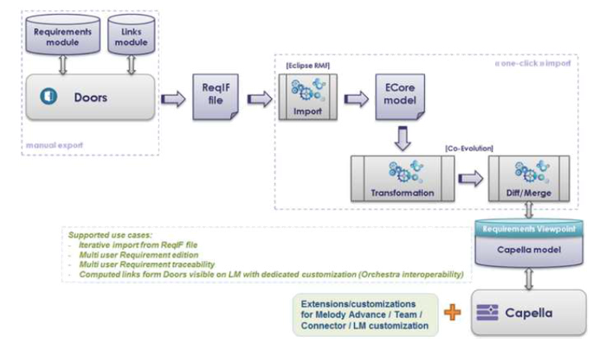
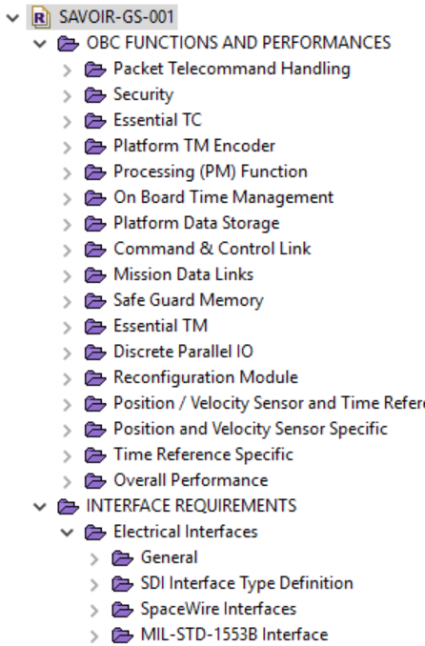
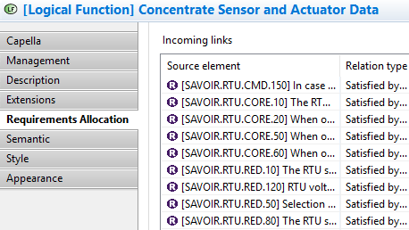
SAVOIR CubeSats Workshop: model-based avionics
MBA ETD: requirement management
Requirements from SAVOIR OBC & RTU Specs imported in the model and allocated to functions (Logical Layer)
Analysis of requirements 1 by 1 and mapping into a logical functions
Traceability of Requirements to
Logical Functions
Notes:
Additional Notes

Slide 7
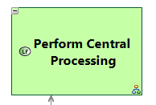
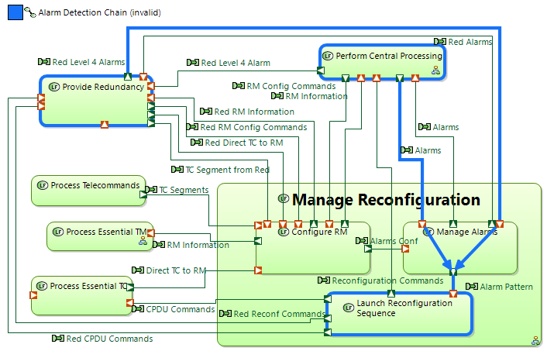
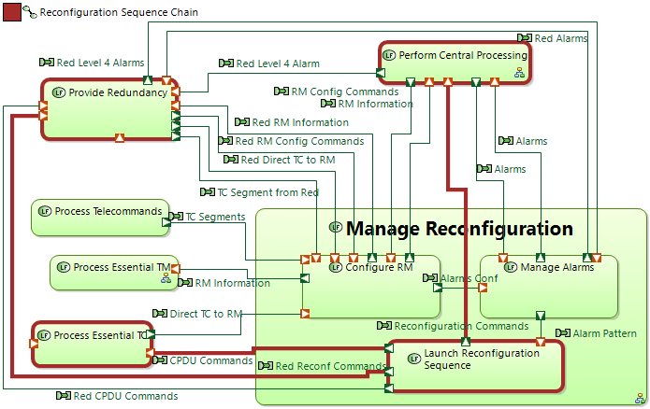
SAVOIR CubeSats Workshop: model-based avionics
MBA ETD: logical modelling
  Modelling at Logical Layer, hierarchically
  Functional Chains: one for each Avionics function
  Examples:
Alarm Detection
Reconfiguration Sequence
Notes:
Additional Notes

Slide 8


SAVOIR CubeSats Workshop: model-based avionics
MBA ETD: from logical to physical modelling
Transition from Logical Functions to Physical Functions
Modelling at Physical Layer:
    1) Logical Functions deployed into Physical Functions
    2) usage of Replicable Elements Collection [REC] (Capella concept)
    3) allocate Physical Functions to Physical Nodes
Example: TC Decoder LF deployed into 2 different PNs
Notes:
Additional Notes

Slide 9
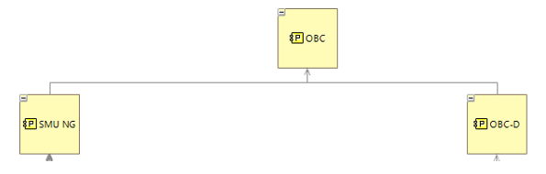
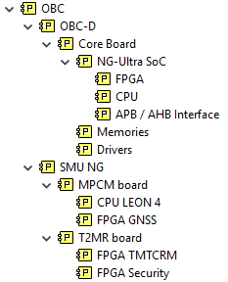
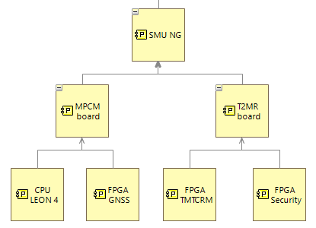
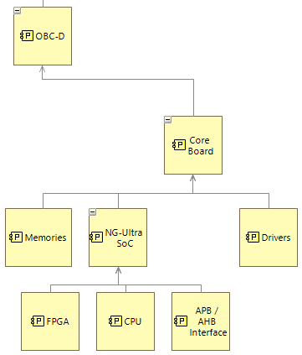
SAVOIR CubeSats Workshop: model-based avionics
MBA ETD: physical modelling
Allocation of Physical Functions to Physical Nodes
Physical Nodes: 2 different products from the same Logical Model, same Behavioral components
Processor + FPGA
SoC based computer
Notes:
Additional Notes

Slide 10
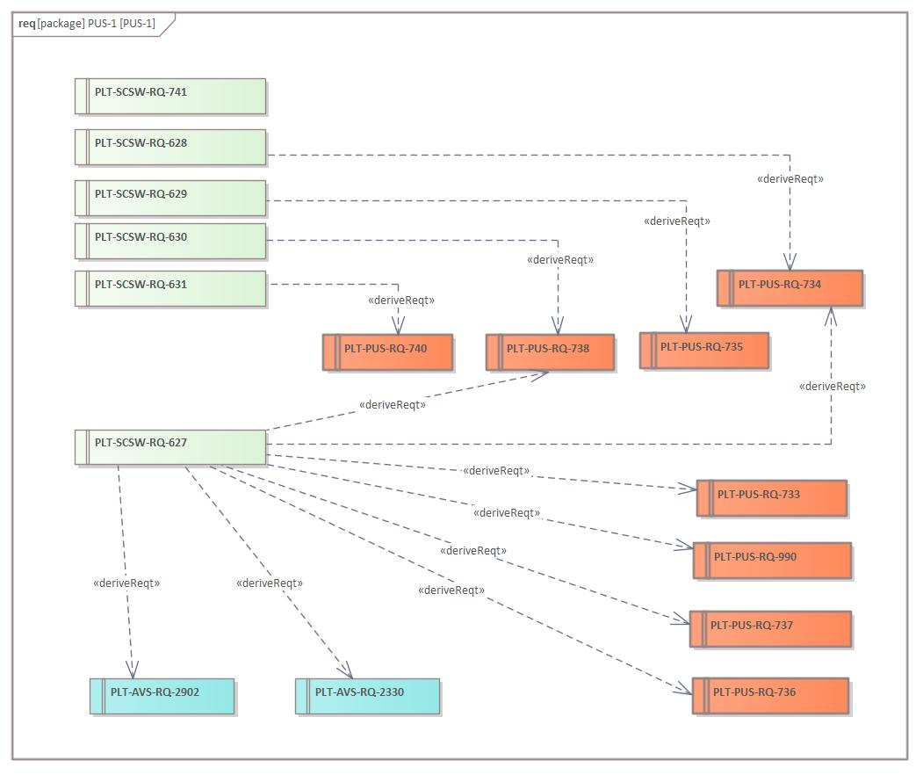
SAVOIR CubeSats Workshop: model-based avionics
PLATO model:
  Enterprise Architect as tool
  SysML as language
  ESA SysML Profile/Toolbox for EA
  Requirement management:
  Import: from docs to excel > from excel to EA model
  Requirements are objects:
    Definition of attributes
    Definition of relations
    automatic verification checks
  Export to documentation
Notes:
Additional Notes

Slide 11
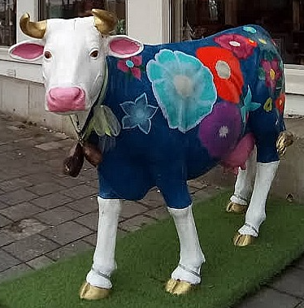
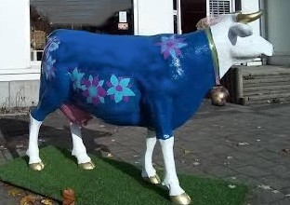
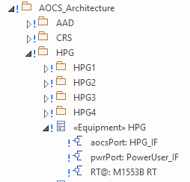
SAVOIR CubeSats Workshop: model-based avionics
PLATO model: one model, several views!!!
  Different perspectives/views of the same element
  Single Source of Truth (SSOT): improve consistency between data from different technical disciplines
I’M BETTY !
I’M BETTY !
Units as instantiations of Equipment
Notes:
Additional Notes

Slide 12
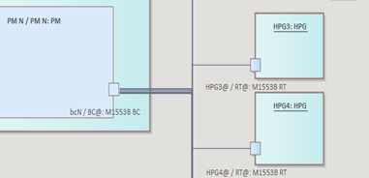
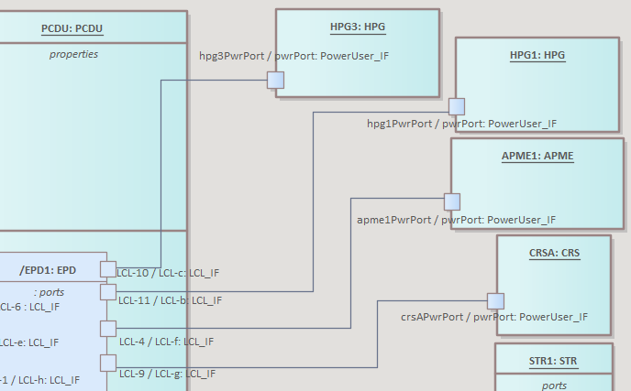
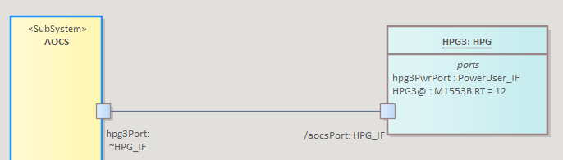
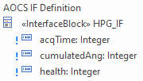

SAVOIR CubeSats Workshop: model-based avionics
PLATO model: SysML [IBD] diagrams to maintain avionics architecture
Communications (1553 Data Bus)
Power Bus
(LCL allocation from Spacecraft Electrical ICD)
AOCS Interface (IRD/IDS)
Generation of machine readable IFs from diagrams
Notes:
Additional Notes

Slide 13
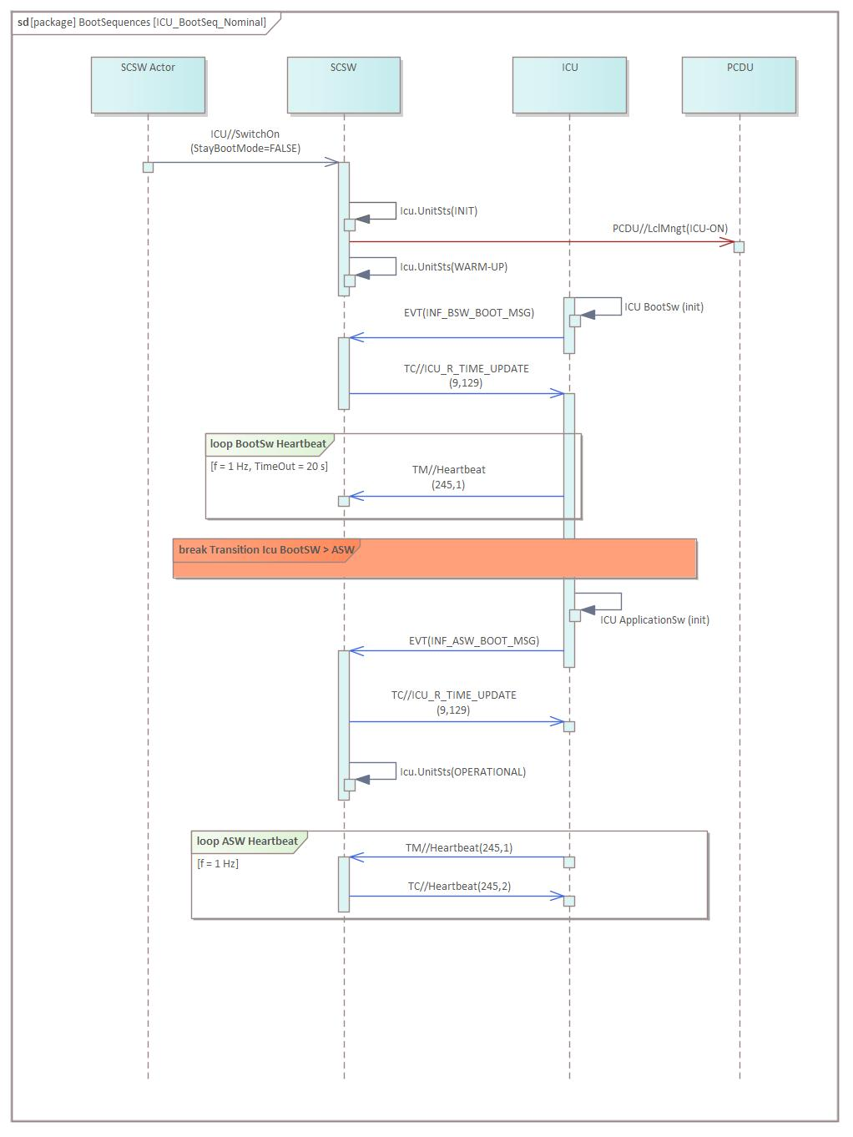
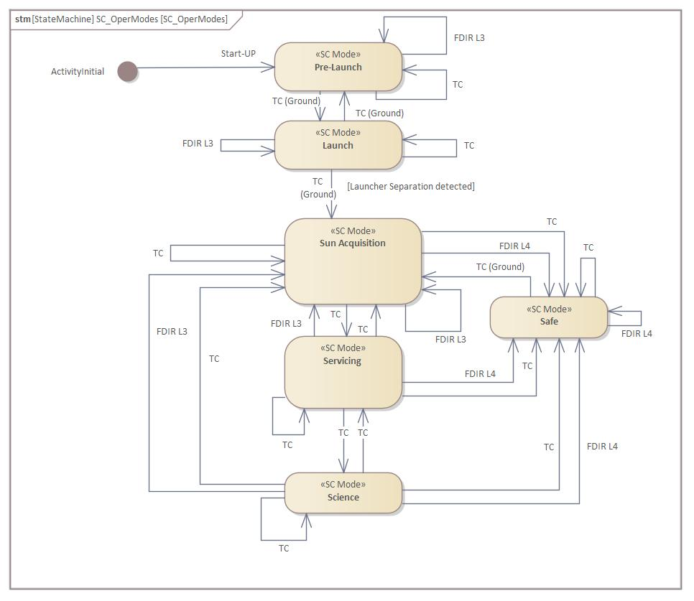
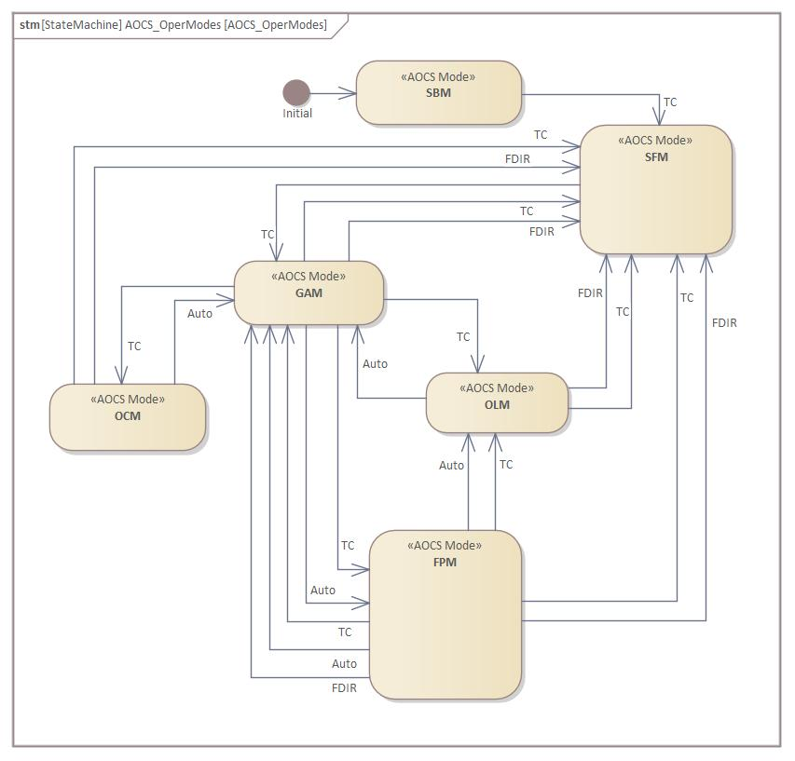
SAVOIR CubeSats Workshop: model-based avionics
PLATO model: SysML diagrams to support co-engineering
  SequenceDiagram for payload handshakes
  State Diagrams for Spacecraft Operational Modes and AOCS modes
Notes:
Additional Notes

Slide 14

SAVOIR CubeSats Workshop: model-based avionics
Conclusions & Roadmap
Functional requirements traced to Logical Functions improves specification maintainability
Logical layer deployed in +1 physical layers to support design trade-offs at early phases
MBSE put into practice in a real use case under development (PLATO) among other ESA projects
Concepts applicable to CubeSat development (short) life cycle from concept definition to integration and testing
Learning curve on methodology, tool, language & data model but… Return on Investment!
Notes:
Additional Notes

Slide 15
Questions?
SAVOIR CubeSats Workshop: model-based avionics
Notes:
Additional Notes

