Slide 1
Towards standardisation of an execution platform
Towards standardization of an execution platform (CoRA)
SAVOIR Cubesat workshop
Christophe Honvault
ESA ESTEC
24/10/2022

Slide 2
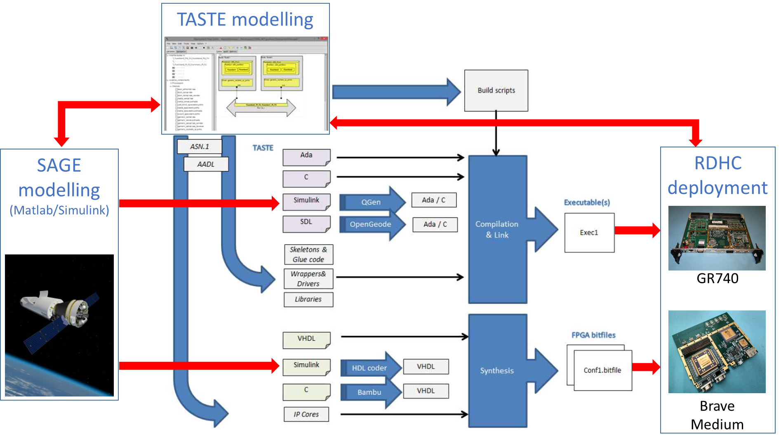
Overview of the development flow
System modelling
(Capella, SysML)
Project
SRD
SAVOIR
IRD
Smart AOCS&GNC Elements
Model-Based Avionics Design
Reconfigurable Data Handling Computer
OSRA SW modelling
SAVOIR
ASRA
SAVOIR
OSRA
GOIRD
OBC
DSSRD

Slide 3
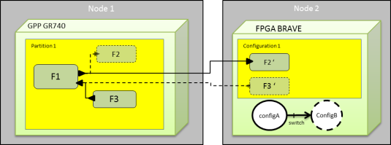
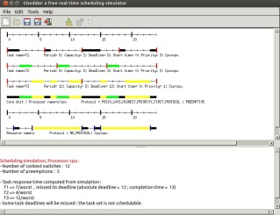
CoRA MBAD insight
Allows to define FPGA configurations IDs
Open Source Tool
Allows to define HW architecture (CPU, FPGA, communication drivers, …) and perform Function allocation
Commercial Tool
MBAD SYSTEM
Items made available
It can be used as a VHDL editor
TASTE VM
TASTE data View
VIVADO HLS
Matlab Simulink
Open
Geode
TASTE Interface View
Embedded Coder
TASTE Concurrency View
TASTE Deployment View
C
Analysis tools
Legacy
Bambu
CHEDDAR
TASTE Building scripts
VHDL
FPGA bitfile(s)
NanoXmap
NanoXpython
FPGA bitfile(s)
IP cores
SW binary image

Slide 4
Execution platform software
On-Board Software Reference Architecture (OSRA)
On-Board Software Reference Architecture for Payloads (OSRA-P)
Payload Execution Platform Software (PEPS)
And maybe soon (GSTP Compendium 2022):
Model-based execution platform for space applications: The activity is aiming at developing a modelling environment targeting the automatic generation of the execution platform of payloads and platforms.

Slide 5
Execution Platform
MicroPython
Mathematical Library
libPUS (Cmd/Ctrl)
SAVOIR FMS
RTEMS
XtratuM
FreeRTOS
Linux

Slide 6
CoRA MBAD family
CoRA RDHC
ZynQ 7000
BRAVE Large
ZynQ Ultrascale+
GR740
4 x Leon4
2 x ARM A9
ARM R5
2 x ARM R5
+ 4 ARM A53
SW
MBAD
SpW
Hard Bus
Soft Bus
Hard Bus
BRAVE
medium
Xilinx FPGA
Large FPGA
Ultra FPGA
HW

