Slide 1
Microchip Radiation Tolerant FPGAs
Tim Morin
March 15, 2023

Slide 2
Agenda
Quick Product Update
  RT PolarFire® FPGA
  RTG4™ FPGA
Microchip and RISC-V – The Road Less Traveled

Slide 3
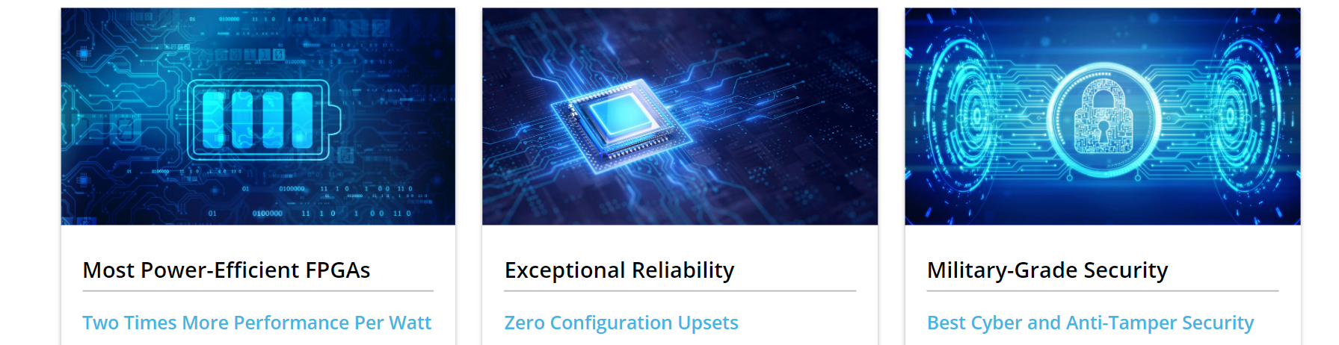
Microchip FPGA Vision and Differentiation
To enable innovation by offering the
most power-efficient programmable solutions
2x
Power Efficiency
Exceptional Reliability
Zero Configuration Upsets
Military-Grade Security
Best Anti-Tamper and Cybersecurity

Slide 4
RT FPGA Families
Logic Density
3X to 6X
More Resources
RT PolarFire®
481 KLE (Not TMR)
33 Mbits SRAM
1,480 Multipliers
24 x 12.7 Gb/sec Serdes
RTG4™
150 KLE (TMR)
5 Mbits SRAM
462 Multipliers
24 x 3.125 Gb/sec Serdes
RTAX™ / RTAX-DSP
RT ProASIC®3
50% Faster
RTSX-SU
Performance

Slide 5
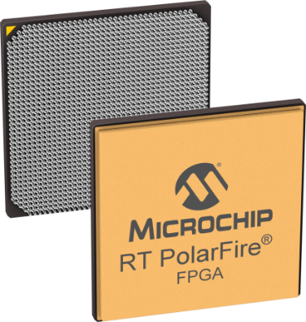
RT PolarFire® FPGA Overview
Two versions
  RTPF500T
  RTPF500ZT
Both derived from commercial PolarFire
  28 nm SONOS: Non-volatile and reprogrammable
  Hermetically sealed, ceramic column grid array package
    1509 solder columns (Six Sigma copper spiral columns)
  Robust TID, 100 krad
  No configuration upsets
    LET 80 MeV-cm²/mg, fluence more than 5E⁸ ions/cm²
  SEFI in reset circuit
    1 in 187 years, in GEO solar min
RTPF500ZT has enhanced capabilities
  Better SEL GPIO Performance
  Better on-orbit programming methodology

Slide 6
RTPF500T Status
Qualification and availability schedule
  Engineering models, PolarFire dev kit – Available NOW
  RT PolarFire dev kit with RTPF500T – Expected May 2023
  MIL-STD-883B qualification for RTPF500T completed
    B-flow and E-flow flight models available to lead times

Slide 7
RTPF500T/RTPF500ZT Radiation Summary
Fabric Flops / LSRAM
SEU in flip-flops report
SEU | Errors /bit-day, Geo Solar Min
 | Fabric Flip Flops | Fabric LSRAM
Unprotected | ~ 1e⁻⁷ | ~ 5e⁻⁸
Protected (TMR/EDAC) | ~ 1e⁻¹¹ | ~ 5e⁻¹⁵
Flip Flops : TMR with constrained placement
LSRAM : EDAC (SECDED)

Slide 8
RTPF500T/RTPF500ZT Radiation Summary
GPIO SEL
GPIO V_{DDI} | GPIO V_{DDAUX} | RTPF500T SEL LET_{TH} (MeV.cm²/mg) | RTPF500ZT SEL LET_{TH} (MeV.cm²/mg)
3.3V +3%/-5% | 3.3V +3%/-5% | 25* | 37**
2.5V +3%/-5% | 2.5V +3%/-5% | 58 | 80
1.8V ±5% | 2.5V +3%/-5% | 58*** | 80****
Notes: * Destructive SEL observed in RTPF500T 3.3V at LET > 25 MeV.cm²/mg ** Destructive SEL observed in RTPF500ZT 3.3V at LET 68 MeV.cm²/mg *** Tested MPFS250T and saw SEL at LET=66, but since the LET_{th}=58 at 2.625V, LET_{th} should be equal or better at 1.89V **** Not tested, but since we meet LET=80 at 2.625V, we should meet LET=80 at 1.89V No other destructive SEL observed unless board decoupling capacitor requirements are not followed. No uSEL observed on (VDD25/VDDA25) on RTPF500ZT
No SEL observed on HSIO

Slide 9
RTPF500T vs RTPF500ZT
 |  | RTPF500T | RTPF500ZT
Part numbers start with |  | RTPF500T, RTPF500TL, RTPF500TS, RTPF500TLS | RTPF500ZT, RTPF500ZTL, RTPF500ZTS, RTPF500ZTLS
Packaging | CG1509, LG1509 | Compatible | Compatible
Availability Qualification | Engineering Models | Now | 1H 2024
 | Mil Std 883 Class B Flight Models | Now | 2H 2024
 | QML Class Q Flight Models | 1H 2023 | 2H 2024
 | QML Class V Flight Models | Not Planned | 2025
System Services | JTAG and SPI-Target In-Flight Programming | Supported | Supported
 | SPI-Initiator In-Flight Programming | Not Supported | Support Planned *
 | System Services on Temporary Exit of System Controller Suspend Mode | Not Supported | Support Planned *
* Pending testing and validation

Slide 10
RTG4™ FPGA

Slide 11
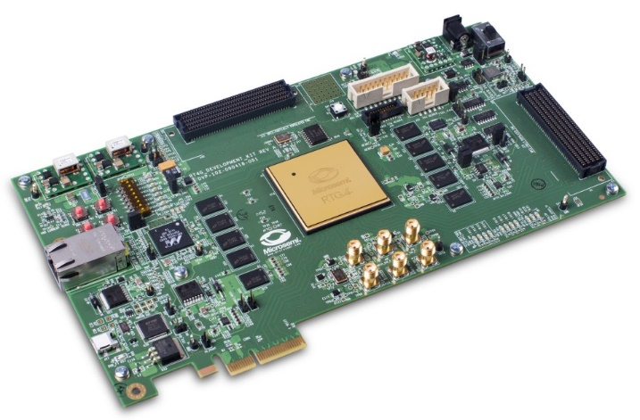
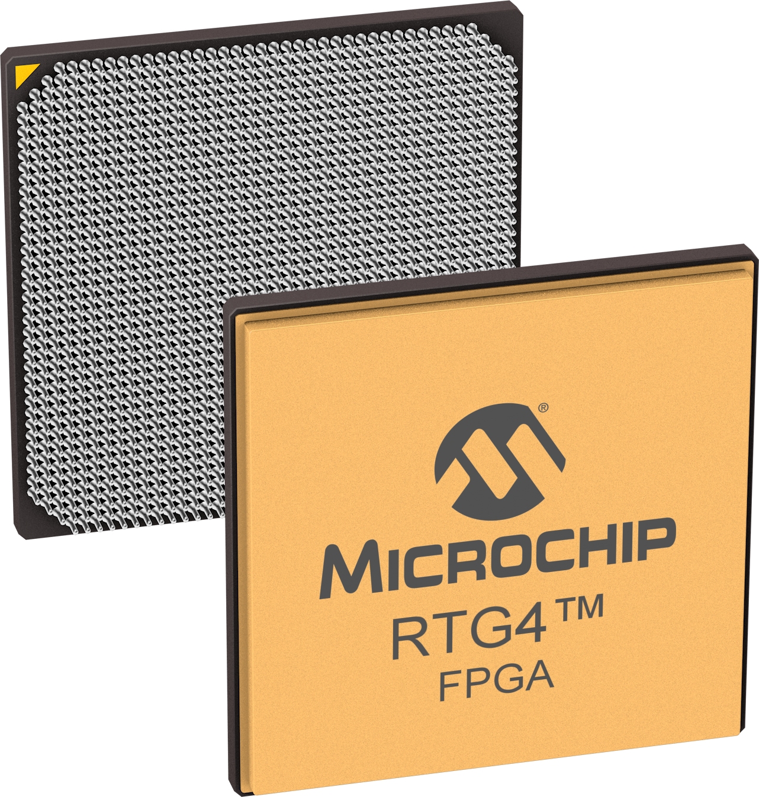
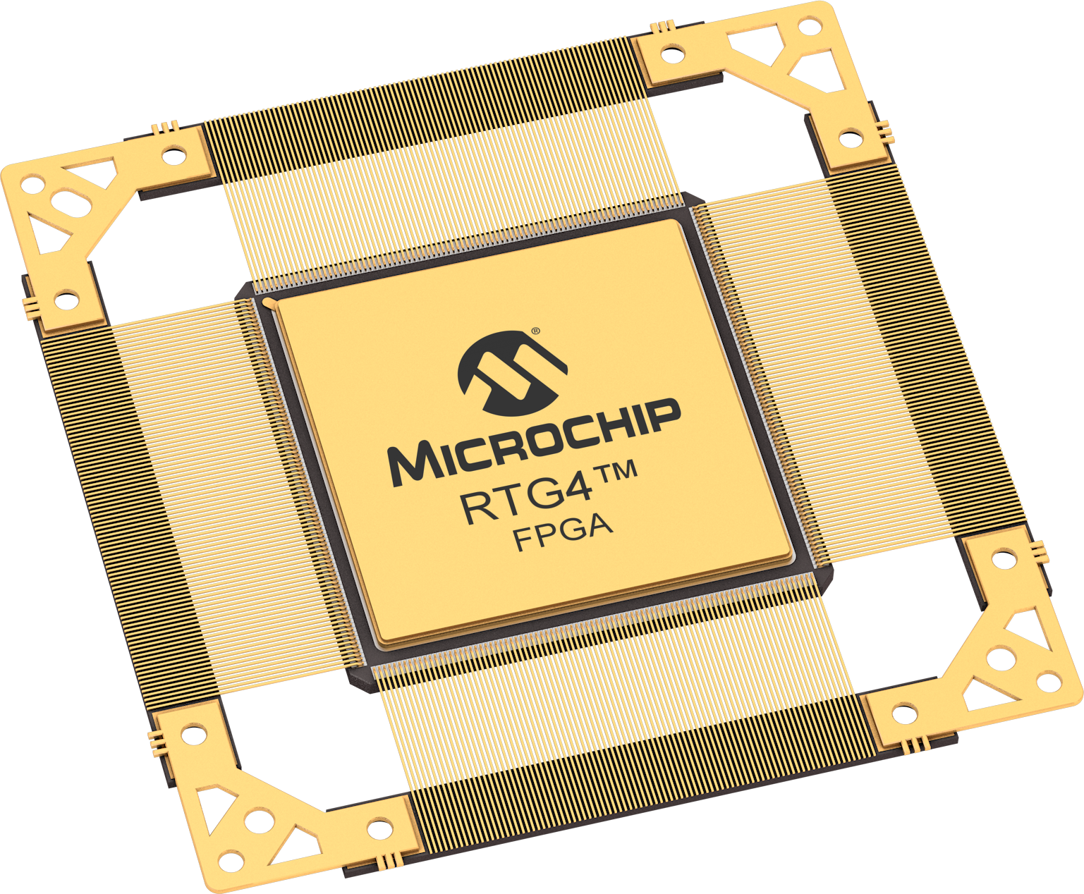
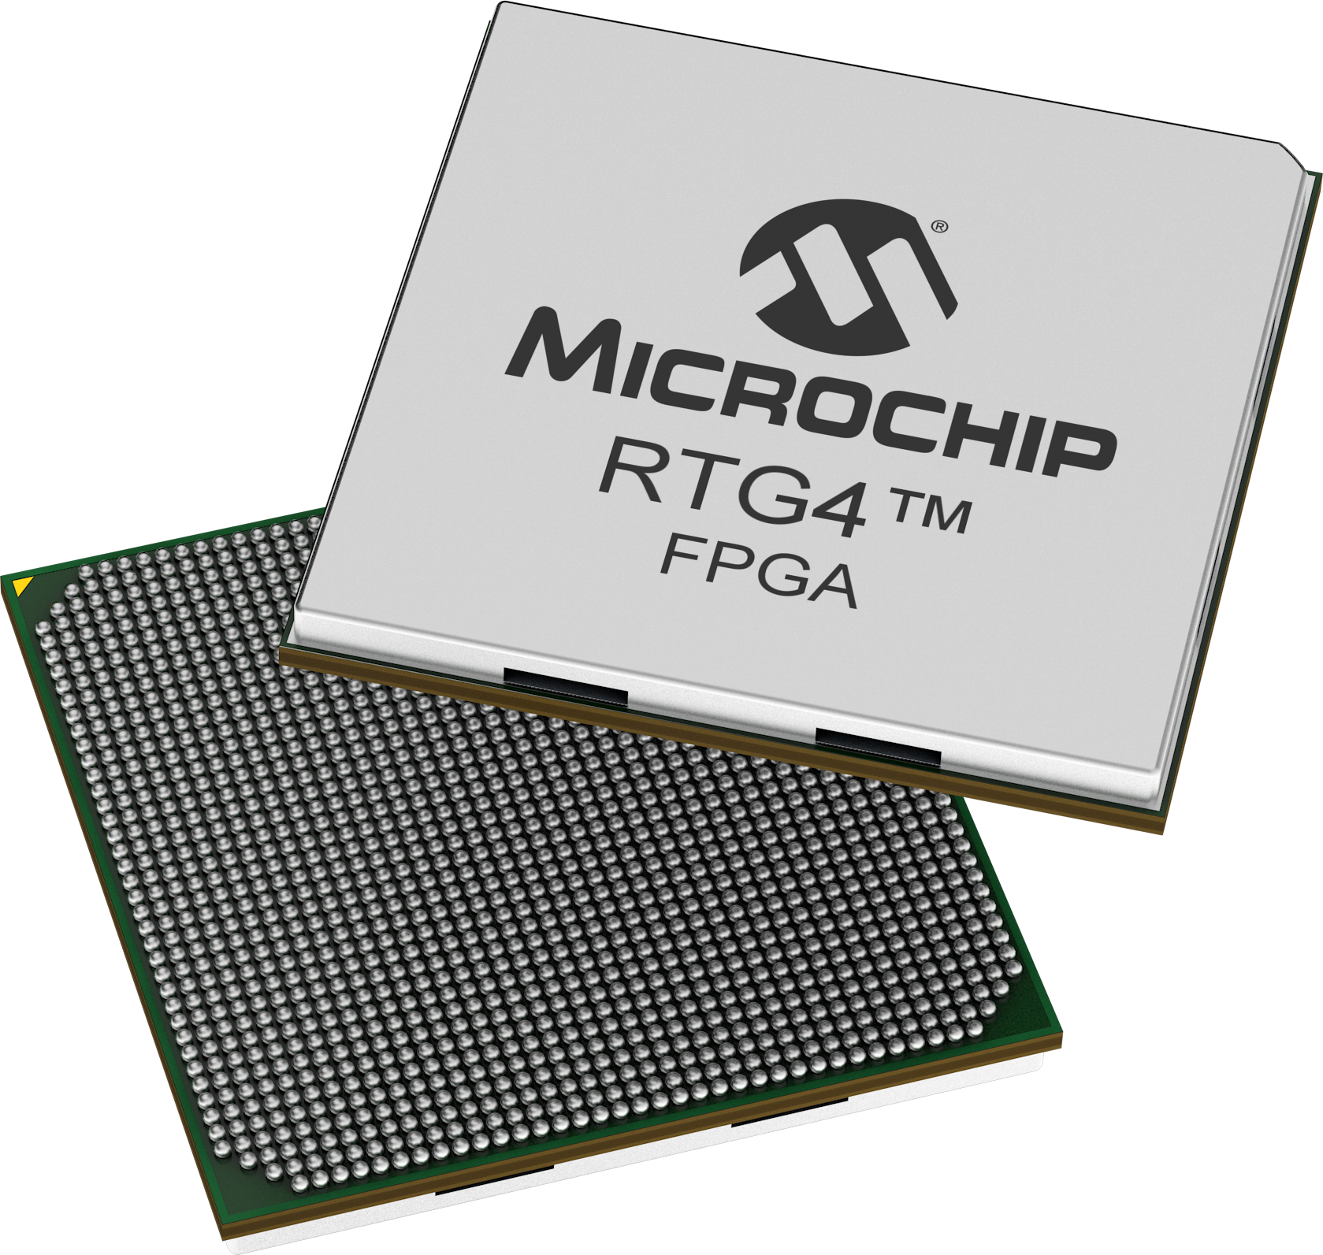
RTG4™ FPGA Qualification and Availability
 | RT4G150- LG1657 | RT4G150- CB1657 | RT4G150- CG1657 | RT4G150- CQ352 | RT4G150- FC1657, FCG1657
Package Type | Ceramic Land Grid 1657 | Ceramic Ball Grid 1657 | Ceramic Column Grid 1657 | Ceramic Quad Flat Pack 352 | Plastic Ball Grid 1657
Development Kit | - | Available Today | Available Today | - | -
Daisy Chain | - | - | Available Today | - | Available Today
Mechanical Sample | - | - | - | Available Today | -
PROTO | Available Today | Available Today | Available Today | Available Today | Available Today
Flight Units – QML Q and V | Available Today SMD Published | - | Available Today SMD Published | Available Today SMD Published | -
Flight Units – Sub-QML | Available Today | - | Available Today | Available Today | Available Today

Slide 12
RTG4™ FPGA Screening Flows
Screening
Flow
Purpose
Package
Qualification
Burn-In
Temp Test
Life Test
DPA
V
NSS, NASA Class1
Hermetic Ceramic
QML-V
Static
-55°C –
Wafer-Lot
Assy Lot
Dynamic
125°C
E
Advanced
Hermetic Ceramic
QML-Q
Static
-55°C –
Generic
Optional
Traditional Space
Dynamic
125°C
Group C
B
Entry Level
Hermetic Ceramic
QML-Q
Dynamic
-55°C –
Generic
None
Traditional Space
125°C
Group C
R
New Space,
Hermetic Ceramic
MIL-STD-883
Dynamic
-55°C –
None
None
Strategic Programs
Class B
125°C
Mil
New Space,
Hermetic Ceramic
MIL-STD-883
None
-55°C –
None
None
Ceramic
Strategic Programs
Class B
125°C
Mil
New Space,
Plastic
JEDEC
None
-55°C –
None
None
Plastic
Strategic Programs
Non-Hermetic
125°C
PROTO
Prototyping
Plastic and
None
None
-55°C –
None
None
Ceramic (Hermeticity
125°C
not guaranteed)

Slide 13
RTG4™ FPGA Flip-chip Bump Change (1)
Background
  Leaded flip-chip bump material was discontinued by Microchip vendor
  Impacting all RTG4 in ceramic packages (CG1657 and CQ352) in all screening flows
    RTG4 in plastic package and RT PolarFire are NOT impacted. They always use lead-free bump
Plans
  Issued RTG4 flip-chip bump customer notification
  Qualifying RTG4 lead-free bump parts
    Mil-Std-883B qualification – expected 2H 2023
    QML-Q qualification – expected 2H 2023
    QML-V qualification – expected 1H 2024
Flip-chip bump inside package

Slide 14
RTG4™ FPGA Flip-chip Bump Change (2)
Customer notification
  Microchip PCN JAON-26GOCS315 released in November 2022
  GIDEP SC7-C-23-0001 acknowledged
Important timelines for leaded-bump RTG4
  Last Time Buy (LTB): April 2023
  Last Time Ship (LTS): April 2024
Replacement parts with lead-free bump
  All standard RT4G150 parts in CG1657 and CQ352 have equivalent replacement lead-free bump part
    Ex: RT4G150-CGG1657B, RT4G150-CQG352B
    G references lead-free flip-chip bump for RTG4 FPGA family
      No change to the Six Sigma columns which have lead content
No design impact when migrating to replacement parts
  No change in board design, reflow profile, board assembly flow or software setting

Slide 15
RTG4™ FPGA Flight Heritage
Mission Extension
Vehicle 1 and 2
Launched
2019, 2020
US National Programs
Launched 2020
CAS-500
Launched 2021
Landsat 9
(NASA)
Launched 2021
Lucy
(NASA)
Launched 2021
AIDA DART
(NASA)
Launched 2021
Artemis-1
(NASA)
Launched 2022
Worldview
Legion
Launch 2023
JUICE
(ESA)
Launch 2023
SLIM
(JAXA)
Launch 2023

Slide 16

RT Update Conclusion
RT PolarFire® FPGAs
  MIL-STD-883B qualification for RTPF500T completed
  RTPF500ZT has improved radiation performance, added system services and a path to QML-V qualification
RTG4™ FPGAs
  Leaded bump last-time-buy is April 2023
  Ongoing lead-free bump qualification, anticipating MIL-STD-883B and QML-Q in 2023
Microchip Space Forum
  Free virtual on-demand presentations available now
Sign up for Microchip Space Brief newsletter to receive quarterly updates

Slide 17
Microchip RISC-V Road Trip or The Road Less Traveled
Tim Morin

Slide 18
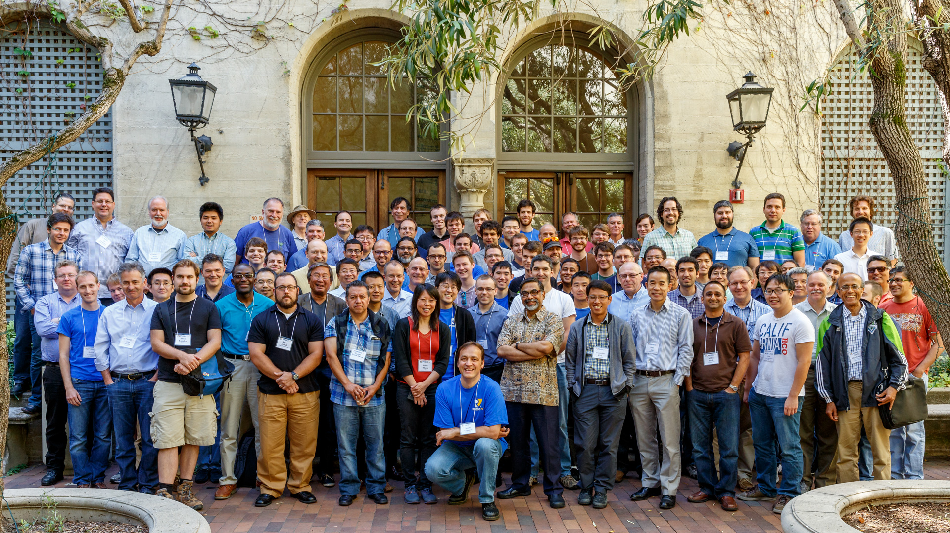
June 2015
2nd RISC-V Workshop
Berkeley California

Slide 19
The Road Trip
The Opportunity
When you come to a fork in the road take it
The Road Trip
The Decision
What's around the corner?

Slide 20

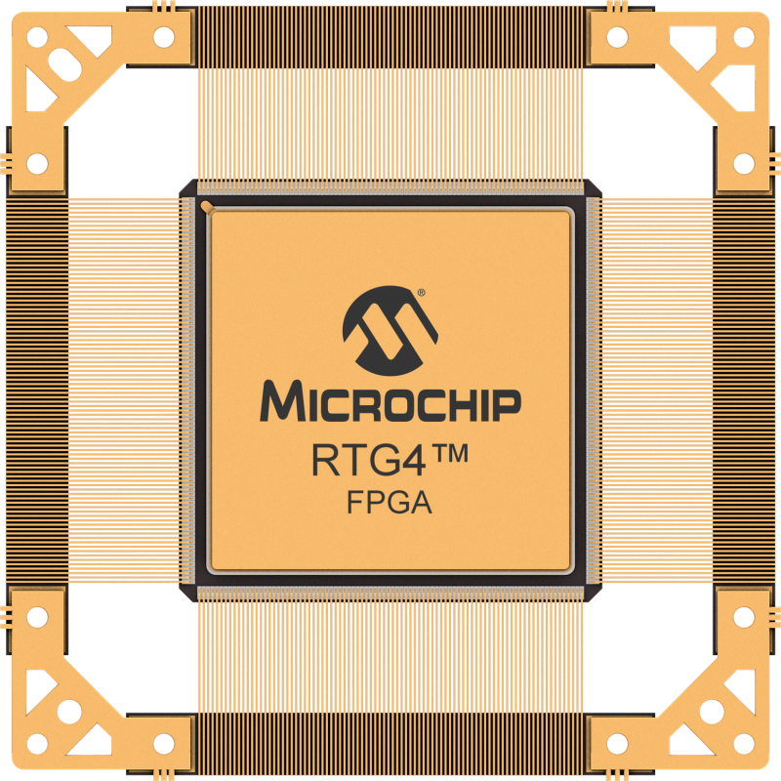
The Opportunity
A&D client building an assembly for a strategic platform
Needs a soft CPU with Cache
What could go wrong?

Slide 21
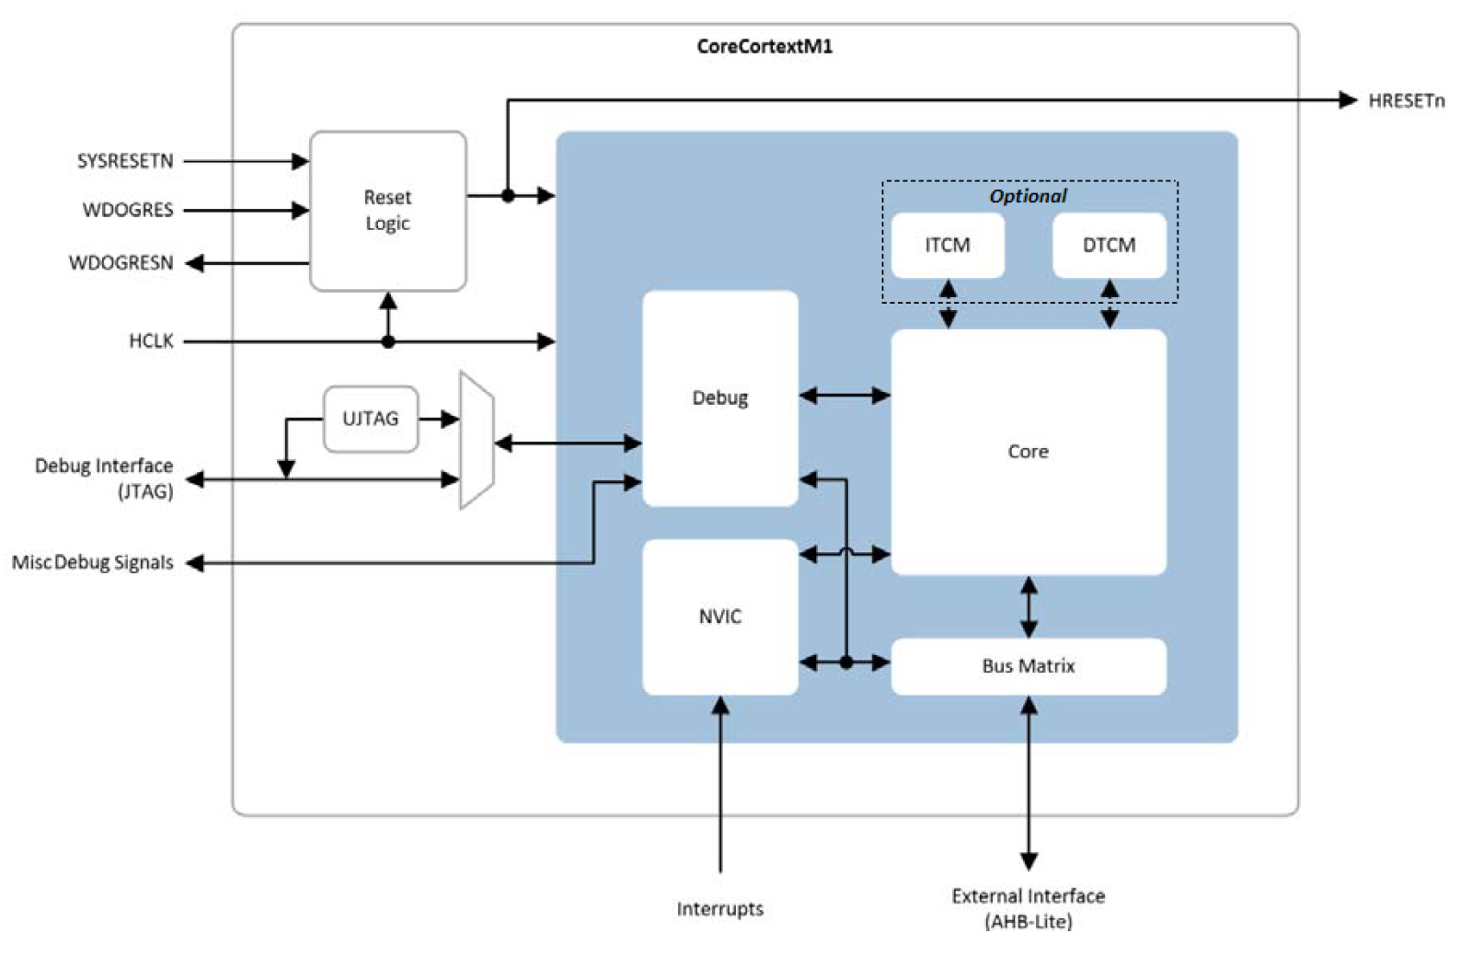
ARM Cortex-M1
Jointly developed between Actel and ARM in 2006
Unfortunately, no Cache

Slide 22
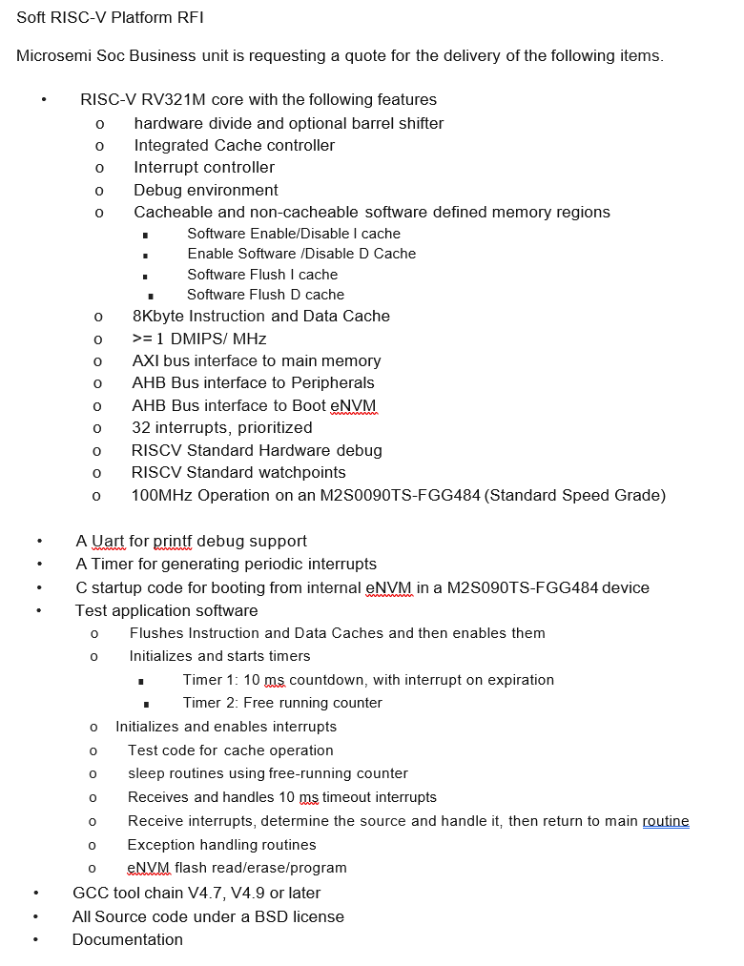

We get into the Soft RISC-V Business
1-page requirements document
$ was exchanged
3 months later the client was up and running with some basic code
RISC-V is about business innovation

Slide 23
Mi-V RISC-V Soft CPUs
RISC-V Soft CPU | MiV_RV32 | Mi-V_RV32IMAF_L1_AHB | Mi-V_RV32IMA_L1_AHB | Mi-V_RV32IMA_L1_AXI
LEs | 4k-10k | 26k | 10k | 10k
Coremark Score | 0.177-2.77 | 2.01 | 2.01 | 2.01
Cache Size | Libero 2023.01 | 8KB I/D | 8KB I/D | 8KB I/D
Tightly Coupled Memory (TCM) | Yes-configurable depth to 256Kb | N/A | N/A | N/A
Compressed | optional | N/A | N/A | N/A
Mul/Div | Optional, MACC, Pipelined-MACC, or 32 cycle fabric (LEs) | Yes | Yes | Yes
Atomics | N/A | Yes | Yes | Yes
Floating Point | Libero 2023.01 | Single Precision | N/A | N/A
Interface(s) | APB3/AHB/AXI | AHB | AHB | AXI
Debug | Optional | Yes | Yes | Yes
SECDED | Optional | Optional | Optional | N/A
Availability | Now | Now | Now | Now

Slide 24
Benchmarks: Soft CPUs

Slide 25
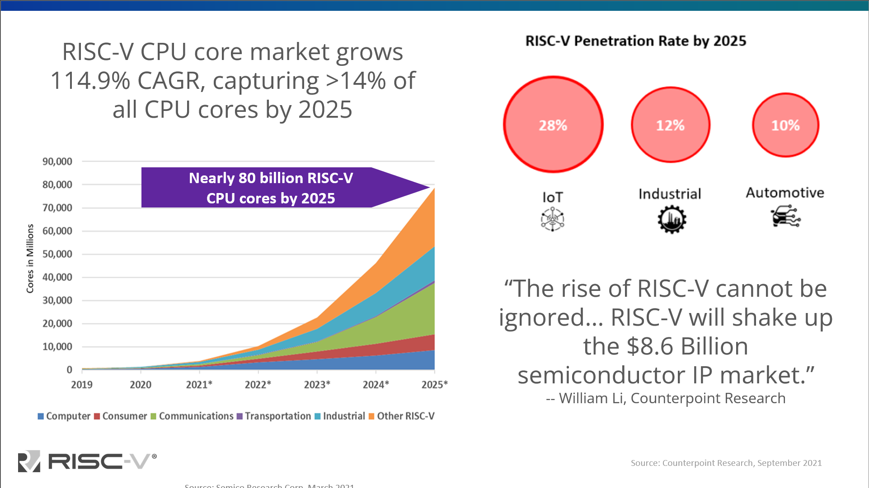
First RISC-V PO
2015

Slide 26


Slide 27
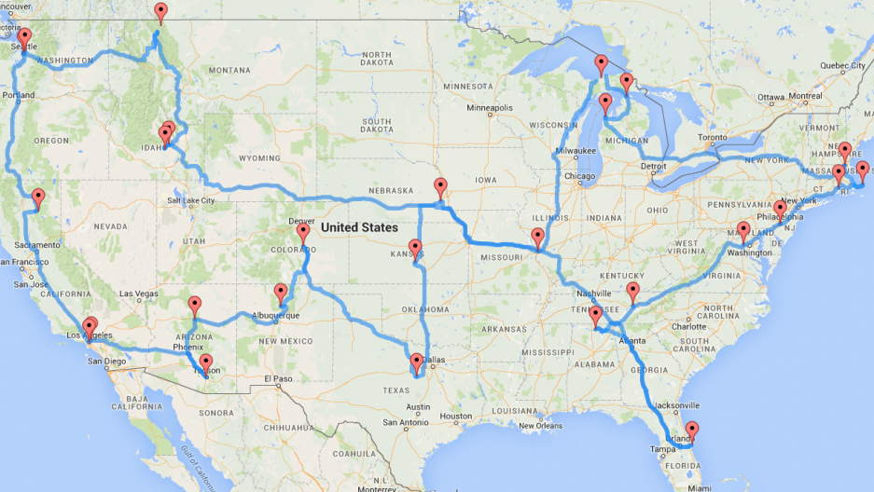
Our next SoC FPGA platform needs to run Linux
ARM or RISC-V?
Marketing : We’re already in the RISC-V business
Management : But the the world is ARM based!
Marketing : Doesn’t matter, OSs exist to abstract the underlying hardware away
Management : Prove it

Slide 28
The Road Trip
Mission : bring back client validation to green light the next project

Slide 29
Have you heard of RISC-V?
But we use ARM!
A new free and open ISA developed at UC Berkeley
  Via a permissible BSD license
ISA designed for
  Simplicity - < 50 instructions required to run Linux
  Longevity – standardized instructions are fixed, your code runs forever
RISC-V foundation setup to
  Protect the ISA
  Foster adoption
RISC-V is not an open-source processor
  Although open-source implementations will exist
  Provides everyone an “architectural” license to innovate
Microchip Confidential and Proprietary

Slide 30
Embedded Linux Adoption
OS (Linux) abstracts the Computer
Abstract Computer
Abstract Implementation
SoC Implementations
CPU
ISA
ARM A53 - ISA
RISCV - ISA
CPU
Micro Architecture
ARM - Arch
RISCV - Arch
IO
ARM A53 - ISA
RISCV - ISA
IO
Interconnect
Interconnect
Interconnect
ARM - Arch
RISCV - Arch
Memory
Ethernet
PCIe
SD/WiFi
IO
IO
Memory
Interconnect
Interconnect
Memory
Memory
IO
IO
DDR
Flash
Memory
Memory
No two ARM chips have the
same memory map
No two RISC-V chips have the
same memory map
Platform fragmentation in the ARM ecosystem and inexpensive compute fuels Linux (OS) adoption.
The ISA doesn’t matter! Just ask Linus Torvalds!

Slide 31
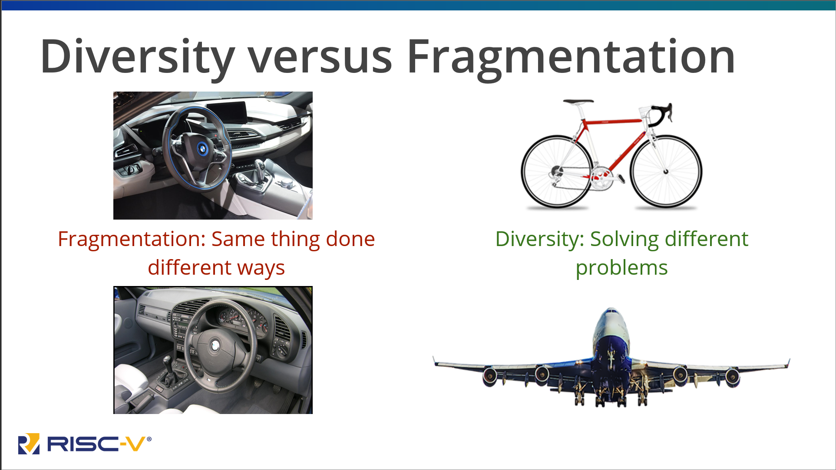

Slide 32
The Decision

Slide 33
Enjoy Absolute Freedom to Innovate…
Asymmetric processing with 2X power efficiency
  Quad-core 64-bit RISC-V processors
  Linux® and Real-time operating systems
Highly flexible 2MB L2 cache
With the most comprehensive RISC-V development ecosystem
PolarFire® SoC

Slide 34
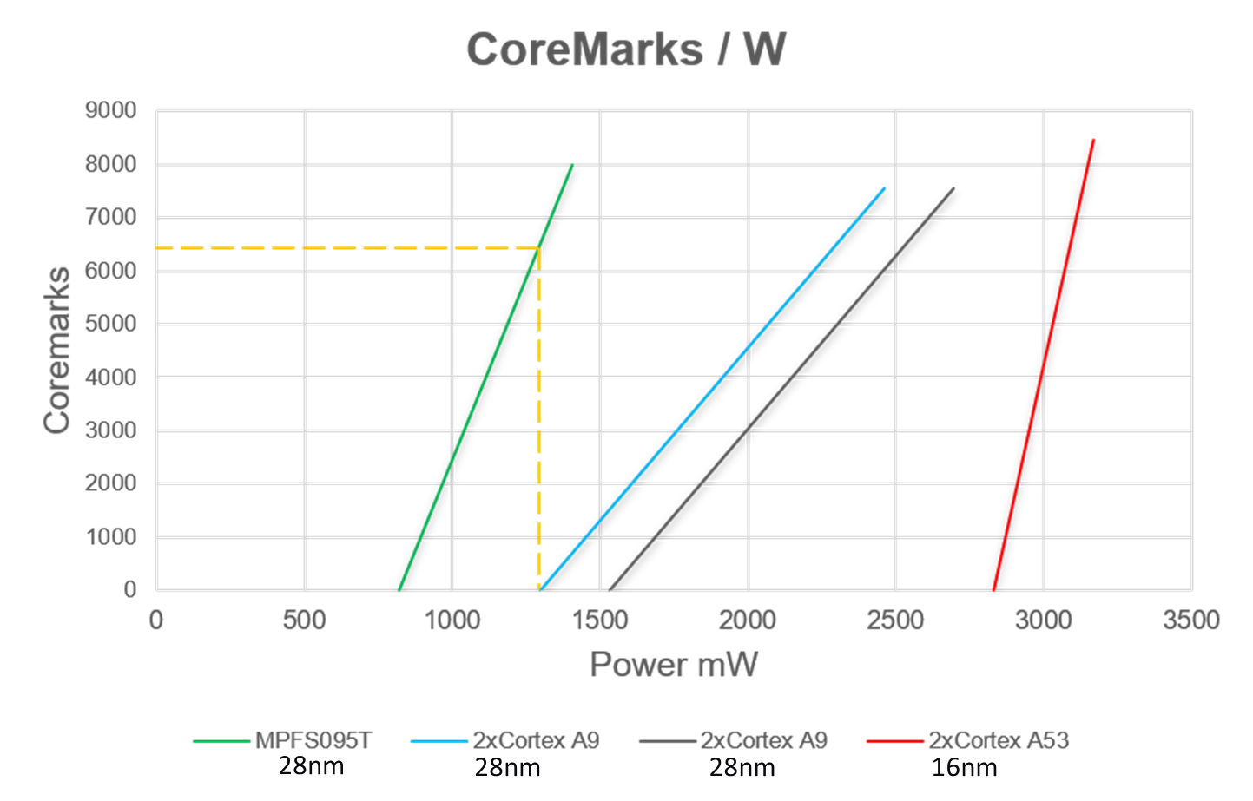
PolarFire SoC has a 6K CoreMark head start!

Slide 35






















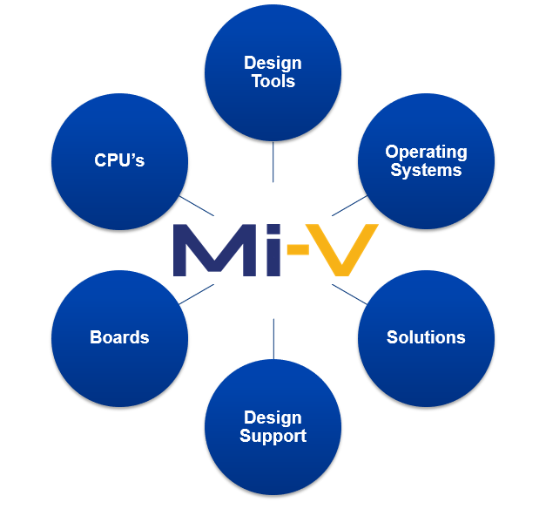














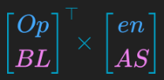






















The Most Complete RISC-V Development Ecosystem
Dev
Tools
Intellectual
Property /
Soft CPU
Operating
System /
RTOS
Hardware
Middleware
Design
Services
Mi-V.org

Slide 36
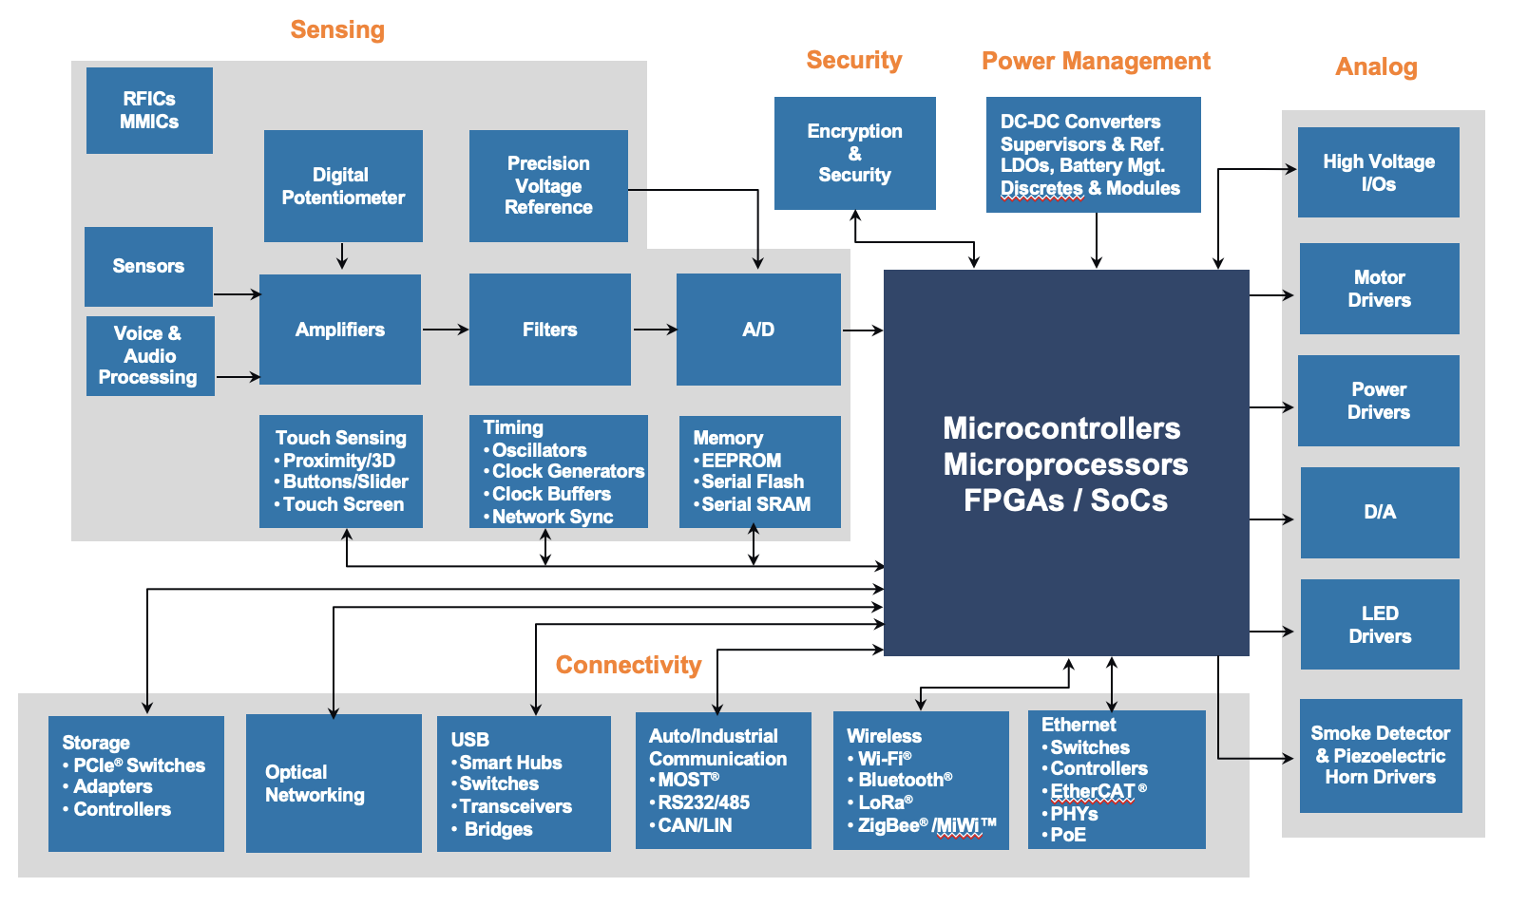
Part of Microchip’s Commitment to Total System Design
Devices
Firmware
Software
Tools
Support

Slide 37

What's around the corner?

Slide 38

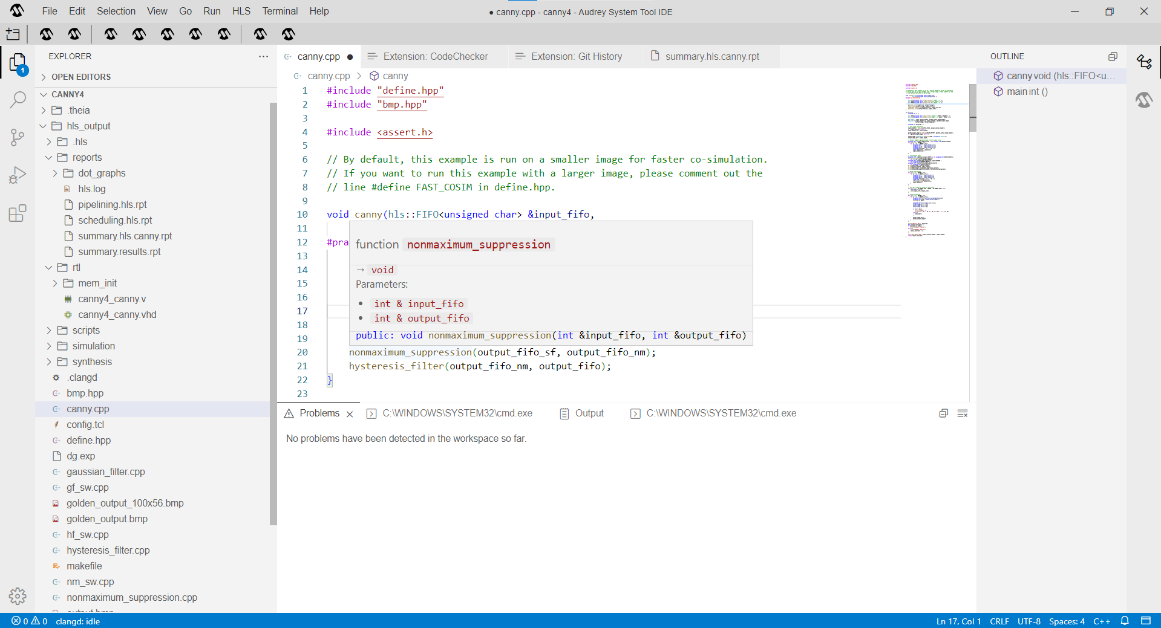
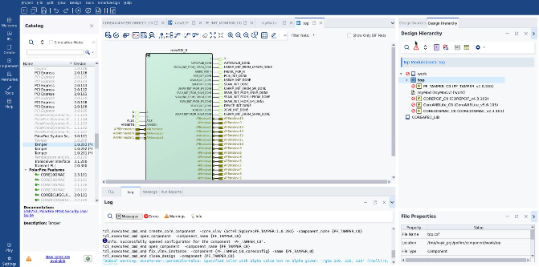

Next: The Second Generation of PolarFire® FPGAs
15x
System-Level Design Gets Its Own Suite
We’re Doubling Power Efficiency… Again!
PLUS…
Deterministic, asymmetric processing
HPSC-compatible core complex
Mil-grade anti-tamper and cybersecurity
Immune to single event upsets (SEU)
Total 4X gain with PolarFire® 2 FPGA
System Designer
3x
Abstracted C/C++ and RTL flows
Complete SoC creation with C/C++
Hardware/software partitioning and co-design
Full SoC debug to speed bring-up
Pre-silicon software development
2x
FPGA Designer
Modern and intuitive UI
Fast timing closure
Adaptive design flows
Better IP handling and delivery
Faster simulation and expanded debug
Power Efficiency
CoreMark® Score
TOP/S
PolarFire® SoC

Slide 39

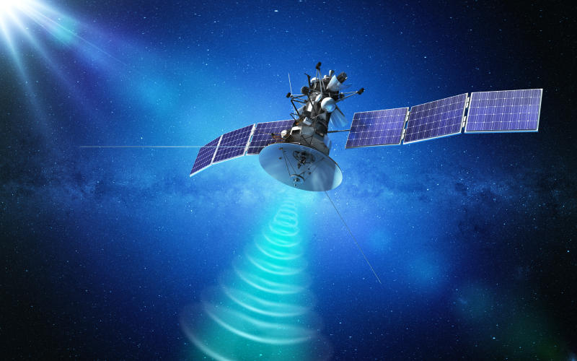


Tuned for Power-Hungry 100G Edge Technologies
AI/ML at the Edge
Zero-Fail Conditions
Multiple Concurrent CNNs
Multifold CoreMark Performance Increase
Immune to Single Event Upsets
Resists Next Generation Threats
Smart Embedded Vision
Low Latency, High Throughput
Secure Communications
Up to 8K Video
100G Processing
64x64 MIMO Radio
32G Multiprotocol Transceivers

Slide 40

What's around the next corner?

Slide 41
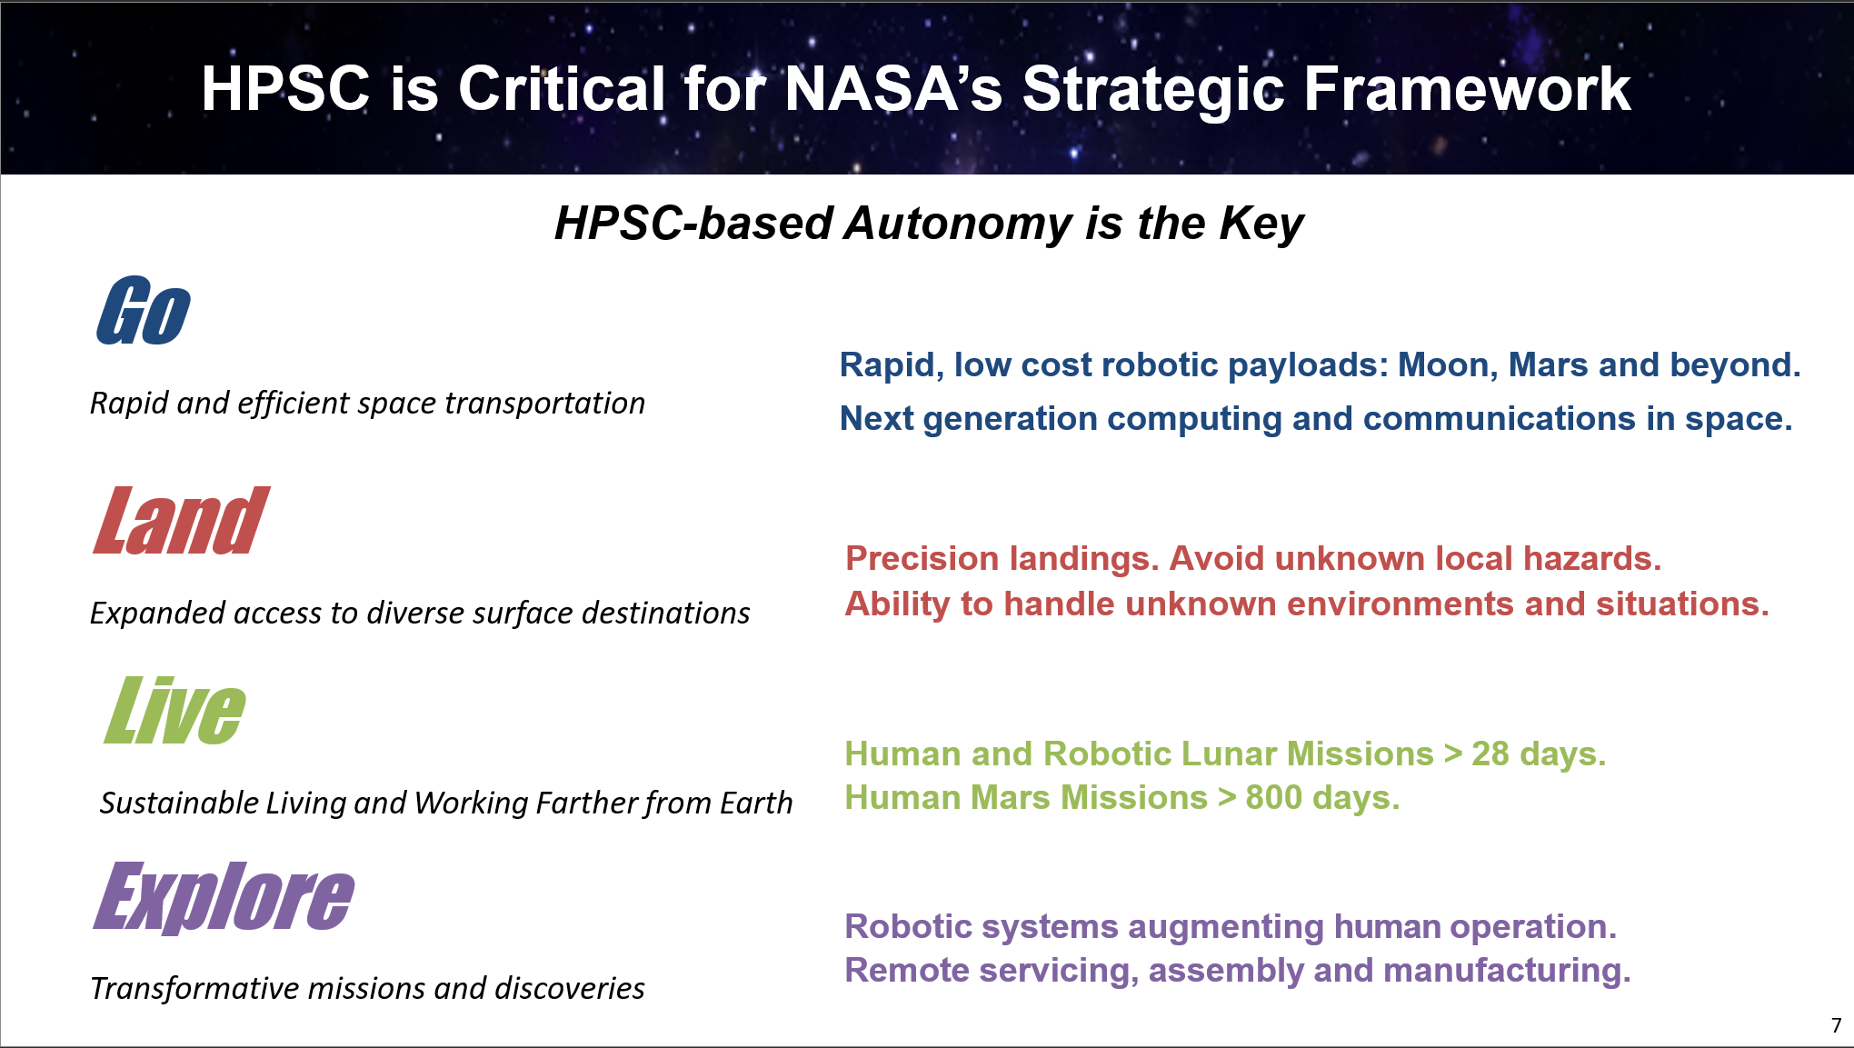

Slide 42
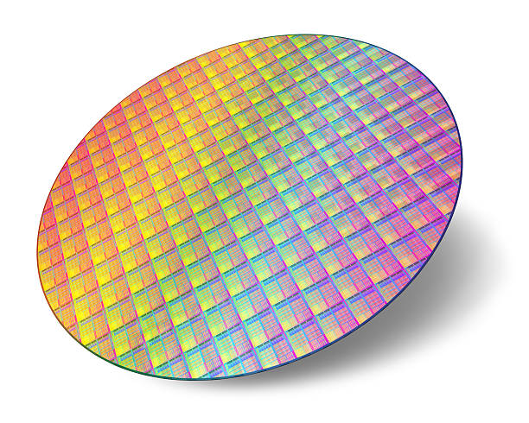

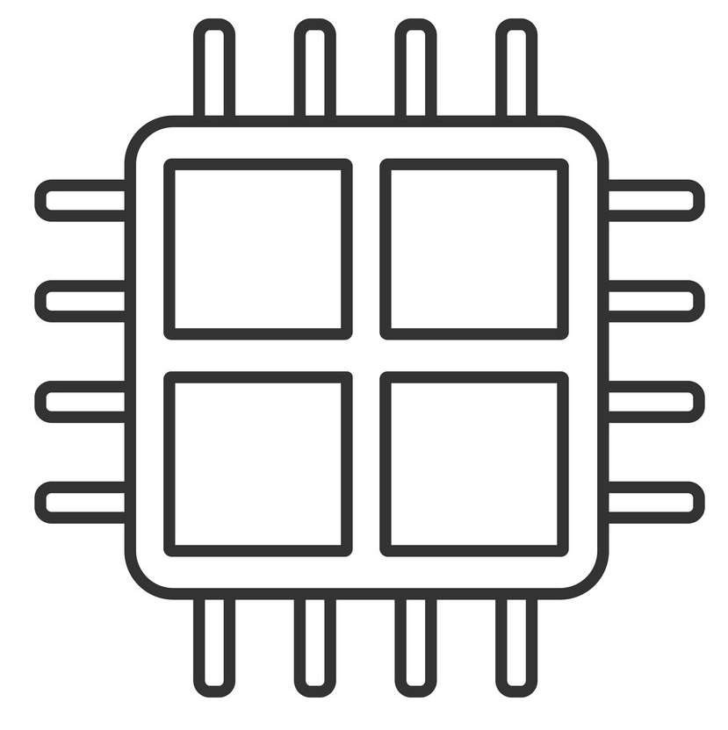








HPSC Architecture Highlights
Advanced
FinFET Process
Machine
Learning
Multi-Core
RISC-V
Space Compute
Time Sensitive
Ethernet
Networking
PCIe
Real-time
Processing
Deterministic
Latency
SWaP Optimized Heterogenous
Fault Tolerant
Architecture
Co-processor
Interfaces
Secure
Enclave
Extensible Power
& Performance
Vector Engines
43

Slide 43





Extensible Space System Solution
Scalable High Performance On-Board Computer
Expansion
Cameras/
Sensors
RF
Data
Storage
Payloads
Spacecraft Bus
Expansion
Machine Learning
Hardware Acceleration

Slide 44



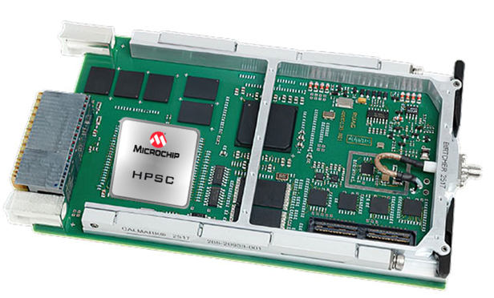



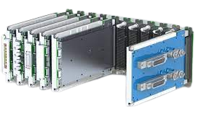
Enabling HPSC-Based SBC Ecosystem
Single Board Computer (SBC) Partners To Fully Address Customer Development Needs
Open/Interoperable
Build vs. Buy
SBC Partners
U.S.
DoD
ESA
NASA to only buy SpaceVPX SBCs,
DoD will buy SOSA compliant SBCs,
ESA transitioning to CompactPCI Serial,
Defense Primes increasingly buy
off-the-shelf SBCs.
Target to work with partners to develop flight-capable HPSC-based SBCs in various form factors for different end-markets (Space, ESA, Defense, etc.)

Slide 45
HPSC Timeline
Collateral Available
2023
First Silicon Available
2024
Flight-Ready Production 2025

Slide 46
RISC-V Take Aways
RISC-V breathes new life into the semiconductor industry
CPU Architectural licenses are free
Leading to more diverse compute solutions for OEMs
Microchip has been a pioneer in this effort
The future is very bright for RISC-V and space-based computing.

Slide 47
Thank You

