Slide 1
Static Analysis
Adam@Adiuvoengineering.com
www.adiuvoengineering.com

Slide 2
“FPGAs should be forbidden in space applications until the designers learn how to design with them”
Lessons Learned from FPGA Developments - 2002 – S Habinc

Slide 3
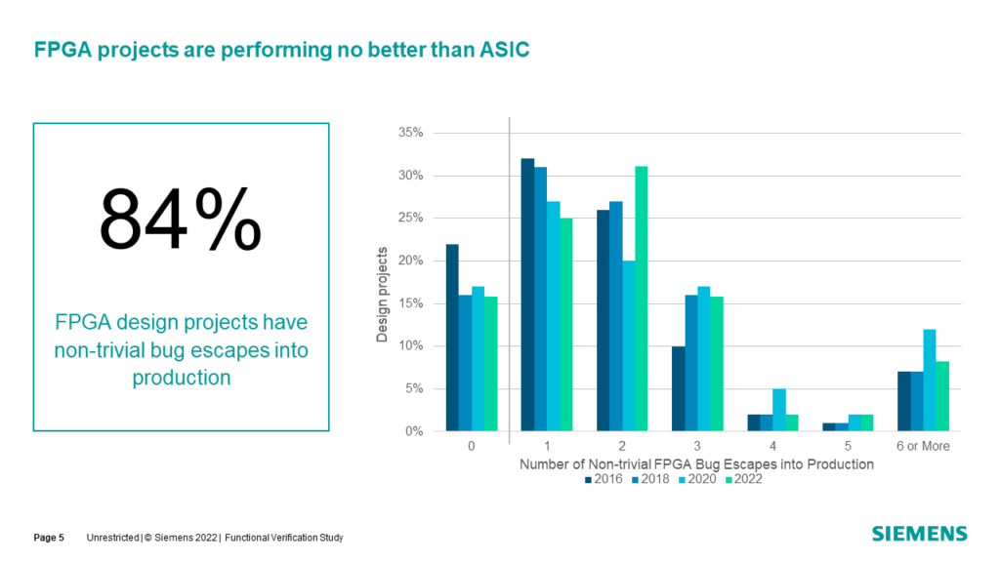
We are Pretty Bad at Designing FPGAs

Slide 4
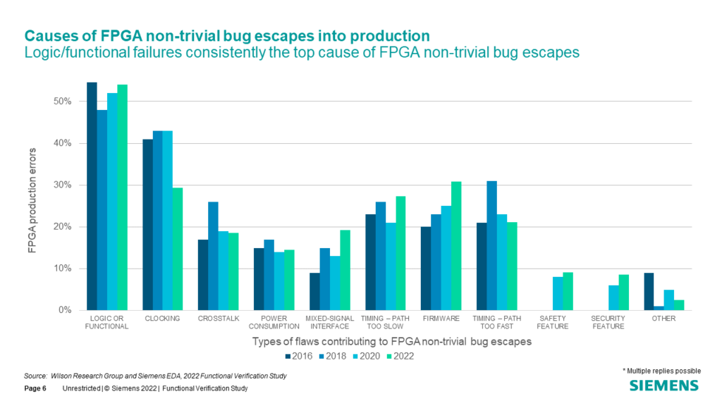
Types of Errors we see

Slide 5
Why is this
Several Reasons
Incomplete / Poor / Fluid Requirement specifications
Project time scales - We are expected to do more faster
Poor Process – Ill defined process to go from beginning to end
Investment in tools – Reliance on free versions of tools, simulators etc.
We are human bugs happen – The key is to find them early, and efficiently

Slide 6
What is Static Analysis
Analyses RTL, to find issues in minutes which might take hours in Synthesis and Simulation.
Done correctly it enables a better quality of code for simulation and synthesis.
Adiuvo uses Blue Pearls – Visual Verification Suite

Slide 7
What is Blue Pearl's Visual Verification SuiteTM
Analyze RTL™ linting and debug –
  This enables us to ensure coding standards are followed, analyse the design for several structural issues, verify the design complies with manufacturer coding standards e.g. Xilinx Ultrafast Methodology, run path analysis and explore finite state machines.
Clock Domain Crossing –
  Analyze design and clocking structures to ensure CDC is implemented correctly in the design.
Automated SDC generation –
  Identified false paths and multi-cycle paths in your design and generated the appropriate SDC file.

Slide 8
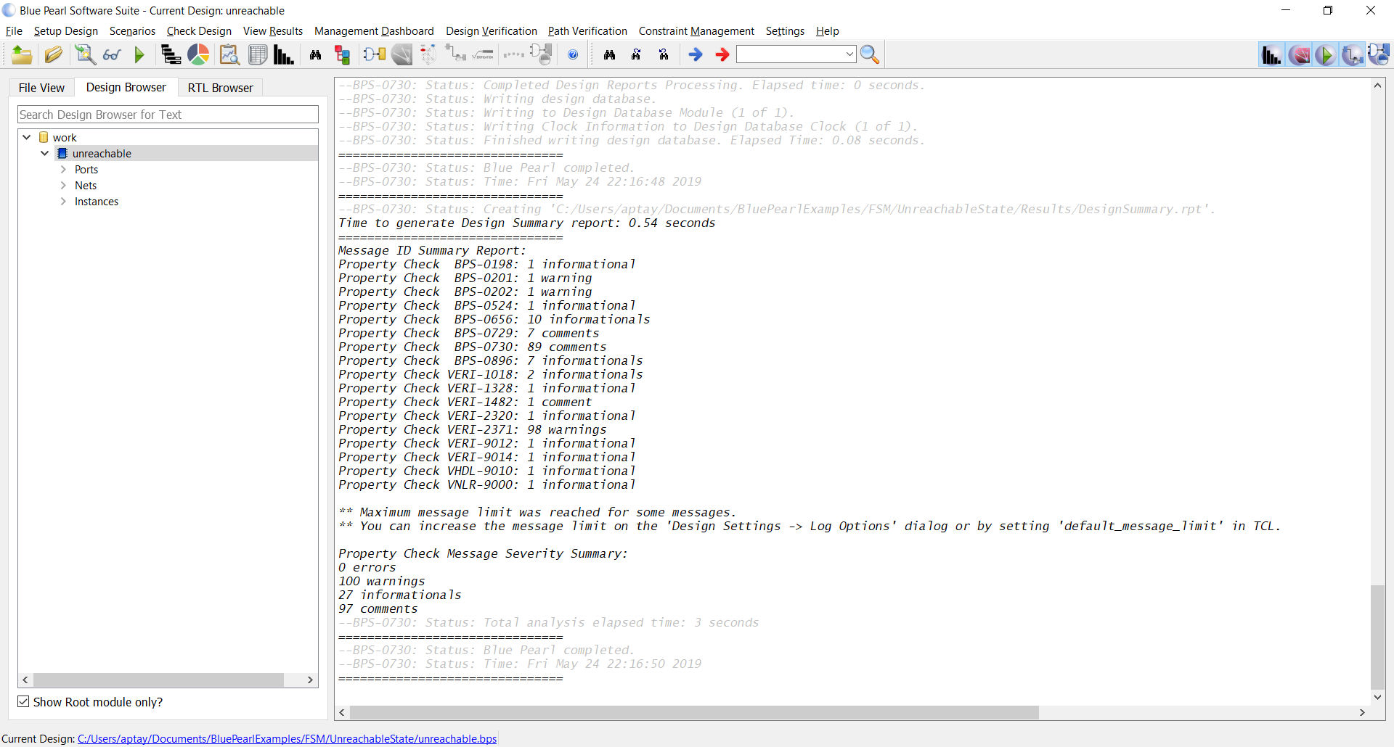
VVS Workspace
Design Analysis Settings
Visual Analysis Environments
Checked Out Licenses
Tool Menu
Messages
Design Browser

Slide 9
Adiuvo / ESA Project
Multi Year project to analyse IP cores using static analysis tool Blue Pearl Visual Verification Suite.
2020 – Creation of coding rules and analysis circa 50% of IP cores, ESA Training
2021 – Analysis of remaining blocks
2022 – Reflect changes on identified block, rerun verification – training of ESA Engineers in basic and advanced BPS.

Slide 10
ESA BPS Coding Rules
Activity Started in 2020 to identify Set of coding rules which can be applied by ESA to its IP cores
Some challenges – ESA is unique several organizations delivering RTL code
Diverse presentation standards e.g camelCase, PascalCase, Snake_Case etc.
Presentation standards – Not as important
Coding Standards are however important - These ensure quality of the actual design

Slide 11
ESA BPS Coding Rules
Creation of coding rules pulled from
  ECSS-Q-ST-60-02C
  CNES - DESIGN AND VHDL HANDBOOK FOR VLSI DEVELOPMENT
  ESA IP - ESA IP Core Technical Requirements
  ESA Model - VHDL Modelling Guidelines
  Realtra Coding Rules

Slide 12
Coding Rules covering
ESA BPS Coding rules cover
  FSM Unreachable States
  No Initialization statements
  Ensuring all Flip Flops are Set / Reset
  Input and Output Registers being used
  Unconnected and undriven pins and nets
  Identifying use of Hard Coded Constraints
  Incomplete Sensitivity Lists
  CDC Incorrectly performed
  Unconstrained INT
  Latch Creation
  Using RE and FE edges of the clock

Slide 13
ESA Coding Rules
Collated into a TCL script for use with BluePearl Visual Verification Studio
Available here https://github.com/ATaylorCEngFIET/BPS_Rules
Additional information includes
How to install the BPS Rules
How to use the Scripts and Batch files to analyse a Project

Slide 14
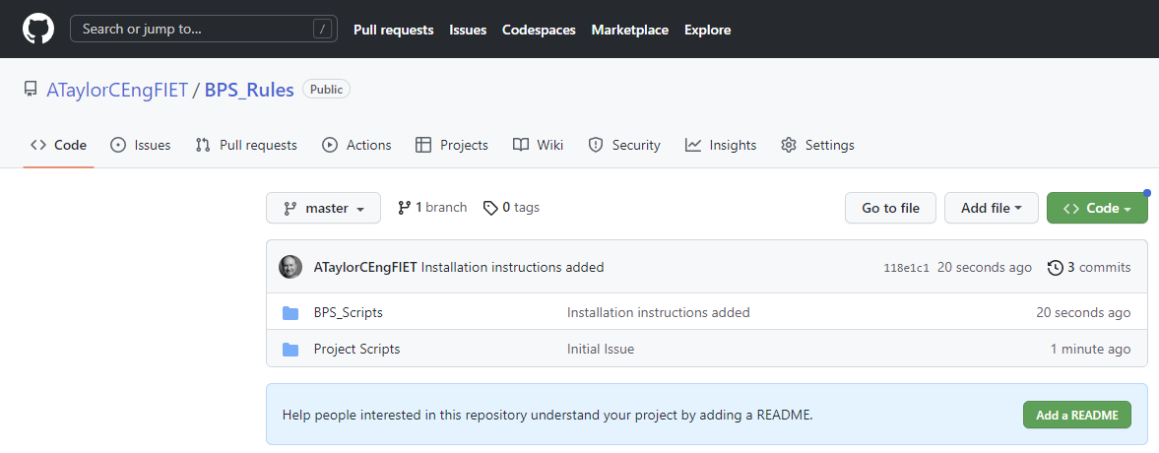
BPS Rules

Slide 15
Modules Analyzed
2020 Batch Components
EDAC
FTADR
HurriCAN
Leon
PTME
SHYLOC 121
SHYLOC 123
SPACE FIBRE
SPW
2021 Batch Components
AUIP
EDAC-07
NoCIP
Pdec
PTCD
SCCC
SPW RMPA
SPW Node

Slide 16
As would be expected with IP cores already verified no MAJOR issues were found however there were some minor issues.

Slide 17
Main Issues
Unbound generics
Reset not synchronously de-asserted
Arithmetic Overflow Warnings
Clock Synchronizer Warnings
Combination feedback loop created
Missing bit ranges
Missing if then else, check no latches are created
Update design to include all registers being capable of being reset – this prevents reliance on unknown register states at power up which could lead to undefined behaviour

Slide 18
Main Issues
Update source code to remove hard coded constants from the source files to ensure the code is more readable.
Correct FSM implementations to behave correctly in SEE environment.
If-then-else statements too deep – Can impact timing
Mixed edge clocking – check to ensure no timing issues
Signals used but no driver – check how these signals are used to ensure this isn’t an issue

Slide 19
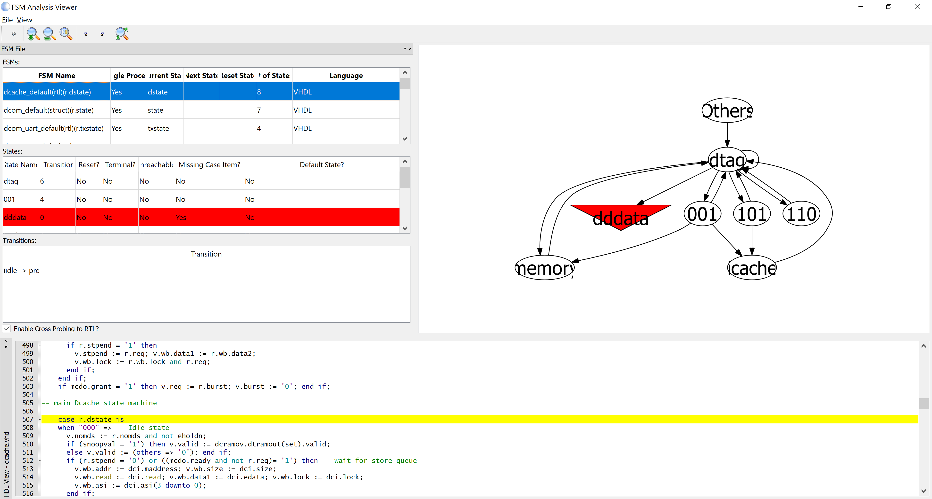
Example of FSM Issue Found

Slide 20
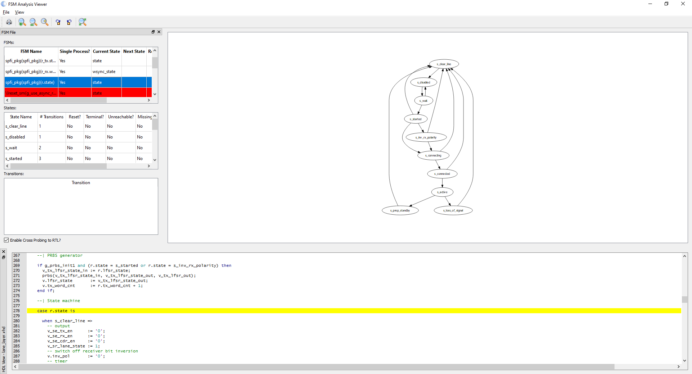
Example of FSM Issue Found
FSM Only 10 of 16 states covered

Slide 21
Module Correction Flow

Slide 22
Project Flow

Slide 23
Configuring the Simulation

Slide 24
Adiuvo Plato
Adiuvo Design Three FPGA for ESA Plato Mission PLIU
  CTRL – Platform Controller - Manages 10,000 Registers and 54 PID Loops Circa 20K SLOC
  RTD – Ultra Low noise FPGA / ADC – Game Changing Accuracy & Stability! Circa 15K SLOC
  Heater – Low Noise High Power Heater drive
Static Analysis with agreed ESA rules used across all the modules prior to simulation – Full code coverage and synthesis.

Slide 25
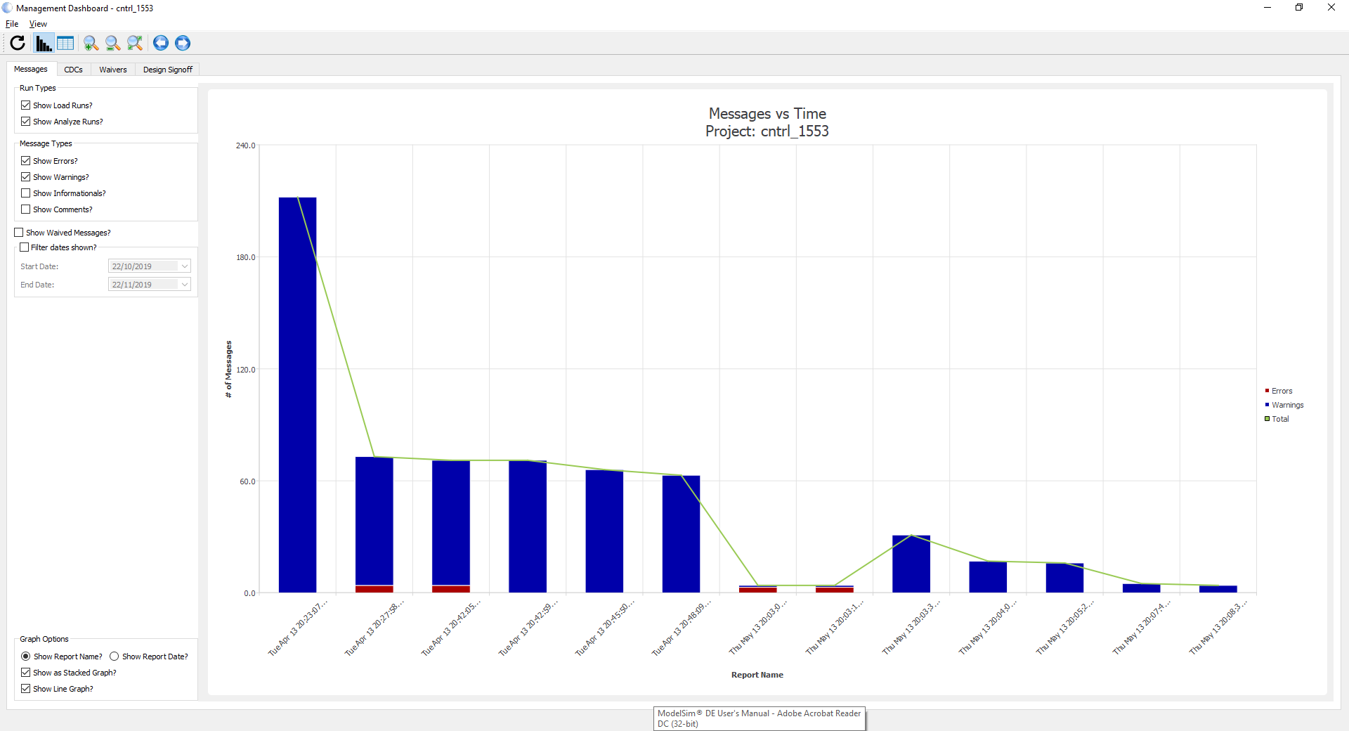
Adiuvo Plato

Slide 26
Adiuvo Plato
All warning removed from code except for some which are waived
If Then Else Depth - Lucky Running at 6 MHz
Internal Clock Warning - None PLL divide by 2.5
Tri State – Warning on MRAM Interface
IO Types used - I2C
Demonstrates BPS is finding issues as the code is developed and the few warning not corrected are waived after analysis. And presented to ESA in verification plan with justification.

Slide 27
Adiuvo Gateway
Adiuvo Developing FPGA for ERSA CDHU – Circa 30K lines of RTL
Static Analysis was run on the modules against the ESA coding rules – Integrated as part of the CI Suite
Each evening code in repo checked against results

Slide 28
Adiuvo Model Based
Adiuvo Recently Pioneered model-based FPGA design targeting MicroChip PolarFire using a newly developed tool.
Developed using model-based flow – SysML to RTL
  RTL Generated is vendor independent – Includes AXI Network instantiation
  Circa 100K lines of code
  Massively reduced development time & right first time – come see demo
Next challenge is to run the ESA Rule set against the output code – Optimistic as we wrote the tool it will work as expected but will report back next year!

Slide 29


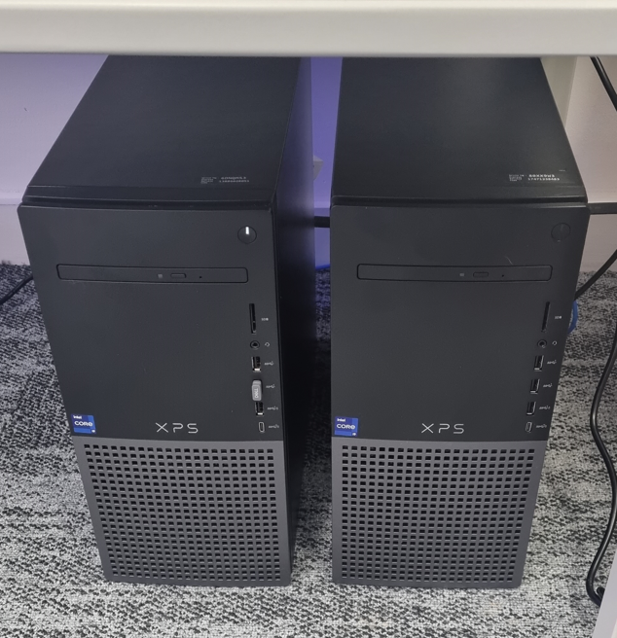
Conclusion
Static Analysis great tool in the toolbox to help enforce good coding practice.
Enables entry into Simulation with a better code quality
Reduces development time (but hard to quantify) – When implemented in CI flow beneficial as just view reports no need to remember to do it

Slide 30


www.adiuvoengineering.com
adam@adiuvoengineering.com

