Slide 1
SpacE FPGA Users Workshop (SEFUW) 2023, ESTEC, Noordwijk, 14-16 March
High-Performance UVM Verification IP
for SpaceWire Codec
Simone Vagaggini^{1,2}, Marco Trafeli¹, Daniele Davalle¹, Lucana Santos³, Roberto Ciardi^{1,2}, Pietro Nannipieri², Luca Fanucci²
¹IngeniArs S.r.l., Via Ponte a Piglieri 8, Pisa, Italy
²Dept. Of Information Engineering, University of Pisa, Via Caruso 16, Pisa, Italy
³European Space Research and Technology Centre, European Space Agency, Keplerlaan 1, Noordwijk, The Netherlands
SpacE FPGA Users Workshop (SEFUW) 2023

Slide 2
OUTLINE
Introduction
UVM-based SpaceWire Codec Twin Model
UVM-based Verification Environment Architecture
Verification Campaign
UVM-based Approach Advantages
Results and Conclusions
Q&A
SpacE FPGA Users Workshop (SEFUW) 2023

Slide 3
OUTLINE
Introduction
UVM-based SpaceWire Codec Twin Model
UVM-based Verification Environment Architecture
Verification Campaign
UVM-based Approach Advantages
Results and Conclusions
Q&A
SpacE FPGA Users Workshop (SEFUW) 2023

Slide 4
INTRODUCTION
Verification Intellectual Property (VIP) for
Functional Verification of any SpaceWire Codec,
Fully compliant with Universal Verification Methodology (UVM)
SpacE FPGA Users Workshop (SEFUW) 2023

Slide 5
INTRODUCTION
Verification Intellectual Property (VIP) for
Functional Verification of any SpaceWire Codec,
Fully compliant with Universal Verification Methodology (UVM)
Developed by IngeniArs S.r.l.
SpacE FPGA Users Workshop (SEFUW) 2023

Slide 6
INTRODUCTION
Verification Intellectual Property (VIP) for
Functional Verification of any SpaceWire Codec,
Fully compliant with Universal Verification Methodology (UVM)
Developed by IngeniArs S.r.l.
Funded by European Space Agency
SpacE FPGA Users Workshop (SEFUW) 2023

Slide 7
INTRODUCTION
Verification Intellectual Property (VIP) for
Functional Verification of any SpaceWire Codec,
Fully compliant with Universal Verification Methodology (UVM)
Developed by IngeniArs S.r.l.
Funded by European Space Agency
Activity goals:
Check the compliance of IP Cores with the SpW standard
SpacE FPGA Users Workshop (SEFUW) 2023

Slide 8
INTRODUCTION
Verification Intellectual Property (VIP) for
Functional Verification of any SpaceWire Codec,
Fully compliant with Universal Verification Methodology (UVM)
Developed by IngeniArs S.r.l.
Funded by European Space Agency
Activity goals:
Check the compliance of IP Cores with the SpW standard
Evaluate the UVM advantages
SpacE FPGA Users Workshop (SEFUW) 2023

Slide 9
INTRODUCTION
Verification Intellectual Property (VIP) for
Functional Verification of any SpaceWire Codec,
Fully compliant with Universal Verification Methodology (UVM)
Developed by IngeniArs S.r.l.
Funded by European Space Agency
Activity goals:
Check the compliance of IP Cores with the SpW standard
Evaluate the UVM advantages
Prove the UVM applicability to space systems
SpacE FPGA Users Workshop (SEFUW) 2023

Slide 10
INTRODUCTION
Verification Intellectual Property (VIP) for
Functional Verification of any SpaceWire Codec,
Fully compliant with Universal Verification Methodology (UVM)
Developed by IngeniArs S.r.l.
Funded by European Space Agency
Activity goals:
Check the compliance of IP Cores with the SpW standard
Evaluate the UVM advantages
Prove the UVM applicability to space systems
Promotion of UVM-based Verification Approach
SpacE FPGA Users Workshop (SEFUW) 2023

Slide 11
OUTLINE
Introduction
UVM-based SpaceWire Codec Twin Model
UVM-based Verification Environment Architecture
Verification Campaign
UVM-based Approach Advantages
Results and Conclusions
Q&A
SpacE FPGA Users Workshop (SEFUW) 2023

Slide 12
UVM-BASED SPACEWIRE CODEC TWIN MODEL
Emulates the ideal behavior of a SPW Codec
SpacE FPGA Users Workshop (SEFUW) 2023

Slide 13
UVM-BASED SPACEWIRE CODEC TWIN MODEL
Emulates the ideal behavior of a SPW Codec
Fully compliant with Rev.1 of SpW Standard
SpacE FPGA Users Workshop (SEFUW) 2023

Slide 14
UVM-BASED SPACEWIRE CODEC TWIN MODEL
Emulates the ideal behavior of a SPW Codec
Fully compliant with Rev.1 of SpW Standard
Developed in SystemVerilog HVL
SpacE FPGA Users Workshop (SEFUW) 2023

Slide 15
UVM-BASED SPACEWIRE CODEC TWIN MODEL
Emulates the ideal behavior of a SPW Codec
Fully compliant with Rev.1 of SpW Standard
Developed in SystemVerilog HVL
Fully compliant with UVM
Easily reusable and maintainable
SpacE FPGA Users Workshop (SEFUW) 2023

Slide 16
UVM-BASED SPACEWIRE CODEC TWIN MODEL
Emulates the ideal behavior of a SPW Codec
Fully compliant with Rev.1 of SpW Standard
Developed in SystemVerilog HVL
Fully compliant with UVM
Easily reusable and maintainable
Host interface
Packets and BC transmission and reception
Configuration changes and readings
SpacE FPGA Users Workshop (SEFUW) 2023

Slide 17
UVM-BASED SPACEWIRE CODEC TWIN MODEL
Emulates the ideal behavior of a SPW Codec
Fully compliant with Rev.1 of SpW Standard
Developed in SystemVerilog HVL
Fully compliant with UVM
Easily reusable and maintainable
Host interface
Packets and BC transmission and reception
Configuration changes and readings
Data-Strobe interface
Communication with DUT or any system with SpW interface
SpacE FPGA Users Workshop (SEFUW) 2023

Slide 18
UVM-BASED SPACEWIRE CODEC TWIN MODEL
Direct Communication with DUT
SpacE FPGA Users Workshop (SEFUW) 2023

Slide 19
UVM-BASED SPACEWIRE CODEC TWIN MODEL
Direct Communication with DUT
Automatic link initialization
SpacE FPGA Users Workshop (SEFUW) 2023

Slide 20
UVM-BASED SPACEWIRE CODEC TWIN MODEL
Direct Communication with DUT
Automatic link initialization
Automatic TX and RX credit handling
SpacE FPGA Users Workshop (SEFUW) 2023

Slide 21
UVM-BASED SPACEWIRE CODEC TWIN MODEL
Direct Communication with DUT
Automatic link initialization
Automatic TX and RX credit handling
Automatic TX of NULLs when needed
SpacE FPGA Users Workshop (SEFUW) 2023

Slide 22
UVM-BASED SPACEWIRE CODEC TWIN MODEL
Direct Communication with DUT
Automatic link initialization
Automatic TX and RX credit handling
Automatic TX of NULLs when needed
Automatic recognition of all types of errors
SpacE FPGA Users Workshop (SEFUW) 2023

Slide 23
UVM-BASED SPACEWIRE CODEC TWIN MODEL
Direct Communication with DUT
Automatic link initialization
Automatic TX and RX credit handling
Automatic TX of NULLs when needed
Automatic recognition of all types of errors
No actions needed by the user
SpacE FPGA Users Workshop (SEFUW) 2023

Slide 24
UVM-BASED SPACEWIRE CODEC TWIN MODEL
Direct Communication with DUT
Automatic link initialization
Automatic TX and RX credit handling
Automatic TX of NULLs when needed
Automatic recognition of all types of errors
No actions needed by the user
Higher level of abstraction
Only packets and BCs to be defined
SpacE FPGA Users Workshop (SEFUW) 2023

Slide 25
UVM-BASED SPACEWIRE CODEC TWIN MODEL
Direct Communication with DUT
Automatic link initialization
Automatic TX and RX credit handling
Automatic TX of NULLs when needed
Automatic recognition of all types of errors
No actions needed by the user
Higher level of abstraction
Only packets and BCs to be defined
Significant Simplification of the Verification Process
Significant Reduction in Verification Time and Cost
SpacE FPGA Users Workshop (SEFUW) 2023

Slide 26
OUTLINE
Introduction
UVM-based SpaceWire Codec Twin Model
UVM-based Verification Environment Architecture
Verification Campaign
UVM-based Approach Advantages
Results and Conclusions
Q&A
SpacE FPGA Users Workshop (SEFUW) 2023

Slide 27
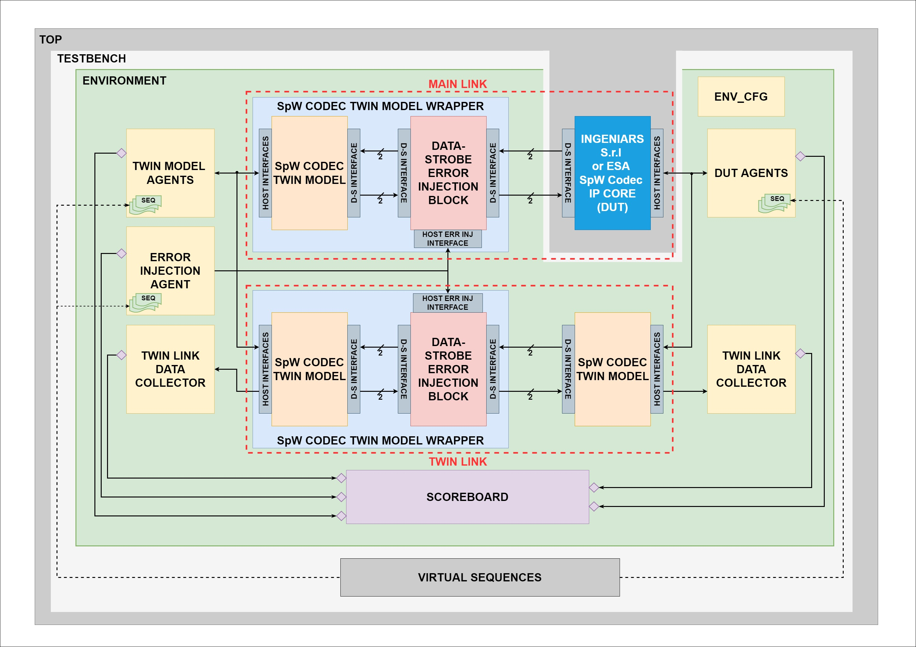
UVM-BASED VERIFICATION ENVIRONMENT ARCHITECTURE
Main Link
Communication between DUT and Twin Model
SpacE FPGA Users Workshop (SEFUW) 2023

Slide 28
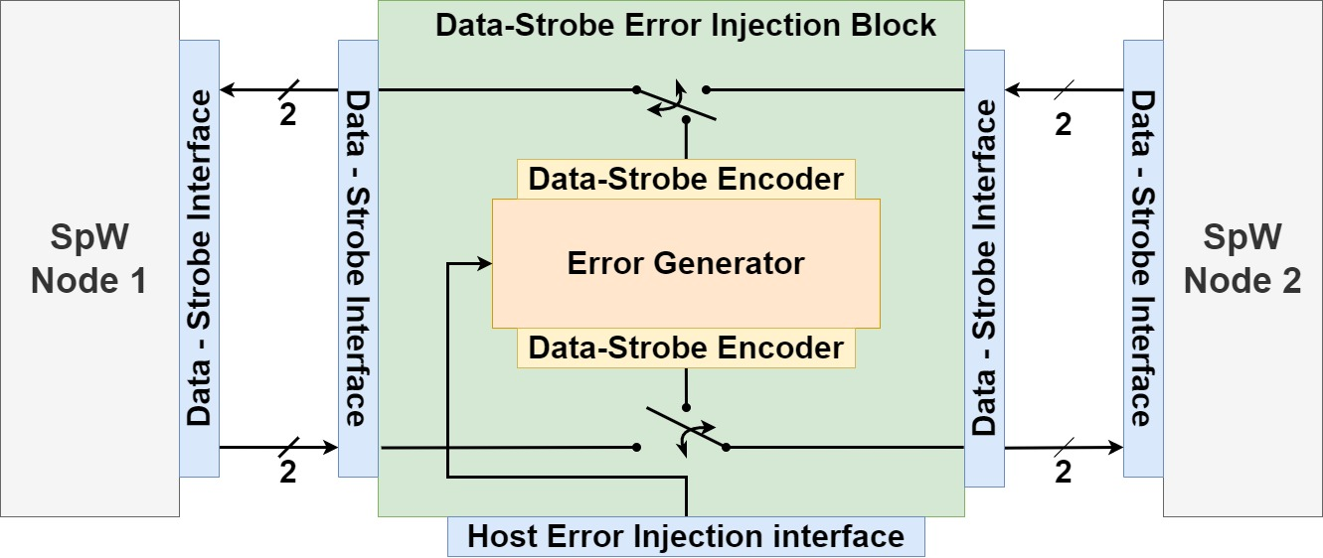
UVM-BASED VERIFICATION ENVIRONMENT ARCHITECTURE
Main Link
Communication between DUT and Twin Model
Data-Strobe Error Injector
SpacE FPGA Users Workshop (SEFUW) 2023

Slide 29
UVM-BASED VERIFICATION ENVIRONMENT ARCHITECTURE
Main Link
Communication between DUT and Twin Model
Data-Strobe Error Injector
Twin Link
Communication between two Twin Models
SpacE FPGA Users Workshop (SEFUW) 2023

Slide 30
UVM-BASED VERIFICATION ENVIRONMENT ARCHITECTURE
Main Link
Communication between DUT and Twin Model
Data-Strobe Error Injector
Twin Link
Communication between two Twin Models
Same stimuli of the Main Link
SpacE FPGA Users Workshop (SEFUW) 2023

Slide 31
UVM-BASED VERIFICATION ENVIRONMENT ARCHITECTURE
Main Link
Communication between DUT and Twin Model
Data-Strobe Error Injector
Twin Link
Communication between two Twin Models
Same stimuli of the Main Link
Emulates the ideal behavior of the SpW Link
SpacE FPGA Users Workshop (SEFUW) 2023

Slide 32
UVM-BASED VERIFICATION ENVIRONMENT ARCHITECTURE
Main Link
Communication between DUT and Twin Model
Data-Strobe Error Injector
Twin Link
Communication between two Twin Models
Same stimuli of the Main Link
Emulates the ideal behavior of the SpW Link
Support automated verification of all possible simulation scenarios
SpacE FPGA Users Workshop (SEFUW) 2023

Slide 33
UVM-BASED VERIFICATION ENVIRONMENT ARCHITECTURE
Environment Configuration
SpacE FPGA Users Workshop (SEFUW) 2023

Slide 34
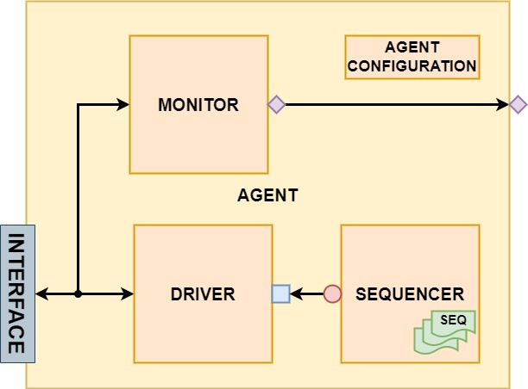
UVM-BASED VERIFICATION ENVIRONMENT ARCHITECTURE
Environment Configuration
Agents
DUT
Twin Model
Error Injection
SpacE FPGA Users Workshop (SEFUW) 2023

Slide 35
UVM-BASED VERIFICATION ENVIRONMENT ARCHITECTURE
Environment Configuration
Agents
DUT
Twin Model
Error Injection
Twin Link Data Collectors
SpacE FPGA Users Workshop (SEFUW) 2023

Slide 36
UVM-BASED VERIFICATION ENVIRONMENT ARCHITECTURE
Environment Configuration
Agents
DUT
Twin Model
Error Injection
Twin Link Data Collectors
Scoreboard
SpacE FPGA Users Workshop (SEFUW) 2023

Slide 37
OUTLINE
Introduction
UVM-based SpaceWire Codec Twin Model
UVM-based Verification Environment Architecture
Verification Campaign
UVM-based Approach Advantages
Results and Conclusions
Q&A
SpacE FPGA Users Workshop (SEFUW) 2023

Slide 38
VERIFICATION CAMPAIGN
Defined and implemented 153 testcases
100% of functional coverage of SpW Standard Rev.1
SpacE FPGA Users Workshop (SEFUW) 2023

Slide 39
VERIFICATION CAMPAIGN
Defined and implemented 153 testcases
100% of functional coverage of SpW Standard Rev.1
Verification Campaign on IngeniArs SpW Codec IP Core
SpacE FPGA Users Workshop (SEFUW) 2023

Slide 40
VERIFICATION CAMPAIGN
Defined and implemented 153 testcases
100% of functional coverage of SpW Standard Rev.1
Verification Campaign on IngeniArs SpW Codec IP Core
Verification Campaign on ESA SpW Codec IP Core
Basic VHDL adapter has been developed
SpacE FPGA Users Workshop (SEFUW) 2023

Slide 41
VERIFICATION CAMPAIGN
Defined and implemented 153 testcases
100% of functional coverage of SpW Standard Rev.1
Verification Campaign on IngeniArs SpW Codec IP Core
Verification Campaign on ESA SpW Codec IP Core
Basic VHDL adapter has been developed
DUT | Compliance with SpW Standard | Compliance with SpW Standard Rev.1 | Code Coverage – Statements | Code Coverage - Branches
IngeniArs S.r.l. SpW Codec IP Core | 🗸 | 🗸 | 96.05% | 92.08%
ESA SpW Codec IP Core | 🗸 | X | 95.24% | 91.72%
SpacE FPGA Users Workshop (SEFUW) 2023

Slide 42
OUTLINE
Introduction
UVM-based SpaceWire Codec Twin Model
UVM-based Verification Environment Architecture
Verification Campaign
UVM-based Approach Advantages
Results and Conclusions
Q&A
SpacE FPGA Users Workshop (SEFUW) 2023

Slide 43
UVM-BASED APPROACH ADVANTAGES
Maintainability
SpacE FPGA Users Workshop (SEFUW) 2023

Slide 44
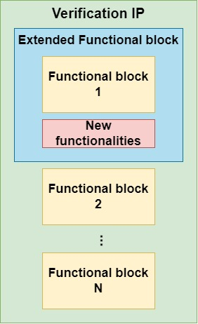
UVM-BASED APPROACH ADVANTAGES
Maintainability
Add functionalities (extension)
SpacE FPGA Users Workshop (SEFUW) 2023

Slide 45
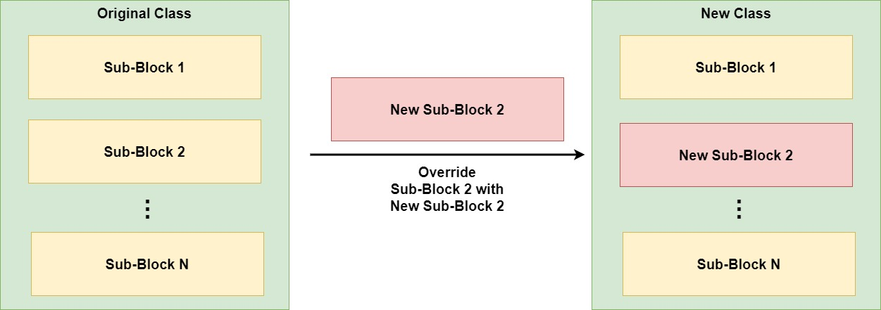
UVM-BASED APPROACH ADVANTAGES
Maintainability
Add functionalities (extension)
Update functionalities (override)
SpacE FPGA Users Workshop (SEFUW) 2023

Slide 46
UVM-BASED APPROACH ADVANTAGES
Maintainability
Reusability
SpacE FPGA Users Workshop (SEFUW) 2023

Slide 47
UVM-BASED APPROACH ADVANTAGES
Maintainability
Reusability
From a single functional block
SpacE FPGA Users Workshop (SEFUW) 2023

Slide 48
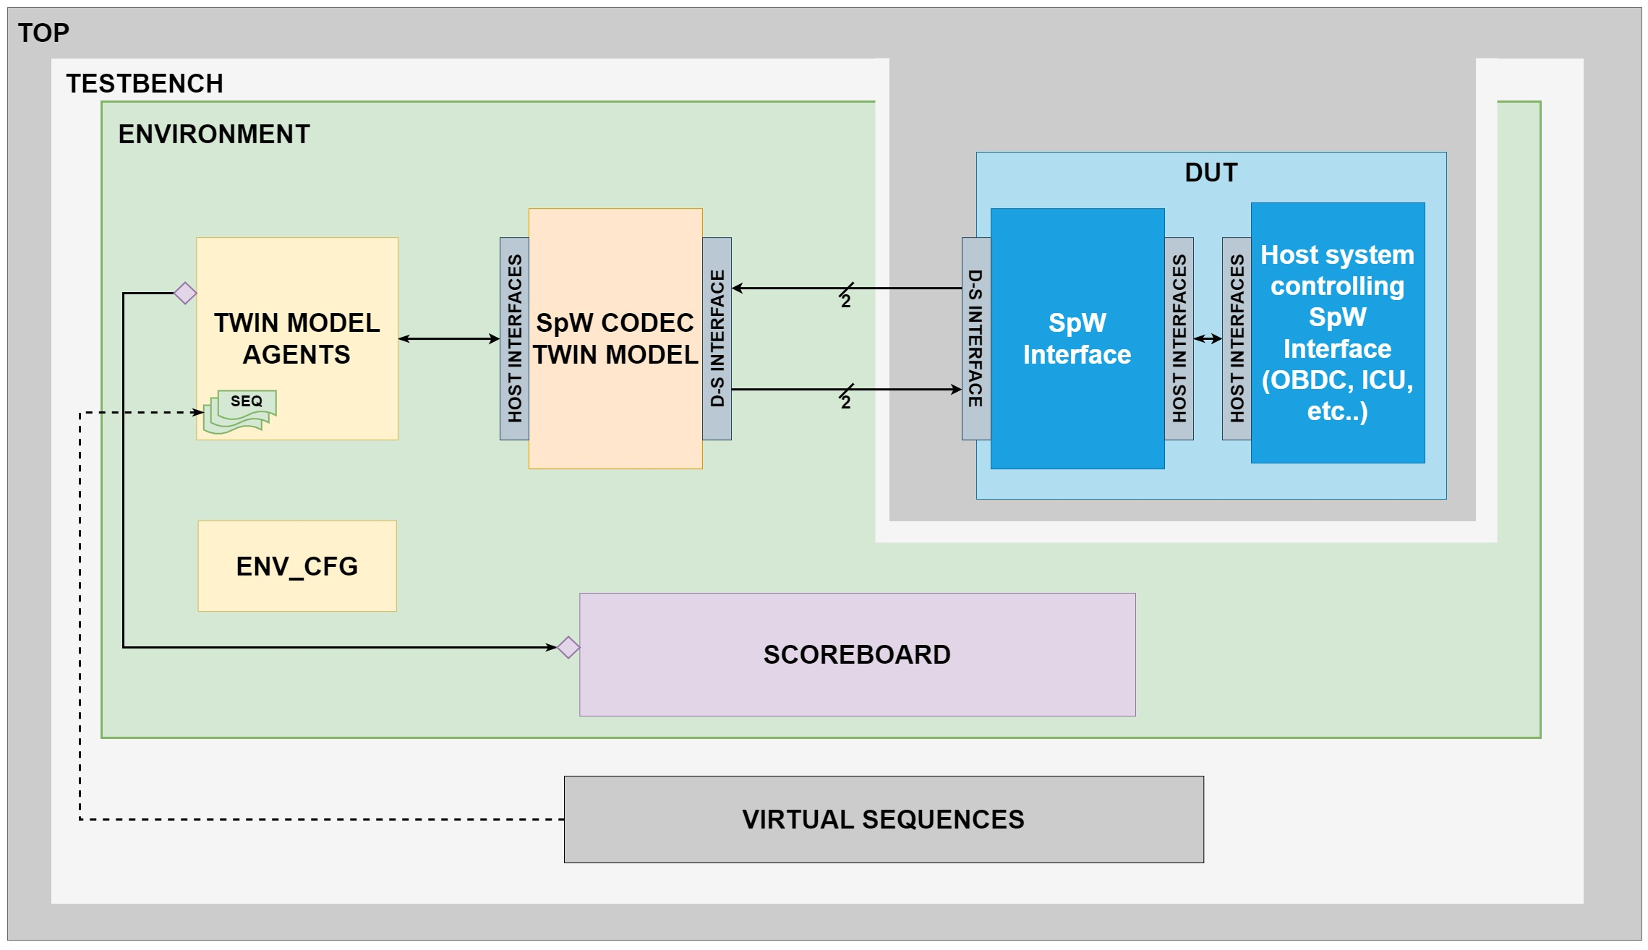
UVM-BASED APPROACH ADVANTAGES
Maintainability
Reusability
From a single functional block
SpacE FPGA Users Workshop (SEFUW) 2023

Slide 49
UVM-BASED APPROACH ADVANTAGES
Maintainability
Reusability
Separation between Verification IPs developers and users
SpacE FPGA Users Workshop (SEFUW) 2023

Slide 50
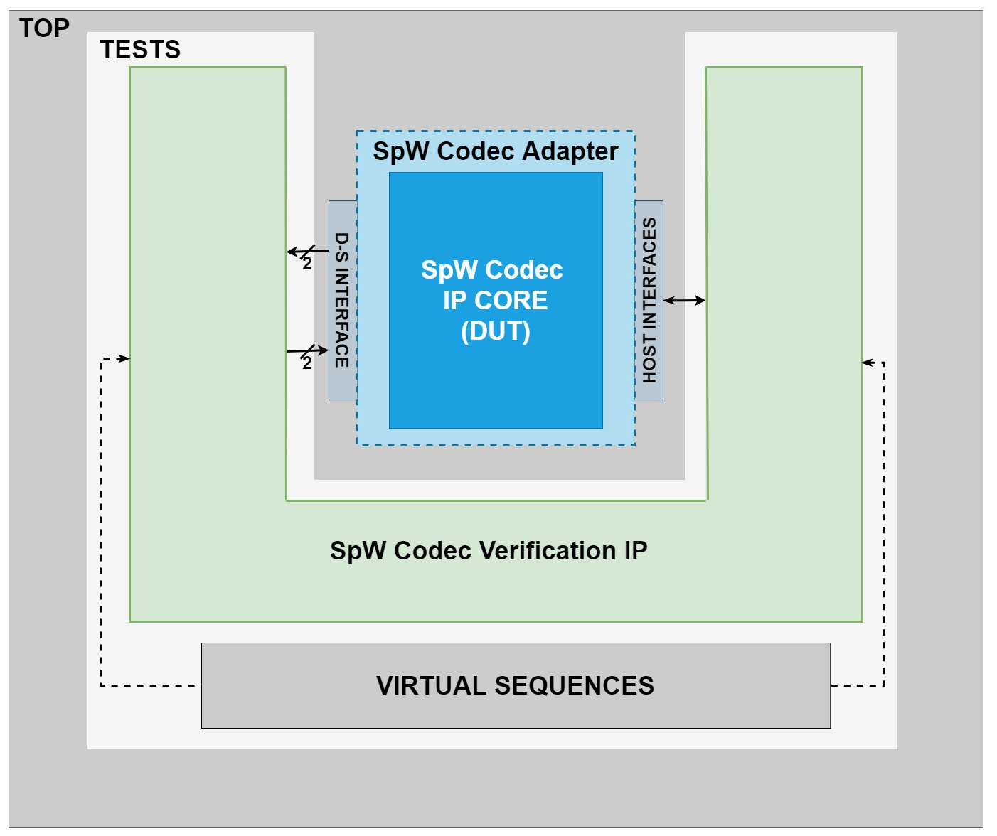
UVM-BASED APPROACH ADVANTAGES
Maintainability
Reusability
Separation between Verification IPs developers and users
Usability without deep knowledge of the VIPs architecture, SystemVerilog HVL and UVM standard
SpacE FPGA Users Workshop (SEFUW) 2023

Slide 51
UVM-BASED APPROACH ADVANTAGES
Maintainability
Reusability
Separation between Verification IPs developers and users
Usability without deep knowledge of the VIPs architecture, SystemVerilog HVL and UVM standard
Very user-friendly definition of new testcases
SpacE FPGA Users Workshop (SEFUW) 2023

Slide 52
UVM-BASED APPROACH ADVANTAGES
Maintainability
Reusability
Separation between Verification IPs developers and users
Usability without deep knowledge of the VIPs architecture, SystemVerilog HVL and UVM standard
Very user-friendly definition of new testcases
Possibility to buy VIPs developed by other companies
SpacE FPGA Users Workshop (SEFUW) 2023

Slide 53
UVM-BASED APPROACH ADVANTAGES
Maintainability
Reusability
Separation between Verification IPs developers and users
Usability without deep knowledge of the VIPs architecture, SystemVerilog HVL and UVM standard
Very user-friendly definition of new testcases
Possibility to buy VIPs developed by other companies
Visit IngeniArs Booth to
prove our SpW Codec Verification IP
SpacE FPGA Users Workshop (SEFUW) 2023

Slide 54
OUTLINE
Introduction
UVM-based SpaceWire Codec Twin Model
UVM-based Verification Environment Architecture
Verification Campaign
UVM-based Approach Advantages
Results and Conclusions
Q&A
SpacE FPGA Users Workshop (SEFUW) 2023

Slide 55
RESULTS AND CONCLUSIONS
Verification IP supporting a full test Campaign of any SpW Codec

Slide 56
RESULTS AND CONCLUSIONS
Verification IP supporting a full test Campaign of any SpW Codec
Based on SpW Codec Twin Models

Slide 57
RESULTS AND CONCLUSIONS
Verification IP supporting a full test Campaign of any SpW Codec
Based on SpW Codec Twin Models
Double-Link Environment Architecture

Slide 58
RESULTS AND CONCLUSIONS
Verification IP supporting a full test Campaign of any SpW Codec
Based on SpW Codec Twin Models
Double-Link Environment Architecture
Completely automated and self-checking

Slide 59
RESULTS AND CONCLUSIONS
Verification IP supporting a full test Campaign of any SpW Codec
Based on SpW Codec Twin Models
Double-Link Environment Architecture
Completely automated and self-checking
Supporting all communication scenarios provided by the SpW Standard

Slide 60
RESULTS AND CONCLUSIONS
Verification IP supporting a full test Campaign of any SpW Codec
Based on SpW Codec Twin Models
Double-Link Environment Architecture
Completely automated and self-checking
Supporting all communication scenarios provided by the SpW Standard
Employed in verification campaigns:
Up to 100% functional coverage of SpW Standard, Rev.1.

Slide 61
RESULTS AND CONCLUSIONS
Verification IP supporting a full test Campaign of any SpW Codec
Based on SpW Codec Twin Models
Double-Link Environment Architecture
Completely automated and self-checking
Supporting all communication scenarios provided by the SpW Standard
Employed in verification campaigns:
Up to 100% functional coverage of SpW Standard, Rev.1.
On IngeniArs S.r.l. SpW Codec IP Core

Slide 62
RESULTS AND CONCLUSIONS
Verification IP supporting a full test Campaign of any SpW Codec
Based on SpW Codec Twin Models
Double-Link Environment Architecture
Completely automated and self-checking
Supporting all communication scenarios provided by the SpW Standard
Employed in verification campaigns:
Up to 100% functional coverage of SpW Standard, Rev.1.
On IngeniArs S.r.l. SpW Codec IP Core
On European Space Agency SpW Codec IP Core

Slide 63
RESULTS AND CONCLUSIONS
Verification IP supporting a full test Campaign of any SpW Codec
Fully compliant with UVM with advantages in terms of:
Maintainability
Reusability in other projects

Slide 64
RESULTS AND CONCLUSIONS
Verification IP supporting a full test Campaign of any SpW Codec
Fully compliant with UVM with advantages in terms of:
Maintainability
Reusability in other projects
Reusable for Verification of any SpW Codec IP Core
Very user-friendly
Knowlegde of SystemVerilog, UVM and VIP Architecture not required

Slide 65
RESULTS AND CONCLUSIONS
Verification IP supporting a full test Campaign of any SpW Codec
Fully compliant with UVM with advantages in terms of:
Maintainability
Reusability in other projects
Reusable for Verification of any SpW Codec IP Core
Very user-friendly
Knowlegde of SystemVerilog, UVM and VIP Architecture not required
Reusable for Testing of any DUT with SpW Interfaces

Slide 66
RESULTS AND CONCLUSIONS
Verification IP supporting a full test Campaign of any SpW Codec
Fully compliant with UVM with advantages in terms of:
Maintainability
Reusability in other projects
Reusable for Verification of any SpW Codec IP Core
Very user-friendly
Knowlegde of SystemVerilog, UVM and VIP Architecture not required
Reusable for Testing of any DUT with SpW Interfaces
Significant reduction of verification time and costs
Significant increase of DUTs reliability

Slide 67
QUESTIONS & ANSWERS
Thanks for your attention!
For more information about SpW Codec Verification IP:
Visit IngeniArs Booth
Email:
simone.vagaggini@ingeniars.com
marco.trafeli@ingeniars.com
daniele.davalle@ingeniars.com
Company Website:
www.ingeniars.com
SpacE FPGA Users Workshop (SEFUW) 2023

