Slide 1
HLS to BitstreAM Design Flow for NG-ULTRA using Siemens EDA & NanoXplore
SpacE FPGA Users Workshop, 5th Edition – 15/03/2023

Slide 2
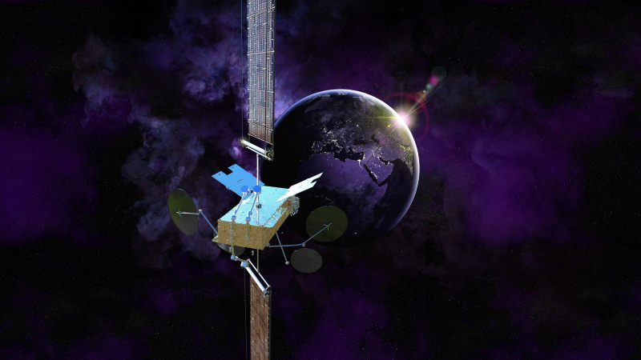
IntRoduction
TAS is supporting NanoXplore technology for many years and has participated with ADS in the development of the NG-Ultra
TAS has selected NanoXplore technology in some of our key programs
TAS needs an efficient design tool chain to achieve sufficient performances
SPACE INSPIRE

Slide 3
OPERA Project
NanoXmap toolsuite was oriented to cover NG-MEDIUM & NG-LARGE variant
NX needed to refine their algorithms for NG-ULTRA with the help of end users
OPERA H2020
Objectives were
To assess the performances that can be achieved by some designs in NG-ULTRA technology and compare it with performances achieved in the reference technologies
Mature the NanoXmap toolsuite as fast as possible
Horizon 2020 was the EU's research and innovation funding programme from 2014-2020
It allows TAS to jump into NG-ULTRA technology !

Slide 4
NG-ULTRA

Slide 5
TAS DESIGN FLOw
We use Catapult to design complex DSP algorithm
We use Precision to perform hardened synthesis targeting multiple FPGA vendors and families (Xilinx, Microchip, …)
We have been collaborating since 2021 with Siemens and NanoXplore to make Precision and Catapult support NG-Ultra

Slide 6
Collaboration
Add new features to support NG-ULTRA in Precision & Catapult
Transfer technological informations needed for synthesis
Evaluate reference designs using engineering builds of Precision & Catapult
15/03/2023

Slide 7
USE CASE : ALtimeter
Implementation of an altimeter DPU into the NG-Ultra technology (excluding DAC, ADC, RF)
The use case includes a chip generator, an echo receiver, a TM formatter and a sequencer.

Slide 8
USE CASE
The use case includes 5 designs that have been initially mapped in ASIC or FPGA technology
Name | Technology | Complexity | Frequency | Catapult blocks
Sequencer | RTAX1000 | 4000 (R+C Cells) 4 Kbits RAM | 50 MHz | None
Digital Waveform Generator | ATC18RHA | 2 Mgates – 40 kflip-flops 5 Mbits of RAM | 400 Mhz 200 Mhz 100 Mhz (main) 10 Mhz | None
Echo Receiver | ATMX150RHA | 5.2 Mgates – 110 Kfli-flops 4 Mbits of RAM 1 PLL | 100 MHz | fft ifft …
Echo preprocessor | ATMX150RHA | 2 Mgates – 40 kflip-flops 2.5 Mbits of RAM | 100 Mhz | fft Ifft Signal encoder Signal decoder
Output Formatter | RTAX2000 | 5000 (R+C Cells) 180 Kbits pf RAM | 50 Mhz | None

Slide 9
Exploring NXMAP tooL PERFORMANCES
Porting the sequencer into the NG-ULTRA
Sequencer is a simple design with few cells (6K LUTS / 6K DFF) and no « complex » elements (few BRAM / no DSP)
Press-button strategy : Synthesis and Place & Route using NxMap
Ran with default options. Only constraining the design clock (target frequency).
Done using the « script » approach, instead of using the GUI.
Analysis of the synthesis and P&R results :
post-synthesis maximum frequency : 155 MHz
Much lower post-P&R maximum frequency : 91.391 MHz

Slide 10
Synthesis and P&R performance optimization
Different performance optimization have been tested:
Synthesis and P&R parameters tuning -> Minimum impact
Constraint Placement
constrain the design or parts of design to be placed and routed into a specified region of the FPGA.
Maximum frequency post P&R reached = 103.018 MHz -> twice the performance of the initial design in RTAX technology

Slide 11
NXMAP vs. Precision synthesis
 | NxMap | Précision + NxMap
Max. Frequency* | 155 MHz | 139 MHz
DFF | 1611 | 1511
LUT | 1734 | 1811
CARRY | 382 | 235
BRAM | 4 | 4
DSP | 0 | 1
Occupation looks similar,
except for the CARRYs.
* Frequency comparison have no sense at this stage

Slide 12
Catapult / Precision / NXMAP FLOW – Focus on CATAPULT
Update the files (sources, scripts) to be compatible with the latest version of catapult
Run Catapult on several blocks, targetting Xilinx Kintex Ultrascale FPGAs to verify the validity of the change
Run Catapult with the same blocks, now targetting NG-ULTRA
First tests done with library that did not contain memories. Memories have been externalized ➔ too many IOs in the design, NxMap synthesis fails.
Tests done with final libraries provided by Siemens,
the RTL code is successfully generated.
A performance problem has been detected on floating point operator generation that does not fulfill the initial timing constraint (130 MHz). Can be a library problem or a technology limitation ?
Today we cannot guaranted that the pefromances will be met after synthesis + P&R. Work not yet done.

Slide 13
Reference Design Evaluation
The 5 design are merged to form one design and the complexity is estimated.
Our complexity evaluation is performed post-synthesis, using both Precision & NanoXplore
Observations :
Catapult successfully performs HLS for NG-ULTRA
Both Precision & NX successfully perform logical synthesis, with similar results*
NG-ULTRA can fit the reference design
 | 4-LUTs | Carry | DFFs | DSPs | RAMs | RFBs
NX | 229242 | 54342 | 145757 | 352 | 446 | 702
PRECISION | 194873 | 7091 | 133203 | 1220 | 334 | 1478

Slide 14
Conclusion AND PERSPECTIVES
Having a high performance HLS flow is essential for TAS future project.
We need an improvement of 50% in the performance to cover our needs.
Work with Nx and Siemens is to be continued.

