Slide 1
Open-source reconfigurable processing system for novel high-performance space applications
Álvaro Ortega¹, Alfonso Rodríguez², Eduardo de la Torre², Juan Antonio Ortega¹
¹AIRBUS CRISA
²Universidad Politécnica de Madrid

Slide 2


A bit of spam…
Center of Industrial Electronics (CEI-UPM)
  Reseach center at Universidad Politécnica de Madrid, Spain
  Research lines: Digital Embedded Systems, Power Electronics
  Strong relationship with companies (e.g., Industrial Council)
Digital Embedded Systems @ CEI-UPM
  7 full-time professors (1 on temporary leave) + 6 full-time PhD students
  Research lines: IoT systems, post-quantum cryptography, Edge AI/ML, Reconfigurable HW and FPGAs, adaptive RISC-V processors
  Strong presence in competitive project calls (e.g., H2020, KDT JU)

Slide 3
Context and Motivation
NewSpace scenarios
  Space missions treated as a commercial industry
  Higher computational requirements → better devices and processors
  Higher competition → reduction in costs, reusability
Run-time reconfigurable COTS SRAM-based FPGA devices
  Support for time-multiplexed HW resources (same FPGA, larger accelerators)
  Support for OTA HW updates (increased system lifetime)
  Less tolerant to radiation-related effects (additional fault detection, mitigation and recovery techniques are required)
Open-source standards, computing architectures and tools

Slide 4

Main Issues in FPGA-Based Systems
Lack of proper hardware architectures to deal with highly dynamic scenarios
Computing Performance
Energy Efficiency
Fault Tolerance
Lack of adequate design tools to isolate developers from low-level technology details
Automated DPR Flows
High-Level
Accelerator Descriptions
Lack of user-friendly runtime environments to manage application execution
Computation Offloading
Parallel Execution
DPR Management
D. Göhringer, “Reconfigurable Multiprocessor Systems: Handling Hydras Heads – A Survey”, in SIGARCH Comput. Archit. News, vol. 42, no. 4, p. 39–44, Dec. 2014.

Slide 5
The ARTICo³ Framework
FPGA-Based High-Performance Embedded Computing Platform
Processing
Architecture
Design-Time
Support
Run-Time
Support
https://github.com/des-cei/artico3

Slide 6
ARTICo³ Architecture
Global
Memory
Hierarchical
Memory Model
Hardware
Acceleration
Bus-Based
DMA-Enabled
Communication
Configurable
Datapath
Embedded
Monitoring
Infrastructure
Power Monitor

Slide 7
ARTICo³: Configurable Datapath
Configurable voter unit
  Bypass (Simplex)
  Comparator (DMR)
  Majority voter (TMR)
Reduction engine
  ADD, MAX, MIN
AXI-P2P bridge

Slide 8
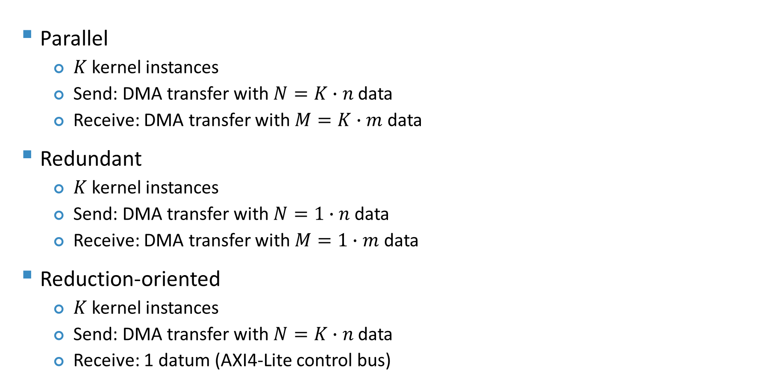
ARTICo³: Operation Modes
Parallel
  $K$ kernel instances
  Send: DMA transfer with $N=K∙n$ data
  Receive: DMA transfer with $M=K∙m$ data
Redundant
  $K$ kernel instances
  Send: DMA transfer with $N=1∙n$ data
  Receive: DMA transfer with $M=1∙m$ data
Reduction-oriented
  $K$ kernel instances
  Send: DMA transfer with $N=K∙n$ data
  Receive: 1 datum (AXI4-Lite control bus)

Slide 9
ARTICo³: Accelerator Virtualization
Memory-mapped virtualization
  Virtual address subranges for each kernel ID
  Isolation between kernel functionality and FPGA location
  Multicast commands in control bus
    Write operations: kernel reset
    Read operations: reduction operation code

Slide 10
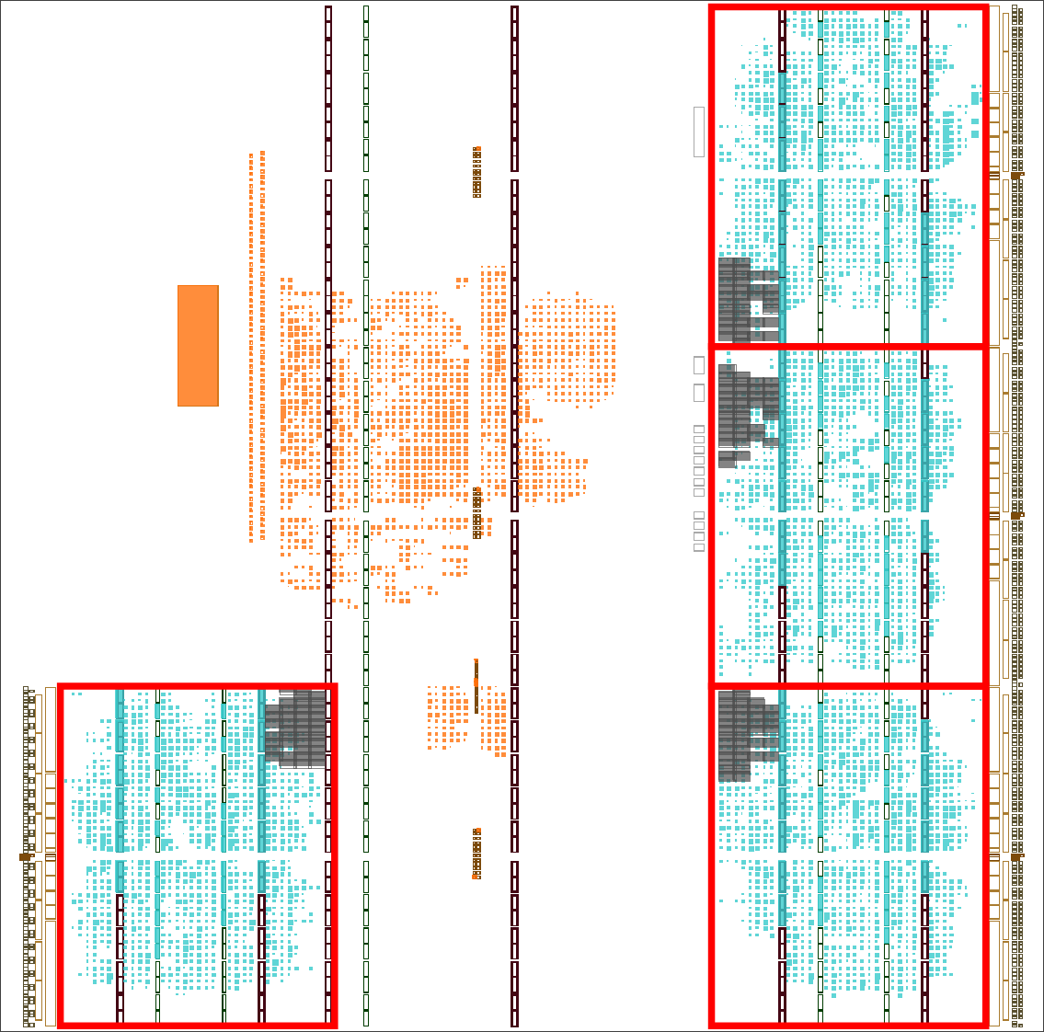
ARTICo³: Hardware Generation
entity <kernel_name> is
port (
-- Port list
);
end <kernel_name>;
A3_KERNEL(a3reg_t <reg_i>, (...),
a3const_t <mem_j>, (...),
a3in_t <mem_k>, (...),
a3inout_t <mem_l>, (...),
a3out_t <mem_m>, (...)) {
a3reg_init(<reg_i>);
(...)
}

Slide 11
ARTICo³ Toolchain (Hardware + Software Generation)

Slide 12
ARTICo³ Runtime and C API
Type | Function
System | artico3_init
 | artico3_exit
Slot | artico3_load
 | artico3_unload
Memory | artico3_alloc
 | artico3_free
Kernel | artico3_kernel_create
 | artico3_kernel_release
 | artico3_kernel_execute
 | artico3_kernel_wait
 | artico3_kernel_reset
 | artico3_kernel_wcfg
 | artico3_kernel_rcfg
Monitor | artico3_hw_get_pmc_<type>
Helper | ftoa3
 | a3tof
Full Reconf.
DPR
4 Accs.
2 Accs.
2 Accs.
Accelerator
Management
1 Acc.
1 Acc.
1 Acc.

Slide 13

Run-Time Solution Space Exploration with ARTICo³
ARTICo³-enabled CCSDS 123 compressor (HyLoC)
Input Image: AVIRIS (calibrated) 512 samples, 512 lines, 224 bands
Accelerators | Iterations | Theor. Throughput Msamples/s | Actual Throughput Msamples/s | Energy Efficiency mW/(Msamples/s)
1 | 4096 | 7.72 | 6.92 | 378.18
2 | 2048 | 15.45 | 13.28 | 197.1
4 | 1024 | 30.9 | 24.52 | 106.73
8 | 512 | 61.81 | 42.48 | 61.61
16 | 256 | 123.62 | 67.04 | 39.1
9.69x
XC7K325T-2FFG900C
FPGA @ 100 MHz
XC7Z100-2FFG900
ARM @666.67 MHz
FPGA @ 100 MHz

Slide 14
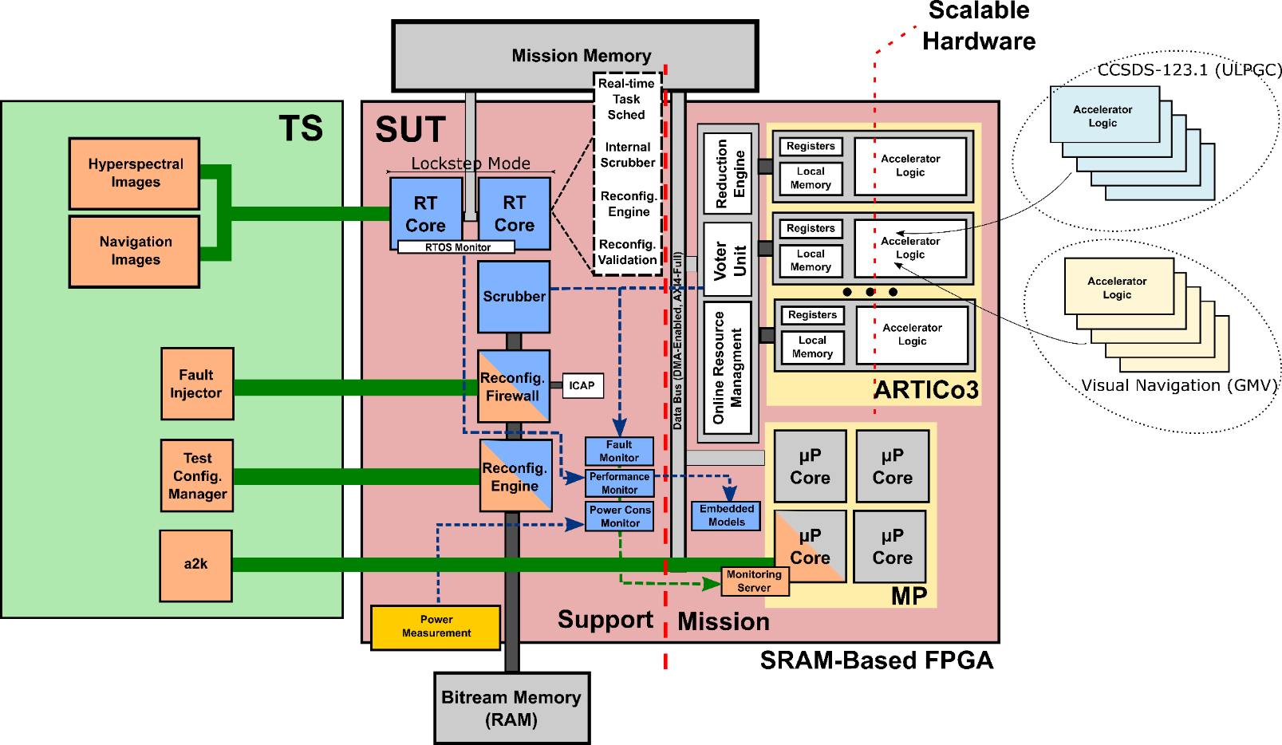





Hardening ARTICo³ MPSoCs for Space Applications
Single platform that unifies System Under Test (SUT) and Test System (TS)
RTEMS ported to Zynq US+ (locked-step execution on Cortex-R5)
On-board processor for space applications on reconfigurable, non-rad-hard, SRAM-based COTS FPGA
H2020-ECSEL-2015-2-IA-two-stage (grant ID 692455)

Slide 15
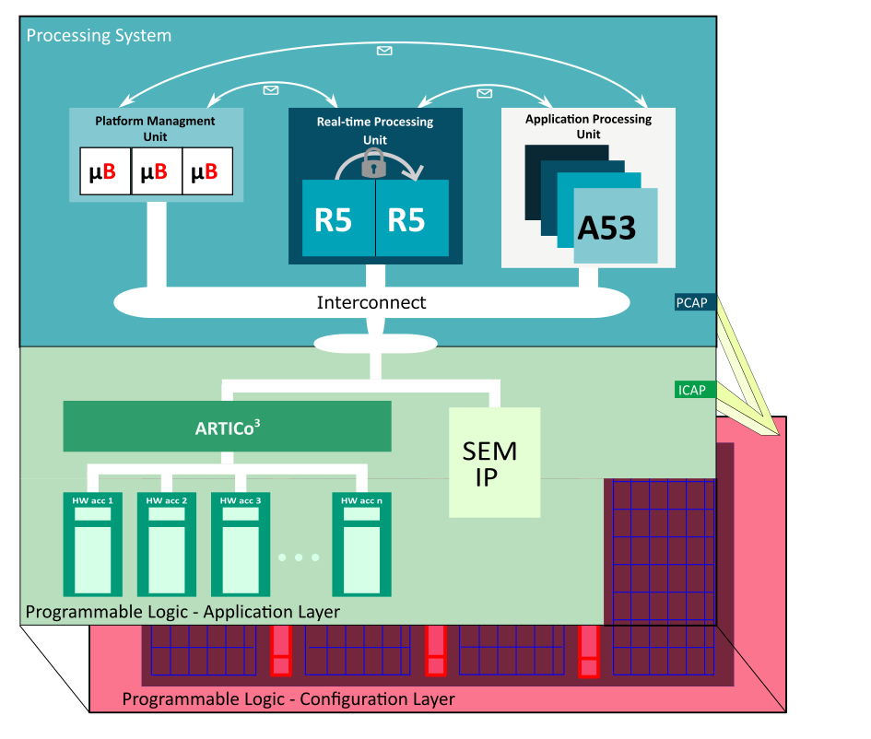
Hardening ARTICo³ MPSoCs for Space Applications
Passive fault-tolerance techniques
  Modular redundancy in ARTICo³ accelerators
  Locked-step execution on Cortex-R5 processors
Adaptive-rate active fault-tolerance techniques
  [HW] ECC/CRC scrubber (SEMIP)
  [SW] Configuration-aware scrubber
  [SW] Blind scrubber
Performance, error and power consumption monitors (i.e., PMCs)
On-board fault injection support for V&V
Safe, secure and predictable reconfiguration mechanisms (i.e., firewall)

Slide 16
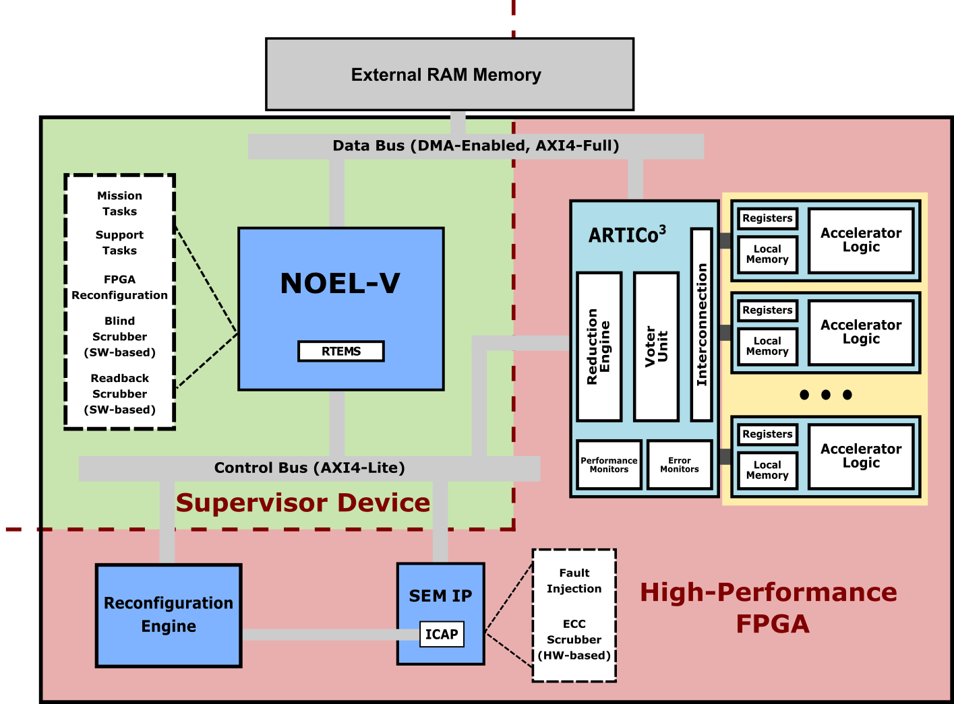
Going full Open Source
Migration from ARM Cortex-R5 processors to NOEL-V (RISC-V)
Implementation on reference NOEL-V design on KC705 (Kintex-7) board
HW
Integration of ARTICo³ on NOEL-V subsystem w/ AHB2AXI bridges
HW
Integration of HWICAP on NOEL-V subsystem to support reconfiguration
HW
Integration of scrubber and fault injection mechanisms (SEMIP + SW)
HW
SW
Development of low-level drivers (HWICAP, SEMIP and DMA engine)
Arbitration HW/SW
SW
https://www.gaisler.com/index.php/downloads/leongrlib

Slide 17
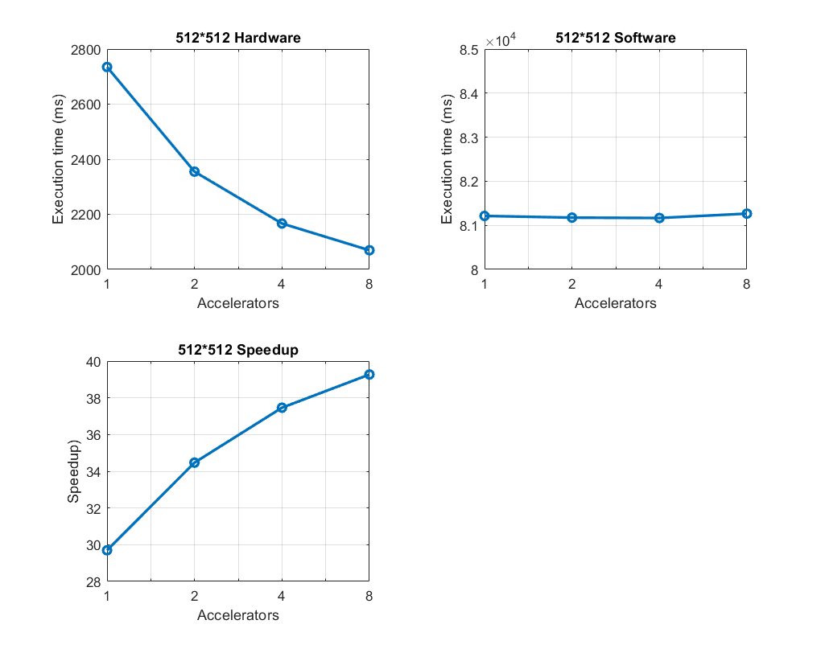
Experimental Results (I)
ARTICo³ block-based matrix multiplication demo
Reconfiguration time ~250 ms/acc
Limited speedup due to bus bandwidth

Slide 18
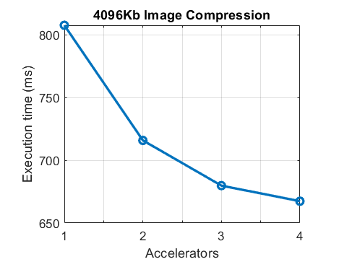
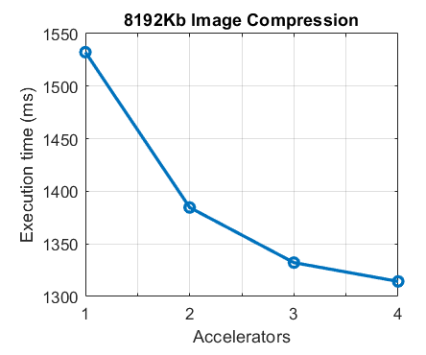
Experimental Results (II)
CCSDS 121 data compression algorithm
8-bit data
16-bit data
Reconfiguration time ~250 ms/acc
Limited speedup due to bus bandwidth

Slide 19
Experimental Results (III)
Fault tolerance metrics for HW- and SW-based scrubbers
Application | #Accs | Abitration (ms) | Repair (ms) | Reset (ms) | Blind scrubber (ms)
Matmul | 1 | 63.88 | 209.42 | 70.56 | 269.34
 | 2 | 62.64 | 218.69 | 77.38 | 539.28
 | 4 | 64.48 | 219.84 | 78.76 | 1097.27
 | 8 | 62.78 | 224.57 | 75.13 | 2199.61
CCSDS 121 | 1 | 62.21 | 214.37 | 76.4 | 229.11
 | 2 | 63.26 | 214.74 | 78.94 | 476.31
 | 3 | 63.29 | 226.36 | 77.53 | 782.42
 | 4 | 64.63 | 232.98 | 77.86 | 1047.70
Initialization time (reset) in datasheet for ECC repair: 71 ms
Blind scrubbing overheads dependent on the #accelerators

Slide 20
Conclusions
User-accessible HW-accelerated framework
Transparent FPGA reconfiguration support
Hierarchical mixed HW/SW fault detection, recovery and mitigation
Full open-source computing stack for space applications
  NOEL-V processor
  RTEMS operating system
  ARTICo³ acceleration infrastructure

Slide 21
Future Activities (and Wishlist)
Finish the migration of the scrubber stack (i.e., reconfiguration-aware)
Evaluation of multi-FPGA setups
  Supervisor device: NOEL-V + RTEMS + SW-based support stack
  High-performance device: DPR-capable computing substrate
Evaluation of alternative acceleration approaches (e.g., ISA extensions)
Migration to space-grade reconfigurable FPGA families (NanoXplore)

Slide 22
THANK YOU FOR
YOUR ATTENTION
alfonso.rodriguezm@upm.es

