Slide 1


ARIETIS
An example of NG-Medium usage
Jokin PERRET– 16/03/2023

Slide 2
AGENDA
EREMS & INNALABS
ARIETIS Project
Designing with NG-Medium
Conclusion

Slide 3
1-EREMS & INNALABS 2-ARIETIS Project 3-Designing with NG-Medium 4-Conclusion
EREMS & INNALABS

Slide 4
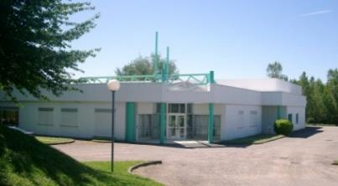



1-EREMS & INNALABS 2-ARIETIS Project 3-Designing with NG-Medium 4-Conclusion
EREMS & INNALABS
----- EREMS --------------------------------------------------------------------------------------------------
  Independent SME, based near Toulouse, created in 1979
  Aim:
  Development of electronic equipment, and associated software
  for high technological fields, especially for space
  Space activities:
    A very strong heritage (space activities since 82)
    Development of flight and ground equipment
  Staff
    170 employees (110 engineers)
  Revenue
    2021/22 : 17,4 M€
  Certifications:
    ISO 9001 : 2015
    EN 9100 : 2018
  Memberships:
  Design, Manufacturing, Test, and Qualification of electronic equipment
  Major Field of expertise:
    Power conversion
    Front End and acquisition
    On Board Computer, Data Handling Unit
    Motor Drive Electronics
  Projects from class 1 to NewSpace:
TELECOMMUNICATION SATELLITES
EARTH OBSERVATION
HUMAN SPACE FLIGHT
SCIENTIFIC PROGRAMS
R&T

Slide 5
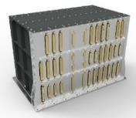

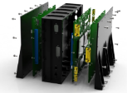




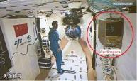
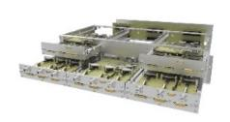
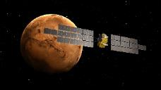


1-EREMS & INNALABS 2-ARIETIS Project 3-Designing with NG-Medium 4-Conclusion
EREMS & INNALABS
----- EREMS --------------------------------------------------------------------------------------------------
EARTH OBSERVATION PROGRAMS
CERES RTU modules
CERES / FLEX SAP (Passivation Units)
SWOT RTU modules and assembly
IASI-NG/METOP-SG 3 main units of the instrument
PLEIADES-NEO Complete set of Electronic equipment of the optical instrument
COPERNICUS LSTM FEE
CO3D Processing & Mass Memory Optical instrument electronics
Mechanism Drive electronics
  Projects from class 1 to NewSpace...
TELECOMMUNICATION SATELLITES
Electronic units onboard:
  IRIDIUM-Next (Battery electr. modules)
  E3000 / EOR
and soon other types of units flying on
  SpacebusNeo
  EurostarNeo
SCIENTIFIC PROGRAMS (satellites/probes)
SVOM ECLAIR/UGTS (ECLAIR OnBoardComputer)
PLATO ARIETIS (Gyro Electronics)
EXOMARS MicrOmega (RF Synthetiser)
SVOM MXT/MDPU (MXT OnBoardComputer)
CARMEN Radiation monitors
SOLAR-ORBITER High Voltage Power Supply
MSR ERO RIU
HUMAN SPACE FLIGHT
CARDIOSPACE 2 on Tiangong 3
MTB-2 on BION-M n°2
TELEMAQUE (Alpha Mission)
LUMINA (Alpha Mission)
NEWSPACE
ANGELS - PCDU
KINEIS Constellation - PCDU
MMX Rover - PCDU
DARWIN CU – BOMO
CO3D - 3 main units
R&T
projects linked to Data Handling electronics and processing, Power Distribution

Slide 6
1-EREMS & INNALABS 2-ARIETIS Project 3-Designing with NG-Medium 4-Conclusion
EREMS & INNALABS
----- INNALABS ------------------------------------------------------------------------------------------------
  Independent SME, formed in Ireland Oct 2011
  Head quarter in Dublin Ireland since Aug 2012
  Business type : Develop Inertial sensors & systems
  Staff: 55 employees
  Patent Registered: 32 Patents
  Revenue 2022 : 10-15 M€
  Education Hi levels - technology
  Certification ISO 9001 2015
  Key markets:
    Aerospace & Defence
    Space
    High End Industrial
    Emerging Technologies
  Space Heritage:
    TRL9 for gyro and accelerometers (space proven).
    New products being developed both in class 1 quality and new space quality.
  Mission statement:
To become a leading global brand which is acknowledged as a premier designer & manufacturer of inertial components & systems
which provide innovative solutions which add value to our customers

Slide 7
1-EREMS & INNALABS 2-ARIETIS Project 3-Designing with NG-Medium 4-Conclusion
ARIETIS PROJECT

Slide 8
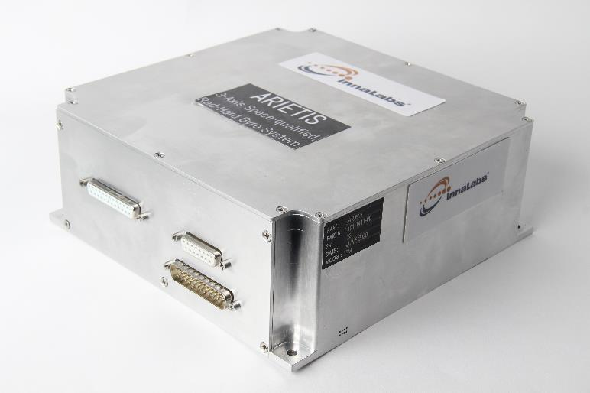
1-EREMS & INNALABS 2-ARIETIS Project 3-Designing with NG-Medium 4-Conclusion
2 – ARIETIS PROJECT
----- Aim -------------------------------------------------------------------------
Development of a stand alone 3-axes Gyroscope Unit
  space class 1 applications (ESA ECSS standard, class1 EEE parts)
  10/15 year lifetime for LEO/GEO
  High reliability
  ITAR-free
Off-the-shelf product
----- Main features ------------------------------------------------------------
Very low noise
  maximum range: 4,5 deg/s
  precision: 0,01 deg/h
Low power : 8,5W
Satellite Interfaces:
  RS422 (default) / RS485 / CAN
  Analog & Digital outputs
----- Key applications ---------------------------------------------------------
Earth observation, Science and Exploration
Already selected for LEO and science missions: PLATO and LSTM
----- Important dates --------------------------
Engineering models available since Q2 2022
Qualification in 2023
Flight Models available from Q1 2024

Slide 9
1-EREMS & INNALABS 2-ARIETIS Project 3-Designing with NG-Medium 4-Conclusion
2 – ARIETIS PROJECT
----- EREMS & INNALABS complementary association ----------------------------------------------
1st time for INNALABS to propose a gyroscope for space application
1st design for INNALABS involving digital regulation of the sensors
1st Gyroscope electronic for EREMS
EREMS main activity is space application electronic’s development with a lot of class 1 projects
EREMS has years of FPGA application expertise
INNALABS main activity is gyroscope development
INNALABS provides
  Overall mechanical and electronic design
  Gyroscope expertise
  Regulation loop detailed definition
  Sensor manufacturing
  EGSE manufacturing
  mechanical integration
  performance validation
  environmental test
EREMS provides
  Space class 1 electronic expertise
  Digital design expertise
  Power supply board design and development
  FPGA design and development
  EEE procurement
  PCB design
  board manufacturing
  board unitary testing

Slide 10
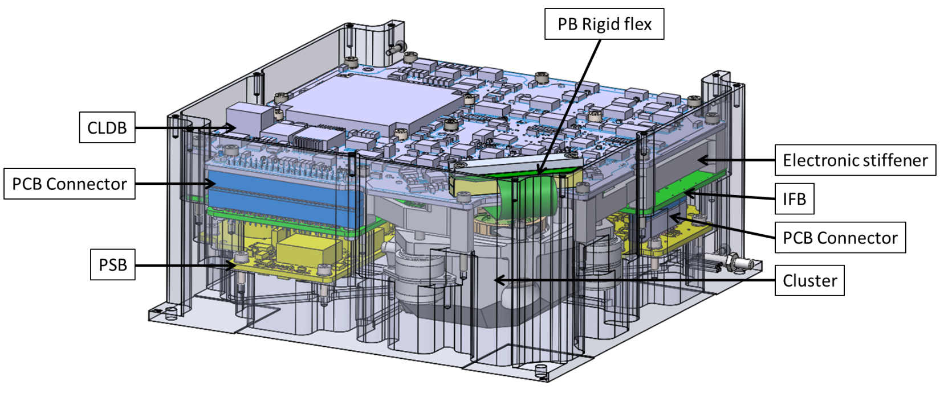
1-EREMS & INNALABS 2-ARIETIS Project 3-Designing with NG-Medium 4-Conclusion
2 – ARIETIS PROJECT
----- Internal architecture ----------------------------------------------------------------------------------
Power Supply board (PSB)
InterFace Board (IFB)
Digital Board (CLDB with NG-medium FPGA)
3 Proximity boards

Slide 11
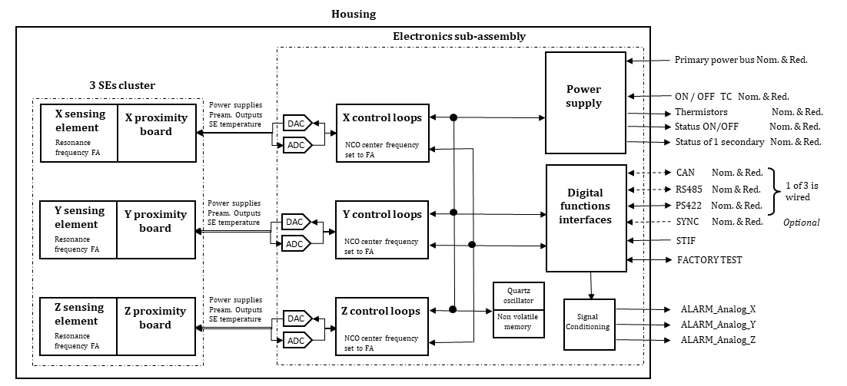
1-EREMS & INNALABS 2-ARIETIS Project 3-Designing with NG-Medium 4-Conclusion
2 – ARIETIS PROJECT
----- Internal architecture ----------------------------------------------------------------------------------

Slide 12
1-EREMS & INNALABS 2-ARIETIS Project 3-Designing with NG-Medium 4-Conclusion
2 – ARIETIS PROJECT
----- FPGA development ------------------------------------------------------------------------------------
2 major problematics in 2018
  Complex design
    very precise control loops
    1st time digital regulation for INNALABS
    1st time Gyro for EREMS
  New target NG-Medium selected
    Technology qualification ongoing
    Poor maturity of NanoXplore’s development tools
    EREMS has no much experience with the technology
Solution: segregation and anticipation
  Validate algorithm before NG-medium porting activities
    Avoid mixing issues
    Give time for NanoXplore tool progression
  Plan early timing closure activities on complete design
    before FPGA PDR (Preliminary Design Review)
Theoretical modeling: Simulink
Main Goal: specification and theoretical validation
quantification studies for FPGA implementation
1 axis breadboards: Igloo2
Anticipate NG-medium difficulties for the algorithm implementation
3 axes EM1 & EM2: Igloo2
Main goal: Algorithm update and Onboard validation of the 3 axes design
design functionally identical to FM
3 axes EM3: NG-medium
algorithm resource optimization
main goal: Onboard validation with final FPGA target
large effort on timing closure
numerous small design rework
design identical to FM
Main Goal: Onboard validation of the algorithm and preparation for 3 axes model
Gyro algorithm developed with NG-medium target in mind
Bit accurate vhdl vs Simulink algorithm verification
fast development for other modules

Slide 13
1-EREMS & INNALABS 2-ARIETIS Project 3-Designing with NG-Medium 4-Conclusion
DESIGNING WITH NG-MEDIUM

Slide 14
1-EREMS & INNALABS 2-ARIETIS Project 3-Designing with NG-Medium 4-Conclusion
3 – Designing with NG-Medium
----- ARIETIS FPGA as of today ----------------------------------------------------------------------------
Key characteristics:
  Complex & fast regulation loops
    8MHz / 1MHz / 500kHz
  Large amount of DSP usage
  1 clock domain: 80MHz
  86 configurable parameters
  134 vhdl files
  About 60 % of NG-medium
Detailed NG-Medium occupancy:
+------------------+------------------+-------------+-----------------+------------+--------+--------+------------+--------------+-------------+-----------+----------+
| | | | 1 - bit | Register | Cross | Clock | Clock | Digital | Memory | | |
| 4-LUT | DFF | XLUT | Carry | file | domain | Buffer | switch | signal | block | WFG | PLL |
| | | | | block | clock | | | processor | | | |
+------------------+------------------+-------------+-----------------+------------+--------+--------+------------+--------------+-------------+-----------+----------+
| 8694/32256 (27%) | 9720/32256 (31%) | 0/2016 (0%) | 5823/8064 (73%) | 0/168 (0%) | 0/0 | 0 | 0/336 (0%) | 90/112 (81%) | 24/56 (43%) | 1/32 (4%) | 0/4 (0%) |
+------------------+------------------+-------------+-----------------+------------+--------+--------+------------+--------------+-------------+-----------+----------+
Estimated FE occupancy is 19262/32256 (60%)

Slide 15
1-EREMS & INNALABS 2-ARIETIS Project 3-Designing with NG-Medium 4-Conclusion
3 – Designing with NG-Medium
----- Timing closure activities ------------------------------------------------------------------------------
Started in 2022 with complete FPGA Design working on Igloo2
  3 AXES management validated with EM1/EM2
  Over 100MHz frequency reached without any timing or placement constraint
  Some modules are already tagged for large rework
First run with NXmap3.11:
  Huge effort needed for 80MHz target
Iterative Methodology applied :
  Nxmap run with random seeds
  NanoXplore’s Timing analyzer
  Case by case approach depending on critical paths:
    Multicycle constraint definition
    Test NXmap option/directive
    Consider small design rework
    Placement constraint definition
    Define False paths until large module rework
  Back to step 1
20,541 MHz
NXmap with random seed
timing analyzer
case by case approach depending on critical paths

Slide 16
1-EREMS & INNALABS 2-ARIETIS Project 3-Designing with NG-Medium 4-Conclusion
3 – Designing with NG-Medium
----- NXpython scripting ------------------------------------------------------------------------------------
ARIETIS project counts more than 560 NXmap recorded runs during timing closure progression
Scripting is mandatory for efficient timing closure progression
We recommend using several scripts.
We chose the following principle:
  1 Main script with most of options and synthesis/placement/routing commands
  1 sub-script for source list
  1 sub-script for IO definitions
  1 sub-script for multicycle definitions
  1 sub-script for placement constraints

Slide 17
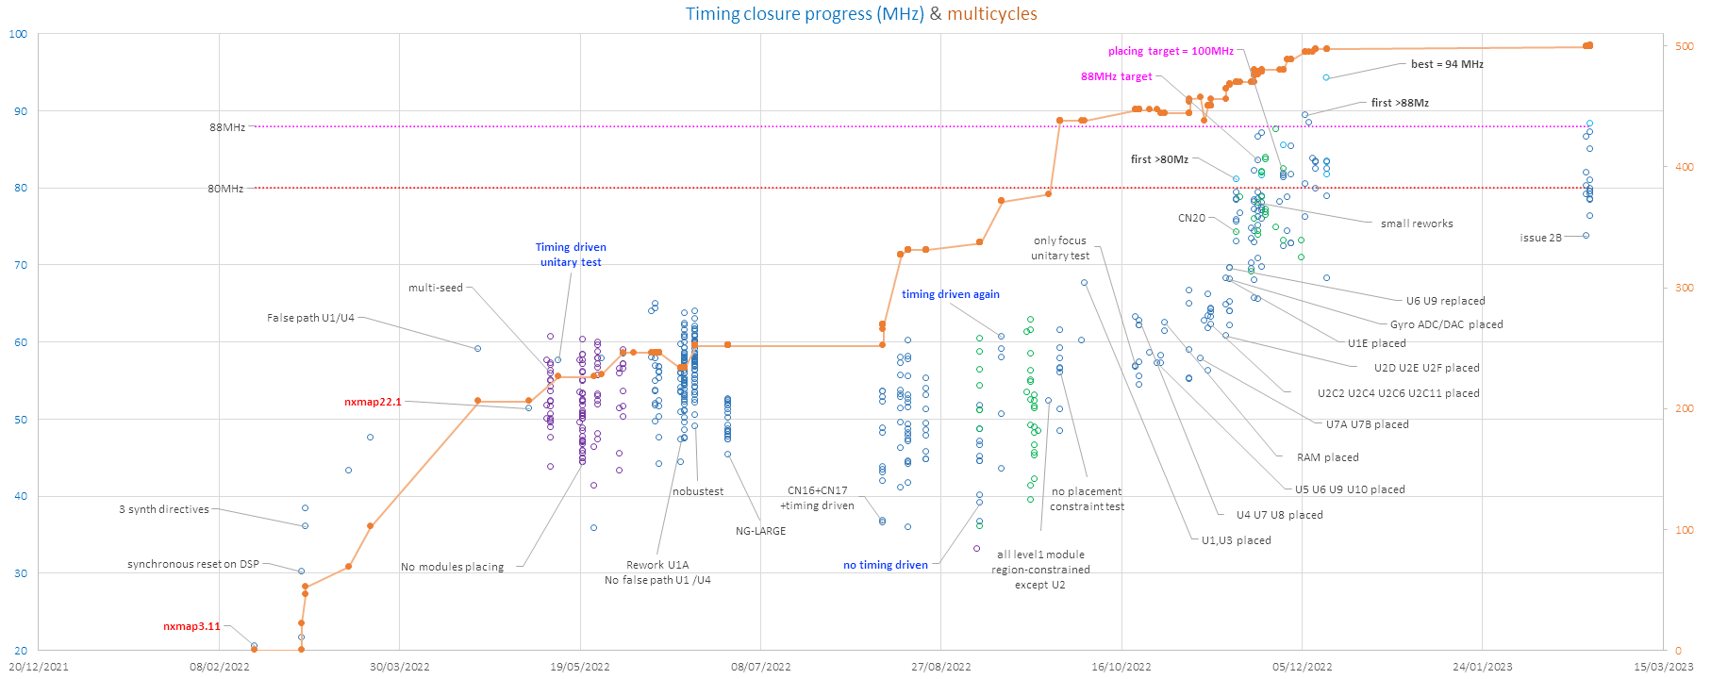
1-EREMS & INNALABS 2-ARIETIS Project 3-Designing with NG-Medium 4-Conclusion
3 – Designing with NG-Medium
----- Timing closure overall progression ----------------------------------------------------------------
Multicycles
placements
small reworks
Multi-seed

Slide 18
1-EREMS & INNALABS 2-ARIETIS Project 3-Designing with NG-Medium 4-Conclusion
3 – Designing with NG-Medium
----- Multicycles ----------------------------------------------------------------------------------------------
Very effective progression at the start of timing closure
Requires anticipation because multicycle structures have
to be implemented in the vhdl design
When well-anticipated, multicycle definition is
straight-forward and easy to verify
It sometimes requires complex design
analysis to be certain that there is no possible path
breaking the multicycle
ARIETIS case:
  Total of 500 multicycle constraints defined
  Very good progression from 20MHz to 60MHz
  Only minor progression after that
Large amount of multicycle raise 1 big question:
  How to verify that none of the constraint is wrong ?

Slide 19
1-EREMS & INNALABS 2-ARIETIS Project 3-Designing with NG-Medium 4-Conclusion
3 – Designing with NG-Medium
----- Multi-seed -----------------------------------------------------------------------------------------------
Launch several run of NXmap with random seeds
  Not implemented as baseline command in NXmap or NXpython
  Requires specific scripting
One of most useful things we added
  Counteracts the bad/good luck effect of random seed
  Essential to give more timing progress results
  Shows about 20MHz spreading between good and bad seeds
  Eases determining which part of the design requires priority attention
  Allows verifying that each new constraint/design change is actually a progression and not just good luck on seeds
Unfortunately some options make the multi-seed scripting fail at the 2nd run:
  Timing driven option
  Placement constraint
Less efficient solution:
  Manually launch several NXmap runs in parallel

Slide 20
1-EREMS & INNALABS 2-ARIETIS Project 3-Designing with NG-Medium 4-Conclusion
3 – Designing with NG-Medium
----- Timing driven -------------------------------------------------------------------------------------------
New functionality implemented in NXmap22.1
  One of most expected addition to NXmap
  supposed to adapt element placing and routing to timing estimation/analysis
1st try results:
  Nxmap run takes x5 to x10 longer time
  We Lost multi-seed ability
  Frequency dropped about -10MHz
We supposed it was related to the non exhaustiveness of our multi-cycle definition list
  NXmap might spend too much effort on paths that could actually be multi-cycled
  We reactivated the timing driven later with a more complete multicycle list
It was hard to measure efficiency of the feature during ARIETIS timing closure
  No multi-seed means no reliable way to compare results
In the end, it’s with timing driven activated that the targeted 80MHz and the +10% margin were reached for ARIETIS
  Best run 94MHz
  About 1/3 runs > 80MHz
  About 1/15 runs > 88MHz

Slide 21
1-EREMS & INNALABS 2-ARIETIS Project 3-Designing with NG-Medium 4-Conclusion
3 – Designing with NG-Medium
----- Placement constraints --------------------------------------------------------------------------------
Without any placement constraint:
  The design “grows” in a symmetrical way around the center of the FPGA
  Nxmap Spreads resources even if they are linked to the same data-path
It Requires a lot of iterations to find good placement solutions
  It’s a mix between defining very constrained region for module to improve internal paths performances
  And accepting larger regions to give space for routing and also improve non-constrained paths performances
Limitations from NXmap22.1
  Loss of multi-seed ability
  Hard/Soft option for region definition is clumsy
  Region definition is limited to tiles
  No tool to determine each module resource usage
  No report to list resources actually affected to a region
  Sub-modules regions have to be declared before the module above

Slide 22
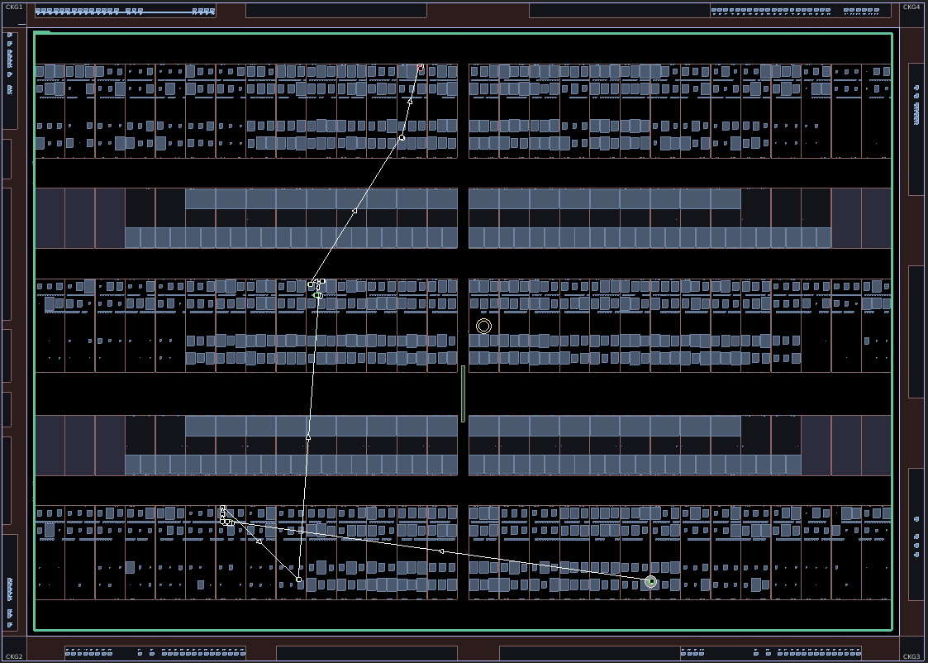
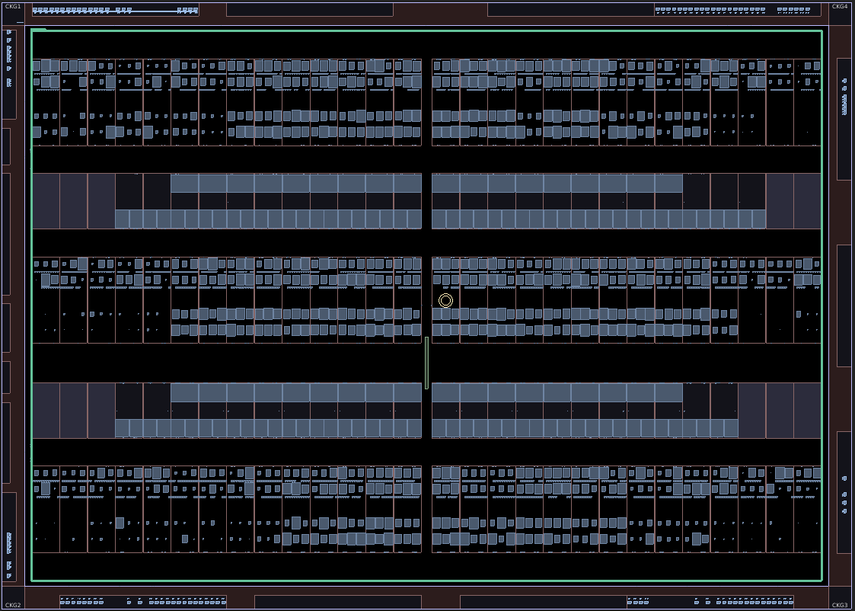
1-EREMS & INNALABS 2-ARIETIS Project 3-Designing with NG-Medium 4-Conclusion
3 – Designing with NG-Medium
With no placement constraint
Symmetrical aspect
grow effect around ‘focus’ point at the center of FPGA
Corners are underexploited
Spreading effect observable on critical paths
What does it look like after placement constraint ?

Slide 23
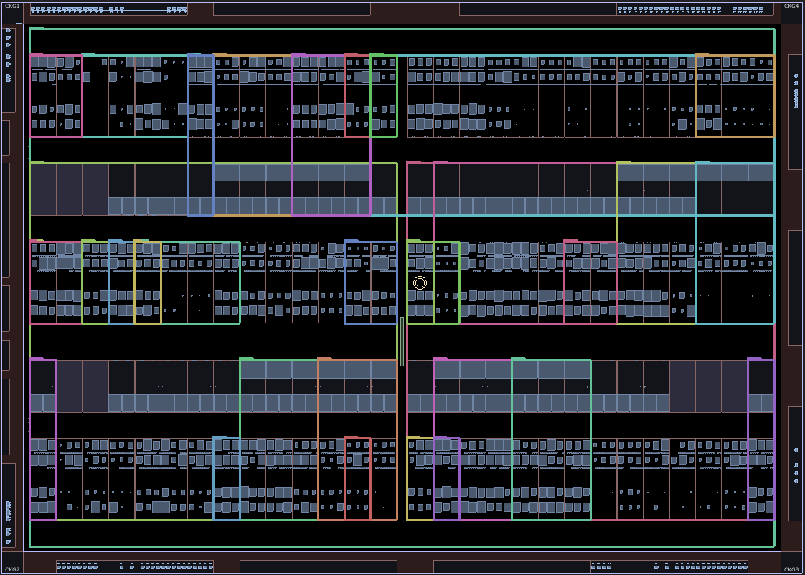
1-EREMS & INNALABS 2-ARIETIS Project 3-Designing with NG-Medium 4-Conclusion
3 – Designing with NG-Medium
After 42 regions defined
What worked for ARIETIS ?
Usage of ‘Soft’ Regions
Smallest possible regions for interface small modules with few interactions with other modules
Give some margin to large modules (typically top level modules)
Distinct non overlapping regions for the 3 axes
No constraint on large module that requires a lot of interactions with others (Main controller)
Constrain all RAM usage close to the modules accessing it
Select sub-module to be constrained depending on which one came often in critical path results

Slide 24
1-EREMS & INNALABS 2-ARIETIS Project 3-Designing with NG-Medium 4-Conclusion
3 – Designing with NG-Medium
----- Small and Large module reworks -------------------------------------------------------------------
Add multicycle structures to the design
Enhance synthesis for multi-cycles’ enable signals
  Give top priority to enable signal in each clocked process
  This ‘forces’ NXmap to get less logic on enable signal paths
Hunt avoidable logic between modules
Multiplication operation work arounds:
  Use synthesis constraint to force DSP usage for multiplication operations with a constant
  Break large size multiplications in 2 such as they can each fit in 1 DSP

Slide 25
1-EREMS & INNALABS 2-ARIETIS Project 3-Designing with NG-Medium 4-Conclusion
3 – Designing with NG-Medium
----- A few more details -------------------------------------------------------------------------------------
Hard or Soft regions ?
In ARIETIS case, ‘Hard’ option Fails at placement (2/5) for most of our modules
‘Soft’ option works but has a major drawback:
  Unrequested resources from other modules are affected to the defined region
  Can totally block placement progression until you affect these resources to an other region
Reset tree routing optimization:
  Instantiate global buffer in 1 vhdl sub-module
  Affect the module to a 1-tile region at the closest point to global buffers location (center of FPGA)
  Do not use ‘registered’ option for IOs
Change the focus point ?
  No effect observable
NG-Large test ?
  Bigger size => More spreading => Frequency drop around 20MHz

Slide 26
1-EREMS & INNALABS 2-ARIETIS Project 3-Designing with NG-Medium 4-Conclusion
CONCLUSION

Slide 27
1-EREMS & INNALABS 2-ARIETIS Project 3-Designing with NG-Medium 4-Conclusion
4 – CONCLUSION
----- ARIETIS project feedback -----------------------------------------------------------------------------
Very challenging project
  Complex FPGA design with High frequency target
  New technology with NG-medium
  Required a lot of co-engineering between EREMS and INNALABS
Starts producing results
  Algorithm onboard validation with Igloo2
  Timing closure successful on NG-medium
First onboard tests of ARIETIS with NG-Medium are currently ongoing

Slide 28
1-EREMS & INNALABS 2-ARIETIS Project 3-Designing with NG-Medium 4-Conclusion
4 – CONCLUSION
----- NXmap feedback ---------------------------------------------------------------------------------------
NXmap tools have a lot of room for improvement to help FPGA designers progress faster on challenging projects.
  Simple projects should easily produce good results
  Projects with high frequency and high resource usage require a lot of effort
The FPGA technology is promising
  94 MHz on such a complex design is a real achievement
  We expect upcomming tool improvements to help reduce the effort needed for future projects
Impulse was rapidly tested in 2023 but failed with our NXmap22.1 script for ARIETIS design
  Further investigation required with NanoXplore support, but should be resolved with small script adaptations
  Some additions are greatly appreciated :
    New IHM allows more human-friendly manipulations & investigation
    Get module resource usage without having to define regions
Some key features to be improved:
  Add multi-seed ability
  Have access to a post-synthesis schematic viewer
  Improve Hard / Soft regions behavior
  Improve effectiveness of Timing Driven

Slide 29
1-EREMS & INNALABS 2-ARIETIS Project 3-Designing with NG-Medium 4-Conclusion
4 – CONCLUSION
----- Contacts --------------------------------------------------------------------------------------------------
FPGA related subjects
  Jokin PERRET: jokin.perret@erems.fr
EREMS other projects
  Yohann BALLOT: yohann.ballot@erems.fr
INNALABS and ARIETIS equipment
  Alberto TORASSO: alberto.torasso@innalabs.com
  Rachel MURRAY: rachel.murray@innalabs.com

Slide 30
1-EREMS & INNALABS 2-ARIETIS Project 3-Designing with NG-Medium 4-Conclusion
MANY THANKS

