Slide 1

EDA Tools for the analysis and mitigation of radiation effects on FPGAs
Eleonora Vacca
Sarah Azimi
Corrado De Sio
Andrea Portaluri
Daniele Rizzieri
Luca Sterpone

Slide 2
Goal
Enhance state-of-the-art techniques for the reliability analysis and mitigation of radiation effects on FPGAs
Development of Electronic Design Automation (EDA) tool set
  Analysis of SEU / SET effects impact on FPGA circuit reliability
    Capability of evaluating redundancy architecture such as TMR
  Accurate error rate estimation
  Mitigation of SEU / SET effects at the FPGA place and route level
  Compatibility with commercial tools
    AMD Xilinx
    Microchip
    NanoXplore

Slide 3
Back-end EDA tools
Physical Design Description (PDD) converters
  A set of netlist conversion tool for FPGA logic and routing resources generation, storage and management
PDD Place
  A resource balanced and timing-driven placement software tool for any FPGA architecture
PDD Routing
  A FPGA-oriented routing algorithm for any FPGA architecture
PyXEL
  An integrated environment for the correlation of PDD and FPGA configuration memory

Slide 4
Back-end tool flow
Standard
Implementation Flow
Back-end tool set
Exchange Files for
Front-end tools
Design Entry
Synthesis
Architecture & Bitstream Structure
PDD Convs
Netlist
PDD format
PyXEL
Resource Bitmap
PDD
File
Mapping
Place and Route
PDD Place
PDD Routing
Bitstream
Bitstream Generation
PDD Convs
PDD Annotated
Configurable Parameters
Island or Channel Style
FPGA
Logic And Routing
Area
I/O
Pins
Block RAM and DSPs
Embedded Cores

Slide 5
Back-end tool flow
Standard
Implementation Flow
Back-end tool set
Exchange Files for
Front-end tools
Design Entry
Synthesis
Architecture & Bitstream Structure
PDD Convs
Netlist
PDD format
PyXEL
Resource Bitmap
PDD
File
Mapping
Place and Route
PDD Place
PDD Routing
Bitstream
Bitstream Generation
PDD Convs
PDD Annotated
Configurable Parameters
Island or Channel Style
FPGA
Logic And Routing
Area
I/O
Pins
Block RAM and DSPs
Embedded Cores

Slide 6
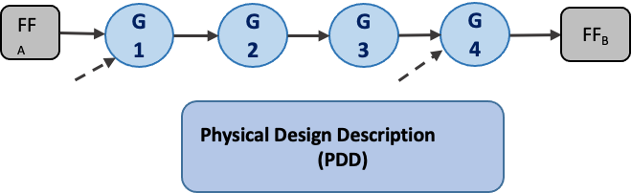
Physical Design Description
The PDD is a graph description of the FPGA mapped circuit
The model is characterized by
  Nodes: mimic resources such a LUTs, hardwired cores, BRAMs, …
  Edges: mimic routing resources such as drivers, PIPs, segments, …
The annotated PDD includes delay and configuration data
49
clock/redundant_clock_toggling
C NOR2B
75
N_49_i
C INV
85
Clock_pad/U0/U0
C IOPAD_TRI
…
…
…

Slide 7
Back-end tool flow
Standard
Implementation Flow
Back-end tool set
Exchange Files for
Front-end tools
Design Entry
Synthesis
Architecture & Bitstream Structure
PDD Convs
Netlist
PDD format
PyXEL
Resource Bitmap
PDD
File
Mapping
Place and Route
PDD Place
PDD Routing
Bitstream
Bitstream Generation
PDD Convs
PDD Annotated
Configurable Parameters
Island or Channel Style
FPGA
Logic And Routing
Area
I/O
Pins
Block RAM and DSPs
Embedded Cores

Slide 8
PDD Converters
The netlist converter tools are a fundamental part of the framework since they guarantee the compatibility of the model with existing FPGAs
AMD Xilinx Vivado
Python Extract DB to PDD
SDC, PIP and Bitlevel constraints
Microchip
Flattened Netlist to PDD
PDC Constraints
NanoXplore
Driver HDL to PDD
Cluster Constraints

Slide 9
Back-end tool flow
Standard
Implementation Flow
Back-end tool set
Exchange Files for
Front-end tools
Design Entry
Synthesis
Architecture & Bitstream Structure
PDD Convs
Netlist
PDD format
PyXEL
Resource Bitmap
PDD
File
Mapping
Place and Route
PDD Place
PDD Routing
Bitstream
Bitstream Generation
PDD Convs
PDD Annotated
Configurable Parameters
Island or Channel Style
FPGA
Logic And Routing
Area
I/O
Pins
Block RAM and DSPs
Embedded Cores

Slide 10

Bitstream formats are proprietary and FPGAs vendors do not disclose information about them
Electrical and logical behaviours of routing segments are not known and are architecture dependant
The mapping between bitstream bits and FPGA resources is a hard topic

Slide 11
PyXEL generates bitmaps to relate resources and bitstream bits
Bitmaps are binary files that are used to enable or disable resources

Slide 12



Configuration Bits DB
Implemented designs
Bit/Resources Correlation
Active High/Active Low filtering
Fake PIP filtering
…
Configuration
Bits DB
Extract Device Information
Create Tile-Encoding pairs
Understand
Bit Resource
Bitstream Structure
Device Architecture
Tiles Architecture
(Bitmap, Tile configuration) Pairs
- pip_x, pip_y, pip_z…
- pip_a, pip_b, pip_x, pip_y…

Slide 13
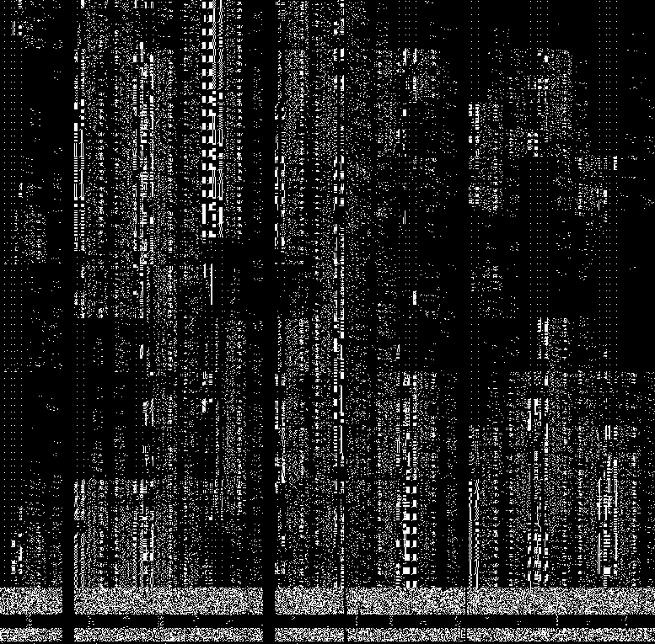
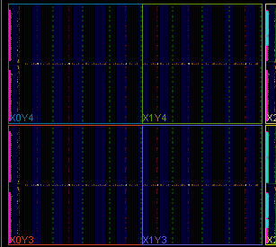
Bitstream Analysis and Visualization
Bitstream Parsing, Manipulation, Visualization
Tiles-to-bits mapper
Supported Devices: Series7, US, US+ Families
  Case of Study: Z7000 - KU040 - KU060 – ZU1CG

Slide 14
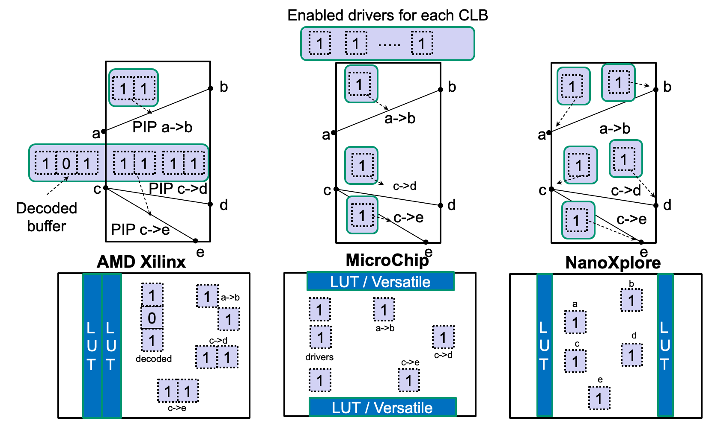
Configuration Memory Models
FPGA
Architecture
PyXEL
Bitmap

Slide 15
Back-end tool flow
Standard
Implementation Flow
Back-end tool set
Exchange Files for
Front-end tools
Design Entry
Synthesis
Architecture & Bitstream Structure
PDD Convs
Netlist
PDD format
PyXEL
Resource Bitmap
PDD
File
Mapping
Place and Route
PDD Place
PDD Routing
Bitstream
Bitstream Generation
PDD Convs
PDD Annotated
Configurable Parameters
Island or Channel Style
FPGA
Logic And Routing
Area
I/O
Pins
Block RAM and DSPs
Embedded Cores

Slide 16
Front-end - EDA tools
VERI-Place (aka VERI-Py)
  VERIfication and Placement tool for the analysis and mitigation of SEU effects in FPGA configuration
  Reliability calculation
SETA (aka PySETA)
  Single Event Transient Analysis tool for the analysis of SET effects including Propagation Induced Pulse Broadening (PIPB) effect
PySELFI
  SELective Filtering of SET for any FPGA architecture
  Fundaments of the tools are included in ECSS-Q-HB-60-02A – Techniques for radiation effects mitigation in ASICs and FPGAs handbook

Slide 17
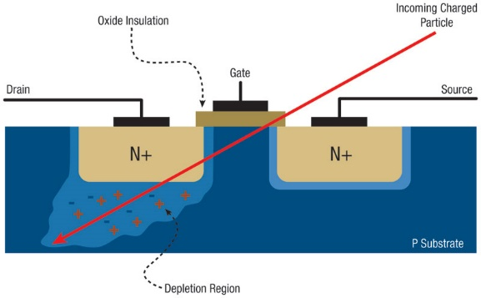
SEUs on SRAM-based FPGAs - Background
SEUs may cause structural changes in the circuit implemented on the FPGA
TMR techniques suffer cross-domain failure induced by single and multiple bitflips within the configuration memory

Slide 18
VERI-Py: A Reliability Prediction Tool
AMD Xilinx Implementation Flow
Design Entry
Synthesis
1
Configuration coding
Architectural map
SEU insertion, propagation and classification
Cumulative effect and reliability results
Net2VCRAM
XC7Z020 Bitstream
Netlist
2
Virtual CRAM
CRAM2PDD
Mapping
PDD_arch
Place and Route
Bitstream
3
Bitstream Generation
Bitflip CRAM
MBU_arch
Classification
Propagation
4
Reliability Plot

Slide 19
VERI-Py: A Reliability Prediction Tool
Bitstream
DB
Conf₀
SEU₁
PDD
Configuration i
Extraction of
Architectural map j
Architectural Map_{j}
MonteCarlo
Single Modification
On Configuration
Conf₀
SEU₂
Real
Bitstream
Configuration
Bitstream
Conf_{i}
SEU_{j}
Propagation
Configuration SEU_{j} j = 12030
“pip INT_L_X42Y57 SL1END1 -> ER1BEG2;”
Architectural Map_{j}
Net 1 “….sub_alu_k/result_o[17];”
Net 2 “….channel_0/ar_cmd_fsm_0_n_26;”
net “….sub_alu_k/result_o[17] ;”

Slide 20
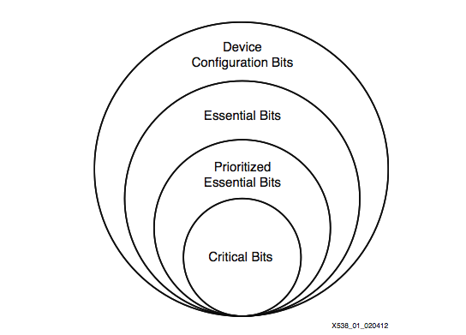
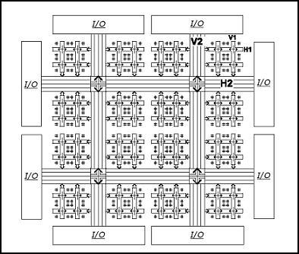
VERI-Py Main Achievement
Accurate identification of TMR single point of failures
M0
M1
VOTER
M2
0 | 1 | 0 | 0 | 0 | 0
1 | 0 | 0 | 0 | 0 | 0
1 | 1 | 0 | 0 | 0 | 0
0 | 0 | 0 | 0 | 1 | 0
0 | 1 | 0 | 1 | 0 | 0
0 | 0 | 0 | 0 | 0 | 0

Slide 21
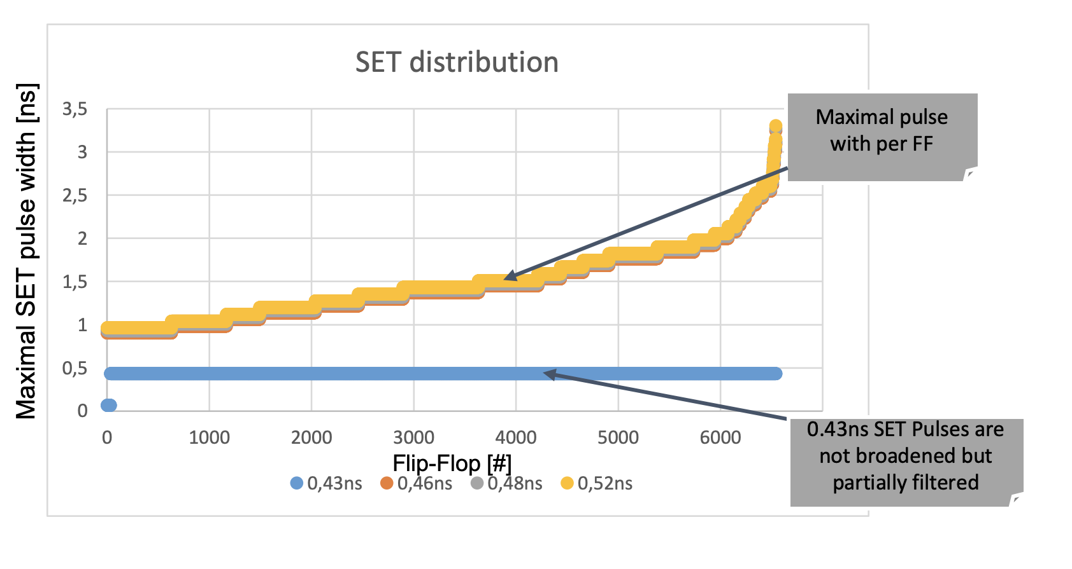
PySETA
Single Event Transient Analysis of circuit sensitive nodes
Injection [#] | Source SET [ns] | SET reach to FF [ns]
(1) | 0.35 | 0.40
(2) | 0.35 | 0.42
(3) | 0.35 | 0.30
… | … | …
FF_{A}
G1
G2
G3
G4
FF_{B}
Physical Design Description
(PDD)
Terminal nodes are the destination points of SET propagation

Slide 22
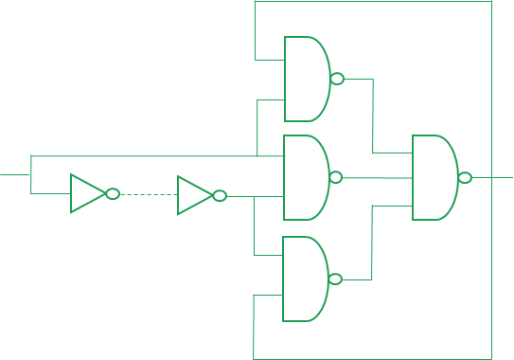
PySELFI
Selective Filtering logic structure insertion at the netlist level
G1
G2
FF_{A}
G3
G4
G5
FF_{B}

Slide 23
PySELFI
Selective Filtering logic structure insertion at the netlist level
G1
G2
FF_{A}
G3
G4
G5
FF_{B}

Slide 24
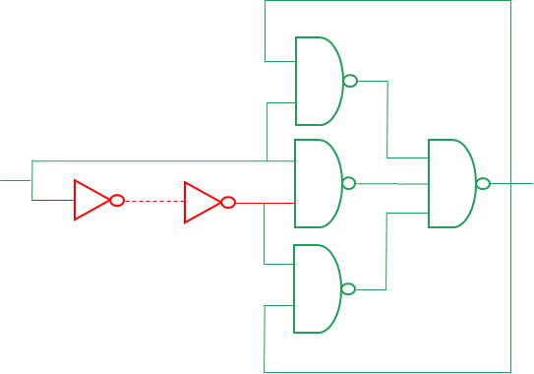
PySELFI
Calculation of SET filtering delay with respect to max SET pulse reported by PySETA
PySETA is compatible with ProASIC3, SmartFusion-II, PolarFire and RTG4
Filtering insertion is at Verilog level or integrated in FPGA tools
G1
G2
FF_{A}
G3
G4
G5
FF_{B}

Slide 25
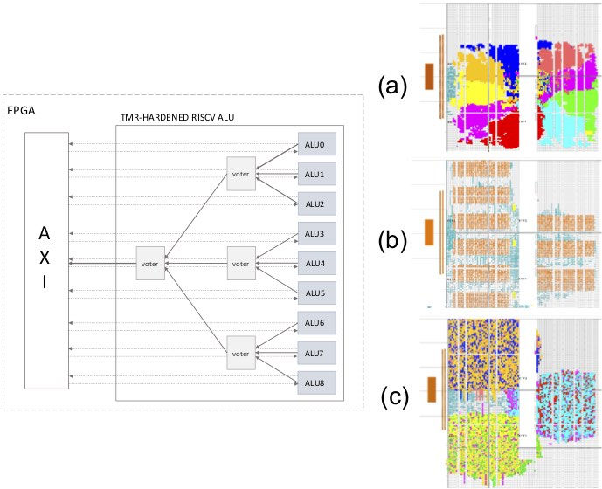
Experimental Results
AMD-Xilinx Zynq XC7Z020 28nm CMOS SRAM-based FPGAs
The developed tool has been applied to a TMR benchmark
Three different alternative layouts
TMR design | LUT [#] | PIP [#]
(a) Original | 11,572 | 13,590
(b) Isolated Domains | 11,578 | 14,642
(c) Resource Sharing | 11,572 | 24,948

Slide 26
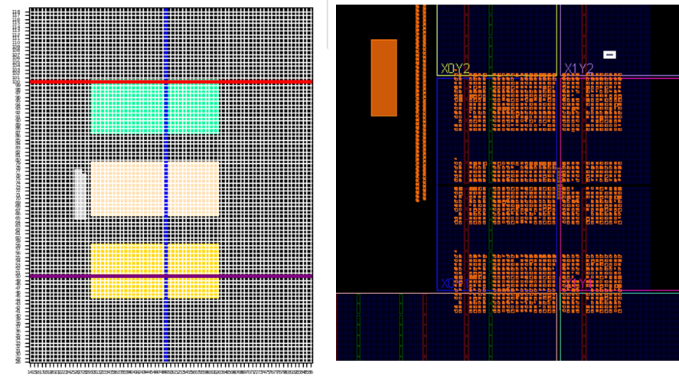
The Placement Tool – Design Interface
Redundant modules are automatically recognized and reorganized in the FPGA area
  Adopting a per-domain isolation policy, not requiring user intervention
The customization of other modules is left to the preference of the user
  User will indicate the name of the module, choosing from a list, and coordinates (x_{min}, x_{max}, y_{min}, y_{max}) of the new region of the device in which to confine it
Provides a preview of the placement solution realized

Slide 27
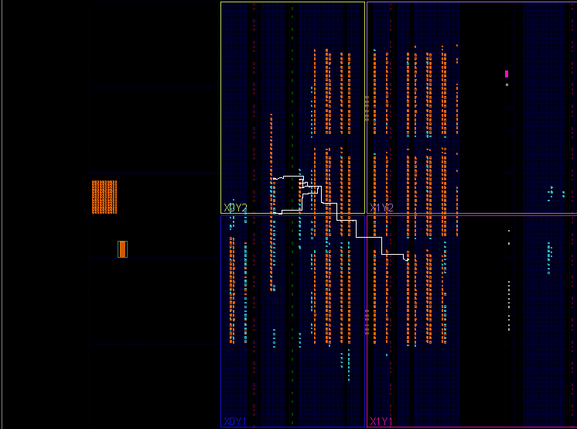
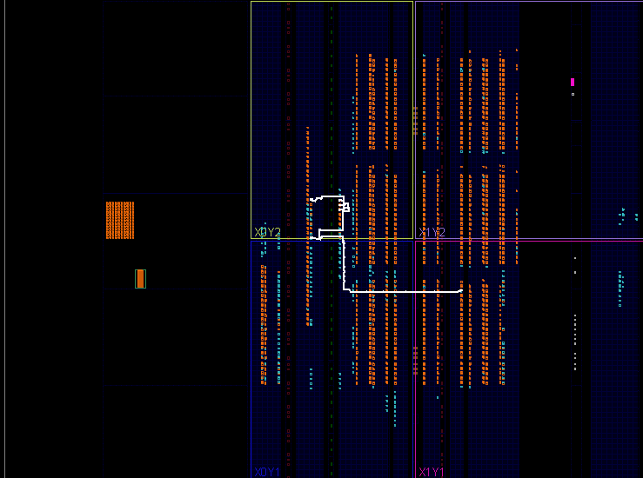
Routing Tool
Original Vivado Routing Path
Customized SEU-aware Routing Path

Slide 28
Experimental results
Energies ranging from 50.80 MeV up to 150 MeV
Average flux 4.134 10⁷ proton.cm⁻²s⁻¹
Resource Sharing
Default
TMR isolated

Slide 29
Predicted vs Measured Reliability
Radiation Test Mitigatef TMR
Radiation Test Default TMR
Radiation Test Resource sharing TMR
Predicted Mitigated TMR
Predicted Default TMR
Predicted Resource sharing TMR

Slide 30
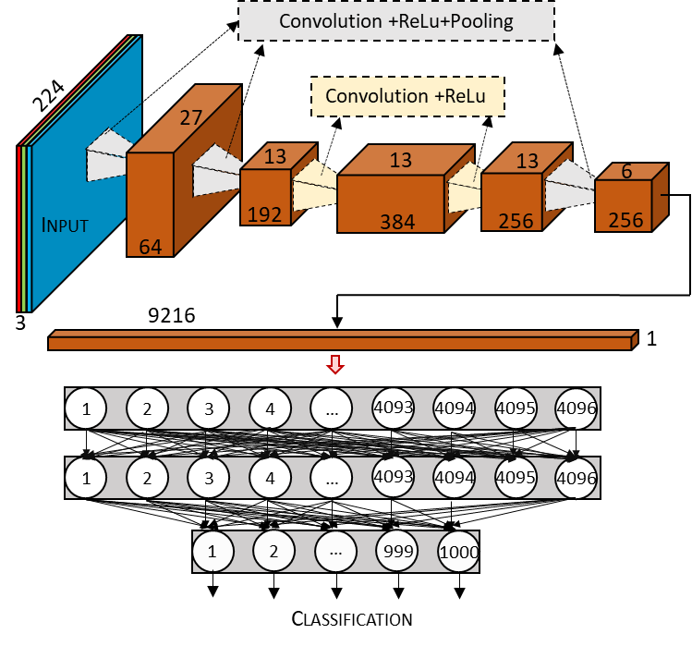
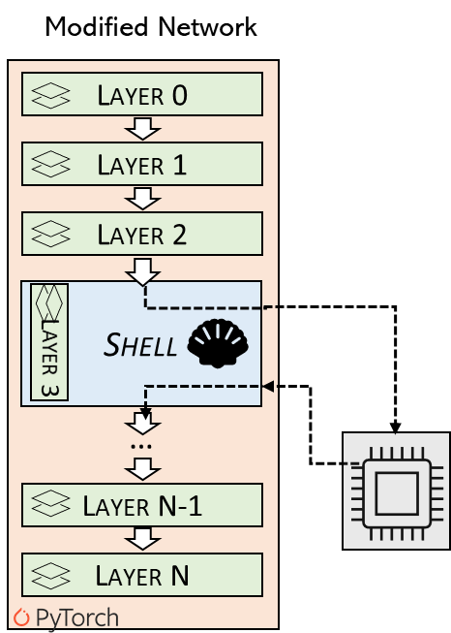
Experimental Analysis on AI
Network architecture: AlexNet CNN and Torchvision
Multichannel Convolutional Layer
Compared with 10,000 SEU injection of VERI-Py bitstream coordinates

Slide 31
SET analysis and mitigation
Analysis and mitigation of ZFNet CNN on RT4G150 Microchip Rad-Hard Flash-based FPGA
Resource | Available | Utilization
 |  | [#] | [%]
4LUT | 151,824 | 120,904 | 85.9
DFF | 151,824 | 123,084 | 81.1
Math 18x18 | 462 | 382 | 82.7
LSRAM 18K | 209 | 202 | 96.7

Slide 32
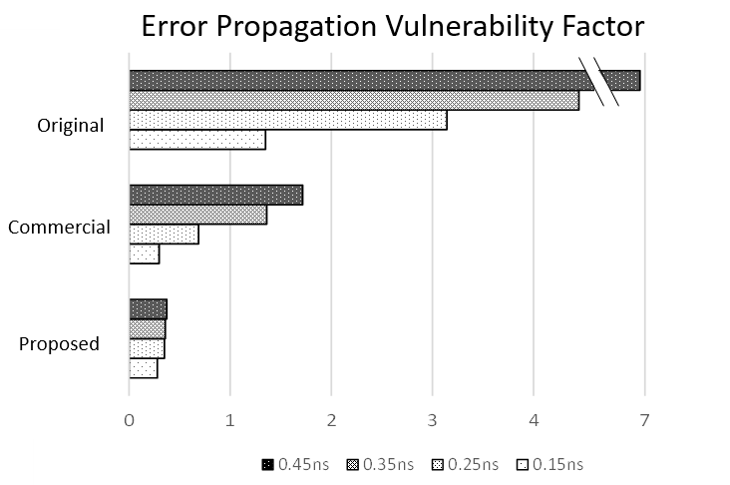
SET analysis and mitigation
Application of PySELFI versus Commercial Solution and Filtering at 600ps

Slide 33
Conclusions
EDA tools are compatible with state-of-the-art FPGA used in space domain
  A viable solution for implementing resilient FPGA circuits for space
Reliability evaluation includes a wide spectra of hardware faults

Slide 34
Future works
Propose a comprehensive analysis involving more complex hardware cores such as AI accelerators
  layers, network architectures and fault models would be extended
Reliability comparison of different hardware (e.g., HW accelerators on FPGAs) exploiting the developed platform
Continue to expand our approach with the results from emulation-based fault injection and radiation tests

Slide 35

Thank you
luca.sterpone@polito.it

Slide 36
Routing Switch architectural model
The model is based on the routing organization of AMD-Xilinx SRAM-based FPGAs
  Connection clusters towards nearby resources
  2 - short lines
  4 - longitudinal and diagonal lines
  6 - long lines
  12 - hex lines

Slide 37
Reliability Prediction Tool
Monte Carlo analysis with a limit up to 100,000 iterations per SEU combination
Bit Classification criterias
  Accumulated: bitflips accumulated in the virtual configuration memory
  Miss: number of upsets that did not hit any programmed resources
  Error: bitflips causing an error propagated to the output
  Filtered: bitflips that, even if there are related to a used resource, they did not propagate the error until an output cell

