Slide 1
SpaceFibre and SpaceWire IP Cores for the Next Generation of Radiation-Tolerant FPGAs Marti Farras Casas, Alberto Gonzalez Villafranca, Albert Ferrer Florit – STAR-Barcelona Chris McClements, Andrew MacLennan, Steve Parkes – STAR-Dundee www.star-dundee.com @STAR_Dundee
20 Years of Spacecraft Networking Innovation

Slide 2
Contents
SpaceWire and SpaceFibre technology
SpaceFibre
STAR-Dundee test equipment and STAR-System
SpaceFibre IP cores on current and next generation FPGAs
The STAR-Tiger SpaceFibre Routing Switch

Slide 3
SpaceWire Technology and IP cores
Spacecraft onboard data-handling network technology
Connects together instruments, data compressor, data processors, data storage, downlink transmitter and control computer on-board a spacecraft
Low to medium bit rates up to 400 Mbit/s, typical 200 Mbit/s maximum
SpaceWire standard
Written by Steve Parkes, STAR-Dundee’s Chief Technical Office
With inputs from international spacecraft engineers
Recently updated to Rev.1
SpaceWire technology
Being used or designed into well over 100 spacecraft
STAR-Dundee SpaceWire IP cores used extensively in USA, Europe, Japan
Available for NanoXplore, Xilinx and Microchip FPGAs
SpaceWire Interface, Routing switch, RMAP protocol handling, DMA, AXI slave bridge
Updated for ECSS-E-ST-50-12C Rev.1

Slide 4
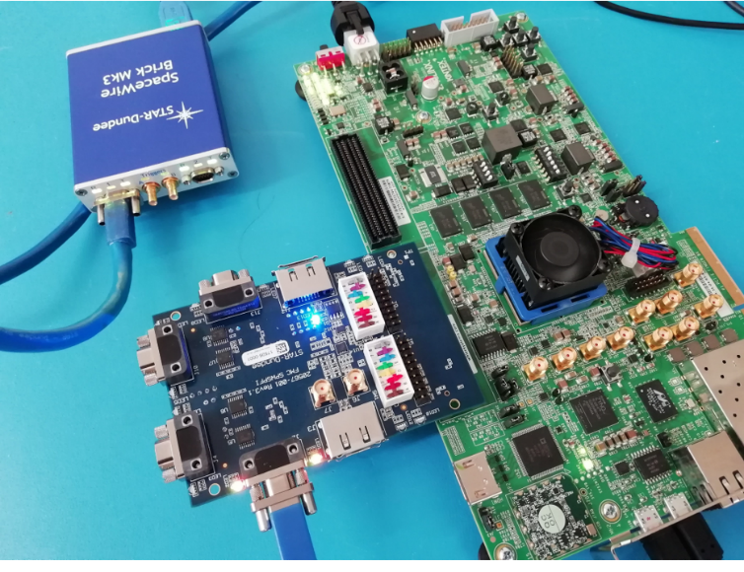
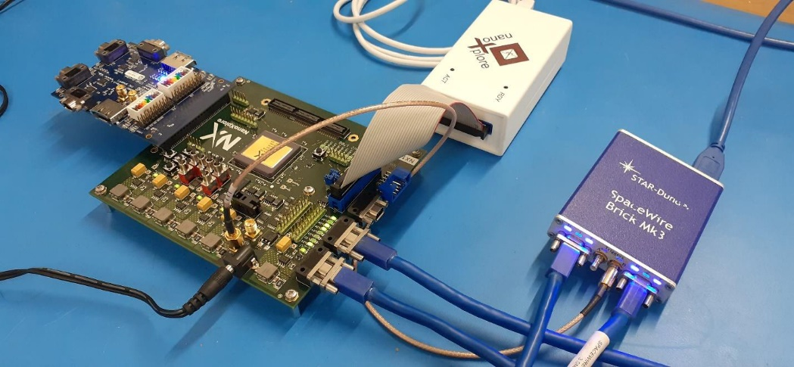
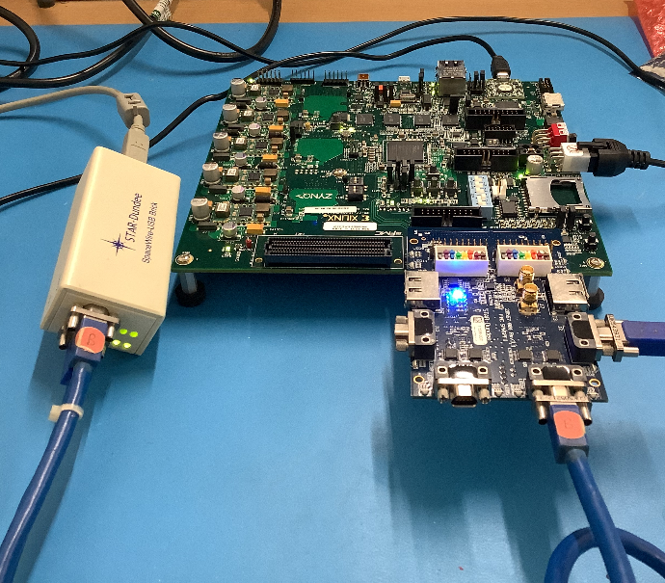
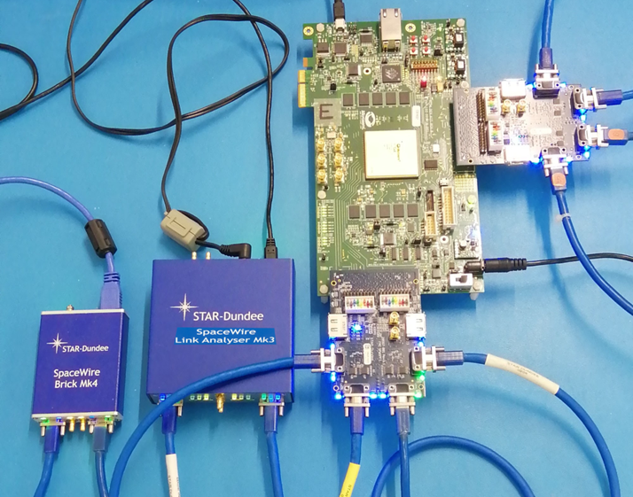
SpaceWire Technology and IP cores
NG-Medium Test
Kintex Ultrascale Test
PolarFire test
Zynq (including PS PL bridge)
RTG4 test

Slide 5
SpaceFibre for payload data-handling
Very high performance
6.25 Gbit/s per lane and higher depending on SerDes
Multi-lane capability
Increases link bandwidth - Quad lane link at 6.25 Gbit/s per lane gives 25 Gbit/s
Arbitrary number of lanes with graceful degradation when a lane fails
In-built Quality of Service
Bandwidth reservation, priority and scheduling
Fault detection, isolation and recovery capabilities
At the link level enabling rapid error recovery (a few microseconds)
Provides data integrity and reliable data delivery

Slide 6
SpaceFibre for payload data-handling
Low-latency broadcast messages
For time distribution, synchronisation, event signalling, error notification, etc.
Runs over electrical or optical cables
Few metres electrical, 100 metre Fibre optic
Small implementation footprint
Taking a few percent of a recent radiation tolerant FPGA
Added as both data & control planes in SpaceVPX Vita 78 recently released

Slide 7
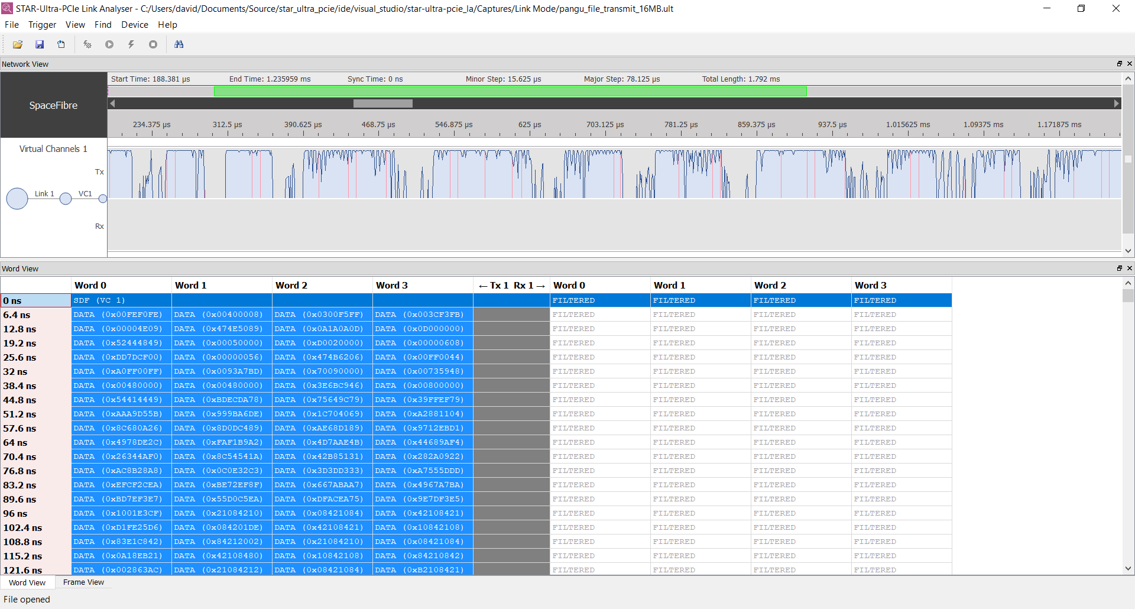
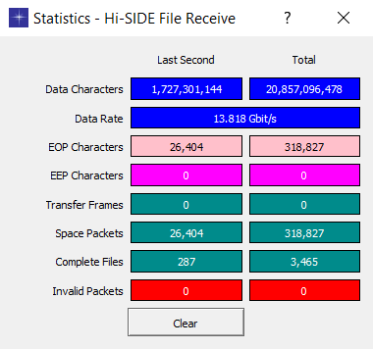
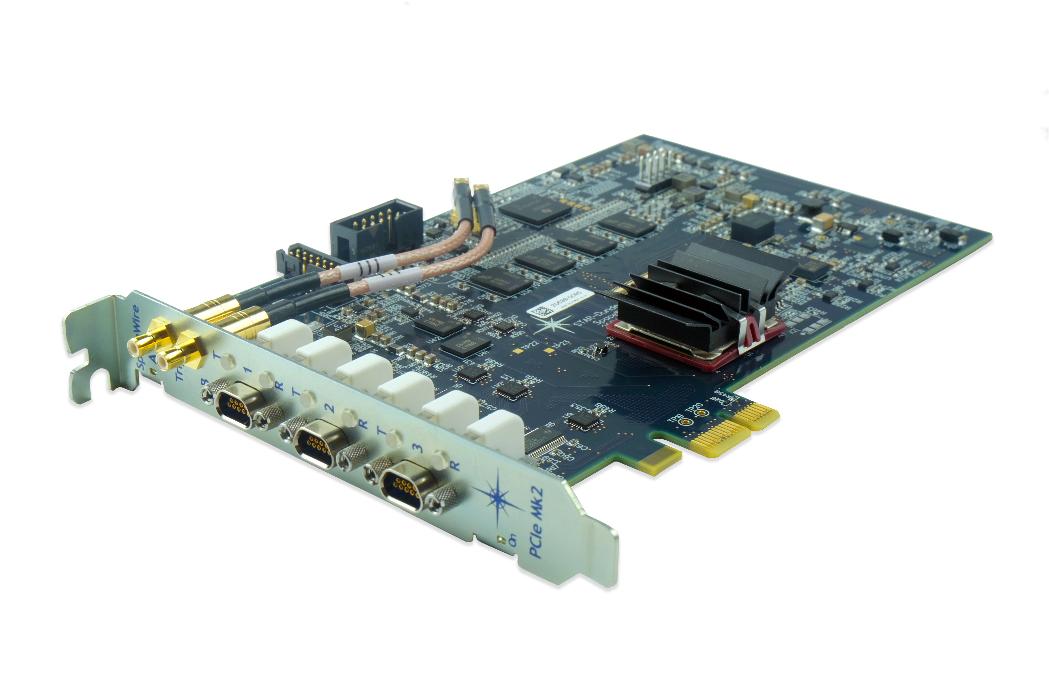
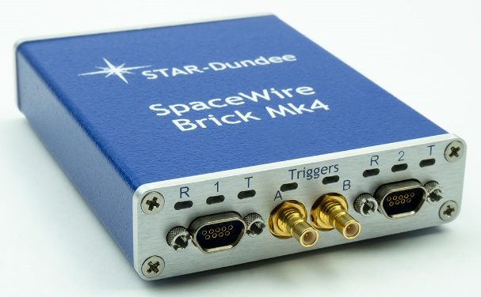
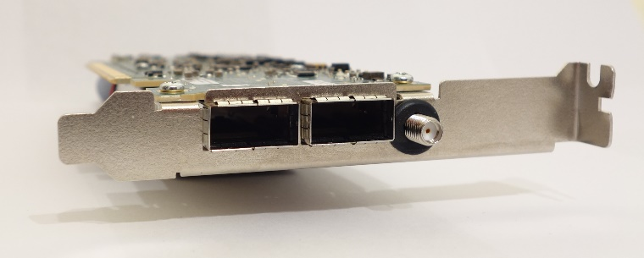
STAR-System and Test Devices
STAR-System is the software stack used for all STAR-Dundee’s test and development equipment
Software suite:
Device drivers, GUI applications, C, C++, APIs
Version 5.00 introduced a Python API and RMAP Initiator Application
Packet Libraries:
RMAP, CCSDS Space Packet Protocol, CCSDS Transfer Frames
Test equipment for both SpaceWire and SpaceFibre EGSE
PCIe Mk2
(PCIe Gen3 x1 to SpaceWire)
STAR-Ultra PCIe
(PCI Gen3 x8 to SpaceFibre)
Brick Mk4 (USB to SpaceWire)

Slide 8
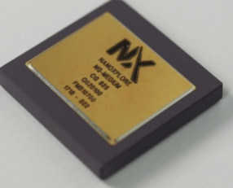
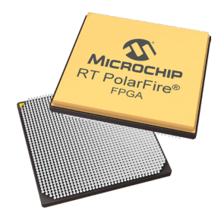
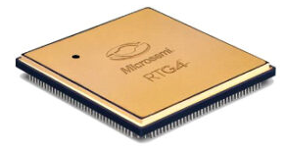
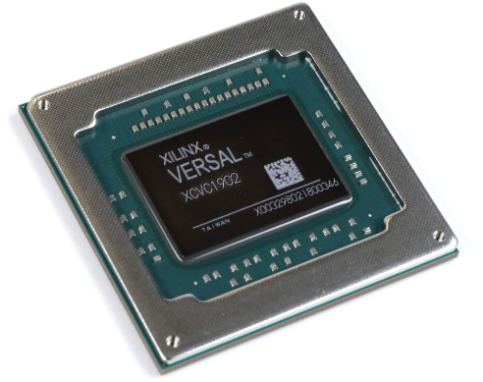
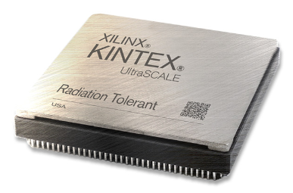
New Generation FPGAs for Space
Microchip RTG4
65 nm
Flash-based – Non-volatile
Radiation-hardened by design
24x SerDes @ 3.125 Gbit/s
Xilinx Kintex UltraScale
20 nm
SRAM-based – Volatile
Radiation-tolerant
32x SerDes @ 12.5 Gbit/s
NanoXplore BRAVE family (NG-Large / NG-Ultra)
65 / 28 nm FD-SOI
SRAM-based – Volatile
Radiation-hardened by design
4x SerDes @ 6 Gbit/s / 32x SerDes @ 12.5 Gbit/s
Microchip PolarFire
28 nm
SONOS-based – Non-volatile
Radiation-tolerant
24x SerDes @ 10 Gbit/s
Xilinx Versal
7 nm FinFET
SRAM-based – Volatile
Radiation-tolerant
44x SerDes @ 25 Gbit/s

Slide 9
SpaceFibre IP Core
Number of virtual channels
Use of an APB / AXI4-Lite with registers
Management
APB / AXI4-Lite Signals
Broadcast
APB / AXI4-Lite Signals
Virtual Channel AXI4-Stream
Independent clock for each AXI interface
User Interfaces
Technology independent RTL with optimisations for specific FPGAs
Depth of internal buffering
SpaceFibre Interface
IP Core
Optional
8B/10B Encoding
8B/10B Decoding
Number of lanes, Tx/Rx unidirectional lanes,
hot/warm redundancy
HSSL Interface
Bidirectional lane
Lane 1
Lane 1
SERDES
SERDES
SERDES
Unidirectional lane
Lane 2
Lane 2
Type of SerDes interface:
RTG4, PolarFire, Xilinx, BRAVE, TLK2711, Parallel
Serial Data
Lane 3
Unidirectional lane
Lane 3
Lane 4
Inactive unidirectional lane
Lane 4

Slide 10
SpaceFibre IP Cores General Features
Use of EDAC protection in memories
Guaranteed, straightforward timing closure
Lane rate only limited by Serdes (e.g. up to 3.125 Gbps on RTG4)
For the whole temperature and voltage range (i.e. fast & slow corners)
With EDAC and SET filters
Does not require specific placement or timing constraints.
Even with more than 80% FPGA utilisation
Low latency
Less than 400 ns for Broadcasts (including 250 ns due to SerDes latency)
Streaming frame sending option
Compact design

Slide 11
SpaceFibre IP Core General Features
Configurable
Number of lanes, virtual channels, ports
High performance
Optimised for radiation hardened FPGAs
Easy to use
AXI4-Stream interface for each Virtual Channel
Reference designs for RTG4, PolarFire, KUS, Versal, BRAVE...
Safe
Extensive verification and validation
Tested in radiation environment

Slide 12
SpaceFibre Single-Lane Interface IP Resources
 | RTG4 |  |  | XQRKU060 *
 | LUT | DFF | LSRAM | LUT | DFF | RAMB36
1 VC | 2.2% | 1.6% | 1.9% | 0.5% | 0.4% | 0.4%
2 VCs | 2.6% | 1.9% | 2.9% | 0.7% | 0.4% | 0.6%
4 VCs | 3.5% | 2.7% | 4.8% | 0.9% | 0.6% | 0.9%
RTG4 and
Kintex Ultrascale
 | RTPF500T * |  |  | XQRVC1902 *
 | LUT | DFF | LSRAM | LUT | DFF | RAMB36
1 VC | 0.6% | 0.5% | 0.5% | 0.2% | 0.1% | 0.2%
2 VCs | 0.7% | 0.6% | 0.8% | 0.2% | 0.2% | 0.3%
4 VCs | 1.0% | 0.8% | 1.3% | 0.3% | 0.2% | 0.5%
PolarFire and
Versal

Slide 13
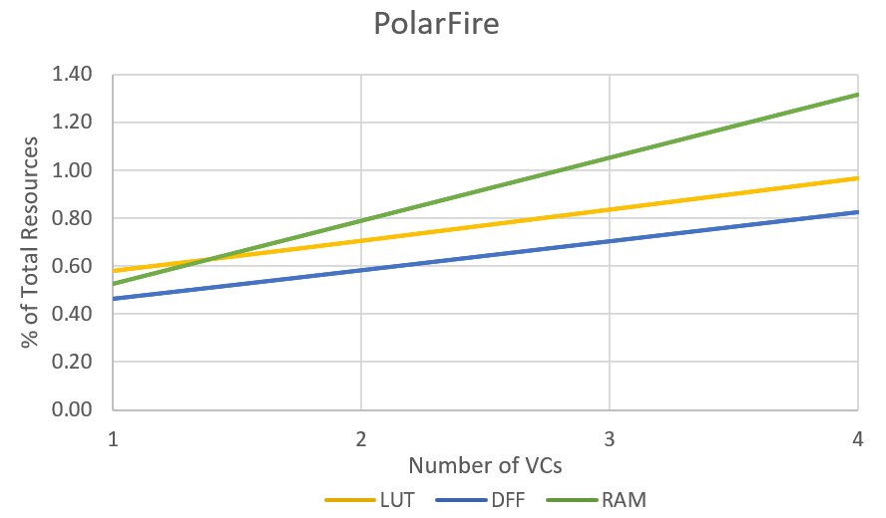
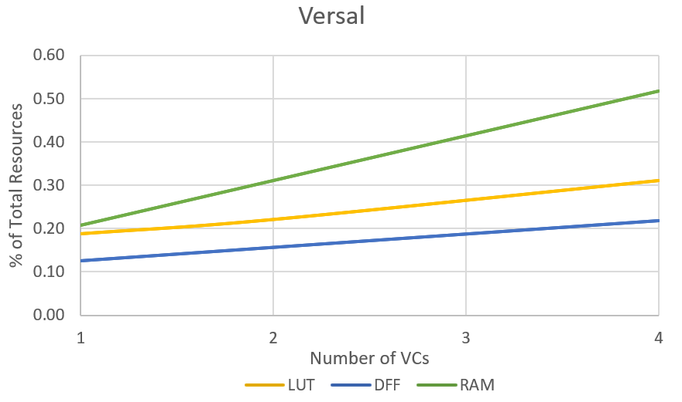
SpaceFibre Single-Lane Interface IP Resources
TMR in PolarFire
DFF ~ x 2.8
LUT ~ x 2
RTPF500T
XQRVC1902

Slide 14
SpaceFibre Single-Lane Interface IP Resources
NG family share the same type of fabric resources
IP implementation expected to use the same resources in NG-Large and NG-Ultra
In terms of % of resource usage for the SpFi IP Core
NG-Large is equivalent to the RTG4
NG-Ultra is equivalent to the PolarFire
 | NG-Large |  |  | NG-Ultra
 | LUT | DFF | RAM | LUT | DFF | RAM
1 VC | 2.0% | 1.9% | 4.2% | 0.5% | 0.5% | 1.2%
2 VCs | 2.4% | 2.4% | 6.3% | 0.6% | 0.6% | 1.8%
4 VCs | 3.2% | 3.3% | 10.4% | 0.8% | 0.8% | 3.0%

Slide 15
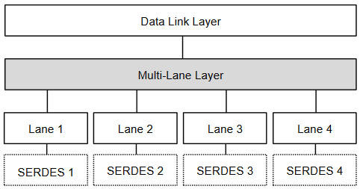
SpaceFibre Multi-Lane Interface IP Core
Multi-Lane is an optional capability of the SpFi standard
Allows several physical lanes to behave as a single logical link
Higher throughput
Redundancy
Hot (< 3 µs) & Warm (< 80 µs)
Lanes can be operated independently
Any number of lanes supported
Unidirectional lanes supported

Slide 16
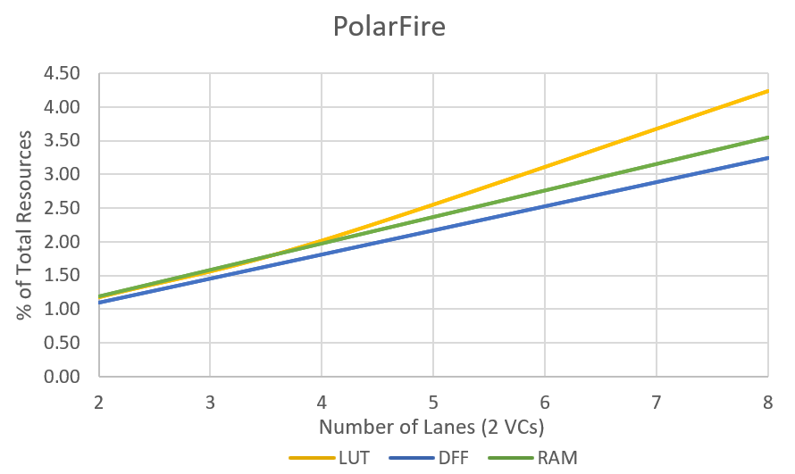
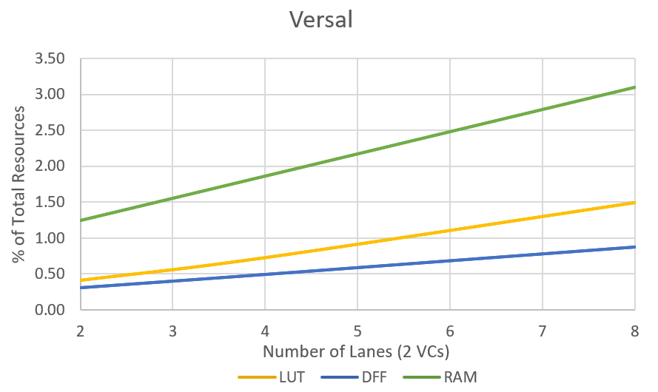
SpaceFibre Multi-Lane Interface IP Resources
Values for different configurations available at https://www.star-dundee.com/wp-content/star_uploads/conference_papers/spacefibre/89Gonzalez.pdf
RTPF500T
XQRVC1902

Slide 17
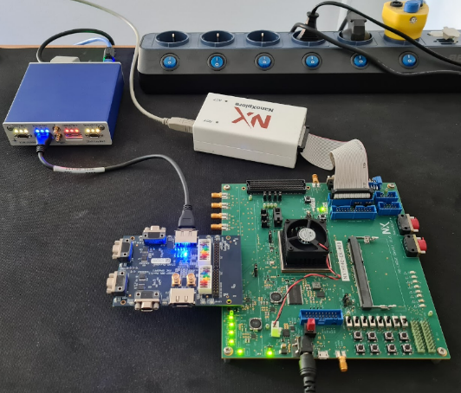
SpaceFibre IP on NanoXplore FPGA
NanoXplore NG-Large Evaluation Kit
Successful link connection established with STAR-Fire unit
2 Gbps setup
Correct data transmission without any data errors
Retry events periodically appear
Currently debugging this problem in collaboration with NanoXplore
The final validation of the IP to be completed soon
Reference design with SerDes configuration, clock scheme details, memory instantiation (EDAC), etc. provided with IP
STAR Fire
eSATA
FMC
NG-Large
Evaluation
Kit
FMC Mk3
SpW/SpFi

Slide 18
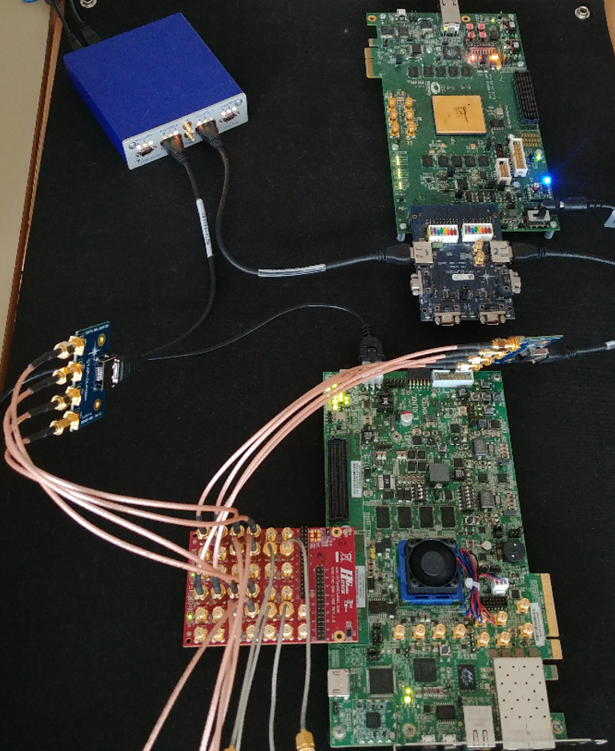
Demonstration - SpaceFibre Multi-lane Interface IP Implementation
Test Equipment
STAR Fire
SpaceFibre Multi-lane on
RTG4
SpaceFibre Multi-lane on
Kintex Ultrascale

Slide 19
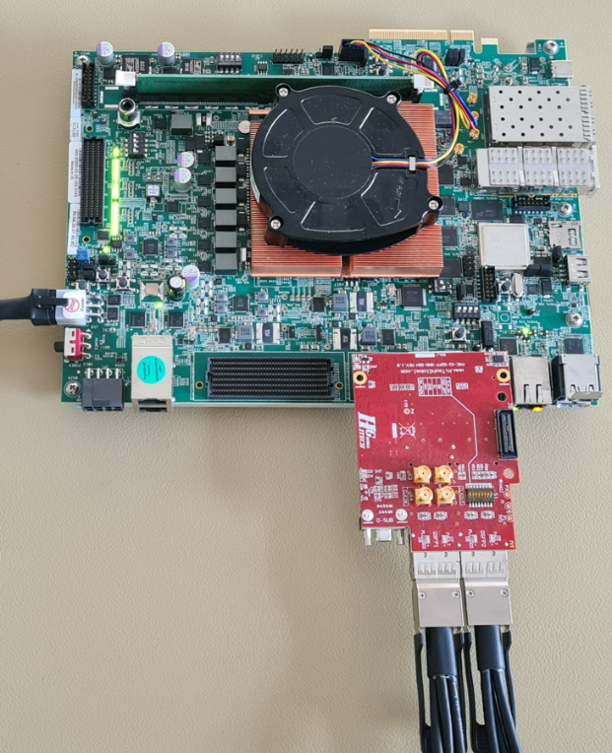
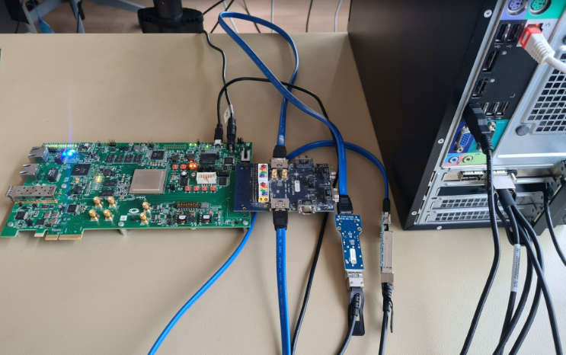
Demonstration - SpaceFibre Multi-Lane Interface IP Implementation
Xilinx Versal VCK190
6.25 Gbit/s demonstration
VCK190
MPF300
FMC SpW/SpFi
STAR-Ultra
QSFP to SFP
FMC
to
QSFP
eSATA to SFP
Microchip PolarFire MPF300 development kit
3.125 Gbit/s demonstration
QSFP to SFP

Slide 20
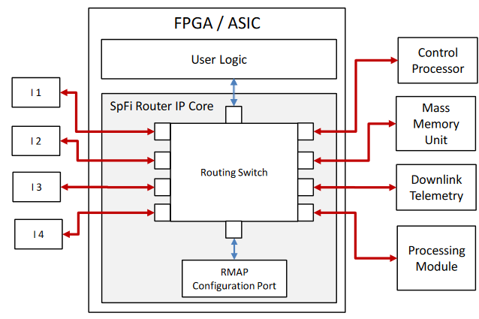
SpaceFibre Routing Switch IP Core
Full non-blocking switch matrix
Deterministic low-latency switching
Supports path, logical addressing and group adaptive routing
Fully configurable
Port types
SpaceFibre → Number of lanes, VCs
AXI4-Stream Internal → Number of VCs
SpaceWire
Target technology

Slide 21
SpaceFibre Routing Switch IP Core
Supports virtual networks that can be static or dynamically configured
Up to 64 virtual networks
Configuration port with RMAP protocol
Isolates each virtual network using priority, scheduling and bandwidth reservation QoS
Within the same virtual network:
Packet by packet round robin arbitration for packets going to the same output port
Automatic packet spill on timeout
Additional timeout timers to detect a babling node

Slide 22
SpaceFibre Routing Switch IP Core

Slide 23
SpaceFibre Single-Lane Routing Switch IP Resources
SpFi Interface IP Cores are included
Additional Configuration port and RMAP target is also included
Port count includes 1x internal AXI4-Stream (2 VCs) and 1x SpW ports
 | RTG4 |  |  | XQRKU060 *
 | LUT | DFF | LSRAM | LUT | DFF | RAMB36
6 Port 2 VCs | 20.9% | 18.0% | 22.5% | 5.4% | 4.2% | 4.4%
10 Port 4 VCs | 64.9% | 50.1% | 60.8% | 16.9% | 11.8% | 11.9%
RTG4 and
Kintex Ultrascale
 | RTPF500T * |  |  | XQRVC1902 *
 | LUT | DFF | LSRAM | LUT | DFF | RAMB36
6 Port 2 VCs | 6.2% | 5.6% | 6.1% | 1.9% | 1.5% | 5.0%
10 Port 4 VCs | 19.4% | 15.8% | 16.6% | 6.0% | 4.2% | 13.2%
PolarFire and
Versal

Slide 24
SpaceFibre Multi-Lane Routing Switch IP Resources
SpFi Multi-lane Interface IP Cores are included
Additional Configuration port and RMAP target is also included
Port count includes 1x internal AXI4-Stream (2 VCs) and 1x SpW ports
 | RTG4 |  |  | XQRKU060 *
 | LUT | DFF | LSRAM | LUT | DFF | RAMB36
2 Lane 6 Port 2 VCs | 31.6% | 29.3% | 28.2% | 8.6% | 6.5% | 3.1%
2 Lane 10 Port 4 VCs | 92% | 76.7% | 81.2% | 24.9% | 16.5% | 9.4%
4 Lane 6 Port 2 VCs | 50.9% | 45.6% | 56.0% | 14.1% | 9.9% | 5.7%
4 Lane 10 Port 4 VCs |  |  |  | 38.8% | 23.9% | 17.2%
2 Lanes
4 Lanes

Slide 25
SpaceFibre Multi-Lane Routing Switch IP Resources
PolarFire and Versal FPGA utilisation
 | RTPF500T |  |  | XQRVC1902 *
 | LUT | DFF | LSRAM | LUT | DFF | RAMB36
2 Lane 6 Port 2 VCs | 9.8% | 9.3% | 4.4% | 2.9% | 2.4% | 3.5%
2 Lane 10 Port 4 VCs | 28.2% | 24.4% | 13.4% | 6.8% | 6.1% | 10.5%
4 Lane 6 Port 2 VCs | 15.8% | 14.5% | 8.1% | 4.8% | 3.6% | 6.4%
4 Lane 10 Port 4 VCs | 44.2% | 36.2% | 24.4% | 13.4% | 8.8% | 19.2%
2 Lanes
4 Lanes

Slide 26
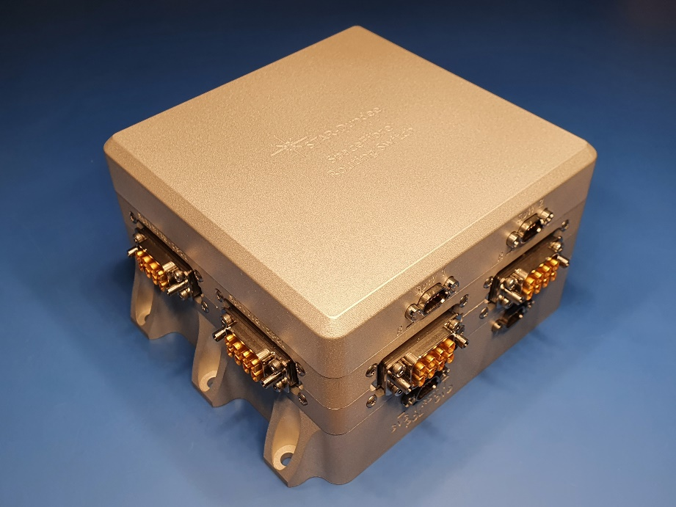
STAR-Tiger SpaceFibre Routing Switch
Primary element of the payload data-handling network for the Hi-SIDE project
10 port multi-lane SpaceFibre Routing Switch
Spaceflight TRL5 level design
Radiation tolerant EM flight parts or industrial/commercial equivalents
Power consumption: 14.2W
Typical at 20 °C, all links running with lanes speeds of 6.25 Gbit/s
Conduction cooled
-25°C to +55 °C
Size: 108 x 108 x 68mm
Mass: 1.32 kg
European Space Forum Innovation in Space Award won by Hi-SIDE Team: https://www.hi-side.space/

Slide 27
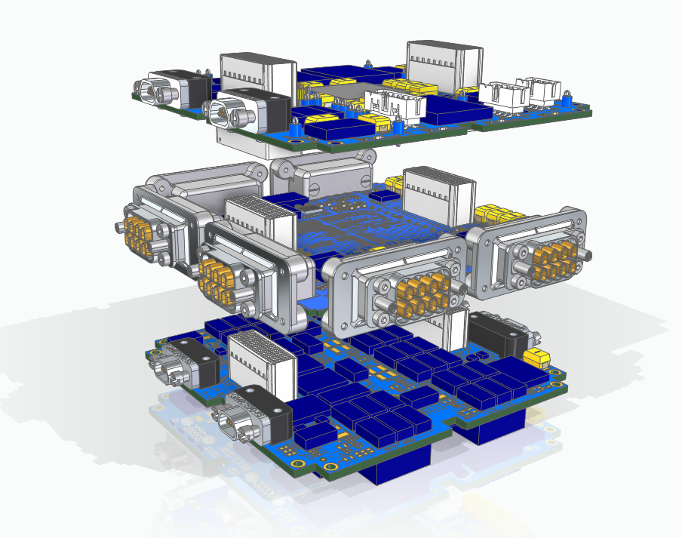
STAR-Tiger SpaceFibre Routing Switch
Power supply board
Texas Instruments radiation tolerant components are used
Primary and redundant power supplies
FPGA board
KU060 industrial grade FPGA
The FPGA is surrounded by six Elara connectors
Each connector provides four lanes of SpaceFibre
Configuration board
FPGA and flash programming
FPGA scrubbing routines
Configuration Board
FPGA Board
TI Power
Supply Board

Slide 28
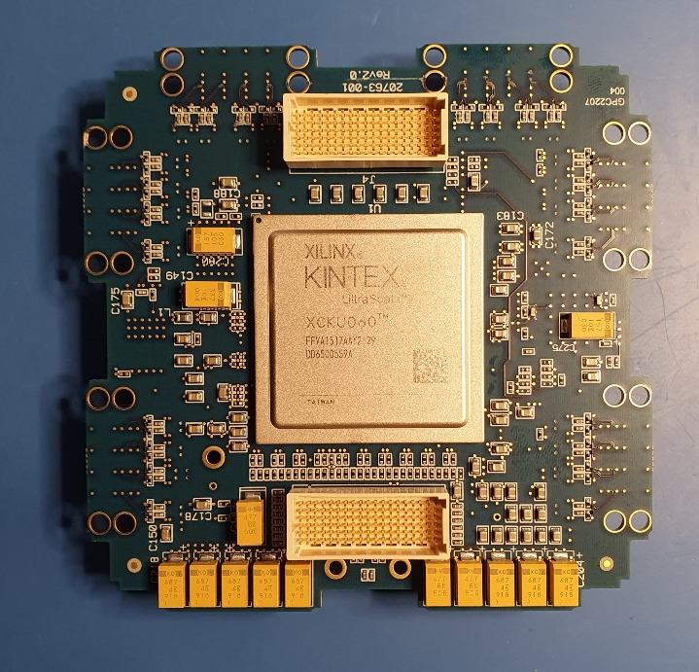
STAR-Tiger SpaceFibre Routing Switch
Aggregate throughput 200 Gbit/s
10 SpaceFibre ports
Two quad-lane ports
Eight dual-lane ports
Lane speeds up to 6.25 Gbit/s
Port data rate
9.6 Gbit/s dual-lane port
19.2 Gbit/s quad-lane port
2 SpaceWire interfaces
Flash memory or FPGA can be programmed over SpaceWire

Slide 29
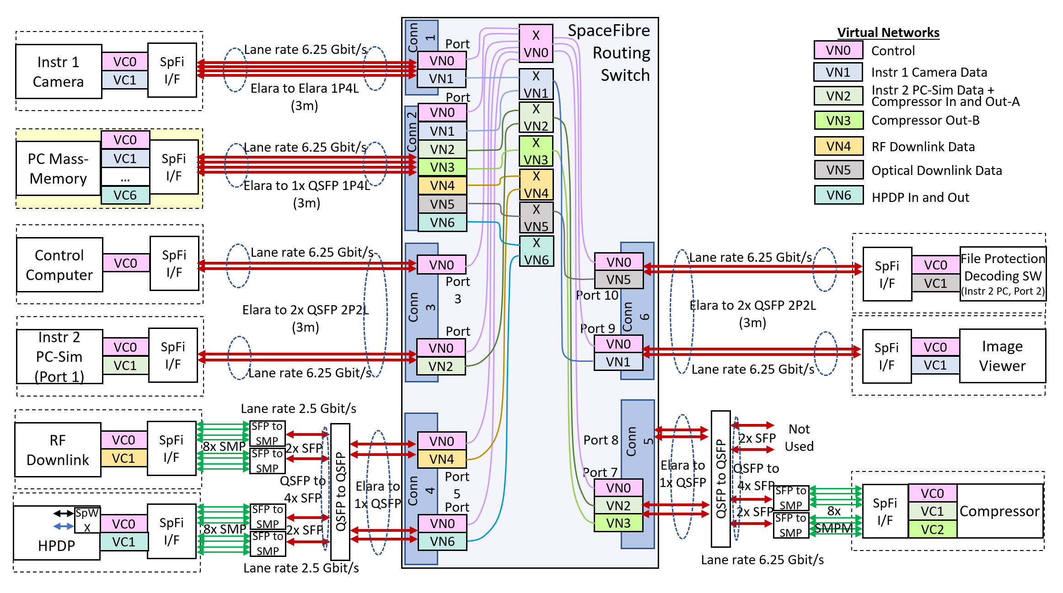
Hi-SIDE Demonstration System Block Diagram

Slide 30
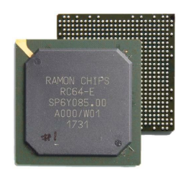
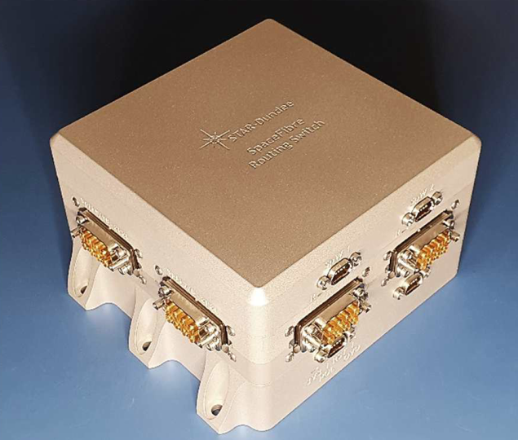
Summary
STAR-Dundee provides both SpaceWire and SpaceFibre IP cores
SpaceWire Interface and Routing Switch IP cores
SpaceFibre Interface and Routing Switch IP cores
Supporting IP cores
RMAP Initiator and Target IP cores
DMA and AXI bridge
The IPs have been designed specifically for space applications
Designed for the highest performance in RTG4 and other rad-had FPGAs
Exhaustive verification and validation, including radiation testing
IP Core can be used without knowledge of the internals of the SpaceFibre protocol
Reference designs available that show how to interconnect to different SerDes/Transceivers

Slide 31
Demonstration and References
Demonstration setup
PolarFire MPF300T and Versal VCK190 – SpaceFibre Multi-lane
STAR-Ultra PCIe
Reference Material
A. Gonzalez Villafranca, et. al., “SpaceFibre IP Cores for the Next Generation of Radiation-Tolerant FPGAs”, ISC 2022
https://www.star-dundee.com/wp-content/star_uploads/conference_papers/spacefibre/89Gonzalez.pdf
A. Ferrer Florit et. al., “SpaceFibre Multi-Lane Routing Switch IP”, ISC 2022
https://www.star-dundee.com/wp-content/star_uploads/conference_papers/spacefibre/88Ferrer.pdf
A. Gonzalez Villafranca, et. al., “Mitigation and Recovery of Single Event Effects in RTG4 FPGA Transceiver Links Using SpaceFibre”, RADECS 2022
https://www.star-dundee.com/wp-content/star_uploads/conference_papers/spacefibre/2022_RADECS_RTG4_Rad_Test-ver_2.pdf
S. Parkes , et. al., “SpaceFibre Payload Data-Handling Network”, ISC 2022
https://www.star-dundee.com/wp-content/star_uploads/conference_papers/spacefibre/87-Parkes.pdf
D Gibson, et. al., “Hi-SIDE: Monitoring, Control and Test Software in a SpaceFibre Network”, ISC 2022
https://www.star-dundee.com/wp-content/star_uploads/conference_papers/spacefibre/78Gibson.pdf

