Slide 1
CNES Activities on NanoXplore Chips
SEFUW Presentation
14/03/2023
_
DTN/TVO/ET

Slide 2
Contents
SEFUW: CNES activites on Nx chips
FPGA IPs
  DDR2
  ESIStream
  RISC-V
Designs
  R5 Reference design
  PhotoBooth
  Cipher Design
COMODO Boards

Slide 3
IPs : DDR2, ESIStream, Risc-V

Slide 4
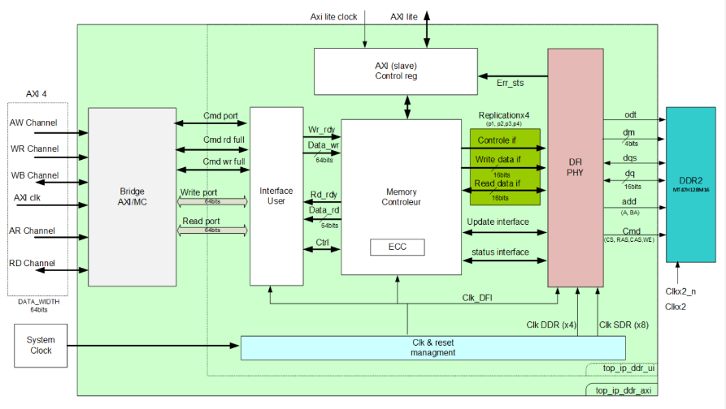
IP DDR2
SEFUW: CNES activites on Nx chips
DDR2 developed by LGMi for NG-MEDIUM through R&T
Tested on evalkit NX1H35-EK with DDR2 module memory
NG-LARGE is ongoing (end foreseen mid 2023)
Two interfaces:
  user interface (UI)
  AXI

Slide 5
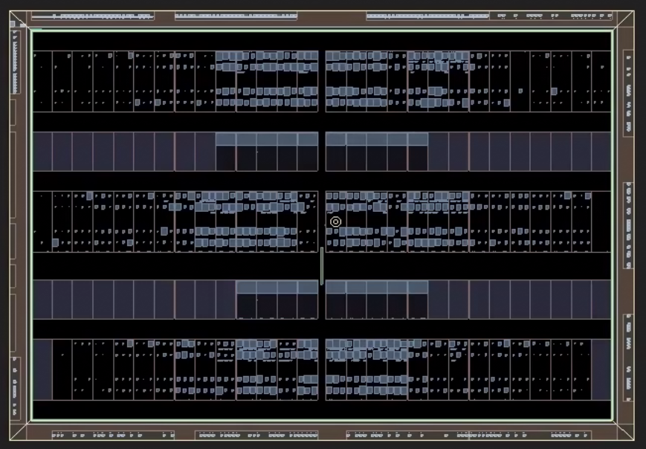
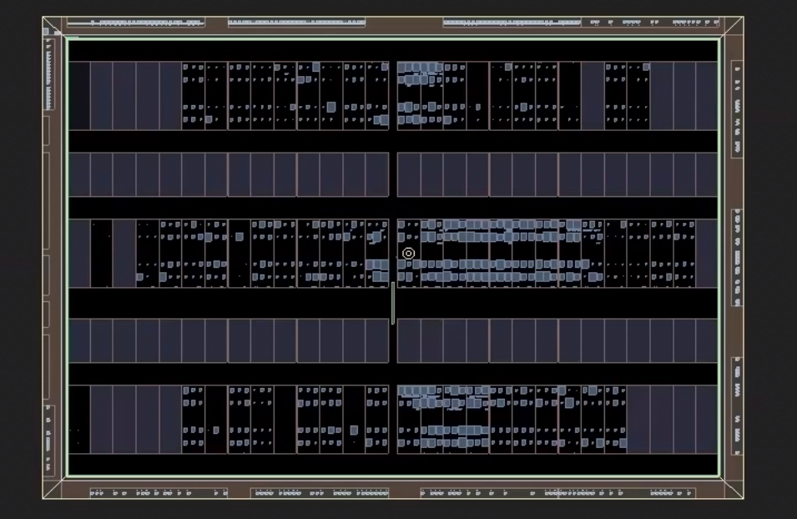
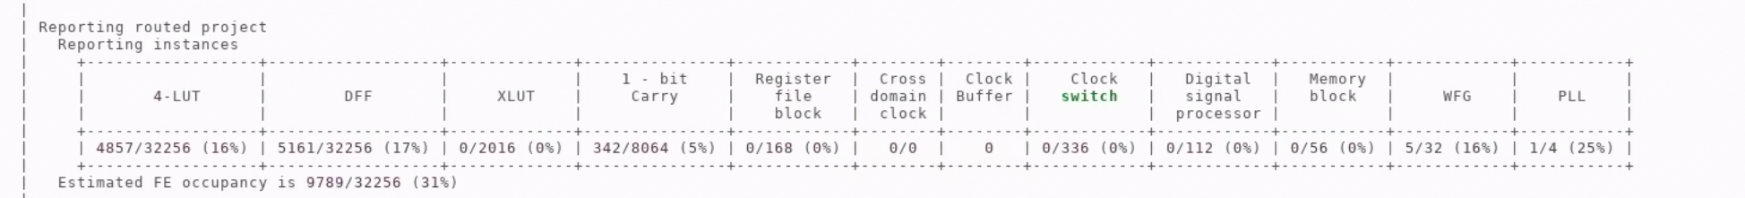
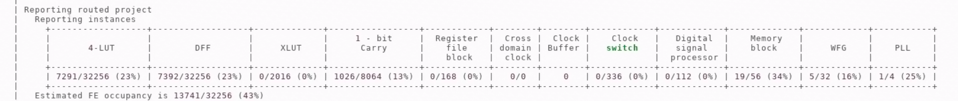
IP DDR2
SEFUW: CNES activites on Nx chips
DDR2- NG-MEDIUM AXI mode
DDR2- NG-MEDIUM UI mode

Slide 6
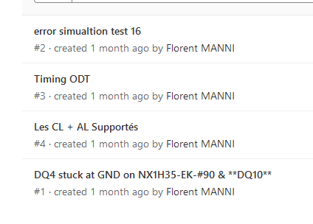
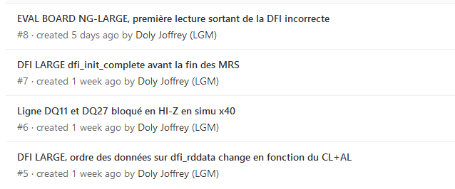
IP DDR2 : next steps
SEFUW: CNES activites on Nx chips
4 bugs have been corrected on NG-MEDIUM, see Gitlab figure:
Currently 4 bugs on NG-LARGE development, see Gitlab figure:

Slide 7
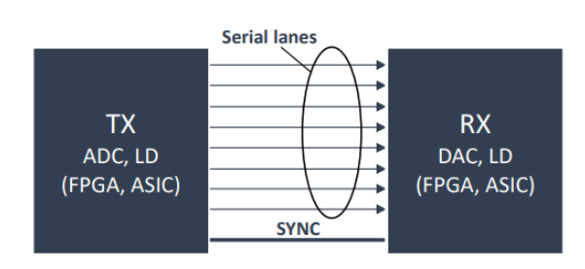
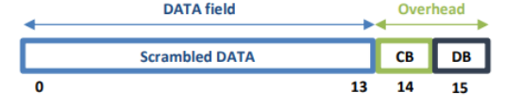
ESISTREAM : Protocol Brief
SEFUW: CNES activites on Nx chips
ESIStream stand for Efficient Serial Interface Stream.
14B/16B encoding.
Open source and license-free. (https://www.esistream.com/protocol)
Clock recovered from the data.
High speed serial interface.
Can be used with any system requiring a serial interface
Already well implemented on Xilinx chips

Slide 8
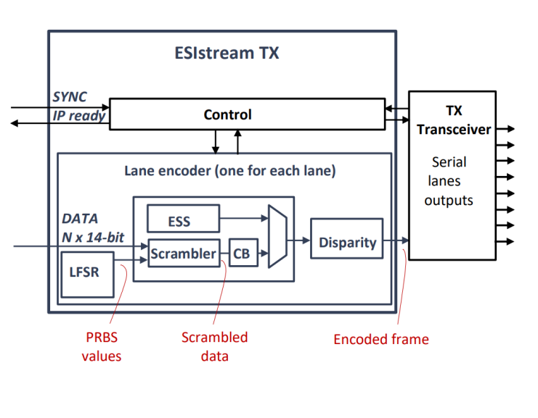
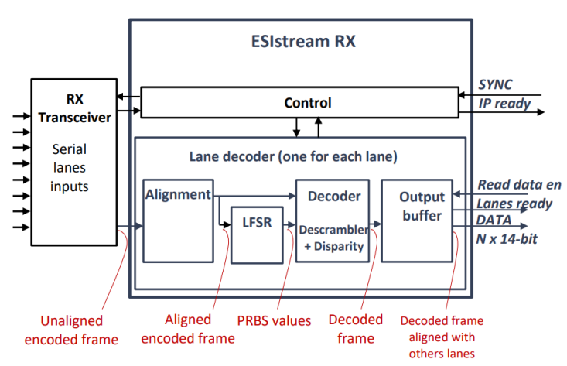
ESISTREAM On Nx Chips
SEFUW: CNES activites on Nx chips
HSSL Lanes have part of ESIStream protocol (coder and decoder) in silicium
Tx Lane encoder:
  LFSR generator.
  Scrambler + Clock bit generator.
  ESIStream Synchronization Sequence generator.
  Disparity bit module.
Rx Lane decoder:
  Frame alignement module.
  LFSR module.
  Decoder module (descrambler and disparity).
  Output buffer.

Slide 9
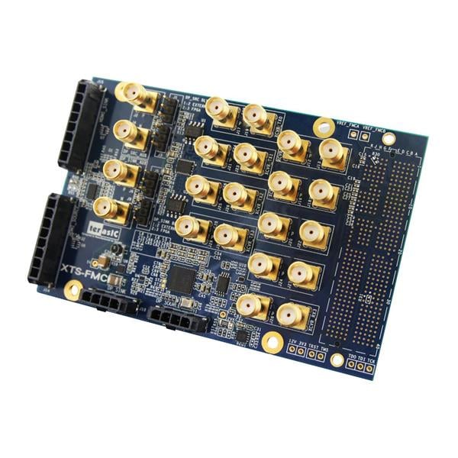
ESISTREAM : R&T Steps
SEFUW: CNES activites on Nx chips
R&T developed by NanoXplore
Support of Teledyne E2V
Protocol RTL Simulation
NG-ULTRA
OnBoard Loopback
NG-LARGE
DAC DD700
NG-ULTRA
ADC AQ600
Ongoing:
RTL Simulation of ESIStream
sources
Step 2:
NG-ULTRA DevKit + HSSL FMC Board
Step 3:
COMODO-L
(see next slides)
+ FMC board DD700
Step 4:
COMODO-U
(see next slides)
+ FMC board AQ600

Slide 10
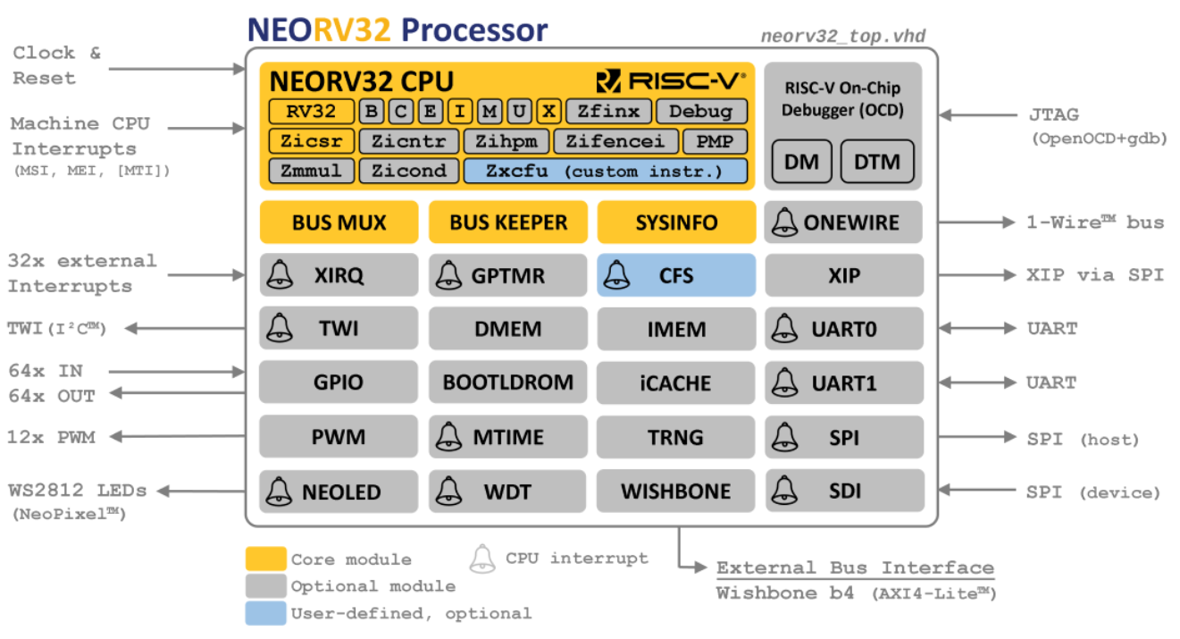
Soft Core RISC-V
SEFUW: CNES activites on Nx chips
all-in-one package: CPU + SoC + Software Framework & Tooling
completely described in behavioral, platform-independent VHDL - no platform-specific primitives, macros, attributes, etc.
Open source and license-free. (https://github.com/stnolting/neorv32)
Continuous integration thanks to Linty services

Slide 11
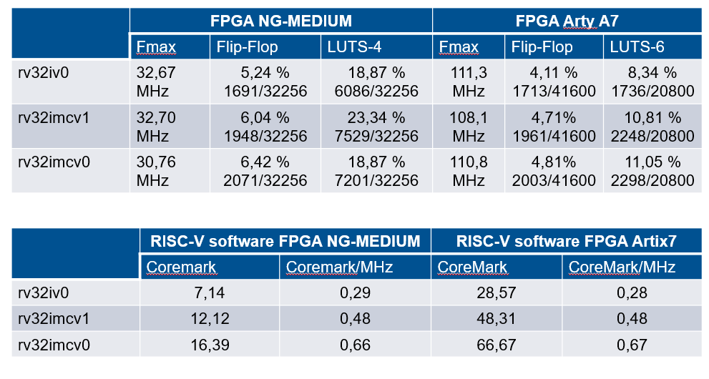
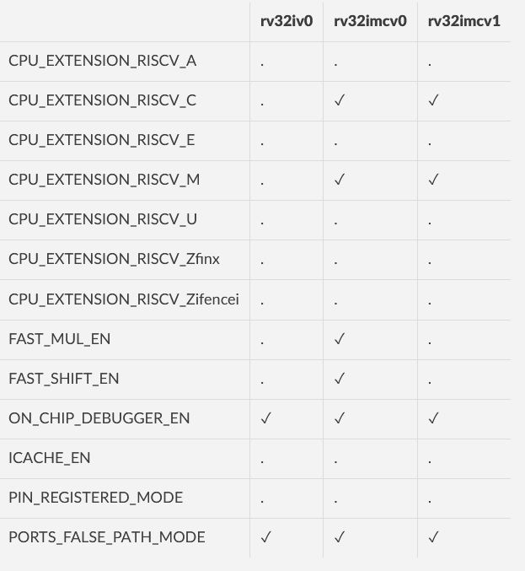
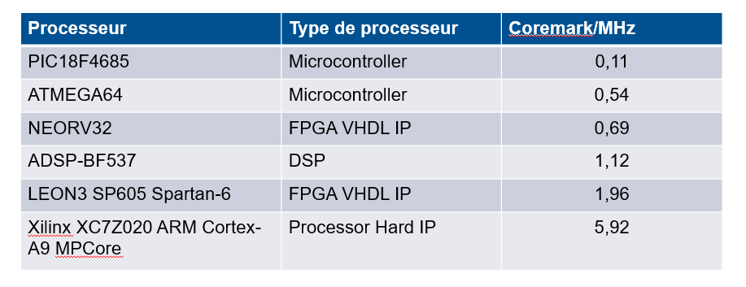
Neorv32 performances (V1.5.7 – june 2021)
SEFUW: CNES activites on Nx chips
Rv32iv0 minimale
Rv32imcv1 intermédiaire
Rv32imcv0 performance

Slide 12
R5 reference design on NG-LARGE

Slide 13
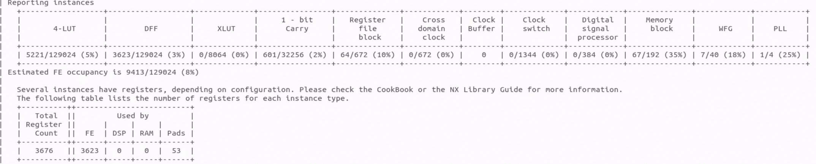
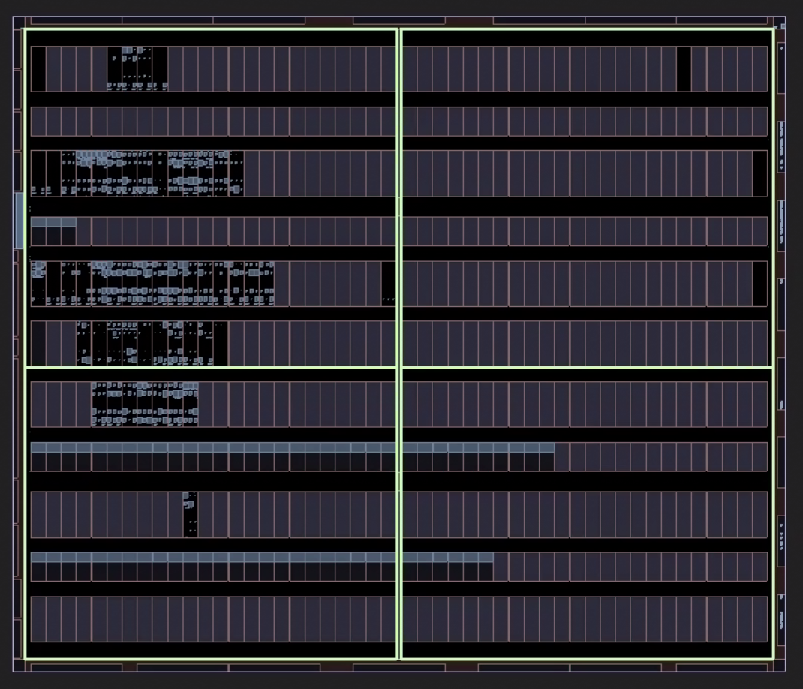
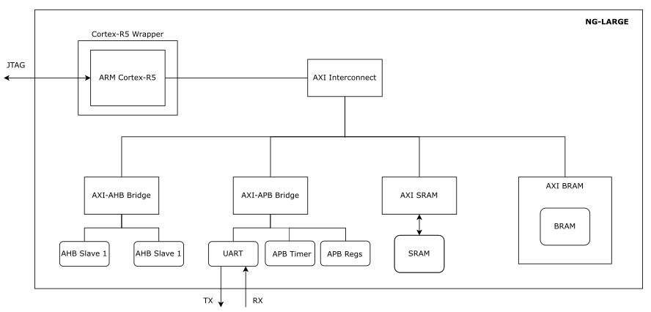
Project General description (architecture)
SEFUW: CNES activites on Nx chips
Implemented on NgLarge evalboard
Notes:
Generic SOC design with axi bridge and peripheral
It is not a huge design 8% of the FPGA .
Expected performances are downgraded (we want to assess the design flow and the result on board) see next slide

Slide 14
R5 Reference Design and XNG implementation
SEFUW: CNES activites on Nx chips
R5 Reference design will be implemented on COMODO-L (see next slides)
XNG has been implemented on NG-LARGE R5 processor thanks to the R5 Reference design
  Currently working with BRAM memories (for software)
Qualification is ongoing, waiting for DDR2 memory
  The design has been adapted for XNG : Specific timer with software breakpoint management, DDR controller…
XNG on NG-ULTRA (R52) is ongoing (H2020 HERMES contract)
LVCUGEN (generic flight software using XNG) development on NG-ULTRA will start soon

Slide 15
PHOTOBOOTH DESIGN

Slide 16
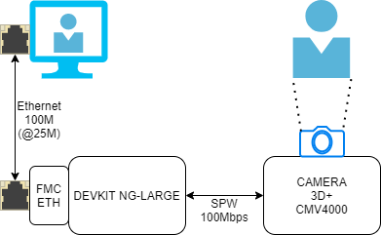
PHOTOBOOTH : General Description
SEFUW: CNES activites on Nx chips
How to show CASPEX and NanoXplore technology to everyone?

Slide 17
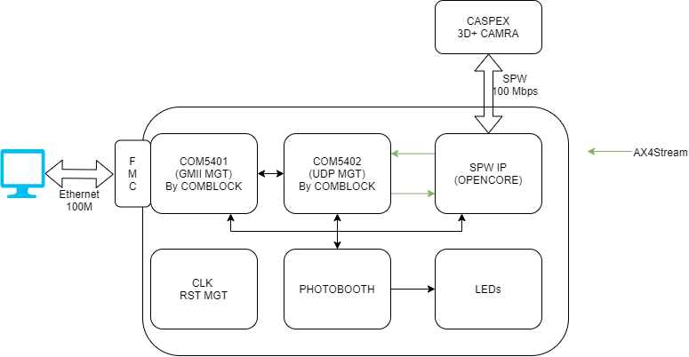
PHOTOBOOTH : FPGA Design
SEFUW: CNES activites on Nx chips
IP SPW : OpenCore → switch to NX SPW Codec
IP COMBLOCK 5401 and 5402 from AXI4Stream to GMII/RGMII Interface
Global Photobooth entity to manage each block → could be a Risc-V core, R5

Slide 18
CIPHER DESIGN

Slide 19
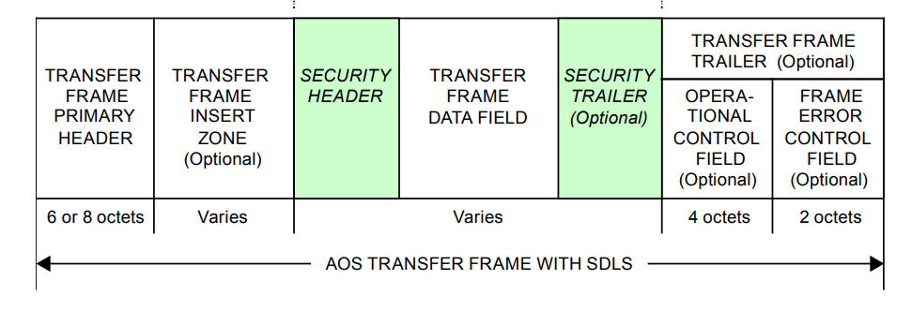
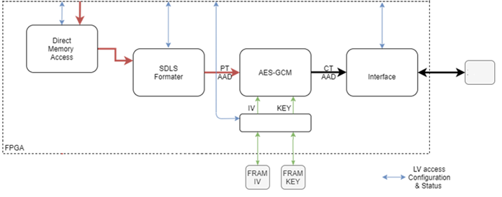
Cipher Design : Context
SEFUW: CNES activites on Nx chips

Slide 20
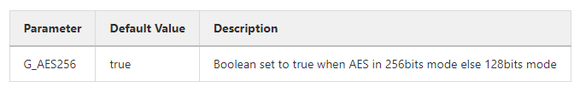
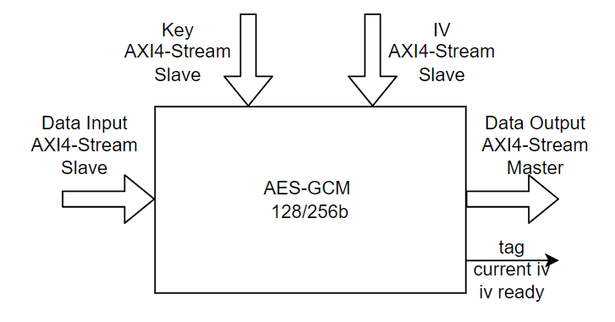
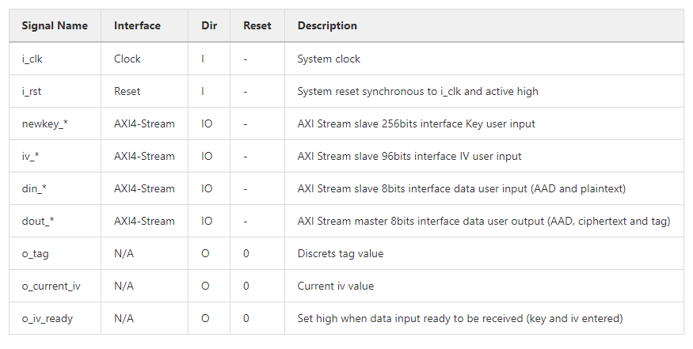
IP Architecture
SEFUW: CNES activites on Nx chips

Slide 21
IP Features
SEFUW: CNES activites on Nx chips
AXI4-Stream Interface for key input for 128 and 256 bits key length
Internal Key Expansion processing
AXI4-Stream Interface for IV inputIV input of 96 bits length
AXI4-Stream Interface for Data input (AAD and PlainText)
Supports only GMAC messages or GMAC and PlainText or only PlainTextSupports data input of 8bits granularitySupports AAD data masking for tag computation
AXI4-Stream Interface for Data output (AAD, CipherText and Tag)
Simple, fully synchronous and reusable design in all architectures (no target dependency)
Implemented according to the National Institute of Standards and Technology (NIST) Special Publication 800-38D
Fully validated with NIST CAVP "Cryptographic Algorithm Validation Program" tests vectors
Data Rate 55 Mbps with a 100MHz clock. (~Freq/2 bps)
IP Resources
AES-GCM 256b mode with Key expansion:
CHIP | LUT | FF | BRAM
ZYNQ7x | 1250 | 2500 | 1.5
NG-LARGE | 2400 | 2540 | 6

Slide 22
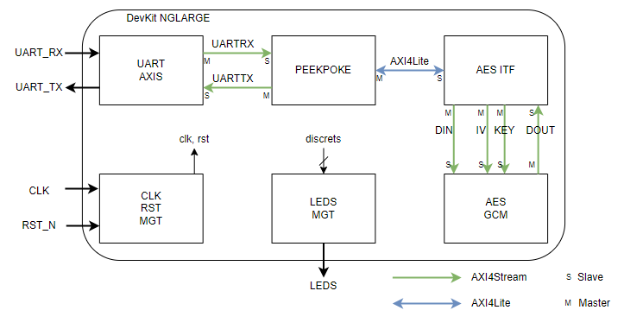
IP Validation on DevKit NG-LARGE & Briquette (Zynq US+)
SEFUW: CNES activites on Nx chips

Slide 23
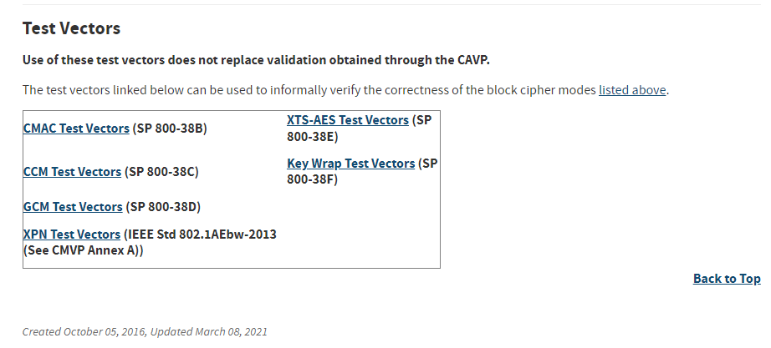
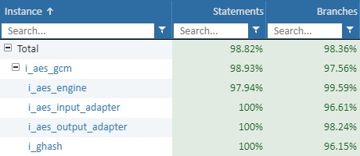
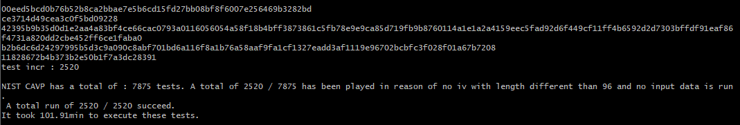
Validation : coverage and NIST Test Vectors
SEFUW: CNES activites on Nx chips
Coverage : 9 scenariis

Slide 24
COMODO BOARDS

Slide 25


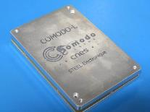
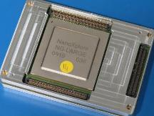
COMODO
SEFUW: CNES activites on Nx chips
R&T developed by STEEL Electronique
COMODO Versal is also ongoing
COMODO-L
EM (Available)
COMODO-L
Flight (End of 2023
COMODO-U
Fabrication ongoing
COMODO-U
First tests

Slide 26
THANK YOU ! QUESTIONS?

