Slide 1
Lessons learned for SDRAM testing
QEC Final Presentation Days 2023
Said Bounasser
26/06/2023

Slide 2
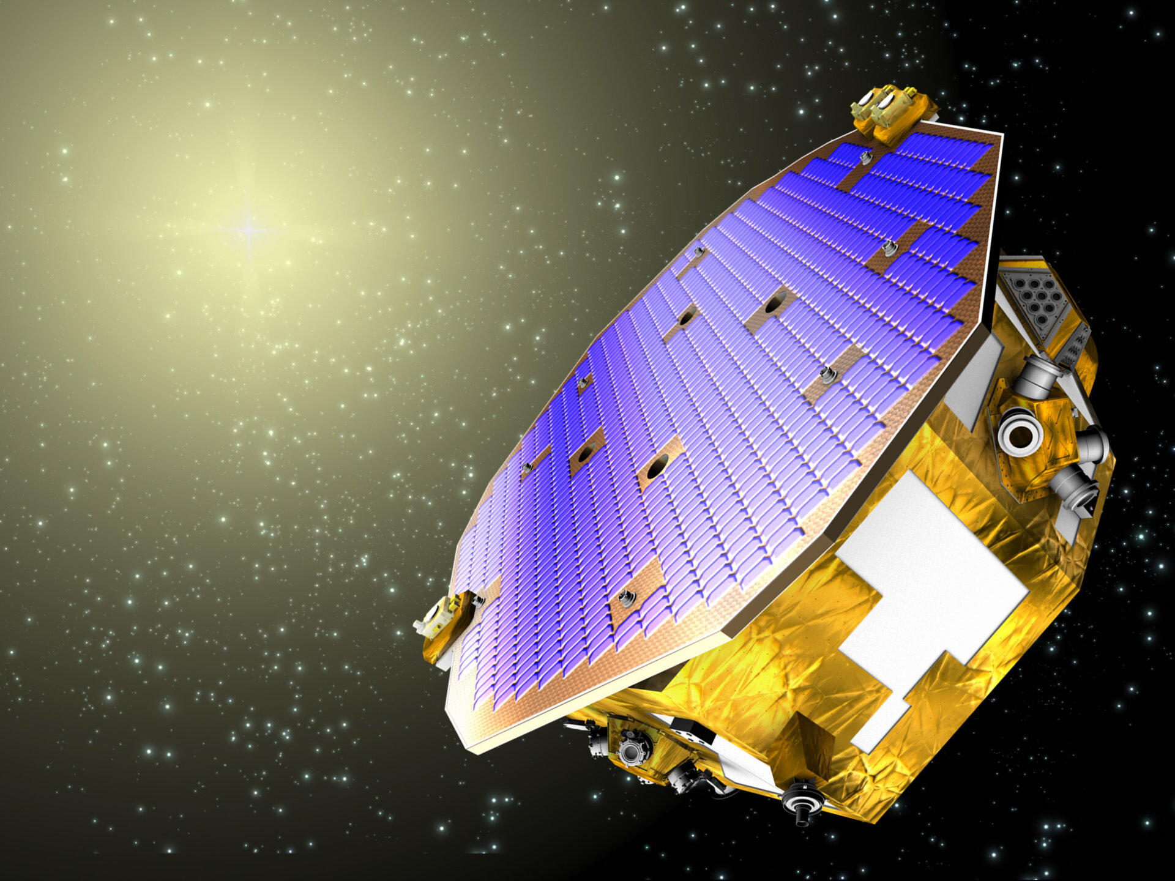



Context
IPN 506: “Stuck bits in SDRAMs observed in-flight on several spacecraft”, raised in March 2018.
Stuck-bits (SB) and Intermittent Stuck-bits (ISB) have been detected in orbit in several missions. Impacted memory: ELPIDA EDS5104ABTA.
Investigation of radiation effects on the ISSI SDRAM. Parts were provided from two lots by 3D+.
Outcome:
Testing guidelines.
SEE (SB/SEU/SEFI) sensitivity screening of the ISSI SDRAM.
LISA Pathfinder
SMOS
SWARM
JASON-2

Slide 3
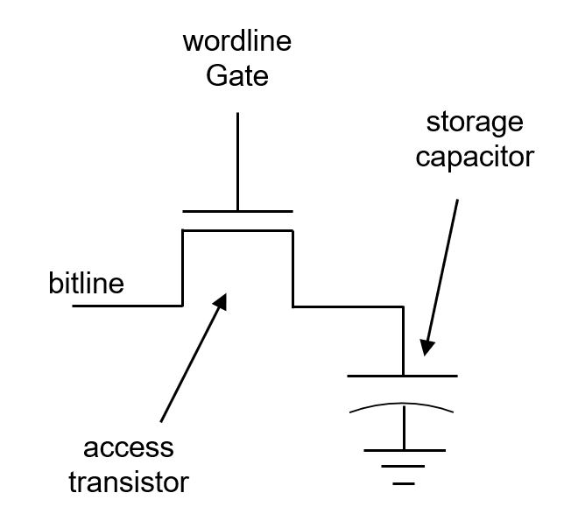
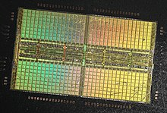
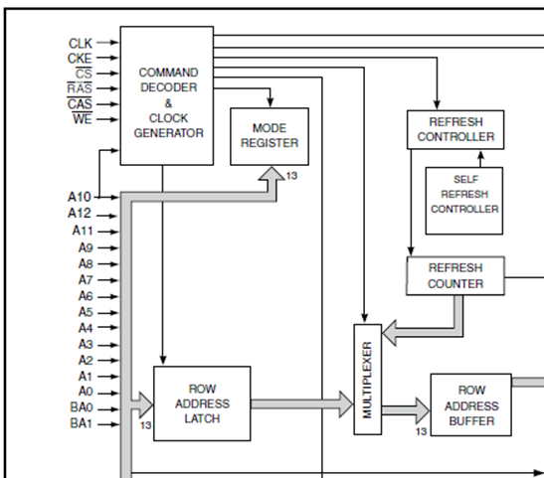
Functional block diagram
512Mbits SDRAM, 3.3V, 143MHz,
8-bit data word memory, 4 Bank.
SEU
Stuck-Bits
SEFI
ISSI
datasheet
Die example of a Samsung SDRAM
Stuck-bit, SEU/MCU/MBU, SEFI detection can be all implemented in the same test routine.

Slide 4
DRAM Retention Time (RT)
If the bit’s RT gets lower than the refresh period, an error occures at the next refresh cycle.
If not cleared, risk of events accumulation and impact at system level.
Scientific data corruption, telemetry saturation, reset..
Self-refresh will only perpetuate the error.
Error is cleared if:
Memory content is re-written, but subject to error if persistent .
Discard the faulty row/bit.
An EDAC strong enough is implemented.
Except specified otherwise, stuck-bits here are given for a RT_{TH} of 64ms and ambient room temperature.
Level 1 logic
V_{max}
V_{min}
RT failure
Error
propagated
to next cycle
Level 0 logic
T_{REF}
T_{REF}
T_{REF}
Time [A.U]

Slide 5

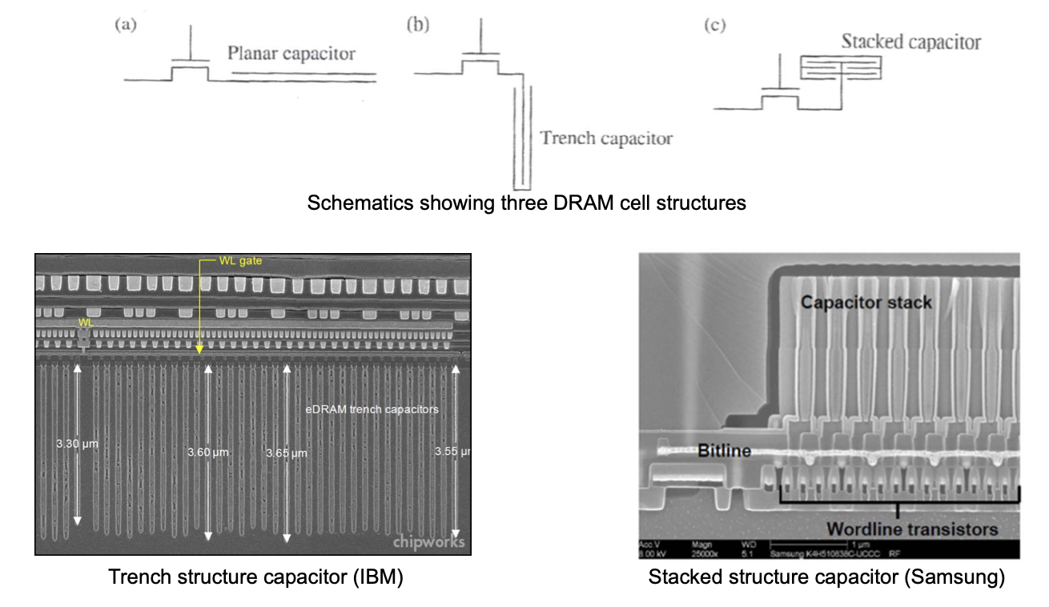
Abstraction level vs technology information
Problem: Different technologies, proprietary information.
How to construct an efficient testing strategy independently of the DRAM tested.
High level characterization
Temperature
Retention Time screening
Pattern
Irradiation source
In-situ measurement follow-up
-> SB rate for a given mission.
-> Will my EDAC be strong enough?
SW/HW interface
Logic
Devices
Electrons
J. Liu, ISCA 2013

Slide 6
What factors influence the Retention Time - Reliability
Non exhaustive list of parameters.
Temperature
  When temperature rises, SB count will rise too.
  -> Importance to test at your operating temperature.
2) Manufacturing process
  Margin to the 64ms threshold can be of a few hundreds of ms to few seconds.
  -> Importance of pre-screening parts.
3) Inter-cell interference
  A bit ability to store its information is by its bit’s content and neighbouring write/read operation.
  -> Importance of testing different pattern, search for the worst case pattern.
4) Radiation
  TID/Proton/Heavy-Ion are all found to create stuck-bits. They are observed in space and in ground experiment.

Slide 7
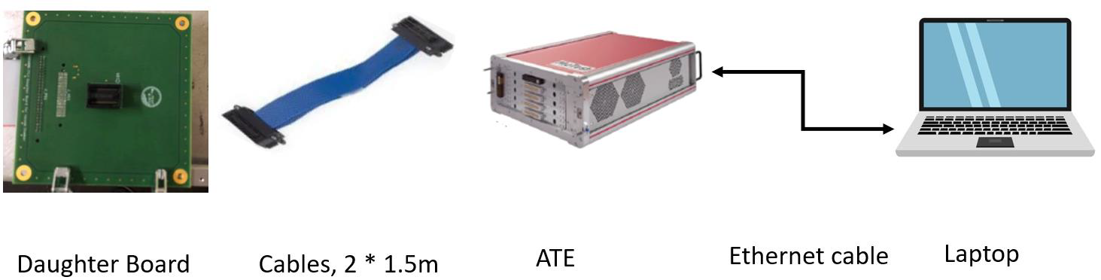
Dynamic sliced algorithm using a PRBS pattern
Beam On
Going through the whole memory.
Per slice of 100 lines.
Repeated write/read operation to trigger and catch SEFIs.
PRBS and /PRBS pattern alternatively written in the memory.

Slide 8
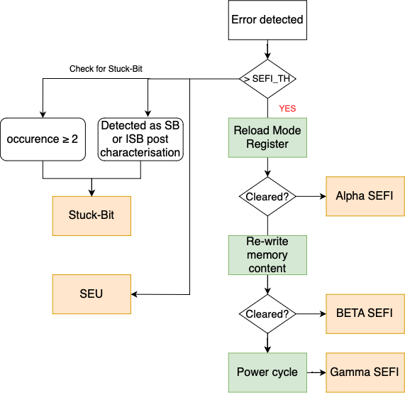
Error classification procedure - Beam ON
SEFI_TH = 50
Each time errors are recorded in a slice, a recovery procedure is applied to discriminate events.
If a given bit, is recorded 2 times or more in error during a run, or later found stuck, it is removed from the SEU cross-section and labeled as stuck-bits.
SEFI recovery procedure is based on the JPL classification.

Slide 9
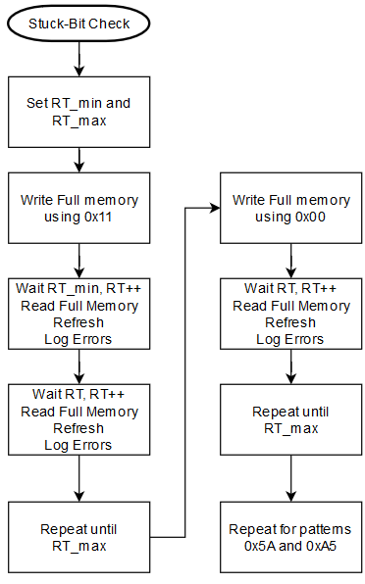
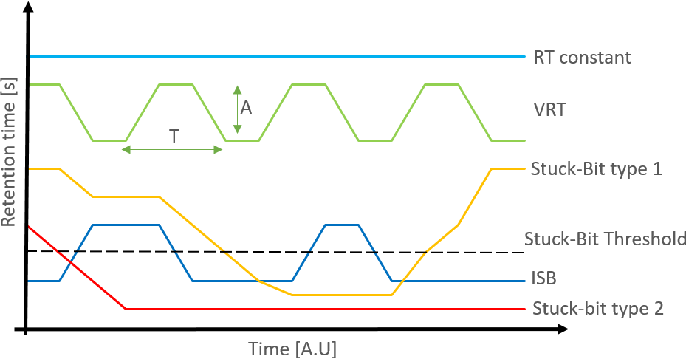
SB characterization procedure – Beam off

Slide 10
VRT and ISB characterization procedure – Beam off

Slide 11
Pre-Irradiation characterization
Lot_DUT

Slide 12
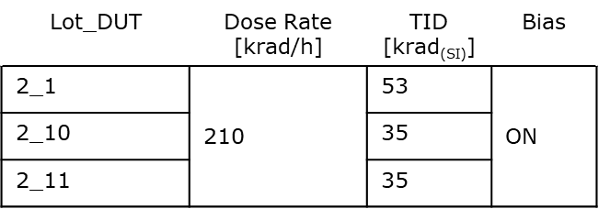
TID characterization
2_1
Pattern 0x00

Slide 13

TID created Stuck-Bit
SB can’t be created by TID.
1 weak cell was present in the DUT 2_1.
Its RT value was divided by 2 each ~20krad.
After 40krad it couldn’t hold its value after 64ms.
This specific bit was only sensitive to the pattern 0xA5, it was fine for 0x5A, 0x00 and 0x11.
-> Only 1 bit out of 3 * 512MBits SDRAM
But there was also only 1 weak cell

Slide 14
Proton SEE characterization
SEFI:
1 A-SEFI
5 B-SEFI
SB_A
SB_B
No difference between pristine device and TID pre-irradiated.

Slide 15
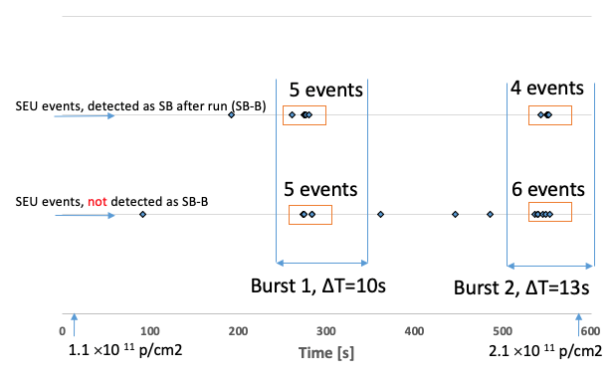
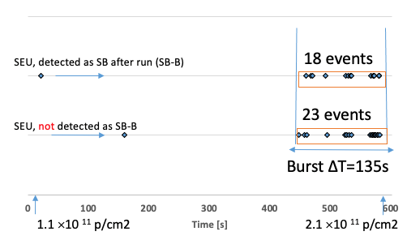
Proton SEE event timeline
Burst of events, with a mix of detected SB and SEU.

Slide 16
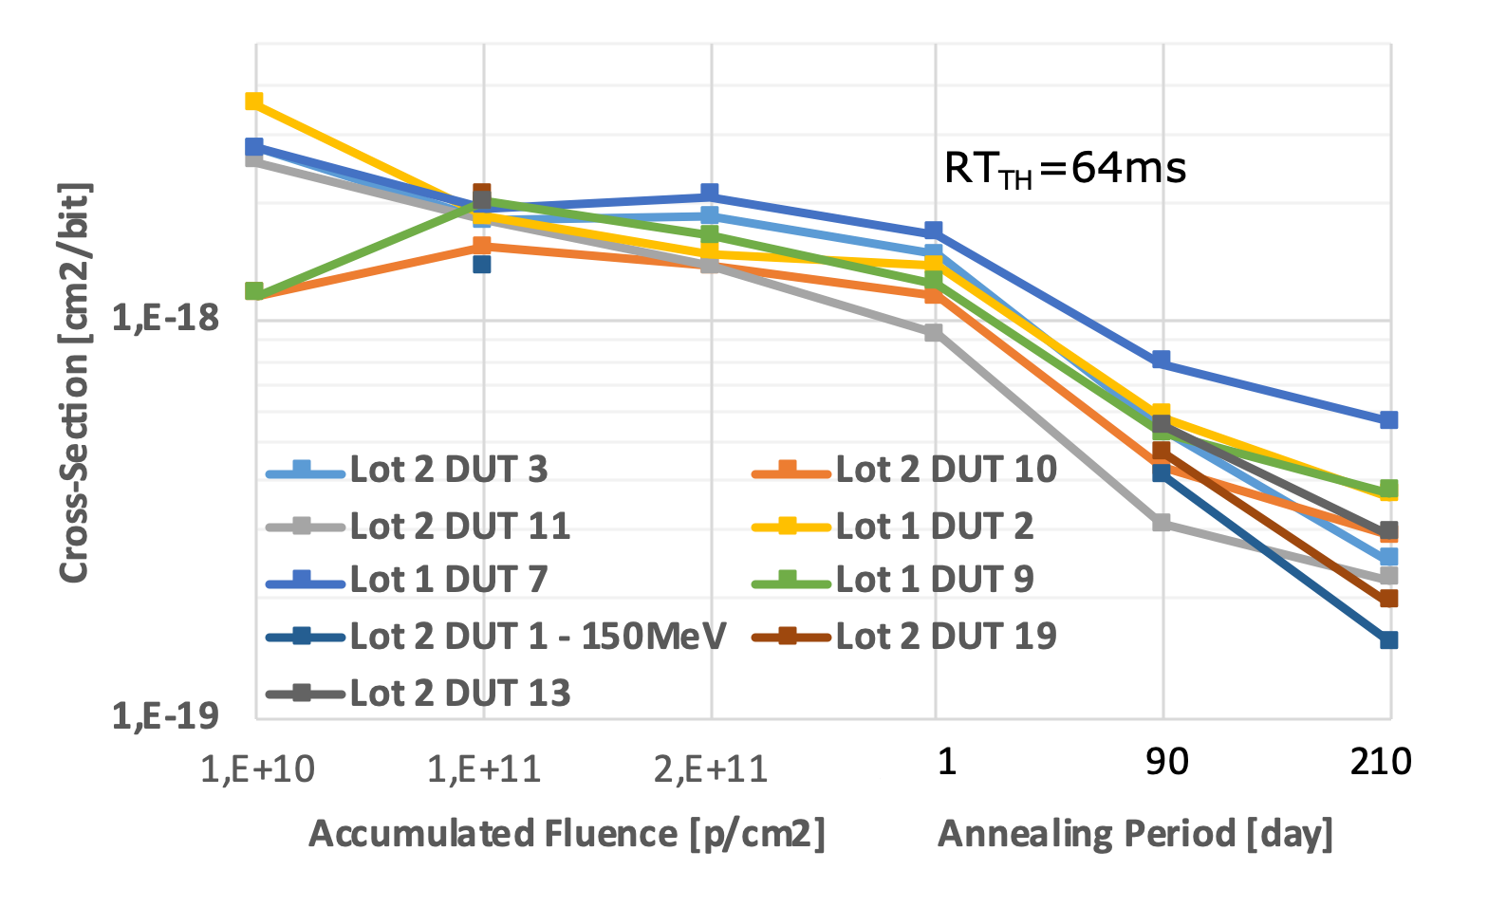
Proton SB cross-section and annealing
SB cross-section is flat along the accumulated fluence.
Higher variability at low accumulated fluence due to a lower amount of SB created.
Annealing measurement after 1, 90 and 210 days (unbiased at ambiant temperature) have been recorded.
SB created are persistent over time.
Not much variation from lot to lot.

Slide 17
Proton induced ISB

Slide 18
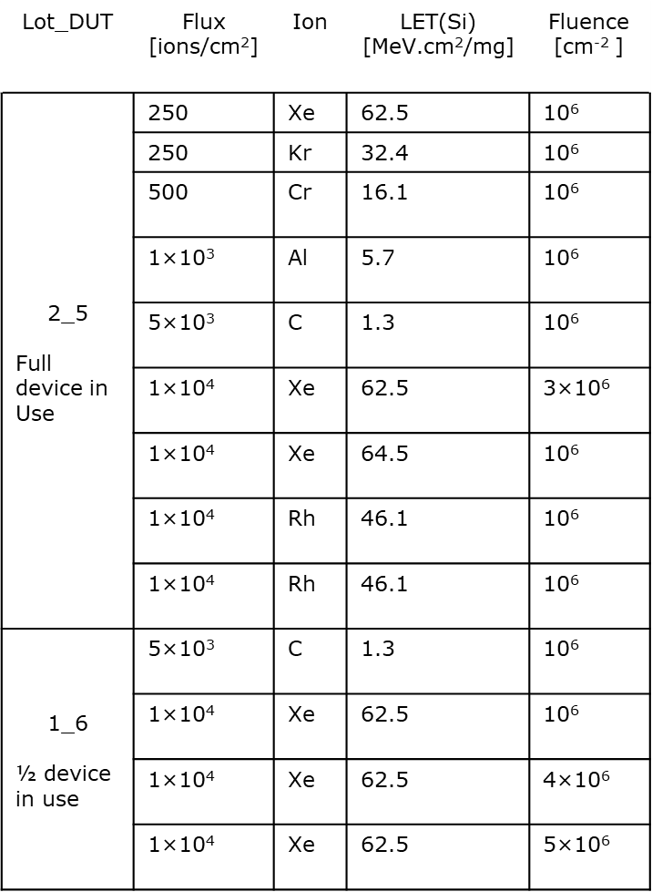
Heavy-Ion SEE test

Slide 19
Stuck-Bit cross-Section and annealing

Slide 20
SB and ISB measurement for DUT 1_6
ISB
Legend
After X Days of Annealing
Measurement Duration
2nd
12h
RT_{MAX}[s]
6th
24h
21th
13 days
41th
24h
67th
24h
RT_{MIN}[s]
Stuck-Bit
Occurrence
Annealing Period [Day]
Percent of Time Spent below SB_{TH}

Slide 21
Testing procedure summary
Pre Characterization, search for the weakest cell. Temperature measurement.
In situ measurement under irradiation, check for SEU/SEFI and SB.
Rapid first post characterization, search for stuck-bits using static patterns and RT_{TH} ranging from 16ms to 16s. In between runs.
Long term post characterization, annealing effect and ISB 24h measurement. Temperature measurement.

Slide 22
Key take aways
Proton and Heavy-Ion are a must for SB testing. TID test must be performed if weak cell with low margin regards to the 64ms threshold are present in the device, or high operating temperature.
Short and long-term measurements are preferred to evaluate annealing effects and compute SB for short and long terms.
ISB measurement is preferred for a more precise extraction of SB count.
Do stuck-bits measurement at your operating temperature as it plays a major role in the SB count.
Test the whole memory under beam to catch as much as possible of SEFIs and with a dynamic PRBS pattern.
Create a unique list of SB, detected with different patterns. Test two patterns at minimum. Remember that a given bit cell is sensitive with a combination of its written content and in the neighbouring cells.

Slide 23
Counter measure for Stuck-Bits
EDAC implementation but it can be defeated for a SB + 1 SEU in the same word for a SECDED.
Use a higher refresh rate. In absence of radiation degradation, the designer can decide to use a much lower refresh rate to save power, but if in presence of SB, one should increase the refresh rate in the faulty row.
Bit/Row repairs mechanism (remapping the logical bit/row address that points to the faulty bit/row to a spare one).

Slide 24
In-flight data vs ground testing
Atypical shape
Single-event ?
Cumulative?
“Experimental characterization and In-flight observation of weakened cell in SDRAM”, Anne Samaras, 2015
More results were presented at NSREC and RADECS 2020

