Slide 1

Heavy ion SEE testing of the Microsemi RTG4 flash-based FPGA
R. Sharp¹, L. Tambara²
¹Radtest Ltd, United Kingdom
²Frontgrade Gaisler, Sweden

Slide 2
Content
Motivation and objectives
Experimental set-up and test vehicle
Results
Conclusions
Acknowledgements

Slide 3
Motivation and objectives
The RTG4 FPGA integrates Microsemi’s fourth generation flash-based FPGA fabric and high-performance interfaces
RTG4 FPGAs are manufactured on a low-power, 65nm process and they are immune to SEU in the configuration memory
The information on TID and SEE results available at the start of the work was encouraging, making these devices very attractive for space applications
The objective of this work was to obtain heavy ion SEE test data on the RTG4, in the context of a real space design
The implementation of a tailored version of the Gaisler GR740 ASIC in the RTG4 enabled the use of several existing test cases that had already been proven during SEE testing of the GR740 in 2016

Slide 4
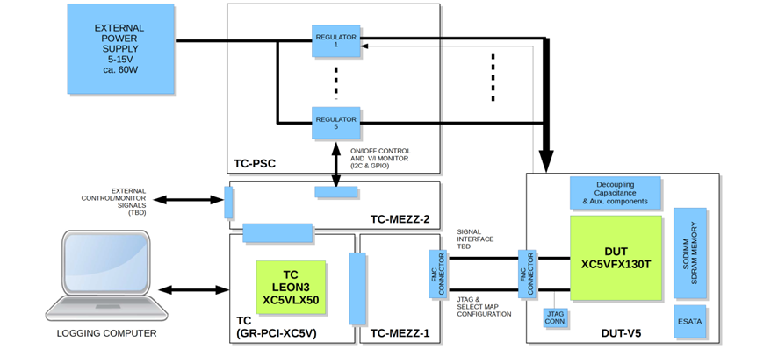
Experimental set-up
The test set-up was based upon an earlier version, used to test the Virtex-5 FPGA
The TC-FPGA design was updated, transferring the FPGA functionality that was developed for the GR740 SEE test system into this test system. Additional functionality included PLL lock monitoring, a debug interface for control of the DUT and a static test capability.
Temperature sensing was added via a mezzanine solution and existing connections

Slide 5
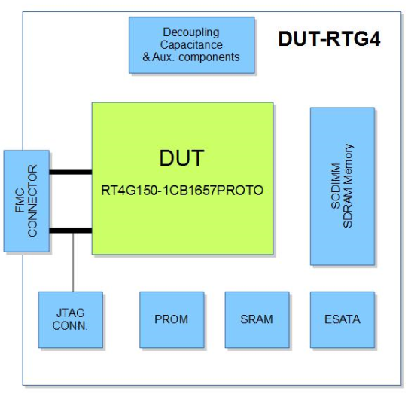
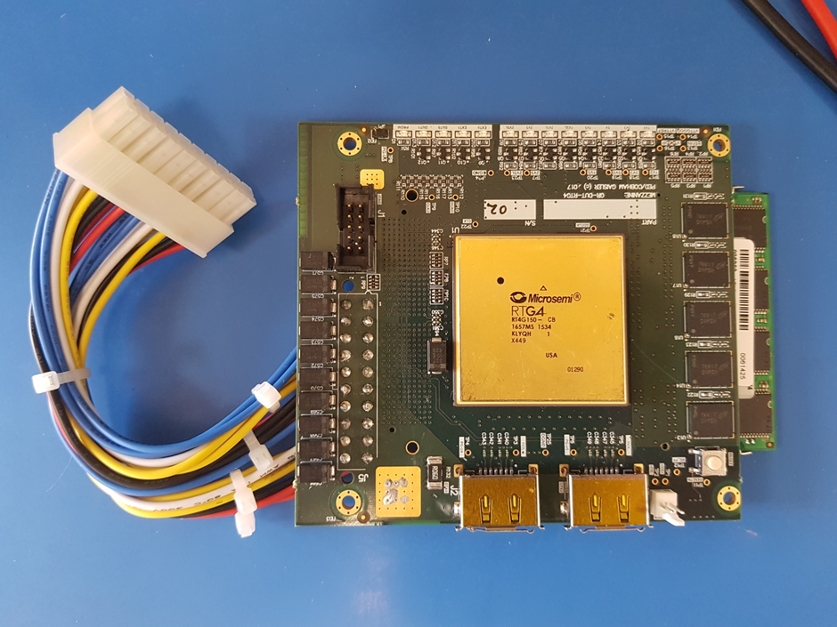
DUT board

Slide 6
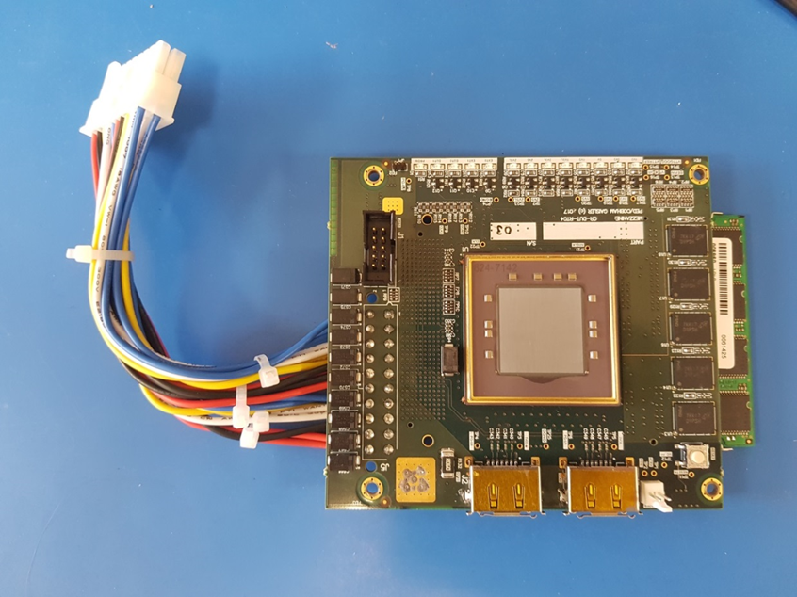
DUT preparation
Three samples were provided by the manufacturer
Back thinning to between 60 (one sample) and 110 (two samples) microns

Slide 7
Test vehicle
The VHDL description of the GR740 was reduced to fit onto the RTG4 by:
  reducing from 4 to 2 cores
  no FPUs
  L2 cache reduced from 2MiB to 64kiB
  all communications controllers disabled except SpaceWire and UARTs
  Clock frequency reduced from 250MHz to 40MHz
Key features retained:
  2 LEON4FT processors
  basic peripherals, including a timer unit, interrupt controller and UART
  L2 cache with scrubber
  L1 cache was identical to the GR740 except that hardened flip-flops were used for the register file
  PLL enabled
  SpaceWire interface

Slide 8
Target scope of testing
Several different design permutations were implemented, as follows:
Fault tolerance:
  technology agnostic EDAC from GR740
  RTG4 built-in memory EDAC
SpaceWire clock recovery:
  DDR clock sampling from GR740
  RTG4 built-in CCC clock conditioning circuit
SET filtering:
  enabled
  disabled
There was insufficient beam time available to test all of these and so coverage focused on those that could provide the most interesting results

Slide 9
Test software
The application test software consisted of two parts:
  the target software running on one of the LEON4FT cores
  the host monitor software running on a host computer
The target software could execute different applications and report error events to the host computer
Three test cases were used:
  Instruction unit on L2 (IU on L2) was a single core, synthetic stress test designed to access all of the L2 cache
  Instruction unit multiprocessing (IUMP) was a multiprocessor test similar to the IU on L2 test, but with the IU located in the L1 cache
  SpaceWire (SPW) was a single core test that allows data to be sent from the main memory (possibly cached by the L2 cache, if enabled) via the SpaceWire ports and routed back for comparison using a loopback scheme. Of all the three test cases, this one made the most use of the FPGA’s global resources.

Slide 10
Irradiation campaigns
Three campaigns were performed:
1) HIF at UCL, Belgium for a ‘dry run’ to validate the set-up and test three design permutations
  Verify DUT reset functionality
  Verify current and temperature monitors functionality
  Characterise L2 scrubber operation
2) RADEF, Finland for a second ‘dry run’, due to uncertainties over when TAMU would be available
  Gather more data with SET filtering on and off
  Evaluate the RTG4’s built-in fault tolerance resources
  Assess the use of two SpW ports instead of one (tested at UCL)
TAMU, USA
  Primary campaign to test as many test cases as possible with gold ions at high LET
  Various ion species and angles were used to investigate 3D effects on the RTG4’s hardened fabric
  All test cases were resynthesised with Libero v11.9, which became available shortly beforehand

Slide 11
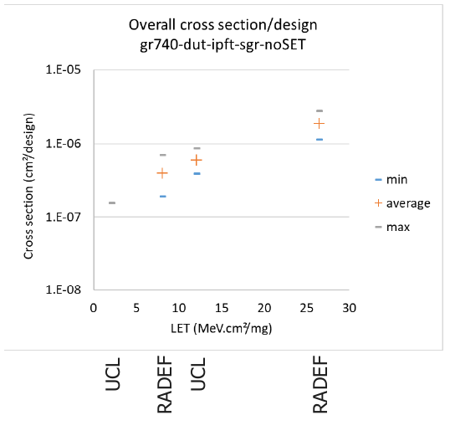
Results - dry runs - RADEF v. UCL
Comparison of overall results (no SET filter)
LSRAM static data derived from IU on L2

Slide 12
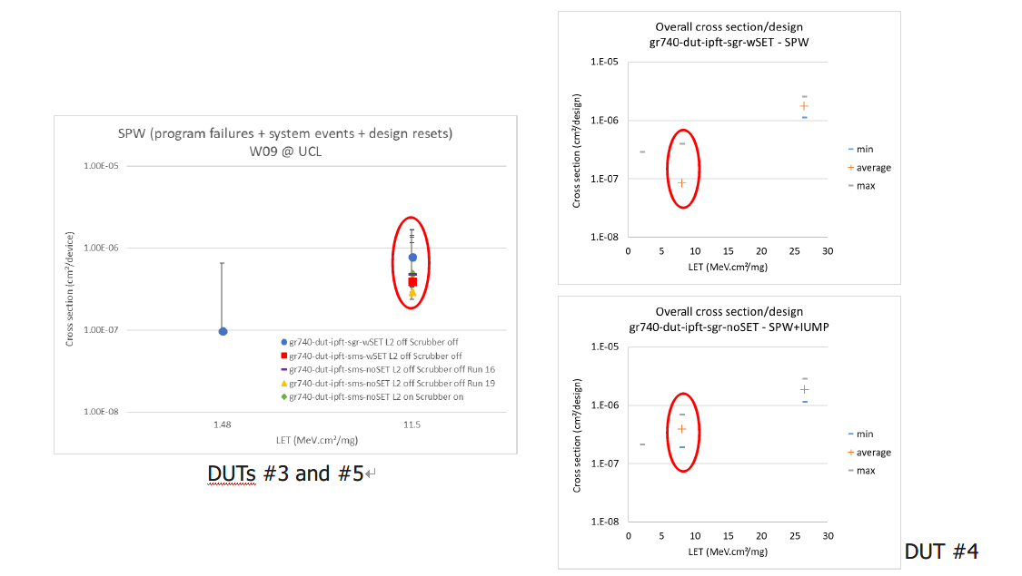
Results - dry runs - SpaceWire
Comparison between UCL (left) and RADEF (right)
Broadly similar results from two different facilities and on different test samples

Slide 13
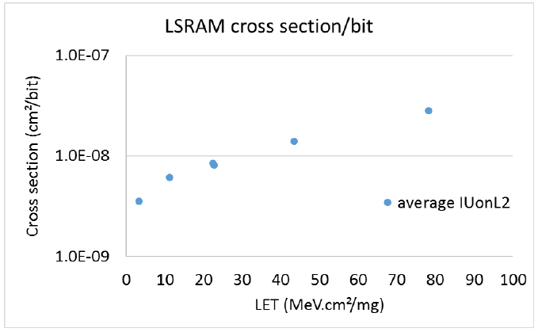
Results - TAMU
Overall results with SET filter
LSRAM static data from IU on L2

Slide 14
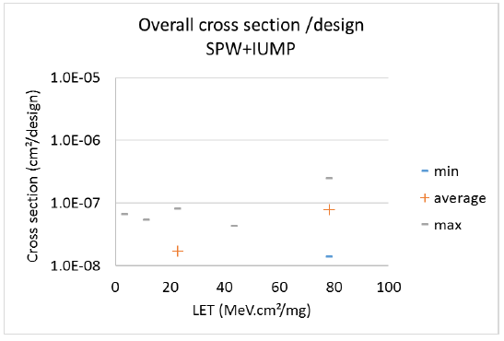
Results - TAMU - SpaceWire
SET filter results consistent across all tests
~ factor of 10 difference for design events (lower at TAMU)
The trigger for these is undefined but it is suspected that the synthesis tool had an influence
Only a few design resets were observed (typ. 1 or 2 per LET)

Slide 15
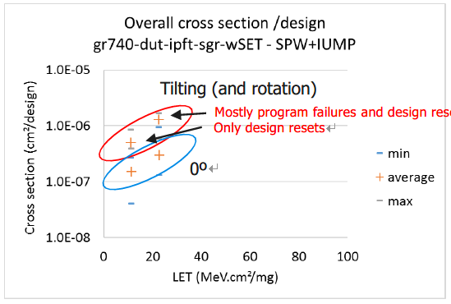
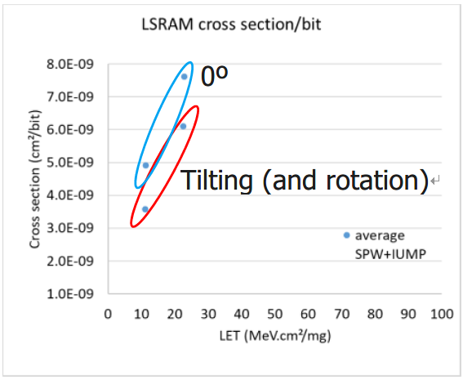
Results - tilting and rotation
LET = 11: Ar at 0° and Ne at 58° (plus 90° rotation) LET = 22: Cu at 0° and Ar at 45° (plus 90° rotation)

Slide 16
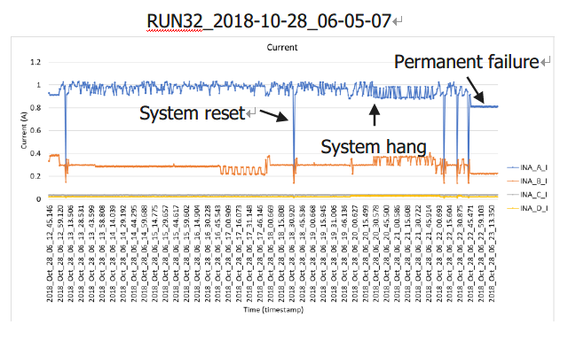
Total dose
DUT #03: 50.2 krad[Si]
DUT #04: 63.3 krad[Si]
DUT #05: 9.4 krad[Si]
DUT #04 suffered permanent failure during run 32, preceded by multiple system resets and a system hang
These events were visible in the current log but not in the temperature data, due to thermal lag

Slide 17
Conclusions
Three samples of the RTG4 flash-based FPGA have been heavy ion SEE tested with the GR740 implemented within
Good consistency was observed between the three heavy ion facilities
No latch-up was observed
Significant numbers of correctable errors were observed
  The SET filter was effective at reducing error counts and raising the threshold LET
  The Gaisler ECC design appears to have a lower cross-section than the Microsemi ECC
The impact of tilting and rotating the test sample was measurable at low LET and decreased as LET rose
No significant differences were noted between the two implementations of SpaceWire
Author: Richard Sharp

Slide 18
Acknowledgements
Special thanks go to my co-author and colleagues at Gaisler (especially Fredrik Sturesson) for their various contributions to the project
Ken O’Neill at Microsemi/Microchip for arranging provision of the test samples
This work was funded under ESA contract number 4000113697/15/NL/SW

