Slide 1
Analysis of TID testing of a statistically large quantity of parts
J. Voegtli¹, R. Sharp¹, L. Oswald², N. Hong², B. Archer²
¹Radtest Ltd, United Kingdom
²University of Oxford, United Kingdom

Slide 2
Content
Motivation and objectives
Experimental set-up and results
Analysis
Conclusions and future perspective
Acknowledgements

Slide 3
Motivation and objectives
To embrace the approach of the NewSpace industry and the move to COTS parts, by re-evaluating standard procedures
Improve understanding of lot-to-lot and part-to-part variations within an example component
Confirm, evaluate and upgrade the state of the art using a far larger data set than has previously been possible
Investigate the radiation response of a statistically significant number of parts
Acquire parts from numerous date codes and from two separate manufacturers
Enhance previous work to investigate the effectiveness of the 3-sigma tolerance limit
Investigate methods for determining optimal sample size given a random selection of components from different lots

Slide 4
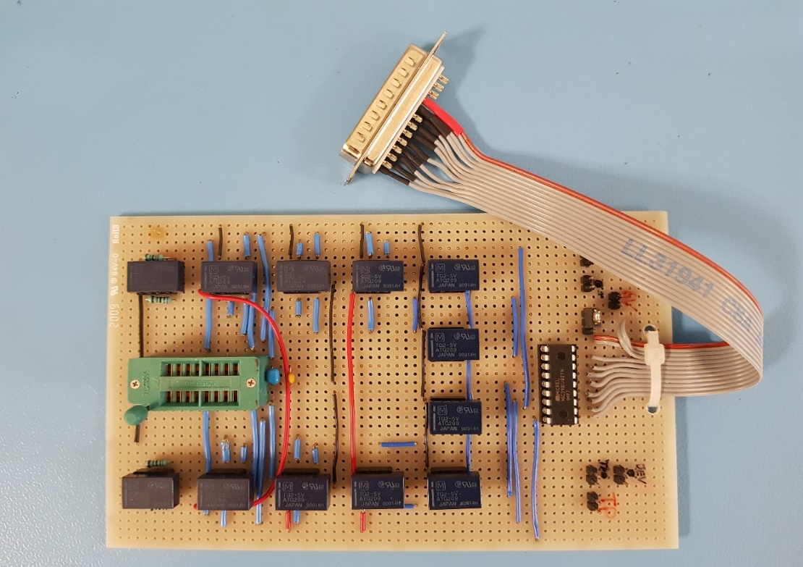
Experimental set-up
A total of 1000 quad-comparators across 10 date codes (1992 – 2019, TI and STM)
5 dose steps followed by two annealing steps at a dose rate of 0.86 krad[Si]/h
TID testing in agreement with the requirements of ESCC 22900
Devices split into 20 groups (runs) of 50 comparators
Planned testing of 2 runs at ESTEC to enable comparison of data
Bespoke test board to measure parameters on all four comparators [1]
[1] R. E. Sharp, J. Voegtli, E. Bradley, C. Poivey, “Total dose effects on large quantities of LM239N comparators from two manufacturers” paper DW5 at RADECS2021
Author: Jorn Voegtli

Slide 5
Experimental results
I_{S}
V_{IO}
I_{IO}
I_{IB+}
Author: Jorn Voegtli

Slide 6
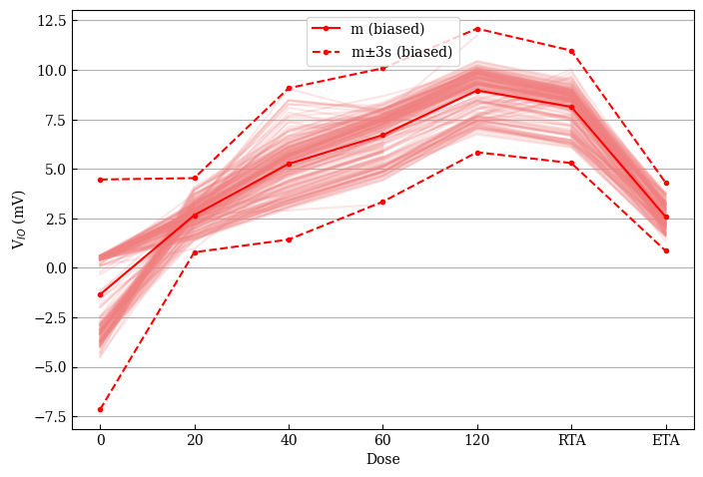
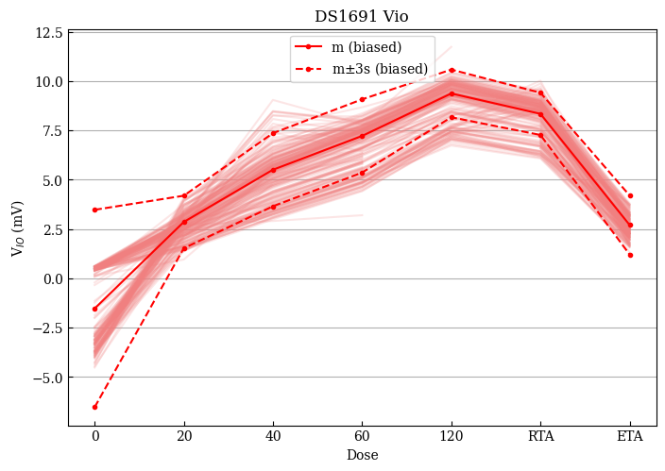
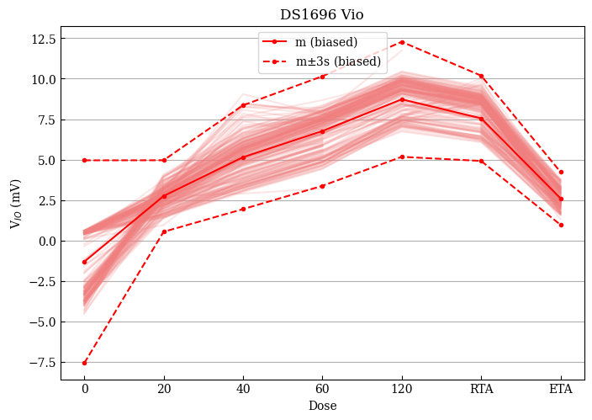
Analysis and discussion
Investigating one-sided tolerance limits plotted for 50 devices in one date code and bias condition
Investigation into the lot-to-lot variability by plotting mean and sigma for one date code, bias and run against the other results of similar date code and bias conditions
Quality of capture by one-sided tolerance limit of 5 devices across 50 is dependent on devices chosen
Author: Jorn Voegtli

Slide 7
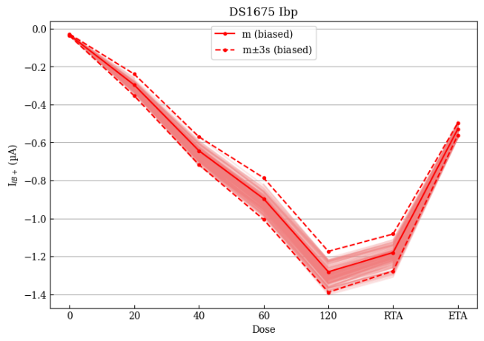
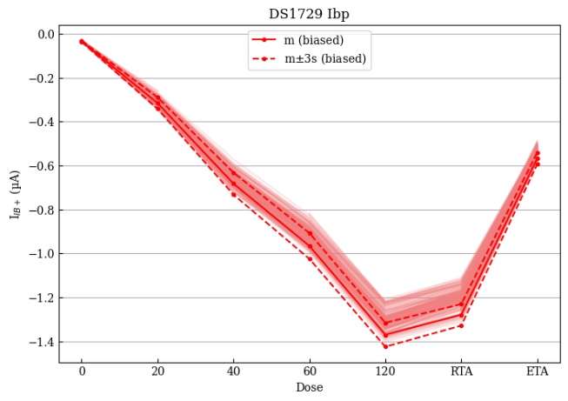
Analysis and discussion
Author: Jorn Voegtli

Slide 8
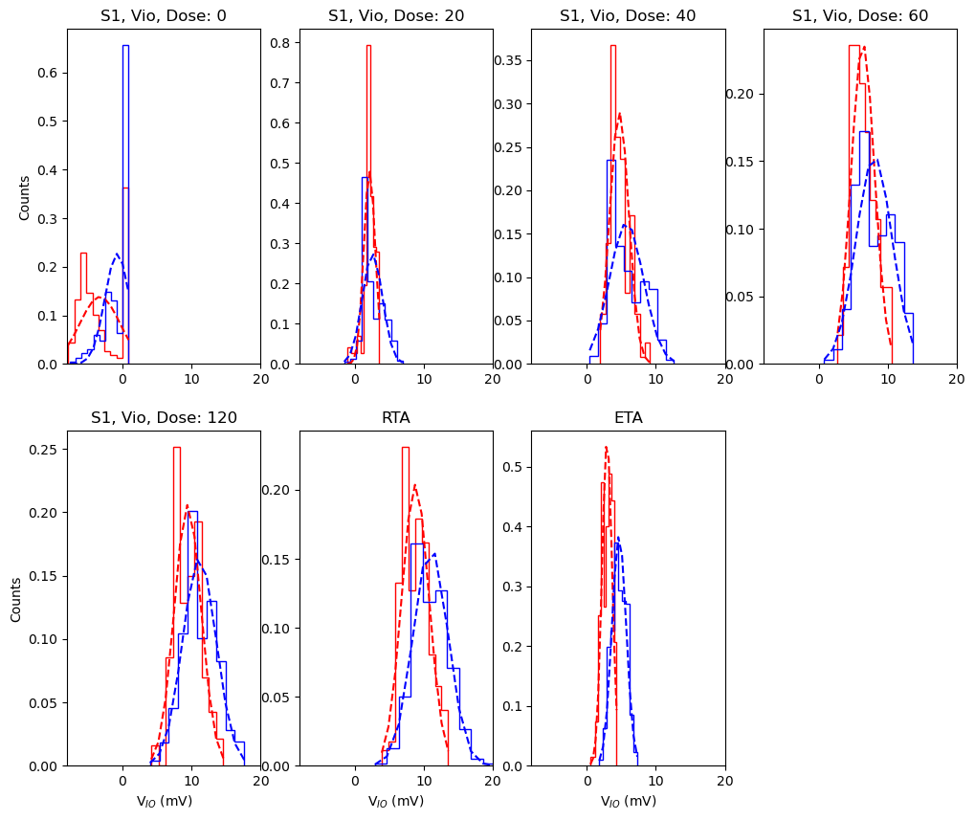
Normality
Investigations into suitability of normality for the device using histograms and qq-plots (Shapiro-Wilk test)
One parameter showed clear one-sided bias pre-irradiation which shifted during irradiation
Shown to be markedly improved in both input bias currents, only ~26% shown to be Gaussian
QQ-plots demonstrates peak data in most cases, with slight skews in some cases
81% of input offset current results demonstrated normality, suggesting good estimation
For other parameters, Breusch-Pagan (chi-squared) test data show only17% significance so assumptions made when performing a least-squares analysis are false
Author: Jorn Voegtli

Slide 9
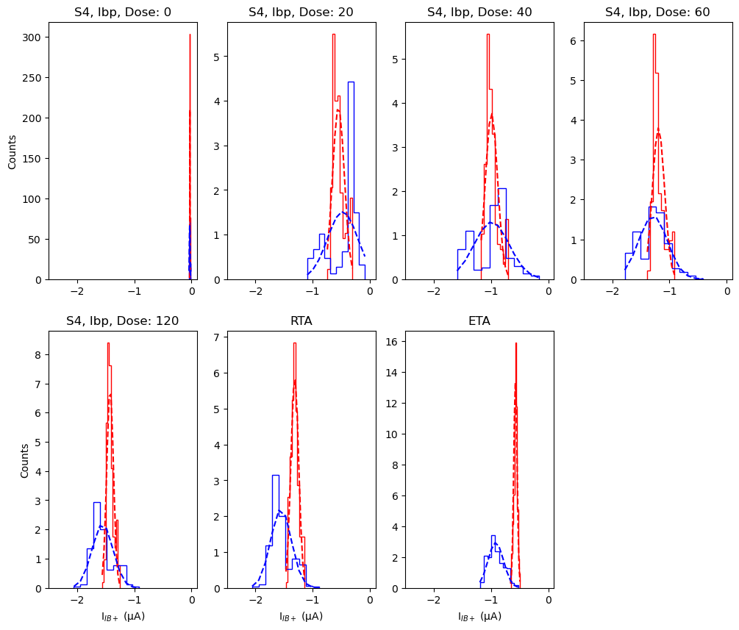
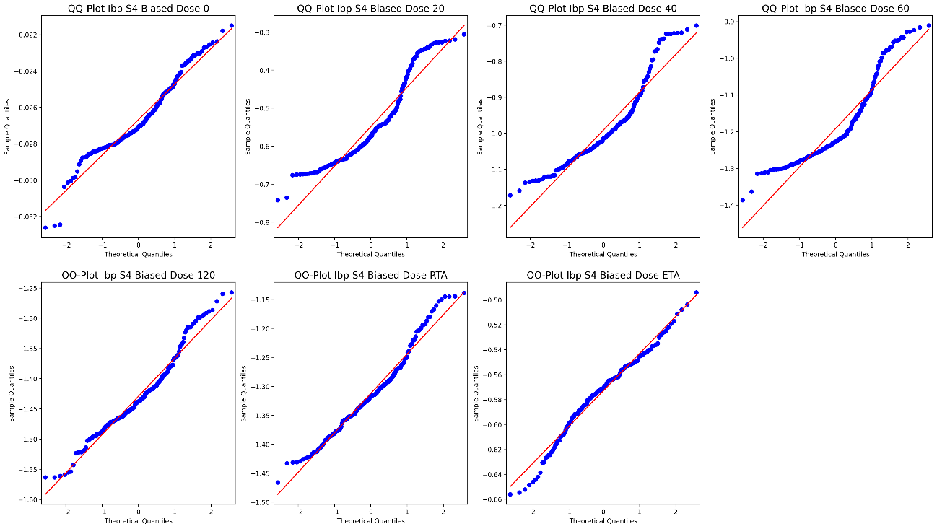
Analysis and discussion
Author: Jorn Voegtli

Slide 10
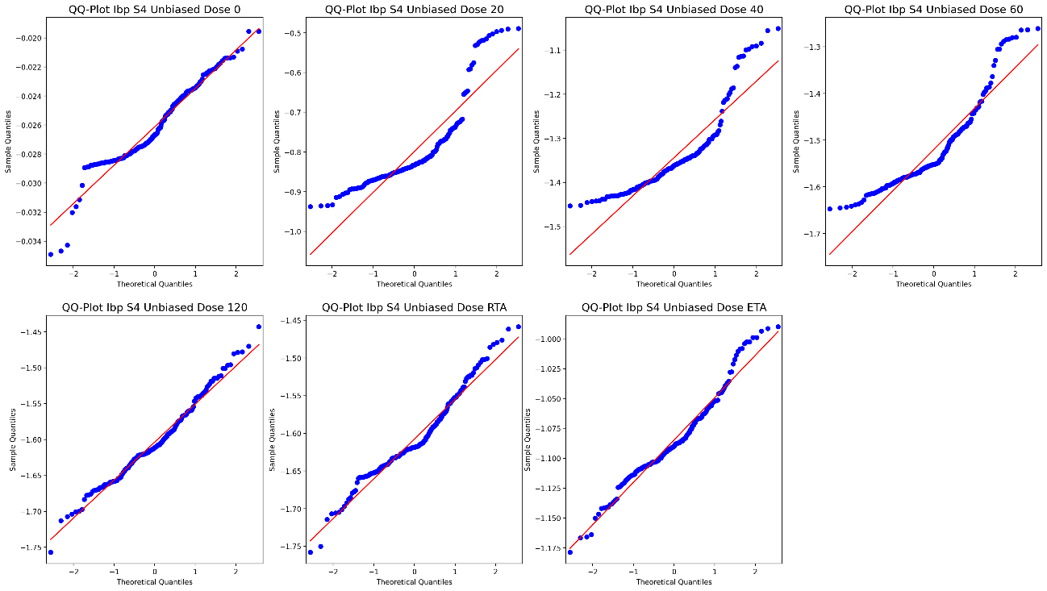
Analysis and discussion
Author: Jorn Voegtli

Slide 11
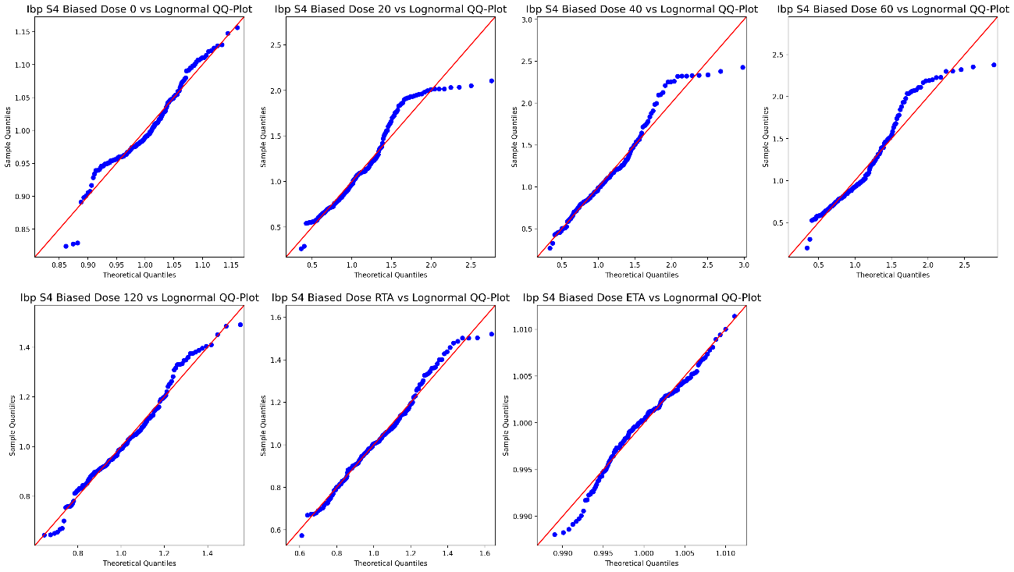
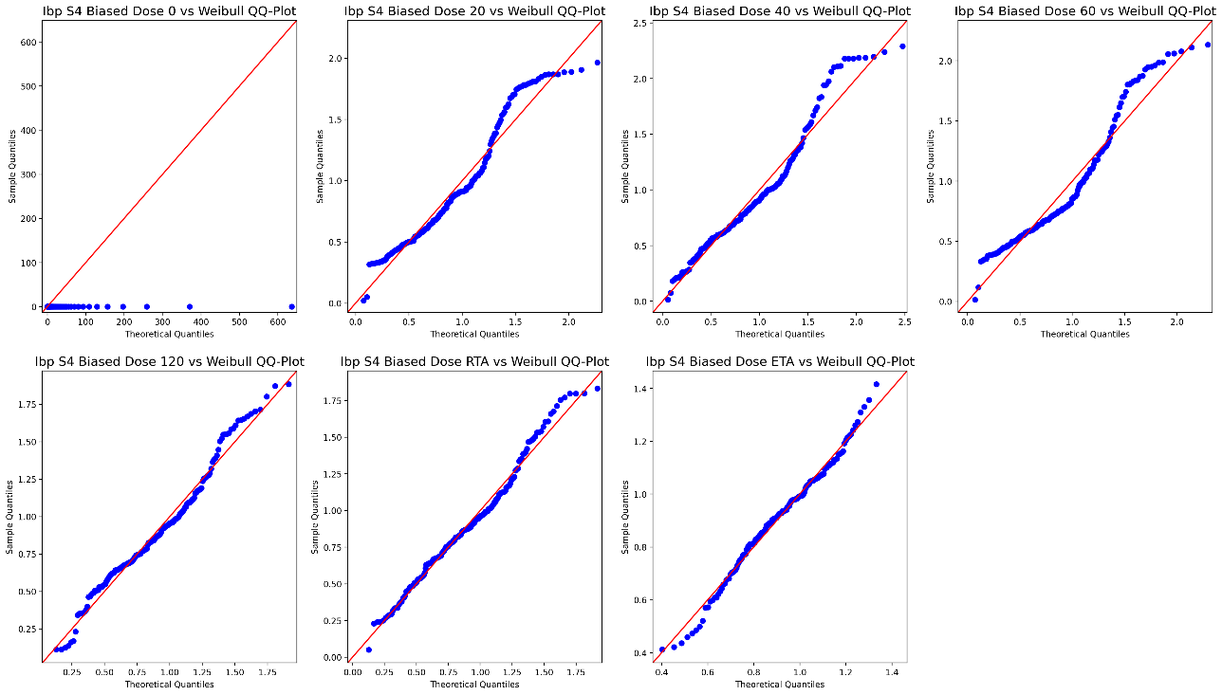
Analysis and discussion
Author: Jorn Voegtli

Slide 12
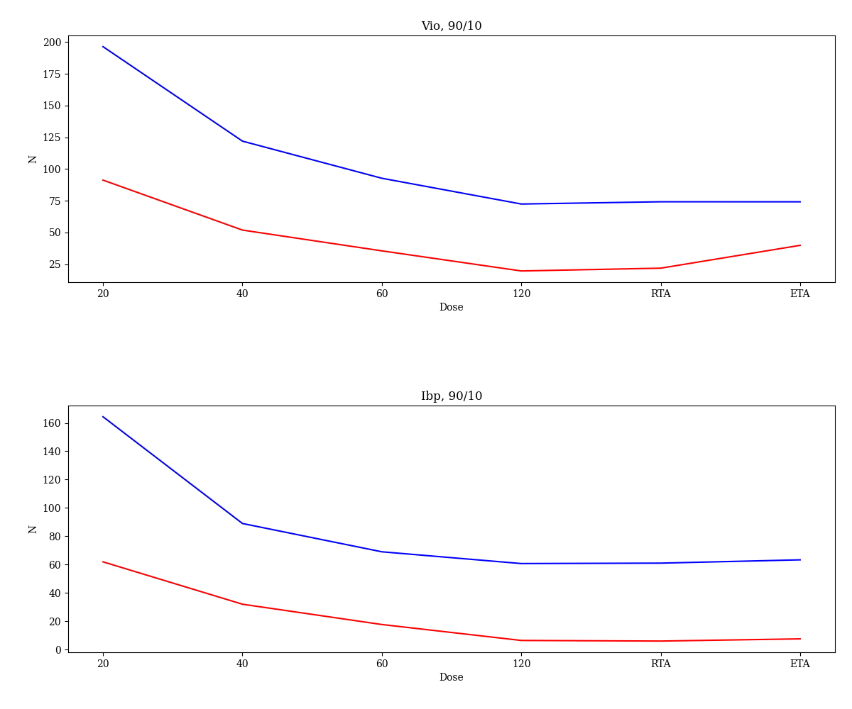
Optimum sample size
Investigate ability to determine method for optimum sample size determination
Confidence Interval and beta error rate limit values: 90% and 95% CI 10% and 20% beta error (sometimes called 90% and 80%)
One-sided tolerance limits suggest capture of typical sample sizes highly dependent on the selection of components
Lot-to-lot variability is reasonably significant in optimum sample size determination, particularly for V_{IO}
Some lots showed significantly low values for N in biased conditions
Author: Jorn Voegtli

Slide 13
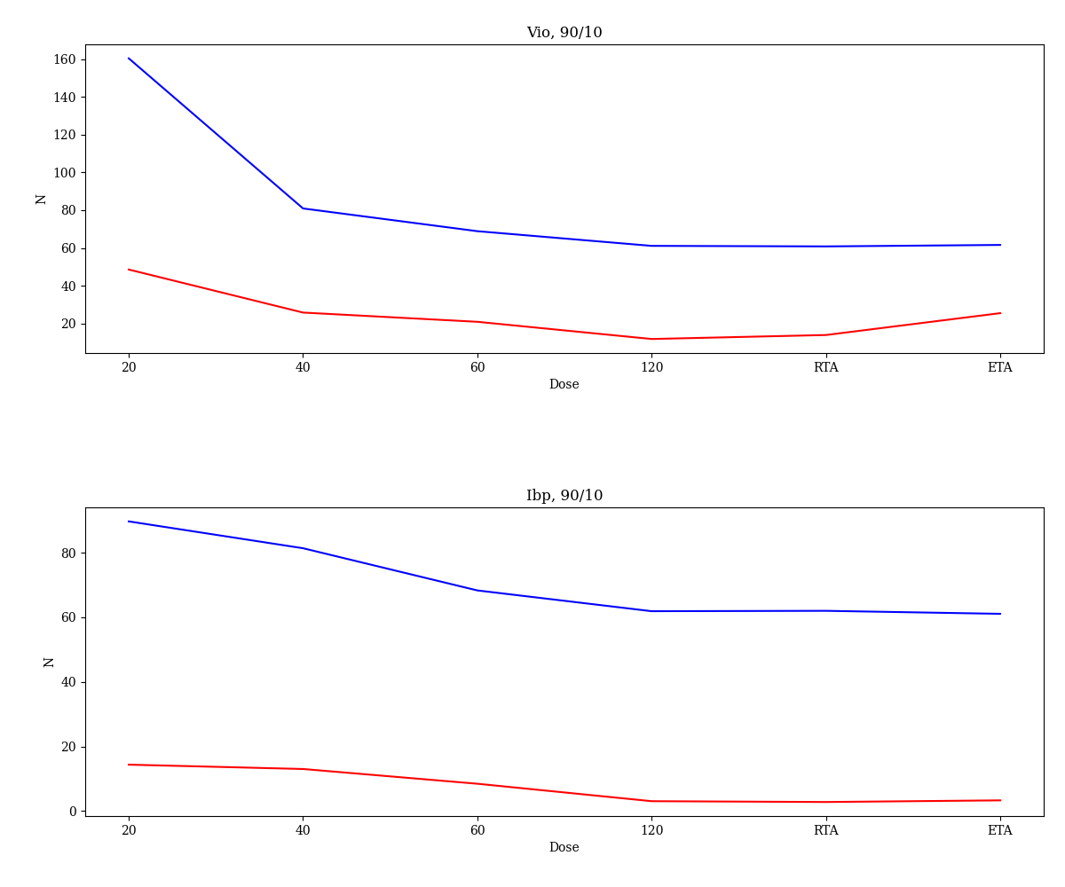
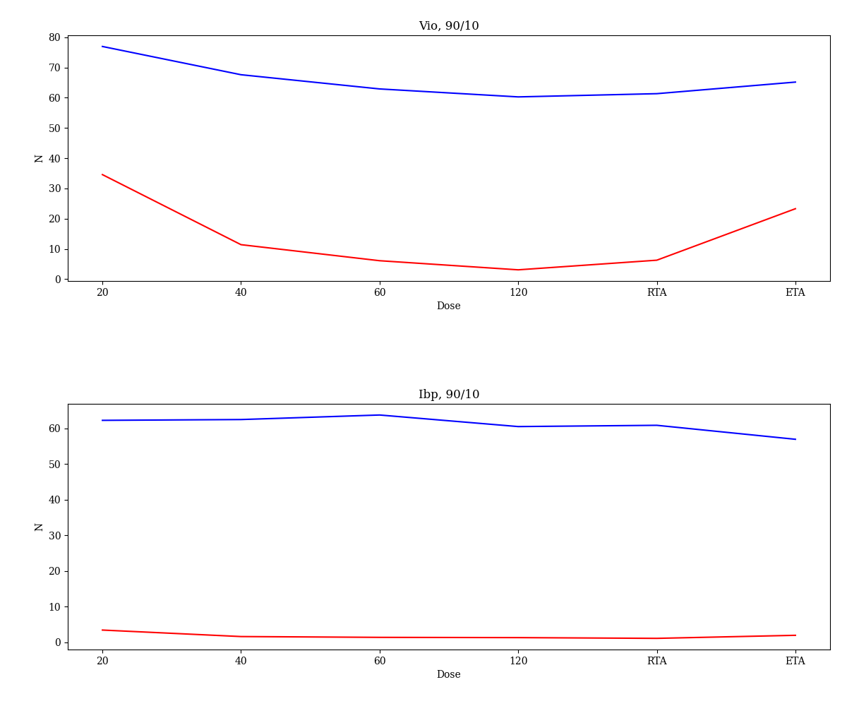
Optimum sample size
S1
S3
Author: Jorn Voegtli

Slide 14
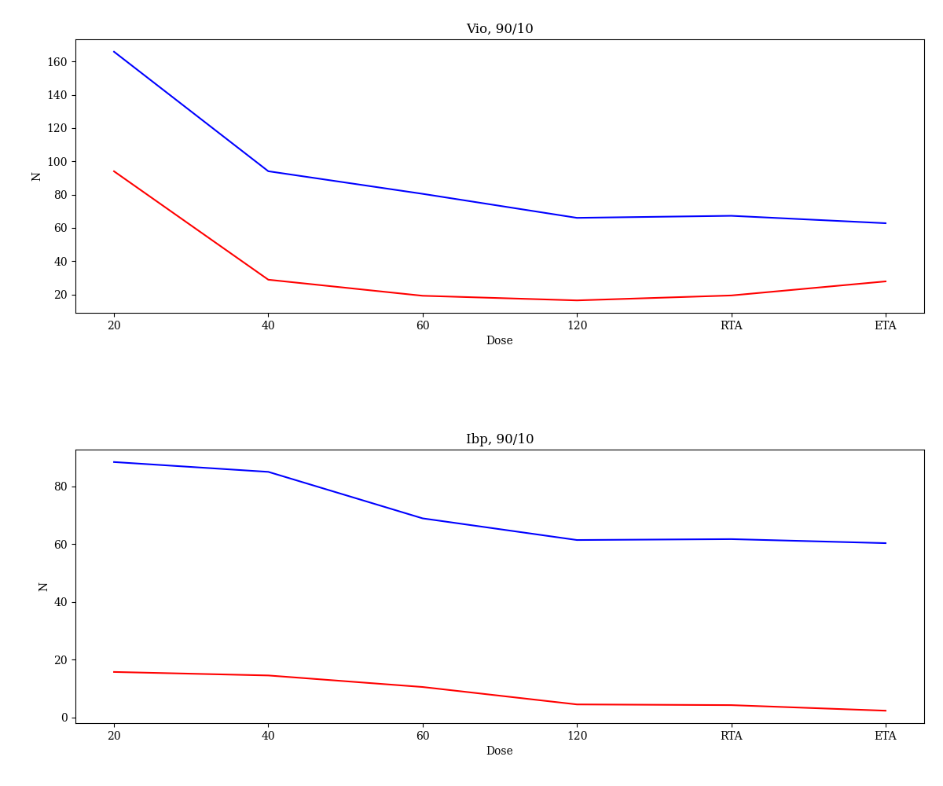
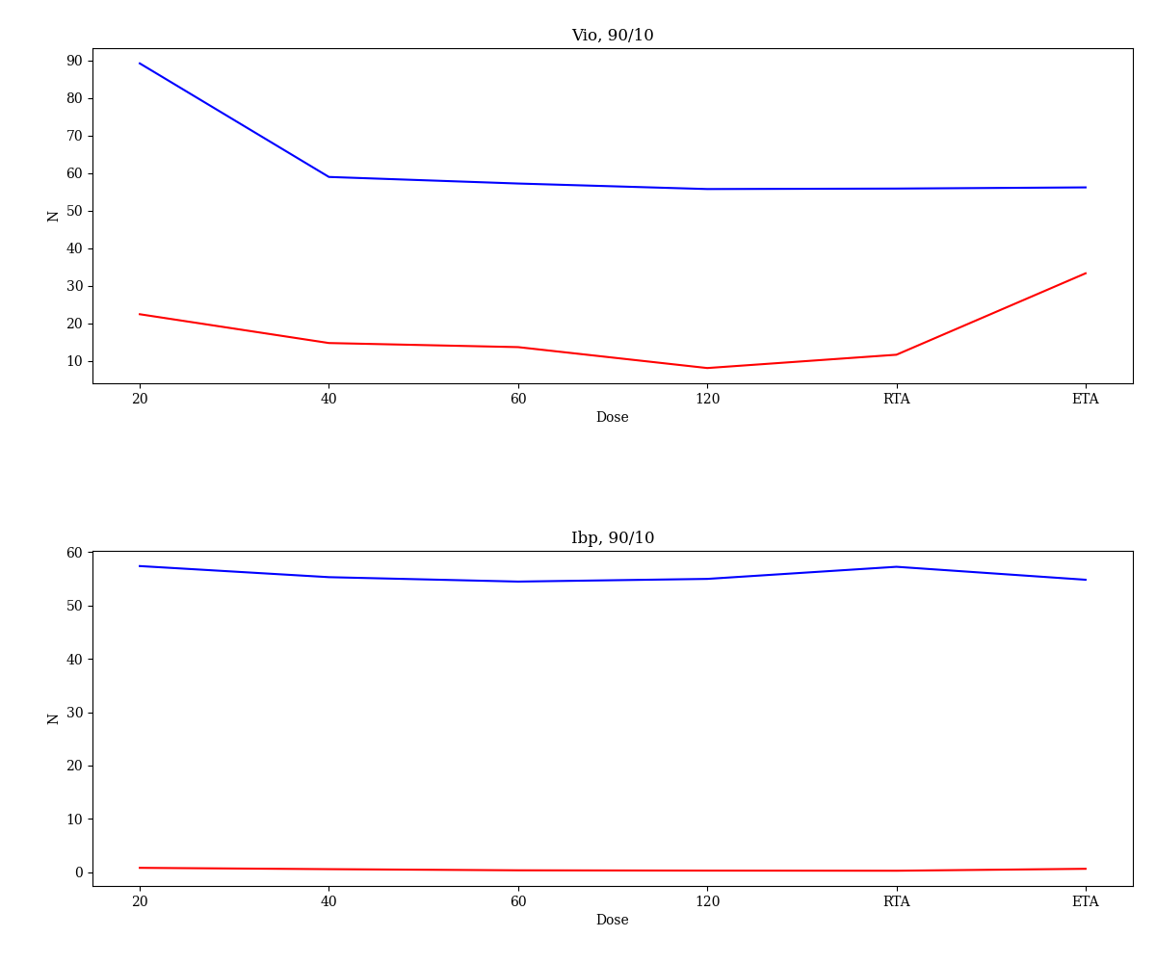
Optimum sample size
T1
T4
Author: Jorn Voegtli

Slide 15
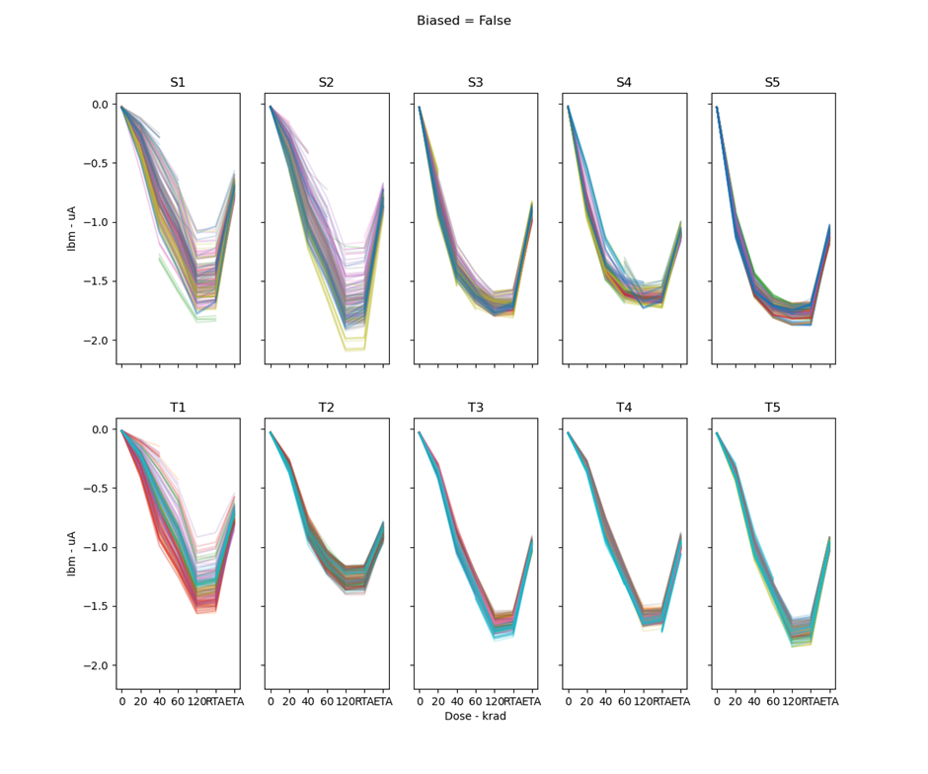
Variation between date codes
Plots of all data points by date code reveal some trends
S1 and S2 seem similar and different from S3 – S5
T1 and T2 seem similar and different from T3 – T5
This suggests a change in the die or fabrication process between the two groups, for both manufacturers

Slide 16
Conclusion and future perspectives
3-sigma tolerance limit shown to be inconsistently effective when applied to a selection of devices within a population.
A method for determining sample size was investigated however was not able to show consistent results between parameters and date code, especially for unbiased test samples.
Normality of the data set was investigated and shown to be a poorly representative distribution for this component. Lognormal and Weibull distributions were also investigated but showed similarly poor representation. Some parameters fit well but most do not.
The data are heteroscedastic so simple statistical analysis tools will fail to represent the data properly
An extension of this work to investigate superior methods of tolerance limits to better capture the population set would be worthwhile.
Investigating different methods for determining optimum sample size to achieve more consistent results. This may also aid improving capture of the population within tolerance limits.
Exploring different distributions and how they fit the data set.
Author: Jorn Voegtli

Slide 17
Acknowledgements
Special thanks to my co-authors for their various contributions to the project. Especially Lucy, Natalia and Ben for their early investigations into the statistical analysis work, as well as Richard Sharp for his help in every step from sample acquisition to manuscript preparation.
I am grateful to Vivien Cai, Yefeng Fan and Peter Jones from Oxford University for their contributions to the early-stage analysis of the work
Completion of the data collection would not have been possible without the help of the team at Radtest Ltd. for sample acquisition and preparation, test and bias board design and testing, and operating and managing the irradiations
Finally, gratitude is expressed to Christian Poivey and ESA for providing the scope of the work and funding under contract number 4000113697/15/NL/SW
Author: Jorn Voegtli

