Slide 1
BepiColombo Radiation Monitor
TEC-QEC Final Presentation Days
Marco Pinto
Research Fellow
ESA TEC-QEC
ESA/ESTEC, The Netherlands
29/06/2023

Slide 2
Acknowledgments
This work is the product of many people
Beatriz Sanchez-Cano, Carlota Cardoso, Richard Moissl, Rami Vainio, Arto Lehtolainen, Phillip Oleynik, Manuel Grande, Patricia Gonçalves, Hajdas Wojchiech, Johannes Benkhoff, Juhani Huovelin, Go Murakami, Haruka Ueno, Yoshizumi Miyoshi, Elsa Montagnon, Santa Martinez, Thomas Cornet, Ignacio Clerigo, Tiago Costa etc…

Slide 3
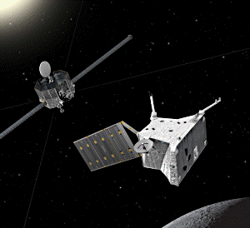
BepiColombo
First European mission to Mercury
Preceded by Mariner 10 and Messenger
Smallest planet
Global magnetic field!
Composed of two Spacecraft
Science objectives:
Formation and Evolution
Interior and Composition
Surface Geology and Crater History
Orbit
Magnetosphere
Atmosphere
Mercury Planet Orbiter (MPO)
Mercury Magnetospheric Orbiter (MMO)
Notes:
https://sci.esa.int/web/bepicolombo/-/59928-science-with-bepicolombo

Slide 4
BepiColombo
Tour through the inner Solar System
Mercury Planet Orbiter (MPO)
Date | Mission event
20-Oct-18 | Launch
10-Apr-20 | Earth flyby
15-Oct-20 | First Venus flyby
11-Aug-21 | Second Venus flyby
1-Oct-21 | First Mercury flyby
23-Jun-22 | Second Mercury flyby
20-Jun-23 | Third Mercury flyby
5-Sep-24 | Fourth Mercury flyby
2-Dec-24 | Fifth Mercury flyby
9-Jan-25 | Sixth Mercury flyby
5-Dec-25 | Arrival at Mercury
14-Mar-26 | MPO in final orbit
1-May-27 | End of nominal mission
1-May-28 | End of extended mission
Mercury Magnetospheric Orbiter (MMO)

Slide 5
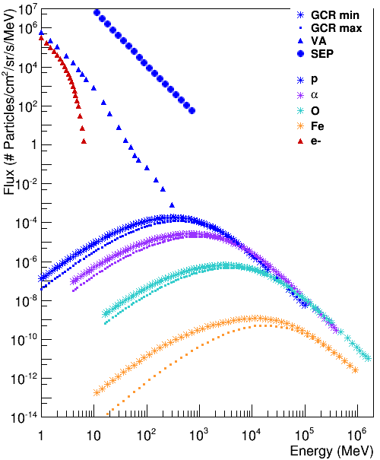
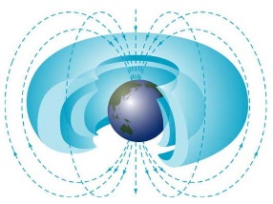
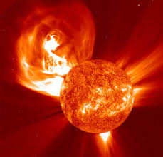
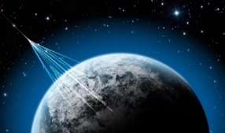
Space Radiation Environment
Van Allen
Radiation Belts
SEP event
Protons and electrons
AP-8 and AE-8 models
Galactic Cosmic
Radiation (GCR)
Protons
Integrated 14 day SEP event of December 2006
p,a, O and Fe
ISO 15390
1 AU from Earth

Slide 6
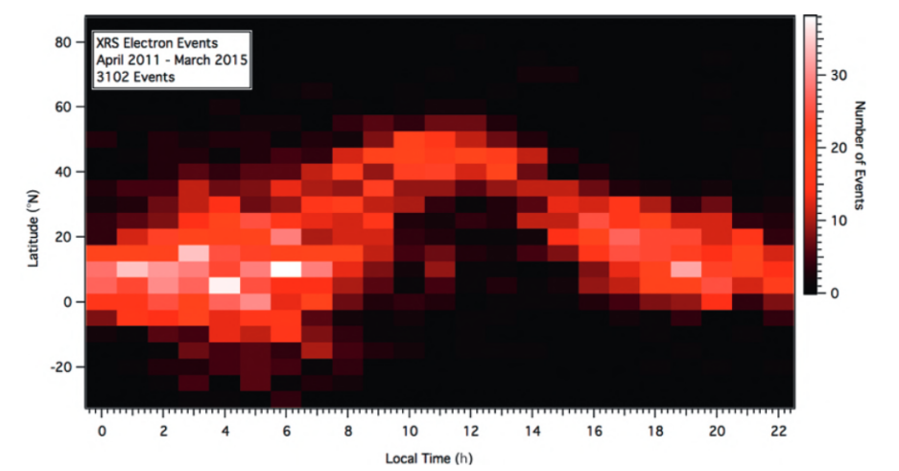
Space Radiation Environment
Messenger also observed transient electrons <300 keV.
Many questions
From: Mercury’s Dynamic Magnetosphere, ser. Cambridge Planetary Science. Cambridge University Press, 2018, p. 461–496.

Slide 7
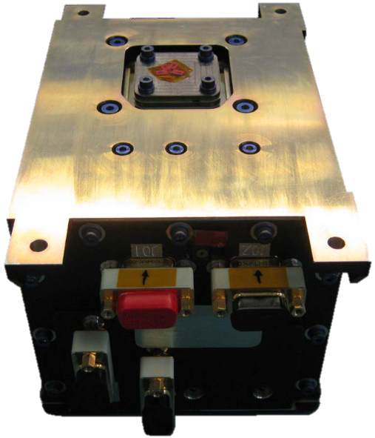
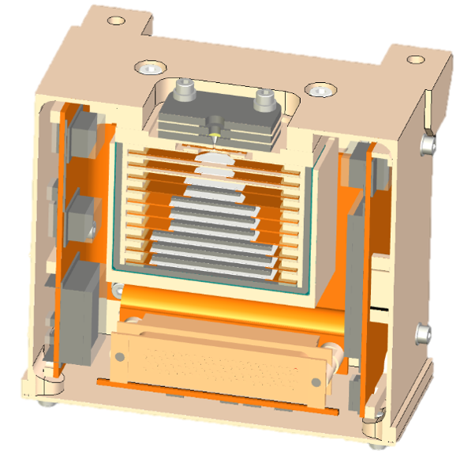
BepiColombo Environmental Radiation Monitor
Stack of 11 silicon detectors interleaved by layers of tantalum and/or aluminum
0.5 ${mm}^{2}$ collimator, shielded by Tantalum allows to operate in high particles fluxes
Field of View of 40º
Low Data Rate
Always on!
12.00 cm
17.48 cm
10.60 cm
Species | Energy | Number of Channels
Electrons | ∼ 0.15 – 10 MeV | 5
Protons | ∼ 1.5 – 100 MeV | 8
Heavy Ions* | ∼ 1 – 50 MeV/(mg*cm^2) | 5
*Manufacturer’s values

Slide 8
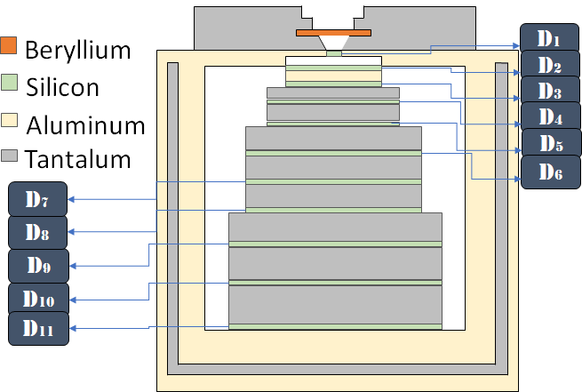
Stack Detectors
Cutoff – 25 µm Beryllium
Electrons (50 keV)
Protons (1.35 MeV)
Collimator
Cut-off
Trigger in first detector
200 µm thick, 50 µm2 area
Threshold > 200 keV (deposited energy)
Electrons avg deposited energy << 200 keV
Same for high energy protons
Other detectors
300 µm thick
Increasingly larger areas
Increase in noise
Larger collection time
Source: M. Pinto et al. 2022

Slide 9
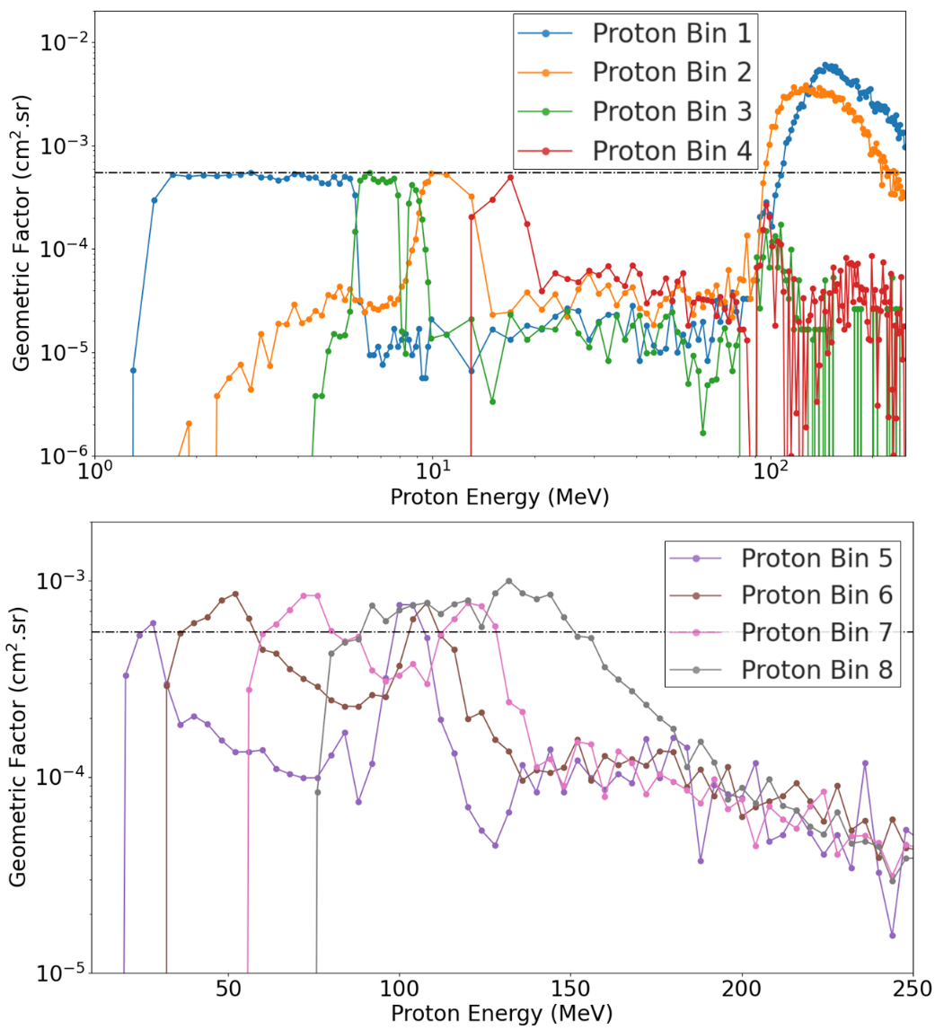
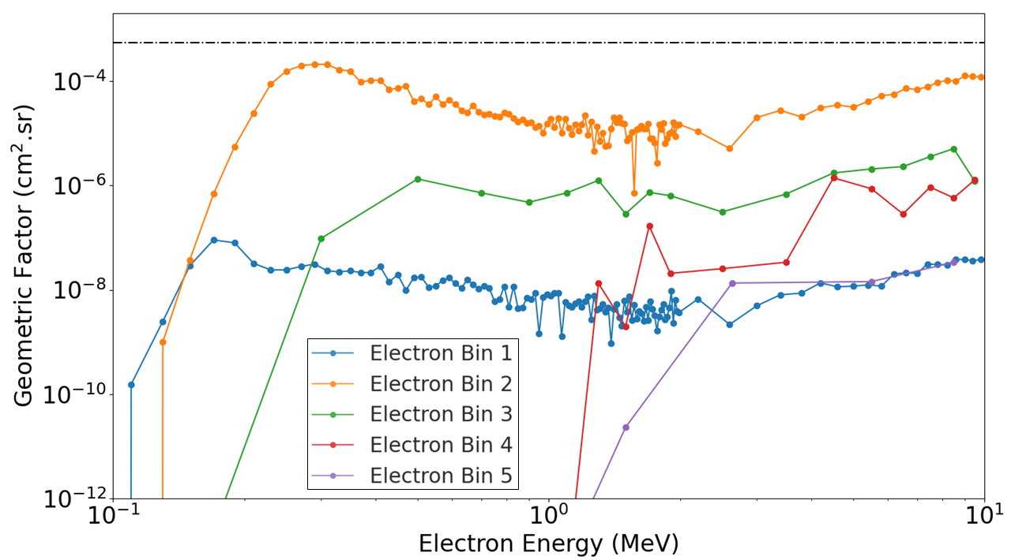
Response Functions
Events are separated into bins – programmable
to be accounted for
$$C_{i}=\int_{0}^{∞}{φ\left(E\right){ RF}_{i}\left(E\right) dE}$$
$C_{i}$: Count Rate
$φ\left(E\right)$: Particle Flux
${RF}_{i}\left(E\right)$: Response Function
Source: M. Pinto et al. 2022
Notes:
Collimator GF
Threshold influence

Slide 10
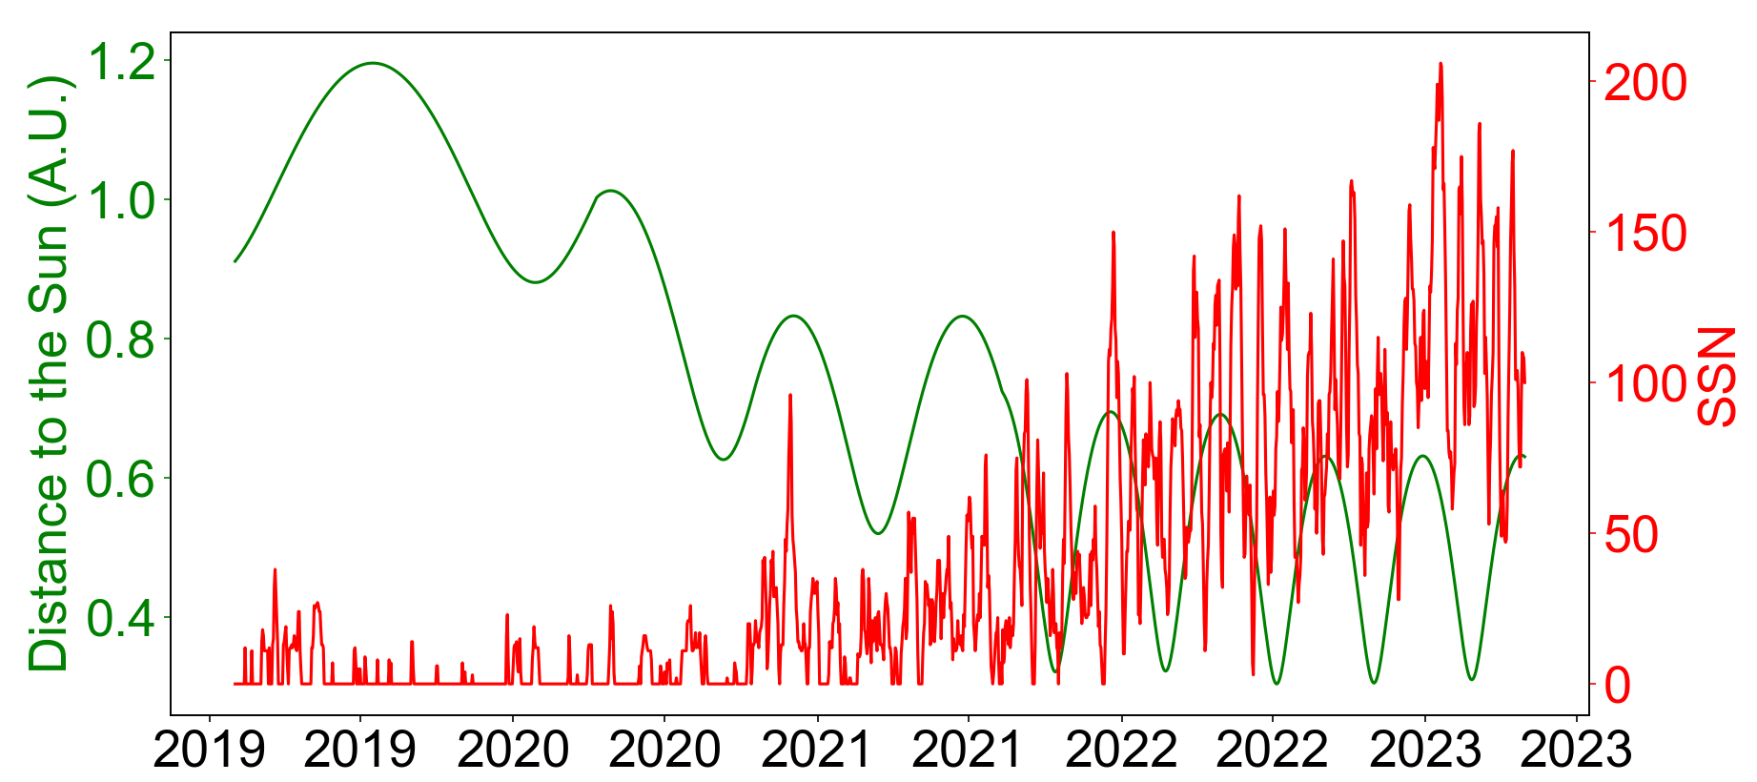
Cruise Observations

Slide 11
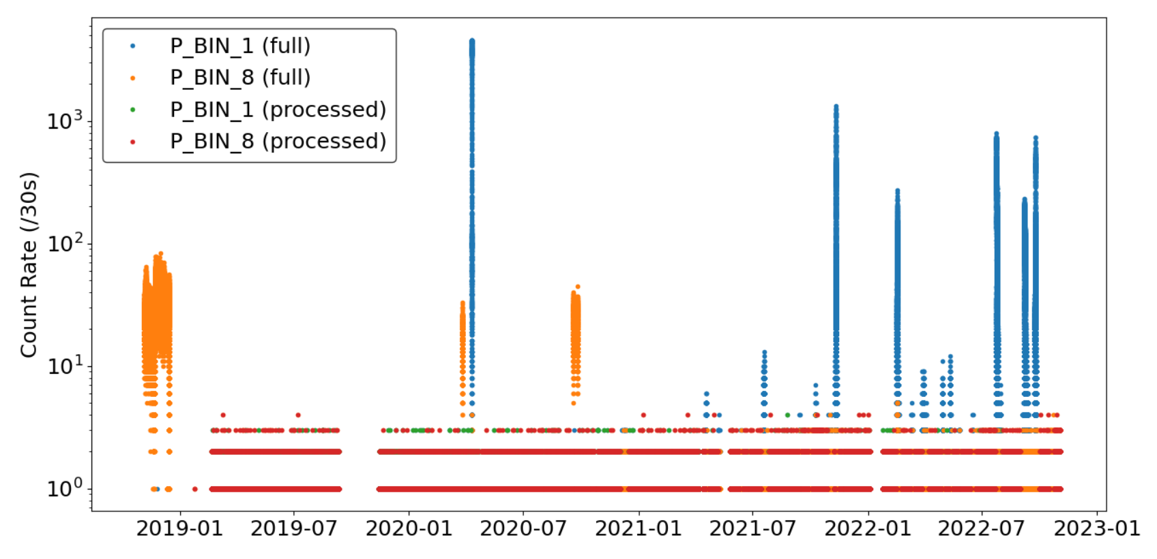
Cruise Observations
SEPs (31)
Earth Flyby (1)
Functional anomaly (2018)
Trigger tests (3)
GCR

Slide 12
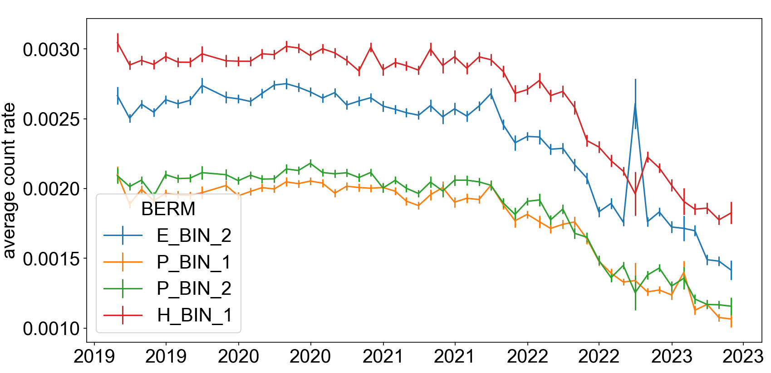
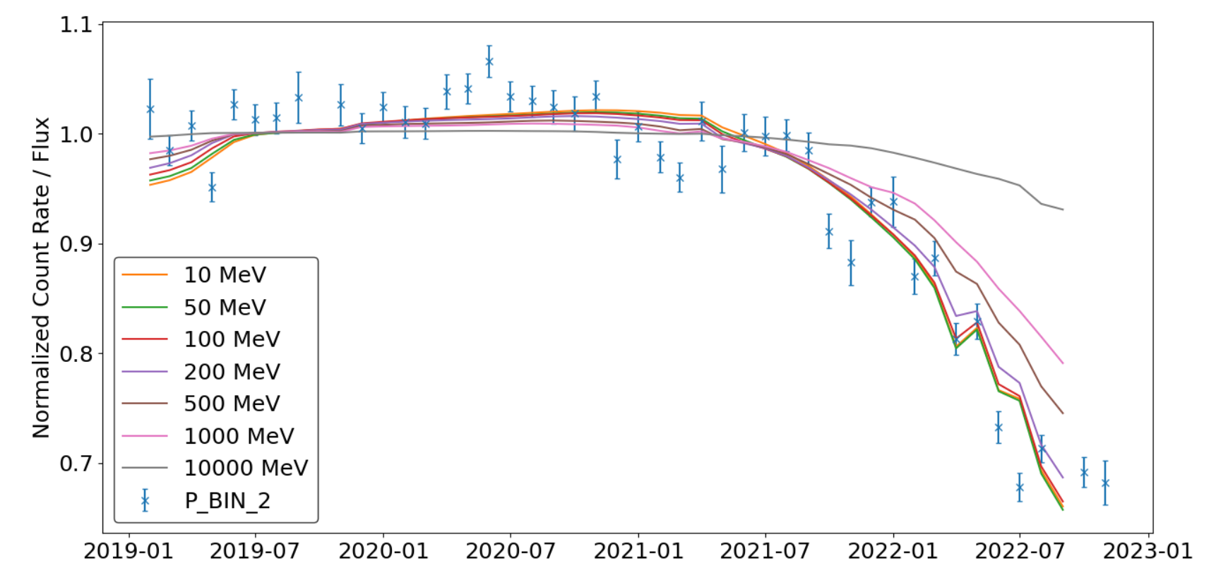
Galactic Cosmic Rays
Some BERM channels are rel. sensitive to GCR p
E_BIN_2 > P_BIN_1/2
H_BIN_1 still needs to be analysed
Many Solar events
Difficult to clean data
Count rate heavily modulated
Up to 40%
In agreement with ISO 15390
Radial gradient not taken into account
Multi-mission analysis on-going

Slide 13
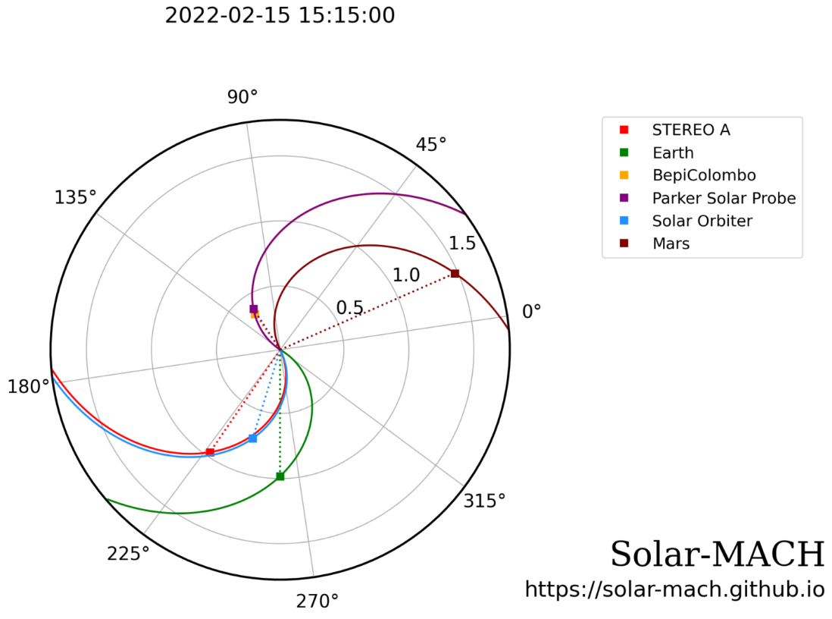
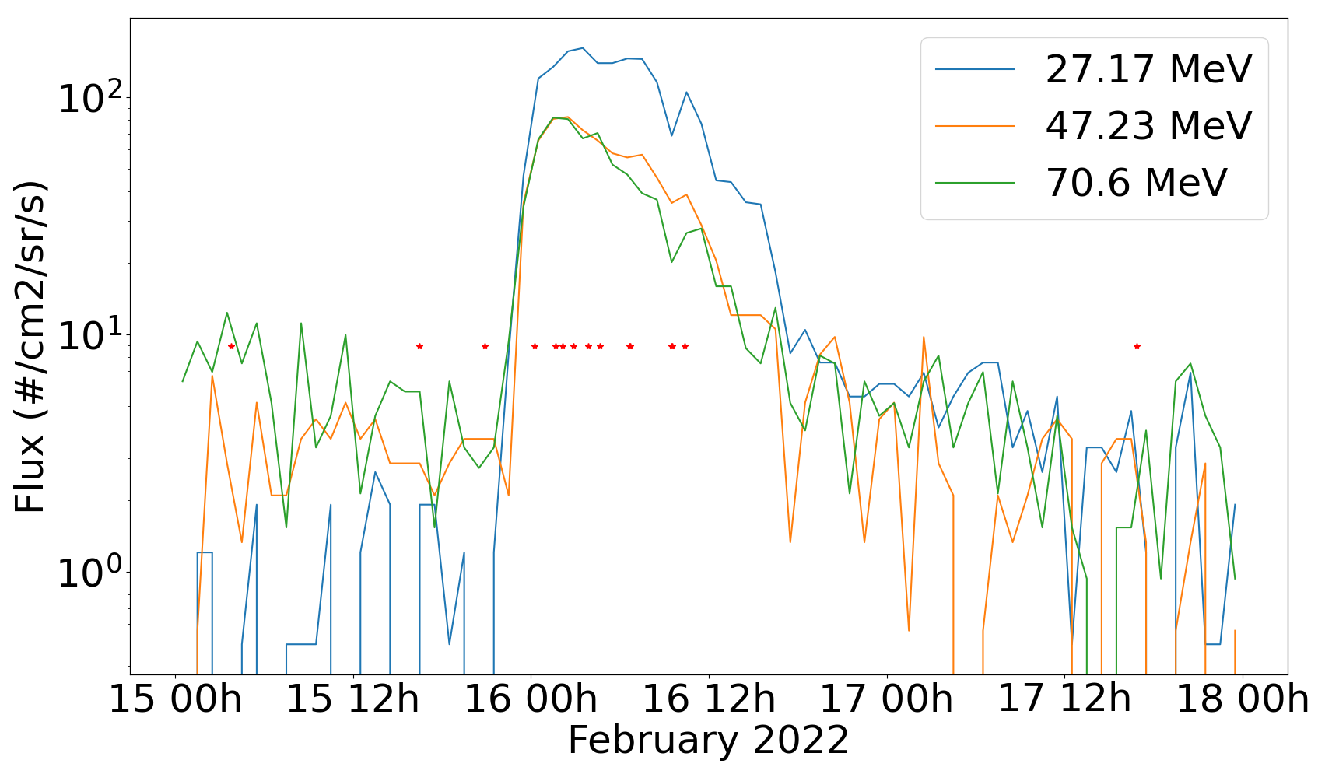
Solar Particle Events
>30 events detected so far
Feb 15, 21:50 UTC: An eruption occurred
Only one with >40 MeV protons
Feb. 2022
Flux comparable with Parker Solar Probe!

Slide 14
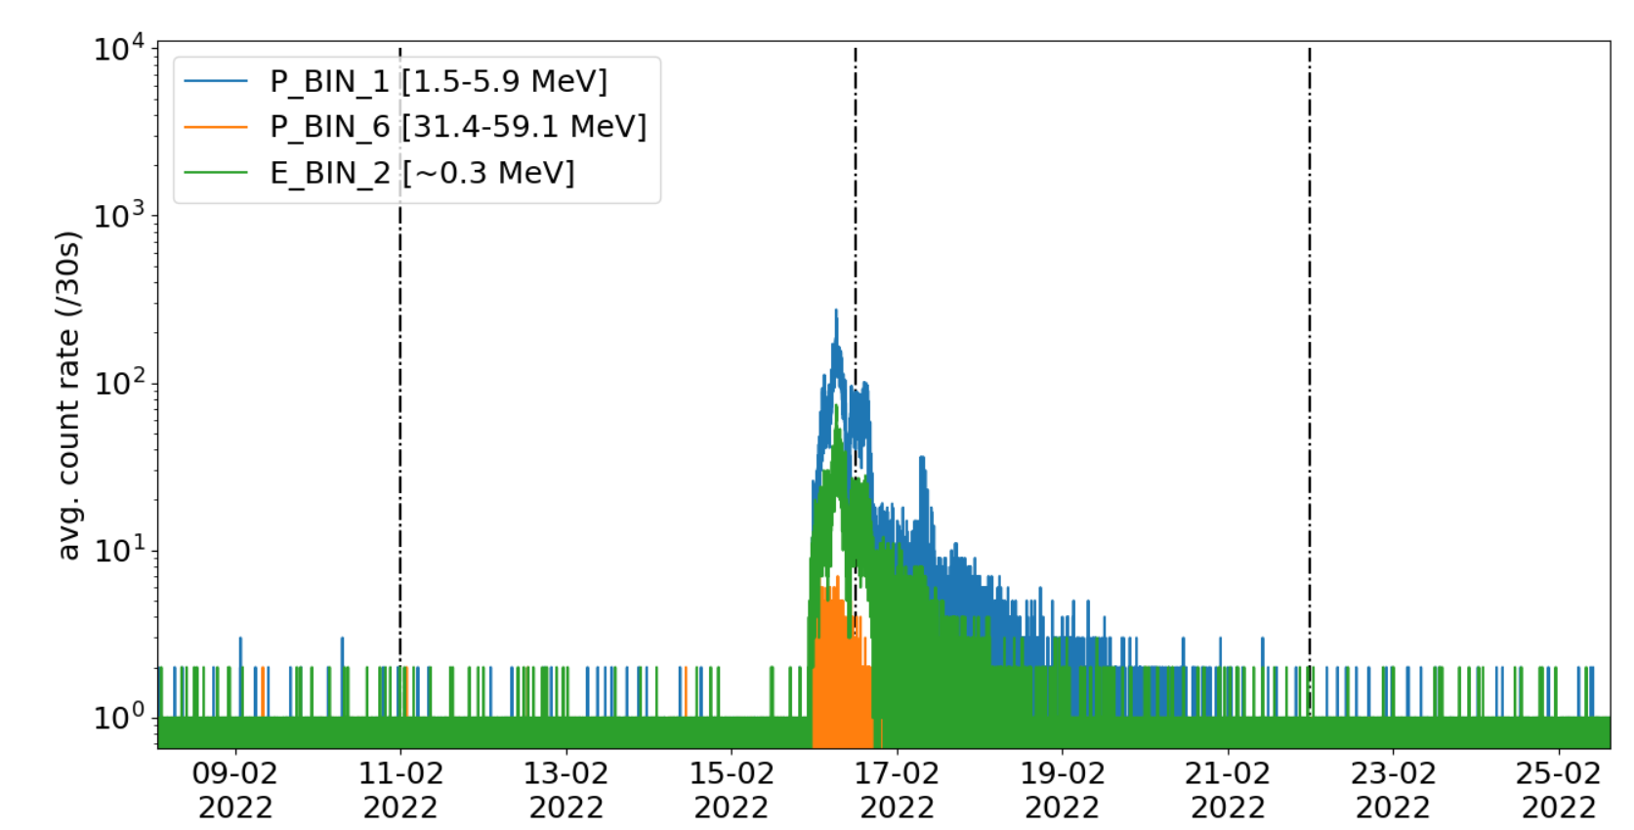
Why does it matter for rad. effects?
Powerful diagnostics tool
Possible causes:
High angular rate, planet occultation, straylight, Solar Event, etc
BepiColombo Star Tracker
>34 anomalies
Most not related with space weather
PIXEL RAM OVERFLOW

Slide 15
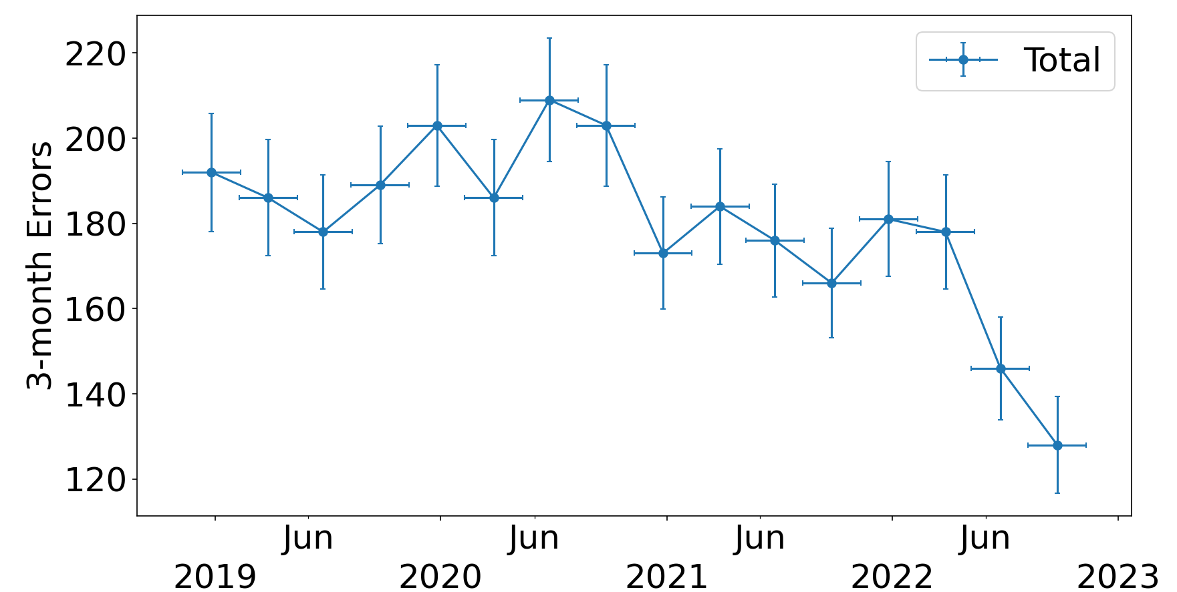
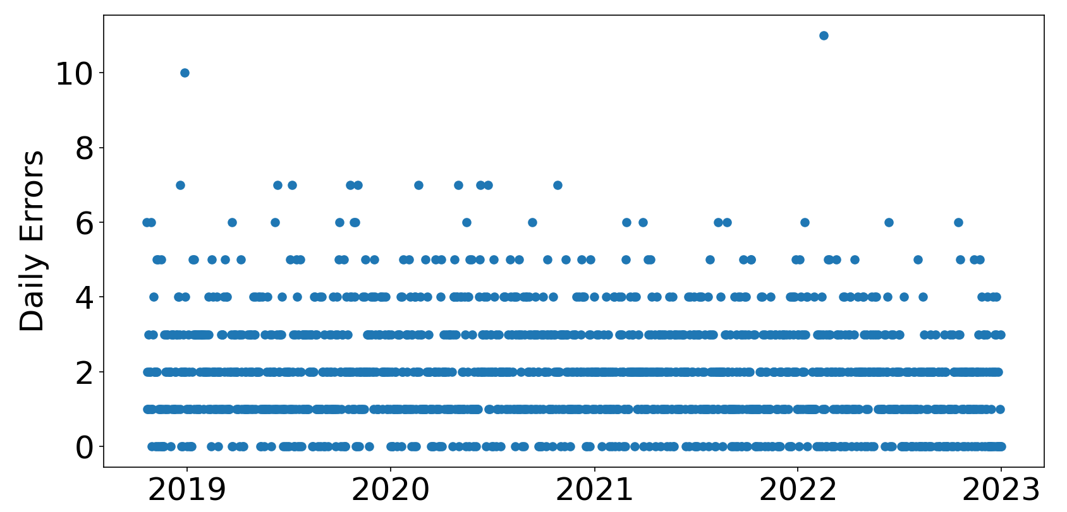
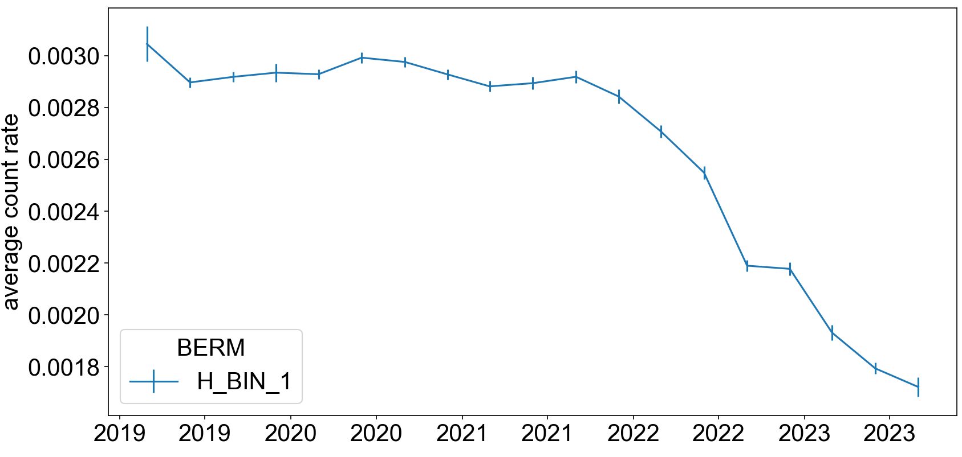
Monitor and Study Radiation Effects – OBC SGM RAM
GCR modulation

