Slide 1

28-30 June 2023
Integrated approach for SEE robust design
TEC-QEC Final Presentation Days, ESTEC

Slide 2
Contents
Context and background
Architecture description
Reliability Analysis
Functional tests (SEE emulation)
Radiation Tests

Slide 3
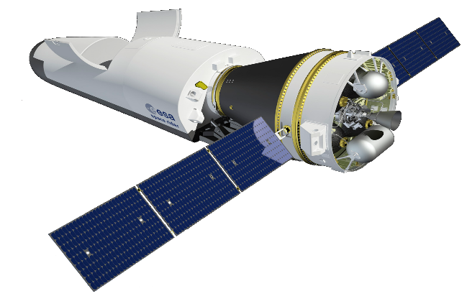
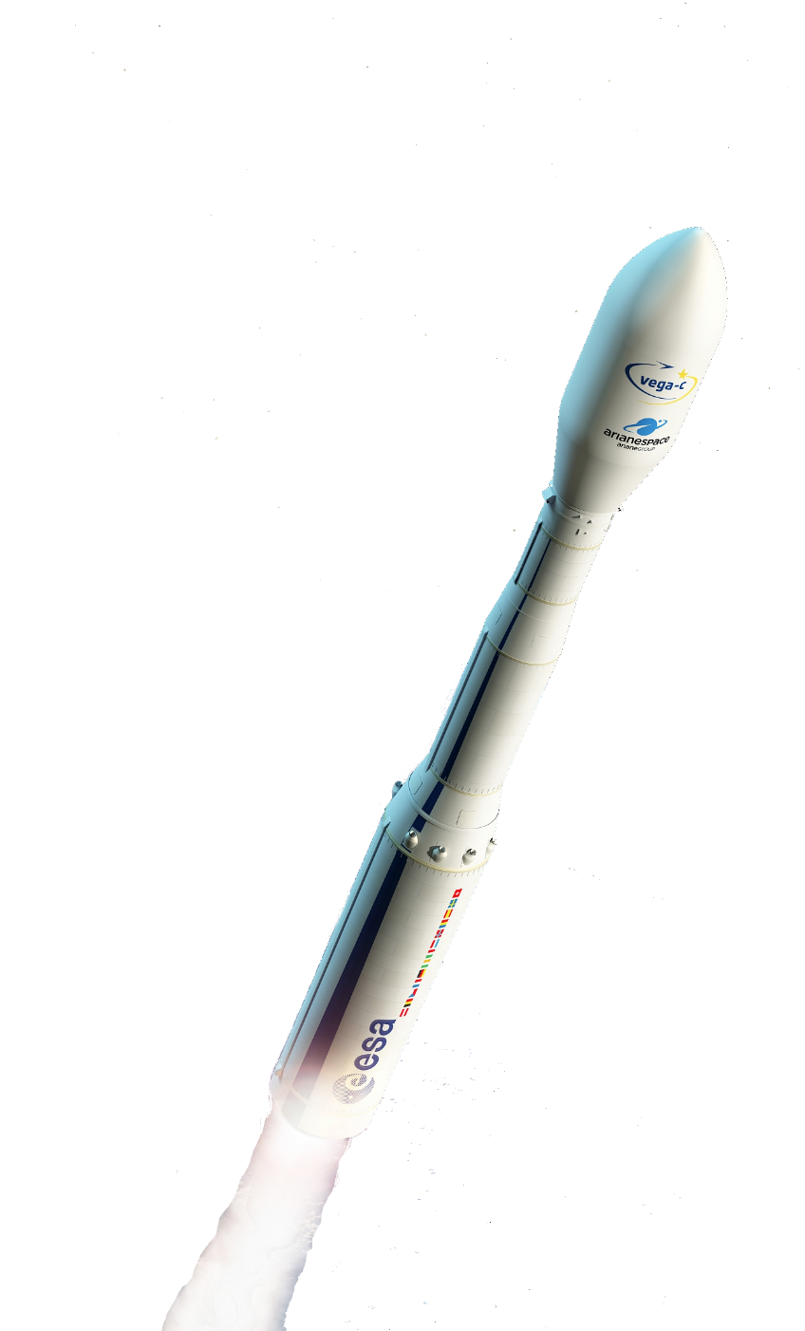
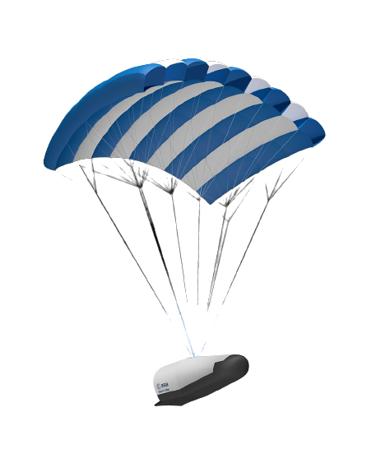

Context and background
Innovation
COTS Microcontroller
Space sector
Reliability
Radiation (SEE)

Slide 4
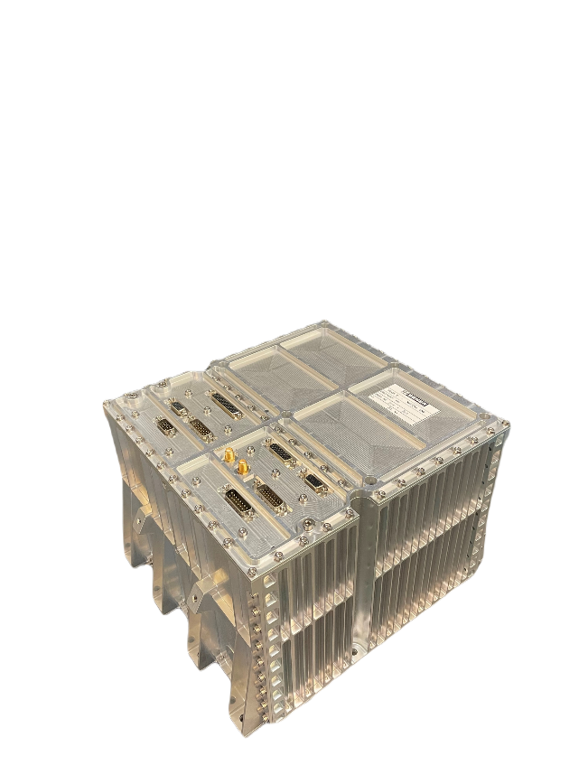
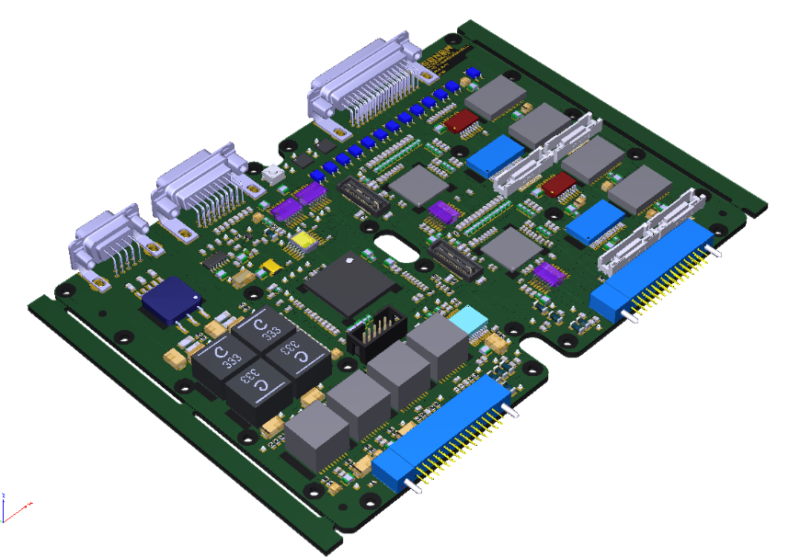
Context and background
NAVIGA
SEL / SEU characterization
…backup solution.

Slide 5
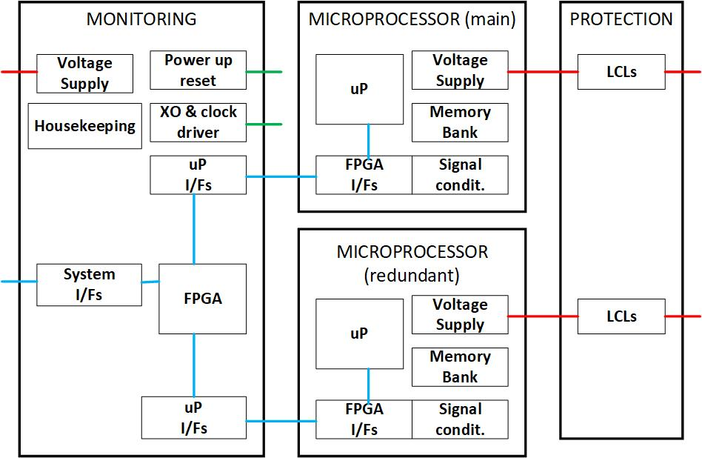
Architecture description
Active redundancy
Same SW / same inputs
ARM® Microcontroller automotive-grade
Arbiter: FPGA (SEE immune)
Fast toggling time: real-time
Versatile Design: single or double microcontroller

Slide 6
Architecture description
When toggling?
- nERROR signal from microcontroller
- 3V3 / 2V5 LCL status signal active.
- WatchDog status signal (micro WD implemented inside FPGA).
- nRST I/O signal from the microprocessor

Slide 7
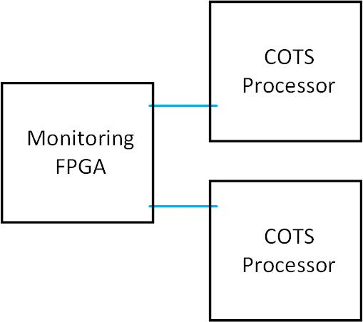
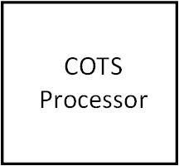
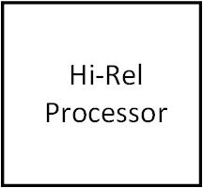
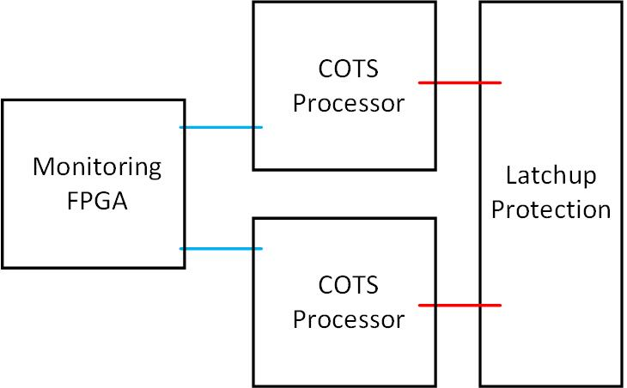
Reliability Analysis
3
Reliability (FIDES) assessment
Four configurations proposed
Vega-C mission profile (NAVIGA)
2
1
Configuration | Reliability
1 | 0,999648
2 | 0,999657
3 | 0,999816
4 | 0,999678
4

Slide 8
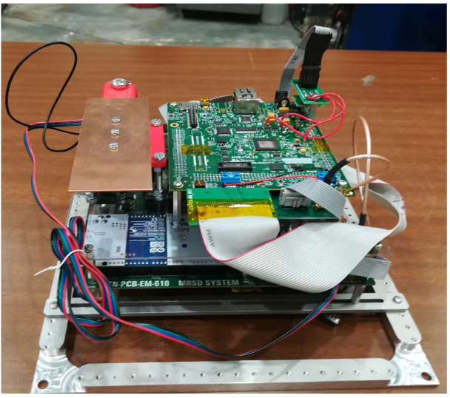
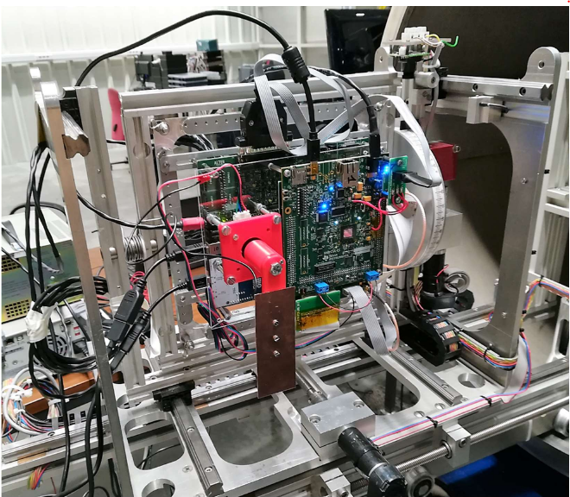
Radiation tests
SEL & SEU
3 samples
Ambient temperature
At HIF – UCL
Complemented by previous test by manufacturer

Slide 9
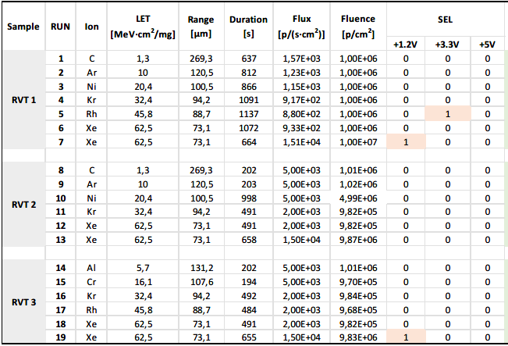
Radiation tests
SEL
SEU
RAM / Flash / PRG Flash
CAN / EMIF / GPIO
PWM
ADC
- Recoverable errors
- One event every 3 hours in Vega-C environment

Slide 10
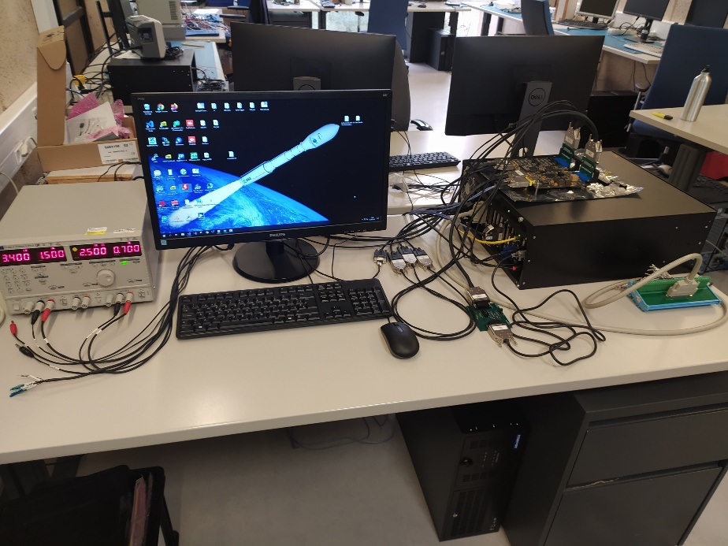
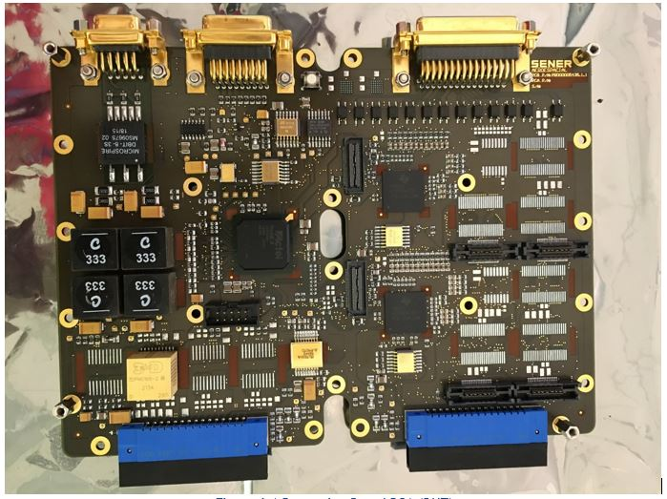
Functional tests (SEE emulation)
Breadboard testing - SEE emulation:
→ events detection
→ arbiter logic decision
→ real-time toggling

Slide 11

Functional tests (SEE emulation)
Single nominal microcontroller (N/R)
nERROR (N/R)
3V3 Error (N/R)
2V5 Error (N/R)
WD Error (N/R)
LCL Error
Event when some data frame can be missed during toggling, protocol is robust, and application goes on correctly.

Slide 12
Options for improvement
Not SEE free…
Power cycle after toggling: recovery of dismissed processor
Evolution of toggling criteria
Actual testing under heavy ions
Also useful as processing capability booster

Slide 13
Conclusions
Double microprocessor architecture presented
Active redundancy configuration improves overall system reliability figures, and avoids Single Point Failure
LCL protection effective avoiding failure propagation but decreases the overall reliability figure (and increases cost).
COST saving! → <100€ vs. >20 k€
Real-time toggling achieved

