Slide 1

In-orbit results from CELESTA
Presenter: Andreas Waets (CERN)
Material prepared by: Raffaello Secondo (CERN) and Andrea Coronetti (CERN)
With input from: Rubén Garciá Alía (CERN), Salvatore Danzeca (CERN), Ivan Slipukhin (CERN), Alessandro Zimmaro (CERN), Paul Peronnard (CERN), Markus Brugger (CERN), Alessandro Masi (CERN), Enrico Chesta (CERN)
Notes:
Speaker notes:
[Text]
My notes:

Slide 2



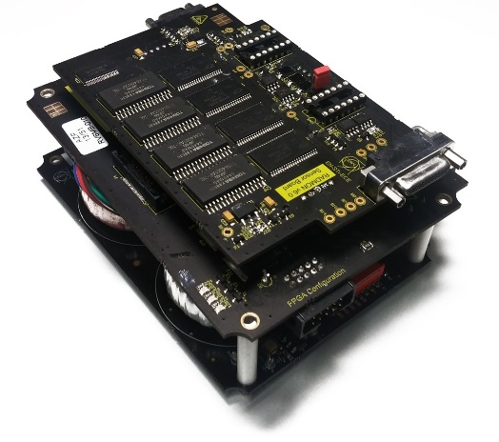
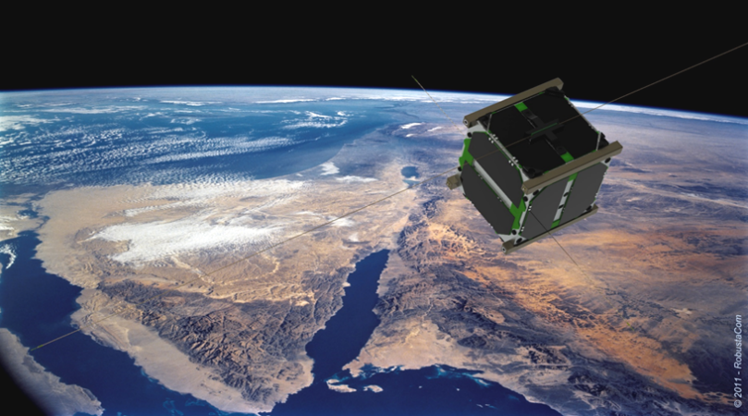
CELESTA MISSION - BACKGROUND
CERN Latchup Experiment and STudent sAtellite: CELESTA.
The scientific Payload of the first CERN-driven Small Satellite.
Collaboration started in 2014
Content of the Talk:
  Design and test results conducted between 2014 and 2017
  In-Flight data analysis: BE-CEM-EPR, SY-STI-BMI
Test Platform:
CHARM a mixed-field facility.
The RadMon V6:
CERN Radiation Monitoring System
ROBUSTA:
CSUM - 1U CubeSat Structure
Notes:
Speaker notes:
[Text]
My notes:

Slide 3
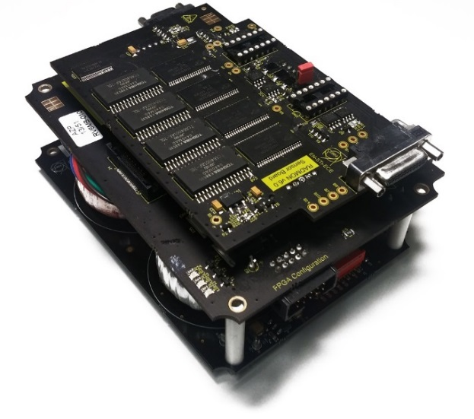
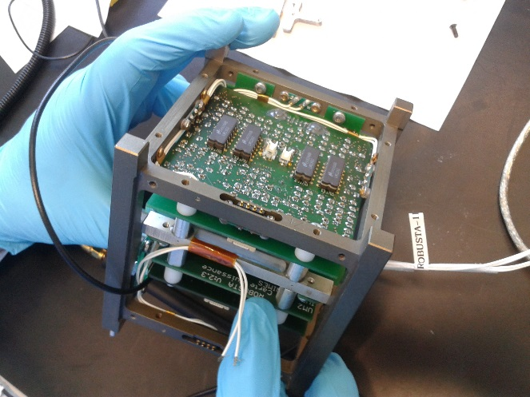
GOALS
ROBUSTA: Radiation On Bipolar
University Satellite Test Application
CubeSat Payload version of the CERN RadMon V6.
Nanosatellites radiation qualification procedure at CHARM.
Comparison of radiation effects between LEO space environment and CHARM.
Test the ROBUSTA platform.
Notes:
Speaker notes:
[Text]
My notes:

Slide 4
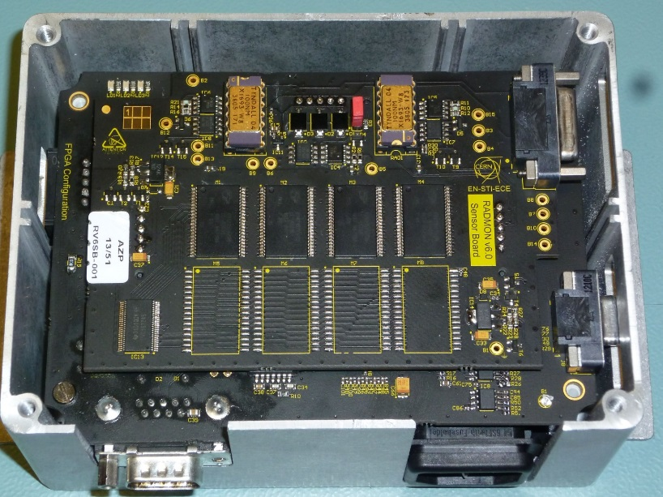
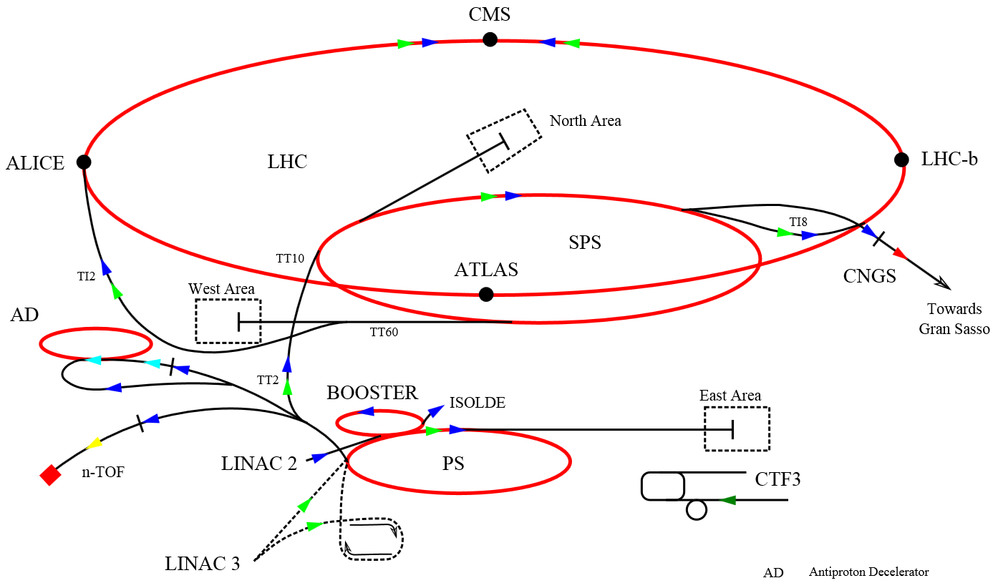
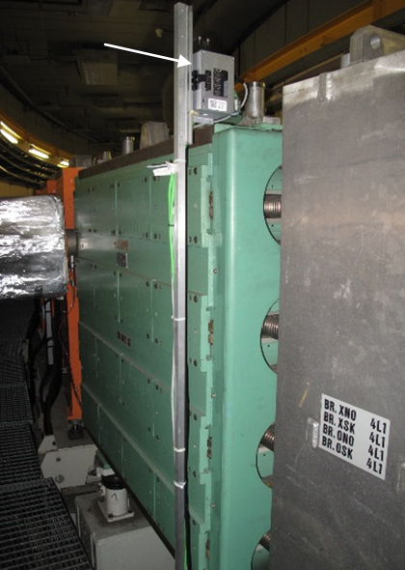
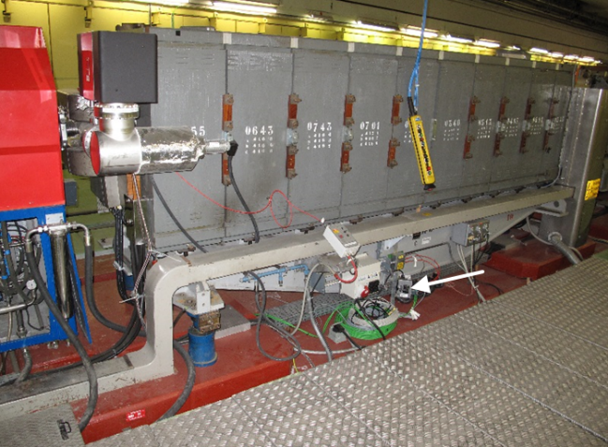
The RadMON
TID Measurement: 100 nm and 400 nm RadFETs.
Displacement Damage: P-i-n Diodes.
HEH and ThN fluence: Two Memory Banks, Cypress and Toshiba SRAM
Based on COTS.
RadFET
P-i-n diodes
SENSORS
Cypress SRAM
Toshiba SRAM
Notes:
Speaker notes:
[Text]
My notes:

Slide 5
Analysis of Mission Environment
STEP 1
Impact of radiation on a given orbit
Two initial Low Earth Orbits (LEO) proposed:
  Circular: 600 km x 600 km Perigee/Apogee.
  Elliptical 300 km x 1200 km Perigee/Apogee.
  Note: final orbit is different from initial analysis
Simulations: STELA + Omere + CREME.
Events concentration: polar cusps + SAA.
SEU Prediction
STEP 2
Feasibility study – Mission Constraints
Prototype Test-Board.
Characterization of sensors and full system at CHARM.
Design of Final Payload.
STEP 3
3D Model FASTRAD analysis
TID: $≈$ 84 Gy.
Total Fluence (HEH>20 MeV): order of 10¹⁰ HEH/cm² for an elliptical orbit
Notes:
Speaker notes:
[Text]
My notes:

Slide 6
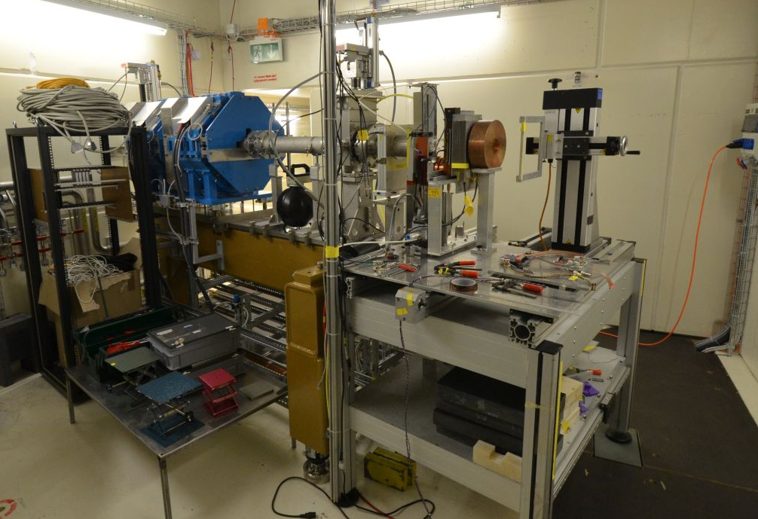
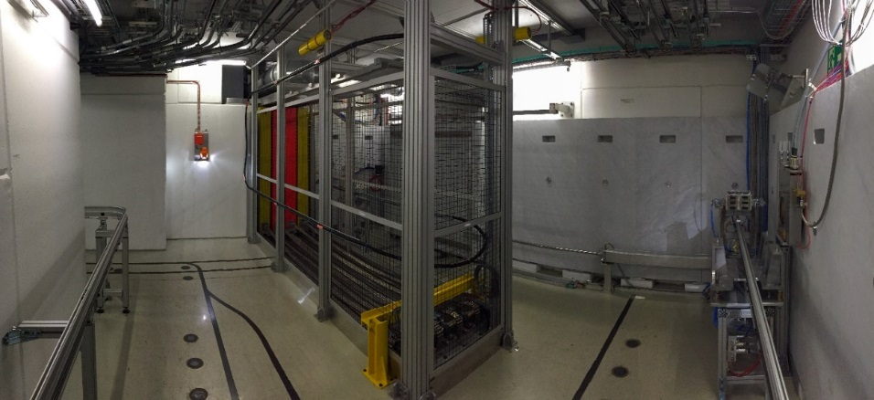
Focused beams and Mixed-Field
The PSI-PIF Irradiation Area
CHARM: Cern High Energy AcceleRator MixedField/Facility
PSI:
Focused Mono-energetic proton beam.
COTS Characterization.
CHARM:
Mixed-particle field
Testing at System Level
Representative radiation fields for space proton environment
Notes:
Speaker notes:
[Text]
My notes:

Slide 7
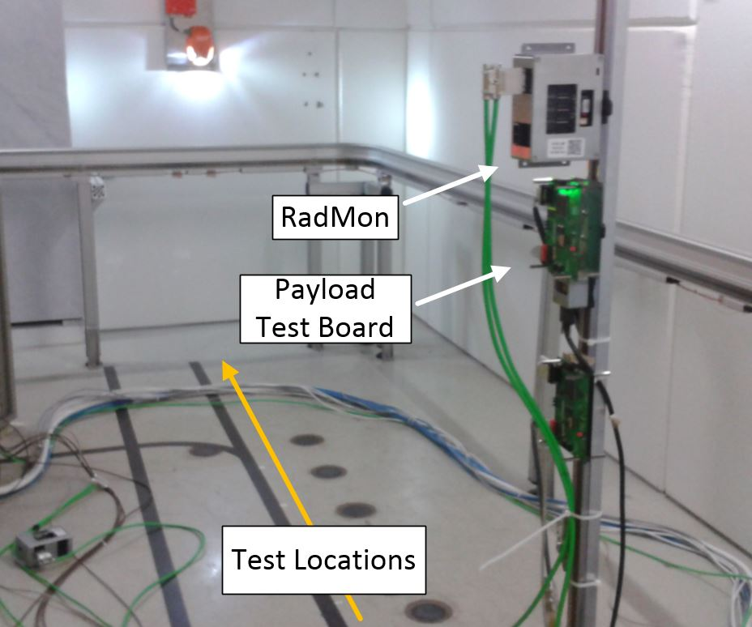
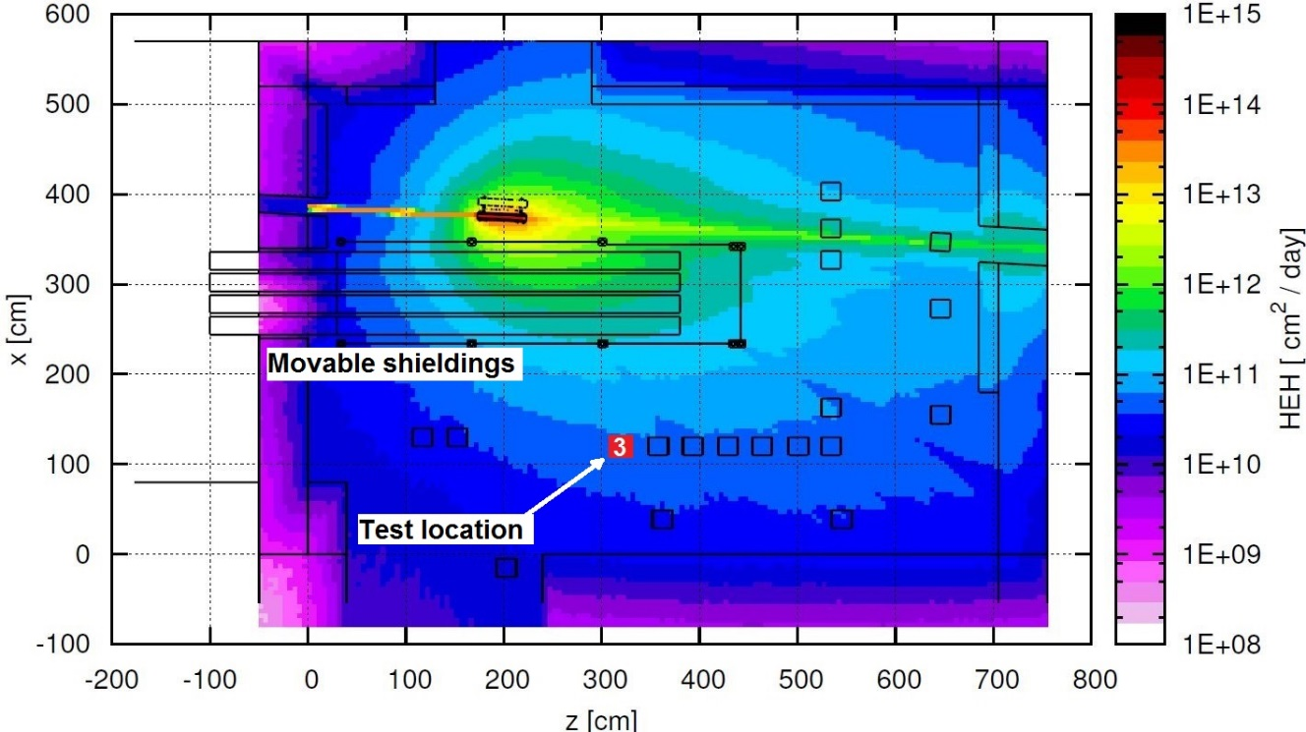
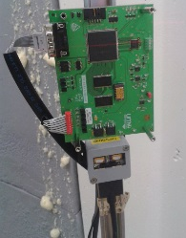
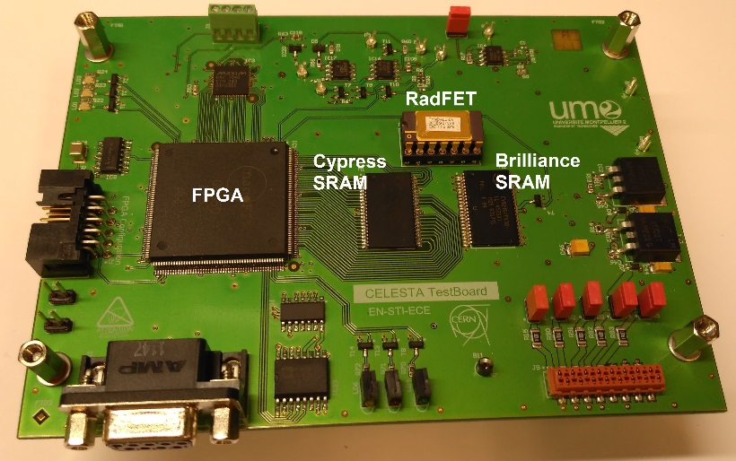

First Test in a Mixed-Field
FIRST PROTOTYPE test board
SEU: Cypress SRAM CY62157EV.
FPGA: ProASIC3
Dose: Tyndall RadFet 100 nm.
Latchup Experiment: Brilliance SRAM BS62LV1600EIP.
UART communication using MODBUS protocol.
COTS selected in terms of TID, SEE and temperature (-20$°$ to 80$°$)
Notes:
Speaker notes:
[Text]
My notes:

Slide 8
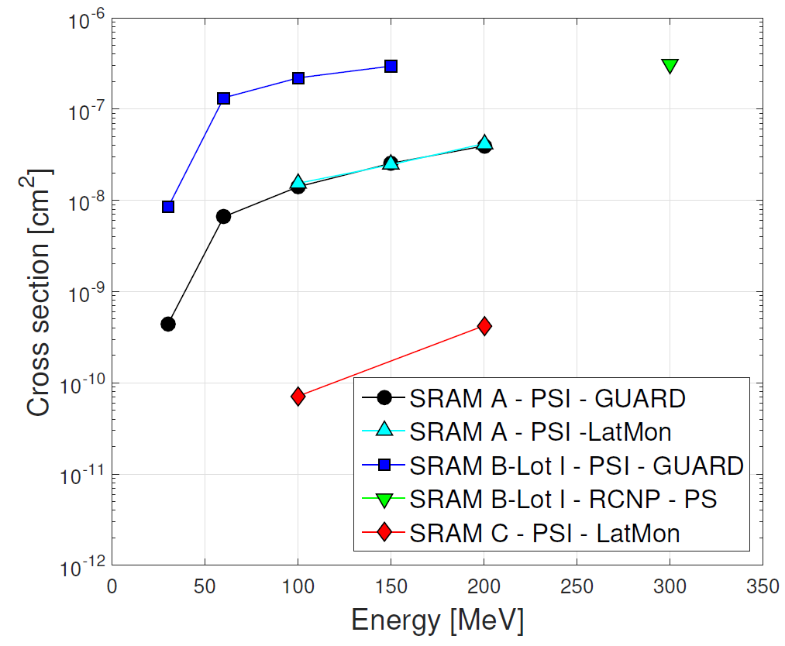
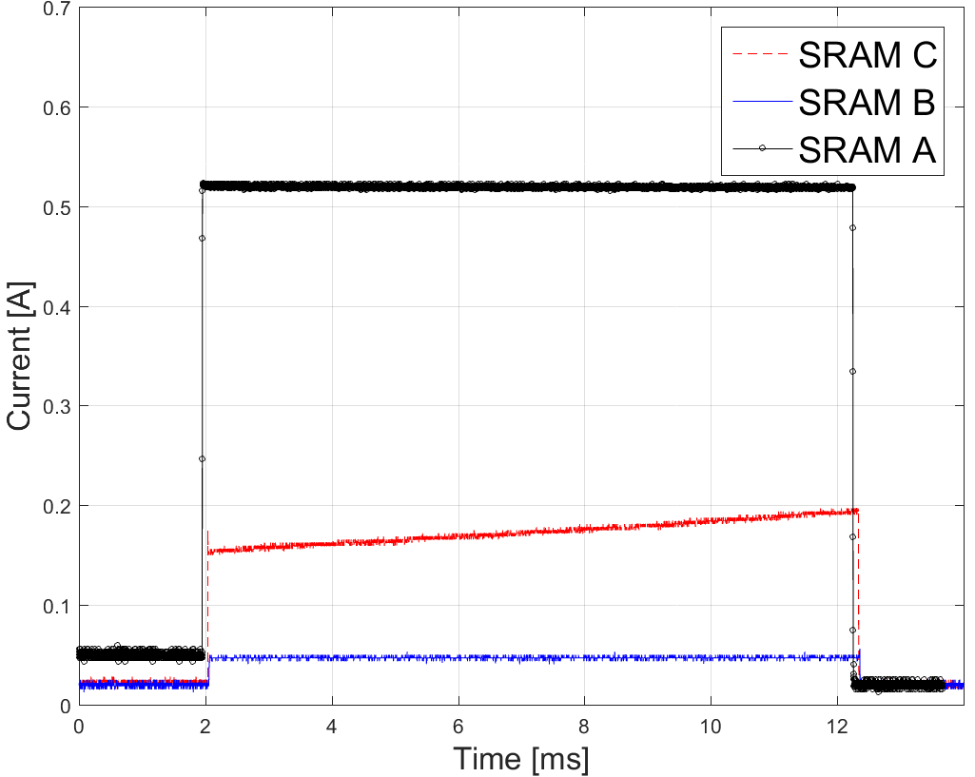
SEL Analysis at PSI on SRAM Candidates
Flux = 6.4·10⁷ p/(cm²·s).
Fluence = 1·10¹⁰ p/cm².
Current threshold: 50 mA for SRAM A and C, 10 mA for SRAM B.
Used different detection systems: LatMon, GUARD, Controlled Power Supply
Candidate SRAM tested
DUT Label | Reference | Manufacturer
SRAM A | IS61LV5128AL-10TLI | Issi
SRAM B | BS62LV1600EIP55 | Brilliance
SRAM C | AS7C34098A-10TNC | Alliance
Latchup Current waveforms: SRAM B lower consumption
Notes:
Speaker notes:
[Text]
My notes:

Slide 9
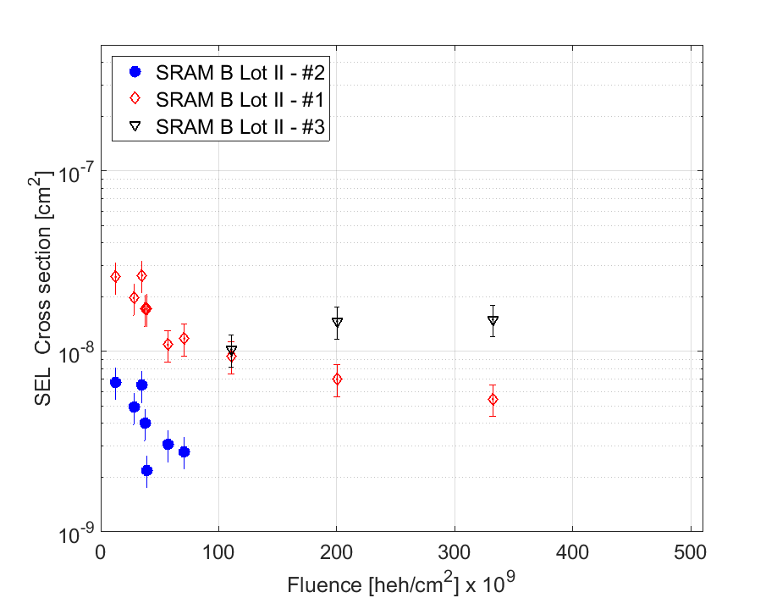
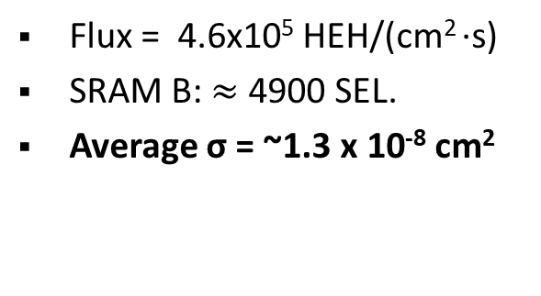
SEL Results at CHARM - II
SRAM B Lot II - Test Location 4
Flux = 4.6x10⁵ HEH/(cm² ·s)
SRAM B: $≈$ 4900 SEL.
Average σ = ~1.3 x 10⁻⁸ cm²
Notes:
Speaker notes:
[Text]
My notes:

Slide 10
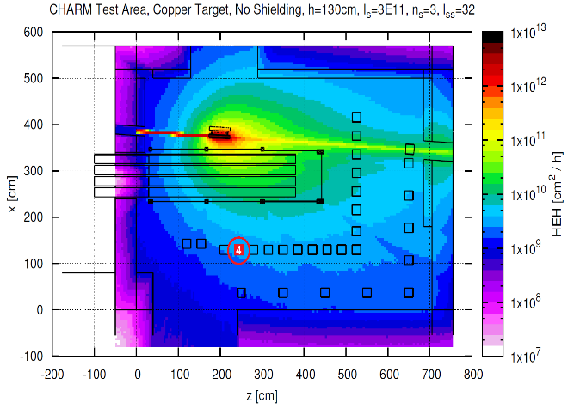
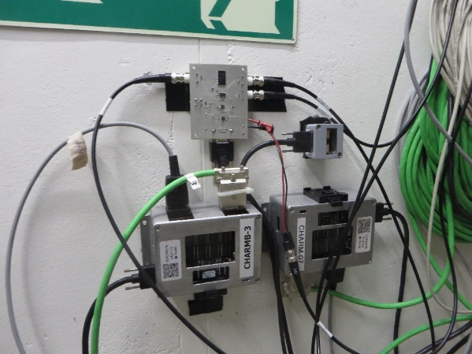
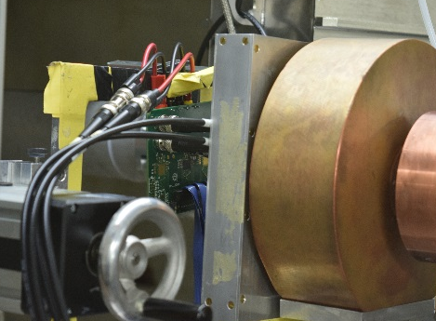
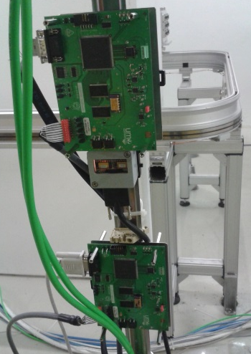
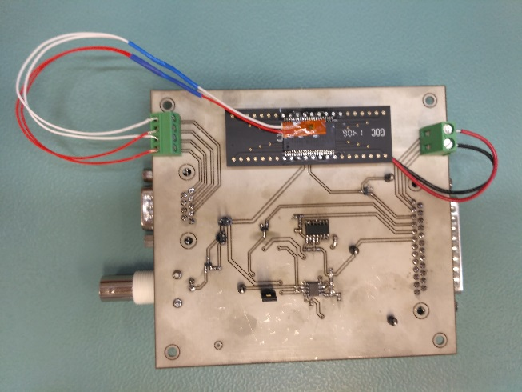
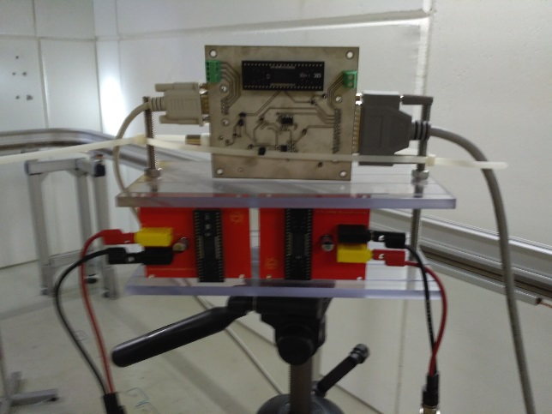
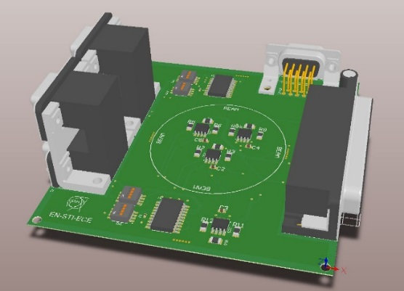
CELESTA Payload Radiation Qualification - Overview
RadMON TID and SEU/MBU
Analysis
Tests on candidates COTS at PSI (ADC, Voltage regulators, opamps…)
Mission Analysis and first test on a prototype board
CAN transceiver
SEL characterization

Slide 11
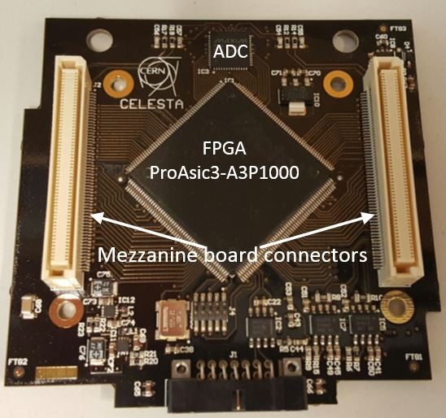
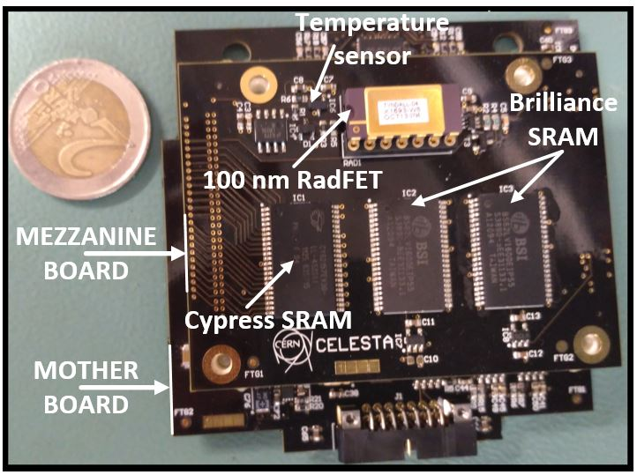
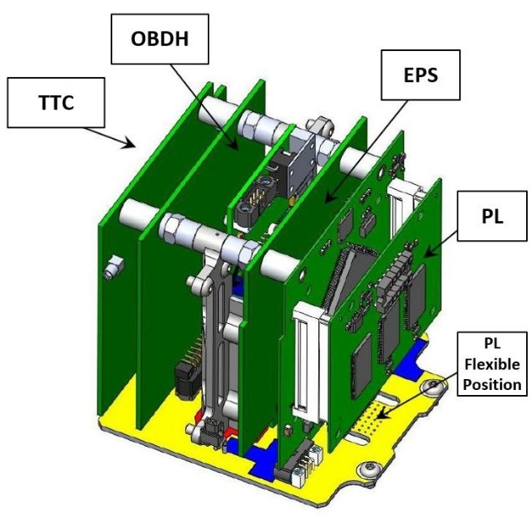
The CELESTA PAYLOAD Module
Mother Board
Fully assembled
Integration on ROBUSTA
Weight: 52 g.
Modular: “Mother Board” + Mezzanine.
180 mW average power.
300 mW peak power.
ROBUSTA compatible, CAN compatible.
Notes:
Speaker notes:
[Text]
My notes:

Slide 12
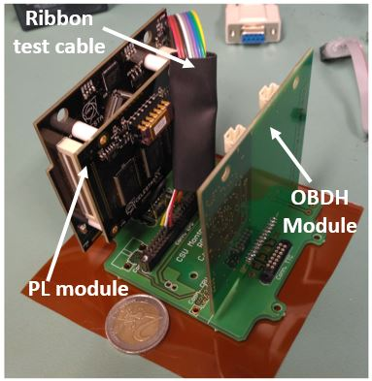
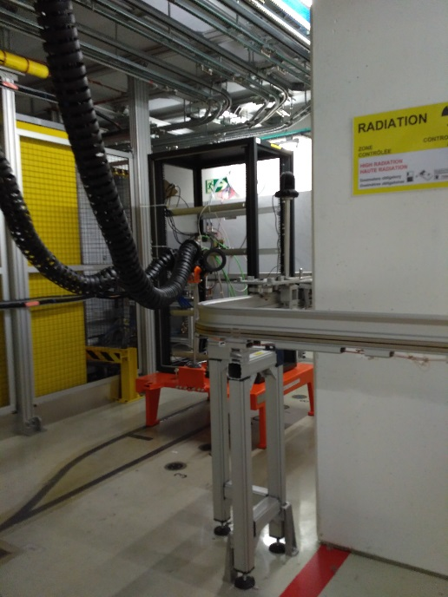
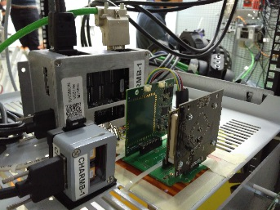
Test Setup in CHARM
Timings:
  2 min reading of the quantities.
  1 min reading of the SRAMs.
CHARM configurations:
  Copper Target + Full shielding (CIIC)
  Partial Shielding (OOIC)
  No shielding (OOOO)
Notes:
Speaker notes:
[Text]
My notes:

Slide 13
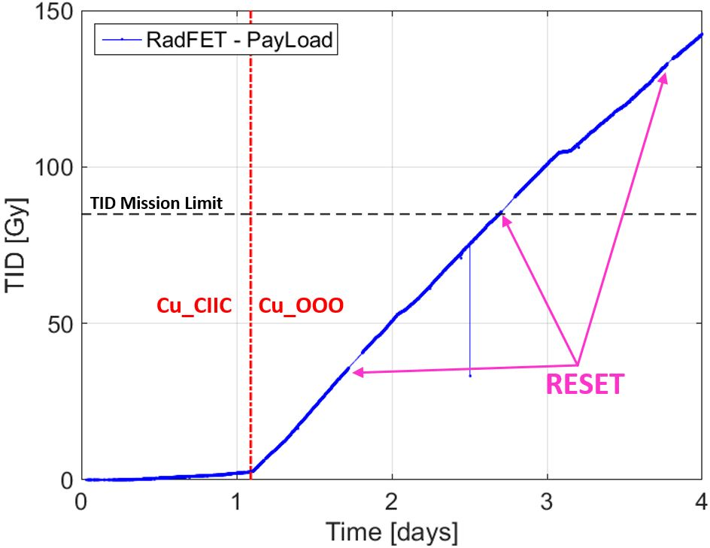
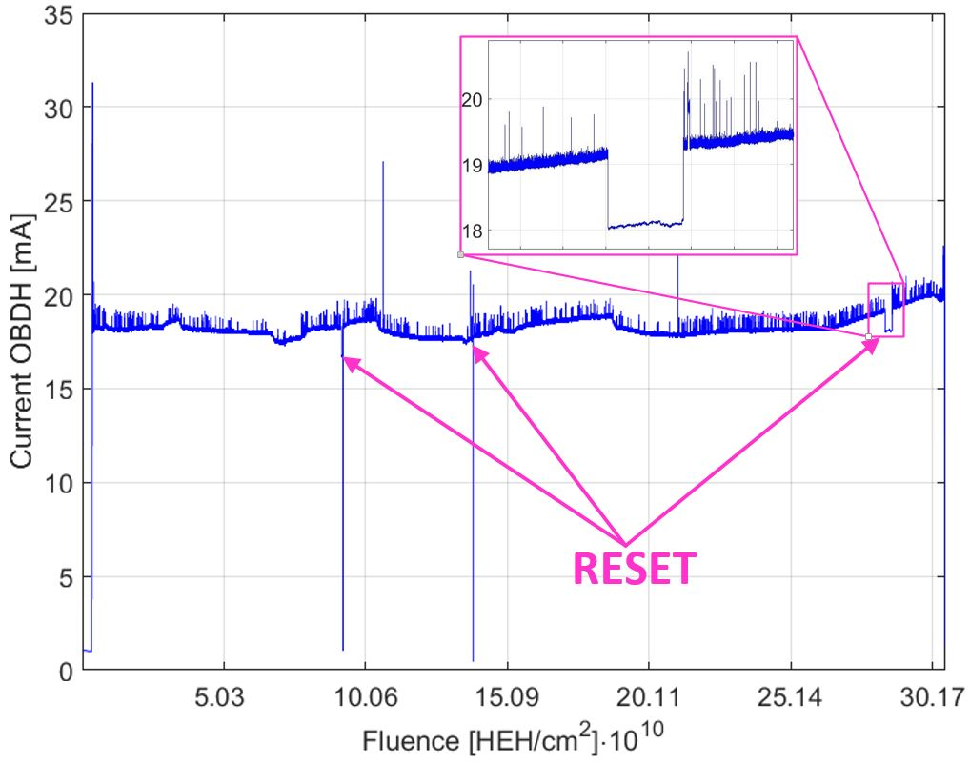
Experimental Results - TID
140 Gy collected during 4 days of irradiation
Notes:
Speaker notes:
[Text]
My notes:

Slide 14
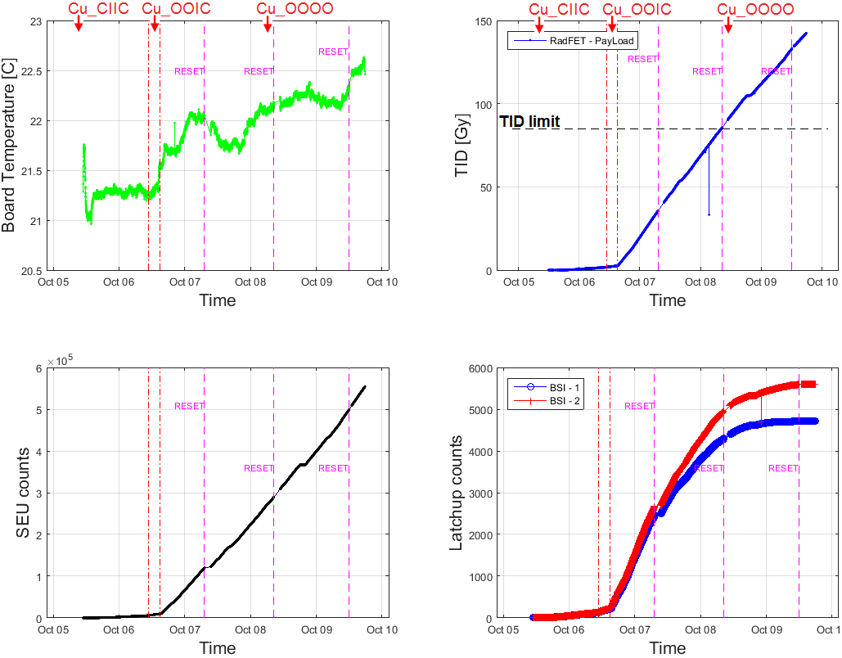
Experimental Results – All sensors
Degradation of SEL cross section with TID (~5 krad)
R. Secondo, “Upgrades of the RadMon V6 and its Integration on a Nanosatellite for the Analysis and the Comparative Study of the CHARM and Low Earth Orbit Environments”, PhD Thesis, Université de Montpellier, 2017.
Notes:
Speaker notes:
[Text]
My notes:

Slide 15
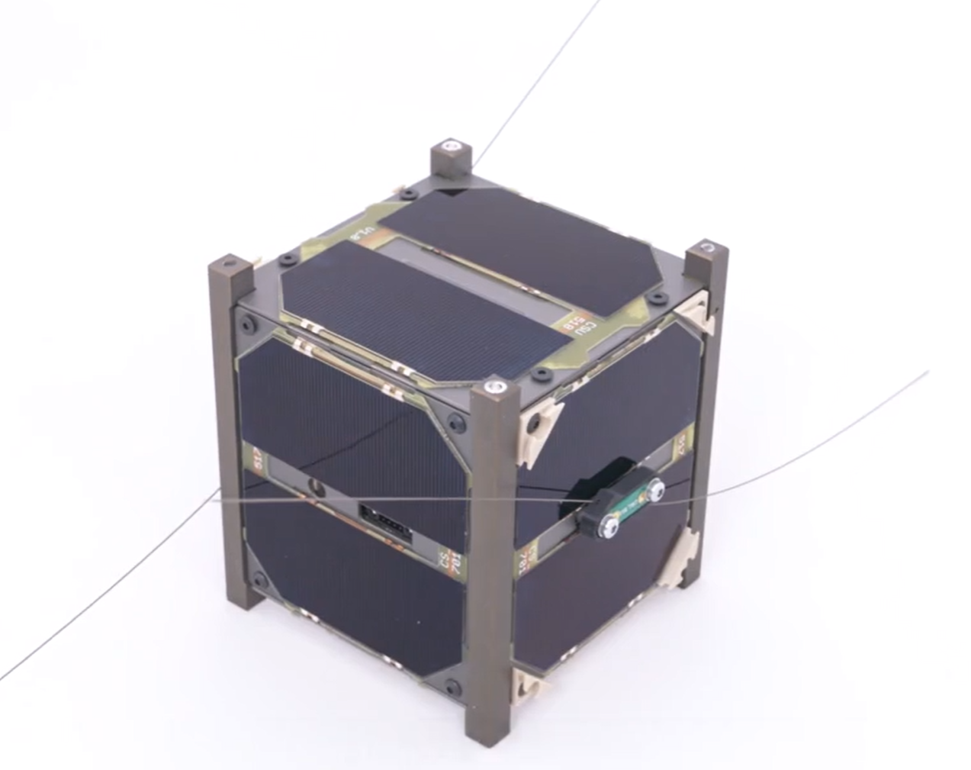
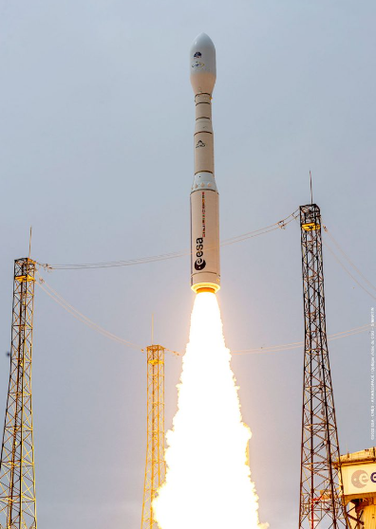
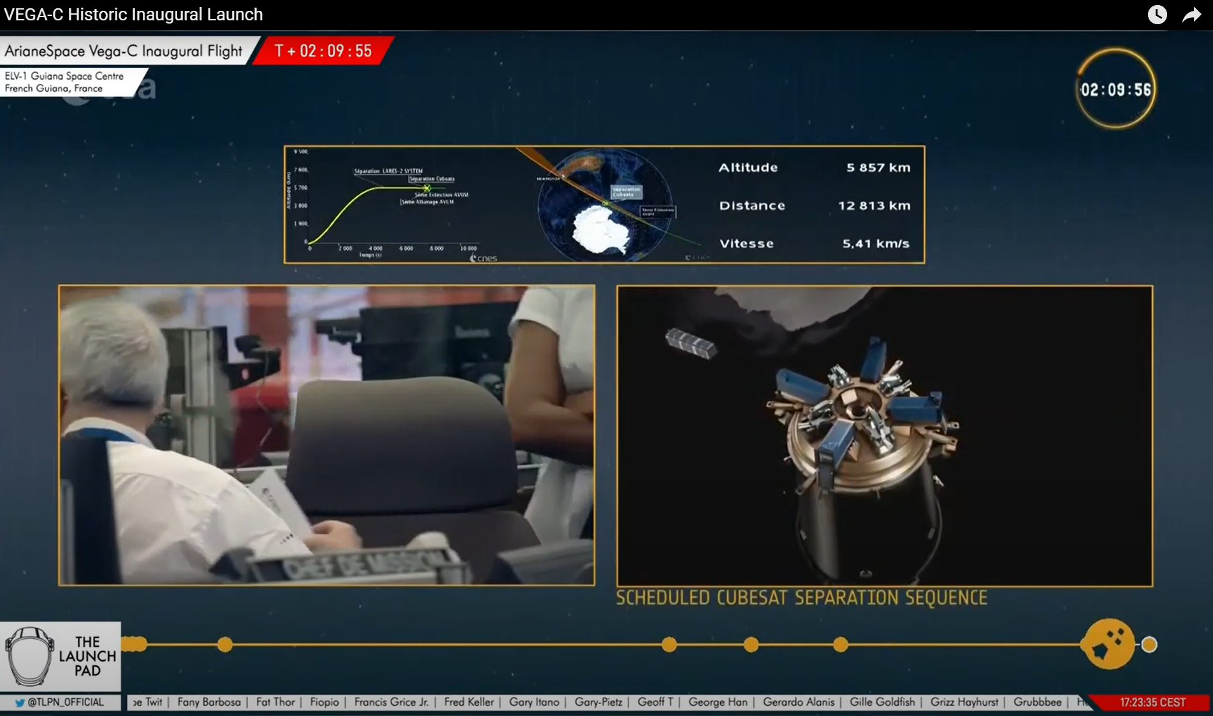
Vega-C Launch – July 2022
13th July 2022 – ESA VEGA-C Inaugural Flight
Notes:
Speaker notes:
[Text]
My notes:

Slide 16
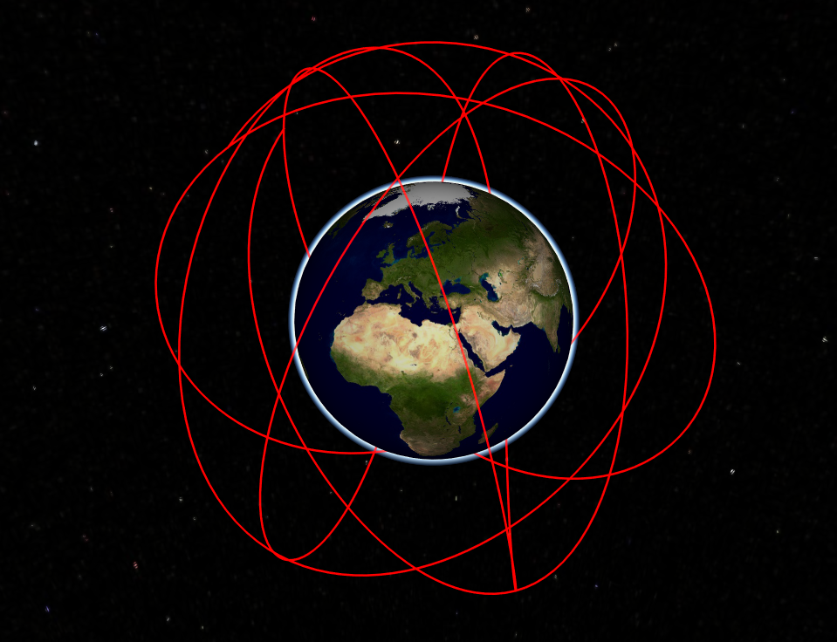
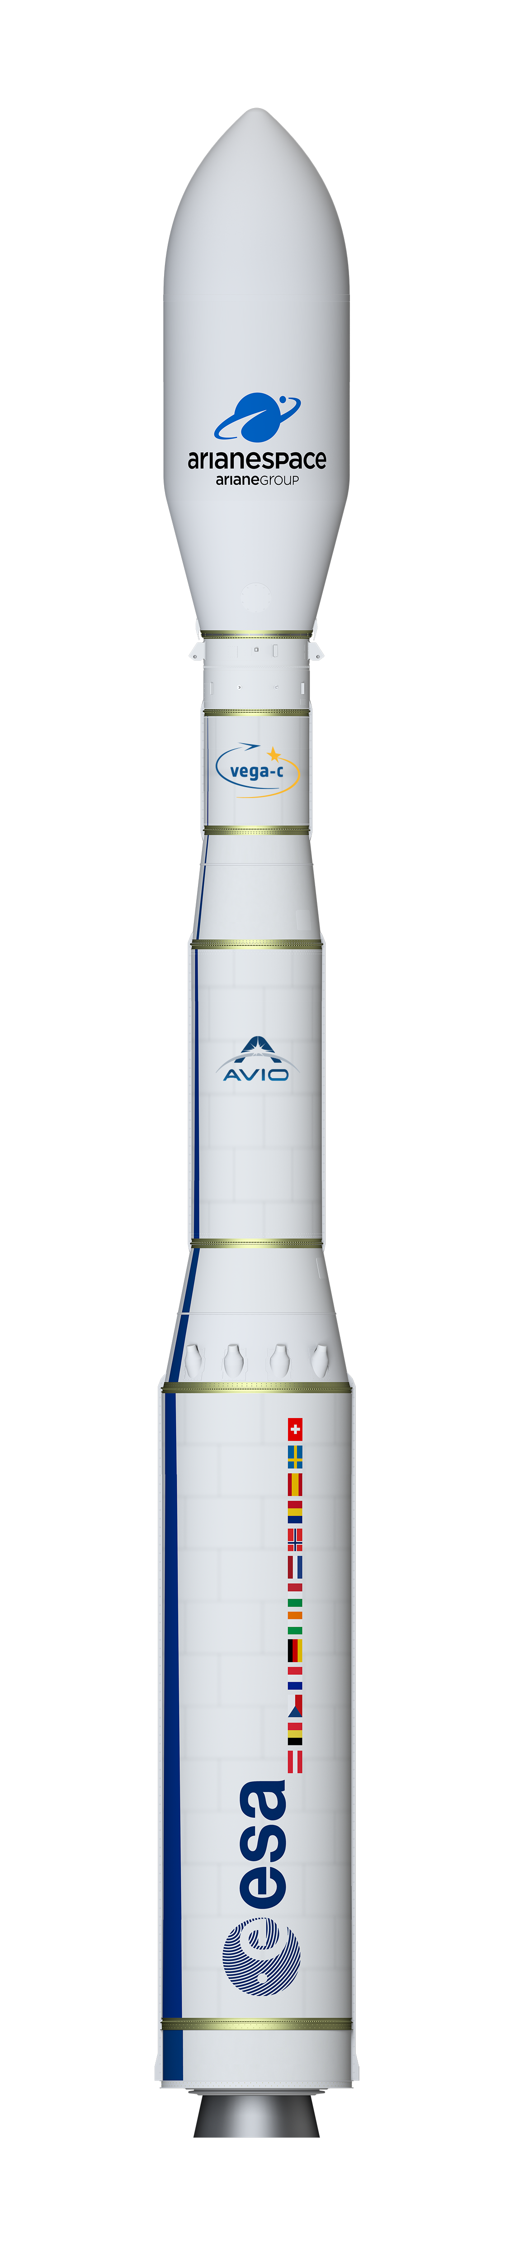
CELESTA orbit and mission
Vega-C maiden flight
Perigee altitude: 5865,4 km
Apogee altitude: 5866,9 km
Inclination angle: 70,16°
Right ascension of the ascending node (RAAN): -52,3°
Argument of perigee: 142,9°
Orbital period: 3.74 hours
Mission launch: 14.07.2022
Data collection starting 20.07.2022
Mission end: 12.09.2022
Trajectory of CELESTA as calculated in OMERE
VEGA-C
Notes:
Speaker notes:
[Text]
My notes:

Slide 17
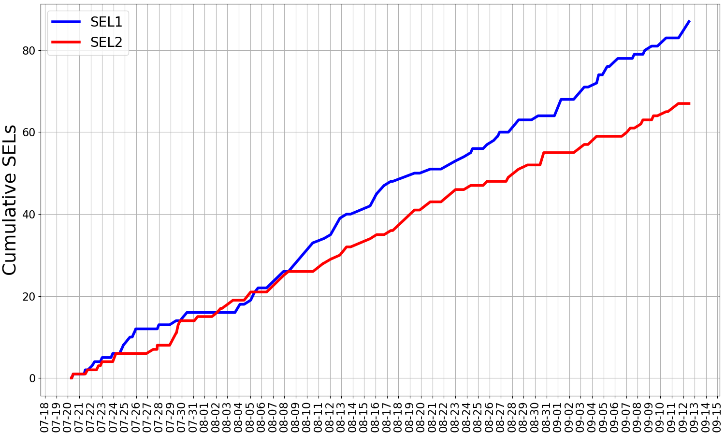
Flight data summary
Courtesy of
A. Coronetti, R. Garcia Alia,
I. Slipukhin
(CERN, SY-STI-BMI),
S. Danzeca, A. Zimmaro (CERN, BE-CEM-EPR)
347 orbits completed
Results for SELs on two Brilliance units as a function of time
SEU and TID data: RADECS ‘23 paper
No possibility for the geolocalization of the events
Notes:
Speaker notes:
[Text]
My notes:

Slide 18
Flight data against predictions
OMERE 5.4.1 used to calculate the environment for the mission timeframe
Models used: AP8, AE8, ESP, GCR ISO 15390:2004
CHARM HEH cross-section for flight date code
  1.33 x 10⁻⁸ cm²
  Step response with E₀ = 20 MeV
Weibull response for ions
2 µm sensitive cell depth
Orbiting deep inside proton belt → proton dominance in the response
GCR Heavy ions rate | 0.29 /dev/day
GCR Protons rate | 0.01 /dev/day
Trapped Protons rate | 1.31 /dev/day
Avg Solar Protons rate | 0.01 /dev/day
Total predicted rate PSI+UCL | 1.62 /dev/day
Total rate CHARM | 2.15 /dev/day
Flight rate SEL1 | 1.59 /dev/day
Flight rate SEL2 | 1.22 /dev/day
Courtesy of
A. Coronetti, R. Garcia Alia, I. Slipukhin
(CERN, SY-STI-BMI),
Notes:
Speaker notes:
[Text]
My notes:

Slide 19
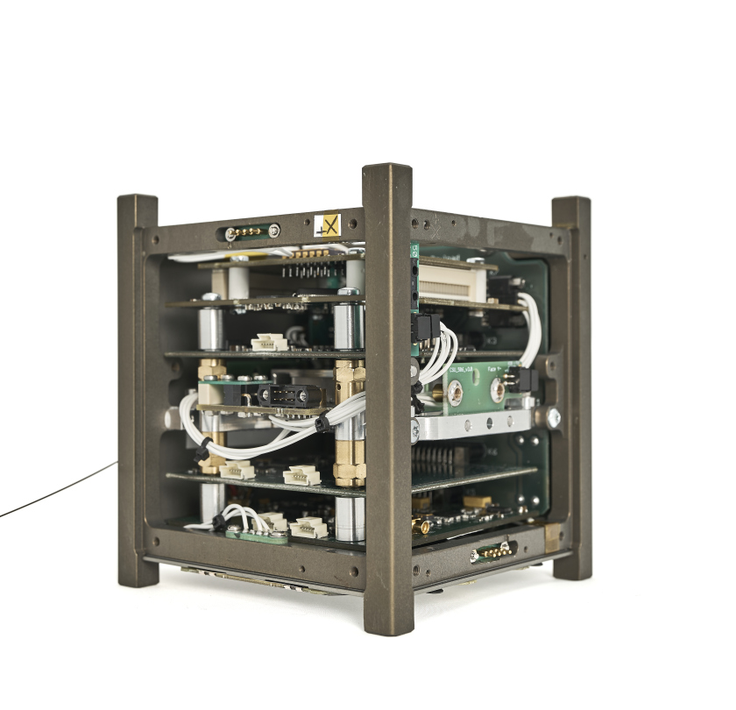

Conclusions
First CubeSat Mission collaboration between CSUM and CERN
CELESTA led the way to a procedure to test small satellites at system level
Payload tested in a LEO representative mixed-field.
Good agreement over predicted and in-flight SEL data.
Notes:
Speaker notes:
[Text]
My notes:

Slide 20
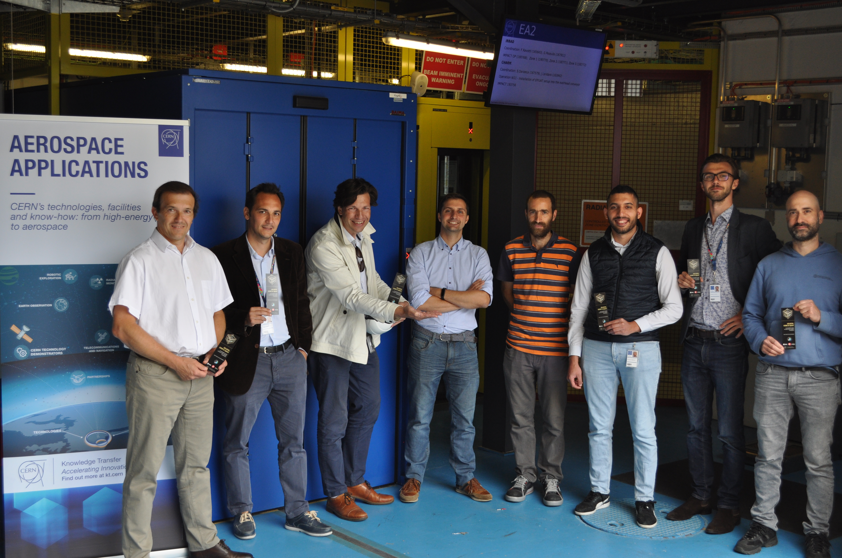
Big thanks to all contributors!
CERN BE-CEM-EPR, SY-STI-BMI and the CSU Montpellier

Slide 21
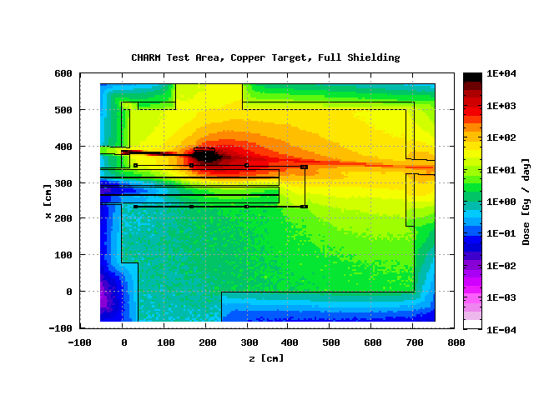
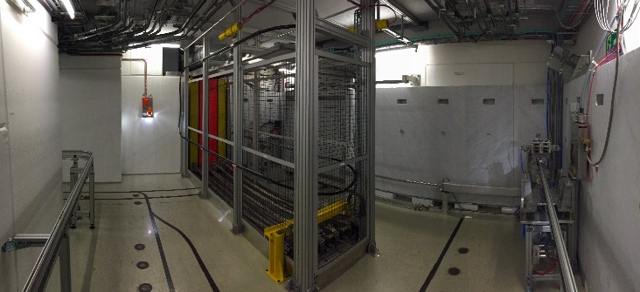
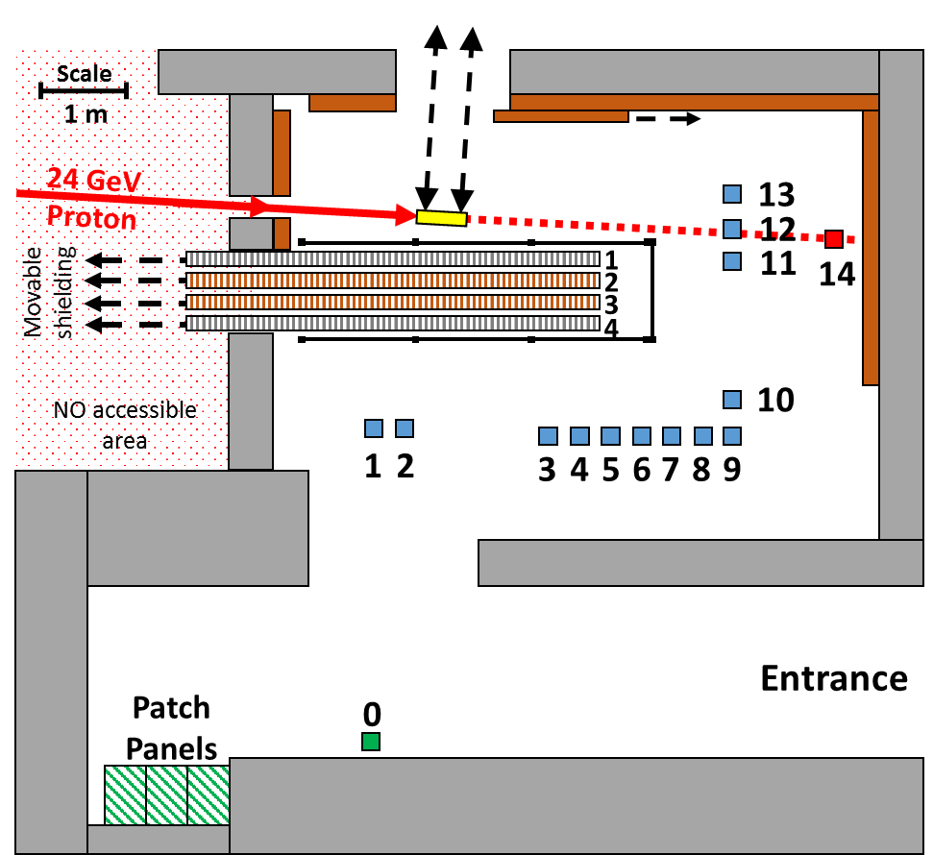
The CHARM Facility
Representative Environments:
  Target material
  Shieldings
  Test Position
Concrete
Iron
Notes:
Speaker notes:
[Text]
My notes:

Slide 22
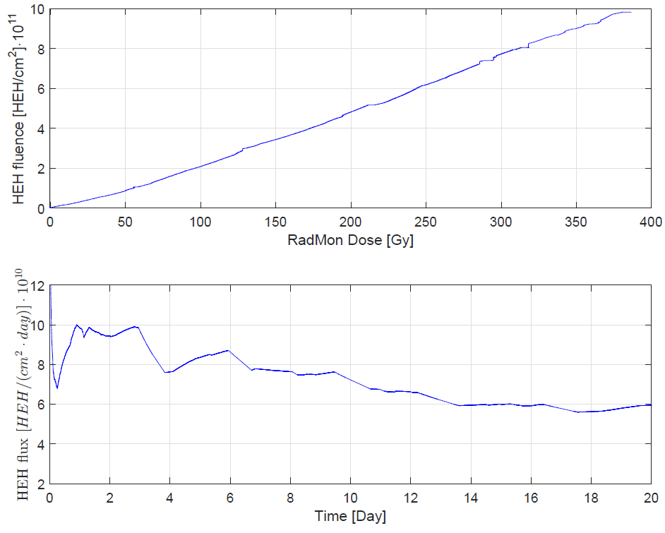

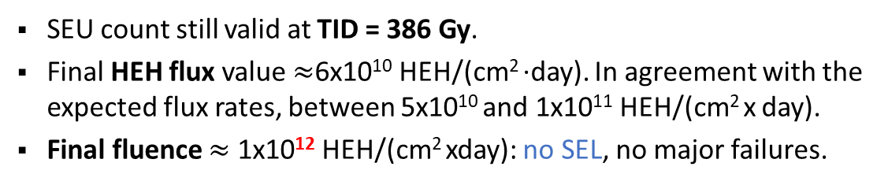
Experimental Results – HEH Fluence
SEU count still valid at TID = 386 Gy.
Final HEH flux value $≈$6x10¹⁰ HEH/(cm² ·day). In agreement with the expected flux rates, between 5x10¹⁰ and 1x10¹¹ HEH/(cm² x day).
Final fluence $≈$ 1x10¹² HEH/(cm² xday): no SEL, no major failures.
R. Secondo et al., "A Nanosatellite Radiation Qualification Procedure At The CHARM Facility Based On The CELESTA Payload Demonstrator", ESA 4S Symposium 2016, Malta, 2016, pp. 1-11.
Notes:
Speaker notes:
[Text]
My notes:

Slide 23
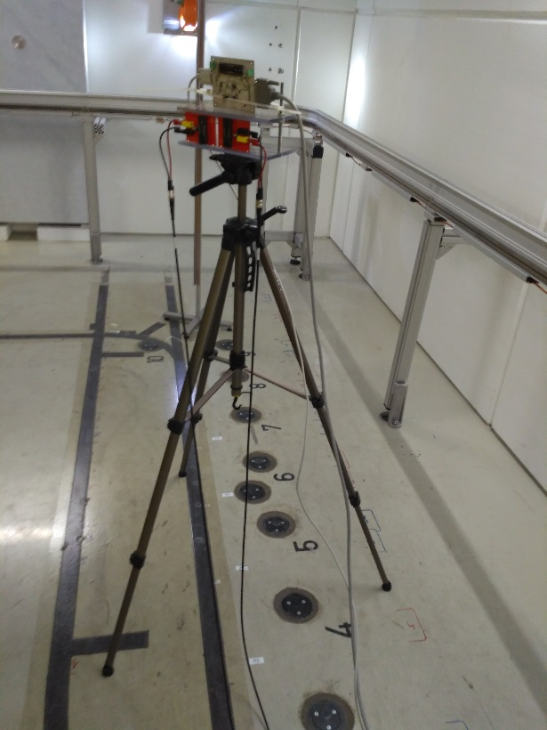
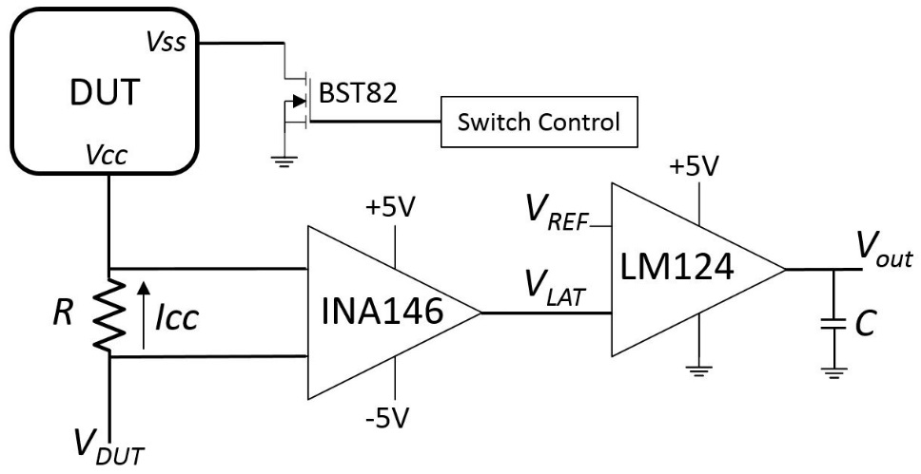


SEL Detection Circuit
Oscilloscope
Analog components - no ADC.
INA146: TID up to 500 Gy in low gain configuration.
LM124: SEL tolerant, TID up to 500 Gy.
BST82: TID up to 320 Gy.
Qualification at CHARM: monitoring signals and supply currents.
Custom-made SEL board to easily test each component
Test in Position 4
Notes:
Speaker notes:
[Text]
My notes:

Slide 24


SEL Results at CHARM - I
Latchup current waveforms.
SRAM A (Issi) and SRAM B (Brilliance)
Example of Latchup signals
R. Secondo et al., "Analysis of SEL on Commercial SRAM Memories and Mixed-Field Characterization of a Latchup Detection Circuit for LEO Space Applications“, in IEEE Transactions on Nuclear Science, vol. 64, no. 8, pp. 2107-2114, Aug. 2017
Notes:
Speaker notes:
[Text]
My notes:

Slide 25


The ROBUSTA Platform
EPS - Electrical Power Subsystem
TT&C - Tracking, Telemetry & Command
OBDH - On Board Data Handling
PL - The Payload
PAYLOAD components:
Packaging: Vibrations + Mass (200 g max).
Mechanical: Board size + Integration in the platform.
Power: < 600 mW average power.
Temperature: -20 ˚C to 80 ˚C.
Communication: CAN Bus
Notes:
Speaker notes:
[Text]
My notes:

