Slide 1
Adoption of SEE laser testing as part of the RHA process for COTS screening and validation
Final Presentation Days 2023 – ESA ESTEC - 28.06.2023
S. Morand¹, S. Dubos², J. Guillermin², L. Foro¹, D. Dam¹, L. Gouyet², C. Binois¹
A. Varotsou², R. Mangeret¹, T. Borel³, C. Poivey³.
¹ Airbus Defence and Space, France.
² TRAD, France.
³ ESTEC, ESA, Netherlands.

Slide 2
Export Control Information concerning this document’s content
This page contents a summary of the export licence information. Detailed information is available in the applicable export license information.
Country of origin for controlled data in this document:
☒ France
☐ Germany
☐ Spain
☐ United Kingdom
1/ European/French regulation controlled content
☒ These commodities do not contain French national dual-use or military controlled data.
☐ These commodities, technology or software are controlled by the European Union in accordance with dual-use regulation 428/2009 under classification [xxxx].
☐ These commodities, technology, or software in total or in parts contain data whose export / transfer / disclosure is restricted by Export Control regulations of French Munitions List, classification [MLxxxx] and exported under license number [18 00xxxx]. Dissemination is only allowed to legal or natural persons who are covered by the appropriate export license.
2/ US Regulation controlled content
☒ These commodities do not contain US national dual-use or military controlled data.
☐ These commodities, technology or software are exported in accordance with the United States Export Administration Regulations. Diversion contrary to U.S. law is prohibited. These commodities, technology or software are controlled under ECCN [none].
☐ These commodities, technology, or software are authorized by the U.S. Government for export only to [none] for use by [none] under [none]. They may not be resold, diverted, transferred, or otherwise be disposed of, to any other country or to any person other than the authorized end‑user or consignee(s), either in their original form or after being incorporated into other end‑items, without first obtaining approval from the U.S. Department of State or use of an applicable exemption.

Slide 3
Summary
Study Objectives
Project Organisation
State of the Art
Selected References & Test Methodologies
Study Results
  Results on TV1
  Results on TV2
  Results on TV3
  Results on TV4
Conclusion & Outlook of the study

Slide 4
Study Objectives
Demonstrate that a Single Event Effect (SEE) laser system can be used as an indicator of the SEE sensitivity of a Commercial Off The Shelf (COTS) component, which means determine experimentally if lot variability and differences in the design can be detected by analyzing their variability in the SEE response.
Propose guidelines to test SEE lot-to-lot variability with a Laser system.
Based on these objectives, the main technical requirements for this study are:
Select devices sensitive to SEE
Perform SEE test using laser and standard tests
Analyse the results and issue guidelines for using laser in investigating lot-to-lot variability of COTS
Product Tree
Functional Tree
Identify 4 COTS candidates with various types of SEE and component families
Obtain good indicator of SEE sensitivity
Define the test plan and prepare the test setup
Compare SEE sensitivity between lots
Perform SEE radiation tests using laser and ionizing particles
Analyze laser data and compare them to standard SEE tests
Issue RHA recommendations for the use of laser for COTS screening and validation

Slide 5
Project Organization / Management
Study title :
Adoption of SEE laser testing as part of the RHA process for COTS screening and validation
Study Reference : ESA AO/1-10651/21/NL/GLC
Contract Officer : Gian Lorenzo Casini
Technical Officer : Christian Poivey
Overall Granted Budget : 100 k€
Project Duration : 15 months
KickOff : 24/09/2021
Partners : Airbus DS (FR), TRAD (FR).
- Regular PM Meeting (Monthly) between ESA / TRAD / Airbus
Pulsed Laser Test at Airbus and TRAD Laser Facility,
Heavy Ion Test at UCL and RADEF.

Slide 6
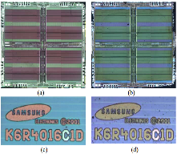
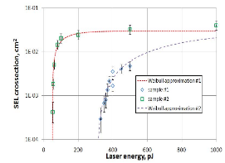
Synthesis of the state of the Art (WP10)
Use of laser testing on COTS Components
Homogeneity to SEE
Response in Various Procured Lots
Numerous contribution available from NRL, IES, IMS, Airbus, TRAD on Highrunner parts and COTS.
Limited information available on such aspect
Could be a consequence of RHA strategy that requires to associate SEE Data with mask, die revision, wafer fab…
No evidence of reference sensitive to SEL not being detected under laser SEE testing (false negative).
Limited work on the variability of SEE response for COTS technology.
Key features
  Laser generated charge densities can outpass the ones from heavy ions.
  Tuning of the beam energy can provide more resolution in the event on-set characterization.
  The spot position control on the die surface allow to precisely identifying each sensitive areas of a given DUT.
SEL Laser Cross-Section for two K6R4008C1C from Pechenkin et al. 2015

Slide 7
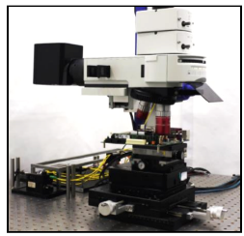
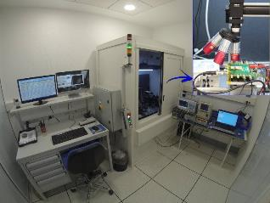
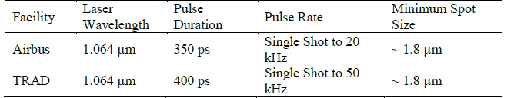
Laser testing facilities
Two facilities with parameters adapted to Single Photon Absorption pulsed laser testing of silicon devices :
AIRBUS Facility
TRAD Laser facility
Laser Pulse energy controlled by energy attenuator.
3-axis (x, y, z) automated stages (< µm resolution)
Inline photodiode for pulse energy control
Inline camera for surface imaging and beam positioning
Software and acquisition system for testing in automated process
sensitivity mapping,
time resolved testing,
threshold (energy, bias) testing

Slide 8


Part Selection Process
TV | TV1 | TV2 | TV3 | TV4
Part reference | MAX186A | LM239A | TPS54362BQPWPRQ1 | R1RW0416DSB
Function | 8ch SAR 12bits ADC 133 KSPS | Open Collector Quad Comparator | Point of Load | 4MB SRAM
Manufacturer | Maxim Integrated | Texas Instruments - ST Microelectronics | Texas Instruments | Renesas
Technology | BiCMOS S3 | JI1 – SH (TI) Bipolar | BiCMOS | CMOS
Package Type | TSOP | TSSOP14 | HTSSOP20 | TSOPII-44
Effect Type | SEL/SEU | SET | SEL / SEB | SEU
Date Code | 1553/1904/2047/2117 | 1406/1805/1811 | 1636/1816/2128 | 1702/1704/1708
Selection Criteria
Variety of Function and SEE type,
COTS,
Multisource Availability,
Variety of Process
Previous known SEE data,
Various Manufacturer.
Former data available in WP20 – D3 - Test Vehicles Pre-Existing Single Event Data, RAD-EEE-000287306.

Slide 9
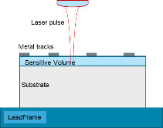
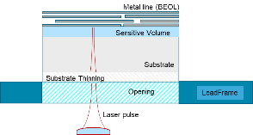
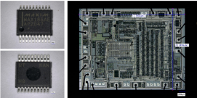
SEE Part Testing Approach
Pulsed Laser Frontside Test
Same samples as heavy ions test
Pulsed Laser Backside Test
Full Die Coverage
TV3 TPS54362-Q1
TV1 MAX186A
Tested in frontside for Heavy Ions & Laser
V_{CC} = 5 V and TAMB
Tested in frontside for Heavy Ions / Backside for Laser
V_{CC} = 18 V and T = 85°C
TV2 LM239A
Tested in frontside
for Heavy Ions & Laser
V_{CC} = 12 V and TAMB
TV4 R1RW0416DSB
Tested in frontside for Heavy Ions / Backside for Laser
V_{CC} = 3.3 V and TAMB

Slide 10
Summary
Study Objectives
Project Organisation
State of the Art
Selected References & Test Methodologies
Study Results
Results on TV1
Results on TV2
Results on TV3
Results on TV4
Conclusion & Outlook of the study

Slide 11
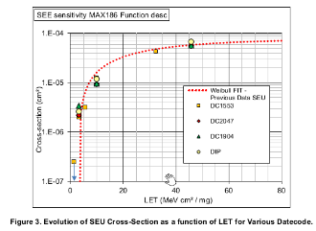
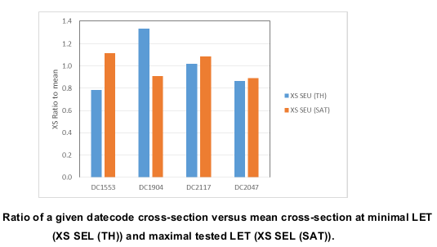
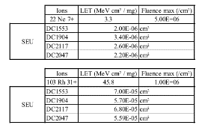
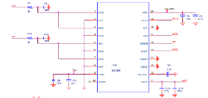
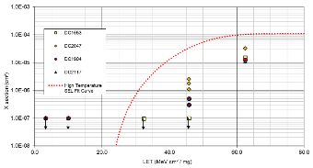
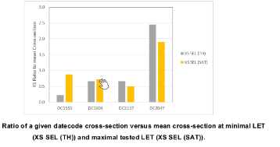
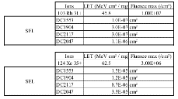
TV1 Results (Heavy-Ions)
TV1 (ADC)
TV2 (CMP)
TV3 (PoL)
TV4 (SRAM)
Xenon – LET 62.5 MeV.cm²/mg – DC1553
SEL is tested at room temperature. Weibull Fit demonstrate previous known data at elevated temperature 85°C.
SEU : Limited variation of sensitivity on the SEU between the evaluated DC.
SEL : All DC detected with SEL signature. On-set is more variable between DC.

Slide 12
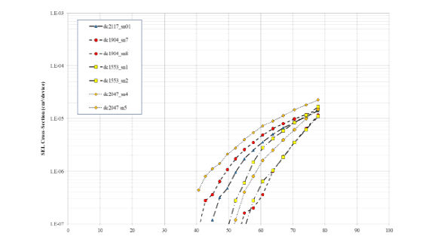
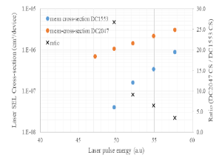
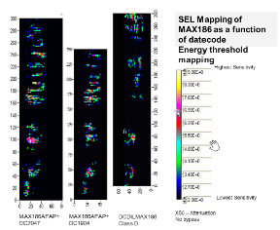
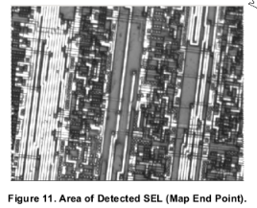
TV1 Results (Pulsed Laser)
TV1 (ADC)
TV2 (CMP)
TV3 (PoL)
TV4 (SRAM)
Pulse Laser Scan on whole surface
Identification of sensitivity spot
Recurrent mapping on sensitive area with fine stepping (typically 2µm padding)
Sensitivity area is identified in the vicinity of the reference pad.
A specific region is identified sensitive to latchup signatures. Evolution of sensitivity with laser energy allow to distinguish parts and confirm datecode DC2047 with highest sensitivity to SEL. DC1553 with lowest sensitivity.

Slide 13
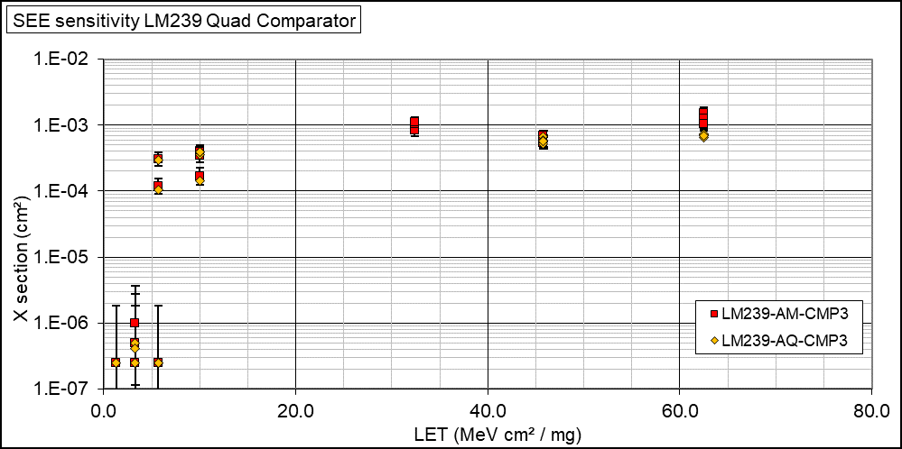

TV2 Results (Heavy-Ions)
TV1 (ADC)
TV2 (CMP)
TV3 (PoL)
TV4 (SRAM)
CMP1
CMP2
CMP3
CMP4
Conclusion:
No significant change of sensitivity between datecodes and comparator function number.
Both SET Directions explored and variable Differential Input Voltage form 0.1 to 1 V.

Slide 14

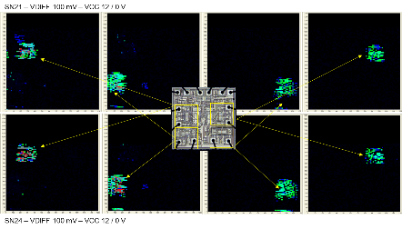
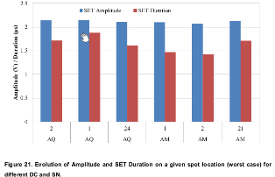
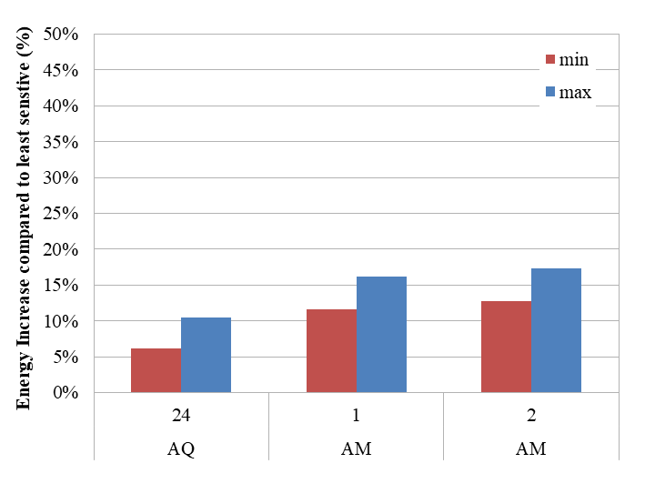
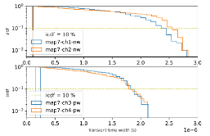
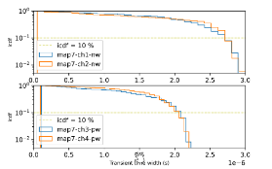
TV2 Results (Pulsed Laser)
TV1 (ADC)
TV2 (CMP)
TV3 (PoL)
TV4 (SRAM)
Mapping Comparison – SET Distribution Comparison
2nd Metric. Worst case spot amplitude
duration measurement
3rd Metric. Energy Threshold Measurement on worst case spot.
1st Metric. Mapping Pulse duration distribution
  Conclusion:
Limited evolution between selected datecodes (AM / AQ Version).
Several laser test methods were used to explore potential variability.
Pulse duration SETs distribution is of interest for such type of function.

Slide 15
TV3 Results (Heavy-Ions)
TV1 (ADC)
TV2 (CMP)
TV3 (PoL)
TV4 (SRAM)
Tested for Overconsumption / SEB at RADEF (28/10/2022) and UCL (9/03/2023) :
  Two different events observed on every DC with two distinct signatures
50 mA peak
3 500 mA peak
85 °C
85 °C
DC1636-1 : low amplitude event during irradiation (LET: 46.1 MeV.cm²/mg)
DC1636-1 : high amplitude event during irradiation (LET: 46.1 MeV.cm²/mg)
  Conclusion:
    Similar saturation cross sections at 46.1 MeV.cm²/mg for all Date Codes: ~ 6×10⁻⁷ cm²/device

Slide 16
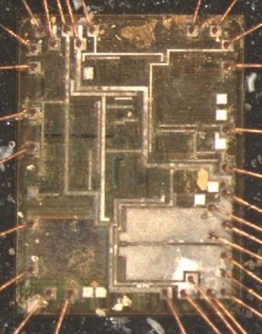
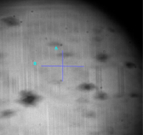
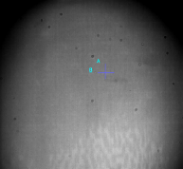
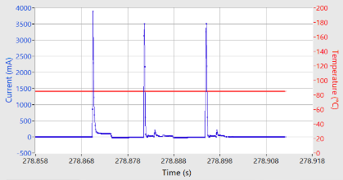
TV3 Results (Pulsed Laser)
TV1 (ADC)
TV2 (CMP)
TV3 (PoL)
TV4 (SRAM)
Backside laser testing of TV3
Identical effects are reproduced with laser and the sensitive areas are localized :
85 °C
DC1816, low amplitude event during laser test (Run 30, x50, E=11 nJ/pulse)
85 °C
DC1636-1, high amplitude event during laser test (Run 54, x50, E=12 nJ/pulse)

Slide 17
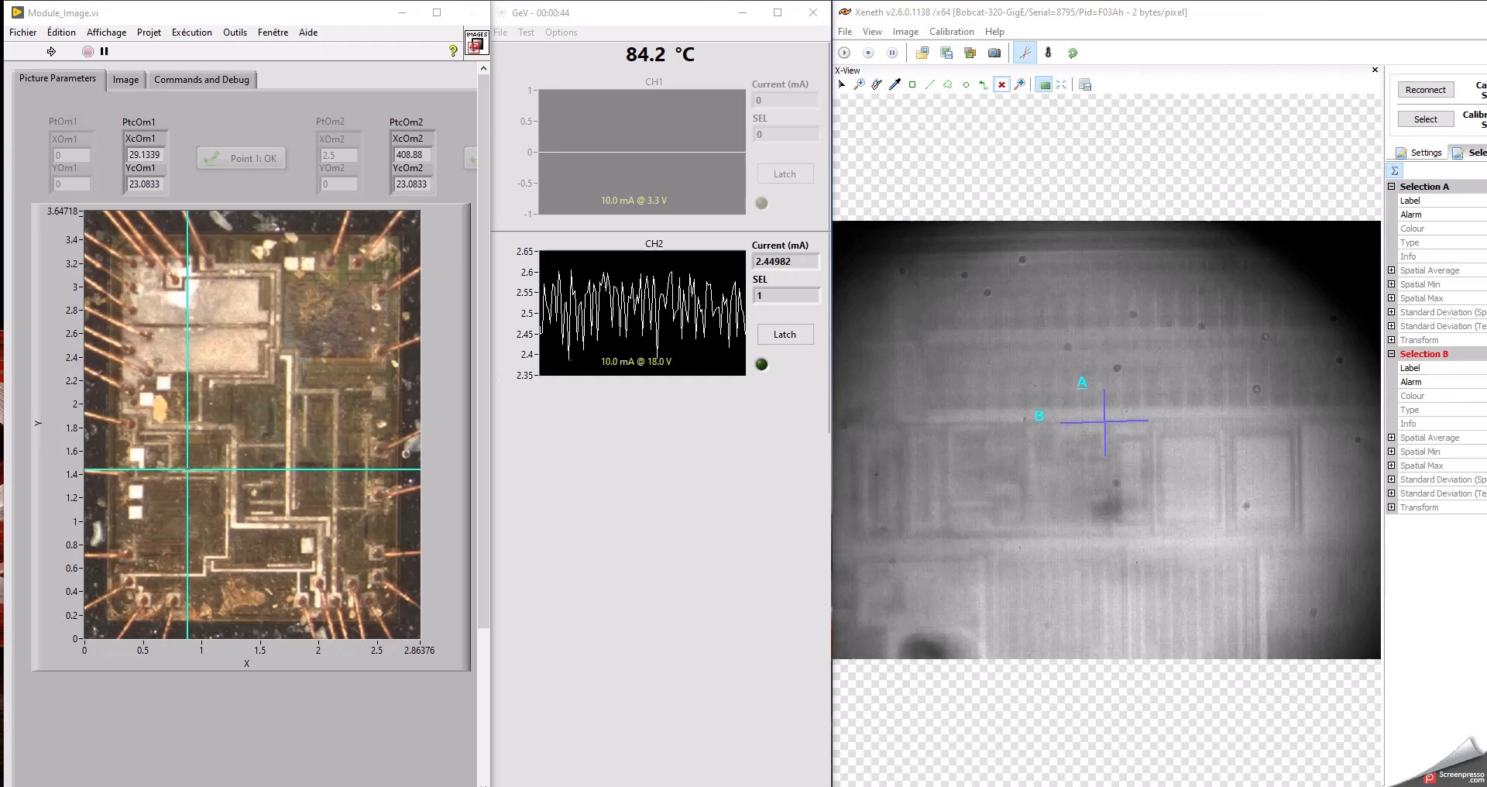

TV3 Results (Pulsed Laser)
TV1 (ADC)
TV2 (CMP)
TV3 (PoL)
TV4 (SRAM)
The small sensitive surface of the device is evidenced with pulsed Laser tests
Equivalent frontside localization
Monitoring and event counting:
Precise backside localization

Slide 18
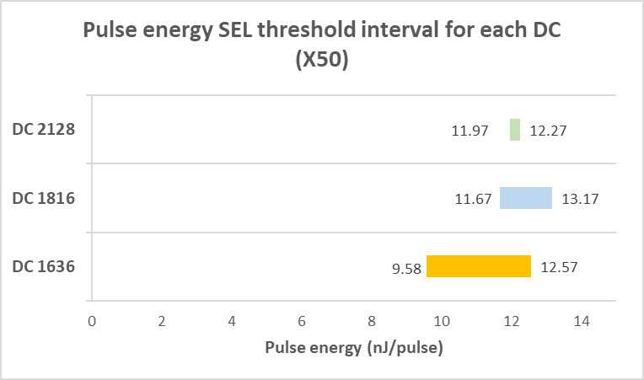

TV3 Results (Pulsed Laser)
TV1 (ADC)
TV2 (CMP)
TV3 (PoL)
TV4 (SRAM)
To compare sensitivity between DCs: Identification of energy threshold for low amplitude events on 3 DUTs per DCs:
Energy is given before entering substrate
Less differences observed with higher magnification:
  x10 mag. - spot size ~ 8 µm
  x50 mag. - spot size ~ 2.6 µm
Small differences in thinning from one DUT to another explains the differences in energy
85 °C
  Conclusion for TV3 :
    Similar behaviour and signatures between heavy ion and laser
    Laser allows precise localization of sensitive areas
    No major part to part variability is observed with laser, neither with heavy ions

Slide 19
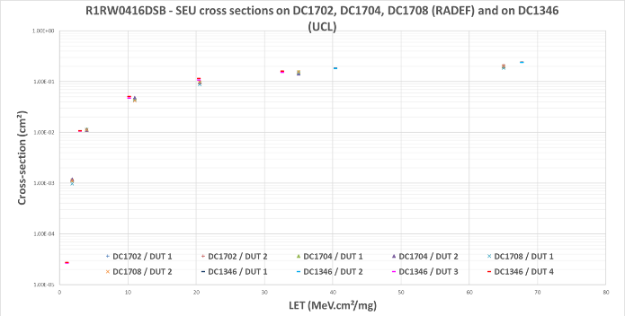
TV4 Results (Heavy-Ions)
TV1 (ADC)
TV2 (CMP)
TV3 (PoL)
TV4 (SRAM)
Tested for SEU at RADEF (28/10/2022)
No part to part variability is observed for SEUs
DC spawn of 6 Weeks did not reveal any change of sensitivity and matches previous UCL tests from 2014.

Slide 20
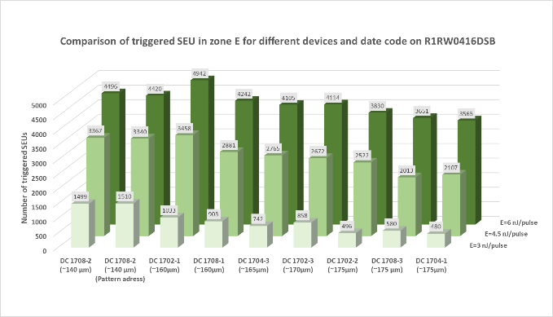
TV4 Results (Pulsed Laser)
TV1 (ADC)
TV2 (CMP)
TV3 (PoL)
TV4 (SRAM)
Backside laser testing
Method: scanning of a memory block at several energies at x50 mag.
Differences are linked to substrate remaining thickness

Slide 21
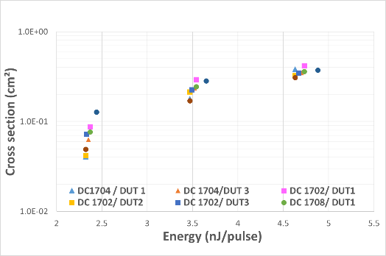

TV4 Results (Pulsed Laser)
TV1 (ADC)
TV2 (CMP)
TV3 (PoL)
TV4 (SRAM)
Laser SEU cross section: energy recalculated taking into account substrate absorption (α =${ 14cm}^{−1}$)
Hypothesis: the tested block is representative of the whole memory blocks
  Conclusion:
    Saturation cross section similar to heavy-ions test (higher because of spot size effect)
    No part to part variability is observed with pulsed laser, neither with heavy ions

Slide 22
Results Summary
On the four tested vehicles, homogeneous behavior is mostly found.
As in previous work, some variability is observed for SEL on-set and Current related events.
Consistent behavior between laser and heavy ion test results provided similar test bench and measurement technics are used.

Slide 23
Drafting Guidelines for SEE Pulsed Laser Screening of EEE COTS
Pulsed Laser test can be selected as a mean to evaluate non-regression between procured batch of a given technology.
  Provided that the capability to generate Single Event Effect of interest is consistent with previous heavy-ions test data
    Ex. pulse duration, amplitude, bias onset, sensitive surface.
Adapt the test approach to the technology node being investigated and packaging. Decision shall be taken after die identification phase.
The use of 1.06 µm SPA laser is considered as the most versatile solution that allow both frontside and thick-backside pulsed laser irradiation ( > 600 µm penetration) provided a higher sensitivity to doping concentration than lower wavelength.
The capabilities to visually spot and record worst case sensitivity regions can ease the non-regression test between batches.
Use of high magnification (≥ x50) with high numerical aperture (≥ 0.4) is recommended.
Single Event Effects (like Latchup) characterization could depend on the test bench dynamics. Ensure the test is following equivalent test conditions between heavy-ions and laser testing.
In the case of backside (through wafer), variability sources can comes from de-processing step variability and needs to be taken into consideration.
Under development

Slide 24

Outlook
ITT – Project Status
ITT Final Review in September with Recommendations and Guidelines delivery for SEE Screening based on pulsed laser testing technics
Contribution Selected for RADECS 2023 RHA Session
WP10 – D1 - Literature Survey; RAD-EEE-000267845. | Delivered
WP20 – D2 - List of the test candidates, RAD-EEE-000287446. WP20 – D3 - Test Vehicles Pre-Existing Single Event Data, RAD-EEE-000287306. | Delivered
WP30 – D4 Test setup and test sample - Setup readiness report, TRAD/ESA/ETU/LASER/AV/120422. | Delivered
WP40 – D5 - Test Plans Definition, TRAD/ESA/ETU/LASER/AV/130422. | Delivered
WP50 – D6/D7 - Adoption of Single Event Effect (SEE) LASER testing as part of the Radiation Hardness Assurance (RHA) Process for Components Off The Shelf (COTS) screening and validation. | Under ESA Review
WP60 – D8 - Laser SEE Screening Guidelines – Final Guidelines. | Drafting

Slide 25
References
V. Pouget, P. Fouillat, D. Lewis, H. Lapuyade, L. Sarger, F. M. Roche, S. Duzellier, and R. Ecoffet, “An overview of the applications of a pulsed laser system for SEU testing” proceedings of 6th IEEE International On-line testing Workshop, 2000.
S. Buchner, D. McMorrow, C. Poivey, J. Howard, Y. Boulghassoul. L. W. Massengil, R. Pease, and M. Savage, “Comparison of single-event transients induced in an operational amplifier (LM124) by pulsed laser light and broad beam of heavy ions”. IEEE TNS 2004, vol. 51, no. 5.
S. Buchner, J. Howard, C. Poivey, D. McMorrow, and R. Pease “Pulsed laser testing methodology for single event transients in linear devices,” IEEE TNS 2004, vol. 51, no. 6.
D. McMorrow, S. Buchner, M. Baze, B. Bartholet, R. Katz, M. O’Bryan, C. Poivey, K. A. Label, R. Ladbury, M. Maher, and F. W. Sexton, “Laser Induced Latchup Screening and Mitigation in CMOS Devices,” IEEE TNS 2006, vol. 53, no. 4.
S. Buchner, N. Roche, J. Warner, D. McMorrow, F. Miller, S. Morand, V. Pouget, C. Larue, V. Ferlet- Cavrois, F. El Mamouni, H. Kettunen, P. Adell, G. Allen, and D. Aveline, “Comparison of Single Event Transients Generated at Four Pulsed-Laser Test Facilities-NRL, IMS, EADS, JPL”, IEEE TNS 2012, vol. 59, no. 4
S. Buchner, F. Miller, V. Pouget, and D. McMorrow, “Pulsed laser testing for Single Event Effect investigations”, IEEE TNS 2013, vol. 60, no. 3.
C. Weulersse, F. Bezerra, F. Miller, T. Carrière, N. Buard, and W. Falo, “Probing SET Sensitive Volumes in Linear Devices Using Focused Laser Beam at Different Wavelengths,” IEEE TNS 2008, vol. 55, no. 4.
F. Miller, S. Morand, A. Douin, R. Gaillard, T. Carrière, and N. Buard, “Laser Validation of a Non-Destructive Test Methodology for the Radiation Sensitivity Assessment of Power Devices”, IEEE TNS 2011, vol. 58, no. 3.
S. Morand, F. Miller, F. Molière, T. Santini, E. Celerault, B. Foucher, P. Austin, T. Carrière, and R. Gaillard, “Development of a Near UV SPA Laser Tool for Wide Band Gap Semiconductor Single Events Assessment”, Radiation and Its Effects on Components and Systems (RADECS), 2012 13th European Conference on, 2012.
N. J.-H Roche, A. Khachatrian, S. Buchner, C. Foster, V. Ferlet- Cavrois, M. Muschitiello, F. Miller, S. Morand, J. Warner, T. Decker, and D. McMorrow, “Application of a Pulsed Laser to Identify a Single-Event Latchup Precursor”, IEEE TNS 2015, vol. 62, no. 6.
S. Morand, C. Binois, H. de Fleurieu, A. Carvalho, A. Samaras, T. Clatworthy, and D. Staerk, “Simultaneous Single Event Transient (SET) Observation on LM139A wired-AND Comparator Circuit”, IEEE TNS 2020.
C. Ngom, V. Pouget, M. Zerarka, F. Cocetti, A. Touboul, M. Matmat. O. Crepel, S. Jonathas, and G. Bascoul, “Backside laser testing of Single-Event Effects in GaN-on-Si power HEMTs”, RADECS 2020.
C. Weulersse, “Laser testing as an optimized complement of heavy ion for SEE testing Experiences from Airbus DS”, G-RAD Workshop, 9 Dec. 2020.
R. Mangeret, “Radiation Testing and the RHA Process”, Short Course, RADECS 2013.
A. Carvalho, “Industrial Point of View for Space Applications: Best Practices from Parts Selection to Flight”, Short Course, RADECS 2107.
R. Mangeret, “Radiation Hardness Assurance: How Well Assured Do We Need To Be?” Short Course, NSREC 2108.
M. Mauguet, “Etude de la génération d’événements singuliers par excitation laser impulsionnel dans des composants silicium utilisés en environnement radiatif”, PhD Thesis, INSA Toulouse, 2019
M. Mauguet, D. Lagarde, F. Widmer, N. Chatry, X. Marie, E. Lorfevre, F. Bezerra, R. Marec, and P. Calvel, “Single events induced by heavy ions and Laser pulses in silicon Schottky diodes”, IEEE TNS 2018, vol. 65.
M. Mauguet, N. Andrianjohany, D. Lagarde, L. Gouyet, L. Azema, N. Chatry, X. Marie, R. Marec, P. Calvel, D. Standarovski, and R. Ecoffet, “Single-event latchup in a CMOS-based ASIC using heavy ions, Laser pulses and coupled simulation”, IEEE TNS 2019, vol. 66.
G. Augustin, M. Mauguet, N. Andrianjohany, N. Chatry, F. Bezerra, E. Capria, M. Sander, and K-O. Voss, “Cross-calibration of various SEE test methods including pulsed X-rays and application to SEL and SEU”, IEEE TNS, RADECS 2019 proceedings.
M. Mauguet, J. Guillermin, B. Vandevelde, N. Chatry, J. Carron, and F. Bezerra, “High current events triggered by heavy ion microbeam and pulsed Laser on a MRAM”, IEEE TNS, RADECS 2020 proceedings.
M. Mauguet, N. Chatry, and J. Guillermin, “Study of latent defects related to SEL induced by Laser pulses on COTS and their impact on long-term reliability “, Oral presentation, ESCCON 2021.
D.H. Habing, “The use of lasers to simulate radiation-induced transients in semiconductor devices and circuits”. IEEE TNS 1965, vol. 12.
A.K. Richter and I. Arimura, “Simulation of heavy charged particle tracks using focused laser beams”, IEEE TNS 1987, vol. 34.
D. McMorrow, “Laser-based testing for SEE”, Short course NSREC 2019
A. Douin et al, “Influence of Laser Pulse Duration in Single Event Upset Testing”, IEEE TNS 2006, vol. 53.
A.I. Chumakov et al. “Compendium of SEE comparative results under ion and laser irradiation”, IEEE Proceedings RADECS Data Workshop (2013).
D. McMorrow et al, “ SEU in substrate-etched CMOS SOI SRAMs using UV optical pulses with wub-micrometer spot size”, IEEE TNS 2013, vol. 60.
D. Lewis et al, “Backside laser testing of ICs for SET sensitivity evaluation”, IEEE TNS 2001, vol. 48.
D. McMorrow et al, “Subbandgap laser induced single event effects: carrier generation via two-photon absorption”, IEEE TNS 2002, vol. 49.
F. Darracq et al, “Investigation on the single event burnout sensitive volume using two-photon absorption laser testing”, IEEE TNS 2012, vol. 59.
N. Mbaye, “Contribution à l’étude de la fiabilité des technologies avancées en environnement radiatif atmosphérique et spatial par des méthodes optiques”, Université Bordeaux1, 2013.
N. Andrianjohany. « Méthodologie de prédiction multi-échelle pour l’évaluation et le durcissement des circuits intégrés complexes face aux événements singuliers d’origine radiative ». Université Aix-Marseille, 2018.
GEO Telecoms Radiation Tools Efficiency Improvement with Methods and Geometry Exchanges for Industrial Tools” (GTREFF), ESA Contract No: 4000111684/14/NL/LF, 2015-2016.
High Accuracy Multi-Scale Tools for Single Event Rate Analysis in Modern Technologies” (HAMSTER), ESA contract N°: 4000124358/18/NL/GLC, 2020-2021.
Electric Orbit Raising Radiation Environment and Solar Array Degradation”, ARTES AT 4F.126 ESA AO/1-9732/19/NL/NR, 2020-2021.
C. Boatella Polo, “SEE Single Event Effects, Radiation environment and its effects in EEE components and hardness assurance for space applications”, ESA-CERN-SCC Workshop, 2017.

Slide 26
Thank you.

