Slide 1
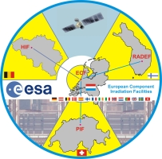
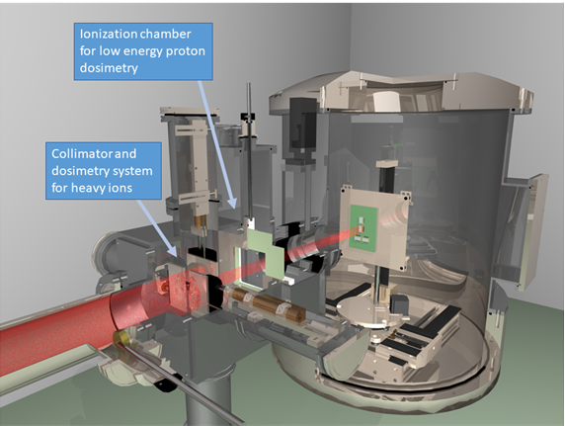
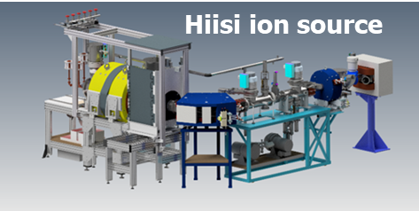
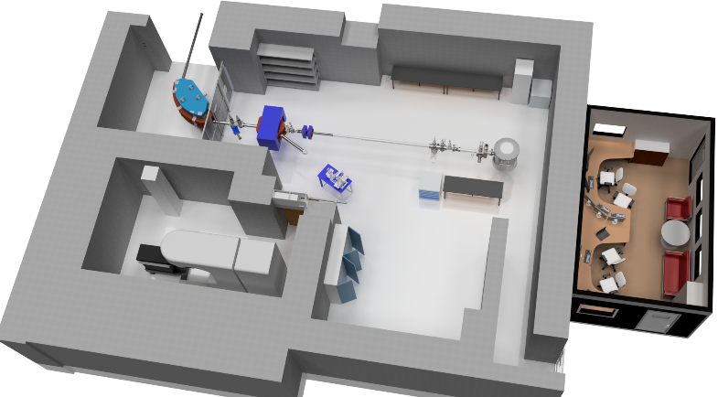
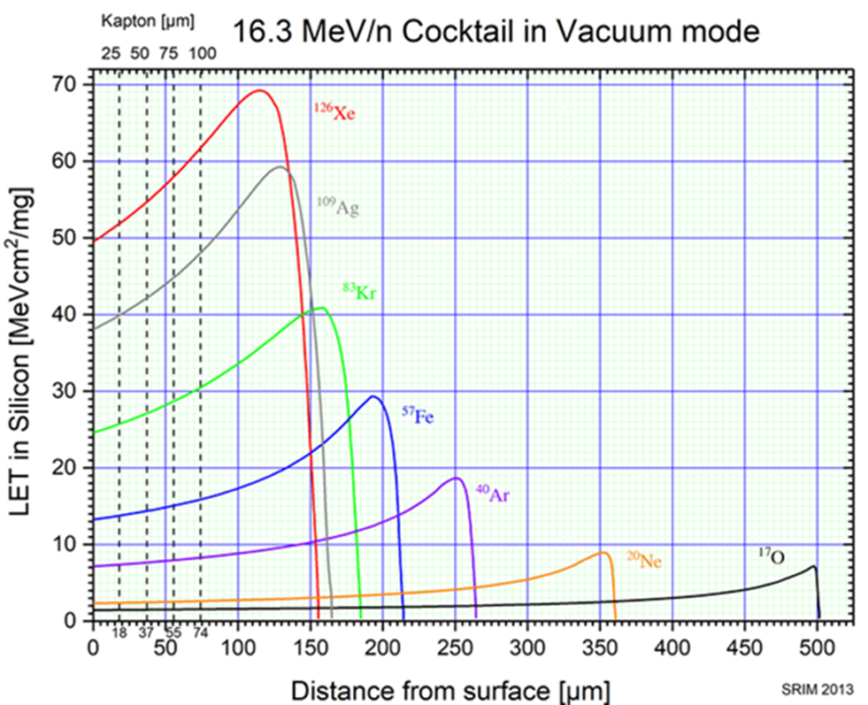
TEC-QEC Final Presentation Day 2023
RADEF status report 2019-2022
ESA/ESTEC Contract No. 4000124504/18/NL/KML/zk:
"Utilisation of the High Energy Heavy Ion
Test Facility (RADEF) at the University of
Jyväskylä (JYFL) for Component Radiation
Studies 2018-2022"
Heikki Kettunen, JYFL
https://www.jyu.fi/accelerator/radef
University of Jyväskylä, Finland

Slide 2
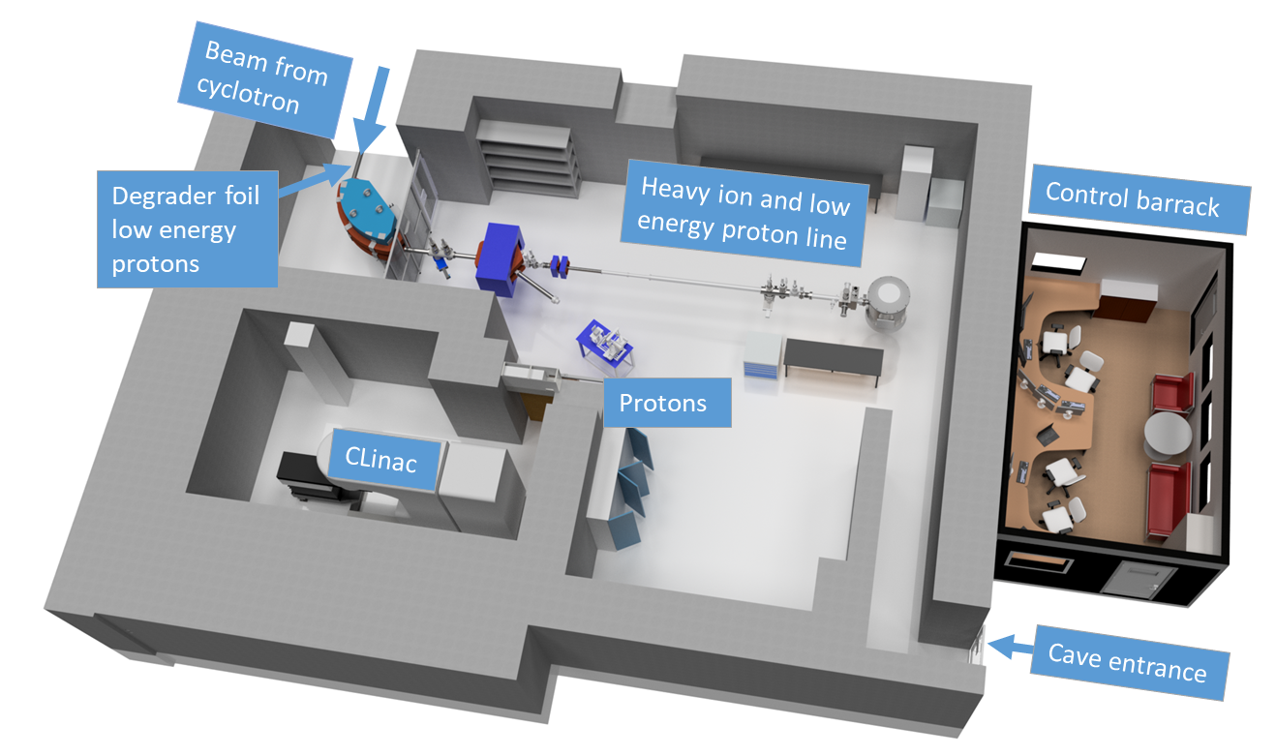
TEC-QEC Final Presentation Day 2023
RADiation Effects Facility - RADEF

Slide 3
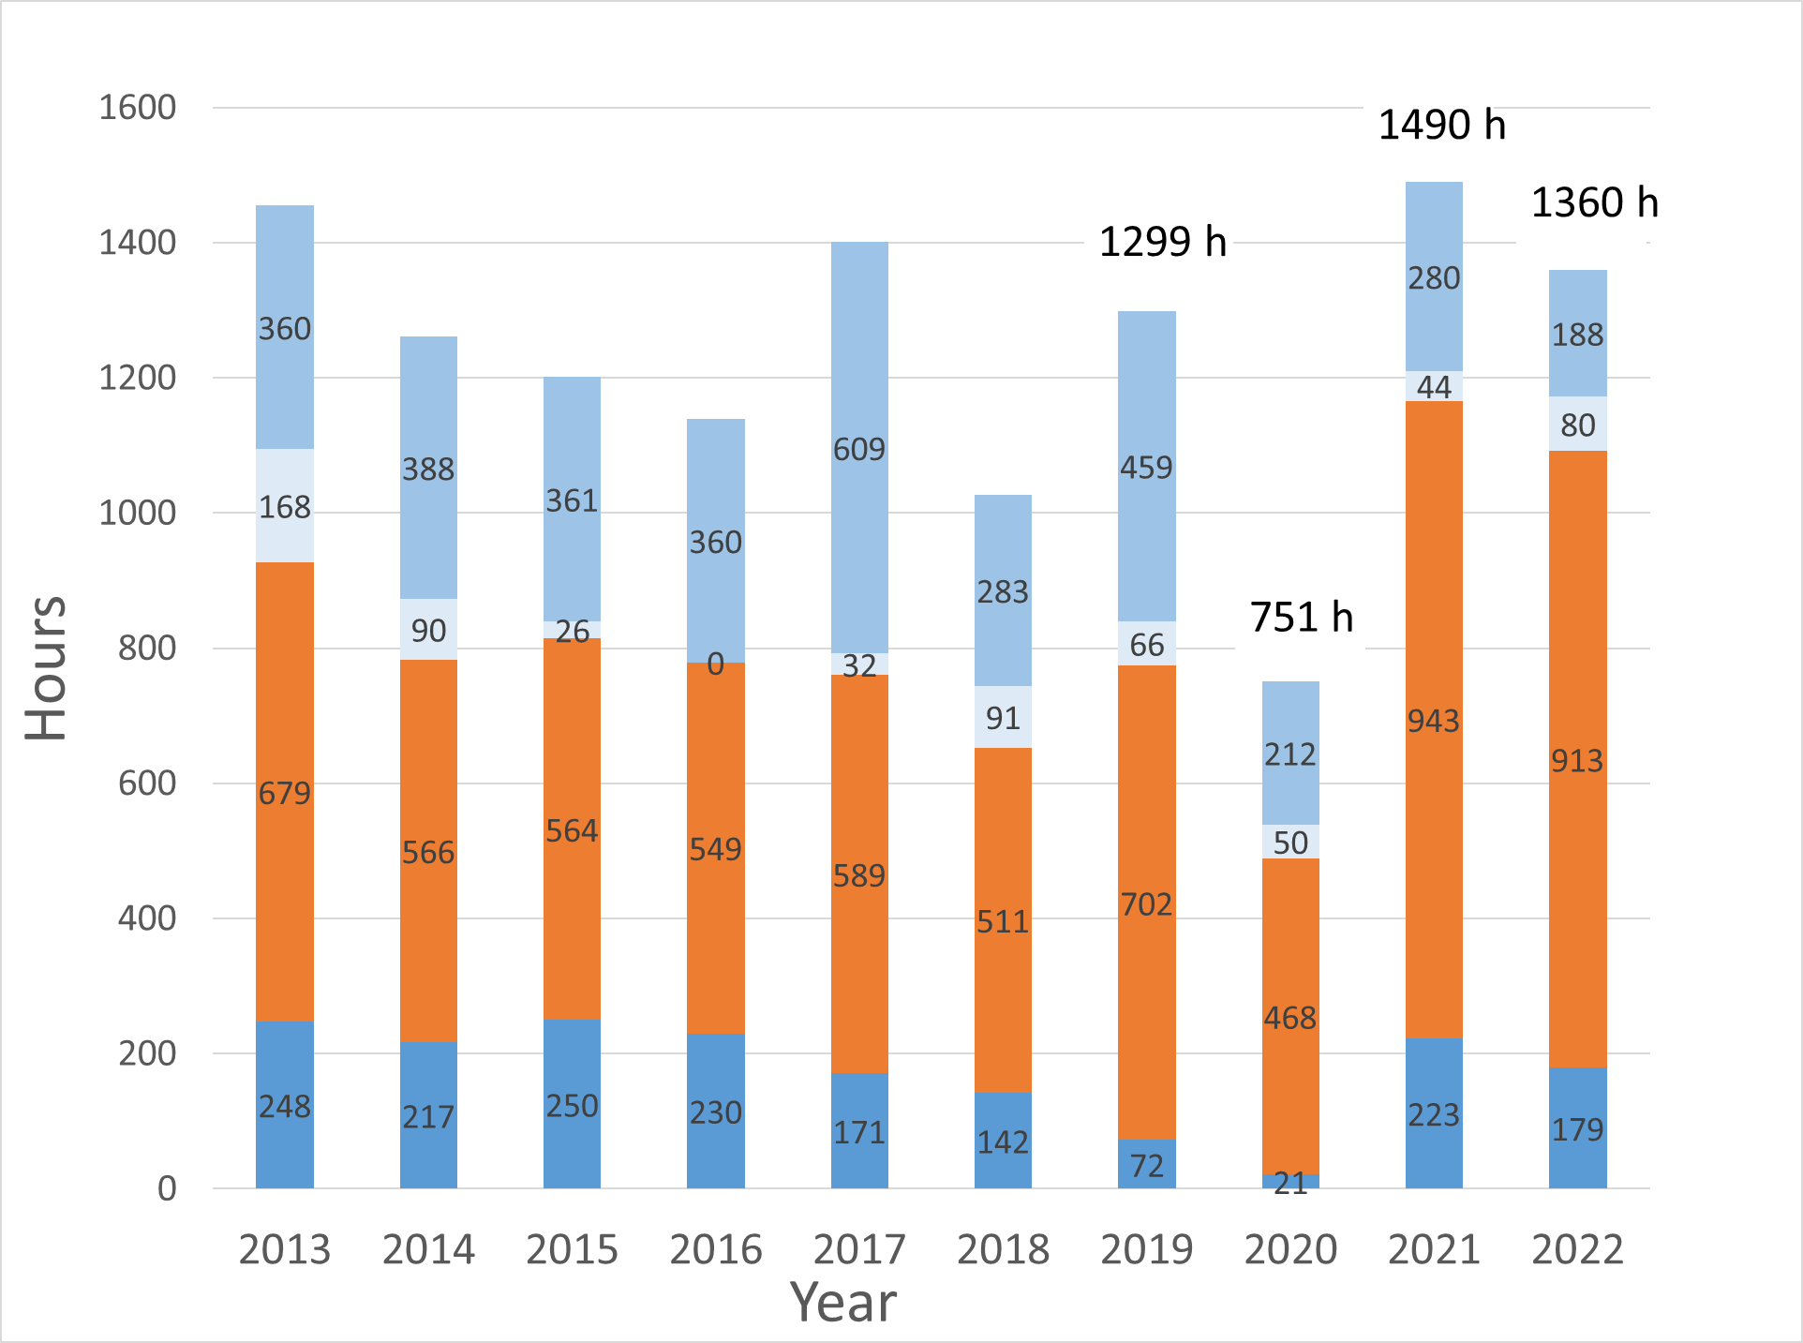
TEC-QEC Final Presentation Day 2023
Annually used beam time at RADEF 2013-2022
RADEF is using 20-25 % of K-130 cyclotron beam time
Statistics for component tests 2019-2022 (ESA, space industry, research)
Other irradiations
R&D
Space Industry
Covid year 2020
Upgrade of the cyclotron operating system, Jan-Feb
For foreing visitors:
Covid-19 -> closed from March to mid-September
Operating from mid-September to December
Component tests
ESA

Slide 4
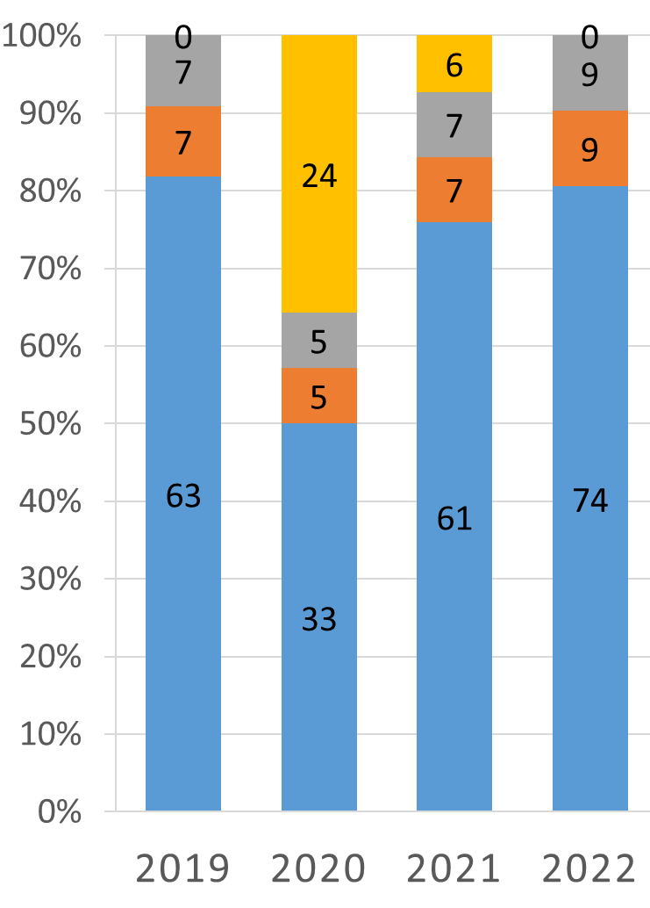
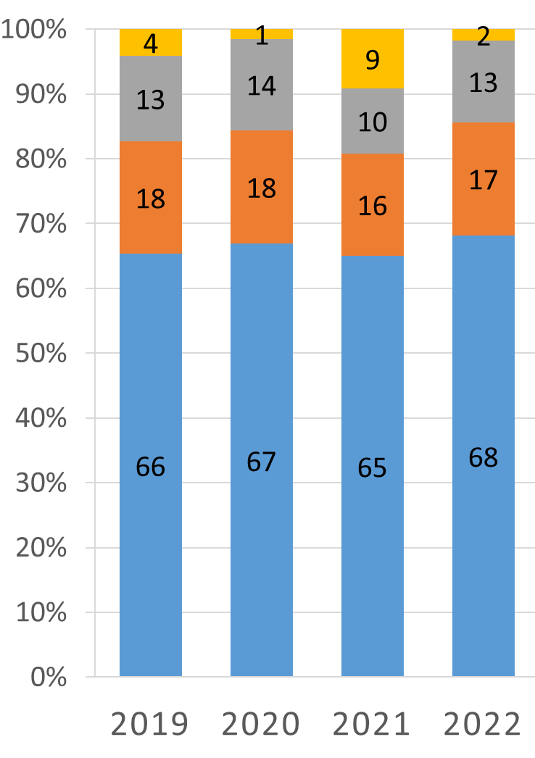
TEC-QEC Final Presentation Day 2023
How beam time was used 2019-2022
ESA
Space Industry
Cyclotron RF-problems on 2021
72h 21h 223h 179h
702h 468h 943h 913h
Fails: RADEF has problems with beam delivery
Stand by: Waiting user to be ready
Beam tuning: Morning tuning, beam changes
Beam on DUT

Slide 5
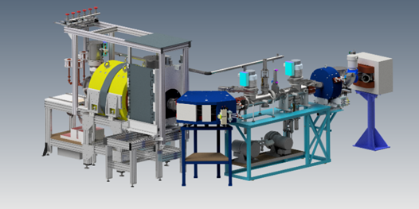
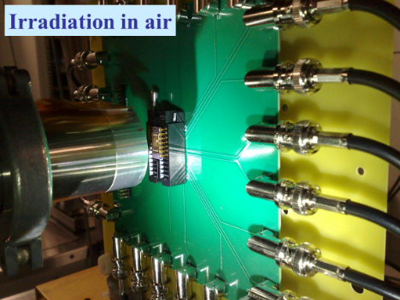
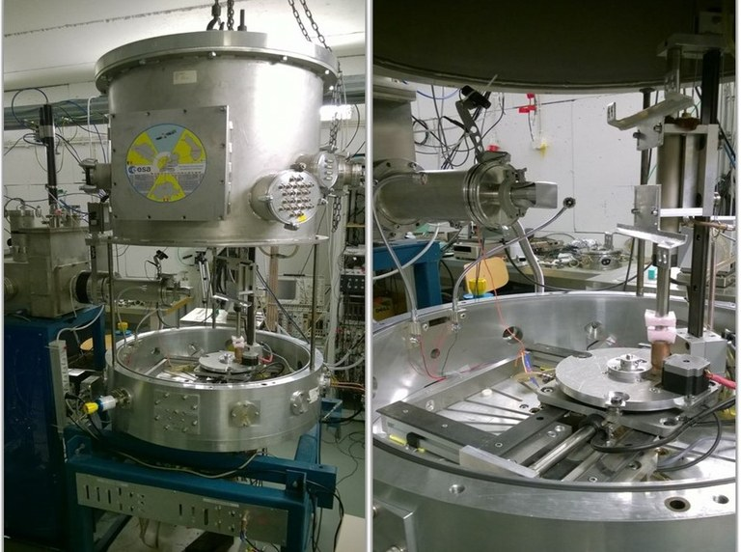
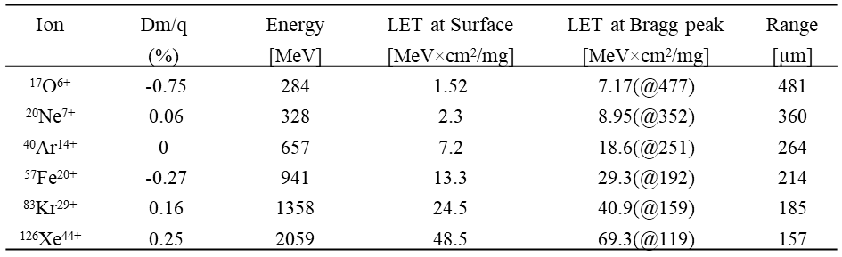
TEC-QEC Final Presentation Day 2023
Heavy ion beams available at RADEF
Hiisi ion source
Four different heavy ion cocktails
Old cocktail (14 GHz ion source since 2005)
9.3 MeV/n: N, Ne, Ar, Fe, Kr, Xe (Xe ~100µm in Si)
New cocktails (18 GHz HIISI ion source since 2019)
10 MeV/n: Ar, Kr, Au (May 2020)
16.3 MeV/n: O, Ne, Ar, Fe, Kr, Xe (Xe~150µm in Si) (Jan 2019)
22 MeV/n: O, Fe, Kr (Kr~257µm in Si) (Sept 2019)
16.3 MeV/n ion cocktail parameters in Si (Srim 2013)
https://www.jyu.fi/accelerator/radef

Slide 6
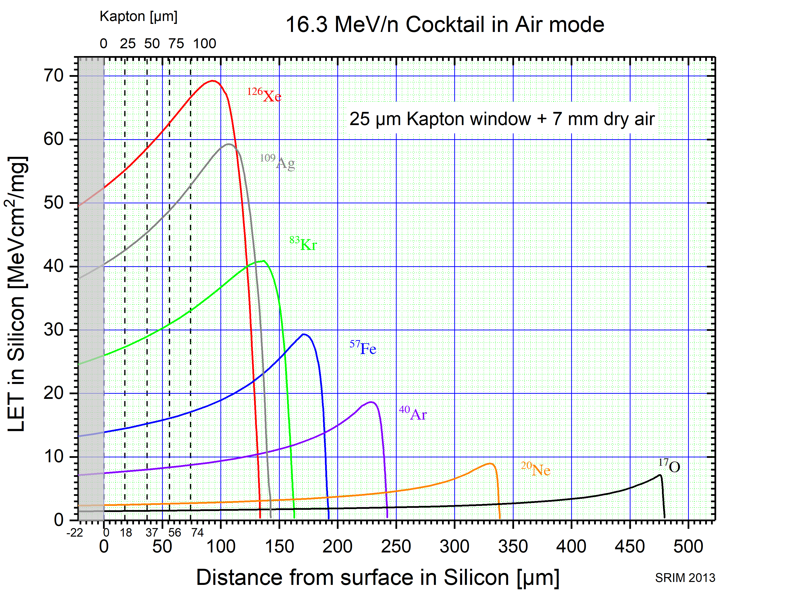
TEC-QEC Final Presentation Day 2023
Bragg curves for RADEF cocktail ions in silicon (Srim 2013)
Ag beam is under development
https://www.jyu.fi/accelerator/radef

Slide 7
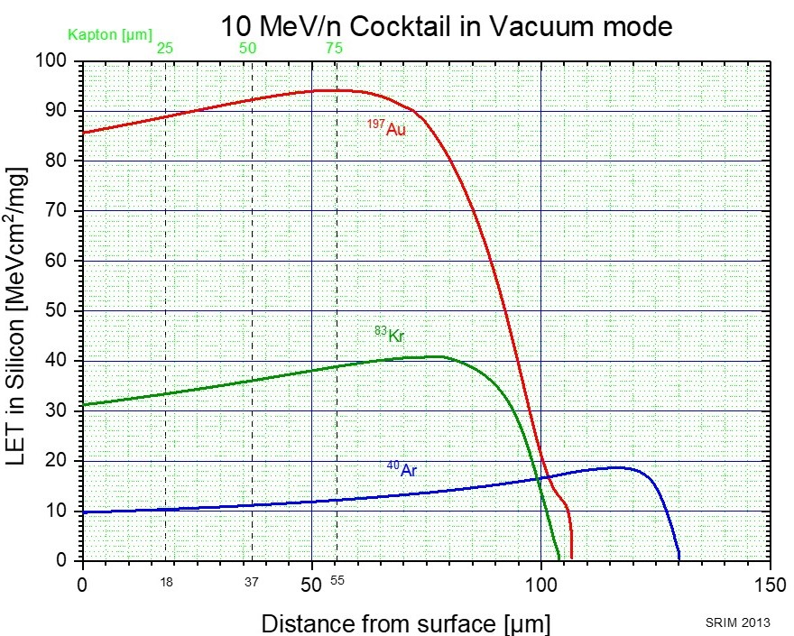
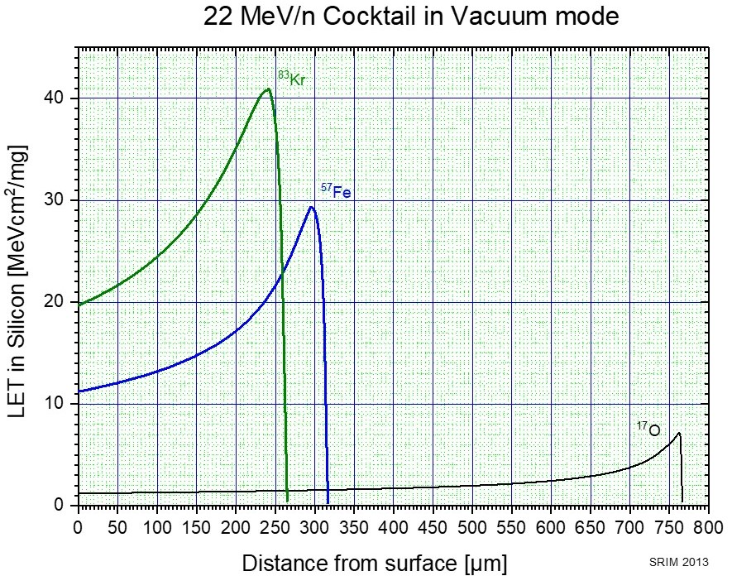
TEC-QEC Final Presentation Day 2023
Bragg curves for RADEF cocktail ions in silicon (Srim 2013)
https://www.jyu.fi/accelerator/radef

Slide 8
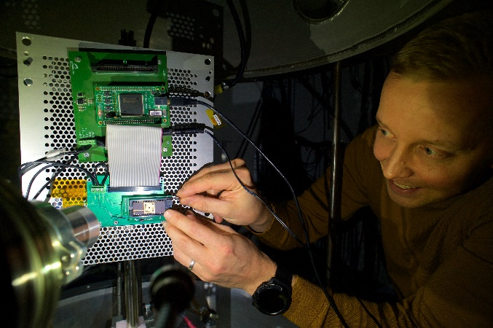
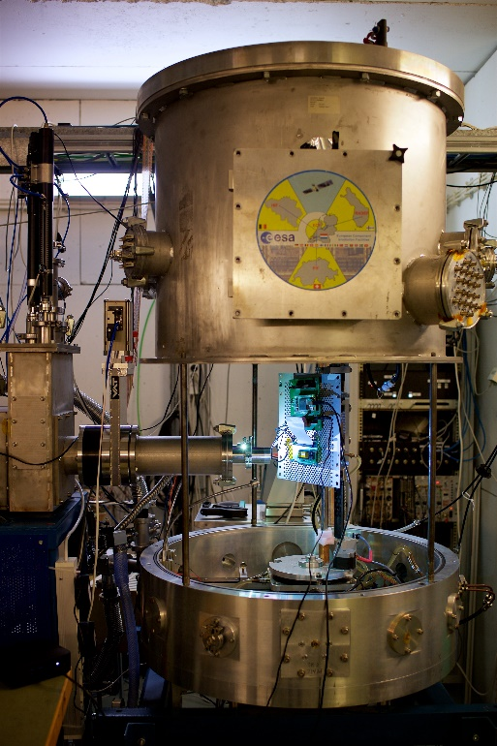
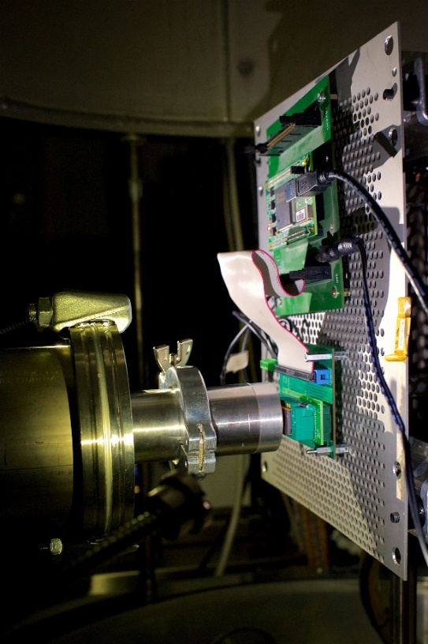
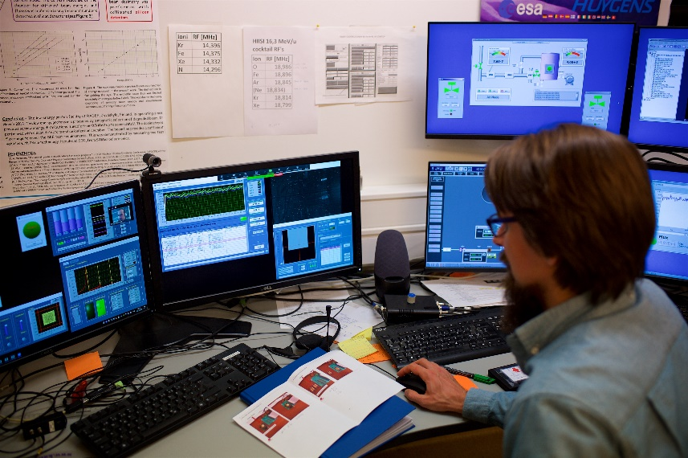
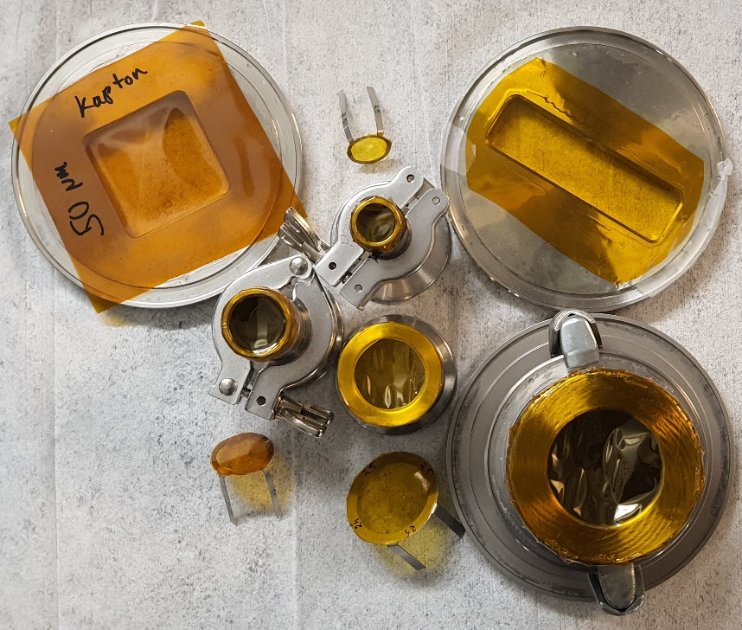
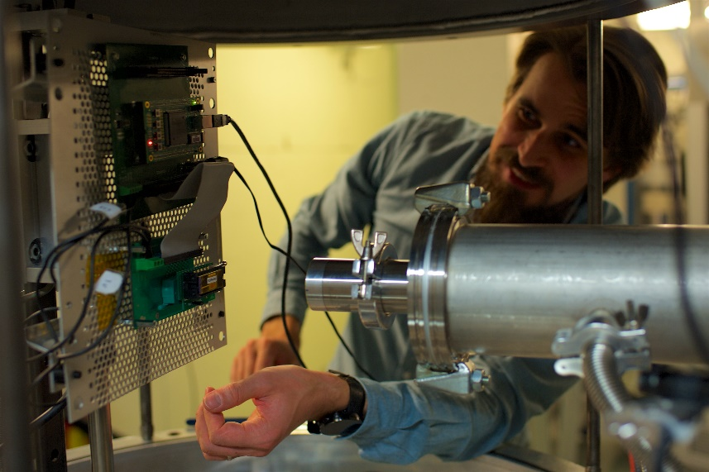
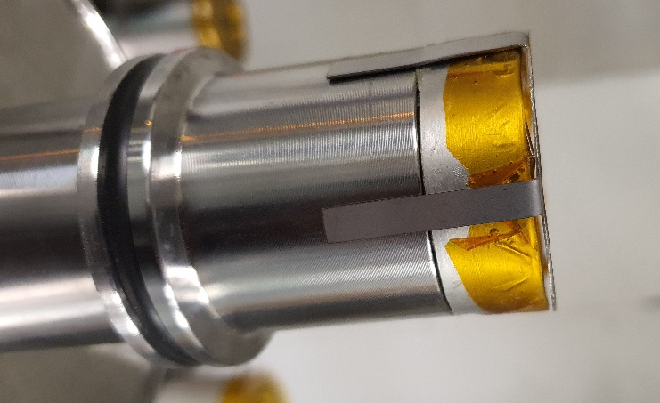
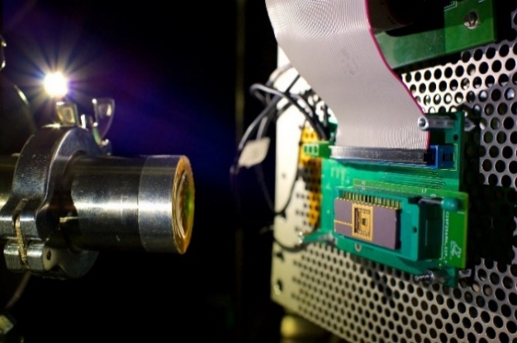
TEC-QEC Final Presentation Day 2023
Irradiation in air and degrader foils

Slide 9
TEC-QEC Final Presentation Day 2023
Low LET Heavy Ion beam possibilities (Srim 2013)
⁴He; E = 120 MeV
LET 0.05 R~4.93mm

Slide 10
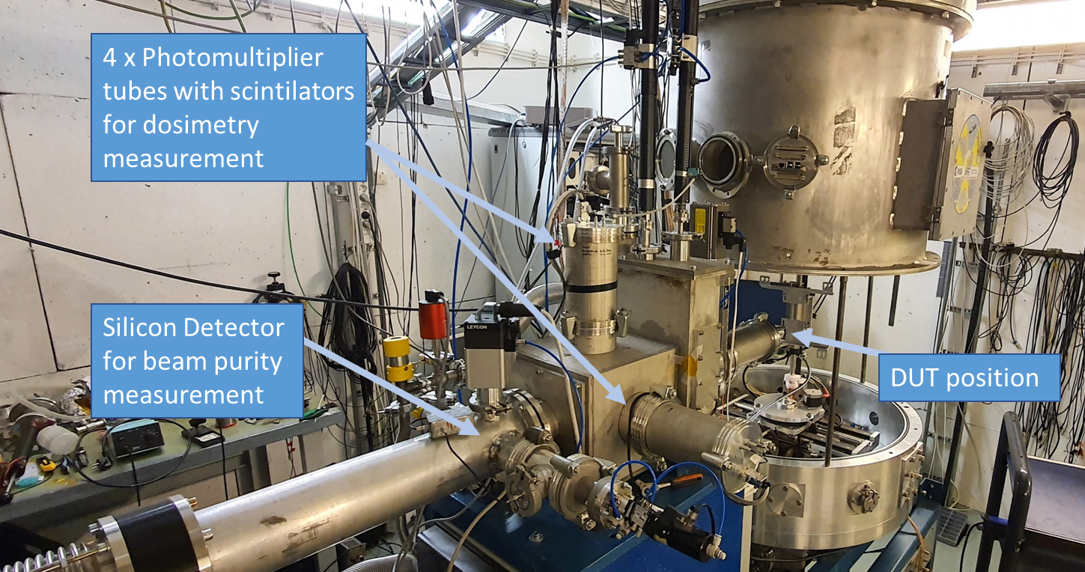
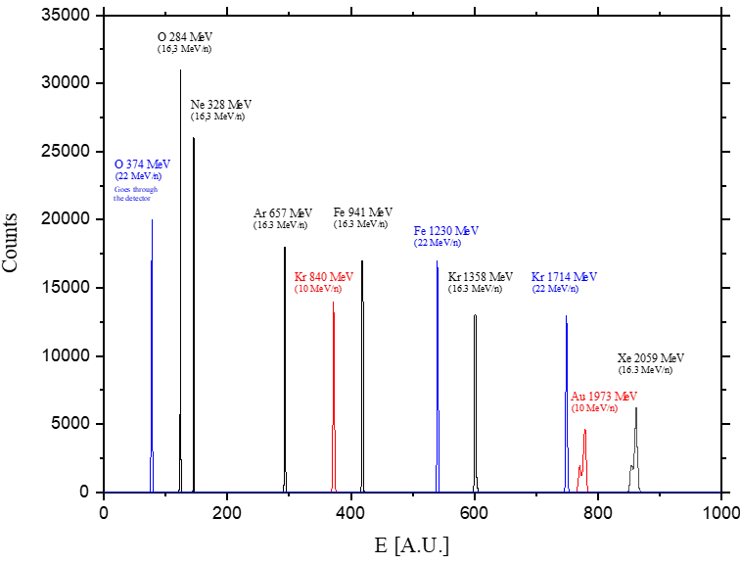
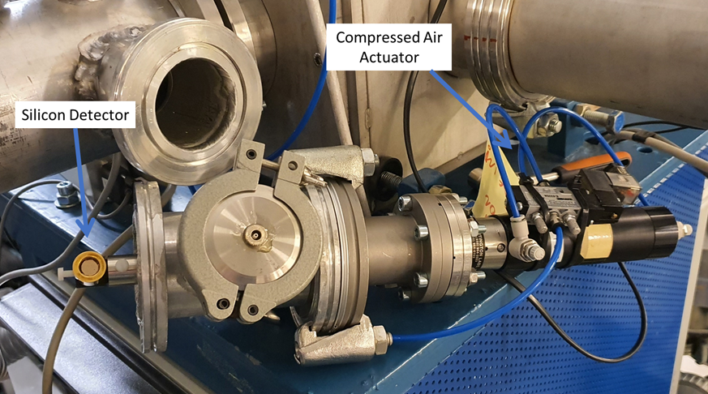
TEC-QEC Final Presentation Day 2023
Silicon detector for beam purity measurements
Measured energy peaks for 10, 16,3 and 22 MeV/n cocktail ions

Slide 11
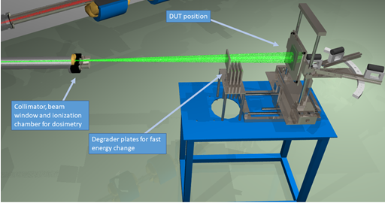
TEC-QEC Final Presentation Day 2023
Proton beams available at RADEF
High energy proton beams (since 2005):
  Proton energies up to 55 MeV
  Energies can be variate with aluminum degraders
  Maximum beam intensity about 3·10⁸ protons/cm²/s for proton energies from 8-55 MeV
  Beam profiles are of Gaussian-form
  The maximum diameter of the irradiated area about 10 cm
  Homogeneity is better than 10 %
  The accuracy of the flux/fluence determination is better 10 %
  Irradiations take place in air
Low enegy proton beams (since 2014):
  Proton energies between 0.4-8 MeV
  Energies can be variate continuously with aluminum degrader and 90-degree magnet
  The straggling of the beam energy is less than 30 keV on the energy range 0.4-3 MeV
  Maximum beam intensity depends on energy. Around 1 MeV the maximum beam intensity is on the order of 10⁶-10⁷ protons/cm²/s and above 2 MeV more than 10⁸ protons/cm²/s
  The maximum diameter of the irradiated area is 5 cm
  Homogeneity is better than 10 %
  The accuracy of the flux/fluence determination is better than 10 %
  Irradiations are done in vacuum

Slide 12
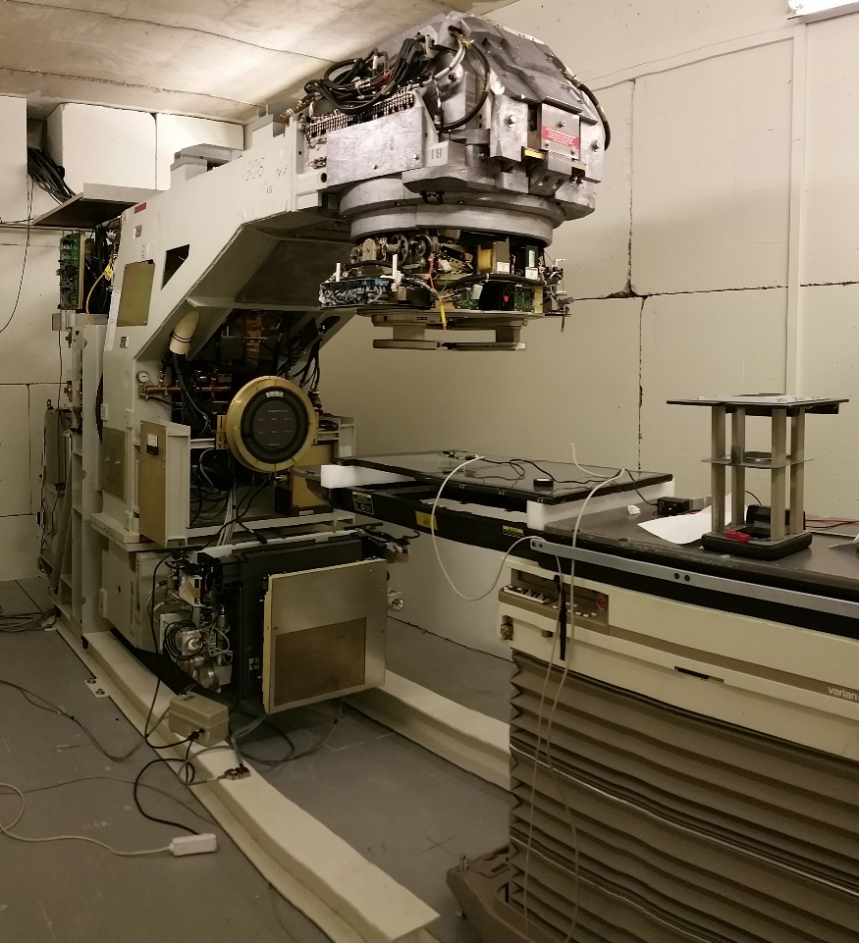
TEC-QEC Final Presentation Day 2023
High energy electron accelerator, LINAC (August 2015)
Model: VARIAN cLINAC 2100 cd
Electron and photon beams
Electron energies: 6, 9, 12, 16 and 20 MeV
Dose rates at maximum in water: 100, 200, 300, 400, 500, 600 and 1000 rad/min
Photons: 6 and 15 MV Bremsstrahlung radiation
Dose rates at maximum in water: 100, 200, 300, 400, 500 and 600 rad/min
Maximum beam size in isocentric point 30x30 cm²
Heavily pulsed beam: 1/1000

Slide 13






TEC-QEC Final Presentation Day 2023
Other projects at RADEF 2019-2022
RADSAGA, RADiation and Reliability Challenges for Electronics used in Space, Aviation, Ground and Accelerators. 2017-2020 (EU-MC), CERN
RADNEXT, RADiation facility Network for the EXploration of effects for indusTry and research, 2020-2024 (EU), CERN
RADMEP, Radiation and its Effects on MicroElectronics and Photonics Technologies 2020-2026, (EU), University Jean Monnet
Estimation of proton induced Single Event Effect rates in very deep submicron technologies (LEPSEE), 2020-2022, 4000130439/20/NL/KML (ESA), Beyond Gravity, Finland
Radiation Characterisation of EEE components for ESA space applications (RCEEE), 4000129159 (ESA), 2020-2022, Alter, France

Slide 14
TEC-QEC Final Presentation Day 2023
Doctoral theses done at RADEF since 2019
Daniel Söderström: Radiation effects on SDRAMs and Optical Fiber-Based Dosimetry of High-Energy Electrons, May 2023
Andrea Coronetti: Relevance and guidelines of radiation effect testing beyond the standards for electronic devices and systems used in space and at accelerators, November 2021
Corinna Martinella: Single-Event Radiation Effects in Silicon Carbide Power MOSFETs, June 2021
Maris Tali: Single-Event Radiation Effects in Hardened and State-of-the-art Components for Space and High- Energy Accelerator Applications, June 2019

Slide 15
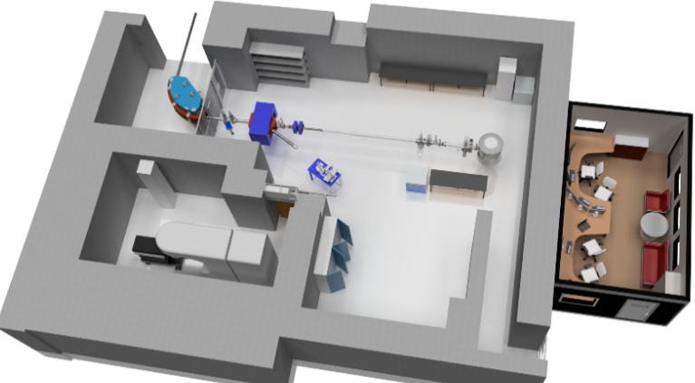
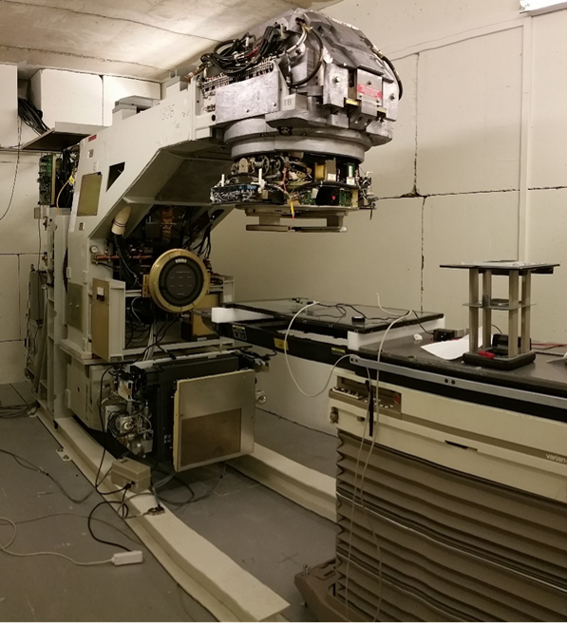
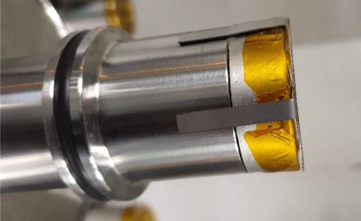




TEC-QEC Final Presentation Day 2023
Thank you for your attention

