Slide 1
Board Level Testing Study
#
ENABLING
YOUR
AMBITIONS
ESA contract 4000136100/21/NL/GLC/ov
Technical officer Christian Poivey
Guillaume Montay, Matthieu Beaumel

Slide 2
Current validation method of a board
Proposed validation method
Tested board
Worst case analysis
Results
Conclusions

Slide 3
Board Level Testing study
Purpose
To assess how testing at board level can replace testing at component level, mainly for ionizing dose
Especially interesting for low cost COTS-based boards
Study plan
To perform a complete Worst-Case Analysis based on component data
To test a board
To compare the results between analysis and measurement
At multiple temperature
At several doses
To provide recommendations for board level radiation testing

Slide 4
Board Level Testing – Current validation method of a board
Worst-Case Analysis
Document analyzing board functions from component-level inputs
3 sources of effects on electrical component parameters
Temperature → minimum/25°C/maximum in operation
Ageing → average temperature with long enough duration covering all missions
Dose → End-Of-Life value of worst-case mission
Simplification hypotheses at board level: uniform temperature, single mission profile, single maximum dose, etc.
In the WC approach for recurrent board, mostly impossible to relax constraints
→ WCA hypotheses preferably cover all cases
Lot-to-lot variation mainly due to ionizing dose
→ WCA envelope
→ radiation Lot Acceptance Test performed at component level
WCA susceptible to evolve only in case of radLAT results out of budget

Slide 5
Board Level Testing – Current validation method of a board
Component-level data inputs for Worst-Case Analysis
Temperature dependence
Sometimes included in the specification limits only, for space-qualified components → No effect ~ initial dispersion
Datasheet curve or thermal coefficient specified for parameters critical or known for their high sensitivity
Evaluation data on few samples, datapack for space-grade components
Ageing
Almost certainly no specific data – Exception: evaluation data on components developed/procured specifically
Generic data found in
ECSS-Q-TM-30-12A (12.10.2010) –Space product assurance– End-of-life parameter drifts –EEE Components
ECSS-Q-60-11A (7.09.2004) –Space product assurance– Derating & end-of-life parameter drifts– EEE components
Not all families of components have received generic assumptions e.g. PWM, DAC, ADC
Activation energies are rarely used
Drift values directly used with covering duration (18 y.) and average temperature (+55°C for passive, +85°C for active)

Slide 6
Board Level Testing – Current validation method of a board
Component-level data inputs for Worst-Case Analysis
Dose
Evaluation data
Specification for rad-hard components
Radiation Lot Acceptance Tests (radLAT)
performed at component level and at room temperature for verification
Component-level data inputs
Quasi-systematically verified for dose effects
Mostly not verified for each lot for temperature & ageing effects

Slide 7
Board Level Testing – Current validation method of a board
Electrical board level testing is performed
At room temperature almost systematically for board acceptance
As a function of temperature mostly only during design phase
With regards to dose: never, except for demonstrators or new space (not necessarily in a recurrent way)
With regards to ageing: never, unless hybrids are considered as boards (life test)

Slide 8
Board Level Testing – Proposed validation method
Board design phase
Unchanged: use the most reliable available data, perform component evaluation if needed
Do not necessarily irradiate all sensitive active components, but a subset considered as critical
Board production phase
Take fully functional boards equipped with flight electronic component lots, from capacitors/resistors to active integrated circuits
Measure at 3 temperatures (3T): min / room temperature / max
Irradiate the boards
Apply ageing prior to irradiation if required/desired, e.g. only on first lot

Slide 9
Board Level Testing – Proposed validation method

Slide 10
Board Level Testing – Proposed validation method
Expected benefits
Reduced recurrent costs with COTS-boards: only 1 test for several types of components
Radiation effects measured at board level i.e. system specification level
Validation of WCA by test
Interactions between temperature and dose are covered
Counterparts
Requires the definition of board lots and
the procurement & management of component lots for the manufacturing of board lots
Potential difficulty to find the cause of a failure
the whole lot of boards can be rejected instead of a single component lot
the component procurement & stock should be sized to face delay in board production
Uniform dose on board (gamma irradiation)
High temperature measurement may be limited to the last dose step if annealing effects have to be avoided

Slide 11
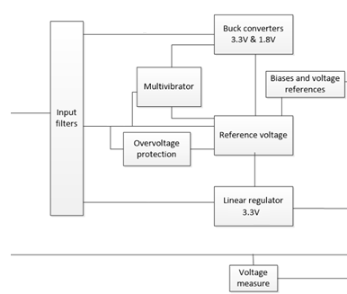
Board Level Testing – Tested board
Existing rad-hard DC/DC converter board (supplied by +5V)
Stabilized +3.3V and +1.8V with buck converters with same architecture
Low Drop-Out (LDO) linear regulator at +3.3V
Two accurate reference levels for an ADC: ~ 2.042 V & 872 mV
Analogue measurement of an external voltage
OverVoltage Protection and multivibrator upstream of the useful supplies feature
8 references of active components
3 diodes
1 op-amp (4 parts, radiation-hardened bipolar)
1 comparator (4 parts , radiation-hardened bipolar)
1 voltage reference (1 part, radiation-hardened bipolar)
2 transistors (6 PNP parts and 5 NPN parts, radiation-guaranteed)

Slide 12
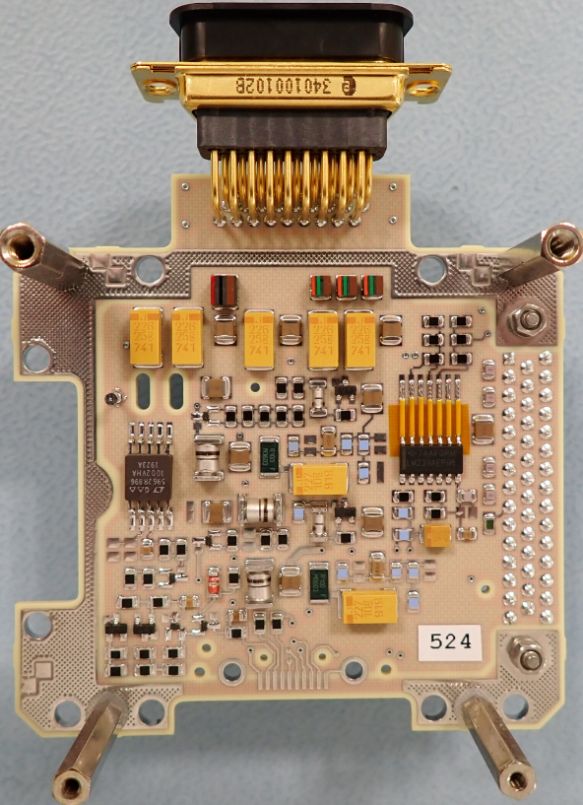
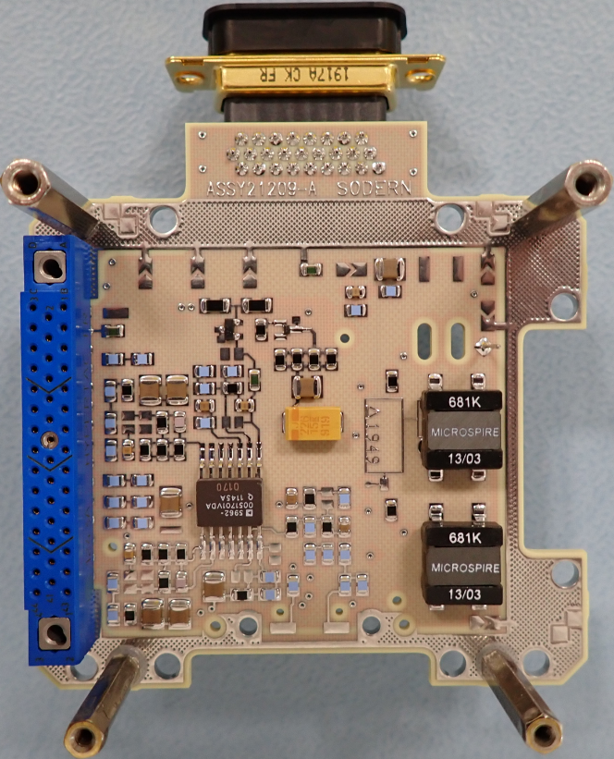
Board Level Testing – Tested board
Modified DC/DC converter board for enhanced TID sensitivity
Stabilized +3.3V and +1.8V with buck converters with same architecture
Low Drop-Out (LDO) linear regulator at +3.3V
Two accurate reference levels for an ADC: ~ 2.042 V & 872 mV
Analogue measurement of an external voltage
OverVoltage Protection and multivibrator upstream of the useful supplies feature
8 references of active components
3 diodes
1 op-amp → known lot of a space-qualified alternative part very sensitive to ionizing dose
1 comparator → COTS automotive-qualified alternative, tested to dose (low sensitivity)
1 voltage reference (1 part, radiation-hardened bipolar) → no pin-to-pin compatible alternative
2 transistors → COTS automotive-qualified alternative, tested to dose

Slide 13
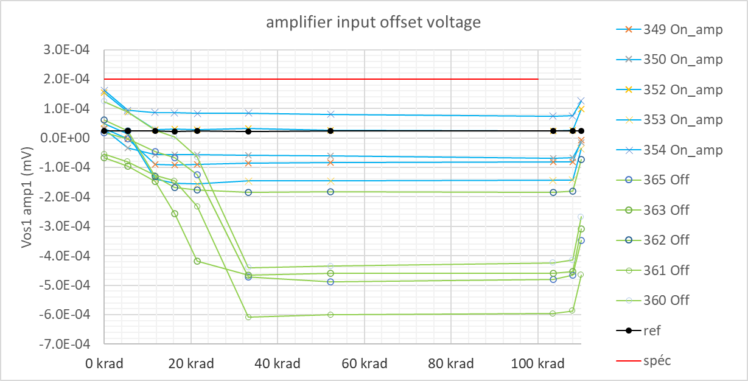
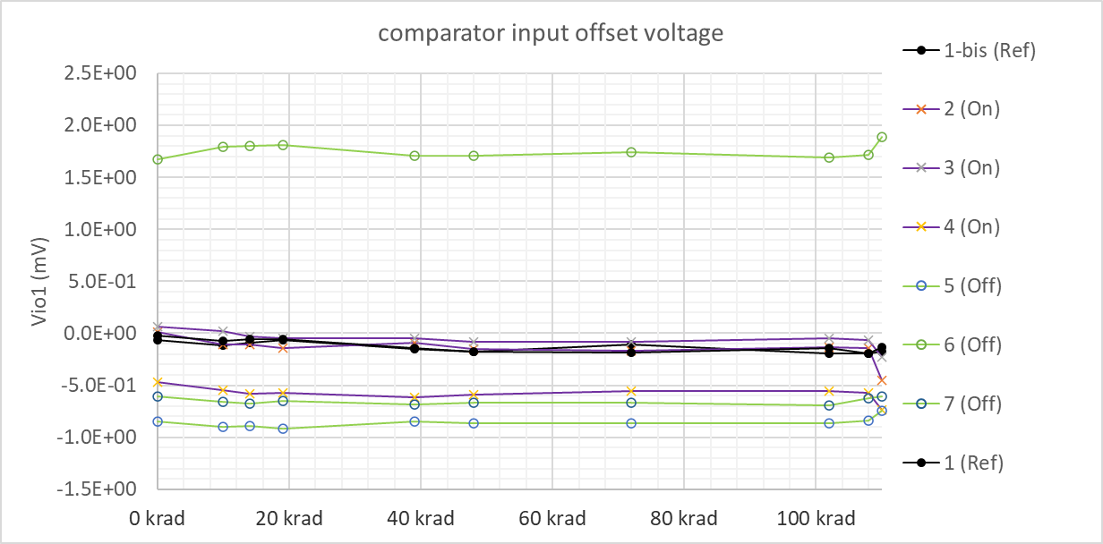
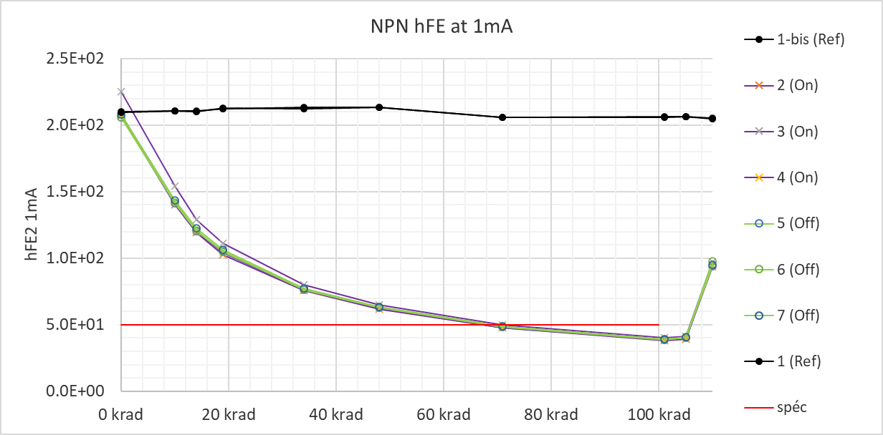
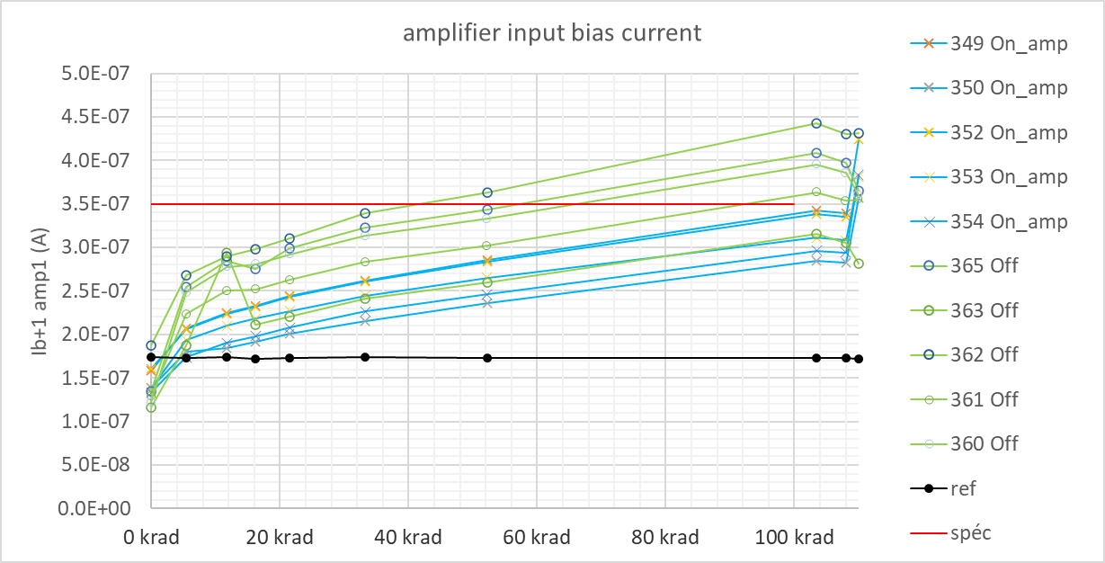
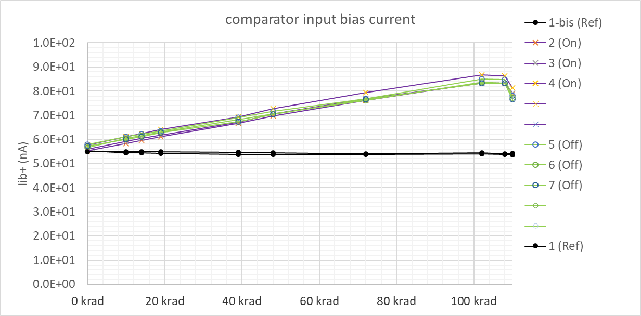
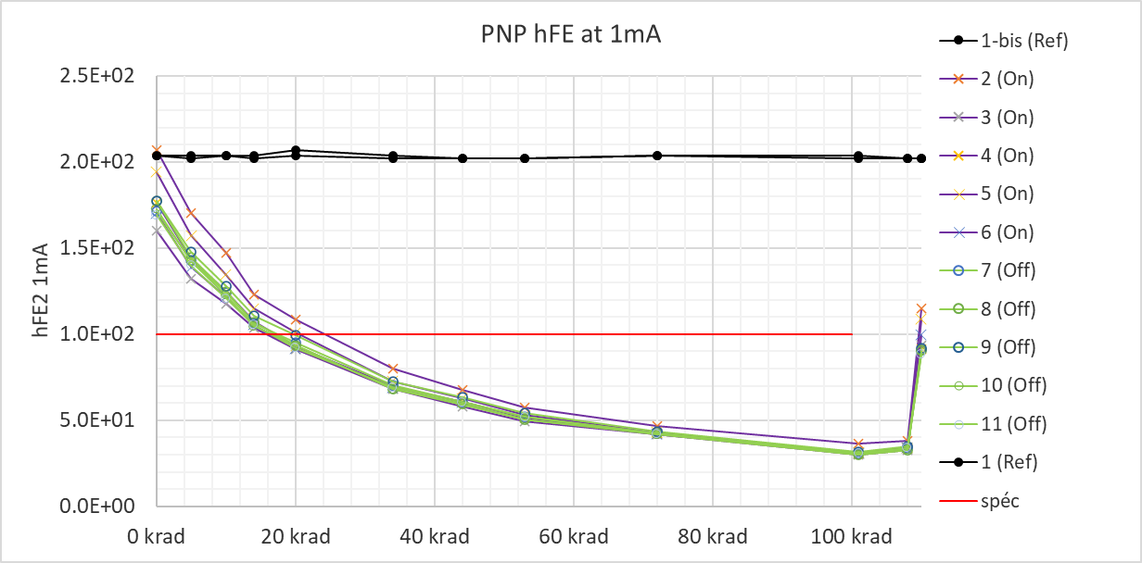
Board Level Testing – Tested board
All lots Co-60 tested at 210-240 rad(Si)/h
Modified DC/DC converter board (supplied by +5V)

Slide 14
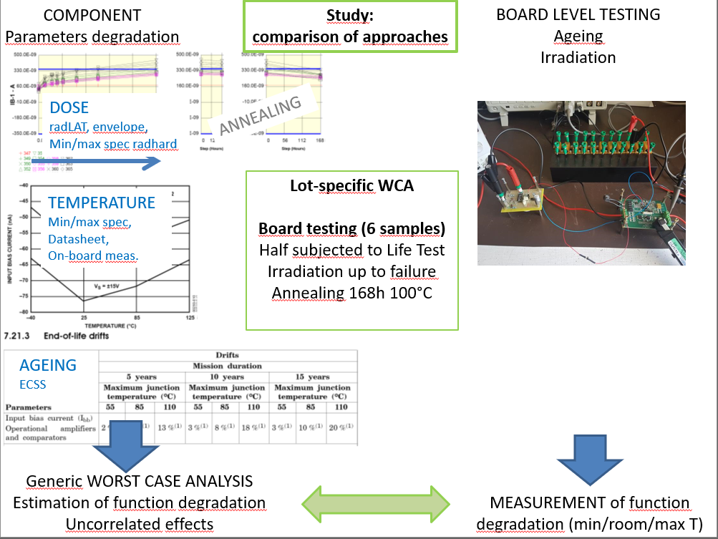
Board Level Testing – Study: Comparison of classic space approach and board level testing
WCA with component-level data specific to mounted lots
Three methods
Extreme Value Analysis (EVA)
extreme values considered for all parameters in all directions
“very” worst case
Root Sum Square analysis (RSS)
assumes a normal law for all parameters, with a standard deviation σ
generally the drifts are considered to be within 3.σ
Monte Carlo Analysis (MCA)
assumes distributions laws for all parameters
generally uniform or normal law
does not provide much understanding of circuit behaviour
Analyses at all tested points but annealing
Only dose-induced drifts inputs taken as lot-dependent

Slide 15
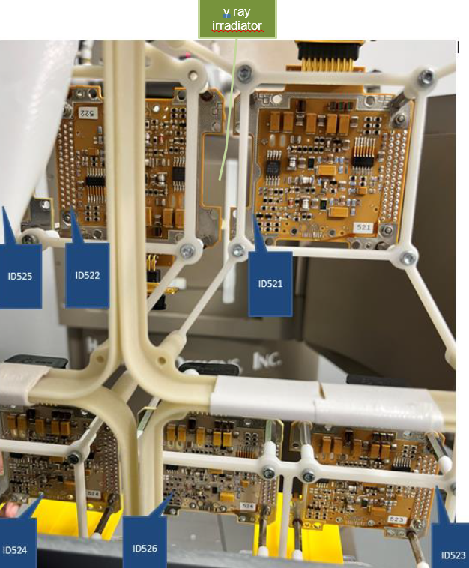
Board Level Testing – Test sequence
6 boards tested
3 aged prior to irradiation (Life Test with biasing): # 521, 522, 523
1300 h at T_{A} = 120 °C, equivalent to 1000 h at 100°C with E_{A} = 0,7 eV
3 not aged: # 524, 525, 526
20, 50, 105 krad total dose steps at 210 rad/h (Co-60 source)
168 h at 100°C post irradiation annealing (unbiased as during irradiation, found worst by WCA)
« 2T » measurements: at +25°C and -55°C after irradiation steps
« 3T » measurements: at +25°C, -55°C and +125°C initial and the final annealing sequence
Measurement step | 1 |  | 2 |  | 3 |  | 4 |  | 5 |  | 6
Boards submitted to LT 521,522,523 | 3T | 1300h 120°C | 3T | 20 krad | 2T | 50 krad | 2T | 105 krad | 2T | 168h 100°C | 3T
Boards not submitted to LT 524,525,526 | 3T | - | - |  | 2T |  | 2T |  | 2T | 168h 100°C | 3T

Slide 16
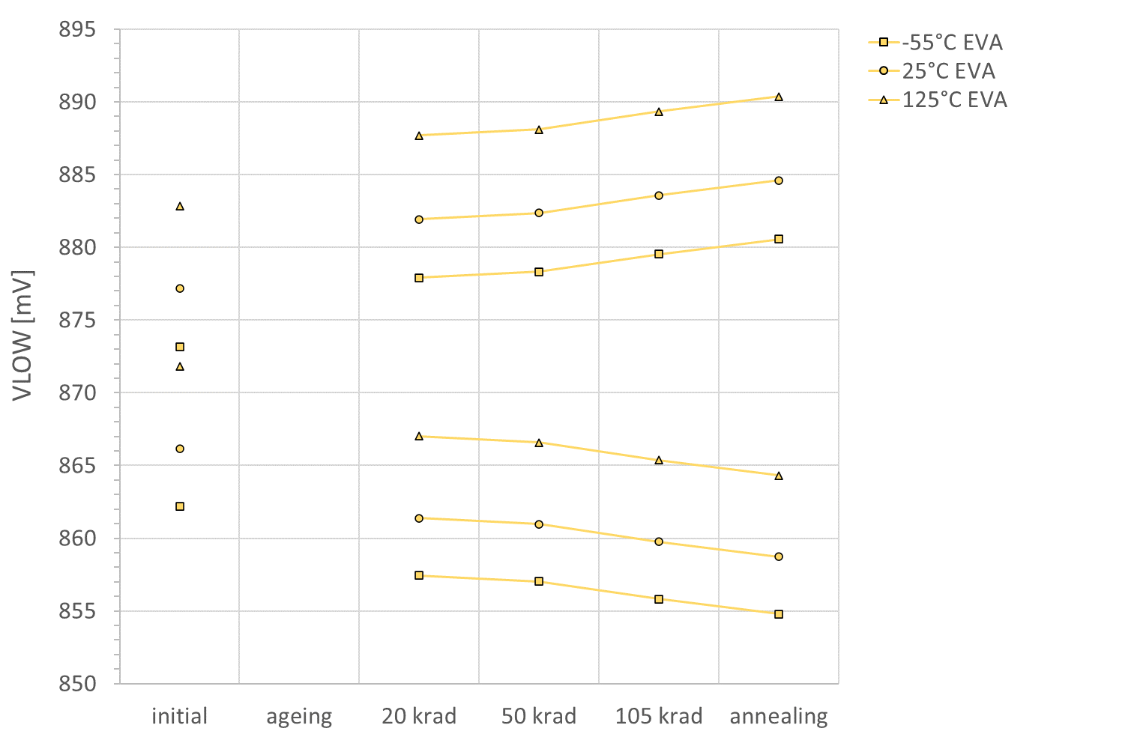
ADC reference VLOW WCA
45 mV span

Slide 17
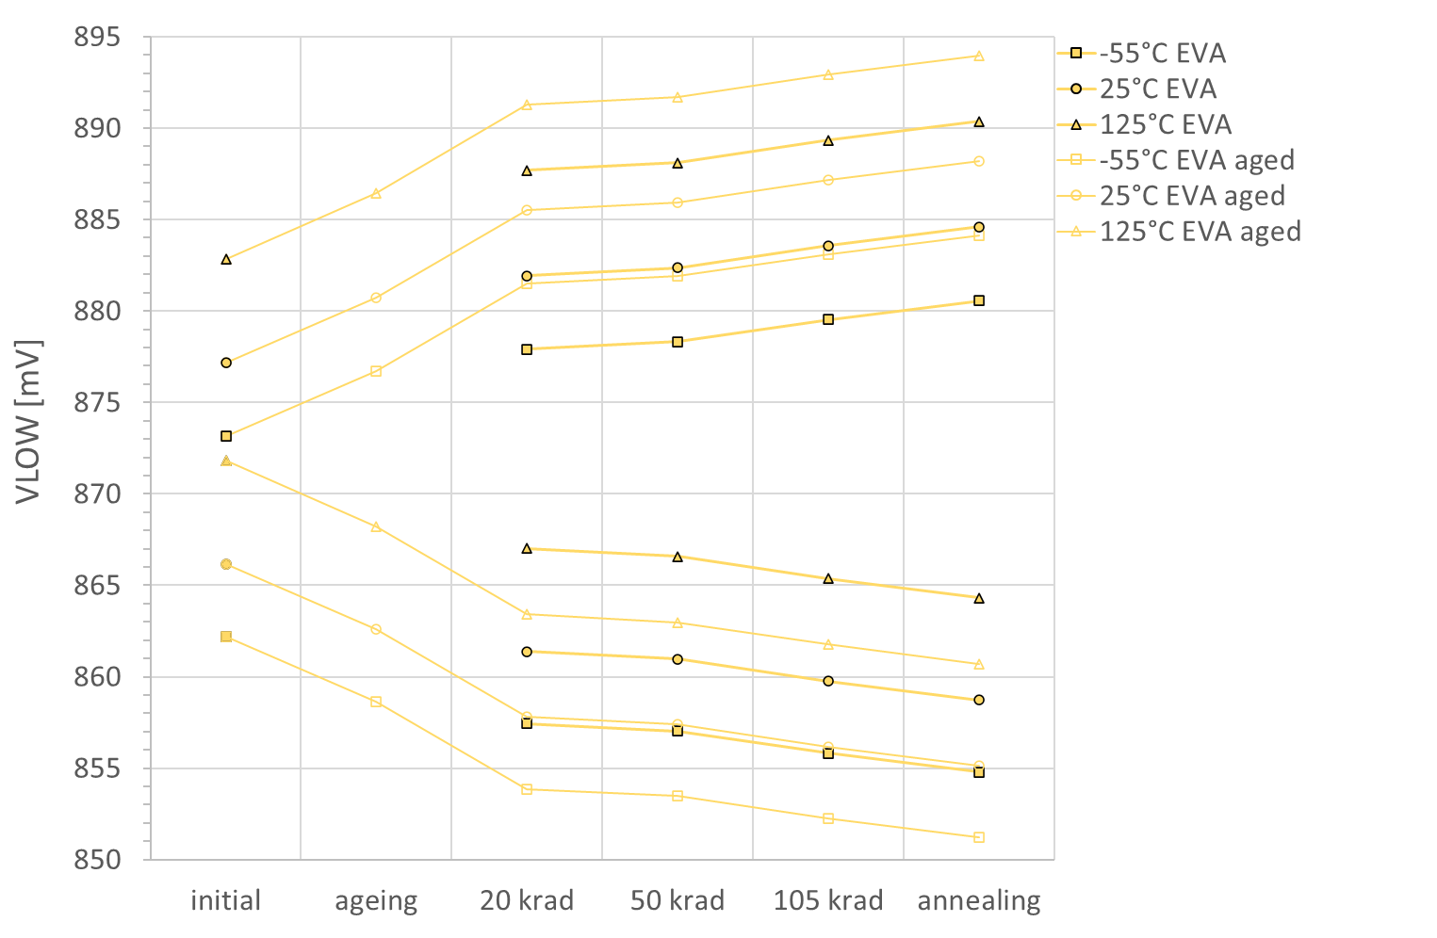
ADC reference VLOW WCA
Only WCA envelopes including ageing on the following graphs for clarity
45 mV span

Slide 18
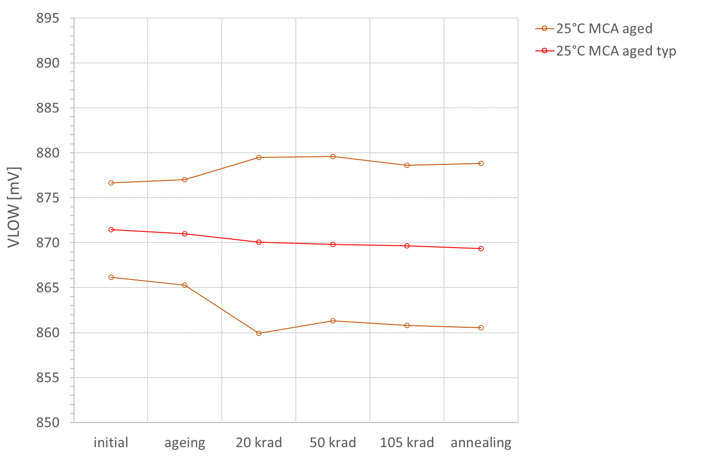
ADC reference VLOW WCA
45 mV span

Slide 19
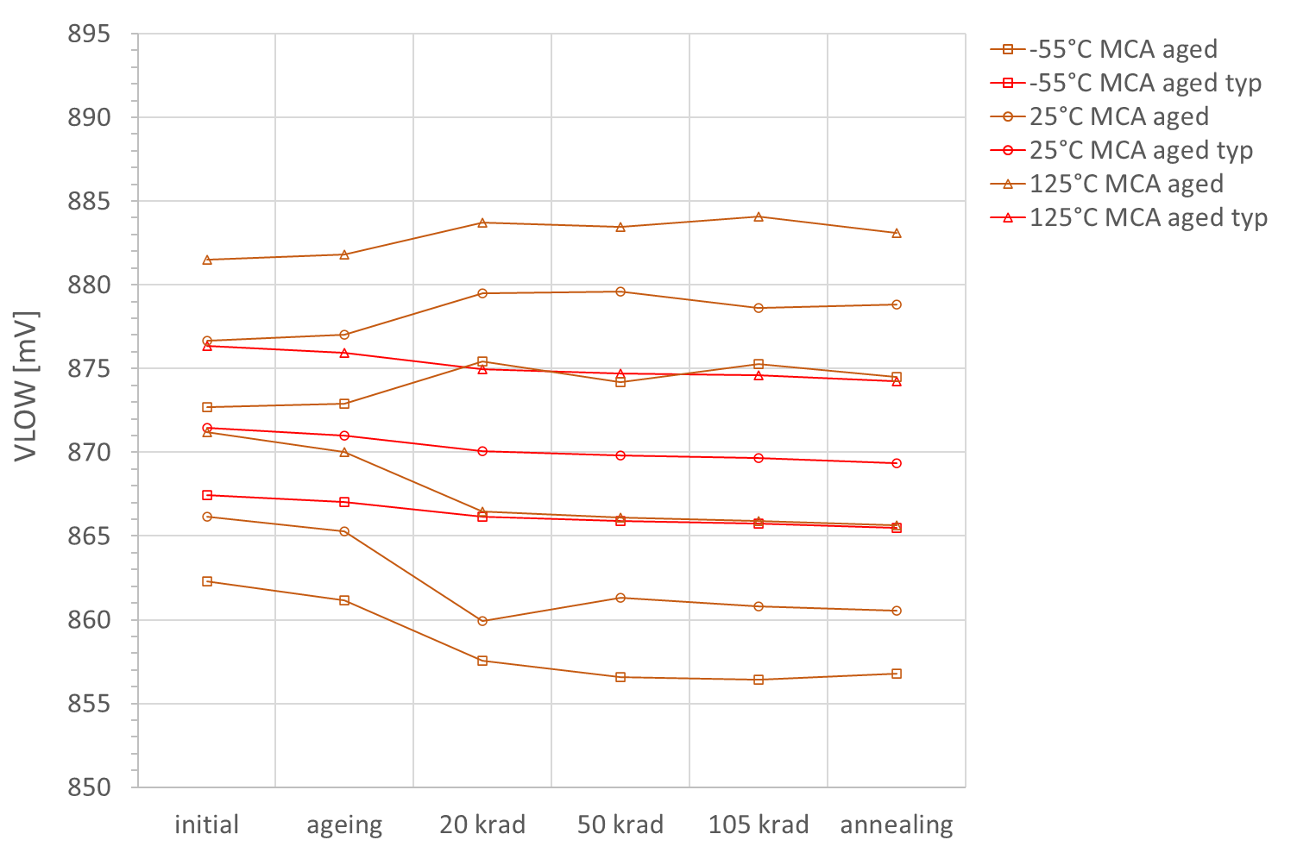
ADC reference VLOW WCA
45 mV span

Slide 20
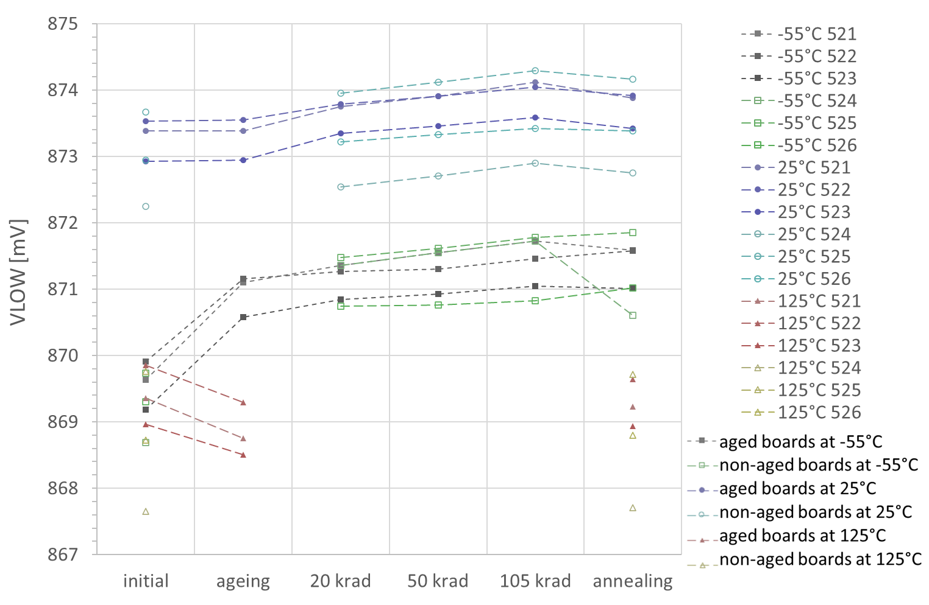
ADC reference VLOW test results
O meas. at 25°C
18 mV span
⃣ meas. at -55°C
Δ meas. at 125°C

Slide 21
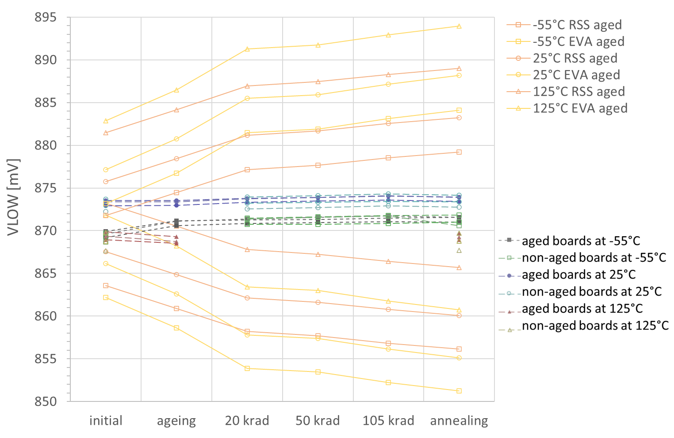
ADC reference VLOW test results
Major overestimation of ageing and dose effects
45 mV span
All points within WCA but at 125°C prior to irradiation: out of RSS & EVA envelopes

Slide 22
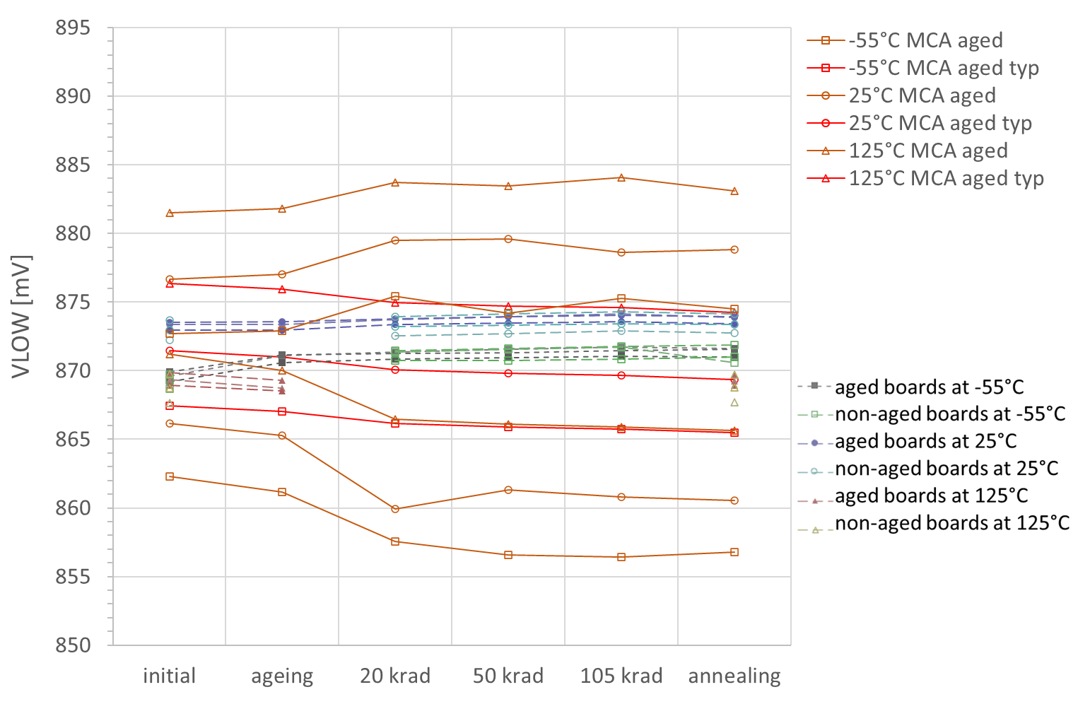
ADC reference VLOW test results
125°C MCA
45 mV span

Slide 23
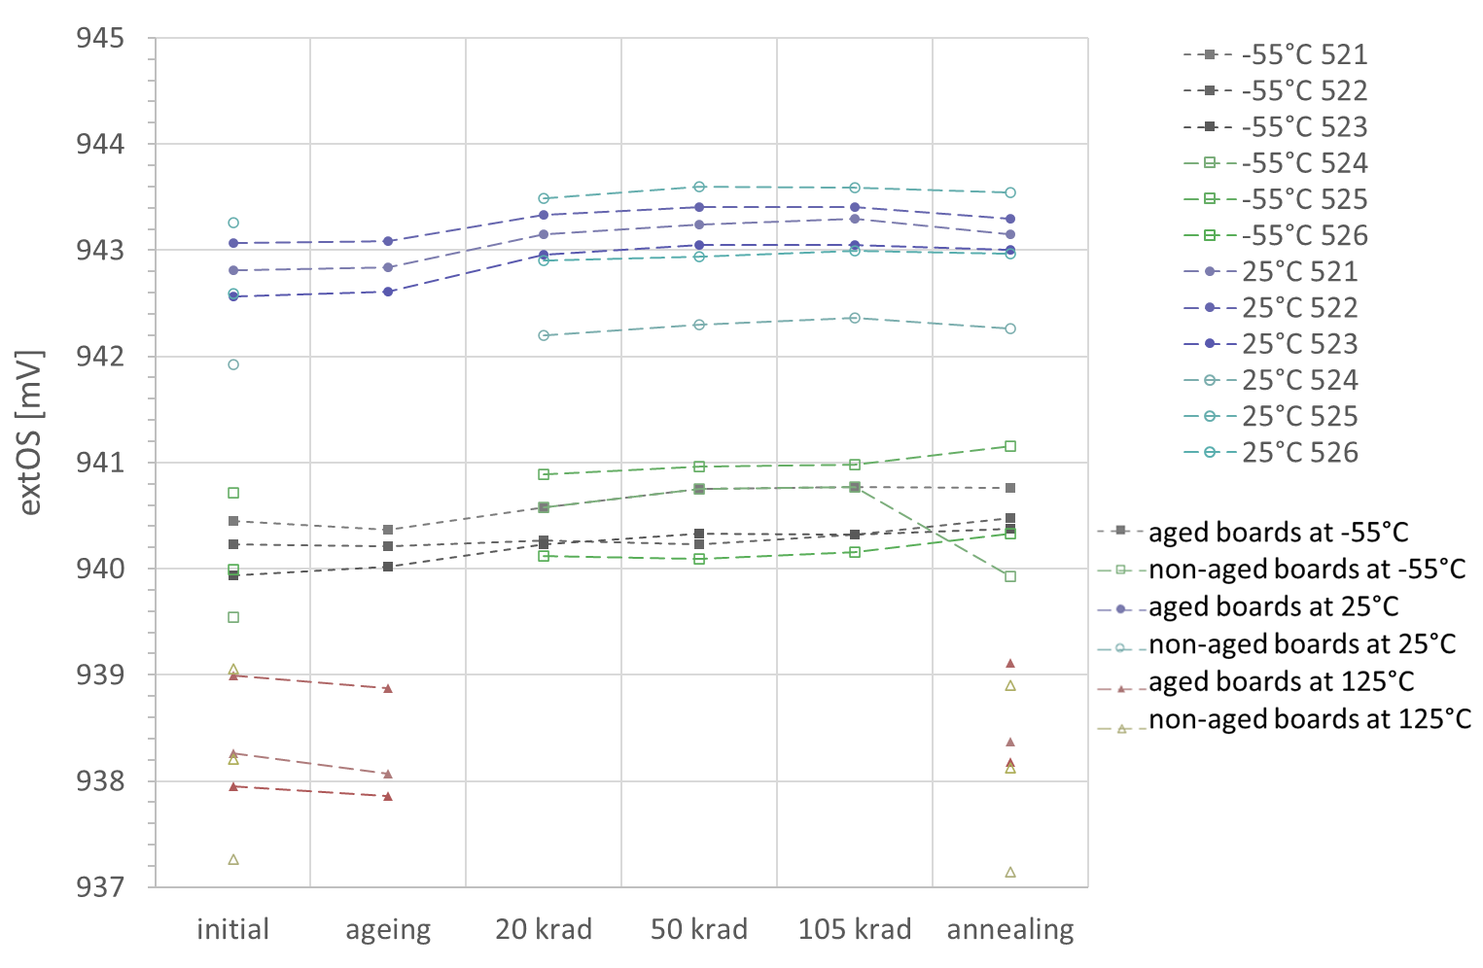
Voltage measurement offset test results
O meas. at 25°C
8 mV span
⃣ meas. at -55°C
Δ meas. at 125°C

Slide 24
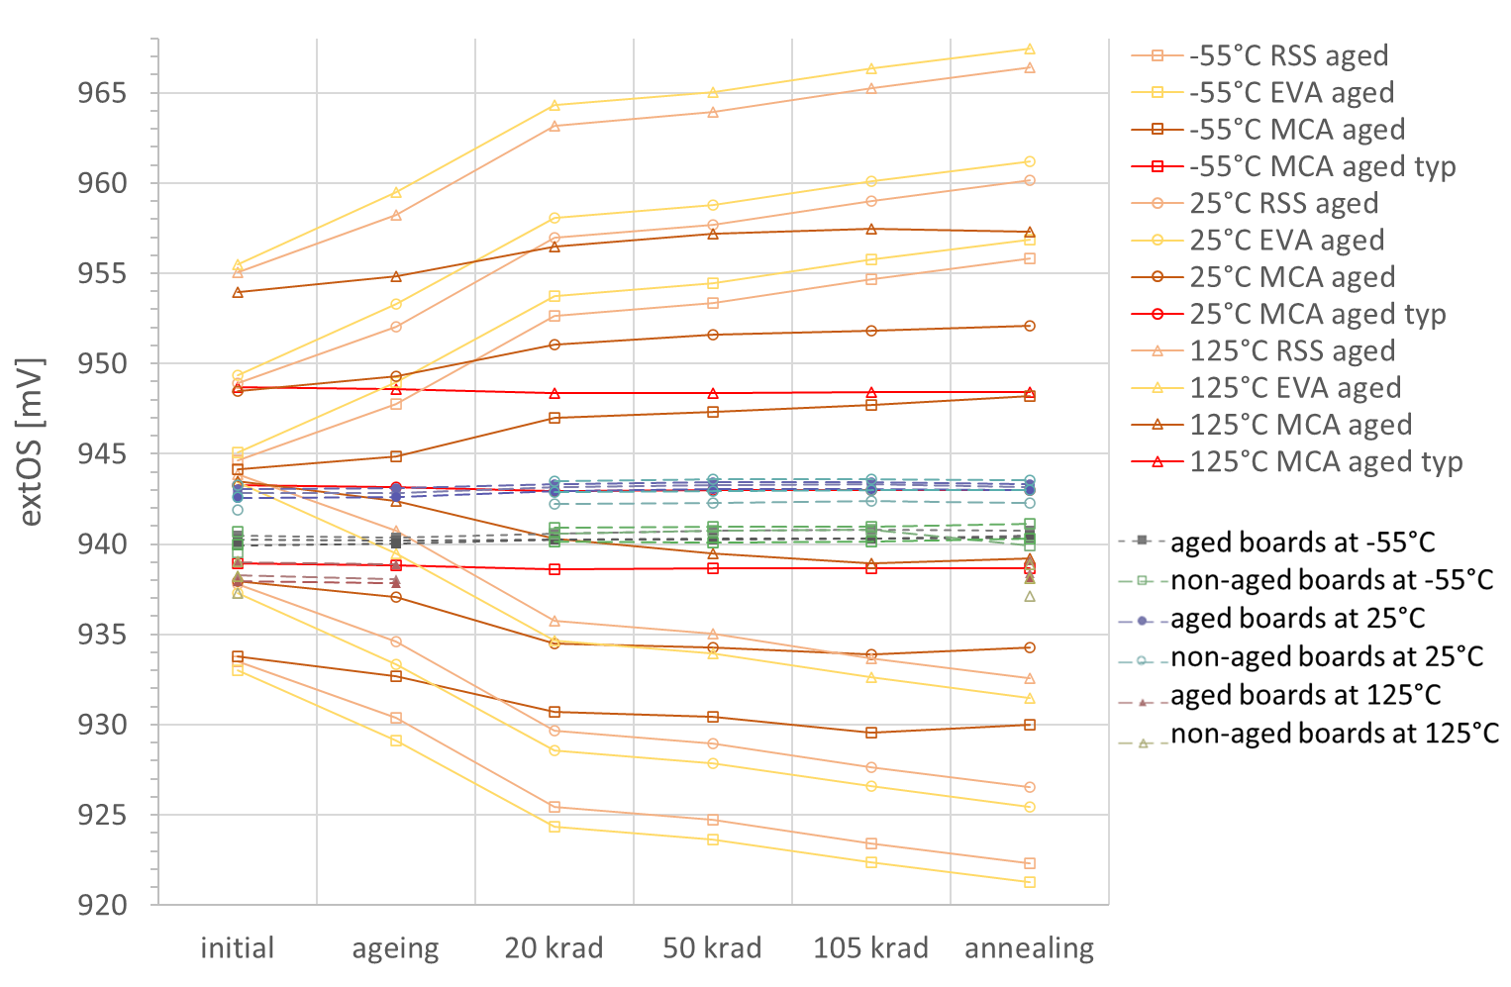
Voltage measurement offset test results
Major overestimation of ageing and dose effects
48 mV span

Slide 25
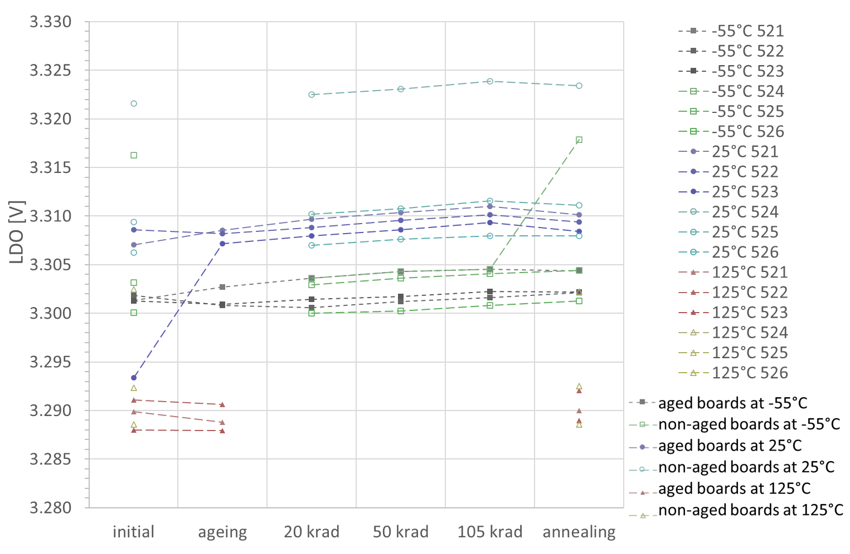
LDO test results
O meas. at 25°C
50 mV span
⃣ meas. at -55°C
Δ meas. at 125°C

Slide 26
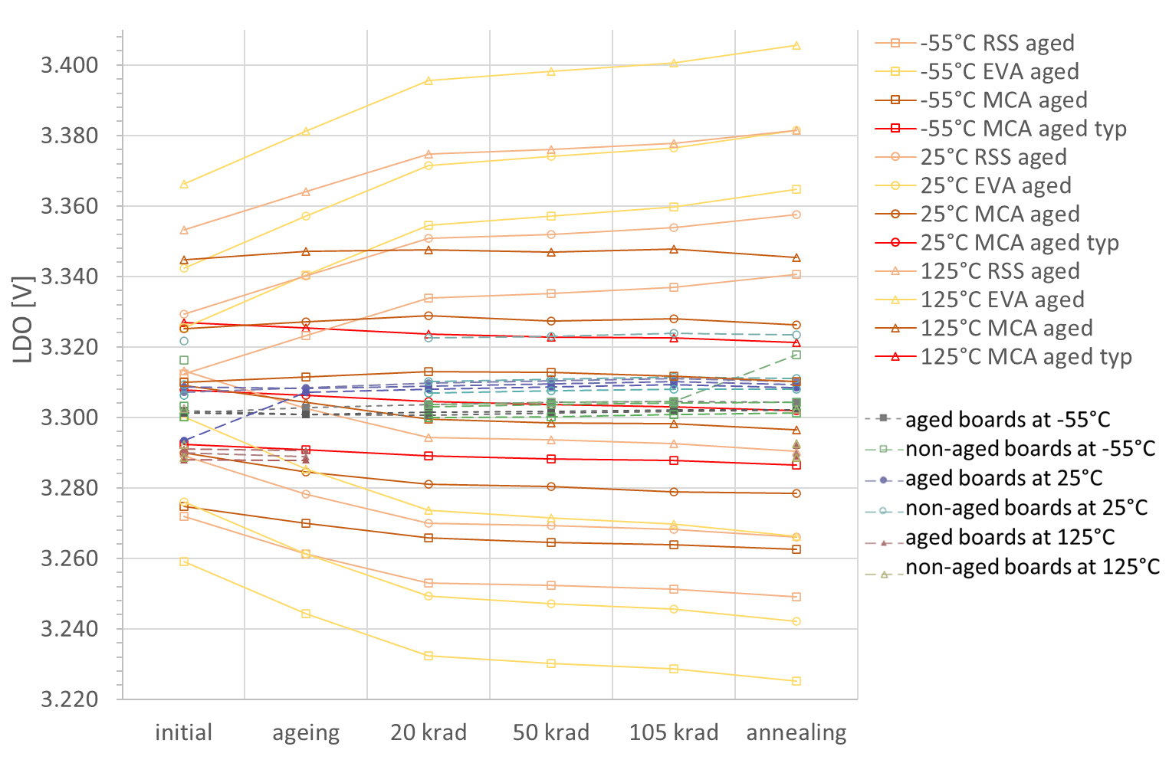
LDO test results
Major overestimation of ageing and dose effects
210 mV span
O meas. at 25°C
⃣ meas. at -55°C
Δ meas. at 125°C

Slide 27
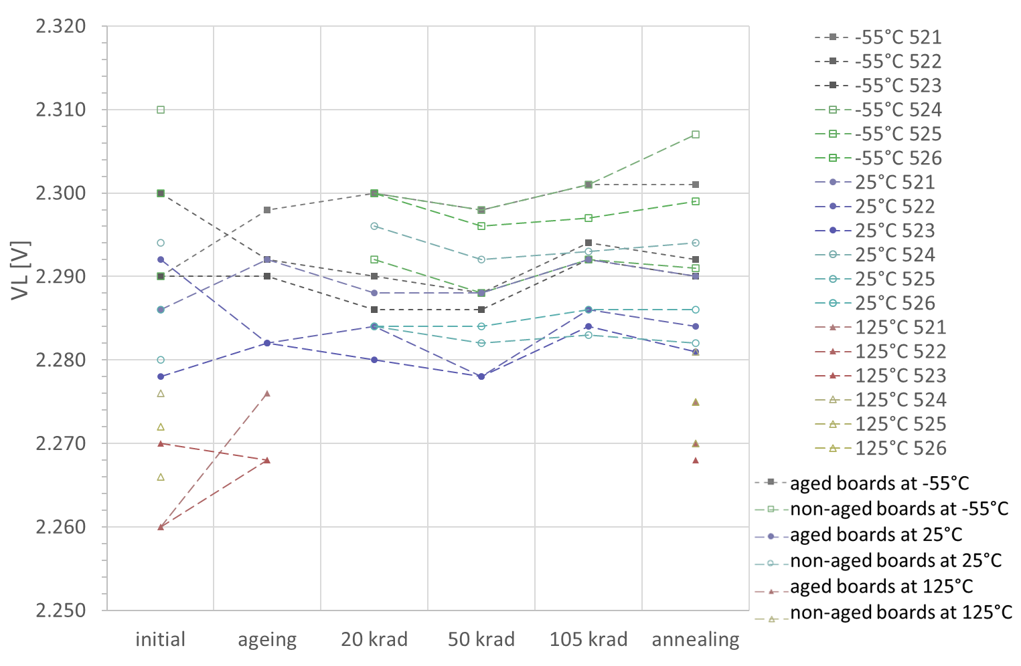
Multivibrator VL test results
70 mV span

Slide 28
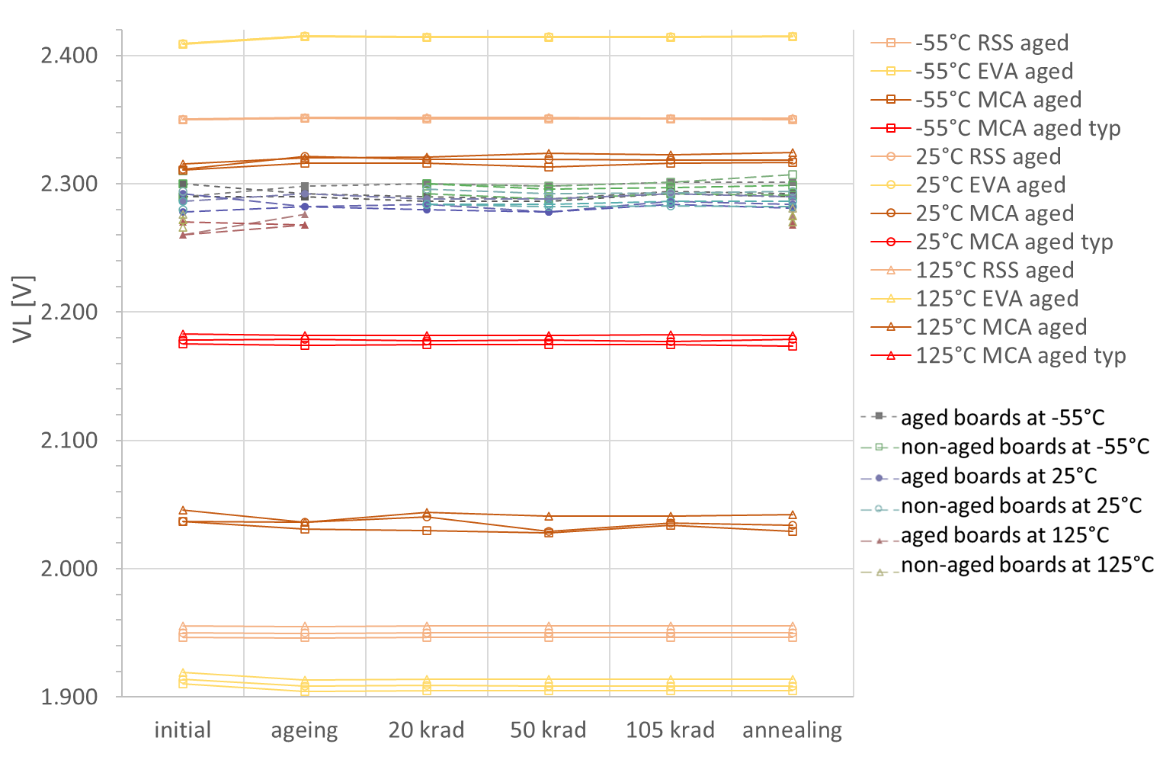
Multivibrator VL test results
500 mV span
No overestimation of ageing and dose effects
but wide inital envelope

Slide 29
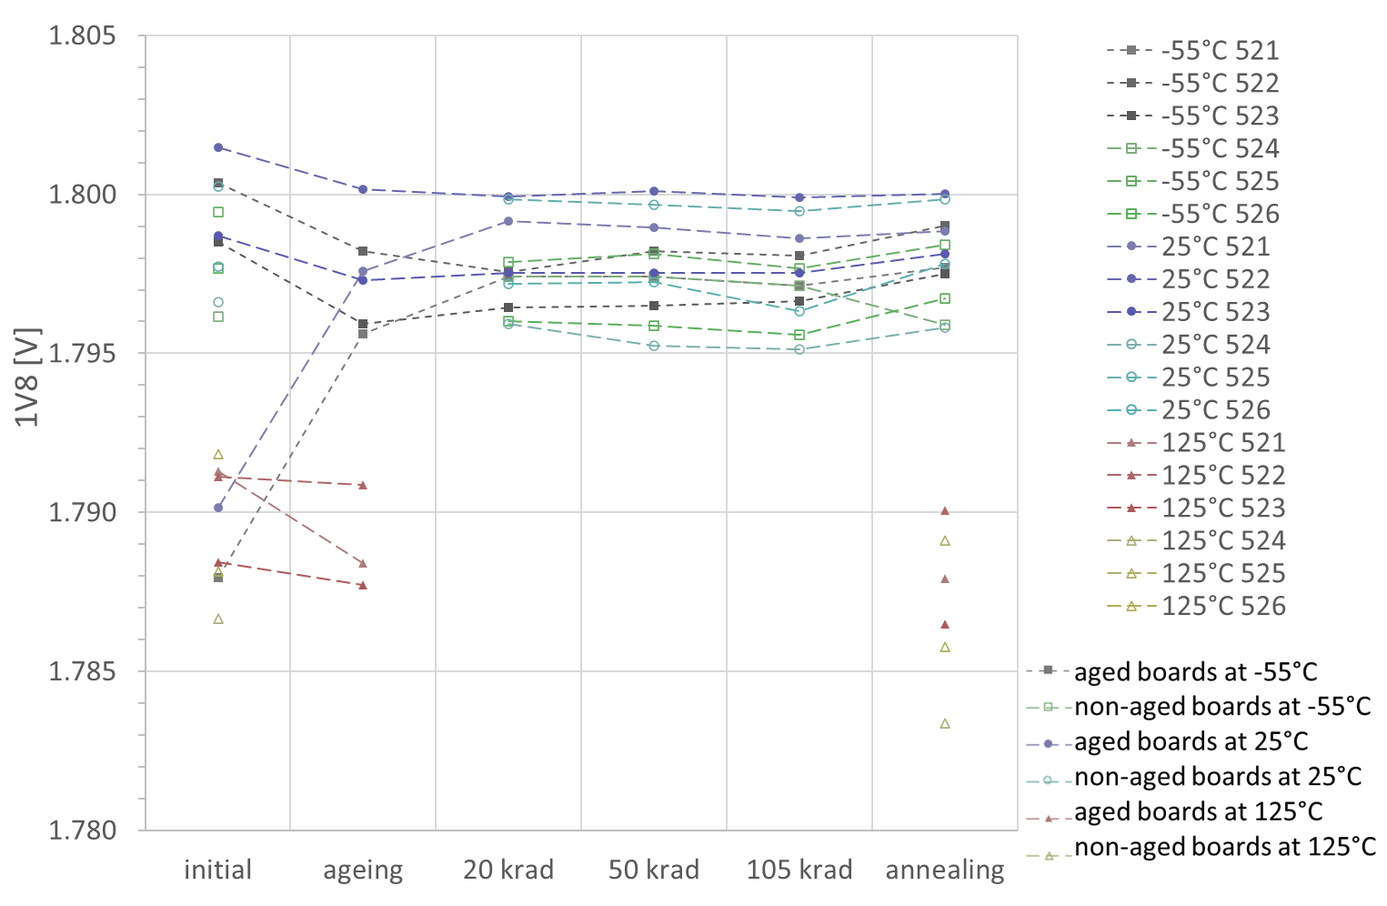
Buck 1V8 test results
O meas. at 25°C
⃣ meas. at -55°C
25 mV span
Δ meas. at 125°C

Slide 30
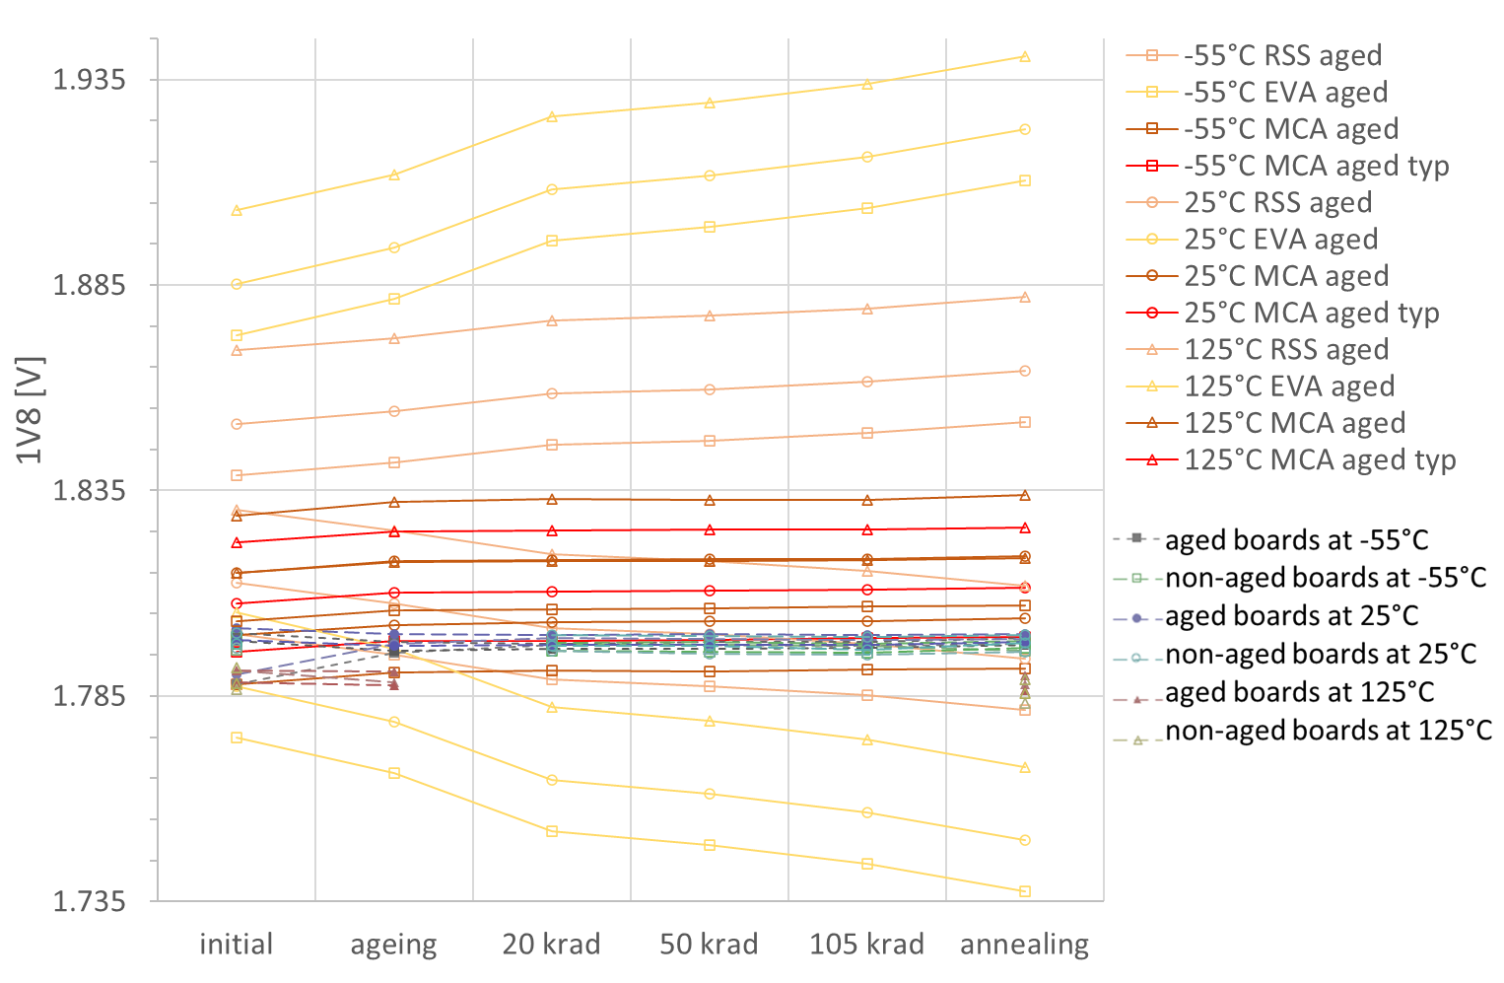
Buck 1V8 test results
Overestimation of temperature dependence
210 mV span
Overestimation of ageing and dose effects with EVA and RSS

Slide 31
Board Level Testing – Observations
Boards irradiated up to 100 krad
Temperature effects generally prevail over ageing and radiation effects
Ageing effects are very weak but stronger than dose effects for most functions
No influence of ageing over subsequent dose effects

Slide 32
Board Level Testing – Observations
WCA for boards irradiated up to 100 krad
Dose effects and ageing are overestimated by WCA budgets for most functions
Dose effects: statistical extremes (p= 0,9 with c=0,9 applied) are summed up for all parts in EVA and RSS methods
Ageing: generic end-of-life drifts are more conservative than experimental life test data
Low initial dispersion compared to WCA: due to the low sample number (6) and the lot homogeneity
EVA and RSS methods sum up initial electrical specification limits for all parts, whereas parts close to specifications limits are rare and only on a few parameters
Temperature behaviour at 125°C wrongly assessed
Cause: same coefficient of voltage reference component applied over the whole temperature while at least a change of sign should have been taken (optimum around 25°C)
MCA enables selecting one’s own confidence level after the simulation results

Slide 33
Board Level Testing – Conclusions
Board level testing is possible, but how to perform it rigourously?
Proposed board level test method can capture all worst-case analysis contributors
Radiation tolerance level measured through board level testing is much higher due to:
The real lot parametric dispersion and ageing drift being taken into account
Favorable statistics (no combination of statistical extremes as in EVA and RSS)
Confidence levels should be set according to the number of boards tested and the statistical parameters of the measured distributions
Analysis is still ongoing (and could be the topic of a next study)
A high confidence level would of course affect the price of the test…
The count of a given component on the board could improve the confidence level
The test plan should take into account what is known on the critical components since their evaluations (e.g. biasing influence on dose sensitivity, expected failure dose)
Targeting the same confidence levels as EVA and RSS methods would be most likely cost-prohibitive
Go/No-Go approaches to board level testing radLAT (“it still works”) do not allow to set a confidence level
Measurement test points to access the relevant electrical parameters must be taken into account in the design phase

Slide 34
20 avenue Descartes 94451 Limeil-Brévannes Cedex France
www.sodern.com
#
ENABLING
YOUR
AMBITIONS

