Slide 1
EMJMD RADMEP: Master on Radiation and Its Effects on Microelectronics and Photonics Technologies
S. Girard¹, A. Javanainen², P. Leroux³, F. Saigné⁴, I. Dosuna⁴, H. Lauwereys³, L. Mattila² and A. Genvrin¹
1. Université Jean Monnet (UJM), Saint-Etienne, France
2.Jyväskylän yliopisto (JYU), Jyväskylä, Finland
3. KU Leuven University of Leuven, (KUL), Geel, Belgium
4. Université de Montpellier (UM), Montpellier, France
paul.leroux@kuleuven.be https://iiw.kuleuven.be/onderzoek/advise
master.RADMEP@univ-st-etienne.fr https://master-radmep.org/

Slide 2
EMJMD = Erasmus Mundus Joint Master Degree
High-level master programme designed and delivered by an international partnership of higher education institutions
At least 3 HEIs from 3 different countries
EU aims to foster excellence and internationalization
Scholarships offered to the best-ranked applicants worldwide
Grants cover tuition fees, travel cost and living allowance
European Education and Culture Executive Agency (EACEA): https://www.eacea.ec.europa.eu/index_en

Slide 3
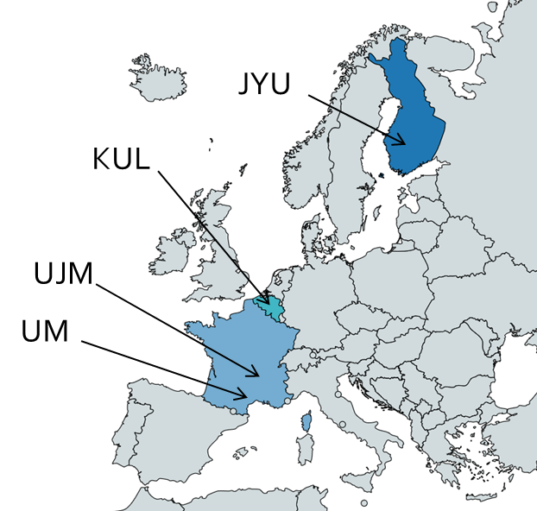
RADMEP = Radiation and its Effects on MicroElectronics and Photonics Technologies
Conceived within the framework of ITN RADSAGA
Accepted by the EACEA through the Erasmus+ grant (619659-EPP-1-2020-1-FR-EPPKA1-JMD-MOB)
Started in Sept. 2020 and will end in Aug. 2026 (4 intakes)
A multidisciplinary and innovative programme covering the impact of Radiation on MicroElectronics and Photonics
RADMEP goals:
To improve the student career prospects
To respond to the needs of the industry, agencies and society

Slide 4
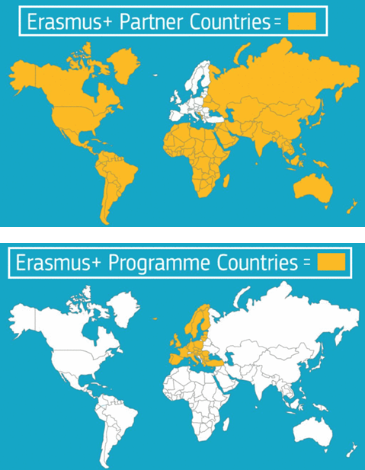
RADMEP Scholarships
Over the 4 intakes, 60 (grants) are available depending on your country
46 grants for partner countries: max. 49 k€
14 For programme countries: max. 35 k€
Details: https://master-radmep.org/scholarship/

Slide 5
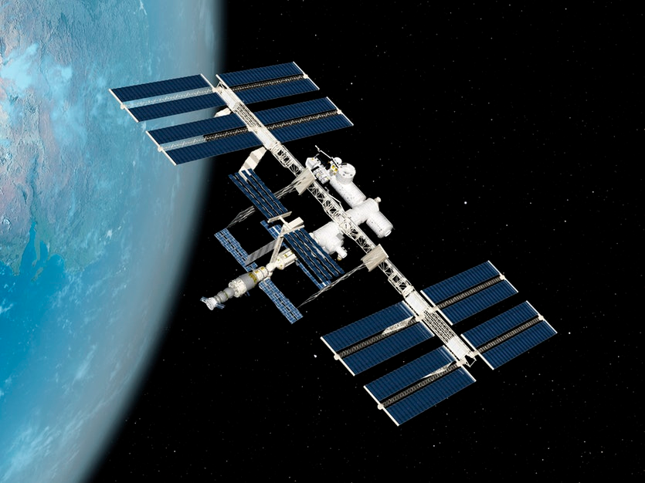
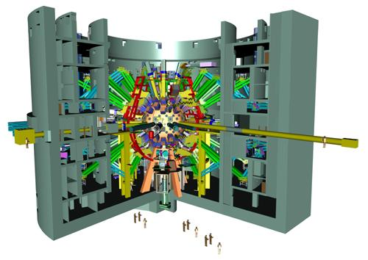
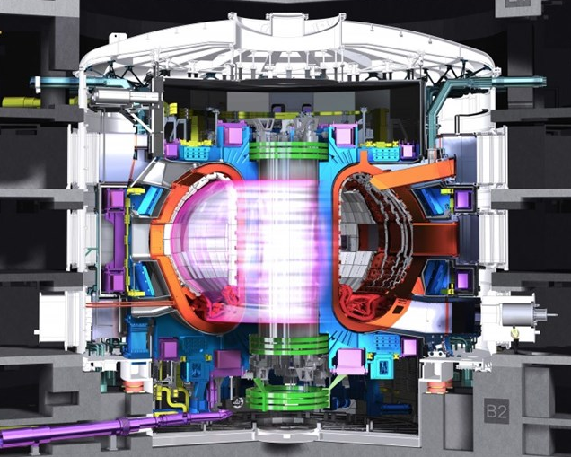
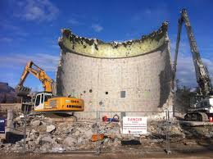
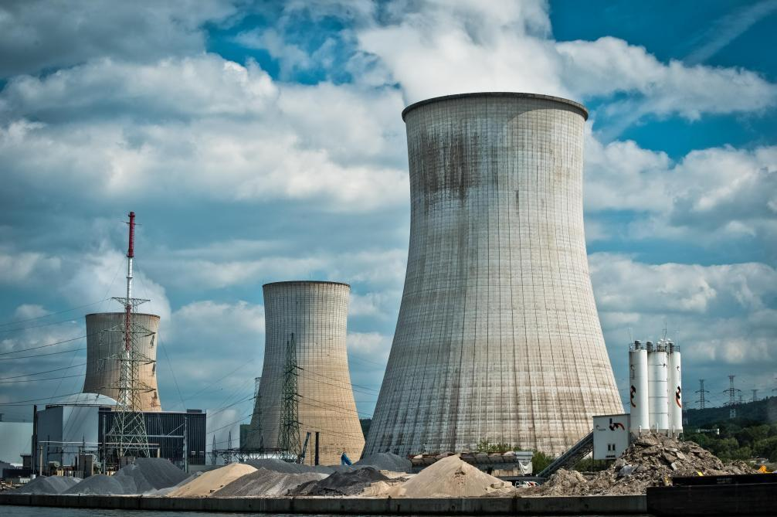
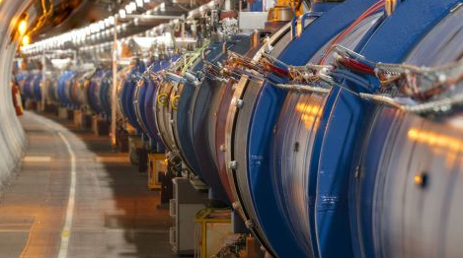
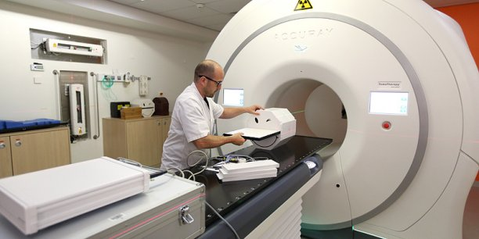
RADMEP: Why are we interested in radiation effects?
Primary sources of natural radiation
Galactic cosmic rays
Solar radiation
Radioactive isotopes
Man-made radiation sources
Nuclear power plants (fission)
Nuclear fusion facilities,
Particle accelerators,
Medical facilities
SPACE
SPACE
FUSION (LMJ, NIF)
FUSION (ITER)
DISMANTLING
NUCLEAR
Radiation effects studies on the performances of technologies is crucial to ensure that devices, components and systems can tolerate these environmental constraints
HIGH ENERGY PHYSICS
MEDICAL

Slide 6
Two Key EU Enabling Technologies Microelectronics Photonics
RADMEP: Why microelectronics and photonics?
Lifeblood of 40% of all innovations
Components and integrated systems are found in virtually all electronic products from computers and telephones to cars and buildings.
Substantial leverage effect in Europe impacting
20-30% of the economy
10 % of the workforce
around 30 million jobs.
Radiation Effects on Microelectronics & Photonics align with the strategic research axes of the four full partners
There was no Master degree covering this aspect in EU
J. Prinzie et al, Nature Electronics, 2021

Slide 7
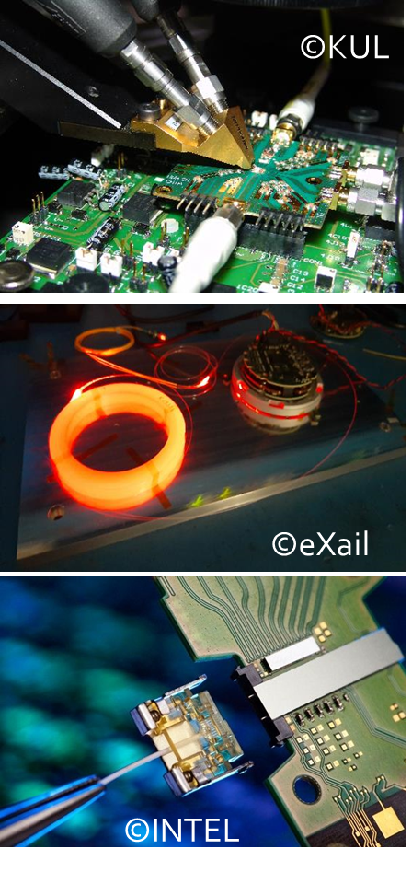
RADMEP: How to master the multi-scale, multi-physics of radiation effects, radhard design and radiation testing?
A deep understanding of radiation effects on modern microelectronics and photonics requires combining theory, tools and experiments
Radiation environment - Technology
Particle - matter interaction
Electronic devices and optical components
Electronic and photonic Integrated Circuits
System level design and assessment
Lectures (semesters 1 to 3), labs, seminars and dedicated workshops
Two different tracks for semester 3: Photonics and Microelectronics

Slide 8
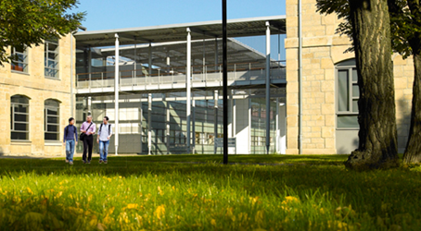
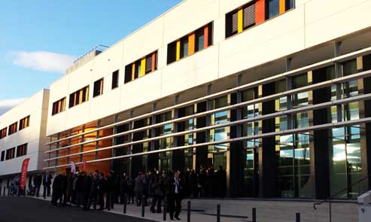
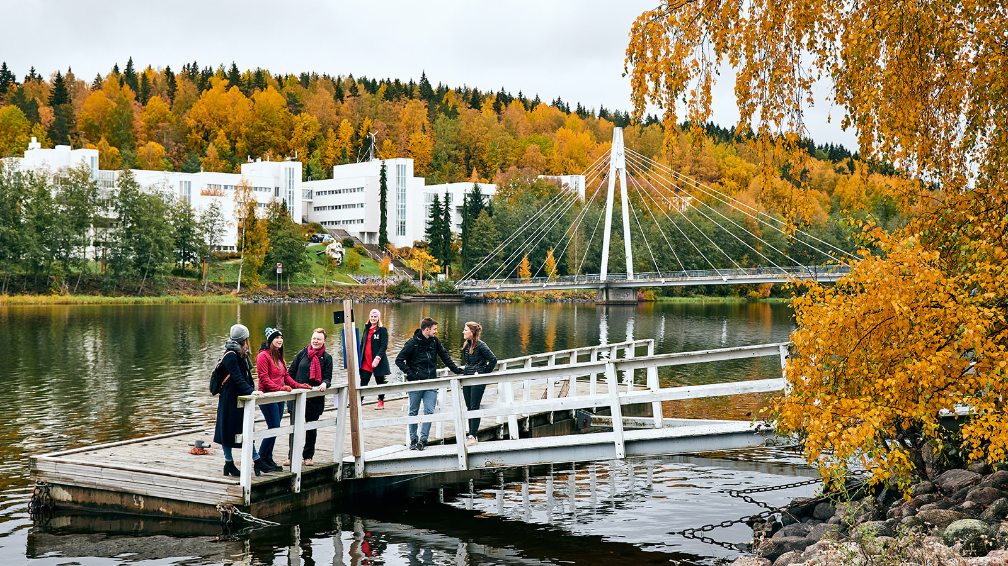
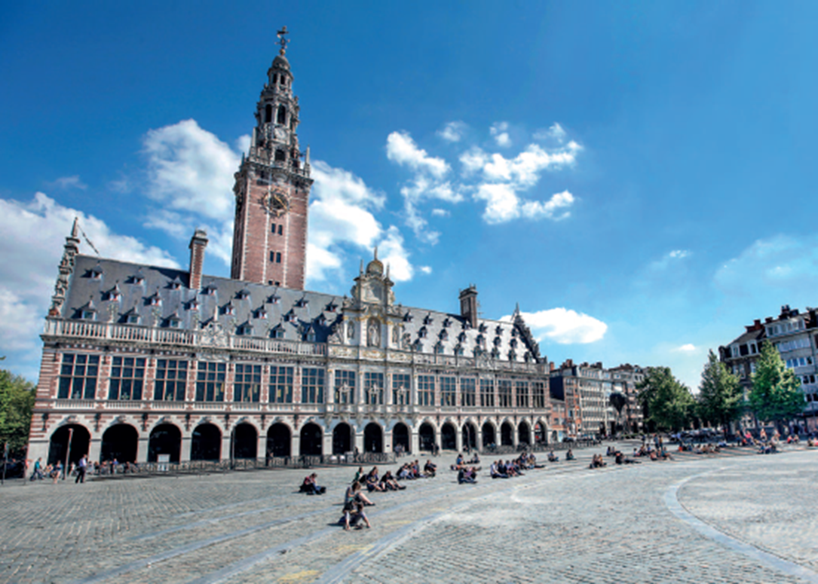
RADMEP mobility scheme

Slide 9
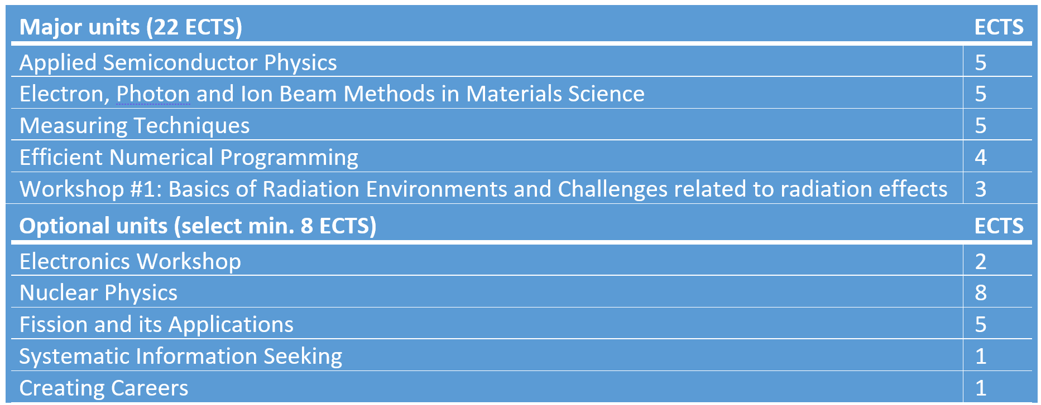
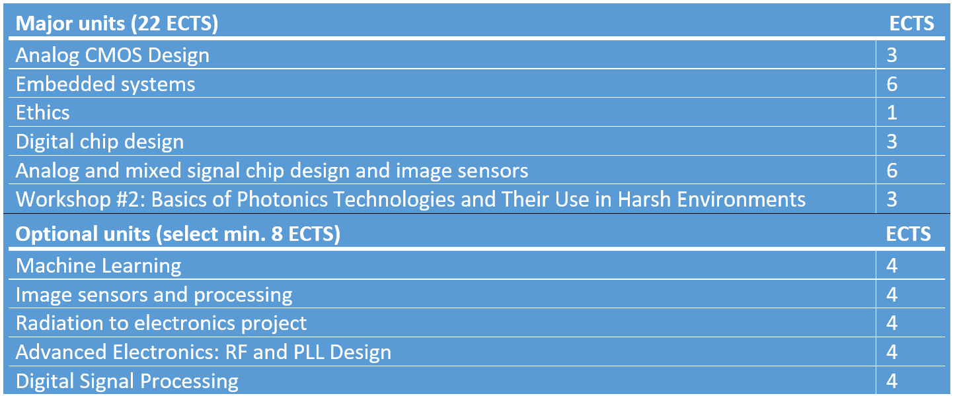
RADMEP semesters 1 and 2
Semester 1
Semester 2

Slide 10
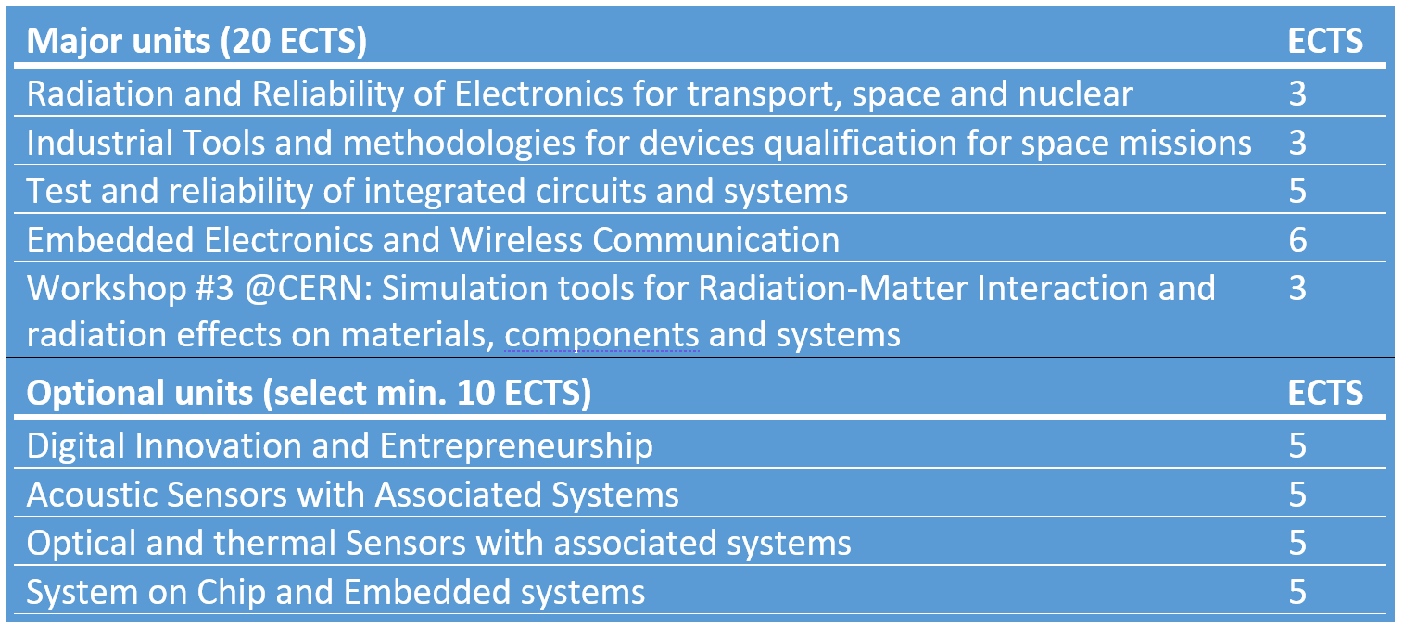
RADMEP semesters 3 and 4
Semester 3
Photonics
Microelectronics
Semester 4
MSc thesis @ academic, research or industrial partner (30 ECTS)

Slide 11
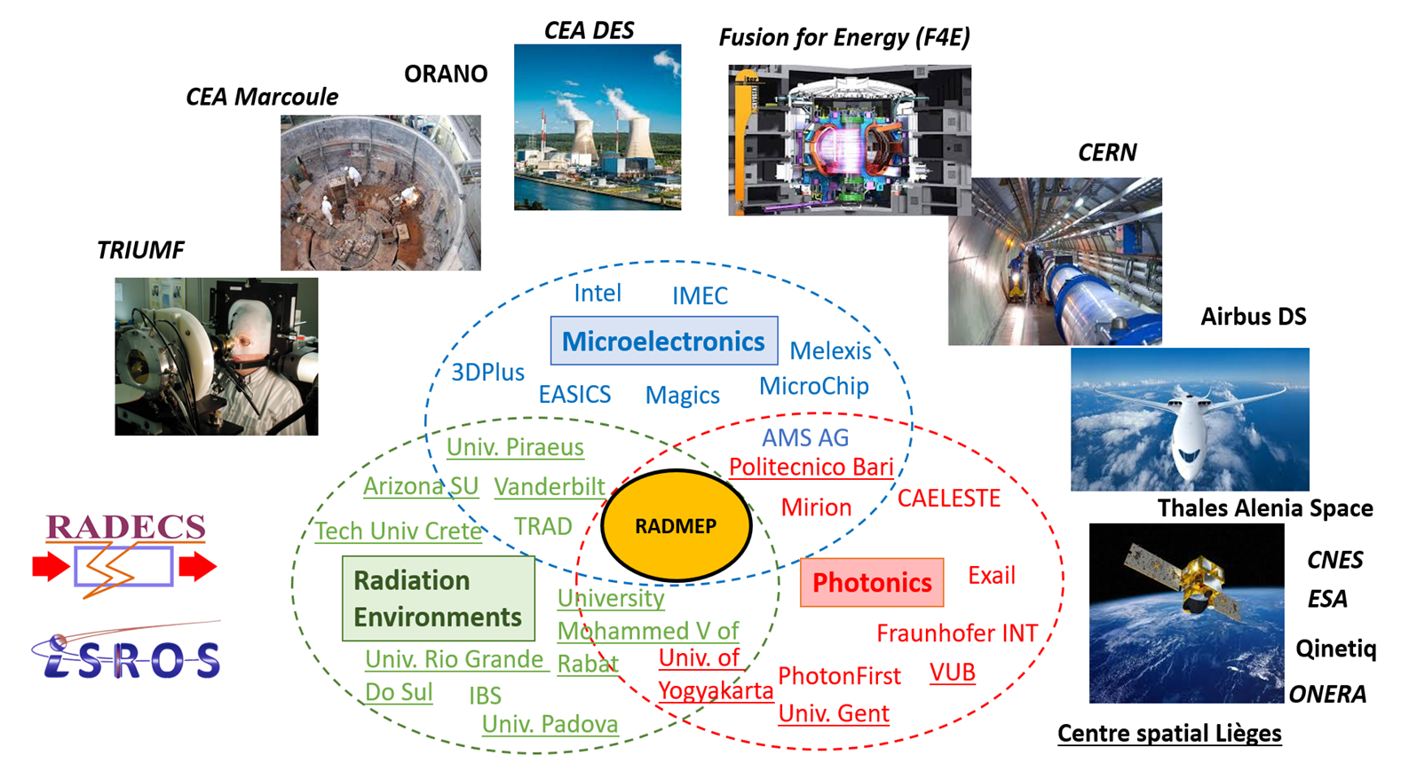
RADMEP: A large consortium with its Associated Partners that are directly involved in the training programme
It is still possible to join the consortium as Associate Partner!
Thanks to EU support, RADMEP is able to welcome invited scholars, delivering lectures or seminars to the students. More than 24 scholars from 12 institutions for the first intake.

Slide 12
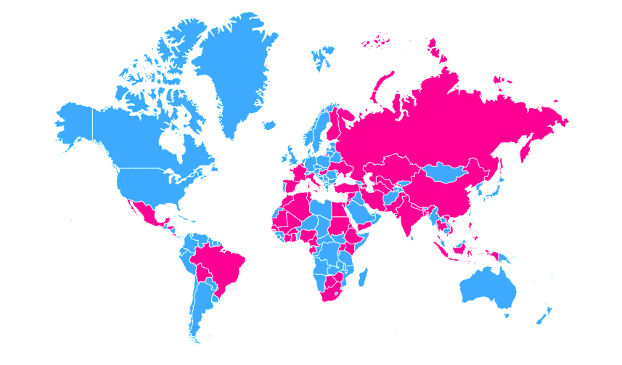
Applying to RADMEP
Applicants must hold a bachelor’s degree, preferably in the fields of microelectronics, photonics or physics
Applicants must possess a solid background in the fields of (semiconductor/radiation) physics, photonics or electronics
A strong command of written and oral English is required
340 applications (3 intakes)
from 57 different countries for 44 delivered EMJMD grants

Slide 13
RADiation facility Network for the EXploration of effects for indusTry and research (RADNEXT)
RADNEXT is a H2020 INFRAIA-02-2020 infrastructure project, coordinated by CERN with the main purpose of enhancing accessibility to irradiation facilities for research on radiation effects in electronics.
TRANSNATIONAL ACCESS
More than 6000 beam time hours are awarded (in 2021-2025) via a competitive proposal process
Free of cost to users
Quarterly calls for proposals (evaluated by experts)
Both academic and industrial groups are eligible
Types of beams: proton, neutron, heavy ion, muon, mixed-field, photon, electron
To this end, RADNEXT provides
A network of irradiation facilities and a structure for facility access
Transnational access to irradiation facilities
A research program devoted to improving radiation effects testing responding to the emerging needs of electronics component and system irradiation
This project has received funding from the European Union's Horizon 2020 research and innovation programme under grant agreement No 101008126

Slide 14
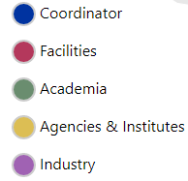
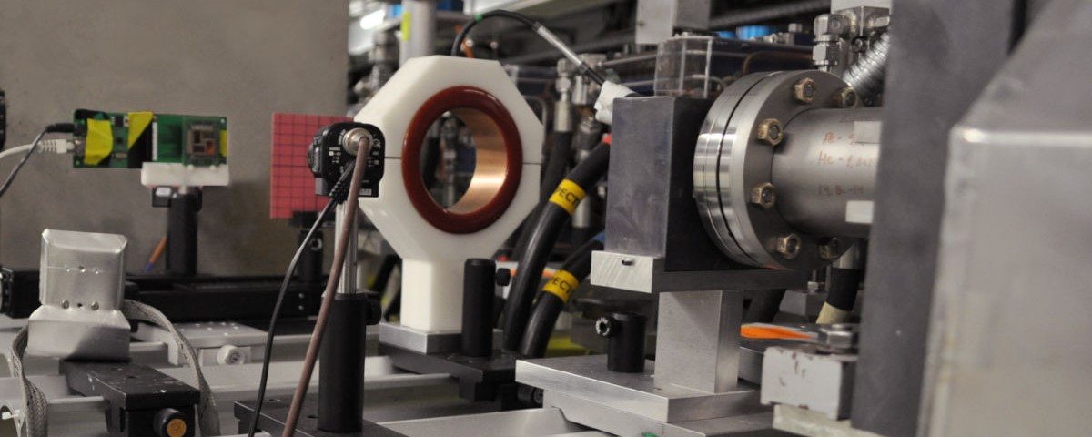
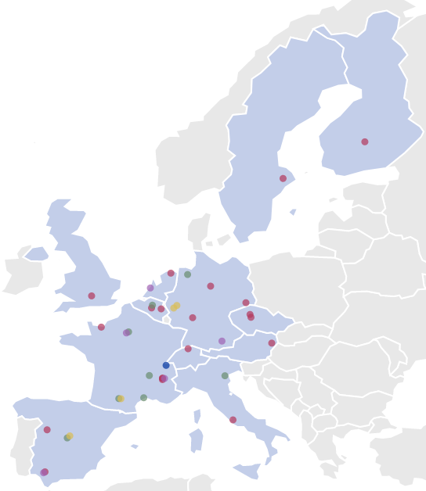
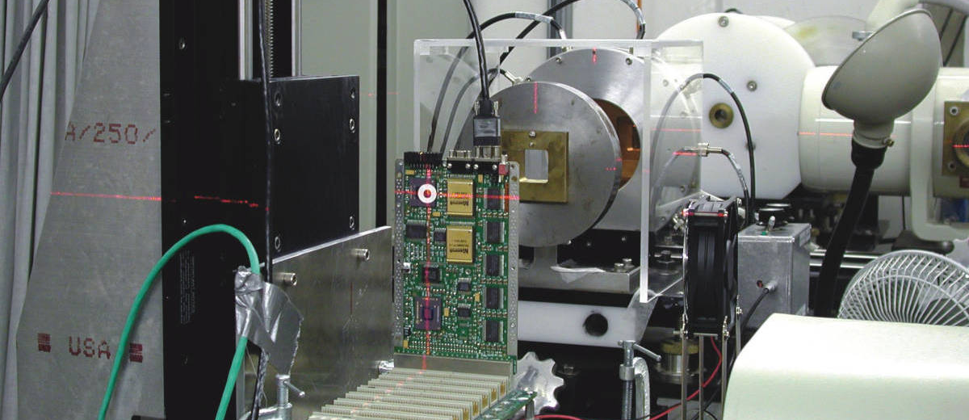
RADiation facility Network for the EXploration of effects for indusTry and research (RADNEXT)
Coordinator:
21 irradiation facilities
8 academic partners and 9 academic supporters
4 agencies and research institutes
5 industrial partners and over 20 industry supporters
Contact us
radnext.web.cern.ch
radnext.network@cern.ch
linkedin.com/company/radnext
twitter.com/RADNEXT_EU
This project has received funding from the European Union's Horizon 2020 research and innovation programme under grant agreement No 101008126

Slide 15
RADMEP: Conclusions & Perspectives
RADMEP is a successful programme with a strong increase in the number of applications (170 for intake #3) and several self-funded students already welcomed
Students from the first intake will get their diploma (from 3 HEIs) in September 2023
Already 3 abstracts with RADMEP students submitted to RADECS 2023
Work in progress to implement new teaching techniques such as remote lab experiments (radiation testing at Full Partner or Associate Partner site): first experiment on optical fibers planned in S3 2023
RADMEP strongly benefits from the link with RADNEXT project led by CERN in which the 4 Full Partners are also involved

Slide 16
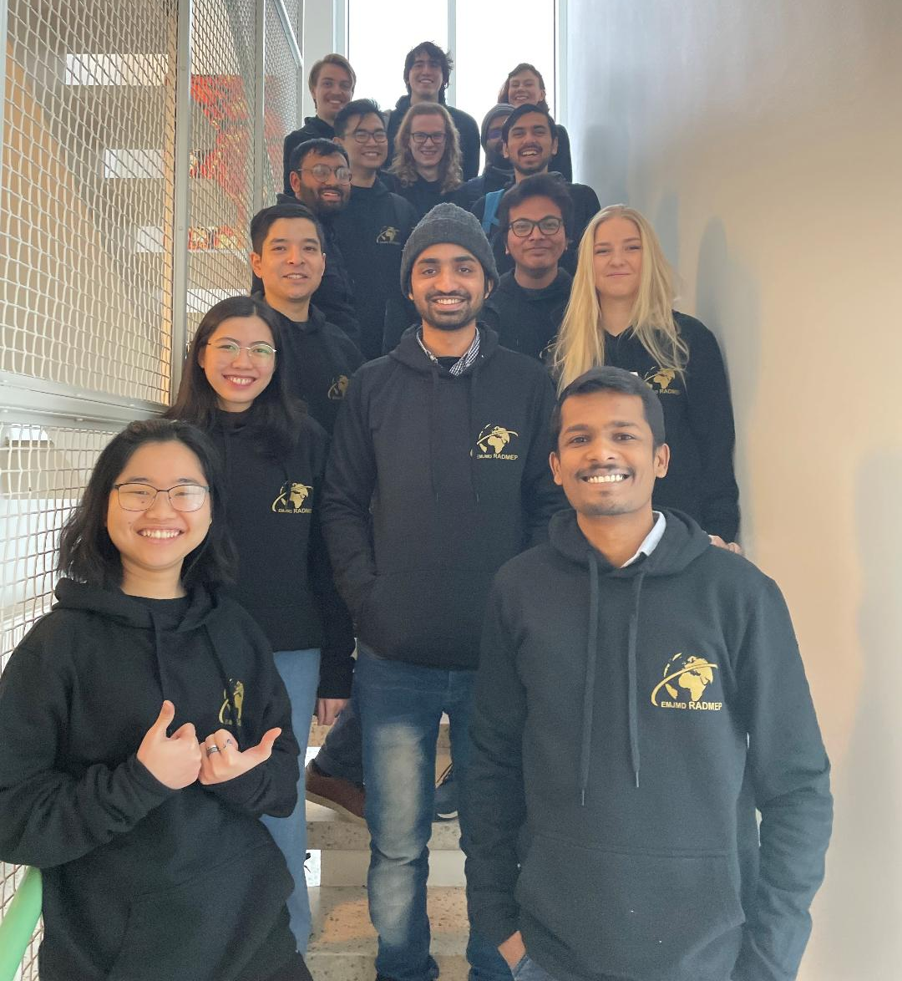
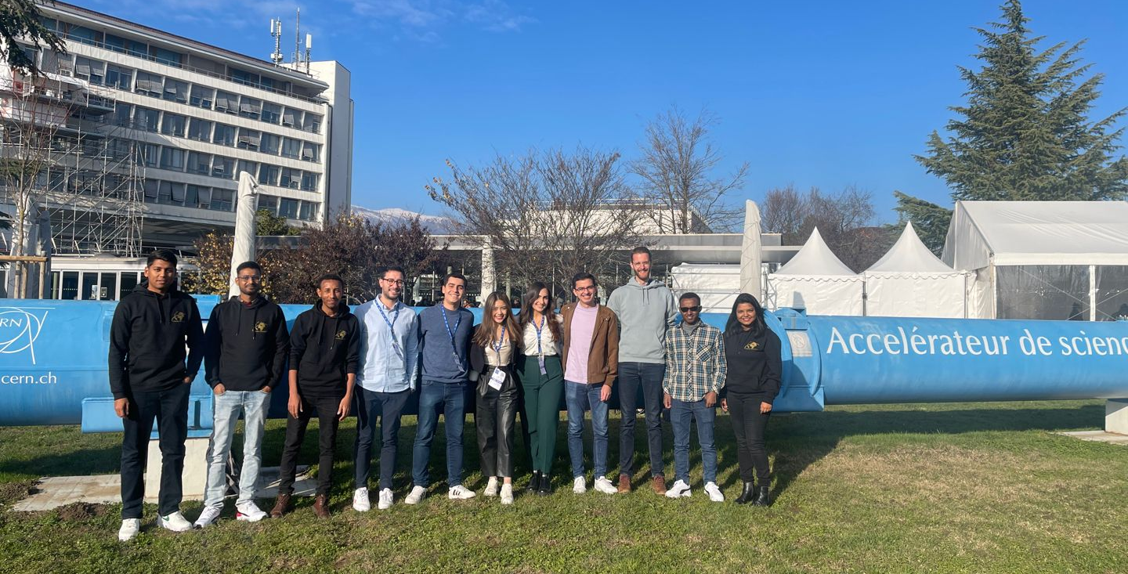
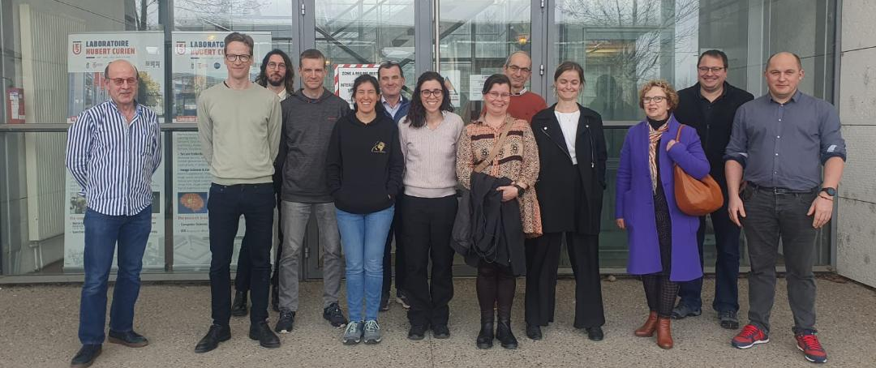
Thanks for your attention
Any questions?
Radmep intake #1 @ CERN (Dec 2022)
Radmep team @ UJM (March 2023)
Radmep intake #2 @ JYU (Dec 2022)

