Slide 1
ML-based Anomaly Detection on Space-Grade Hardware
Anomaly Detection Anomaly Prognosis (ADAP)
Andreas Koch
andreas.c.koch@airbus.com
PhD Student
Airbus Defence and Space GmbH

Slide 2
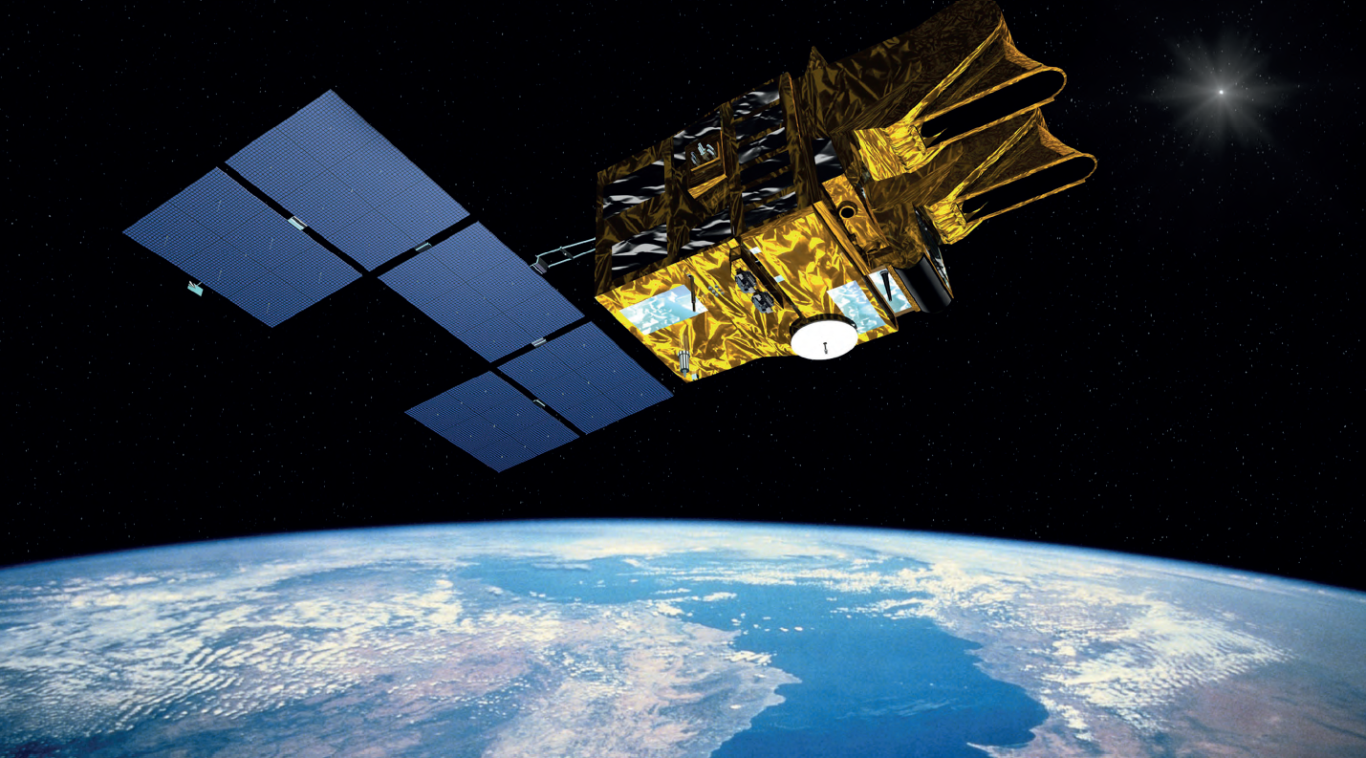
Our contribution
A novel labeled dataset for anomaly detection in spacecraft (provided to ESA)
Development of Machine Learning (ML) models
Implementation of on-board computer with the capability of supervising ML applications
Accelerated deployment of ML models on space-grade hardware

Slide 3
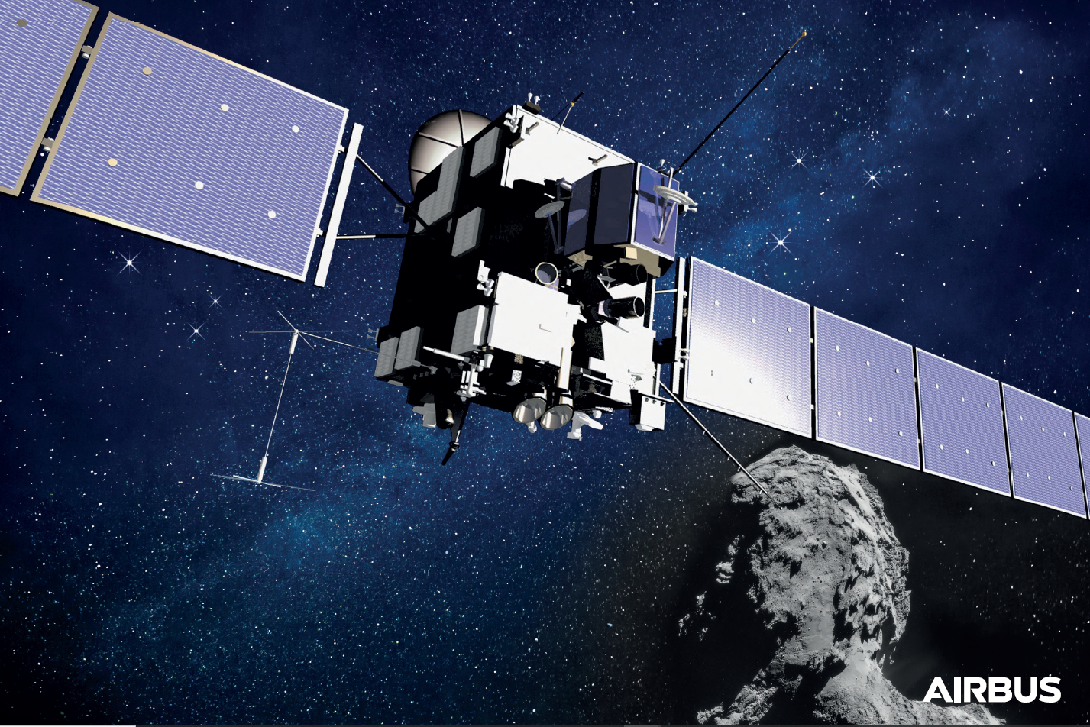
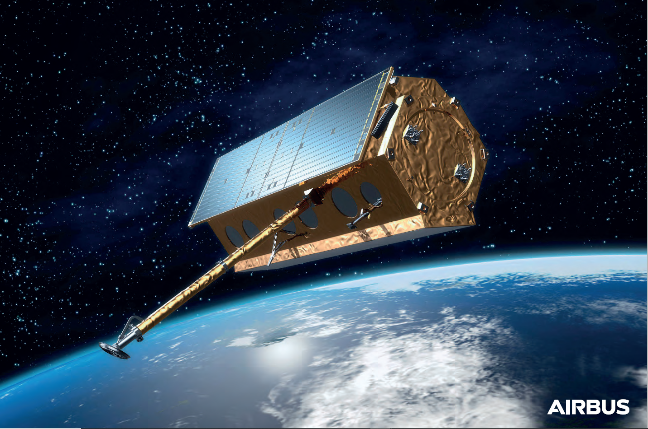
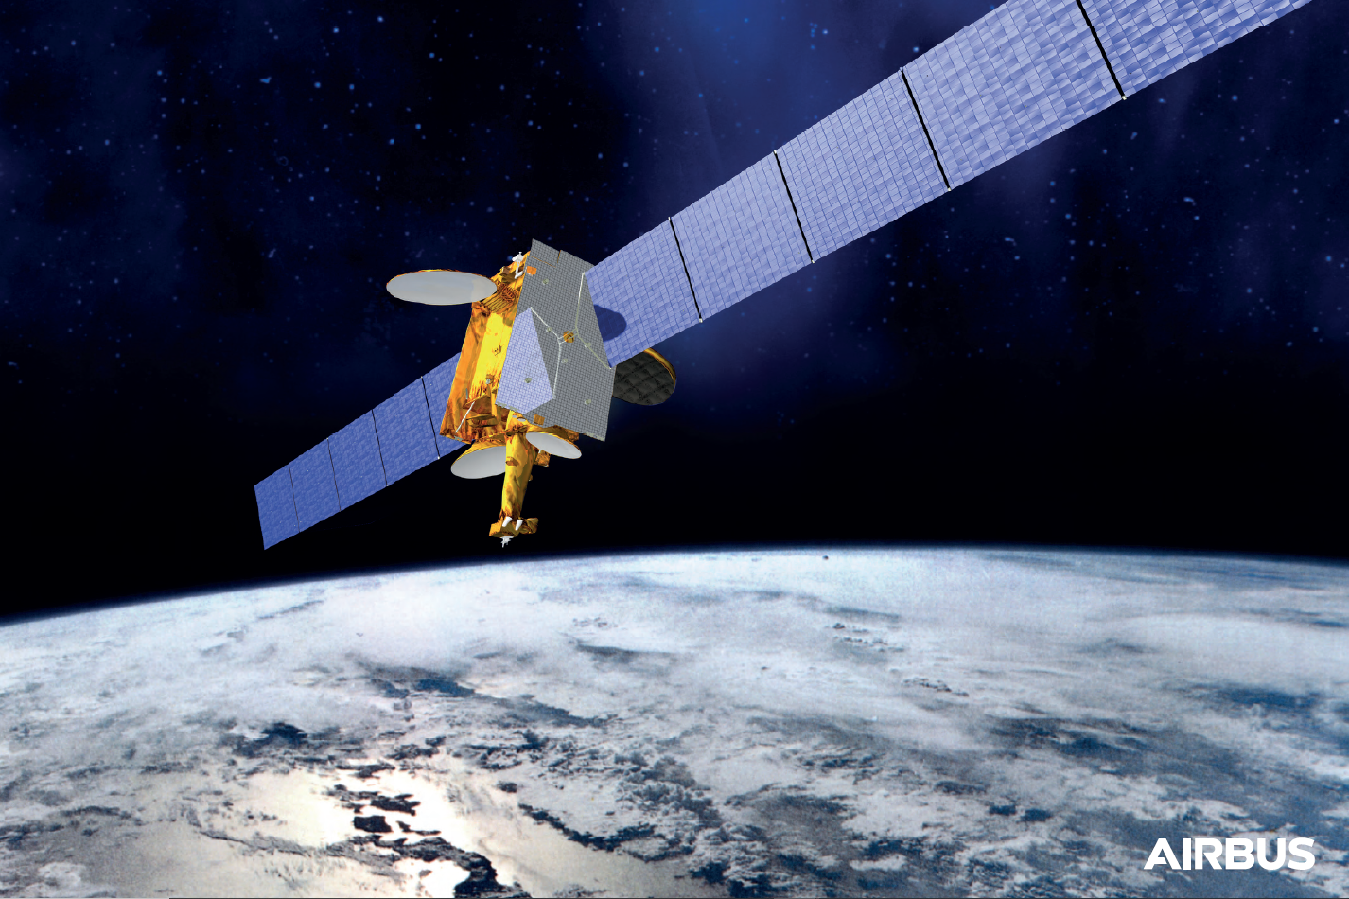
Dataset
Anomaly Detection Anomaly Prognosis (ADAP)
Anomaly A
Anomaly B
Anomaly C (Simulated)
AOCS Sensor
Payload Antenna Corona Discharge
Solar Array Micro Meteoroid Degradation
Previously unknown external perturbation led to the sensor failing to detect the transition from Earth to Deep Space, resulting in erroneous pitch and roll pointing
Payload temperatures were abruptly rising, but were still within temperature limit ranges of the classical FDIR of all affected sensors. This event remained undetected, causing damage to the antenna.
As known from various missions, a micro meteoroid impact usually creates irreversible damage, causing a full or partial outage of one of its sections and thus a permanent drop in power.

Slide 4
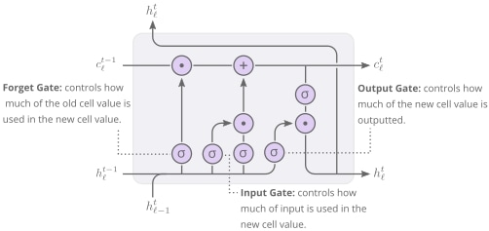
Algorithms
Anomaly Detection Anomaly Prognosis (ADAP)
https://alexlenail.me/NN-SVG/LeNet.html
https://distill.pub/2019/memorization-in-rnns/
Anomaly B
Anomaly A & C
2-layer LSTM model (21k parameters)
Autoencoder model (11k for A & 62k for C)
Recurrent neural network forecasting the next telemetry value based on the 100 previous telemetry values for 49 telemetry channels simultaneously. The model learned to predict nominal behavior only in an unsupervised manner, anomalies are detected in case of deviations.
This convolutional autoencoder model is trained in an unsupervised manner on nominal telemetry and learns to represent the input in an abstract feature space. Anomalies are not learned to be well represented in this space and will have a significant reconstruction error.

Slide 5
Firmware
Anomaly Detection Anomaly Prognosis (ADAP)
Python / C
ML Application
Communicates with real-time OS, which acts as a supervisor to ML applications
Facilitates ML inference via hardware acceleration with application-specific accelerator
Petalinux / RTOS
Encapsulates firmware required by respective ML application
Guest OS
Communicates with real-time OS, which acts as a supervisor to ML applications
Xen Hypervisor
Manages lifecycle of guest operating systems
Hypervisor
Ensures every ML application and its corresponding hardware accelerator stick to their allocated resources

Slide 6
Hardware Accelerators
FPGA Resource Utilization on Xilinx Zynq Ultrascale+ MPSoC
Anomalies | Processor | DSPs | BlockRAM | LUTs
A & C | DPU | 704 | 261 | 58592
B | DLP | 73 | 50 | 58475
A, B & C | Total | 777 / 2520 (30.8%) | 311 / 912 (34.1%) | 117067 / 274080 (42.7%)
Xilinx Vitis AI
Matlab Deep Learning HDL Toolbox
Deep Learning Processing Unit (DPU)
Deep Learning Processor (DLP)
Programmable engine for accelerated computation of convolutional neural networks (CNNs). This IP is integrated as a block into the programmable logic (PL) and receives instructions via Xilinx intermediate representation (XIR) library from within a Petalinux OS.
→ Anomaly A & C
Target-independent generic processor for deep learning with support for convolutional as well as recurrent neural networks. It is integrated into the programmable logic (PL) of our target hardware and it receives instructions from a C application being executed in a FreeRTOS guest OS.
→ Anomaly B

Slide 7
Results
On-Board Performance
Anomaly | Model | Throughput [MB / s] | Peak [W] | Delta [W] | Energy [µJ / Bit]
A | VAI QAT | 1.431 | 5.040 | 0.077 | 0.430
B | DLP | 0.505 | 5.221 | 0.007 | 1.325
C | VAI Quantized | 6.929 | 5.283 | 0.324 | 0.090

Slide 8
Results
Accuracy

Slide 9
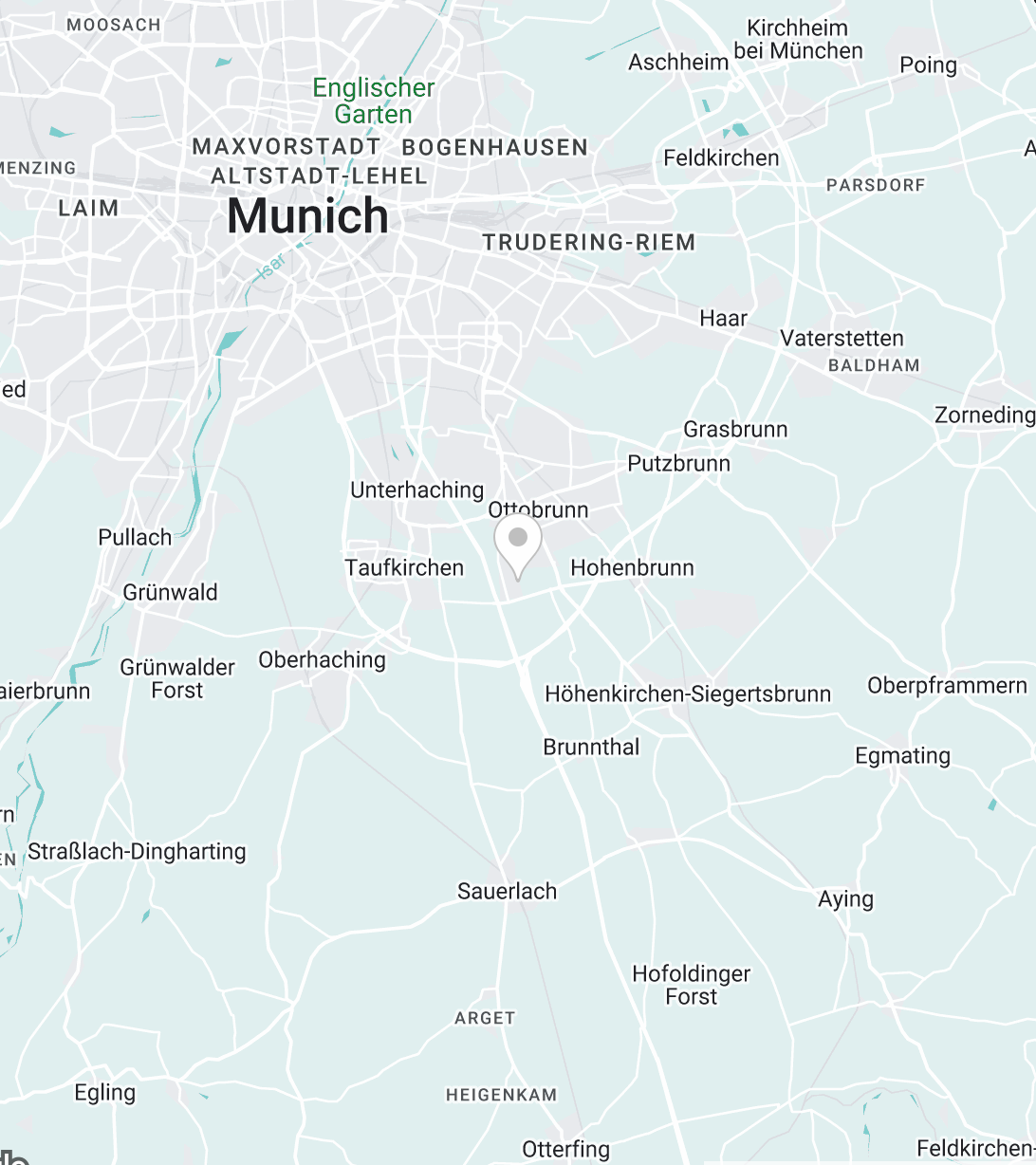
Contact Us
Airbus Defence and Space GmbH,
Evoleo Technologies GmbH and
Frauenhofer IIS
andreas.c.koch@airbus.com
https://www.linkedin.com/in/andreasckoch

