Slide 1
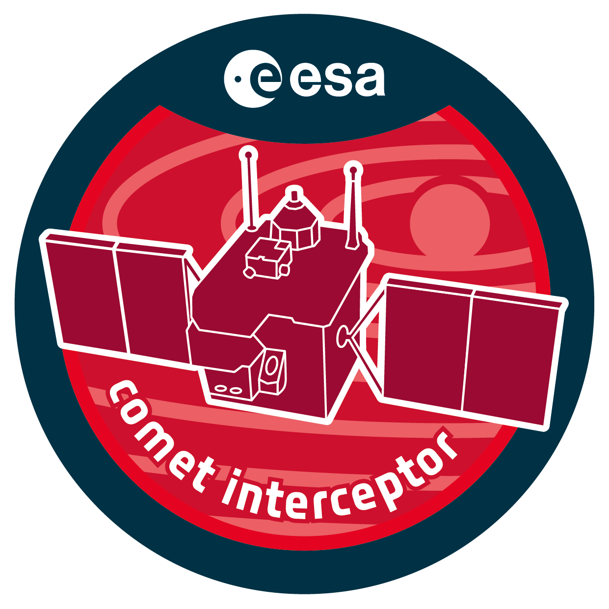
Thermal Design and Analysis of the Comet Camera ESTEW 2023 University of Bern Sebastian Wolf 10.10.2023

Slide 2
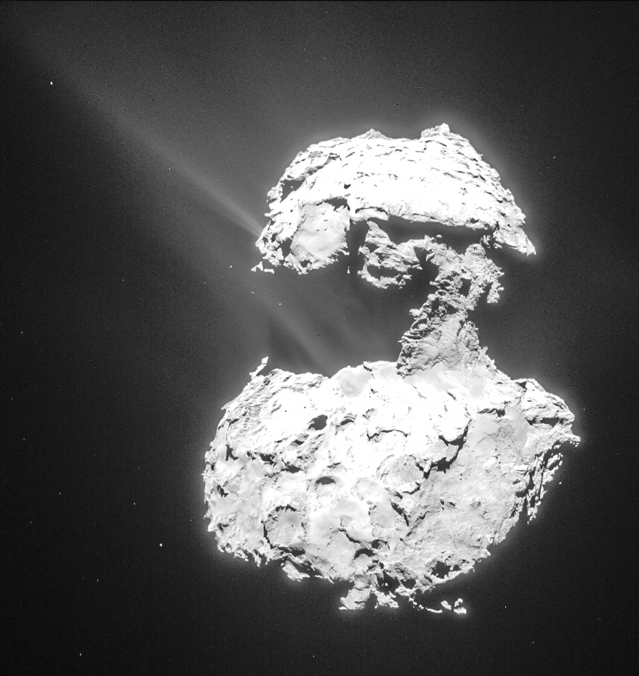
Comet Interceptor Mission Concept
Explore a comet, which has rarely approached the Sun before
Fast track mission
Dual launch with ARIEL in 2029
Stand-by parking at L2 until target is identified

Slide 3
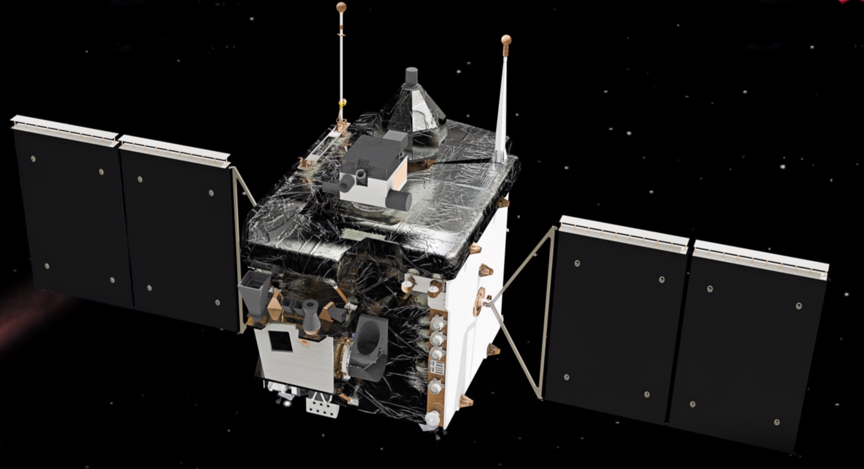
Comet Interceptor Satellite overview
Probe B1 / B2
Dust Protection
Rotating Mirror Assembly
and Comet Camera
OHB Italia

Slide 4
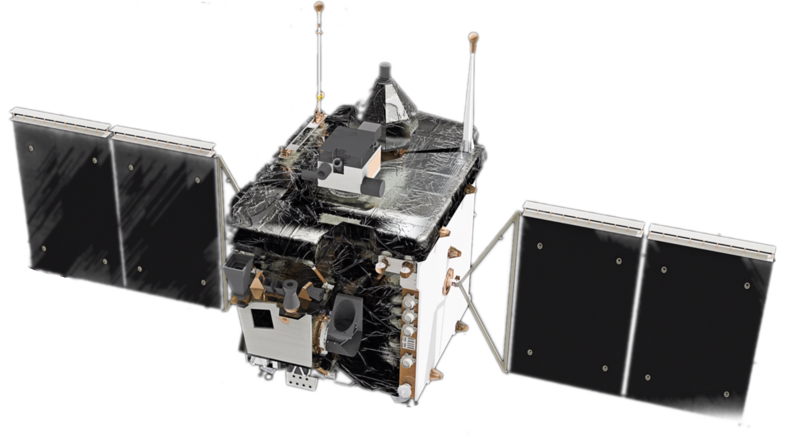
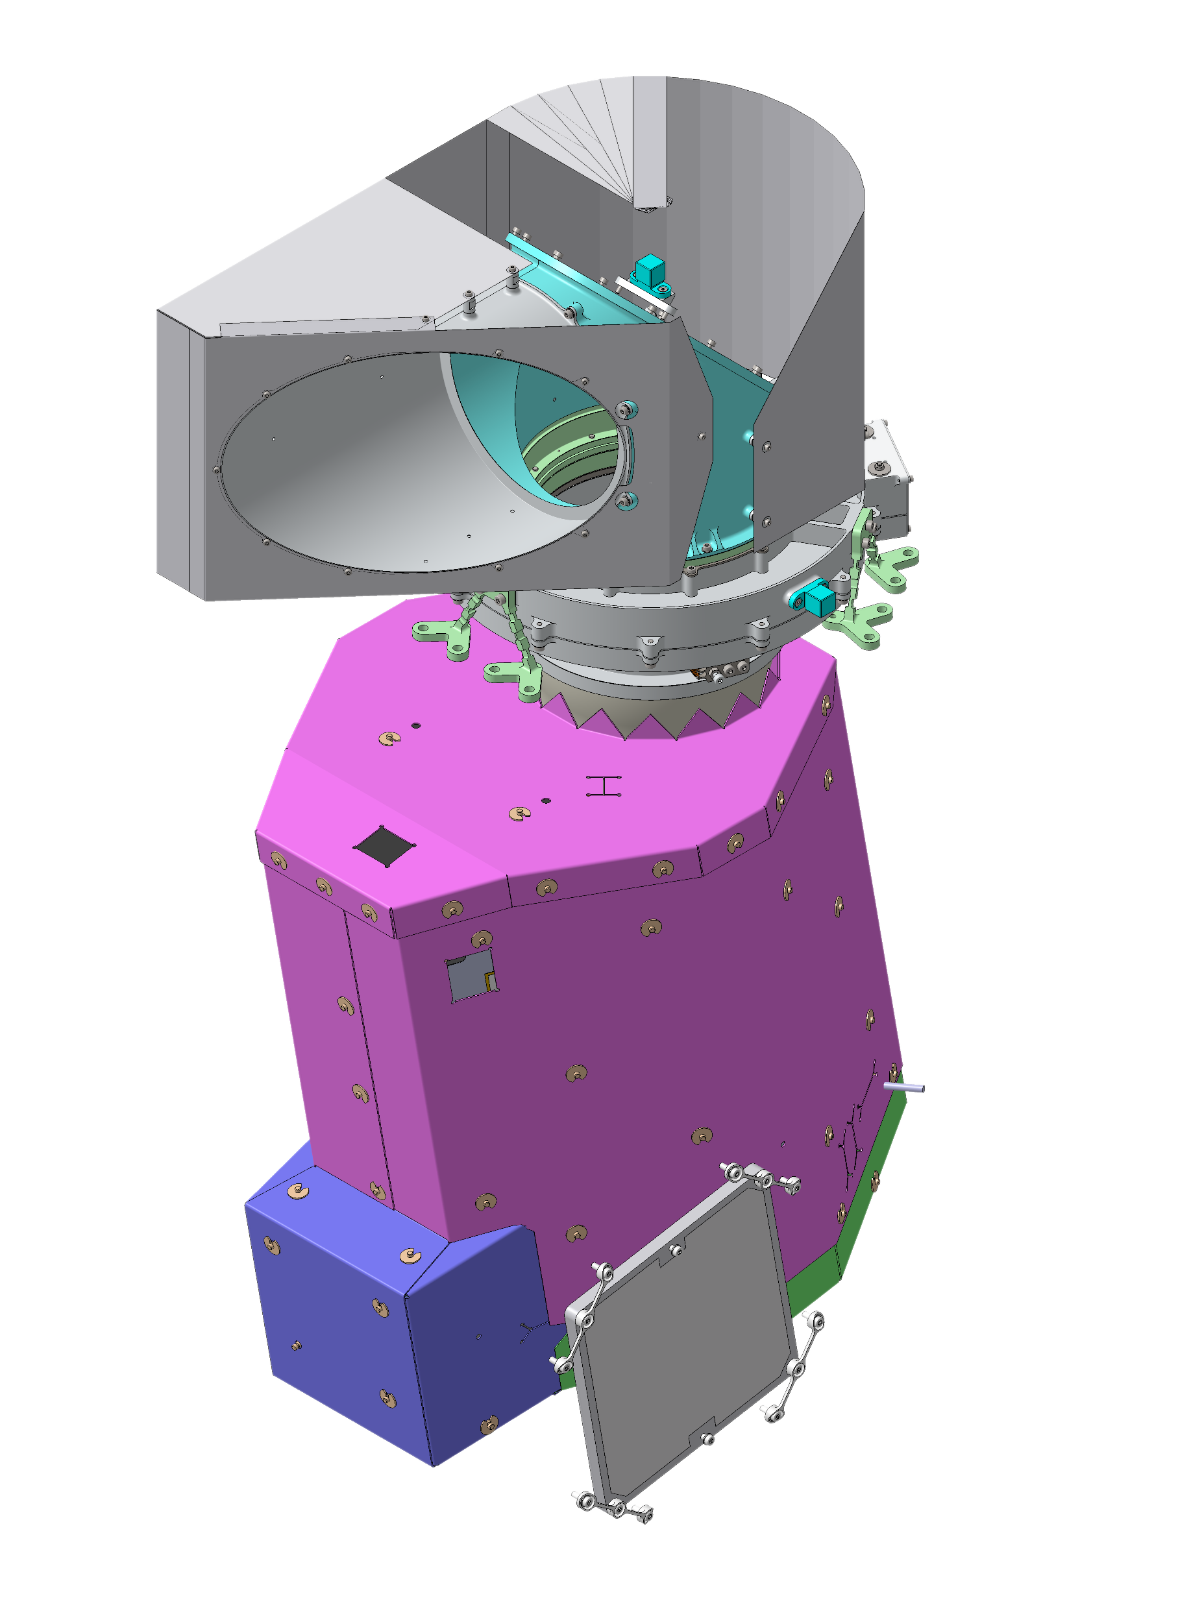
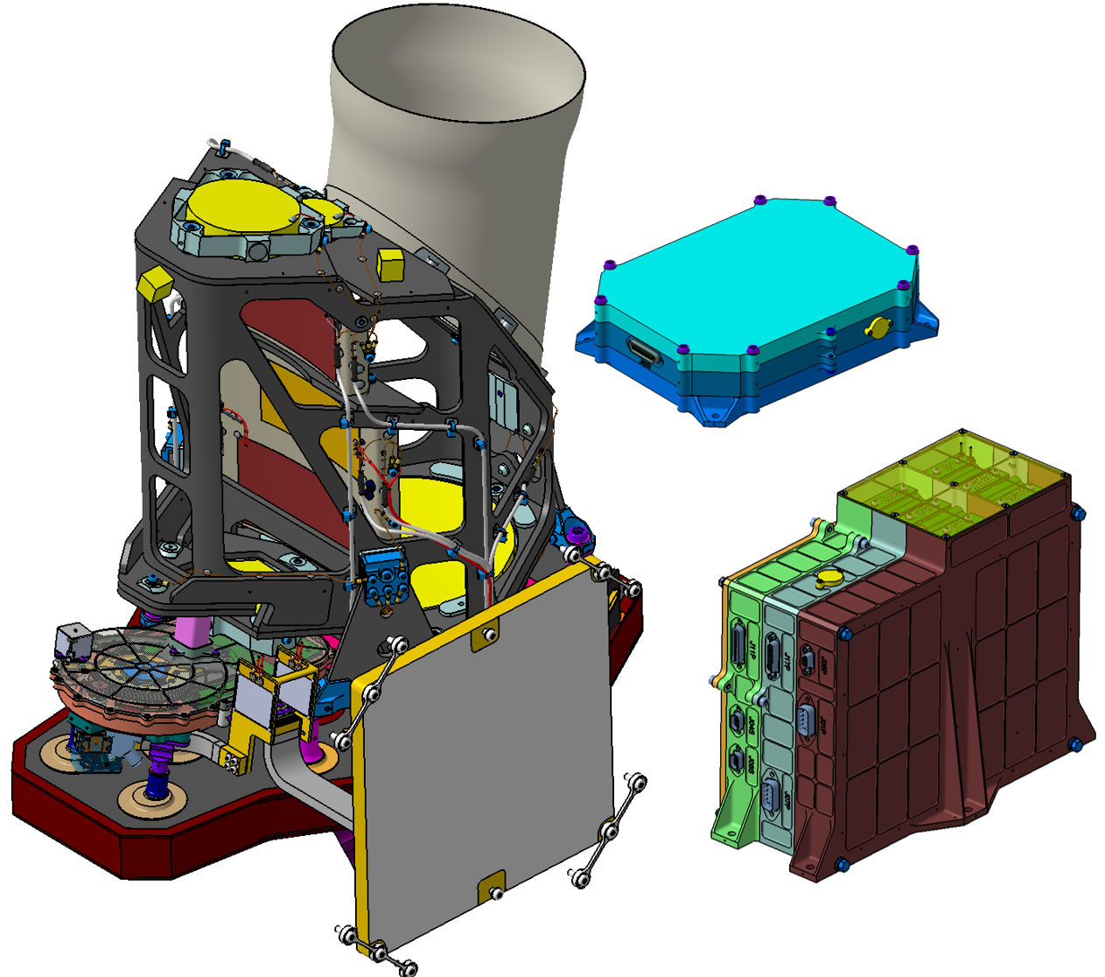
Comet Camera
RMA: rotates CoCa’s Field of View to follow comet
2 Electronic boxes:
PEU -> Detector signal reading
ELU -> Power conversion, filter wheel drive, temperature control and data processing
OHB Italia
Notes:
We zoom in a bit
CoCa consits of the Telecope and two Electronic Boxes
-PEU performs the analog signal conditioning and driving the detector. It is mounted separately from the CSU on the S/C. The unit however is needed to be in close range to the detector for EMC mitigation.
-ELU drives the various elements of the instrument. The filter wheel and thermal control will be operated by a dedicated control board (FTC). The digital communications within the instrument and to the spacecraft will be performed by the digital processing module (DPM). The power conditioning for the instrument is performed by the power converter module (PCM).
The objective of the RMA is to rotate the CoCa Field of View (FoV) in order to follow the object during fly-by without requiring moving the spacecraft.
During initial approach, while the object is angularly close to the relative velocity vector, the scan mirror is orienting the FoV along this velocity vector. The optics will be designed in such a way to minimize its optical degradation during this period.
When the spacecraft will be flying-by the object (meaning the object will be angularly going away from the velocity vector up to 180 degrees), the scan mirror will rotate the CoCa field of view in order to follow the object. The Dust Protection System will protect the SMA optics from damages due to dust environment as far as possible.
Sun illumination possible,

Slide 5
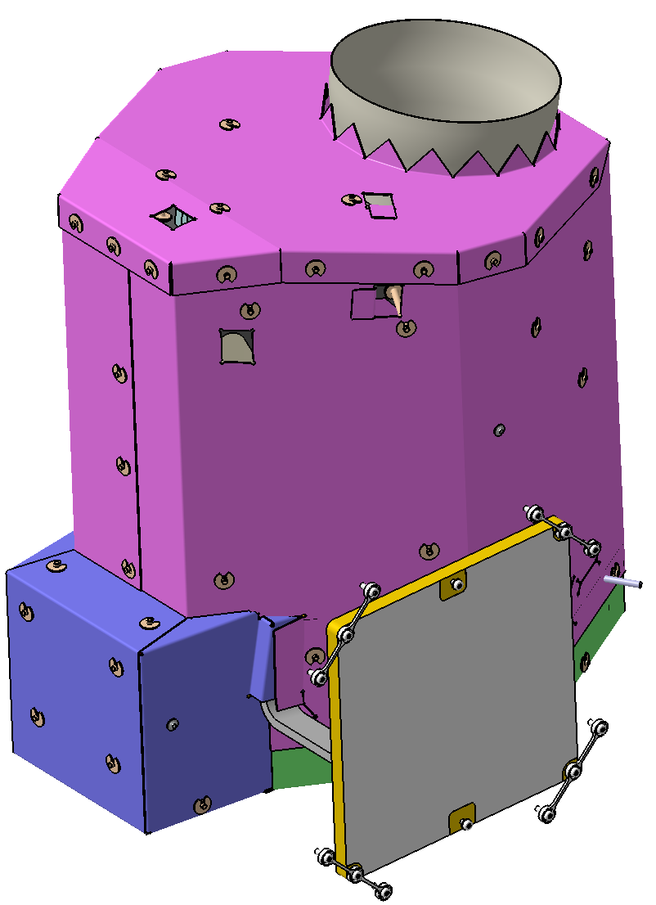
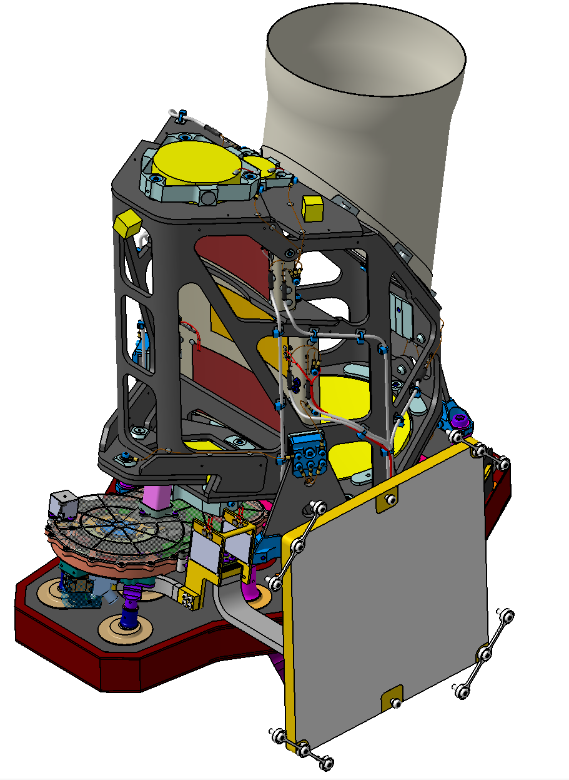
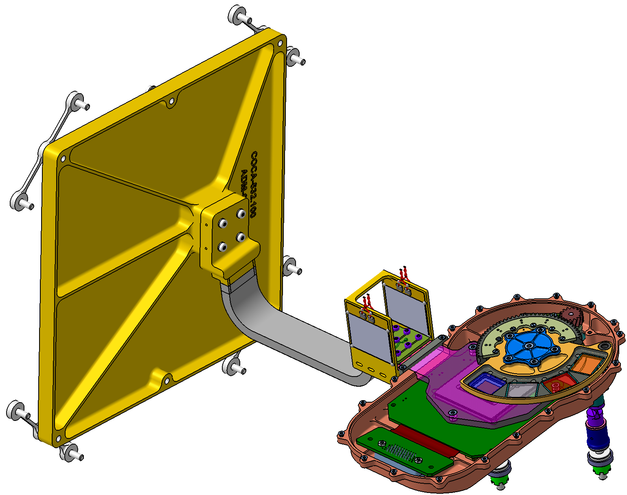
Telescope and Thermal Requirements
Four mirror telescope and an imaging detector sensitive to optical light (CaSSIS TGO design)
Four optical filters (400-1050nm) on a drive wheel
Radiative / conductive decoupling from S/C:
MLI
Ti bipods
Pad
heaters
Pad heaters
Stabilize detector at 0°C
(Trade off dark current vs. qualification efforts)
Prevent motor from overheating
Stabilize Telescope structure at 20°C
(Mirror alignment)
Notes:
The optical system consists of a four mirror off-axis telescope with a nominal aperture of 135 mm, a focal length of 880 mm and a focal-ration of f/6.5. The telescope is based on the CaSSIS TGO design. The collected light from the target object passes through one of four optical filters on a four-position filter wheel before reaching the detector (Figure 2) in the focal plane assembly (FPA). The filters cover the wavelength range of 400-1050 nm with a nominal bandwidth of 100 to 150 nm.
The detector is a backside illuminated CMOS device from e2v, based on the system currently under development for the JANUS instrument. A cold finger with a subsequent emitter will be used to reduce the detector operational temperature and with it, the dark current.
The CSU, being an optical device with strict stability requirements, must be thermally and mechanically decoupled from the S/C. In fact, thermo-elastic stresses and parasitic heat fluxes generated by the S/C must be minimized. For this reason, the whole unit is suspended on three titanium bipods and is completely wrapped in MLI.
Want to go deeper to FPA thermal design now

Slide 6
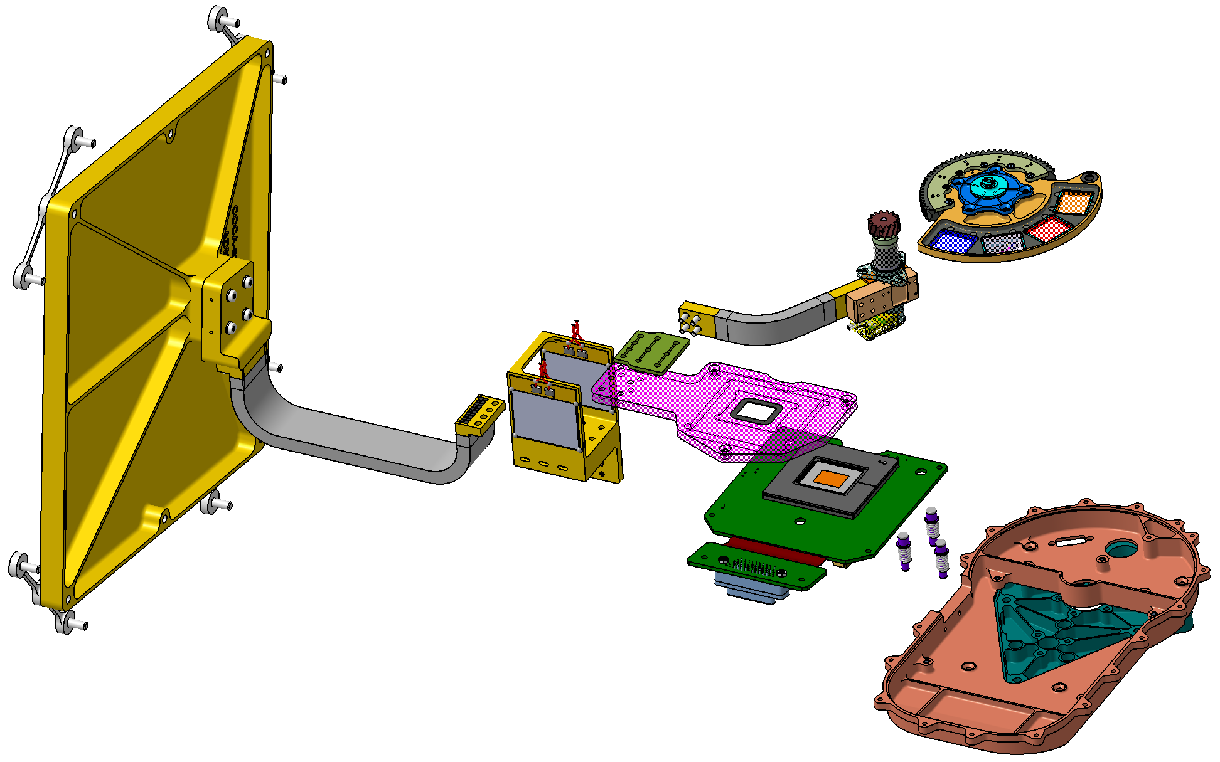
Focal Plane Assembly – Thermal Design Thermal HW is designed and provided by Admatis
Graphite /
Copper strap
(both 0.1W/K)
3 Springs press
Detector/ PCB assembly
onto heat sink
Heated radiator I/F for
Detector and Motor
Notes:
-Design criteria: in hot operation 15K of control margin are needed.
-No I/F thermal fillers are used
-Detector design with these 3 springs are heritage from DLR Berlin Janus /Juice

Slide 7
Thermal Analysis

Slide 8
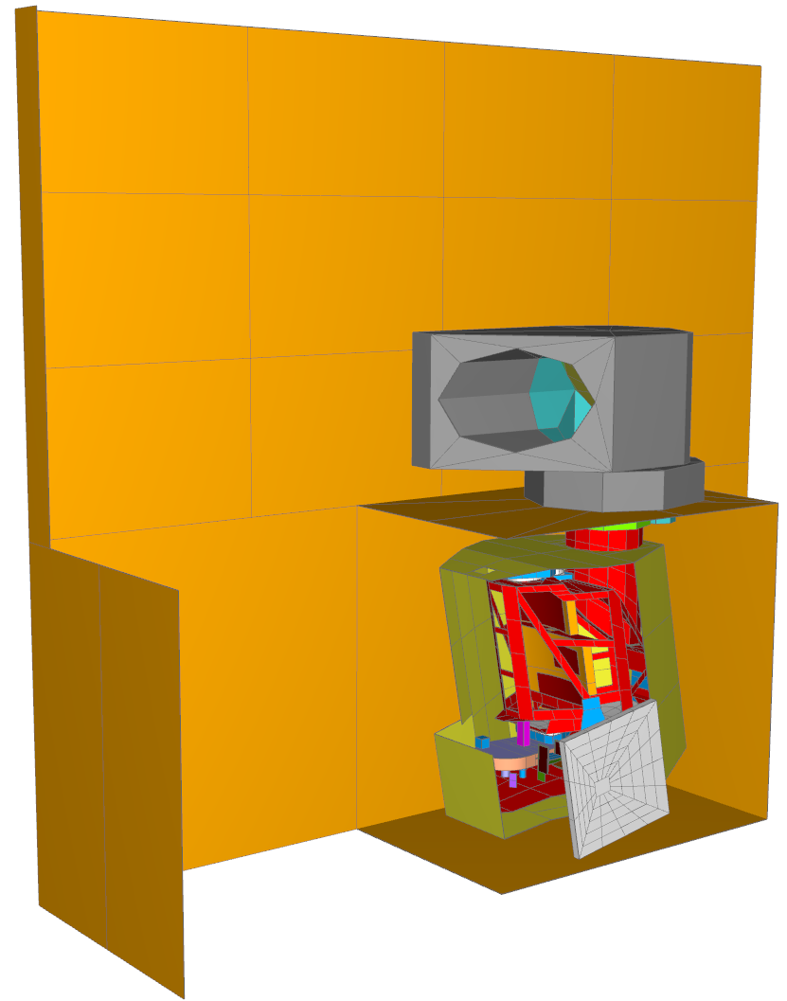
Thermal Analysis - Environment
Simplified S/C GMM
Detailed Rotation Mirror Assembly GMM (CSL)
Environmental fluxes:
Comet IR / albedo | neglected
Earth IR / albedo | neglected
Sun | 0.85 AU to 1.2AU

Slide 9
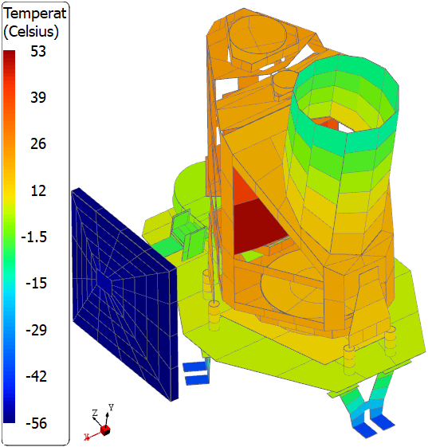
Thermal Analysis Results
 | Operational |  | Survival
 | Cold | Hot
Input
Total Dissipation | 0.6 W | 1.75 W | -
S/C Cavity Sink temperature | -47 °C | 5 °C | -47 °C
Conductive S/C Interface temperature | -40 °C | 20 °C | -40 °C
Results
Telescope Heater Power | 12.8 W | 4.4 W | 3.8 W
FPA Heater Power | 4.6 W | 1.4 W | 4.4 W
Heat Balance
Radiative flux to RMA | -3.4 W | -3.0 W | -0.9 W
Radiative flux Radiator to space | -5.0 W | -5.5 W | -4.3 W
Radiative flux to S/C cavity | -5.1 W | -0.3 W | -1.5 W
to Cond. S/C I/F | -3.7 W | 0.1 W | -1.1 W
to Cond. harness I/F (ELU/PEU) | -0.5 W | 0.7 W | -0.2 W
Cold operational temperatures
Notes:
You see here:
MLI is hidden
-Cold radiator
-Cold entrance baffle, sees cold RMA
-Telescope heater that are comparatively warm (50°C) to keep the telescope at 20°C.
But that is quite expensive in terms of heater power demand.
Losing quite a lot to RMA and cavity in Cold conditions
Overall, up to 17.4 W of heater power demand.
Loosing 3W to RMA.
5W to a cold cavity
Residual heat flux through harness to Proximity Electronic Unit

Slide 10
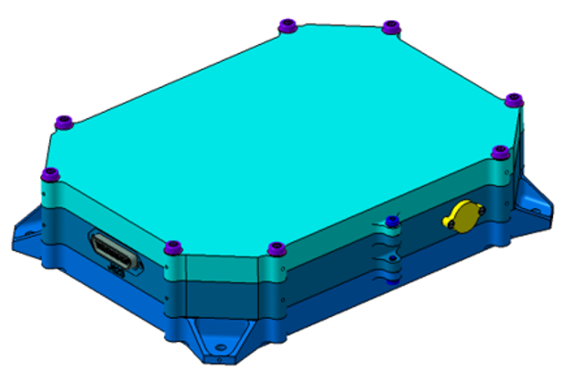
Problems / Design improvements
Strong harness link to the Proximity Electronic Unit and large temperature gradients to it
increased Radiator area
Heat exchange with S/C cavity
Changed from a black S/C cavity to one covered with VDA
Gold coating of radiator rear side
Helps a in Hot non op. phases as well!
Sun intrusion, hotspots on CFRP structure
To be checked

Slide 11
Validation

Slide 12
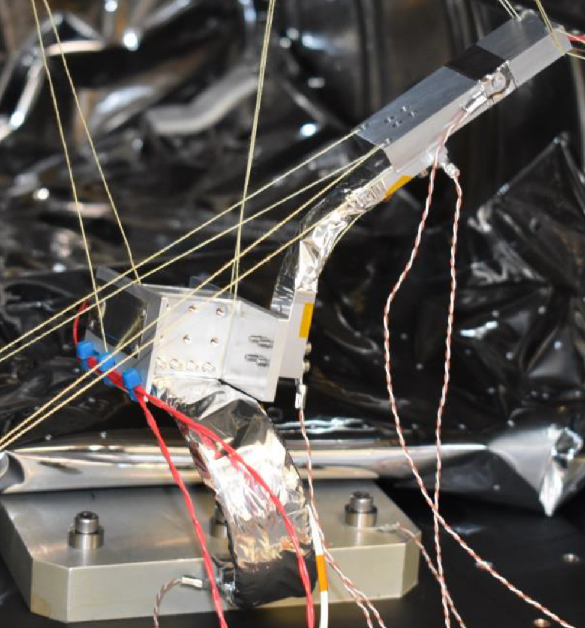
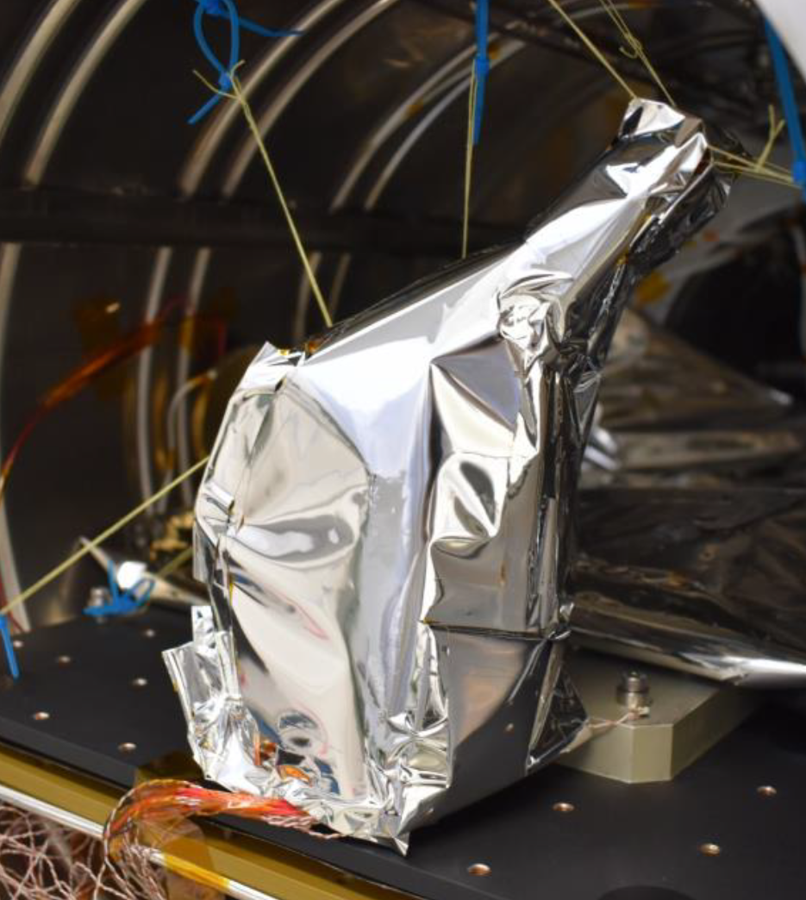
Thermal Hardware Balance Test - Admatis

Slide 13
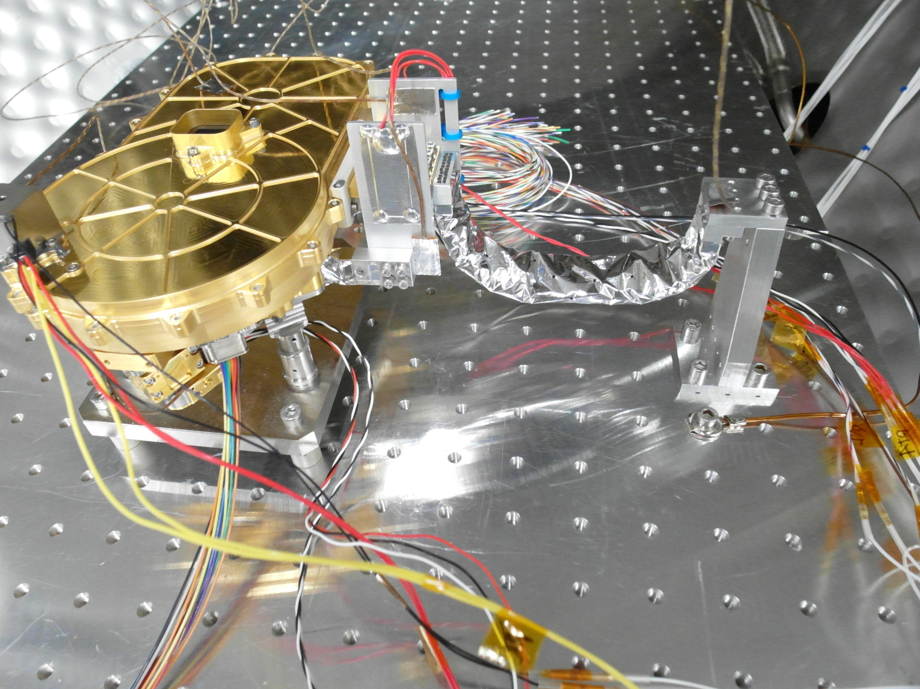
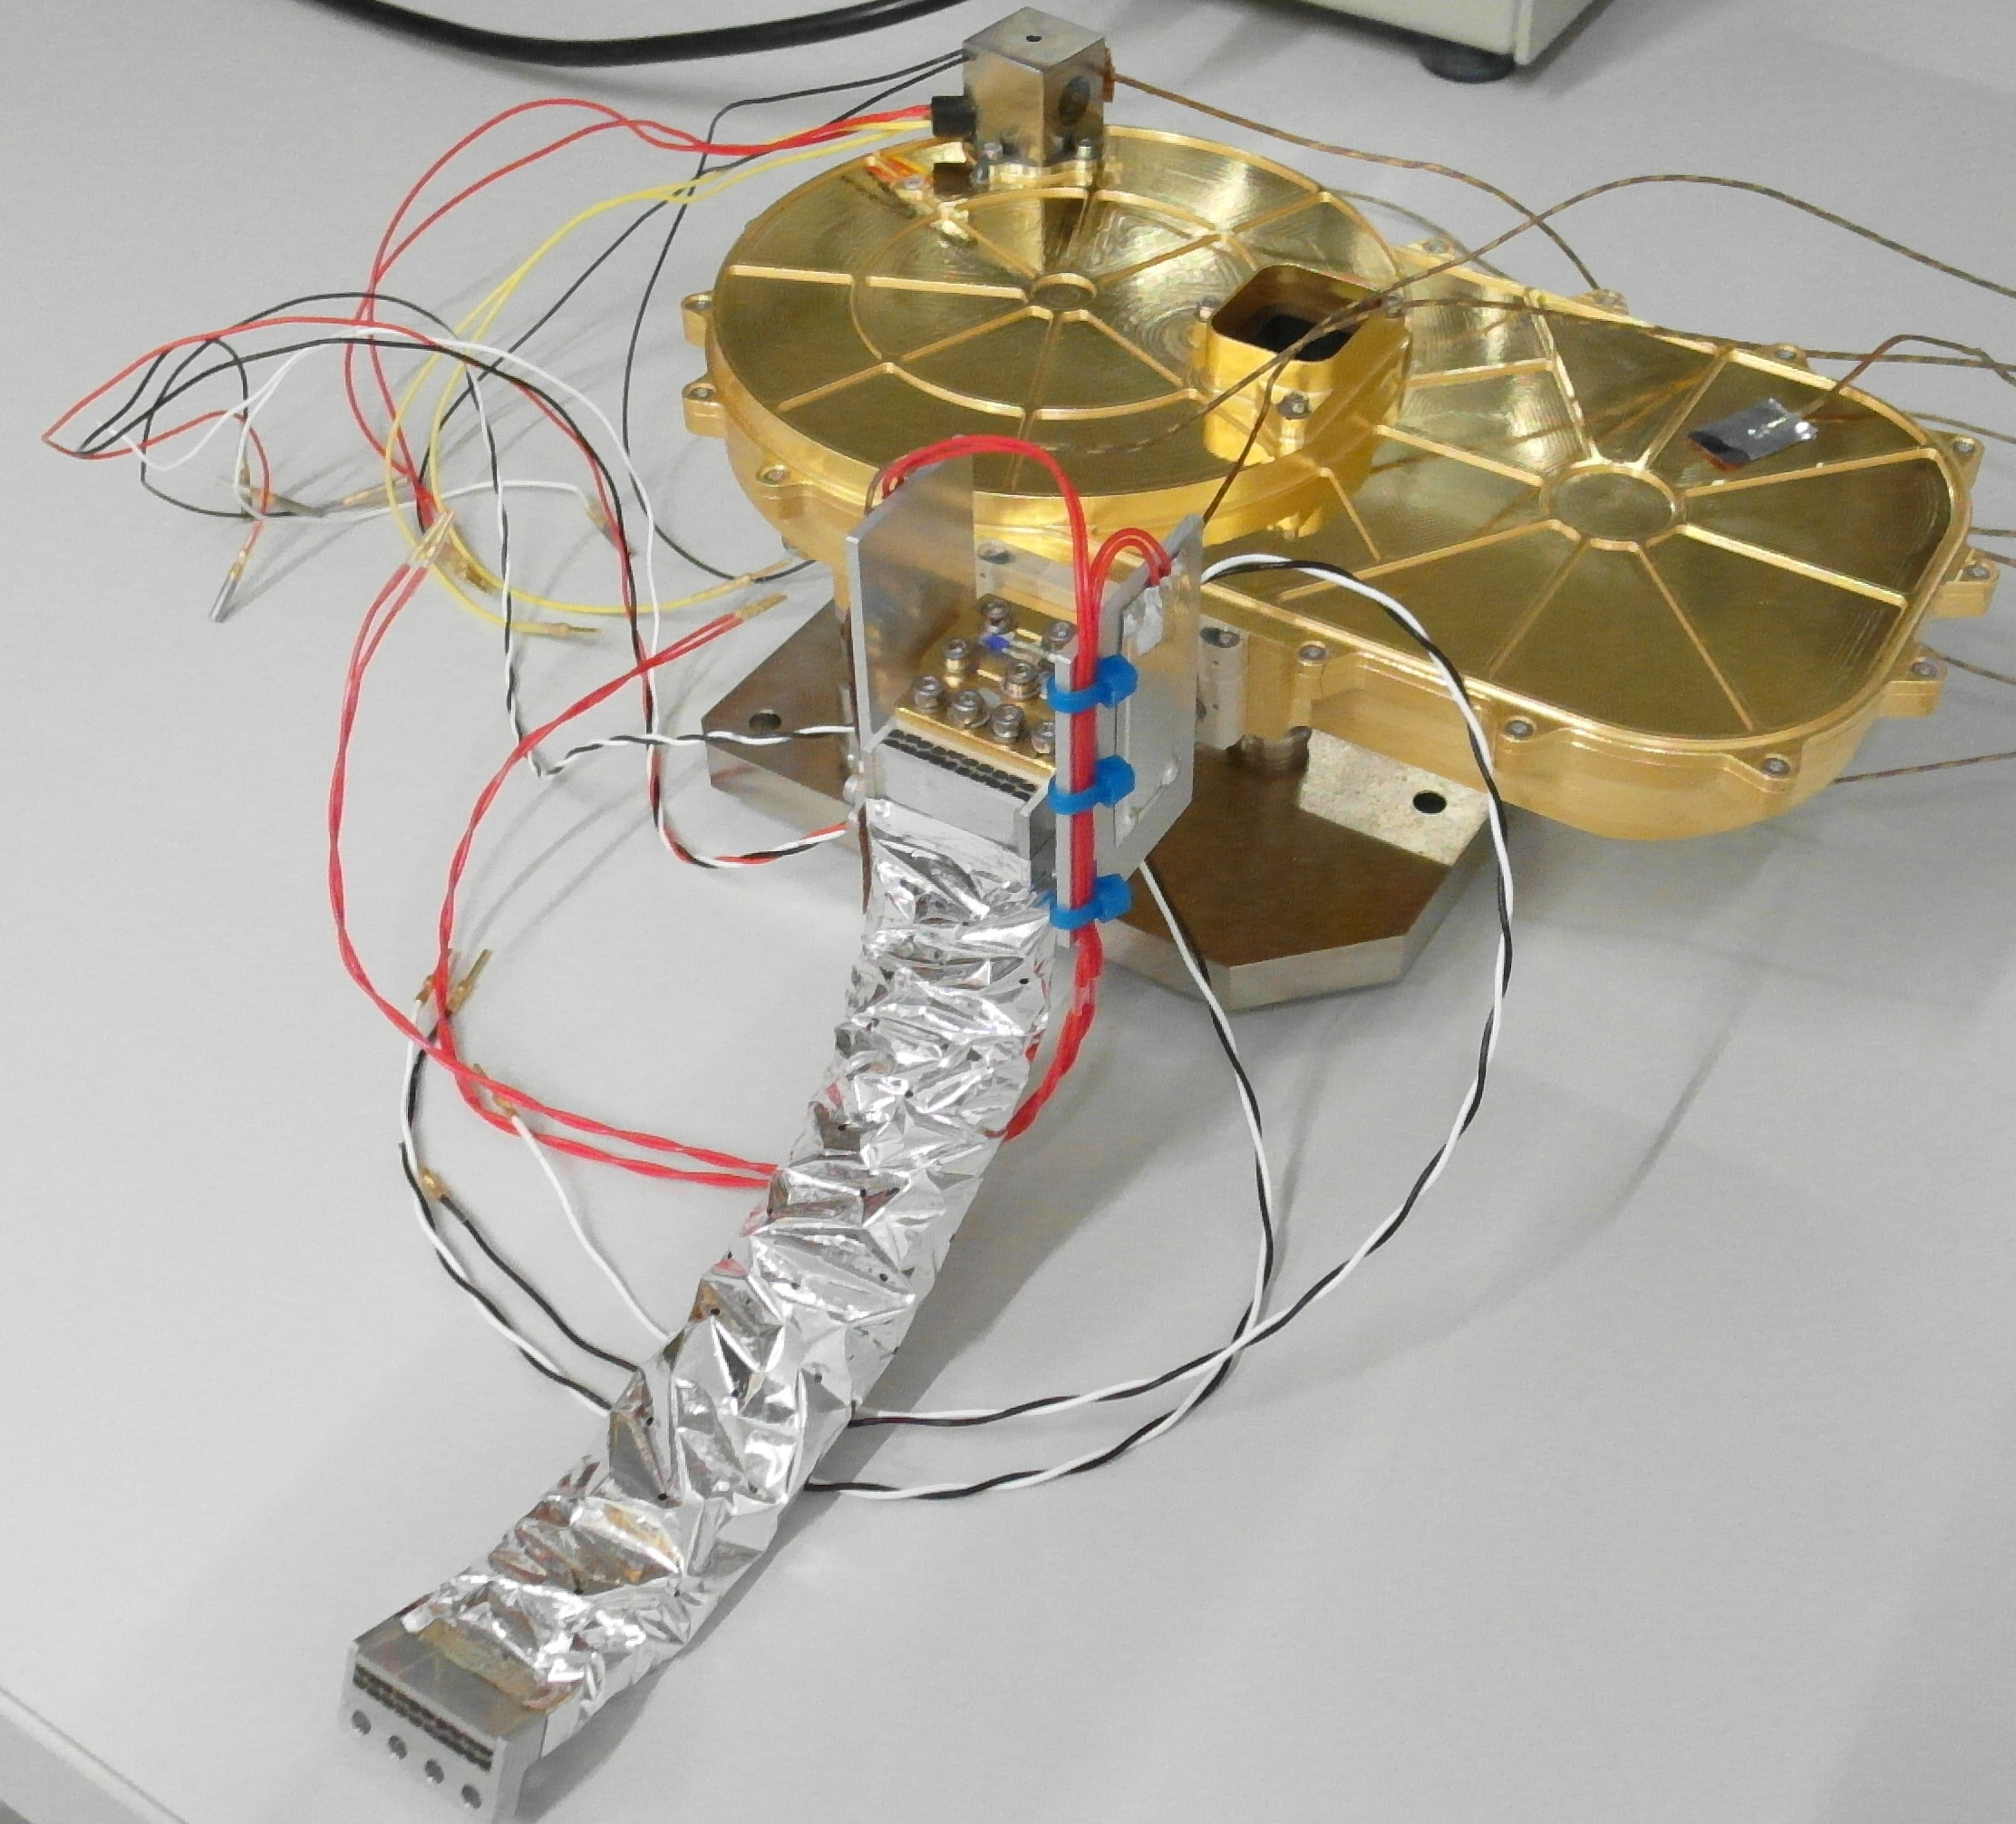
FPA MT-EQM
ToDo
FPA EQM correlation
STM thermal balance test of both Electronic boxes
Notes:
Mechanical Thermal flight like representation, but Electronics in STM quality.

Slide 14
Thank you!
Special thanks to Airbus for providing us Thermica!

Slide 15
Links to project websites
https://www.cometinterceptor.space/
https://www.cosmos.esa.int/web/comet-interceptor/home
https://www.space.unibe.ch/

