Slide 1
IADC-41 @ESA in Darmstadt, Germany

Slide 2
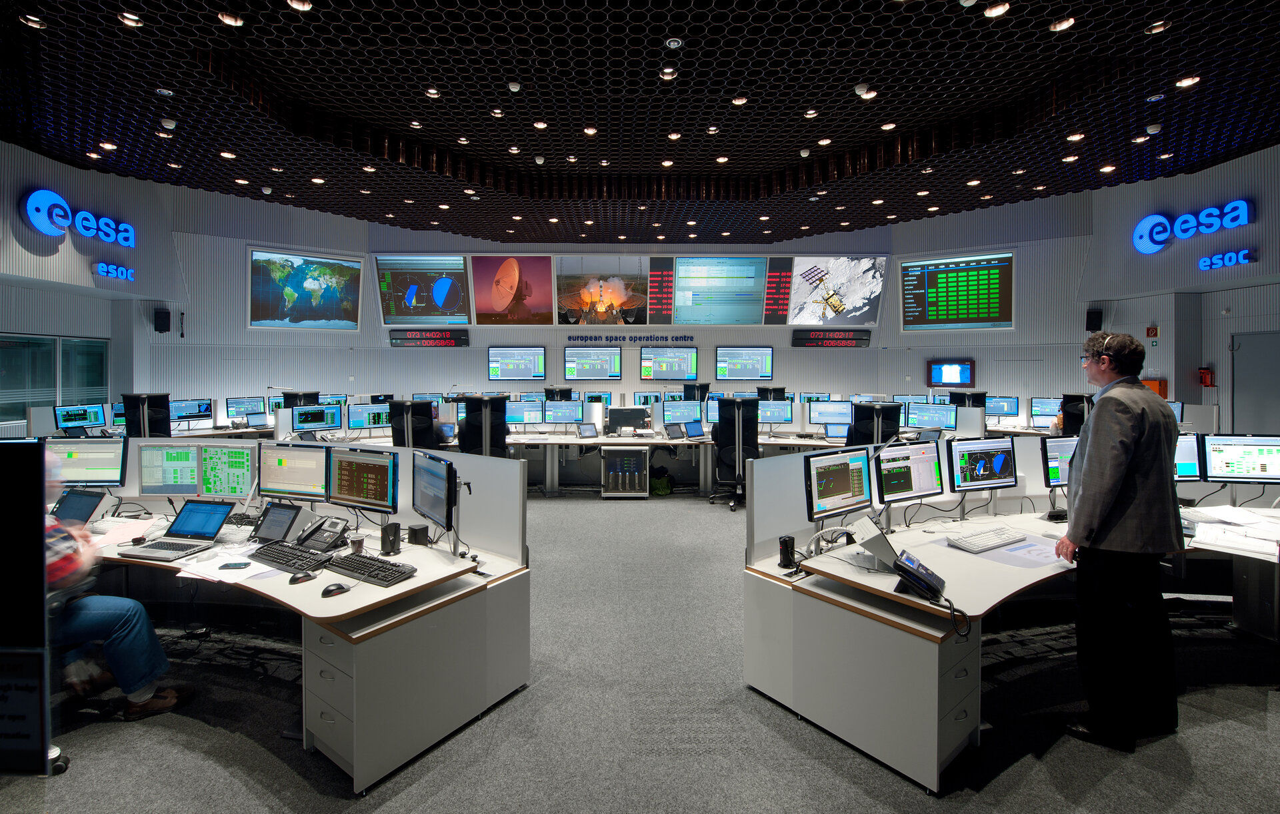
Overview
June 12 -15, 2023
ESA/ESOC, Darmstadt, Germany

Slide 3
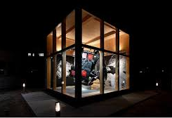
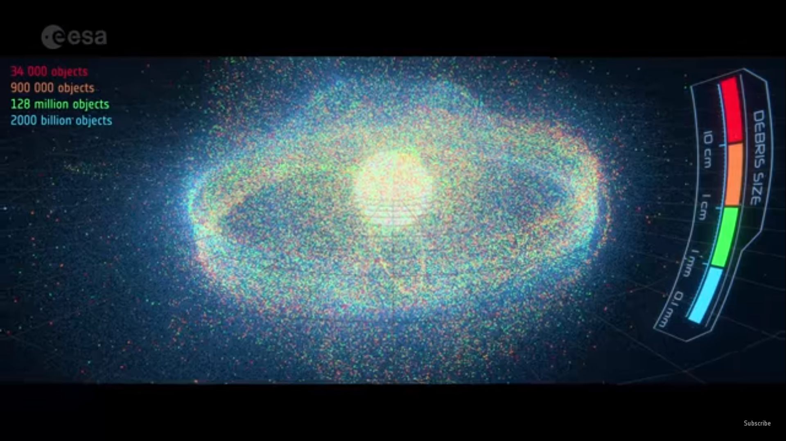
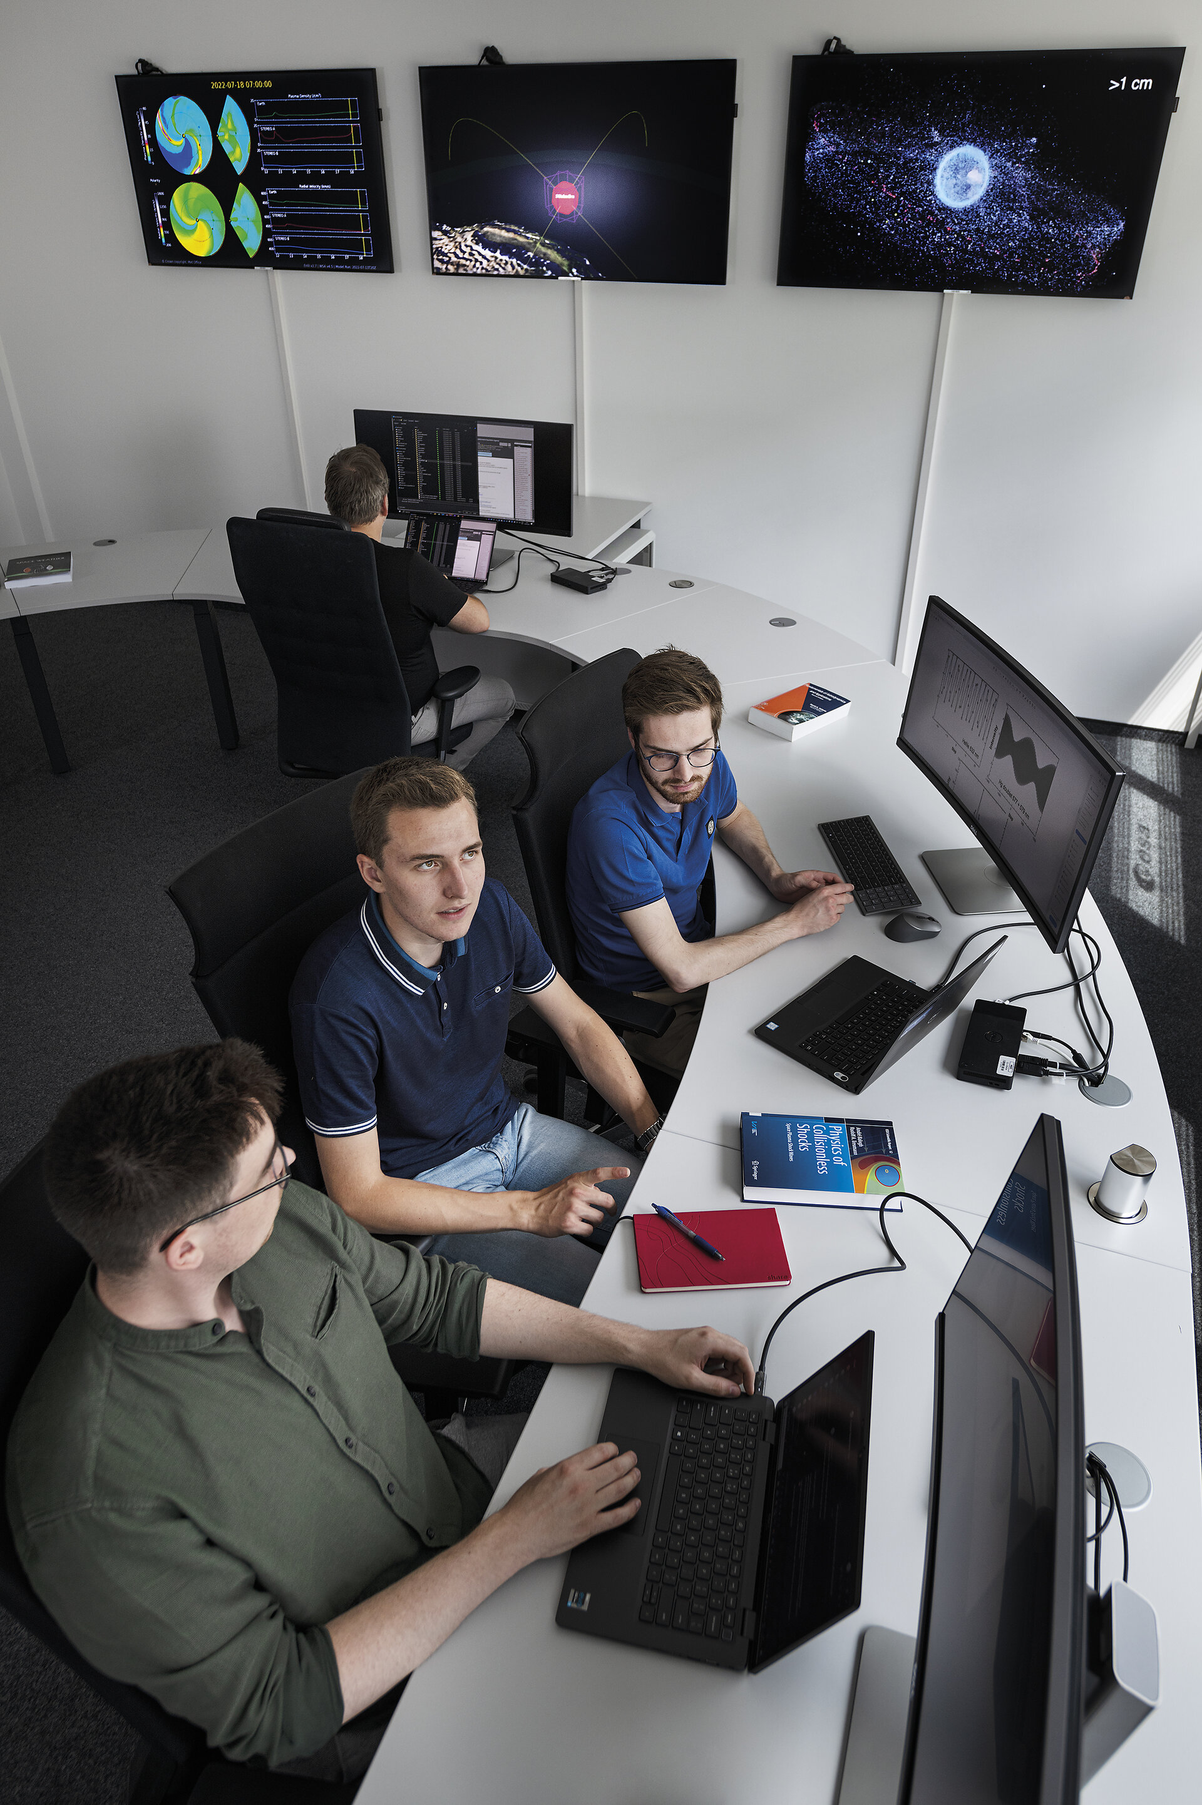
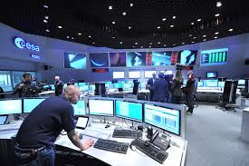
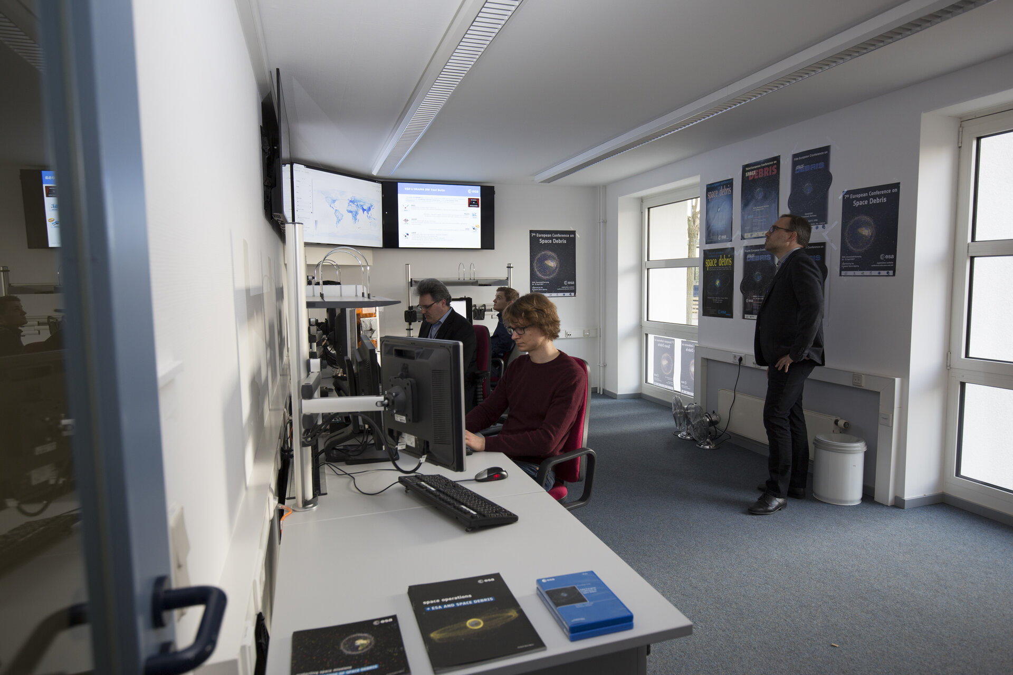
ESOC

Slide 4

Logistics
WG1
Coffee & Lunch
H-I
Conference Centre (Building H)
H-II/III
H-IV
Foyer (1)
WG2
H-V/VI
WG3
WG4
Lower Foyer (F)
SG: K112
Plenary Session
Joint WG Sessions
Ground Level (0)
Entrance
Pressconference Centre

Slide 5
Meeting Agenda (1/4)

Slide 6
Meeting Agenda (2/4)

Slide 7
Meeting Agenda (3/4)

Slide 8
Meeting Agenda (4/4)

Slide 9
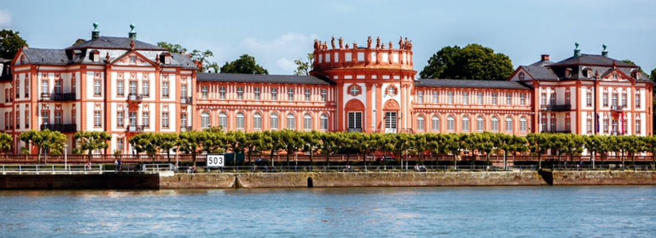
Logistics
There will be free coffee, tea, and water during the IADC meeting. Also free lunches will be provided to IADC delegates.
Reception: Monday, June 12th, at the ESOC canteen, with free beverages and finger food
IADC Dinner: Wednesday, June 14th at Schloss Biebrich, Wiesbaden.

Slide 10
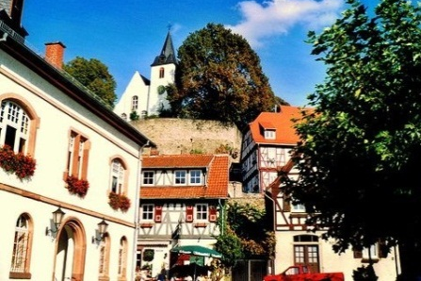

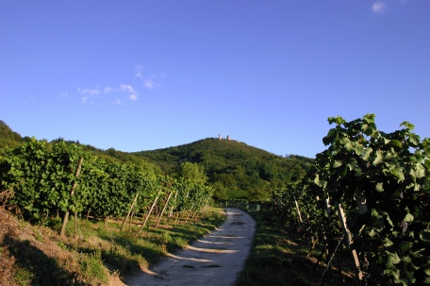
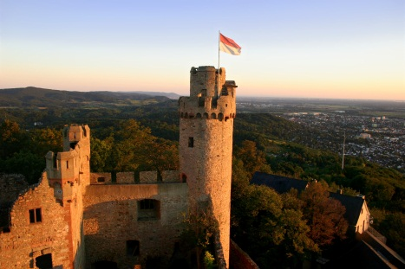
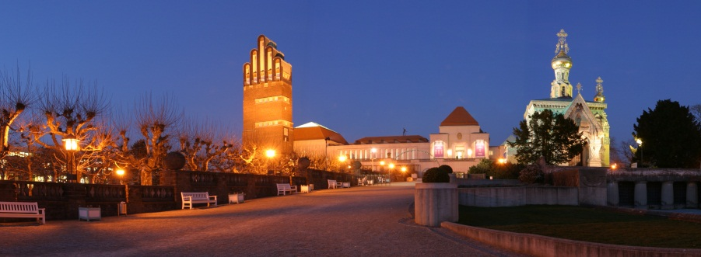
Explore the Vicinity

