Slide 1
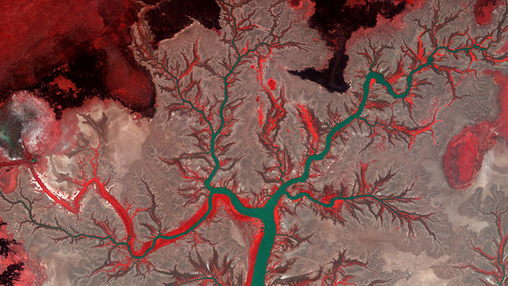
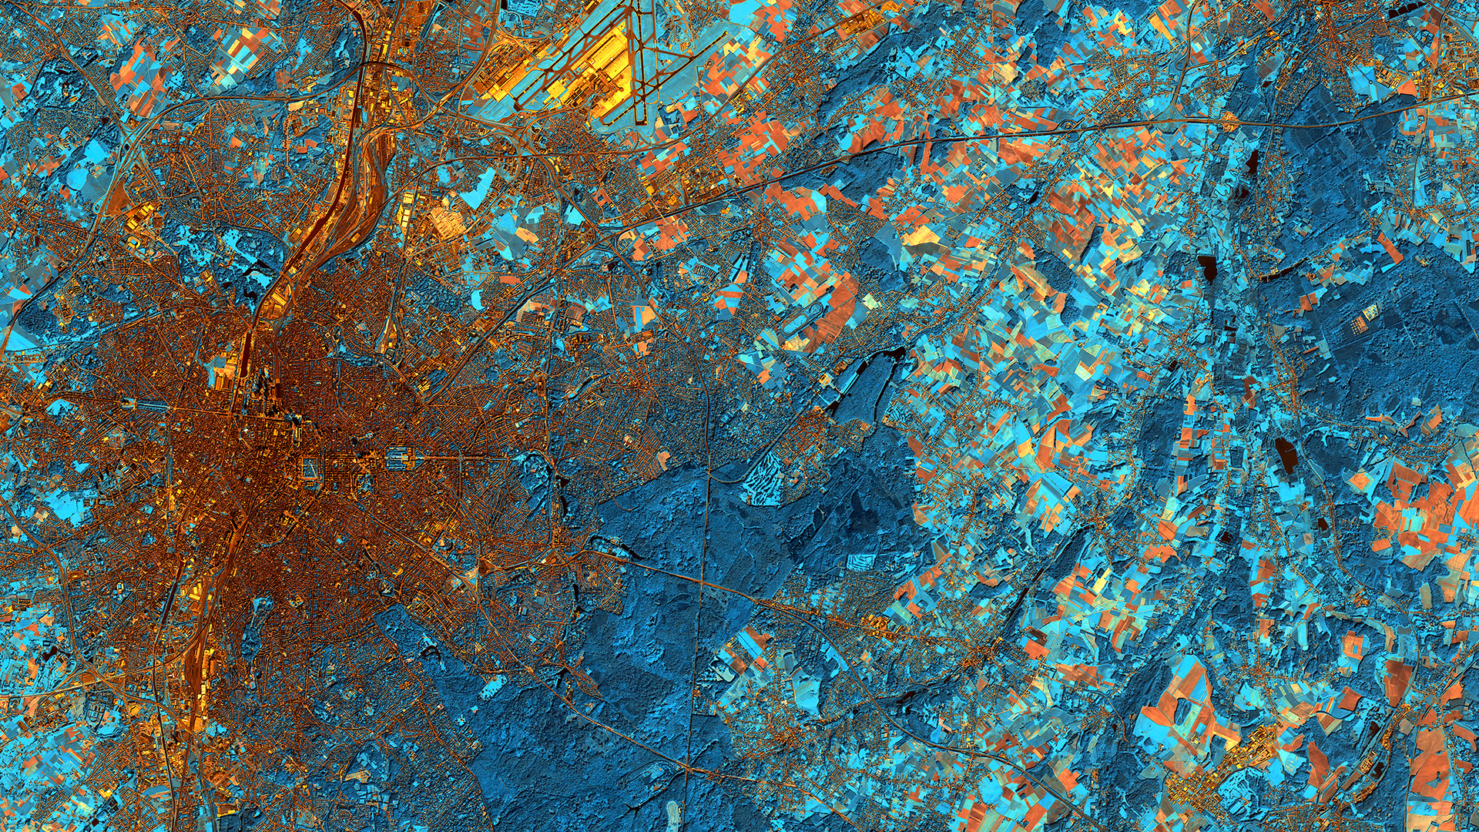
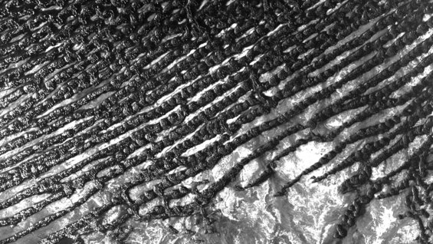
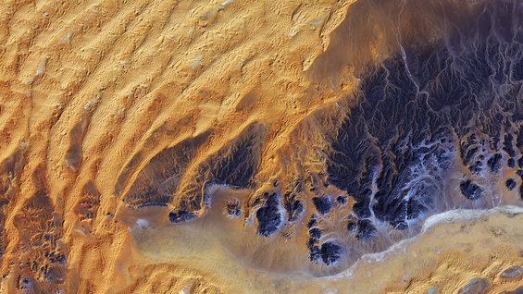
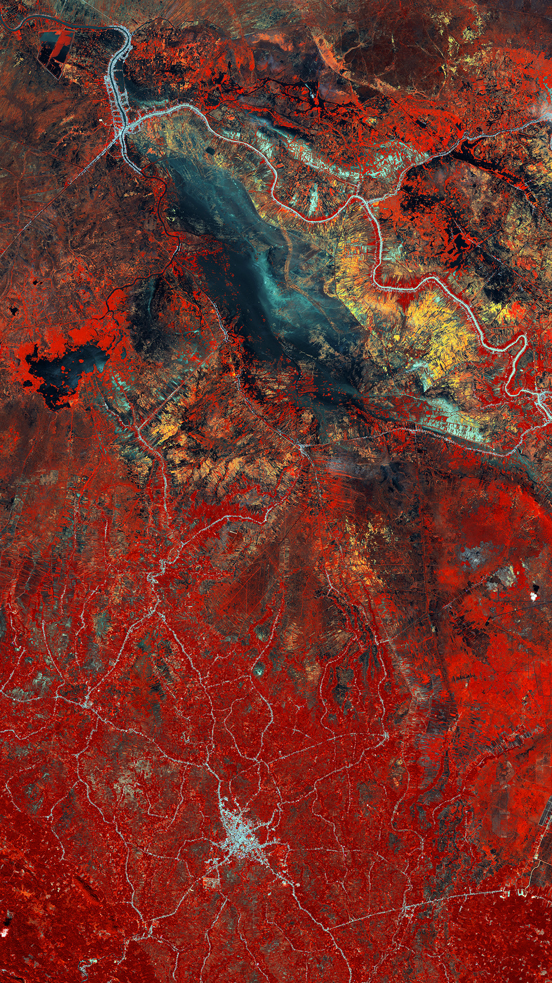
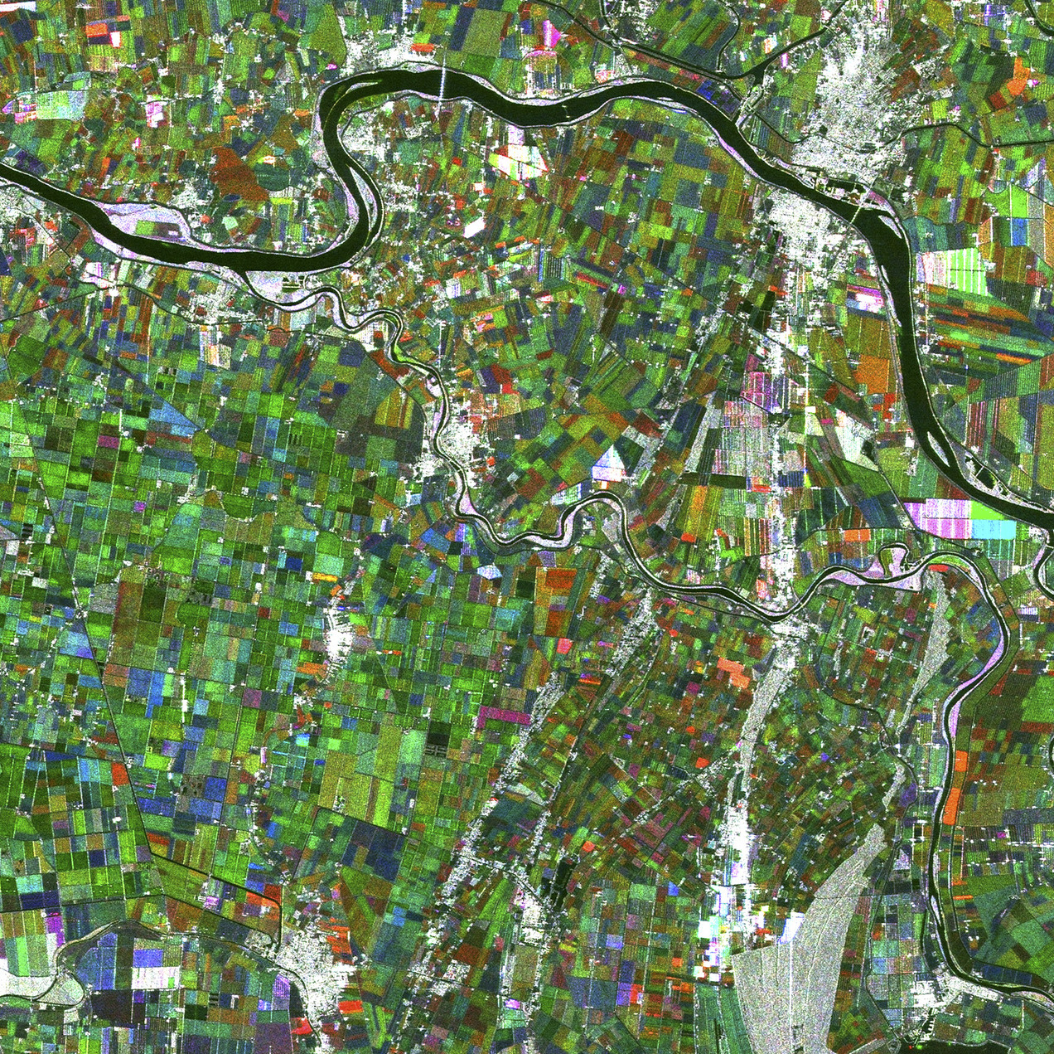
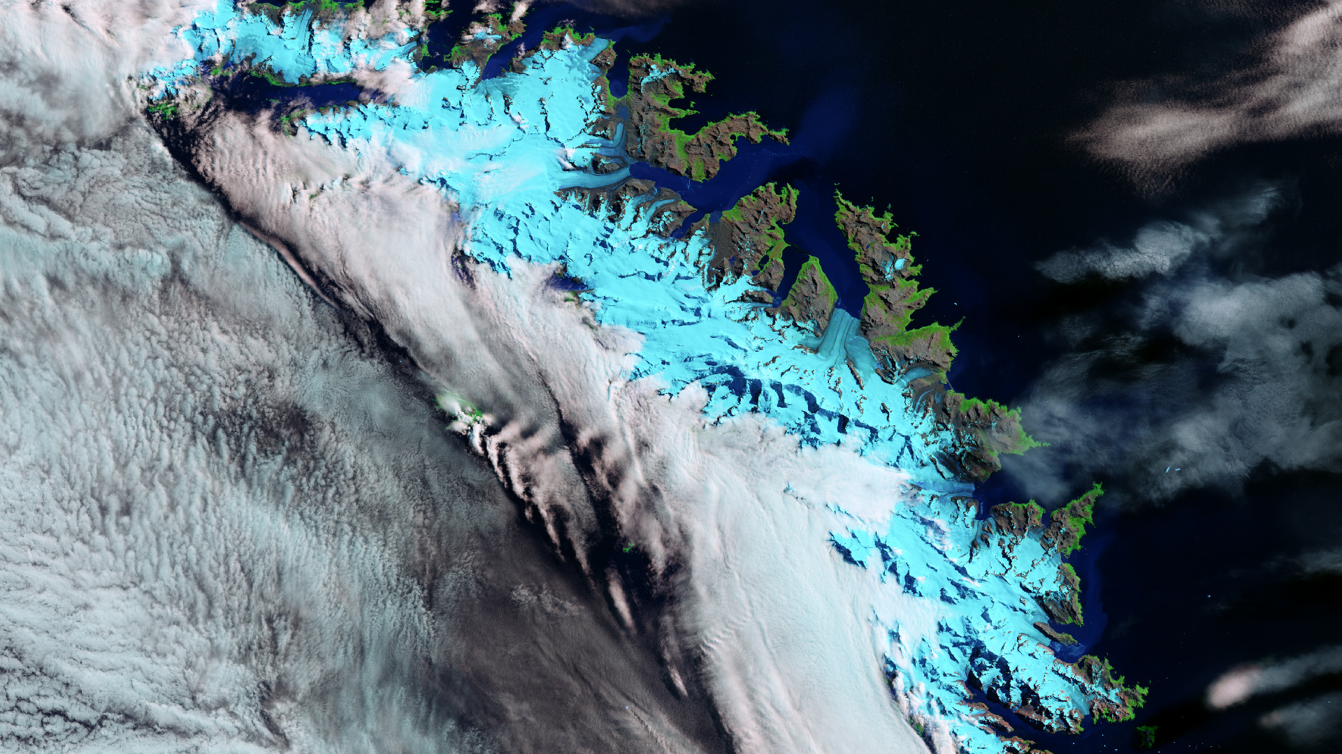
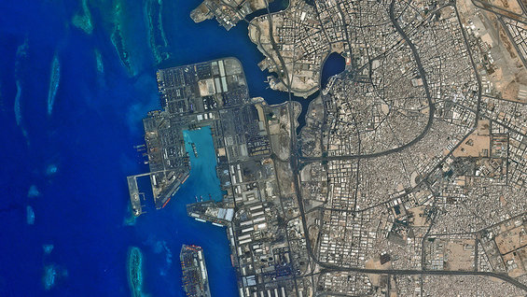
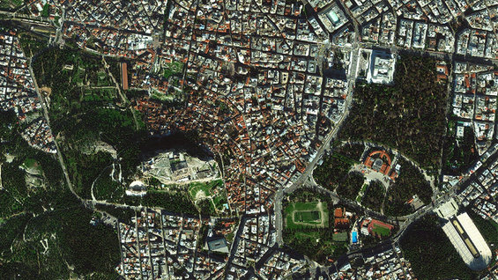
Definition of Sustainable Development Goals based indices for the Earth observation missions assessment
Marco Nugnes, Camilla Colombo, Chiara Zuliani, Valerio Santoro
Politecnico di Milano
Space Capacity allocation for the sustainability of space activities Workshop, Milan, 6-8 June 2023

Slide 2
Agenda
1. Introduction
Background overview
Sustainable Development Goals 2030
Earth observation services
2. Modelling
3. Results
4. Conclusions and future developments

Slide 3
Introduction
Background overview
Space Economy: entire value chain that, starting from research, development and manufacturing of enabling space infrastructures (upstream) goes up to the production of innovative enabled services (downstream)^{[1]}
Wellbeing Economy: capacity to create a virtuous circle in which citizens’ well-being drives economic prosperity, stability and resilience […] ^{[2]}
[1] https://www.mise.gov.it/images/stories/documenti/all_6_Piano_Strategico_Space_Economy_master_130520 16_regioni_final.pdf
[2] https://www.oecd.org/
[3] https://www.eib.org/attachments/thematic/future_of_european_space_sector_en.pdf
[4] https://www.wwf.eu/?uNewsID=875891
Wellbeing Economy infographic. Courtesy of World Wide Fund [4].
Notes:
- Sottolineare che si sta sviluppando un indice che valuta l’effetto di una missione spaziale in termini di benefits alla società basato sugli SDGs.
As you can.. Growing double rate
Let me now intro.. Newborn.. Endorsed by Council of EU and embraced by Iceland, Scotland, Finland and New Zeland joining WEGo network
Infographic – GDP growth persp – societal thriving – wellb of citizens and the planet. SDGs can guide decision making

Slide 4
Introduction
Sustainable Development Goals 2030
The 17 Goals were adopted by all UN Member States in 2015, as part of the 2030 Agenda for Sustainable Development which set out a 15-year plan to achieve the Goals
Courtesy of the United Nations [4].
[4] https://www.un.org/sustainabledevelopment/news/communications-material/

Slide 5
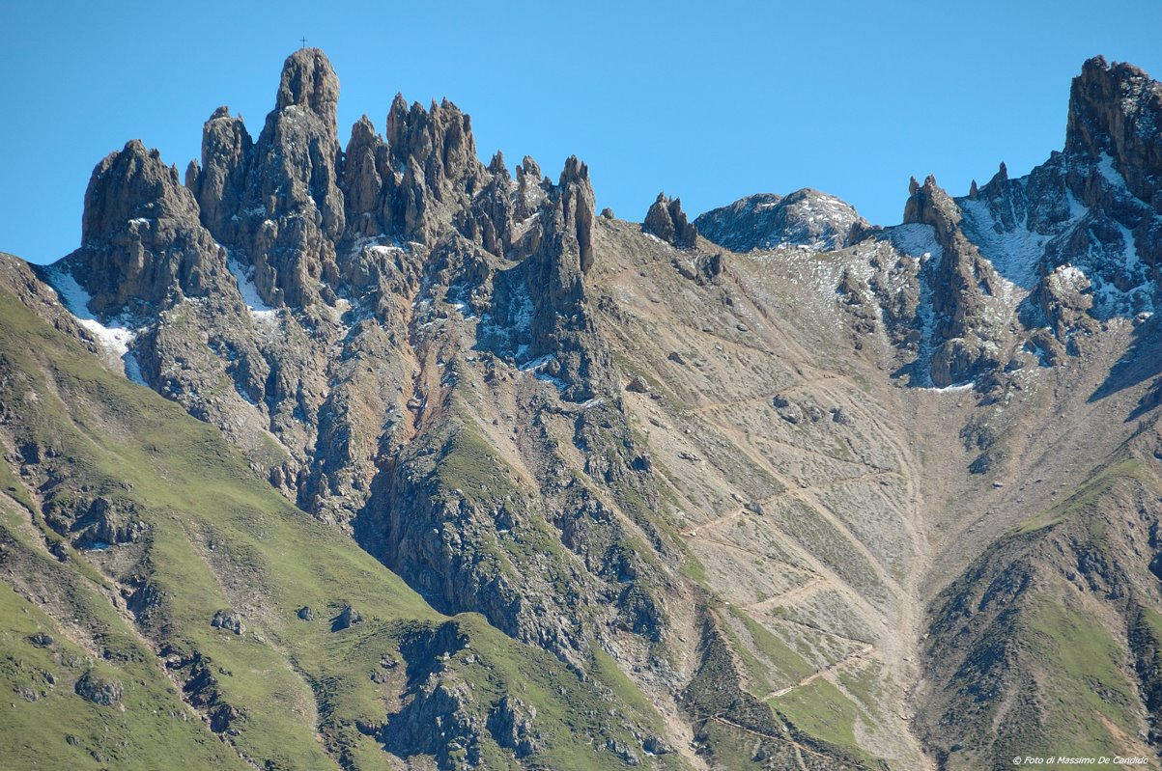
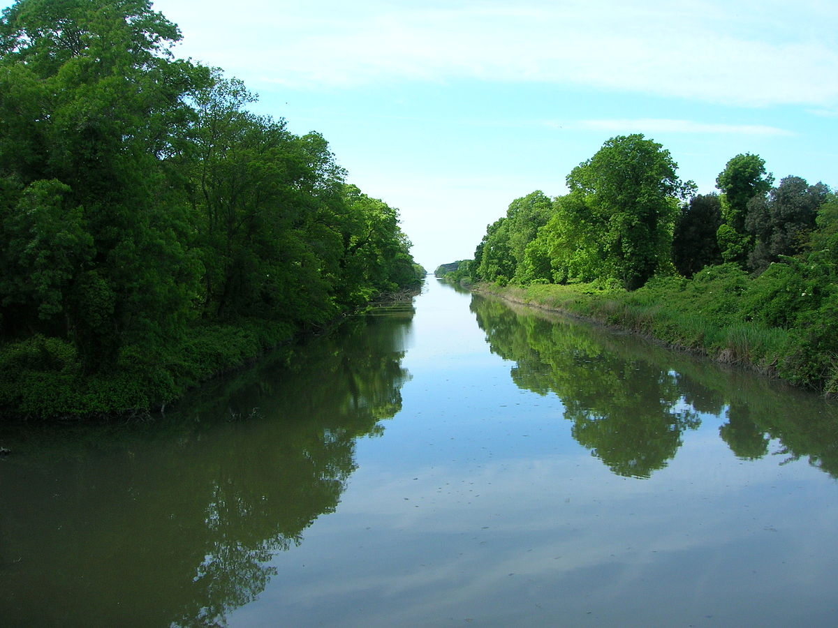
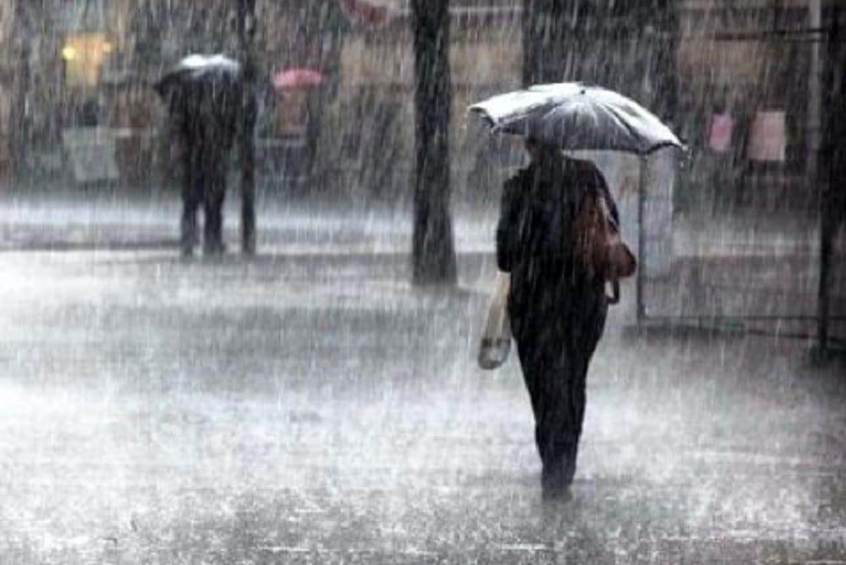
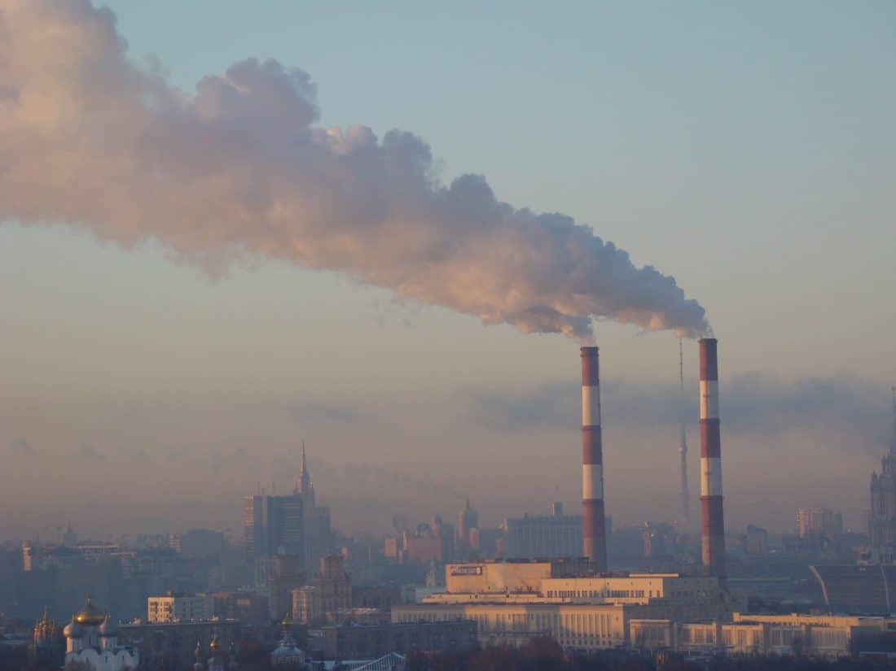
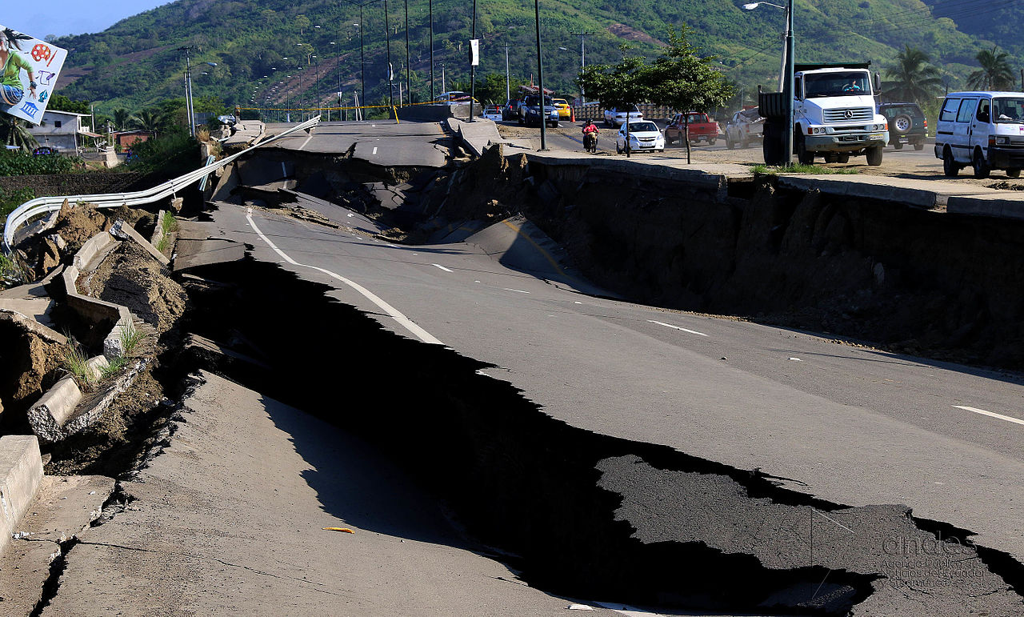
Introduction
Earth observation services
Built-up land (Blt)
Agriculture (Agr)
Wild nature (Wild)
Geology (Geo)
Limnology (Limn)
Oceanography (Ocean)
Meteorology (Meteo)
Air Quality Monitoring
(AQM)
Hazards monitoring (Haz)
Questa foto di Autore sconosciuto è concesso in licenza da CC BY-SA-NC

Slide 6
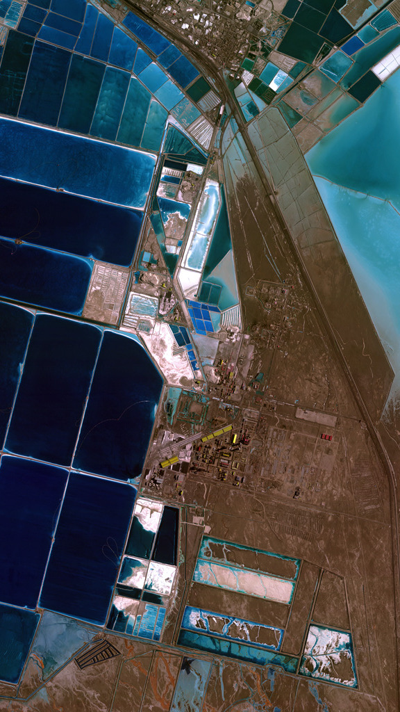
Agenda
1. Introduction
2. Modelling
Performance indices
Mission and sensors analysed
Flowchart
Spatial resolution index
Temporal resolution index
Spectral efficiency index
Earth coverage index
3. Results
4. Conclusions and future developments

Slide 7
Modelling
Performance indices
The core of the modelling is made of the four performance indices focusing on the payload and orbit main characterizing factors.
Spatial resolution index I_{SR} (0-100)
Spectral efficiency index I_{Spectr} (0-100)
How well?
What?
Temporal resolution index I_{TR} (0-100)
Earth coverage index I_{Cov} (0-100)
How frequently?
Where?

Slide 8
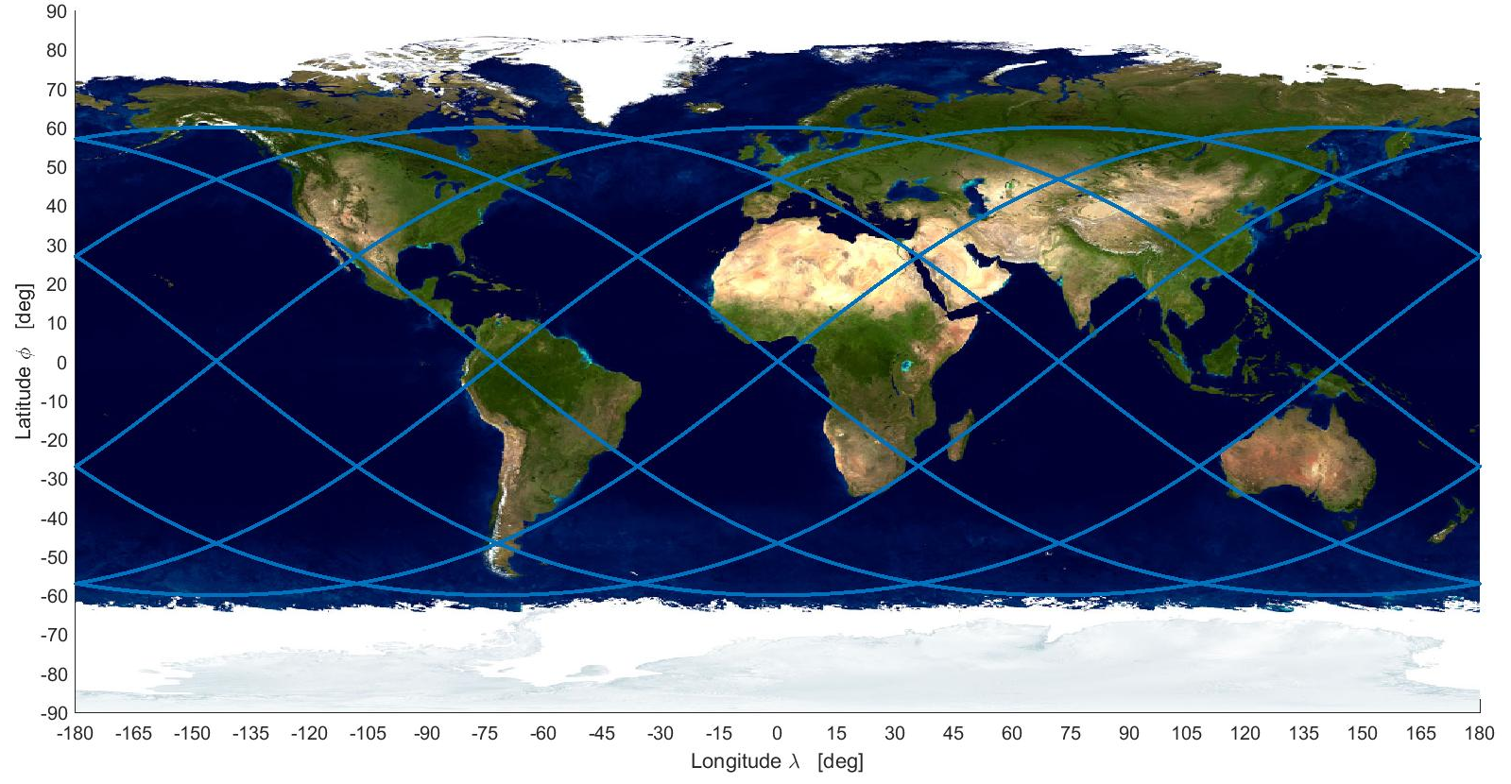
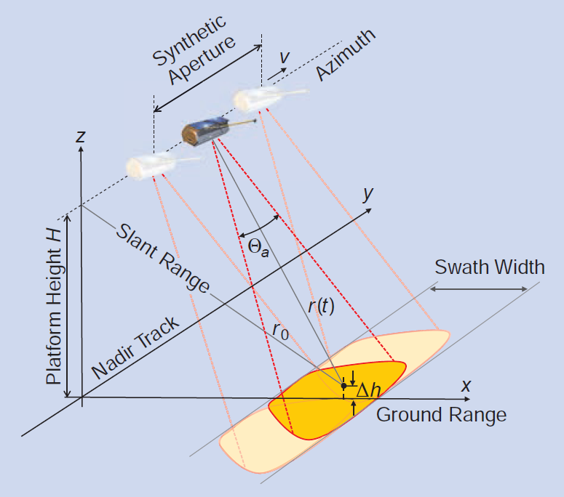
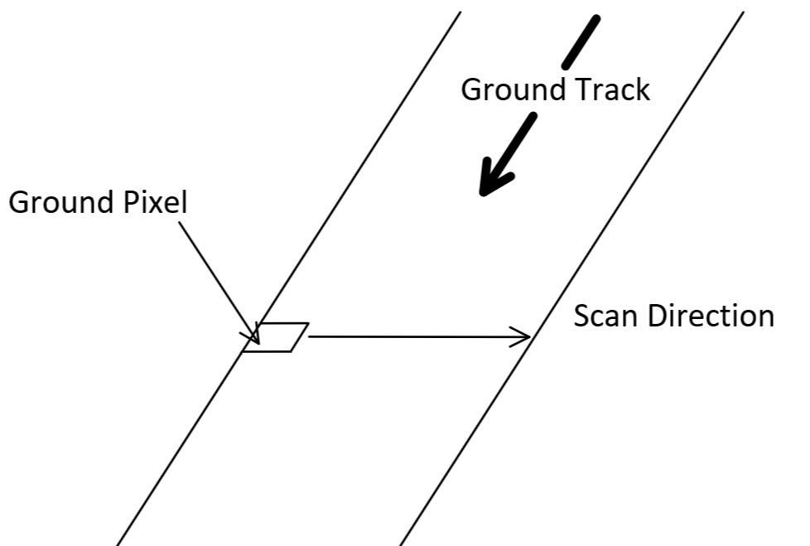
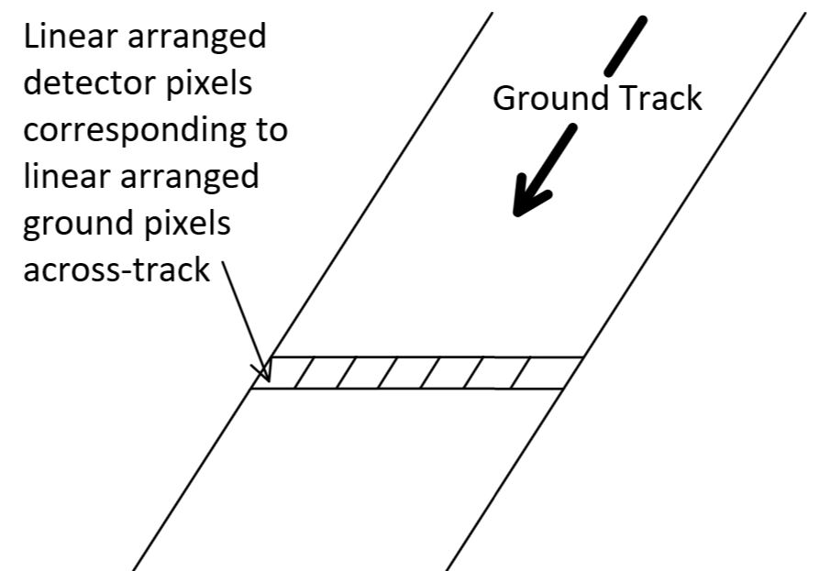
Modelling
Missions and sensors analysed
Union of Concerned Scientists database lists 2787 operational satellites around the Earth. 28% (785 satellites) are for Earth observation (EO), of which more than 93% lie on Low Earth Orbits (LEO)
Orbits considered: Sun-synchronous orbits (73% of LEO EO missions). All have eccentricity values < 0.01, hence the assumption of circular orbits. Finally, assumption of repeat ground track orbits
Sensors considered: passive (whiskbroom, pushbroom) and active (Synthetic Aperture Radars)
Whiskbroom
Pushbroom
Synthetic Aperture Radar (SAR)
[5] A. Moreira. “A tutorial on Synthetic Aperture Radar”, IEEE Geoscience and Remote Sensing Magazine, 2013
Courtesy of Moreira [5]

Slide 9
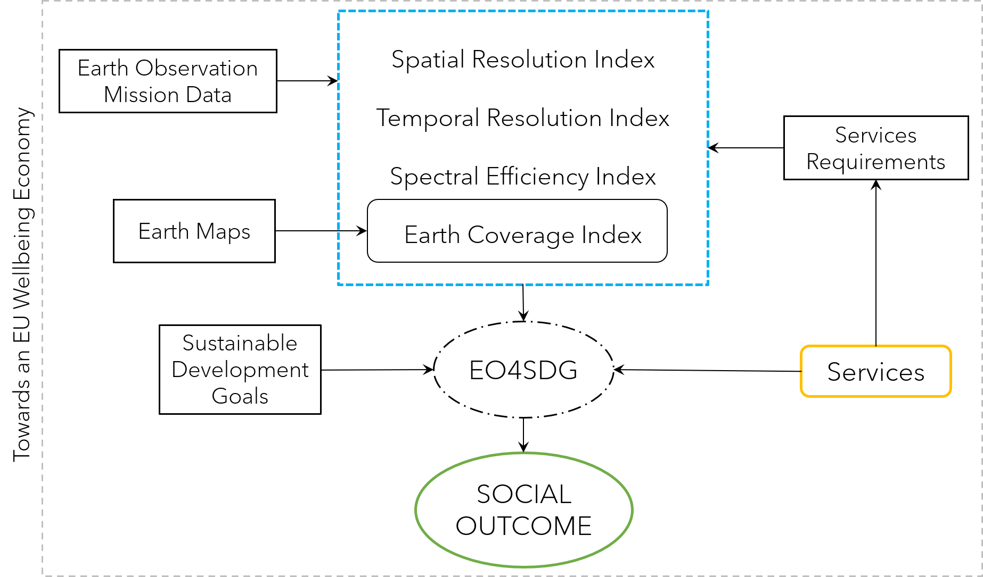
Modelling
Flowchart
Notes:
- Starting from EO mission data (orb and sens tech par) and from the ident of sev services

Slide 10
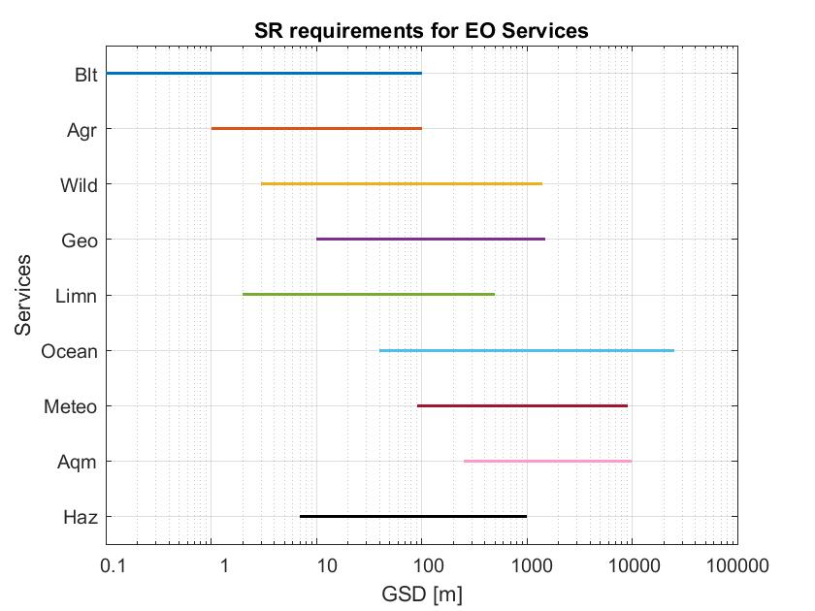
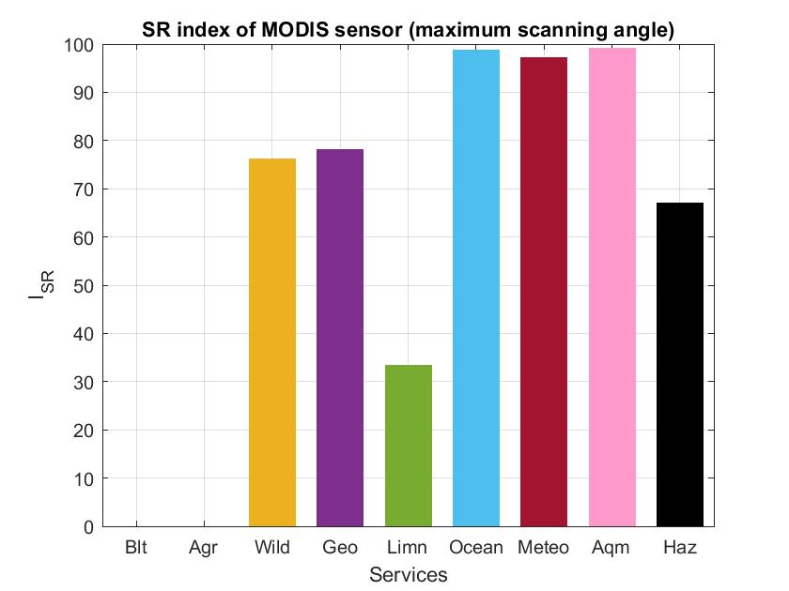
Modelling
Spatial resolution index
Ground Sample Distance (GSD): the pixel size on the ground surface measured by the instrument
Requirements
Model
Model validation
Whiskbroom sensor
Computed GSD | Literature GSD | Error
250.00 m | 250 m | 0%
GSD model validation for MODIS sensor on-board Terra
Pushbroom sensor
Computed GSD | Literature GSD | Error
20.00 m | 20 m | 0%
GSD model validation for HRVIR sensor on-board SPOT-4
SAR sensor
Variable | Computed | Literature | Error
Range resolution | 17.33 m | 18 m | 3.72%
Azimuth resolution | 5.95 m | 6 m | 0.83%
Index definition
$$I_{SR}= \frac{{SR}_{service,max} − {SR}_{operative}}{{SR}_{service,max} − {SR}_{service,min}} 100$$
Spatial resolution model validation for SAR on-board JERS-1

Slide 11
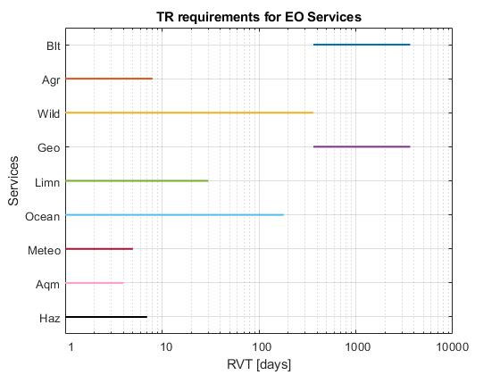
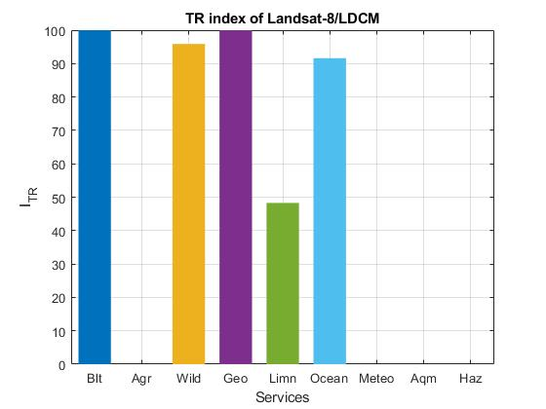
Modelling
Temporal resolution index
ReVisit Time (RVT): time elapsed between two successive observations of the same ground point on the surface of the Earth
Requirements
Model
Model validation
Variable | Computed | Literature | Error
S’_{width} | 735.35 km | 735.43 km | ~ 0%
RVT | 4 | 4 | 0%
RVT_{min} | 1 | 1 | 0%
RVT model validation for HJ-1A satellite
Variable | Computed | Literature | Error
S’_{width} | 823.76 km | 830.17 km | 0.77%
RVT | 5 | 5 | 0%
RVT_{min} | 1 | 1 | 0%
Index definition
$$I_{TR}= \frac{{RVT}_{service,max} − {RVT}_{operative}}{{RVT}_{service,max} − {RVT}_{service,min}} 100$$
RVT model validation for IRS–P6 satellite

Slide 12
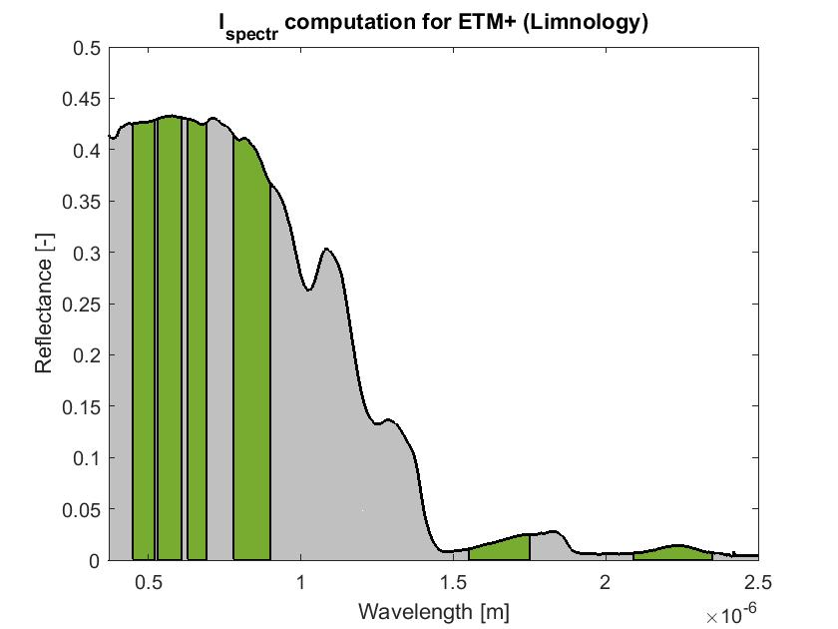
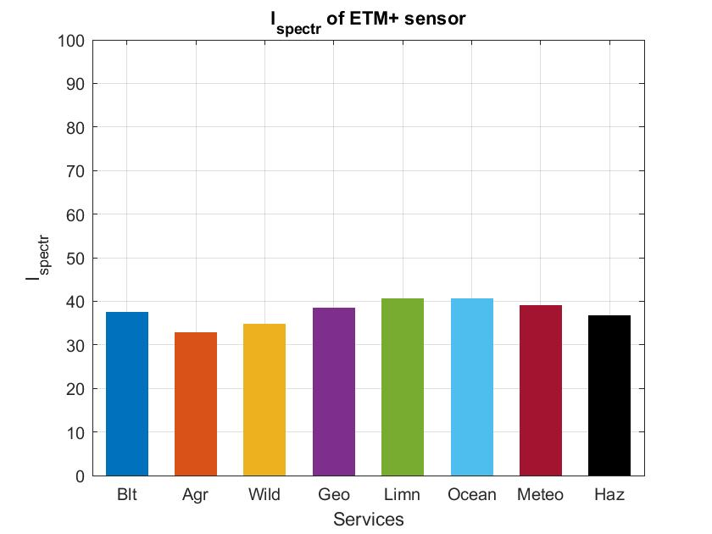
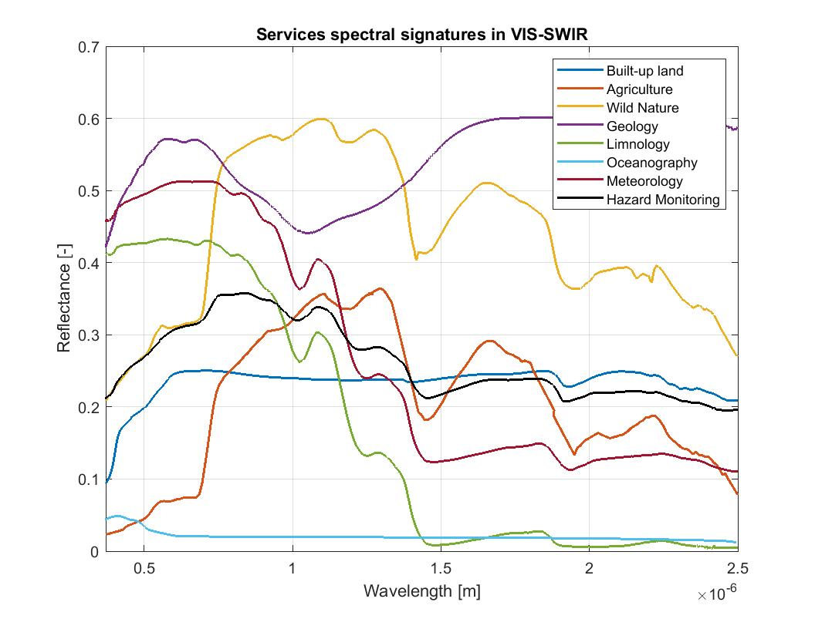
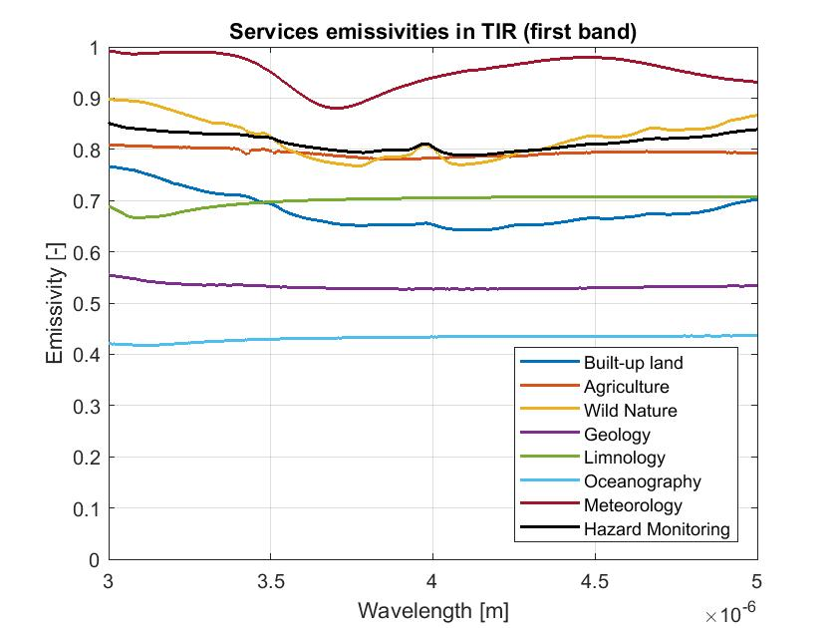
Modelling
Spectral efficiency index for passive sensors
reflectance in the VIS-SWIR domain (0.37 – 2.5 µm)
Spectral signatures based on
emissivity in the TIR domain (3 – 5, 8 – 14 µm)
Flowchart
Area-proportional evaluation
Index application
Services spectral signatures
$$I_{Spectr}= \frac{A_{operative}}{A_{service}} 100$$
Index definition
Final index obtained through a proportional-to-bandwidth average between I_{Spectr,VISSWIR} and I_{Spectr,TIR}

Slide 13
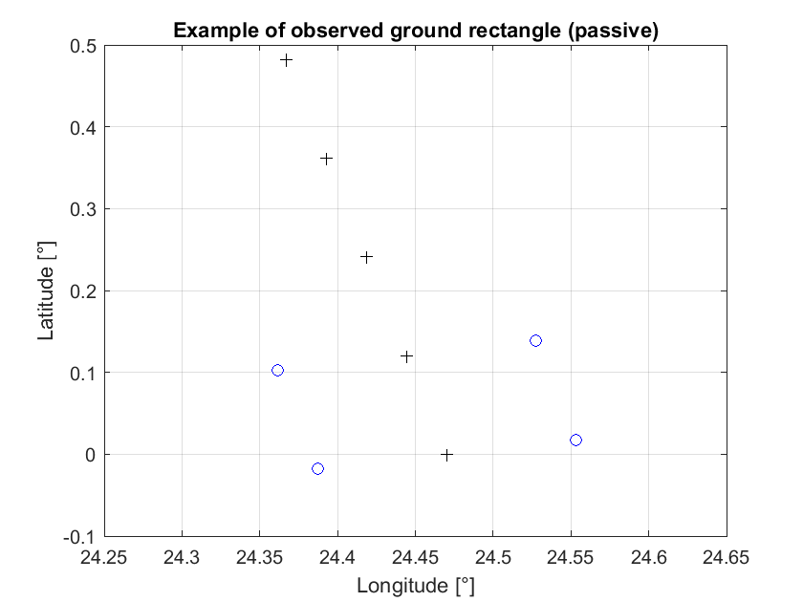
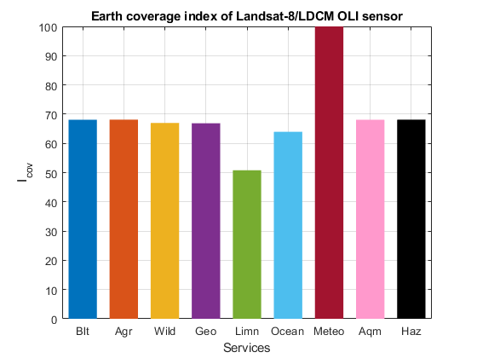
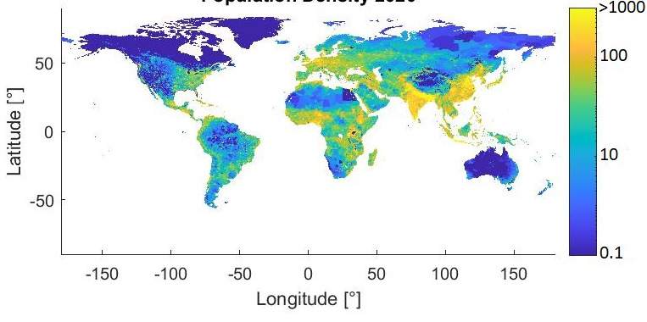
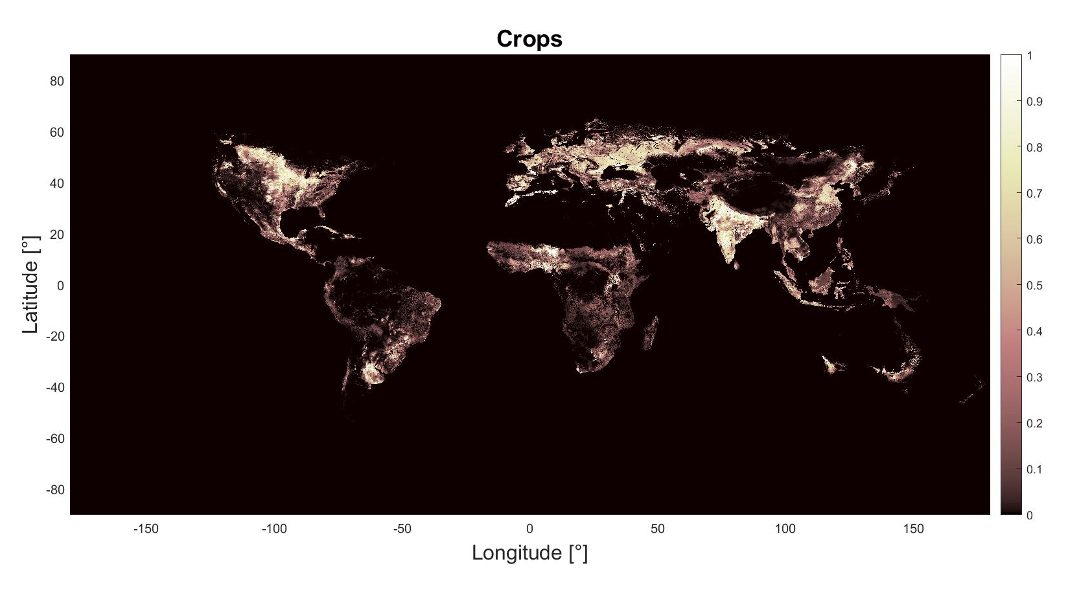
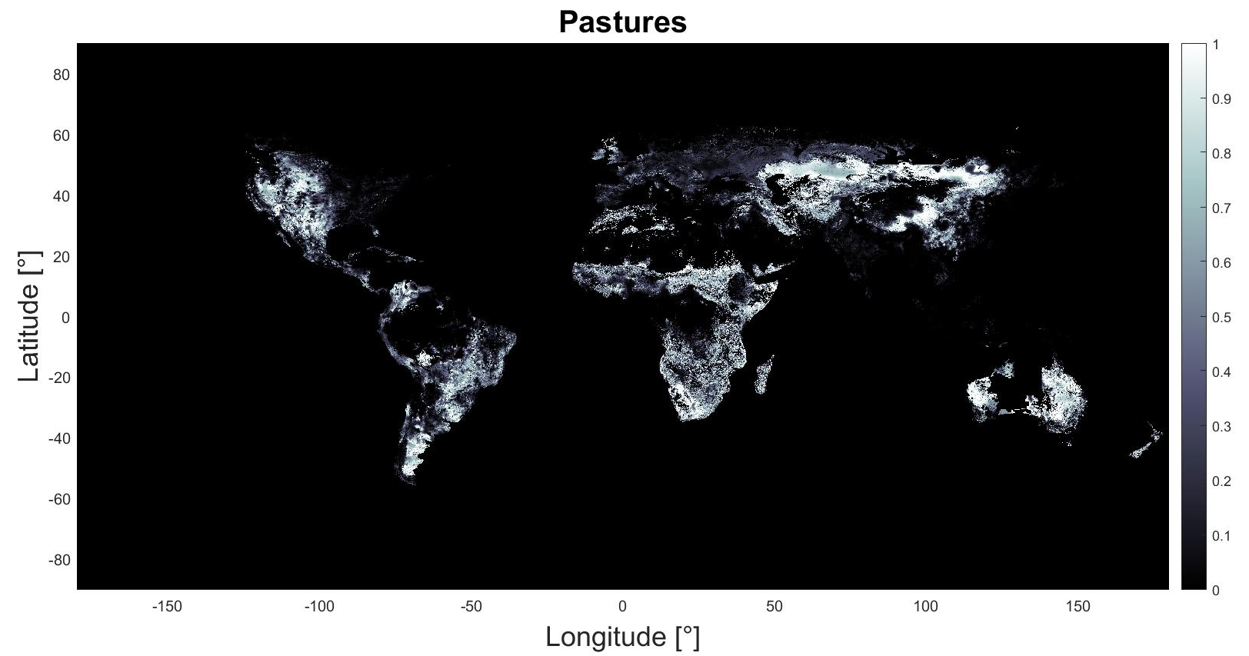
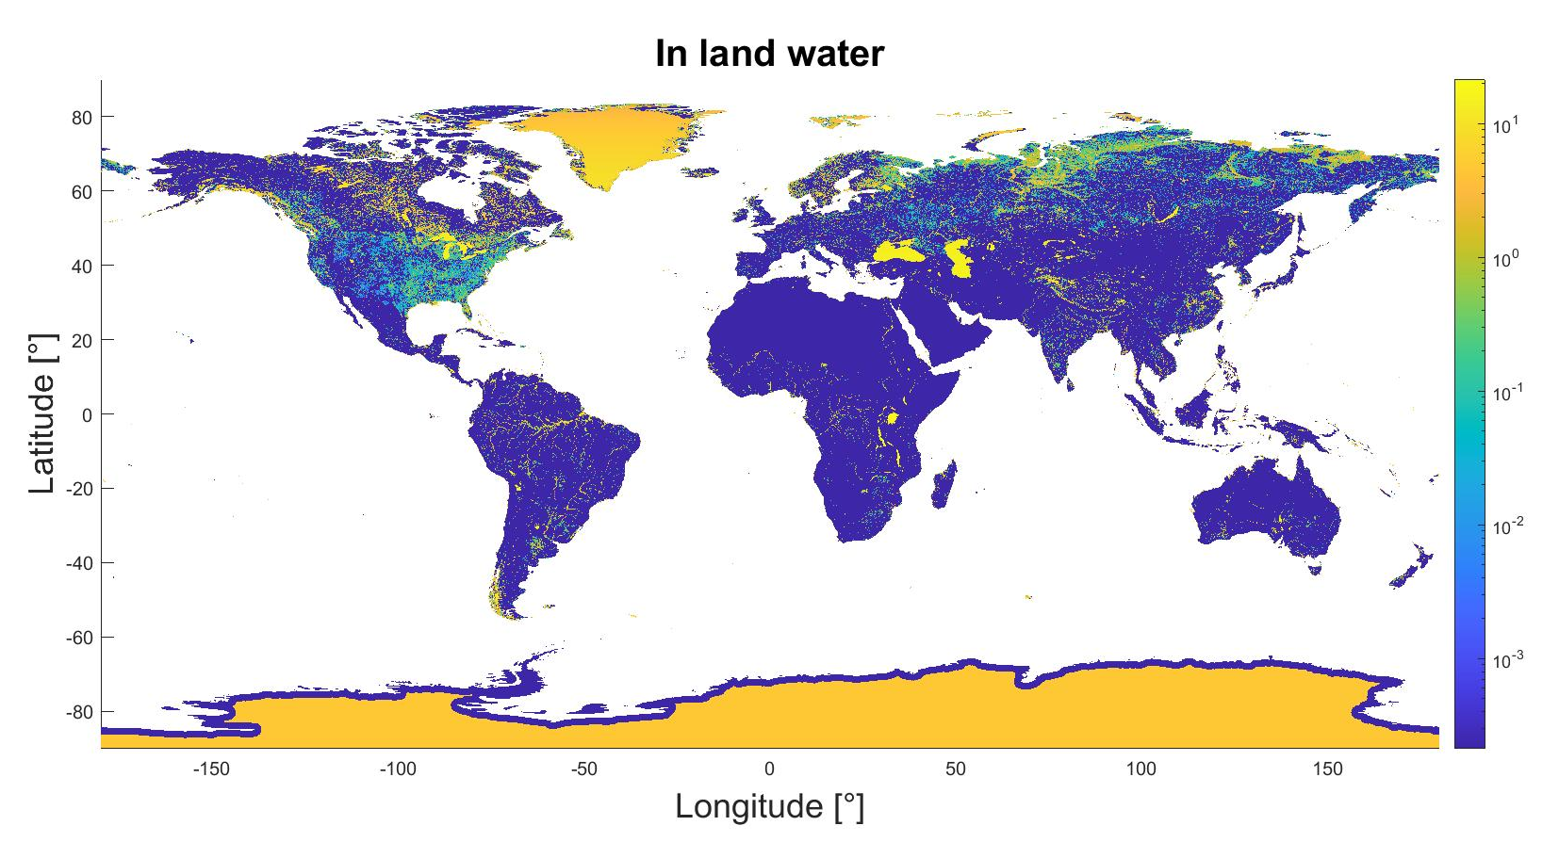
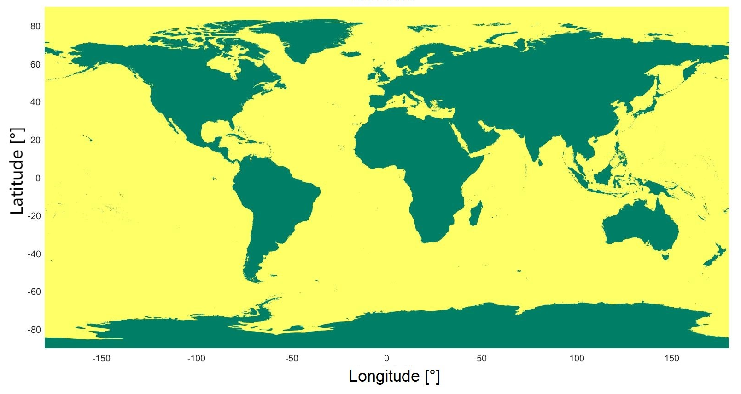
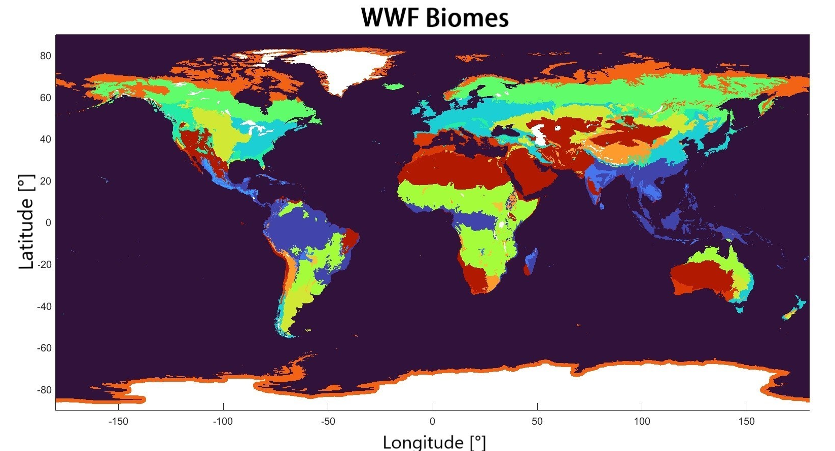
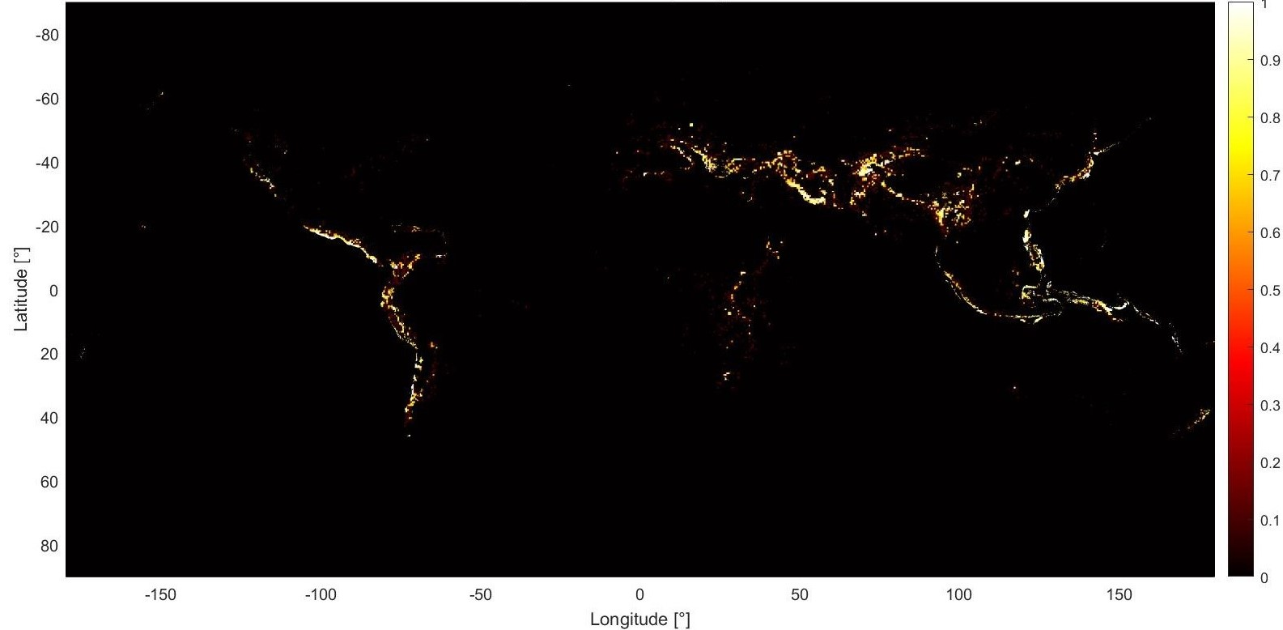
Modelling
Earth coverage index
The index is based on the service visibility in a repeat cycle with respect to the total service visibility
Datasets
Population density
Crops
Pastures
In-land water
Index definition $I_{vis}= \frac{n_{obs, serv}}{n_{tot, serv}} 100$
Oceans
WWF biomes
Earthquakes hazard
4320 x 8640 pixels services layers

Slide 14
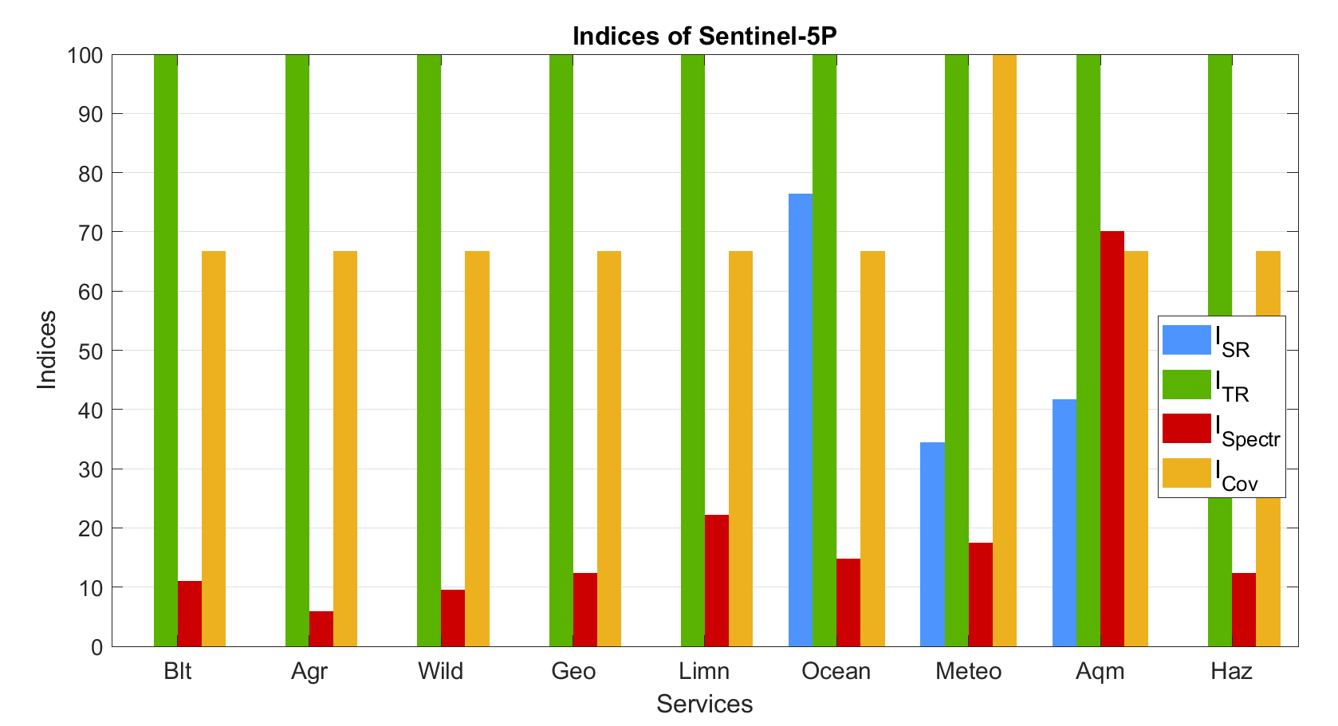
Modelling
Services indices
Services indices: the mean among the four aforementioned indices
E.g.
If $I_{Spectr}=0 ⟹I_{service}=0$
$$I_{blt}=\frac{I_{SR,blt}+I_{TR,blt}+I_{Spectr,blt}+I_{Cov,blt}}{4}$$

Slide 15
Agenda
1. Introduction
2. Modelling
3. Results
Earth observation for the Sustainable Development Goals 2030
Earth observation services contribution to the SDGs and SDG indices
Copernicus program evaluation
5. Conclusions and future developments

Slide 16
Results
Earth observation for the Sustainable Development Goals 2030
Identification of the role of each service to support the SDGs through several Activities, readjusted from the possibilities listed by UNOOSA and bearing in mind all previous works to support the Agenda
Goal | Activity | Blt | Agr | Wild | Geo | Limn | Ocean | Meteo | AQM | Haz | Activity weight (0-1)
1. No Poverty | Natural disaster forecast and management | 1 | 0 | 0 | 0 | 0 | 0 | 0 | 0 | 5 | 0,3
 | Optimising sustainable utilisation of natural resources | 0 | 3 | 4 | 1 | 3 | 0 | 0 | 0 | 0 | 0,3
 | Mapping populated areas and their access to basic services | 5 | 0 | 0 | 0 | 1 | 0 | 0 | 0 | 0 | 0,4
7,5 |  | 2,3 | 0,9 | 1,2 | 0,3 | 1,3 | 0 | 0 | 0 | 1,5
2. Zero Hunger | Crop productivity optimisation | 0 | 5 | 0 | 0 | 3 | 0 | 3 | 1 | 0 | 0,5
 | Livestock management optimisation | 0 | 5 | 2 | 0 | 2 | 0 | 0 | 0 | 0 | 0,5
10,5 |  | 0 | 5 | 1 | 0 | 2,5 | 0 | 1,5 | 0,5 | 0
0: The service cannot support at all the Activity
1: The service is marginal for the achievement of the Activity
2: The service can poorly support the Activity
3: The service can moderately support the Activity
4: The service can strongly support the Activity
5: The service is fundamental for the Activity achievement
Total score of each service with the weighted sum of the scores of such service for each activity
SDG total score
E.g. SDG #1: the total is 7.5, given by 2.3 + 0.9 + 1.2 + 0.3 + 1.3 + 0 + 0 + 0 + 1.5

Slide 17
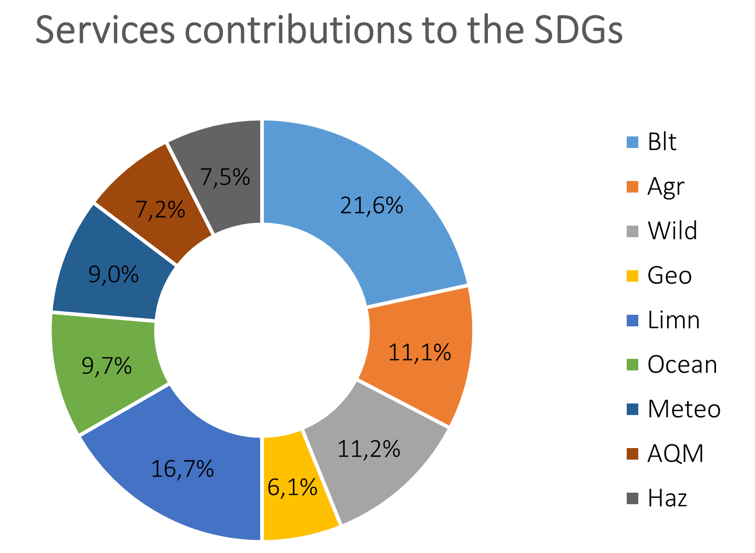
Results
Earth observation services contribution to the SDGs and SDG indices
EO majorly contributes to Goal 13 (Climate Action), followed by Goal 15 (Life on Land) and Goal 12 (Responsible Consumption and Production)
Major contributions from Built-up land and Limnology services
Two sets of indices:
Relative indices: contribution of a mission to the SDGs with respect to given service maximum capability
$$I_{SDGX, rel}= \frac{I_{blt}N_{blt,X}+I_{agr}N_{agr,X}+…+I_{haz}N_{haz,X}}{Total of Goal X}$$
Absolute indices: it considers the maximum value among all the services capability
$$I_{SDGX,abs}= \frac{I_{blt}N_{blt,X}+I_{agr}N_{agr,X}+…+I_{haz}N_{haz,X}}{Total of Goal 13}$$

Slide 18
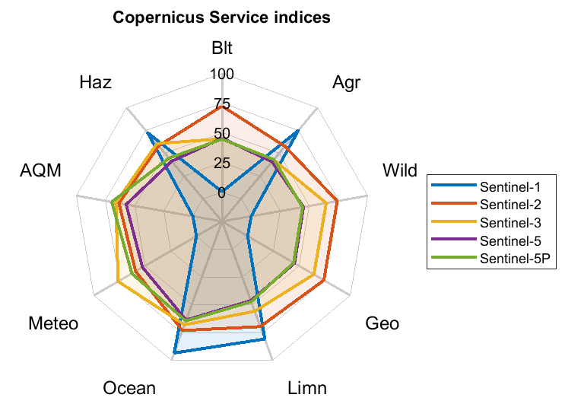
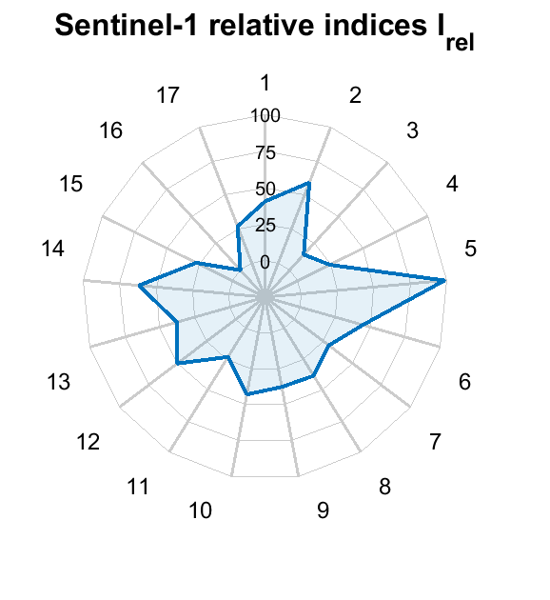
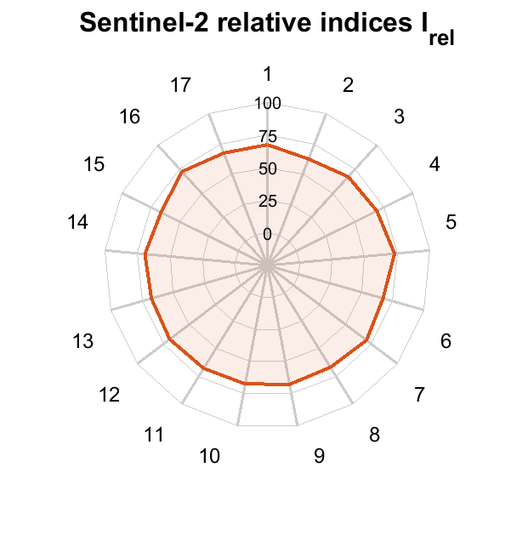
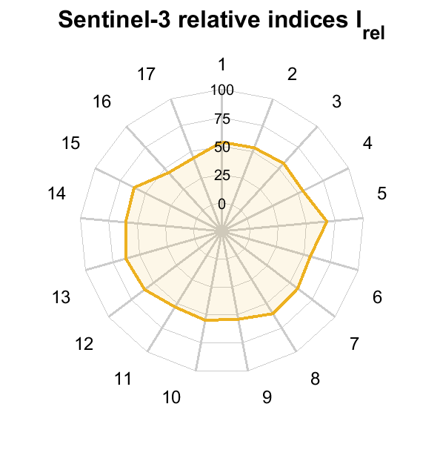
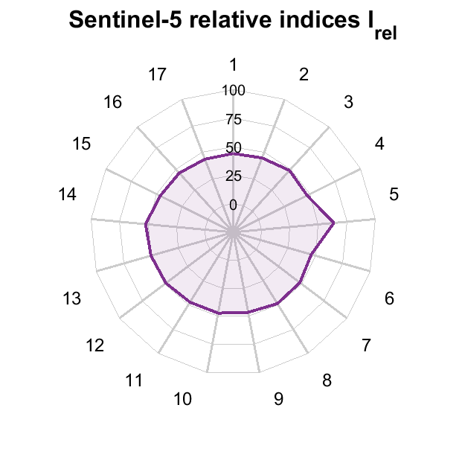
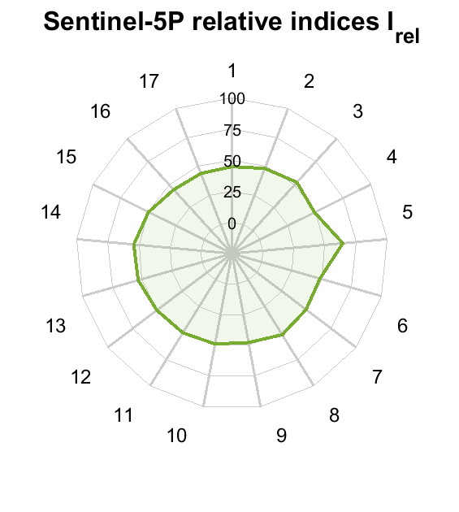
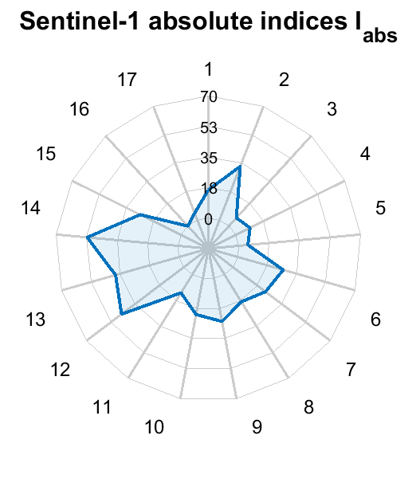
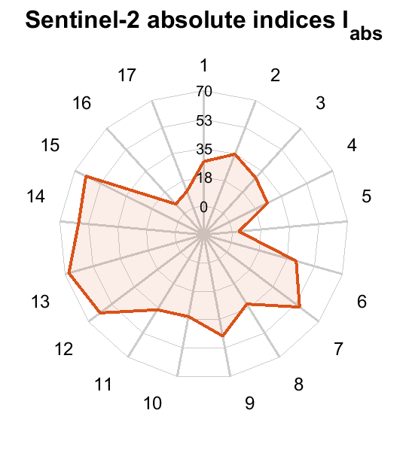
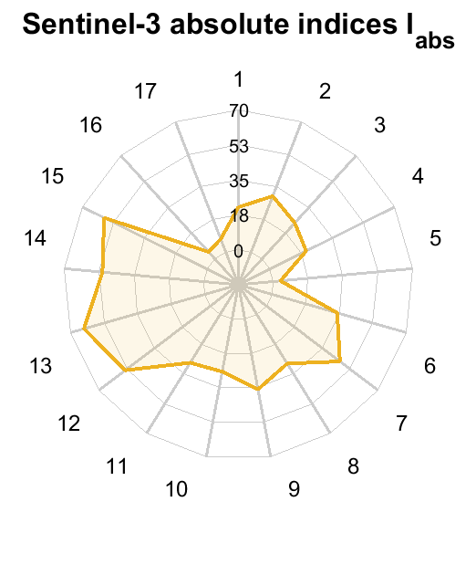
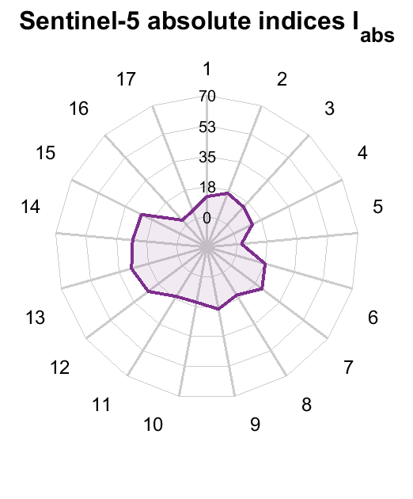
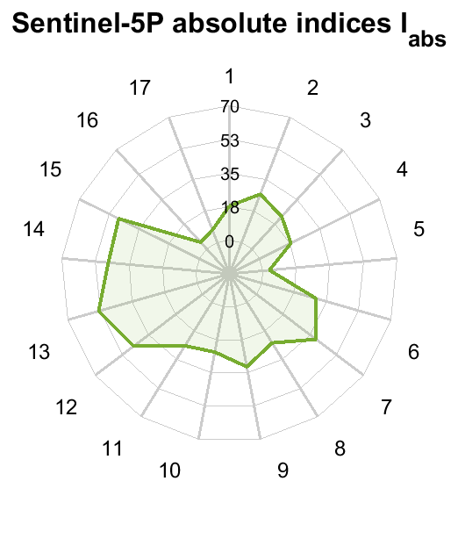
Results
Copernicus program evaluation
Service indices of Copernicus program
Relative indices of Copernicus program
Absolute indices
Notes:
Copernicus: EO program of ESA, able to evaluate 5 out of 6 missions
S1 radar mission, other passive sensors
Left spider dgrm → Service indices

Slide 19
Agenda
1. Introduction
2. Modelling
3. Results
4. Conclusions and future developments

Slide 20
Conclusions and future developments
Conclusions
The complete derivation of a tool for the evaluation of the social value assessment of EO missions is achieved
Missions technical parameters
I_{SR} , I_{TR} , I_{Spectr} , I_{Cov}
Service indices
EO4SDG
Social rating
Including other types of perturbation, such as the atmospheric drag
Extending evaluable orbits types, such as geostationary and elliptical orbits, and evaluable sensors types, such as lidars, radar altimeters and microwave radiometers.
Improving services classification, by creating sub-services and including new services
Including other missions’ features, such as their footprint in terms of orbit crowding and space debris, the orbit maintenance requirements, readiness from the acquisition and open-source availability of data, international cooperation fostering
Extending the analysis to Navigation and Telecommunication applications, but also to other space missions' classes, such as Exploration and Safety and Security

Slide 21
Thank you for your attention!
This project has received funding from the European Research Council (ERC) under the European Union’s Horizon 2020 research and innovation programme (grant agreement No 679086 – COMPASS)
Marco Nugnes, Camilla Colombo, Chiara Zuliani, Valerio Santoro,
marco.nugnes@polimi.it
camilla.colombo@polimi.it
@COMPASS_ERC
www.compass.polimi.it

Slide 22
Introduction
Socio-economic value of space missions and state of the art
Programs and agencies working to define the socio-economic value of space missions
United Nations Office for Outer Space Affairs
United Nations Committee of Experts on Global Geospatial Information Management (UN-GGIM)
Group on Earth Observations
European Space Agency
Committee on Earth Observation Satellites
Qualitative social benefits evaluation
Scalera et al. “Social value rating of Earth remote sensing missions through the United Nations Sustainable Development Goals 2030”
Quantitative social benefits evaluation
Notes:
Many space..
However, only qualitative
Scalera

Slide 23
Introduction
Thesis aim and novelty of the work
Scope: to give a quantitative indication of the contribution an Earth observation mission can make to the achievement of the Sustainable Development Goals (SDGs) set by the UN, in a perspective of sustainability
With respect to other works:
quantitative evaluation rather than qualitative
With respect to Scalera:
Air Quality Monitoring service added
Novel technique for the Temporal resolution index
New methodology for the Spectral efficiency index of SAR sensors
Earth coverage index developed through several world data layers
Cloud coverage considered
Possibility of analysing also hyper-spectral sensors and satellite constellations
Quantitative link between services and SDGs

Slide 24
Agenda
1. Introduction
2. Thesis groundwork
Sustainable Development Goals 2030
Earth observation services
Performance indices
Missions and sensors analysed
Thesis structure
3. Modelling
4. Results
5. Conclusions and future developments

Slide 25
Modelling
Spatial resolution index 1
Ground Sample Distance (GSD): the pixel size on the ground surface measured by the instrument
Flowchart
Model validation
Whiskbroom sensor
Computed GSD | Literature GSD | Error
250.00 m | 250 m | 0%
GSD model validation for MODIS sensor on-board Terra
Pushbroom sensor
Computed GSD | Literature GSD | Error
20.00 m | 20 m | 0%
GSD model validation for HRVIR sensor on-board SPOT-4
SAR sensor
Variable | Computed | Literature | Error
Range resolution | 17.33 m | 18 m | 3.72%
Azimuth resolution | 5.95 m | 6 m | 0.83%
Spatial resolution model validation for SAR on-board JERS-1

Slide 26
Modelling
Spatial resolution index 2
$$I_{SR}= \frac{{SR}_{service,max} − {SR}_{operative}}{{SR}_{service,max} − {SR}_{service,min}} 100$$
SR service requirements
Index computation
Index application

Slide 27
Modelling
Temporal resolution index 1
ReVisit Time (RVT): time elapsed between two successive observations of the same ground point on the surface of the Earth
Flowchart
Model validation
Variable | Computed | Literature | Error
S’_{width} | 735.35 km | 735.43 km | ~ 0%
RVT | 4 | 4 | 0%
RVT_{min} | 1 | 1 | 0%
RVT model validation for HJ-1A satellite
Variable | Computed | Literature | Error
S’_{width} | 823.76 km | 830.17 km | 0.77%
RVT | 5 | 5 | 0%
RVT_{min} | 1 | 1 | 0%
RVT model validation for IRS–P6 satellite

Slide 28
Modelling
Temporal resolution index 2
TR service requirements
Index computation
$$I_{TR}= \frac{{RVT}_{service,max} − {RVT}_{operative}}{{RVT}_{service,max} − {RVT}_{service,min}} 100$$
Index application

Slide 29
Modelling
Spectral efficiency index for passive sensors – Air Quality Monitoring
Based on gases detection bands in the UV (0.1 – 0.37 µm), VIS-SWIR (0.37 – 2.5 µm) and TIR (3 – 5, 8 – 14 µm) domains
Flowchart
Index based on a boolean evaluation
Index definition
Gases detection bands
$$I_{Spectr,AQM}= \frac{n_{obs,gases}}{n_{tot,gases}} 100$$
Mission | I_{spectr,AQM}
AIRS | 50
MODIS | 16.67
CERES | 100
Index application
I_{spectr,AQM} of AIRS, MODIS and CERES sensors

Slide 30
Modelling
Spectral efficiency index for SAR sensors
Based on sensor operative band (Ku, X, C, etc..) and signal polarisation (HH, HV, VH, VV)
Courtesy of Meyer [5]
Relative scattering strength by polarisation
Rough surface | VV > HH > HV or VH
Double bounce | HH > VV > HV or VH
Volume | HV or VH > > HH or VV
Link : ‘’pct_{pol}’’
Index definition: $I_{Spectr}= \frac{100+{pct}_{pol}}{2}$
Services type of scattering (0-2)
SARs operative bands common applications
 | Rough surface | Double bounce | Volume
Blt | 1 | 2 | 0
Agr | 2 | 0 | 1
Wild | 2 | 1 | 2
Geo | 2 | 1 | 0
Limn | 2 | 2 | 0
Ocean | 2 | 0 | 0
Haz | 2 | 2 | 2
 | Ku | X | C | S | L | P
Blt |  | ✓
Agr |  | ✓ | ✓ | ✓ | ✓
Wild |  |  |  |  | ✓ | ✓
Geo |  | ✓ |  |  | ✓
Limn | ✓ | ✓ | ✓ | ✓ | ✓
Ocean |  | ✓ | ✓ | ✓ | ✓ | ✓
Haz |  | ✓ | ✓ | ✓ | ✓
[5] “The SAR Handbook: Comprehensive Methodologies for Forest Monitoring and Biomass Estimation”.

Slide 31
Modelling
Earth coverage index 1
The index is based on the service visibility in a repeat cycle with respect to the total service visibility
Flowchart
Datasets
Population density
Crops
Pastures
In-land water
Oceans
WWF biomes
Earthquakes hazard
4320 x 8640 pixels services layers

Slide 32
Modelling
Earth coverage index 2
Ground track computation and identification of the pixels seen by the sensor
Index computation $I_{vis}= \frac{n_{obs, serv}}{n_{tot, serv}} 100$
Passive sensors
Active sensors
$$I_{Cov}= I_{vis}$$
Index application
$$I_{Cov}= I_{vis}I_{Cloud}$$

Slide 33
Results
Pléiades and PRISMA – passive sensor missions
Notes:
Passive sensors
Pleiades, very high resolution mission → french space agency, PRISMA, hyperspectral mission → ASI

Slide 34
Results
COSMO-SkyMed SG and Biomass – SAR missions
Notes:
COSMO-SkyMed sar mission of ASI X band fully pol, Biomass → Earth explorer mission of the ESA, P band, fully polarimetric
COSMO even if limited to certain services, provide significant social performances

Slide 35
Conclusions and future developments
Conclusions
The complete derivation of a tool for the evaluation of the social value assessment of EO missions is achieved
MMissions technical parameters
I_{SR} , I_{TR} , I_{Spectr} , I_{Cov}
SService indices
EO4SDG
SSocial rating
Passive instruments
Synthetic Aperture Radars
High versatility in terms of services supply
Hyper-spectral sensors are filling the gap of passive instruments in terms of spectral efficiency
Support the SDGs more effectively
Limited number of services according to their operative band
Higher services indices, especially in full-polarimetric modes
Support less effectively the SDGs (higher indices but less Goals)
Next future of EO still characterised by a combination of these two imaging technologies complementarity of the attainable data

Slide 36
Conclusions and future developments
Criticalities and future developments
Criticalities:
Intrinsic difficulty in quantifying something not directly measurable like social benefits
The boundaries lability of service requirements, on which the four technical indices are based
Arithmetic average of the four performance indices may results in a loss of information
Modelling the flexibility of the sensors imaging modes
Validity of the assigned quantities of EO4SDG table need to consolidate also employing surveys and/or stakeholders’ advice
Future developments
Including other types of perturbation, such as the atmospheric drag
Extending evaluable orbits types, such as geostationary and elliptical orbits,
and evaluable sensors types, such as lidars, radar altimeters and microwave radiometers.
Improving services classification, by creating sub-services and including new services
Including other missions’ features, such as their footprint in terms of orbit crowding and space debris, the orbit maintenance requirements, readiness from the acquisition and open-source availability of data, international cooperation fostering
Extending the analysis to Navigation and Telecommunication applications, but also to other space missions' classes, such as Exploration and Safety and Security

