Slide 1
Implementation of Rapidly-Scanned, Infrared Laser Absorption Diagnostics in NASA Electric Arc Shock Tube Experiments
Outline:
Background
Theory
Results
Conclusions
Efaine Chang, Dylan Drescher, Jesse Streicher,
Christopher Strand, Prof. Ronald K. Hanson
Andrea Fagnani, Brett Cruden
High Temperature Gasdynamics Laboratory
Stanford University
1
10th International Workshop on Radiation of High Temperature Gases for Space Missions Oxford, September 10, 2024

Slide 2
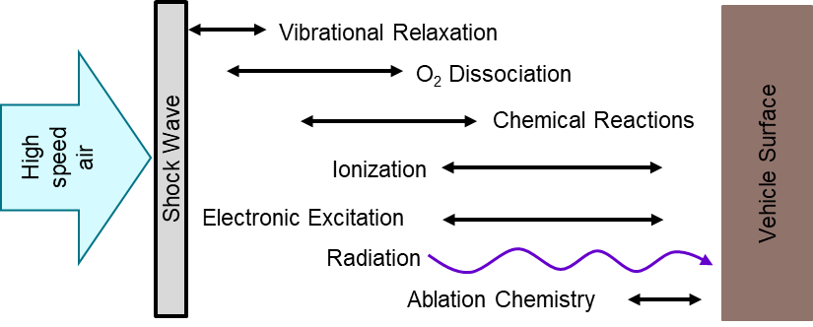
Motivation
Background
Theory
Results
Conclusions
Many types of ground tests are needed for validating nonequilibrium models
Reflected Shock Tube (e.g., Stanford)
Incident Shock Tube (e.g., EAST/T6)
Shock Tunnels (e.g., T5/T6)
Stagnated test gas provides high time resolution
Integration of multiple UV laser diagnostics
Low enthalpy conditions and limited test time
High-velocity incident shocks reproduce relevant conditions
Optical access typically includes absorption and emission diagnostics
Temporal and spatial resolution are coupled
Valuable for studying flow around test geometries
Access to high enthalpy gas with long test times
Flow can introduce non-uniform lines of sight
Nozzles can freeze species in nonequilibrium quantities
2

Slide 3
Motivation
Background
Theory
Results
Conclusions
EAST is an established, high-enthalpy facility using emission spectroscopy.
Project Goal: Combine Stanford absorbance diagnostic expertise with EAST facility and emission diagnostic capabilities to investigate nonequilibrium in low-speed air.
Develop an IR-based laser absorption diagnostic for hypersonic flight conditions
Provide direct, quantitative measurements of state-specific populations
Refine and validate theoretical models
Stanford
Absorption Diagnostics: CN, O*, N*, NO, T, n_{e}
Spectroscopy: fast-scanned infrared absorption to infer T and n
Kinetics: vibrational relaxation, electronic excitation, ionization, and chemical reactions
NASA
EAST Facility: Very fast incident shock speeds provides wide range of test conditions
Emission diagnostics: very large spectral range for many species simultaneously
Radiation models: excited state nonequilibrium

Slide 4
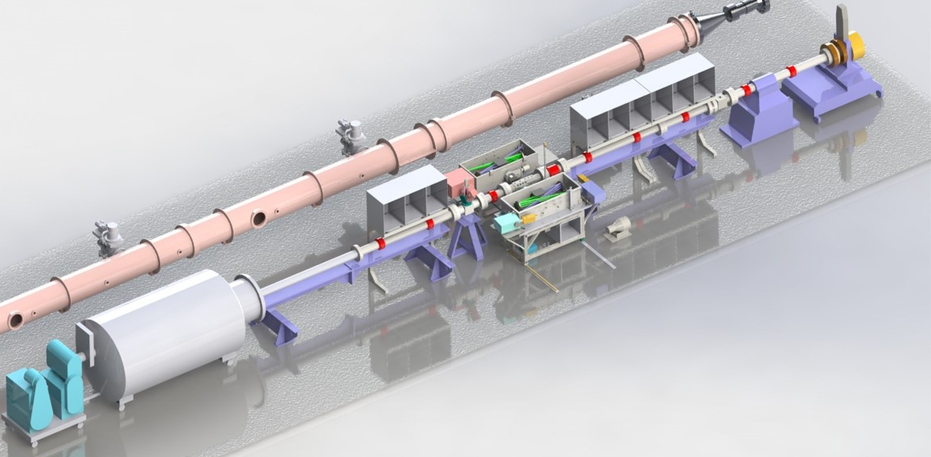
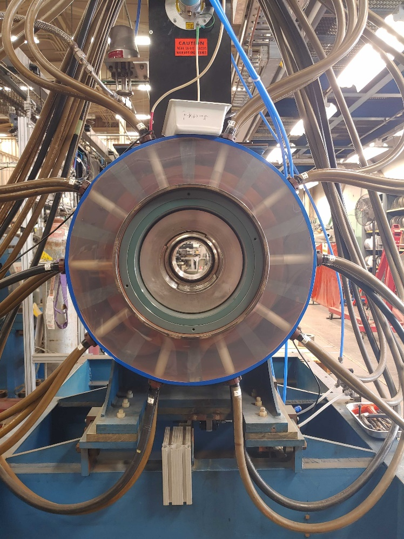
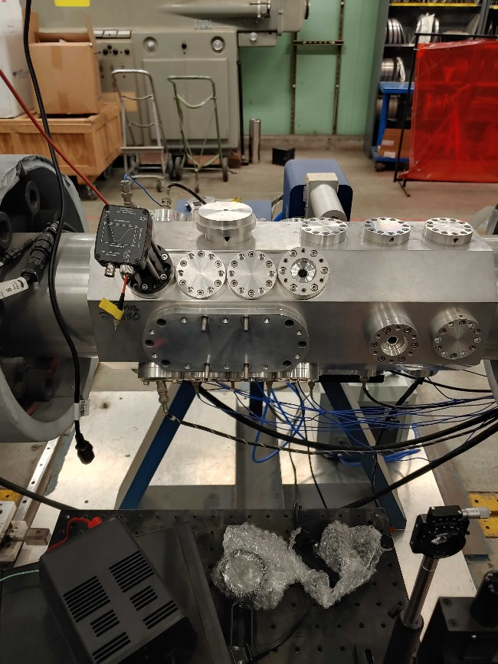
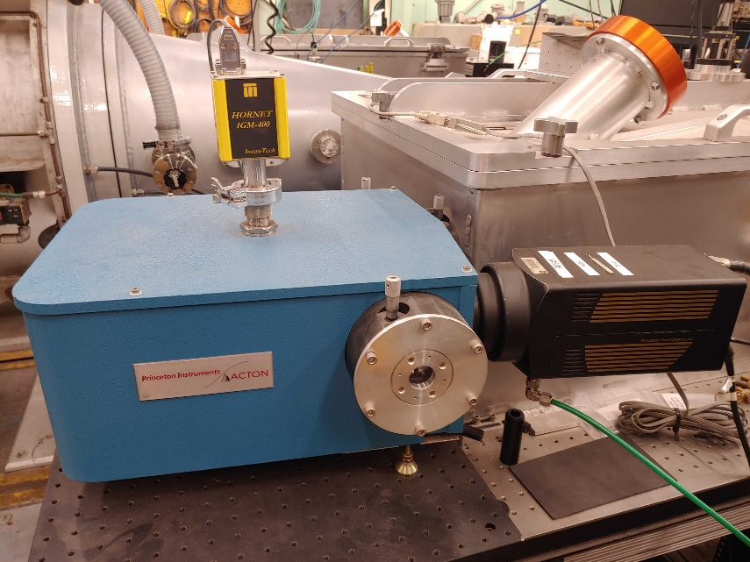
Background
Theory
Results
Conclusions
EAST Facilities
Overview
~400 m² footprint
Shock speeds 1.3 – 46 km/s
Pressures 10⁻⁴ – 10⁰ atm
40-kV high voltage DC power supply
1.25 MJ capacitor bank
Circular ports for pressure, line-of-sight optical diagnostics
Slot windows for emission diagnostics
HVST, 10 cm diameter
9 m driven section
Electric Arc Driver
Test Section
Emission Spectrometers
Expansion Cone (Optional)
Dump Tank
https://www.nasa.gov/ames/thermophysics-facilities/electric-arc-shock-tube

Slide 5
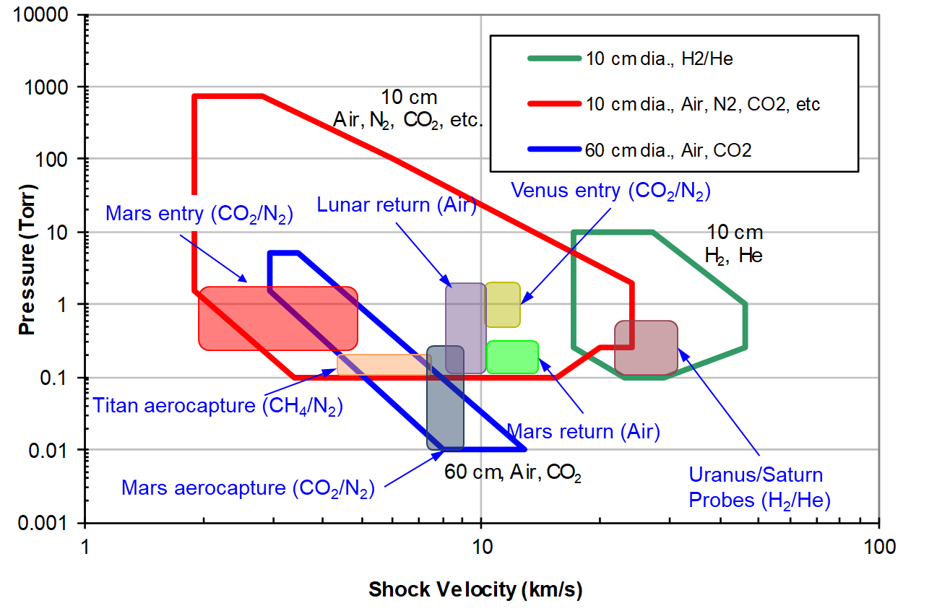
Interest in Low-Speed Air
Background
Theory
Results
Conclusions
Previous EAST tests focused on lunar return conditions [1]. → Velocities generally in excess of 10 km/s
→ Lowest velocity considered ~7 km/s
Interest in shock layer kinetics at lower velocities
OES infers high-lying excited states
→ Challenging to infer information on low-lying states
Low-Speed Air (NO)
Low-Speed Air (O*,N*)
https://www.nasa.gov/ames/thermophysics-facilities/electric-arc-shock-tube
[1] Brandis, A., et al., 43rd AIAA Thermophysics Conference (2012).
There is an opportunity for absorption-based experimental data.

Slide 6
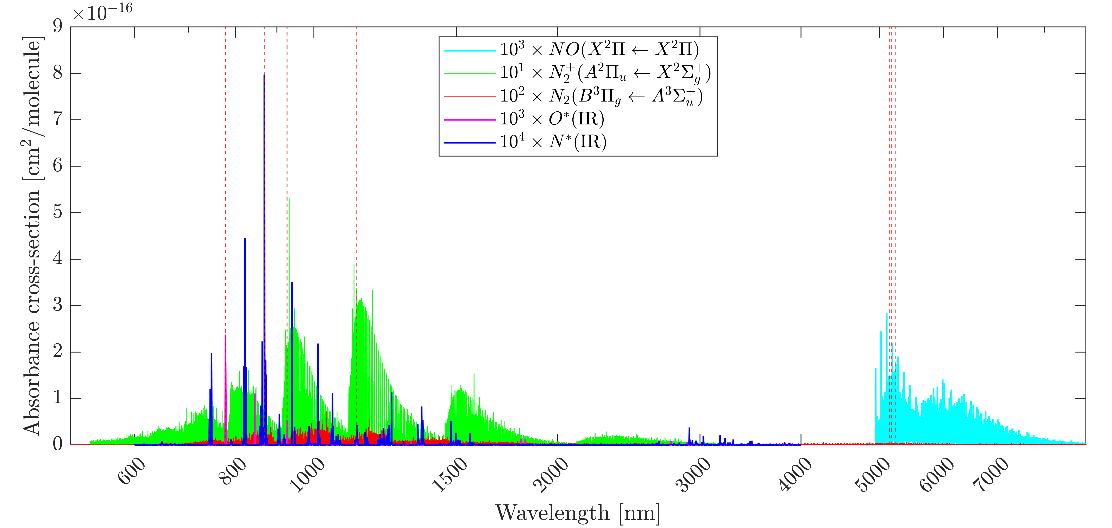
Laser Absorption Spectroscopy
Background
Theory
Results
Conclusions
Absorption is a function of fundamental, quantum-mechanical properties of the absorbing species and the number density in the absorbing state.
Beer-Lambert Relation
$$α_{ν}=−\ln\left(\frac{I_{t}}{I_{0}}\right)=\sum_{i}{PX_{\text{abs}}}S_{i}\left(T\right)ϕ_{i}\left(ν\right)L$$
$$A_{i}=PX_{\text{abs}}S_{i}\left(T\right)L$$
$$Δν_{D} = 7.1623× {10}^{−7}ν_{0}\sqrt{\frac{T}{M}}$$
_{L}
I₀
I_{t}
Monochromatic light source
at wavelength ($ν$)
Detector
Uniform Test Gas
(T, P, $χ$)
Assuming independent rotational and vibrational distributions
$$A_{i}=n_{j}L\frac{A_{21,i}g_{2,i}}{8πcν_{0,i}Q_{j}(T_{rot},T_{vib})}exp(−(\frac{E_{rot,1,i}}{k_{B}T_{rot}}+\frac{E_{vib, 1,i}}{k_{B}T_{vib}}))(1−\exp{(−(\frac{ΔE_{rot,i}}{k_{B}T_{rot}}+\frac{ΔE_{vib,i}}{k_{B}T_{vib}})))}$$
Rewriting with spectroscopic constants
$$A_{i}=n_{j}L\frac{A_{21,i}g_{2,i}}{8πcν_{0,i}Q_{j}(T)}exp(−\frac{E_{1,i}}{k_{B}T})(1−\exp{(−\frac{ν_{0,i}}{k_{B}T}))}$$

Slide 7
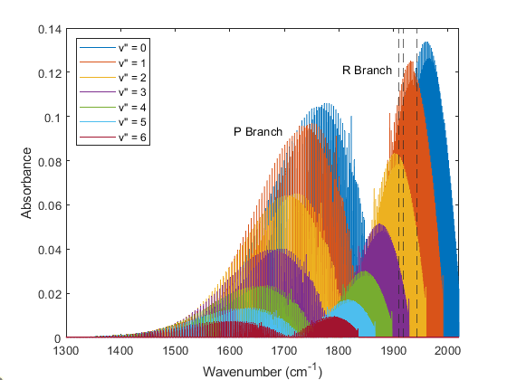
Nitric Oxide (NO)
Background
Theory
Results
Conclusions
Excellent indicator of non-equilibrium behavior
Formation described by Zeldovich reactions $NO+O↔O_{2}+N$
$N_{2}+O↔NO+N$
Strongly coupled with T
Presence at high-T can be used to measure gas properties using TDLAS

Slide 8
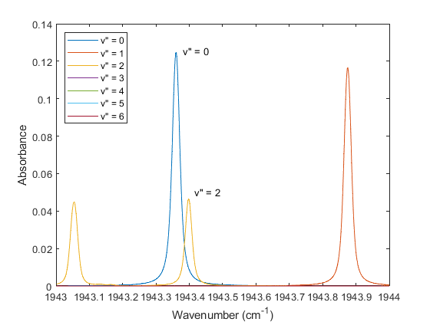
Line Selection (NO)
Background
Theory
Results
Conclusions
Line selection is optimized for
Spectral isolation from interfering species
Sufficient absorbance (>0.1)
Large sweep of v” and J”
Multiple features captured in a single scan, by a single laser at >500 kHz scan rates.
Wavelength selection covers
9 features at ~5.2 um
v” = 0-3, J” = 9.5-59.5

Slide 9
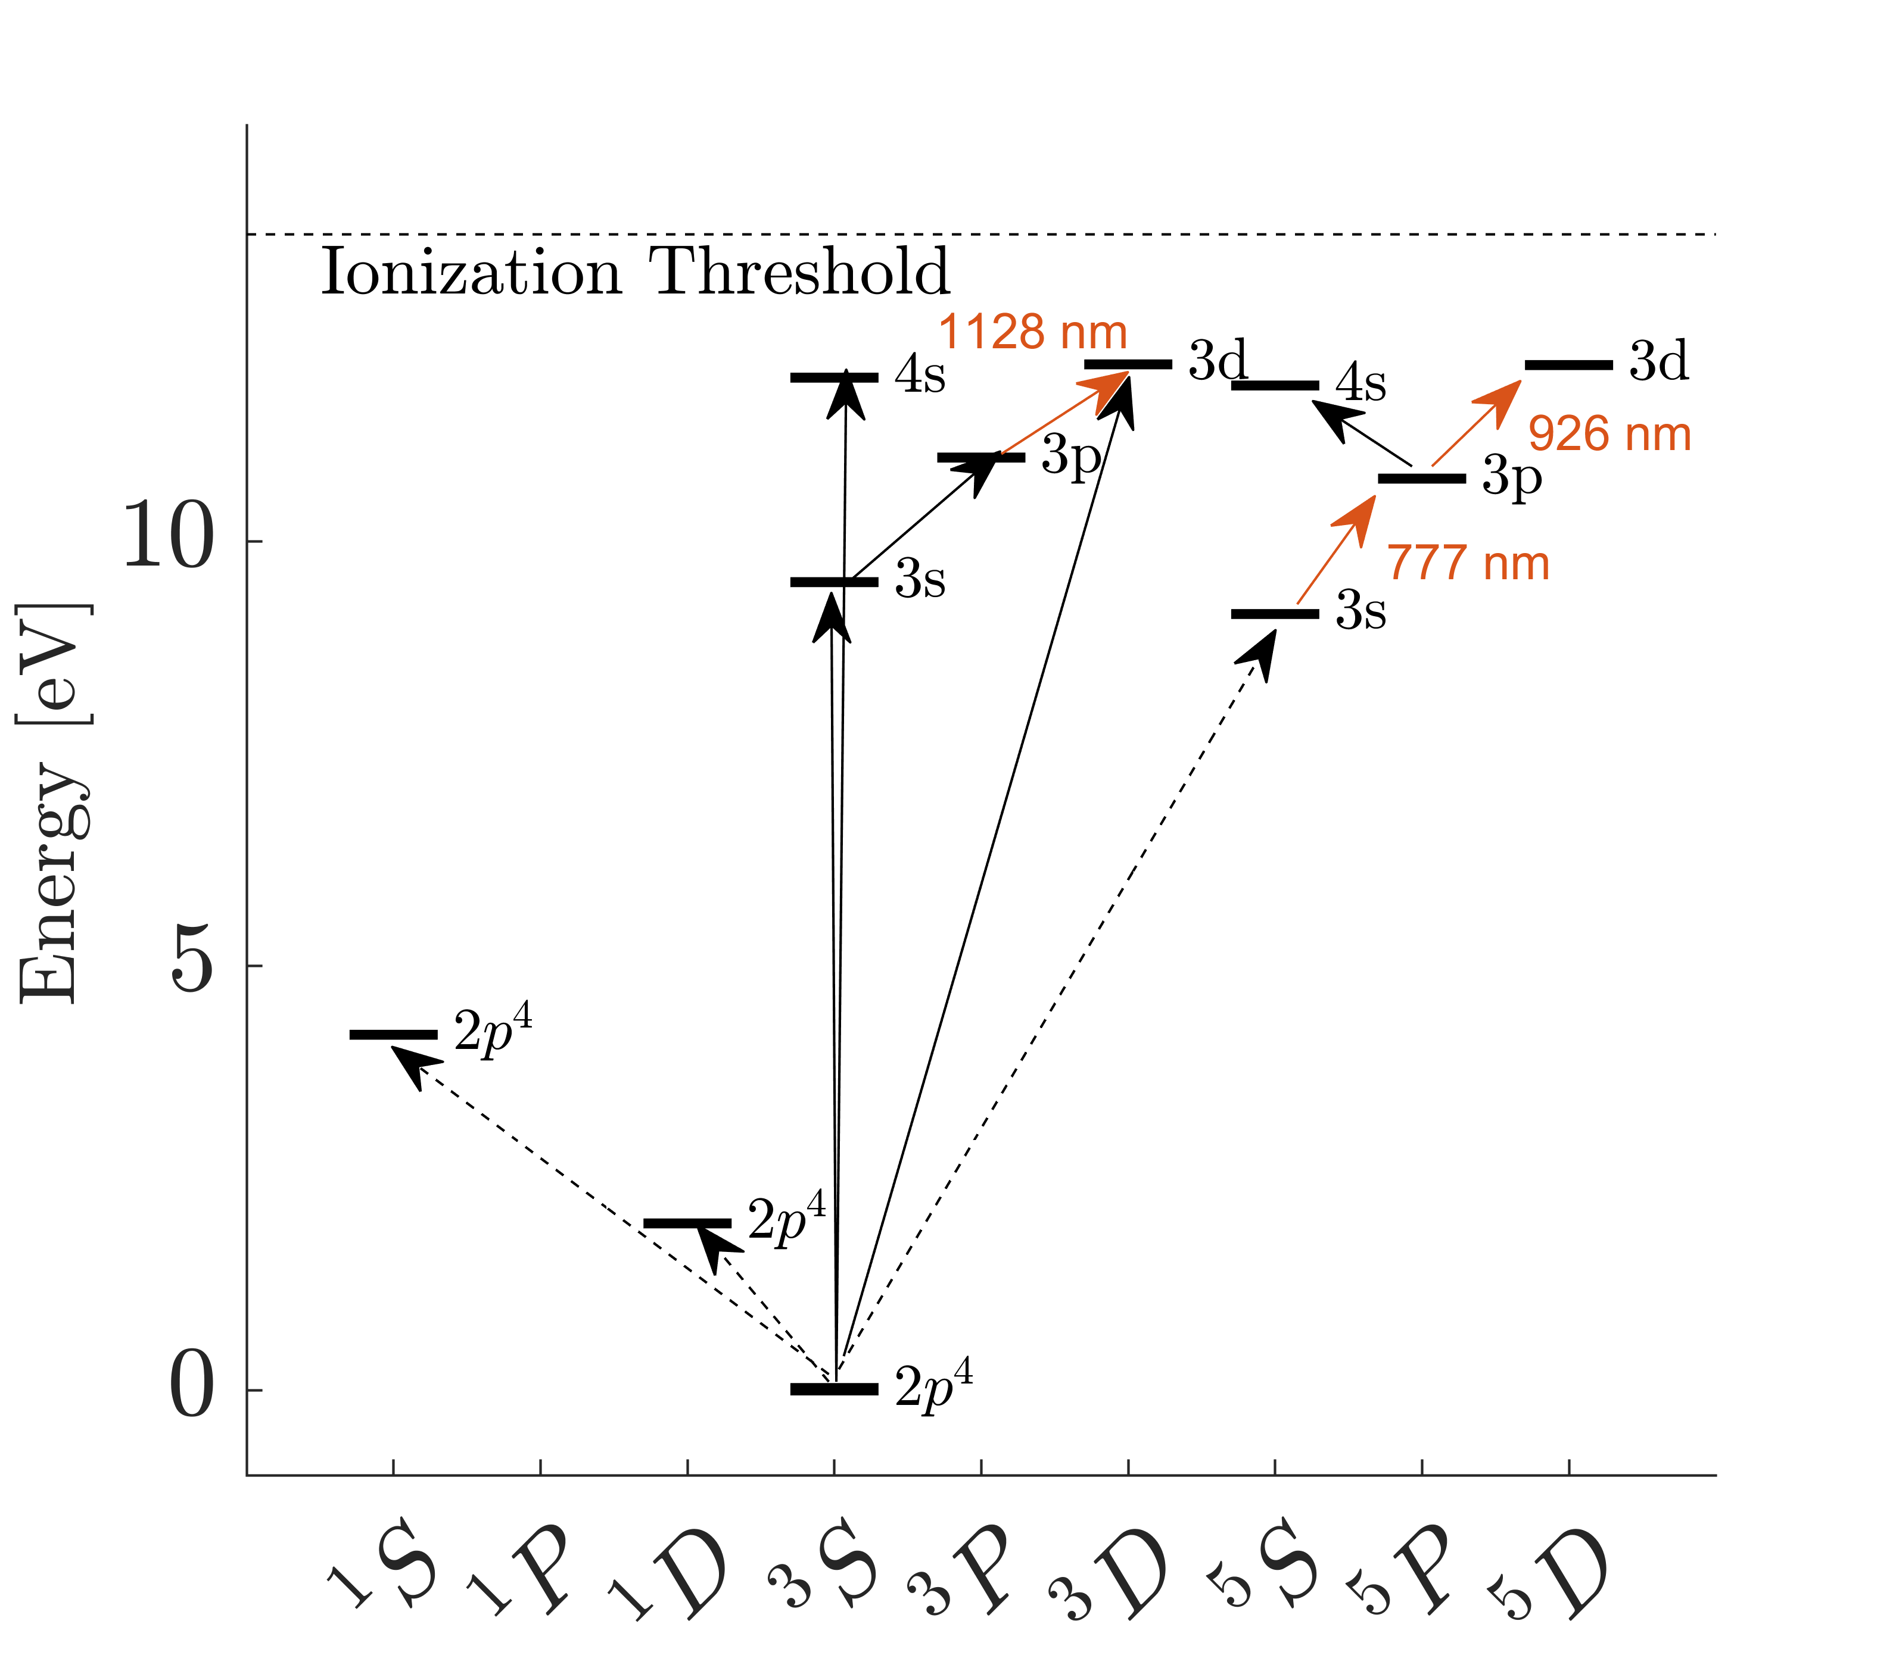
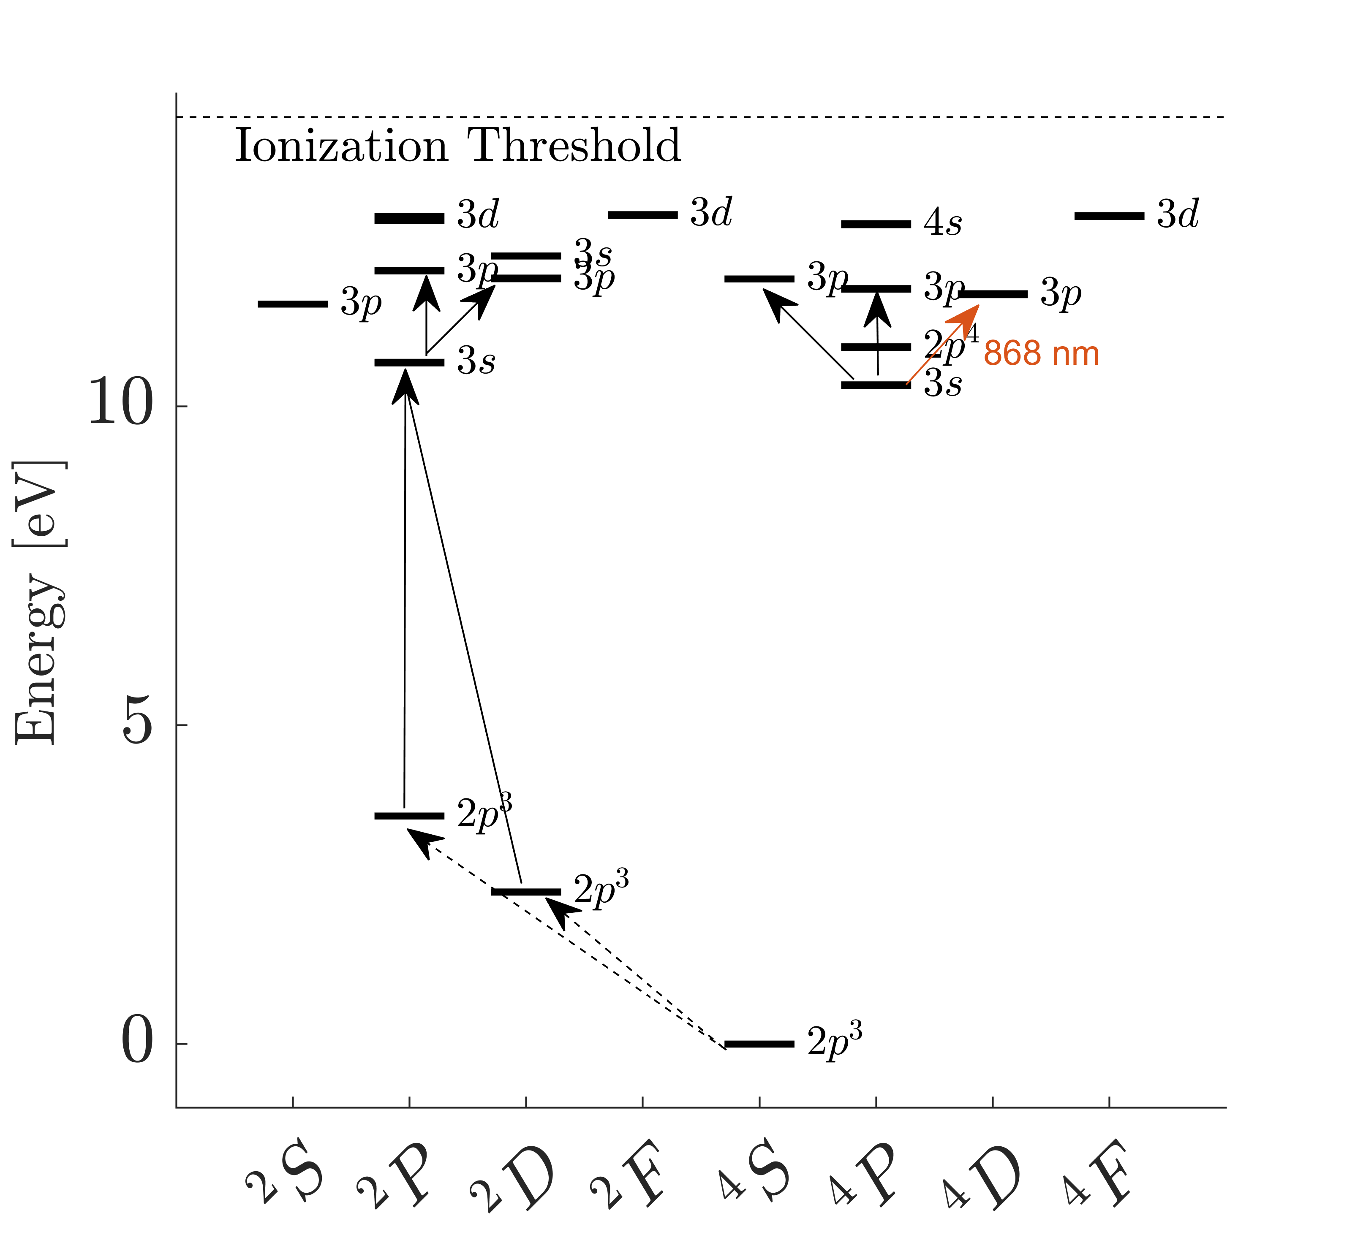
Excited Atomic Species (O*, N*)
Background
Theory
Results
Conclusions
At >10000 K, N₂ and O₂ break down into N and O
Radiation originates from ionized species or electronically excited quantum states of neutral species
$$\text{O}\text{∗(777 }\text{nm}\text{), 3}\text{s}\text{ 5}\text{S}\text{°}→ \text{3}\text{p}\text{ 5}\text{P}\text{3}$$
$$\text{O}\text{∗(926 }\text{nm}\text{), 3}\text{p}\text{ 5}\text{P}\text{3}→\text{3}\text{d} \text{5}\text{D}\text{°}\text{2,3,4}$$
$$\text{O}\text{∗(1128 }\text{nm}\text{), 3}\text{p} \text{3}\text{P}→\text{3}\text{d}\text{ 3}\text{D}$$
N*(868 nm), 3s ⁴P $→$ 3p ⁴D°
Lowest lying, easily accessible states

Slide 10
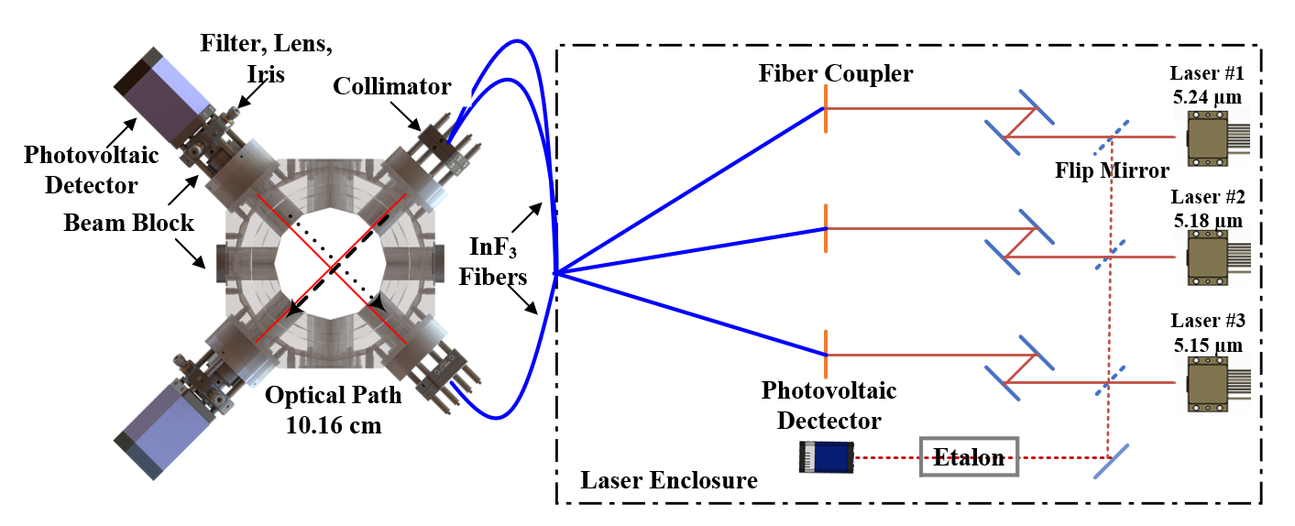
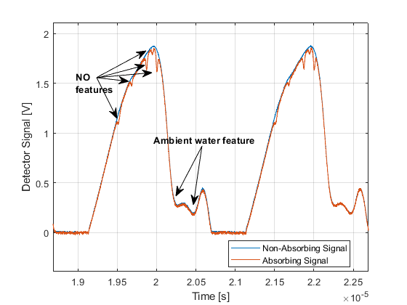
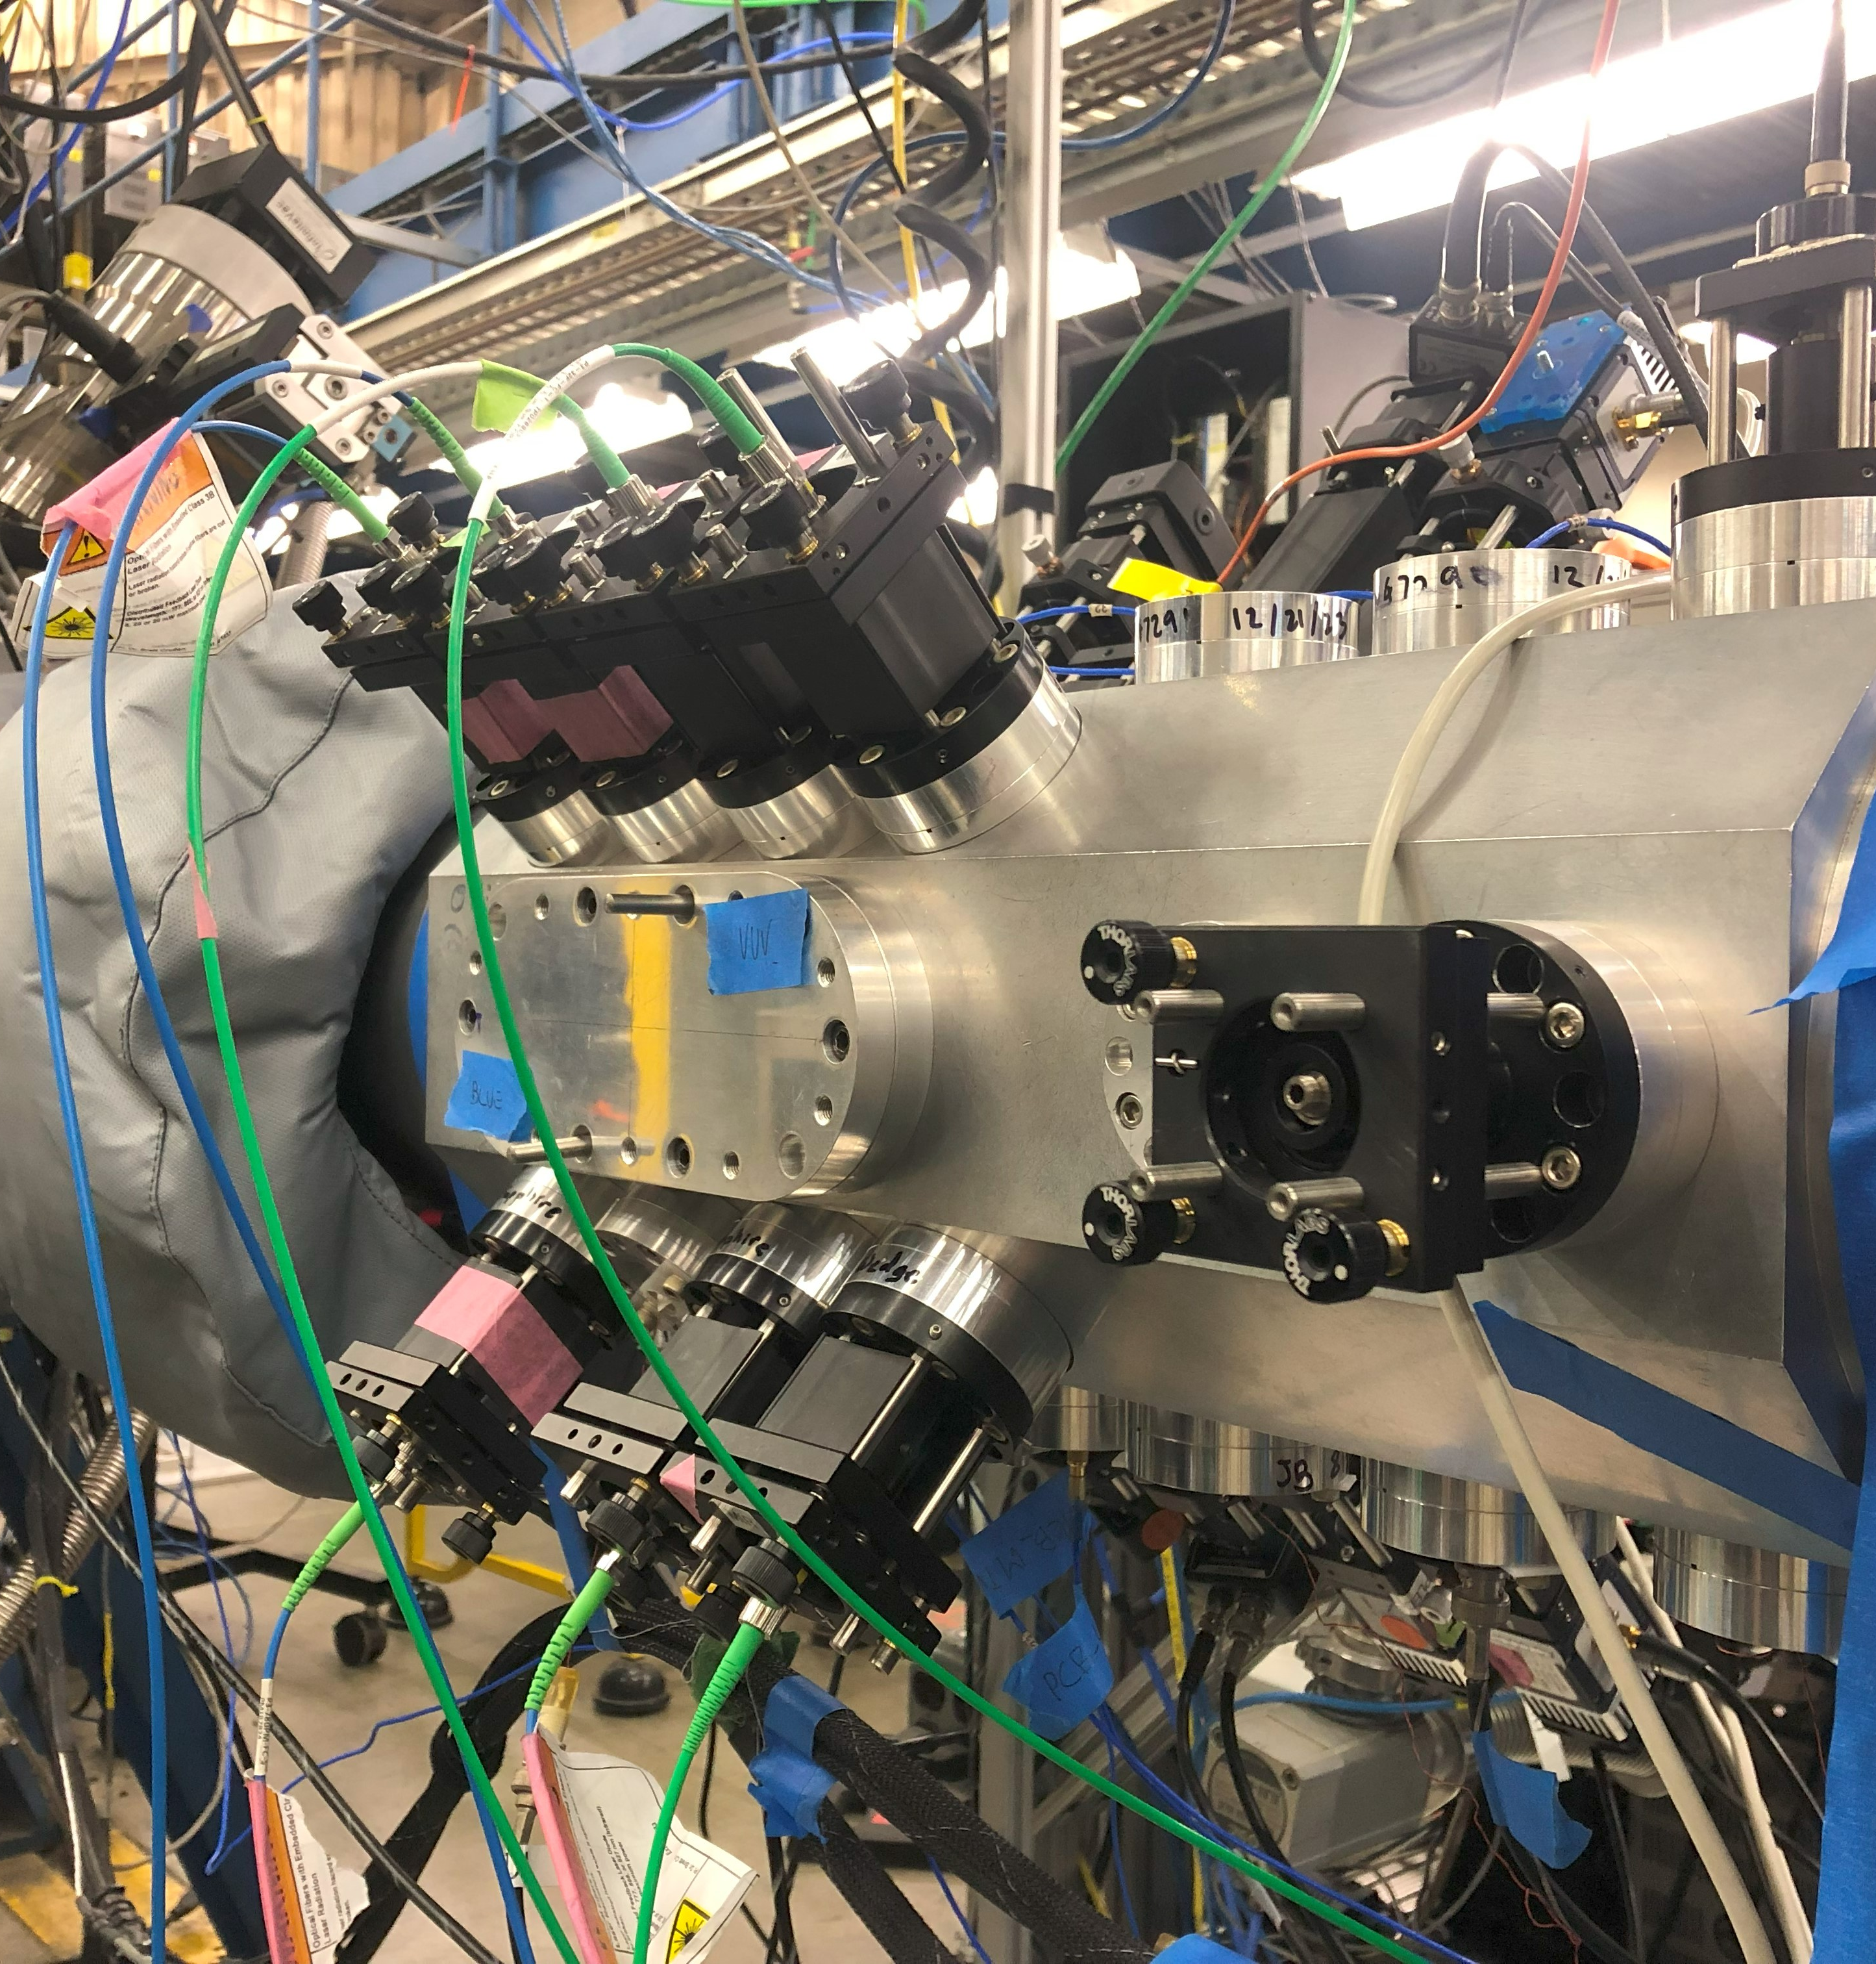
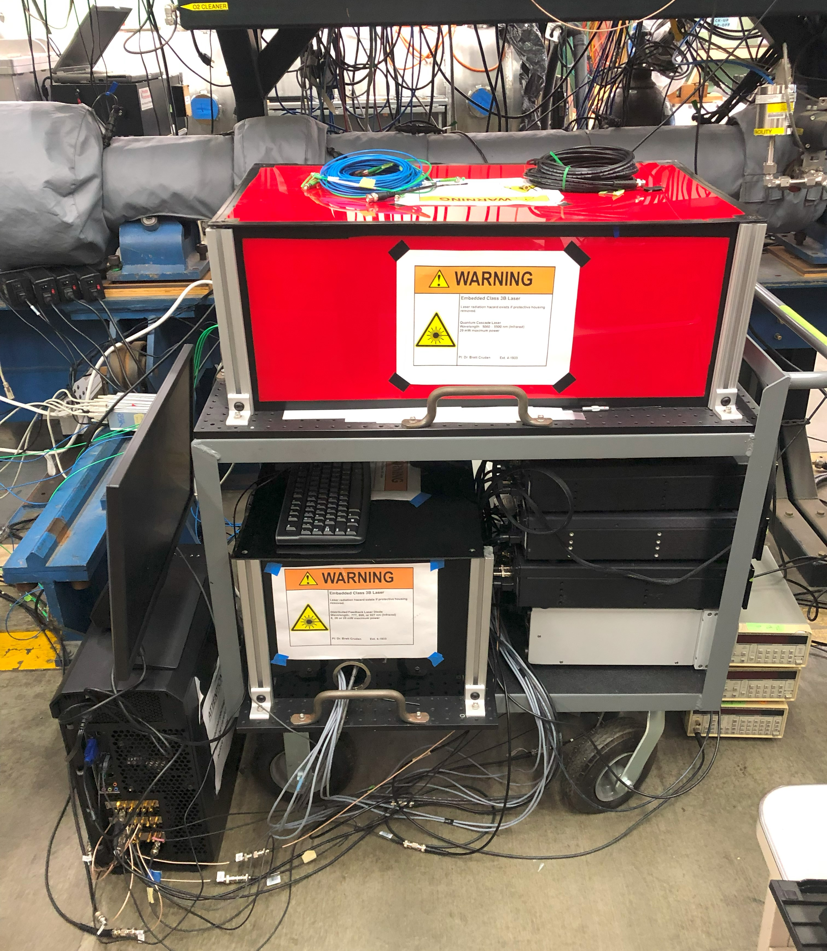
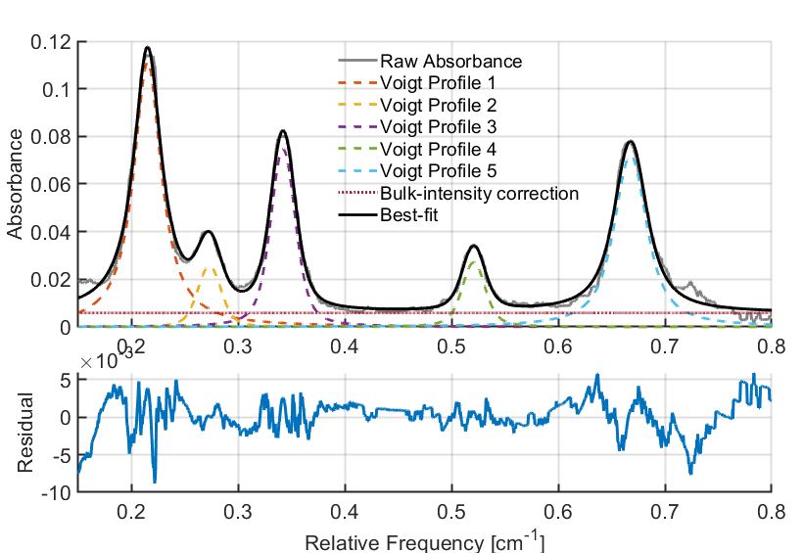
Absorption-Based Diagnostic
Background
Theory
Results
Conclusions
Mitigate non-ideal effects, fiber-couple for ease of use and safety.

Slide 11
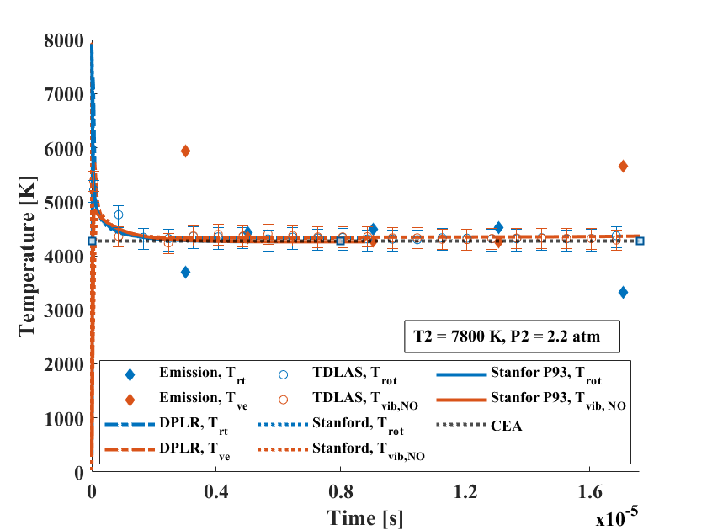
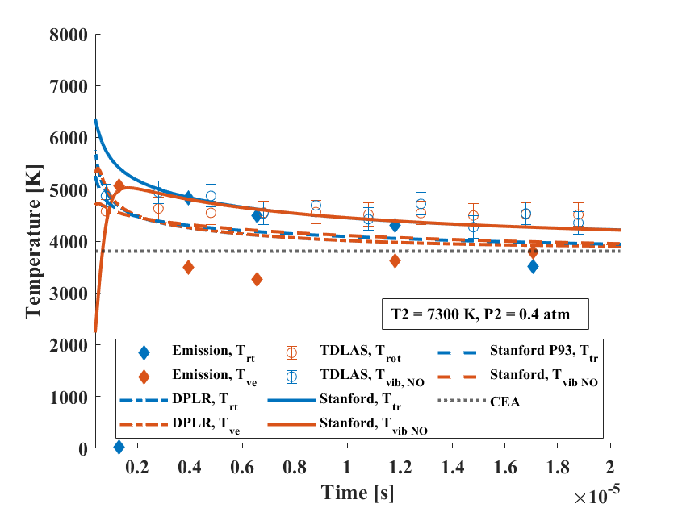
Low Velocity, High Pressure (NO)
Background
Theory
Results
Conclusions
Three kinetics models considered
Stanford
Incident shock code
Park + various sources
Experimental rates for NO, O2
No ionized species
Stanford P93
Incident shock code
Park93 solely
Includes ionized species
DPLR
Stagnation line, flow around sphere
Park + Cruden et al. corrections
TDLAS measurements
(1) Trend well with models; (2) Converge to equilibrium (w/ models), as expected.
** Note that Stanford models provide T_{vib,NO} vs DPLR T_{vib}
TDLAS measurements
(1) Trend well with Stanford model.
At long times all 3 models converge to equilibrium.

Slide 12
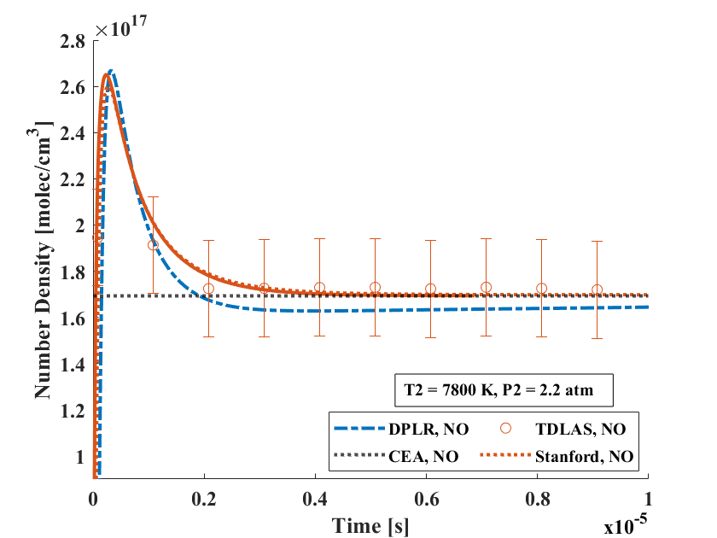
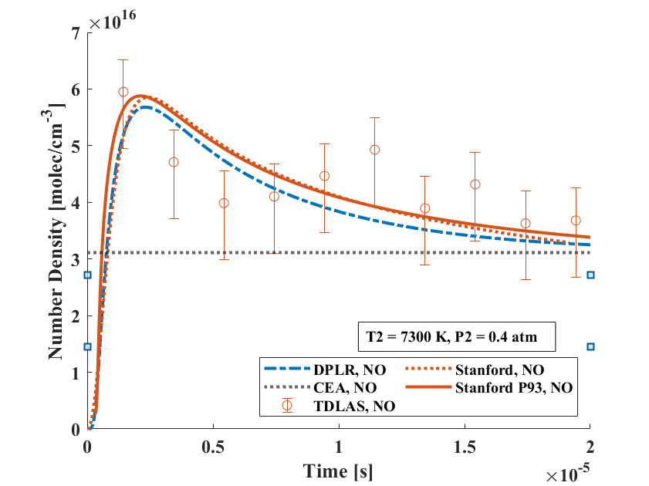
Low Velocity, High Pressure (NO)
Background
Theory
Results
Conclusions
NO measurements at a glance:
TDLAS measurements track models closely in both temperature and number density.
Experimental temperatures agree within 15%. (No emission-inferred number density currently available.)
There exists a 10% offset between measurements and models.
Model discrepancies may be attributed to differing $τ_{VT}$ and $k$ expressions in each model, vibrational energy handling.
TDLAS measurements
(1) Track models closely.
(2) Converge to equilibrium (w/ models), as expected.
** Disagreement between models in NO formation

Slide 13
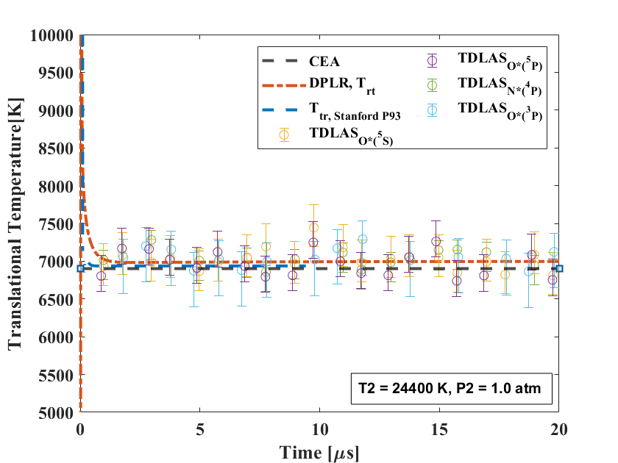
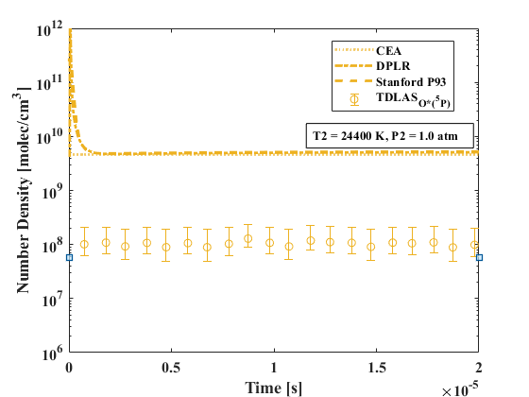
High Velocity Temperature Number Density (O* 5P)
Background
Theory
Results
Conclusions
Experimental temperatures agree within 5-10%.
Measurements suggest a lower number density than models predict.
Large scatter and uncertainty due to low population.

Slide 14
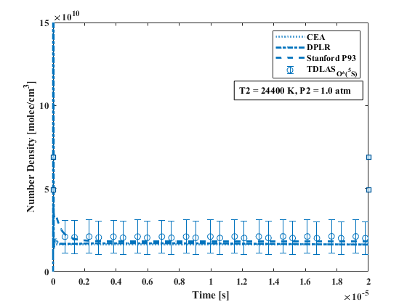
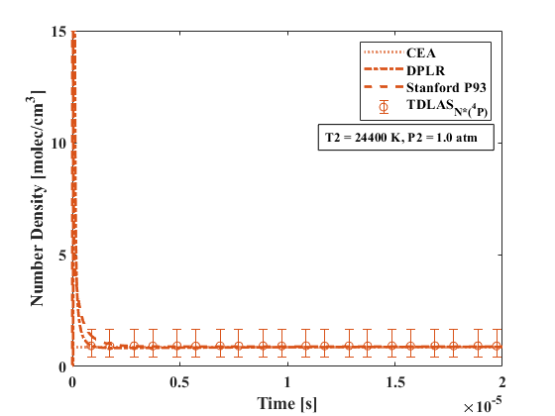
High Velocity Number Densities (O* 5S, N* 4P)
Background
Theory
Results
Conclusions
Measurements in agreement with models.

Slide 15
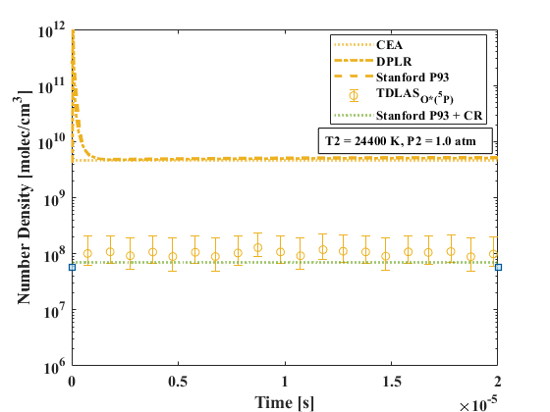
Collisional-Radiative Considerations
Background
Theory
Results
Conclusions
Radiative processes can play a significant role in the kinetics of atomic species electronic excitation.
$Continuum$
Term | $A_{ji}$ [s⁻¹] | $$Λ_{ji}$$ | $A_{ji,eff}$ [s⁻¹]
3s ⁵S⁰ | 5.6E+03 | $$≈0.25$$ | $$O\left({10}^{3}\right)$$
3p ⁵P₃ | 3.7E+07 | $≈$1 | $$O\left({10}^{7}\right)$$
3s ⁴P | 4.0E+08 | $≈$1E-05 | $$O\left({10}^{3}\right)$$
$k_{4c}$
$k_{4c}^{e}$
$k_{6c}$
$k_{6c}^{e}$
$${}_{}^{5}{P^{3}} E_{6}$$
$${}_{}^{5}{P^{0}} E_{4}$$
$k_{46}^{e}$
$k_{46}$
$A_{64}$
Oxygen Atom (O)
$A_{41}$
$k_{14}$
$k_{14}^{e}$
$k_{16}$
$k_{16}^{e}$
$${}_{}^{3}P E_{1}$$
De-excitation through spontaneous emission can be estimated via the Einstein-A coefficient
$$τ_{i}∝\frac{1}{A_{ji,eff}}$$
$$A_{ji,eff}=Λ_{ji}A_{ji}$$
$$Λ_{ji}=\frac{1.875}{k_{0}L\sqrt{π\ln\left(k_{0}L\right)}}$$

Slide 16
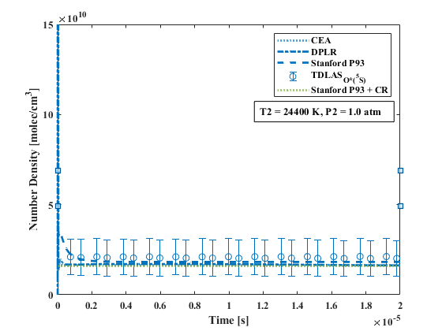
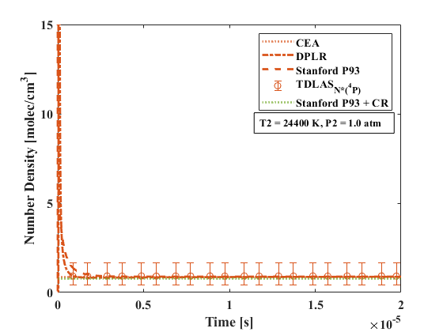
Impact of Collisional-Radiative Corrections
Background
Theory
Results
Conclusions
Original figures
Additional uncertainty from EAST reported U_{is} values (~1%).
Updated figures

Slide 17
Summary
Background
Theory
Results
Conclusions
Seven fast-scanning TDLAS-based diagnostics targeting NO in the mid-IR, and O* and N* in the near-IR have been successfully integrated and demonstrated in the NASA Ames EAST facility.
Stanford measurements have been compared with emission measurements, Stanford models, and Ames modeling (DPLR).
Temperature measurements are consistent between Stanford absorption and NASA emission diagnostics, and relatively consistent with modeling.
Temperature measurements are higher than models suggest.
NO number density measurements track well with Stanford models.
O*(5S) and N*(4P) measurements are higher than models suggest, O*(5P) measurements are lower.
CR considerations resolve some of the disagreement between excited states.
U_{is} reporting uncertainty can resolve some of the remaining disagreement between measurement and model.
These discrepancies motivate ongoing, air kinetics work to resolve the accuracy of modeling assumptions.

Slide 18
Acknowledgements
Stanford
Efaine Chang
Dylan Drescher
Jesse Streicher
Christopher Strand
Professor Ronald K. Hanson
NASA
NSTGRO, 80NSSC21K1268
Andrea Fagnani, USRA
Brett A. Cruden, AMA
Entry Systems Modeling Project
AFOSR
FA9550-19-1-0219
FA9550-21-1-0311

Slide 19
Thank You!

