Slide 1
Ultraviolet Laser Absorption Studies of the Vibrational Relaxation and Kinetics of High-Temperature Air
Outline:
Background
Expt. Methods
Time-Histories
Rates
Conclusions
Jesse Streicher
Spencer Barnes, and Prof. Ronald Hanson
High Temperature Gasdynamics Laboratory
Stanford University
1
10th International Workshop on Radiation of High Temperature Gases for Space Missions Oxford, September 10, 2024

Slide 2
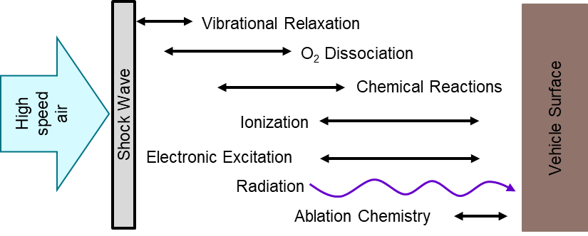
Ground Test Facilities to Reproduce Flight Conditions
Background
Conclusions
Methods
Rates
Time-Histories
Reflected Shock Tube (e.g., Stanford)
Incident Shock Tube (e.g., EAST/T6)
Shock Tunnels (e.g., T5/T6)
Stagnated test gas provides high time resolution
Integration of multiple UV laser diagnostics
Low enthalpy conditions and limited test time
High-velocity incident shocks reproduce relevant conditions
Optical access typically includes absorption and emission diagnostics
Temporal and spatial resolution are coupled
Valuable for studying flow around test geometries
Access to high enthalpy gas with long test times
Flow can introduce non-uniform lines of sight
Nozzles can freeze species in nonequilibrium quantities
2

Slide 3
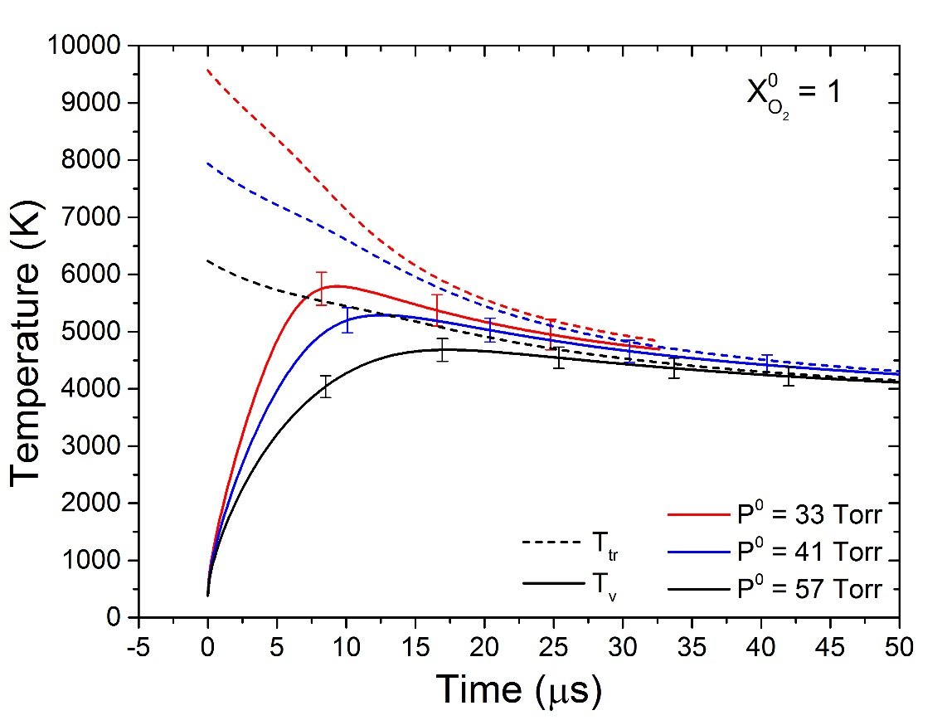
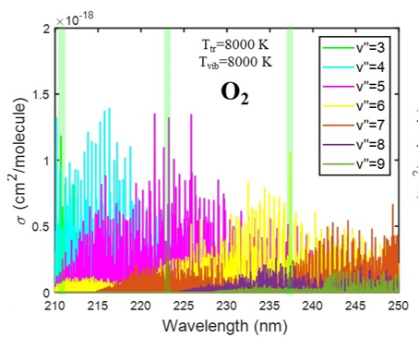
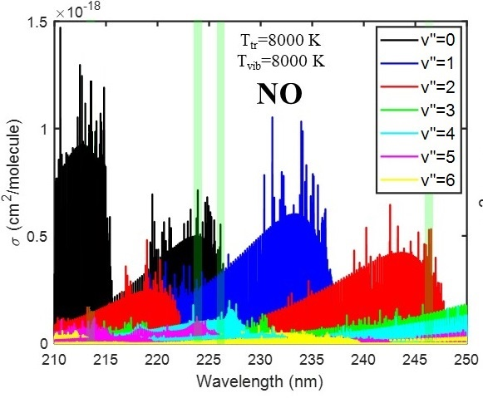
Multi-Step Process for Inferring Reaction Rates
Background
Conclusions
Methods
Rates
Time-Histories
UV Laser Absorption Diagnostic Development
Results
Leverage spectroscopic model to choose vibrational-state-specific wavelength(s)
Measure α(t) for mixtures with well-known temperature and composition
Infer σ(T_{tr},T_{vib}) over wavelength and temperature sweeps
State-Specific Time-History Measurements in Shock Tubes
Results
Measure α(t)
Infer temperature from α ratios
Infer number density from α magnitude
Infer vibrational-state specific number density.
Selected Wavelengths
3

Slide 4
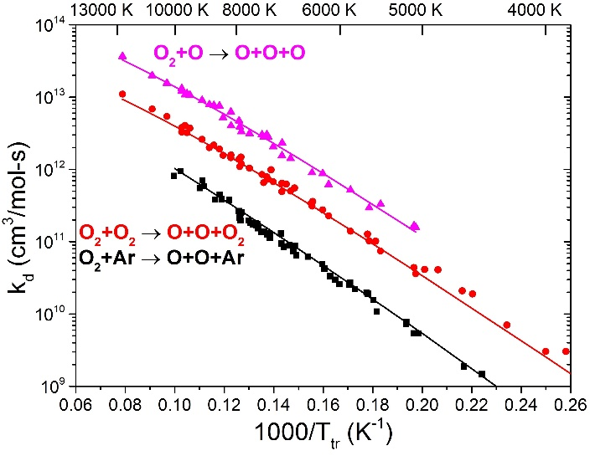
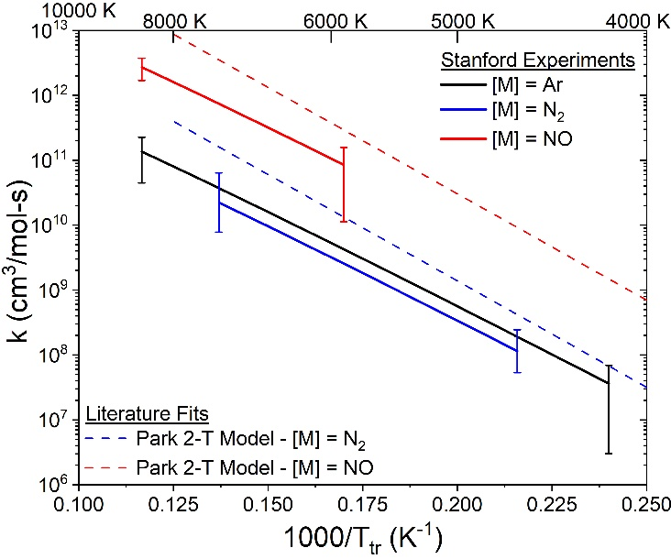
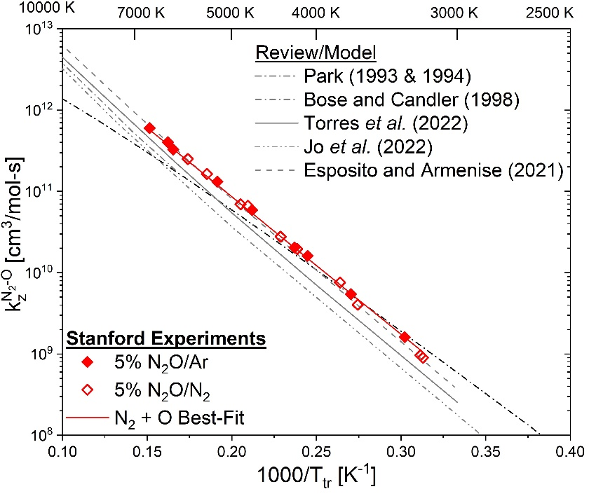
Multi-Step Process for Inferring Reaction Rates
Background
Conclusions
Methods
Rates
Time-Histories
UV Laser Absorption Diagnostic Development
Results
Leverage spectroscopic model to choose vibrational-state-specific wavelength(s)
Measure α(t) for mixtures with well-known temperature and composition
Infer σ(T_{tr},T_{vib}) over wavelength and temperature sweeps
State-Specific Time-History Measurements in Shock Tubes
Results
Measure α(t)
Infer temperature from α ratios
Infer number density from α magnitude
Infer vibrational-state specific number density.
Nonequilibrium Rate Parameter Inferences
Results
τ_{v} from T_{v}(t)
k_{d}^{O2} from n_{O2}(t)
k_{d}^{NO} and k_{z} from n_{NO}(t)
Fit rate parameters with known T-dependence
Experiments have probed either O₂ or NO, motivating an investigation of both in high-T air.
O₂ Dissociation
NO Dissociation
Zeldovich Reaction Rates
4

Slide 5
Experimental Setup – Ultraviolet Laser Diagnostics
Background
Conclusions
Methods
Rates
Time-Histories
Reflected Shock Tube
Measured shock velocity → T⁰, P⁰
Stagnated test gas → t_{part} = t_{lab}
Pressure gauge → P(t)
Mira Laser System
Pulsed, broadly tunable UV
Primarily targets O₂
Sacher Laser System
Continuous-wave, tunable UV
Targets both O₂ and NO
M-Squared Laser System
Continuous-wave, tunable UV
Primarily targets NO
Top View
Det.
End View
Det.
Det.
Det.
15.24 cm
Det.
5 mm
Det.
Shock Wave
UV-grade fused silica windows
Det.
Pump
Det.
Beer-Lambert Relation used to quantify state-specific absorbance:
$$\frac{I}{I_{0}}=\exp{(−α})=exp⁡(−nσL)$$
Pellin-Broca Prism
Pulsed Ti:Sapphire Cavity
Fourth Harmonic Generator
Det.
Frequency Doubling Stages
Pump
Pump
+
Amplifier
Continuous Wave Ti:Sapphire Cavity
Frequency Doubling Stages
5

Slide 6
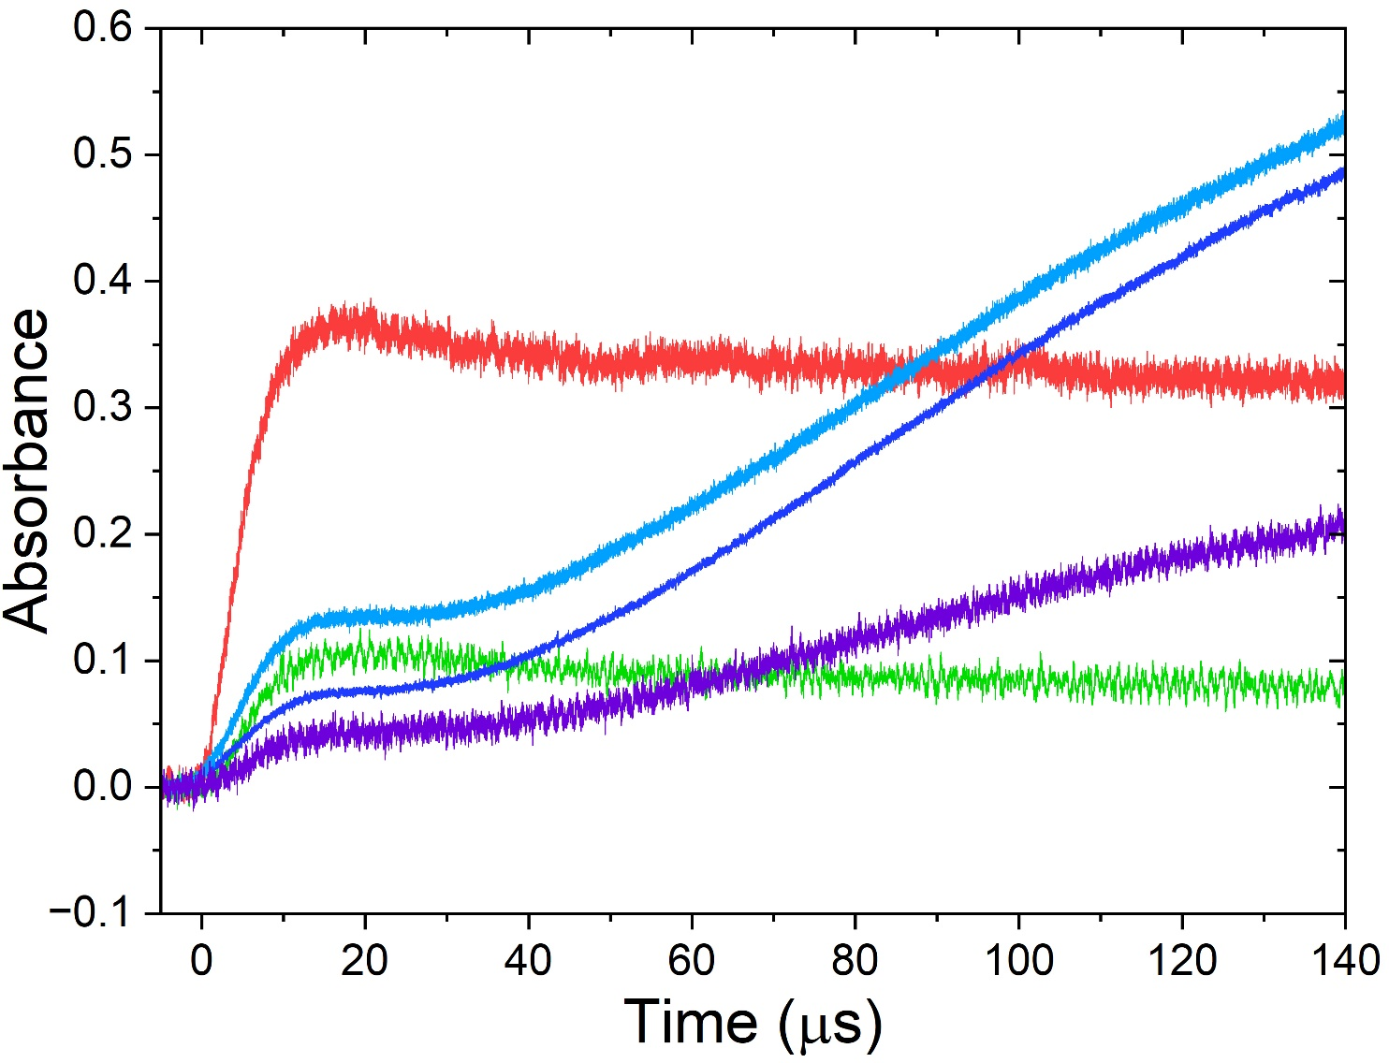
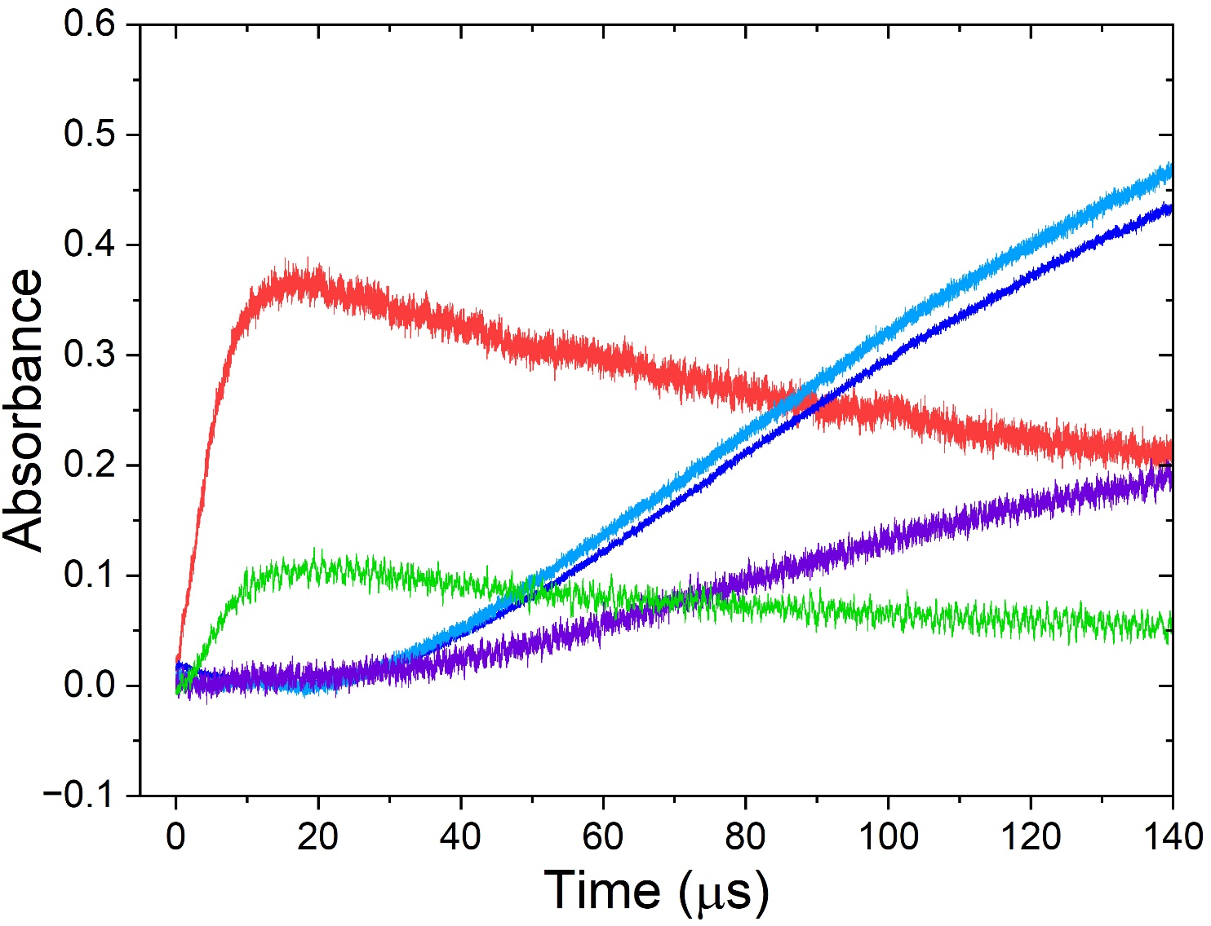
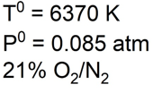
Data Analysis Procedure
Background
Conclusions
Methods
Rates
Time-Histories
α_{λ}
$$α_{λ}^{O_{2}}$$
Note: Separation of $α_{λ}^{O_{2}}$ and $α_{λ}^{NO}$ is informed by separate cross-section studies, and iterated in the full data analysis
$$α_{λ}^{NO}$$
$$\frac{I}{I_{0}}=\exp{(−α})=exp(−nσL)$$
211.2 nm
O₂ v” = 4
NO v” = 0
226.1 nm
224.8 nm
NO v” = 0
246.3 nm
236.9 nm
O₂ v” = 6
NO v” = 2
6

Slide 7
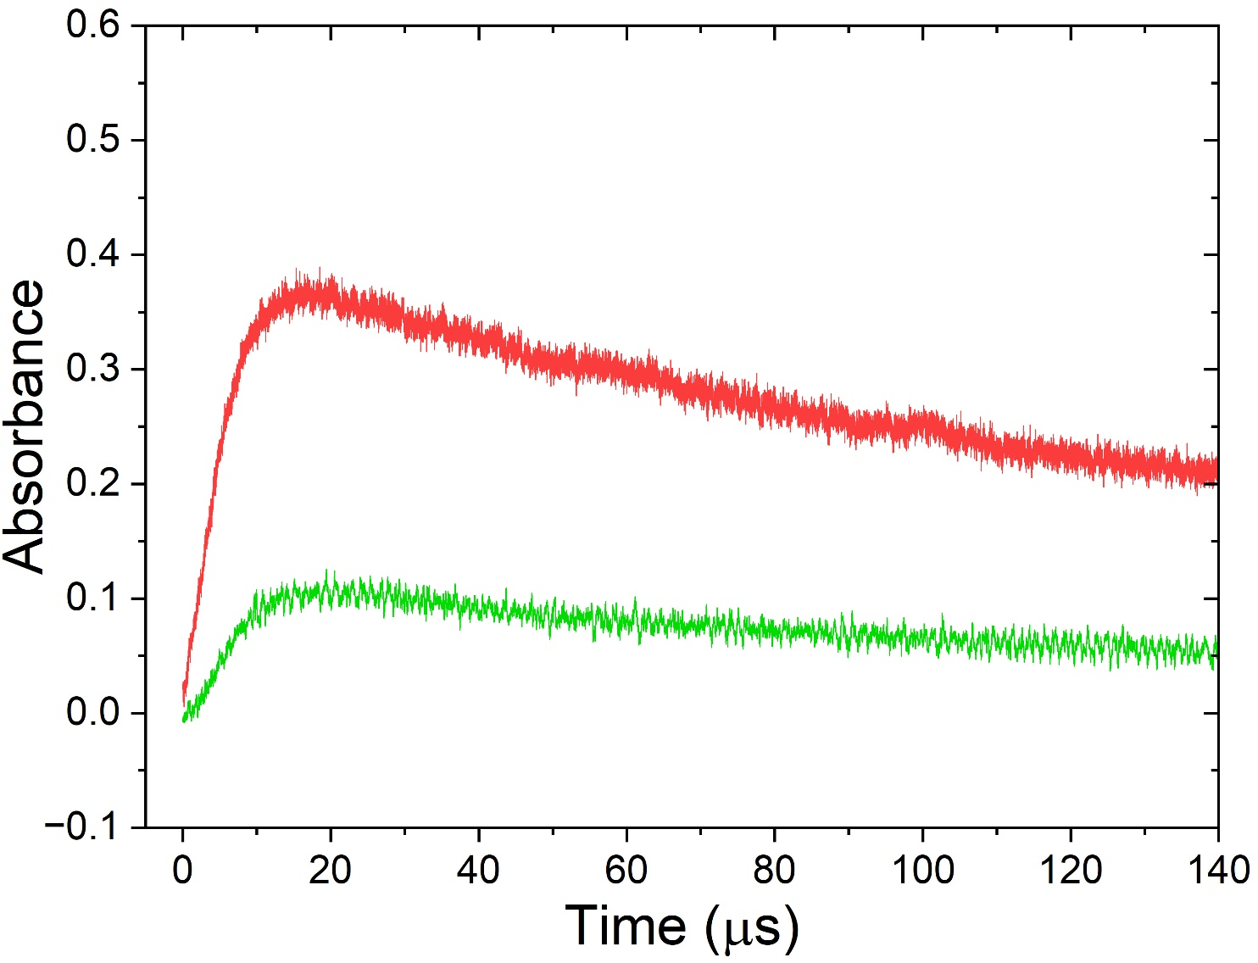
Data Analysis Procedure
Background
Conclusions
Methods
Rates
Time-Histories
α_{λ}
$$α_{λ}^{O_{2}}$$
$$T_{vib}^{O_{2}}$$
$$n_{O_{2}}$$
$$n_{v" = 4,5,6}$$
$$α_{λ}^{NO}$$
Inferred Quantity | Method
Vibrational Temperature | $$\frac{α_{v"=4}}{α_{v"=6}}=\frac{σ_{v"=4}}{σ_{v"=6}}≈f(T_{vib}^{O_{2}})$$
Total O₂ Number Density | $$n_{O_{2}}=\frac{α_{λ}}{σ_{λ1}\left(\text{T}\text{tr}\text{ ,}{\text{T}}_{vib}\right)L}$$
Vibrational-State-Specific Number Density | $$n_{v" = 4}∝α_{v" = 4}$$
O₂ Dissociation Rate | $$\frac{dn_{O_{2}}}{dt}→k_{d}^{O_{2}}$$
O₂ Vibrational Relaxation Times | $$\frac{dT_{v}^{O_{2}}}{dt}→τ_{v}^{O_{2}}$$
Inferred Quantity | Method
Vibrational Temperature | $$\frac{α_{v"=4}}{α_{v"=6}}=\frac{σ_{v"=4}}{σ_{v"=6}}≈f(T_{vib}^{O_{2}})$$
Total O₂ Number Density | $$n_{O_{2}}=\frac{α_{λ}}{σ_{λ1}\left(\text{T}\text{tr}\text{ ,}{\text{T}}_{vib}\right)L}$$
Vibrational-State-Specific Number Density | $$n_{v" = 4}∝α_{v" = 4}$$
O₂ Dissociation Rate | $$\frac{dn_{O_{2}}}{dt}→k_{d}^{O_{2}}$$
O₂ Vibrational Relaxation Times | $$\frac{dT_{v}^{O_{2}}}{dt}→τ_{v}^{O_{2}}$$
7

Slide 8
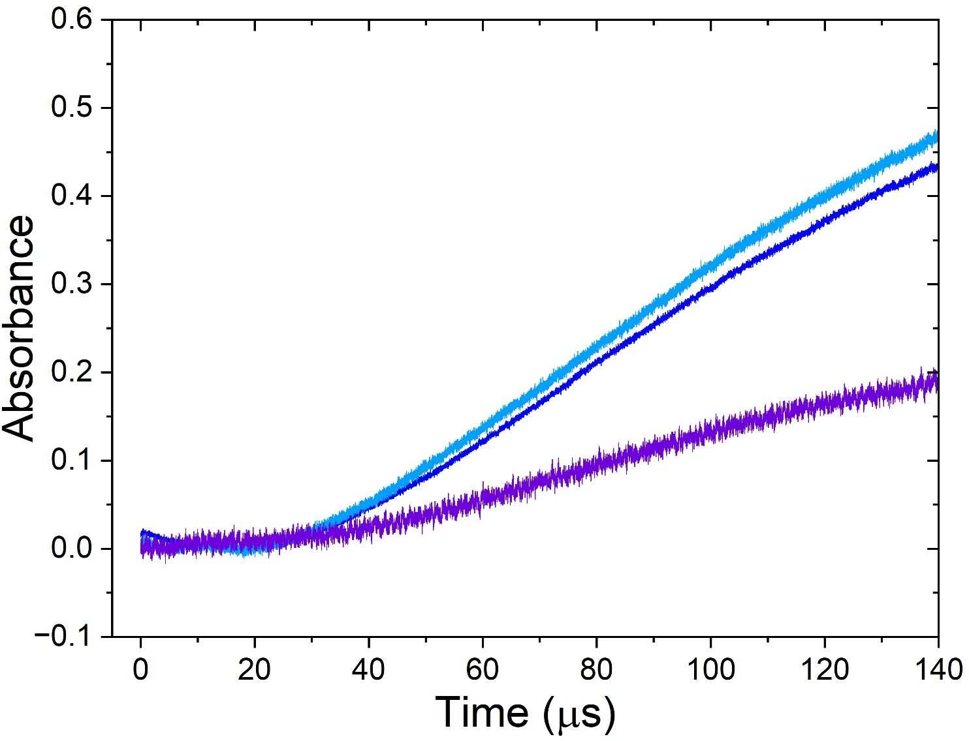
Data Analysis Procedure
Background
Conclusions
Methods
Rates
Time-Histories
α_{λ}
$$α_{λ}^{O_{2}}$$
$$T_{vib}^{O_{2}}$$
$$n_{O_{2}}$$
$$n_{v" = 4,5,6}$$
$$α_{λ}^{NO}$$
$$T_{rot}^{NO}=T_{tr}$$
$$T_{vib}^{NO}$$
$$n_{NO}$$
$$n_{v" = 0,2}$$
Inferred Quantity | Method
Translational/Rotational Temperature | $$\frac{α_{v"=0,J"}}{α_{v"=0,J"}}=\frac{σ_{{J"}_{1}}}{σ_{{J"}_{2}}}≈f(T_{rot}^{NO})→T_{tr}$$
NO Vibrational Temperature | $$\frac{α_{v"=0}}{α_{v"=2}}=\frac{σ_{v"=0}}{σ_{v"=2}}≈f(T_{vib}^{NO})$$
Total NO Number Density | $$n_{NO}=\frac{α_{λ}}{σ_{λ1}\left(\text{T}\text{tr}\text{ ,}{\text{T}}_{vib}\right)L}$$
Vibrational-State-Specific Number Density | $$n_{v" = 0}∝α_{v" = 0}$$
Zeldovich Reaction Rates | $$\frac{dn_{NO}}{dt}→k_{z}^{N_{2}−O}$$
Inferred Quantity | Method
Translational/Rotational Temperature | $$\frac{α_{v"=0,J"}}{α_{v"=0,J"}}=\frac{σ_{{J"}_{1}}}{σ_{{J"}_{2}}}≈f(T_{rot}^{NO})→T_{tr}$$
NO Vibrational Temperature | $$\frac{α_{v"=0}}{α_{v"=2}}=\frac{σ_{v"=0}}{σ_{v"=2}}≈f(T_{vib}^{NO})$$
Total NO Number Density | $$n_{NO}=\frac{α_{λ}}{σ_{λ1}\left(\text{T}\text{tr}\text{ ,}{\text{T}}_{vib}\right)L}$$
Vibrational-State-Specific Number Density | $$n_{v" = 0}∝α_{v" = 0}$$
Zeldovich Reaction Rates | $$\frac{dn_{NO}}{dt}→k_{z}^{N_{2}−O}$$
8

Slide 9
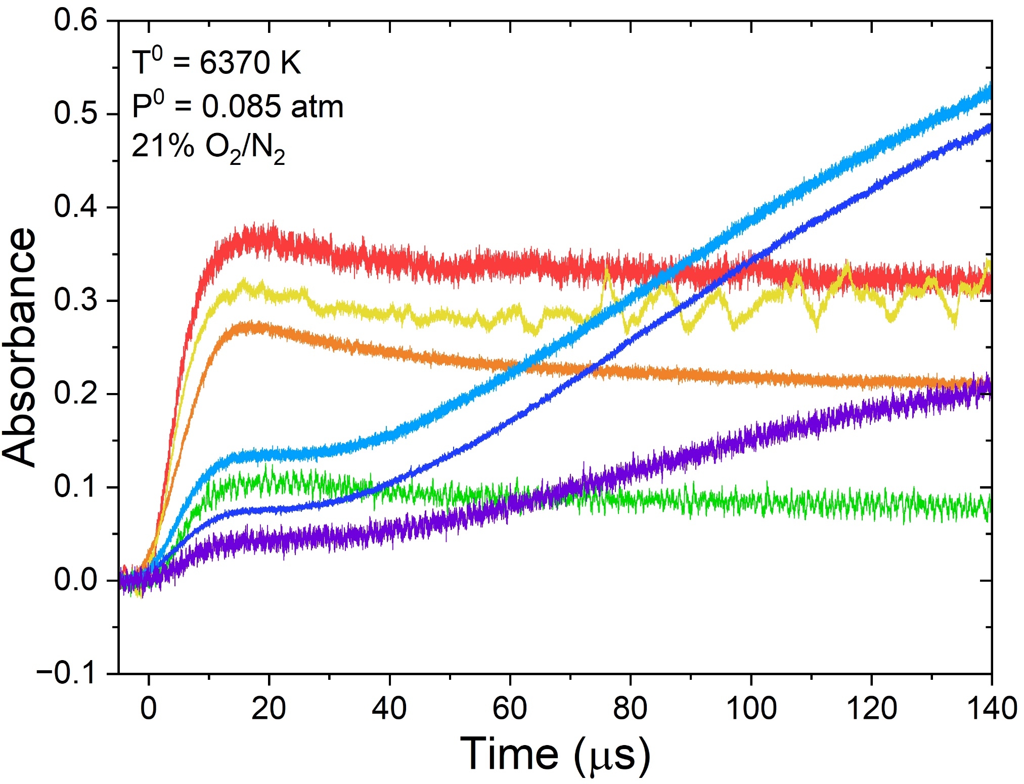
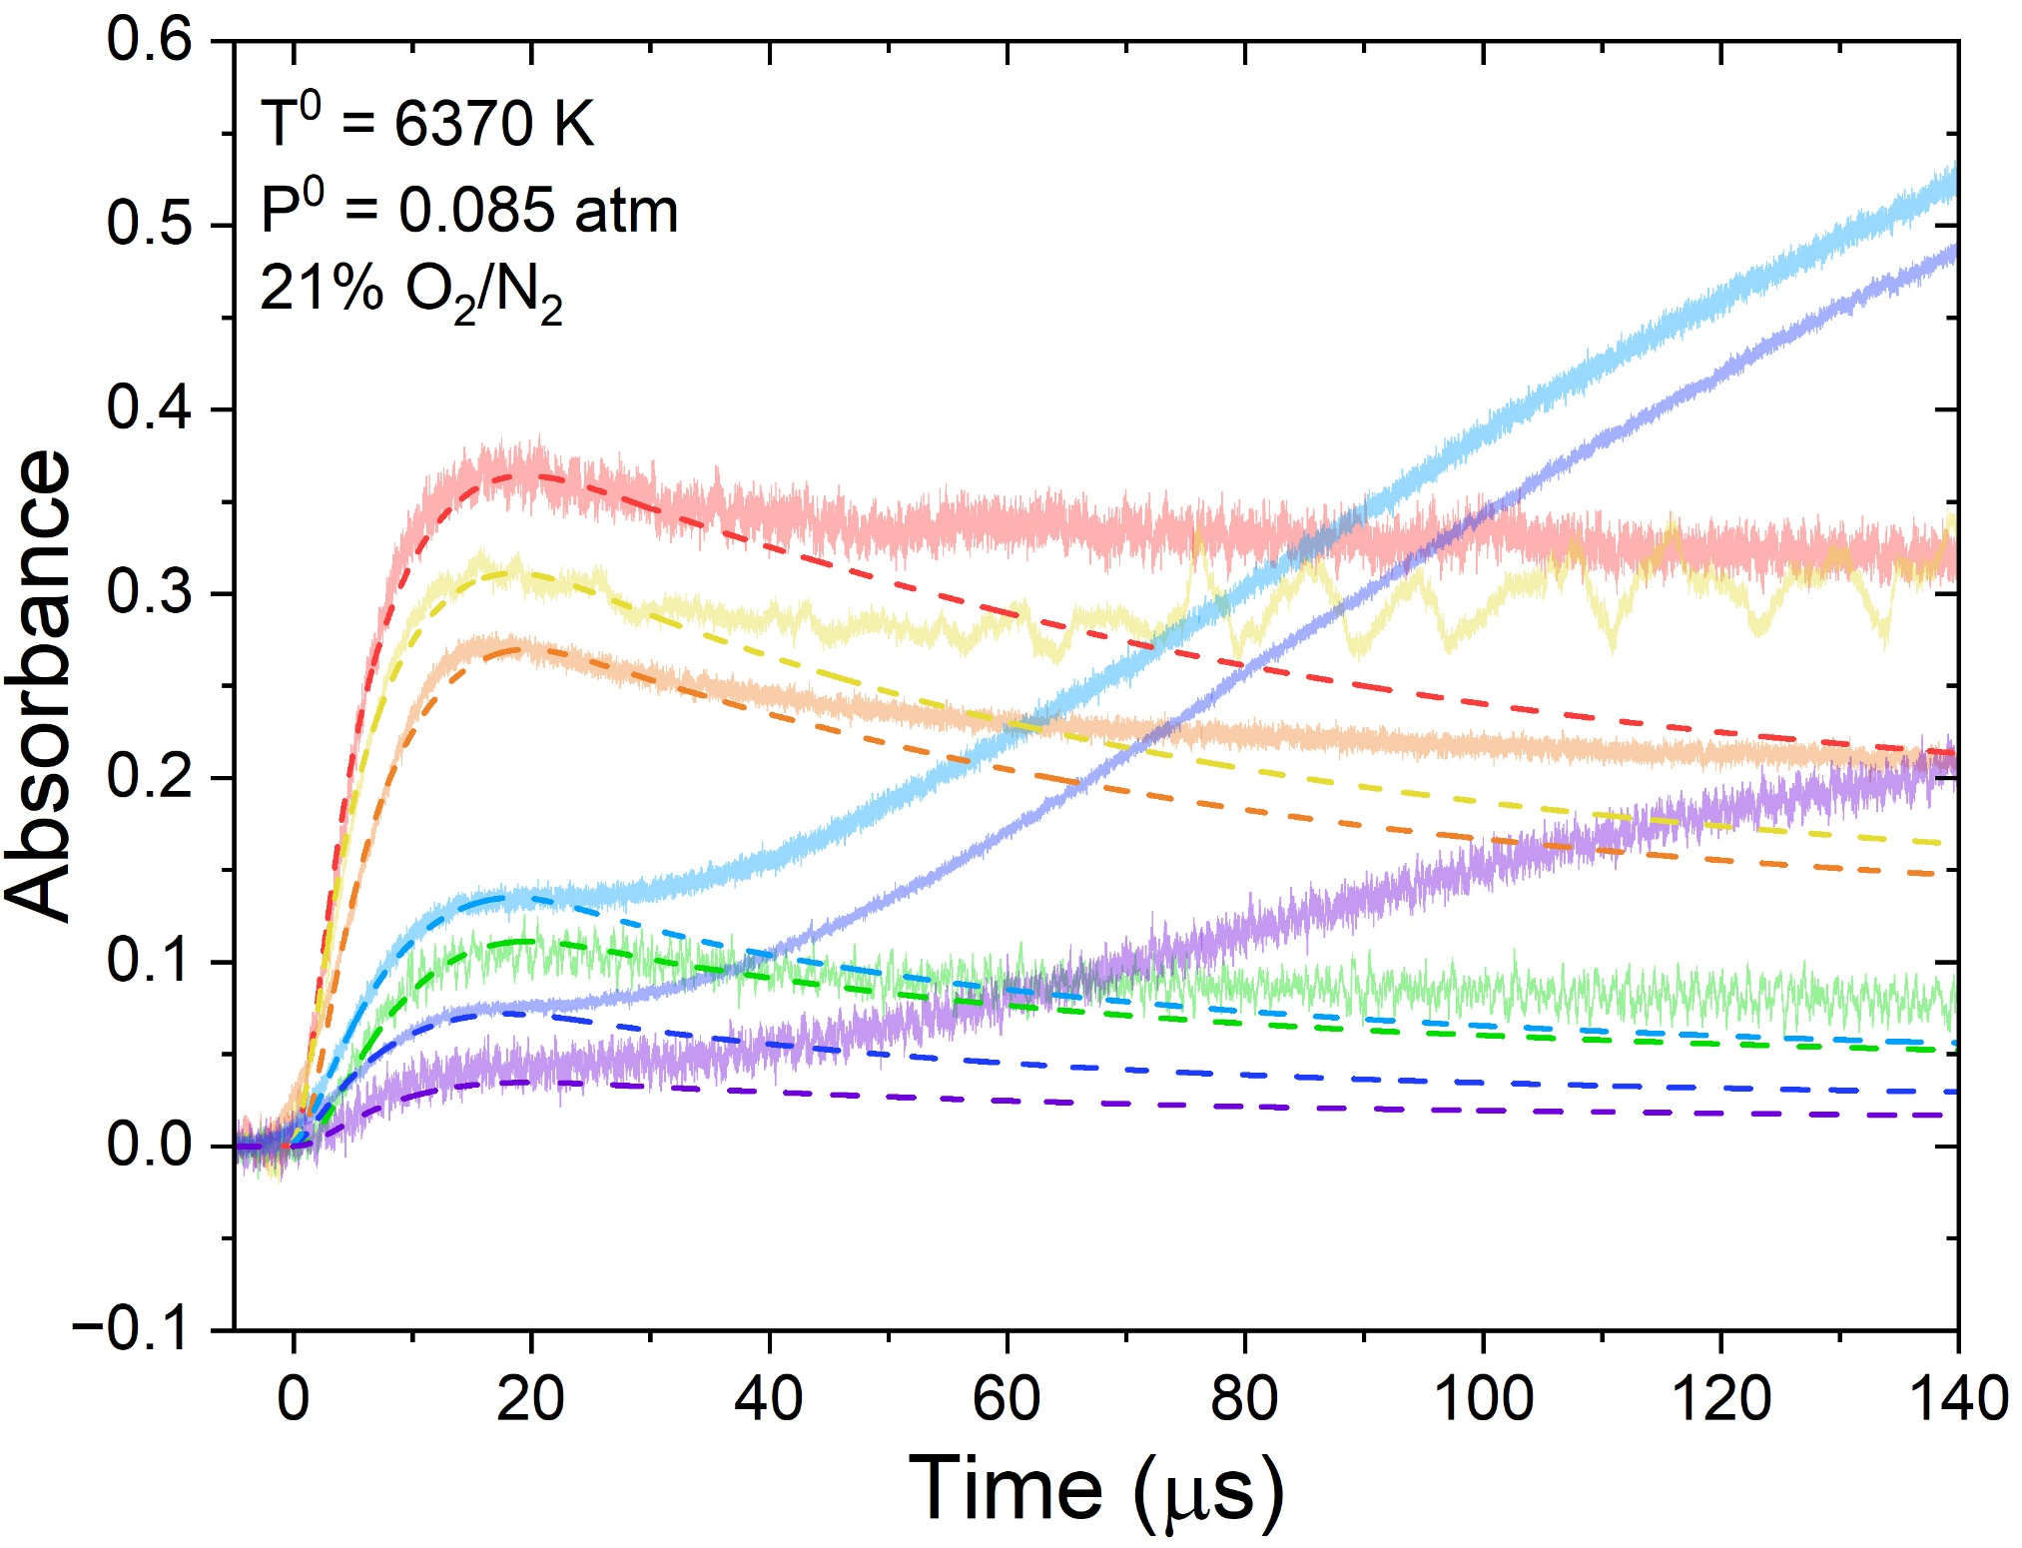
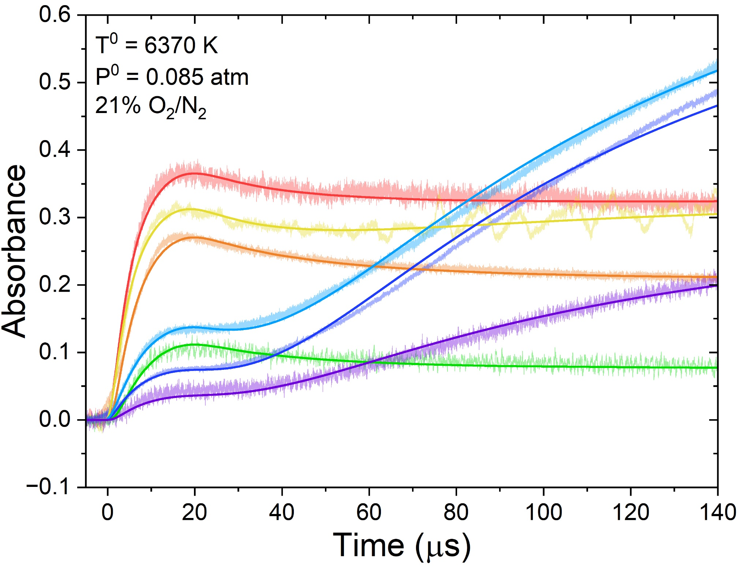
Absorbance Time-Histories
Background
Conclusions
Methods
Rates
Time-Histories
226.1 nm
Absorbance noise is proportional to laser output power
NO v” = 0
211.2 nm
224.8 nm
O₂ v” = 4
NO v” = 0
223.2 nm
O₂ v” = 5
O₂ contributions at all λ, with 236.9 nm least sensitive to NO formation
O₂ v” = 5
221.6 nm
Best-fit simulation captures absorbance behavior at all λ
246.3 nm
236.9 nm
NO v” = 2
O₂ v” = 6
9

Slide 10
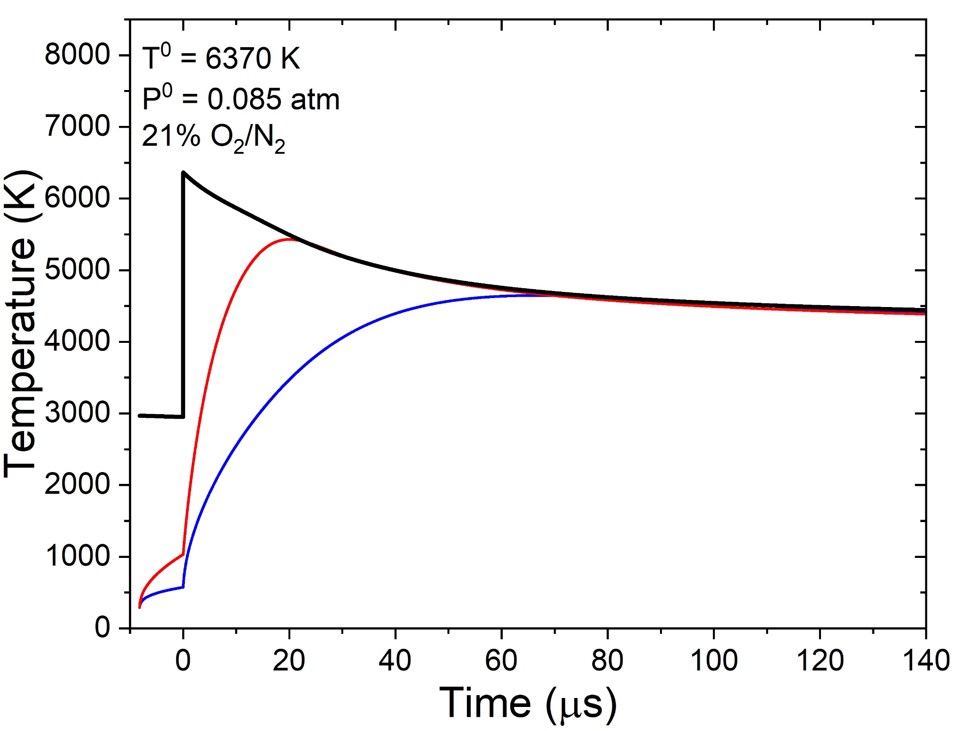
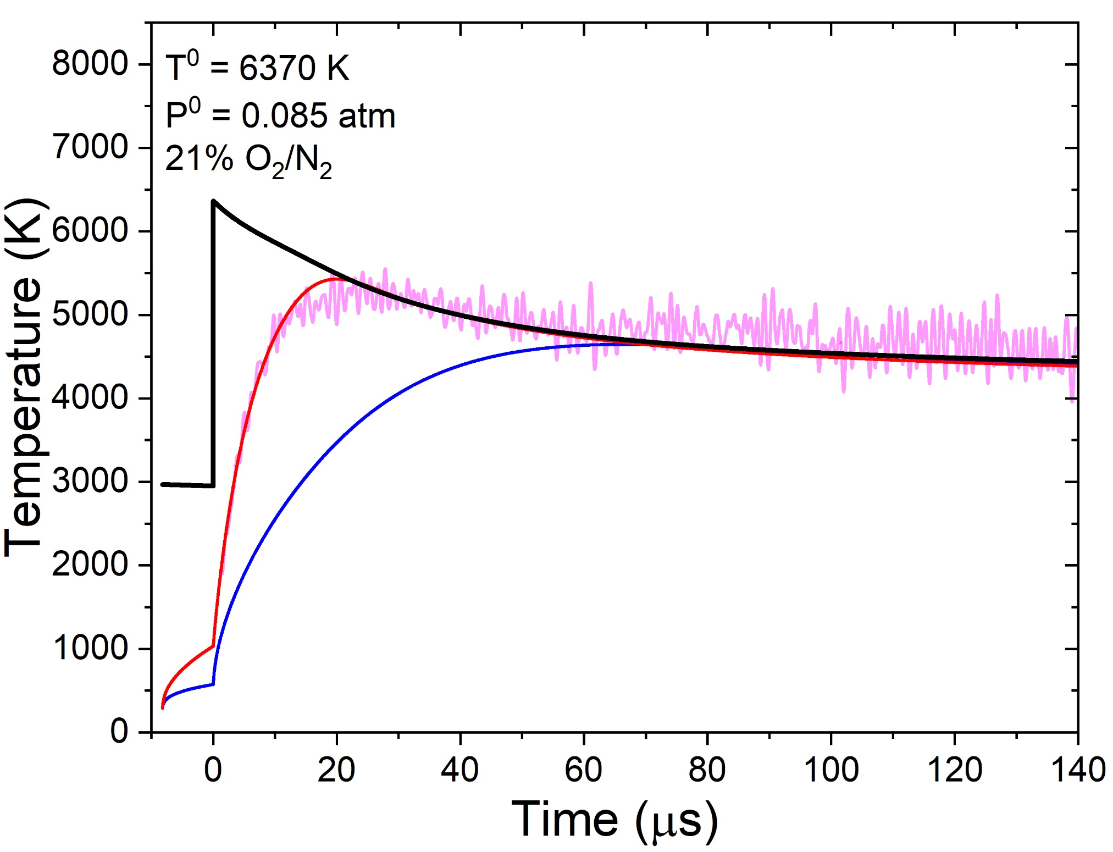
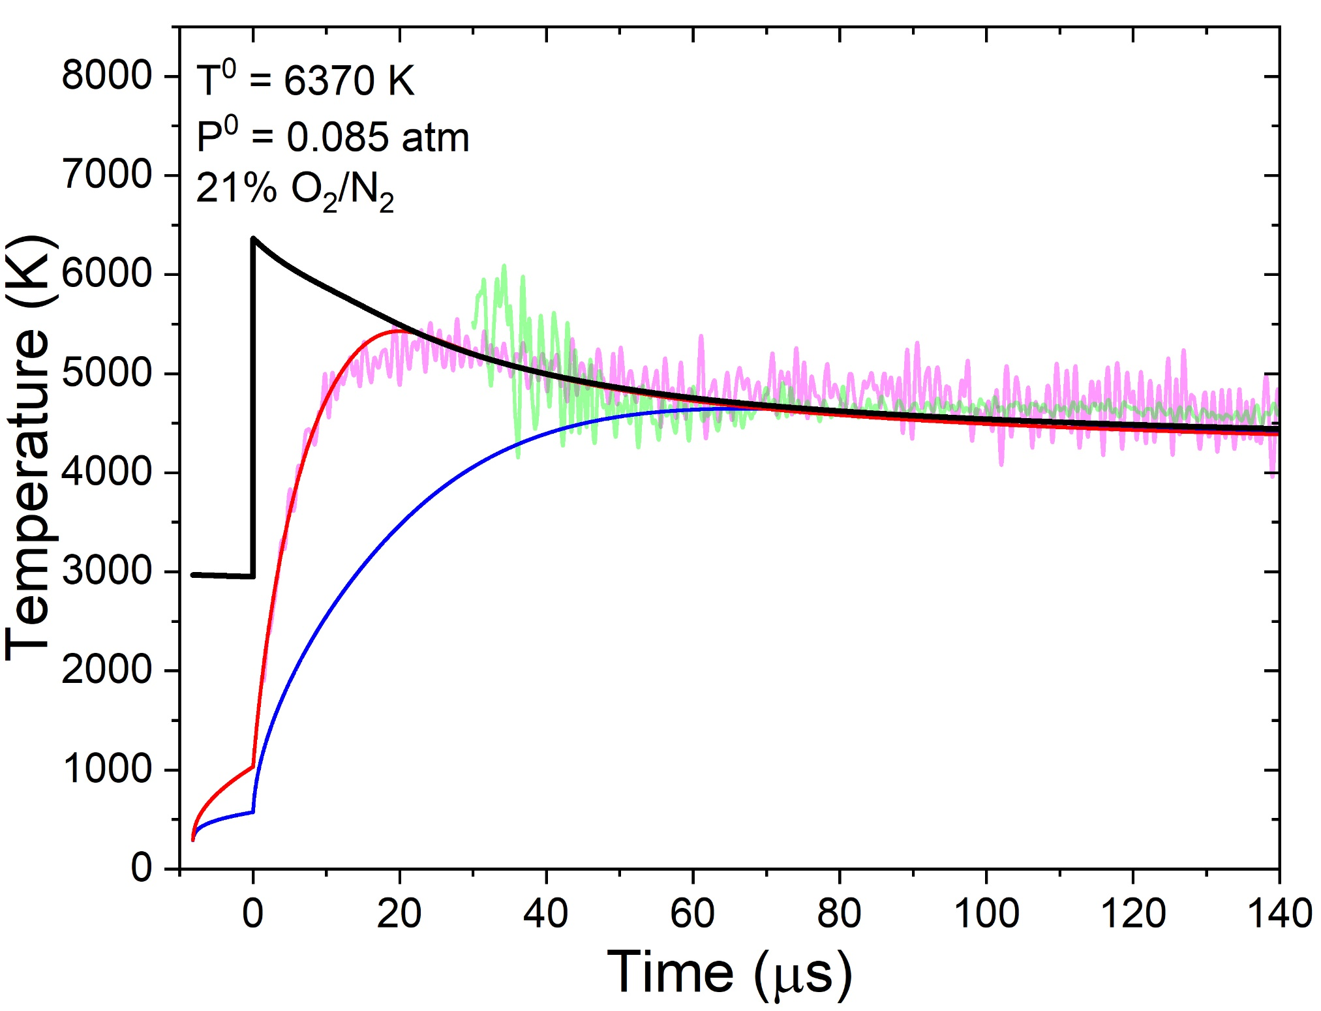
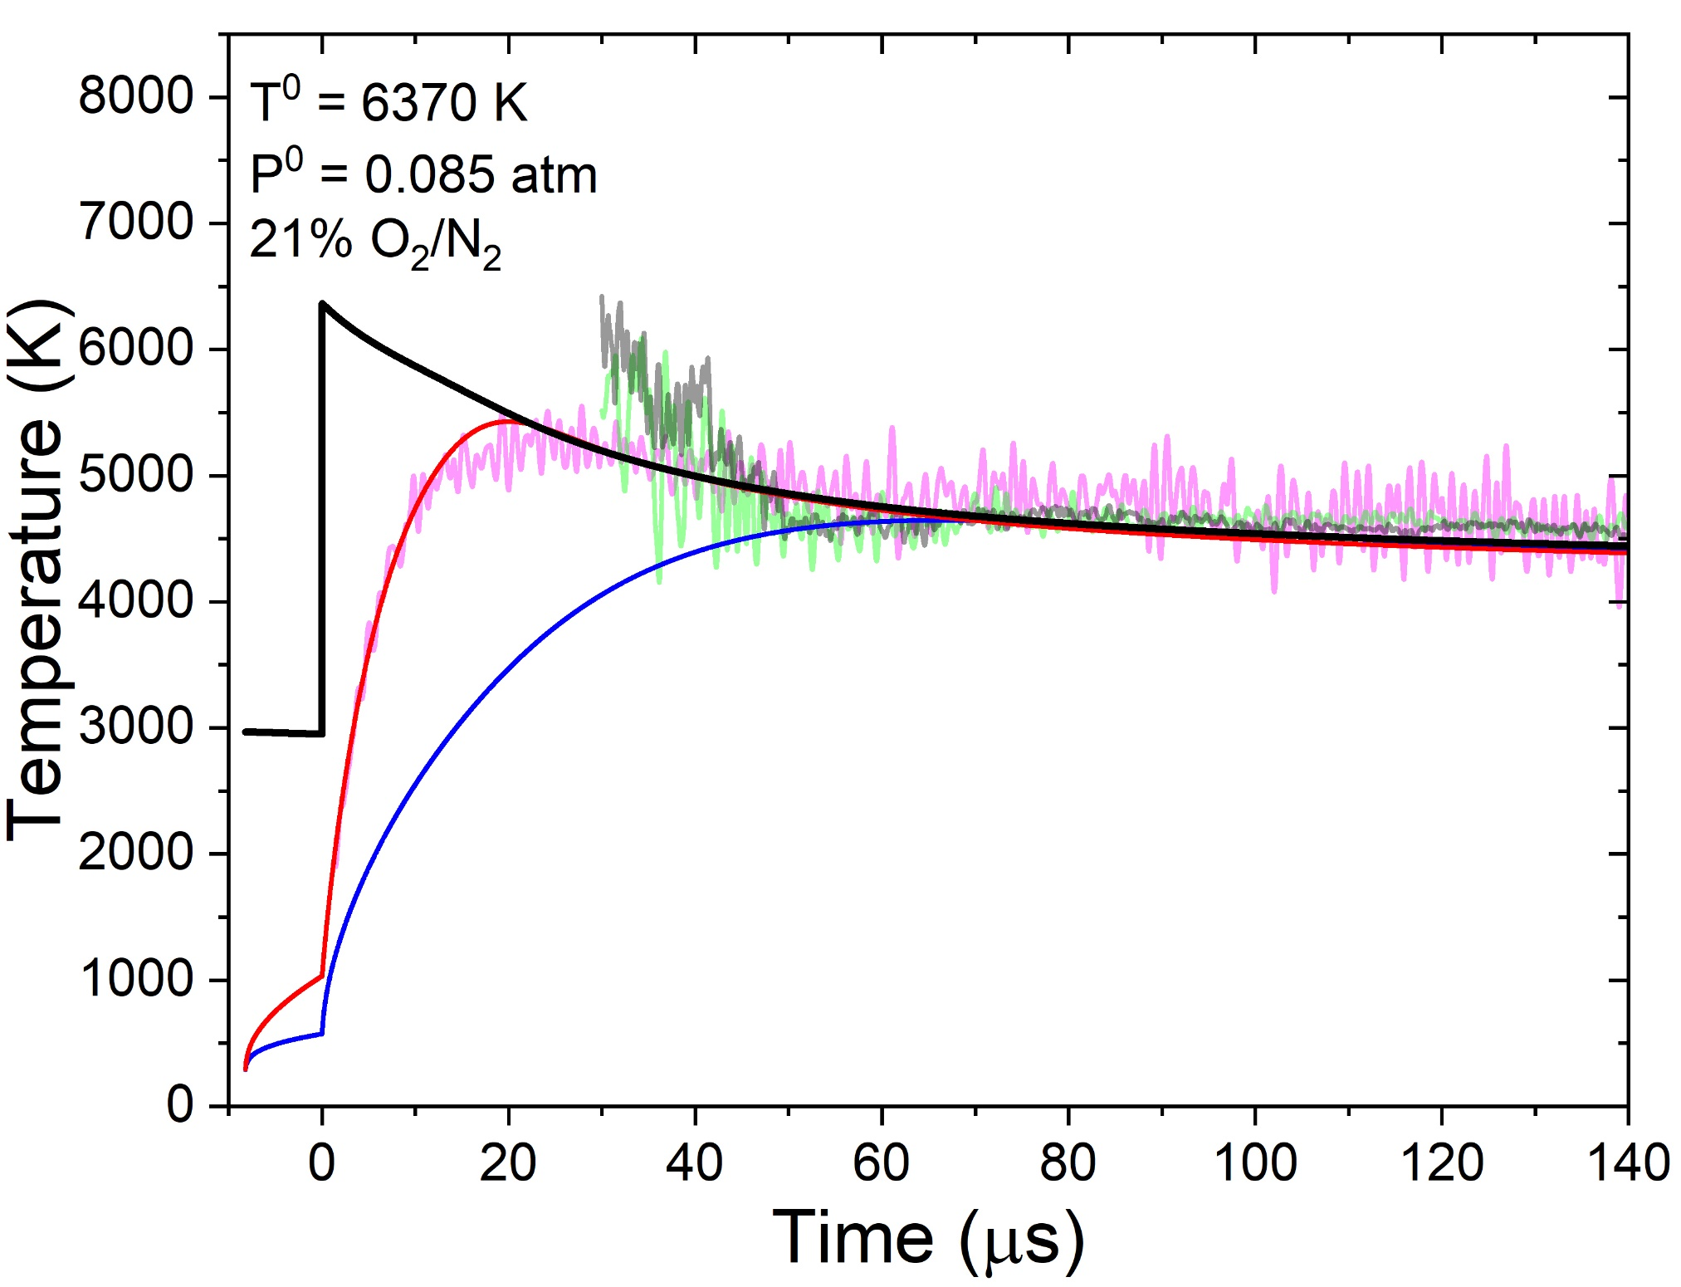
Temperature Time-Histories
Background
Conclusions
Methods
Rates
Time-Histories
Simulations use separate T_{v} for the vibrational relaxation for O₂ and N₂
T_{tr} (inferred)
T_{tr}
T_{v}^{O2} (inferred)
T_{v}^{O2} time histories agree well with previously inferred relaxation times
T_{v}^{O2}
T_{v}^{NO} (inferred)
T_{v}^{N2}
T_{v}^{NO} results suggest NO forms with T_{v} $≈$ T_{tr} after delayed NO formation
Inferred T_{tr} also agrees with both T_{v}^{NO} results and simulations
10

Slide 11
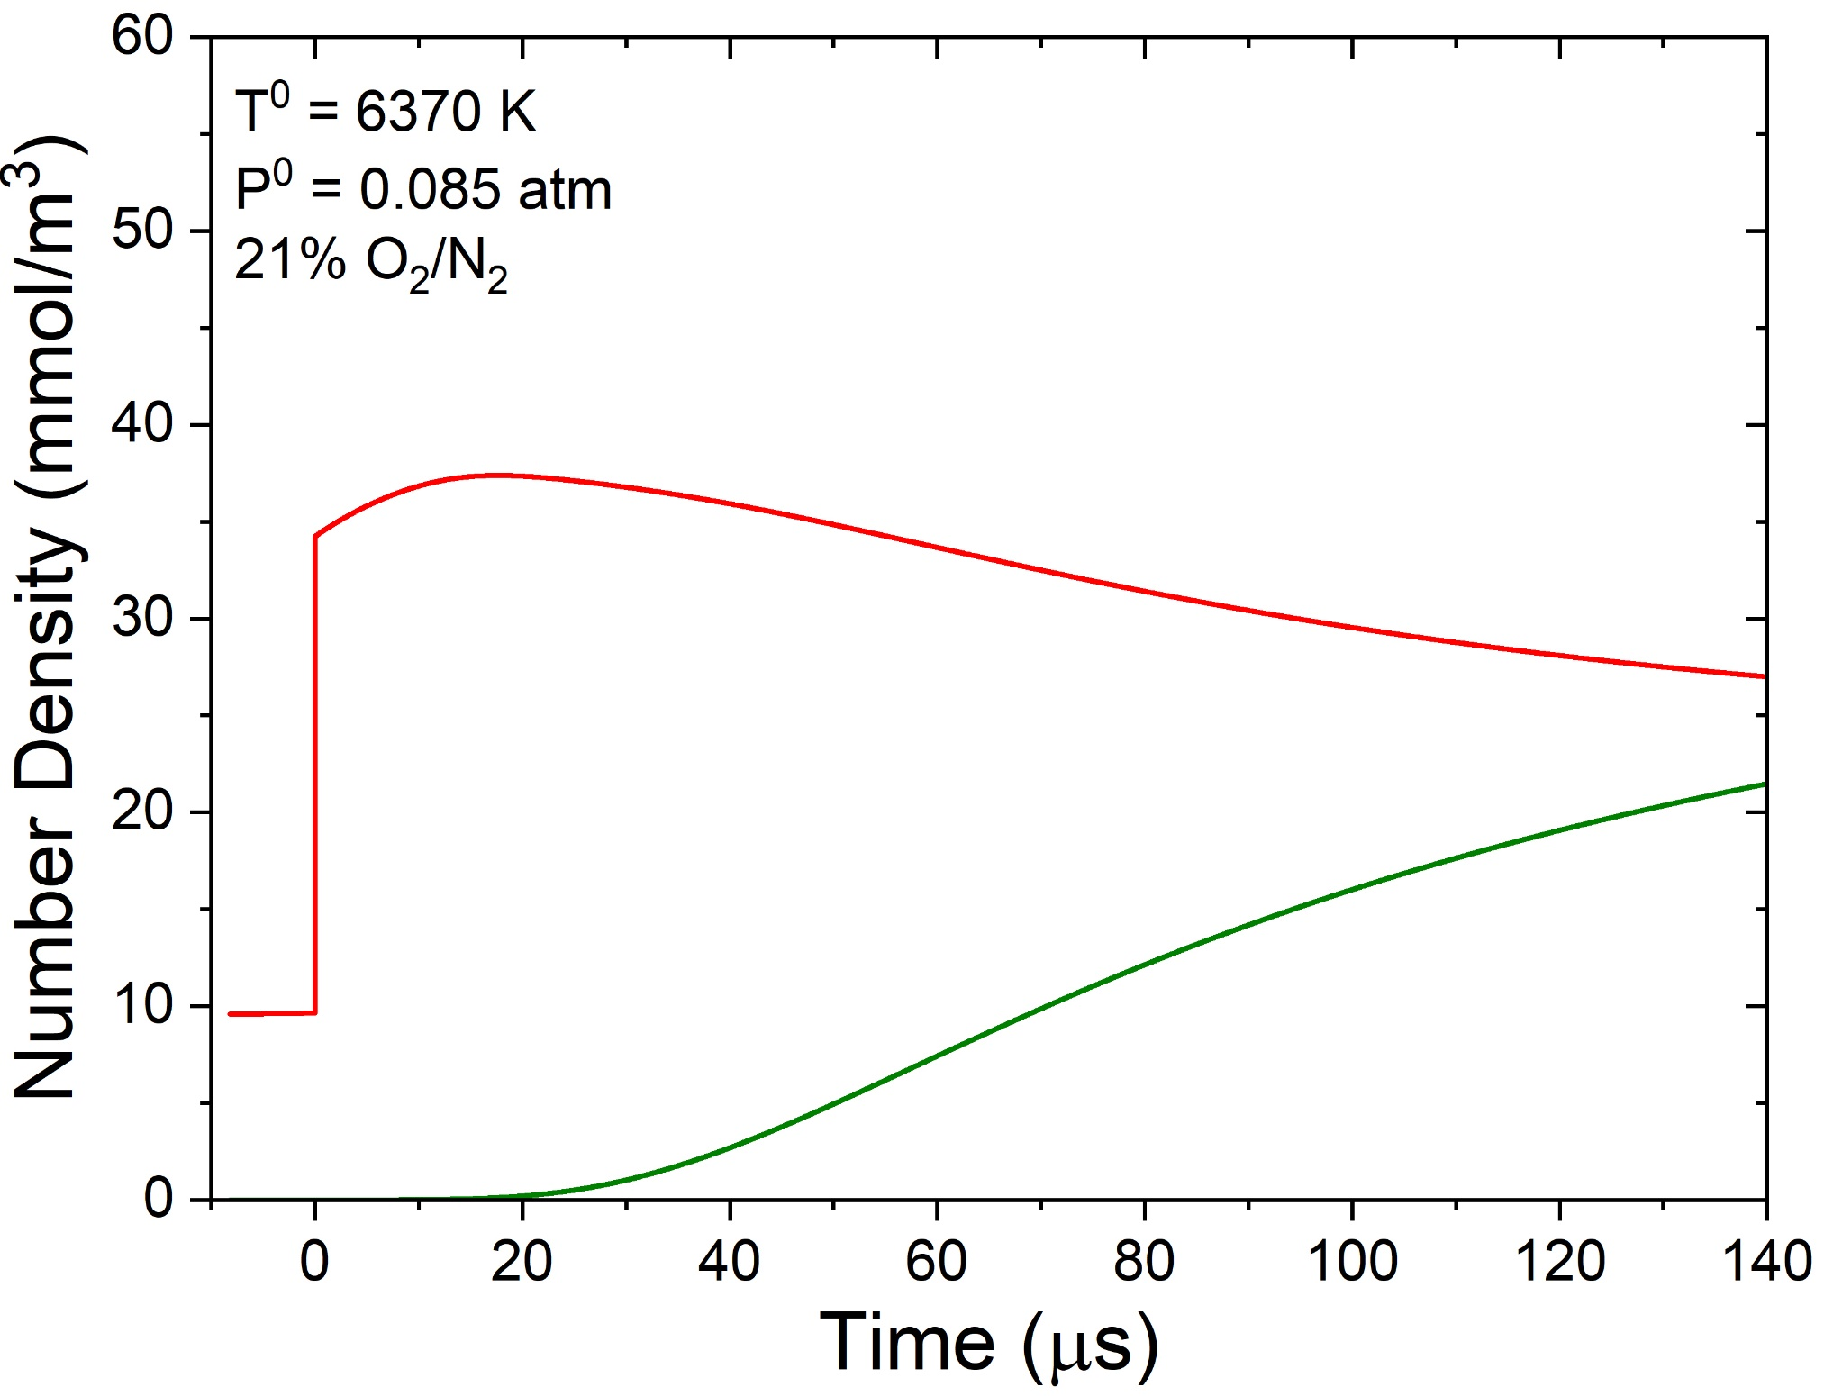
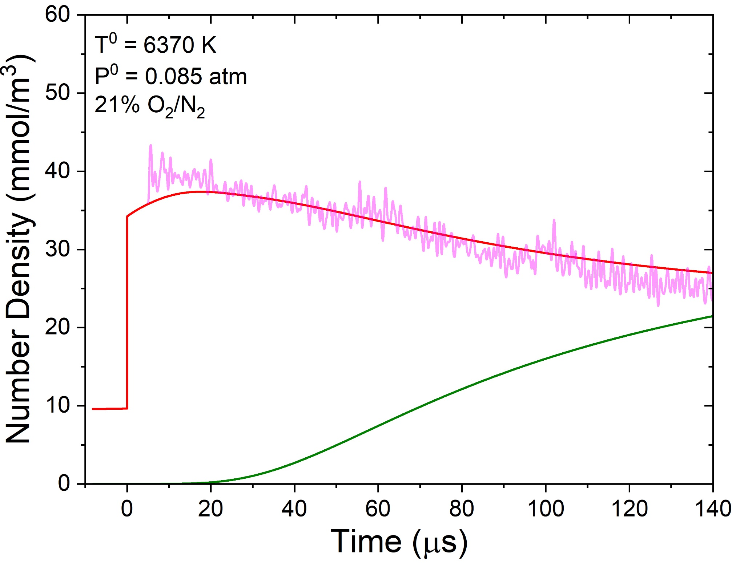
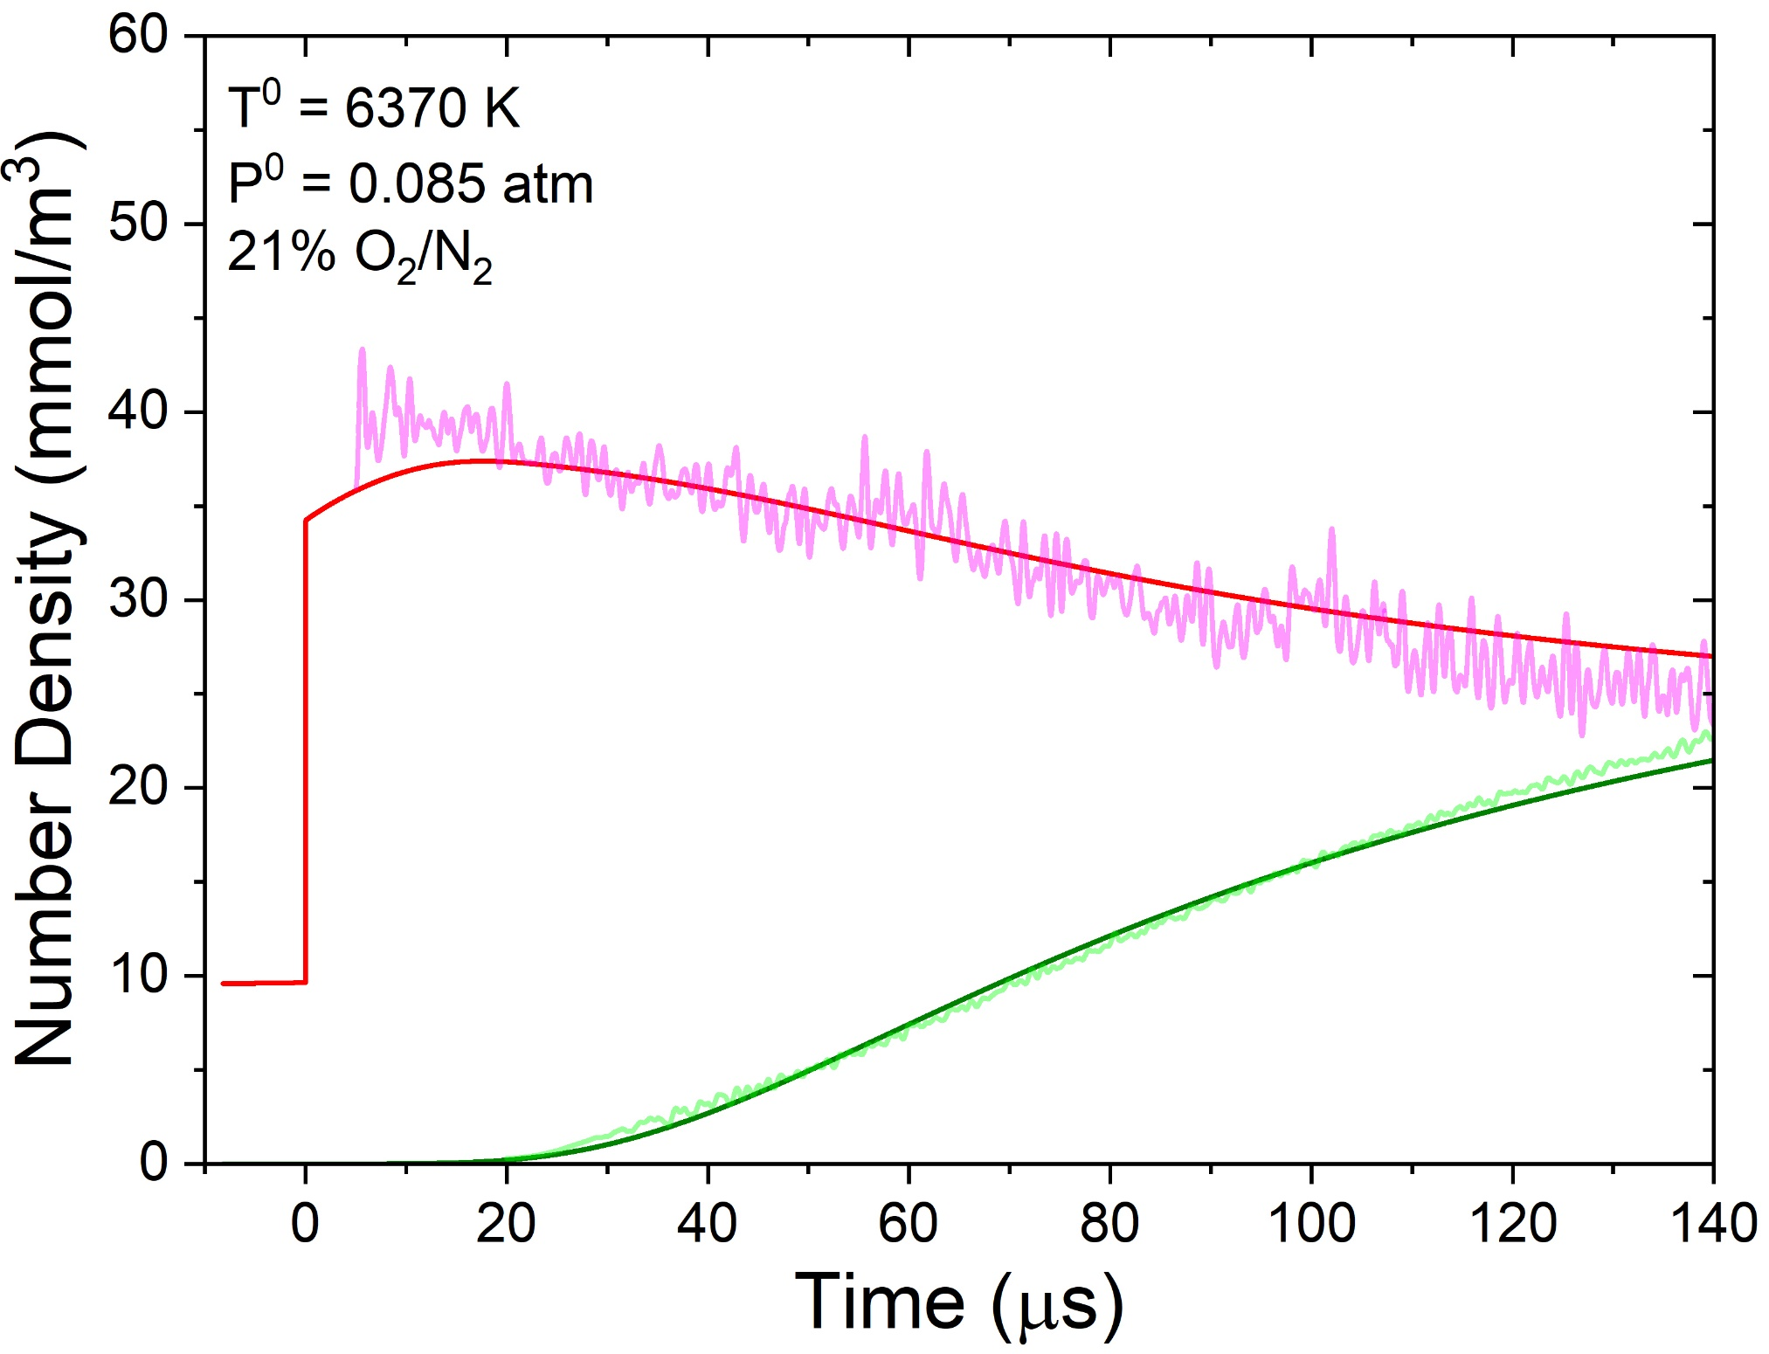
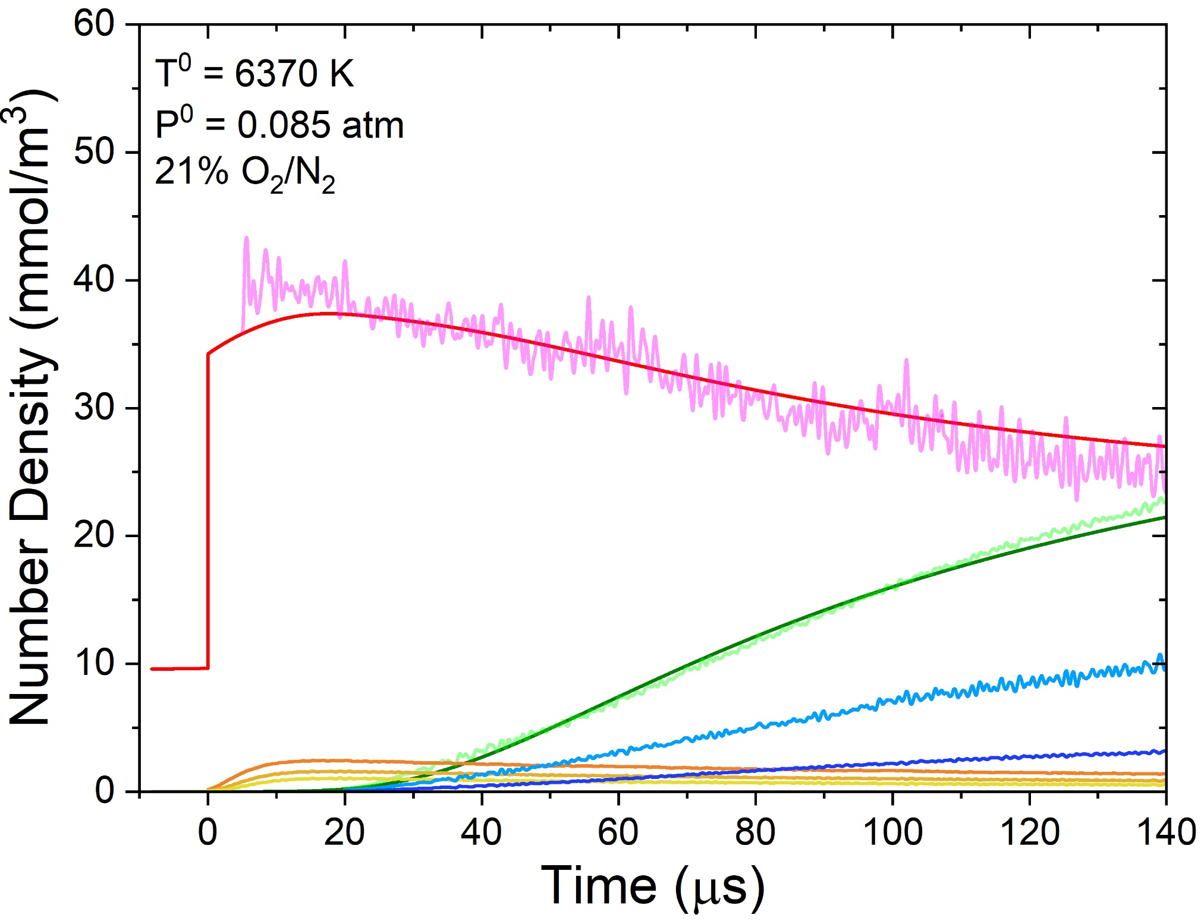
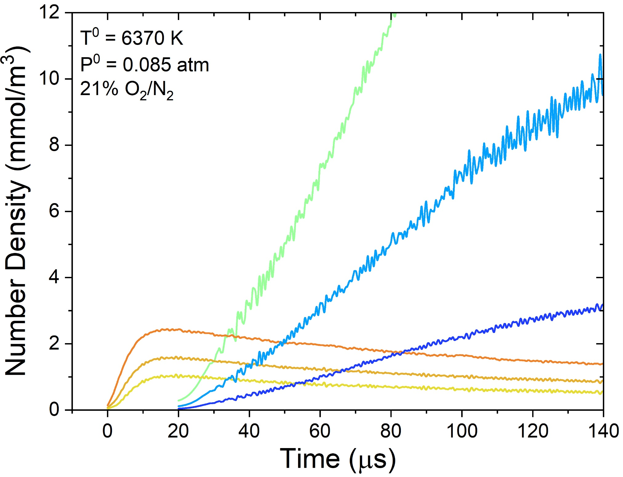
Number Density Time-Histories
Background
Conclusions
Methods
Rates
Time-Histories
n_{O2} and n_{NO} simulations couple density change and chemistry
$$n_{O_{2}}^{tot}$$
n_{O2} decrease primarily sensitive to k_{d}^{O2-O2},
k_{d}^{O2-N2}, and k_{d}^{O2-O}
$$n_{NO}^{tot}$$
$$n_{NO}^{v"=0}$$
$$n_{NO}^{v"=2}$$
n_{NO} increase primarily sensitive to Zeldovich reactions (esp. k_{z}^{N2-O})
$$n_{O_{2}}^{v"=4−6}$$
n_{v”} time-histories highlight vibrational-state sensitivity of diagnostics
11

Slide 12
Features of Best-Fit Model
Background
Conclusions
Methods
Rates
Time-Histories
$$k_{Z}^{N_{2}−O} =AT_{a}^{m}exp\left(−D/T_{a}\right)$$
$$T_{a}=\sqrt{T_{tr}T_{v}^{N_{2}}}$$
Early-time O₂ vibrational relaxation present at all wavelengths
O₂ wavelengths are reasonably reproduced with Jerig et al. k_{d}^{O2-N2}
NO formation delayed, requiring a Park 2-T correction
12

Slide 13
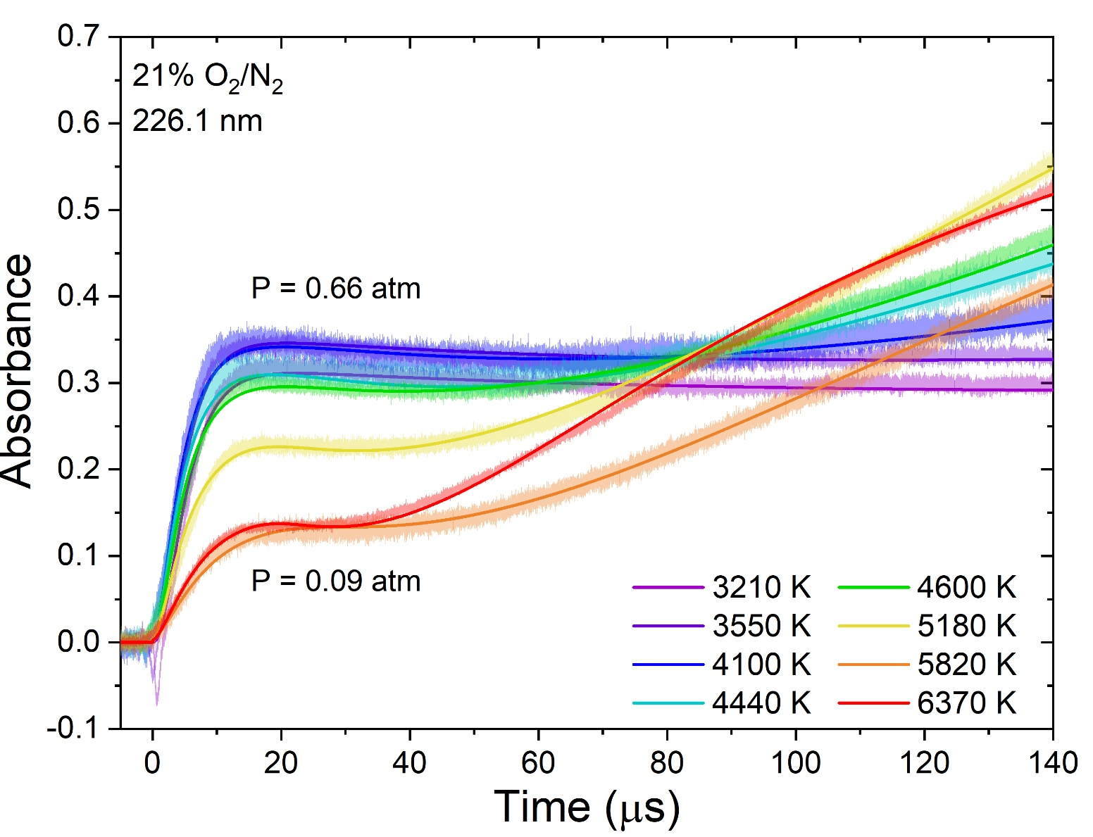
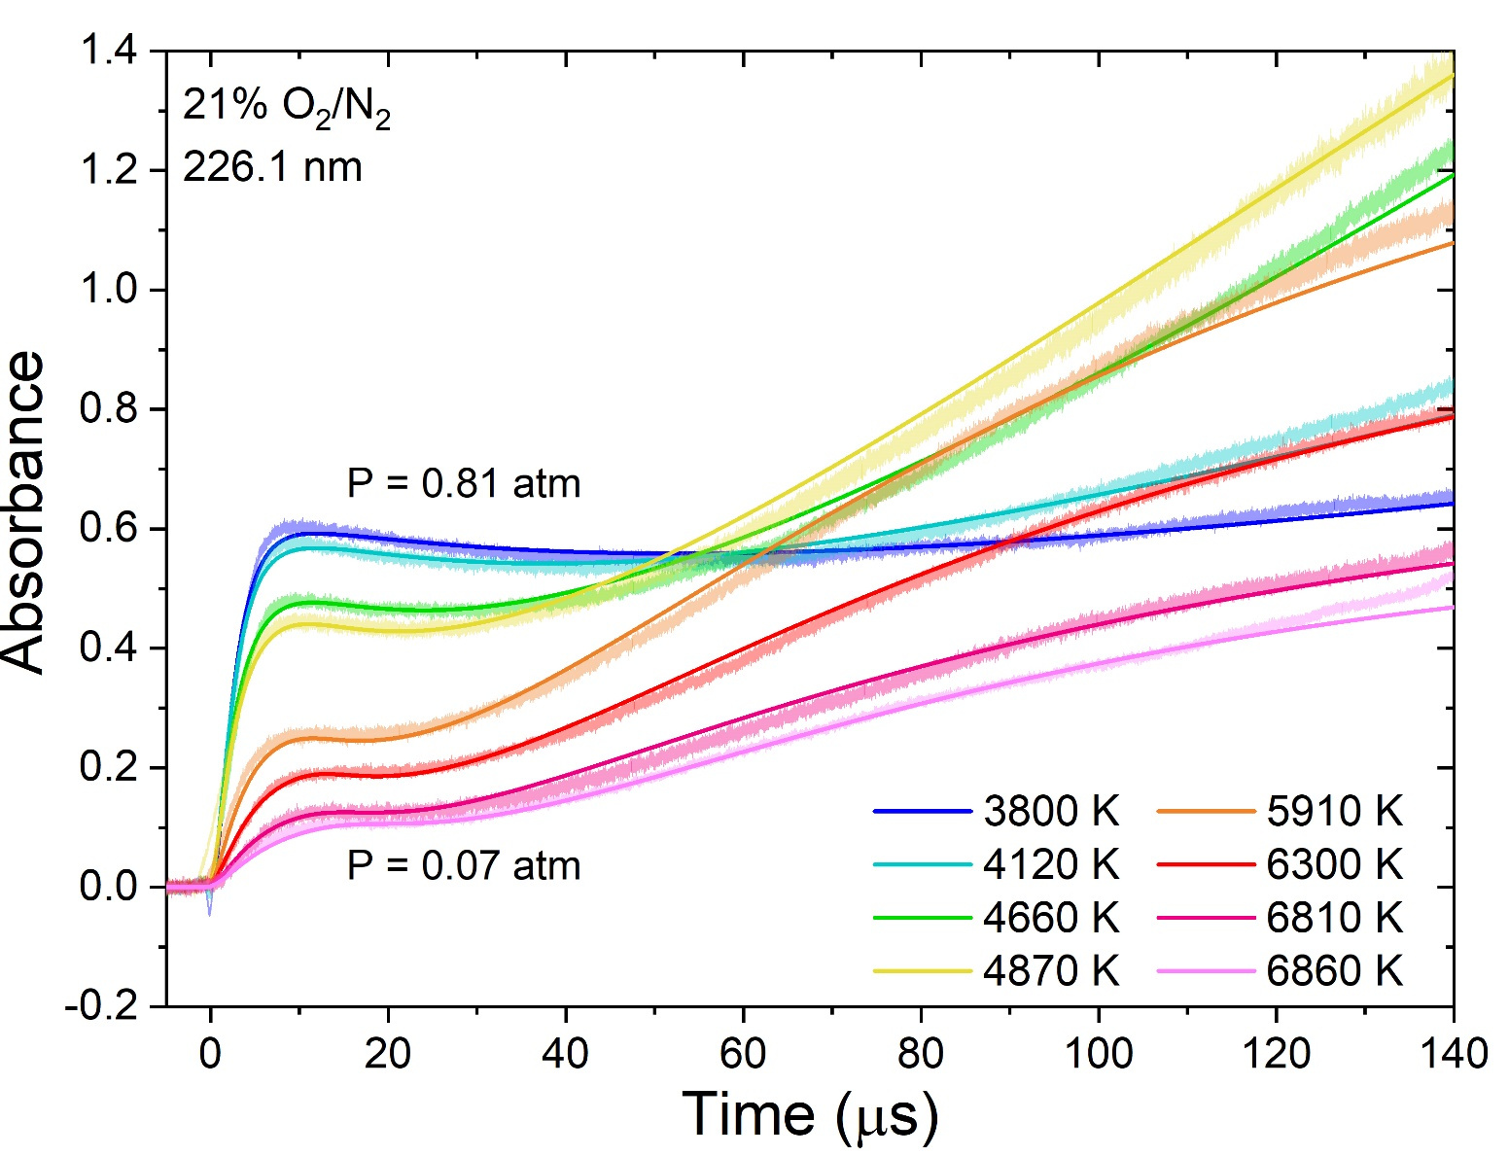
T/P Sweeps Exhibit Consistent Behavior
Background
Conclusions
Methods
Rates
Time-Histories
Delay in NO formation increases at lower temperature
Onset of NO formation occurs earlier in higher pressure experiments
13

Slide 14
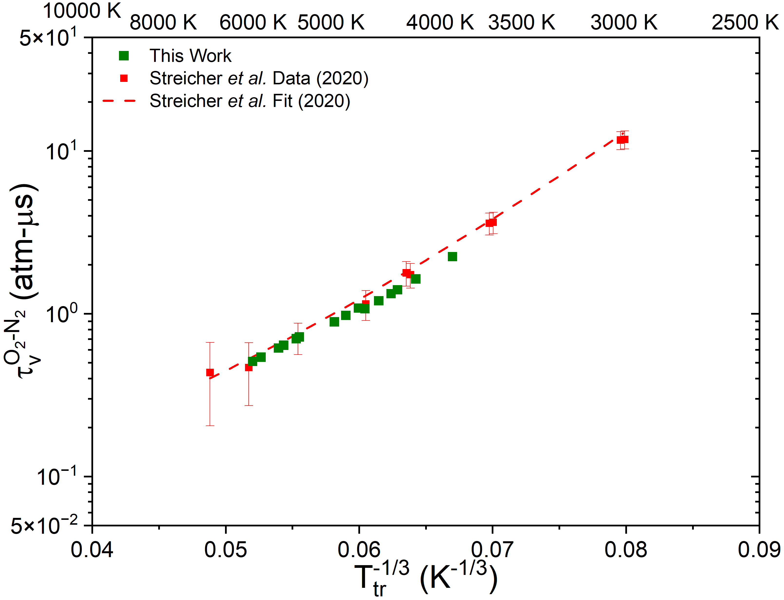
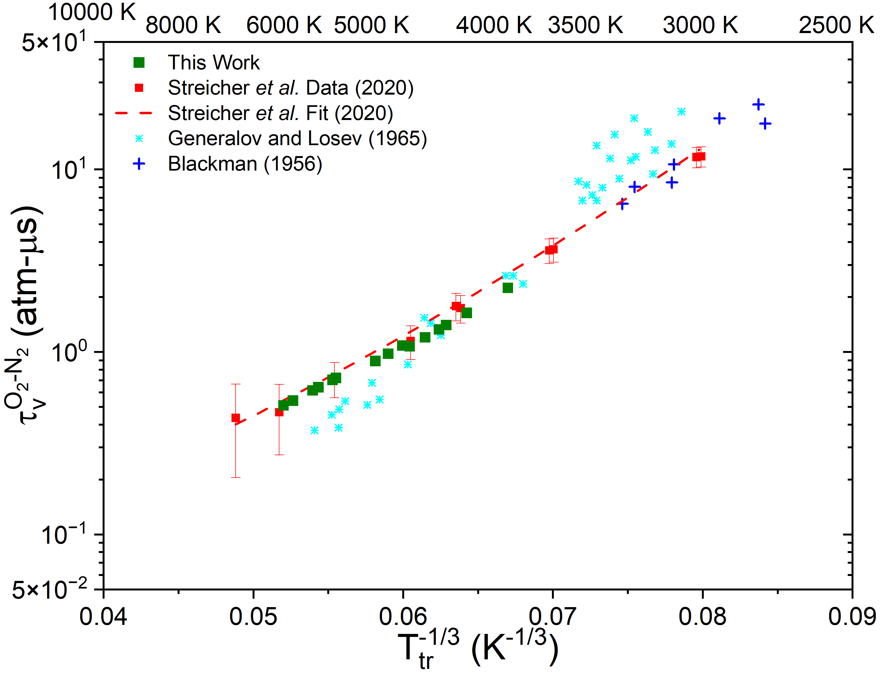
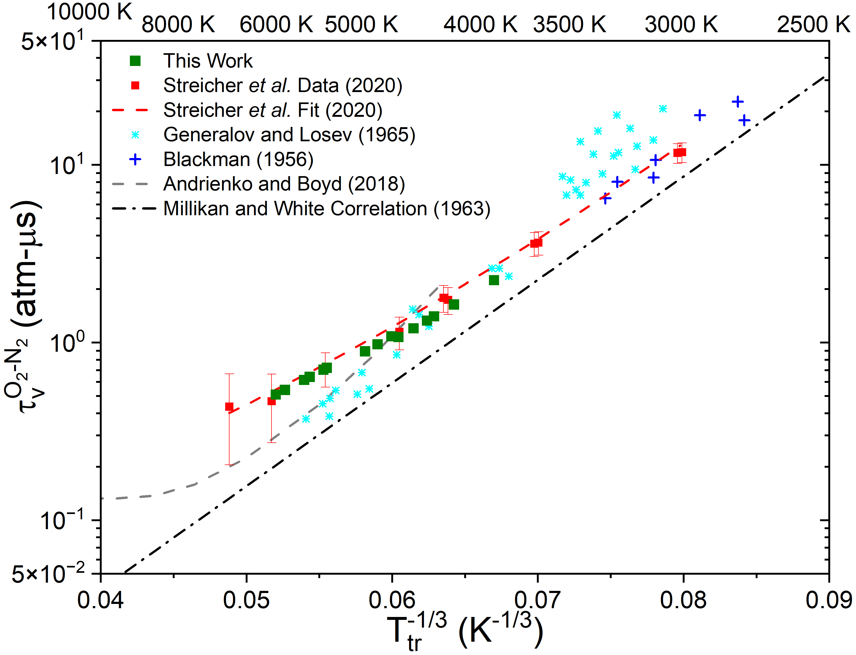
O₂-N₂ Vibrational Relaxation
Background
Conclusions
Methods
Rates
Time-Histories
Data agrees well with previous vibrational relaxation study
Significantly lower scatter than literature
High-T data deviate from the Millikan and White correlation (used in Park 2-T model)
Improved agreement with Andrienko and Boyd
14

Slide 15
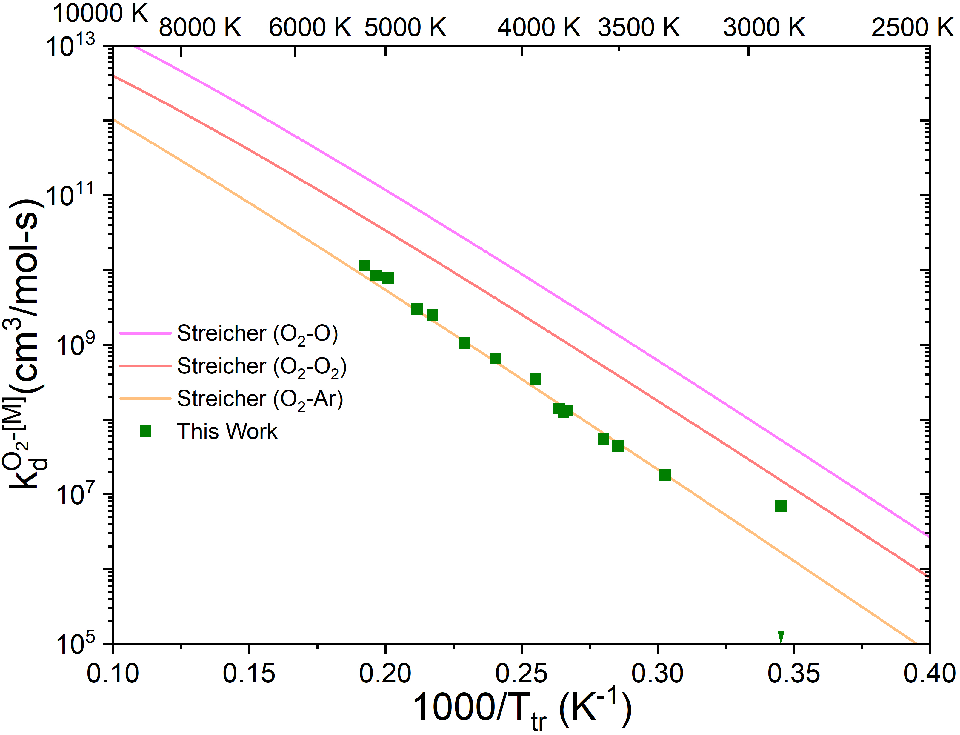
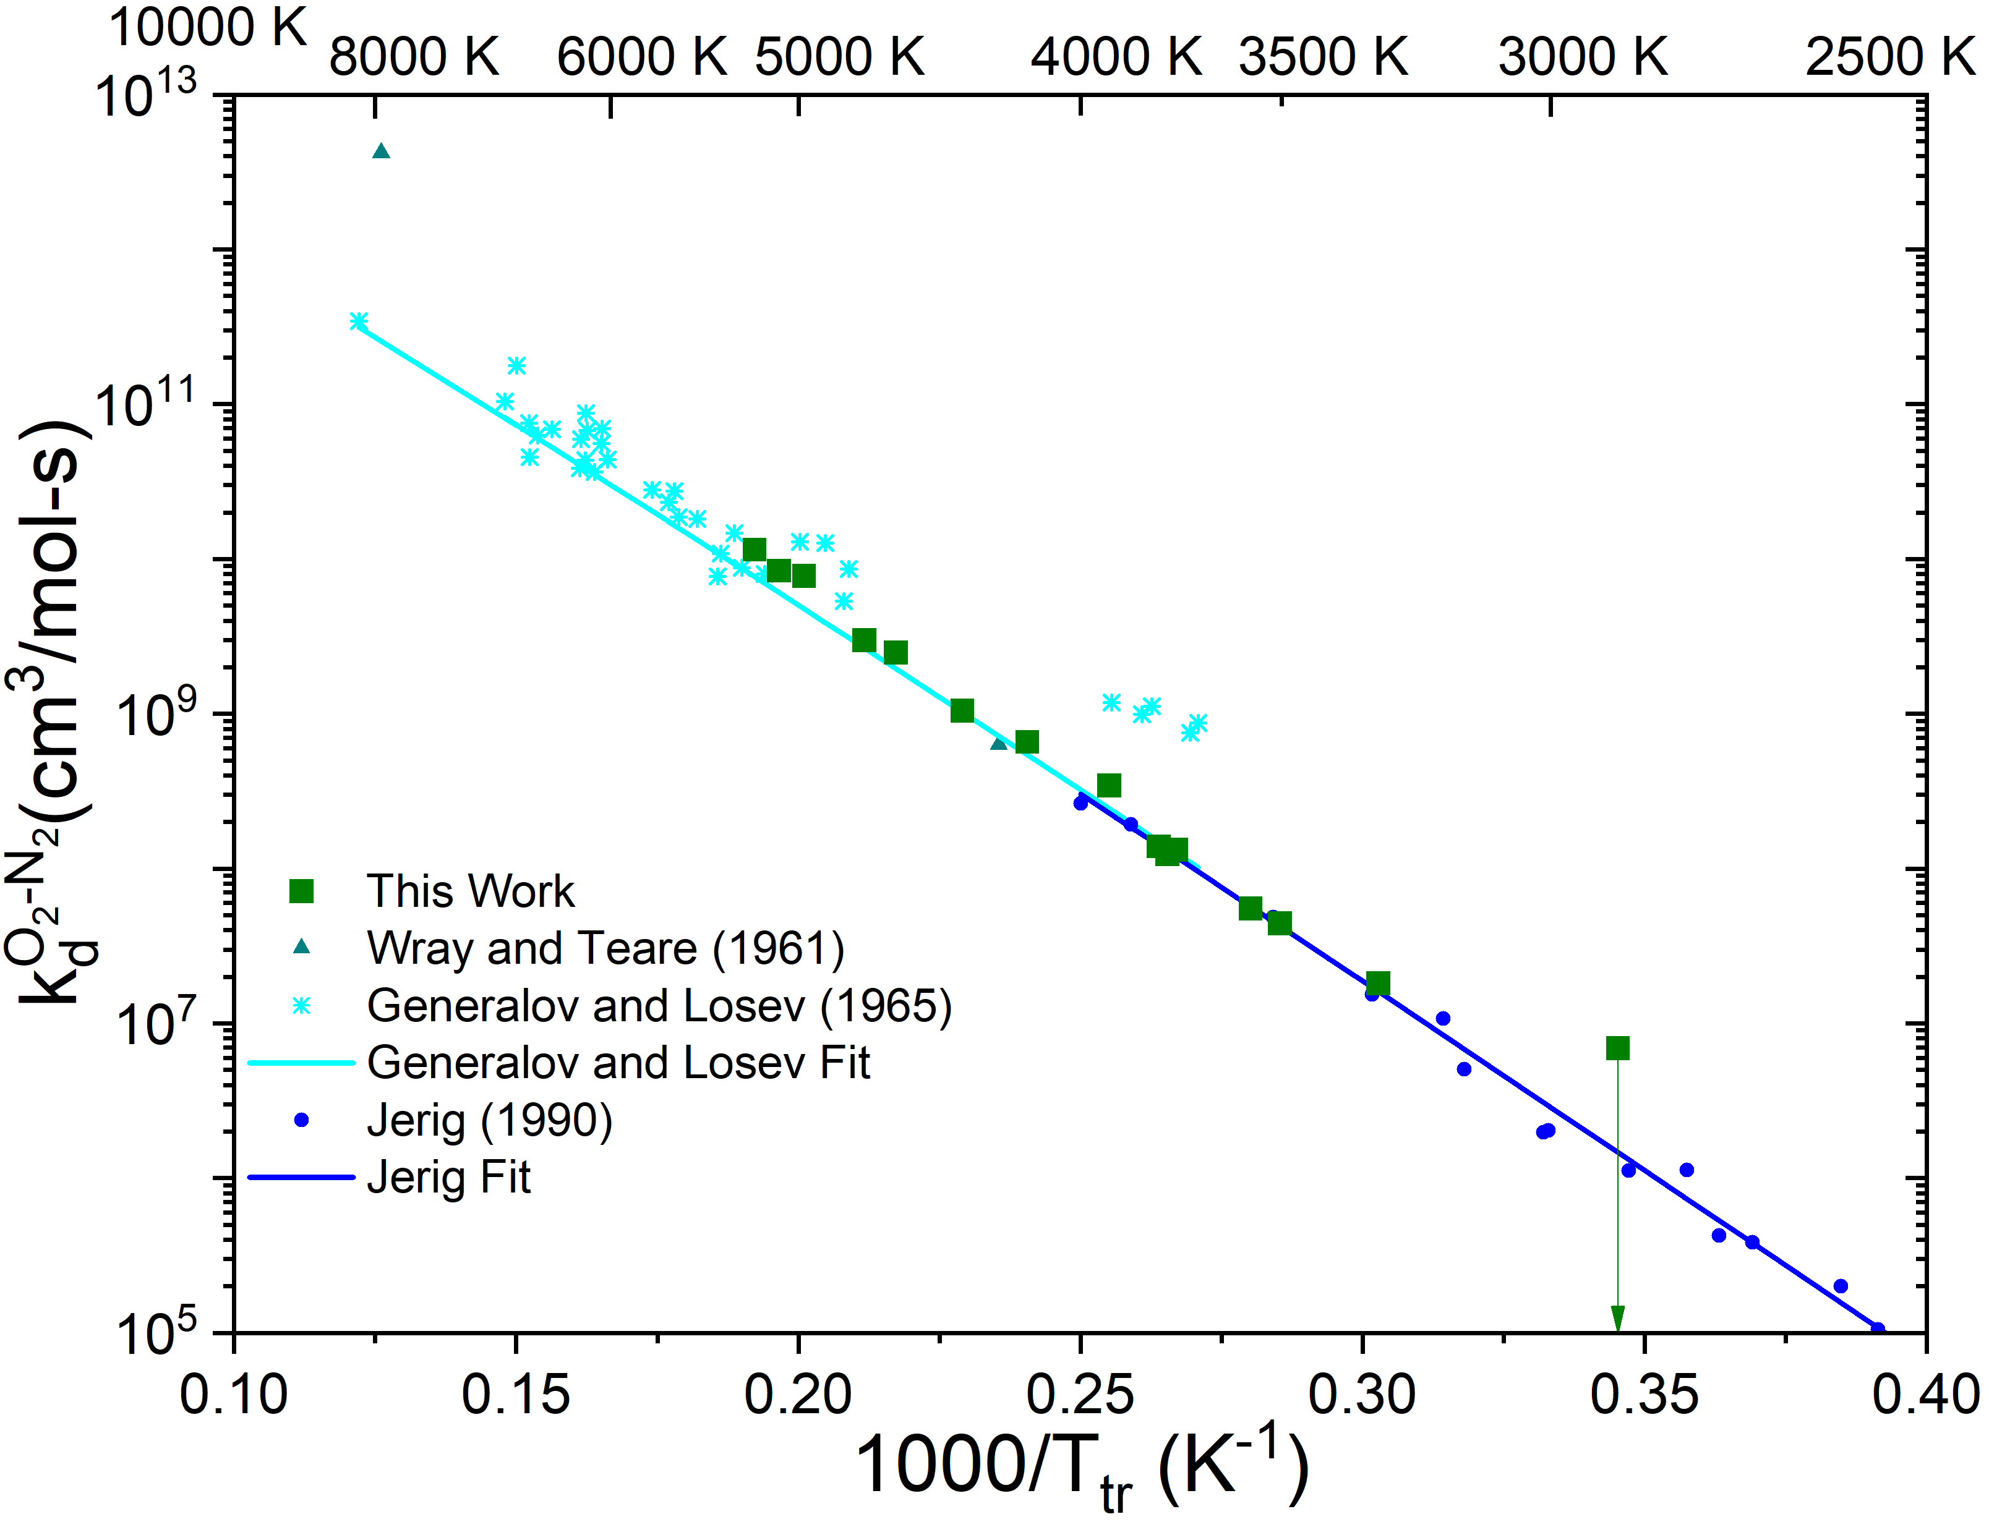
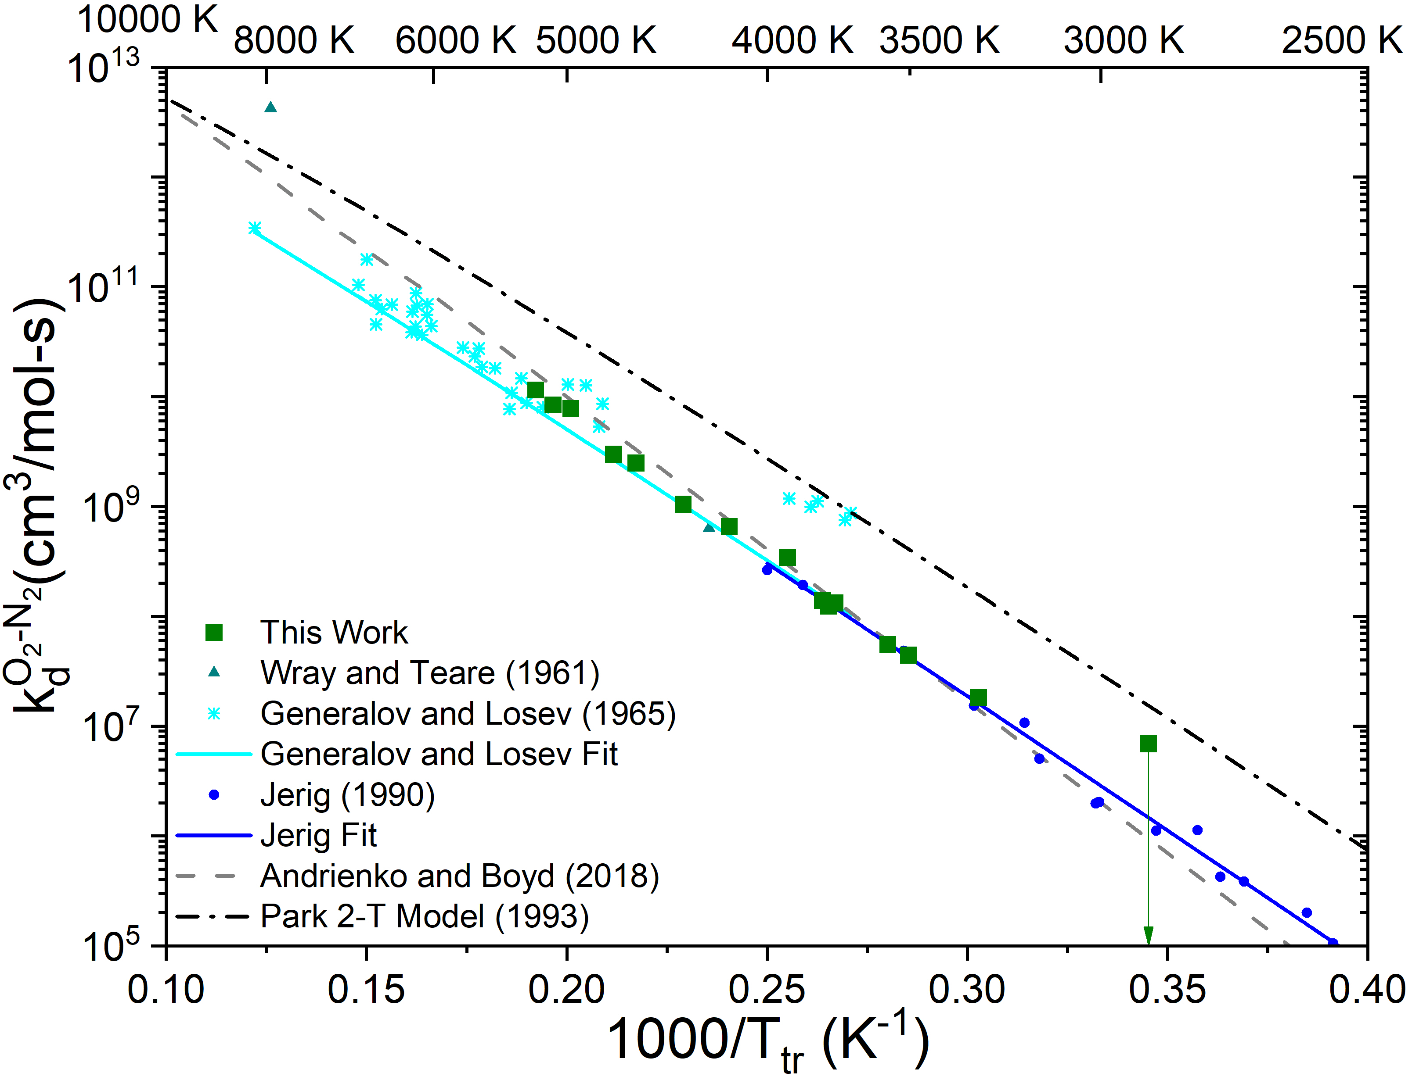
O₂-N₂ Dissociation Rate Inferences
Background
Conclusions
Methods
Rates
Time-Histories
New O₂-N₂ rates are similar to previous O₂-Ar
Data agrees with previous experimental inferences, with lower scatter than literature
Trend agrees well with Andrienko and Boyd rate
O₂-N₂ dissociation ~10x slower than predicted by Park 2-T model
15

Slide 16
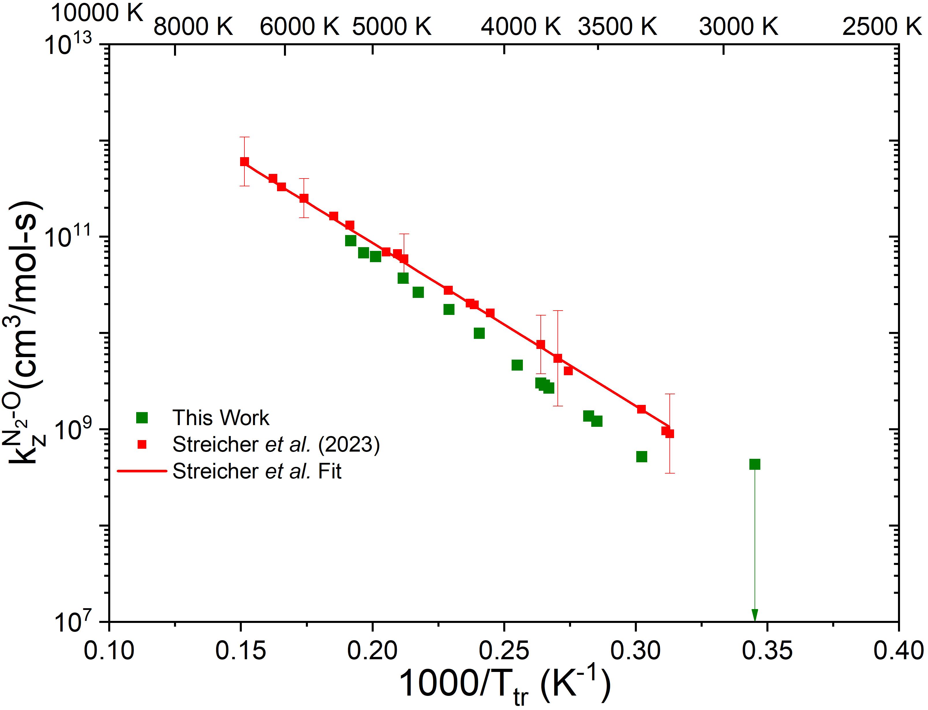
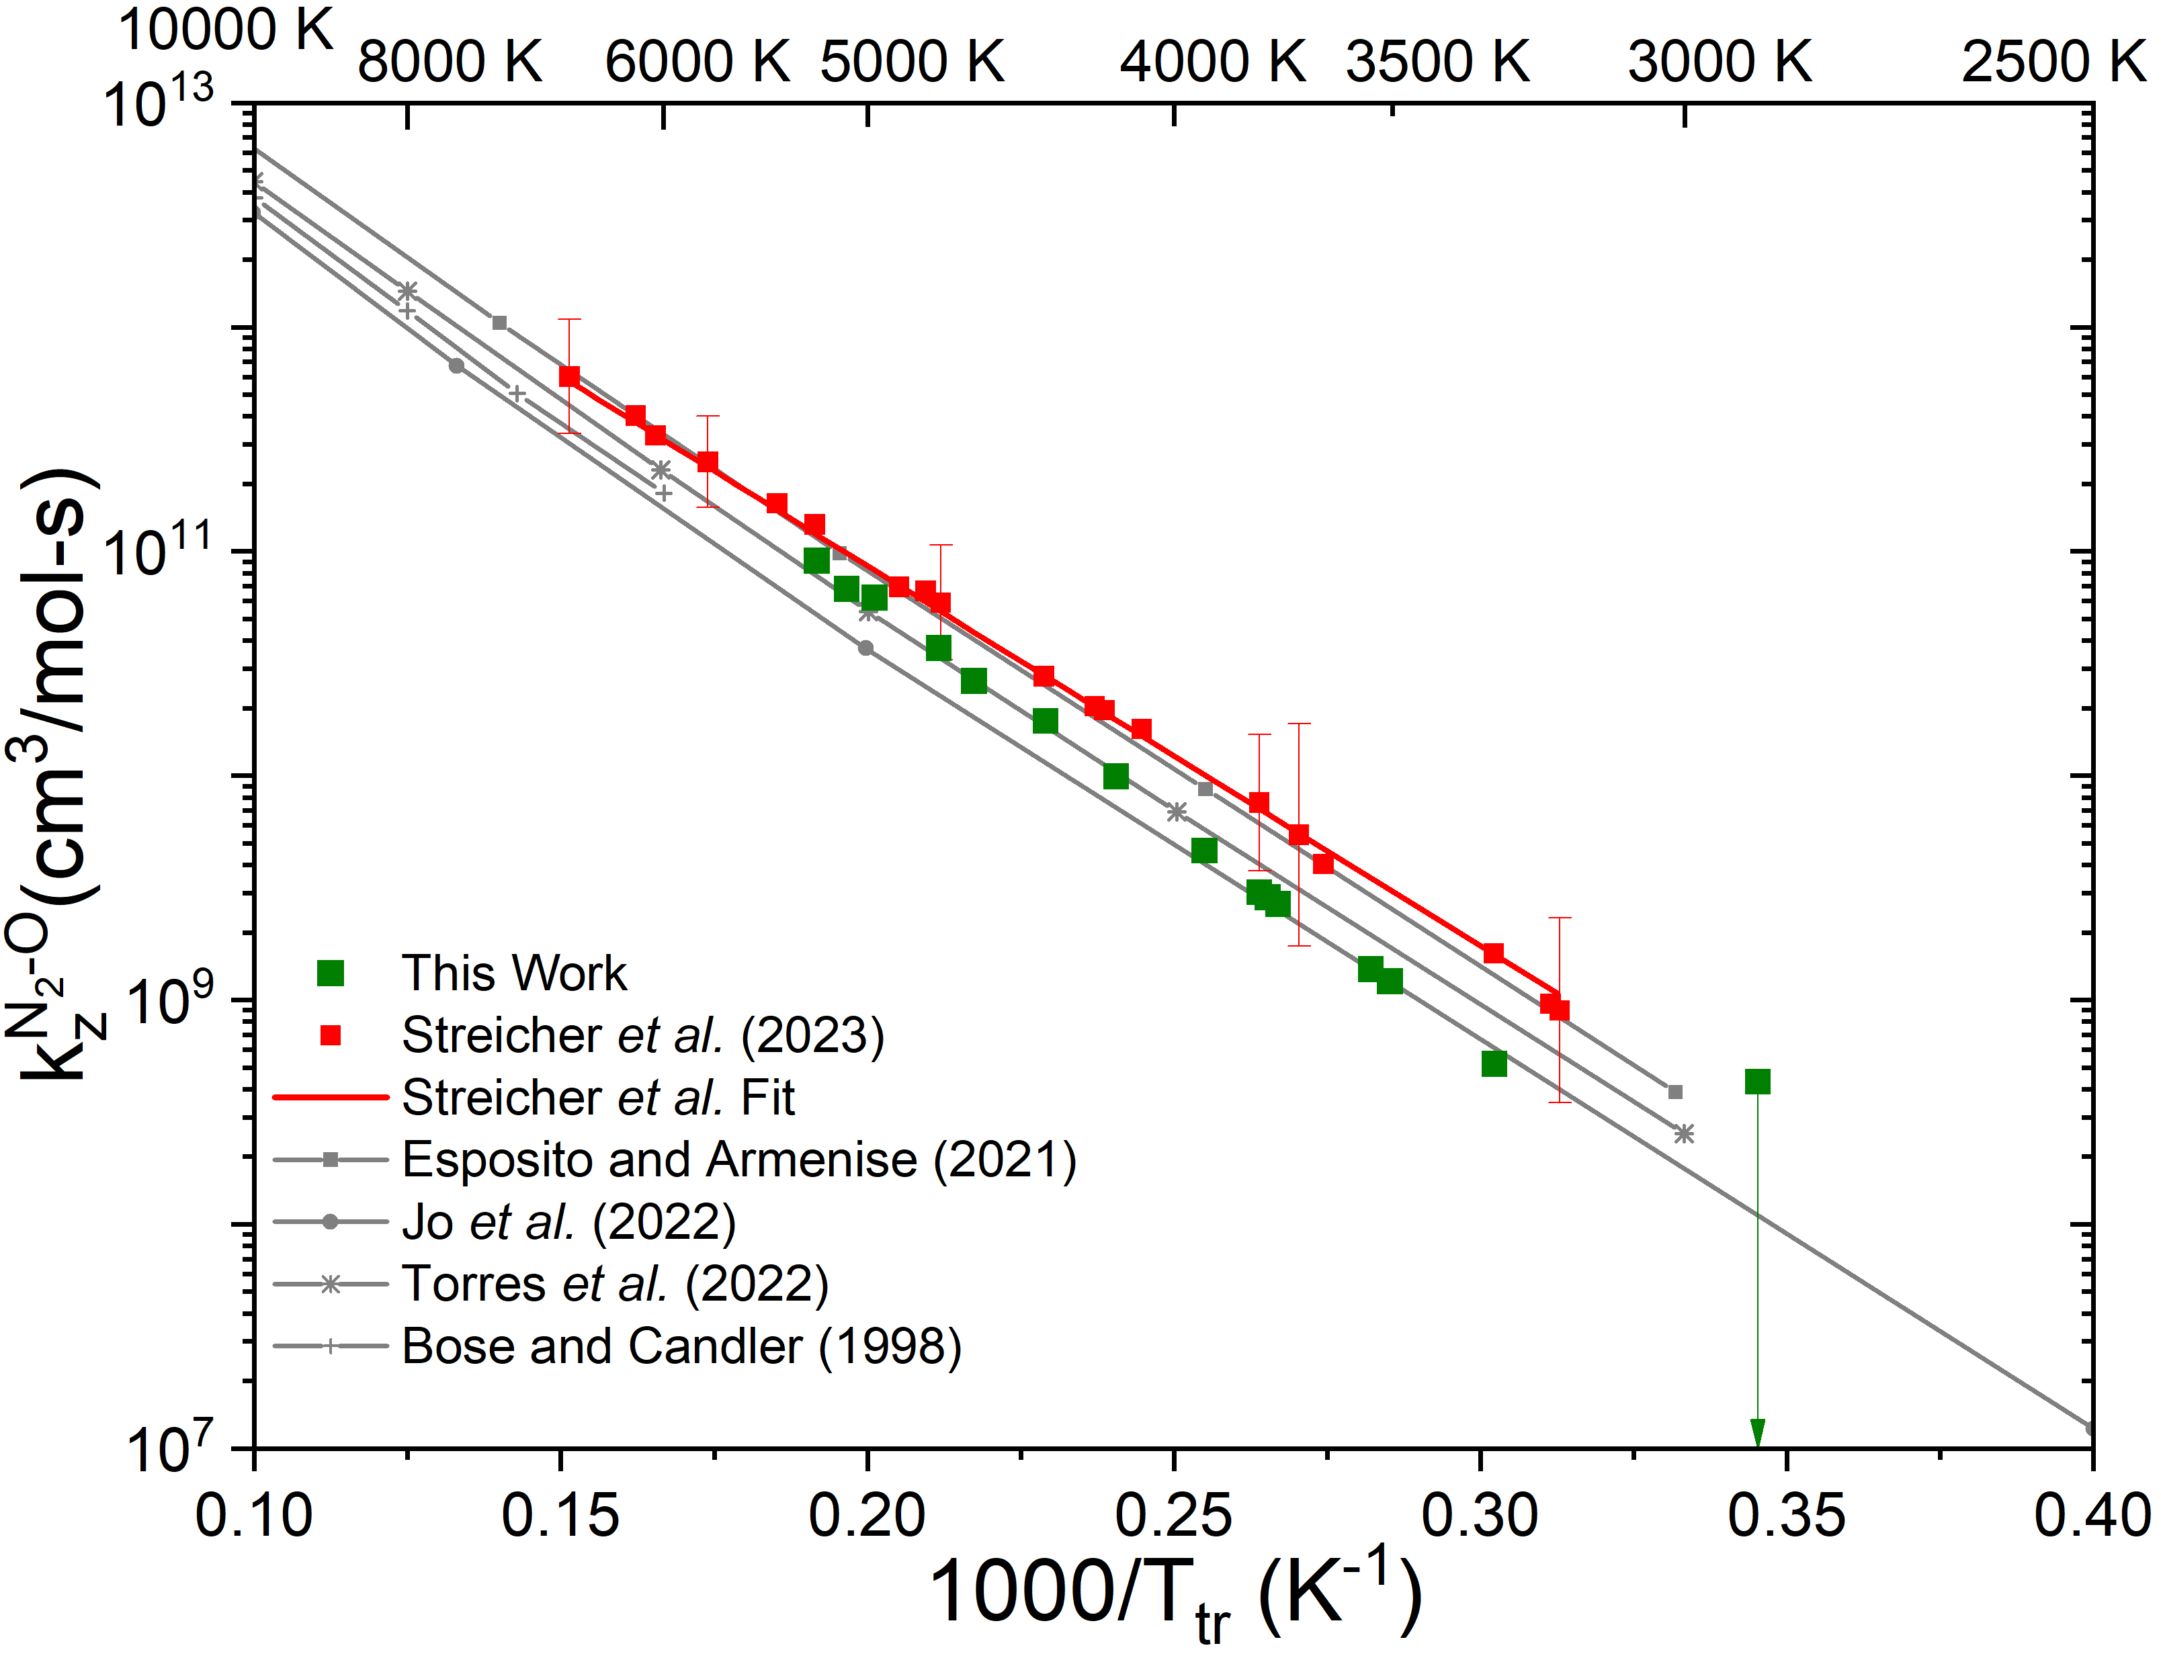
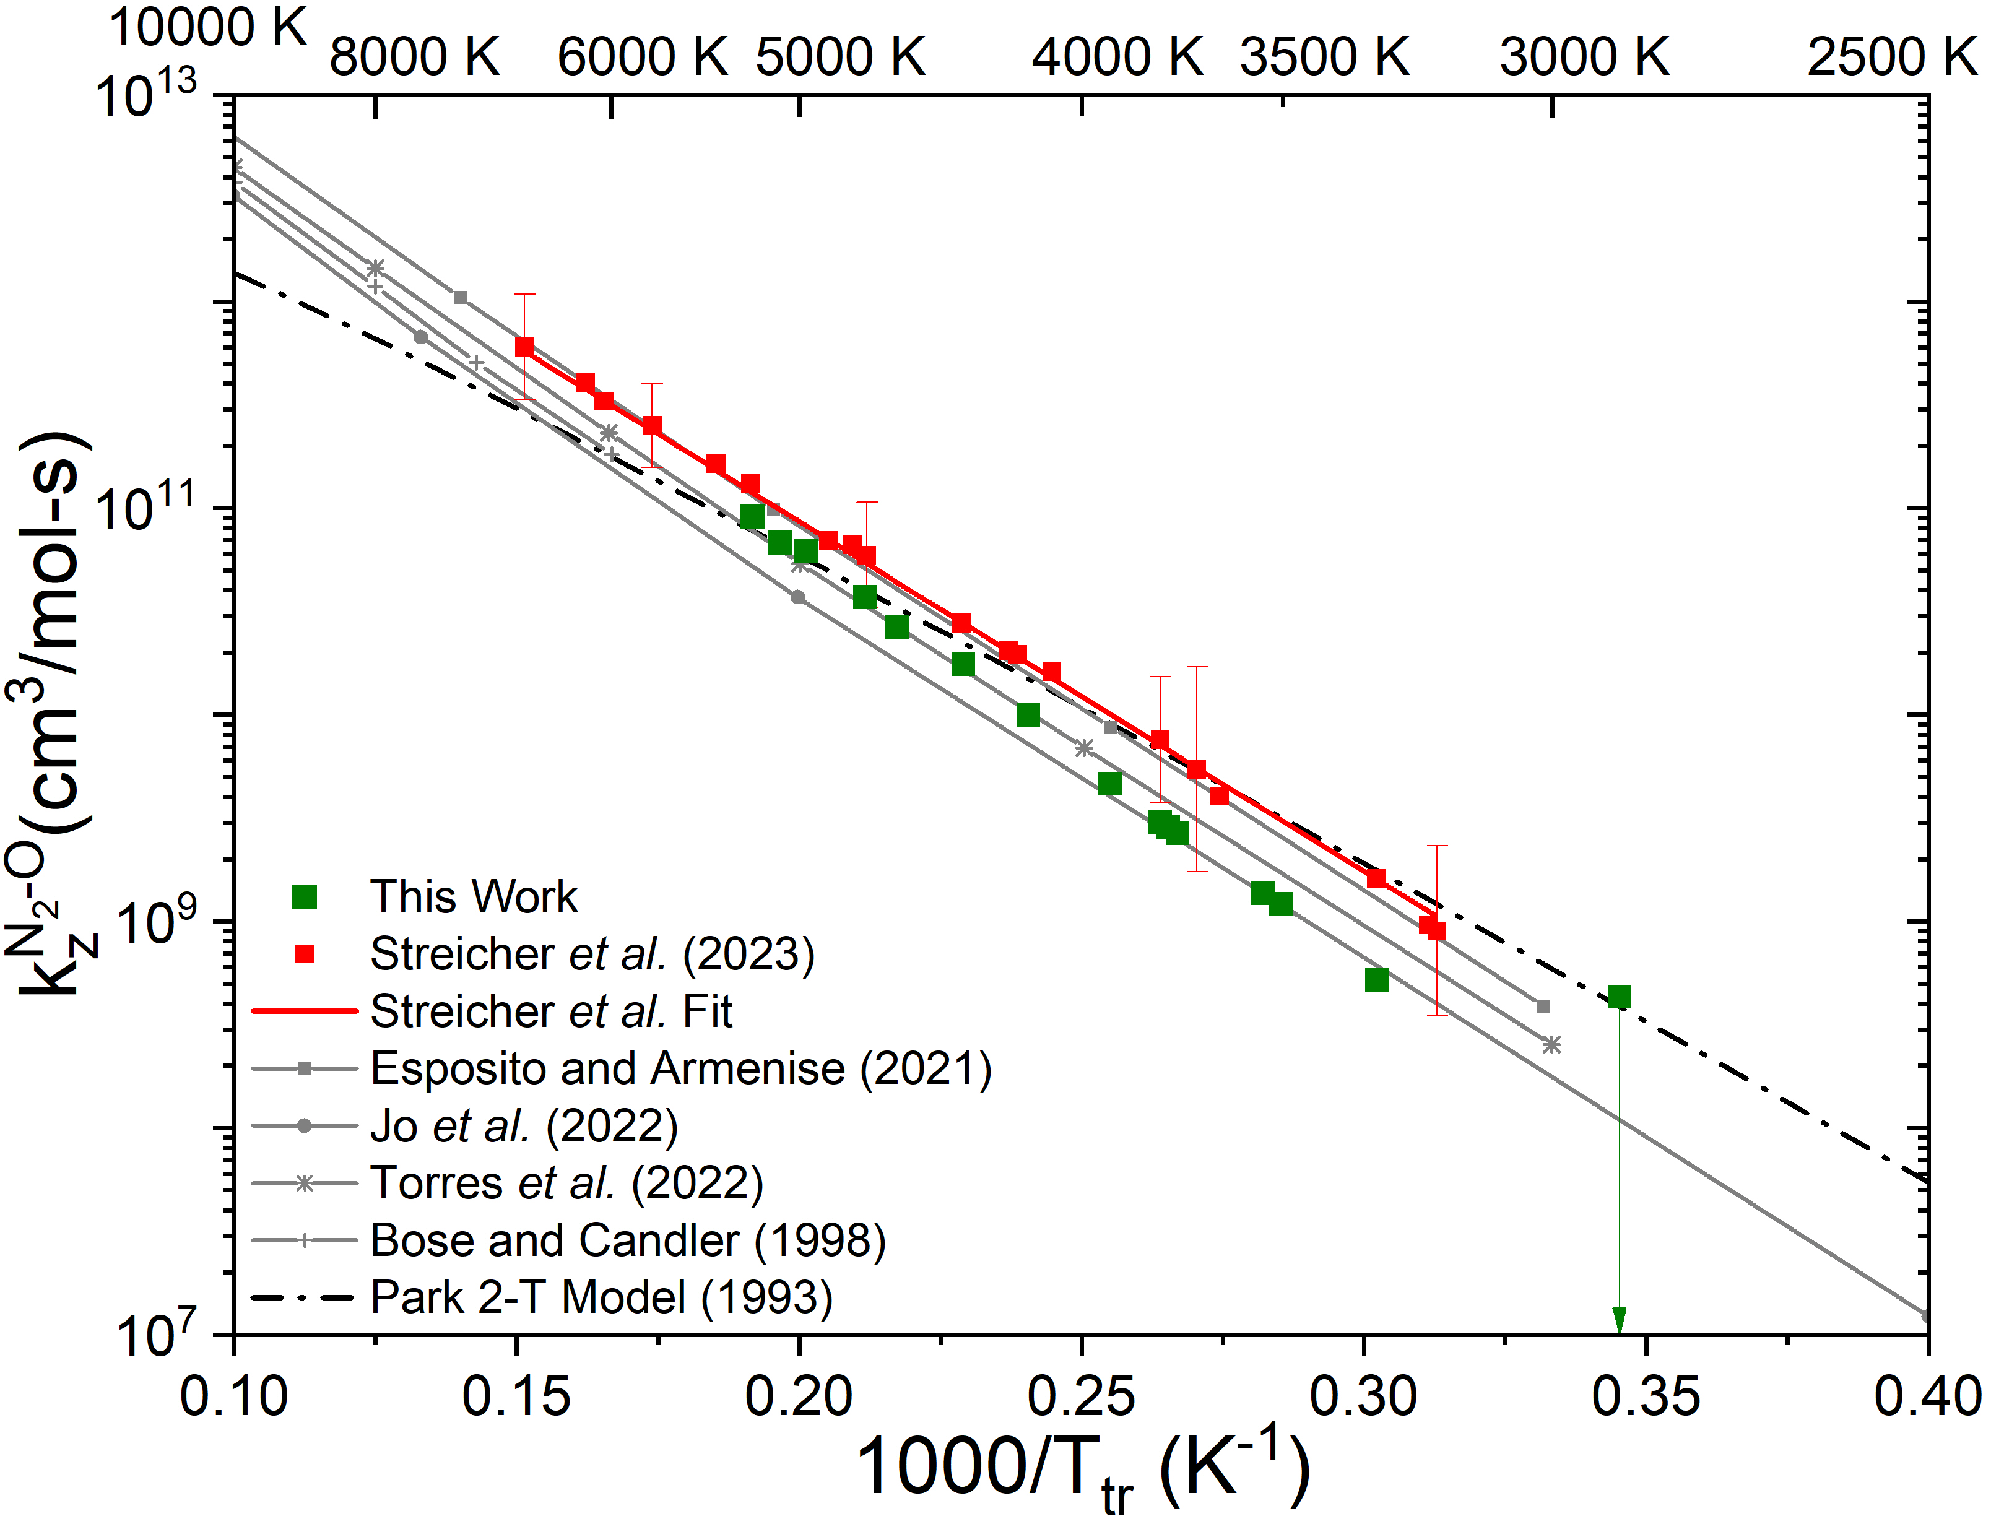
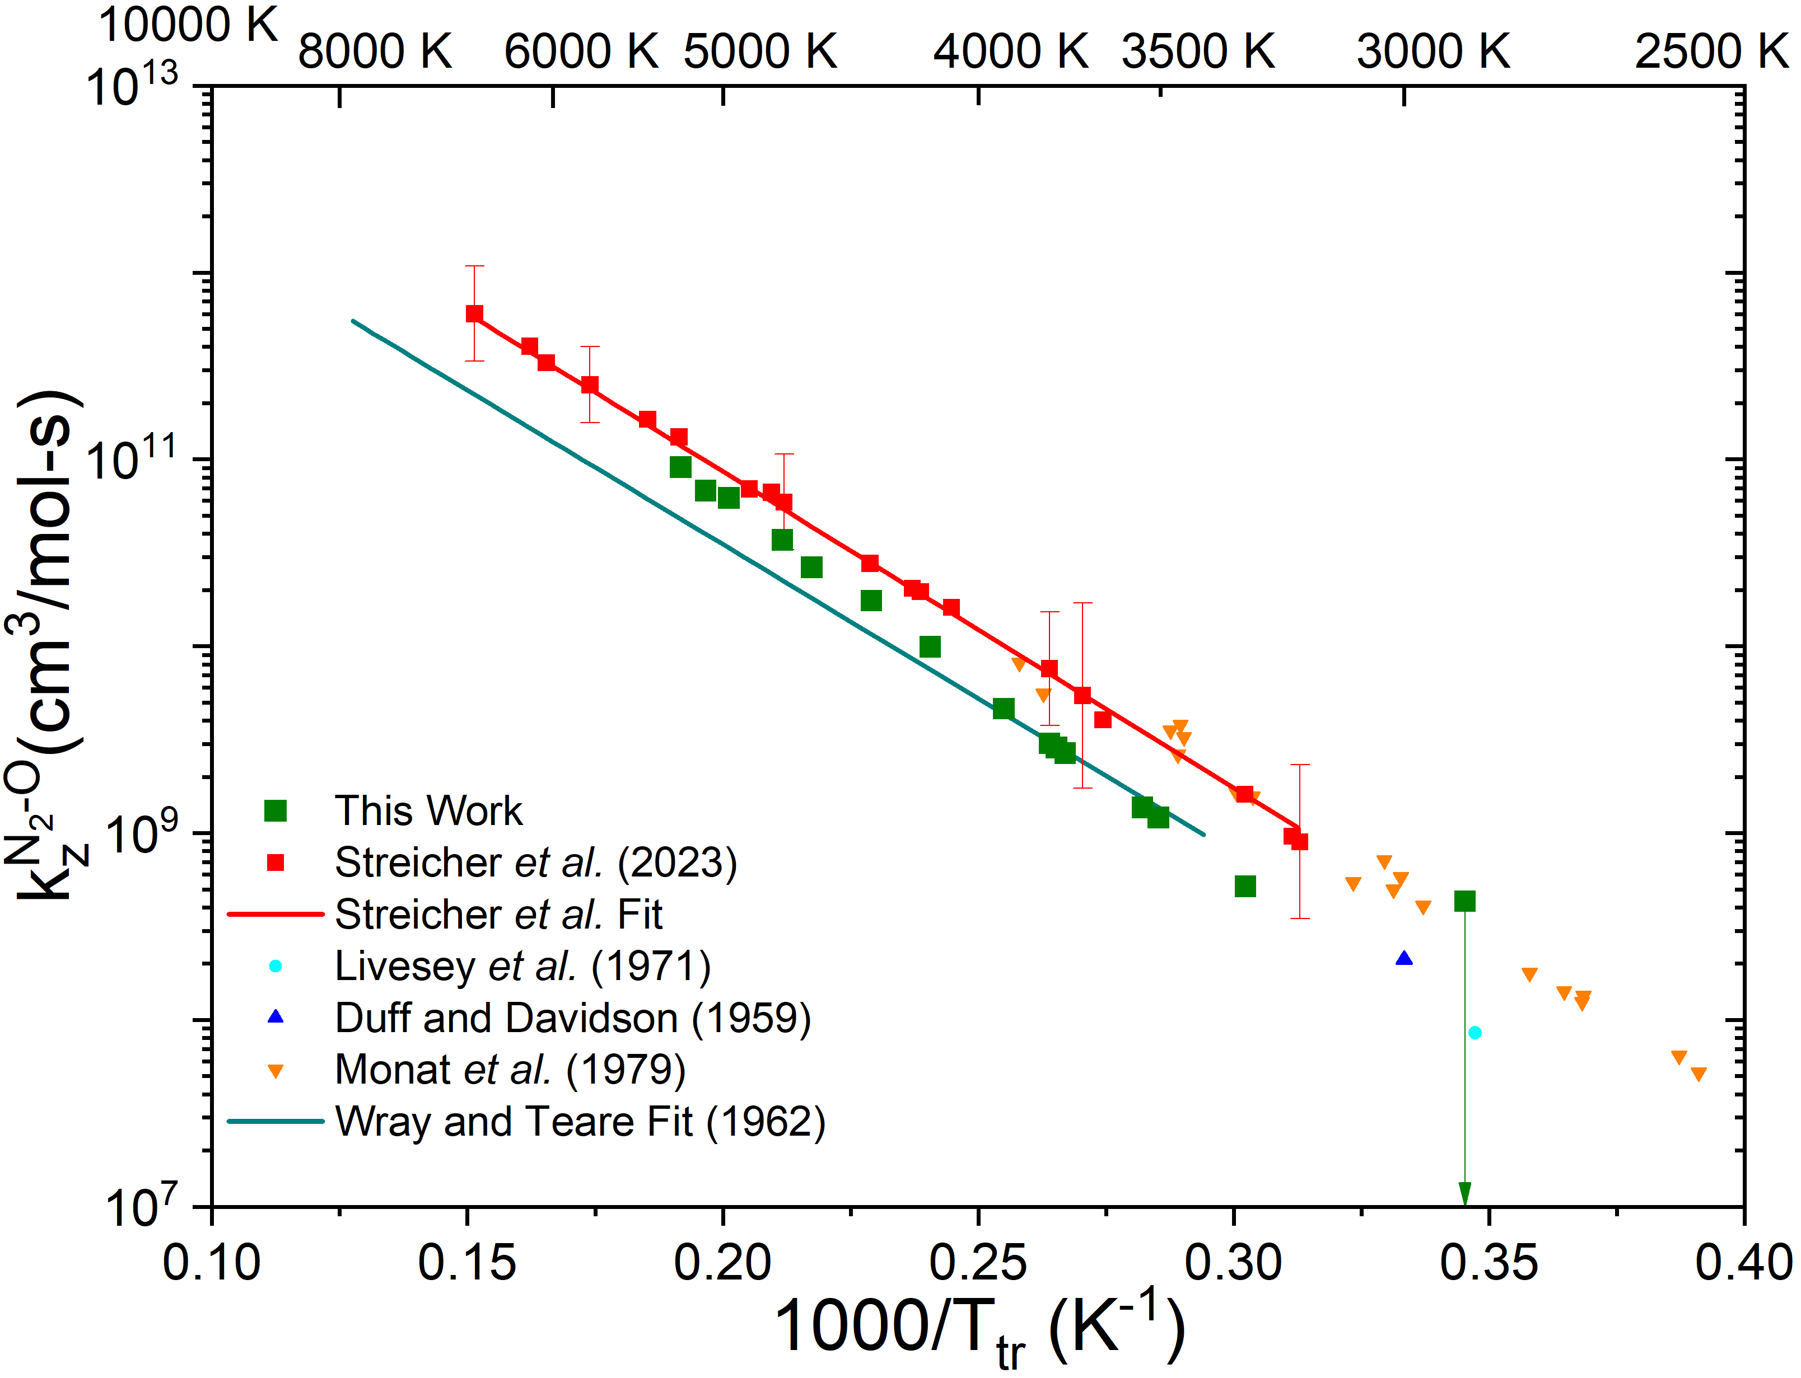
N₂-O Zeldovich Exchange Rate Inferences
Background
Conclusions
Methods
Rates
Time-Histories
Notable difference between rate inferred in 21% O₂/N₂ and in 5% N₂O/N₂ at low-T
Difference between N₂O and air is also present in literature experiments
New results span predictions of QCT models with different activation energy
All recent data and models differ from Park
16

Slide 17
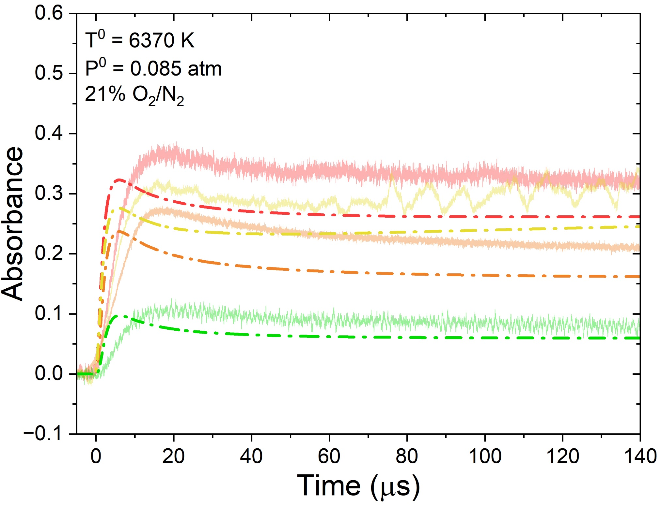
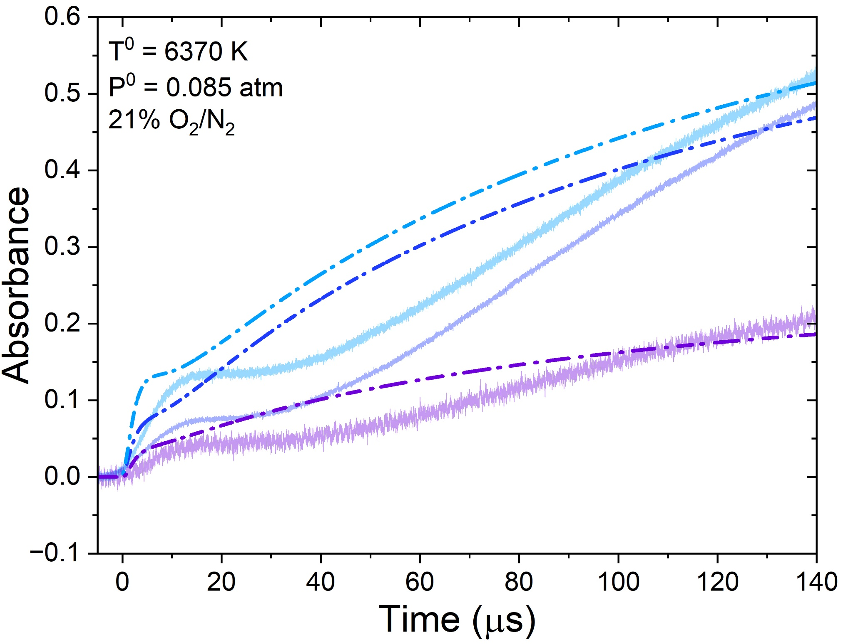
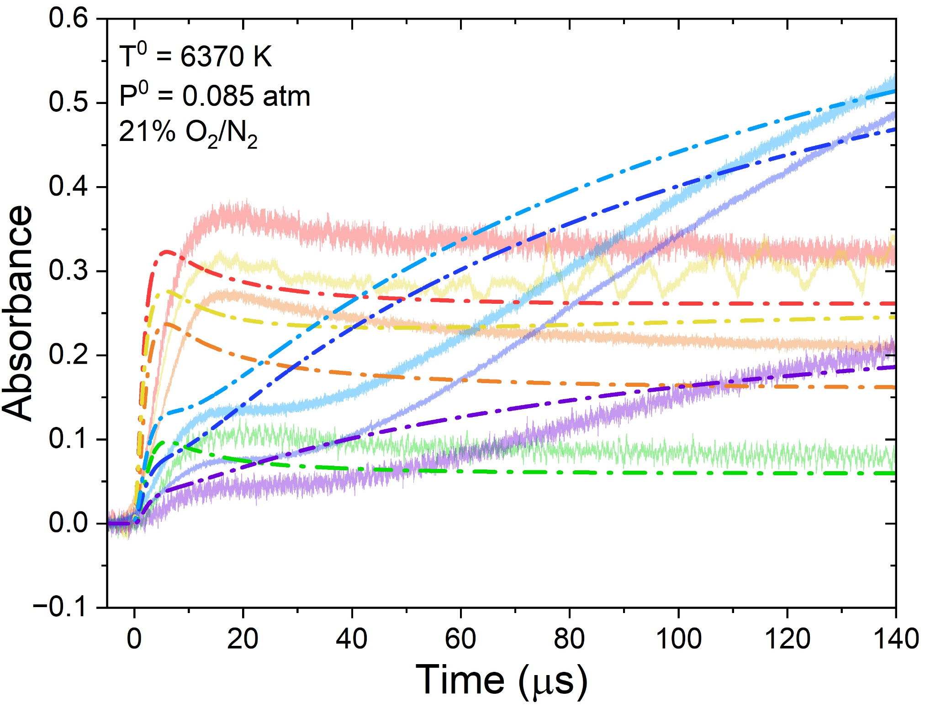
Park Model Comparison
Background
Conclusions
Methods
Rates
Time-Histories
Park 2-T model predicts fast O₂ relaxation and dissociation
Subsequent NO formation also occurring too fast
Overall, Park 2-T model is insufficient to reproduced observations
17

Slide 18
Background
Conclusions
Methods
Rates
Time-Histories
Conclusions
Seven wavelengths probe O₂ in
v” = 4-6 and NO in v” = 0, 2
Optical strategies ensure low noise
Inferred quantities include T_{v}^{O2}, T_{v}^{NO}, T_{tr}, n_{O2}, n_{NO}, and n_{v”}
NO formation in 21% O₂/N₂ mixtures exhibits a delay corresponding to the N₂ vibrational relaxation time
A $\sqrt{T_{tr}T_{v}^{N_{2}}}$ dependence for k_{z}^{N2-O} reasonably reproduces the experimental results
Combined O₂ and NO results differ significantly from Park 2-T model
O₂ vibrational relaxation and dissociation both occur too fast
NO onset is early, with formation occurring slightly too fast
18
Future work will infer k_{d}^{O2-N2} and k_{z}^{N2-O}

Slide 19
Background
Conclusions
Methods
Models
Time-Histories
Acknowledgments
Stanford Colleagues
Students: Spencer Barnes
Principal Investigator: Prof. Ronald Hanson
Support
AFOSR: Dr. S. Popkin and Dr. M. Berman
Collaboration:
University of Colorado Boulder: Prof. I. Boyd, Dr. T. Aiken,
Dr. D. Andrienko, and Dr. R. Chaudhry
… and many helpful conversations with members of the modeling and experimental community!
19

Slide 20
Questions

Slide 21
Backup

Slide 22
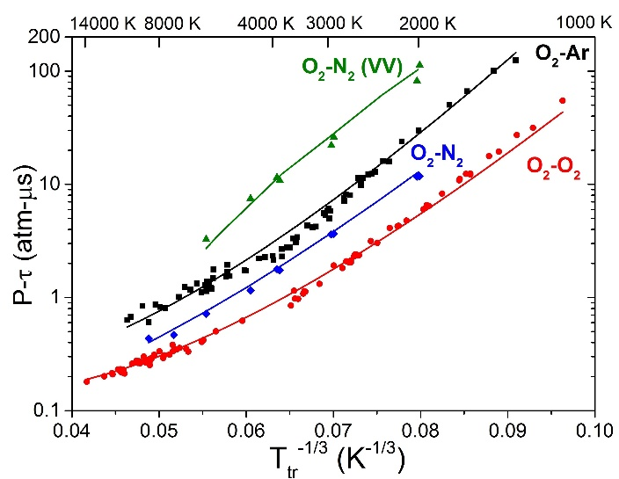
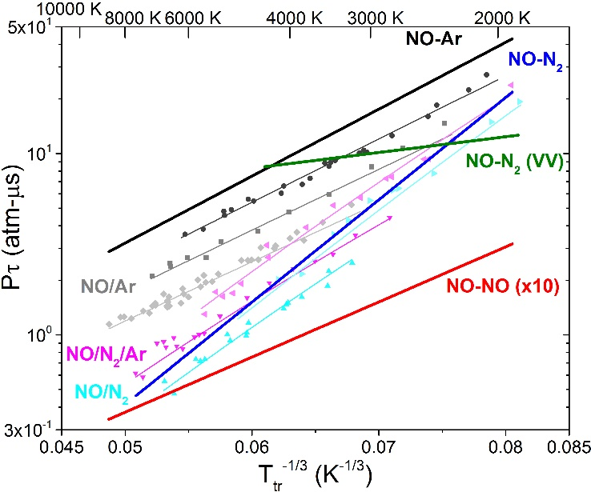
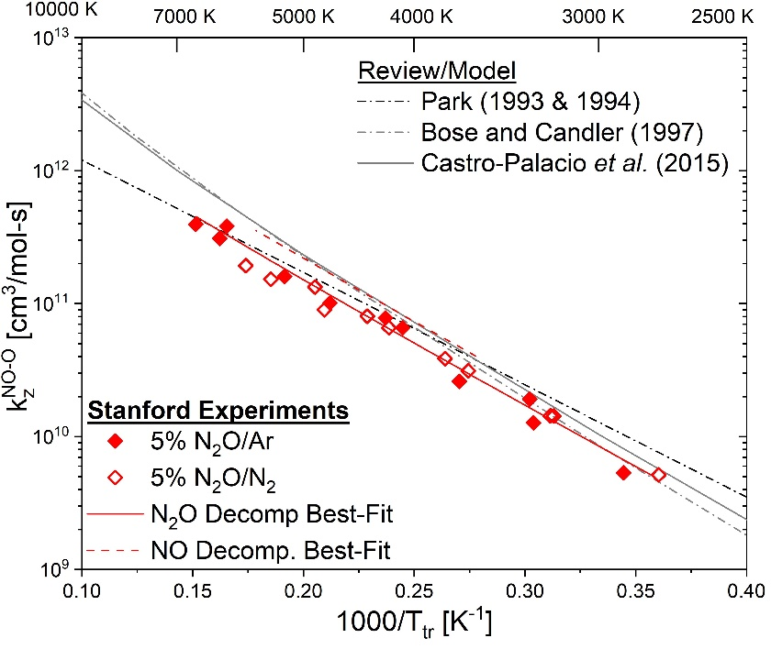
Nonequilibrium Rates Inferred with UV LAS
Background
Conclusions
Methods
Models
Time-Histories
O₂ Vibrational Relaxation
NO Vibrational Relaxation
Zeldovich Reaction Rates
So far, experiments have been limited to probing either O₂ or NO, motivating a full investigation of both in high-temperature air.
O₂ Dissociation
NO Dissociation
22

Slide 23
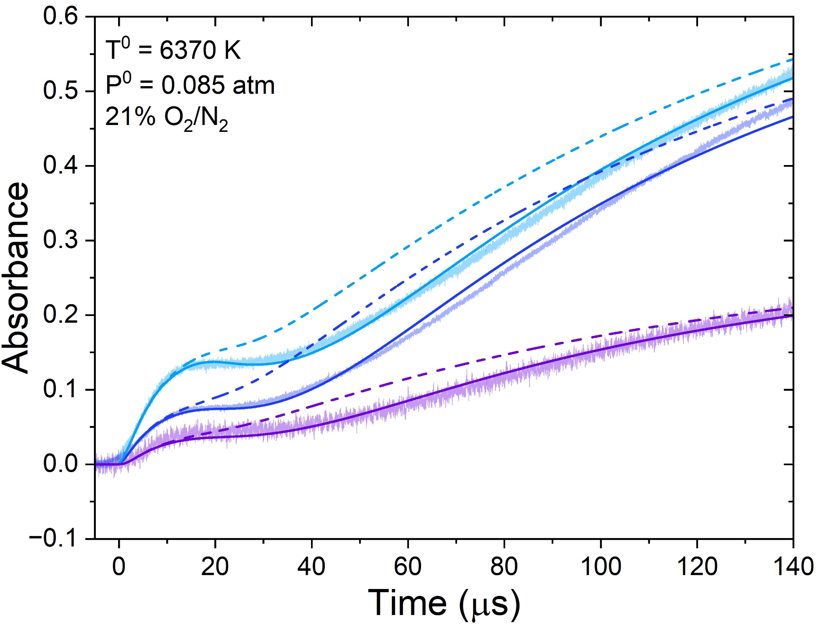
Bose and Candler Model Comparison
Background
Conclusions
Methods
Models
Time-Histories
Bose and Cander QCT rate provides another 2-T expression for k_{z}^{N2-O}
Caveat: a, b, and c were extrapolated to low temperature (<7000 K)
Opportunity for additional QCT investigation of 2-T behavior of k_{z}^{N2-O}
$$k_{Z}^{N_{2}−O}$$
$$=\exp\left(a\left(T_{t}−T_{v}\right)+b\left(T_{t}−T_{r}\right)+c\left(T_{t}^{2}−T_{v}T_{r}\right)\right)×AT_{t}^{m}exp\left(−D/T_{t}\right)$$
23

Slide 24
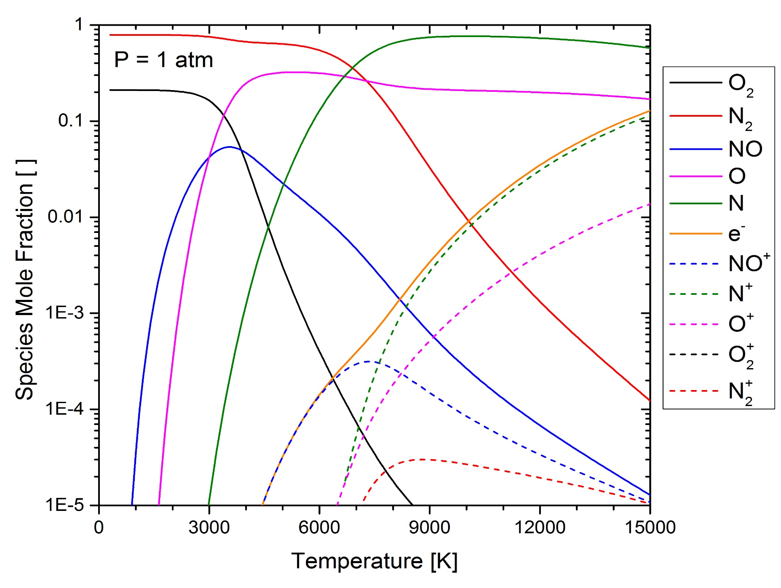
Importance of O₂ and NO in High-Temperature Air
5 Species Air Reactions
[M] = O₂, N₂, O, N, NO
Vibrational Relaxation
O₂(v”) + [M] ↔ O₂(v’) + [M]
N₂(v”) + [M] ↔ N₂(v’) + [M]
Dissociation
O₂ + [M] ↔ O + O + [M]
N₂ + [M] ↔ N + N + [M]
NO + [M] ↔ N + O + [M]
Zeldovich Exchange Reactions
N₂ + O ↔ NO + N
O₂ + N ↔ NO + O
7 Species Air Reactions
NO + [M] ↔ NO⁺ + e⁻ + [M]
11 Species Air Reactions
N + [M] ↔ N ⁺ + e⁻ + [M]
O + [M] ↔ O ⁺ + e⁻ + [M]
N₂ + [M] ↔ N₂ ⁺ + e⁻ + [M]
O₂ + [M] ↔ O₂ ⁺ + e⁻ + [M]
24

Slide 25
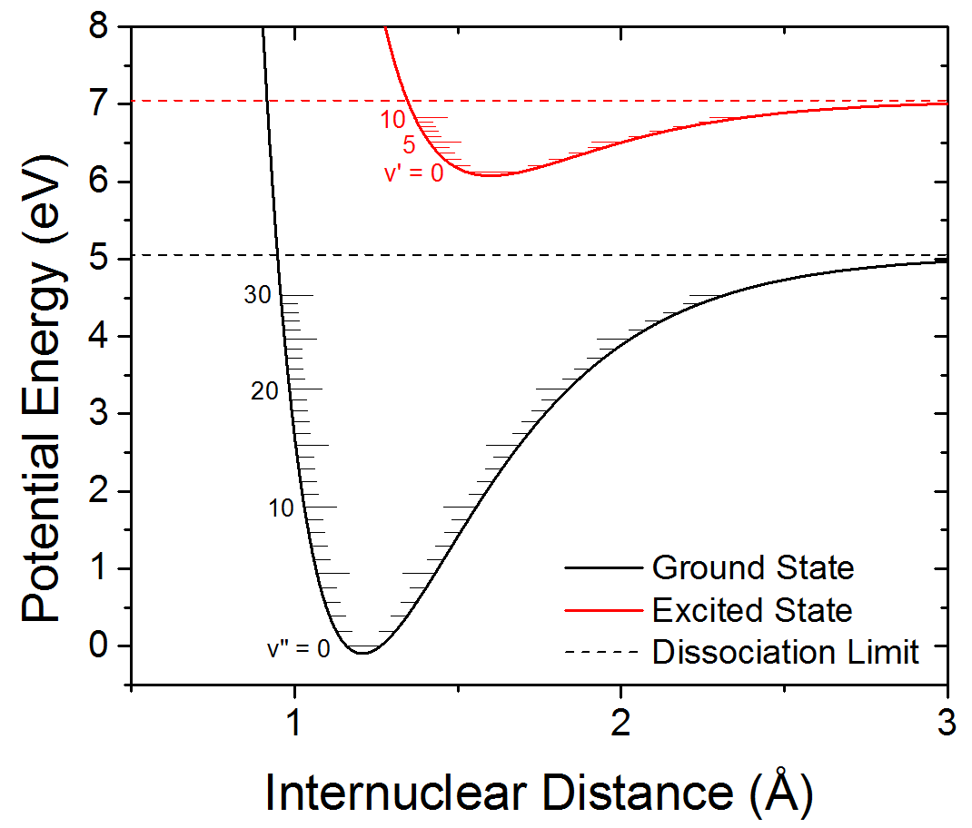
Background
Conclusions
Methods
Rates
Time-Histories
Tv^{NO} Diagnostic
Absorption Process – O₂ in the Ultraviolet
O₂
$$I_{0}$$
Absorbing Gas
$$I$$
Det.
T, P, n_{i}
Incident Intensity
Transmitted Intensity
L
Beer-Lambert Relation
$$\frac{I}{I_{o}}=e^{−α}=e^{−σn_{O_{2}}L}$$
Measurements at 236.9 nm probe v” = 6
Continuous bound-unbound transitions pose challenges for interference-free NO sensing
25

Slide 26
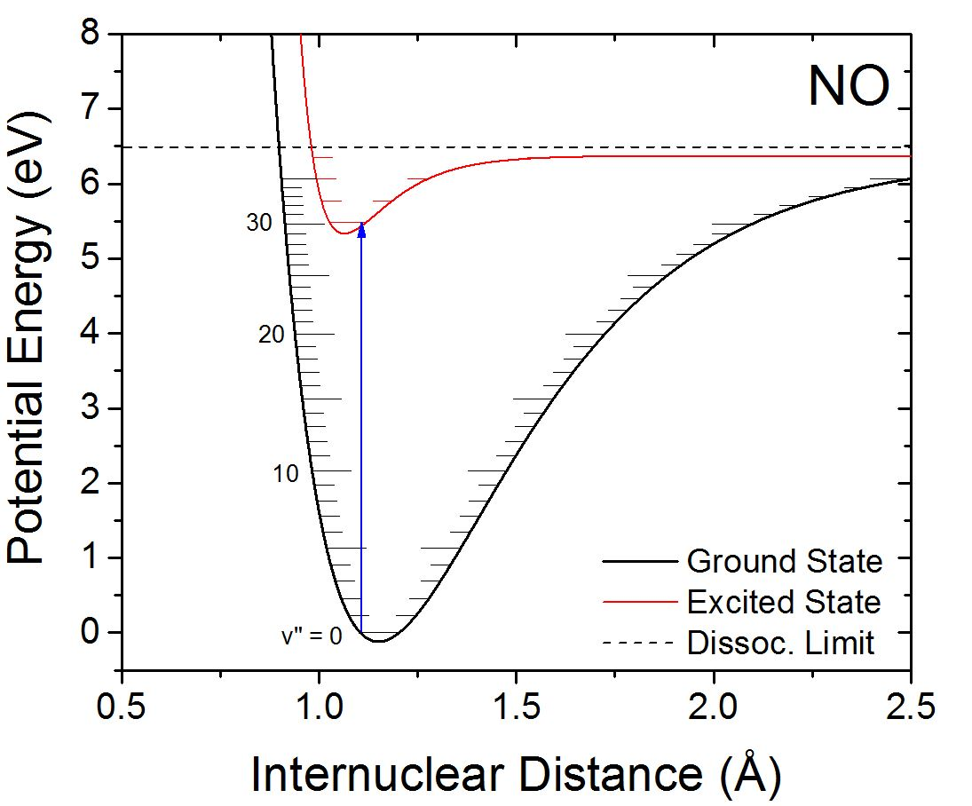
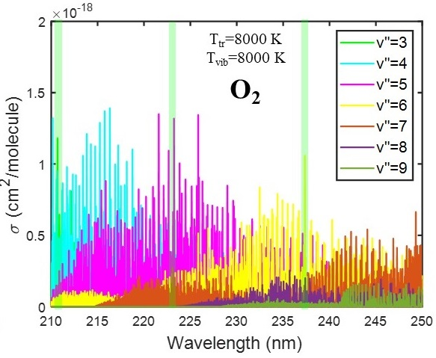
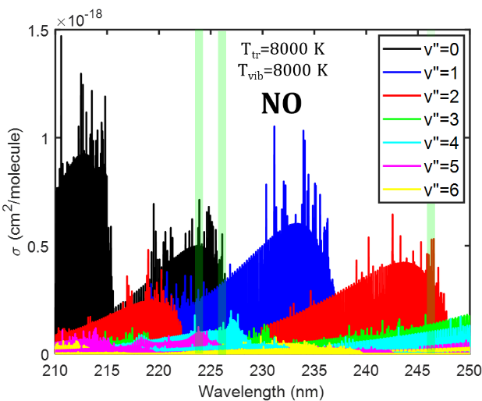
Background
Conclusions
Methods
Rates
Time-Histories
Tv^{NO} Diagnostic
Absorption Process – NO in the Ultraviolet
224.8155 and 246.3222 nm probe v” = 0 and 2, respectively
Diagnostic wavelengths were selected to reduce O₂ interference
Seven diagnostics have been developed, with 246.3222 nm new to this work
26

Slide 27
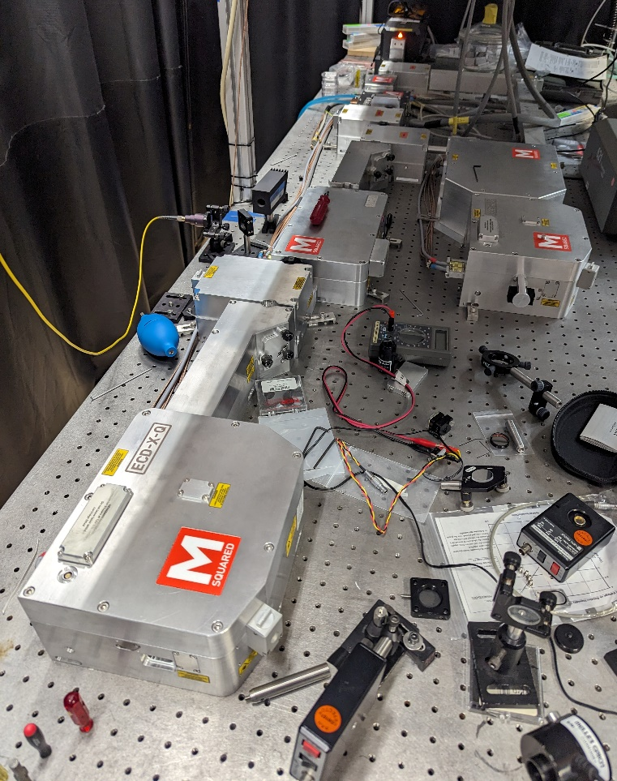
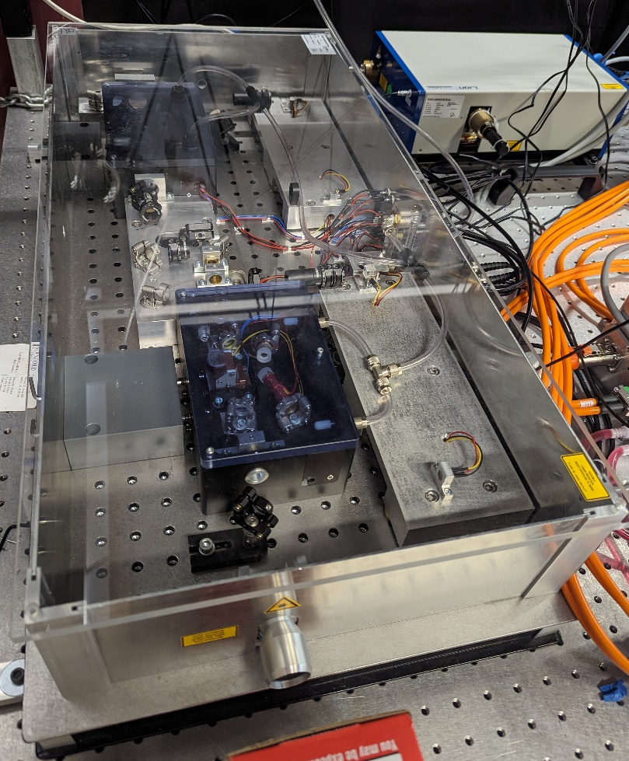
Ultraviolet Laser Diagnostics
Pump
Infrared
Frequency Quadrupling
Mira Laser System
Infrared Pump
Pump
Sacher Laser System
Infrared
Frequency Doubling
Frequency Doubling
M-Squared Laser System
27

Slide 28
Shock Tube Alignment for Common Mode Rejection
I(t) - ”Catch” Detectors
I₀(t) - “Pitch” Detectors
28

