Slide 1
Characterization and Calibration of the COSSTA Radiative Heating Measurements
P. zur Nieden, T. Thiele, N. Wendel, F. Siebe, D. Neeb, A. Gülhan
Institute of Aerodynamics and Flow Technology
Supersonic and Hypersonic Technologies Department

Slide 2
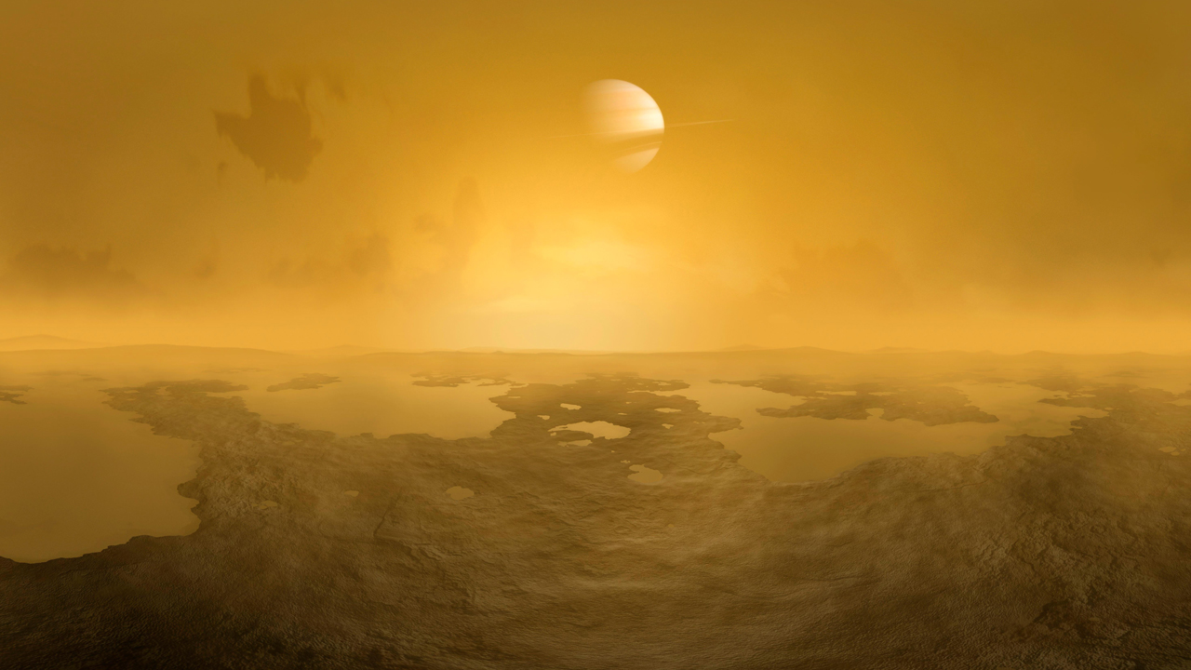
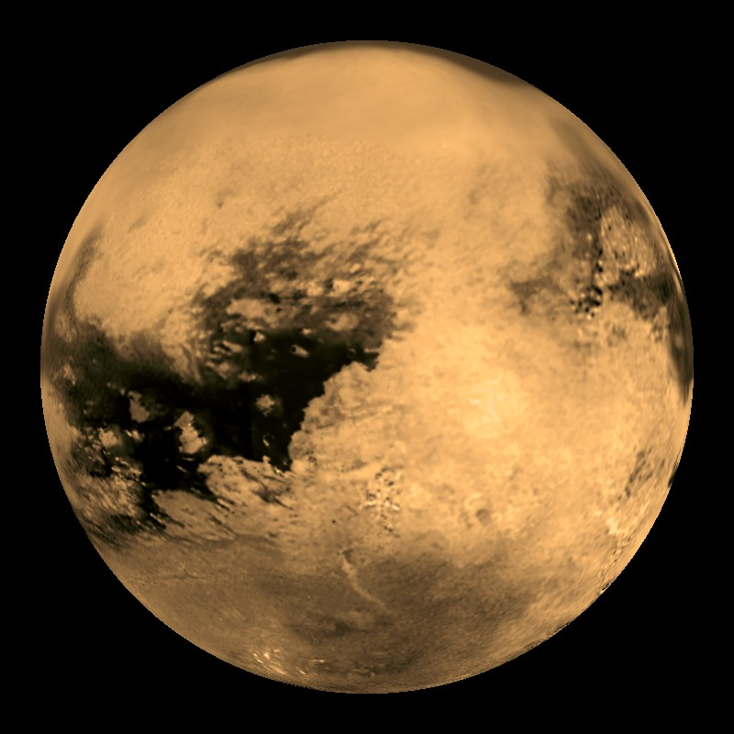
Overview
What is COSSTA?
Atmospheric Entry at Titan
Radiative Heating Measurements
Radiometer Characterization
Set-up
Parameters
Results
Outlook

Slide 3
Overview
What is COSSTA?
Atmospheric Entry at Titan
Radiative Heating Measurements
Radiometer Characterization
Set-up
Parameters
Results
Outlook

Slide 4
What is COSSTA?
?
DrEAM = “Dragonfly Entry Aerosciences Measurements”
Collaboration: DLR & NASA
Instrumentation for atmospheric entry at Titan
Provide critical aerothermodynamic data for TPS
“COmbined Sensor System for Titan Atmosphere” (COSSTA)
Based on COMARS (Schiaparelli)
3 sensor clusters (DLR) containing:
2 total heat flux sensors
3 pressure transducers
7 radiometers

Slide 5
Overview
What is COSSTA?
Atmospheric Entry at Titan
Radiative Heating Measurements
Radiometer Characterization
Set-up
Parameters
Results
Outlook

Slide 6
Overview
What is COSSTA?
Atmospheric Entry at Titan
Radiative Heating Measurements
Radiometer Characterization
Set-up
Parameters
Results
Outlook

Slide 7
Titan‘s Atmosphere
N₂
N₂
CH₄
N₂

Slide 8
Atmospheric Entry at Titan
N₂
CN
N₂
CH₄
N₂

Slide 9
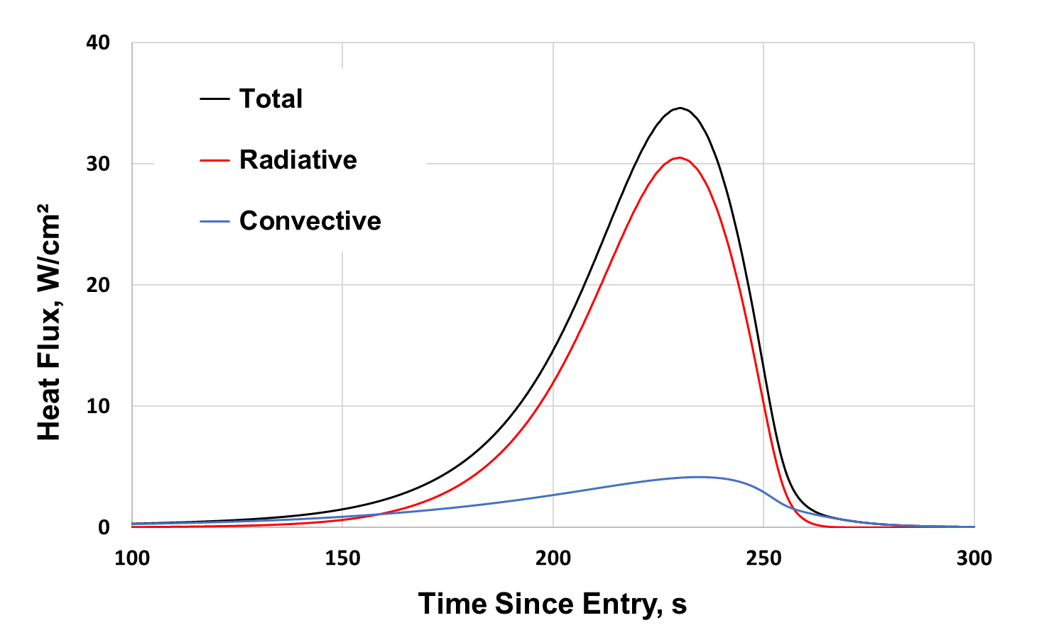
Convection vs Radiation
Backshell Shoulder
CN

Slide 10
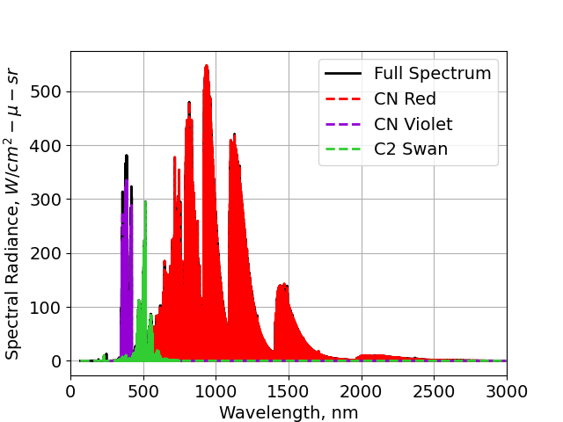
Convection vs Radiation
CN
Notes:
Abundance of methane

Slide 11
Atmospheric Entry at Titan
Nonequilibrium CN concentrations
Accurate modeling extremely difficult!
Important to understand these mechanisms for effective TPS design
Goal:
Enhance our understanding of Titan atmospheric entry
Contribute valuable data to the broader field of entry science
CN

Slide 12
Overview
What is COSSTA?
Atmospheric Entry at Titan
Radiative Heating Measurements
Radiometer Characterization
Set-up
Parameters
Results
Outlook

Slide 13
Overview
What is COSSTA?
Atmospheric Entry at Titan
Radiative Heating Measurements
Radiometer Characterization
Set-up
Parameters
Results
Outlook

Slide 14
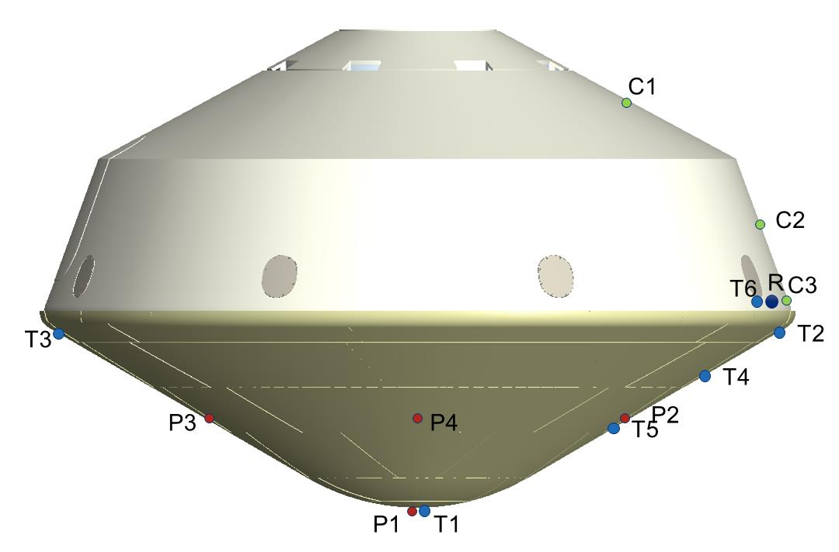
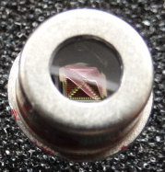
Radiometer Distribution on Backshell of Dragonfly EV
7 thermopile sensors:
2 Narrowband radiometers
CN red / CN violet
2 Narrowband radiometers
CN red / CN violet
2 Narrowband radiometers
CN red / CN violet
1 Broadband radiometer
CN radiation
Notes:
Sapphire window

Slide 15
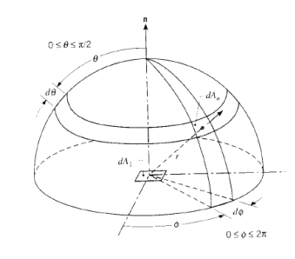
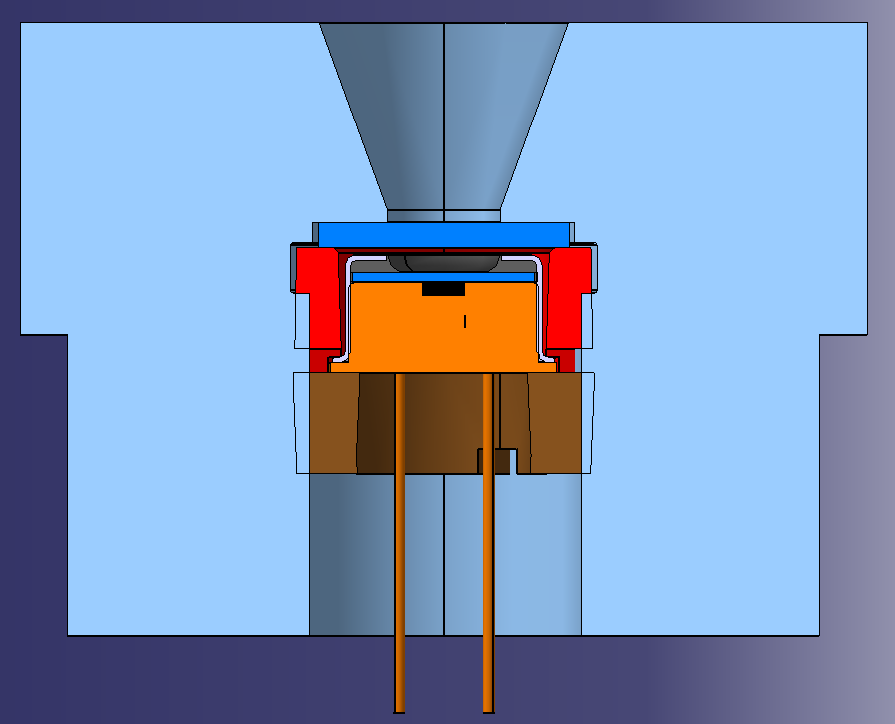
Radiative Heat Flux
$$q_{rad}=\int_{λ}{\int_{θ}{\sin{θ}}}\cos{θ}\int_{φ}{L\left(λ,θ,φ\right)dφdθdλ}$$
$$0≤θ≤π/2$$
$$L\left(λ,θ,φ\right) \left[\frac{W}{m^{2} sr nm}\right]$$
spectral radiance
Short / long pass filter .
$$0≤φ≤2π$$
Radiometer body .
Hemispherical heat flux:
$$q_{rad}=\int_{λ=0}^{∞}{\int_{θ=0}^{π/2}{\sin{θ}}}\cos{θ}\int_{φ=0}^{2π}{L\left(λ,θ,φ\right)dφdθdλ}$$
Thermopile sensor . with Sapphire filter .
Notes:
Particles from pyrolysis / ablation

Slide 16
Interpretation of Measured Heat Flux 1
$$q_{rad}=\int_{λ}{\int_{θ}{\sin{θ}}}\cos{θ}\int_{φ}{L\left(λ,θ,φ\right)dφdθdλ}$$
$$0≤θ≤π/2$$
$$L\left(λ,θ,φ\right) \left[\frac{W}{m^{2} sr µm}\right]$$
spectral radiance
$$0≤φ≤2π$$
$$α$$
$$q_{rad}=f(λ_{filter},α)$$
Hemispherical heat flux:
Irradiance for specific
angle of aperture $α$
filters
$$q_{rad}=\int_{λ=0}^{∞}{\int_{θ=0}^{π/2}{\sin{θ}}}\cos{θ}\int_{φ=0}^{2π}{L\left(λ,θ,φ\right)dφdθdλ}$$

Slide 17
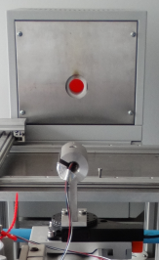
Angular Characterization
Irradiance for specific
angle of aperture $α$
filters
Blackbody Landcal R1500T
1100 °C
Thermopile sensor
Rotation stage

Slide 18
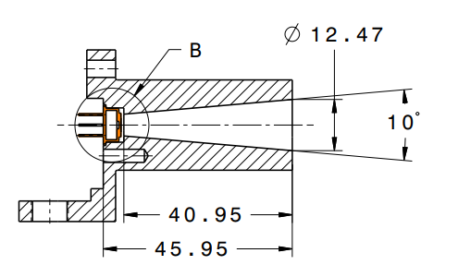
Angular Characterization
Irradiance for specific
angle of aperture $α$
filters
$$40°$$

Slide 19
Interpretation of Measured Heat Flux 2
$$q_{rad}=\int_{λ}{\int_{θ}{\sin{θ}}}\cos{θ}\int_{φ}{L\left(λ,θ,φ\right)dφdθdλ}$$
Irradiance for specific
angle of aperture $α$
filters
Measure of radiance
$$\left[\frac{W}{m^{2} sr}\right]$$
$$40°$$

Slide 20
Interpretation of Measured Heat Flux (Recap)
Hemispherical heat flux
Irradiance
$$0≤θ≤π/2$$
Radiance
$$0≤φ≤2π$$
$$40°$$

Slide 21
Overview
What is COSSTA?
Atmospheric Entry at Titan
Radiative Heating Measurements
Radiometer Characterization
Set-up
Parameters
Results
Outlook

Slide 22
Overview
What is COSSTA?
Atmospheric Entry at Titan
Radiative Heating Measurements
Radiometer Characterization
Set-up
Parameters
Results
Outlook

Slide 23
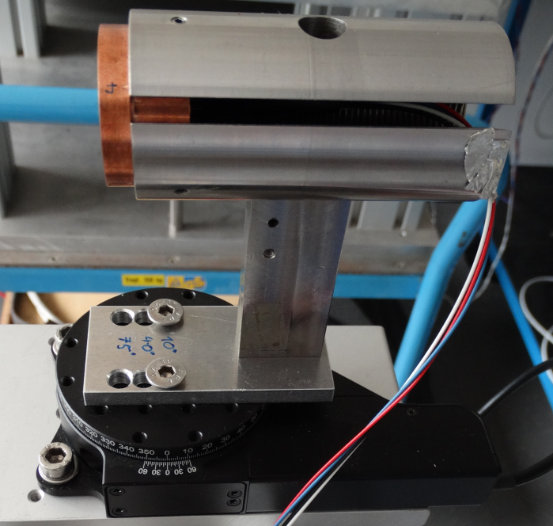
Angular Characterization: Test Setup
200 cm
Radiometer body
with thermopile
Blackbody Landcal R1500T
1100 °C
Rotation stage
Rotation stage

Slide 24
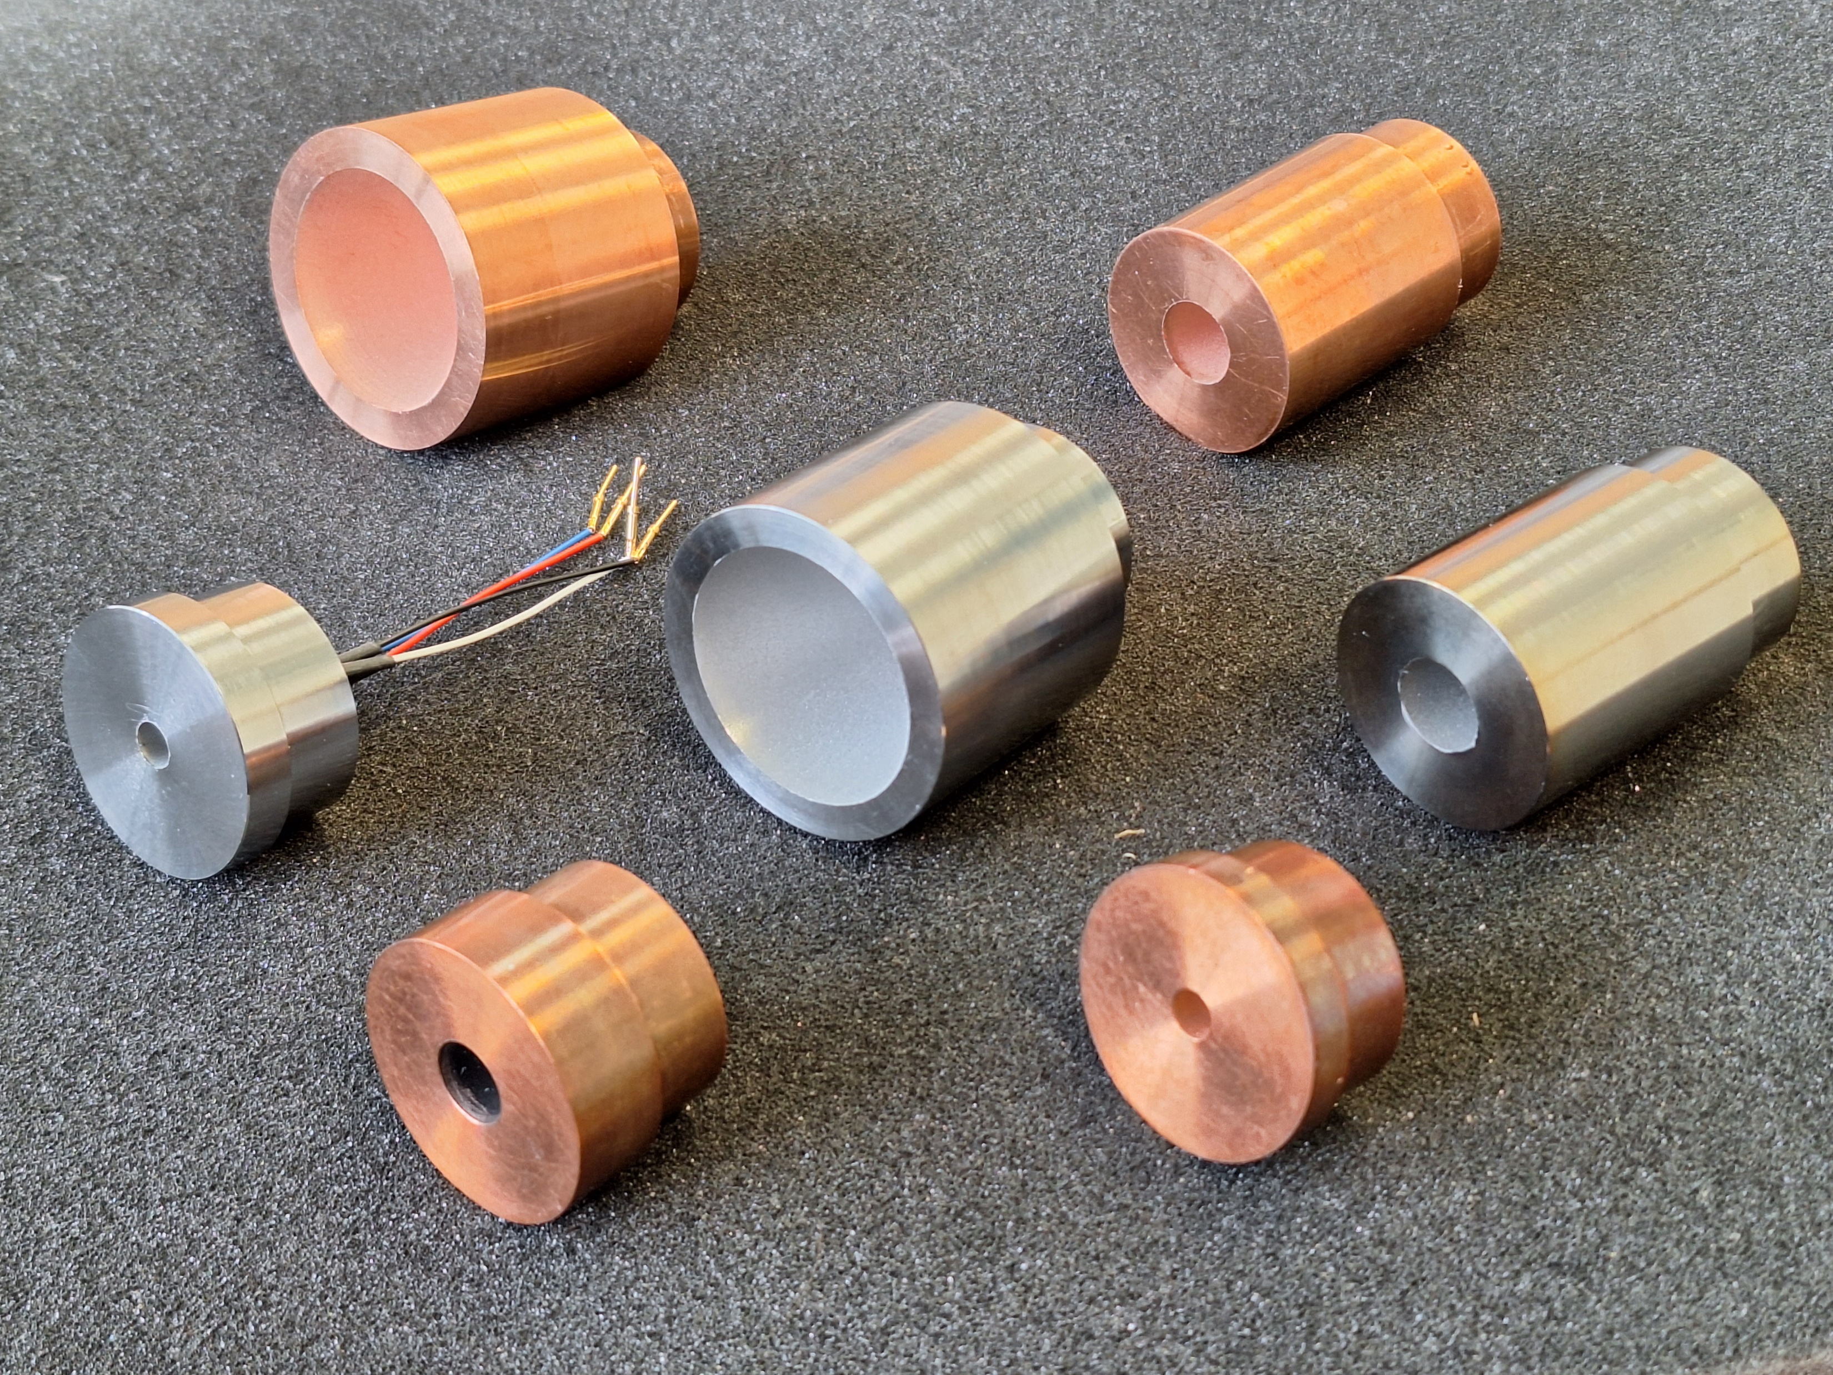
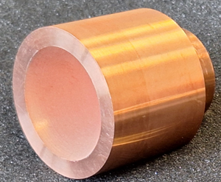
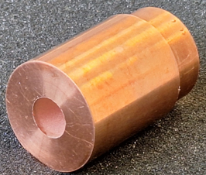
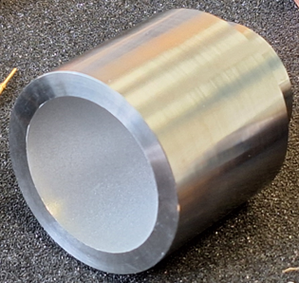
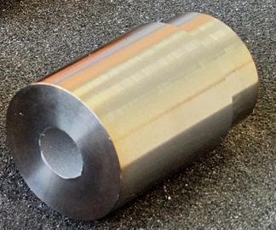
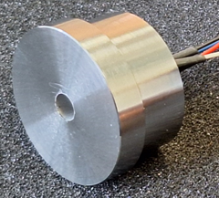
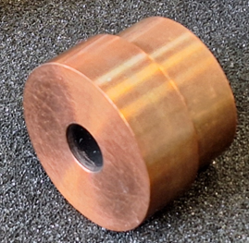
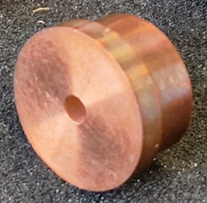
Test Parameters
Surface properties
Length
Angle of aperture

Slide 25
Surface Properties
Copper (smooth/rough)
Titanium (smooth/rough)
Notes:
Abrasive blasting
Defined sandblast
Reduce reflections in the well

Slide 26
Length
Short ~ 8 mm
Long ~ 40 mm

Slide 27
Angle of Aperture
40°
10°

Slide 28
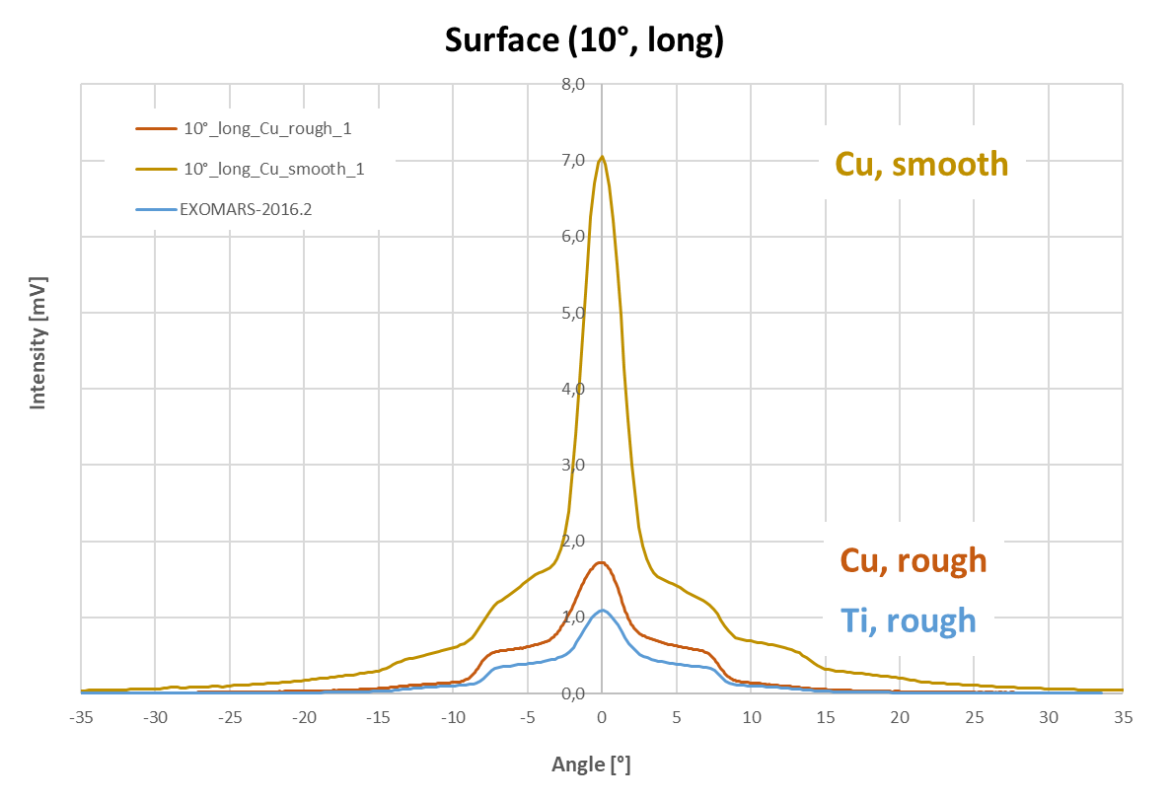
Results: Surface Properties

Slide 29
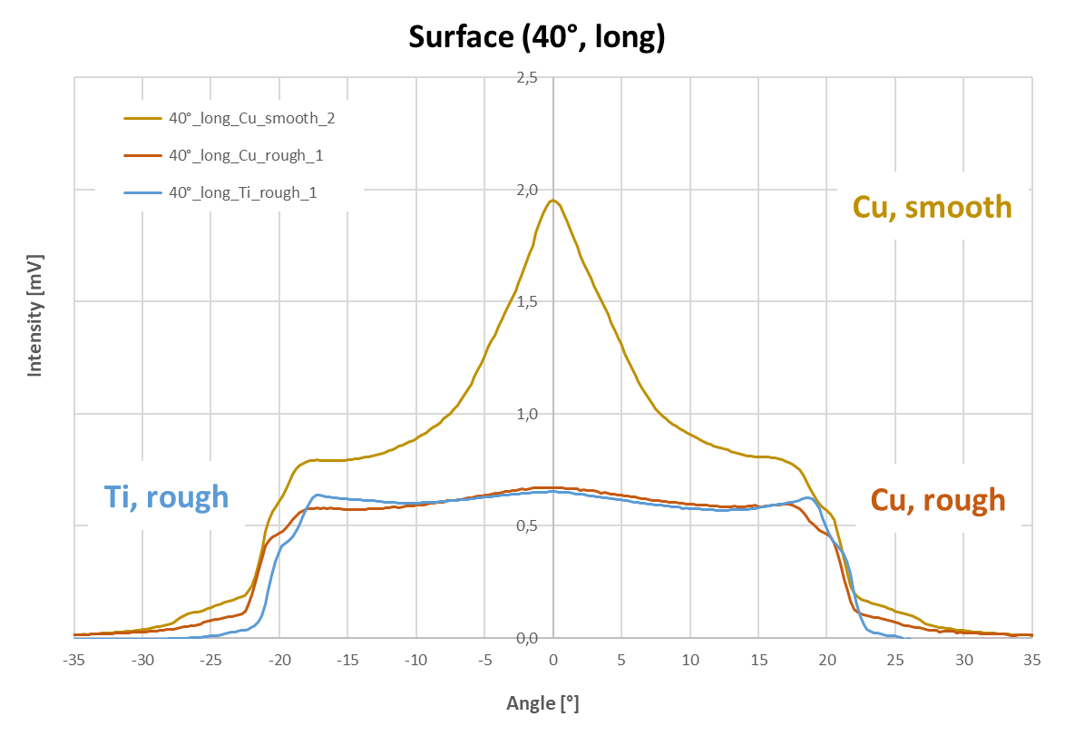
Results: Surface Properties

Slide 30
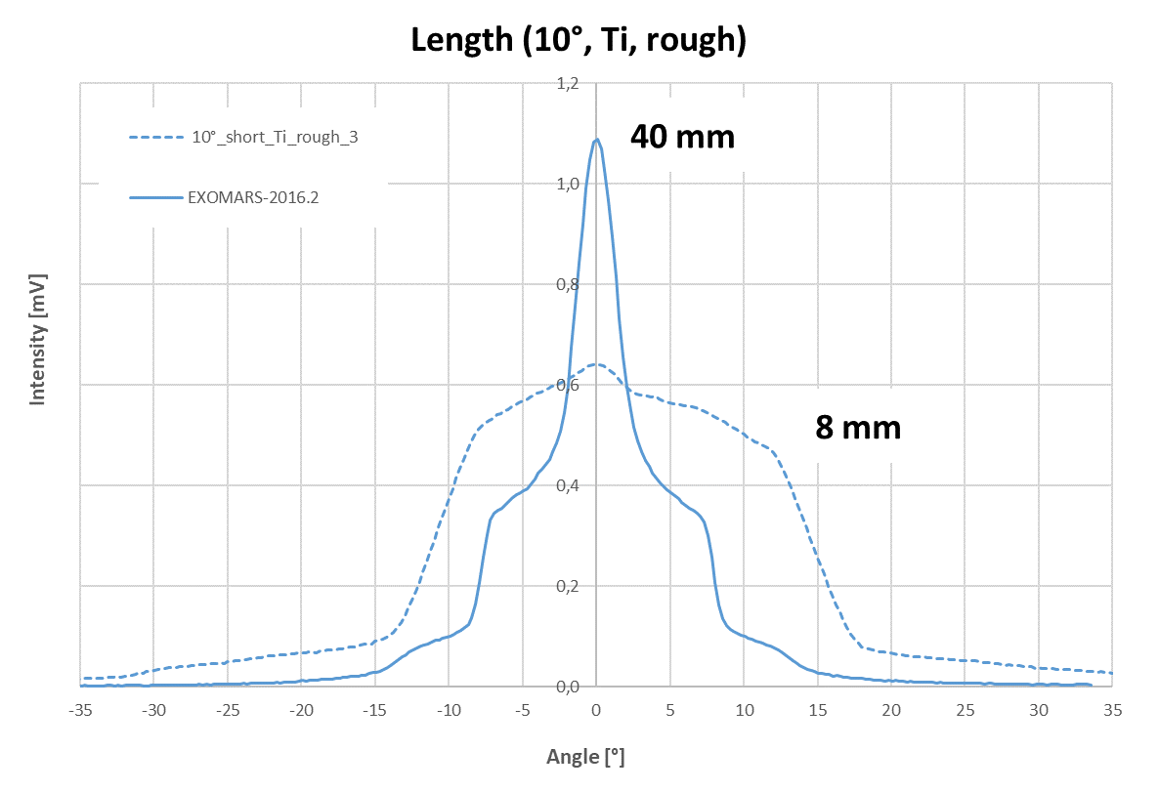
Results: Length

Slide 31
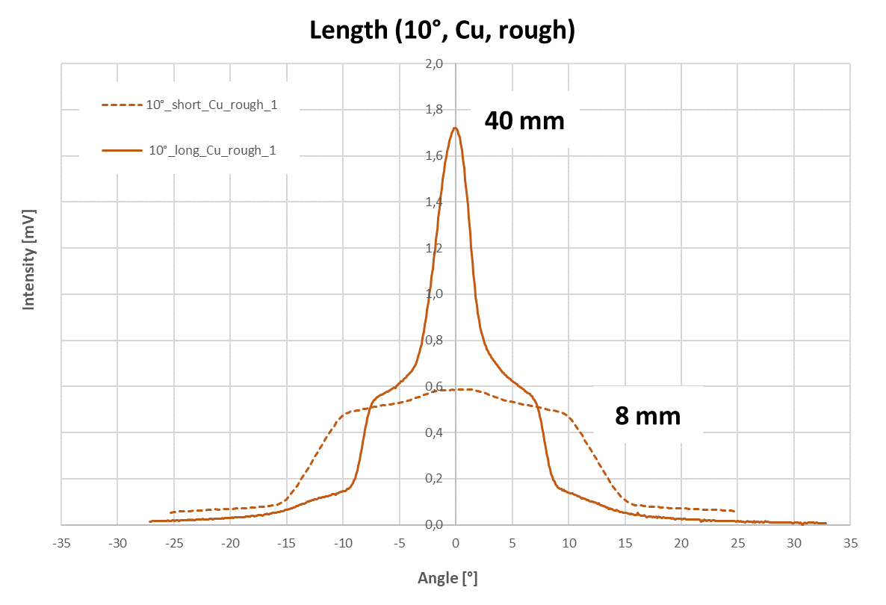
Results: Length

Slide 32
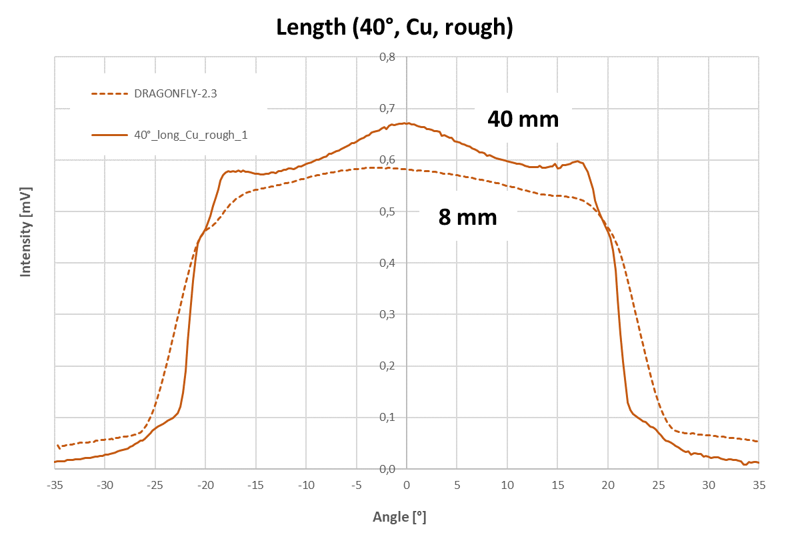
Results: Length

Slide 33
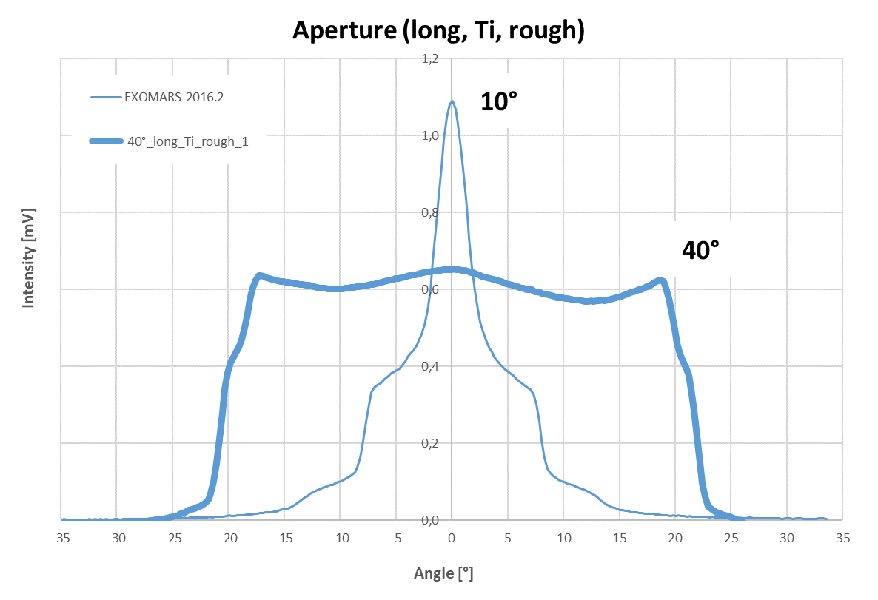
Results: Angle of Aperture

Slide 34
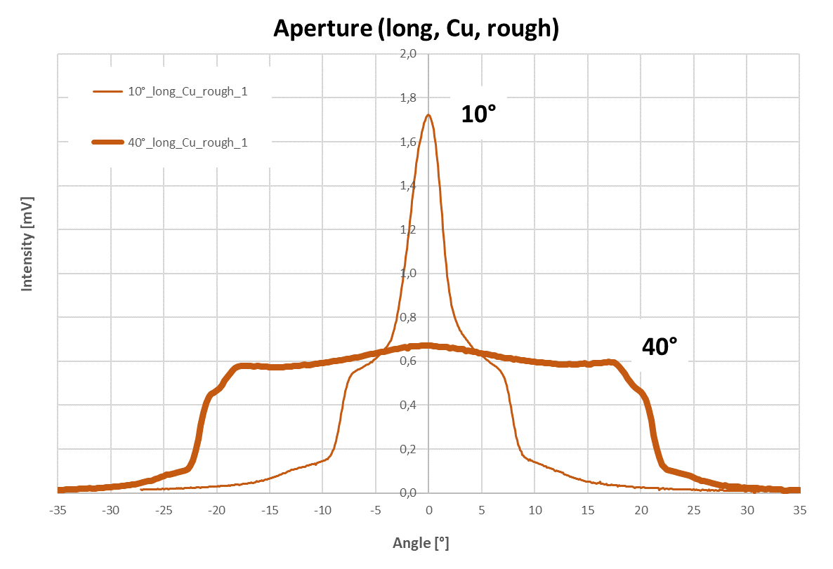
Results: Angle of Aperture

Slide 35
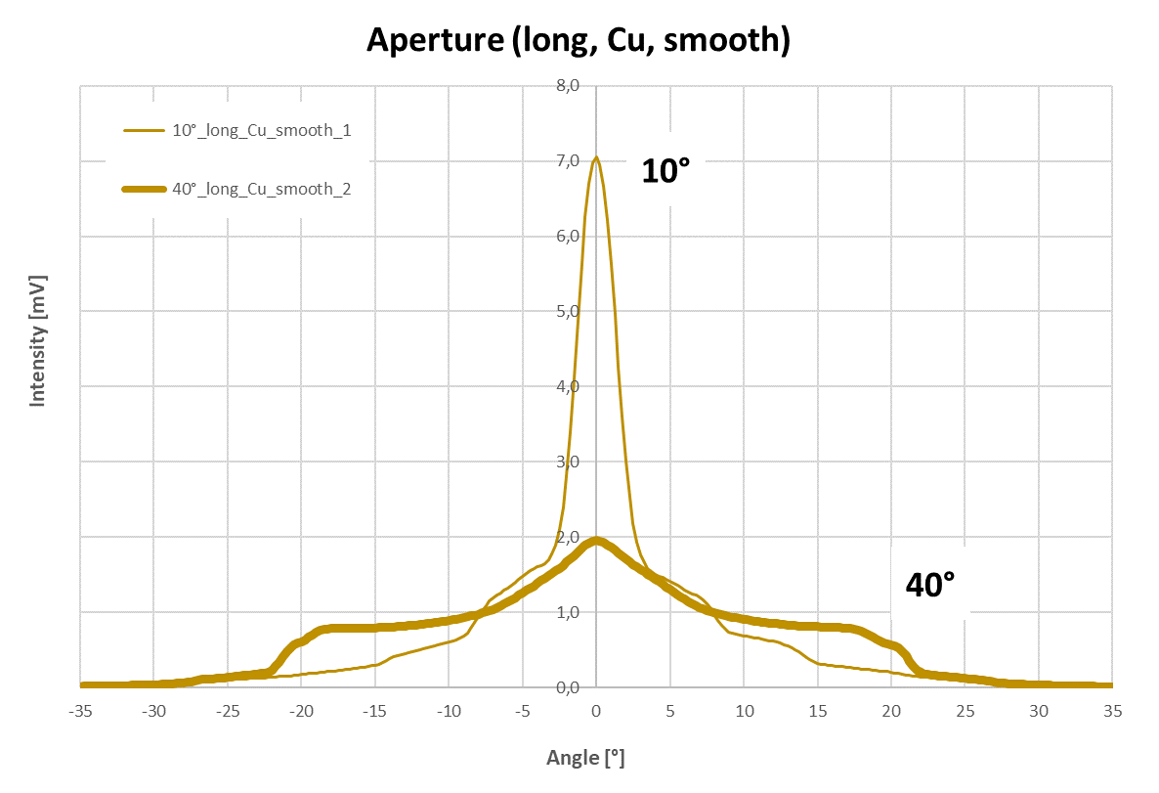
Results: Angle of Aperture

Slide 36
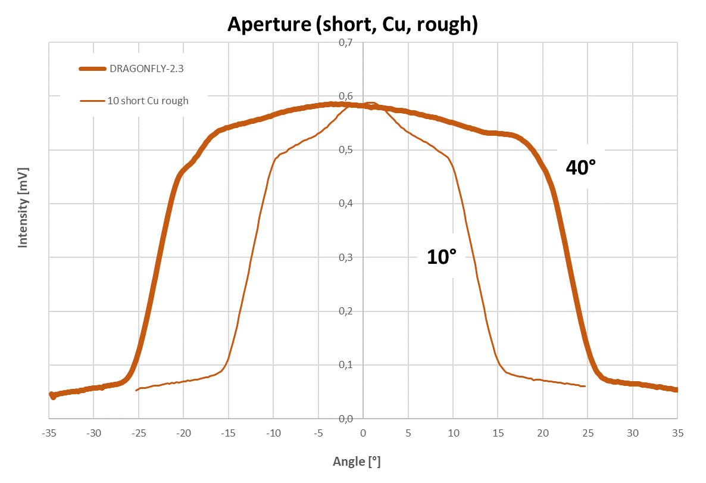
Results: Angle of Aperture

Slide 37
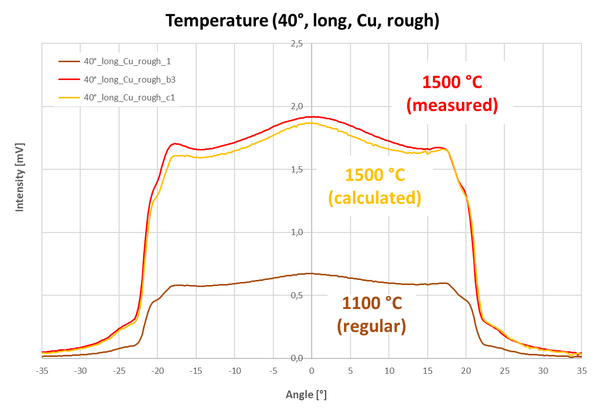
Additional Results: Temperature

Slide 38
Conclusion for Heat Flux Measurement
Influence of material (copper vs titanium) is not significant
Great importance of surface roughness
A shorter distance of the sensor from the capsule surface yields a preferable (plateau-shaped) angular characteristic suitable for measurement of irradiance (rather than radiance)
A greater angle of aperture (40° vs 10°) yields a preferable (plateau-shaped) angular characteristic suitable for measurement of irradiance (rather than radiance)
This is particularly true for a long distance of the sensor from the capsule surface. A shorter distance mitigates this effect.

Slide 39
Overview
What is COSSTA?
Atmospheric Entry at Titan
Radiative Heating Measurements
Radiometer Characterization
Set-up
Parameters
Results
Outlook

Slide 40
Overview
What is COSSTA?
Atmospheric Entry at Titan
Radiative Heating Measurements
Radiometer Characterization
Set-up
Parameters
Results
Outlook

Slide 41
Outlook
Angular characterization of actual flight sensors mounted in COSSTA sensor bodies
Blackbody cavity radiator for broadband radiometers
Measured angular characteristic of narrowband radiometers depends on light source – blackbody vs. red/UV LED
Presumably due to wavelength-dependent reflection in the well
Possible to use LEDs
Calibration of the absolute irradiance for all radiometers
Blackbody surface radiator
Up to 40 W/cm²

Slide 42
Outlook (continued)
Test thermopile sensors for resistance at low temperatures of down to -155 °C
Cryogenic thermal vacuum chamber
Performance check of thermopile channels after exposure to low temperatures
Temperature measurement during temperature cycles
Calibration of the wavelength sensitivity of the thermopile sensors
Dragonfly launch scheduled for 2028
Enhance our understanding of Titan atmospheric entry
Contribute valuable data to the broader field of entry science

Slide 43
Questions…?

