Slide 1

10th International Workshop on Radiation of High Temperature Gases for Space Missions
Thermochemical Characterisation of Shock Heated Flows
Alex B. Glenn, Justin Clarke, Peter L. Collen, Luca Di Mare and Matthew McGilvray
Osney Thermofluids Institute, University of Oxford, United Kingdom
09/09/2024

Slide 2
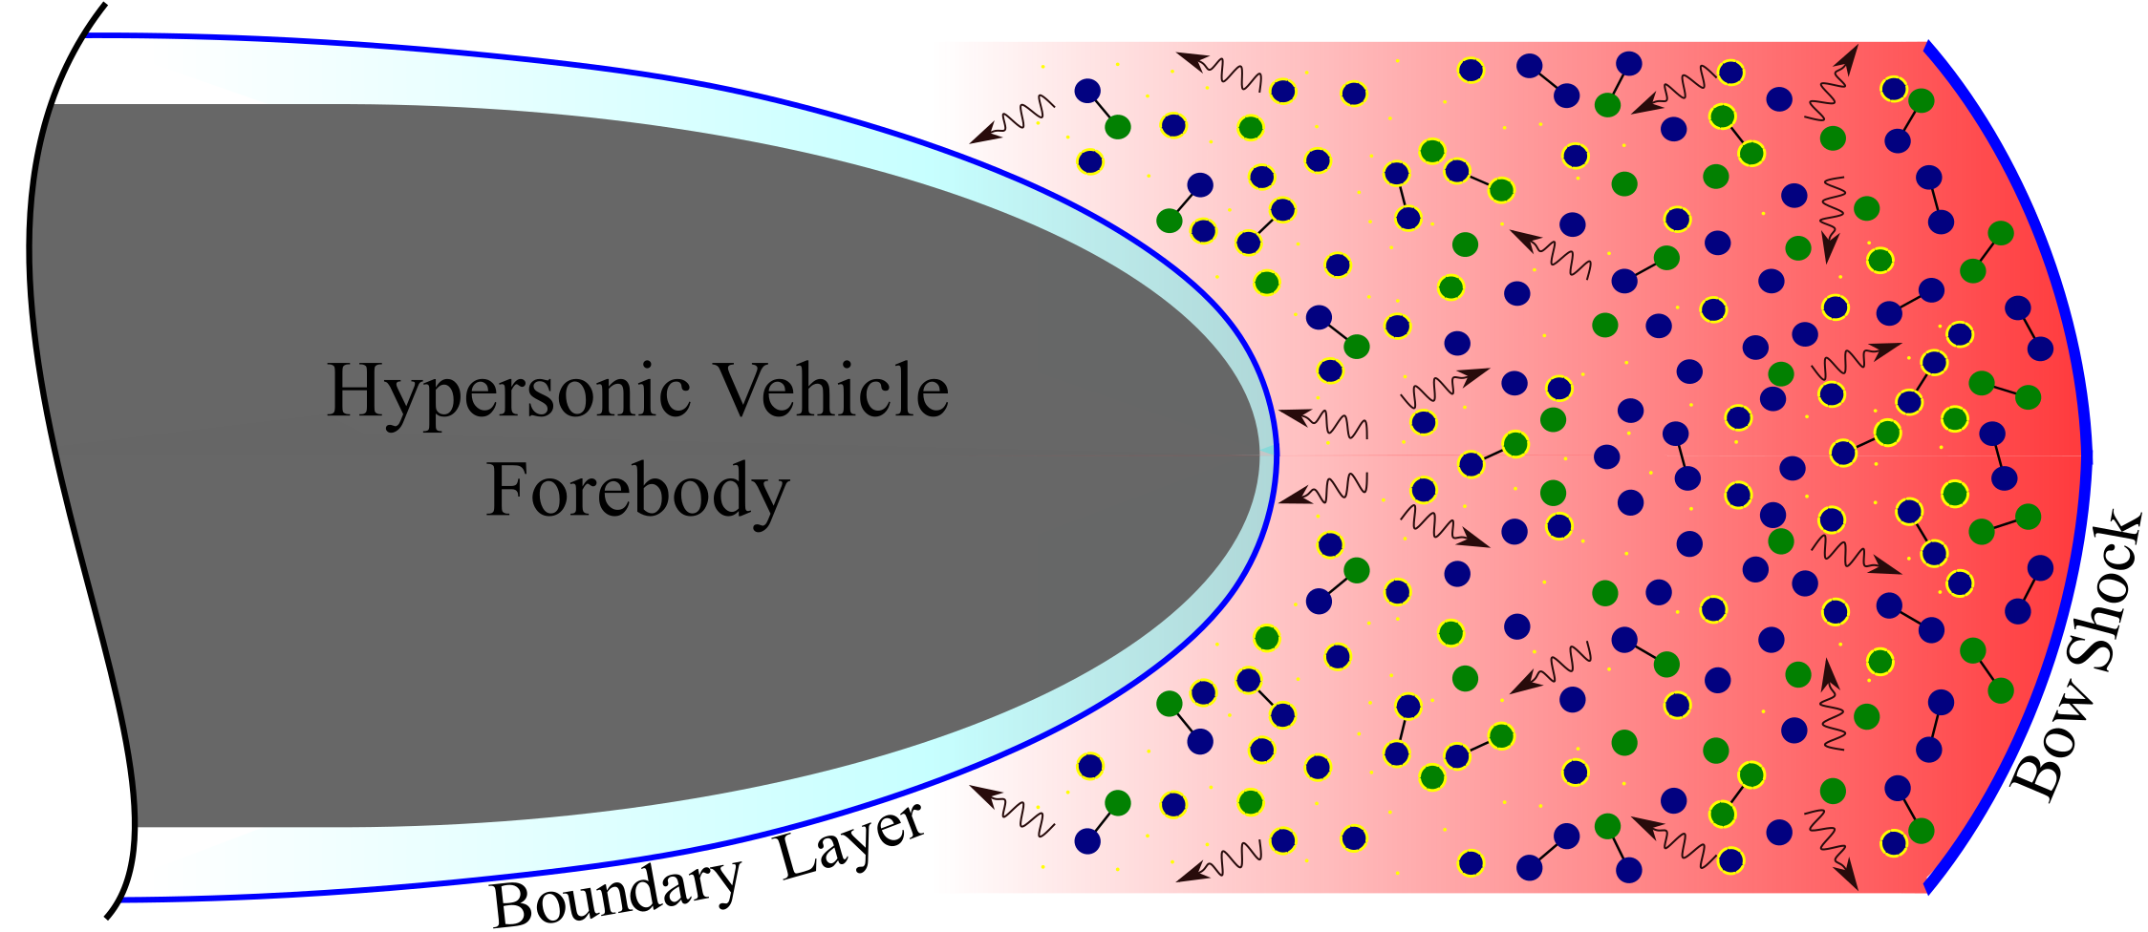
Low Earth Orbit Return Stagnation Lines
Vehicle descends from speeds of ~8 km/s
Radiative heating negligible compared to convective
Non-equilibrium phenomena may reach vehicle surface:
  Influence heat flux via shock wave/boundary layer interactions
  Communications blackout due to excess electrons
  Convective heat load
  Forces on vehicle surface and trajectory from aerothermodynamic couple
  Visibility
Desirable to characterise the thermochemical state through vehicle stagnation line
Illustration of entry vehicle shock layer. Not to scale.
Velocity-altitude map superimposed with high temperature gas effects. Taken from Anderson.

Slide 3
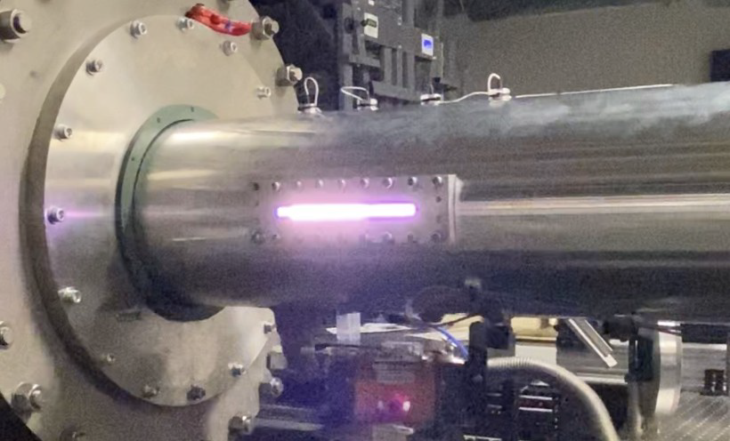
Shock Tubes
Shock tubes can re-create stagnation lines at ground level
Advantages over other impulse facilities:
We know the initial boundary conditions
No scaling required
Full thermochemical evolution
Particle times of flight differ from vehicle stagnation line due to boundary layer mass consumption…
Illustration of hock tube – stagnation line analogy. Not to scale.
Radiation emission as test slug traverses AST window

Slide 4
Particle Time of Flight Discrepancy in Shock Tubes
Illustration of vehicle and shock tube particle time of flight trajectories

Slide 5
Particle Time of Flight Discrepancy in Shock Tubes
Clarke, J., Di Mare, L., and McGilvray, M., “Spatial Transformations for Reacting Gas Shock Tube Experiments,” AIAA journal, Vol. 61, No. 8, 2023, pp. 3365–3374
Illustration of vehicle and shock tube particle time of flight trajectories

Slide 6
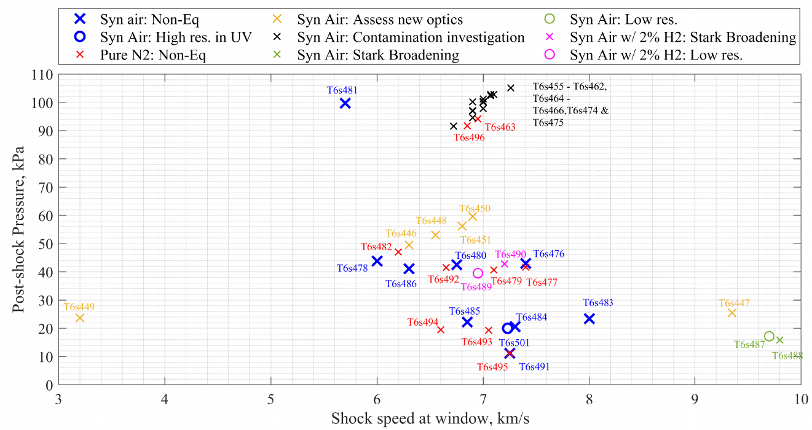
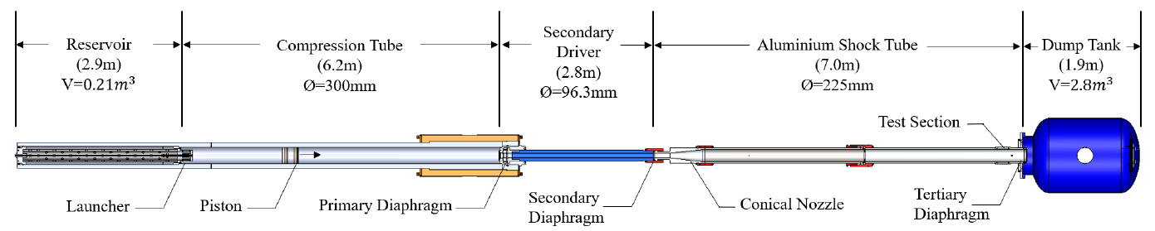
T6 Stalker Tunnel: Aluminium Shock Tube
Large diameter (225 mm)
  Increases integration path length
  Better signal:noise
Relatively thinner boundary layer
  Less shock deceleration
  Longer test slugs
Condition map of 2023 T6 AST LEO campaign.
Section view of T6 Stalker tunnel in Aluminium Shock Tube mode.

Slide 7
T6 Stalker Tunnel: Aluminium Shock Tube
Large diameter (225 mm)
  Increases integration path length
  Better signal:noise
Relatively thinner boundary layer
  Less shock deceleration
  Longer test slugs
Condition map of 2023 T6 AST LEO campaign.
Section view of T6 Stalker tunnel in Aluminium Shock Tube mode.

Slide 8
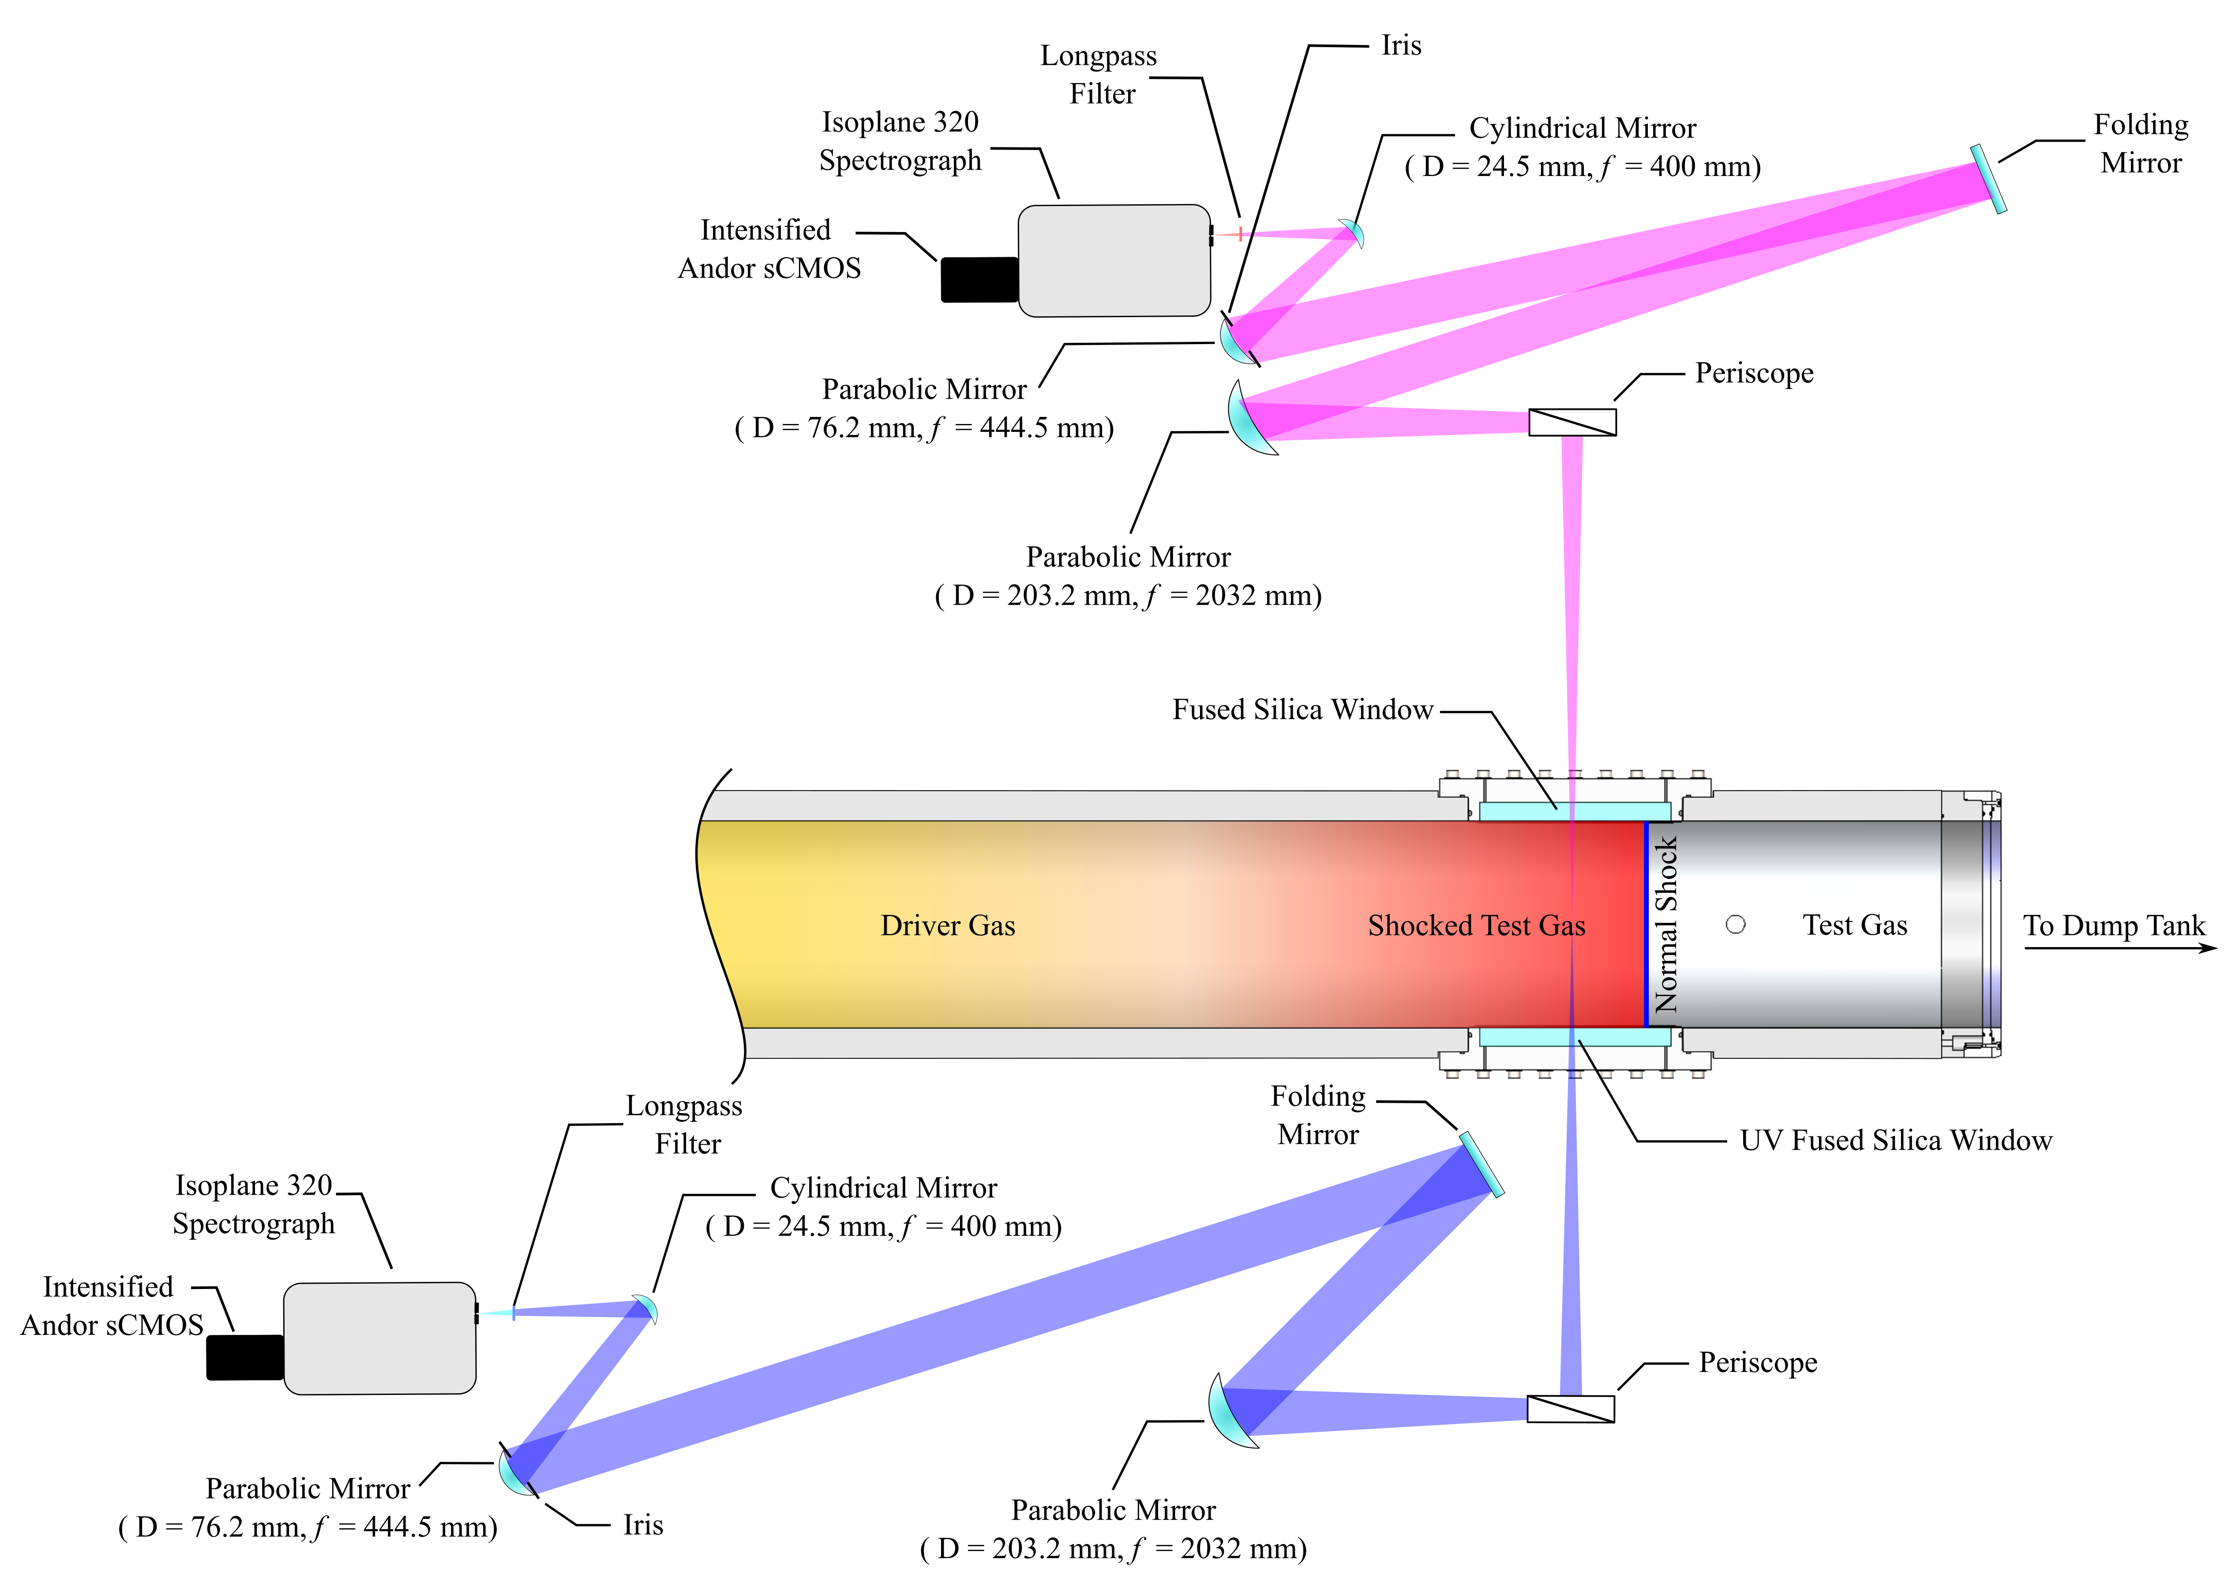
Telecentric Optical Emission Spectroscopy
Calibrated spatio-spectral radiance data for T6s492 (6.65km/s, 90 Pa fill in pure nitrogen). UV/Vis wavelengths on left and Vis/NIR on right.
The Vis/NIR (upper) and UV/Vis (lower) telecentric OES systems capturing radiation from a shock layer. Not to scale.

Slide 9
Constrained Spectral Fitting Routine
Two-temperature model and Boltzmann distributions

Slide 10
Constrained Spectral Fitting Routine
Two-temperature model and Boltzmann distributions
Conserves total enthalpy, mass and momentum by calling OCEAN

Slide 11
Constrained Spectral Fitting Routine
Two-temperature model and Boltzmann distributions
Conserves total enthalpy, mass and momentum by calling OCEAN
Predicts spectral traces via NEQAIR
  Results therefore dependent on the NEQAIR modelling
  Convolve by ILS

Slide 12
Constrained Spectral Fitting Routine
Two-temperature model and Boltzmann distributions
Conserves total enthalpy, mass and momentum by calling OCEAN
Predicts spectral traces via NEQAIR
  Results therefore dependent on the NEQAIR modelling
  Convolve by ILS
Fitting procedure considers all species
  The more information the better

Slide 13
Constrained Spectral Fitting Routine
Two-temperature model and Boltzmann distributions
Conserves total enthalpy, mass and momentum by calling OCEAN
Predicts spectral traces via NEQAIR
  Results therefore dependent on the NEQAIR modelling
  Convolve by ILS
Fitting procedure considers all species
  The more information the better
Starts at most relaxed end of observed test slug and increments towards shock front

Slide 14
Constrained Spectral Fitting Routine
Two-temperature model and Boltzmann distributions
Conserves total enthalpy, mass and momentum by calling OCEAN
Predicts spectral traces via NEQAIR
  Results therefore dependent on the NEQAIR modelling
  Convolve by ILS
Fitting procedure considers all species
  The more information the better
Starts at most relaxed end of observed test slug and increments towards shock front
Currently only ran for UV/Vis and Vis/NIR wavelength regions (but can be expanded!)

Slide 15
Constrained Spectral Fitting Routine
Two-temperature model and Boltzmann distributions
Conserves total enthalpy, mass and momentum by calling OCEAN
Predicts spectral traces via NEQAIR
  Results therefore dependent on the NEQAIR modelling
  Convolve by ILS
Fitting procedure considers all species
  The more information the better
Starts at most relaxed end of observed test slug and increments towards shock front
Currently only ran for UV/Vis and Vis/NIR wavelength regions (but can be expanded!)
Constrained spectral fitting vs previous spectral fitting.
Feature | Constrained Spectral Fitting | Previous Spectral Fitting
Mass conservation | ✓ | X
Momentum conservation | ✓ | X
Energy conservation | ✓ | X
Wavelengths included | As many as possible | Isolate wavelength region for specie of interest
Spatial smearing correction near shock front | ✓ | X

Slide 16
Constrained Spectral Fitting Routine
INPUTS:
Experimental spectra
Shock speed
Tube diameter
Fill pressure and temperature
Composition
ILS functions
Relevant species
Two-temperature model and Boltzmann distributions
Conserves total enthalpy, mass and momentum by calling OCEAN
Predicts spectral traces via NEQAIR
  Results therefore dependent on the NEQAIR modelling
  Convolve by ILS
Fitting procedure considers all species
  The more information the better
Starts at most relaxed end of observed test slug and increments towards shock front
Currently only ran for UV/Vis and Vis/NIR wavelength regions (but can be expanded!)
Constrained spectral fitting
OUTPUTS:
Ttr and Tve profiles
Number density profiles for chosen species
Corresponding pressure, enthalpy and density profiles
Summary of constrained spectral fitting routine.

Slide 17
Next Steps
Validate constrained methodology against artificial data
Apply to EAST-62-40 and compare against previous spectral fitting results
Apply to new T6 AST pure nitrogen data

Slide 18
Validation

Slide 19
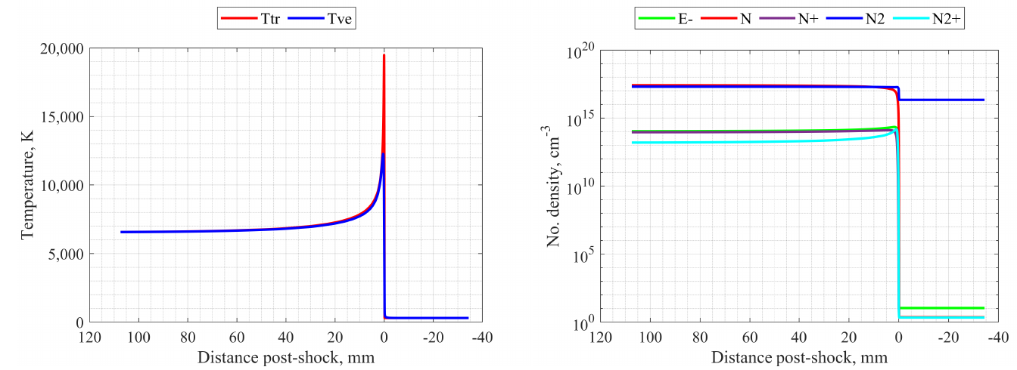
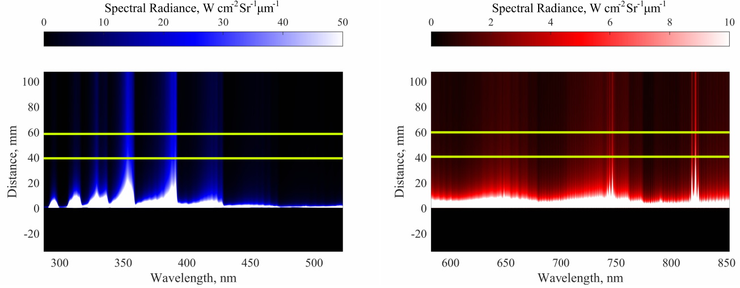
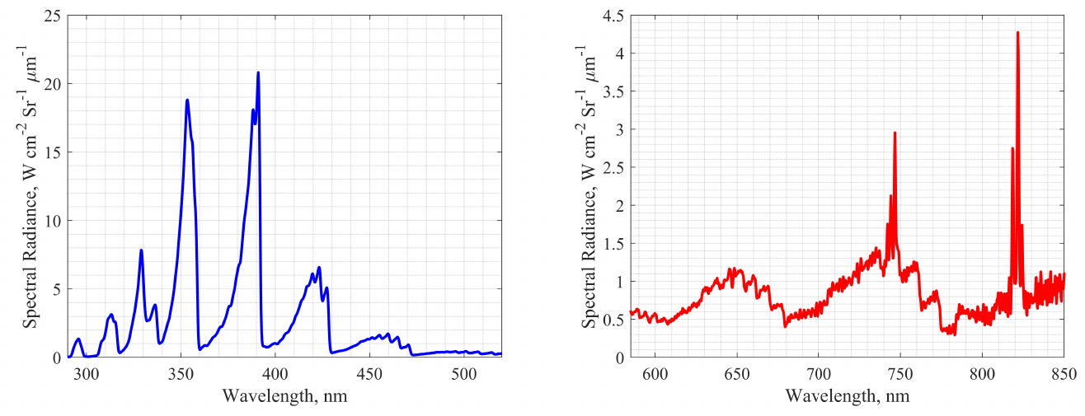
Validate Method - Generate Artificial NESS-NEQAIR Radiance Data

Slide 20
Validate Method - Generate Artificial NESS-NEQAIR Radiance Data
In this work we constrain to the spectral wavelengths and resolutions of the T6 AST dataset, but the methodology is not limited to this!

Slide 21
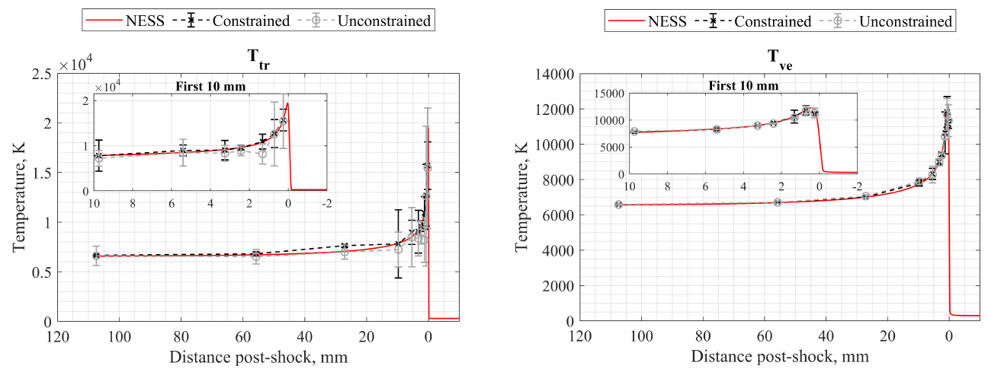
Initial Test – T6s492 (Pure Nitrogen at 6.65km/s, 90 Pa fill)
Constrained and unconstrained temperature results.

Slide 22
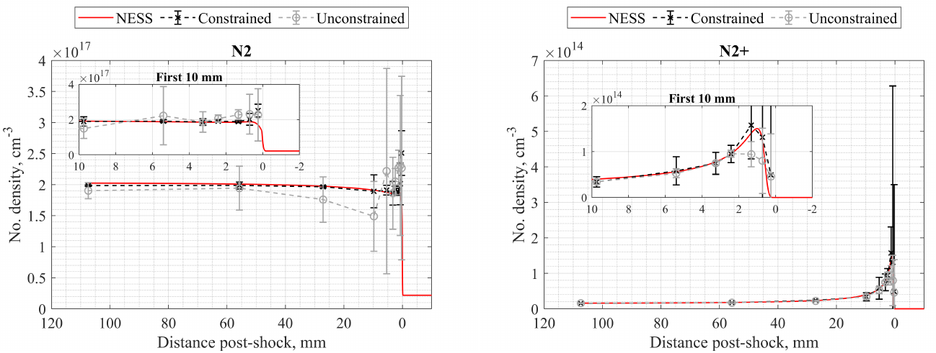
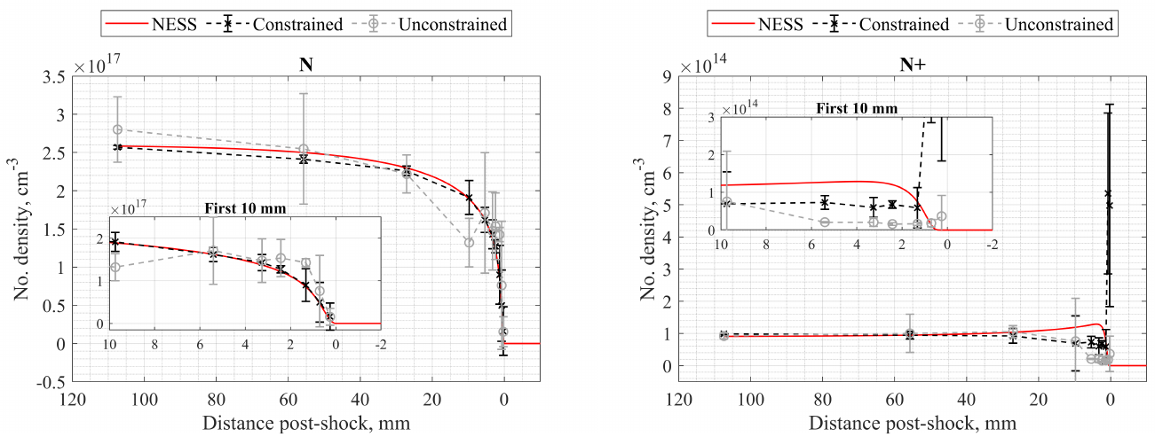
Initial Test – T6s492 (Pure Nitrogen at 6.65km/s, 90 Pa fill)
Species captured well by constrained spectral fitting routine.

Slide 23
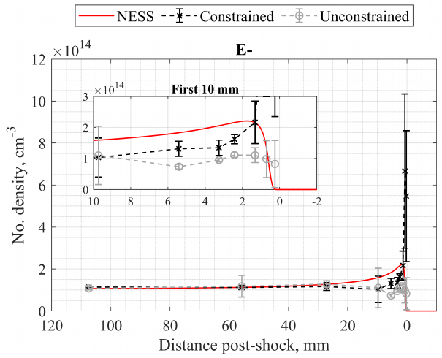
Initial Test – T6s492 (Pure Nitrogen at 6.65km/s, 90 Pa fill)
Species not captured well by constrained spectral fitting routine.

Slide 24
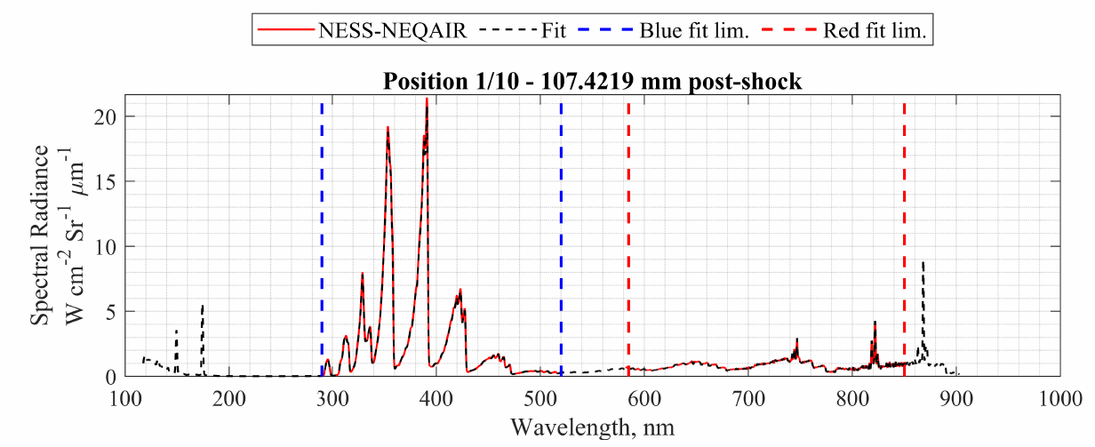
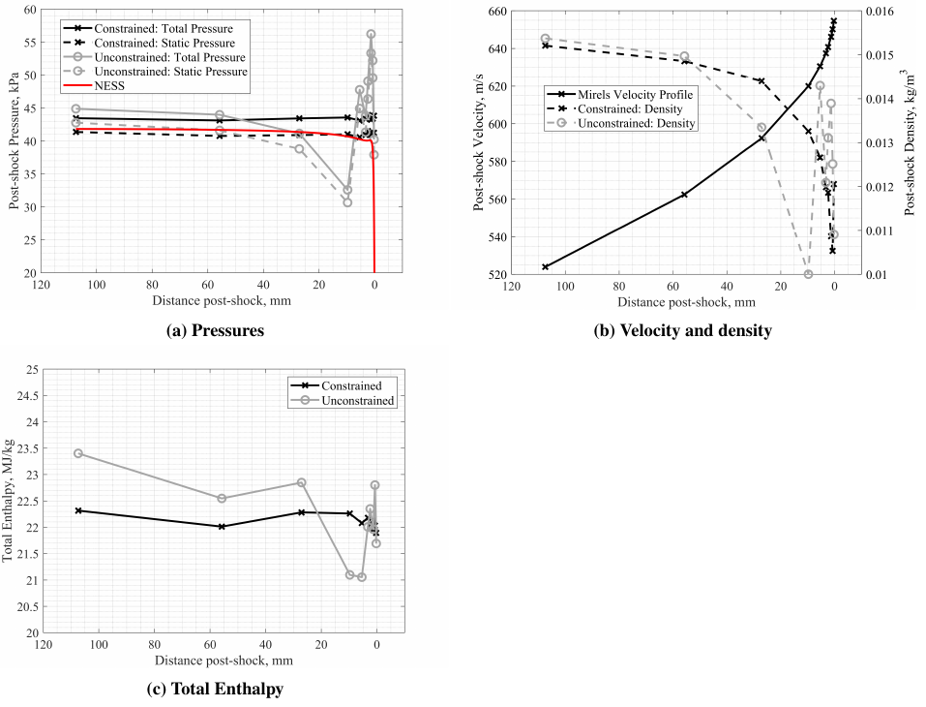
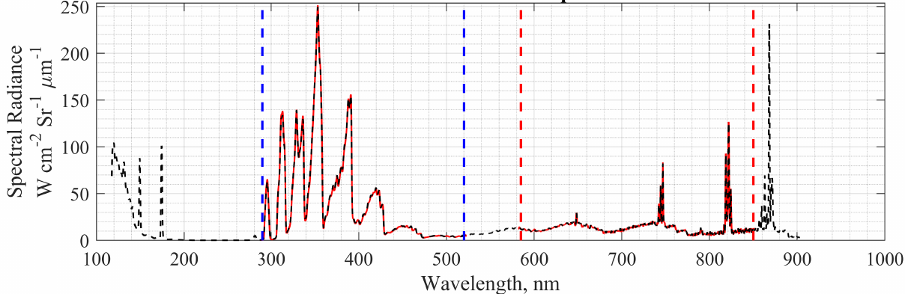
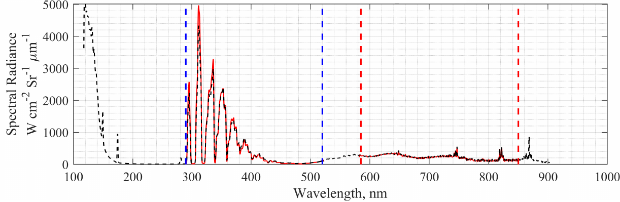
Example Spectral Fits and Physical Properties
Equilibrium
Relaxing
Immediate
post-shock
Physical properties of constrained and unconstrained spectral fitting, calculated via OCEAN.
Spectral fits from constrained routine.

Slide 25
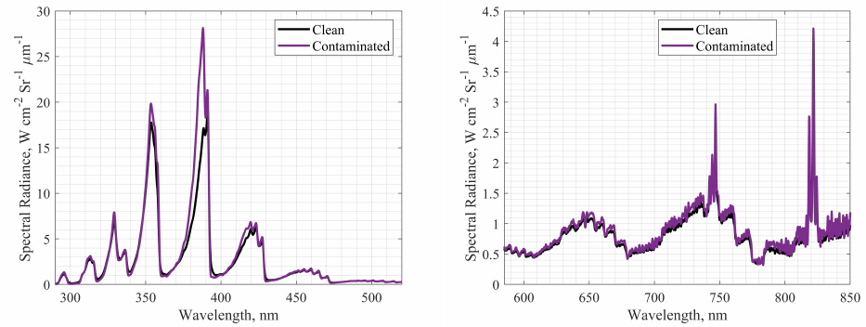
Experimental Artefacts: Contaminants
Repeated NESS-NEQAIR simulation but included 12 contaminants in simulation
Do they influence our ability to extract correct information for species of interest?
Timescales to run for all contaminant species will take too long…
UV/Vis
Vis/NIR
Effect of including contaminants in equilibrium spectra

Slide 26
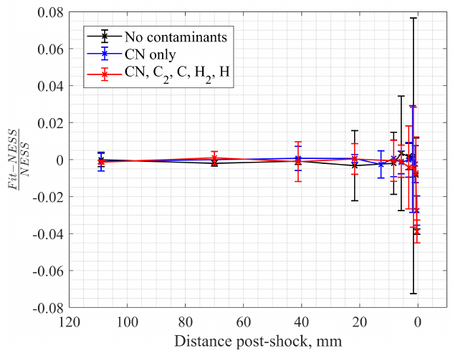
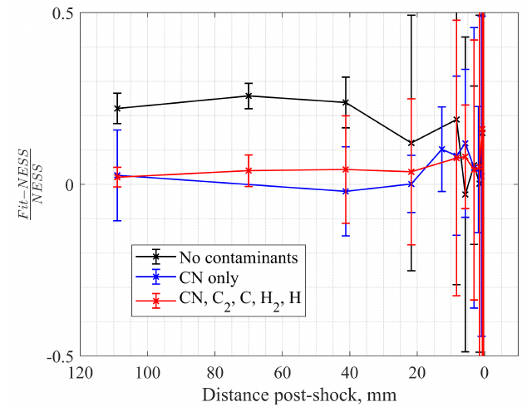
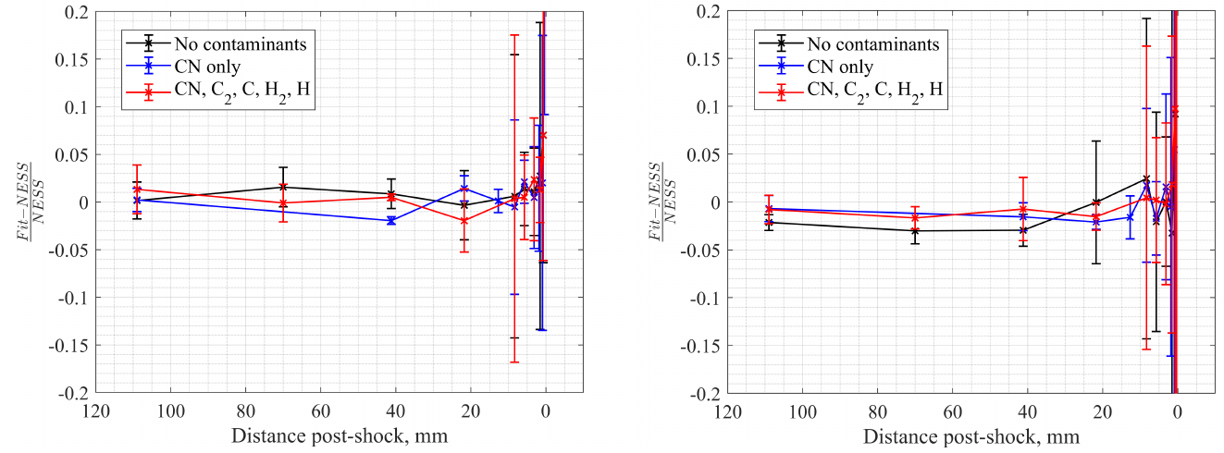
Experimental Artefacts: Contaminants
Ran constrained spectral fitting for N2, N, N2⁺, N⁺, E- and:
No contaminants
CN
CN, C2, C, H2, H
N2⁺ improved by including CN
Don’t need to include other contaminants to capture species of interest well
Tve
N2⁺
N2
N

Slide 27
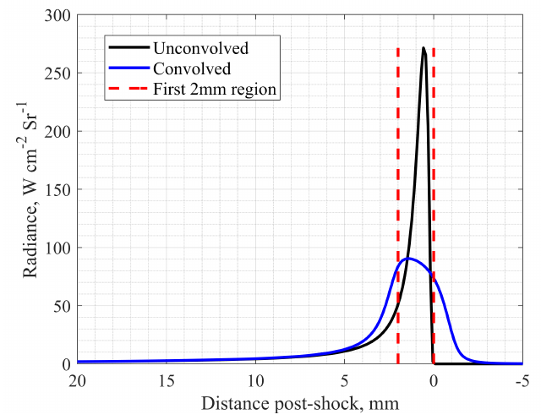
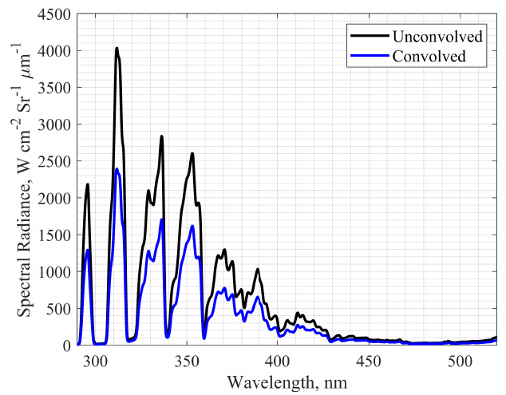
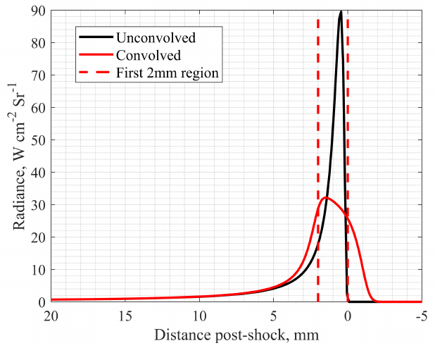
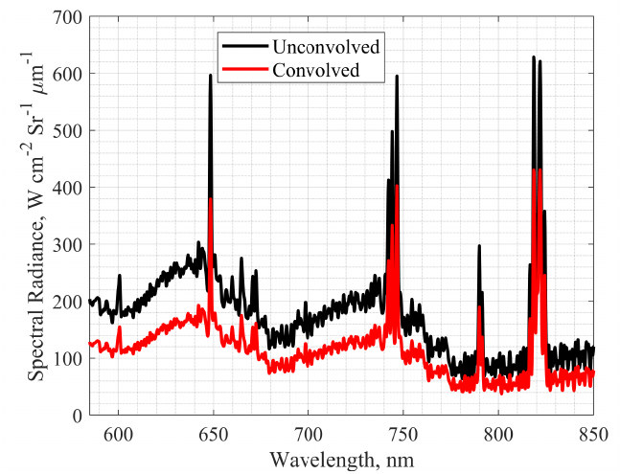
Experimental Artefacts: Spatial Smearing
Spatial smearing occurs from:
  Shock motion
  Camera
  Optics
Applied Spatial Resolution Functions to NESS-NEQAIR profiles
Signal removed from immediately behind the shock
Want a way to account for this…
UV/Vis radiance profiles
UV/Vis Non-Eq. Spectra
Vis/NIR radiance profiles
Vis/NIR Non-Eq. Spectra

Slide 28
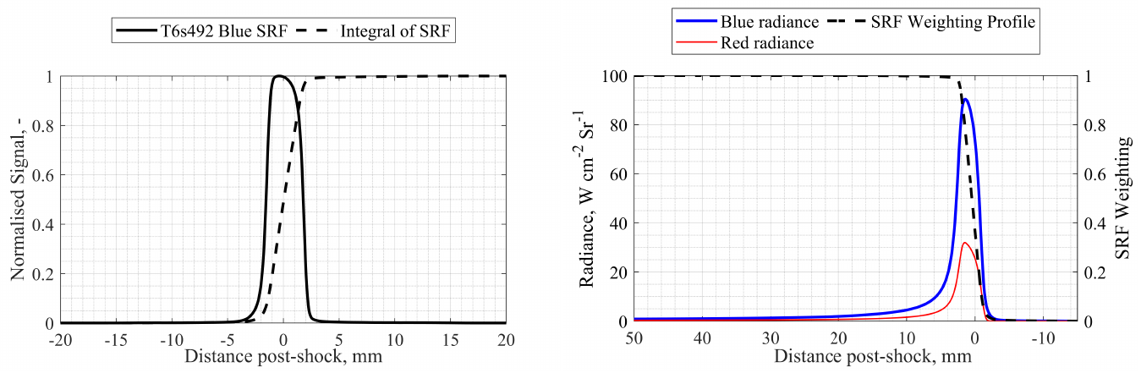
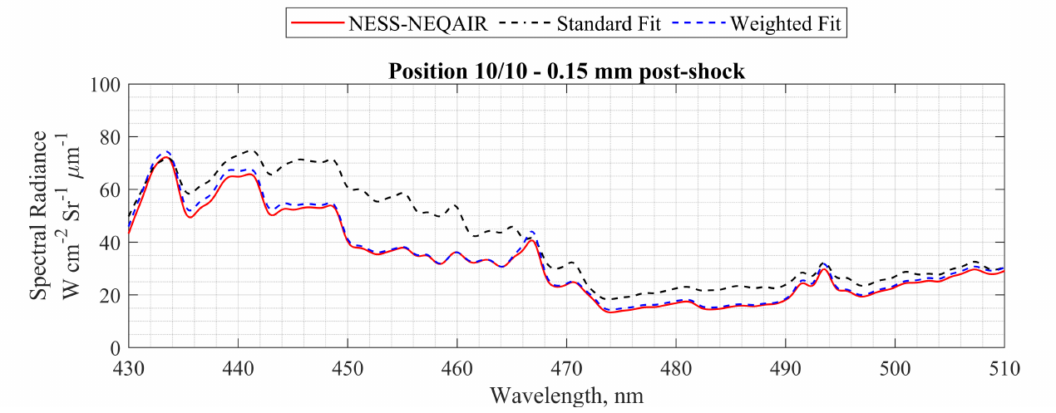
Experimental Artefacts: Spatial Smearing
Cumulative integral of the SRF function used to approximate a scale factor for spectral radiance
Spectral fitting immediately behind shock front improves
Example SRF Profile to generate weighting profile
Positioning relative to radiance profiles
Improvement in spectral fitting immediately behind shock

Slide 29
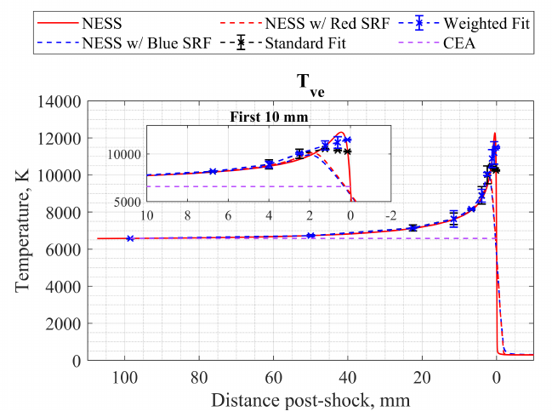
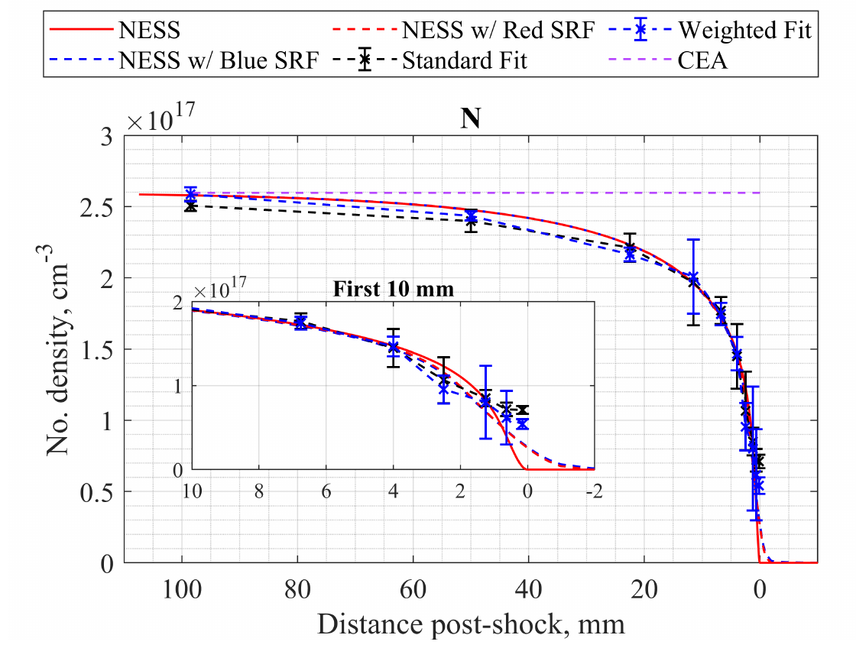
Experimental Artefacts: Spatial Smearing
Profiles extracted by constrained spectral fitting with and without SRF weighting applied
Improves Tve in first ~2/3mm behind shock
Varies with size of SRF
Simulations have shown agreement improves as the camera gate function is reduced

Slide 30
Side Note – Can feed the routine more data!
Results from feeding routine with the NESS E- number density profile
Opportunities to expand the code
Not limited to current dataset!
Can identify other valuable measurements from shock tube experiments

Slide 31
EAST Data

Slide 32
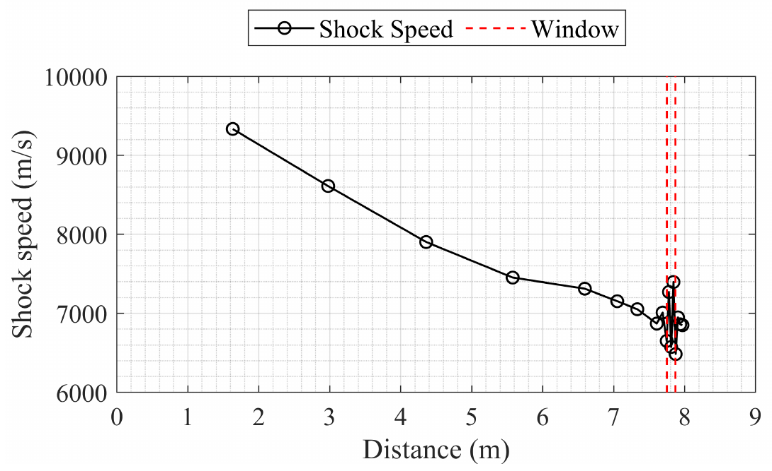
Application to Real Data: EAST-62-40
6.88 km/s, 26.6 Pa in pure nitrogen
Spectral fitting results from Tibère-Inglesse and Cruden available for comparison
Comparison vibrational temperatures extracted from EAST-62-40 via alternate spectral fitting methodologies
EAST-62-40 shock speed profile
Sample number density profiles corresponding to constrained fit results

Slide 33
T6 AST Data

Slide 34
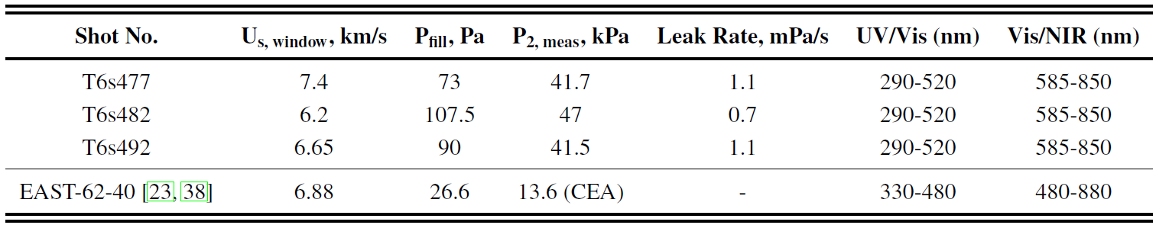
Include T6 AST Data: Pure Nitrogen Shots
Shock speed profiles of selected shots
UV radiance profiles of selected shots

Slide 35
Example Spectral Fits of Real Data: T6s492, 6.65 km/s
End of observed test slug (~110 us)
Relaxing test slug (~20us)
Reasonable fits attained through all portions of the test slug
Predictions in wavelength regions not captured possible via NEQAIR simulation
Peak non-equilibrium (~5us)

Slide 36
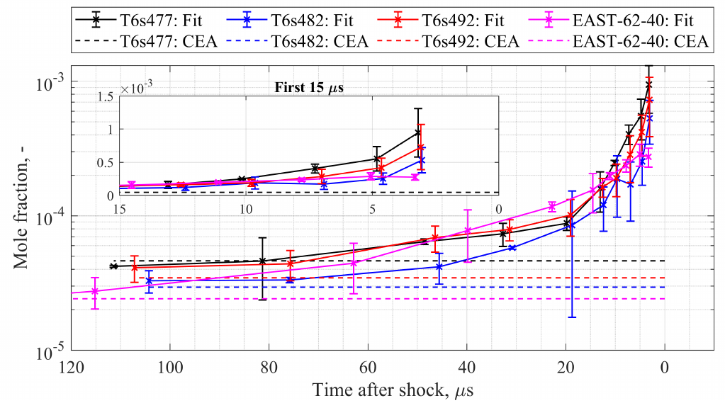
Real Data: Temperatures
Tve
N2⁺ mole fractions through test slugs

Slide 37
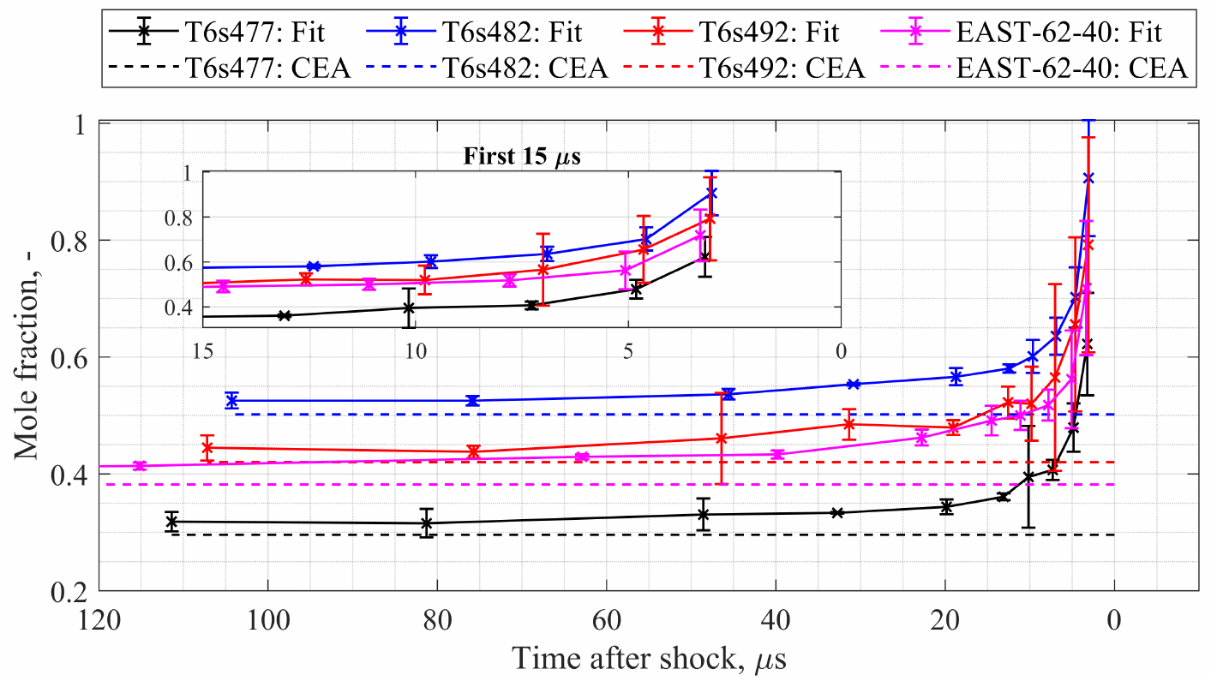
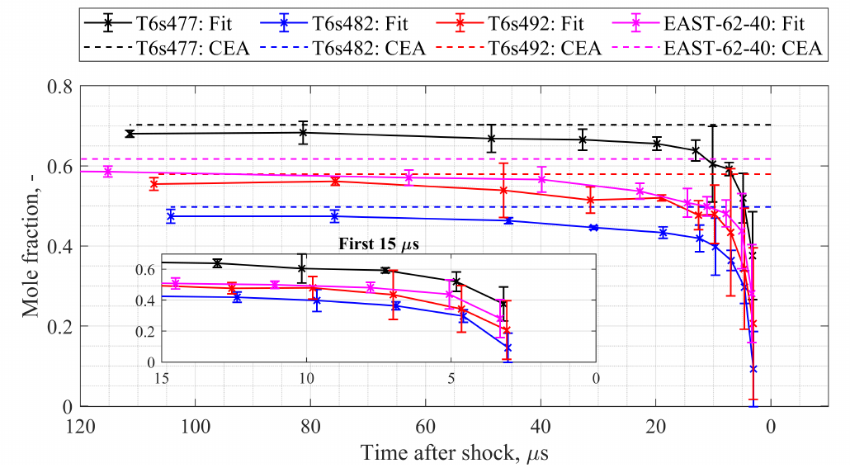
Real Data: N2 and N
N2 mole fractions through test slugs
N mole fractions through test slugs

Slide 38
Conclusions and Further Work
Constrained spectral fitting routine developed
  Conserve mass, momentum and energy through test slug
Validated against artificial data
  Incorporated contaminants and spatial smearing correction
Applied to real shock tube data and compared to previous spectral fitting attempts
Next steps (in the very near future):
  Implement shock deceleration effects
  Trial for higher and lower resolution spectra
  Run for new synthetic air test data

Slide 39
Thank you!

