Slide 1
Emission spectroscopy of ablative heat shield shock layers for earth entry in the T6 free piston driven shock tube
RHTG 2024
PI: Matthew McGilvray
Key Researchers: Aaron Kennedy, Alex Glenn
Date: 12th Sep 2024

Slide 2
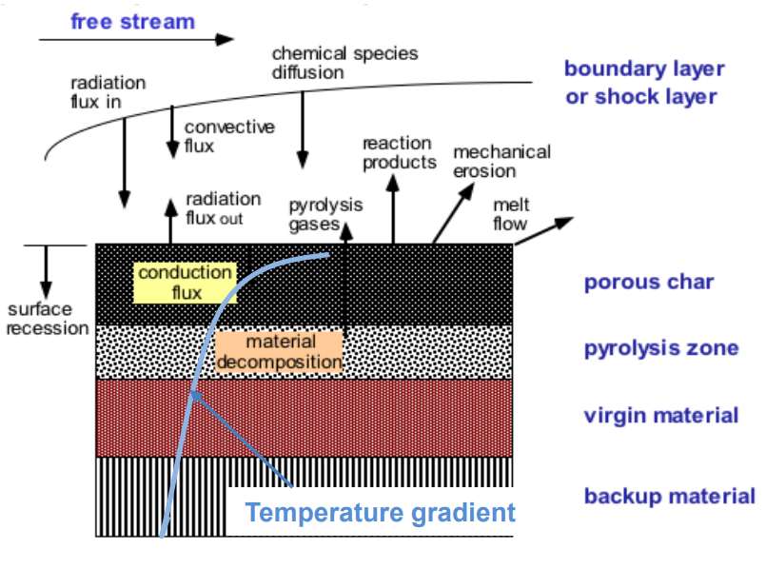
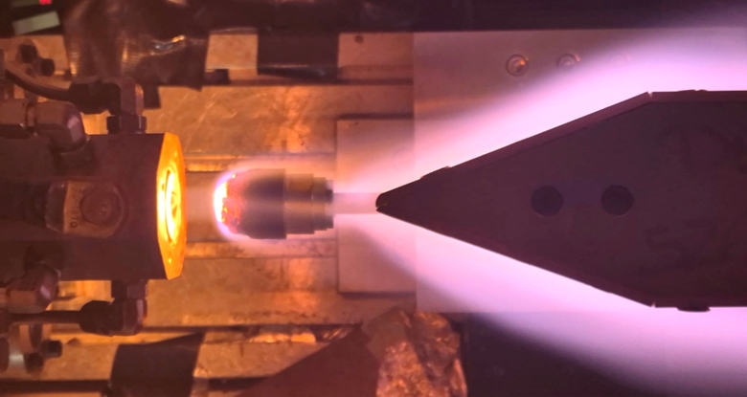
Background
Need for project
Ablative TPS’s are a common in low earth entry missions
Shock Tube facilities allow us to analyse post shock conditions/chemistry found in a shock layer
How does the presence of pyrolysis gas elements effect the post shock radiation?
Diagram showing the layers of an ablative TPS during the ablation process [1]
Osney Plasma Generator (OPG) testing an ablator.

Slide 3
Our Objectives
Create a dataset with emission spectra for CO2 and H2 doped air
2 different premixed gasses
Collect Emission Spectra in:
UV/Vis aka ‘Blue’ 210 nm – 450 nm
Vis/NIR aka ‘Red’ 600nm – 850 nm
Data intended for validation

Slide 4
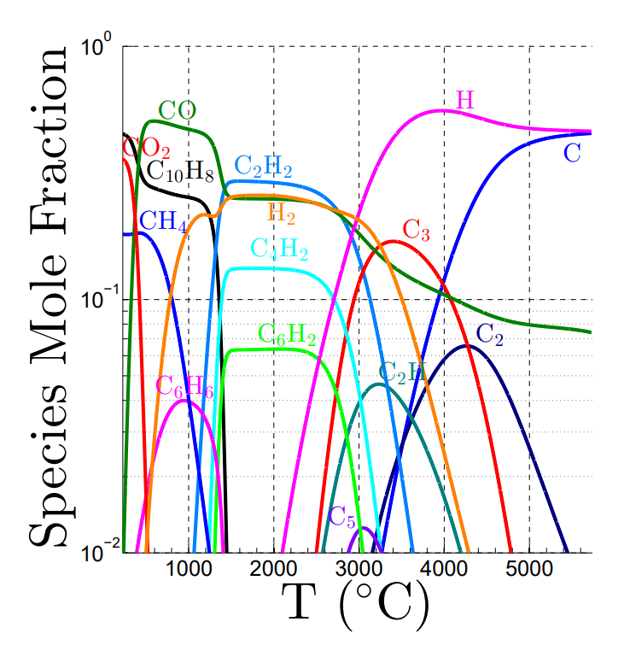
Facility Setup T6 AST
Test Gas mixtures
Free piston driven multimode facility
T6 configured in Aluminium shock tube mode
2 primary test gases designated ABL-1 & ABL-2
ABL-1 = 2% CO2, 2% H2, 20.9% O2 plus 75.1% N2
ABL-2 = 20% CO2, 2% H2, 16.4% O2 plus 61.6% N2
2x spectrometers positioned at the end of the shock tube
Mole Fractions of species in pyrolysis gas of a phenolic ablator [Rabinovitch, J. et al. 2014]

Slide 5
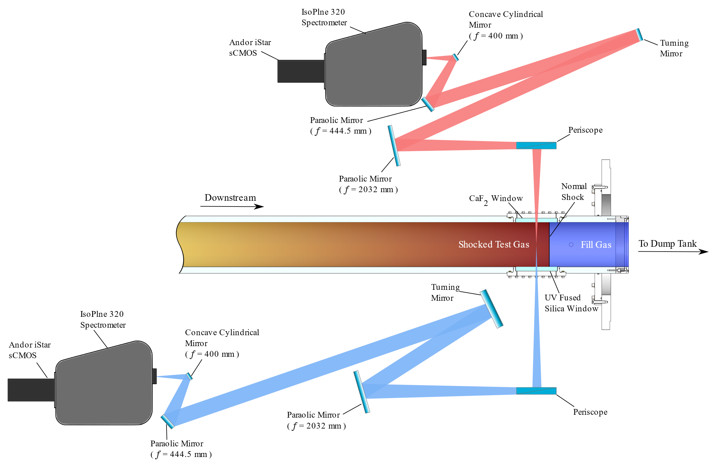
Facility Setup
2x Isoplane 320 Spectrometers
‘Red’ and ‘Blue’ optical sides looking at red and blue wavelengths respectively
Calibrations
Wavelength Cal via Intelical ‘Hg’ source
Spatial Calibration (calibration plate)
Intensity calibration via integrating sphere and D2 lamp

Slide 6
AST Data

Slide 7
Conditions Achieved
20% CO2
shot Number | Actual SS | St fill (Pa) | Post shock P | Post shock P CEA (kPa)
503 | 7127.063 | 32.992 | 20 | 19.833
504 | 5877.027 | 105.6 | 40 | 42.666
506 | 9848.11 | 13.459 | 15 | 15.33
513 | 6994.44 | 72.414 | 40 | 41.877
2% CO2
500 | 7012.72 | 73.128 | 40 | 38.685
507 | 9824.313 | 13.392 | 15 | 13.801
509 | 7080.305 | 33.407 | 20 | 18.062
512 | 5975.495 | 104.726 | 40 | 39.853
Synth Air
499 | 9969.393 | 13.325 | 15 | 14.21
508 | 5930.568 | 104.768 | 40 | 39.551
3 different test gases
3 main Shock speeds
3 different Post shock P’s
A lot of data for comparison!

Slide 8
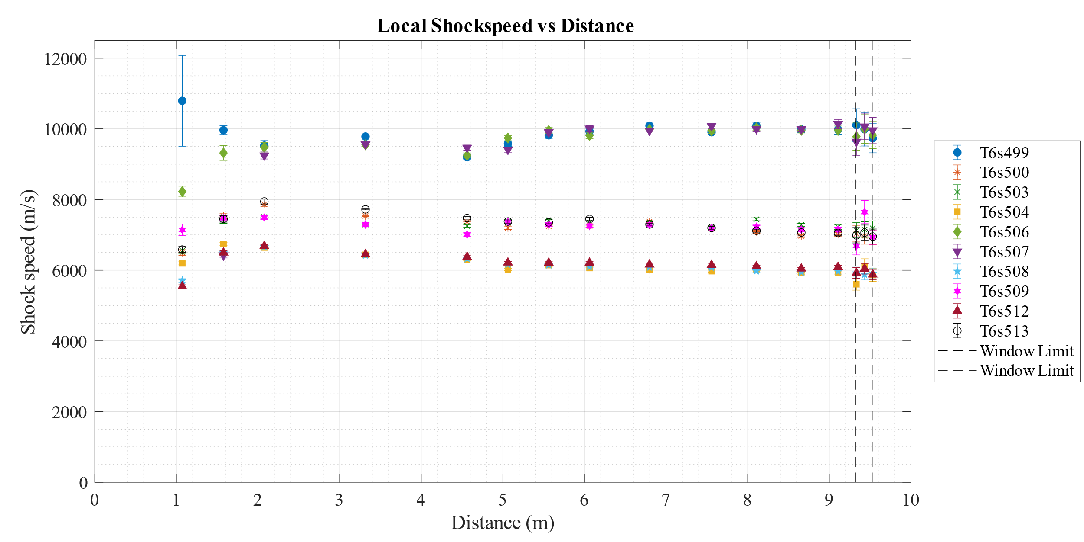
Shock Speeds
Shock speeds looking consistent between shots and test conditions
3 shock speeds at the window:
≈9.9 km/s
≈7.1 km/s
≈5.9 km/s

Slide 9
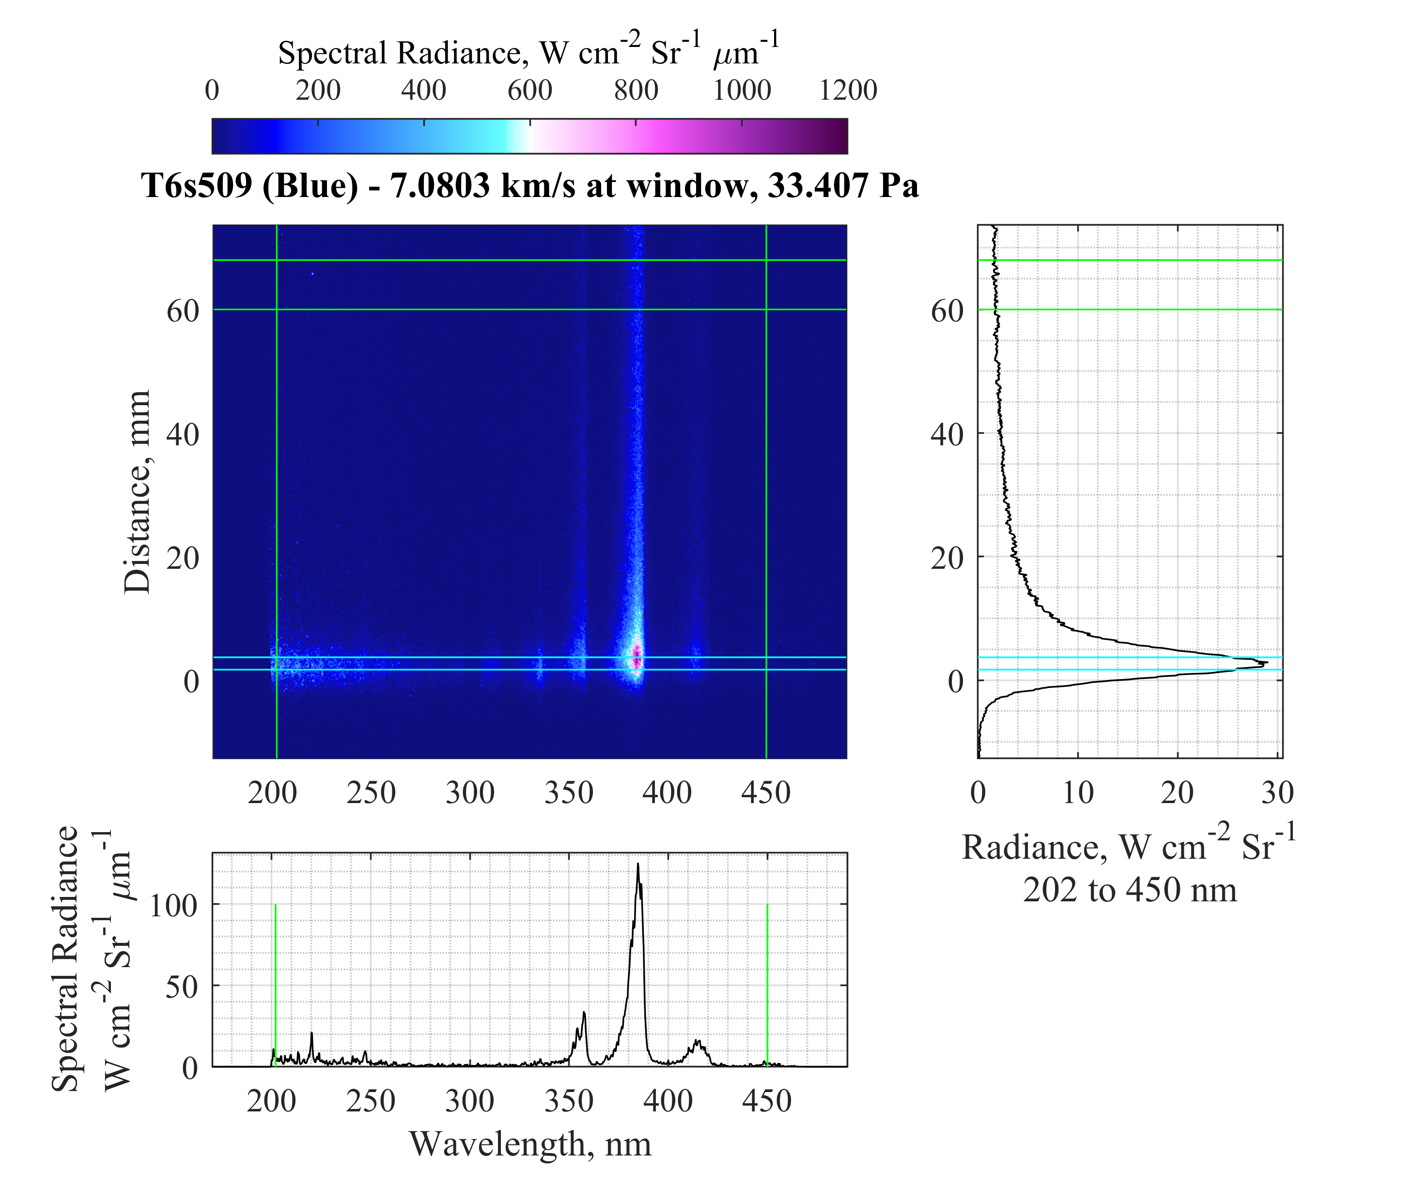
Non-EQ Peak Radiance vs Relaxed radiance Sampling
Example data showing the sampling of peak and relaxed regions of radiance
Following data will compare these two regions for multiple shots

Slide 10
Data Contents
Comparisons of Spectra at similar Speeds and Post Shock Pressures (Effect of Gas Mixture)
5.9 km/s & 40 kPa
7.1 km/s & 20 kPa
9.8 km/s & 14 kPa
Comparison of Spectra of similar Speeds and Gas mixture (Effect of Post shock P)
Comparison of Spectra of similar Post shock P and Gas mixture (Effect of Shock Speed)

Slide 11
Data Contents
Comparisons of Spectra at similar Speeds and Post Shock Pressures (Effect of Gas Mixture)
5.9 km/s & 40 kPa
7.1 km/s & 20 kPa
9.9 km/s & 15 kPa
Comparison of Spectra of similar Speeds and Gas mixture (Effect of Post shock P)
Comparison of Spectra of similar Post shock P and Gas mixture (Effect of Shock Speed)

Slide 12
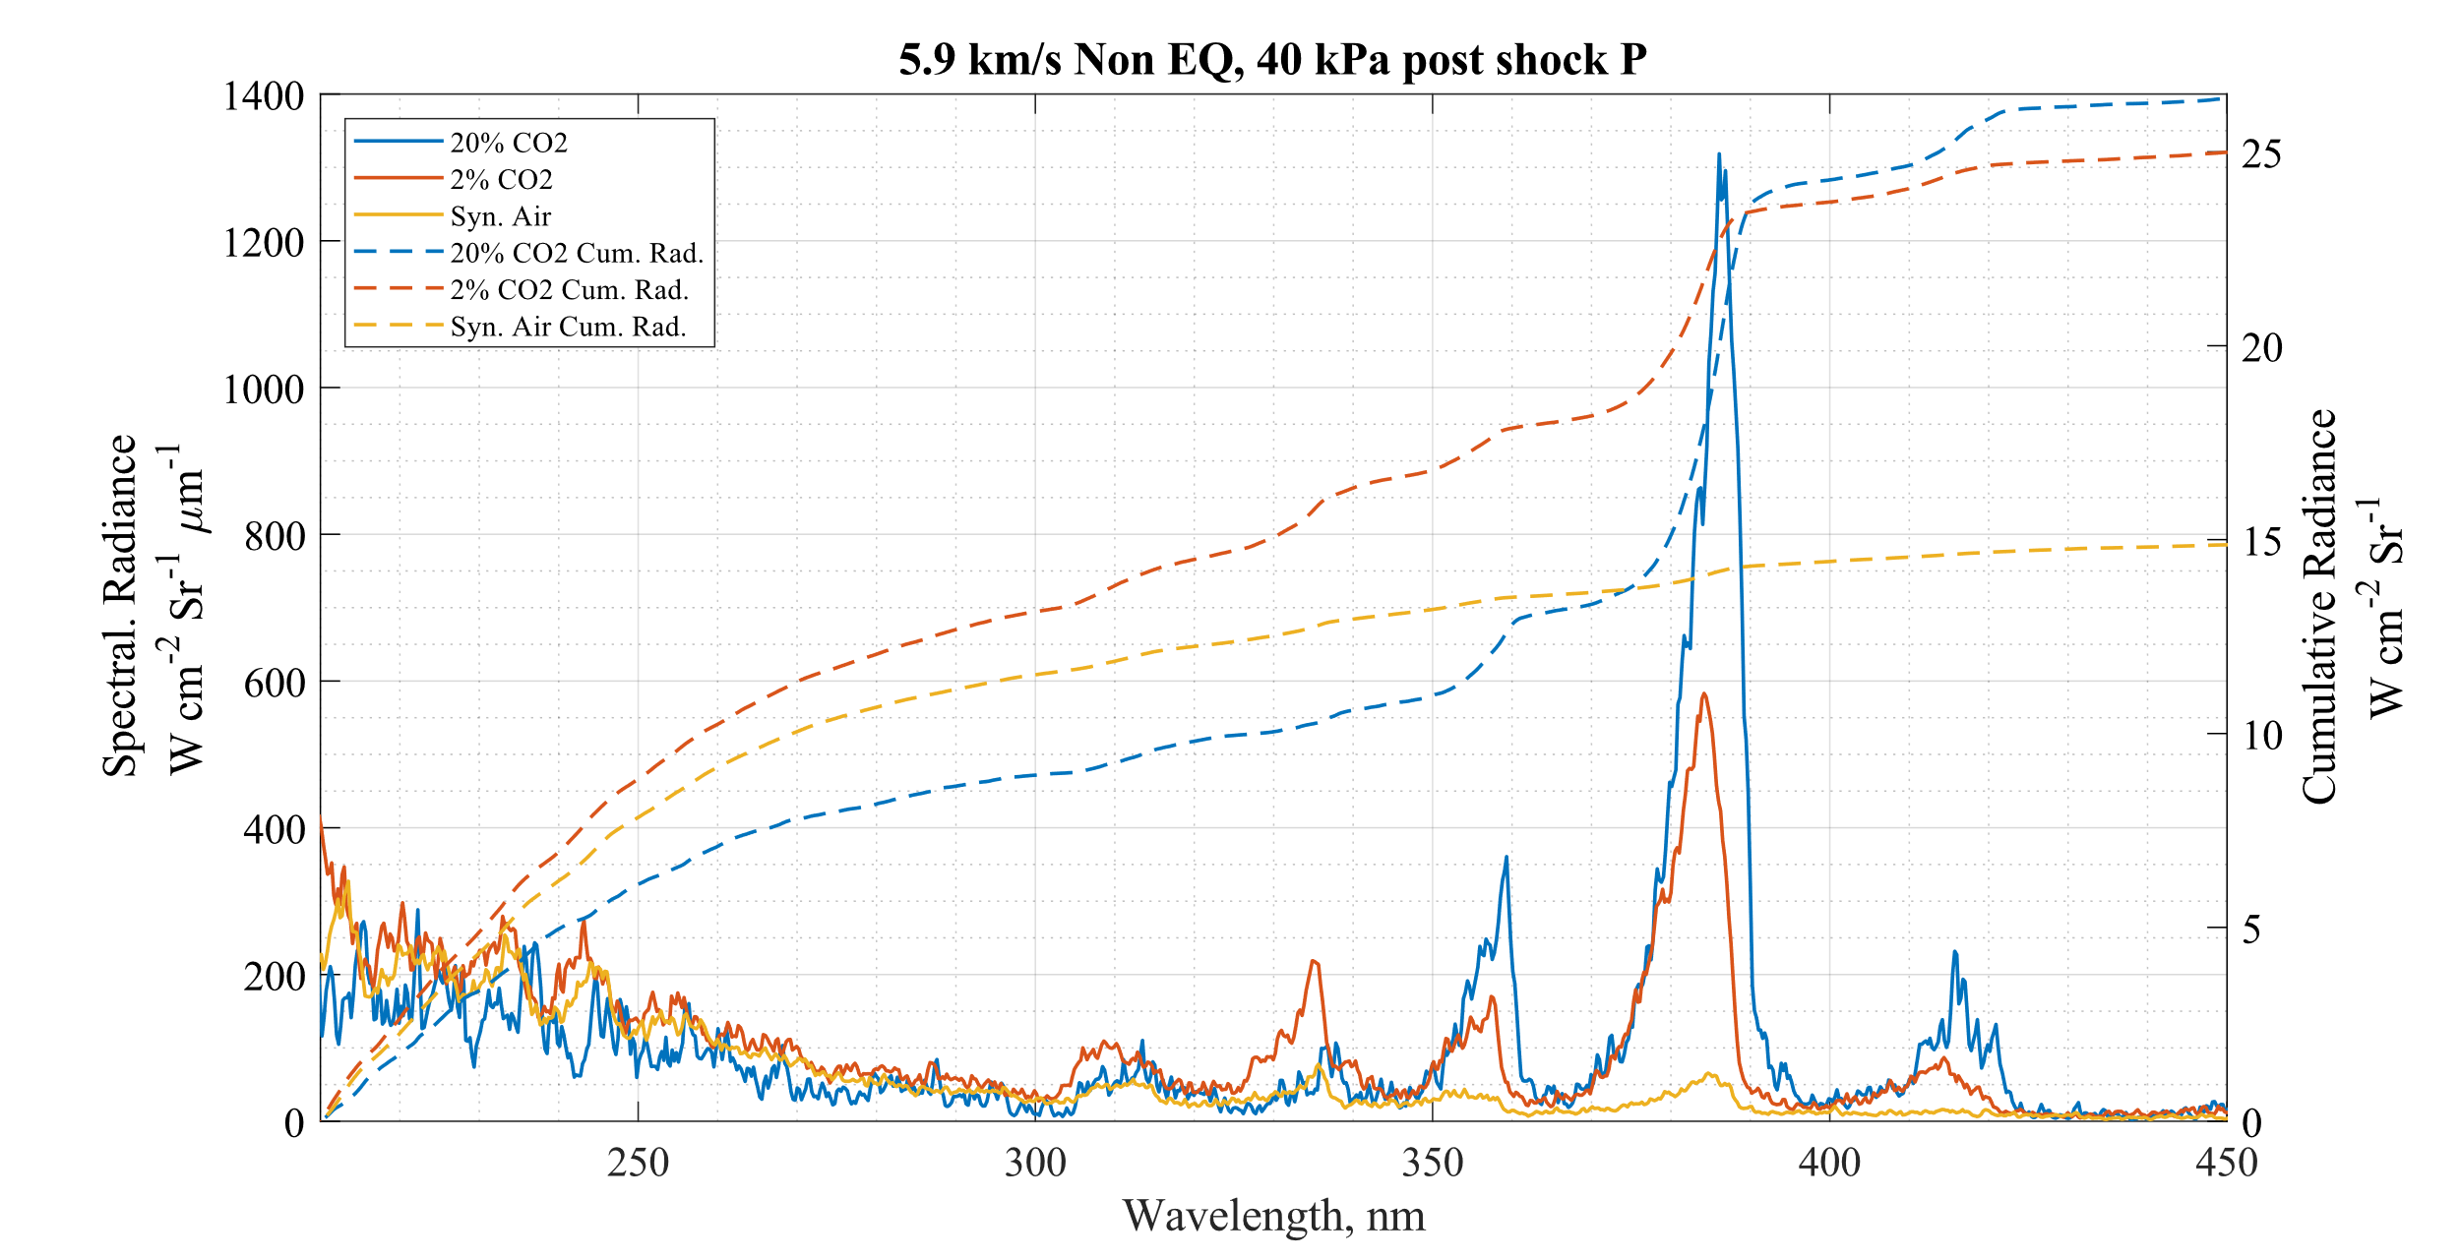
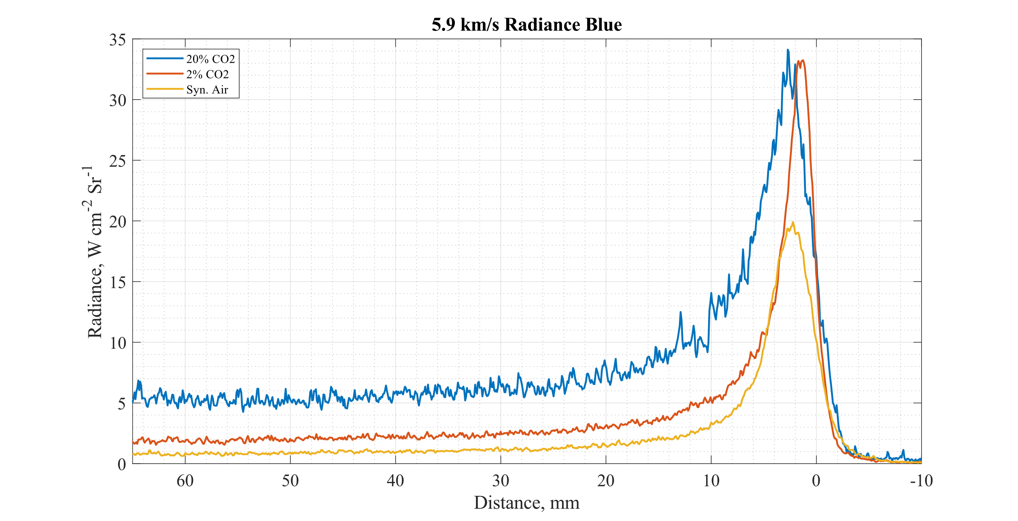
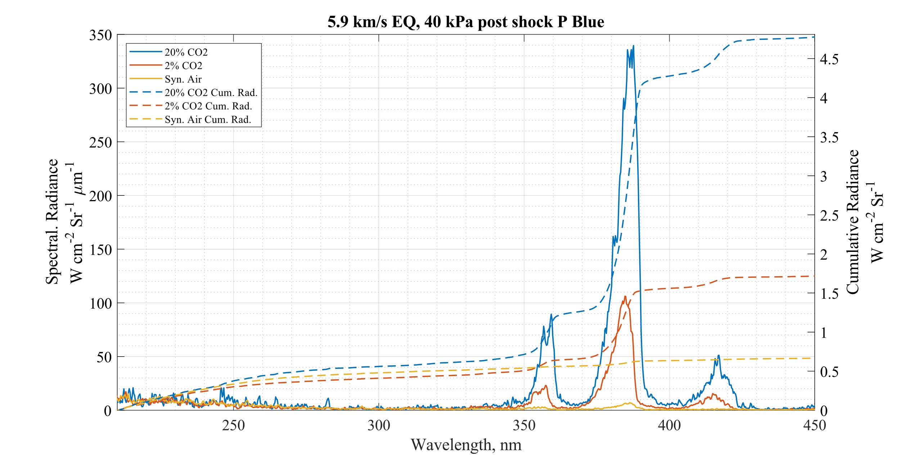
Effect of Gas Comp.≈5.9 km/s & 40 kPa Post Shock
CN
CN
CN
1.Lots of CN dominating spectra.
2. In peak radiance region highest cumulative radiance from 2% CO2 gas followed by Air then by CO2% in lower wavelengths
BLUE

Slide 13
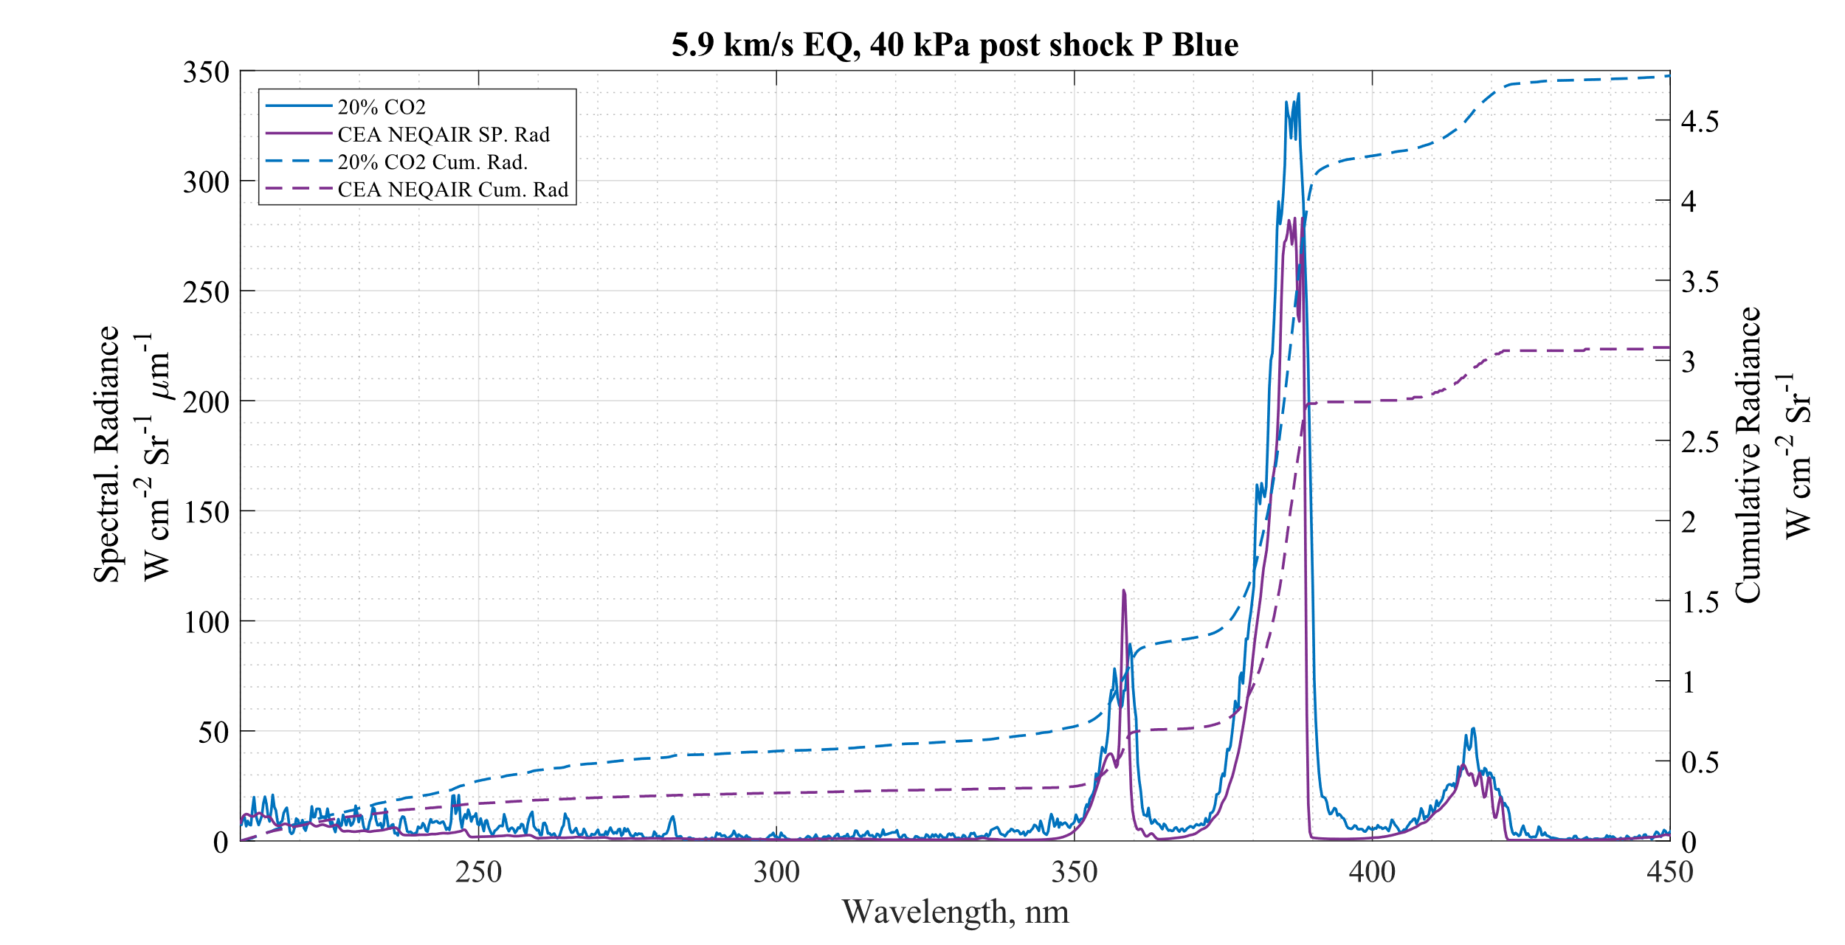
Effect of Gas Comp.≈5.9 km/s & 40 kPa Post Shock
CEA Species | Numb. Density (/cm³) | Mole Frac. %
e- | 1.02E+14 | 0.02%
C | 1.87E+15 | 0.35%
CN | 2.17E+14 | 0.04%
CO | 6.92E+16 | 12.98%
CO2 | 1.09E+13 | 0.00%
H | 1.42E+16 | 2.67%
N | 7.87E+16 | 14.75%
NO | 2.86E+15 | 0.54%
NO+ | 9.27E+13 | 0.02%
N2 | 1.79E+17 | 33.51%
O | 1.87E+17 | 35.10%
OH | 2.21E+13 | 0.00%
O2 | 1.05E+14 | 0.02%
$ρ_{EQ}$ (kg/m³) | Post Shock Eq. T (K)
1.8568E-2 | 5792
1.Quick CEA-NEQAIR comparison with 20% CO2 spectra.
Replicated the features reasonably well.
Underpredicting peak radiance at the moment.
Also divergence in Cumulative radiance.
Need to verify NEQAIR setup before any conclusions taken from this.
BLUE

Slide 14
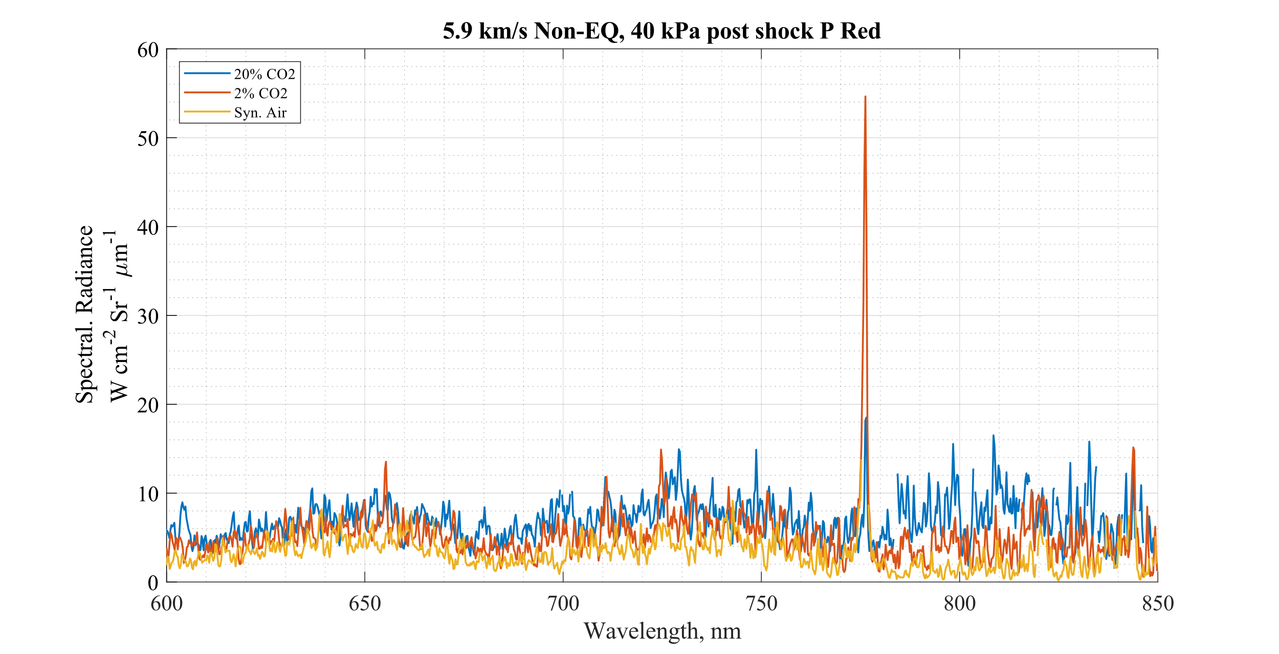
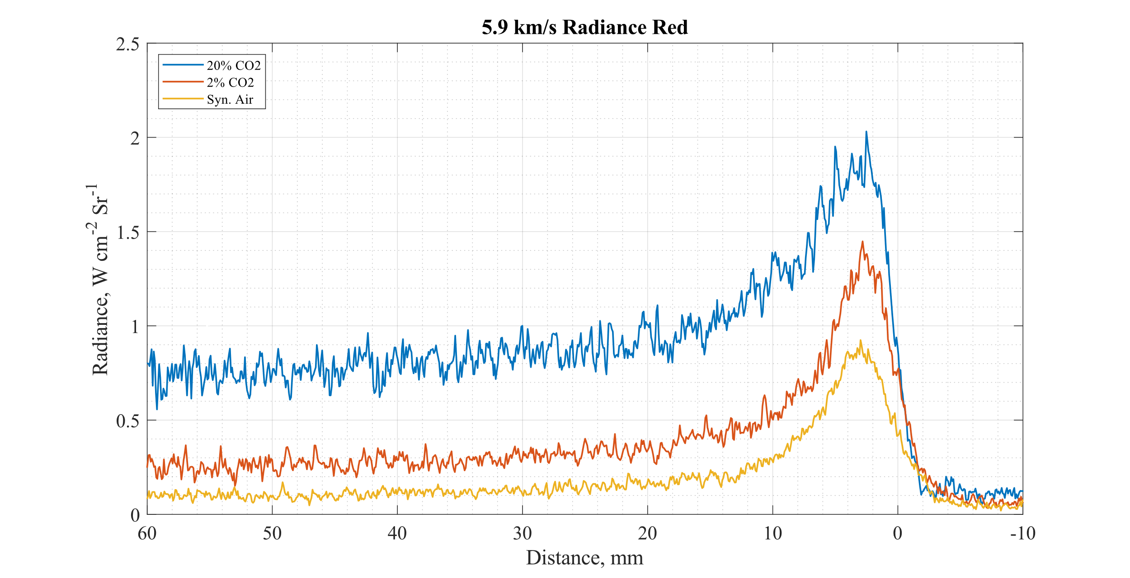
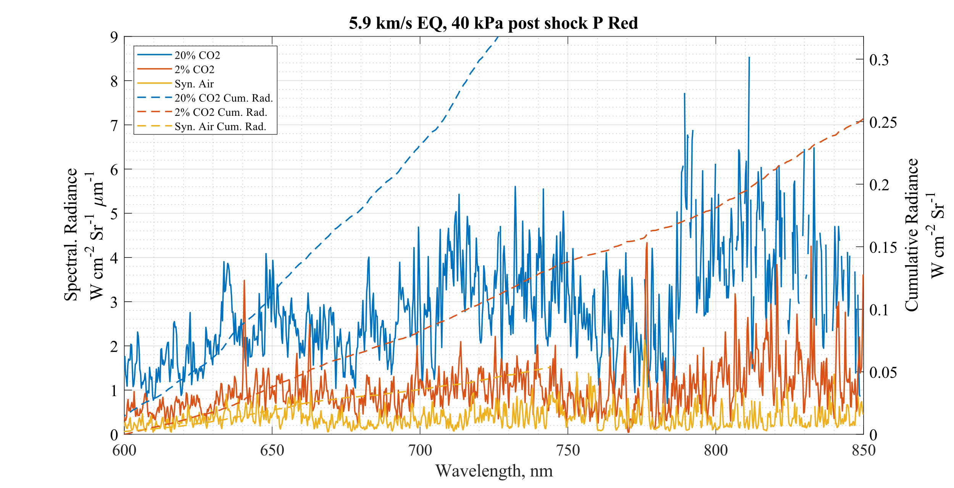
Effect of Gas Comp.≈5.9 km/s & 40 kPa Post Shock
O
H-α
O
1. ‘O’ 777nm line most prominent in the 2% CO2 gas
2. ‘H-α’ line peeking through in Non-Eq 2% CO2 spectra
3. Relaxed region dominated by the CN waves from the 20% CO2 mixture
4. Lots of noise coming from the 2 ablation mixtures despite identical camera settings.
O
RED

Slide 15
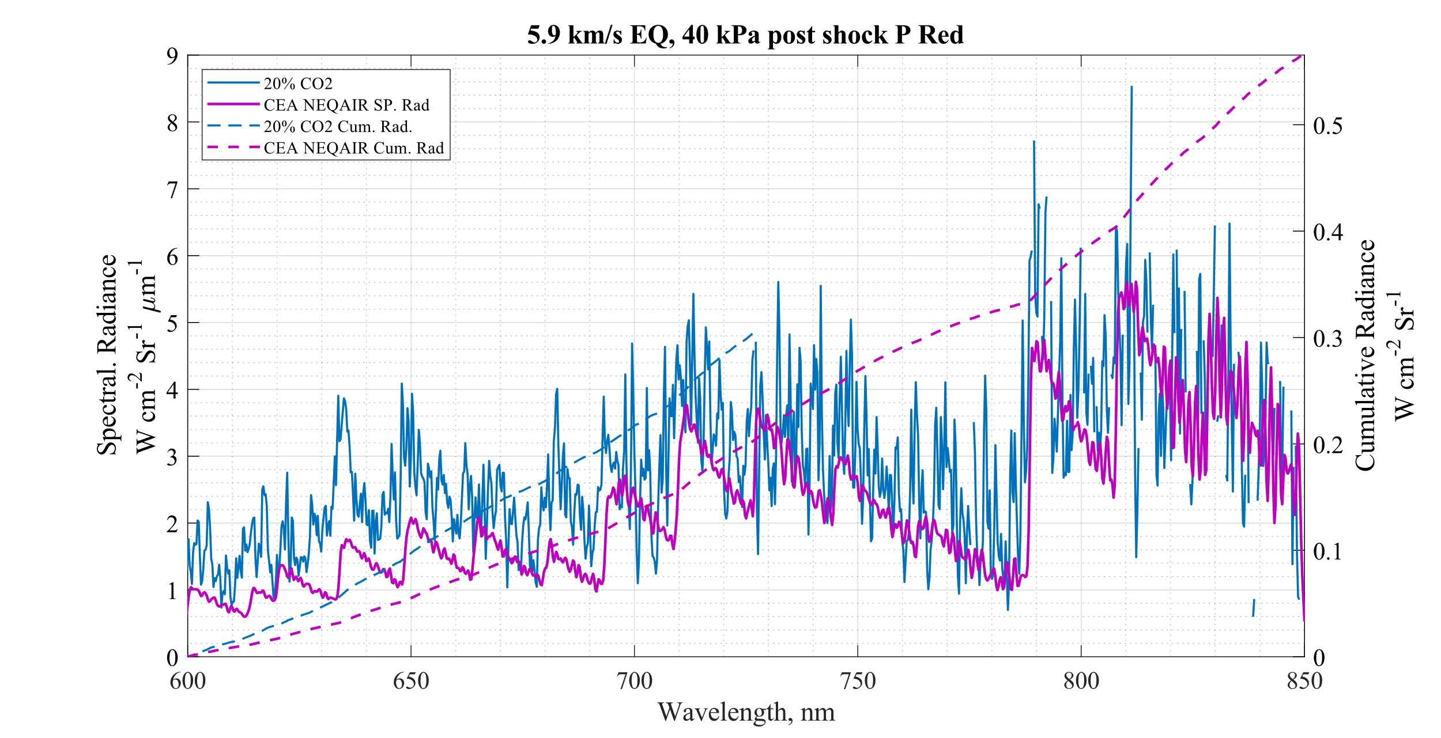
Effect of Gas Comp.≈5.9 km/s & 40 kPa Post Shock
Again replicating the features reasonably well.
Underpredicting spectral radiance across the ‘red’ spectral region.
Also divergence in Cumulative radiance.
Again need to verify NEQAIR setup before any conclusions taken from this!
RED

Slide 16
Data Contents
Comparisons of Spectra at similar Speeds and Post Shock Pressures (Effect of Gas Mixture)
5.9 km/s & 40 kPa
7.1 km/s & 20 kPa
9.8 km/s & 14 kPa
Comparison of Spectra of similar Speeds and Gas mixture (Effect of Post shock P)
Comparison of Spectra of similar Post shock P and Gas mixture (Effect of Shock Speed)

Slide 17
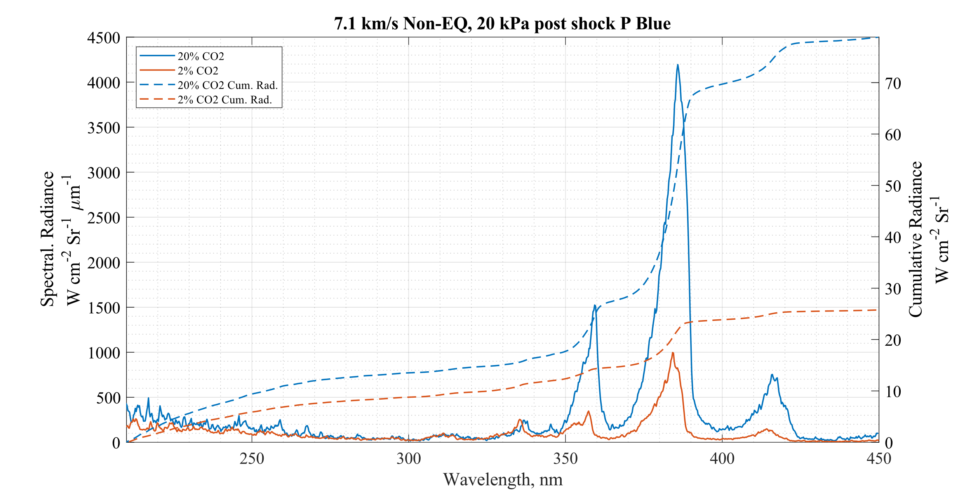
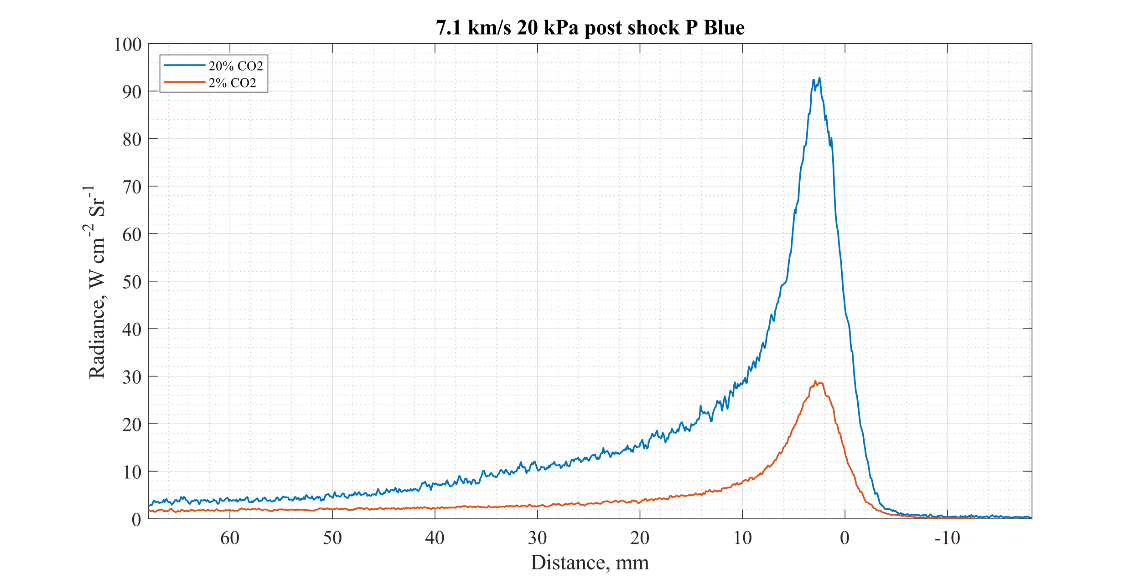
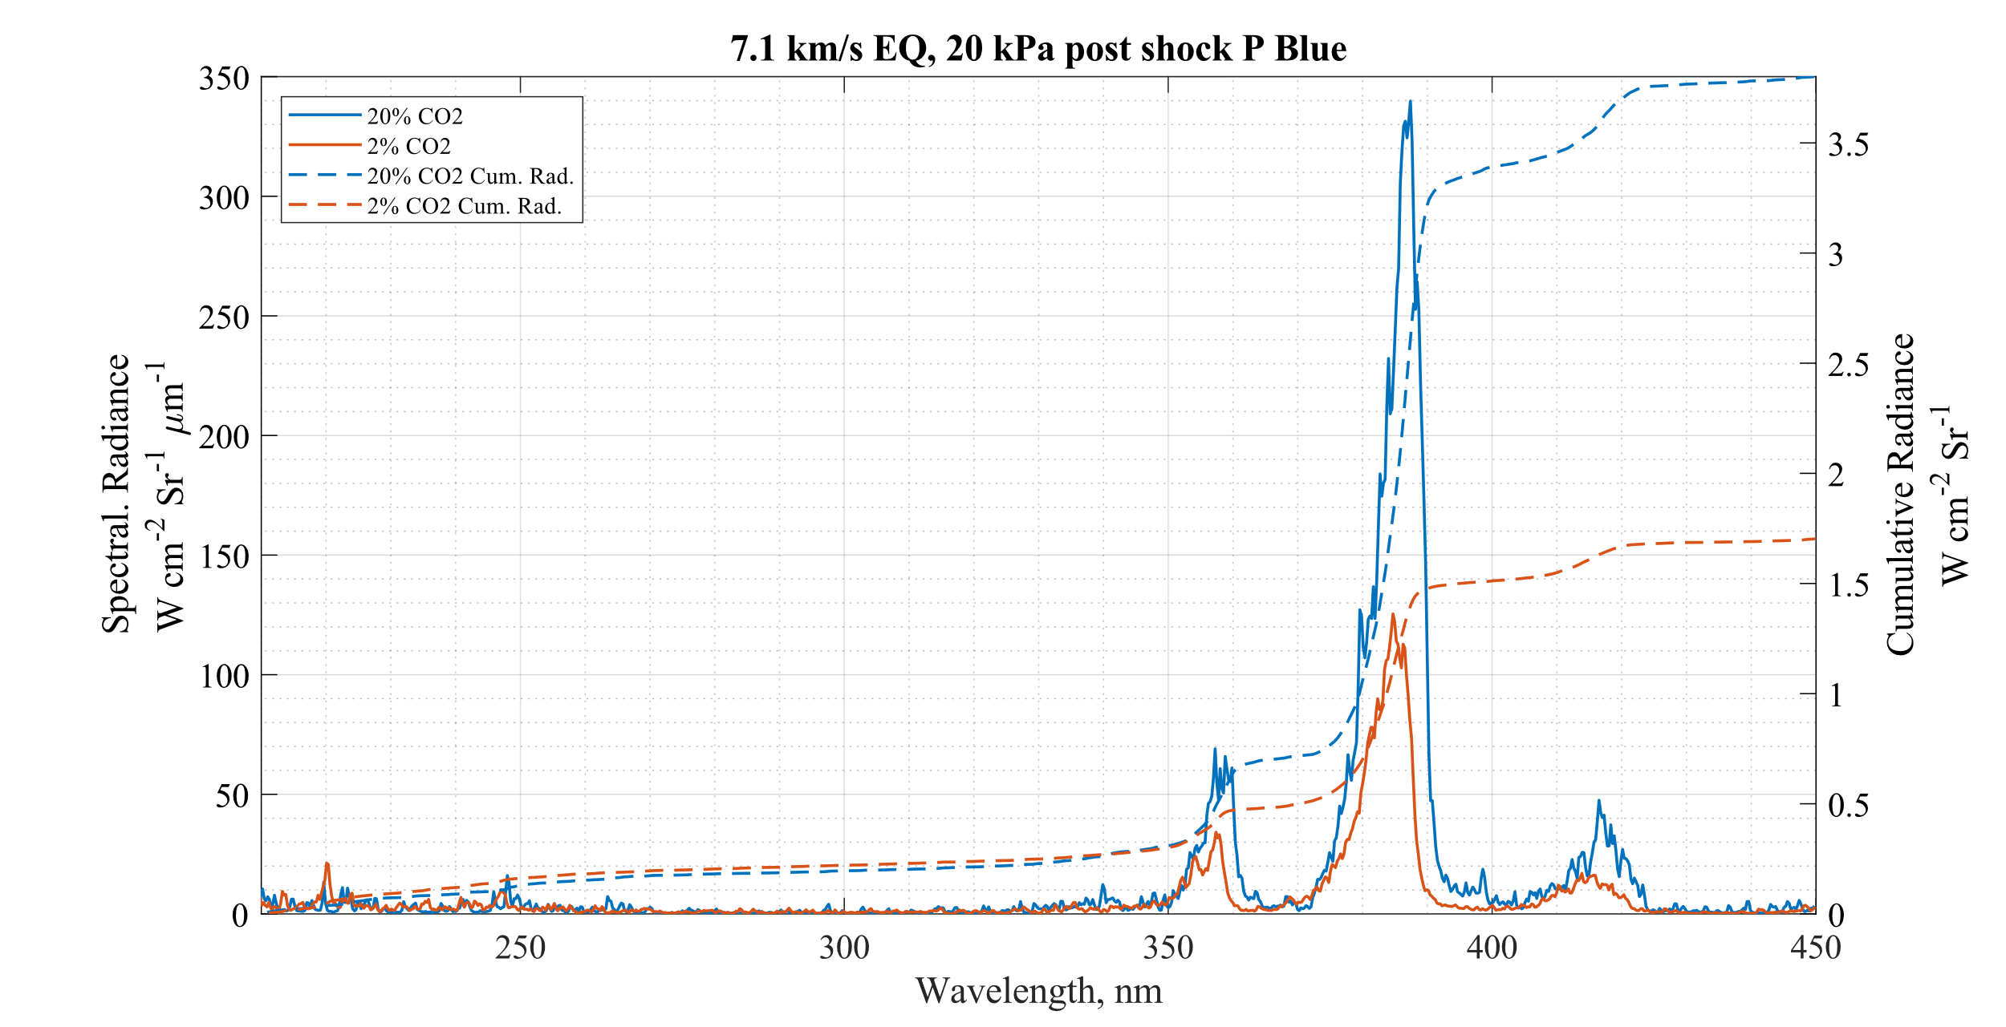
Effect of Gas Comp.≈7.1 km/s & 20 kPa Post Shock
1. Lots of CN dominating spectra.
2. ‘NO’ and ‘CO’ from the 2% CO2 less pronounced in this dataset.
3. In relaxed region, both spectra seem to have similar levels of radiance in lower wavelengths.
4. 20% seems to take a long time to relax possibly due to CN.
BLUE

Slide 18
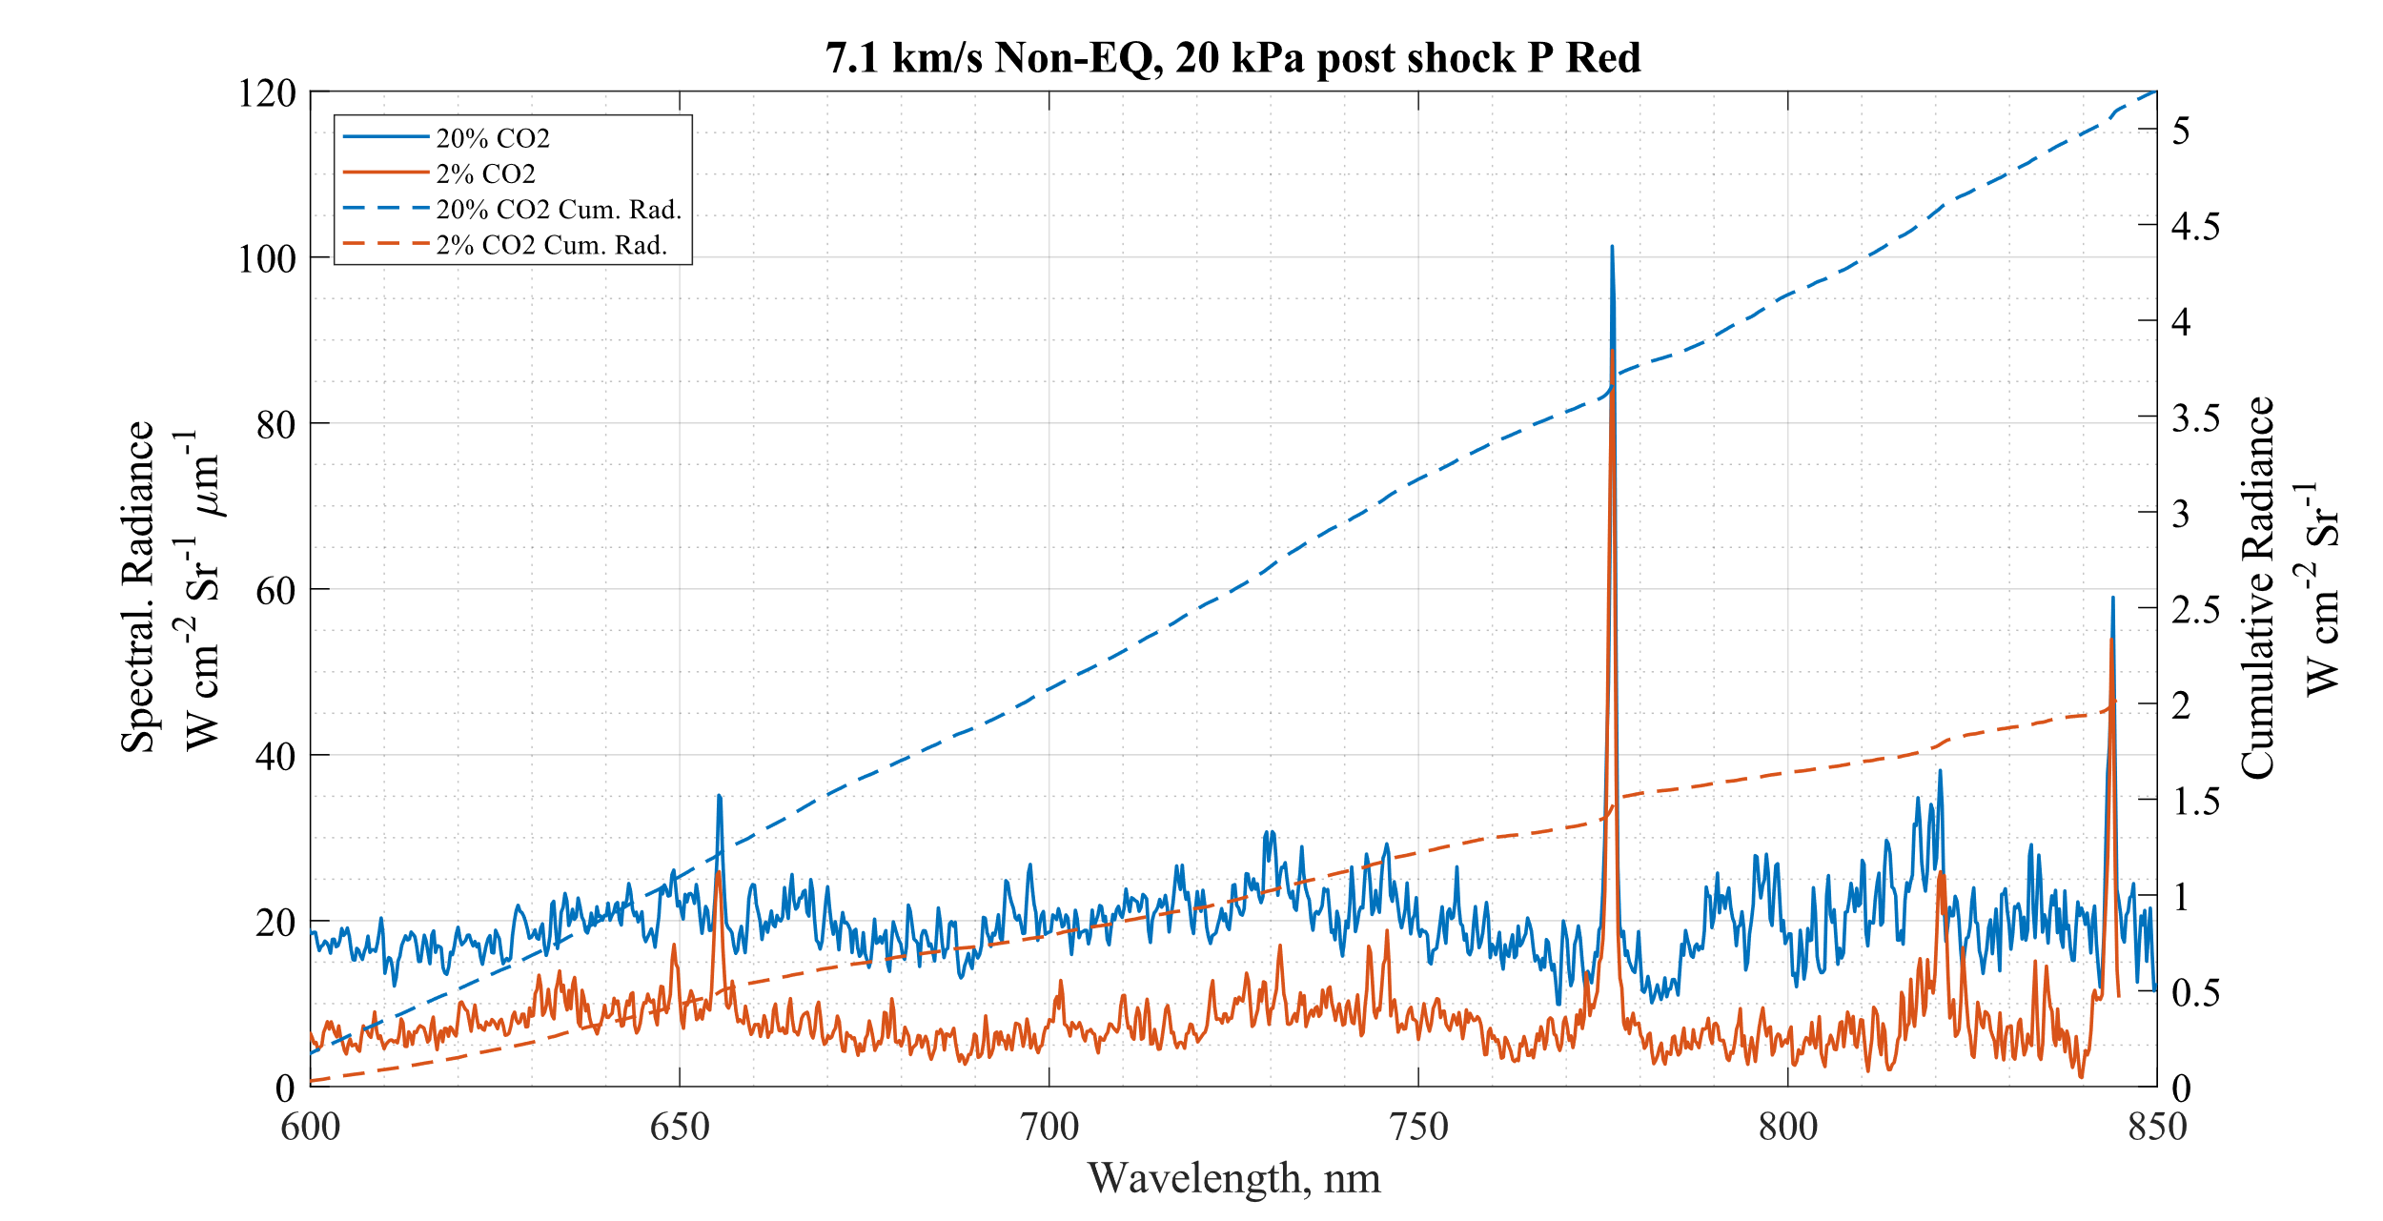
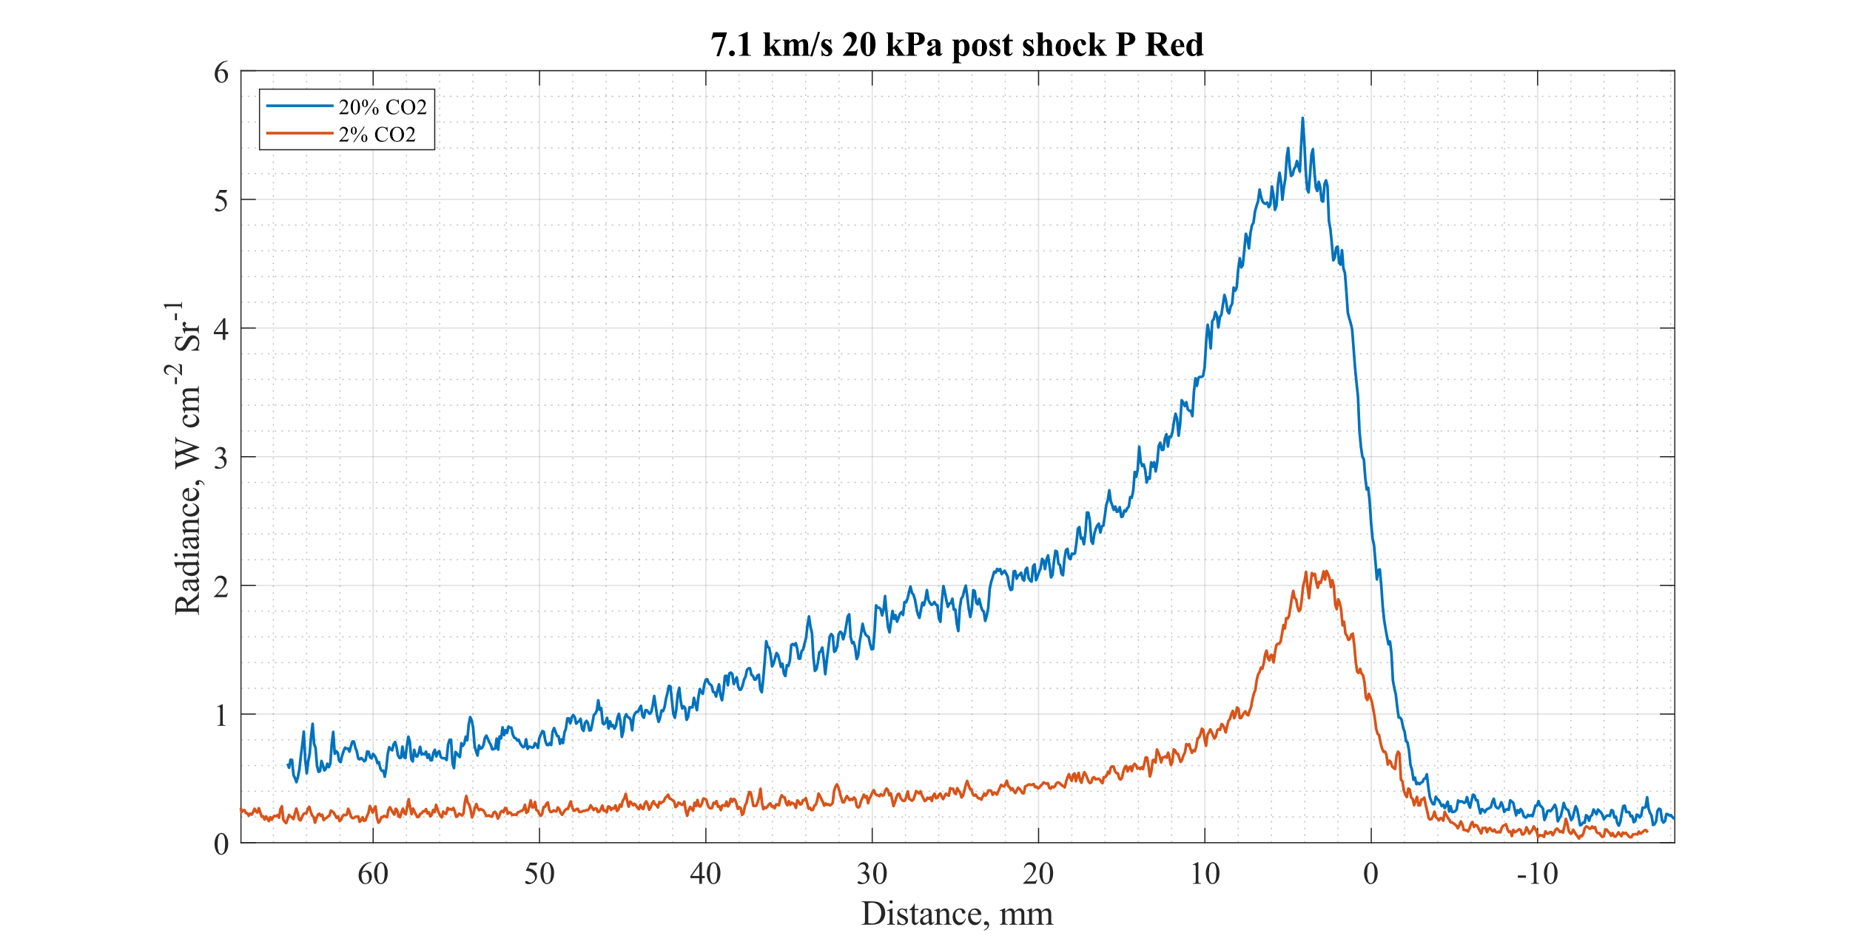
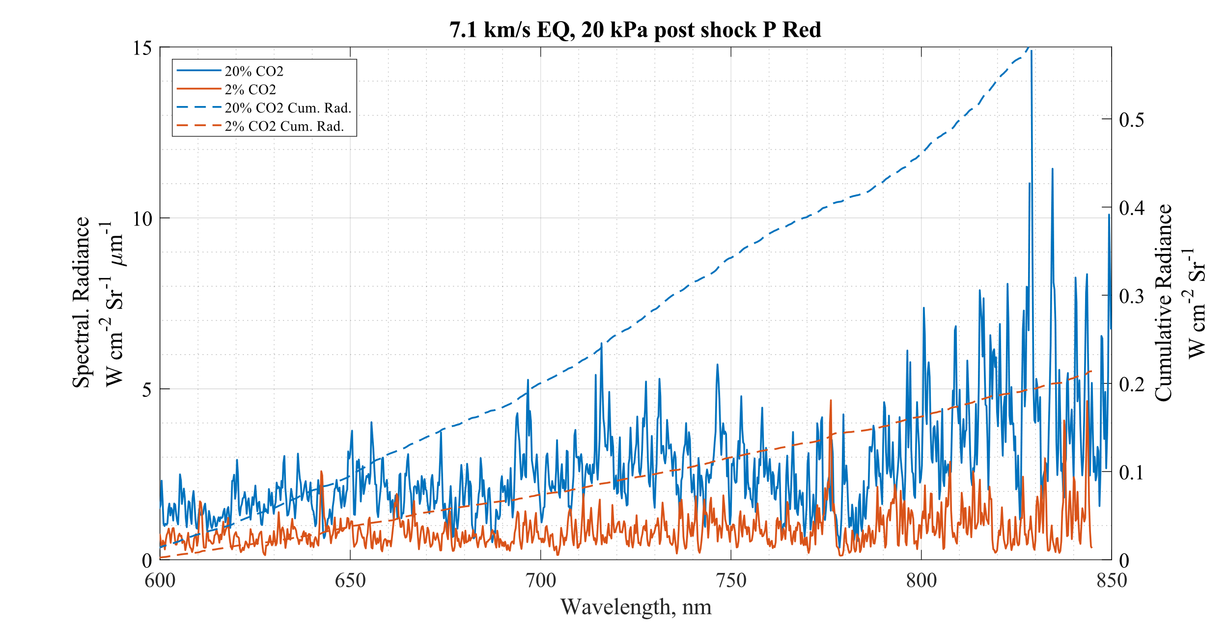
Effect of Gas Comp.≈7.1 km/s & 20 kPa Post Shock
O
O
H-α
1. ‘O’ 777nm line strong in Both mixtures in Non-EQ, and only in 2% Co2 in EQ region.
2. ‘H-α’ line peeking through in Non-Eq 2% CO2 spectra.
3. Both relaxed and Non-EQ regions dominated by the CN waves from the 20% CO2 mixture
O
RED

Slide 19
Data Contents
Comparisons of Spectra at similar Speeds and Post Shock Pressures (Effect of Gas Mixture)
5.9 km/s & 40 kPa
7.1 km/s & 20 kPa
9.8 km/s & 14 kPa
Comparison of Spectra of similar Speeds and Gas mixture (Effect of Post shock P)
Comparison of Spectra of similar Post shock P and Gas mixture (Effect of Shock Speed)

Slide 20
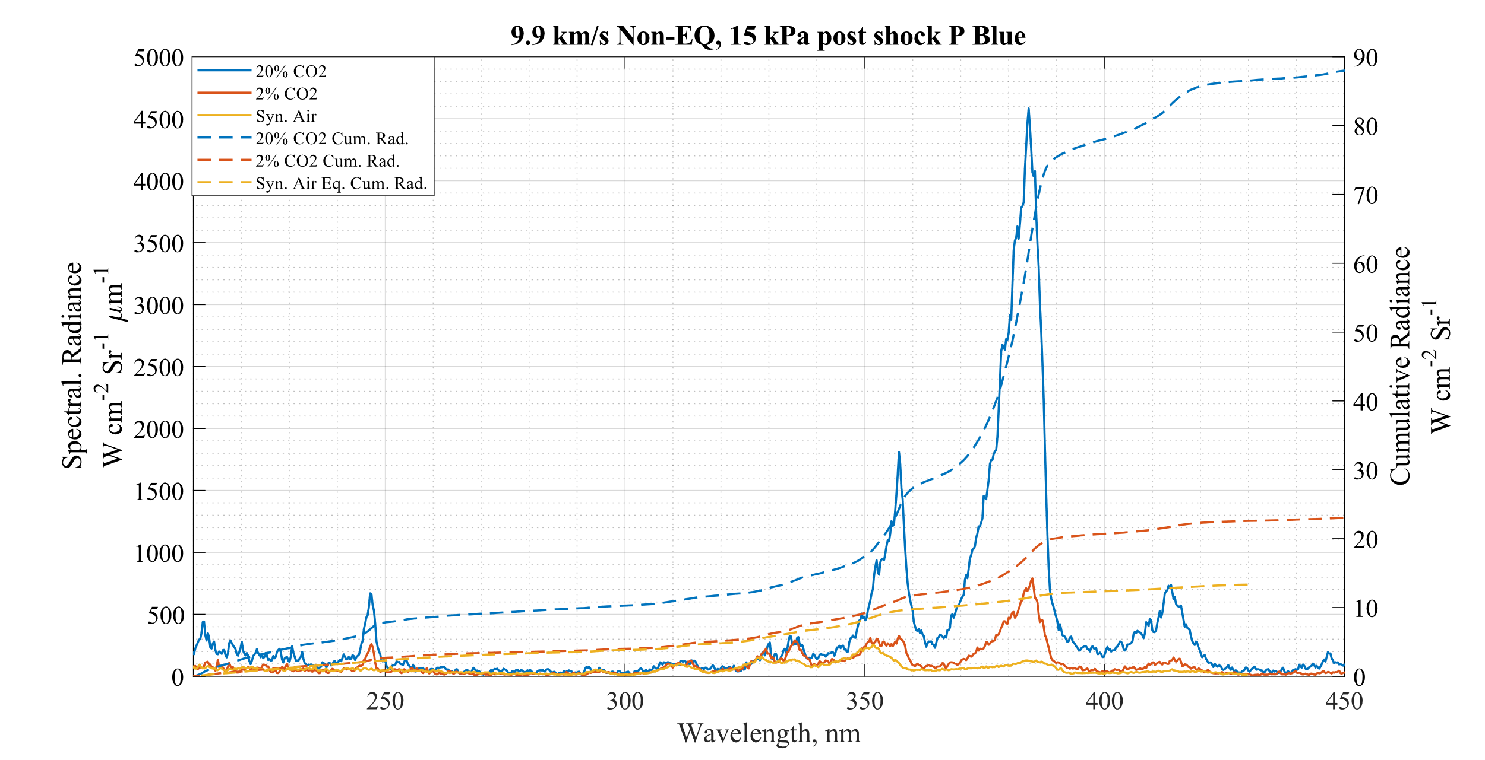
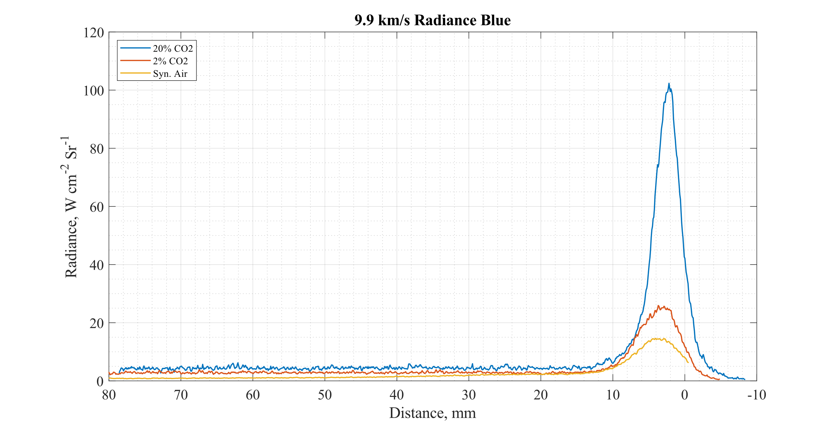
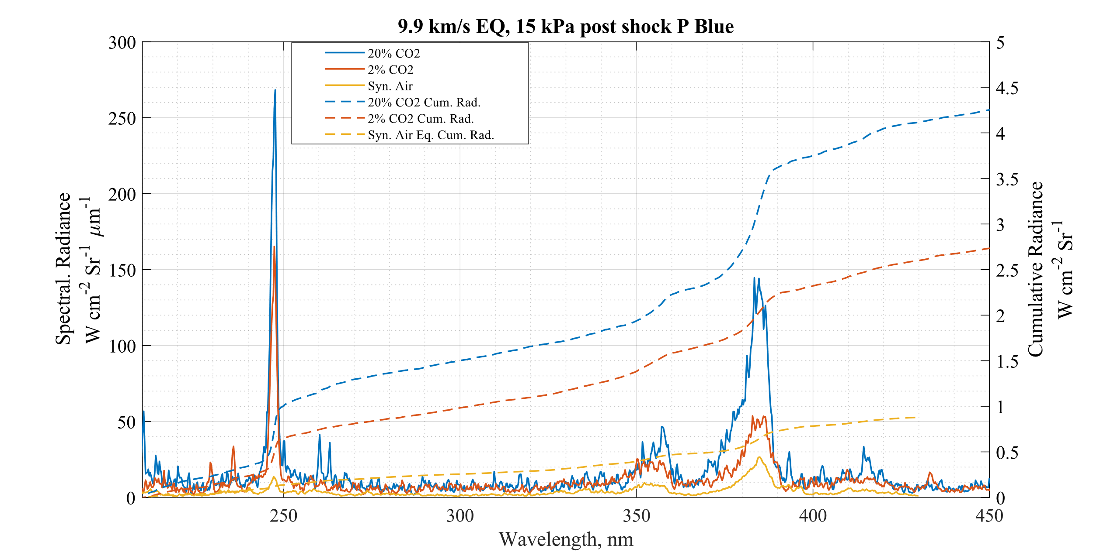
Effect of Gas Comp.≈9.9 km/s & 15 kPa Post Shock
CEA equilibrium values
C
Gas Mix | $ρ_{EQ}$ (kg/m³) | Post Shock Eq. T (K) | Post shock P (kPa)
20% CO2 | 5.29E-3 | 6338 | 15.89
2% CO2 | 4.74E-3 | 6349 | 14.38
Syn. Air | 2.45E-3 | 9598 | 14.39
BLUE

Slide 21
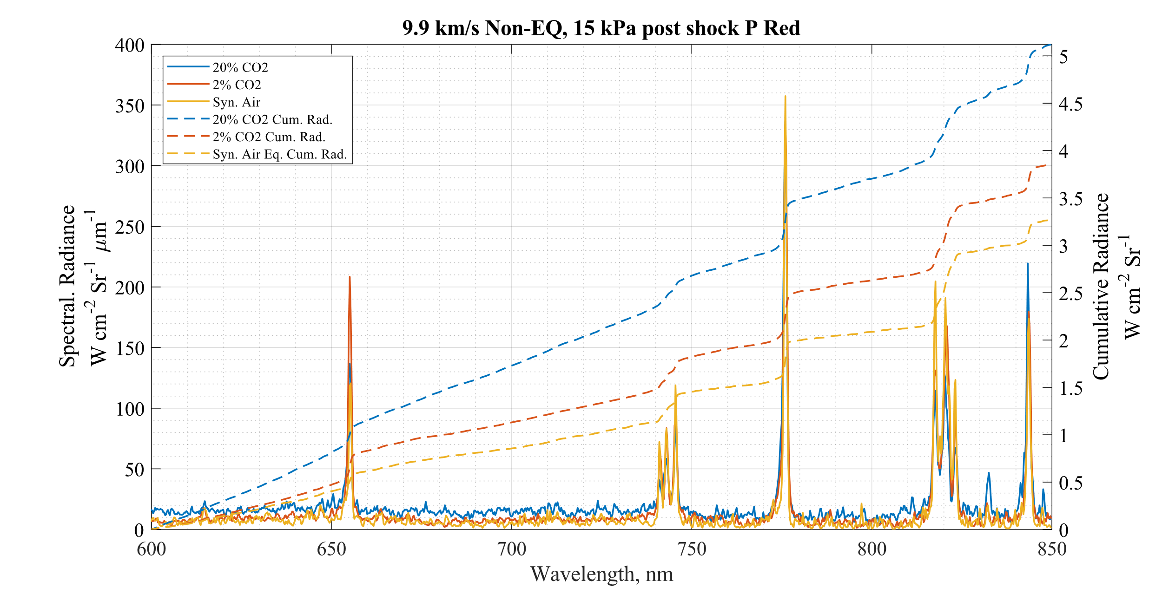
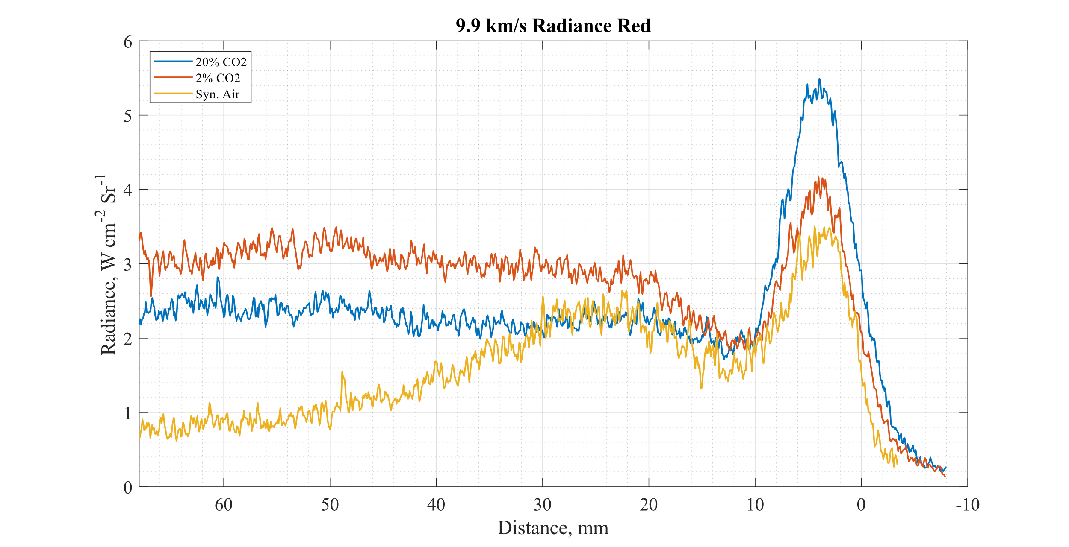
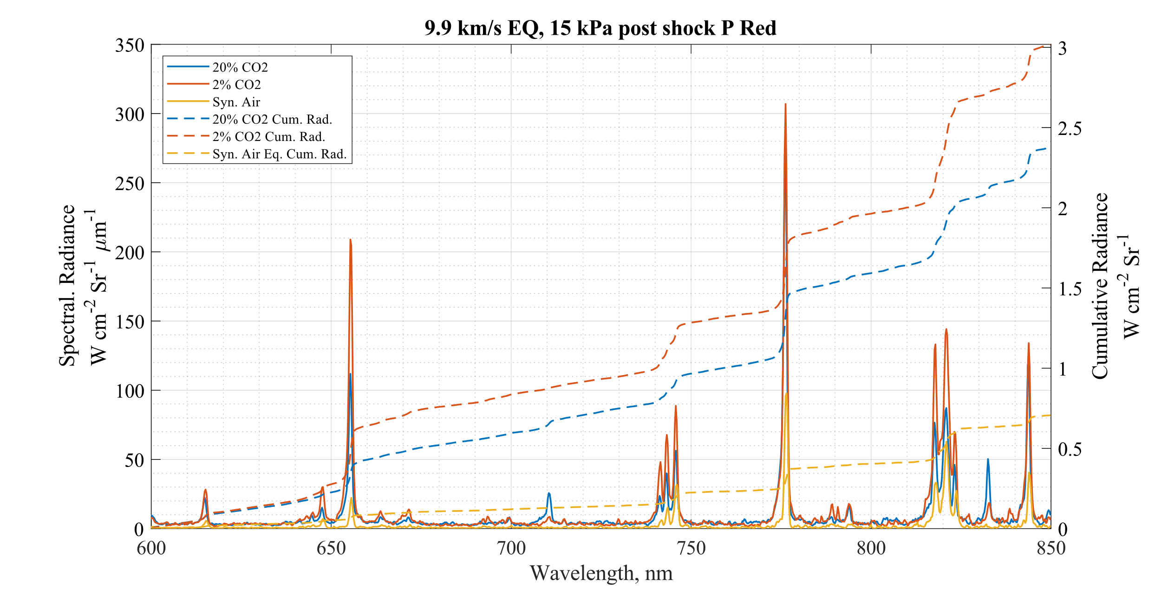
Effect of Gas Comp.≈9.9 km/s & 15 kPa Post Shock
O
N
H-α
O
N
O
CEA equilibrium values
N
Gas Mix | $ρ_{EQ}$ (kg/m³) | Post Shock Eq. T (K) | Post shock P (kPa)
20% CO2 | 5.29E-3 | 6338 | 15.89
2% CO2 | 4.74E-3 | 6349 | 14.38
Syn. Air | 2.45E-3 | 9598 | 14.39
H-α
N
O
O
N
RED

Slide 22
Data Contents
Comparisons of Spectra at similar Speeds and Post Shock Pressures (Effect of Gas Mixture)
5.9 km/s & 40 kPa
7.1 km/s & 20 kPa
9.8 km/s & 14 kPa
Comparison of Spectra of similar Speeds and Gas mixture (Effect of Post shock P)
Comparison of Spectra of similar Post shock P and Gas mixture (Effect of Shock Speed)

Slide 23
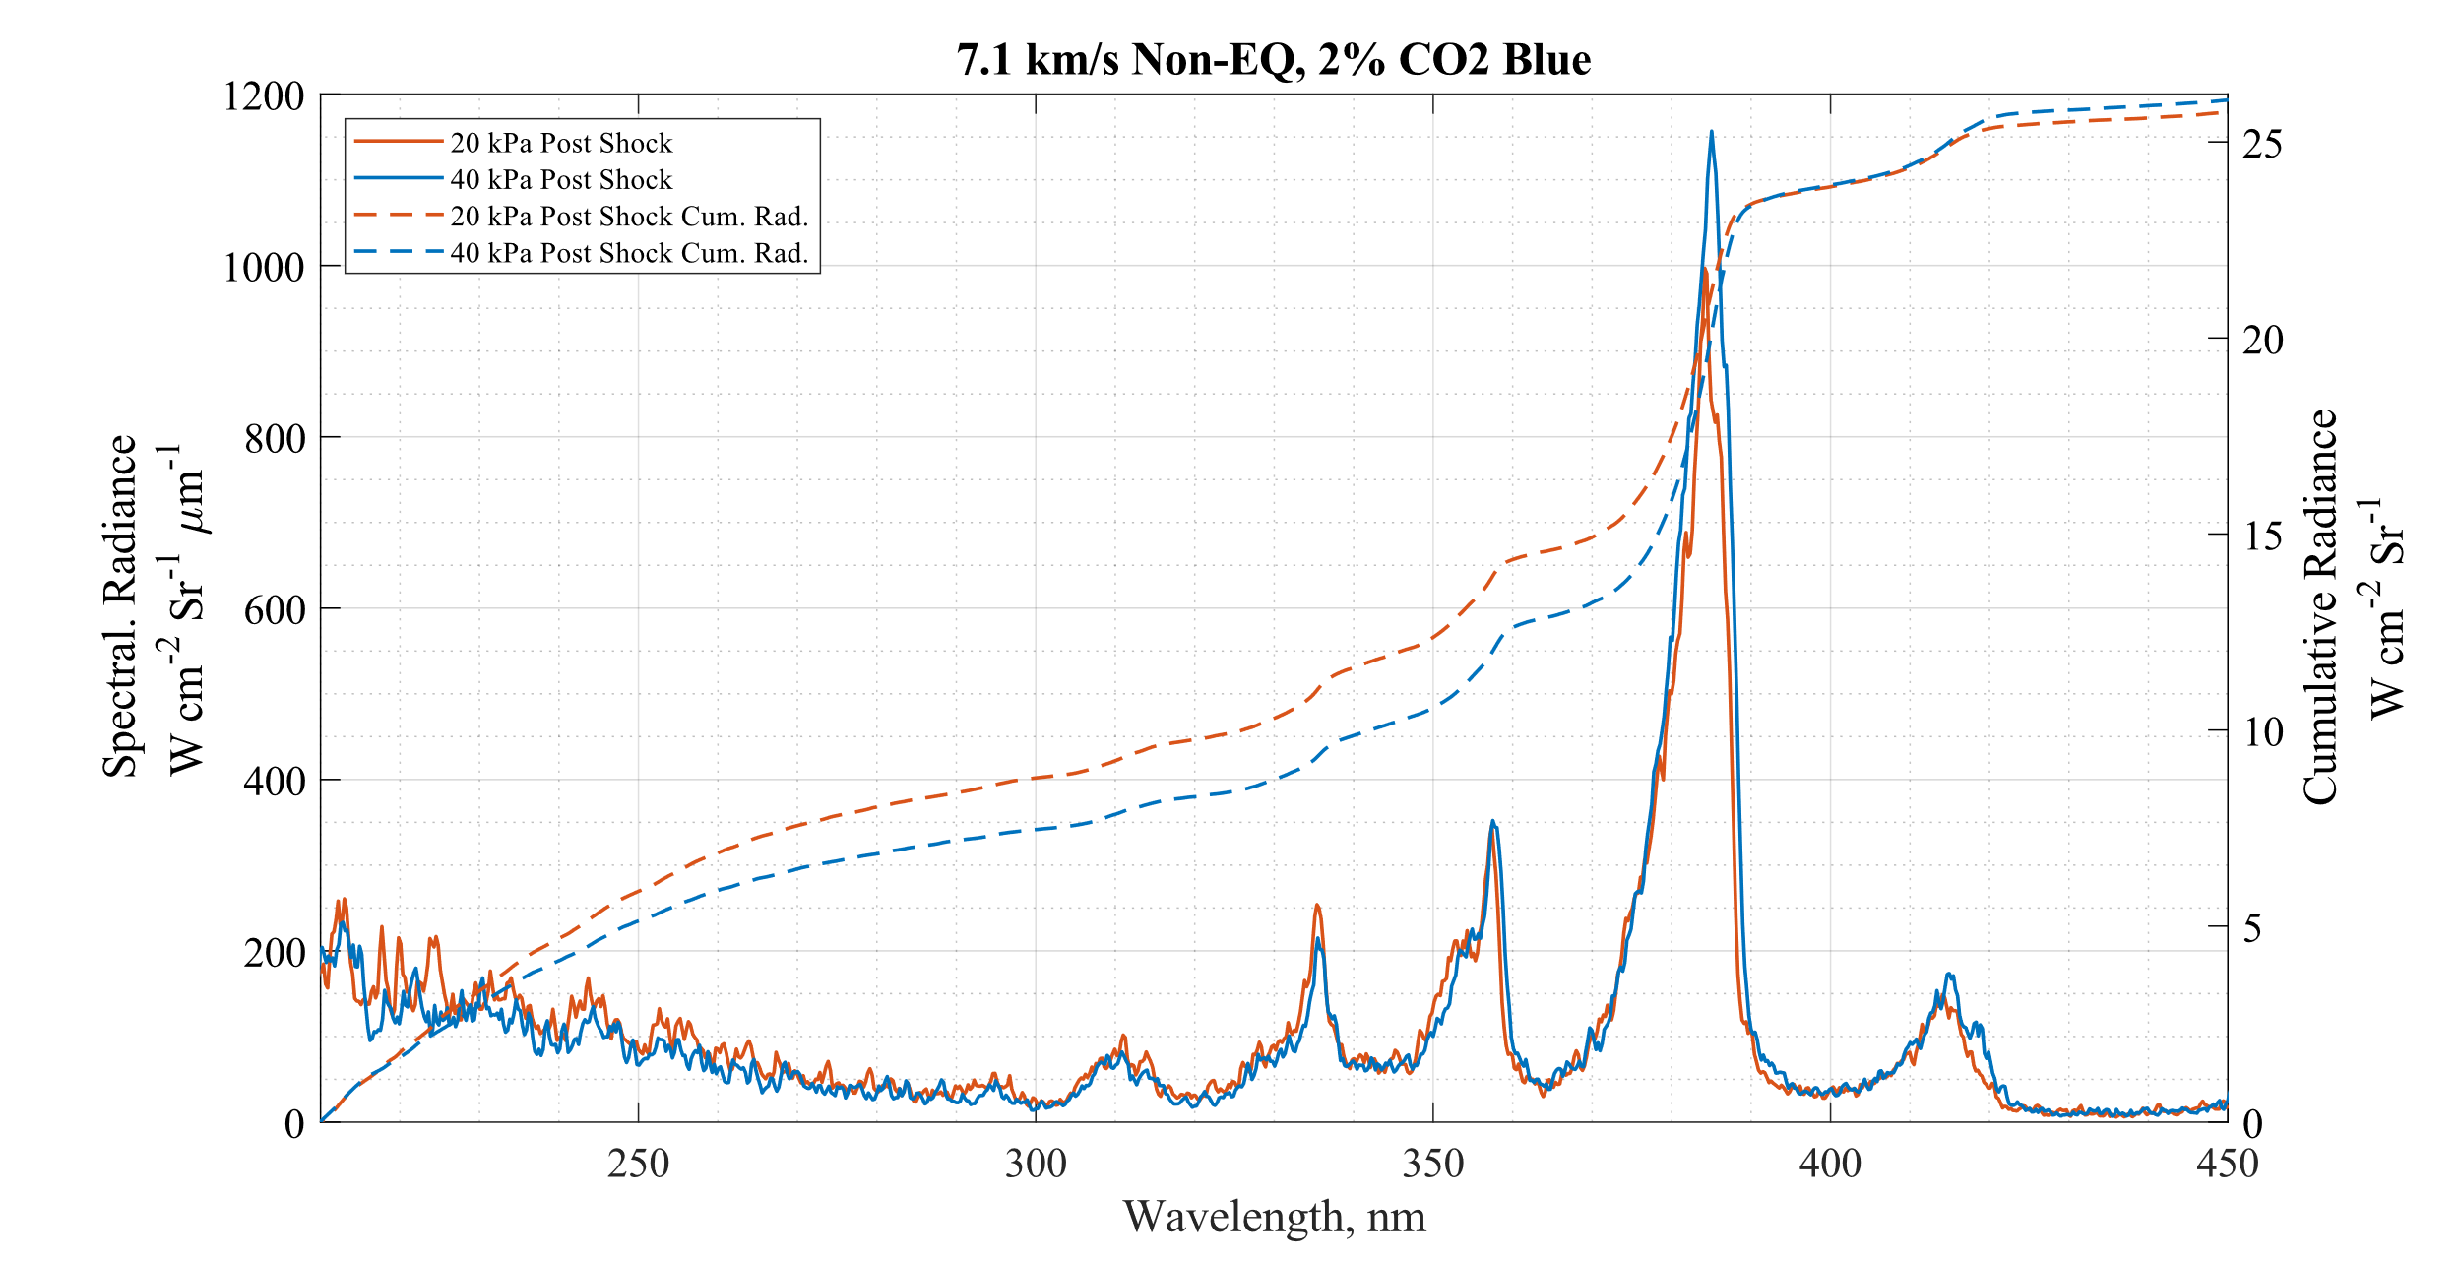
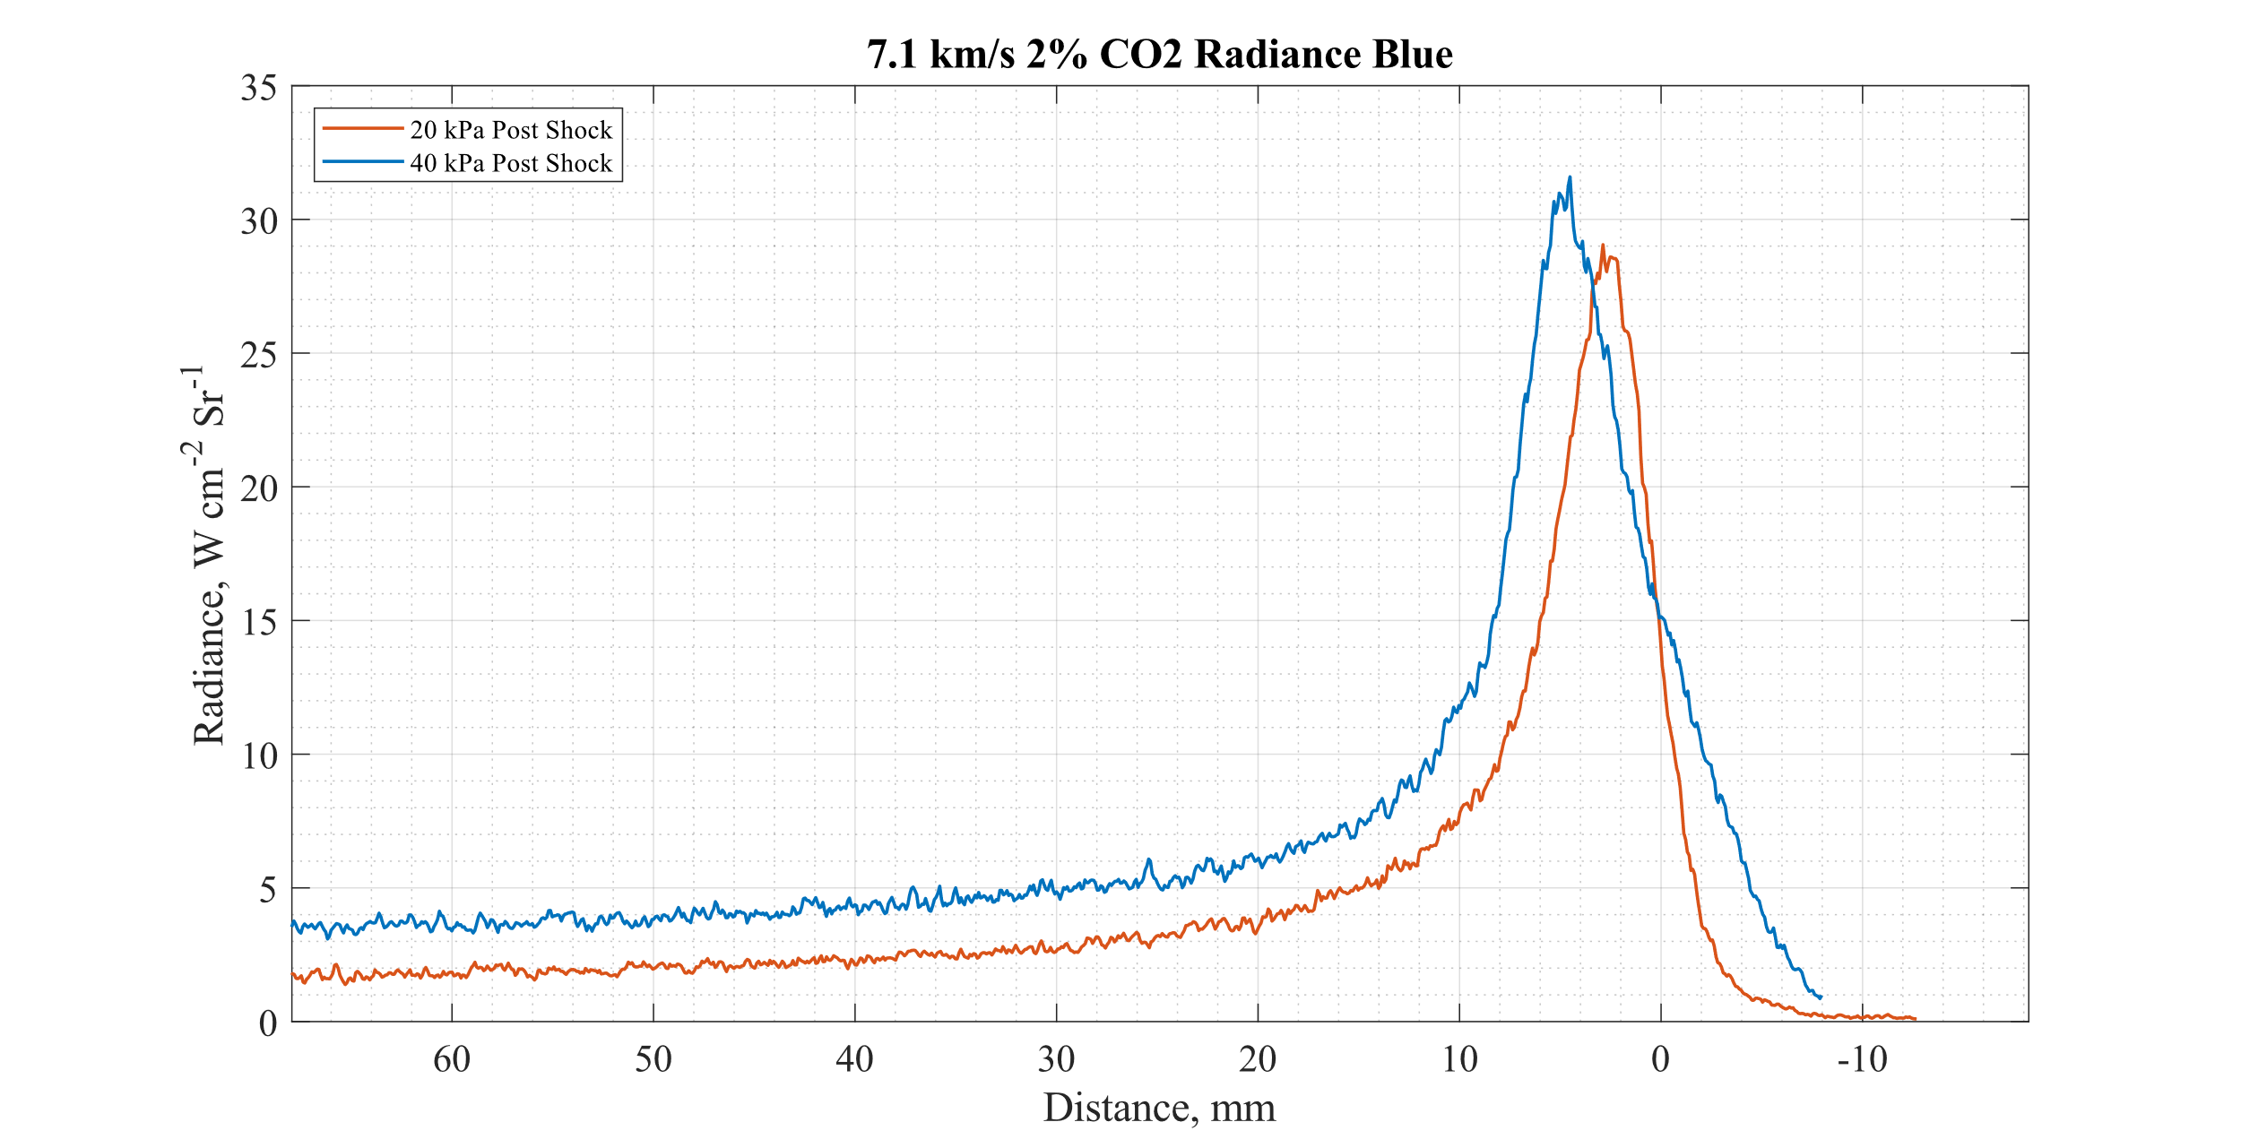
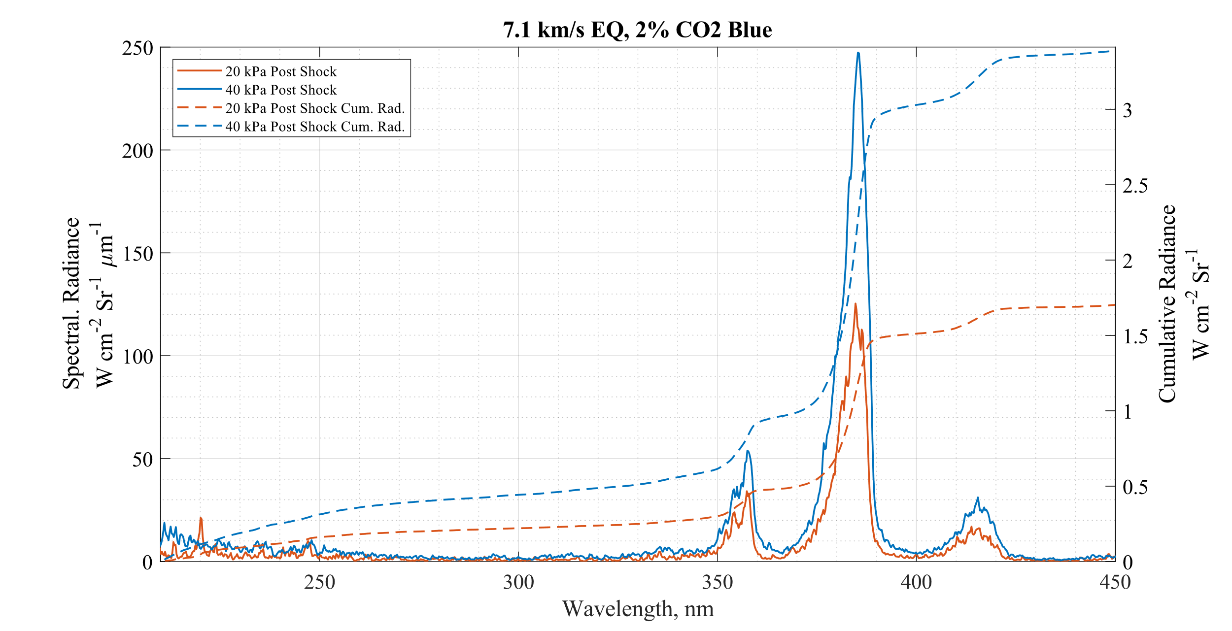
Effect of post shock P 2% CO2 Blue
Higher radiance from the higher post shock P in the relaxed region.
The Non-EQ peak in the 40kPa radiance profile appears to be stretched. (Same camera gating of 200ns).
Spectral radiance in peak Non-EQ region looks almost identical!
BLUE

Slide 24
Effect of post shock P 2% CO2 Blue
CEA equilibrium values
Gas Mix | $ρ_{EQ}$ (kg/m³) | Post Shock Eq. T (K) | Post shock P (kPa)
20% CO2 | 6.12E-3 | 6302 | 18.06
20% CO2 | 1.39E-2 | 6334 | 38.88
BLUE

Slide 25
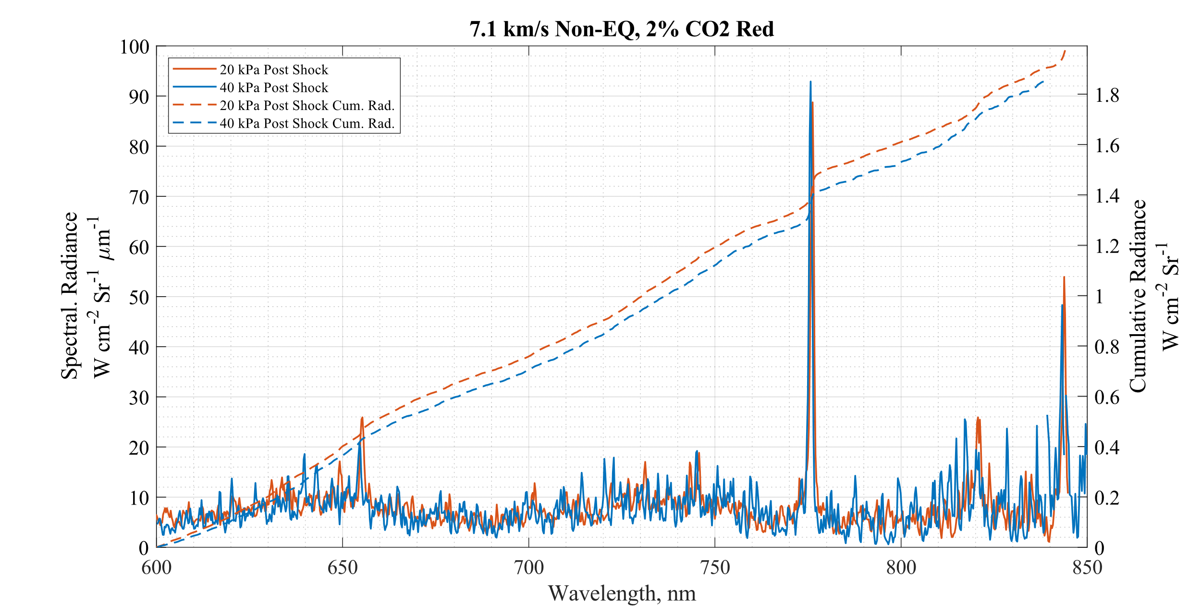
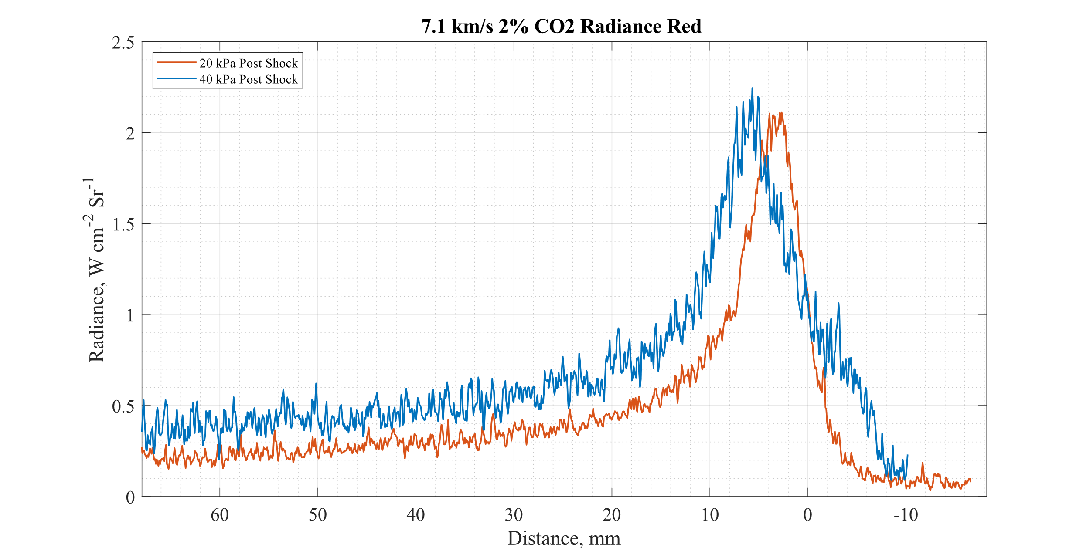
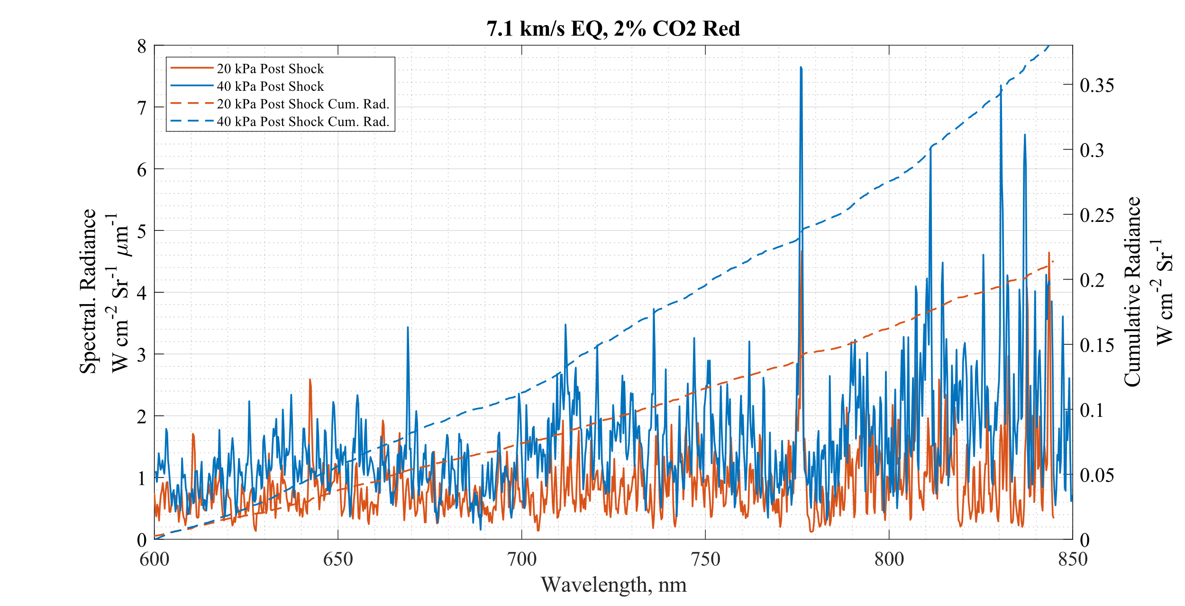
Effect of post shock P 2% CO2 Red
O
H-α
Higher radiance from the higher post shock P in relaxed region.
Non-Eq spectra look almost identical.
The Non-Eq peak in the 40kPa again appears stretched (Same camera gating of 500ns).
O
RED

Slide 26
Data Contents
Comparisons of Spectra at similar Speeds and Post Shock Pressures (Effect of Gas Mixture)
5.9 km/s & 40 kPa
7.1 km/s & 20 kPa
9.8 km/s & 14 kPa
Comparison of Spectra of similar Speeds and Gas mixture (Effect of Post shock P)
Comparison of Spectra of similar Post shock P and Gas mixture (Effect of Shock Speed)

Slide 27
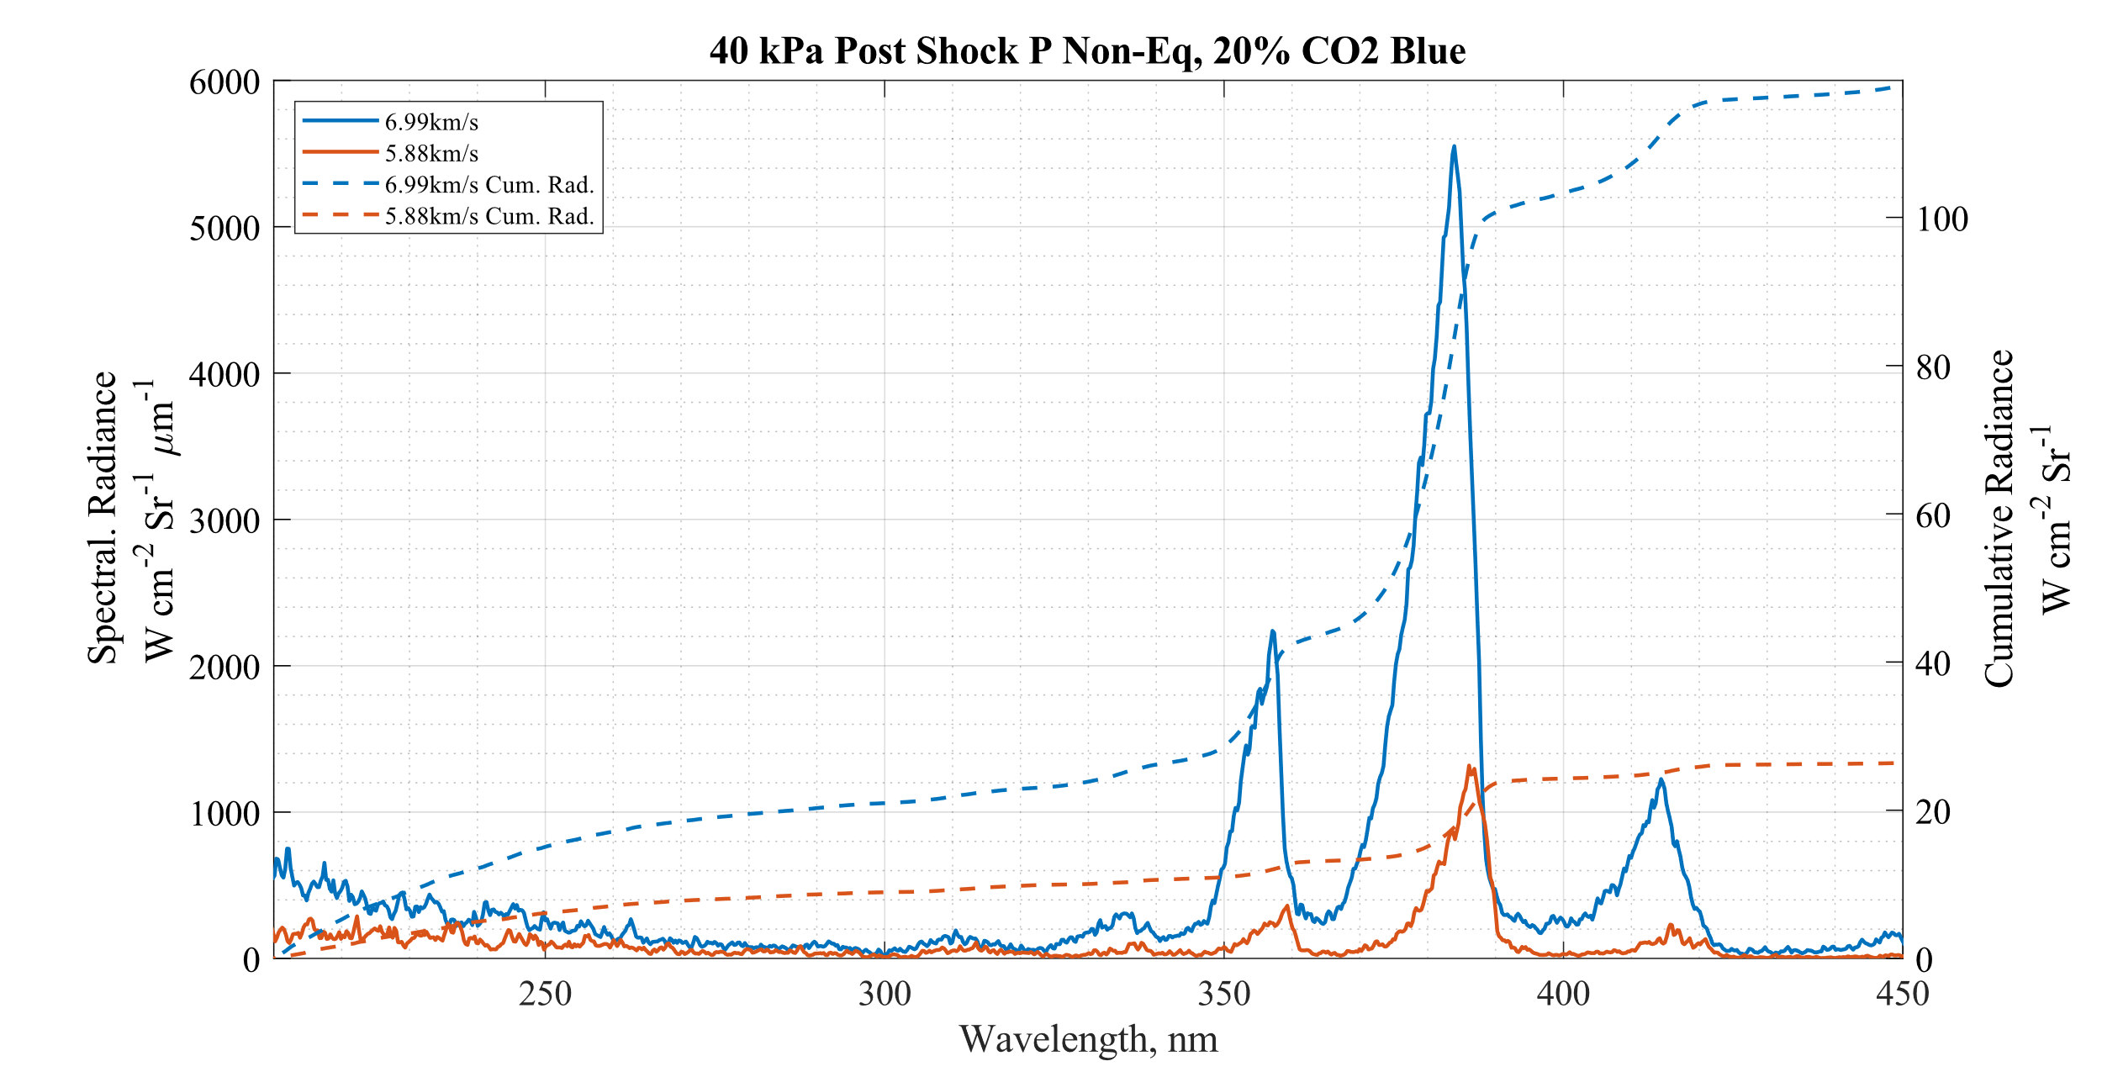
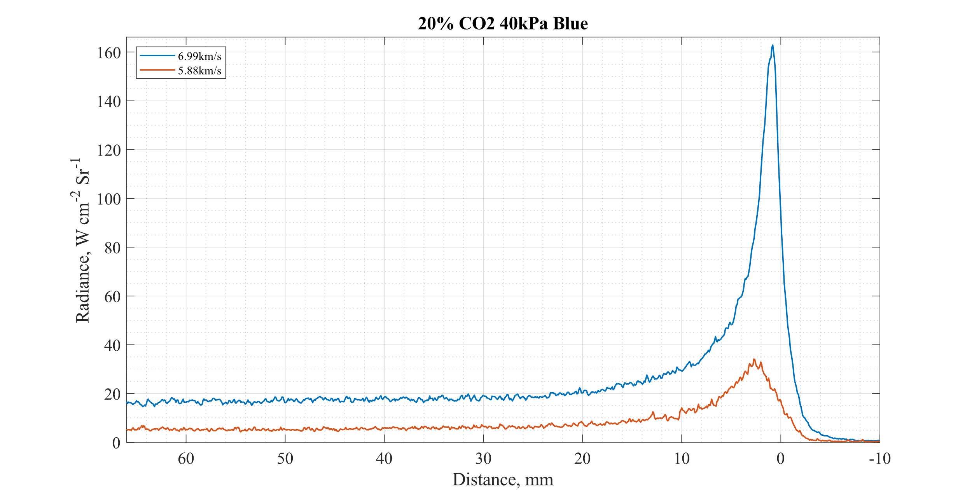
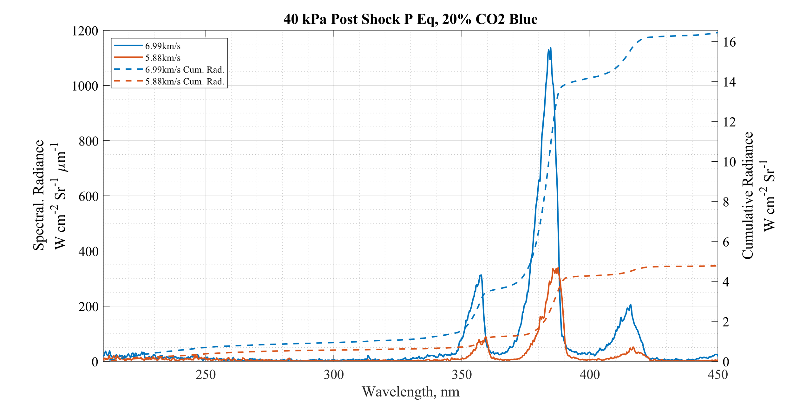
Effect of Shock Speed 20% CO2 40kPa PSP Blue
Much stronger radiance from higher velocity in both relaxed and peak radiance regions.
Radiance upstream approx. 3x more for the higher speed.
Peak radiance approx. 5x greater
BLUE

Slide 28
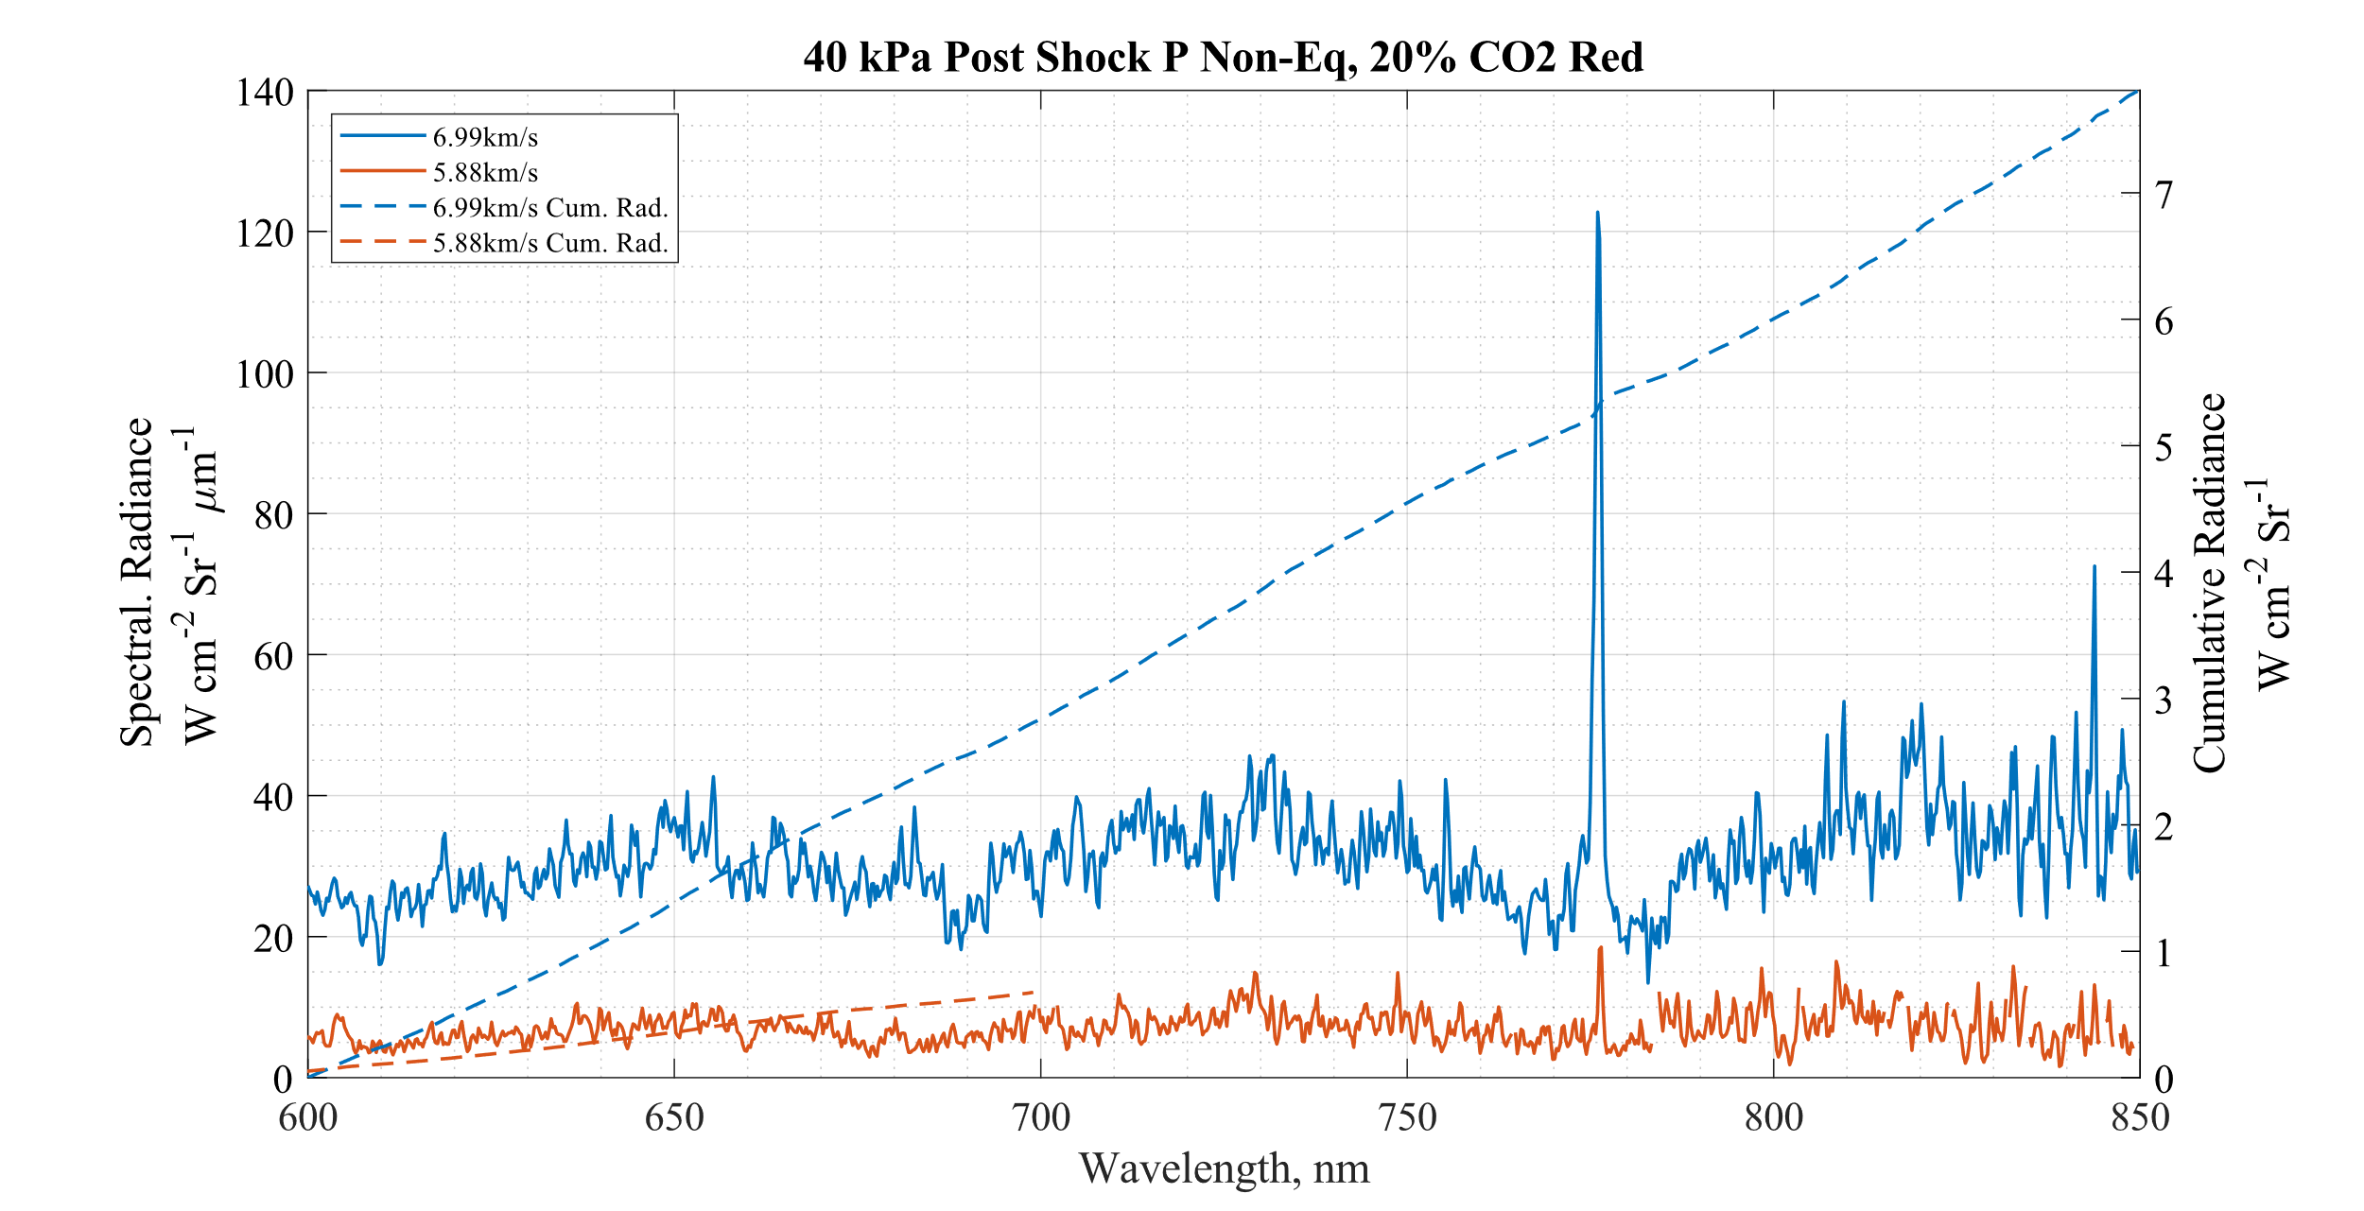
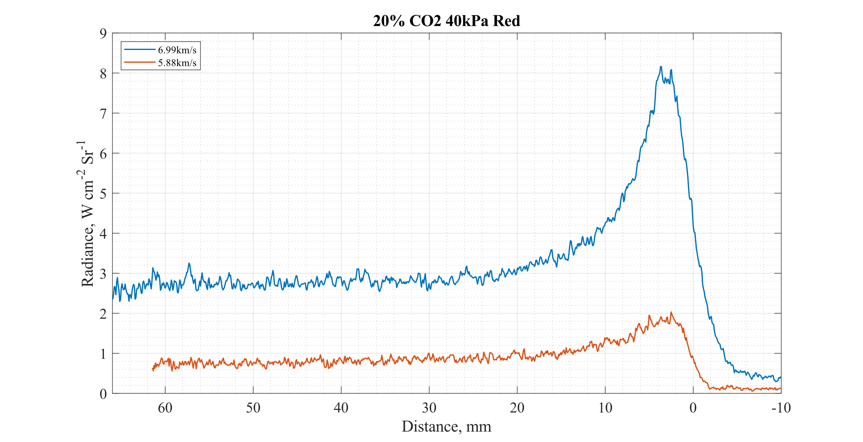
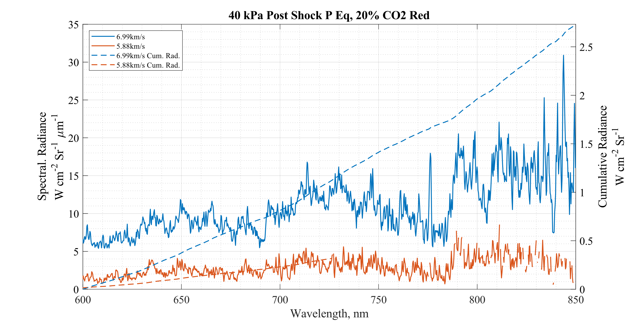
Effect of Shock Speed 20% CO2 40kPa PSP Red
O
Much stronger radiance from higher velocity in both relaxed and Non-Eq regions as with the ‘Blue’ spectra.
‘O’ 777nm line is very strong for the 7km/s line
RED

Slide 29
Summary & Future Work
Collected a Large Spectral dataset in T6 AST
Even Small concentrations of CO2 can cause huge spectral radiance from CN w.r.t. Synthetic Air
Lot’s of noise seeming to be present in the ‘Red’ spectra (related to CO2 concentration?)
Initial NEQAIR sim gives reasonable first pass qualitative fit (More work to be done!)
Following on from Alex’s work, we would like to extend the spectral fitting algorithm to this data set.

Slide 30
Thanks for Listening!

