Slide 1
Network: HYATTMEETING Password: hyattplace We start at 9:30 AM

Slide 2
WELCOME: 15th Geant4 Space Users Workshop
Sponsored by JPL Center for Space Radiation
Dec 5-7, 2013
Pasadena Hyatt Place

Slide 3
Some Announcements
We were not allowed to collect the registration fee.
And JPL fund cannot be used to provide:
Food and beverages
Transportation
Hotel does not allow us to bring “outside” food/drink to the meeting room.
There is a mixer hosted by the hotel for those who responded:
5 – 7 PM at the breakfast gallery area.
It will be right after the scheduled JPL tour.

Slide 4
JPL tour
All US citizens 18 years of age or older visiting JPL MUST present official, government-issued photo identification, such as a driver's license or passport, before being allowed entry.
All non-US citizens (Foreign Nationals) 18 years of age or older MUST present either a passport or resident visa (green card) before being allowed entry. Individuals without the appropriate identification will NOT be admitted to the facility.
Anyone not on our approved roster will not be admitted on to the facility.
Note: Substituting roster names the day of the tour is not allowed
The tour may include considerable walking and stair climbing. Dress comfortably and appropriately for the weather. Cameras are allowed on the tour. While a small personal item can be brought on tour, please refrain from bringing any large items, such as duffle bags and suitcases.
Note: All tours are conducted in English*
Tour guides will meet us in front of the JPL visitor center

Slide 5
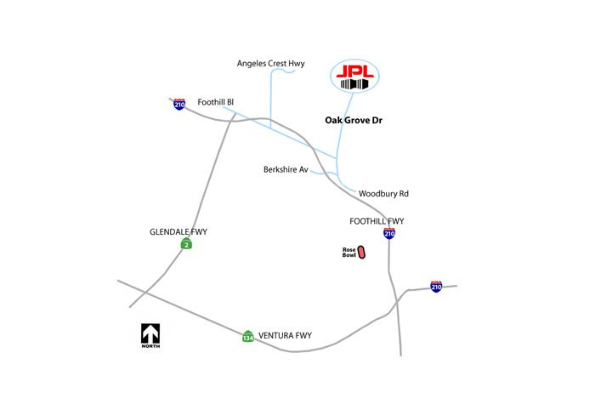
Schedule
Let’s be there by 1:30 PM which means we leave the hotel around 1:15 PM.
The address is: 4800 Oak Grove Dr., La Canada Flintridge, CA 91011.
Further driving instructions can be found on our website.
Park at the visitor parking lot
Let’s try to carpool as much as we can – we have a signup sheet.

Slide 6
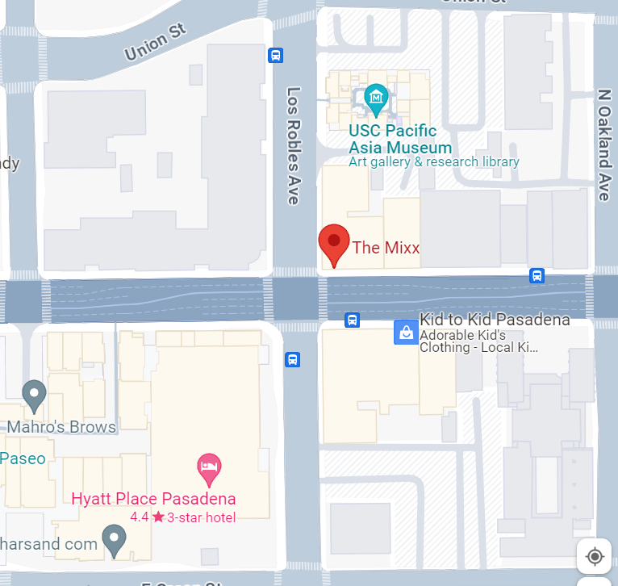
Dinner (Wednesday, 6pm)
The Mixx - 443 E. Colorado Blvd. Pasadena, CA 91101
American Style Restaurant – Open Menu and Bar
Since we did not collect the banquet fee, each individual will get their own check!!

Slide 7
Local Attraction
Norton Simon Museum
Huntington Library
California Science Center
LA Museum of Modern Art (MOMA)
LA County Museum of Art (LACMA)
Getty Center
Disneyland
Universal Syudio

