Slide 1
Characterization and Measurement of the SET Pulse Duration of the DARE65T Standard Cells Libraries
Laurent Berti

Slide 2
Outline
Introduction
SET characterization test structure
  Architecture
  Calibration
  Double hit probability
Measurement results
  Cross section INVD1 vs flavor
  Cross section versus drive strength
  SET pulse width distribution
Conclusion

Slide 3
Introduction
Proper hardening of a digital circuit is related to:
  An error rate specification
  Mission profile, orbits...
Many way to harden a digital circuit
  Best hardening has an important cost in area, power and speed
To predict the error rate and to optimize the level of hardening, we need:
  Cross section versus LET
  Distribution of the SET duration versus LET
The goal of this TV is by measuring the cross section and the SET duration on a limited subset of the standard cells, to be able to calculate them for any standard cells of the DARE65T libraries.

Slide 4
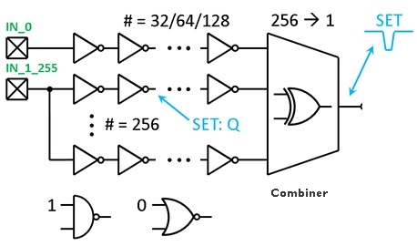
SET characterization test structure
Architecture
Victims are a limited subset of the std cells libraries:
  INV D1, D3, D4 & D16
    Gate length of 60nm and 70nm
    Threshold flavor: Low, Standard and High
  CCELL D1, D2 & D4
  Hardened logic: INVBLx, NAND2BLx & NORD2BLx
Victim arranged in chains of 16 or 32 cells:
  Representative of real logic cone
  Not too long chain to avoid an important pulse broadening (~2ps/gate)
  Parallelization of the victims is done thanks to a balanced NAND/NOR combiner

Slide 5
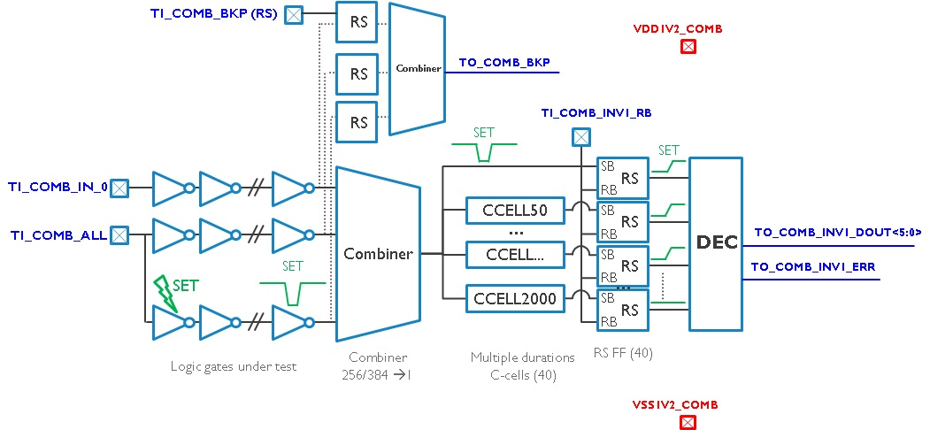
SET characterization test structure
Architecture

Slide 6
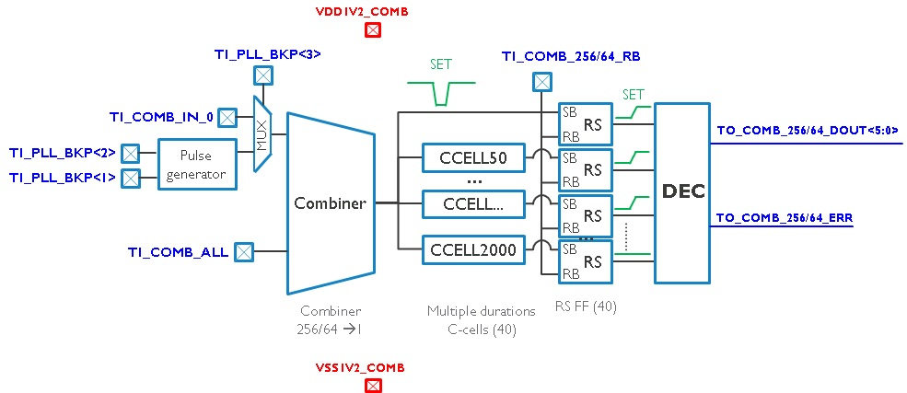
SET characterization test structure
Calibration
Delay SET filter measurement
  Ring oscillator using same delay elements
  Validation of the pulse distortion with the measurement of well-known pulse width

Slide 7
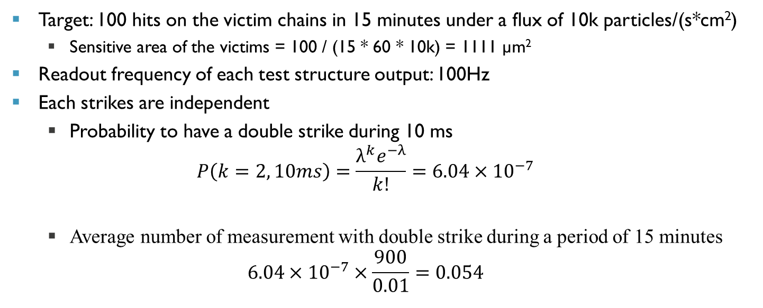
SET characterization test structure
Double hit probability
Target: 100 hits on the victim chains in 15 minutes under a flux of 10k particles/(s*cm²)
  Sensitive area of the victims = 100 / (15 * 60 * 10k) = 1111 µm²
Readout frequency of each test structure output: 100Hz
Each strikes are independent
  Probability to have a double strike during 10 ms
  $P\left(k=2, 10ms\right)=\frac{λ^{k}e^{−λ}}{k!}=6.04×{10}^{−7}$
  Average number of measurement with double strike during a period of 15 minutes
  $6.04×{10}^{−7}×\frac{900}{0.01}=0.054$

Slide 8
Measurement results
Cross section INVD1 vs flavor

Slide 9
Measurement results
Cross section INVD1 vs flavor
Without surprise:
  Saturation cross section similar for the different flavors (Vth and gate length)
  Low LET cross section strongly impacted by the Vth
    LVT drive strength > SVT drive strength > HVT drive strength
  Low LET cross section lightly impacted by the gate length (60 nm vs 70 nm)
LET (MeV.mg⁻¹.cm²) | Cross section (cm²)
 | HVT60N | HVT70N | SVT60N | SVT70N | LVT60N | LVT70N
7.2 | 2.78E-09 | 2.88E-09 | 2.32E-09 | 2.71E-09 | 1.62E-09 | 1.92E-09
13.3 | 4.59E-09 | 4.39E-09 | 4.37E-09 | 4.39E-09 | 3.69E-09 | 3.98E-09
24.5 | 5.86E-09 | 6.13E-09 | 5.18E-09 | 5.44E-09 | 4.98E-09 | 5.05E-09
33.5 | 8.89E-09 | 8.67E-09 | 7.62E-09 | 8.15E-09 | 7.06E-09 | 7.81E-09
48.5 | 8.35E-09 | 8.64E-09 | 7.79E-09 | 7.96E-09 | 7.20E-09 | 7.30E-09
66.3 | 1.34E-08 | 1.30E-08 | 1.24E-08 | 1.23E-08 | 1.16E-08 | 1.20E-08

Slide 10
Measurement results
Cross section vs Drive Strength

Slide 11
Measurement results
Cross section INVD1 vs Drive Strength
LET threshold strongly dependent of the drive strength: proportionality observed
Saturation LET looks similar but... :
  INVD1 has 1 finger and INVD2 has 2 fingers => same junction area but the higher drive strength decrease a little bit the saturation LET
  INVD4 has 4 fingers and the 2 drains are close to each other => less than factor 2 with INVD2
LET (MeV.mg⁻¹.cm²) | Cross section (cm²)
 | INVD1 |  | INVD2 |  | INVD4
 | SVT60N | LVT60N | SVT60N | LVT60N | SVT60N | LVT60N
7.2 | 2.32E-09 | 1.62E-09 | 1.35E-10 | 0.00E+00 | 0.00E+00 | 0.00E+00
13.3 | 4.37E-09 | 3.69E-09 | 2.37E-09 | 1.08E-09 | 2.96E-10 | 0.00E+00
24.5 | 5.18E-09 | 4.98E-09 | 5.03E-09 | 4.30E-09 | 4.27E-09 | 2.37E-09
33.5 | 7.62E-09 | 7.06E-09 | 6.47E-09 | 5.74E-09 | 7.67E-09 | 4.70E-09
48.5 | 7.79E-09 | 7.20E-09 | 6.88E-09 | 6.93E-09 | 1.04E-08 | 9.81E-09
66.3 | 1.24E-08 | 1.16E-08 | 9.55E-09 | 8.67E-09 | 1.22E-08 | 1.23E-08
S
S
D
S
D
S
S
D
S
D
S
S

Slide 12
Measurement results
SET pulse width distribution

Slide 13
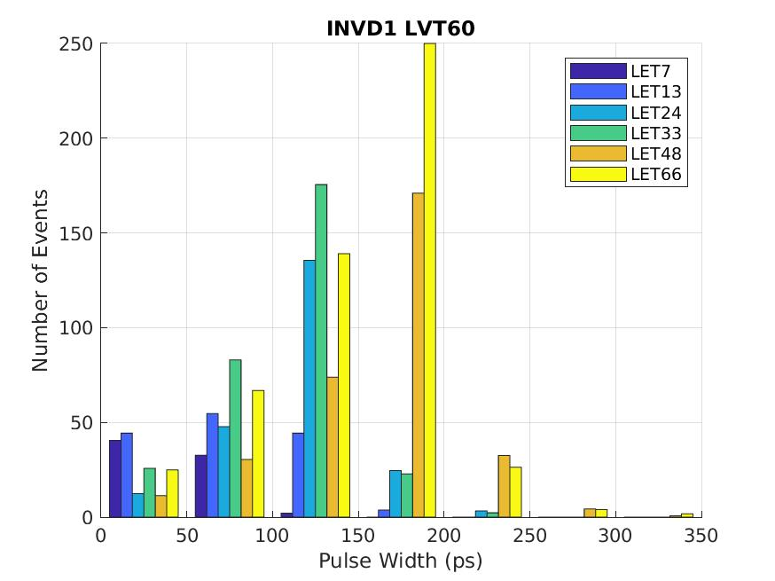
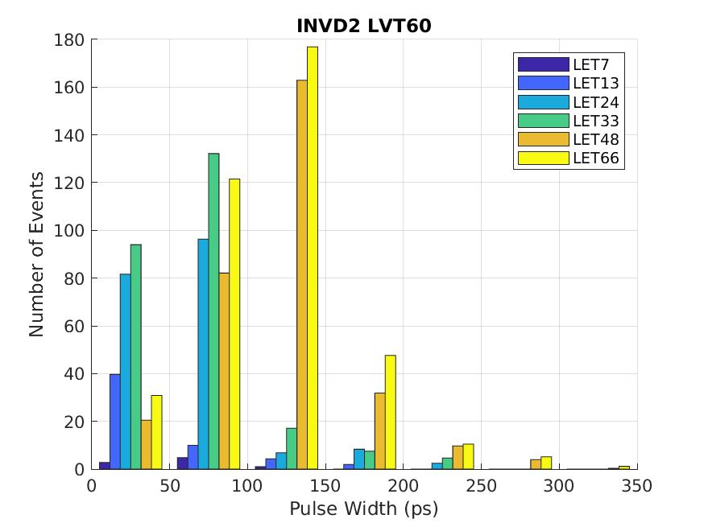
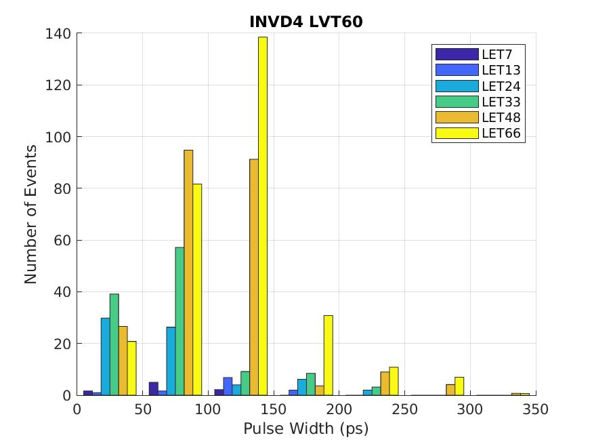
Measurement results
SET pulse width distribution

Slide 14
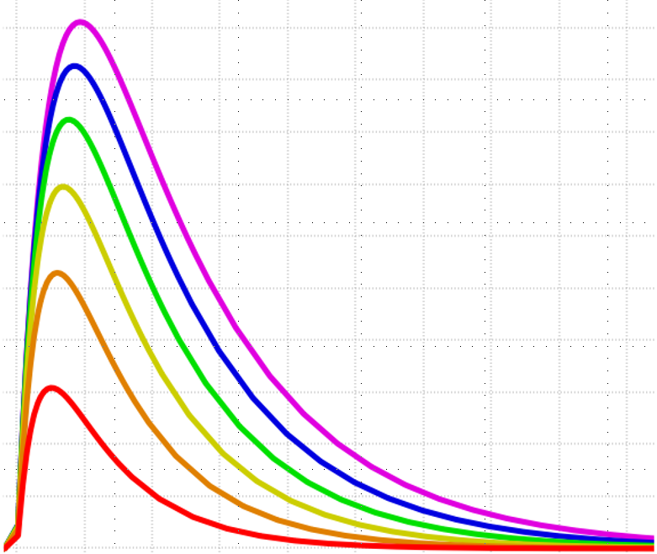
Measurement results
SET pulse width distribution
SET duration is about 100ps to 250ps
  Increase with LET
  Decrease with drive strength
[4] Zheyi Li, Maxim Gorbunov, Henrique Caldas Kessler, Giancarlo Franciscatto, Venkata Sathyajith Kampati, Jinghao Zhao, Jeffrey Prinzie, Laurent Berti; “A Charge-Width Calibration Approach for the Compact Modeling of Single Event Transients”, RADECS 2025

Slide 15
Conclusion
Cross section of the inverters of the 6 DARE65T standard cells libraries have been measured accurately
Thanks to the simplicity of the layout of the inverters, these results can be used to calculate the cross section of any other standard cells of these libraries
  Saturation cross section of any of the standard cell of the DARE65T platform can be directly extracted from the layout
  The LET threshold is proportional to the drive strength
  The cross section versus LET of any standard cell can be calculated
The SET duration versus LET has been measured for Drive Strength 1 till Drive Strength 16 => DARE65T striker has been updated accordingly (RADECS2025 paper)
Using these data, it is possible to predict the soft error rate of a given digital circuit.

Slide 17
Backup slides
[3] Zheyi Li; Laurent Berti; Jan Wouters; Jialei Wang; Paul Leroux, “Characterization of the Total Charge and Time Duration for Single-Event Transient Voltage Pulses in a 65-nm CMOS Technology”, IEEE Transactions on Nuclear Science ( Volume: 69, Issue: 7, July 2022)

