Slide 1

A Scalable Controller for
Power Sources (SCOPS)
Date: June 16, 2025
Speaker: Marc Cousineau
The work is part of the European project SCOPS involving satellite manufacturer teams as well as scientific partners. Grant agreement No 101082266.

Slide 2

















SCOPS
Scalable Controller for Power Sources
Coordinator & project manager
Architecture / ASIC Design
Radiation & End-user tests
DARE180XH library, X-FAB foundry
Architecture, Know-how & Patents
Fully Scalable Microprocessor Power Supply
Design & Test validation
Prototype manufacturing

Slide 3
SCOPS requirements
Main performances goal
To supply future UDSM ASIC & FPGA (Low voltage High current)
Power DCDC converter control for low output voltage (≥ 0.6V), high current (≤ 200A)
Current sharing (parallel operation) up to 10 converters
250 kHz to 3 MHz
Radiation hardened : no SEL, no SEFI, no SET, no SEU and TID 100krad
Chip size 6mm x 5mm
SMD package of BGA 81, 1mm pitch

Slide 4
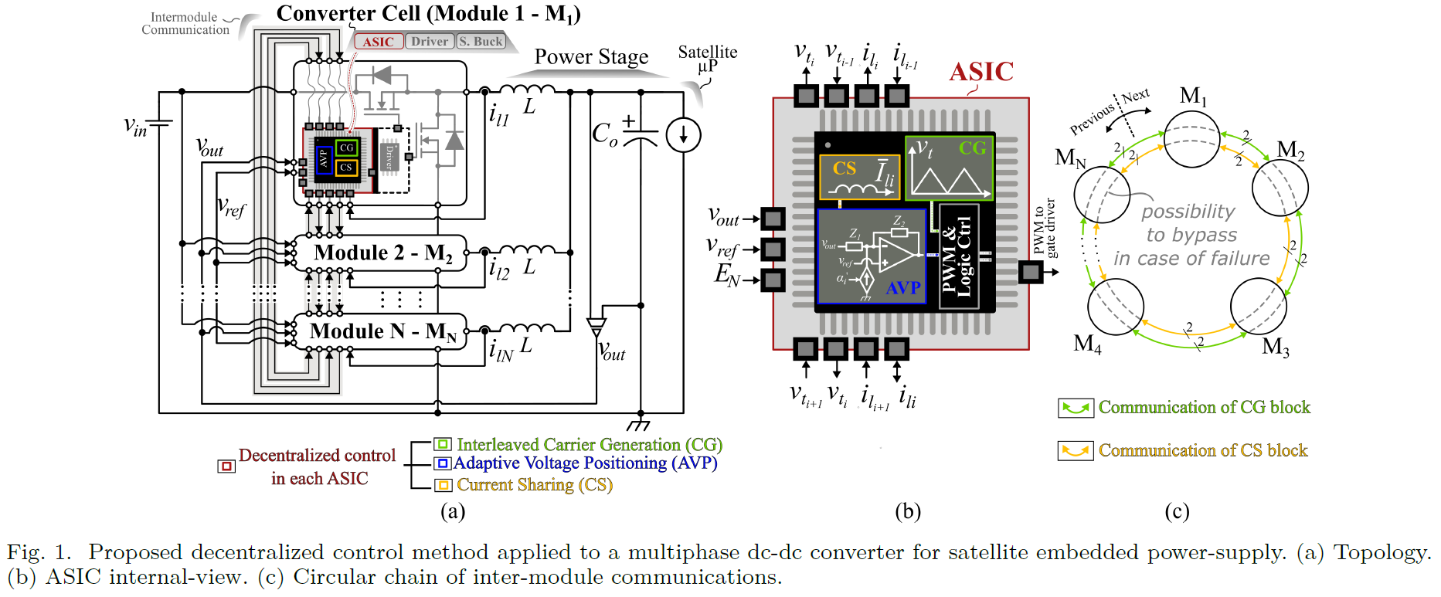
1. INTRODUCTION – DECENTRALIZED CONTROL CONCEPT
Fault tolerant & full operational Power Supply
Fully scalable
No supervisor required
Auto-reconfiguration
(Fault-tolerant)
By-pass
Main blocks as priority
Notes:
Priority given for main blocks 1-CG, 2-AVP, 3-CS

Slide 5
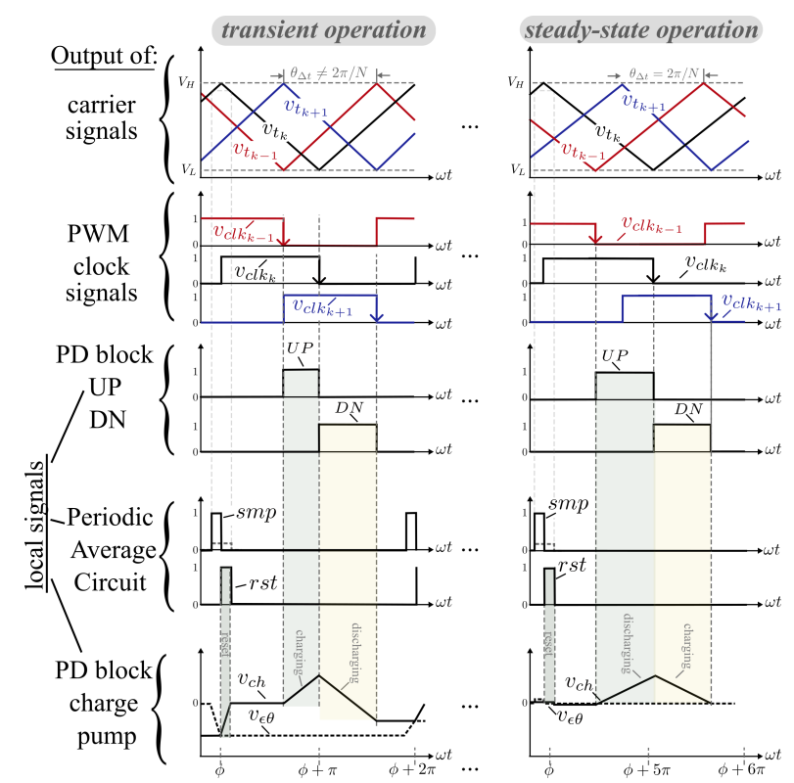
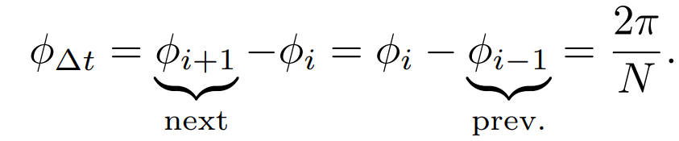
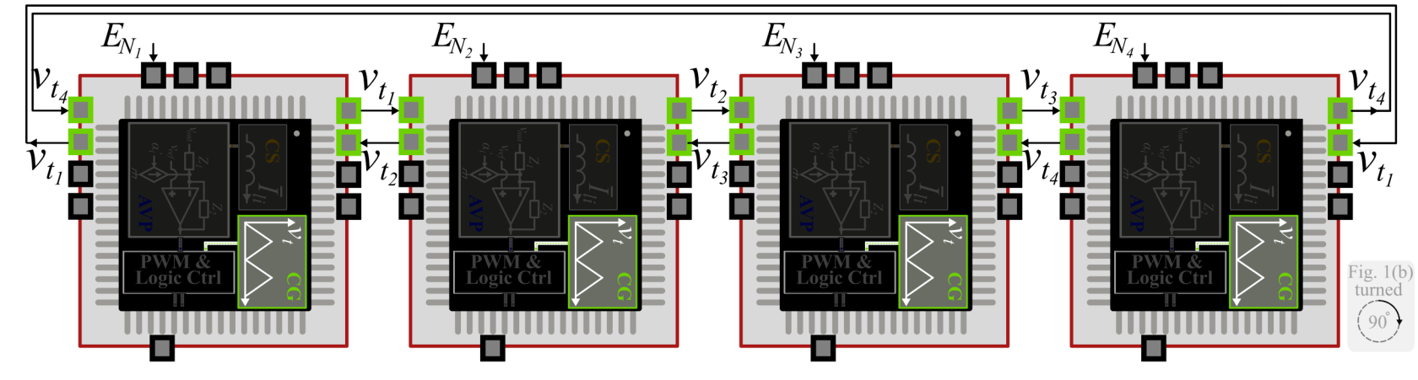
2. MODELING – IMPLEMENTATION OF PROPOSED APPROACH
#1 – Interleaved Carrier Generation (CG) Block
Principle of auto-interleaved Carrier Generation
How does it works ?
We need to place each carrier rigorously at the center of next and previous carriers. So we need sure that:
A chain of Inter-ASIC communications.
Each ASIC exchanges information with its close neighbors
Generation of a relative position error signal
Inter-ASIC chain of communications.
Notes:
Main point for proper operation is that each carrier or triangular signal must be fixed in the center of next and previous carriers

Slide 6
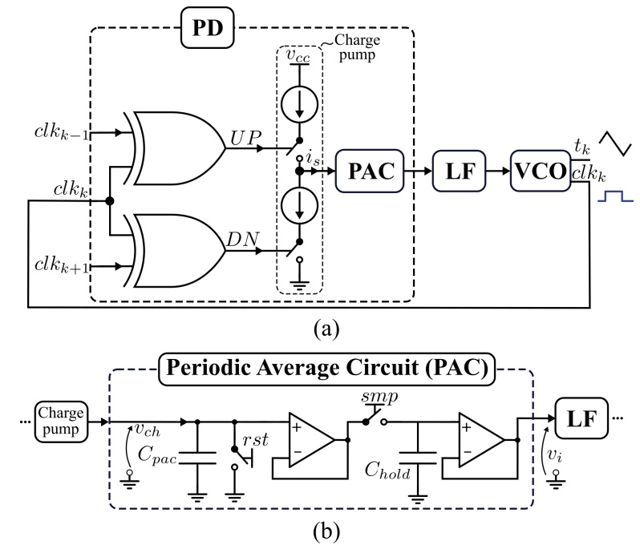
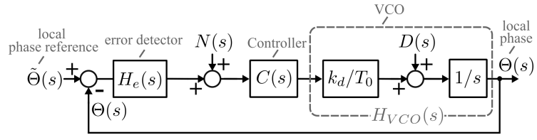
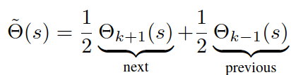
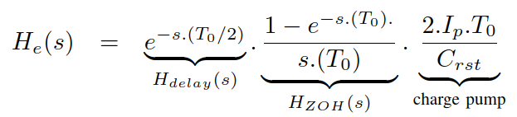

2. MODELING – IMPLEMENTATION OF PROPOSED APPROACH
#1 – Interleaved Carrier Generation (CG) Block
Implementation : a 2-inputs PLL circuit
Low-pass filter and stability concerns
Control block diagram of a single-loop representing one LC elements.
2I-PLL overview for local k-th module example.
(a) PD block. (b) PAC block
Generation of an relative position error signal
Inter-ASIC chain of communications.
Notes:
Main point for proper operation is that each carrier or triangular signal must be fixed in the center of next and previous carriers

Slide 7
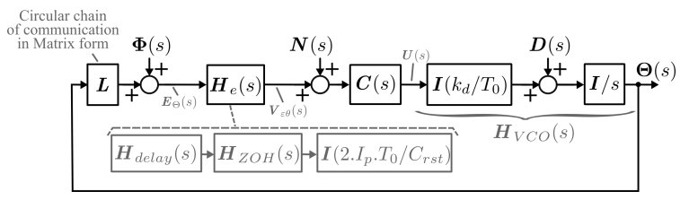
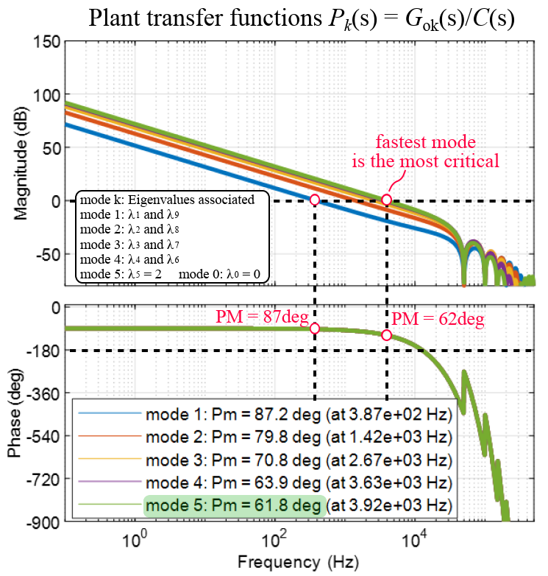
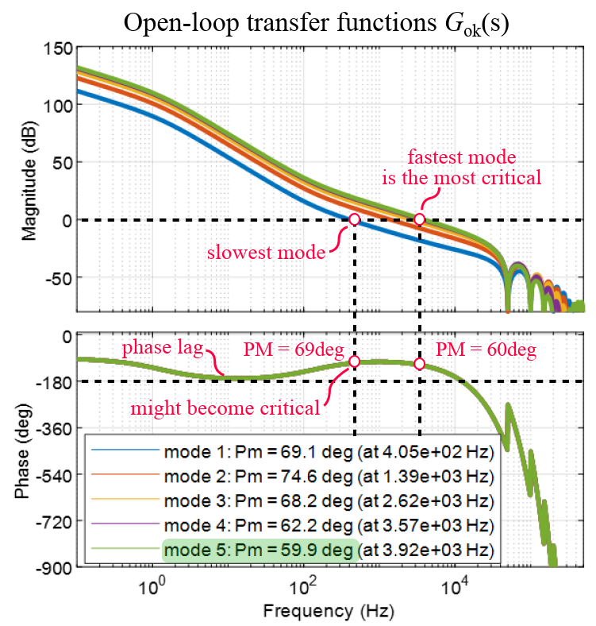
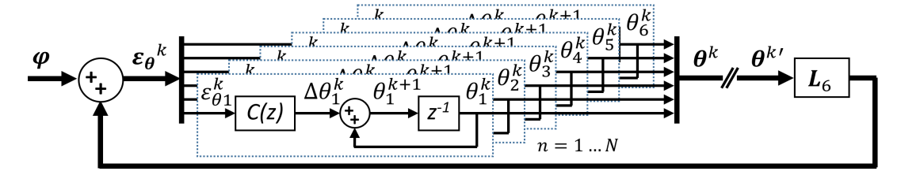
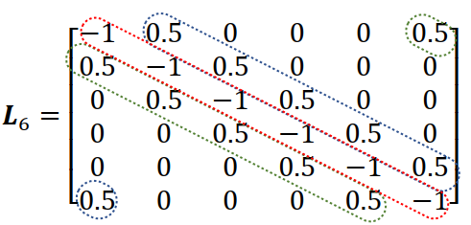
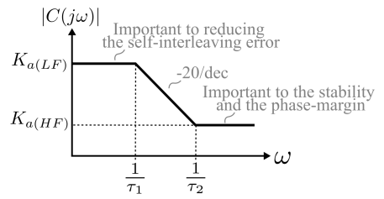

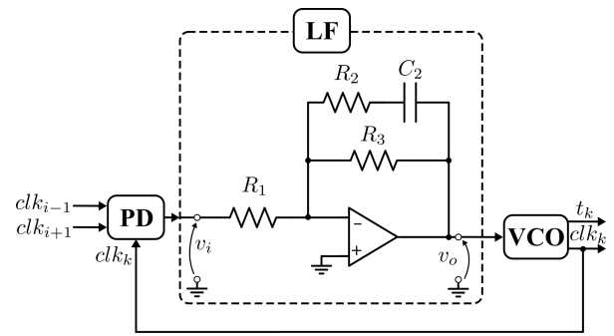
2. MODELING – IMPLEMENTATION OF PROPOSED APPROACH
#1 – Interleaved Carrier Generation (CG) Block
Corrector design and modal response
Modal response
Modal response with a simple proportional for C(s)
Modal response with C(s)
Inter-ASIC chain of communications.
Notes:
Main point for proper operation is that each carrier or triangular signal must be fixed in the center of next and previous carriers

Slide 8
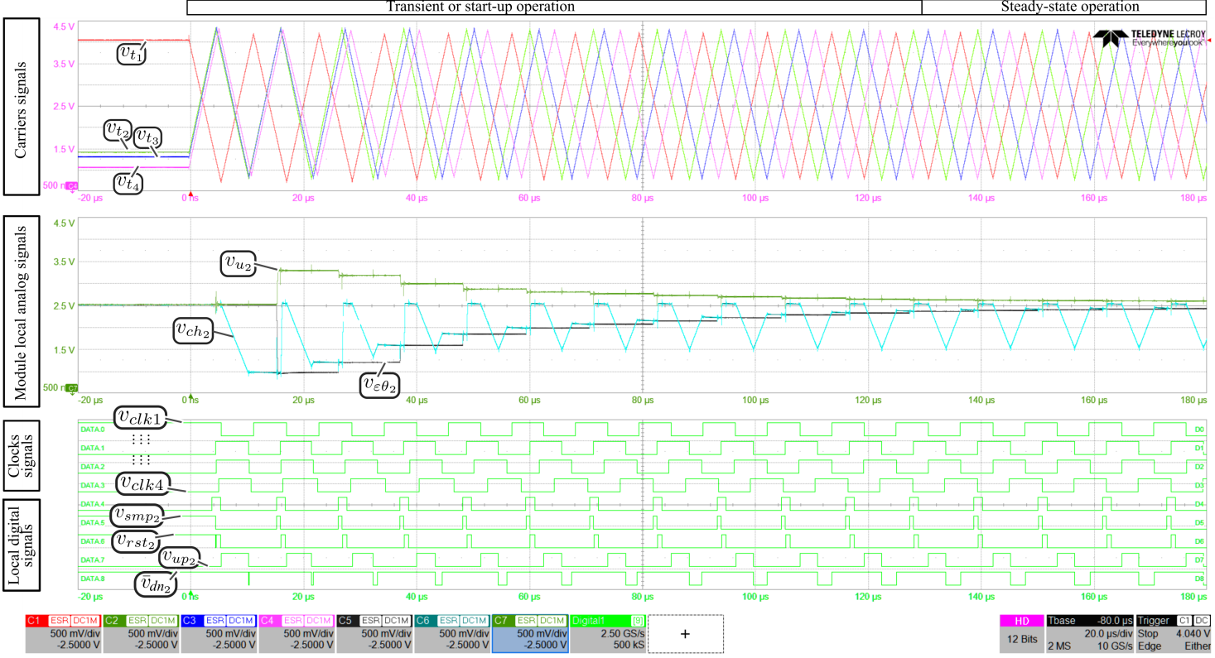
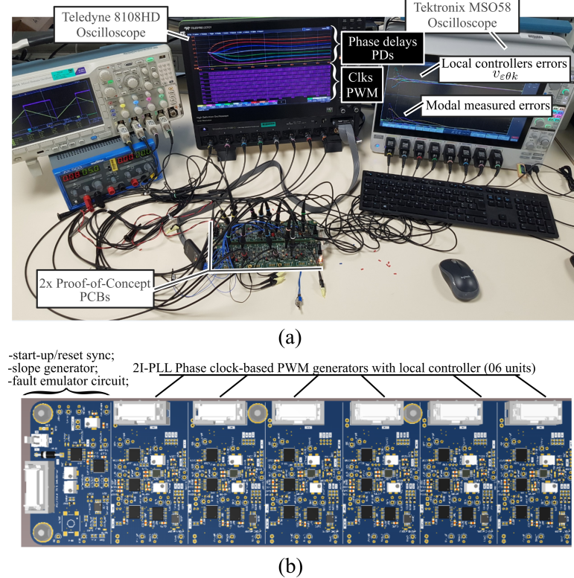
2. MODELING – IMPLEMENTATION OF PROPOSED APPROACH
#1 – Interleaved Carrier Generation (CG) Block
Experimental results
Experimental results. (a) Set-up overview.
(b) Proof-of-concept board with 6 local controller boards and shared functions.
Inter-ASIC chain of communications.
Notes:
Main point for proper operation is that each carrier or triangular signal must be fixed in the center of next and previous carriers

Slide 9
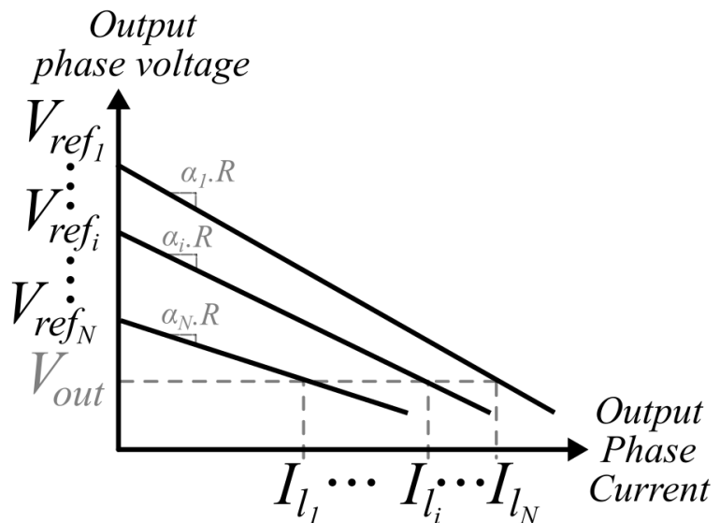

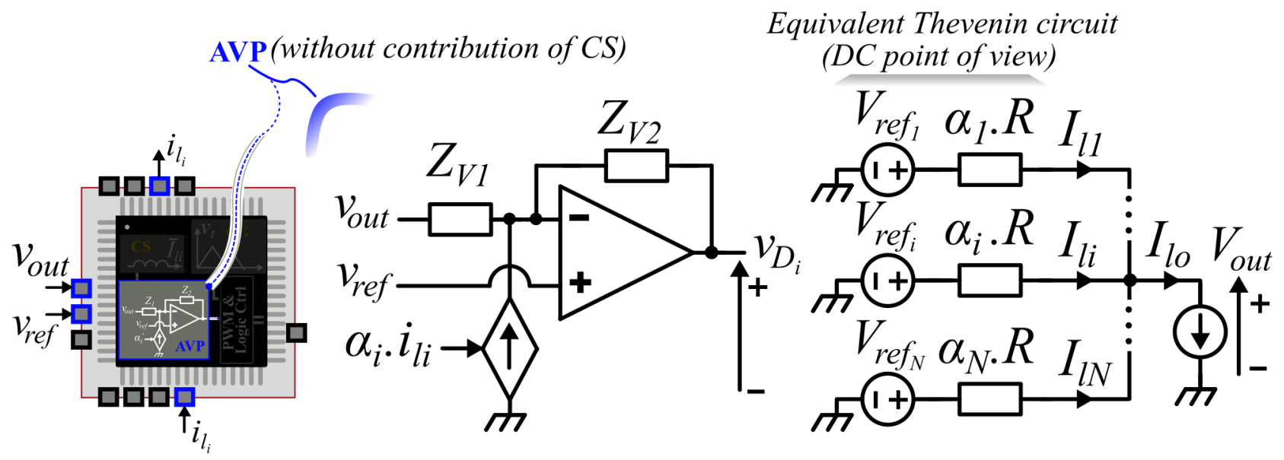

2. MODELING – IMPLEMENTATION OF PROPOSED APPROACH
#2 – Adaptive Voltage Positioning (AVP) Block
Decentralized AVP Principle
Output characteristic (load-line or droop or drop)
Each module determines its own duty-cycle
A drop control method is used
Local voltage reference
Drop control
$$v_{refi}$$
Mismatches between modules must be considered
Resulting in unbalanced currents

Slide 10
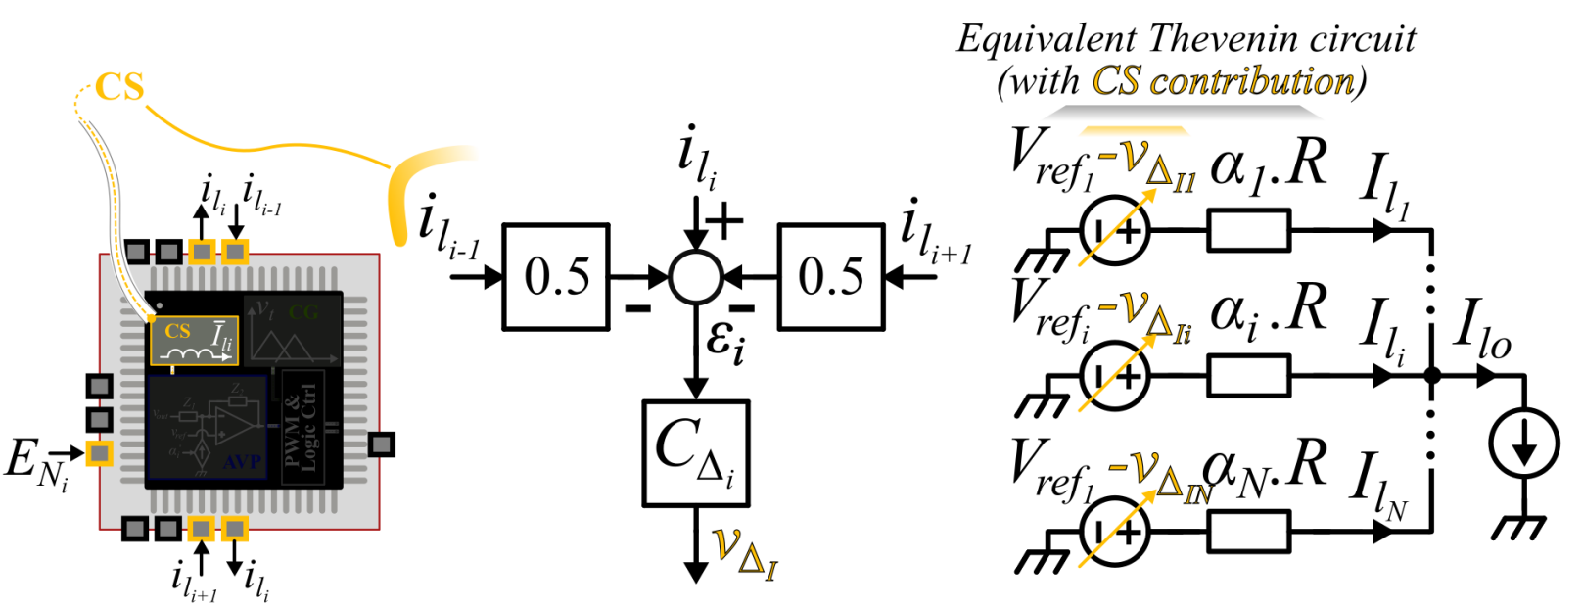

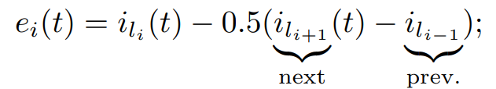
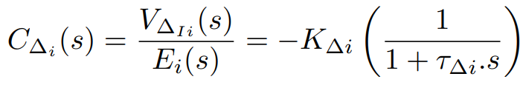
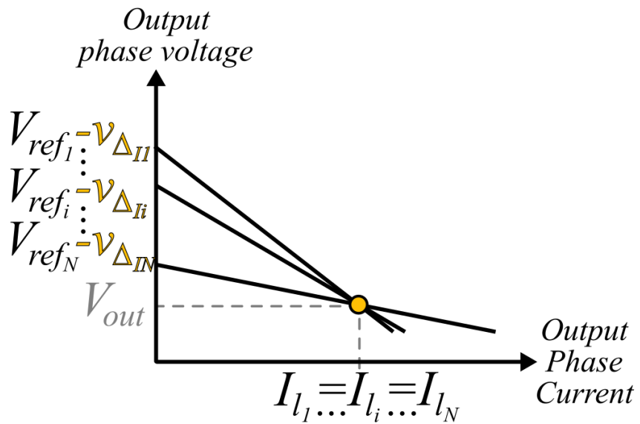


2. MODELING – IMPLEMENTATION OF PROPOSED APPROACH
#3 – Current-sharing (CS) Block
Principle of Current-sharing
Phase current balacing
Without Current-sharing (CS)
Sensitive to R_{drop} mismatches
!
$α$can be affected from sensor mismatches
$$α_{1}R_{{droop}_{1}}$$
$$α_{i}R_{{droop}_{i}}$$
$$α_{N}R_{{droop}_{N}}$$
With Current-sharing (CS)
Closed-loop time
response
Tuned to guarantee system stability
Using the current-sharing function, a focal point is obtained.
($I_{L_{1}}=I_{L_{i}}$=…=$I_{L_{N}}$)
The CS function is decentralized.
CS functions balance the phase currents by adjusting the relative position of the characteristics.
Thanks to the ring communication, it becomes easy to remove a module from the chain.

Slide 11
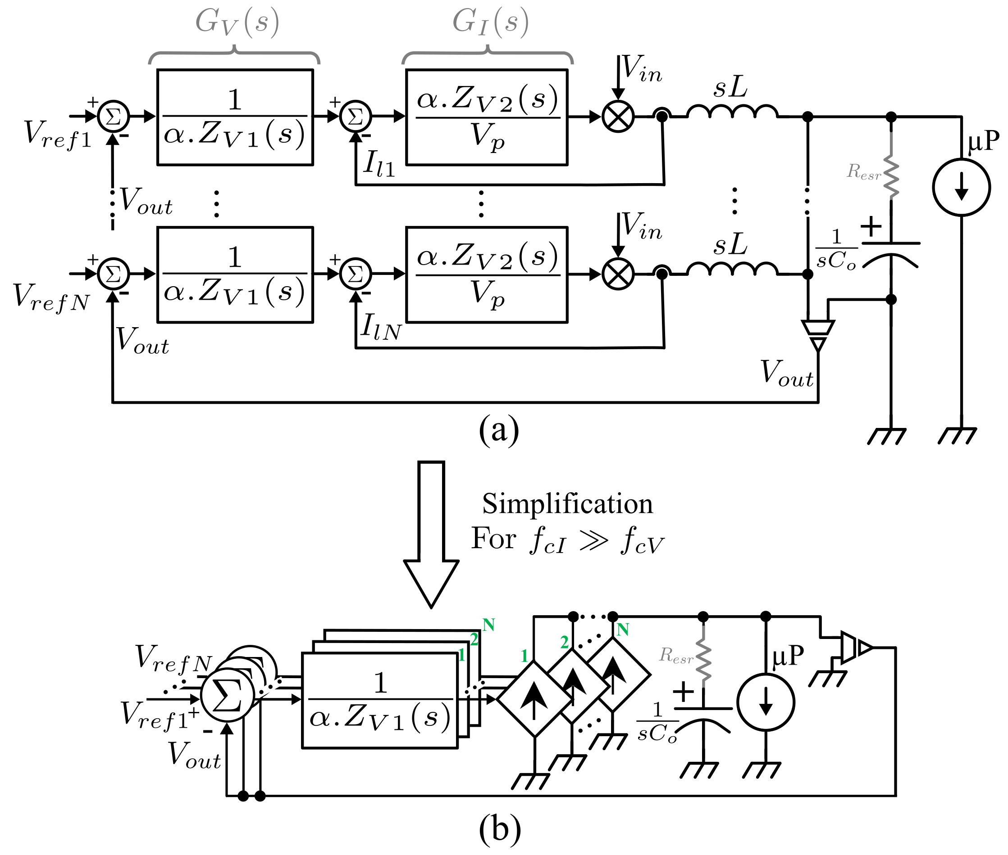
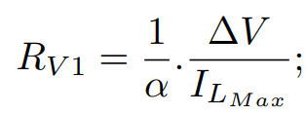
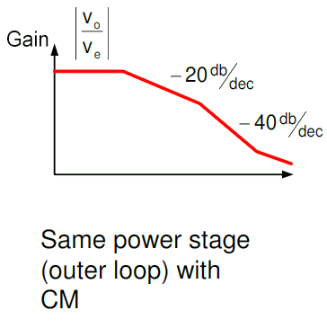
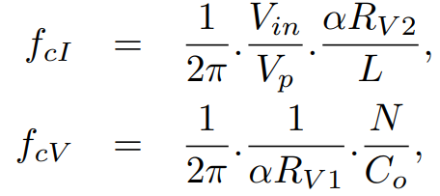
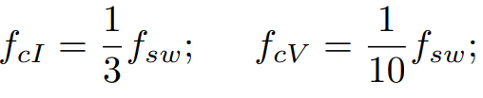



3. DISCUSSIONS – ANALYSIS AND SIMULATION RESULTS
#Design and Stability Analysis
Controller Designs
A high ωci can simplify the buck converter from a 2nd-order system to a 1st-order system (i.e., the inductor becomes a voltage-controlled current source).
1st
Order
2nd
Order
ESR
Effect
HF
AVP control block diagram for N-modules
High ωci
$Z_{V1}\left(s\right)=R_{V1}$, and
Expected open-loop transfer function
$$Z_{V2}\left(s\right)=R_{V2}+\frac{1}{sC_{V2}}$$
Simplified circuit
Frequency relationship and Guidelines. Make sure to
$ω_{sw}$>> $ω_{cTi}$>> $ω_{cT2}$
$ω_{cTi}=0.33ω_{sw}$ and $ω_{cTv}=0.1ω_{sw}$

Slide 12
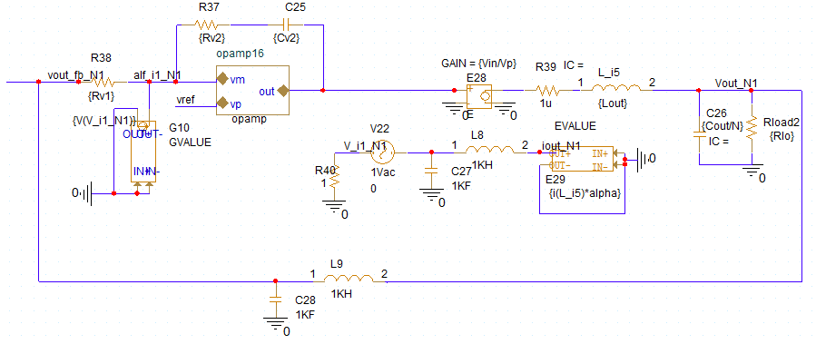
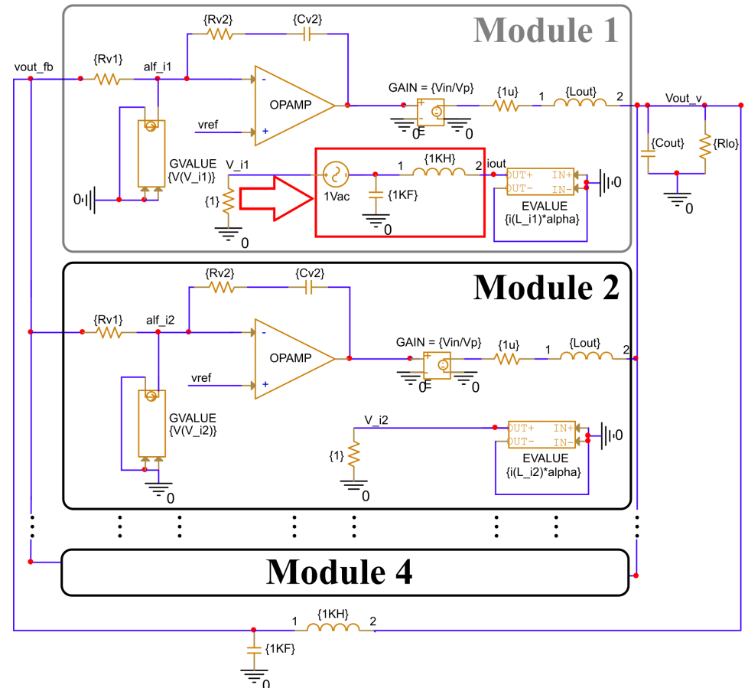
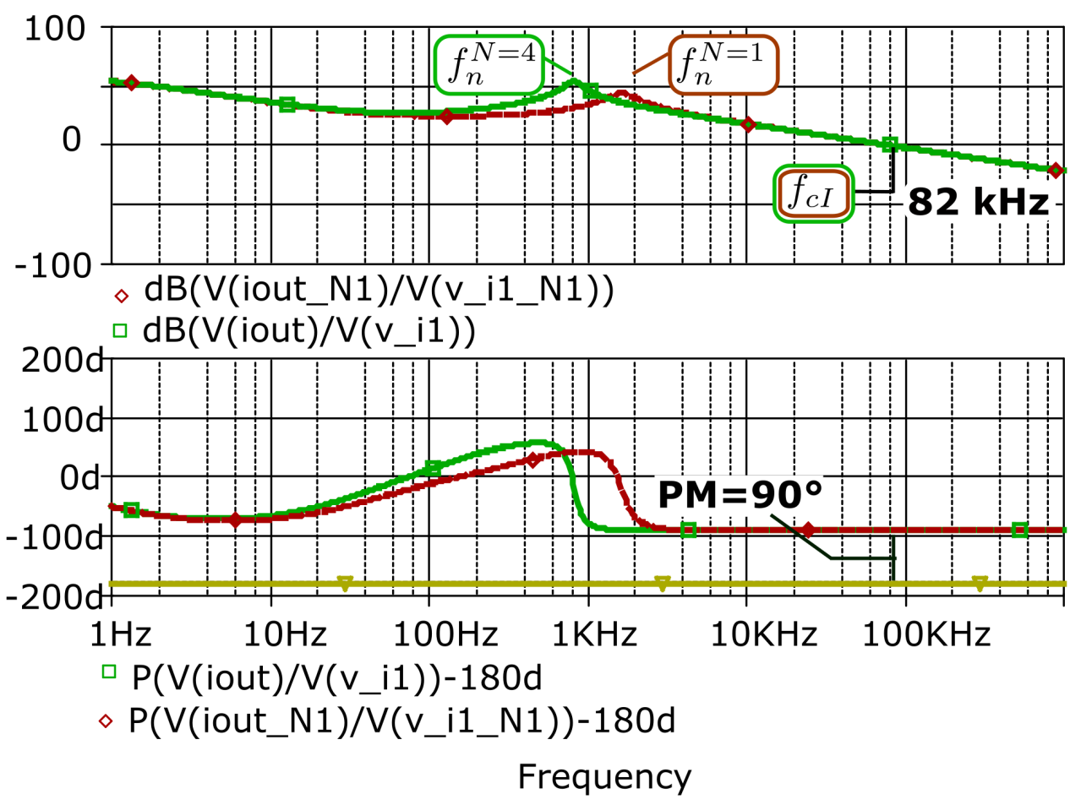
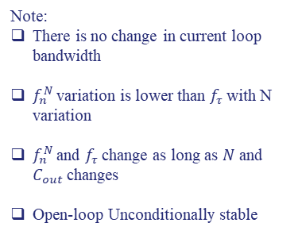
3. DISCUSSIONS – ANALYSIS AND SIMULATION RESULTS
# Simulation results (Frequency-domain)
Impact of N in the current loop (Inner loop)
-20dB/dec
N
+20dB/dec
Theoretical Transfer Function
-20dB/dec
w
w_{n}
w_{cI}
Note:
There is no change in current loop bandwidth
$f_{n}^{N}$ variation is lower than $f_{τ}$ with N variation
$f_{n}^{N}$ and $f_{τ}$ change as long as $N$ and $C_{out}$ changes
Open-loop Unconditionally stable
[Opening
the inner-loop]
Inner-loop

Slide 13
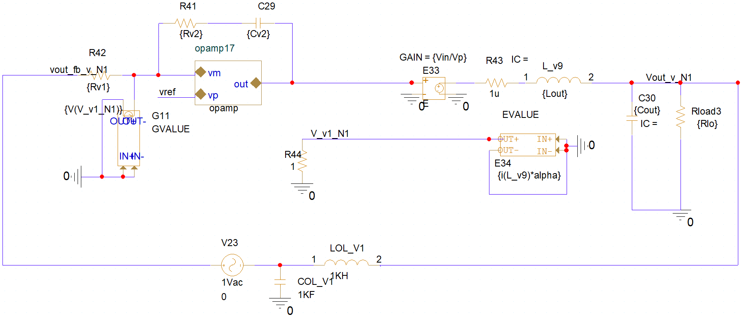
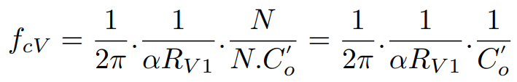
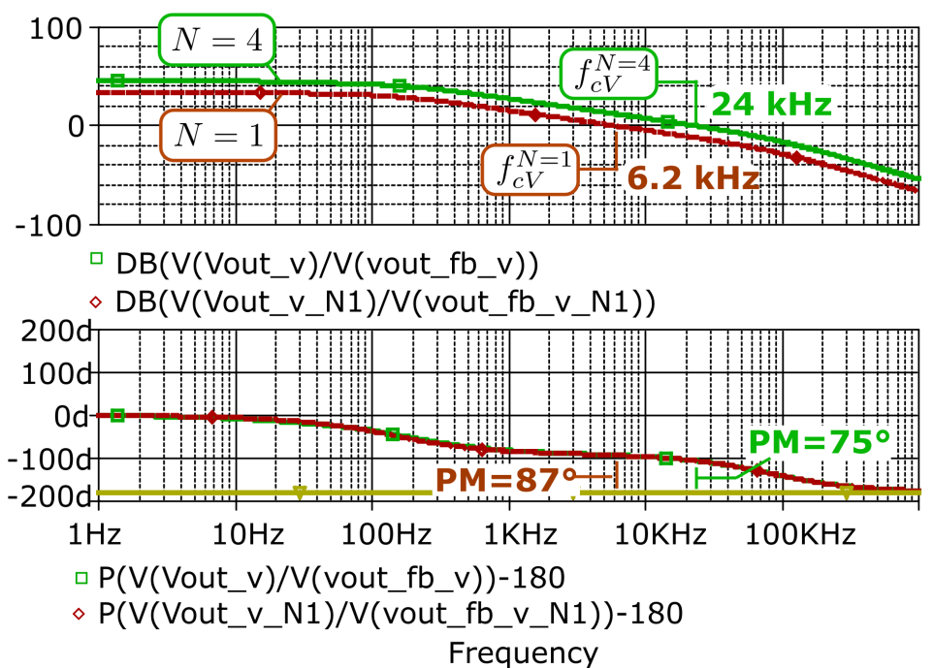
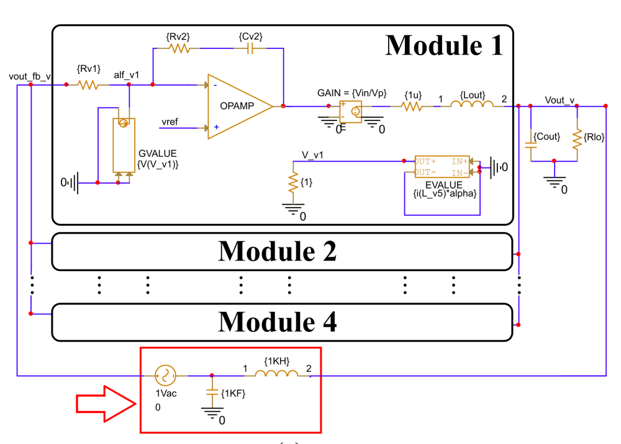

3. DISCUSSIONS – ANALYSIS AND SIMULATION RESULTS
# Simulation results (Frequency-domain)
Impact of N in the voltage loop (Outer-loop)
Design strategy 1
Design strategy 2
If $C_{o}$ value is normalized as $C_{o}^{′}=C_{o}/N$ in one-module there is no change in HF
N
N
Theoretical Transfer Function
-1
w
w_{cV}
Outer-loop with normalized $C_{o}^{′}$
Outer-loop
[Opening the outer-loop]

Slide 14
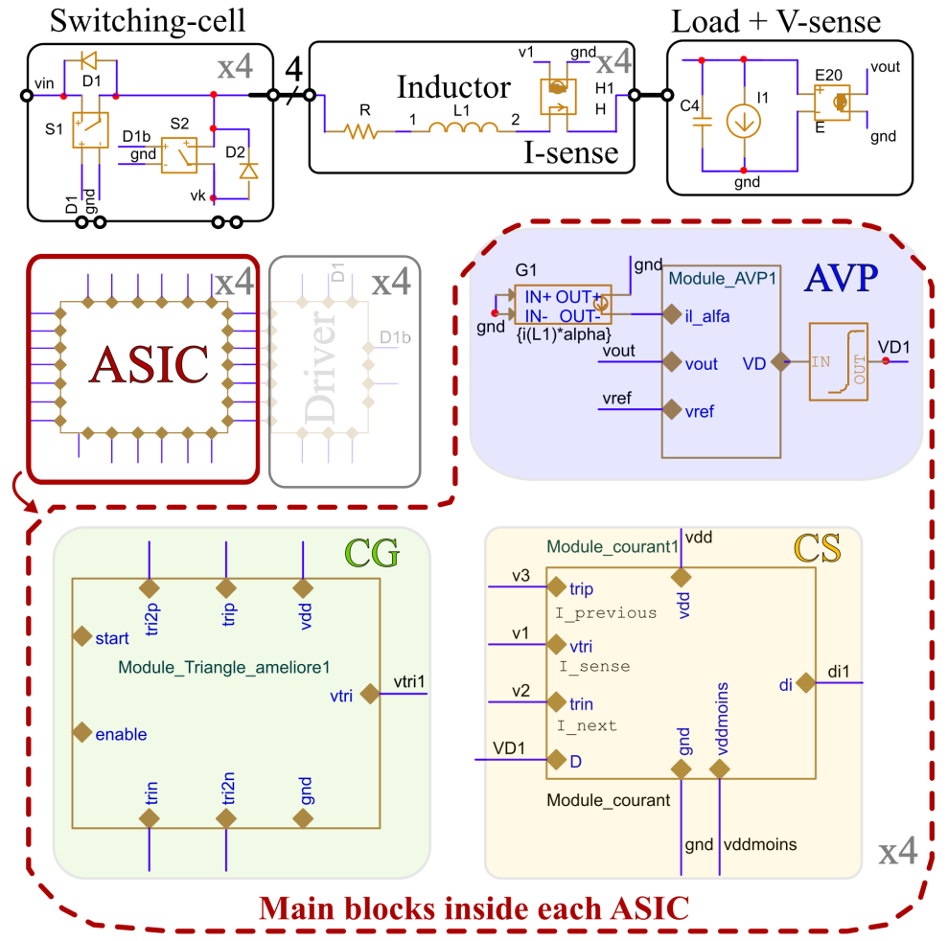
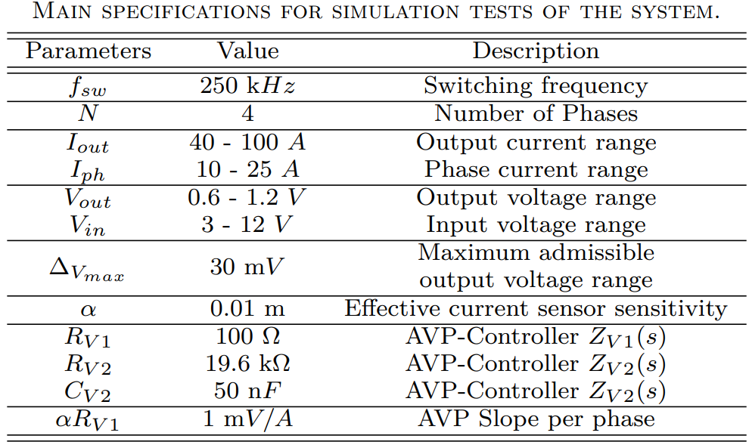
3. DISCUSSIONS – ANALYSIS AND SIMULATION RESULTS
# Simulation results (Time-domain)

Slide 15
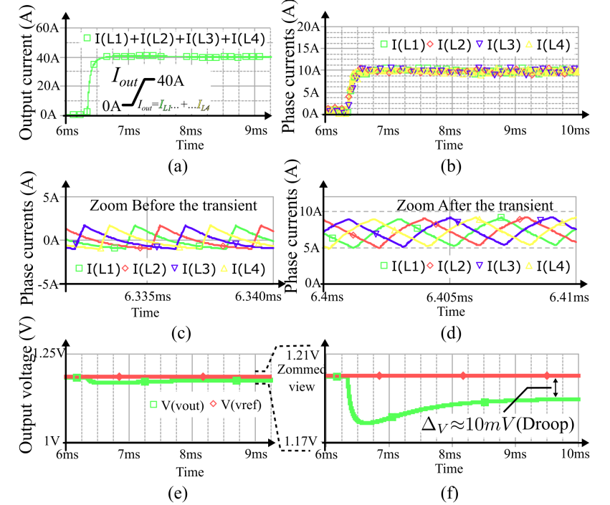
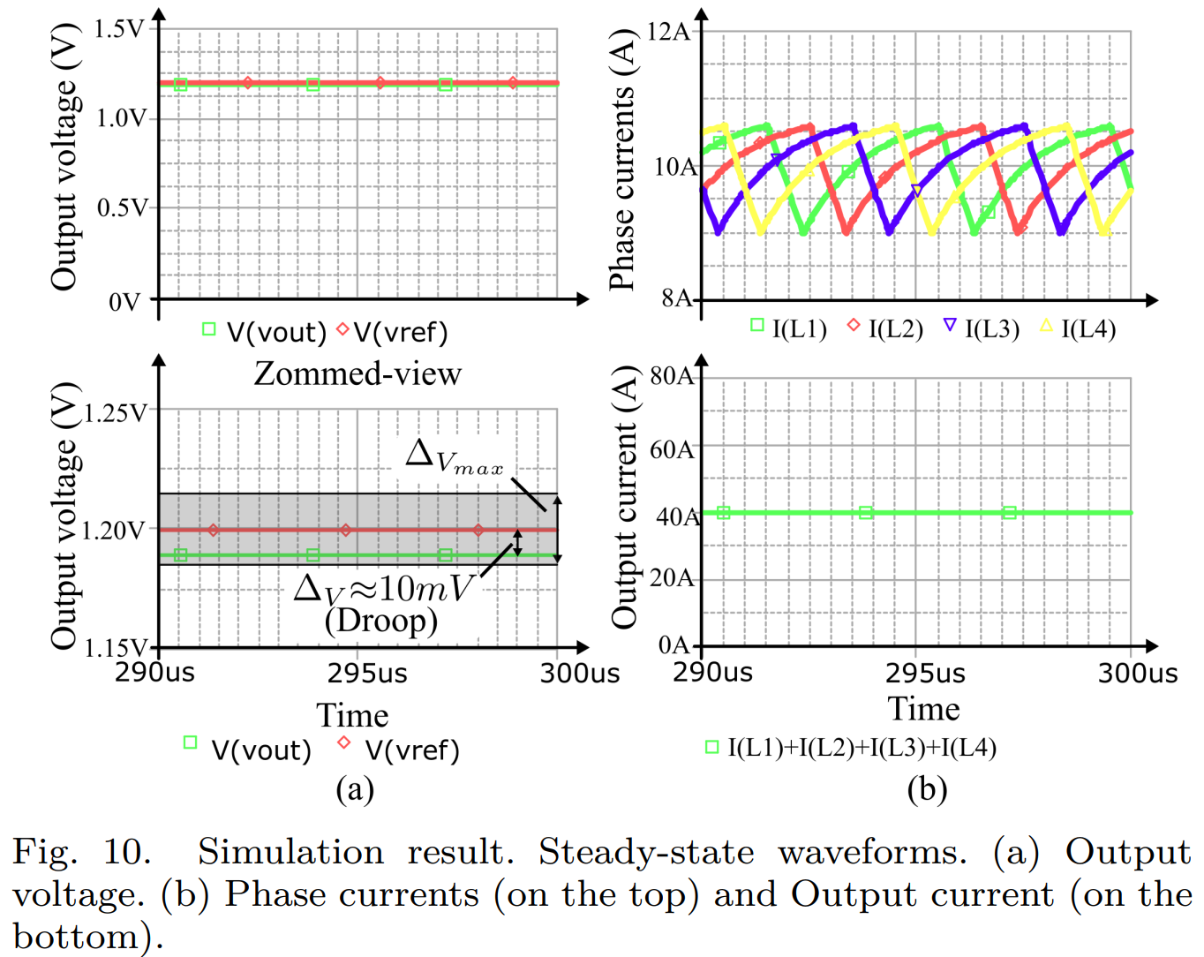
3. DISCUSSIONS – ANALYSIS AND SIMULATION RESULTS
# Simulation results (Time-domain)
Steady State Result
Load Transient Result

Slide 16
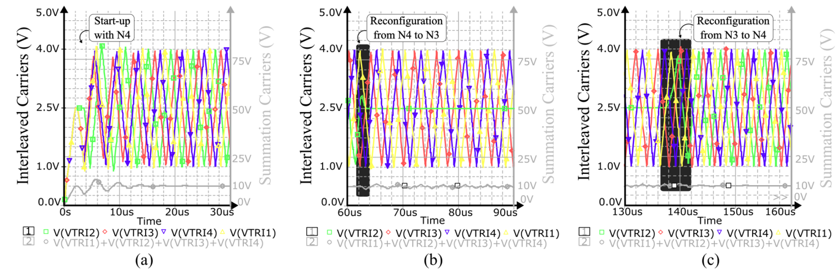
3. DISCUSSIONS – ANALYSIS AND SIMULATION RESULTS
# Simulation results (Time-domain)
CG Block simulation with reconfiguration test
Experimental setup. (a) Start-up
(b) Reconfiguration from 4 to 3 phases
(c) Reconfiguration from 3 to 4 phases

Slide 17
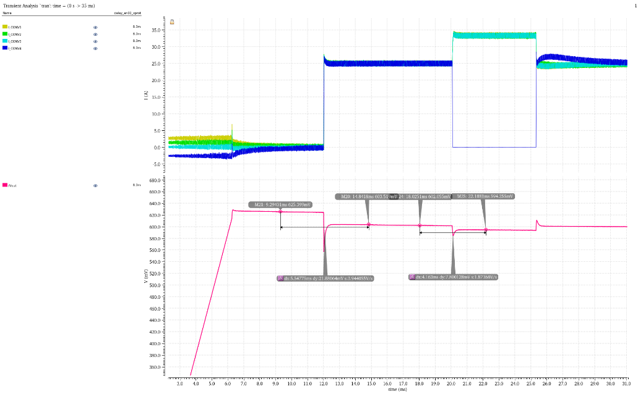
3. analog behavioral modeling and implementation
Prior to the ASIC design phase, a detailed model was developed at sub-block level which allowed :
  the validation of the system architecture down to individual functions
  the debugging and correction of some design hypothesis
mismatch injection all along the benchmark
automatic current balancing
25A load step
per phase [A]
output
voltage [V]
idle
soft ramp
0-100A
load step
phase loss and
reconfiguration
phase
reinsertion
ASIC top architecture
Simulation example for a 4-controller 100 Amperes configuration
Notes:
Local ASIC controllers were implemented in SPICE language as analog behavioral modeling (ABM).
It has auto-reconfiguration capability (in case of failure) occurring either in the power stage or in the IC control stage of the converter in such a way that it is able to continue to operate with N-1 active phases. This is thanks to the usage of local controllers connected together in a circular chain of communications.
The SPICE simulation results validate the performance of the proposed method which can be seen as an effective solution to achieve the requirements of the embedded space system.

Slide 18
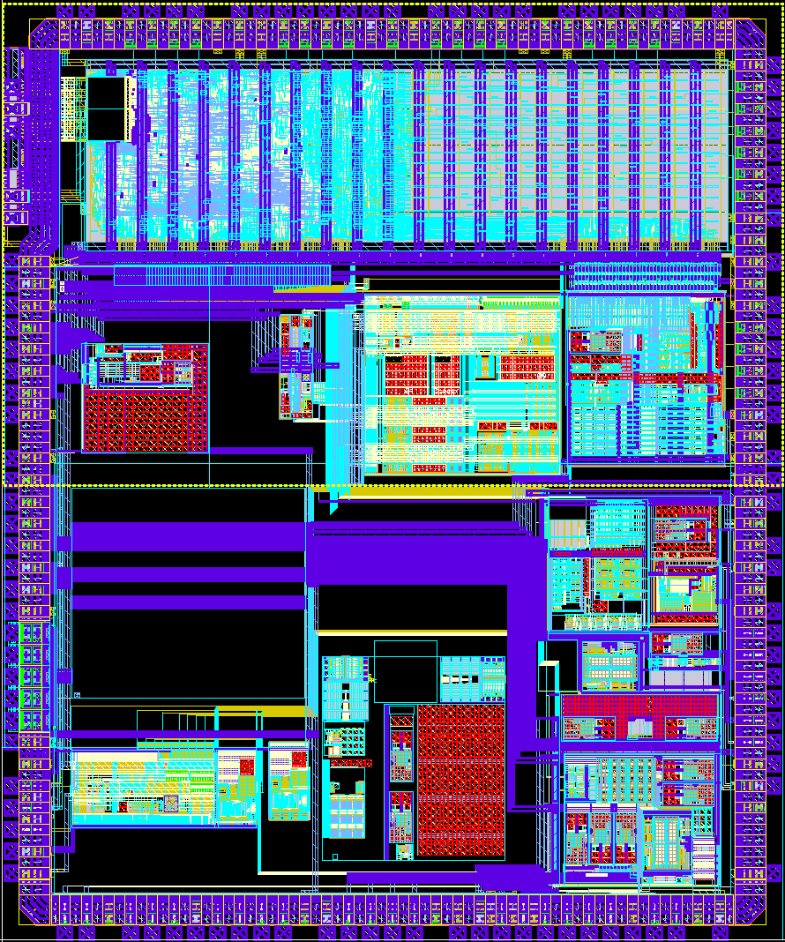
4. Asic HARDENING FOR SPACE
the digital control functions are developed using a design methodology to guarantee the good function over the mission profile with :
  radiation hardened standard cells library
  auto corrective registers, especially the control of the analog part.
  lock free state machines (prevent loss of functionality due to register upset or SEFI)
  system resilient to unexpected reset with a transparent reinsertion of a circuit.
At system level, mismatch and events were injected during the simulations to harden the analog part to the right need (no excess design nor underdesign), especially for :
  current sensing and sharing with other circuits.
  voltage sensing and adaptive voltage positioning.
  pulse with modulation with non overlapping outputs by design
  inter-circuit synchronization or standalone operation.
  integration of electrical constraints of large PCBs.
At top level, mixed signal simulations (digital RTL code + analog at transistor level) to guarantee the right control, connections, and generate test patterns for industrialization.
ASIC Layout (X-Fab 180nm XH018, 5x6 mm² )
Notes:
Local ASIC controllers were implemented in SPICE language as analog behavioral modeling (ABM).
It has auto-reconfiguration capability (in case of failure) occurring either in the power stage or in the IC control stage of the converter in such a way that it is able to continue to operate with N-1 active phases. This is thanks to the usage of local controllers connected together in a circular chain of communications.
The SPICE simulation results validate the performance of the proposed method which can be seen as an effective solution to achieve the requirements of the embedded space system.

Slide 19
4. Conclusions and Futures Works
Conclusions
A decentralized control concept applied to a multiphase interleaved synchronous buck converter suitable for power management in satellites systems has been presented.
Three main features of each local ASIC: i) the self-interleaved carriers/PWM signals, ii) Local AVP voltage regulation, iii) and local the current-sharing capability.
Possibility to improve system functional safety thanks to:
  Modularity and Scalability
  Fault-tolerance and auto-reconfiguration capability (operation with N-1 active phases is guaranteed under a faulty condition).
  Local controllers connected in a circular chain of communications.
The proposed method and theoretical expectations are validated by SPICE simulations and lab. prototypes,
Notes:
Local ASIC controllers were implemented in SPICE language as analog behavioral modeling (ABM).
It has auto-reconfiguration capability (in case of failure) occurring either in the power stage or in the IC control stage of the converter in such a way that it is able to continue to operate with N-1 active phases. This is thanks to the usage of local controllers connected together in a circular chain of communications.
The SPICE simulation results validate the performance of the proposed method which can be seen as an effective solution to achieve the requirements of the embedded space system.

Slide 20
Acknowledgment
This project has received funding from the European Union’s Horizon Europe research and innovation program under grant agreement No 101082266.
The authors acknowledge the active contribution of
  Thales Alenia Space,
  LAPLACE laboratory, Institut National Polytechnique de Toulouse (INP-Toulouse),
  ISD,
  Synergie CAD,
  and IMEC.

Slide 21

Thank you
Visit our website for more: https://scopsproject.eu/
21

Slide 22


OUTLINE
Decentralized Control for a Fault-Tolerant, Fully Scalable Microprocessor Power Supply for Spacecraft Applications
1
INTRODUCTION – DECENTRALIZED CONTROL CONCEPT
2
MODELING – IMPLEMENTATION OF PROPOSED APPROACH
3
DISCUSSIONS – ANALYSIS AND SIMULATION RESULTS (4-phase study case)
4
CONCLUSIONS AND FUTURE WORKS

Slide 23
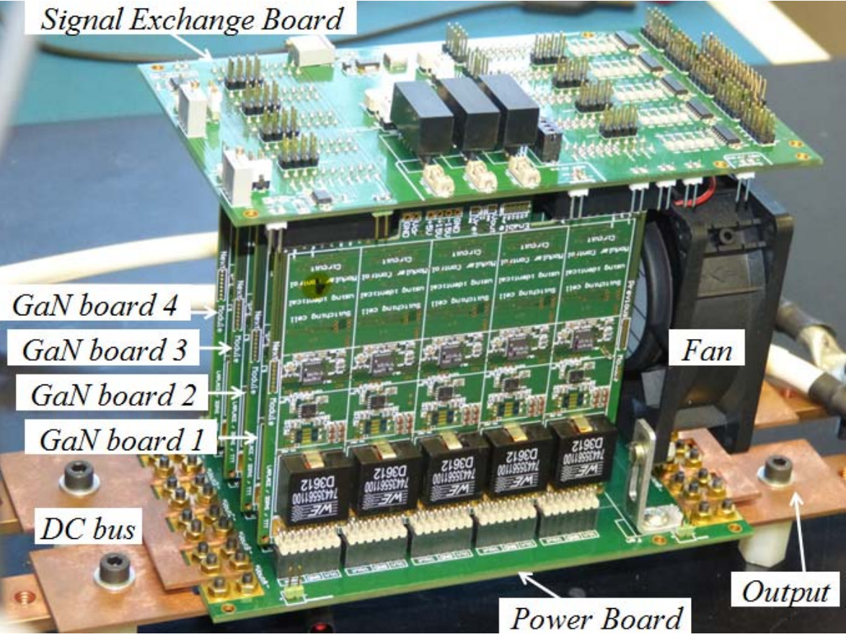
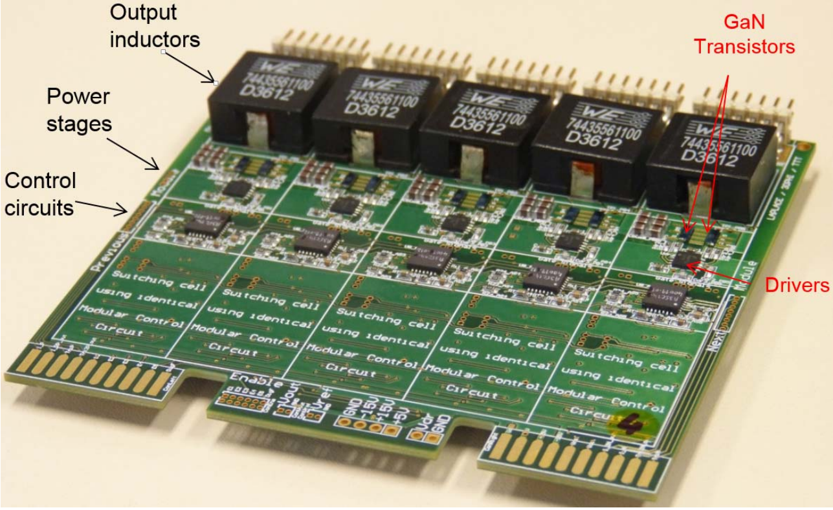
Multiphase-Interleaved DC-DC Converters and decentralized concept (Protoype in Lab Scale)
In 2016 a 25-ph prototype was built as proof-of-concept
@LAPLACE Laboratory - [P4]
Source: [P4]-[P5]
GaN boards including 5 identical legs managed by the decentralized PWM controller (with eGaN FETS EPC1001 (100V, 25A, 125°C, 500kHz)

Slide 24
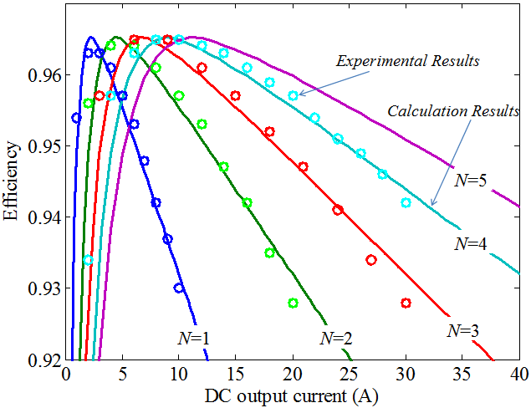
Experimental results :
Dynamic reconfiguration & Efficiency vs N
Behavior of the currents during a reconfiguration sequence (from 4 cells to 3 cells):
Efficiency vs the number of active cells :
Waveforms of cells 2, 3 and 4
when Cell 4 is disabled
(2A/div; 2V/div; 200us/div).
Measured efficiency of designed converter for different number of active cells and for input voltage of 12V and output voltage of 5V. Calculation results are shown in solid lines. Experimental measurements are represented by circles.

Slide 25
SELECTED REFERENCES
[P1] X. Zhou, X. Zhang, J. Liu, P.-L. Wong, J. Chen, H.-P. Wu, L. Amoroso, F. Lee, and D. Chen, “Investigation of candidate vrm topologies for future microprocessors [voltage regulator modules],” in APEC ’98 Thirteenth Annual Applied Power Electronics Conference and Exposition, vol. 1, 1998, pp. 145–150 vol.1.
[P2] M. Cousineau, “Modular static converters with parallel or series architecture and decentralized modular control,” France Patent WO 2014/005 973 Al, 1 9, 2014.
[P3] G. Aulagnier, M. Mannes, E. Rolland, P. Goyhenetche, and M. Cousineau, “Distributed control of a voltage regulator,” U.S. Patent US011 456 671B2, 9 27, 2022
[P4] M. Cousineau and B. Cougo, “Interleaved converter with massive parallelization of high frequency GaN switching-cells using decentralized modular analog controller,” in 2015 IEEE Energy Conversion Congress and Exposition (ECCE), 2015, pp. 4343– 4350.
[P5] M. Cousineau and Z. Xiao, “Fully decentralized modular approach for parallel converter control,” in 2013 Twenty-Eighth Annual IEEE Applied Power Electronics Conference and Exposition (APEC), 2013, pp. 237–243.
[P6] M. Mannes, “Contribution au Contrôle Distribué Tolérant à la Panne des Convertisseurs Multiphasés dédiés à l’alimentation de microprocesseurs pour application automobile,” Ph.D. dissertation, Institut National Polytechnique de Toulouse, 2021.
[P7] M. Mannes, M. Cousineau, M. Vivert, G. Aulagnier, and G. Gateau, “Eigendecomposition of a digital iterative decentralised interleaving for multicellular converters,” Elsevier Journal - Mathematics and Computers in Simulation, vol. 184, pp. 82–105, 2021
[P8] M. M. Hillesheim, M. Cousineau, and L. Hureau, “Reconfigurable Partial-Decentralized Control of a Multiphase Converter for Fail-Operational Automotive Processor Power Supply,” in 2019 21st European Conference on Power Electronics and Applications (EPE ’19 ECCE Europe), 2019, pp. P.1–P.
[P9] R. Erickson and D. Maksimovic, Fundarnentals of power electronics, 2nd ed. Kluwer Academic Publishers Group, 2001.
[P10] G. Almeida, M. Cousineau, D. Le Bars, F. Pecourt, P. Ayzac, "Decentralized Control for a Fault-Tolerant, Fully Scalable Microprocessor Power Supply for Spacecraft Applications," 13th European Space Power Conference (ESPC), 2 - 6 October, in Elche Alicante, Spain, 2023.

Slide 26
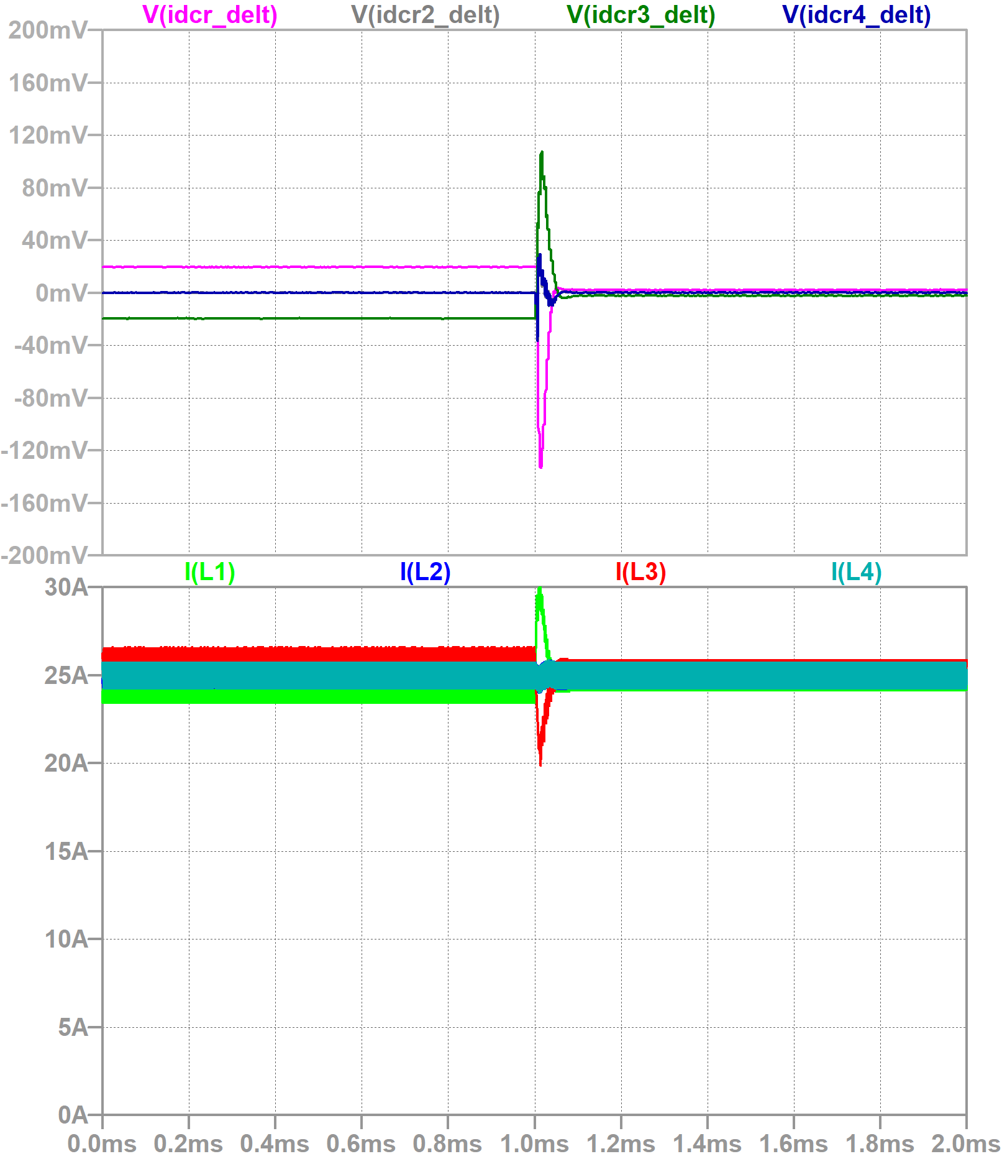
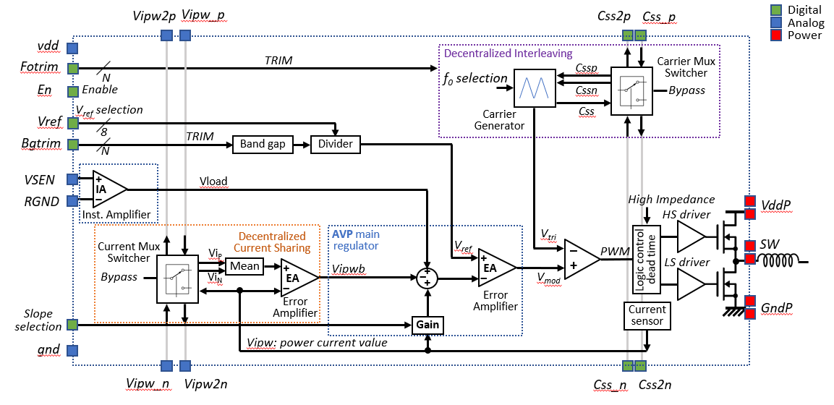
3. DISCUSSIONS – ANALYSIS AND SIMULATION RESULTS
# Simulation results (Time-domain)
Evaluating CS contribution
moment when Current-sharing is enabled
The CS control acts properly
Virtually 0V error in steady-state
In this scenario note that since the method can compensate the current deviation it is possible to observe the benefit of current-sharing when it is enabled after 1ms.

Slide 27
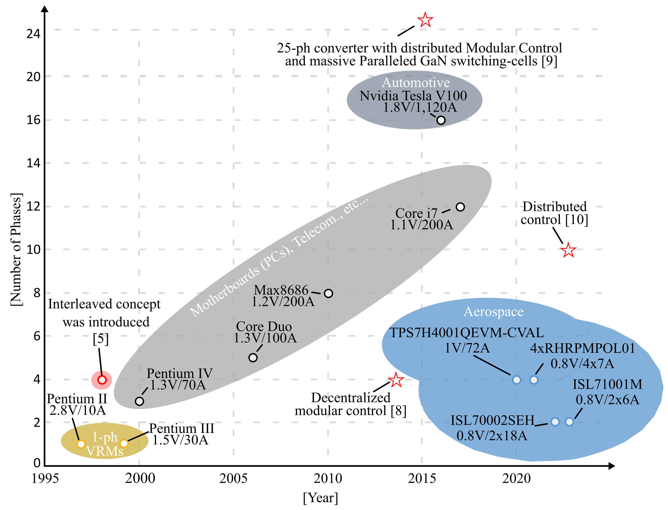
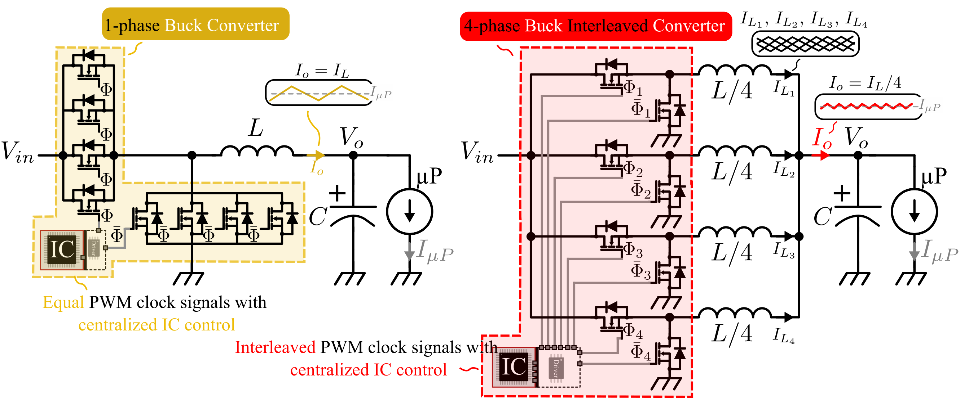

1. INTRODUCTION – DECENTRALIZED CONTROL CONCEPT
Multiphase-Interleaved DC-DC Converters and VRM evolution
Centralized (conventional) and Decentralized (proposed) concepts
Centralized (conventional) and Decentralized (proposed) concepts
[P4]
[P3]
[P1]
[P2]
Source: [P4]-[P5]
Notes:
The concept Is to provide a solution with fault-tolerant capability which permits to keep the operation with N-1 cells or phase in case of fault. It has also features of scalability where we need just make a copy and paste of identical cells to increase the number of phase as a function of the required current level
Each module or phase are connected in a circular chain they share some basic signals with their next and previous cells.

Slide 28
2. MODELING – IMPLEMENTATION OF PROPOSED APPROACH
#1 – Interleaved Carrier Generation (CG) Block
Corrector design and modal response
Modal response
Modal response without C(s)
Modal response with C(s)
Inter-ASIC chain of communications.
Notes:
Main point for proper operation is that each carrier or triangular signal must be fixed in the center of next and previous carriers

Slide 29









2. MODELING – IMPLEMENTATION OF PROPOSED APPROACH
#2 – Adaptive Voltage Positioning (AVP) Block
Decentralized AVP Principle
Main insights of AVP Block
Here, the AVP in a decentralized way consists to place the voltage regulation loop at the $i^{th}$ module level (i.e., locally)
Each module determines its own duty-cycle quantity ($v_{D_{i}}$)
In steady-state the relationship between the output voltage $V_{out}$ and the reference voltage $V_{refi}$ is maintained as
$$v_{refi}$$
Output characteristic (load-line or droop or drop)
Current sensor coefficient
…$V_{{ref}_{i}}$slightly different from $V_{ref}$…it can be seen some local mismatches
$$V_{{ref}_{i}}=V_{ref}±V_{offset}$$
$$×R$$
… $R$ can be associated with $R_{V1}$
If a scenario with asymmetries (mismatches) in the system takes place, the load-line may be observed as in the figure.
Possible mismatches: current sensor sensitivity, Controllers gains (Kp), DCRs, etc.
Virtual impedance (known as droop or drop or load-line
$${×I}_{li}$$
$$V_{droop}$$
AVP controller can P, PI for normal BW performances or Type-2 (integrator + 1 or 2 zeros)
$Z_{V1}\left(s\right)=R_{V1}$, or
$$Z_{V1}\left(s\right)=\frac{R_{V1}}{1+sR_{V1}C_{V1}}$$
$$Z_{V2}\left(s\right)=R_{V2}+\frac{1}{sC_{V2}}$$

