Slide 1
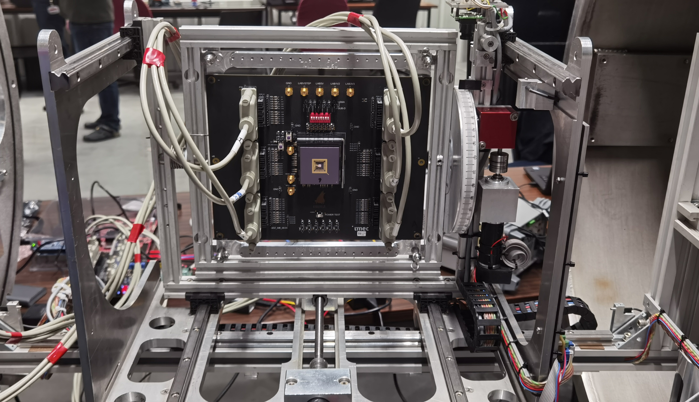
A High-performance TID- And SEE-tolerant ADC In 65 nm for Space Applications
Zheyi Li^{1,2}, Laurent Berti¹, Qiuyang Lin¹, Jinghao Zhao², Maxim Gorbunov¹, Geert Thys¹, Paul Leroux²
¹Imec, Leuven, Belgium
²Katholieke Universiteit Leuven, Geel, Belgium
https://room.eu.com/news/sentinel-3a-satellite-handed-over-to-eumetsat

Slide 2
Outline
Introduction
Radiation-Tolerant ADC Design Tradeoffs and Strategy
Proposed Radiation-Tolerant ADC for Space Applications
Results & Conclusions

Slide 3
SEEs in ADC
SEEs are the primary threat to the designs in advanced planner CMOS techniques
SEEs cause error at ADC outputs
Error can saturate the outputs
Error can be unrecoverable

Slide 4
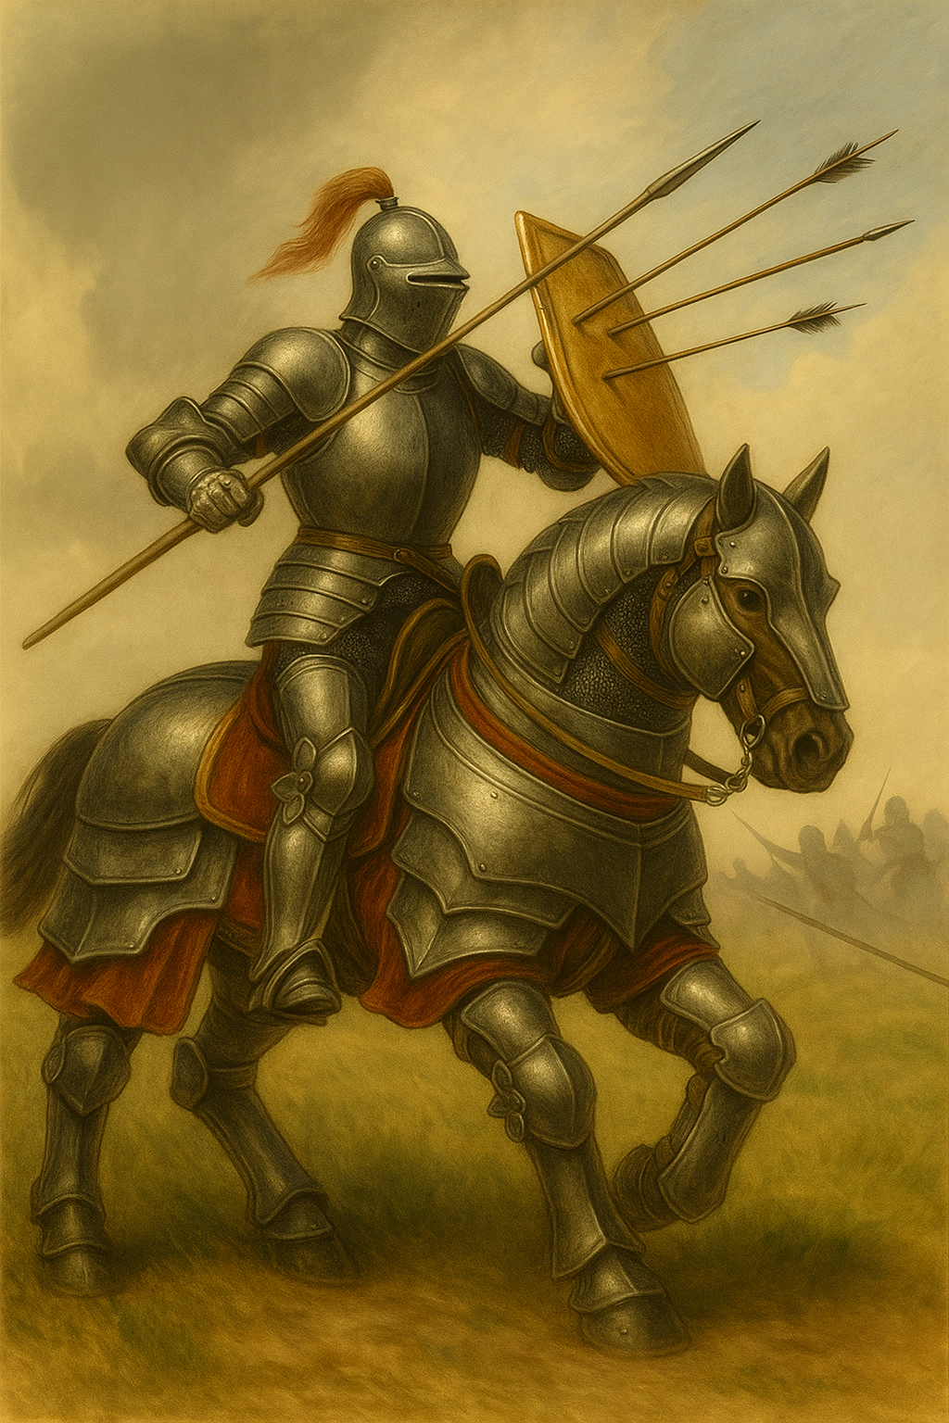
Hardening strategy
ADC
SEEs
Apply hardening method:
TMR
Guard Ring
Higher supply
Filter
….

Slide 5
Hardening strategy
ADC
SEEs
Hasty hardening makes ADC
Heavy
Slow
Power hungry
Area inefficient
=>Do we need harden every part of the ADC?

Slide 6
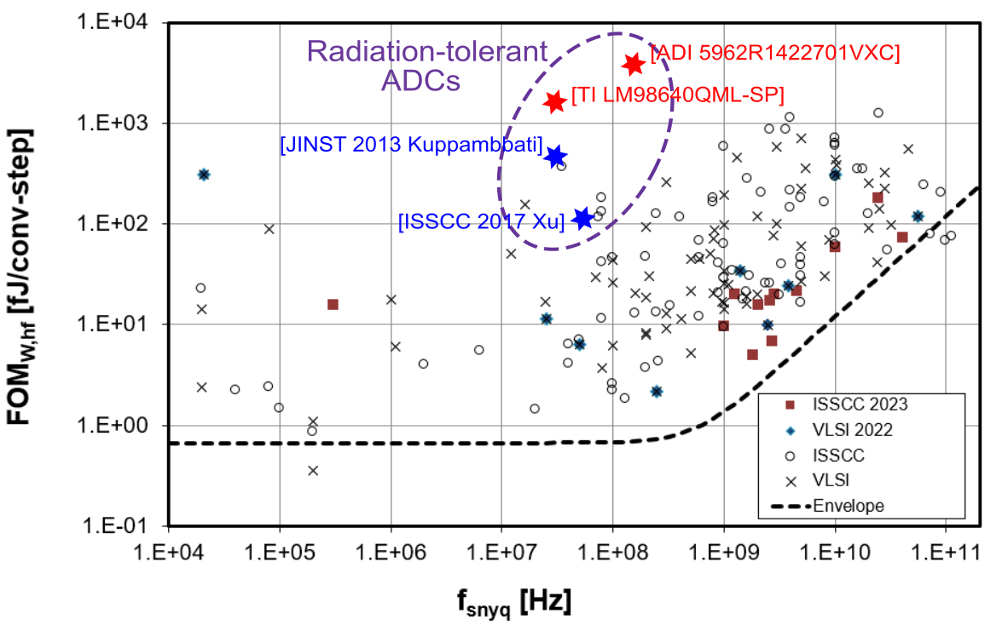
Hardening strategy
ADC
SEEs
B. Murmann, “ADC Performance Survey 1997-2023,” [Online]. Available:
https://github.com/bmurmann/ADC-survey.

Slide 7
Hardening strategy
ADC
SEEs
How about light hardening?
Only harden where it needs.
Limited the penalty.

Slide 8
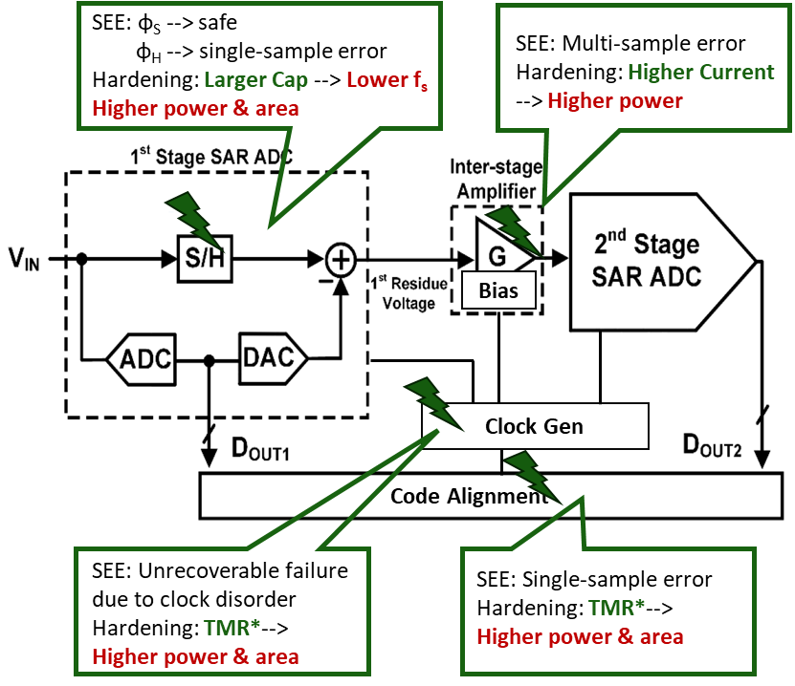
Challenges in SEE Hardening for ADC
SEE-induced error depends on sub-blocks and hit time
Hardening brings penalties in performance
Need a hardening guideline

Slide 9
Outline
Introduction
SEEs and ADC Design Tradeoffs and Strategy
Proposed Radiation-Tolerant ADC for Space Applications
Results & Conclusions

Slide 10
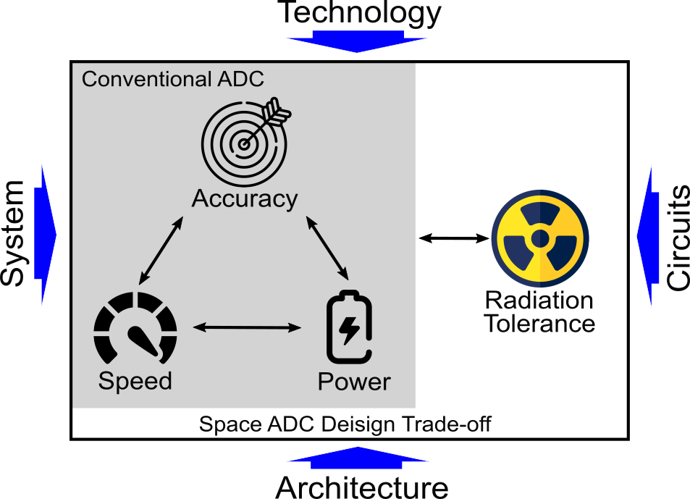
SEEs And ADC Design Tradeoffs 1
Focus on SEEs to

Slide 11
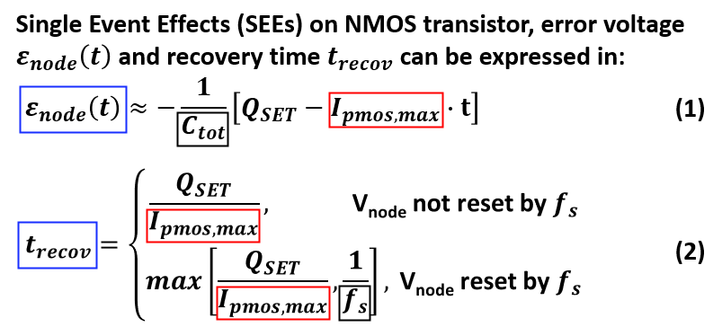
SEEs And ADC Design Tradeoffs 2
Reduce from the SEE source
Higher current
Higher capacitance
Lower sampling speed
Add reset

Slide 12
SEEs And ADC Design Tradeoffs 3
xA_{node}
Reduce from the ADC design
Higher LSB voltage
Larger digital gate width
Smarter design
Reduce Anode
Redundancy in digital blocks
….

Slide 13
Solutions
 | Direct solutions | Comments
From SEE source | Higher current | Power increase
 | Higher capacitance ☺ | Lower speed, Time-interleaving structure
 | Lower sampling speed ☺
 | Add reset ☺ | Negligible power increase
From ADC design | Higher LSB voltage ☺ | Higher Supply, higher power Pipelined structure
 | Larger digital gate width | Power & area increase
 | Reduce A_{node} ☺ | Limited efficiency penalty
 | Redundancy in digital blocks | Power & area increase

Slide 14
Outline
Introduction
SEEs and ADC Design Tradeoffs and Strategy
Proposed Radiation-Tolerant ADC for Space Applications
Results & Conclusions

Slide 15
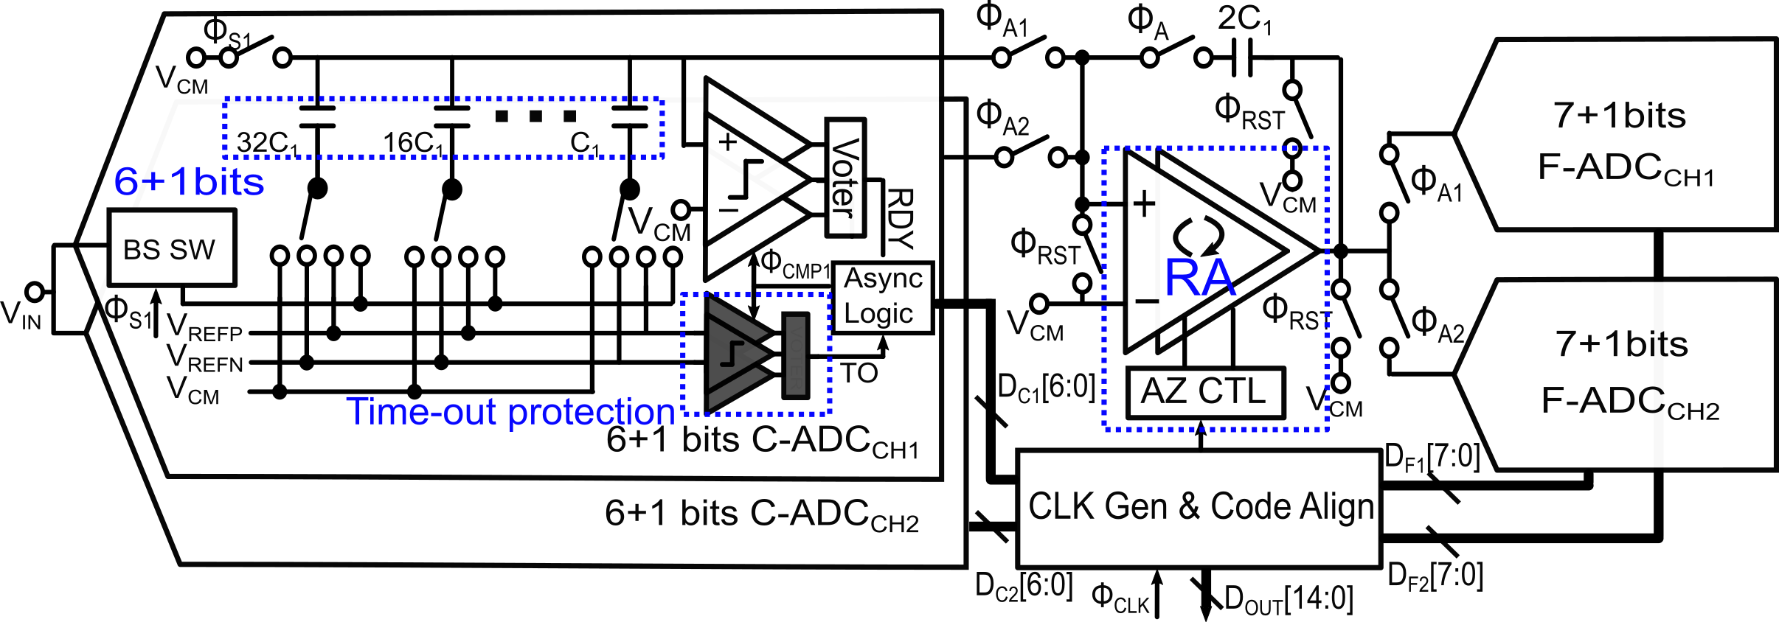
Semi-time-interleaved Pipelined-SAR ADC
6+7 bits division
2 channels with shared RA
Better SEE tolerance
Higher power efficiency

Slide 16
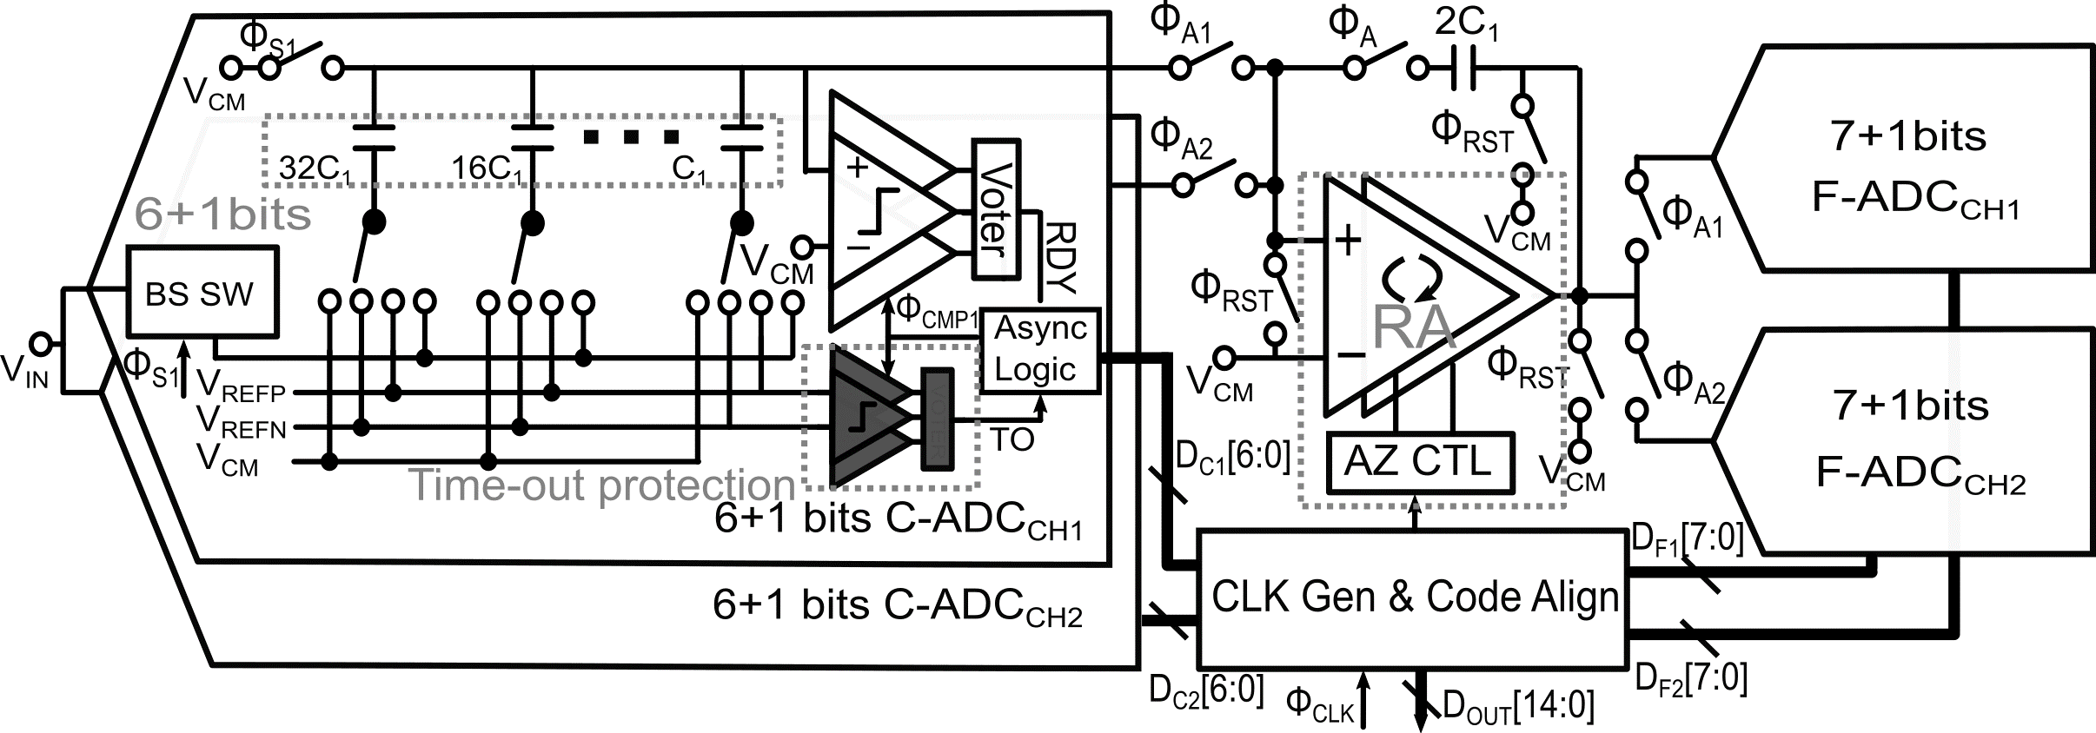
Sub-block 1: RA With Ping-pong Auto-zeroing
RA offset varies with TID effects
Two op-amps with ping-pong AZ
P_{RA}≈ P_{op-amp}, when N>>M

Slide 17
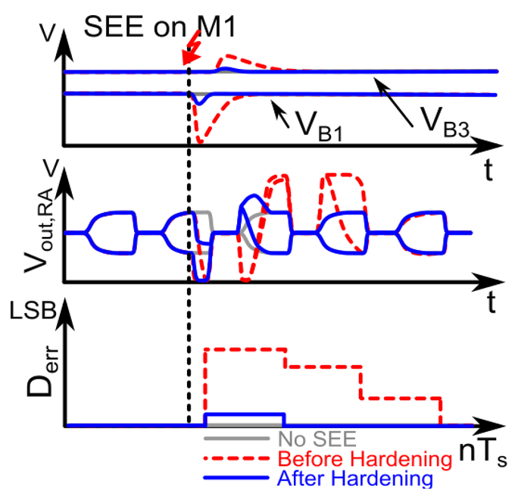
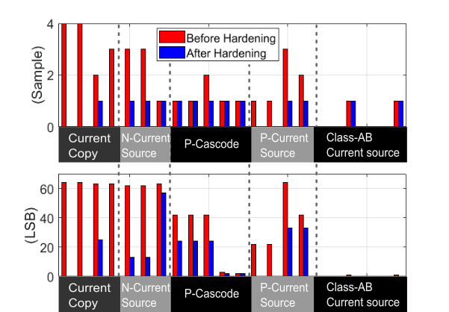
Sub-block 2: Op-amp Bias Hardening
SEEs cause biasing fluctuation and erroneous ADC outputs
Biasing averaging applied
Reduce 𝜖_{𝑛𝑜𝑑𝑒} and 𝑡_{𝑟𝑒𝑐𝑜𝑣} of SEE

Slide 18
Sub-block 3: CLK Generation and Hardening
SEEs cause bit flips in frequency dividers
180° phase shift in control signals φ_{A1,2}
Stay in an abnormal state unless rebooting

Slide 19
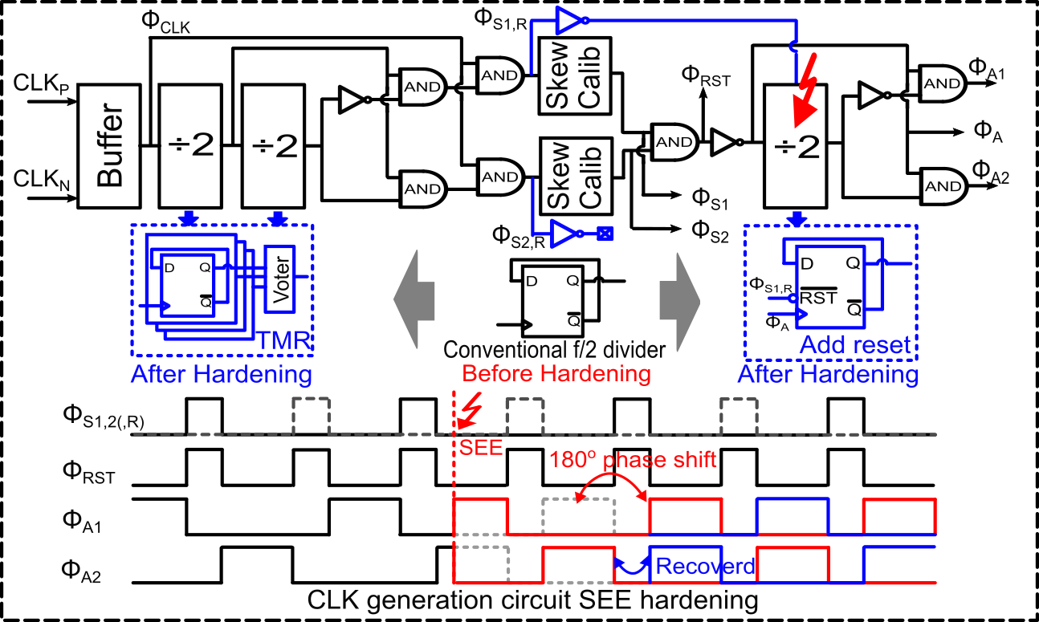
Sub-block 3: CLK Generation and Hardening
Additional Reset
TMR when no reset is available
SEE error recoveries in one sample

Slide 20
Outline
Introduction
SEEs and ADC Design Tradeoffs and Strategy
Proposed Radiation-Tolerant ADC for Space Applications
Results & Conclusions

Slide 21
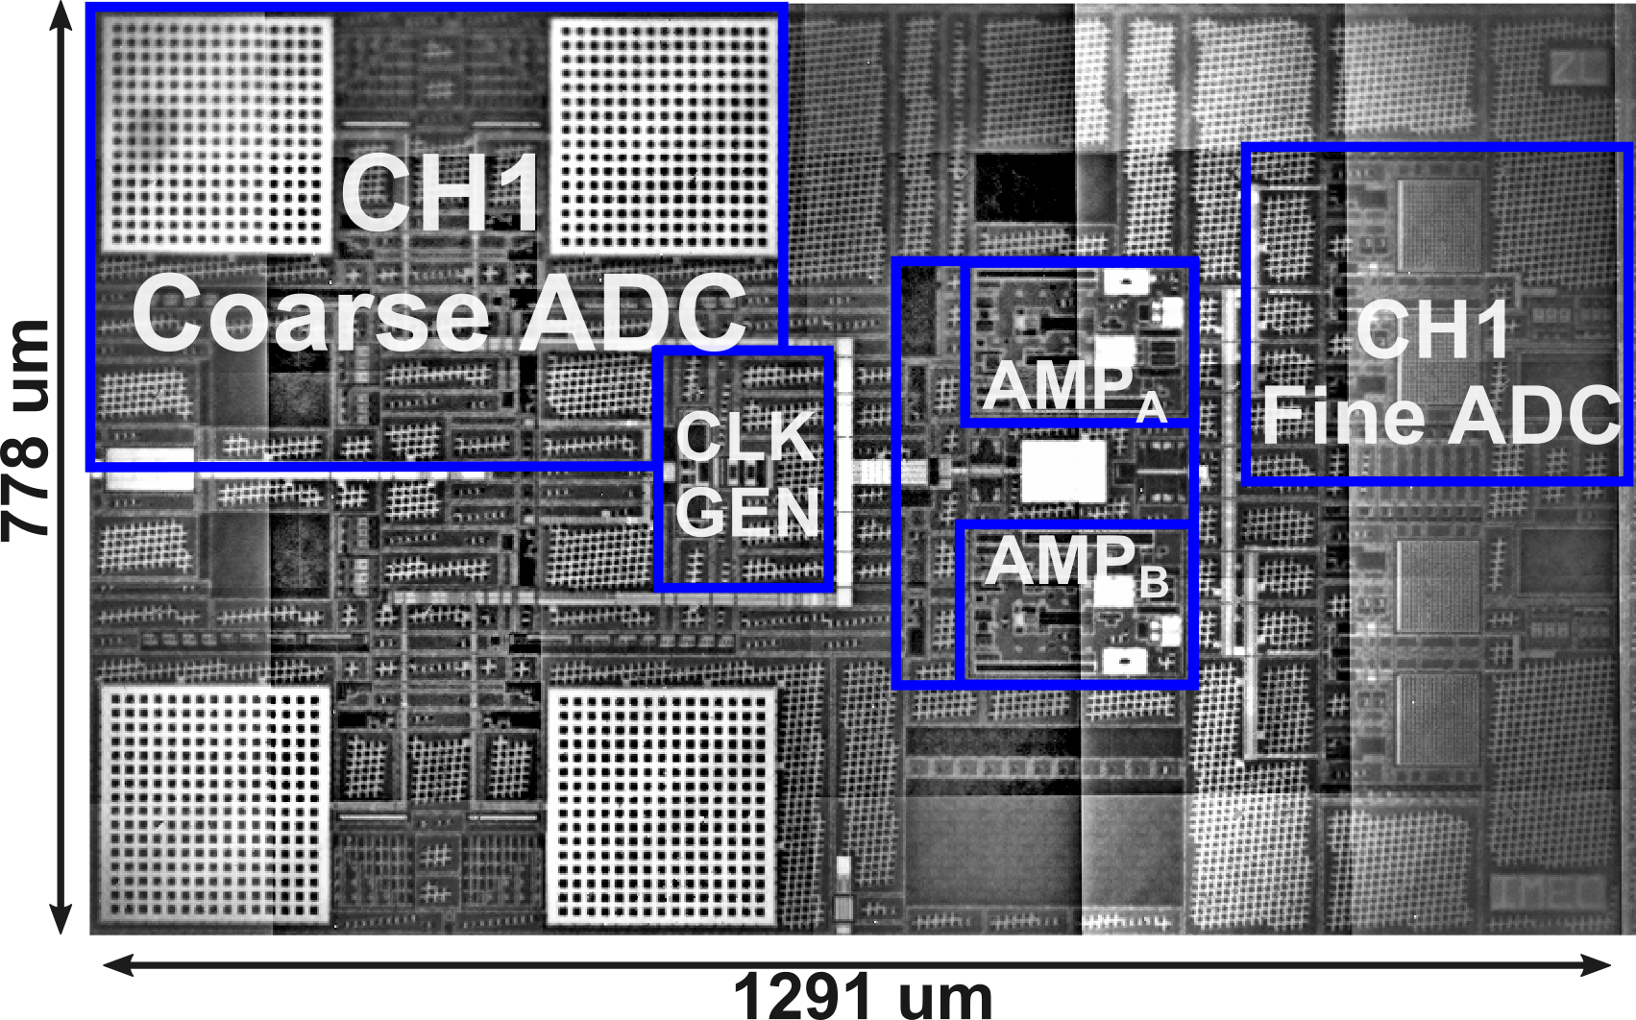
Electrical Performance
Commercial 65 nm CMOS technology
Area 1.004 mm2
Digital from DARE65* platform from imec
*DARE: Design Against Radiation Effects
Power breakdown@ fs=80 MS/s, Nyquist input
Static Performance
Dynamic Performance
Sweep f_{in} @ f_{s}=80 MS/s
Sweep f_{s} with Nyquist input
DNL < ± 0.7 LSBs, INL < ± 1.38 LSBs
fs=80 MS/s, Nyquist input, P_{tot}=13.77 mW ,FoM_{w}= 60.7 fJ/c.step

Slide 22
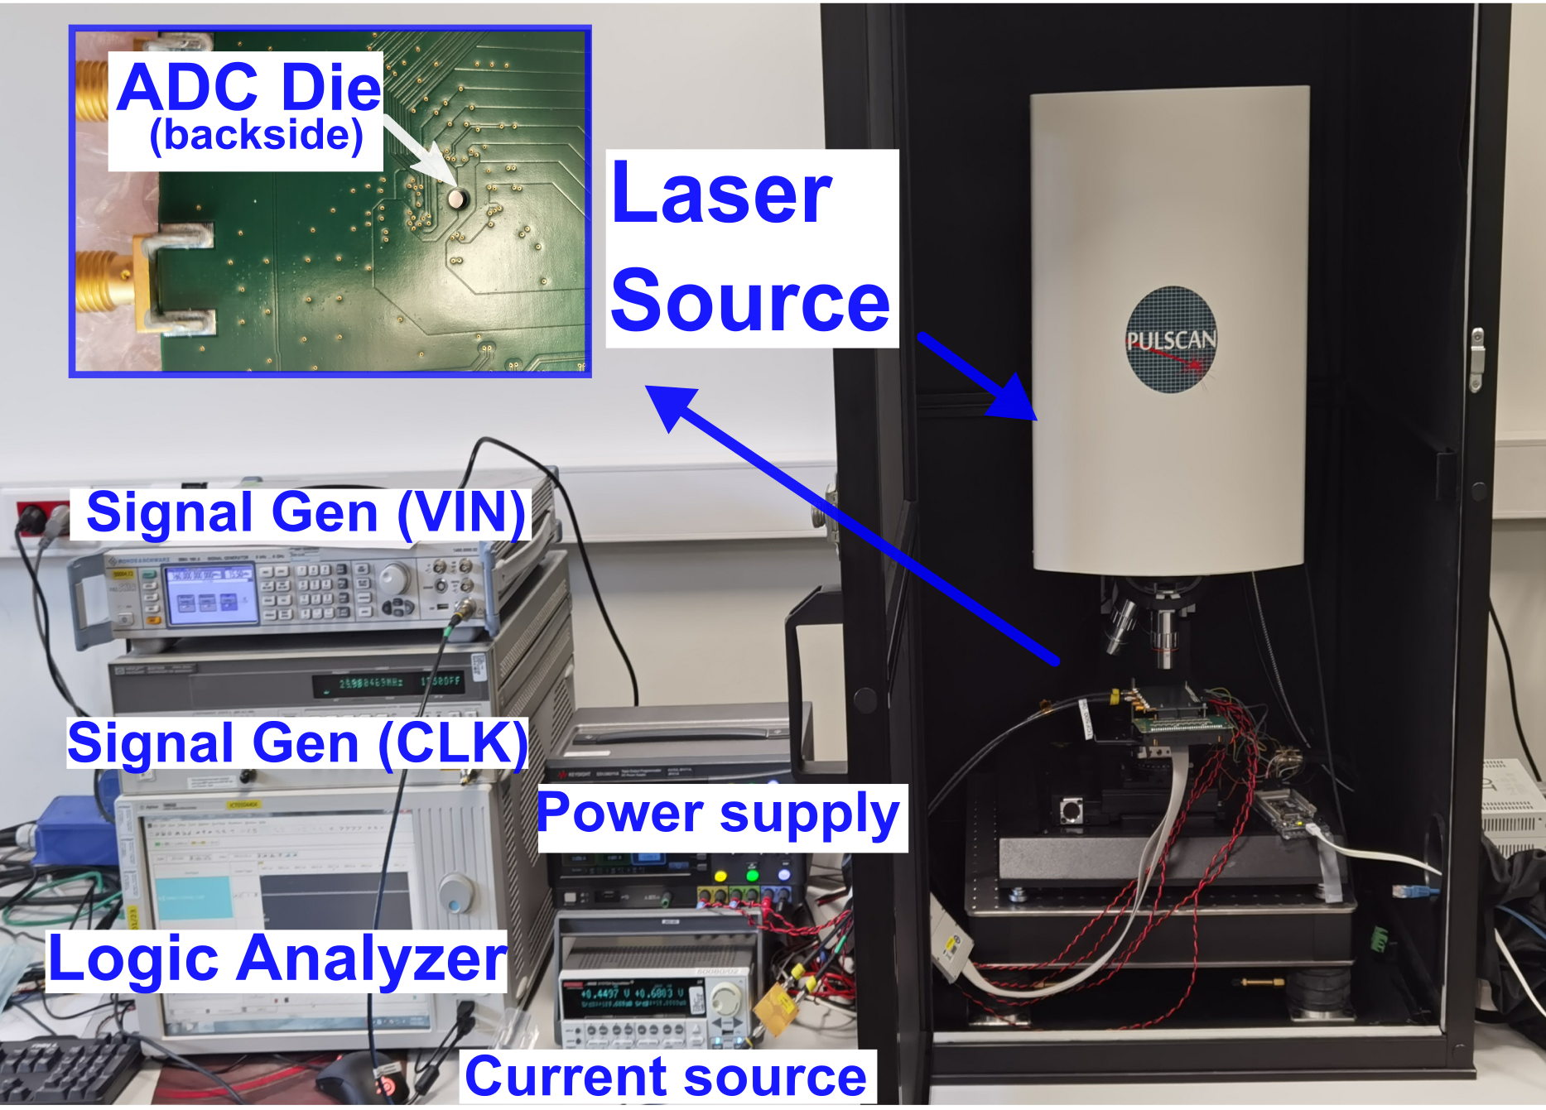
Radiation Test: SEE Tolerance
Two-photon absorption (TPA) laser test [6]
Energy from 0.5 nJ to 1.4 nJ
10 ns laser pulse
1 µm spot size
Threshold energy when observing error outputs
The higher the better
Recovery time after SEE
Fast recovery in samples
Only AZ switches of RA show long recovery time

Slide 23
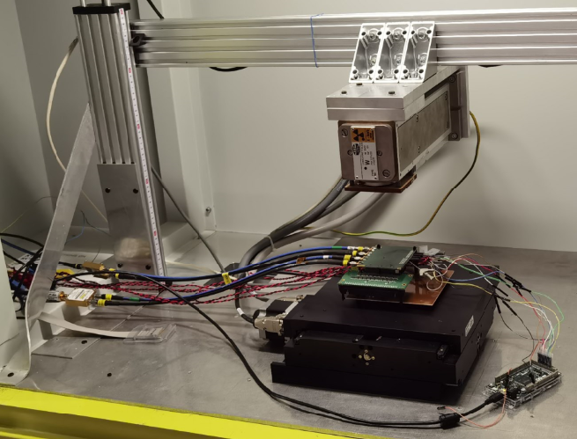
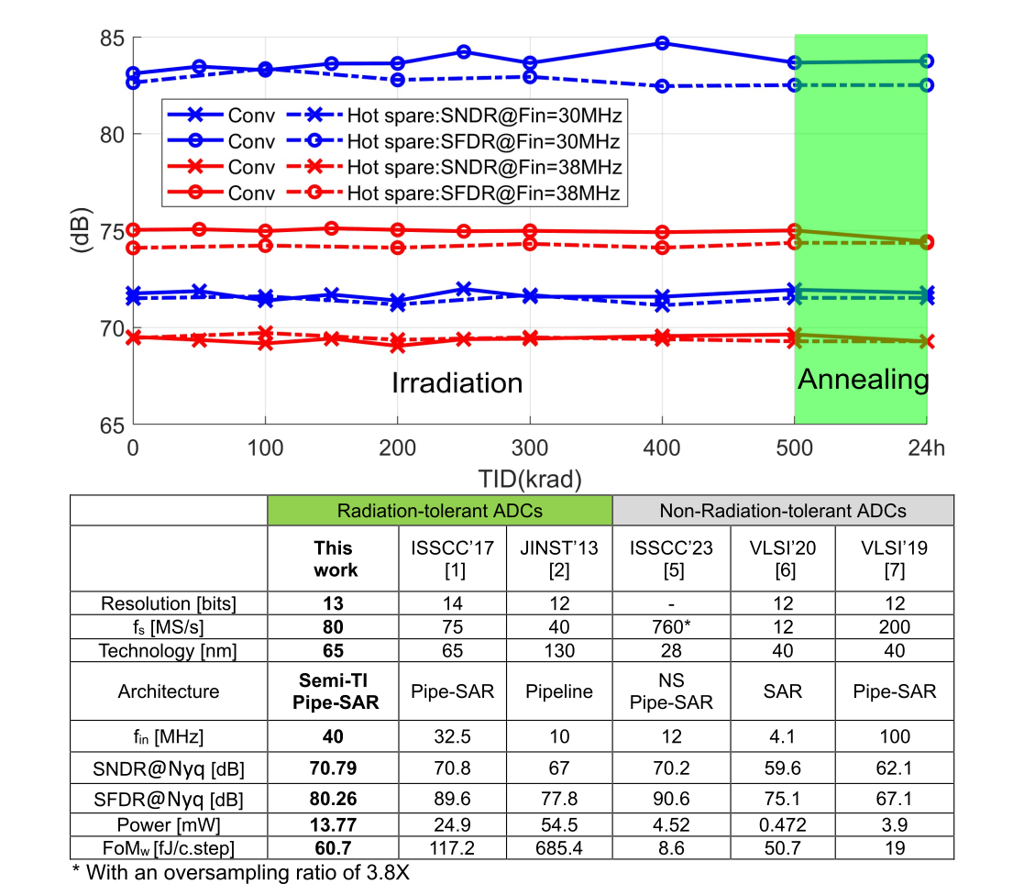
Radiation Test: TID Tolerance
X-Ray Diffraction Tube
X-ray test
100 krad(si)/hour
500 krad(si) in total
Measured every 50 krad
24 hours room-temperature annealing
Conversion mode
With power clock and input
F_{s}=80 MS/s, f_{in}=30 MS/s
Hot spare mode
With power, no clock or input

Slide 24
Benchmark Table (Academic)

Slide 25
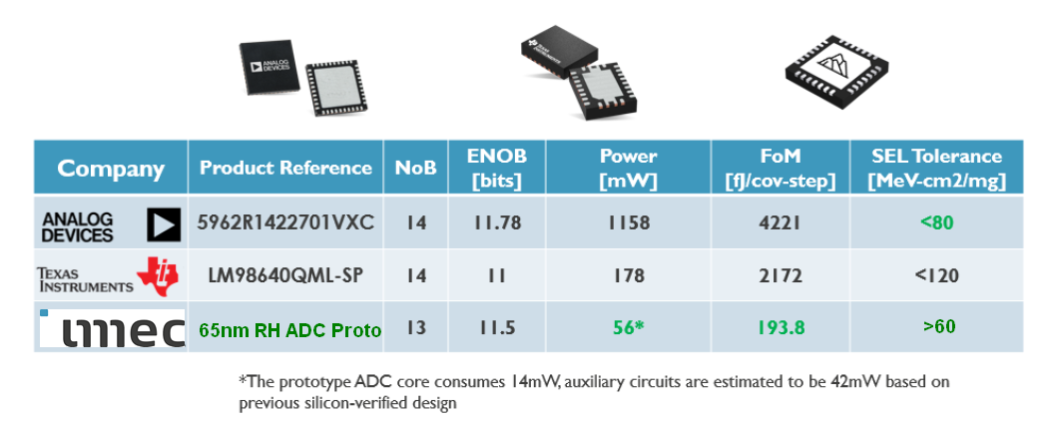
Benchmark Table (Industry)

Slide 26
Furthermore
More details of the work can be found in:
Zheyi Li, Laurent Berti, Jinghao Zhao, Qiuyang Lin, Maxim Gorbunov, Shiwei Wang, Geert Thys, Paul Leroux, "An 80 MS/s 70.8 dB-SNDR Radiation-Tolerant Semi-Time-Interleaved Pipelined-SAR ADC for Space Applications," in IEEE Transactions on Circuits and Systems I: Regular Papers, doi: 10.1109/TCSI.2024.3516475.
More details of the methodologies and tools for analog and mixed-signal design against radiation-induced effects can be found in:
Zheyi Li and Laurent Berti, “Design Tools For Assisting Analog/Mixed-signal Circuit Against Radiation Effects”, Short course in RADECS 2025
Zheyi Li, Maxim Gorbunov, Henrique Caldas Kessler, Giancarlo Franciscatto, Venkata Sathyajith Kampati, Jinghao Zhao, Jeffrey Prinzie, Laurent Berti, “A Charge-Width Calibration Approach forthe Compact Modeling of Single Event Transients”, RADECS 2025, Accepted
Sebastien Trocherie, Zheyi Li, Maxim Gorbunov, Laurent Berti, Levi Van der Elst, Jeffrey Prinzie, Jinghao Zhao,Qichao Ma, Paul Leroux, “Validation of Single-Photon-Absorption Laser Technique for SET Pulse Width Study”, Late news submission in RADECS 2025

Slide 27
References
[1] elsen, william G. "Orbital anomalies in goddard spacecraft for CY 1989." Assurance requirements office, office of flight assurance, NASA goddard space flight center (1992): 4.
[2] "esa bulletin," august 1993, #75, p. 14.
[3] miller, kathleen b., Et al. "Ionizing radiation, cerebrovascular disease, and consequent dementia: A review and proposed framework relevant to space radiation exposure." Frontiers in physiology 13 (2022): 1008640.
[4] oldham, timothy r. "Basic mechanisms of TID and DDD response in MOS and bipolar microelectronics." NSREC short course (2011).
[5] wang, fan, and vishwani d. Agrawal. "Single event upset: an embedded tutorial." 21st ınternational conference on VLSI design (VLSID 2008). Ieee, 2008.
[6] a. Watkins, K. Gnawali, and H. Quinn, “single event effects characterization using a single photon absorption laser,” in 2018 IEEE AUTOTESTCON, 2018, pp. 1–4.
[7] h. Xu et al., "28.6 a 78.5db-sndr radiation- and metastability-tolerant two-step split SAR ADC operating up to 75MS/s with 24.9mw power consumption in 65nm CMOS," 2017 IEEE international solid-state circuits conference (ISSCC), san francisco, CA, USA, 2017, pp. 476-477, doi: 10.1109/isscc.2017.7870468.
[8] kuppambatti, jayanth, et al. "A radiation-hard dual channel 4-bit pipeline for a 12-bit 40 MS/s ADC prototype with extended dynamic range for the ATLAS liquid argon calorimeter readout electronics upgrade at the CERN LHC." Journal of instrumentation 8.09 (2013): p09008.
[9] y. Zhang et al., "10.7 A single-channel 70db-sndr 100mhz-bw 4th-order noise-shaping pipeline SAR ADC with residue amplifier error shaping," 2023 IEEE international solid-state circuits conference (ISSCC), san francisco, CA, USA, 2023, pp. 9-11, doi: 10.1109/isscc42615.2023.10067689.
[10] z. Li et al., "A SAR ADC with reduced kt/C noise by decoupling noise PSD and BW," 2020 IEEE symposium on VLSI circuits, honolulu, HI, USA, 2020, pp. 1-2, doi: 10.1109/vlsicircuits18222.2020.9162846.
[11] m. -J. Seo, Y. -D. Kim, J. -H. Chung and S. -T. Ryu, "A 40nm CMOS 12b 200MS/s single-amplifier dual-residue pipelined-sar ADC," 2019 symposium on VLSI circuits, kyoto, japan, 2019, pp. C72-C73, doi: 10.23919/vlsic.2019.8778005.

