Slide 1
Test System for the Experimental Evaluation of a Low-Power High Performance Four-channel ADC for Space Applications
L. Carranza; M.A. Jalón; J.J. Medina (ALTER Technology Spain)

Slide 2
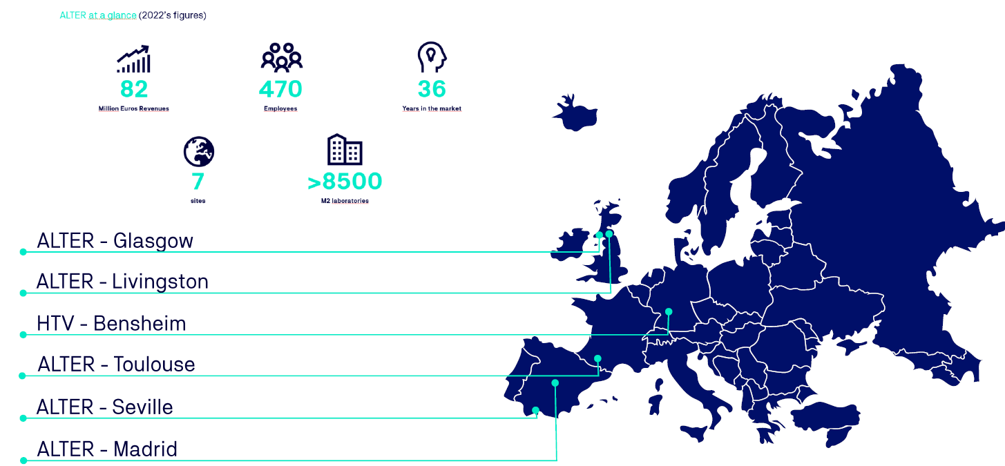
ALTER TECHNOLOGY GROUP
At a glance
AMICSA 2025│ June-2025 │ALTER Technology Spain

Slide 3
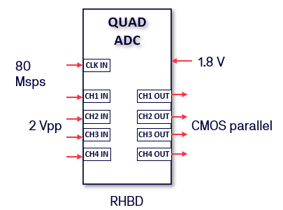

Outline
  Device Under Test: QUAD-ADC
    4 channels
    Simultaneous sampling
    14-bit @ 80 Msps
    1.8 V power supply
    2 Vpp input signal
    CMOS parallel digital output
    Radiation Hardened by Design (RHBD)
  Test System Architecture
    Designed to measure the converters’ Static and Dynamic parameters automatically.
  Radiation Tests
    Total Ionizing Dose (TID)
    Single Even Effect (SEE)
AMICSA 2025│ June-2025 │ALTER Technology Spain

Slide 4
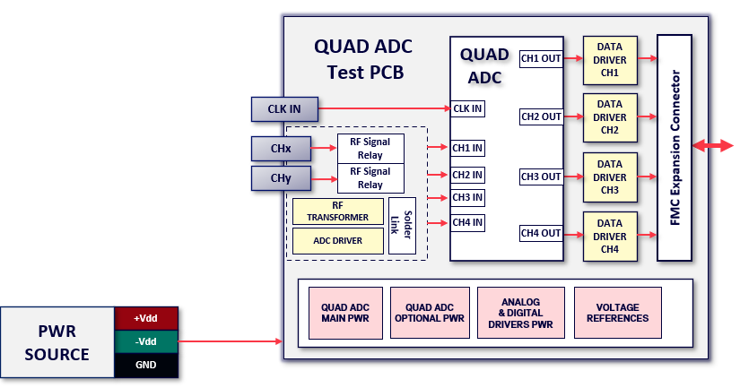
QUAD-ADC Test System Architecture
AMICSA 2025│ June-2025 │ALTER Technology Spain

Slide 5
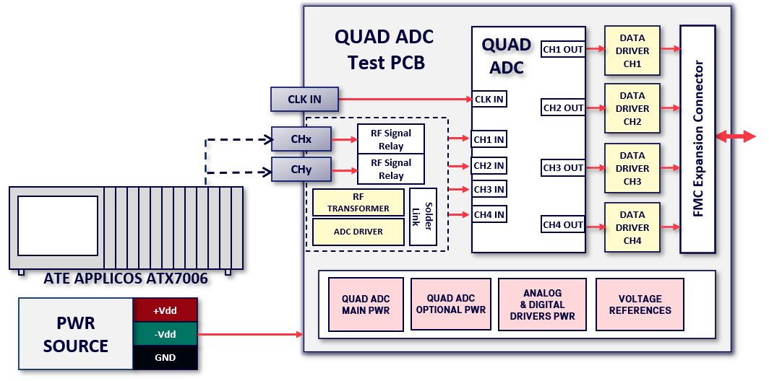
QUAD-ADC Test System Architecture
AMICSA 2025│ June-2025 │ALTER Technology Spain

Slide 6
QUAD-ADC Test System Architecture
DATA
DRIVER
CH1
DDR3 SDRAM
512 MB
XEM7350
QUAD ADC
Test PCB
QUAD
ADC
CH1 OUT
CLK IN
CLK IN
DATA
DRIVER
CH2
SDRAM Controller
Kintex-7 FPGA
CH2 OUT
FIFOs
UART
Controller
FMC Expansion Connector
CHx
RF Signal Relay
CH1 IN
FMC Expansion Connector
RF Signal Relay
DATA
DRIVER
CH3
QUAD ADC
DAQ
USB Endpoints
CHy
CH2 IN
CH3 OUT
RF TRANSFORMER
CH3 IN
Synthetic Signal Generator
Solder
Link
CH4 IN
DATA
DRIVER
CH4
ADC DRIVER
CH4 OUT
USB3.0 Link Microcontroller
200 MHz CLK
200 MHz CLK
ATE APPLICOS ATX7006
QUAD ADC
MAIN PWR
QUAD ADC
OPTIONAL PWR
ANALOG
& DIGITAL
DRIVERS PWR
VOLTAGE
REFERENCES
PWR SOURCE
+Vdd
-Vdd
GND
AMICSA 2025│ June-2025 │ALTER Technology Spain

Slide 7
QUAD-ADC Test System Architecture
DATA
DRIVER
CH1
DDR3 SDRAM
512 MB
XEM7350
QUAD ADC
Test PCB
QUAD
ADC
CH1 OUT
Low Jitter CLK
CLK IN
CLK IN
DATA
DRIVER
CH2
SDRAM Controller
Kintex-7 FPGA
CH2 OUT
FIFOs
UART
Controller
FMC Expansion Connector
CHx
RF Signal Relay
CH1 IN
FMC Expansion Connector
RF Signal Relay
DATA
DRIVER
CH3
QUAD ADC
DAQ
USB Endpoints
CHy
CH2 IN
CH3 OUT
RF TRANSFORMER
CH3 IN
Synthetic Signal Generator
Solder
Link
CH4 IN
DATA
DRIVER
CH4
ADC DRIVER
CH4 OUT
USB3.0 Link Microcontroller
200 MHz CLK
200 MHz CLK
ATE APPLICOS ATX7006
QUAD ADC
MAIN PWR
QUAD ADC
OPTIONAL PWR
ANALOG
& DIGITAL
DRIVERS PWR
VOLTAGE
REFERENCES
PWR SOURCE
+Vdd
-Vdd
GND
AMICSA 2025│ June-2025 │ALTER Technology Spain

Slide 8

QUAD-ADC Test System Architecture
DATA
DRIVER
CH1
DDR3 SDRAM
512 MB
XEM7350
QUAD ADC
Test PCB
QUAD
ADC
CH1 OUT
Low Jitter CLK
CLK IN
CLK IN
DATA
DRIVER
CH2
SDRAM Controller
Kintex-7 FPGA
CH2 OUT
FIFOs
UART
Controller
FMC Expansion Connector
CHx
RF Signal Relay
CH1 IN
FMC Expansion Connector
RF Signal Relay
DATA
DRIVER
CH3
QUAD ADC
DAQ
USB Endpoints
CHy
CH2 IN
CH3 OUT
RF TRANSFORMER
CH3 IN
Synthetic Signal Generator
Solder
Link
CH4 IN
DATA
DRIVER
CH4
ADC DRIVER
CH4 OUT
USB3.0 Link Microcontroller
200 MHz CLK
200 MHz CLK
ATE APPLICOS ATX7006
QUAD ADC
MAIN PWR
QUAD ADC
OPTIONAL PWR
ANALOG
& DIGITAL
DRIVERS PWR
VOLTAGE
REFERENCES
PWR SOURCE
+Vdd
-Vdd
SW: C#
Control / DAQ
DATA PROCESSING
GND
AMICSA 2025│ June-2025 │ALTER Technology Spain

Slide 9
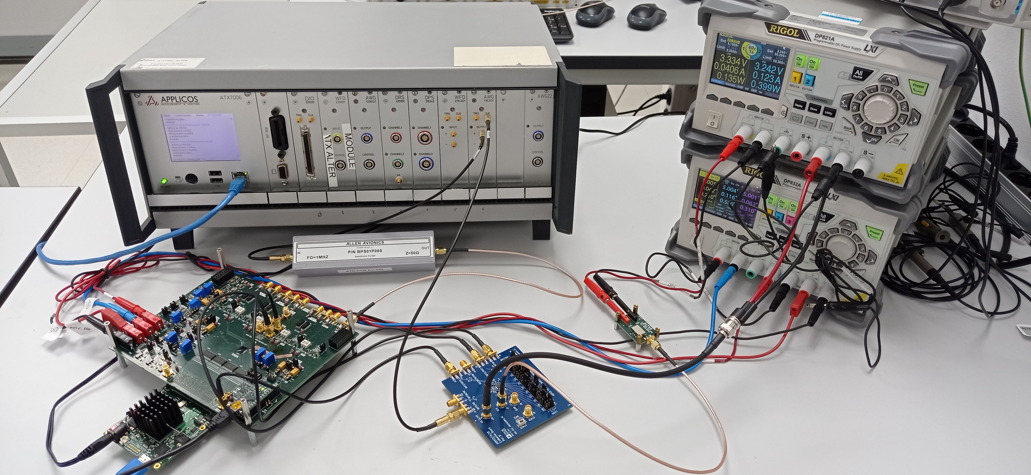
QUAD-ADC Test System Architecture
APPLICOS ATE
Filter
QUAD-ADC
Test PCB
PWR Sources
Low Jitter CLK
CLK distribution system
FPGA Single Board Module
AMICSA 2025│ June-2025 │ALTER Technology Spain

Slide 10
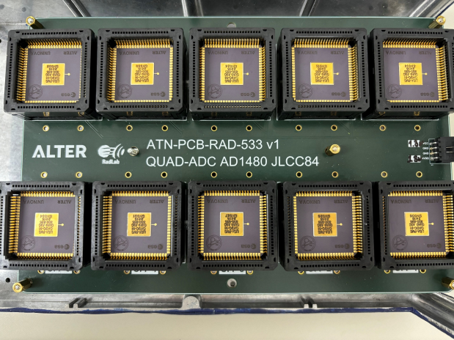
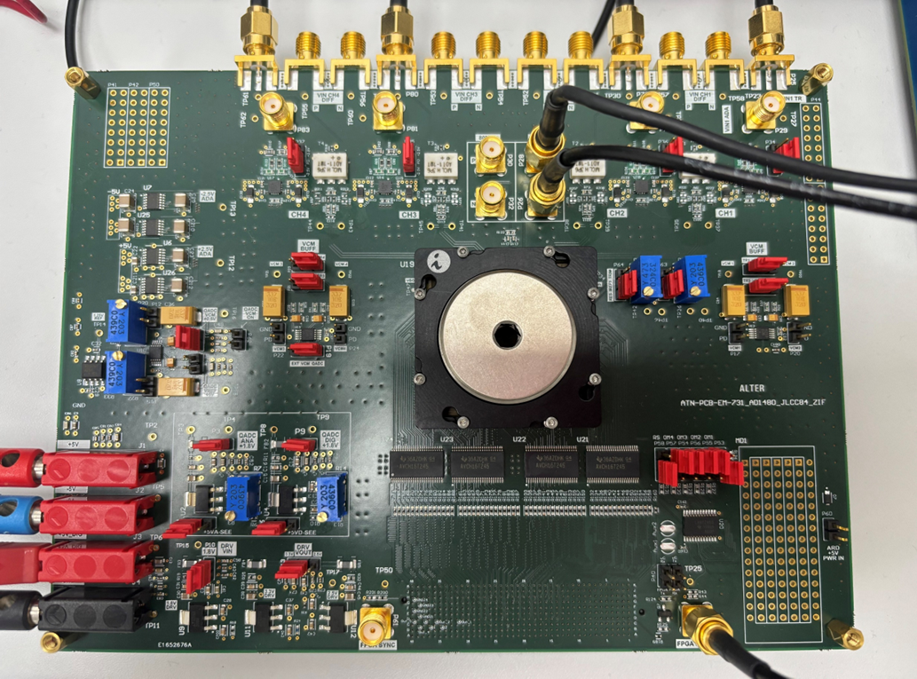
QUAD-ADC Test System Architecture
TID radiation PCB with samples
QADC performance measurement PCB
AMICSA 2025│ June-2025 │ALTER Technology Spain

Slide 11
QUAD-ADC TID: Radiation and measurements results
  TID radiation conditions
  100krad cumulative dose (Cobalt60 source) :
    Dose rate of 210 rad(Si)/h
    Six exposure steps
  Annealing
    24h at 25ºC
    168h at 100º C
  Evaluation of the performance of the QUAD-ADC
  Static parameters: INL, DNL
  Dynamic parameters: SNR, THD, SINA, ENOB, SFDR
  Results
  The static and dynamic performance of the converter was not significantly affected by the TID irradiation.
  The power consumption of the converter remained constant.
AMICSA 2025│ June-2025 │ALTER Technology Spain

Slide 12
QUAD-ADC SEE Test System Architecture
QUAD ADC
Test PCB
DDR3 SDRAM
512 MB
XEM7350
QUAD
ADC
CH1 OUT
Low Jitter CLK
CLK IN
SDRAM Controller
Kintex-7 FPGA
CH2 OUT
FIFOs
UART
Controller
FMC Expansion Connector
FMC Expansion Connector
CH1 IN
QUAD ADC
DAQ
USB Endpoints
CH3 OUT
CH2 IN
CH3 IN
CH4 OUT
CH4 IN
USB3.0 Link Microcontroller
200 MHz CLK
200 MHz CLK
QUAD ADC
MAIN PWR
QUAD ADC
OPTIONAL PWR
SW: C#
Control / DAQ
DATA PROCESSING
AMICSA 2025│ June-2025 │ALTER Technology Spain

Slide 13
QUAD-ADC SEE Test System Architecture
QUAD ADC
Test PCB
DDR3 SDRAM
512 MB
XEM7350
QUAD
ADC
CH1 OUT
Low Jitter CLK
CLK IN
SDRAM Controller
Kintex-7 FPGA
CH2 OUT
FIFOs
UART
Controller
FMC Expansion Connector
FPGA
FMC Expansion Connector
UARTs
ATN SEE TEST SYSTEM
QUAD ADC
DAQ
USB Endpoints
Latch-Up Detector CTRL & Handler
Interrupt Lines
CH1 IN
CH3 OUT
CTRL Unit
Latch-Up Detector Circuitry
CH2 IN
Digital Signal
Generator
CMD Processor
CH3 IN
CH4 OUT
CH4 IN
USB3.0 Link Microcontroller
200 MHz CLK
200 MHz CLK
Analog Signal
Output Circuitry
Main Oscillator
USB
QUAD ADC
MAIN PWR
QUAD ADC
OPTIONAL PWR
PWR SOURCE
+Vdd
-Vdd
SW: C#
Control / DAQ
DATA PROCESSING
GND
AMICSA 2025│ June-2025 │ALTER Technology Spain

Slide 14
QUAD-ADC SEE Test System Architecture
QUAD ADC
Test PCB
DDR3 SDRAM
512 MB
XEM7350
QUAD
ADC
CH1 OUT
Low Jitter CLK
CLK IN
SDRAM Controller
Kintex-7 FPGA
CH2 OUT
FIFOs
UART
Controller
FMC Expansion Connector
FPGA
FMC Expansion Connector
UARTs
ATN SEE TEST SYSTEM
QUAD ADC
DAQ
USB Endpoints
Latch-Up Detector CTRL & Handler
Interrupt Lines
CH1 IN
CH3 OUT
CTRL Unit
Latch-Up Detector Circuitry
CH2 IN
SET/SEU (ORC) Detector
Digital Signal
Generator
CMD Processor
CH3 IN
CH4 OUT
CH4 IN
USB3.0 Link Microcontroller
200 MHz CLK
200 MHz CLK
Analog Signal
Output Circuitry
Main Oscillator
USB
QUAD ADC
MAIN PWR
QUAD ADC
OPTIONAL PWR
PWR SOURCE
+Vdd
-Vdd
SW: C#
Control / DAQ
DATA PROCESSING
GND
AMICSA 2025│ June-2025 │ALTER Technology Spain

Slide 15
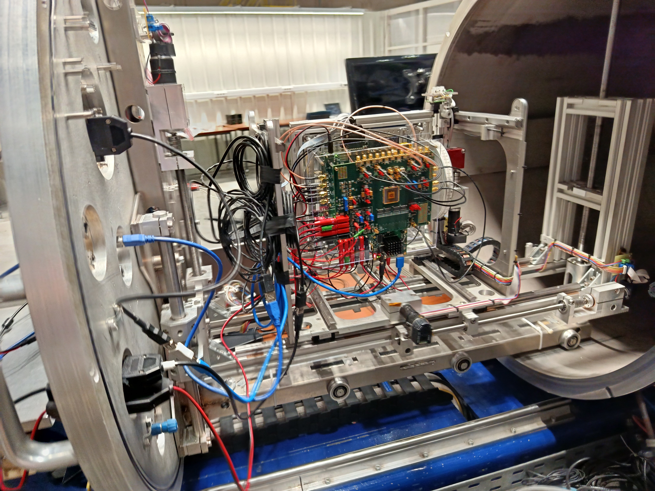
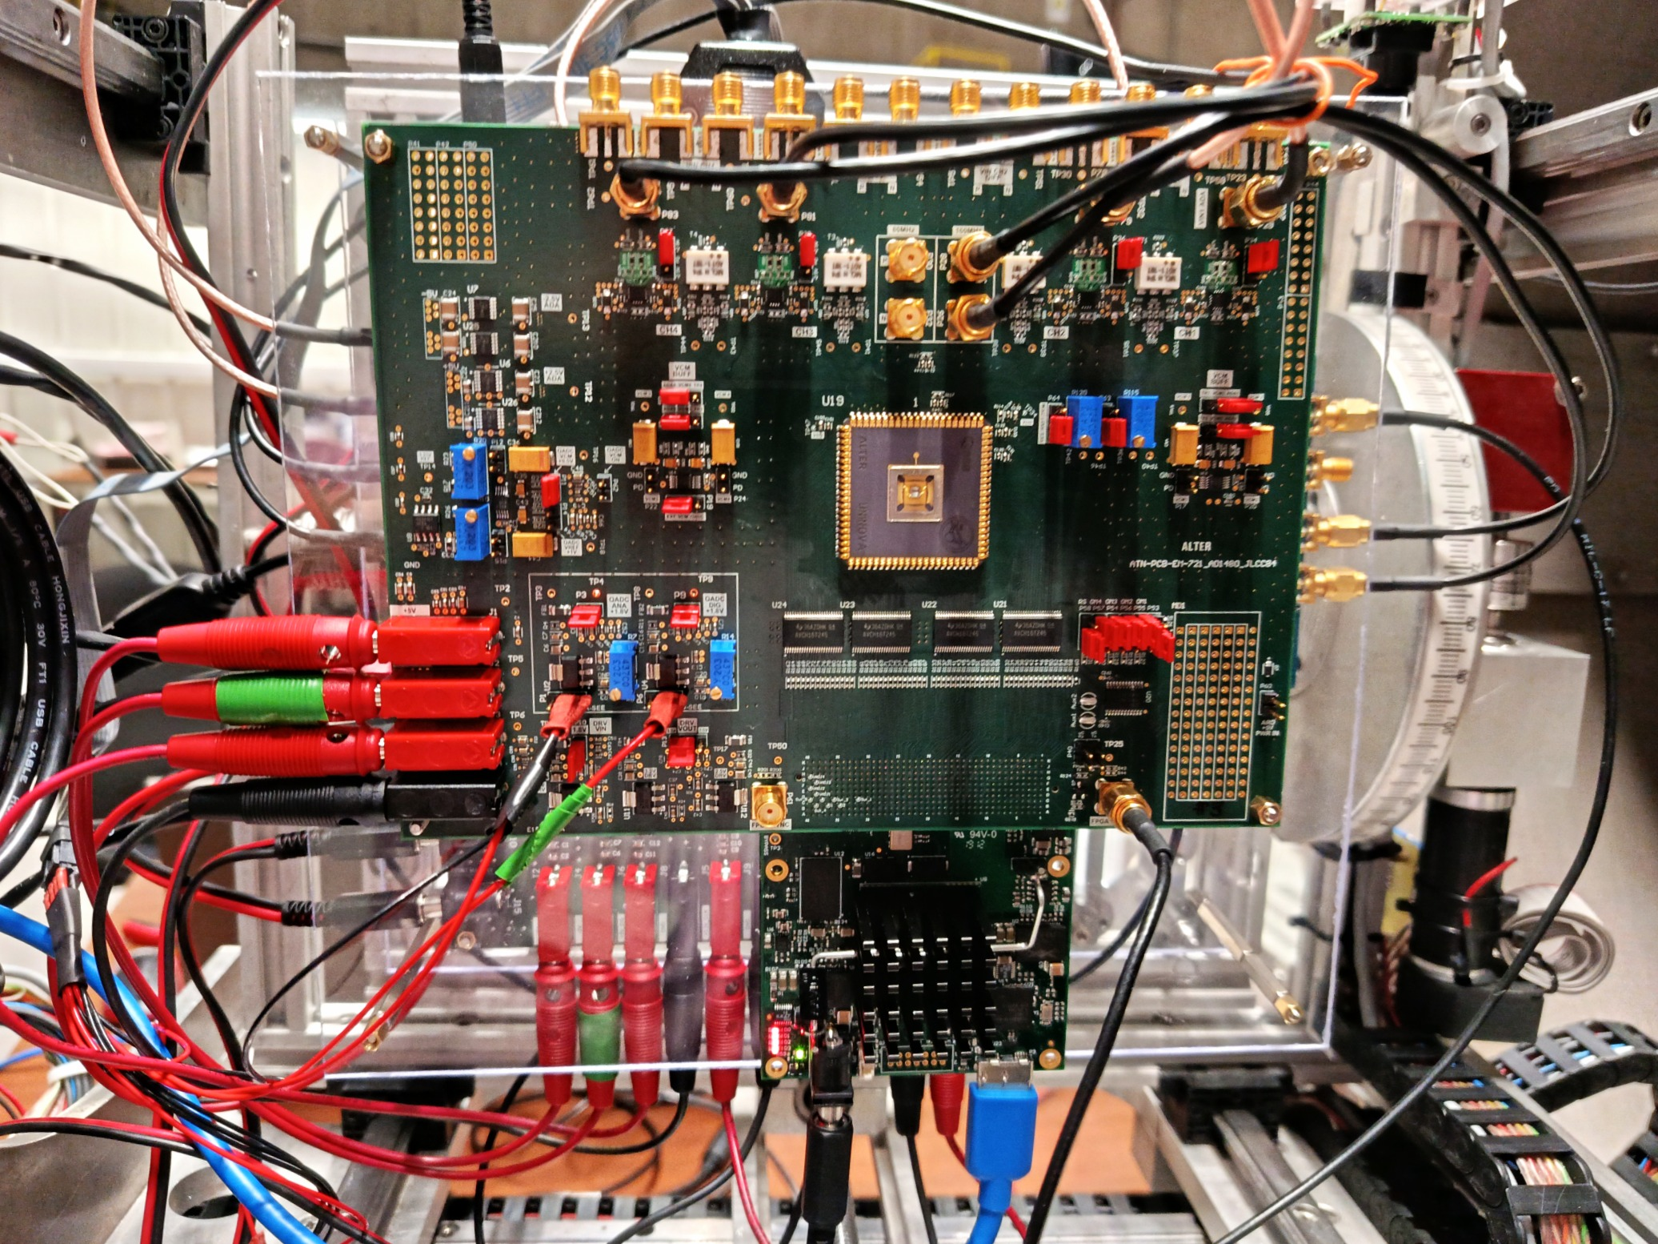
QUAD-ADC SEE Test System
SEE test system inside the radiation chamber: general view
SEE test system inside the radiation chamber: main PCB
AMICSA 2025│ June-2025 │ALTER Technology Spain

Slide 16
QUAD-ADC SEE Test: Conclusions
Three samples of the converter were irradiated with heavy ions, with energies up to 62.5 MeV.cm².mg-1, while monitoring its operation with the SEE test platform. From the experimental results of high energy ion irradiation on the QUAD-ADC it can be stated that:
  The ADC1480 is immune to SELs up to at least a LET of 62.5 MeV·cm2/mg.
  When the device is exposed to radiation, the consumptions on the analogue and digital sides remain unchanged within their nominal values up to at least a LET of 62.5 MeV·cm2/mg.
  The converter remains functional, i.e. no SEFI has been observed, up to at least a LET of 62.5 MeV·cm2/mg.
  ADC transient Out Of Range Conversions occur from a LET of 46.1 MeV·cm2/mg.
AMICSA 2025│ June-2025 │ALTER Technology Spain

Slide 17
QUAD-ADC Radiation Test: Conclusions
This work presented the development of a test system designed to evaluate the static and dynamic performance of a prototype four-channel, 14-bit 80 MSPS RHBD. This system has been used to evaluate the radiation resistance of the device.
The integration of the device into a test platform for SEE characterization has been also presented, along with results demonstrating the ADC's resistance to radiation.
The results of the TID tests show that no significant degradations of the static and dynamic parameters are observed. On the other hand, the results of the SEE tests show that the converter is immune to SELs up to at least a LET of 62.5 MeV·cm2/mg and only transient Out of Range Conversions occur from a LET of 46.1 MeV·cm2/mg.
AMICSA 2025│ June-2025 │ALTER Technology Spain

Slide 18



QUAD-ADC Radiation Test: Acknoledgement
Hugo Serra, Fábio Passos, Edgar Albuquerque, Nuno Paulino, Luís B. Oliveira, João P. Oliveira, Paulo Santos, João Goes
Boris Glass, Sven Wittig
Szymon Bednarski (ALTER UK)
Juan Jose Esteban
AMICSA 2025│ June-2025 │ALTER Technology Spain

Slide 19

THANK YOU!
19
19
AMICSA 2025│ June-2025 │ALTER Technology Spain
19

Slide 20




Inspired by knowledge
Juan Jose MEDINA DEL BARRIO Project Lead manager Technical Project Office Department ALTER TECHNOLOGY TÜV NORD S.A.U. Email: jj.medina@altertechnology.com Ph: +34 664 709 958 - mobile Web: www.altertechnology.com Address: C/ Tomás A. Edison 4 41092 Sevilla - SPAIN
Manuel MORALES DOMINGUEZ EEE Parts Engineer and Product Assurance Parts Engineering Department ALTER TECHNOLOGY TÜV NORD S.A.U. Email: manuel.morales@altertechnology.com Ph: +34 673 509 405 - mobile Web: www.altertechnology.com Address: C/ Tomás A. Edison 4 41092 Sevilla – SPAIN

