Slide 1




LLC with Flyback DC-DC Converter for the Supply of Low Voltage and High Current
P. DUBUS¹, K. MAKRIS², T. GRZEGORY², A. MATHEWSON², C. PAPADAS²
J. OLIVER³, N. VAN DER BLIJ³, J. PONIN⁴, P. MAYNADIER⁴
1 POWERLOGY, France
2 ISD SA & ISD Aerospace Ltd
3 ESA
4 THALES ALENIA SPACE SAS

Slide 2
Agenda
Introduction,
Main Requirements,
Analysed Solutions for Topology Selection,
Description of the Selected Solution,
Regulation Mode,
High Level Simulation Model,
Matrix Transformer,
Converter Breadboard,
Conclusion.

Slide 3
Introduction
This converter will be used to power the last generation of high power IC demanding high current with low voltage from 100V regulated power bus.
A functional model will be manufactured and tested (TRL4).
This work is funded by an ESA R&D programme (4000135644/21/NL/MM/mr).

Slide 4
Main Requirements
The converter has a 1V Main output and a secondary Intermediate Bus output to power remote Point of Load converters.
External ON/OFF commands, primary under-voltage protection and secondary overload and overvoltage protections shall also be provided.
Param. | Min | Typ | Max | Unit | Remarks
Vin | 90 | 100 | 110 | V
Vmain |  | 1.0 |  | V | Adjustable by +/- 10%
Imain | 0 |  | 50 | A
Vibus |  | 8.0 |  | V
Iibus | 0 |  | 2.5 | A
Efficiency | 92.5 |  |  | % | Peak Efficiency
Losses |  |  | 6 | W

Slide 5
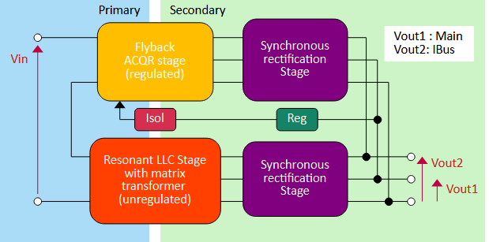
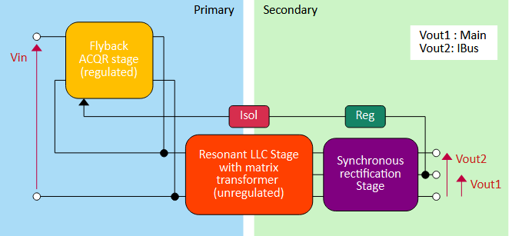
Analysed Solution for Topology Selection (1)
Substantial Trade Off has been done during the beginning of the design phase.
5 different topologies were analysed:
(a) Quasi-Parallel LLC and AC/QR Flyback
(b) Partial AC/QR Flyback pre-regulator and LLC

Slide 6
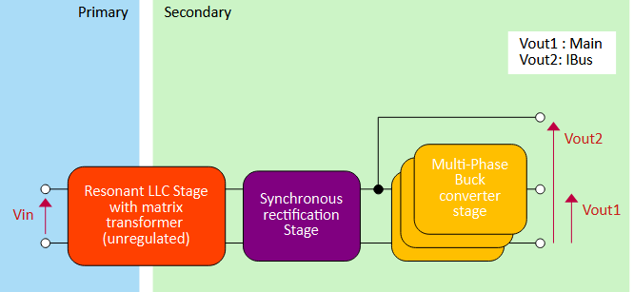
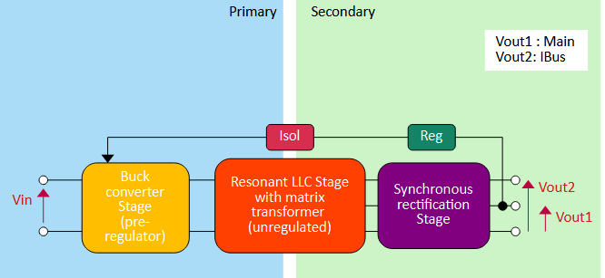
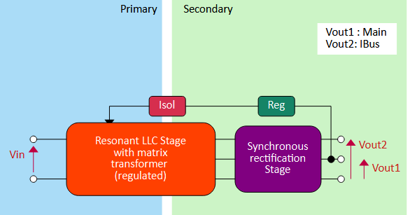
Analysed Solution for Topology Selection (2)
(c) LLC driven Multi-Phases Buck
(d) Buck driven LLC
(e) Regulated LLC

Slide 7
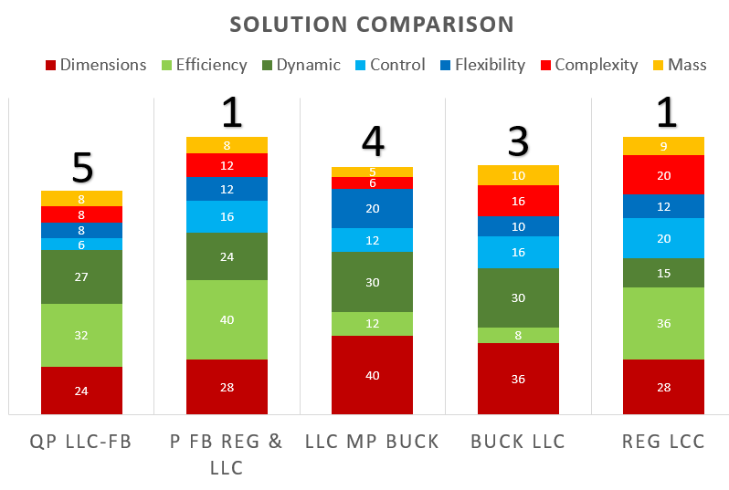
Analysed Solution for Topology Selection (3)
Criteria and Weight for topology comparison:
Results:
Criteria | Weight
Dimensions | 4
Efficiency | 4
Dynamic Performances | 3
Flexibility | 2
Control | 2
Complexity | 2
Mass | 1
Best are: Partial Flyback Pre-Regulator + Resonant LLC / Regulated LLC
Partial Flyback Pre-Regulator + Resonant LLC selected (Control + Dynamic)

Slide 8
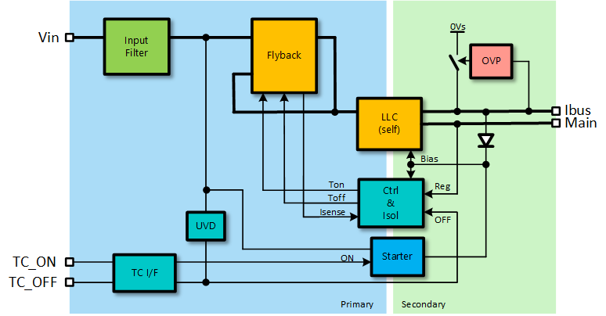
Description of the selected solution (1)
Converter made of 2 power cells:
An Active-Clamp / Quasi-Resonant (AC/QR) Flyback
A LLC working at its fixed resonant frequency
Flyback and LLC inputs are in series. Flyback output is connected to LLC input.
LLC as a fixed gain (DC transformer).
Flyback is used as pre-regulator. (Regulation).

Slide 9
Description of the selected solution (2)
The serial/parallel connection of the Flyback to the LLC limits the Flyback power (25% typical as Vin LLC = 80V and Vin Flyback = 20V).
LLC operation at its resonant frequency for maximum efficiency.
Synchronous rectification at both outputs.
Commands are simplified as voltages and currents are in phase.

Slide 10
Description of the selected solution (3)
The Flyback uses a resonant circuit during the OFF phase (Lr, Cclp) and operates with a constant OFF time.
Two operating modes possible. A Quasi-Resonant (QR) mode at low output power and an Active Clamp (AC) mode at high output power. Selection is made by changing the Toff duration.
Energy available to do ZVS is stored into:
Lr + Lc In QR mode (low load).
Lr in AC mode (high load).

Slide 11
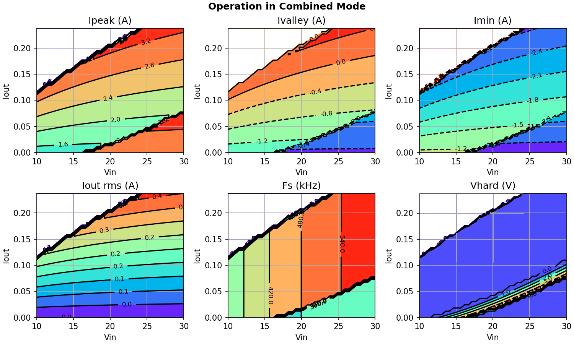
Regulation Mode
Mode selection is function of the Flyback load and consists in changing the Toff duration.
Constant OFF time regulation mode simplify mode selection.
This mode of control, inherently stable, allows to minimize the response time for better dynamic performances.

Slide 12
LLC and Matrix Transformer (1)
The LLC transformer has to handle large current on the main output (50A) and needs also to have a high turn ratio between the primary and the main output (1/40).
The selected solution is a Matrix Transformer (Magnetic circuit with a high number of legs and “individual” transformer per leg).
The multiplication of the number of legs with serial connection of the primary windings and parallel connection of the secondary windings allows:
the reduction of the output current value per secondary winding and
the limitation of the turn ratio between the primary and secondary per leg.

Slide 13
LLC and Matrix Transformer (2)
For the initial design an optimization using Genetic Algorithm was used to define the optimal parameters for the Matrix Transformer.
We arrive to a solution with:
  8 legs
  5 turns for the primary windings (all in series)
  1 turns for the secondary windings (in parallels for the main, in series for ibus)
This solution minimize the transformer size but make the LLC layout and test complex.
A new design has been done limiting the number of legs to 4 with 10 turns per legs for the primary windings. Matrix Transformer is slightly larger but the size of the overall LLC converter is reduced (part count reduced, test simplified).

Slide 14
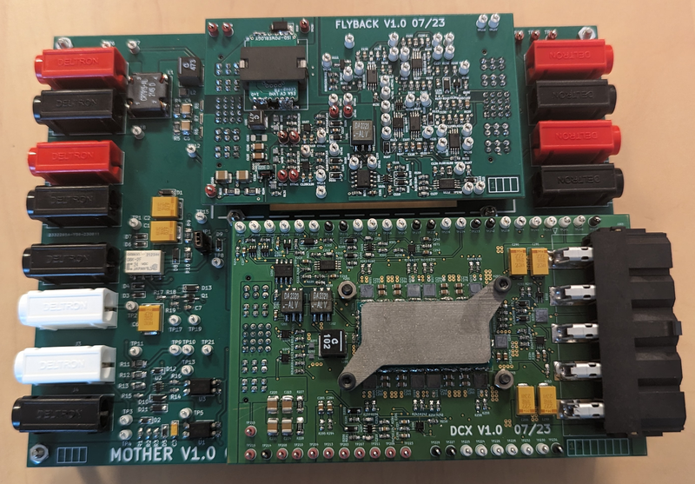
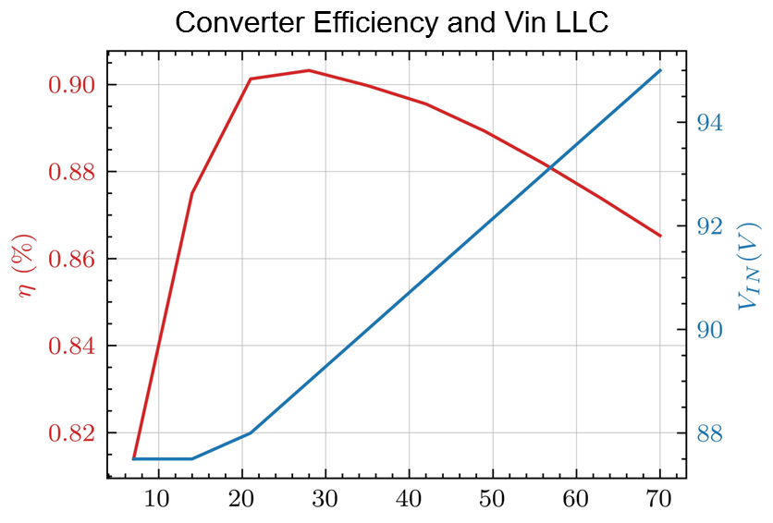
First BB Test Results
A Breadboard has been tested and two problems have been identified:
  Overall converter Efficiency is lower than expected
  The voltage at LLC input is very sensitive to the
  output power
Problem is located at LLC converter level.
Cooper losses are higher than expected due to the complex MxTrf configuration.
This justify the MxTrf redesign with now only 4 legs and easier layout with minimization of main winding track lengths.

Slide 15
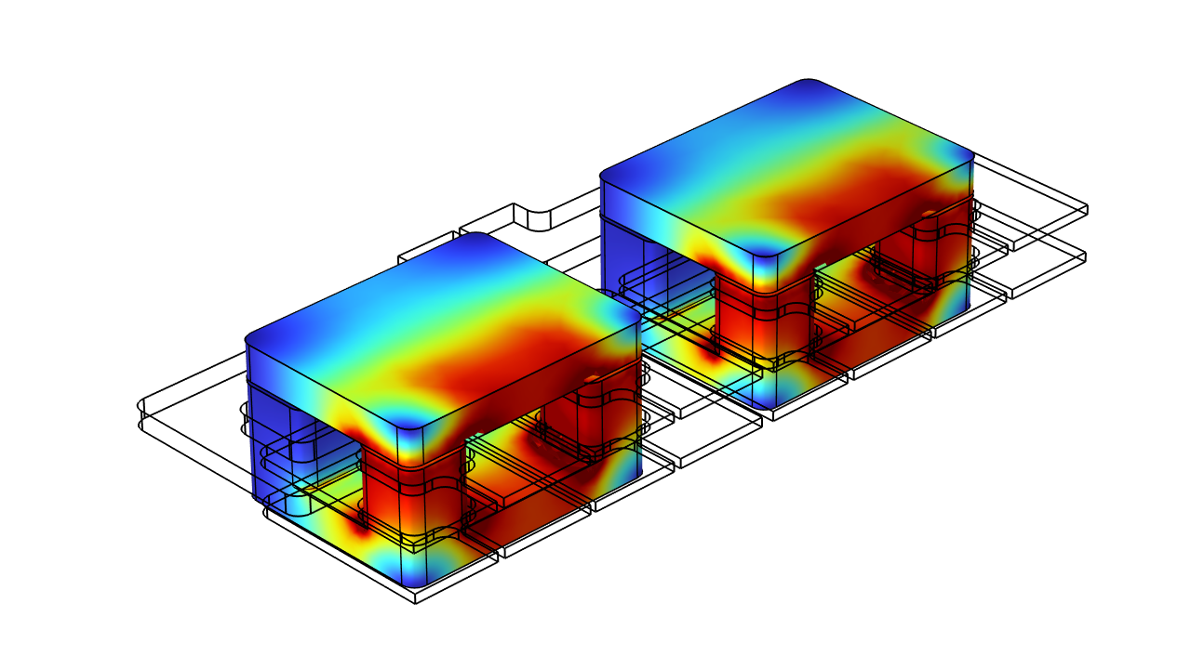
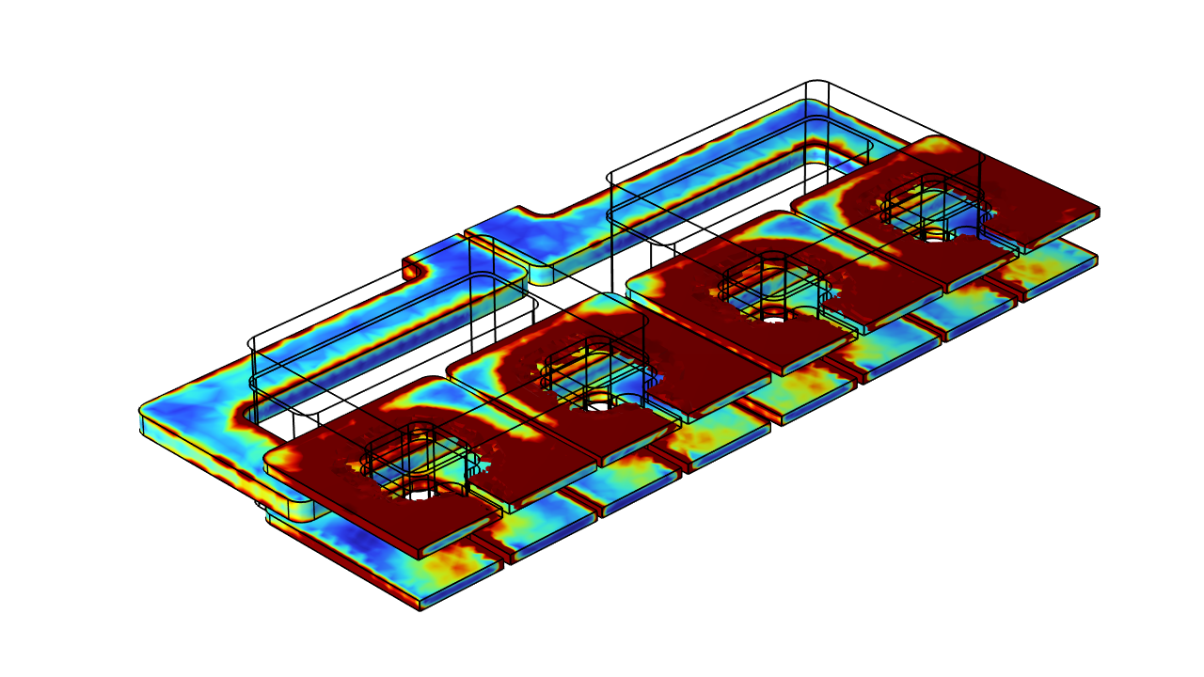
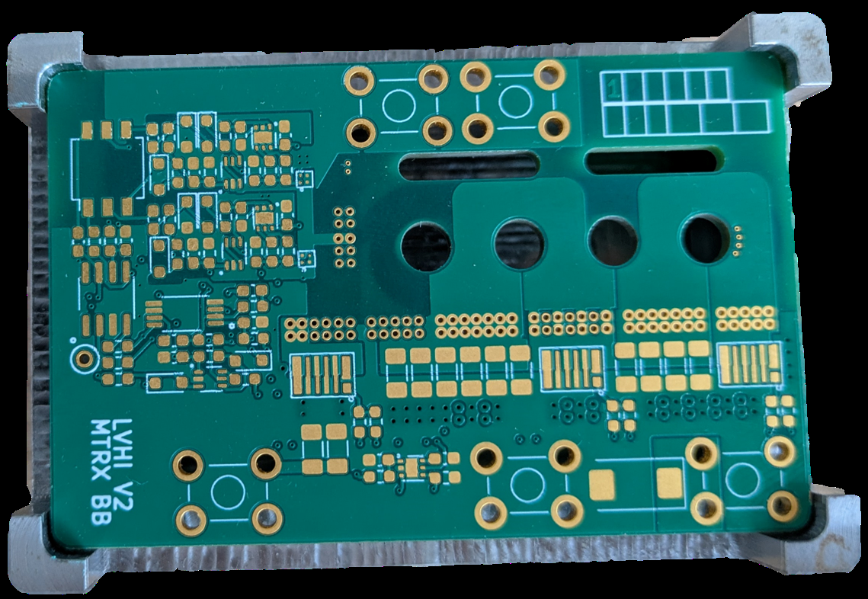
New LLC BB
A new BB limited to the LLC converter is under manufacturing.
The new matrix transformer has been simulated to check the correct operation and predict the performances.
A new PCB BB is available
and we are waiting for the ferrite
which have been also modified.

Slide 16
Conclusion
The selected converter topology has two power cells but is sized for 1.25 times the total output power.
The Flyback runs in soft switching conditions with rectifying diode thanks to the relatively high output voltage (80 V).
The LLC runs at its resonant frequency for maximum efficiency with simple control circuits and a 4 legs Matrix Transformer (redesign).
Efficiency of the first breadboard is lower than expected. Problem comes from the Matrix Transformer and LLC layout. New breadboard is under manufacturing.
EM will be build after to confirm the converter performances.

